Slide 1
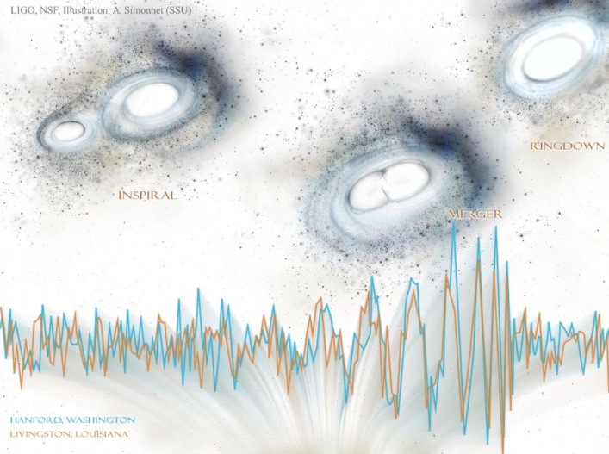
Data analysis techniques for gravitational waves
3rd Manitou School
Dr. S. Mastrogiovanni
(mastrosi@roma1.infn.it)
S. Mastrogiovanni 3nd Manitou School Toulouse 1-6 July 2024

Slide 2
Outline of the lectures
What to expect: A soft introduction to many topics that will make you able to understand what LIGO, Virgo, KAGRA are publishing (from a personal angle).
Difference between Bayesian and frequentist statistics.
Searching for GW signals in time and frequency domain.
Bayesian parameter estimation
Population inference.
S. Mastrogiovanni 3nd Manitou School Toulouse 1-6 July 2024

Slide 3
Some references
Gravitational Wave Open Data workshop: Online course with lectures, Tutorials.
A good introduction to GW DA aspects (from the GW stochastic searches)
An introduction to LVK CBC signal extraction (from C. Berry blog article).
Information Theory, Inference, and Learning Algorithms - D. MacKay (for a longer introduction)
S. Mastrogiovanni 3nd Manitou School Toulouse 1-6 July 2024

Slide 4
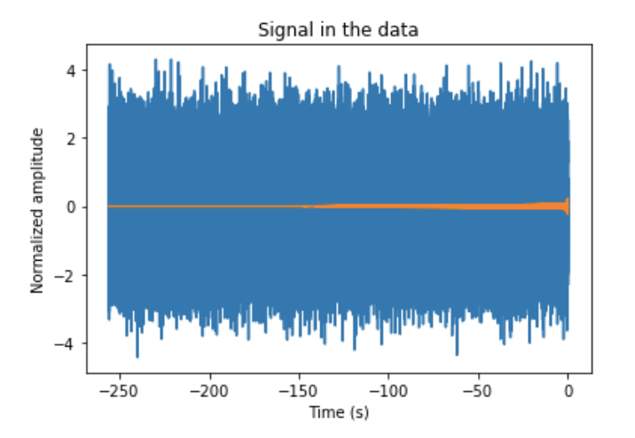
Introduction to Data Analysis
The scope of data analysis for GWs:
Is there a signal?
Detection problem
What parameters the signal has?
Parameter estimation
Is it a Binary Neutron star or black hole?
Model selection problem
In this data strain there is a Binary Neutron star signal with 1.4-1.4 solar masses.
S. Mastrogiovanni 3nd Manitou School Toulouse 1-6 July 2024

Slide 5
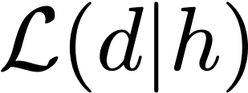
Introduction to Data Analysis
We have two possible kind of approach to data analysis
The Frequentist approach: Based on the possibility to repeat your experiment.
The Bayesian approach: Based on subjective probability.
Both the methods needs the definition for a likelihood.
The Likelihood is a measurement of the “probability” to produce the data you have observed, given your “signal”.
S. Mastrogiovanni 3nd Manitou School Toulouse 1-6 July 2024

Slide 6
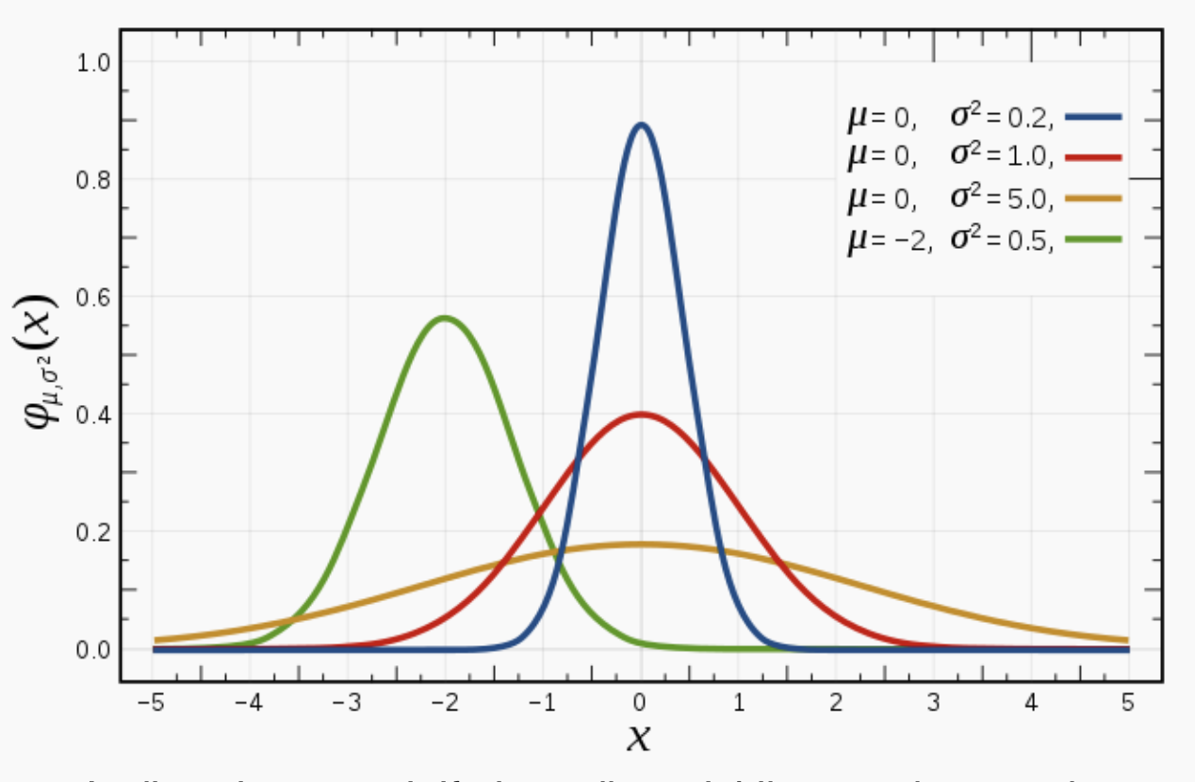
Introduction to Data Analysis
The most known likelihood, the Gaussian Likelihood.
Gaussian likelihood:
Gives the probability of obtaining a data sample x given two parameters: mean and variance
S. Mastrogiovanni 3nd Manitou School Toulouse 1-6 July 2024

Slide 7
Introduction to Data Analysis
Having the likelihood, both the frequentist and the Bayesian method can work.
For frequentists: The likelihood is a probability that can be estimated by repeating my experiment. Example:
Draw N samples from a Gaussian distribution and then histogram it. From the histogram, you can calculate the mean and the standard deviation.
For Bayesian: The likelihood is a model and the probability is the belief of the experimenter in that model.
S. Mastrogiovanni 3nd Manitou School Toulouse 1-6 July 2024

Slide 8
Introduction to Data Analysis
Having the likelihood, both the frequentist and the Bayesian method can work.
For frequentists: The likelihood is a probability that can be estimated by repeating my experiment. Example: Draw N samples from a Gaussian distribution and then histogram it. From the histogram, you can calculate the mean and the standard deviation.
For Bayesian: The likelihood is a model and the probability is the belief of the experimenter in that model.
S. Mastrogiovanni 3nd Manitou School Toulouse 1-6 July 2024

Slide 9
Introduction to Data Analysis
For a frequentist, detecting something means to choose between two hypothesis:
Hypothesis 0: The signal is not present.
Hypothesis 1: The signal is present.
In order to decide what hypothesis we believe, frequentists construct a “detection statistic”, i.e. a number for which you can quantify
Detection statistic. Just a number
Distribution of Lambda under the null hypothesis
Distribution of Lambda under the hypothesis 1
S. Mastrogiovanni 3nd Manitou School Toulouse 1-6 July 2024

Slide 10
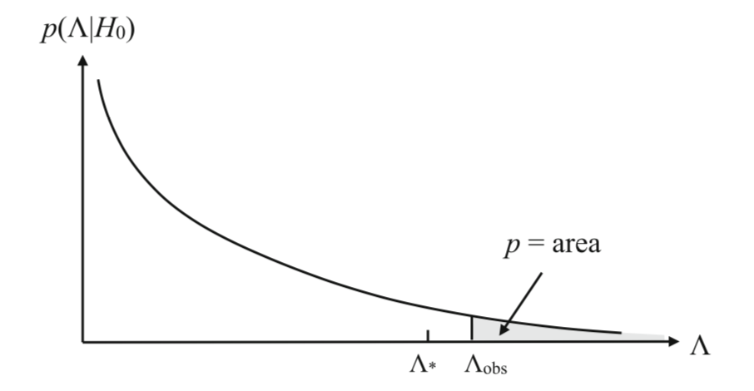
Introduction to Data Analysis: Detection problem (freq.)
Noise only distribution of the detection statistic
J. D. Romani & N. Cornish, Living Rev. Relativ. 2017, 20:2
We reject the Hypothesis 0 using a (1-p)% Confidence Level. If your detection statistic exceed the threshold of the noise-only distribution! Well you have a detection.
False alarm probability: The probability of confusing noise for signal. The noise can be mistaken as a detection!
S. Mastrogiovanni 3nd Manitou School Toulouse 1-6 July 2024

Slide 11
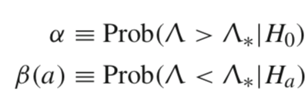
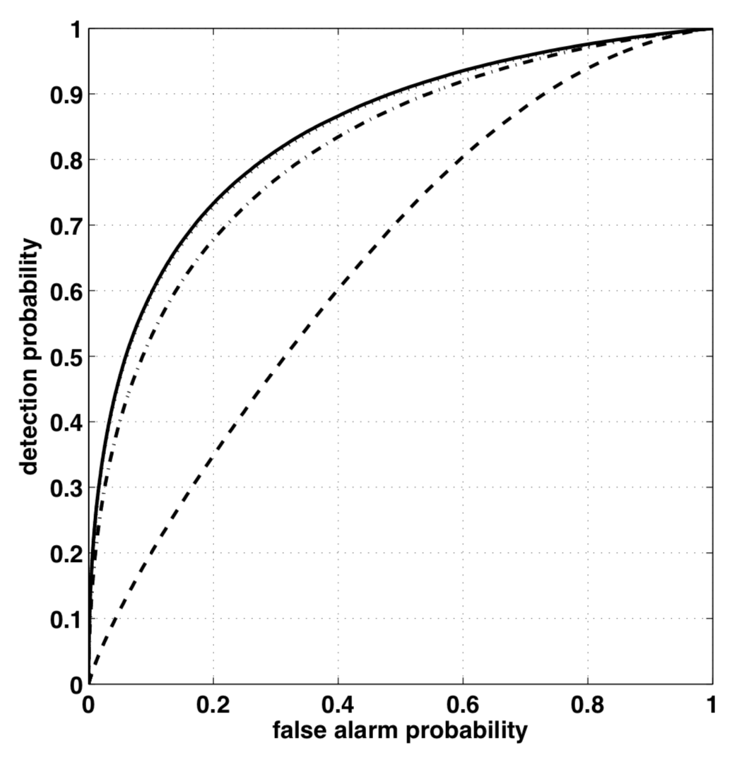
Introduction to Data Analysis: Detection problem (freq.)
A Good Frequentist method has two variables under control.
False alarm probability - The noise can produce triggers
False dismissal probability (1- Detection probability)
When you decide a threshold for your detection problem, you need to find the sweet spot between
A Low false alarm probability.
An high detection probability
Detection probability for a GW with SNR 4
J. D. Romani & N. Cornish, Living Rev. Relativ. 2017, 20:2
S. Mastrogiovanni 3nd Manitou School Toulouse 1-6 July 2024

Slide 12
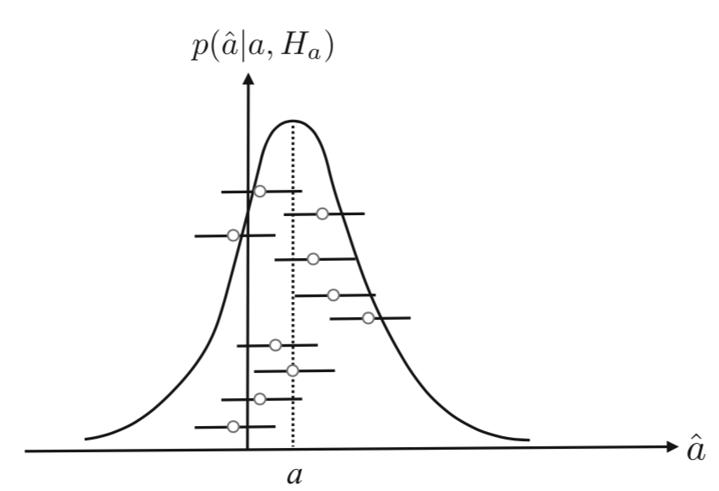
Introduction to Data Analysis: Parameter estimation (freq.)
Estimating parameters for a frequentist means:
Build an estimator in the Hypothesis that a signal is present with a parameter .
Draw the estimator several times, these will give confidence intervals.
Repeat this experiment many times.
J. D. Romani & N. Cornish, Living Rev. Relativ. 2017, 20:2
S. Mastrogiovanni 3nd Manitou School Toulouse 1-6 July 2024

Slide 13
Introduction to Bayesian inference
In these notes we are going to touch only the Parameter Estimation for Bayesians.
But before we need to understand the Bayes Theorem.
Likelihood
Prior
Posterior
Proof (very easy)
S. Mastrogiovanni 3nd Manitou School Toulouse 1-6 July 2024

Slide 14
Introduction to Bayesian inference
In these notes we are going to touch only the Parameter Estimation for Bayesians.
Prior: A belief of the experimenter on the values of the parameters. You can use “flat” priors if you don’t want any information.
Likelihood: We have seen it.
Evidence: The integral of the numerator w.r.t. the parameters. It is a normalisation factor.
Posterior: This is what we want. The probability of the parameters given the data.
Likelihood
Prior
Posterior
Evidence
S. Mastrogiovanni 3nd Manitou School Toulouse 1-6 July 2024

Slide 15
Introduction to data analysis
To blackboard (See notes on DA)
S. Mastrogiovanni 3nd Manitou School Toulouse 1-6 July 2024

Slide 16
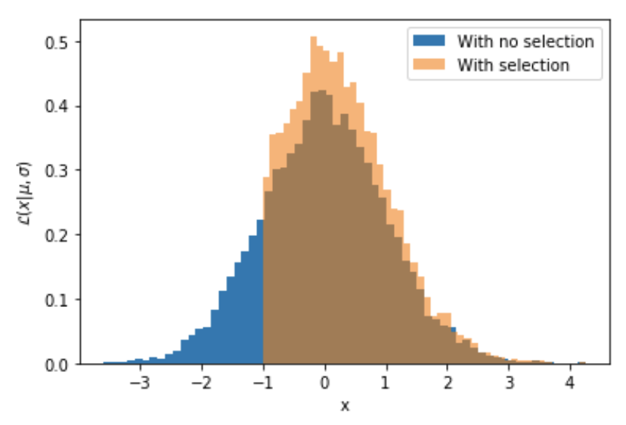
Introduction to Bayesian inference
A random process generating numbers from a normal distribution with mean 0 and variance 1.
Your experiment however gives you only numbers > -1. How you can estimate the mean from these samples?
S. Mastrogiovanni 3nd Manitou School Toulouse 1-6 July 2024

Slide 17
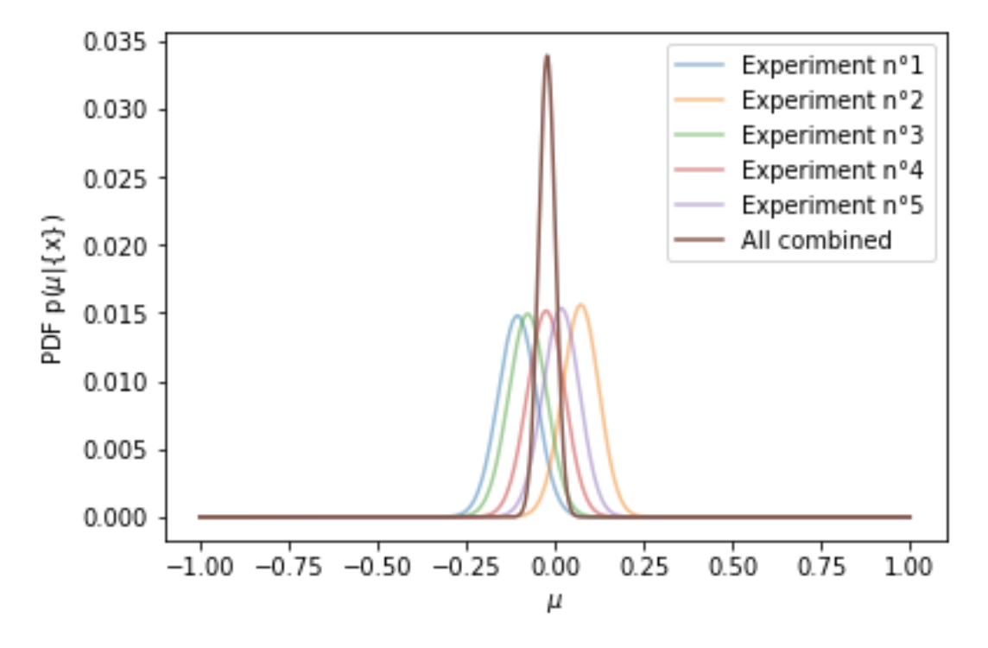
Introduction to Bayesian inference
If you include the selection effect, you will converge to the correct value of the mean.
S. Mastrogiovanni 3nd Manitou School Toulouse 1-6 July 2024

Slide 18
Introduction to Bayesian inference
How to include this?
We should modify the normalisation factor of the likelihood because we know that there are some values of x that we cannot observe.
Likelihood before the selection effect
Likelihood after the selection effect
S. Mastrogiovanni 3nd Manitou School Toulouse 1-6 July 2024

Slide 19
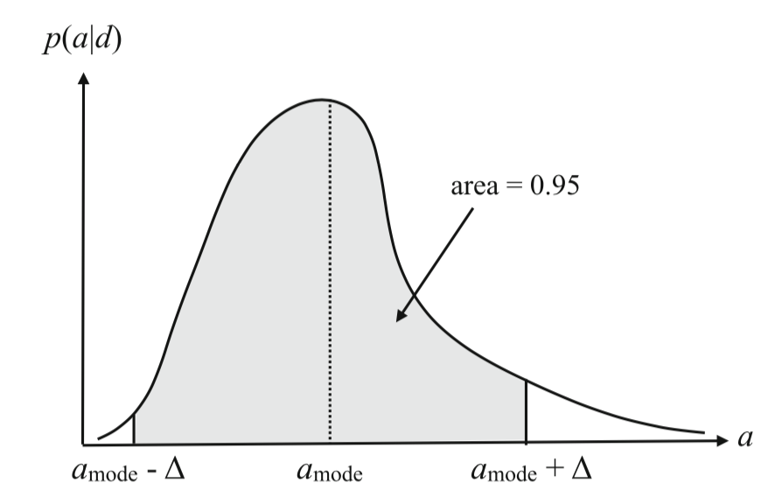
Introduction to Bayesian inference: Parameter estimation
The process of a Bayesian Lerner
The posterior is a distribution
When the posterior goes to zero
You can provide Constraints
J. D. Romani & N. Cornish, Living Rev. Relativ. 2017, 20:2
S. Mastrogiovanni 3nd Manitou School Toulouse 1-6 July 2024

Slide 20
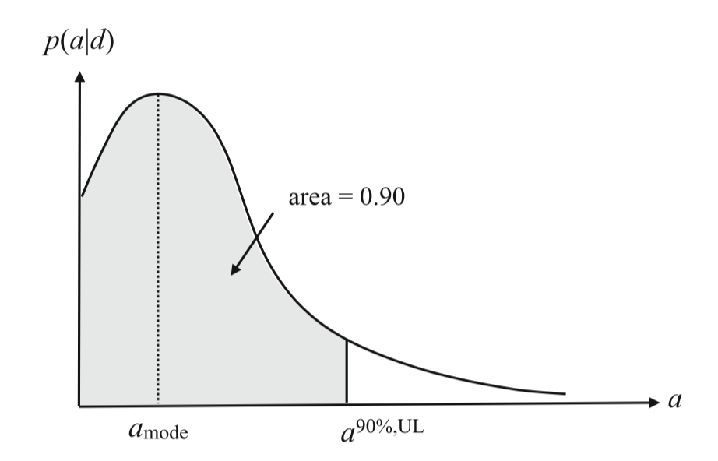
Introduction to Bayesian inference: Parameter estimation
The process of a Bayesian Learner
The posterior is a distribution
When the posterior does not go to zero
You can provide upper limits
J. D. Romani & N. Cornish, Living Rev. Relativ. 2017, 20:2
S. Mastrogiovanni 3nd Manitou School Toulouse 1-6 July 2024

Slide 21
Introduction to data analysis
Click on this link for more
S. Mastrogiovanni 3nd Manitou School Toulouse 1-6 July 2024

Slide 22
Introduction to Hierarchical Bayesian inference
Physics
Statistics
Particles energy E are generated with a gaussian distribution
Particles arrive at our detectors, due to noise I measure E_{obs}
My experiment can detect E_{obs} only above a certain threshold
S. Mastrogiovanni 3nd Manitou School Toulouse 1-6 July 2024

Slide 23
Introduction to Hierarchical Bayesian inference
The likelihood for an inhomogeneous Poisson process in presence of selection biases, for a constant rate in detector time, is (see Mandel+ 2018 MNRAS, Vitale+ 2020)
Rate
Noise process
Expected number of detections
S. Mastrogiovanni 3nd Manitou School Toulouse 1-6 July 2024
7

Slide 24
Introduction to Hierarchical Bayesian inference
If we decide to use a 1/Nexp prior, the hierarchical likelihood can be reduced to the form below
Scale-free likelihood
S. Mastrogiovanni 3nd Manitou School Toulouse 1-6 July 2024
8

Slide 25
Introduction to data analysis
To blackboard (See notes on DA)
S. Mastrogiovanni 3nd Manitou School Toulouse 1-6 July 2024

Slide 26
Introduction to Hierarchical Bayesian inference
From the previous slides we have seen that to calculate the likelihood we need to calculate two integrals, the integral over the parameters of the detected events and the integral to calculate Nexp.
Integral over the events (numerator): Done summing over posterior samples
Number of samples
Prior used for Posterior samples
S. Mastrogiovanni 3nd Manitou School Toulouse 1-6 July 2024

Slide 27
Introduction to Hierarchical Bayesian inference
From the previous slides we have seen that to calculate the likelihood we need to calculate two integrals, the integral over the parameters of the detected events and the integral to calculate Nexp.
Integral over the events (numerator): Done summing over posterior samples
Number of detected events
Number of injections generated (even not detected)
Prior used for injections
S. Mastrogiovanni 3nd Manitou School Toulouse 1-6 July 2024

Slide 28
Introduction to Hierarchical Bayesian inference
The hierarchical likelihood computed numerically is given by the equation below
S. Mastrogiovanni 3nd Manitou School Toulouse 1-6 July 2024

Slide 29
Inferring the rate of a gaussian process
Link
S. Mastrogiovanni 3nd Manitou School Toulouse 1-6 July 2024

Slide 30
Introduction to GW spectral analysis
S. Mastrogiovanni 3nd Manitou School Toulouse 1-6 July 2024

Slide 31
Introduction to time series
The data is the composed by:
Noise: We assume the noise to be gaussian and coloured noise (we will see later what this means.)
The signal from the GW source reprocessed by the detector response.
The data can be though as a collection of data points with signal and noise.
S. Mastrogiovanni 3nd Manitou School Toulouse 1-6 July 2024

Slide 32
Introduction to Bayesian inference
A random process generating numbers from a normal distribution with mean 0 and variance 1.
Your experiment however gives you only numbers > -1. How you can estimate the mean from these samples?
S. Mastrogiovanni 3nd Manitou School Toulouse 1-6 July 2024

Slide 33
Time series
How do we visualise that a signal is present in here?
We work in the frequency domain
S. Mastrogiovanni 3nd Manitou School Toulouse 1-6 July 2024

Slide 34
The Discrete Fourier Transform
The Fourier transform (FFT for fast) is a procedure which allows you to compute the frequency components of your time series.
Change of basis: From the time domain to the frequency domain.
S. Mastrogiovanni 3nd Manitou School Toulouse 1-6 July 2024

Slide 35
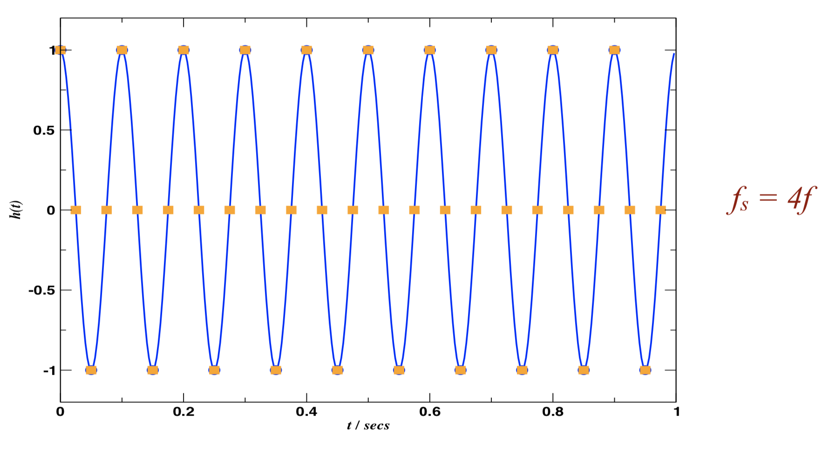
The Discrete Fourier Transform
The Fourier transform (FFT for fast) is a procedure which allows you to compute the frequency components of your time series.
Is it oversampled?
S. Mastrogiovanni 3nd Manitou School Toulouse 1-6 July 2024

Slide 36
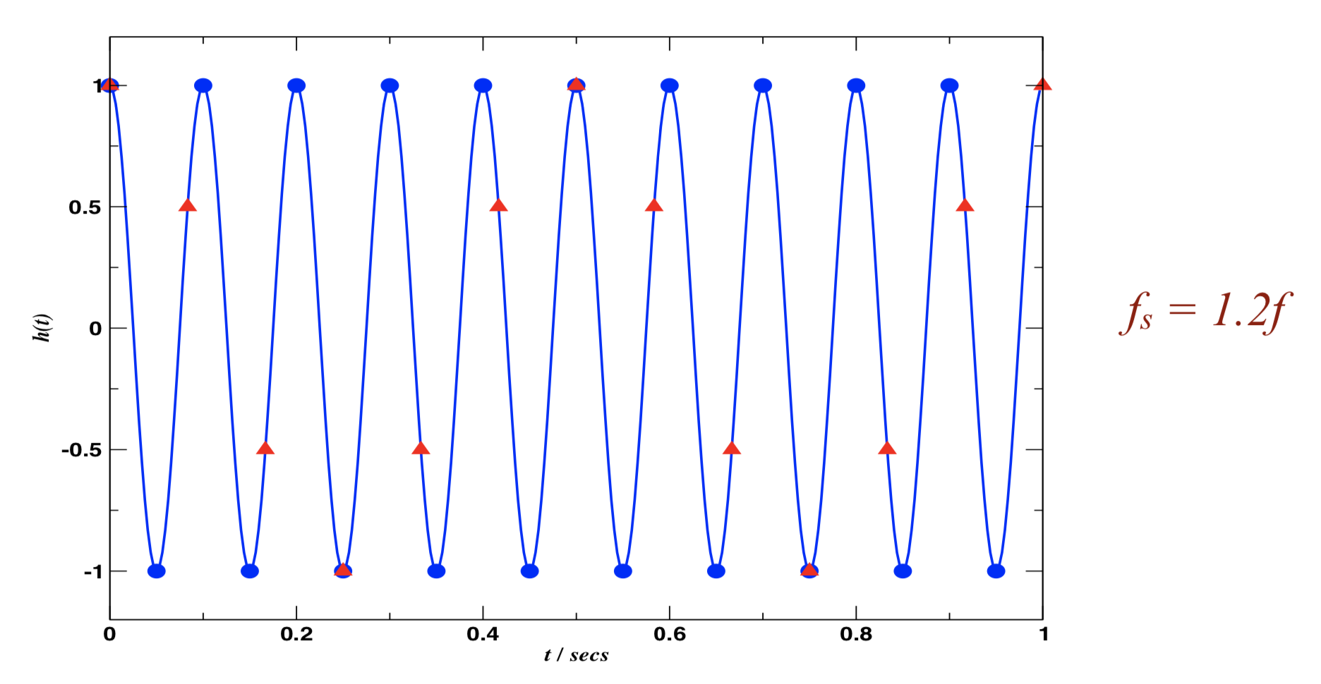
The Discrete Fourier Transform
When you are working with discrete time series, you have some fundamental properties
Looks better but!
S. Mastrogiovanni 3nd Manitou School Toulouse 1-6 July 2024

Slide 37
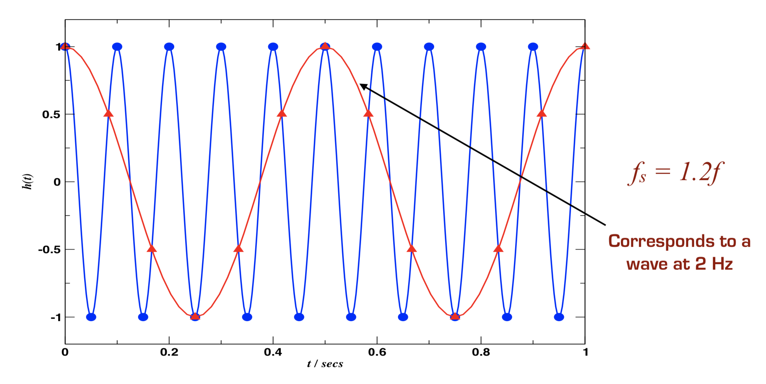
The Discrete Fourier Transform
When you are working with discrete time series, you have some fundamental properties
S. Mastrogiovanni 3nd Manitou School Toulouse 1-6 July 2024

Slide 38
The Discrete Fourier Transform
When you are working with discrete time series, you have some fundamental properties
Fourier transform resolution:
Fourier transform span: You can calculate frequency components up to half of the sampling rate (Nyquist frequency)
S. Mastrogiovanni 3nd Manitou School Toulouse 1-6 July 2024

Slide 39
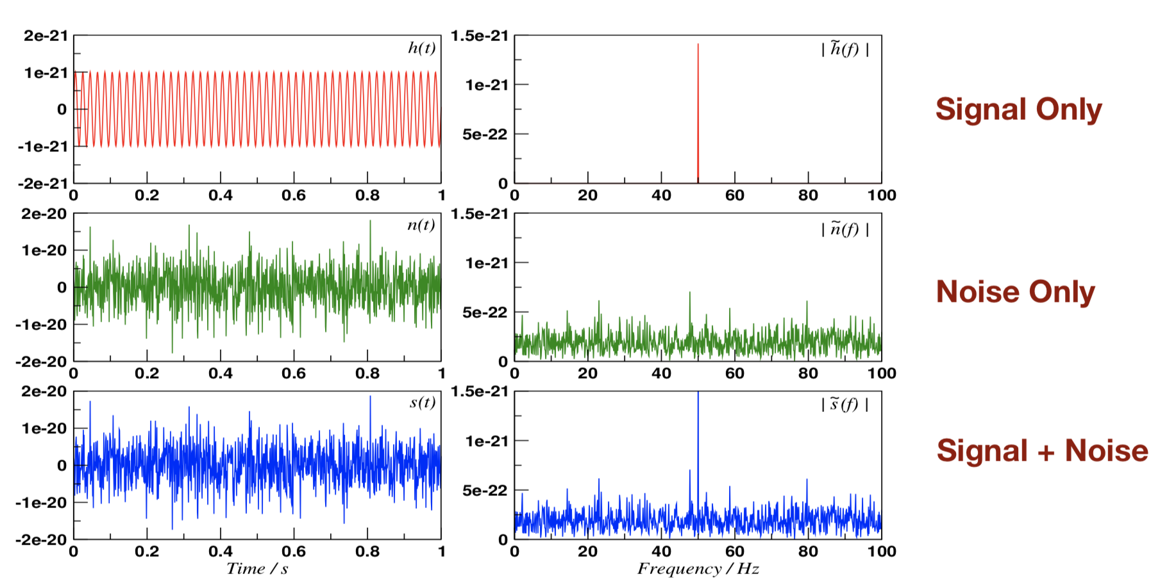
Signals in frequency
If you FT the entire time series, then you can compute the spectra of the signal
S. Mastrogiovanni 3nd Manitou School Toulouse 1-6 July 2024

Slide 40
The convolution
We want to look for this signal with “matched filtering”.
Matched filtering cross-correlate your data with a template.
When the template matches the signal in data, then you have a spike in the cross-correlation
S. Mastrogiovanni 3nd Manitou School Toulouse 1-6 July 2024

Slide 41
The convolution theorem
The convolution theorem relates multiplication of functions in time/frequency domain to convolutions in frequency/time domain
S. Mastrogiovanni 3nd Manitou School Toulouse 1-6 July 2024

Slide 42
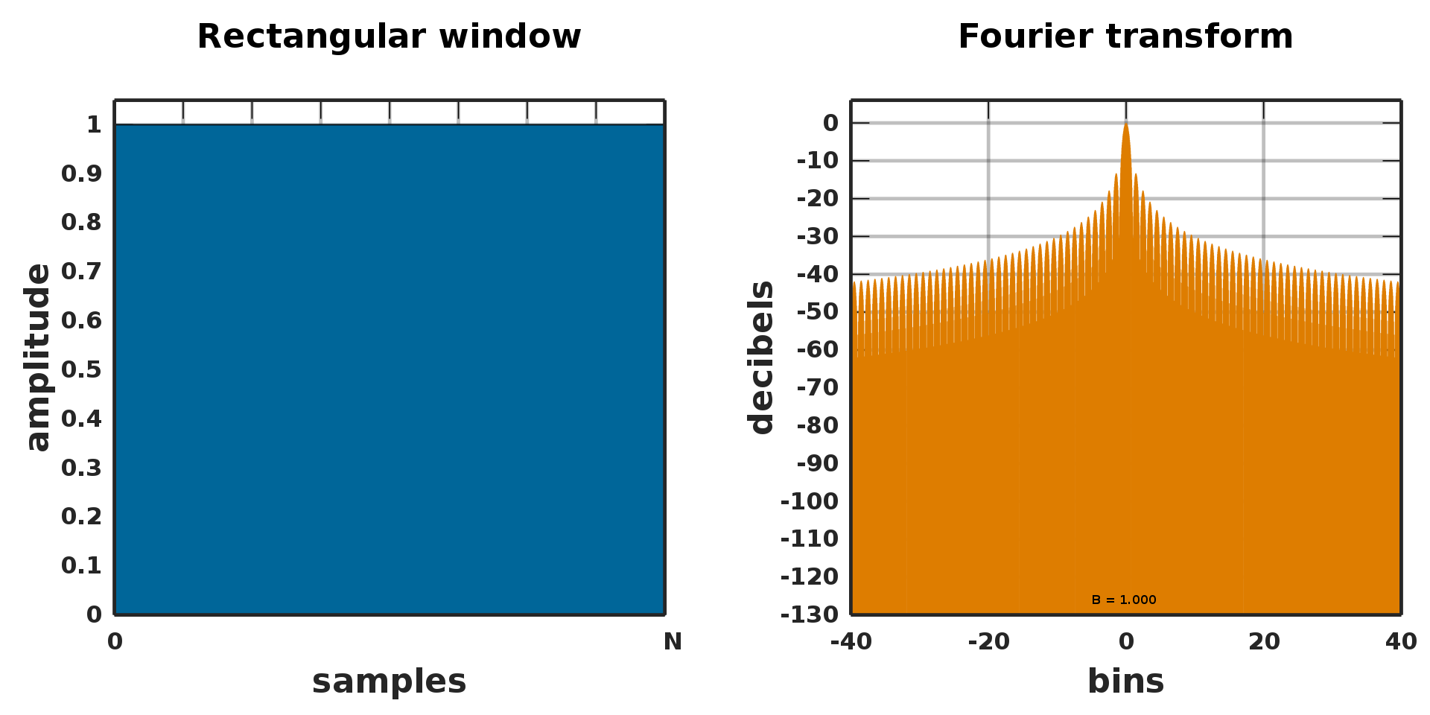
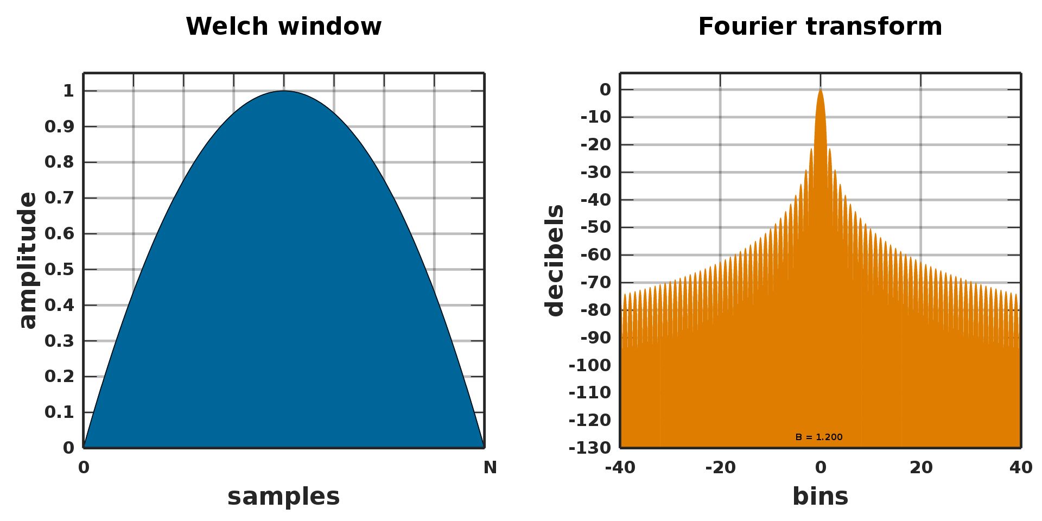
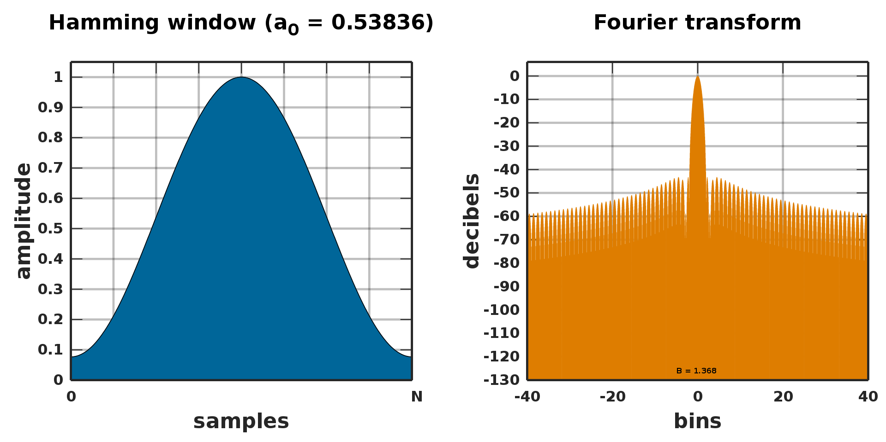
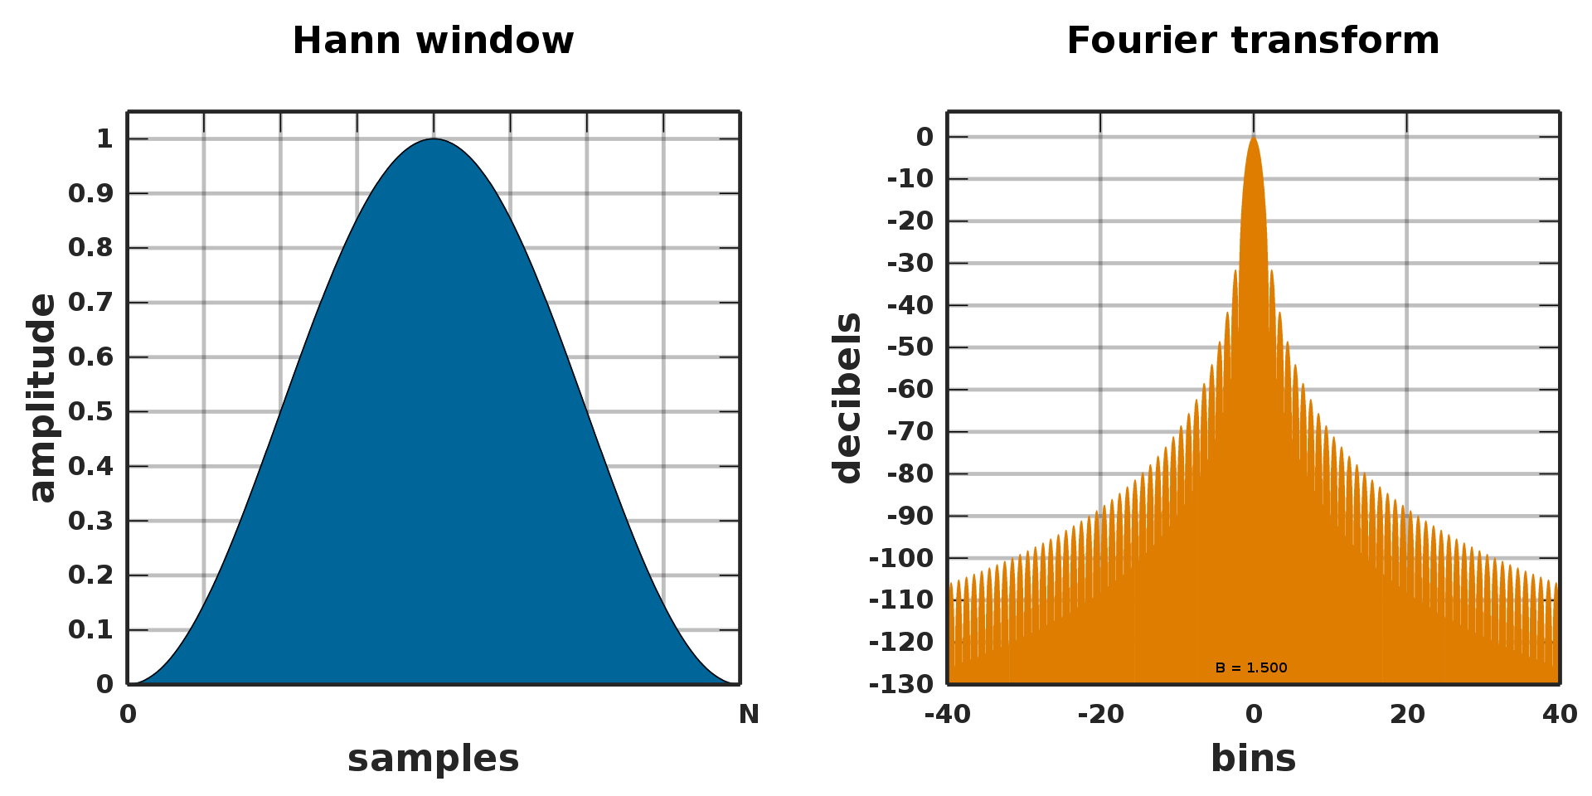
The convolution theorem and windows
S. Mastrogiovanni 3nd Manitou School Toulouse 1-6 July 2024

Slide 43
Signals in frequency
Spectra are good for visualising signals which are:
Continuous signals: They last in all your time series
Deeply buried into the noise: The high resolution of FT helps.
Almost-monochromatic: They are sine waves for combination of them.
If you want instead to visualise “transient signals”, that changes frequency very fast, you need to FT little chunks of data, in which the frequency is more or less constant (w.r.t. the resolution)
S. Mastrogiovanni 3nd Manitou School Toulouse 1-6 July 2024

Slide 44
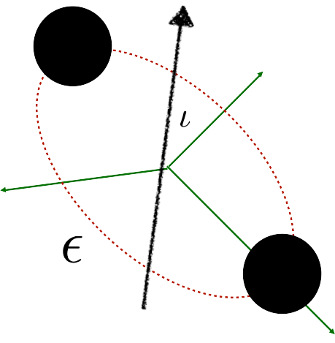
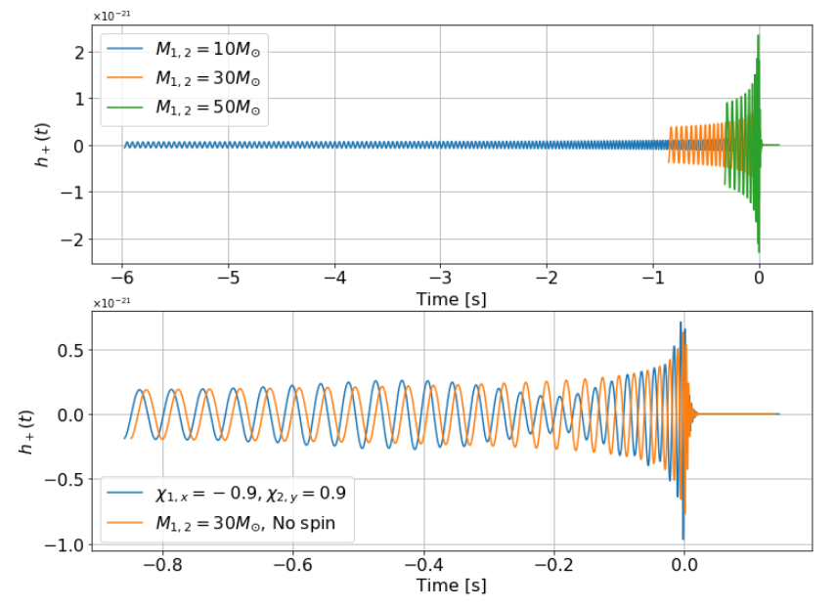
The CBC signal
The parameters:
Intrinsic: Spins, Masses, tidal deformability, Eccentricity
Extrinsic: Time, reference phase, sky position, luminosity distance, orbital orientation
Lower frequency = 20 Hz
Source at 500 Mpc
S. Mastrogiovanni 3nd Manitou School Toulouse 1-6 July 2024

Slide 45
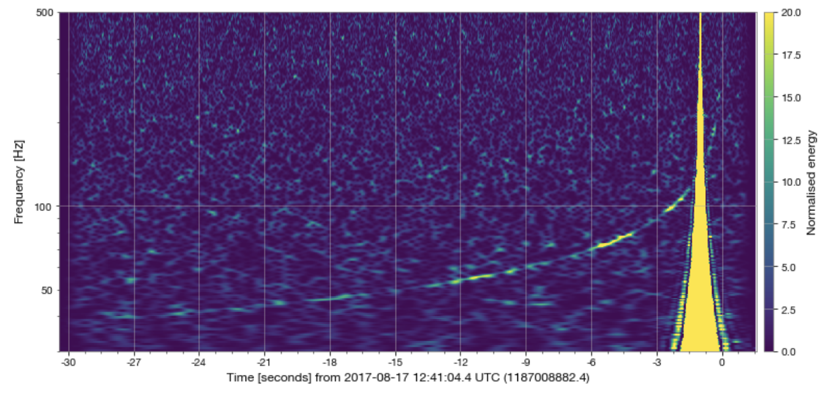
The CBC signal: Time-frequency maps
Here we are dividing the data in 4 seconds chunks and for each of them we plot and FFT.
Higher time resolution
Higher frequency resolution
S. Mastrogiovanni 3nd Manitou School Toulouse 1-6 July 2024

Slide 46
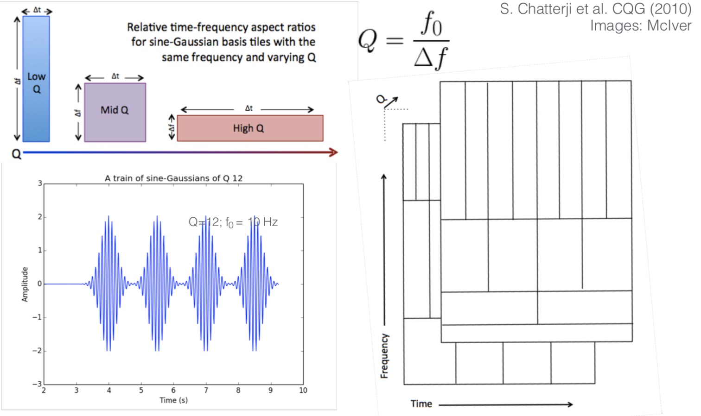
Time-frequency maps: Q-transform
Time-Frequency plots for LIGO are generated with a special FT.
S. Mastrogiovanni 3nd Manitou School Toulouse 1-6 July 2024

Slide 47
Hands-on session: Spectrograms, spectra and Q-transform
Link
S. Mastrogiovanni 3nd Manitou School Toulouse 1-6 July 2024

Slide 48
Introduction to matched filtering
We want to find the optimal filter to convolve with the data
We want to find the optimal filter that maximise the following quintity(SNR)
S. Mastrogiovanni 3nd Manitou School Toulouse 1-6 July 2024

Slide 49
Introduction to matched filtering
We want to find the optimal filter to convolve with the data
We want to find the optimal filter that maximise the following quantity (SNR)
S. Mastrogiovanni 3nd Manitou School Toulouse 1-6 July 2024

Slide 50
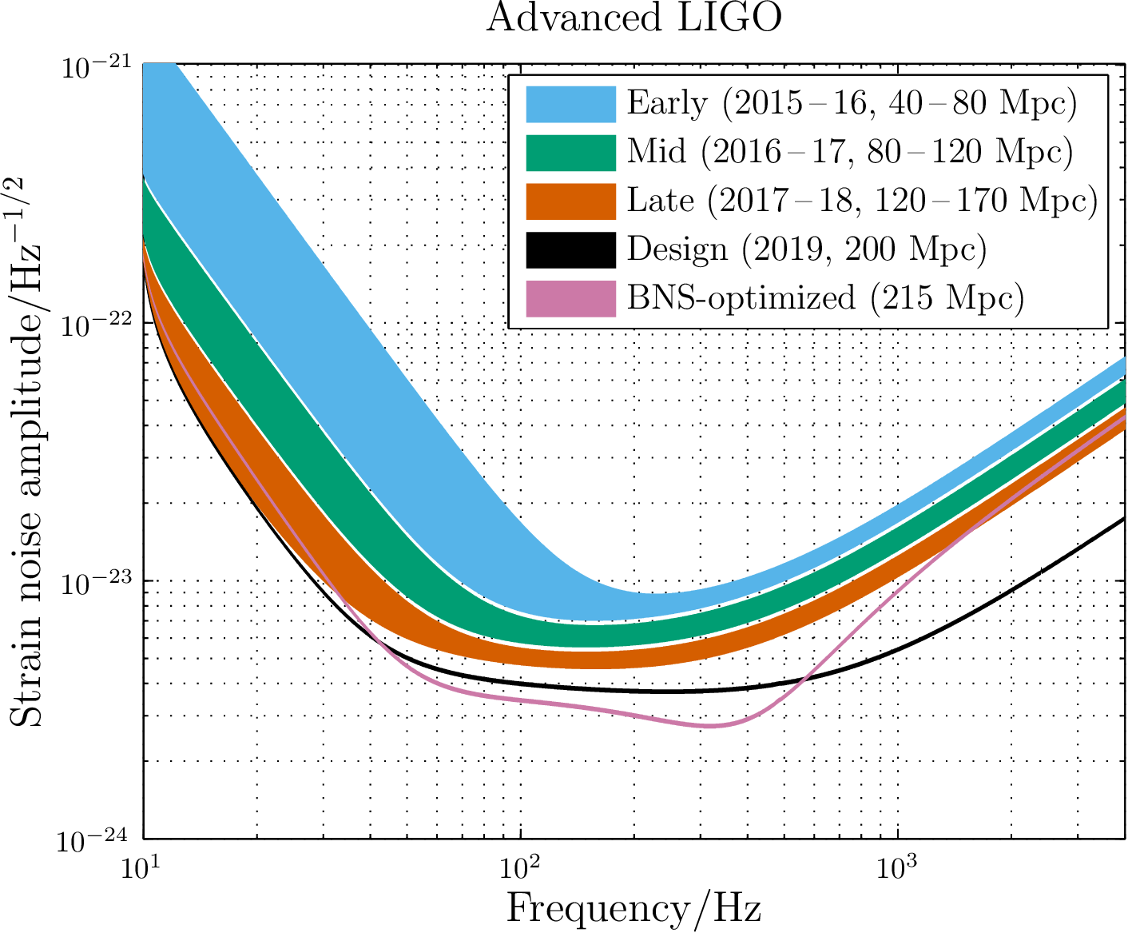
Introduction to matched filtering
The noise background that you have seen in the previous plots it is called power spectral density (PSD)
Power spectral density connected to the fluctuation of gaussian noise.
Can have different amplitude at different frequencies.
S. Mastrogiovanni 3nd Manitou School Toulouse 1-6 July 2024

Slide 51
Introduction to matched filtering
Remember from the previous slide that:
I have assumed that the spectrum is “flat” and used the Cauchy-Schwartz inequality
The Matched filter is the one that allow me to write the Equality in the above disequality, namely
S. Mastrogiovanni 3nd Manitou School Toulouse 1-6 July 2024

Slide 52
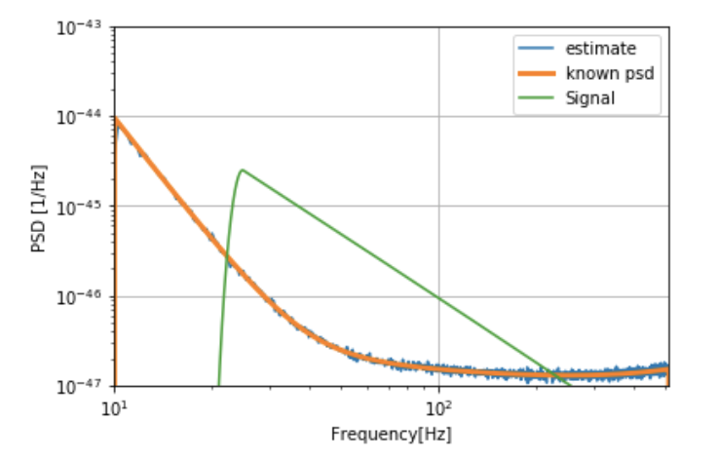
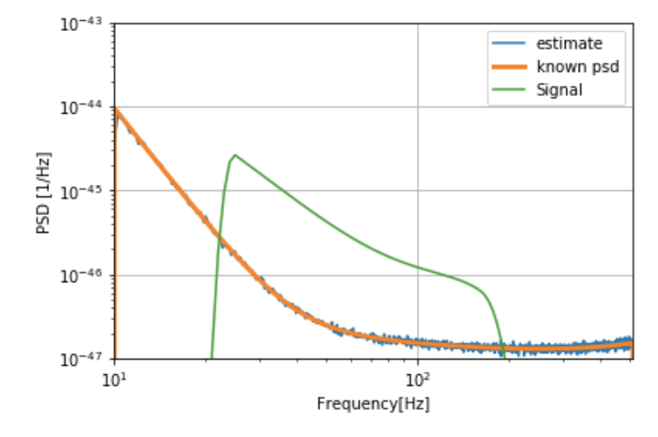
Introduction to matched filtering
With these choice of filter, the SNR become
The SNR is basically an area!
S. Mastrogiovanni 3nd Manitou School Toulouse 1-6 July 2024

Slide 53
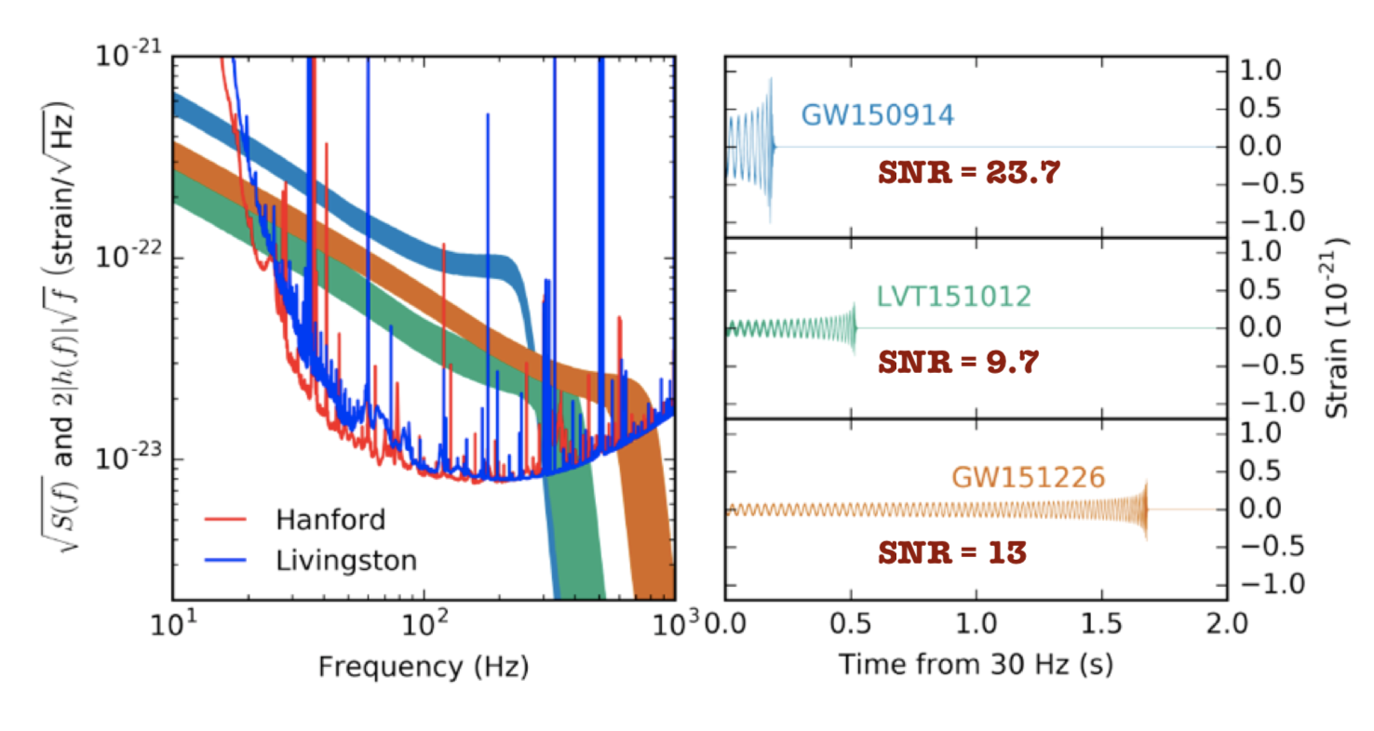
Introduction to matched filtering
Signal to noise events of several events at comparison
S. Mastrogiovanni 3nd Manitou School Toulouse 1-6 July 2024

Slide 54
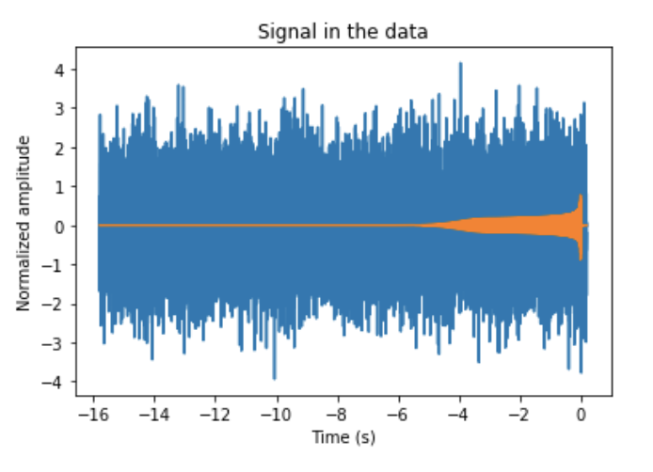
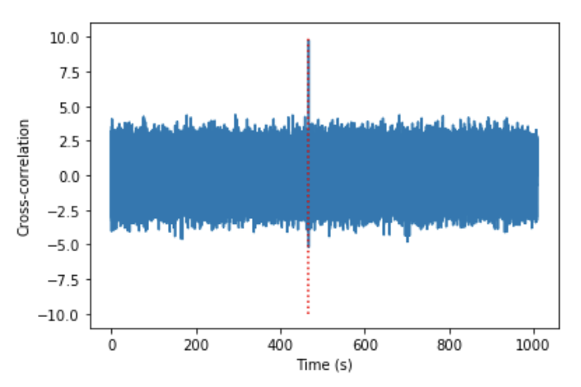
Introduction to matched filtering
We take calculate a template for the waveform, corresponding to some physical parameters, e.g. masses etc.
We slide it on the data and look for excess in the cross-correlation/SNR.
S. Mastrogiovanni 3nd Manitou School Toulouse 1-6 July 2024

Slide 55
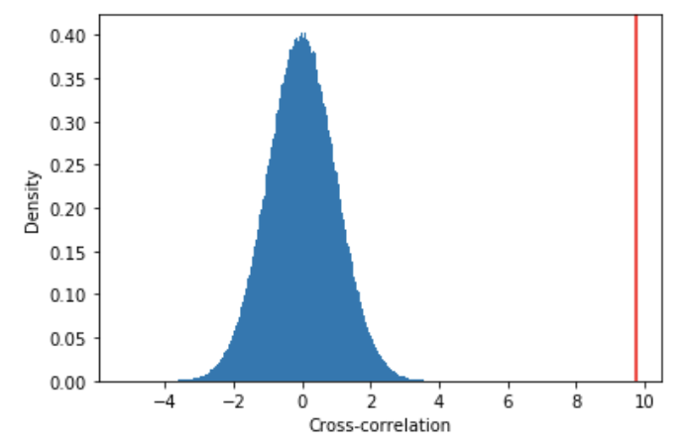
Introduction to matched filtering
When the template is matching the noise, we generate noise background realizations, that can be used to assess the significance of our candidate.
When we match the signal, we obtain a very strong outlier, which is not compatible with the background distribution of the noise.
A preliminary significance can be calculated using the p-value (or False alarm probability).
S. Mastrogiovanni 3nd Manitou School Toulouse 1-6 July 2024

Slide 56
Introduction to matched filtering
In a real search, we take all of our data and we slide pre-built templates for each interferometer. Then we match the interferometer results taking into account the travel-time between them.
Livingston data
Travel time between the LIGOs (8ms)
Hanford data
Signal
Noise
Noise
Noise
S. Mastrogiovanni 3nd Manitou School Toulouse 1-6 July 2024

Slide 57
Introduction to matched filtering
How do we generate noise backgrounds? In a real search we never know when the signal is present or not...
Livingston data
Travel time between the LIGOs (8ms)
Hanford data
Signal
Noise
Noise
Noise
S. Mastrogiovanni 3nd Manitou School Toulouse 1-6 July 2024

Slide 58
Introduction to matched filtering
To generate noise backgrounds we perform the same search but matching the data between interferometers ``wrongly``
Livingston data
Non physical time-shift
Hanford data
False Alarm Rate: In X-years of data, how many times we obtained a value of a given statistic?
Contamination
Contamination
S. Mastrogiovanni 3nd Manitou School Toulouse 1-6 July 2024

Slide 59
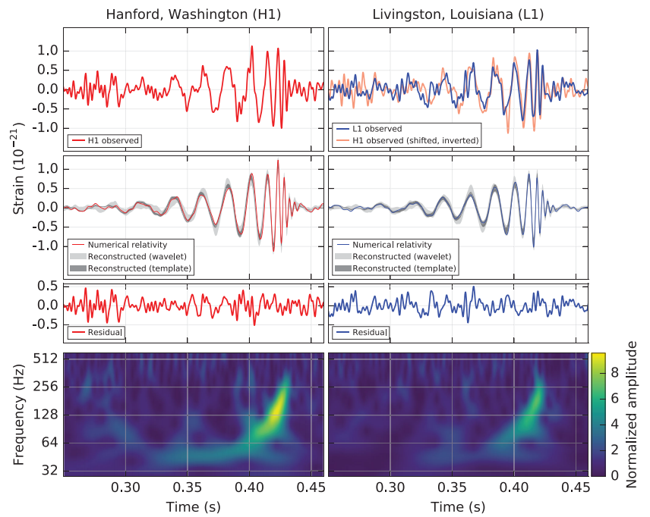
Introduction to matched filtering
GW150914 was detected on September 14, 2015 at 09:50:45 UTC.
The signal was observed between 35 and 250. The strain peak was around 1e-21.
The signal had a SNR of 24.
S. Mastrogiovanni 3nd Manitou School Toulouse 1-6 July 2024

Slide 60
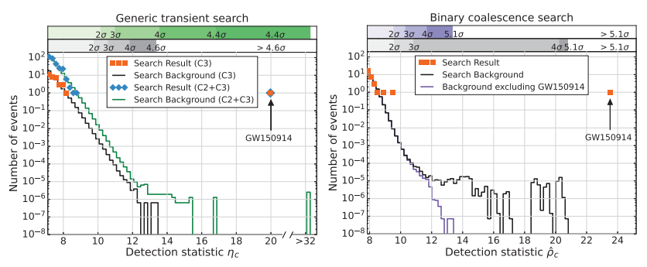
Introduction to matched filtering
The significance of this event was 1 event per 203 000 years, equivalent to a significance greater than 5.1σ.
The event was so loud that contaminated the noise backgrounds when time-sliding data.
S. Mastrogiovanni 3nd Manitou School Toulouse 1-6 July 2024

Slide 61
Introduction to Bayesian parameter estimation
If our noise is gaussian with 0 mean and given PSD, then the likelihood for obtaining N points of noise is
However, remember that your data is a super-position of noise and signal… hence
Where I have defined
S. Mastrogiovanni 3nd Manitou School Toulouse 1-6 July 2024

Slide 62
Introduction to Bayesian parameter estimation
You can verify that subtracting the signal in data gives you back
The scalar product that we have introduced, is directly related to the definition of the SNR. In fact, as we have seen before.
The higher the SNR, the more peaked is the likelihood
S. Mastrogiovanni 3nd Manitou School Toulouse 1-6 July 2024

Slide 63
Introduction to Bayesian parameter estimation
Procedure that we follow in GW data analysis for estimating the parameters of a signal
Try some signal with some parameters
Compute likelihood
Compute prior
MCMC
Posterior
S. Mastrogiovanni 3nd Manitou School Toulouse 1-6 July 2024

Slide 64
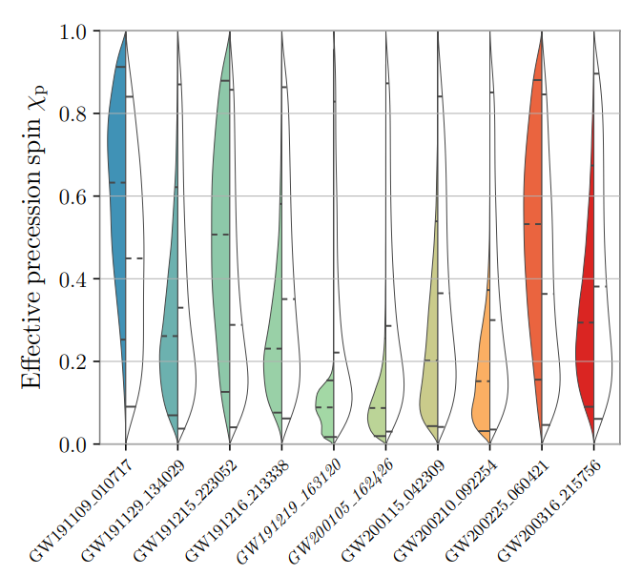
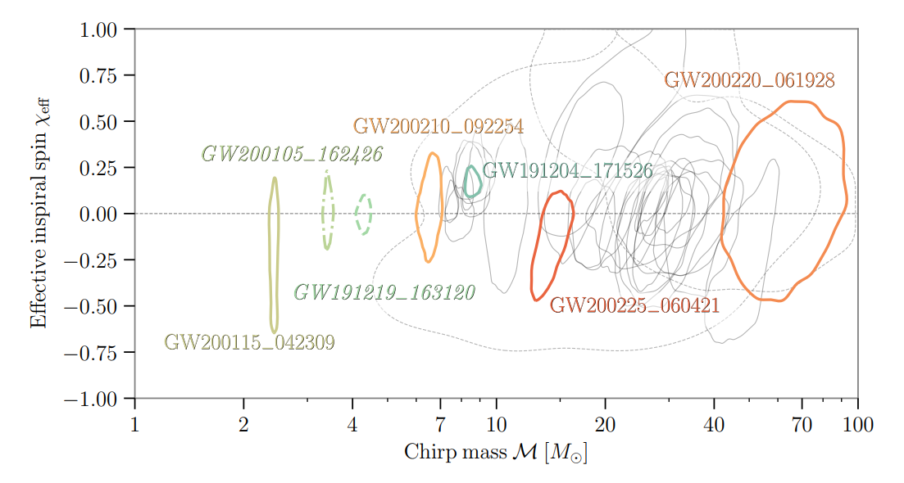
Introduction to Bayesian parameter estimation
S. Mastrogiovanni 3nd Manitou School Toulouse 1-6 July 2024

Slide 65
Matched filtering in action (from GW open data workshop)
Link
S. Mastrogiovanni 3nd Manitou School Toulouse 1-6 July 2024

