Slide 1
PICMIC: The First Results
H. Abreu⁽¹⁾, E. Bechetoille⁽¹⁾,G. Bertolone⁽²⁾, G. Claus⁽²⁾, C. Colledani⁽²⁾, C. Combaret⁽¹⁾, G. Doziere⁽²⁾, C. Hu-Guo⁽²⁾, I. Laktineh⁽¹⁾, H. Mathez⁽¹⁾, H. Pham⁽²⁾, M. Specht⁽²⁾, I. Valin⁽²⁾, L. Zhang⁽³⁾, Y.Zhao^{(2).} , D. Breton⁽⁴⁾, J. Maalmi⁽⁴⁾
(1) IP2I, Institut de Physique des 2 infinis, CNRS/IN2P3
(2) IPHC, Institut Hubert Curien, CNRS/IN2P3
(3) SDU : Shandong University, China
(4) IJCLab - Orsay : Laboratoire de Physique des 2 Infinis CNRS/IN2P3.
La photodétection avec les semi-conducteurs LPSC, 3-4 Juin 2024, Grenoble
<number>

Slide 2
Overview
Concept/Introduction
Description of the Test Bench (HW+FW)
Pedestal thresholds calibration “S-Curves”
Signal Injection ”Hat-Curves”
Direct injection on the chip surface (Probes)
Proof-of-concept Demonstrator
<number>

Slide 3
PICosencod subMICron detector:
Imad’s presentation last year
https://t.ly/Iiw7G
<number>

Slide 4
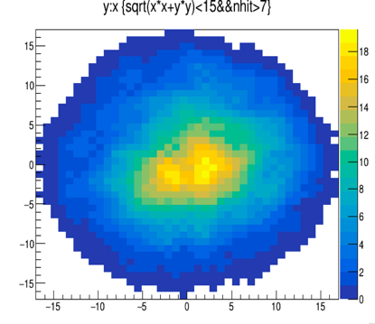
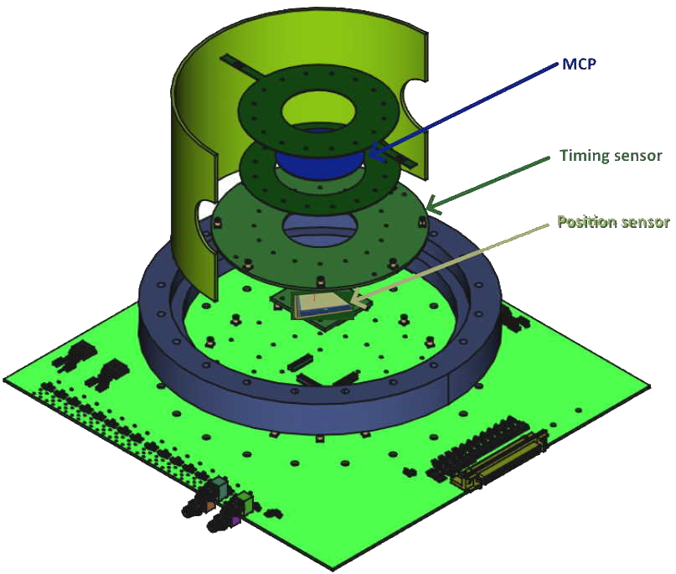
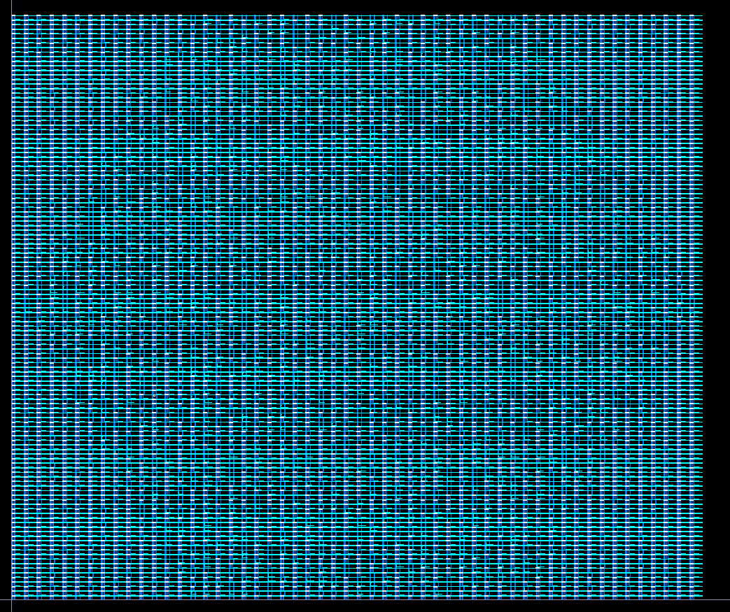
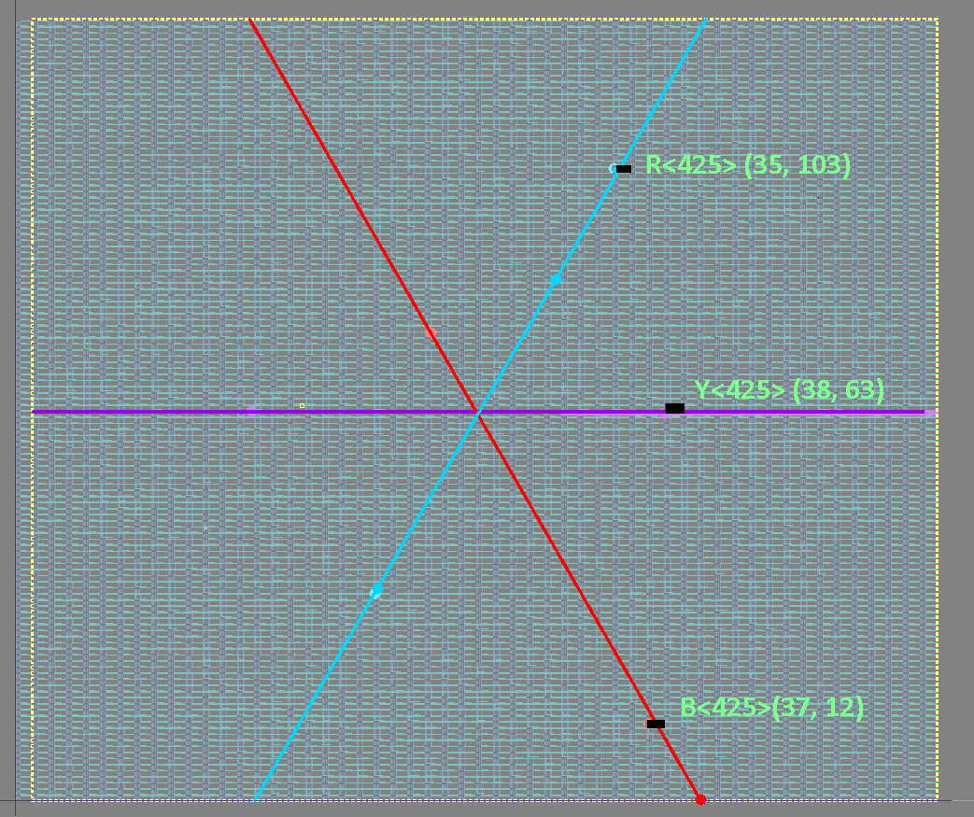
Proof-of-concept Demonstrator
3ps Time precision + 1mm position estimation
t_{i}-t_{j}
=>
(tracker-like)
SAMPIC
HW
(electron absorber)
(Row,Col)(35,103)(38,63)(37,12)
SAMPIC
FirmWare
5µm position, in 400ns frame resolution
E. Bechetoille, PICMIC, TWEPP, 1–6 oct. 2023, Geremeas, Sardinia, Italy
Notes:
Today, the MCP, is not cabable of generating 3ps resolution signal, but SAMPIC measure at the precision.
<number>

Slide 5
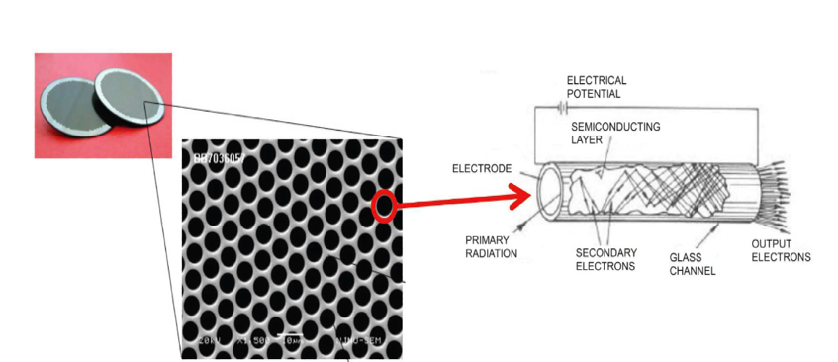
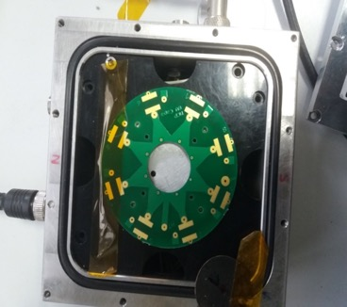
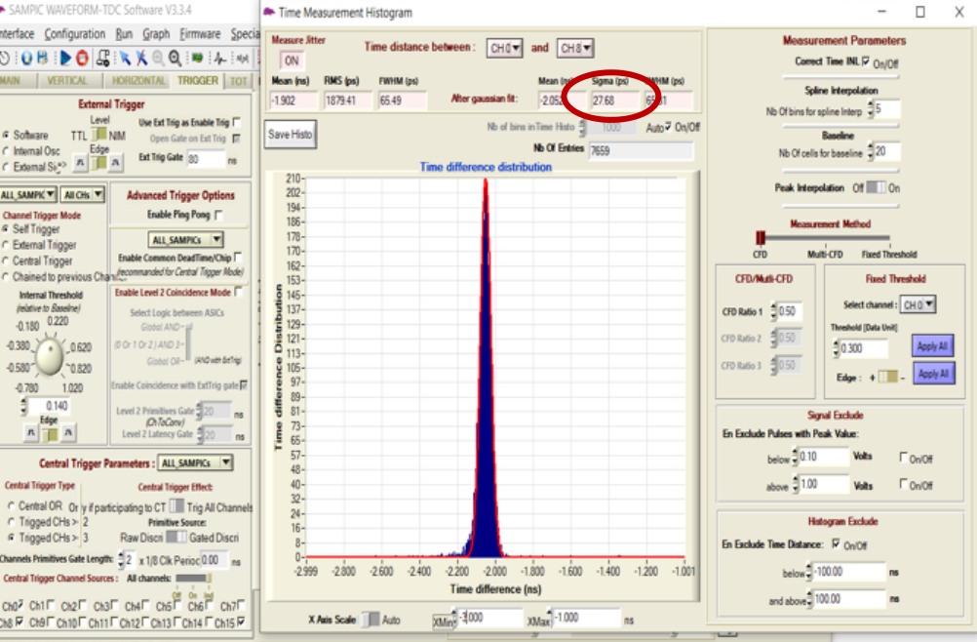
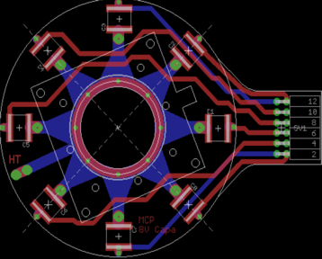
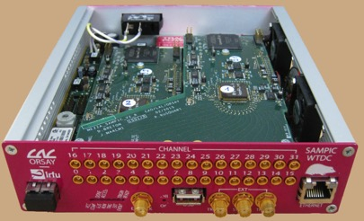
PICosencod subMICron detector:
MCP
it allows the detection of charged particles but also neutral ones such as γ and neutrons when equipped with appropriate converters (photocathode)
Imad’s presentation last year
L/D = 40-200
L is the plate thickness and D the tube diameter
D=3-25 µm
Gain/MCP ≂ 10000
TIME+position
8-point PCB for the time measurement.
PCB to be in contact with the grid
SAMPIC: WTDC ASIC allowing to reach ~3 ps time resolution
y[mm]
ΔT
x[mm]
<number>
- position determination using triangulation.

Slide 6
PICosencod subMICron detector:
POSITION+time
To reach few microns resolution with a limited number of electronic channels, a genuine concept was developed, successfully tested and patented.
- Connect the pixels in woven strips
- Two neighboring pixels are connected to two different strips
- Each strip is connected to one electronic channel
- Share the charge among a few ones
- Crossing the fired strip to determine the position
Reduction of electronic channels, power consumption.
<number>

Slide 7
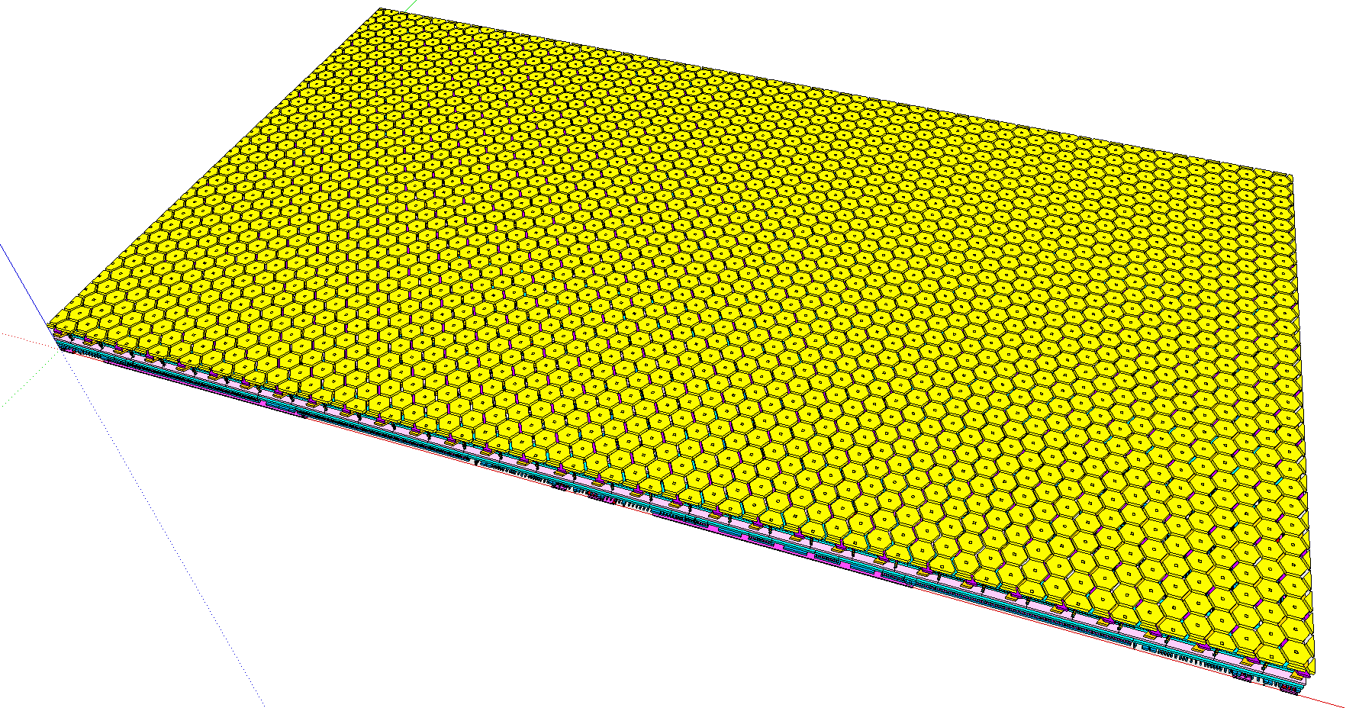
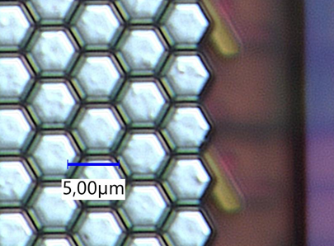
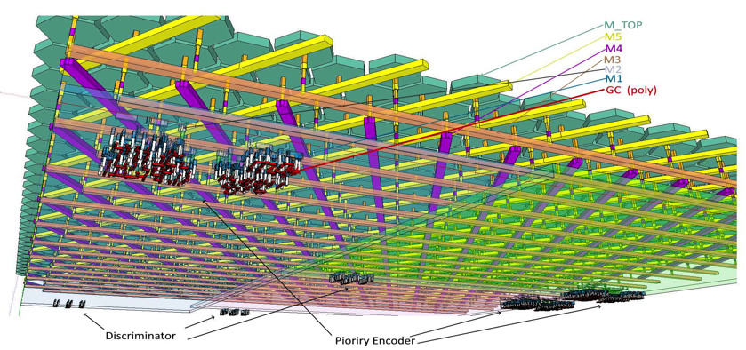
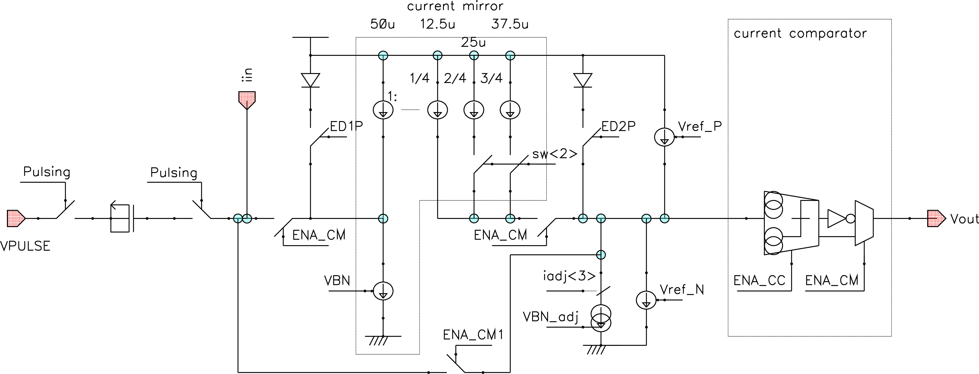
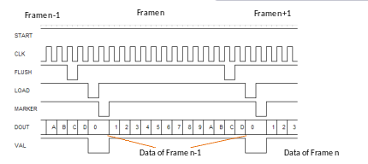
PICosencod subMICron detector:
POSITION+time
6 metal layer technology:
3xdirectionsx852 hexagon(5μm)-strip-lines, in TOP metal interconnector Metal-5-4-3
[53,128] matrix of Analog+Digital comparator readout in M2 & M1, each line gets a comparator.
Very front-end:
- Current mirror + current comparator
- Current reference: global 8-bit tuning DAC + 3-bit local
- protection diodes
Analog readout
i2c Slow control :
- global registers + each readout-cell locally
- Column readout by priority encoder Parallel readout :
- 13-bit data (touched pixel address) + Marker
- 40MHz // readout speed
- 16 sample by frame : 16* 25ns => 400ns frame
Digital readout
<number>

Slide 8
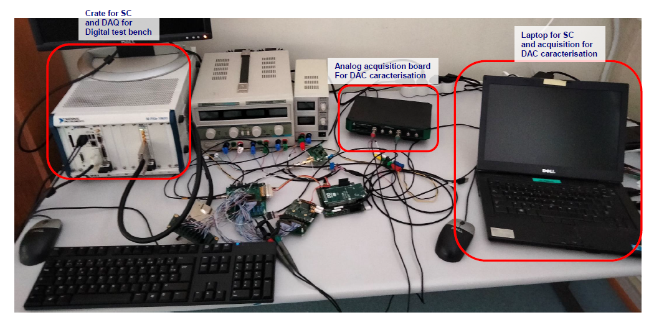
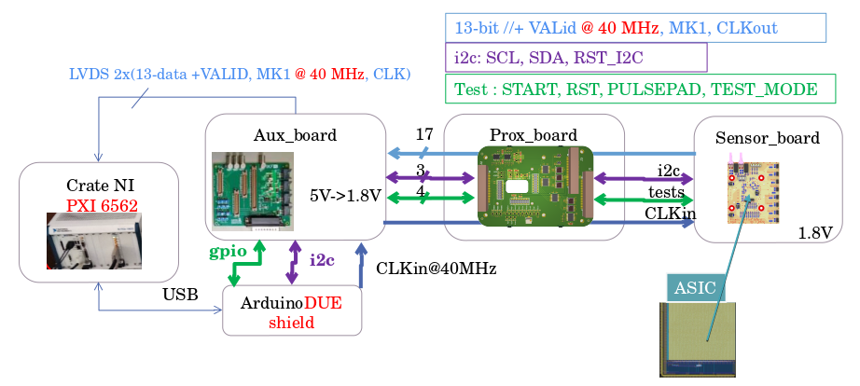
Test Bench
Test bench HW developed by IPHC - New design for sensor board & Arduino shield - Most of the test bench HW reused from a previous project - I2C: Arduino DUE board - DAQ: NI PXI6562 board 16 I/O up to 200 MHz
PICMIC DAQ Sequence Schematic:
<number>

Slide 9
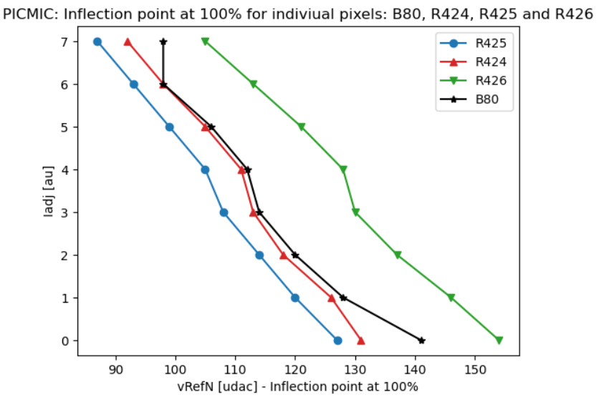
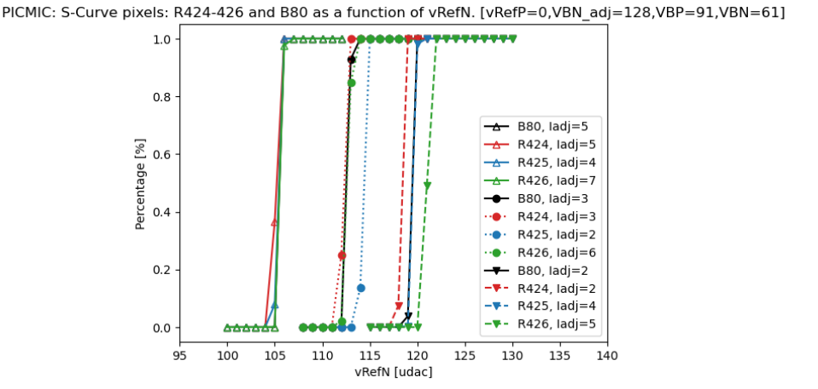
Pedestal threshold calibrations
(1/2)
[Protocol]
Freeze a set of DAC(Global) values driven by : - small dispersion between s-Curves - bigger number of sCurves in a given space of phase vs VRefN(quite sensitive)
Then, additional scan in local values are performed: - iadj<3bits>, sw<2bits>, EN_CM, EN_CC.
To determine value @50% inflection point.
To select the closest sCurves@50% to VRefN
PICMIC Very Front-End synoptic(Analog part)
The first tries were performed choosing a few channels (among the 2556 available):
2D scan [iadj vs VRefN] results following steps1-3 of the protocol
Matched sCurves(VRefN) for sets of values in iadj
<number>

Slide 10
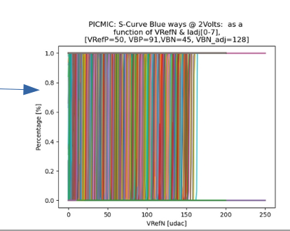
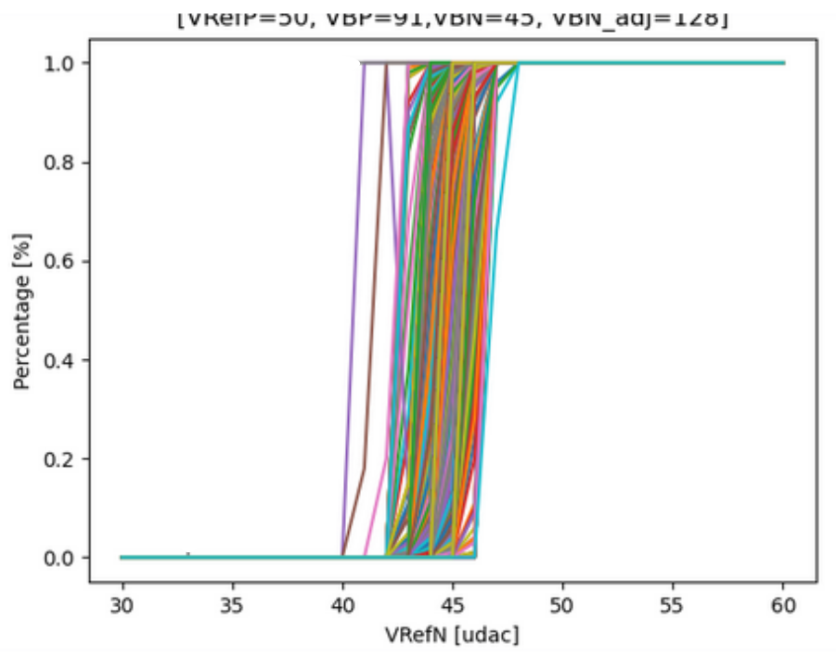
Pedestal threshold calibrations
(2/2)
[Protocol]
Freeze a set of DAC(Global) values driven by : - small dispersion between s-Curves - bigger number of sCurves in a given space of phase vs VRefN(quite sensitive) -- VRefP=50, VBP=90, VNB=45, VBN_adj=128
Then, additional scan in local values are performed: - iadj<3bits>, sw<2bits>, EN_CM, EN_CC.
To determine value @50% inflection point.
To select the closest sCurves@50% to VRefN. The software’s interface of the test bench modified to allow up to 5-Dimensional scans.
Full calibration of 2556 channels. Global fixed, varying local: 32 configurations per channel: ~81800 sCurves to analyse.
full matched sCurves(VRefN)
<number>
*Excluded 38 Yellow channels (Metal 3), noisy due to coupling between memory flush signal in Metal 2

Slide 11
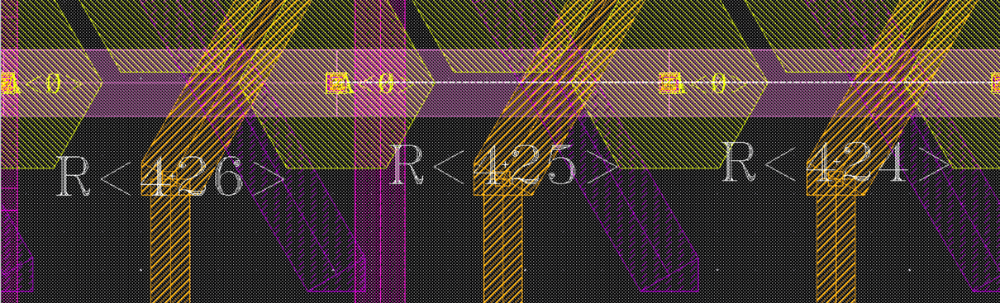
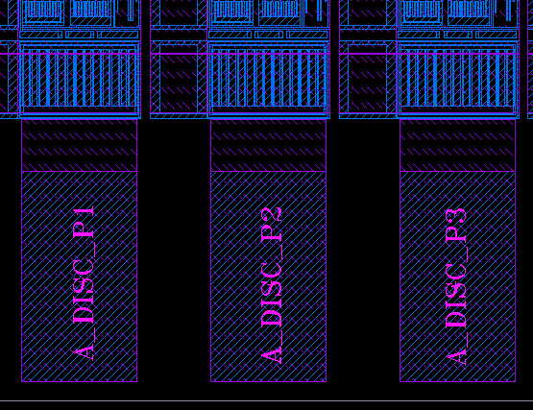
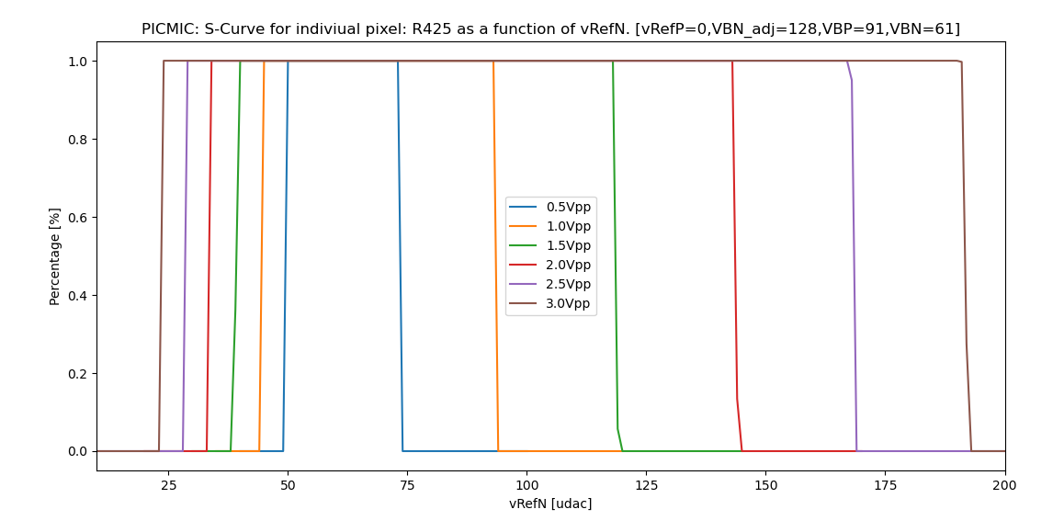
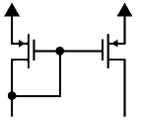
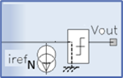
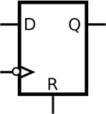
Injections Studies
(1/2)
PICMIC allows external signal injection trough the (PAD): - R424[R68,C28],R425[R103,C35] and R426[R6,C15]. - * it also allows to excite whole columns in the channel matrix (no shown in above layouts).
Voltage injection through external 1pF, then scan of the threshold of Current Comparator.
Below the current threshold, the falling edge sensitive does not trig.
The signal is recorded on falling edge, so above a certain value of iRefN added to threshold current, the comparator does not trig anymore-→ chapeau!
Efficiency [%]
VRefN [udac]
iComp
iComp
iComp
iRefN
‘1’
VPULSE
Dout
ith+iin
iRefN
ith+iin
iRefN
ith+iin
1pF
Vout
1
Vout
1
Vout
1
0
No edges
0
0
fall edge
No edges
Dout
Dout
Dout
1
<number>
1
1
0
0
0

Slide 12
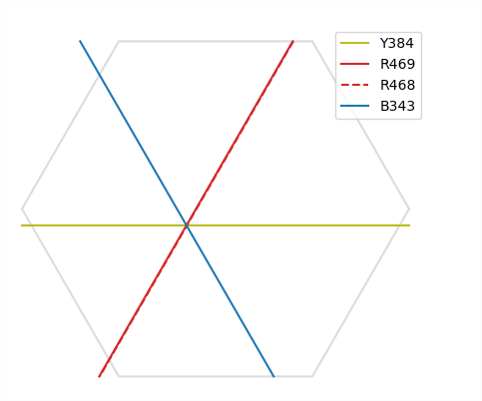
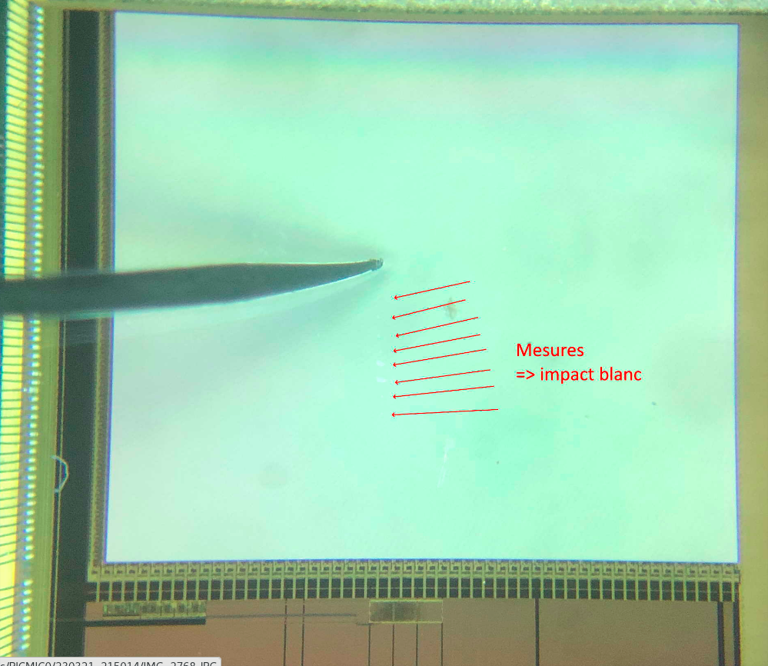
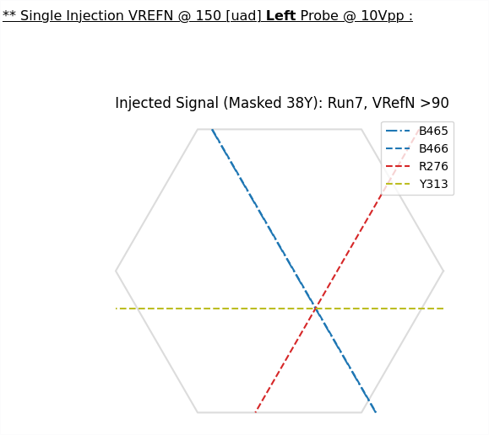
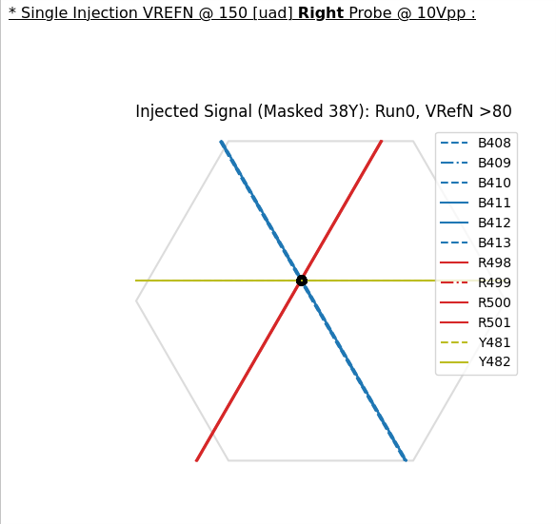
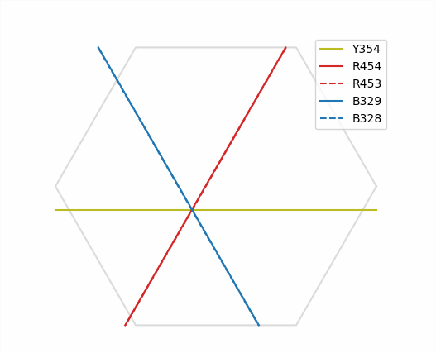
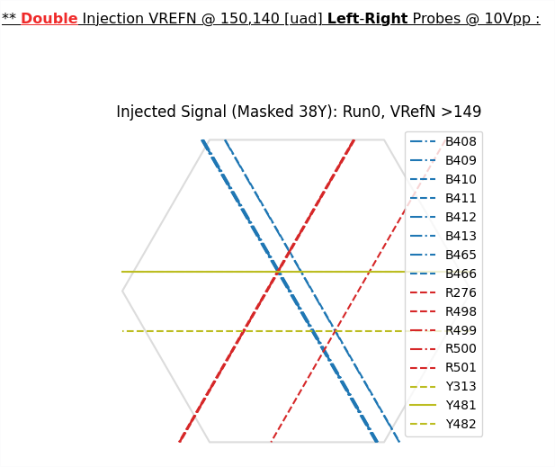
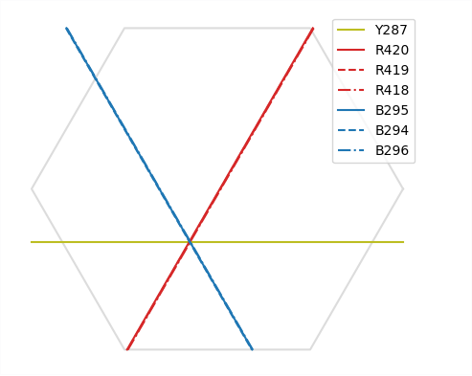
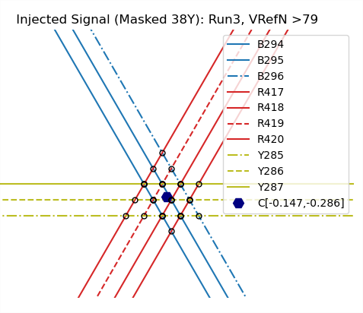
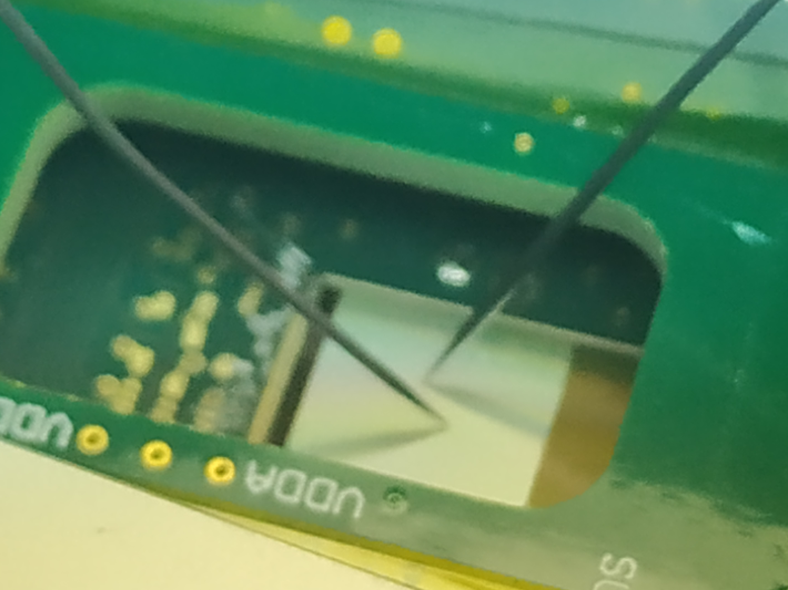
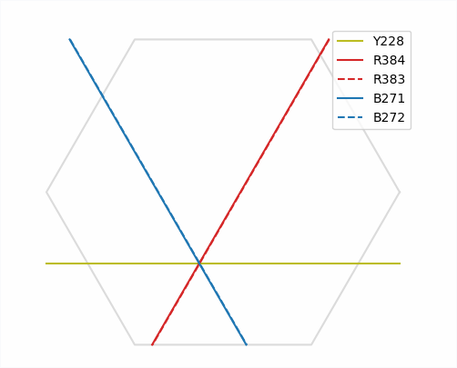
(2/2)
Injections Studies (Probes)
Having the full pedestal thresholds under control (PICMIC calibrated). We proceeded to accomplish an important mainstone. Direct inject on the surface.
Two probes injection
left-probe
right-probe
both-probes
Probe scan from bottom - top
Clustering and centroid estimation
<number>

Slide 13
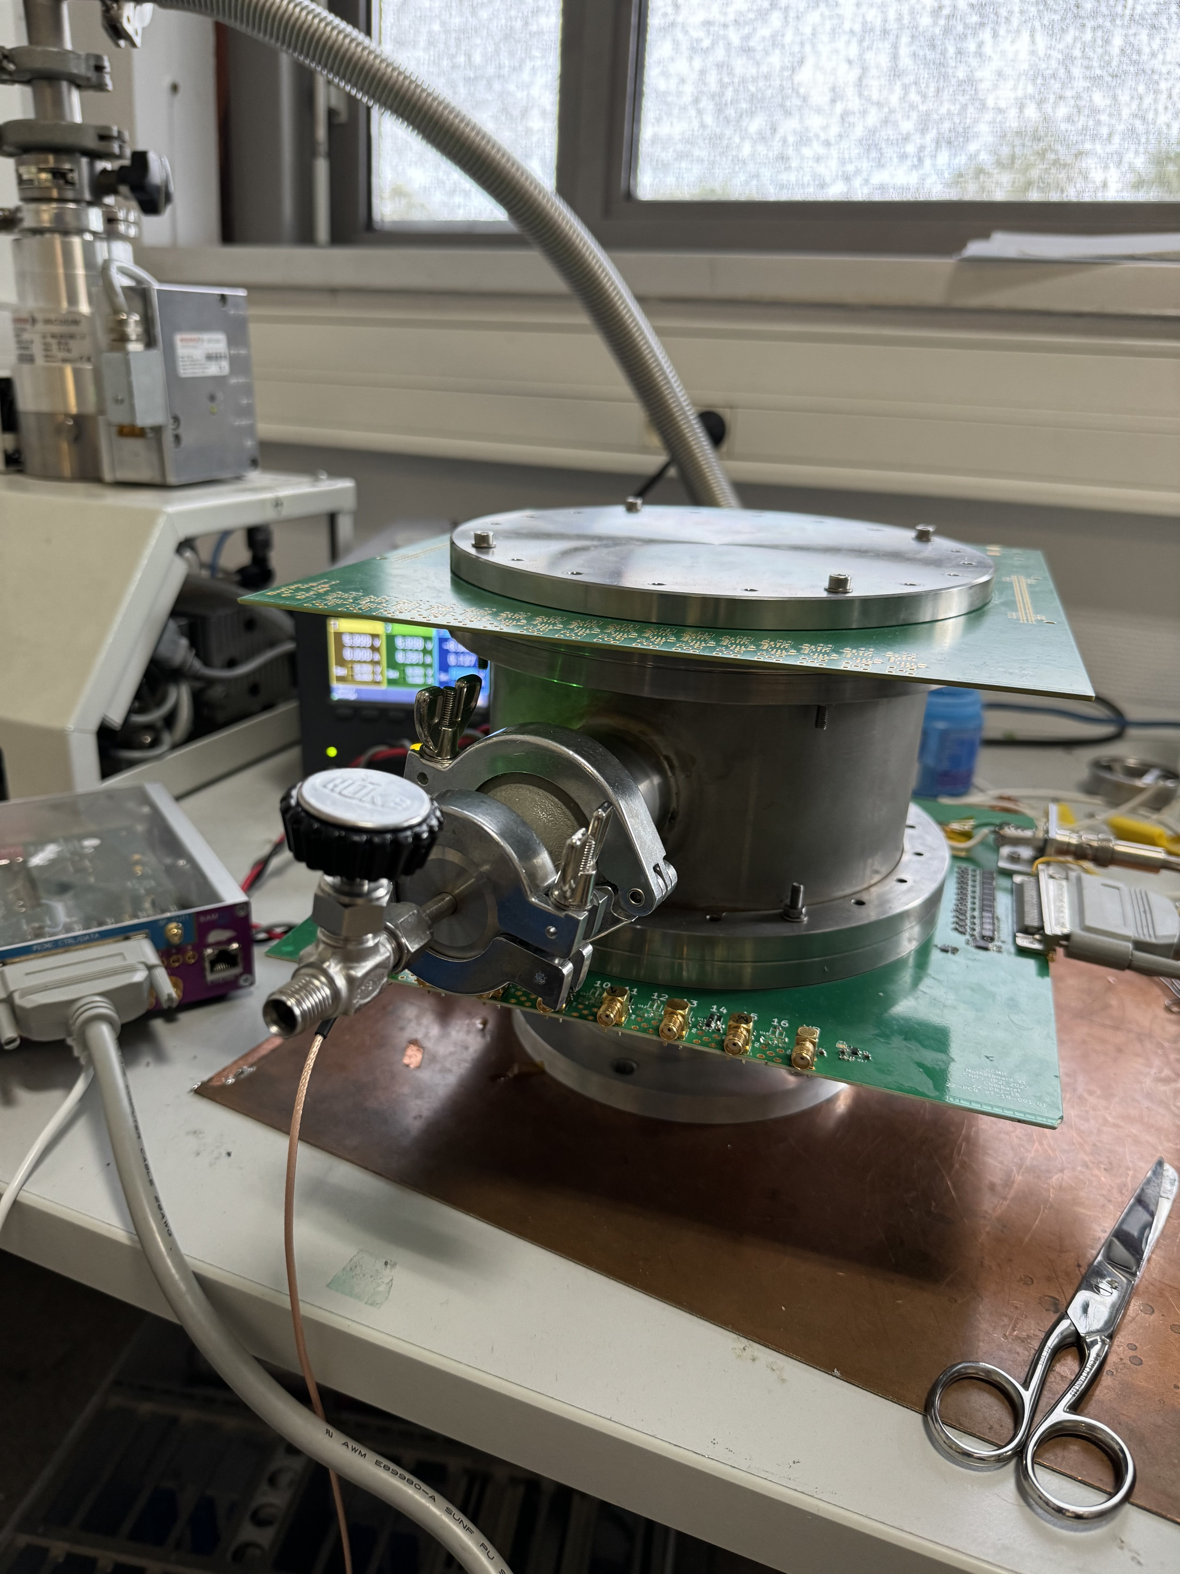
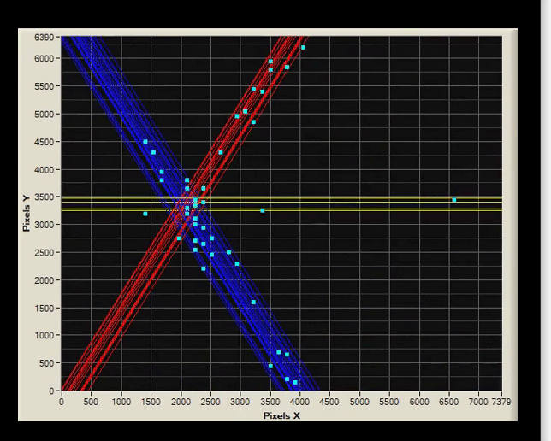
Proof-of-concept demonstrator
First results: Position detector validated.
- SAMPIC WTDC integrated with the PICMIC0. - New Calibration (pedestal threshold) in-situ, to avoid potential noise from the setup.
- concept validated!. - Work in progress to reduce channels dispersion. Fine tune at the calibration level. - Developing coincidence protocols (SAMPIC+PICMIC0) - Looking forward to move and test with beams.
Using a mezzanine to interconnect time+position sensors (IJClab-Orsay)
Future plans:
- Hit rate improvement from 2.5Mhz to 10Mhz or 100MHz (expected)
- Sensor size to increase - Hexagon pitch from 5um to 1.25um - migrated in a smaller tech node like 65nm or less (with more metal layers) - narrow electron shower to keep PICMIC0 target resolution → Going beyond of MCP - Idrogen (high rate readout) : Liroc + picoTDC
<number>

Slide 14
Summary
PICMIC concept validated:
Principle of very precise time measurement already validated.
Principle of very precise positions validated.
A first demonstrator using SAMPIC for time measurement and combining both time and position measurements based on SAMPIC DAQ is being used to combine both very precise time and position measurements.
A new detector NCP is being developed to reach unprecedented resolutions in both time and position.
A board integrating a low-jitter timing preamplifier and discriminator (LIROC-OMEGA) as wellas a precise TDC (piciTDC-CERN).
<number>

Slide 15
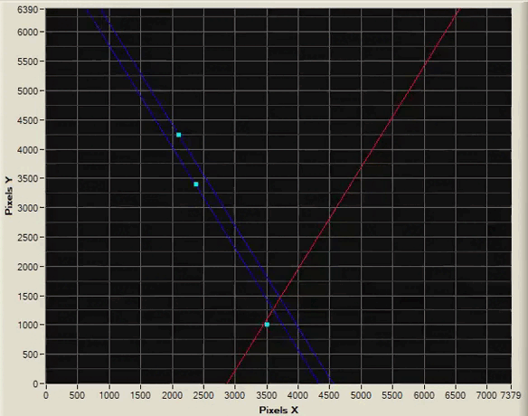
Summary
PICMIC concept validated:
Principle of very precise time measurement already validated.
Principle of very precise positions validated.
A first demonstrator using SAMPIC for time measurement and combining both time and position measurements based on SAMPIC DAQ is being used to combine both very precise time and position measurements.
A new detector NCP is being developed to reach unprecedented resolutions in both time and position.
A board integrating a low-jitter timing preamplifier and discriminator (LIROC-OMEGA) as wellas a precise TDC (piciTDC-CERN).
<number>

Slide 16
BACKUP
<number>

Slide 17
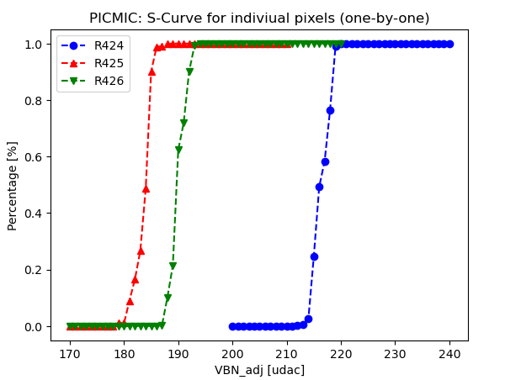
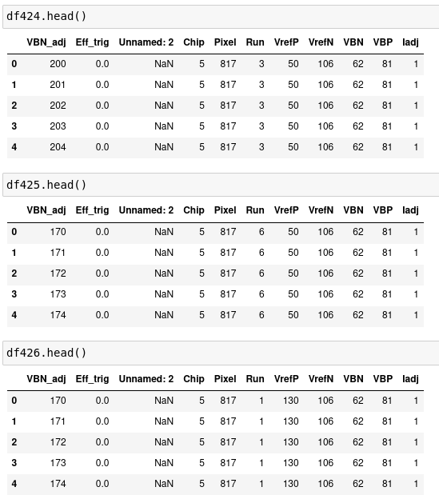
Single pixel s-curves
<number>

Slide 18
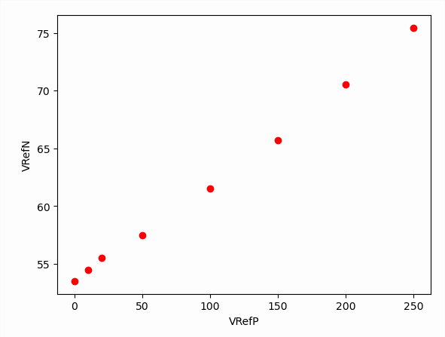
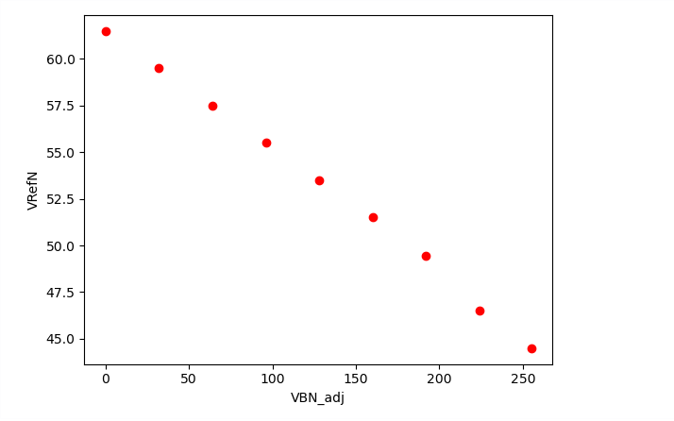
s-curves [update]
Picmic has 5-DAC [VRefN,VRefP,VBN,VBN_adj and VBP]. Global variables.
2 local variables → Iadj<4bits> + SW<2bits>
We started to performing studies to understand relationship between DACs[Globals] +and Local one.
Two-Dimensional scans :
VRefN and VrefP Scan : VRefN and VBN_adj Scan
In both cases, nice linear trend
<number>

Slide 19
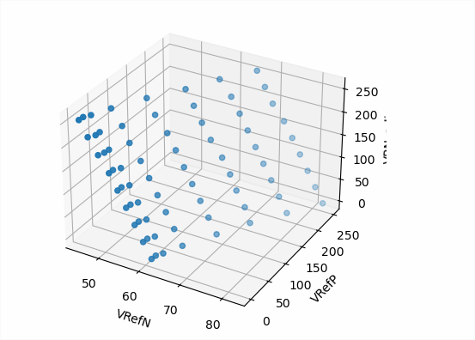
s-curves [update]
Now, Three-dimensional scan. Everything fix except VRefN, VRefP and VBN_adj :
It allows to see previous results and to define the following for the protocol:
Vg= VrefN*400nA-VrefP*80nA-VBN*80nA*10*(1.5 - 0.75*SW<0> - 0.5*SW<1>) (step 1)
Vl= iadj<2>*0.2+iadj<1>*0.6+iadj<0>*1 (step2)
– step1 → compute the mean value at 50% inflection point Vg – step2 → from step1 estimate values in DACs, then fine tune using locals .
As already shown in the last meeting
<number>

Slide 20
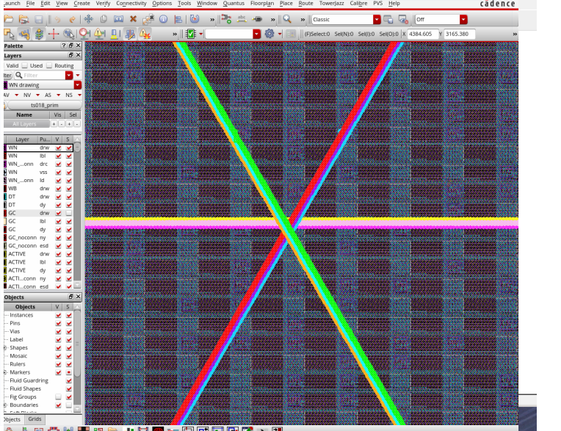
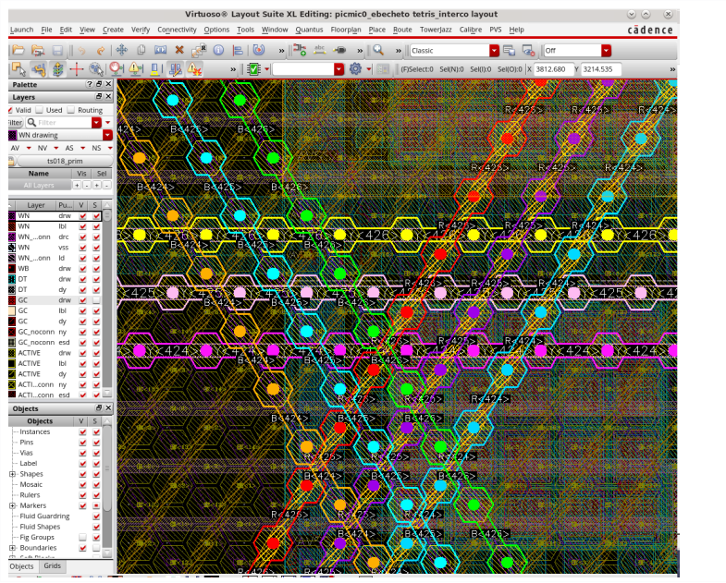
Effects # of ways in sCurve Scan
In order to reduce the iteration time (data production), we studied the effect as is affected the sCurve for a way according the number of ways added together
<number>

Slide 21
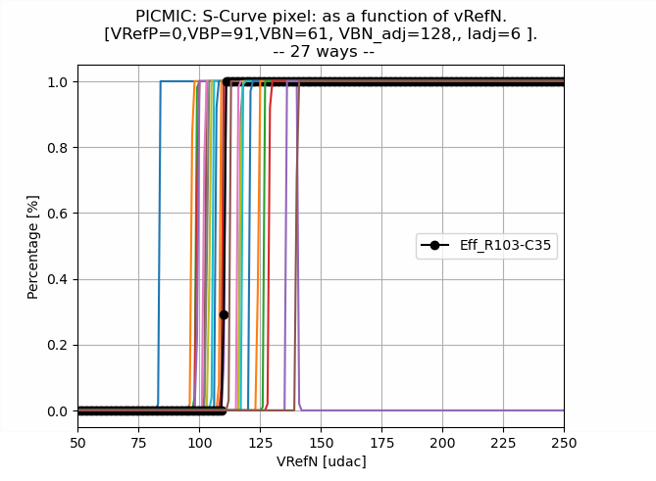
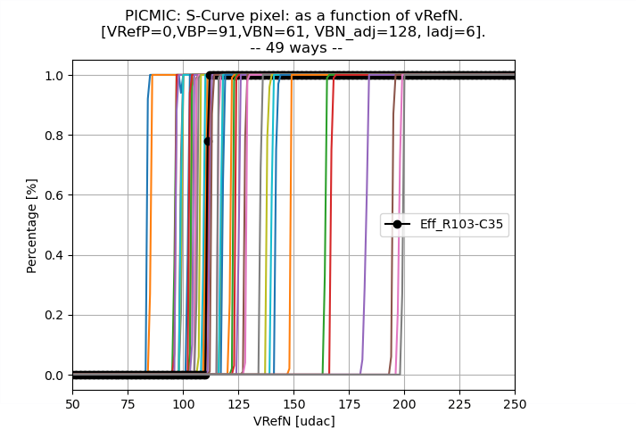
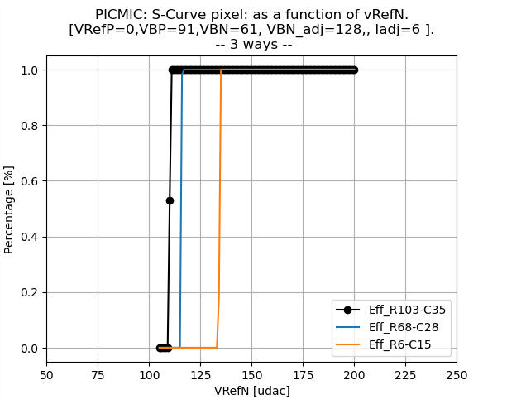
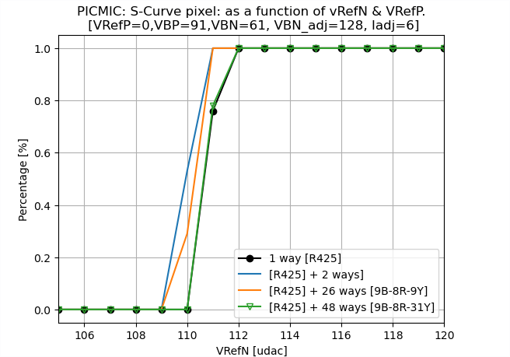
Effects # of ways in sCurve Scan
In order to reduce the iteration time (data production), we studied the effect as is affected the sCurve for a way according the number of ways added together
In agreement within 1 [udac]
<number>

Slide 22
Injection [update]
We roughly know how to melt a few curves. So, lets try again signal injection for three pixels studied previously (R424, R425 and R426) his effect over there.
S-curves in three ways after calibration.
<number>
<number>

Slide 23
Temperature Tests
Temperature lows and stables during DAQ scans (ON during several days).
Effects within 1[udac] in VBN_adj(low current step) value scans.
<number>

Slide 25
Confidential

Slide 26
Confidential
ΔT

