Slide 1
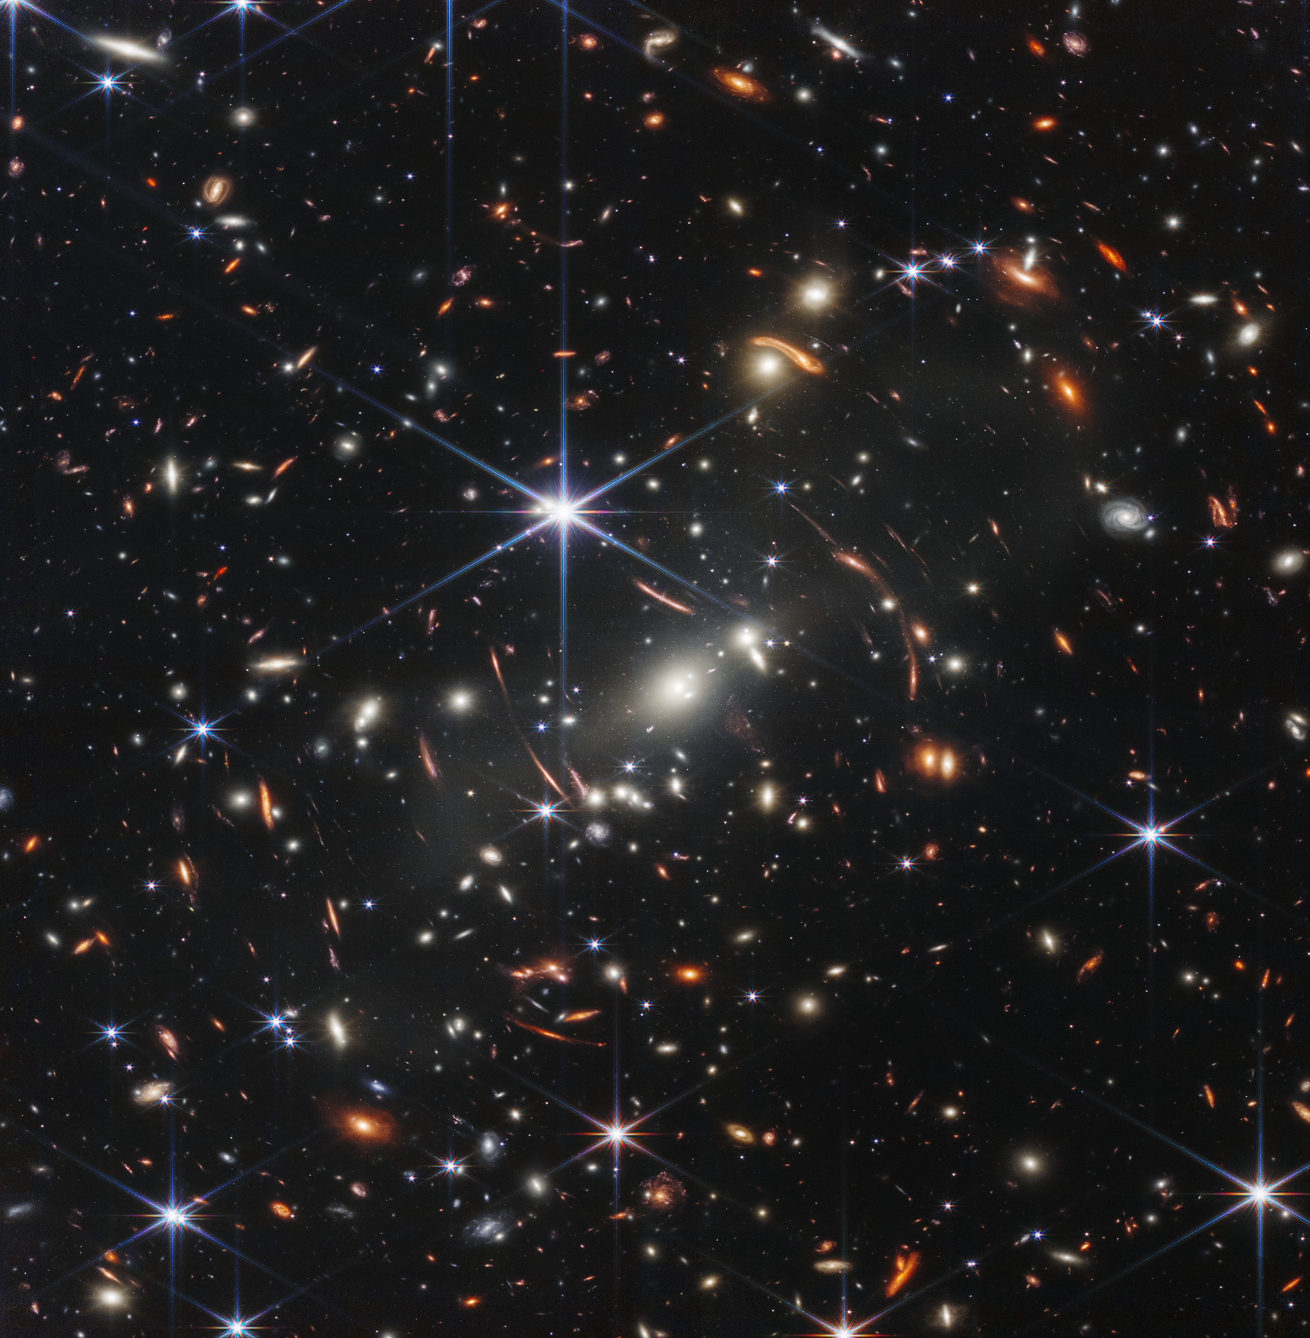
Infrared detectors in astronomy: from classical detectors to avalanche photodiodes
Thibault Pichon
CEA Astrophysique Department
La photo-détection avec les semi-conducteurs
Crédits: NASA, ESA, CSA, STScI

Slide 2
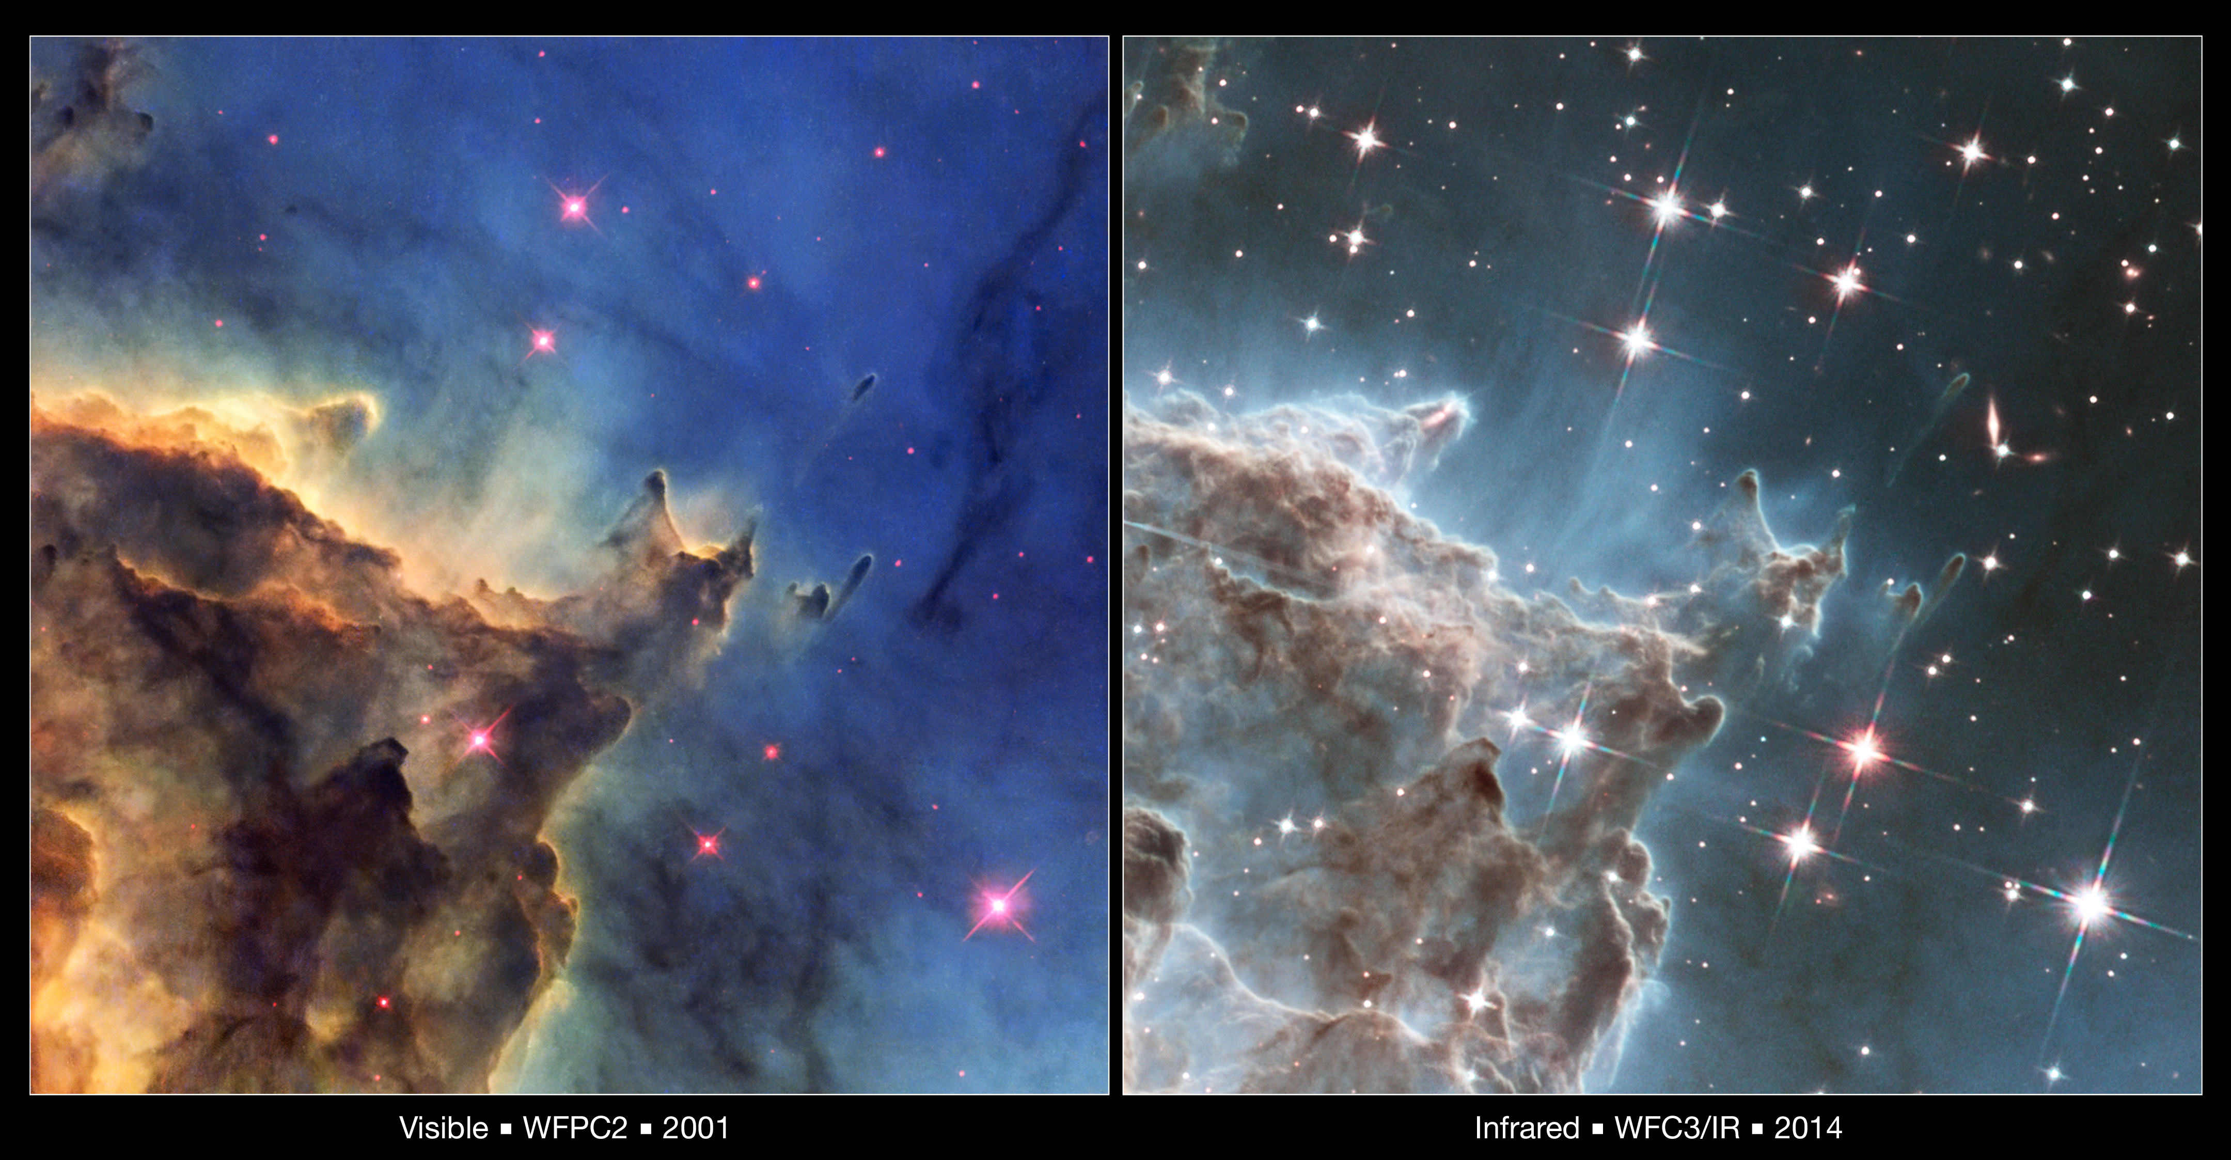
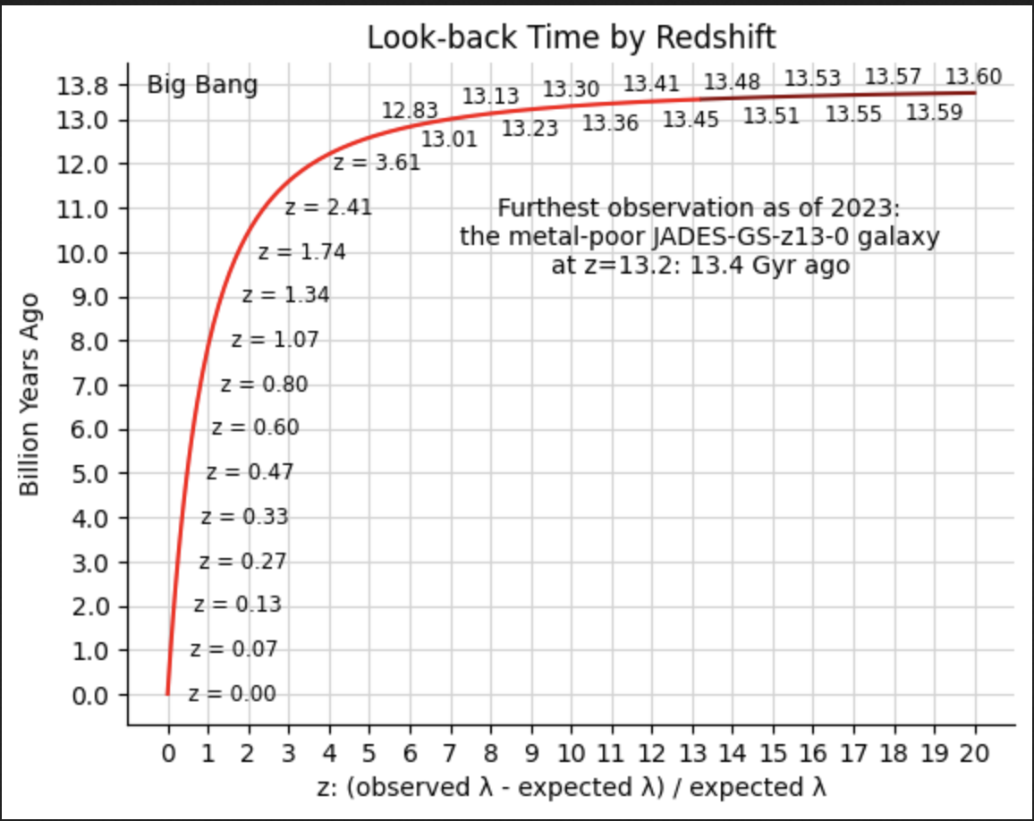
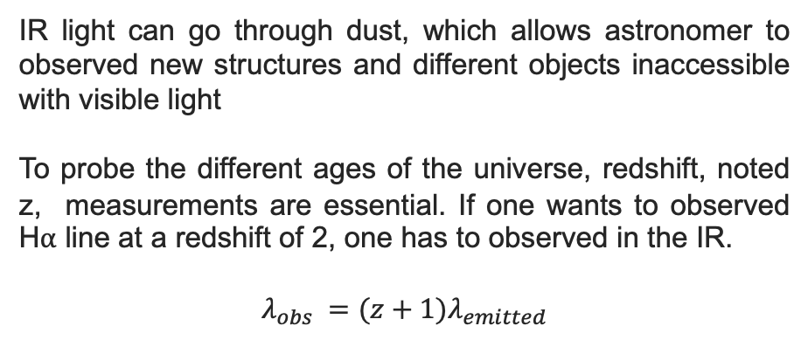
Why IR in astronomy ?
IR light can go through dust, which allows astronomer to observed new structures and different objects inaccessible with visible light
To probe the different ages of the universe, redshift, noted z, measurements are essential. If one wants to observed H⍺ line at a redshift of 2, one has to observed in the IR.
$$λ_{obs} =(z+1)λ_{emitted}$$
This image compares two views of the same detailed area in the star-forming nebula NGC 2174 from the Hubble Space Telescope.
More generally, IR light can be used to study:
Exoplanets atmosphere
Galaxy formation
Large scale structure of the universe
Transient sky
Dark matter and dark energy
…
Crédit NASA

Slide 3
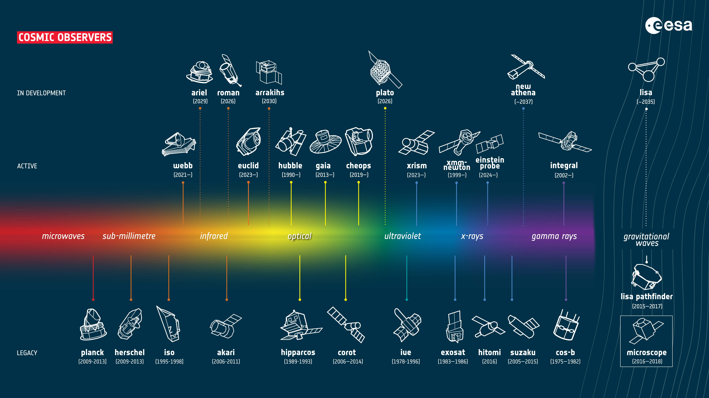
Why IR in astronomy ?
Large scale survey of the chemistry of exoplanets atmosphere
Study of the dark universe
Census of exoplanets
Direct imaging of exoplanets
Study of the first stars and galaxie that formed after the big bang
Study of galaxy formation and evolution
Study of star formation and planet formation
Study of planetary systems
Study of dark matter
Study of the dark universe (dark matter and dark energy)
Source: ESA

Slide 4
Outline
Classical IR detectors based on HgCdTe
  Basic principles
  Performances
  Increase detector sensitivity
Towards Avalanche Photodiodes IR detectors
  Basic principles
  On the use of APD for low flux applications
Conclusion

Slide 5
Outline
Classical IR detectors based on HgCdTe
  Basic principles
  Performances
  Increase detector sensitivity
Towards Avalanche Photodiodes IR detectors
  Basic principles
  On the use of APD for low flux applications
Conclusion

Slide 6
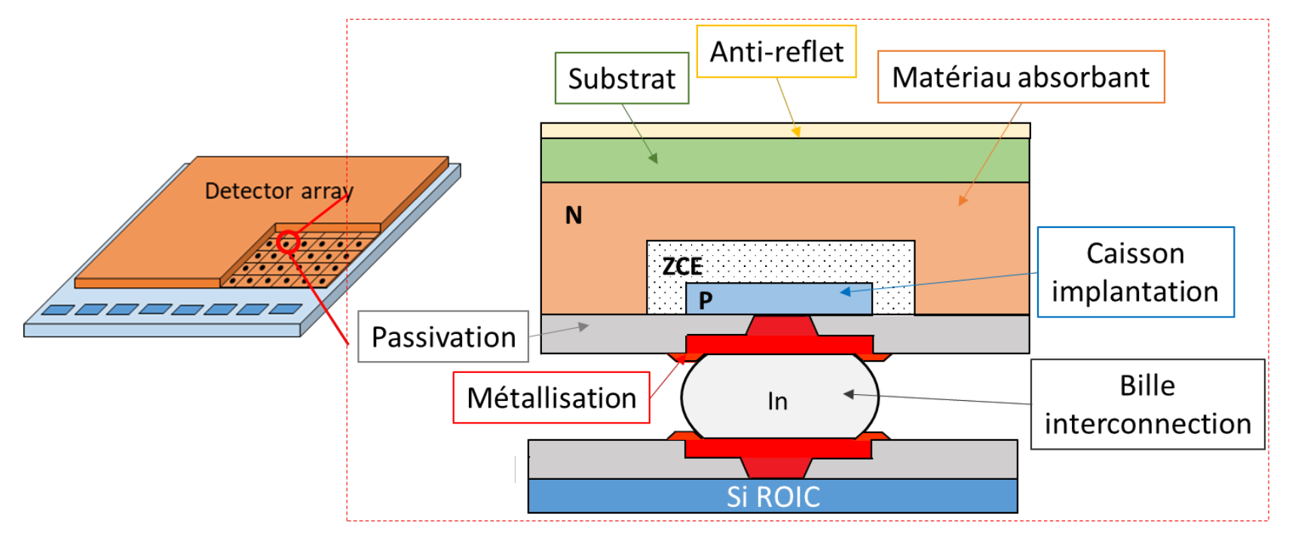
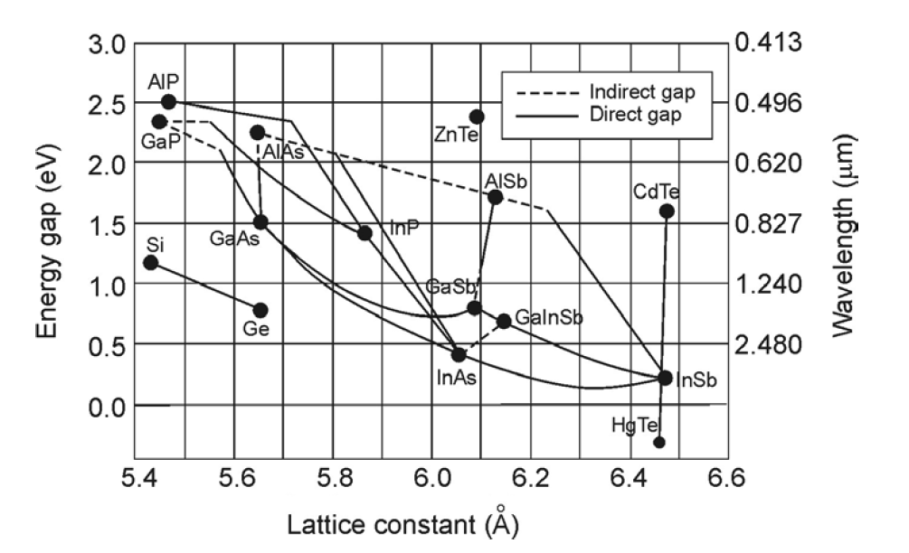
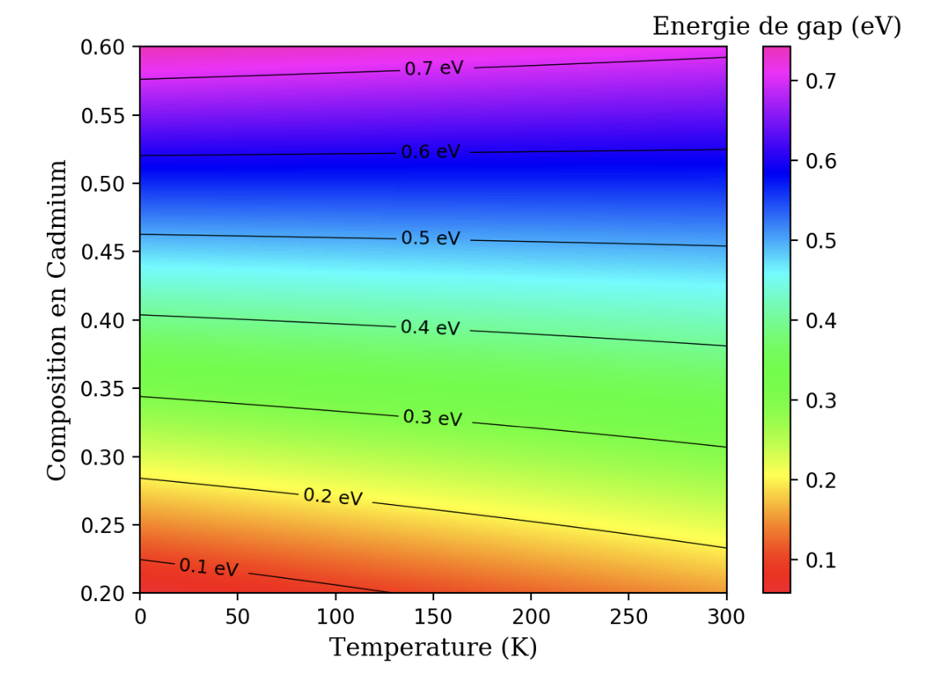
1. HgCdTe-based IR detectors: basic principles
Taken from [1]
The absorbing layer is made of Hg_{1-x}Cd_{x}Te material and has the following material properties:
Based on II-VI material
Direct bandgap semi-conductor
The bandgap can be tuned with the Cd composition, x, and the temperature
[1] LE GOFF, Titouan. Etude de la persistance dans les rétines proches IR en HgCdTe pour les applications en astronomie. 2022. Thèse de doctorat. UGA (Université Grenoble Alpes)

Slide 7
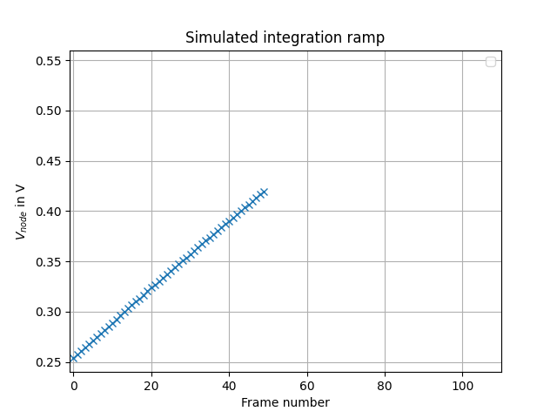
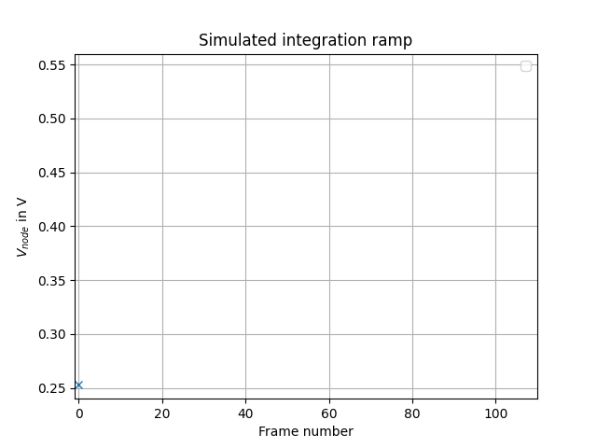
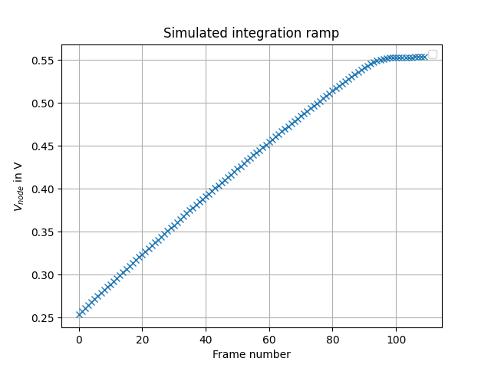
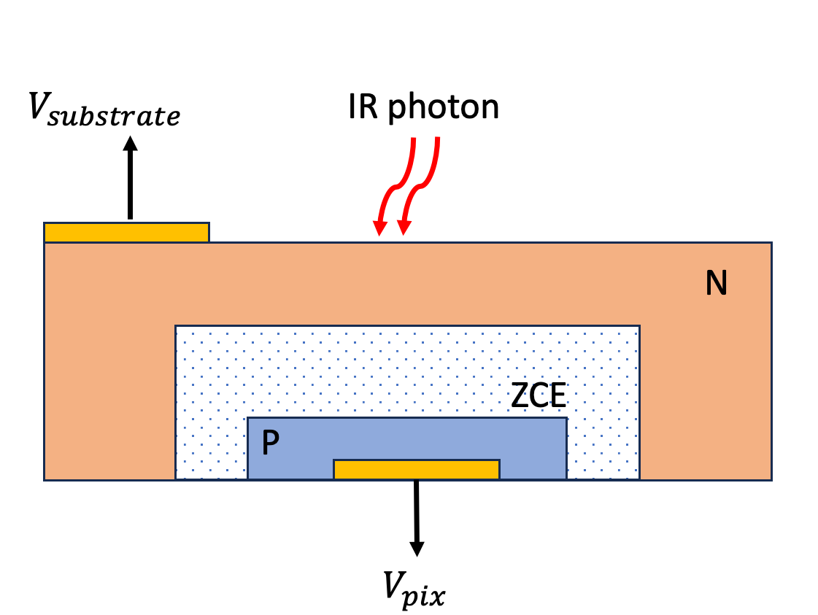
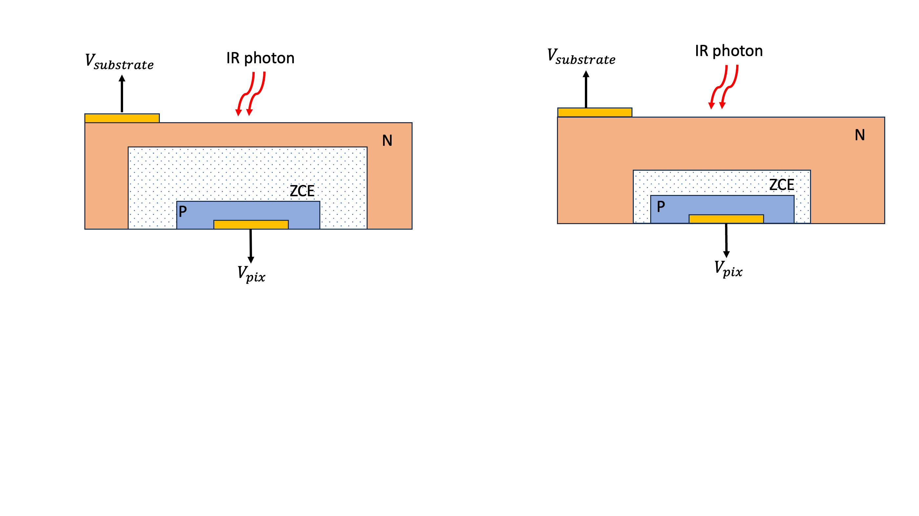

1. HgCdTe-based IR detectors: basic principles
A detector is made of a PN junction. The detectors are then organised in an array.
Photogenerated carriers are collected directly within the PN junction capacitance.
The integrating node is floating during the integration, and the size of the ZCE decrease as charges integrate.
$$V_{node}$$

Slide 8
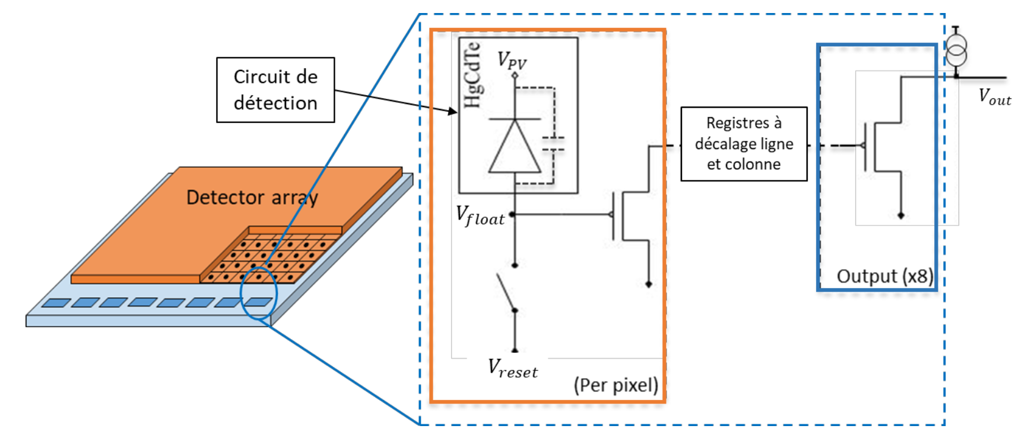
1. HgCdTe-based IR detectors: basic principles
Different readout circuit architectures exists (ROIC, stands for Readout Integrated Circuit):
  Direct injection
  Capacitve TransImpedance Amplifier
  Source follower per detector (SFD)
Advantages
Low noise
Low power consumption
Drawbacks:
Instinsically non linear
Low readout speed
  Direct injection
  Capactive TransImpedance Amplifier
  Source follower per detector (SFD)
Few characteristics
The ROIC architecture is based on 3 transistors per pixel.
Typical detector readout speed is equal to 100kHz.
Detector can be read with different number of outputs (typically 1, 2, 4, 16, 32)
Schematic view of SFD ROIC. Tiré de [1]
[1] LE GOFF, Titouan. Etude de la persistance dans les rétines proches IR en HgCdTe pour les applications en astronomie. 2022. Thèse de doctorat. UGA (Université Grenoble Alpes)

Slide 9
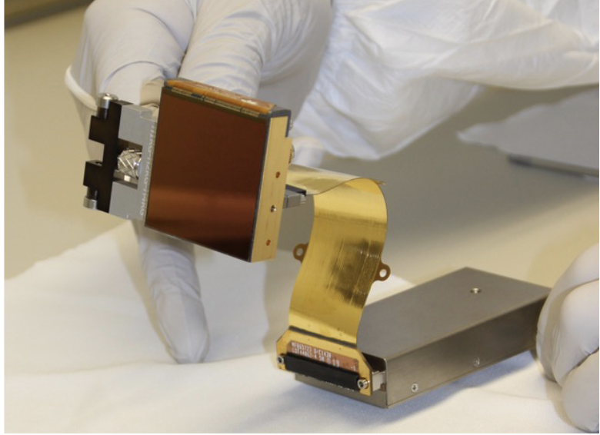
HgCdTe-based IR detectors: performance
These MCT-based IR detectors equip the focal plane of the major space and ground-based instruments. For instance, these detectors can be found in the JWST, EUCLID or HST. But also in instruments of the Extremely Large Telescope (ELT).
H2RG Euclid IR detector of the NISP instrument. Taken from [1]
Characteristics | Value
Detector size | 2048x2048, 4096x4096
Pixel pitch | 18µm
Cut-off wavelength | 1.7µm-13µm
Operating temperature | 35K-130K
Performance
Dark current | < 0.001 e-/s/pix lambda 2.1µm at 100 K < 0.07 e-/s/pix lambda 8.1µm at 42 K
Readout noise | <10 e-
Well depth | ~100 000 e-
QE | ~90%
Median dark current value at 42 K: 0.071 e-/s/pix
Dark current on 8.1µm cutoff IR detector at 42K
[1] JAHNKE, K., GILLARD, W., SCHIRMER, M., et al. Euclid. III. The NISP Instrument. arXiv preprint arXiv:2405.13493, 2024.

Slide 10
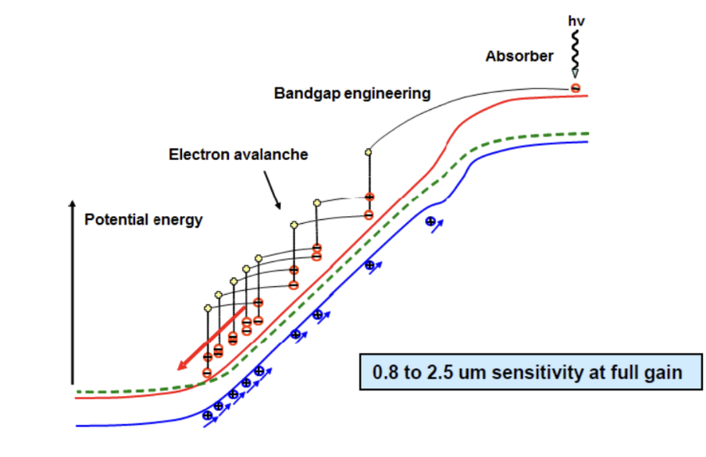
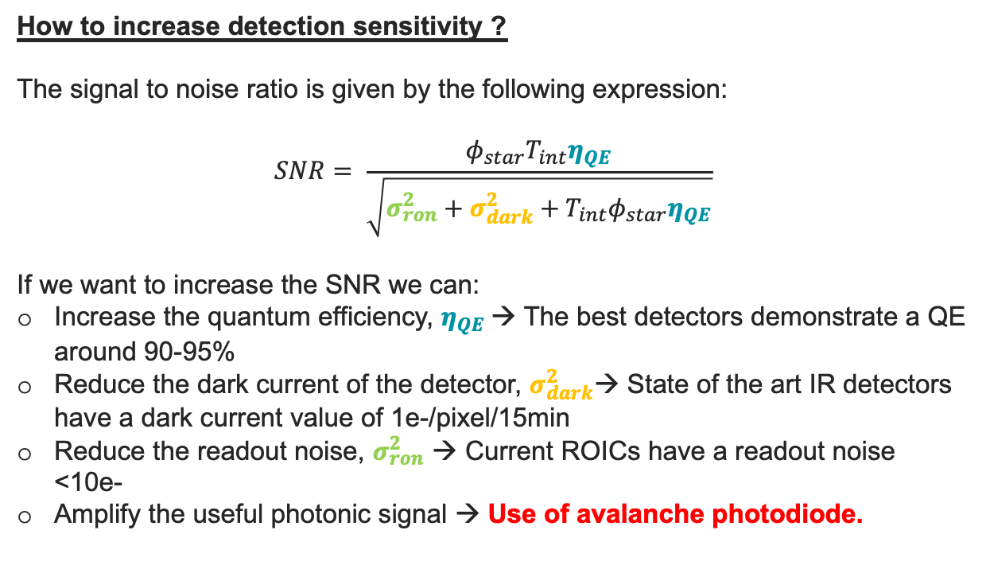
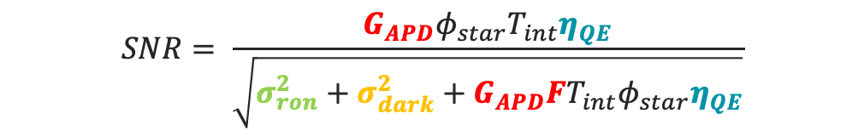
HgCdTe-based IR detector: increase sensitivity
How to increase detection sensitivity ?
The signal to noise ratio is given by the following expression:
$$SNR= \frac{φ_{star}T_{int}η_{QE}}{\sqrt{σ_{ron}^{2}+σ_{dark}^{2}+T_{int}φ_{star}η_{QE}}}$$
If we want to increase the SNR we can:
Increase the quantum efficiency, $η_{QE}$→ The best detectors demonstrate a QE around 90-95%
Reduce the dark current of the detector, $σ_{dark}^{2}$→ State of the art IR detectors have a dark current value of 1e-/pixel/15min
Reduce the readout noise, $σ_{ron}^{2}$ → Current ROICs have a readout noise <10e-
Amplify the useful photonic signal → Use of avalanche photodiode.
Band diagram of an avalanche photodiode. Taken from [1]
$$SNR= \frac{G_{APD}φ_{star}T_{int}η_{QE}}{\sqrt{σ_{ron}^{2}+σ_{dark}^{2}+G_{APD}FT_{int}φ_{star}η_{QE}}}$$
[1] CLAVEAU, Charles-Antoine, BOTTOM, Michael, JACOBSON, Shane, et al. First tests of a 1 megapixel near-infrared avalanche photodiode array for ultra-low background space astronomy. In : X-Ray, Optical, and Infrared Detectors for Astronomy X. SPIE, 2022. p. 330-346.

Slide 11
Outline
Classical IR detectors based on HgCdTe
  Basic principles
  Performances
  Increase detector sensitivity
Towards Avalanche Photodiodes IR detectors
  Basic principles
  On the use of APD for low flux applications
Conclusion

Slide 12
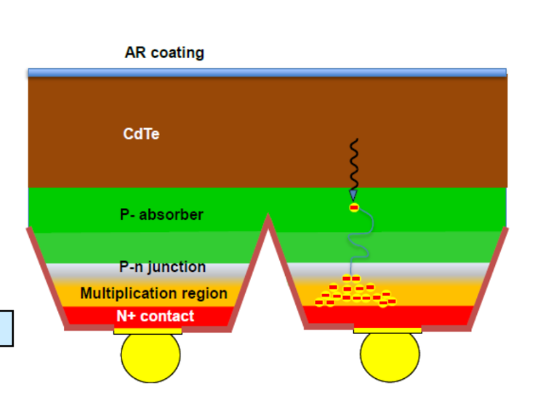
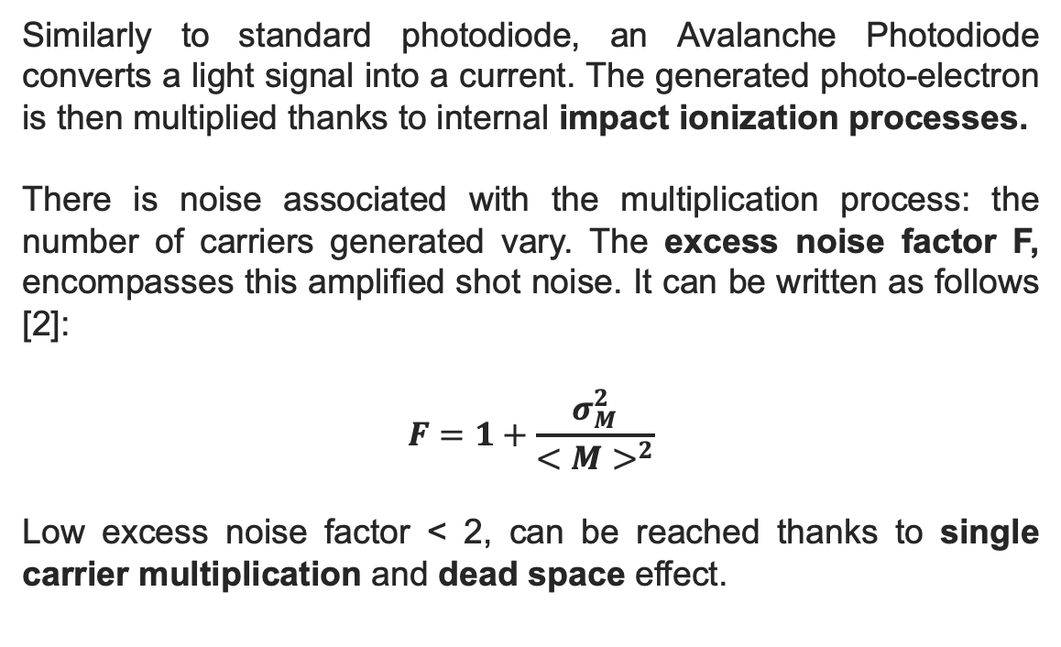
HgCdTe-based APD: basic principles
Similarly to standard photodiode, an Avalanche Photodiode converts a light signal into a current. The generated photo-electron is then multiplied thanks to internal impact ionization processes.
There is noise associated with the multiplication process: the number of carriers generated vary. The excess noise factor F, encompasses this amplified shot noise. It can be written as follows [2]:
$$F=1+\frac{σ_{M}^{2}}{<M>^{2}}$$
Low excess noise factor < 2, can be reached thanks to single carrier multiplication and dead space effect.
Schematic view of a HgCdTe-based avalanche photodiode
It corresponds to the distance a carrier must travel before gaining enough energy to have a significant probability to generate a new carrier throught impact ionization
Band diagram of an avalanche photodiode. Taken from [1]
[1] CLAVEAU, Charles-Antoine, BOTTOM, Michael, JACOBSON, Shane, et al. First tests of a 1 megapixel near-infrared avalanche photodiode array for ultra-low background space astronomy. In : X-Ray, Optical, and Infrared Detectors for Astronomy X. SPIE, 2022. p. 330-346.
[2] ROTHMAN, Johan. Physics and limitations of HgCdTe APDs: A review. Journal of Electronic Materials, 2018, vol. 47, no 10, p. 5657-5665.

Slide 13
HgCdTe-based APD: basic principles
Why HgCdTe is a good material for APD ? [2]
This is due to the HgCdTe band structure. Only electrons are multiplied. The holes are too heavy and loose most of their energy interacting with phonons.
HgCdTe material presents low dark current
State of the art HgCdTe APD, demonstrates a gain of 100 with an excess noise factor lying between 1.1 and 1.4 with moderate applied biases (dozen of volts).
Schematic view of a HgCdTe-based avalanche photodiode
[1] CLAVEAU, Charles-Antoine, BOTTOM, Michael, JACOBSON, Shane, et al. First tests of a 1 megapixel near-infrared avalanche photodiode array for ultra-low background space astronomy. In : X-Ray, Optical, and Infrared Detectors for Astronomy X. SPIE, 2022. p. 330-346.
[2] ROTHMAN, Johan. Physics and limitations of HgCdTe APDs: A review. Journal of Electronic Materials, 2018, vol. 47, no 10, p. 5657-5665.
Band diagram of an avalanche photodiode. Taken from [1]

Slide 14
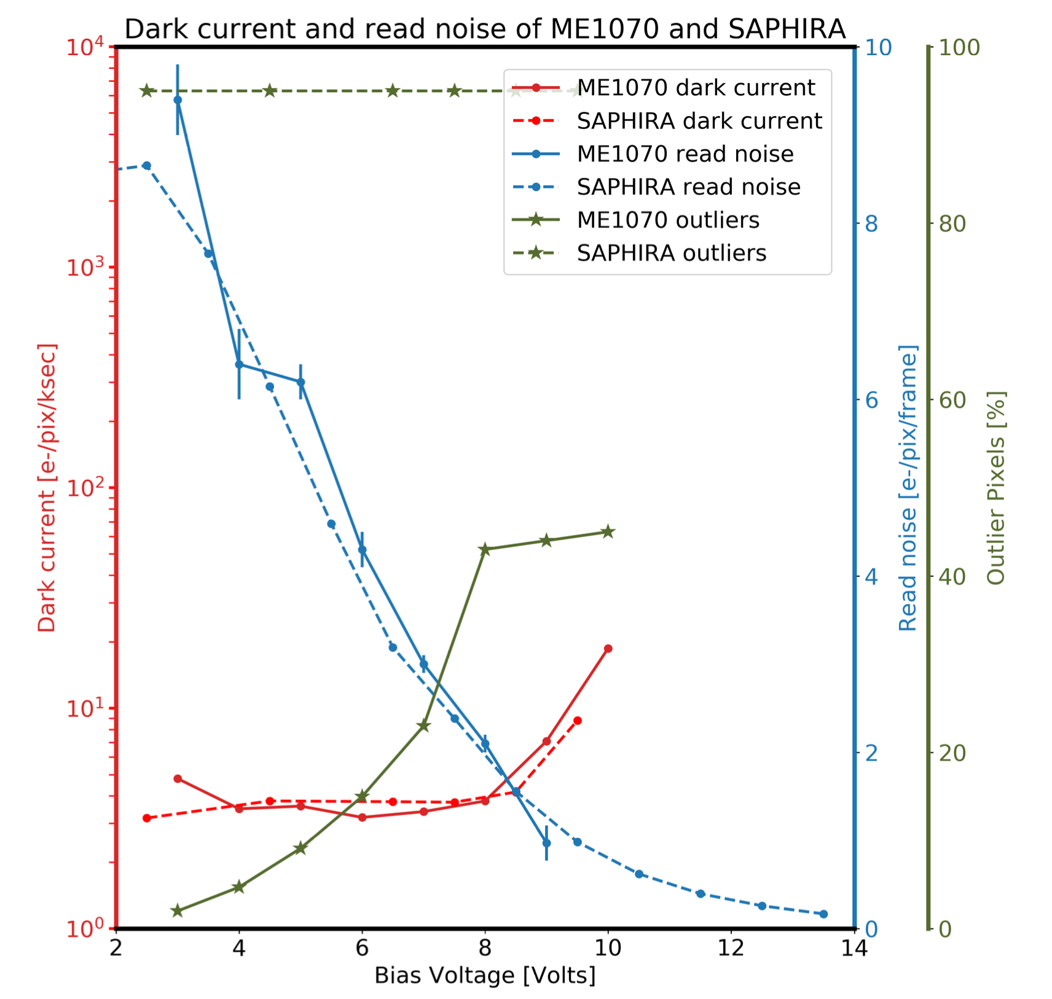
On the use of APD for low flux applications
In astronomy APDs are used mainly for adaptative optics, but not for low flux applications. No science grade devices already exist. Yet developments are ongoing funded by:
  NASA (IkePono development, 1024x1024 array)
  ESA (IBEX development, 2048x2048 array)
  University of Hawaï (IkePono development, 1024x1024 array)
  Current development demonstrates sub-electron readout noise but still has to face main limitations [1]:
  Glow of the readout circuit
  Maintain low dark current while applying high biases
  Persistence
  Loss of QE at low bias voltage
Taken from [1]
[1] CLAVEAU, Charles-Antoine, BOTTOM, Michael, JACOBSON, Shane, et al. First tests of a 1 megapixel near-infrared avalanche photodiode array for ultra-low background space astronomy. In : X-Ray, Optical, and Infrared Detectors for Astronomy X. SPIE, 2022. p. 330-346.

Slide 15
Outline
Classical IR detectors based on HgCdTe
  Basic principles
  Performances
  Increase detector sensitivity
Towards Avalanche Photodiodes IR detectors
  Basic principles
  On the use of APD for low flux applications
Conclusion

Slide 16
Conclusions
HgCdTe based IR detectors are widely used in the most up to date IR instruments and serve very well astronomers.
However in photon-starved applications, we are interested in increasing the detector sensitivity. As shown APD sounds to be promising candidates as they allow sub-electron readout noise. Yet these detectors are still under development.
IR Photon counting arrays with HgCdTe-based APD ?
An excess noise factor below 1.02 would allow us to operate in a photon counting mode. We would reach an almost noiseless multiplication. This could bring major changes in IR astronomy.
First Webb Deep field with NIRCam, Crédits: NASA, ESA, CSA, STScI

Slide 17
Thank you
Crédit : NASA, ESA, CSA, STScI

