Slide 1
ZTF-France meeting, LPNHE, 11-12 January 2024
ZTF passbands
Philippe Rosnet, Chloé Barjou-Delayre
and Nicolas Regnault

Slide 2
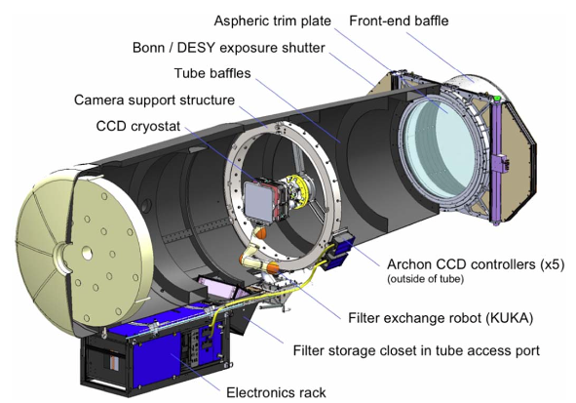
ZTF instrument: Schmidt-telescope
P48 mirror

Slide 3
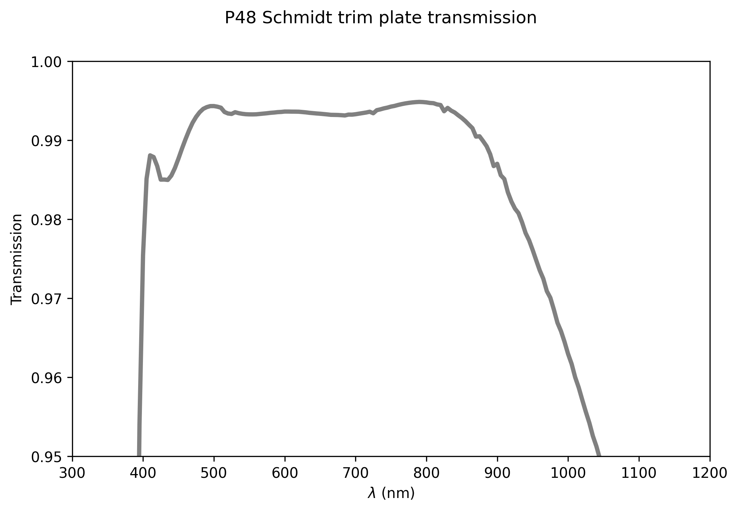
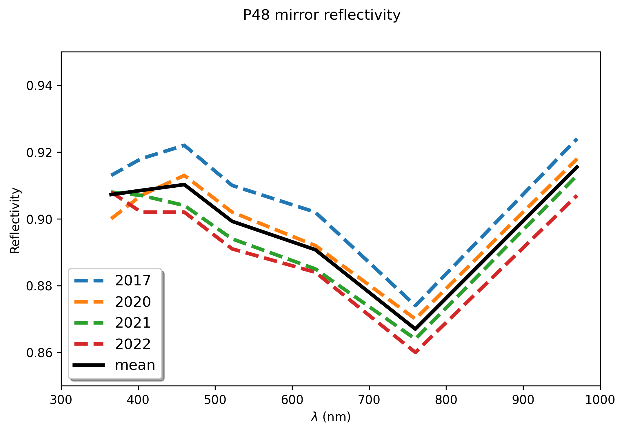
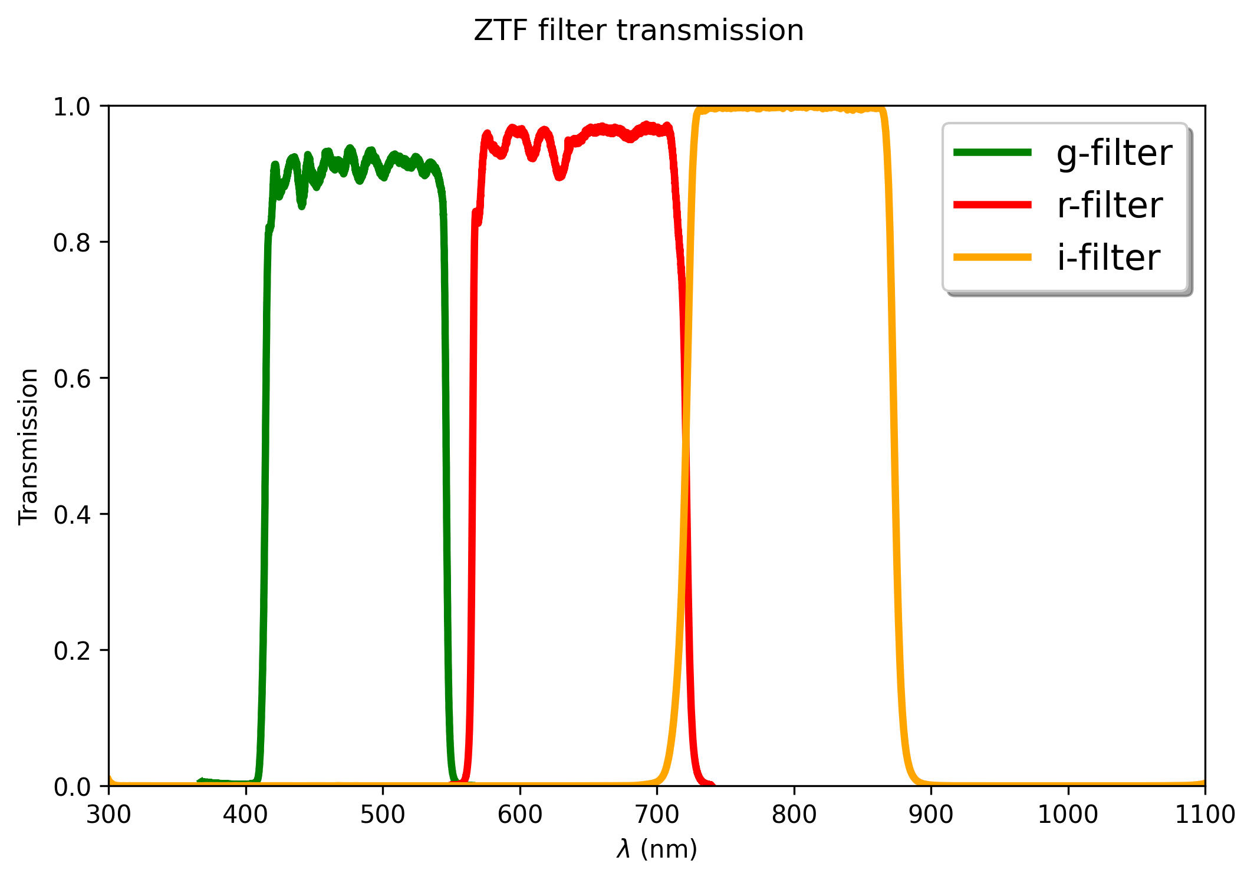
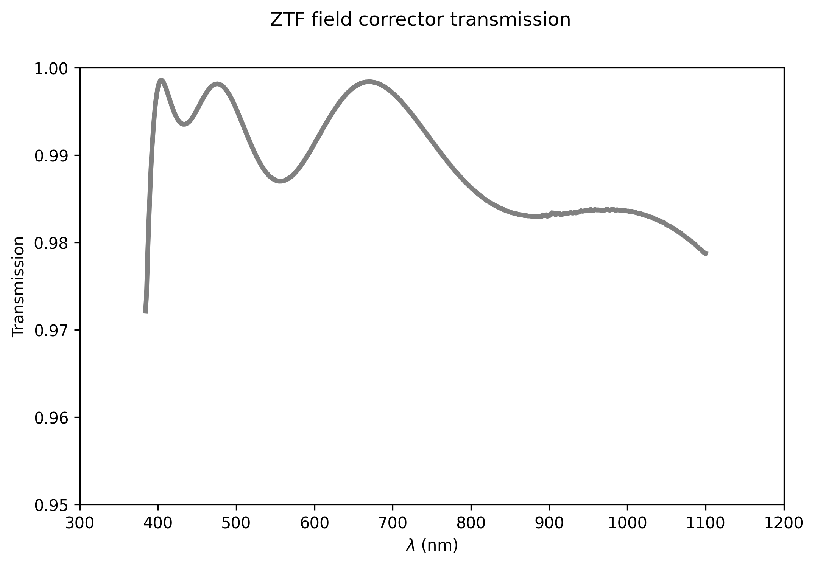
Instrument elements (1)
Aspheric trim plate transmission
P48 mirror reflectivity
ZTF filter transmission
ZTF field corrector transmission

Slide 4
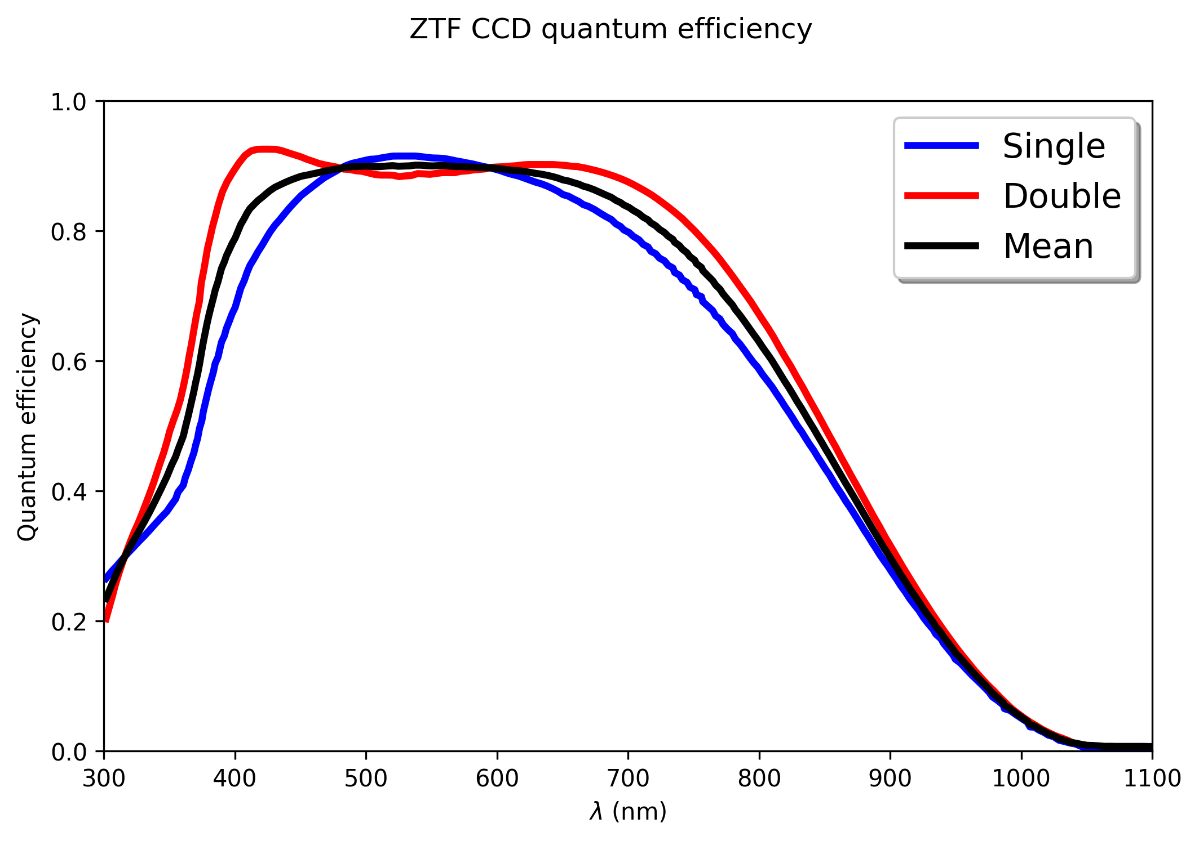
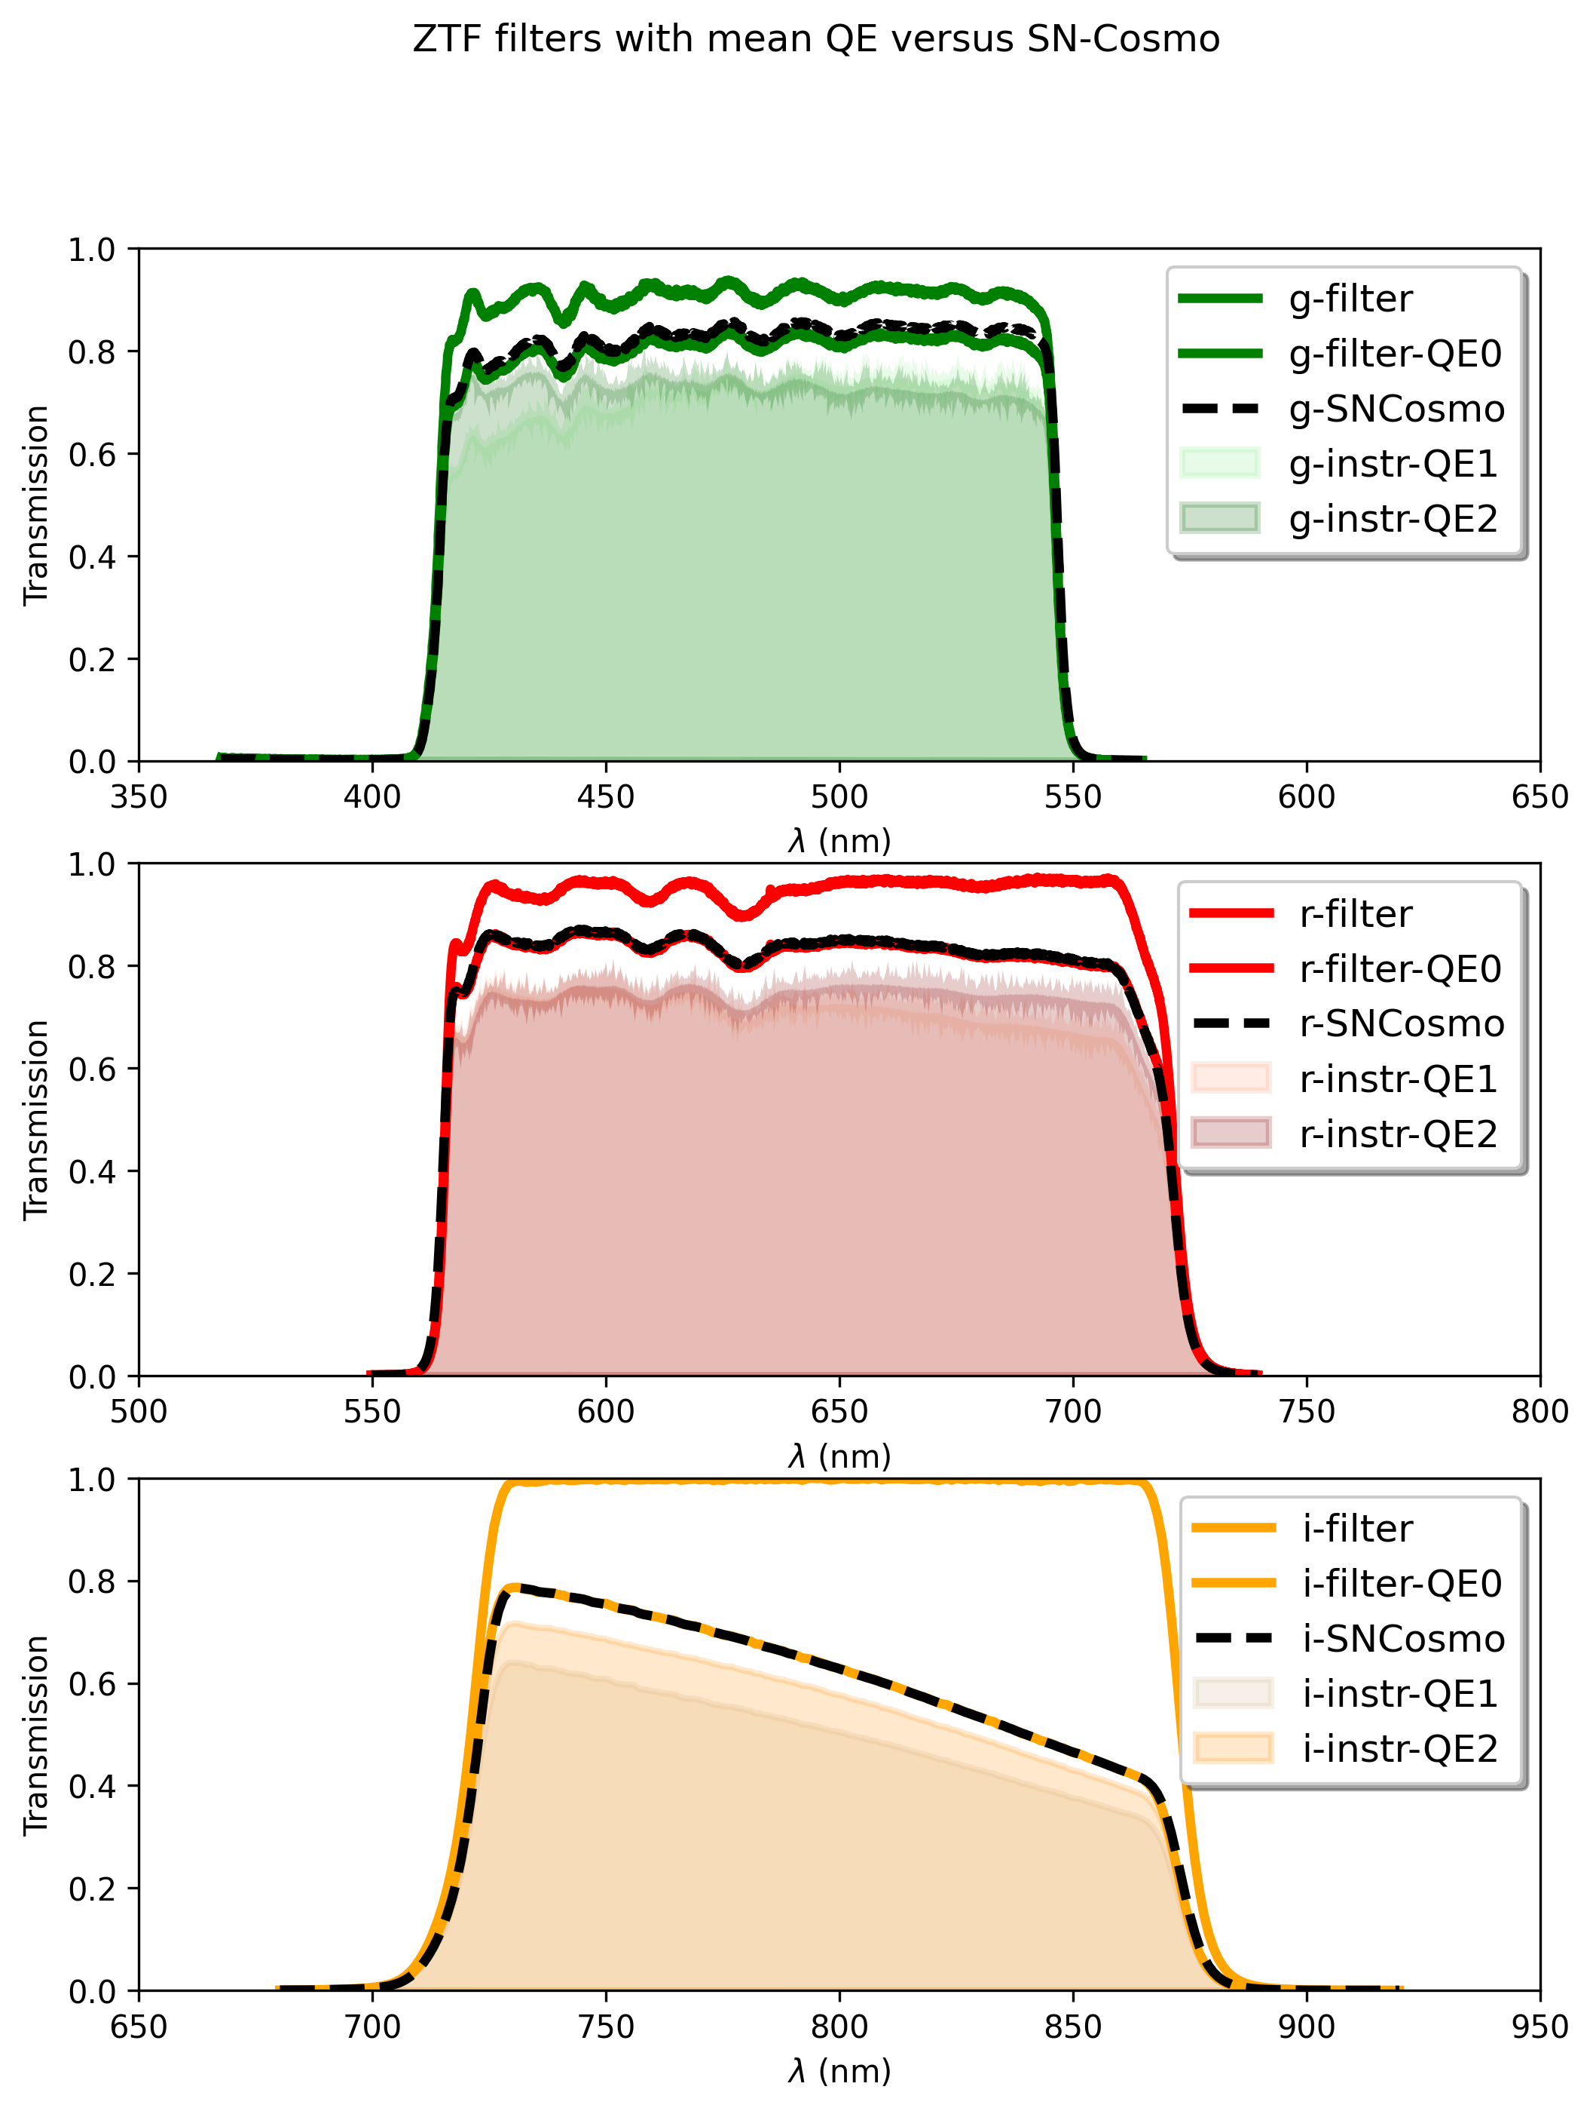
Instrument elements (2)
Full instrument model compared to SNCosmo inputs
ZTF CCD quantum efficiency (QE)
Camera mosaic
Single
coating CCDs
Double coating CCDs

Slide 5
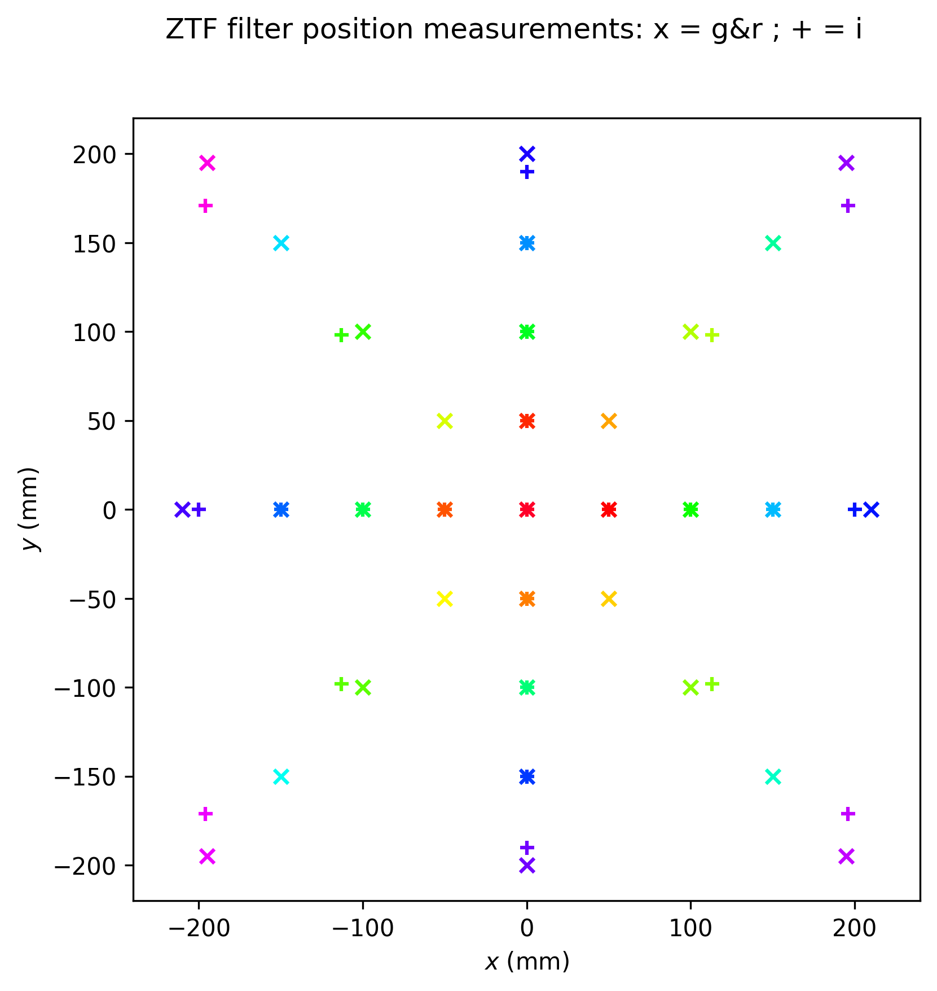
ZTF filter characterization (Caltech)
x g and r-bands at 0° and 4°
+ i-band at 5° (no data at 0°)

Slide 6
Filter transmission dependency
Approximate angular dependence of interference filter transmission (arXiv:0908.3808 )
$T\left(λ, θ\right)=T\left(λ{\left[1−\frac{\sin^{2}θ}{n^{2}}\right]}^{−1/2}, θ=0\right)$
Determination of the effective refracting index of filters: shift of 0° data according to formula above to match 4° data by using as reference point the centre of the filter
Instrument | g-band | r-band | i-band
SDSS | 1.70 | 1.80 | 1.60
ZTF | 1.85 | 1.95 | 1.75
Estimations
Extrapolation
Quantification of the filter transmission shift by computing the 1st moment = mean value of filter transmission
$\left\langle λ\right\rangle =\frac{\int{λT \left(λ\right) dλ}}{\int{T\left(λ\right) dλ}}$

Slide 7
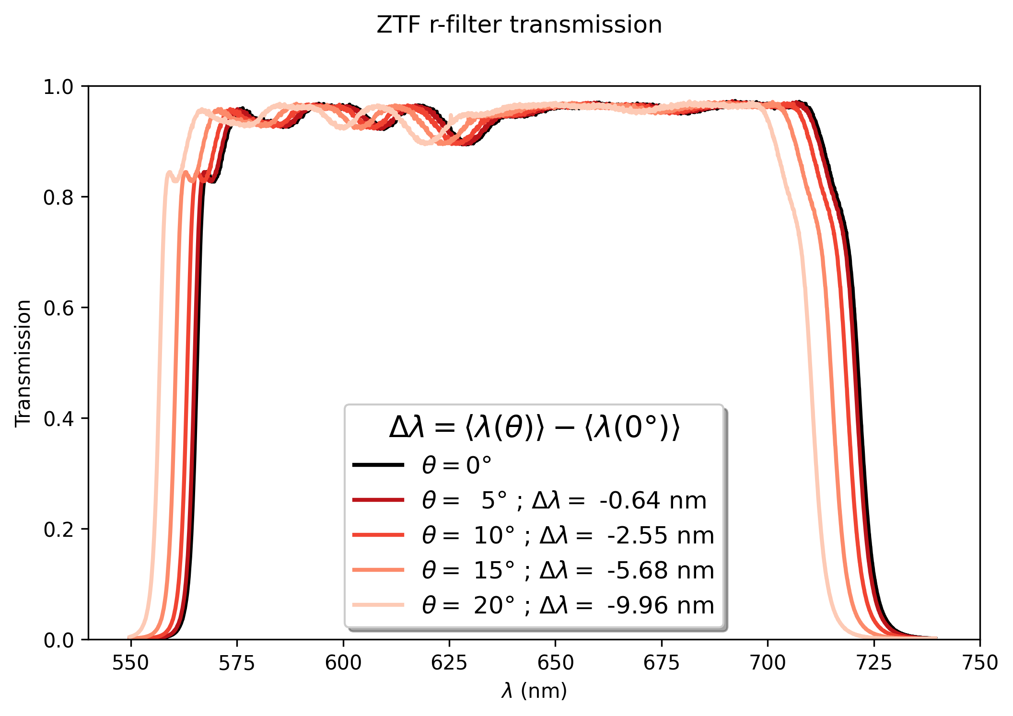
ZTF r-filter shift versus incident light angle
The estimated refracting index $n_{r}≈1.95$ allows to predict the filter transmission at any light incident angle
Question: What is the real light incident angle on ZTF camera?

Slide 8
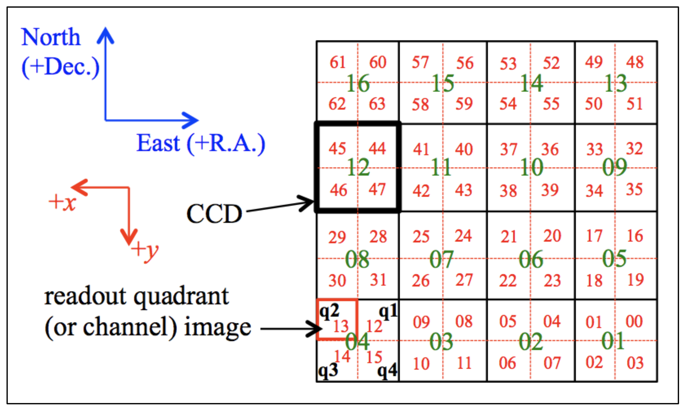
ZTF camera
$$≈3.5°$$
$$≈5°$$
$$≈3.5°$$
Pixel size = 15 µm $≡$ 1.01’’
CCD = 6144 col $×$ 6160 row $≡$ 1.724° R.A. $×$ 1.728° Dec.

Slide 9
Telescope model
$$θ$$
Position (x) on camera correspond to light-rays from sky with incident angle $θ$
Hypothesis: projection of pupil and camera on mirror according to incident angle $θ$ (not realistic on scheme: $θ_{max}≈5°$)
x
Camera
Camera
Pupil projection on mirror
$$θ$$
Mirror
Camera shadow on mirror
Mirror
Camera shadow

Slide 10
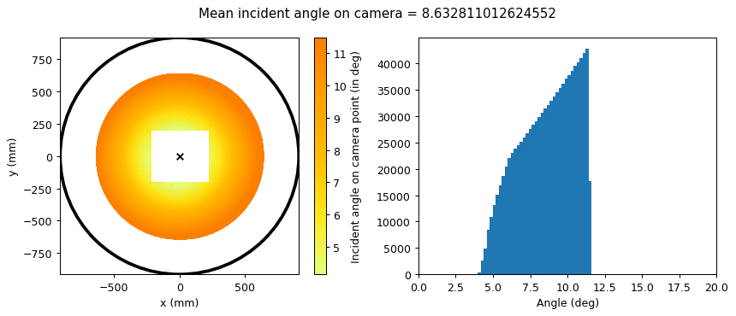
Model result versus incident angle

Slide 11
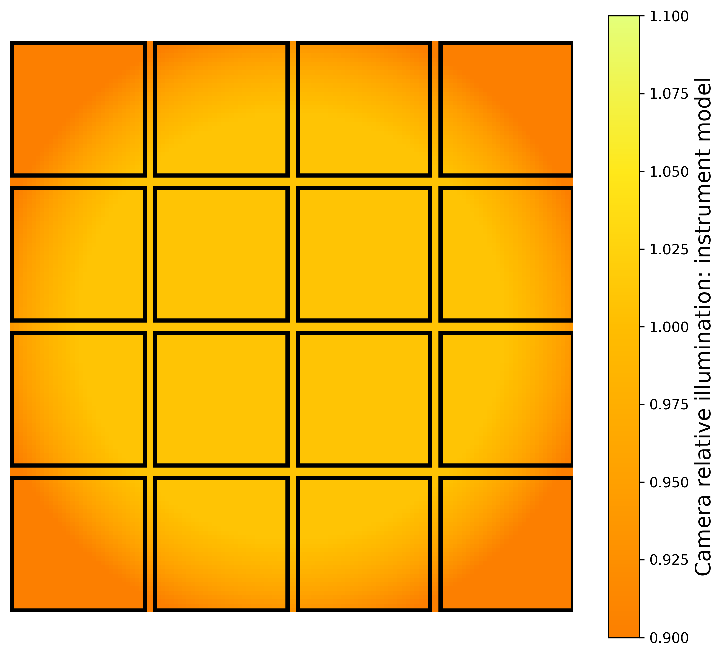
Model results: focal plane relative illumination
Camera at the limit of the field-of-view of the telescope

Slide 12
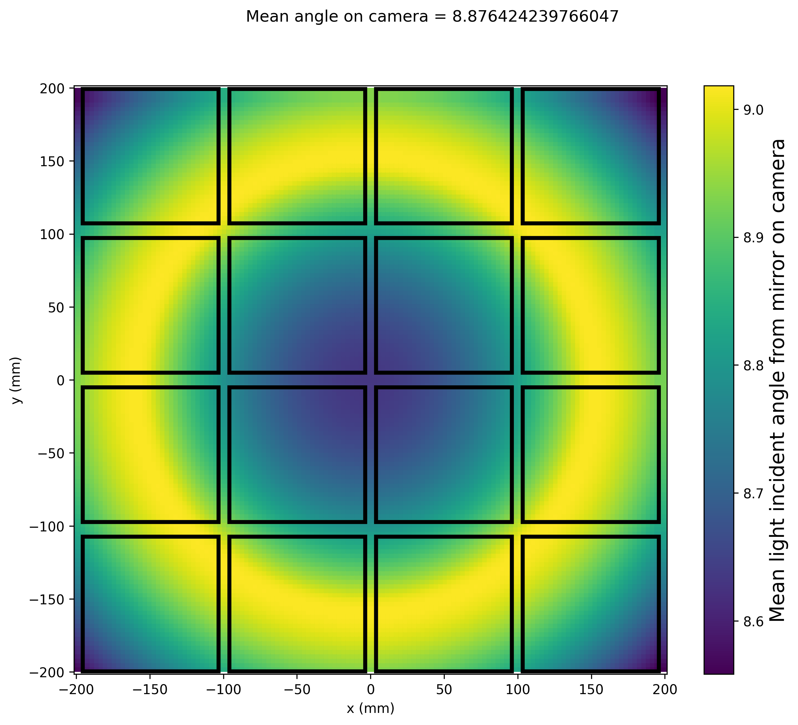
Model result: mean light incident angle on camera

Slide 13
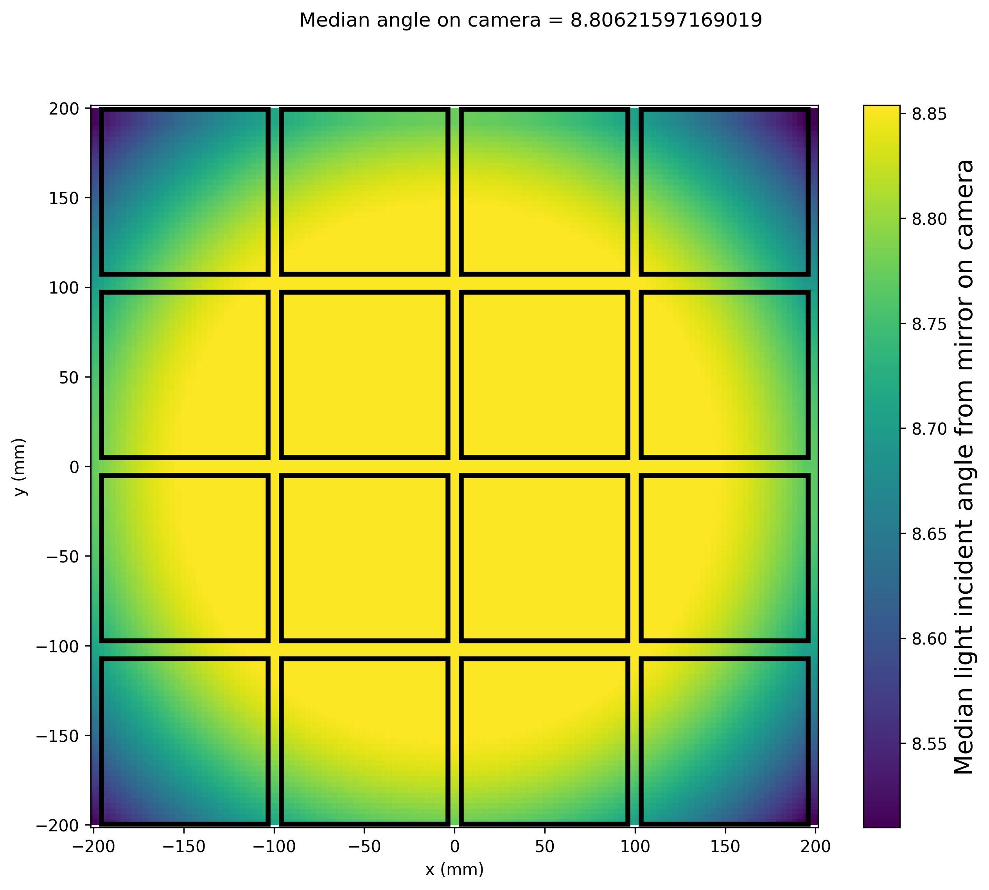
Model result: median light incident angle on camera

Slide 14
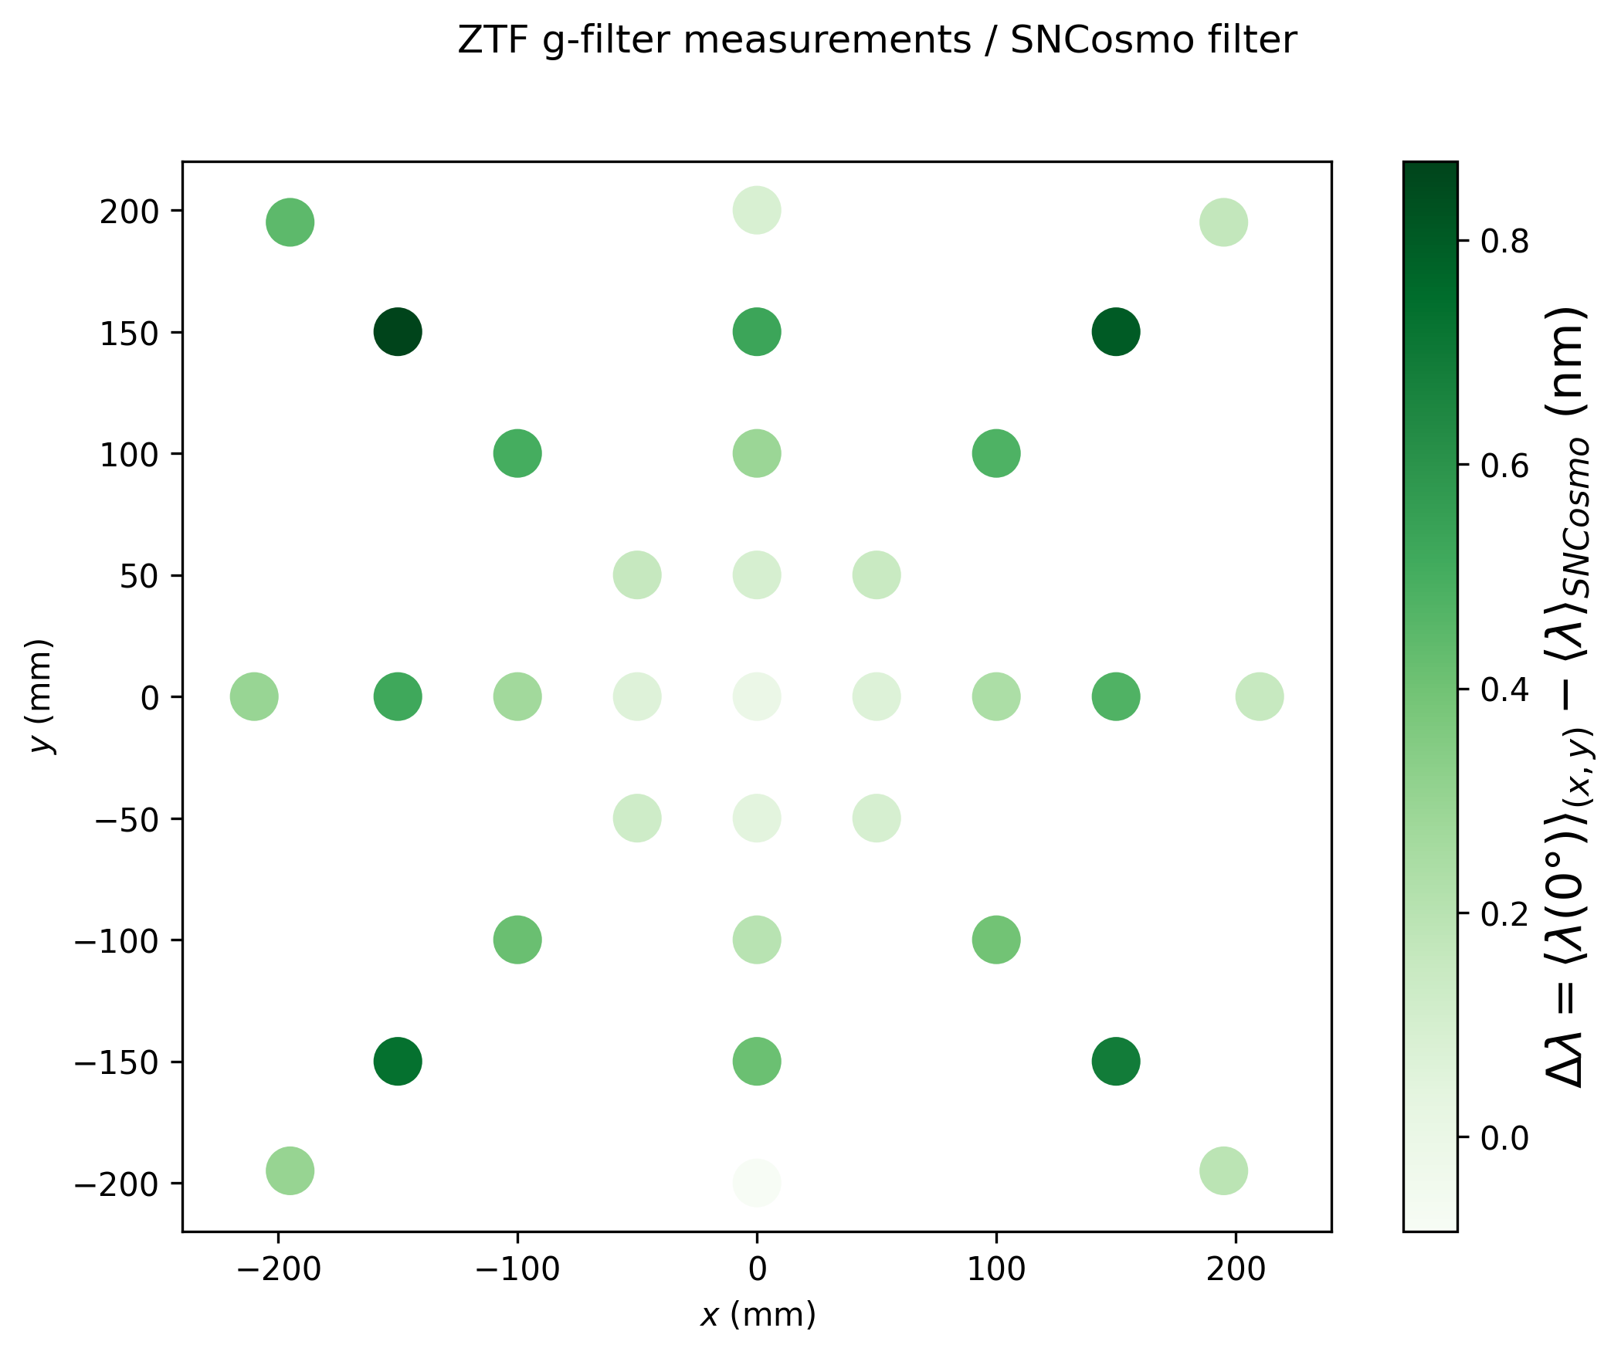
g-band: Caltech data
Filter transmission measured at 0° are compared to filter in SNCosmo

Slide 15
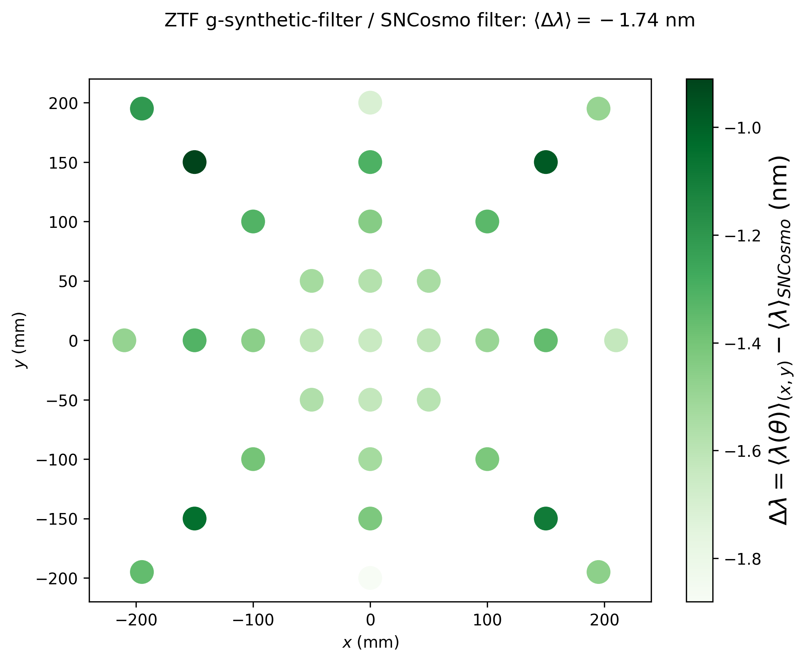
g-band: synthetic filter
Synthetic filters compared to filter in SNCosmo
First-moment mean shift = -1.74 nm

Slide 16
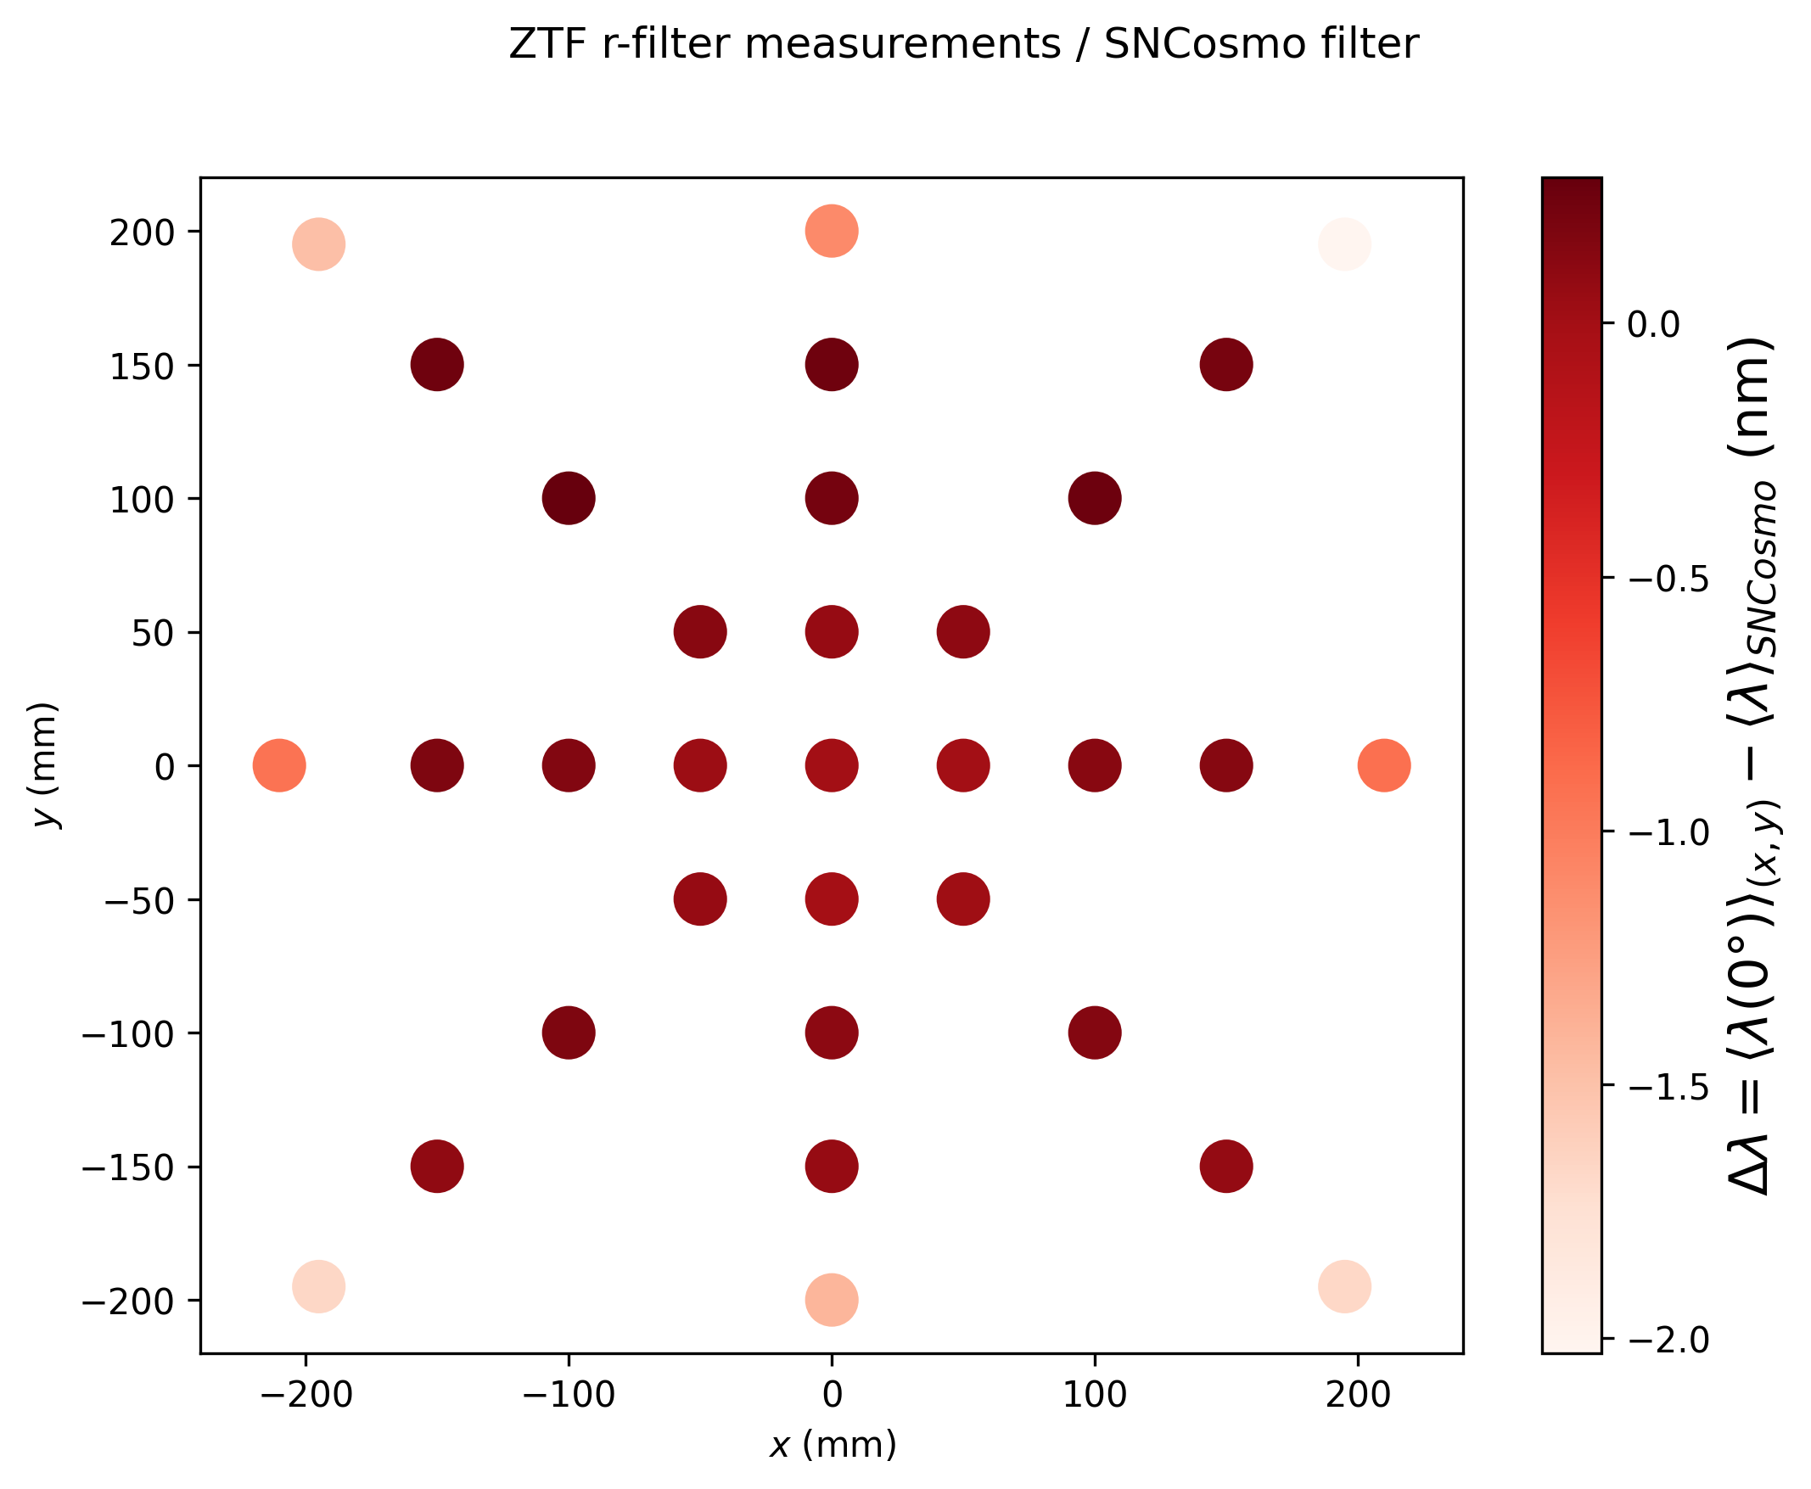
r-band: Caltech data
Filter transmission measured at 0° are compared to filter in SNCosmo

Slide 17
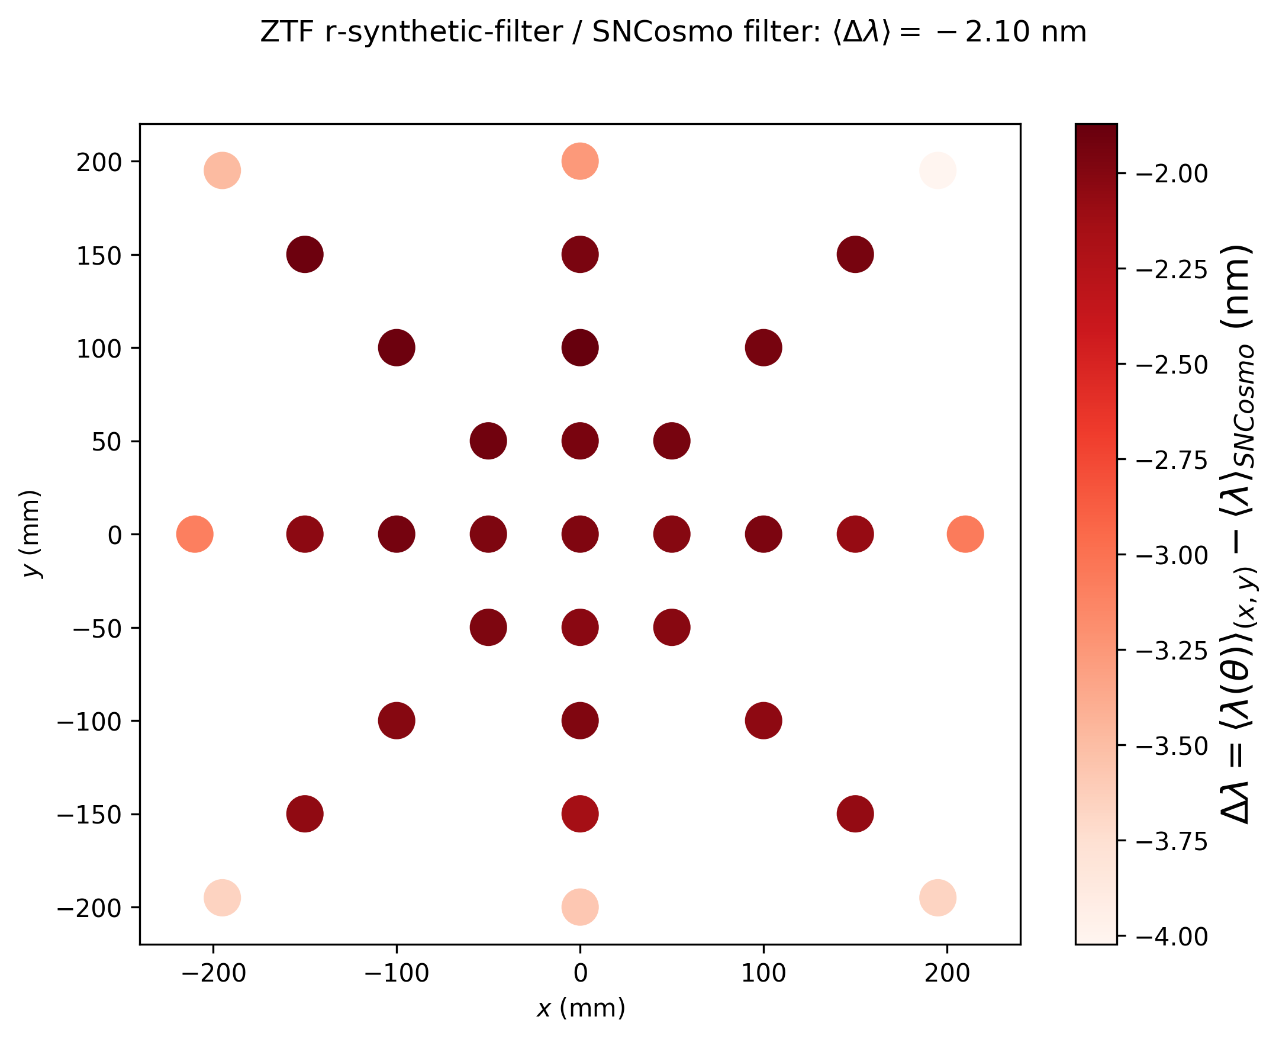
r-band: synthetic filter
Synthetic filters compared to filter in SNCosmo
First-moment mean shift = -2.10 nm

Slide 18
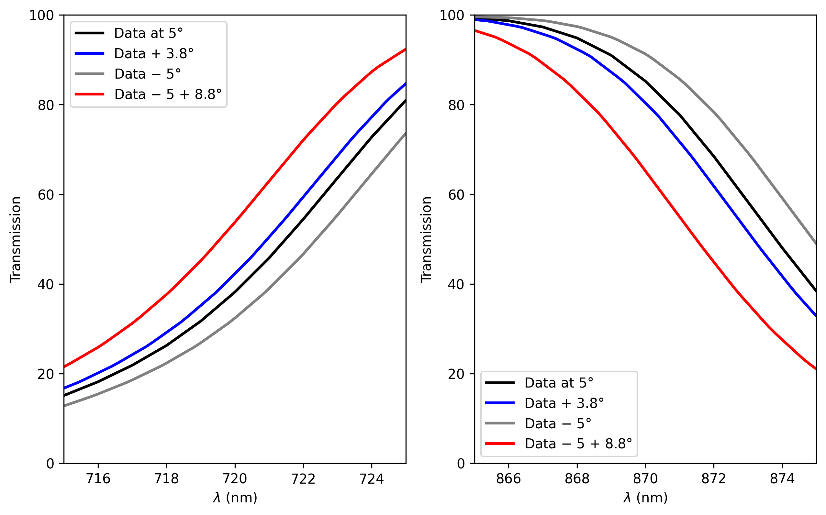
ZTF i-filter: no measurement at 0°
First attempt (assuming linear behaviour): simple application of shift formula $5°\underset{→}{+3.8°}8.8°$
New extrapolation: $5°\underset{→}{−5°}0°\underset{→}{+8.8°}8.8°$

Slide 19
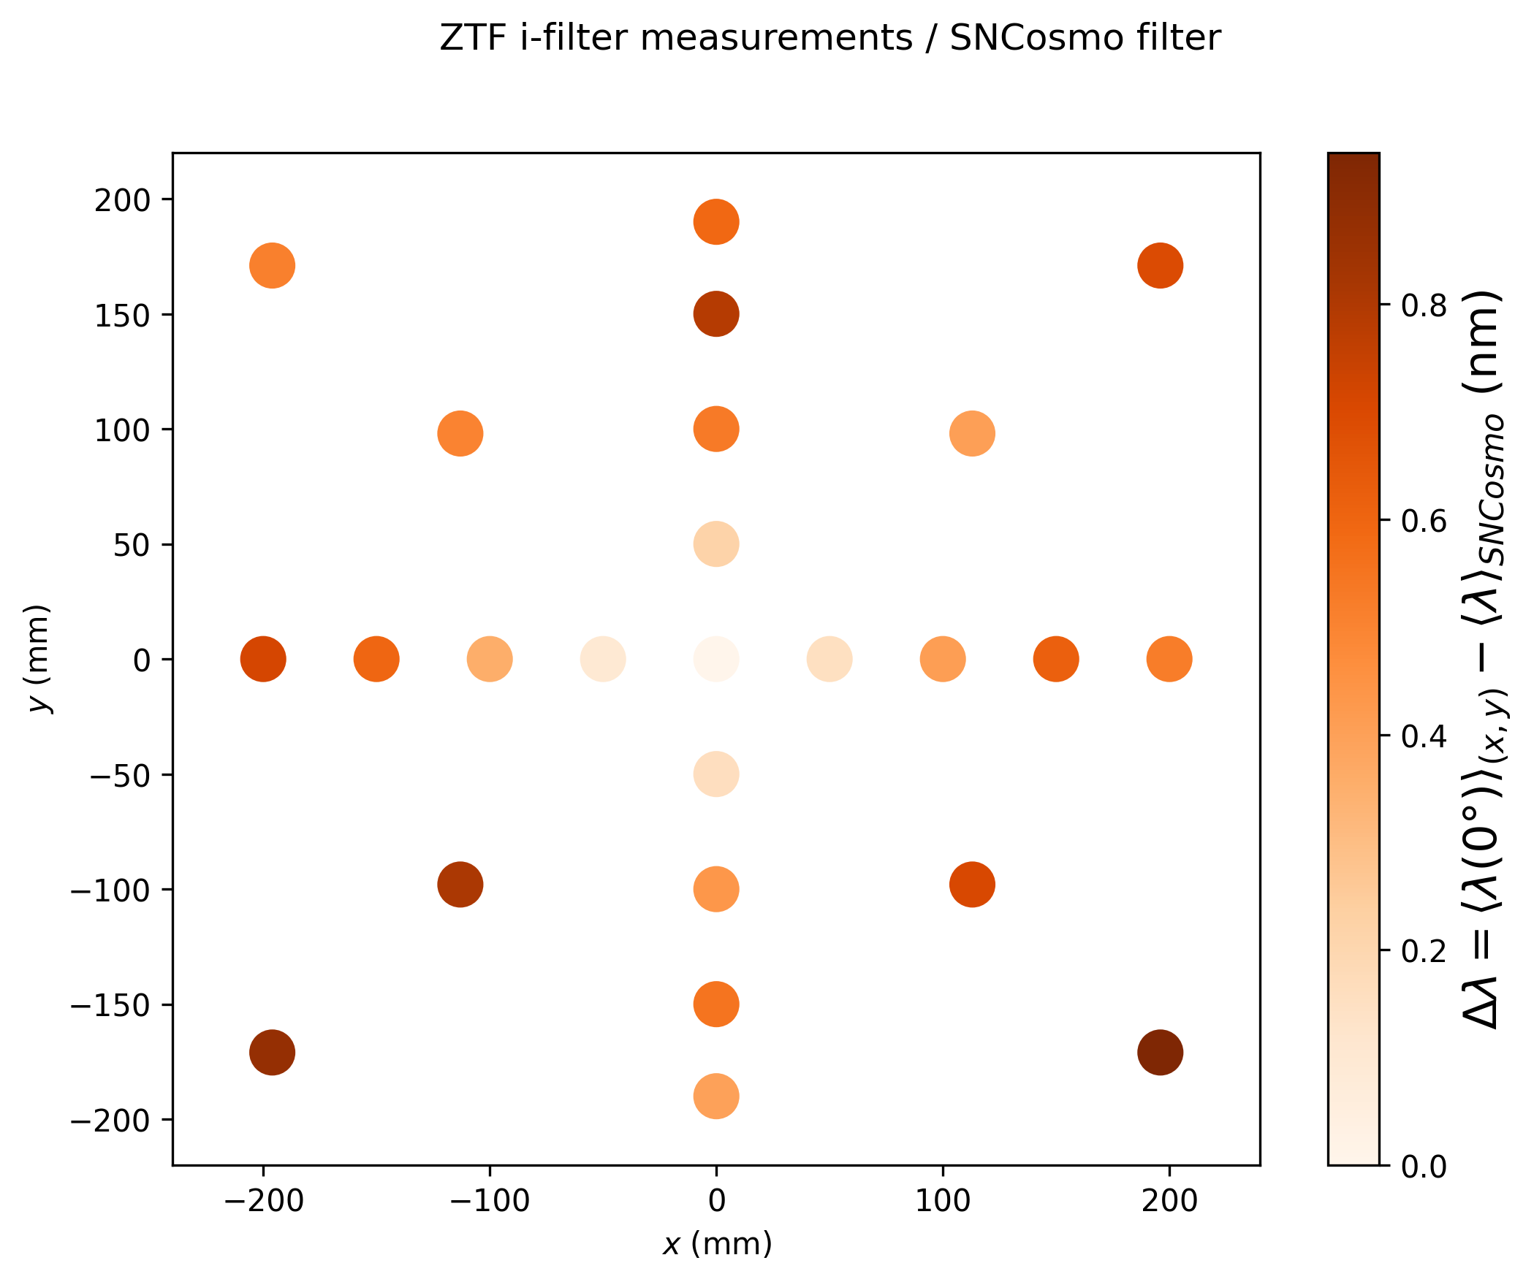
i-band: Caltech data
Filter transmission measured at 5° are compared to filter in SNCosmo

Slide 20
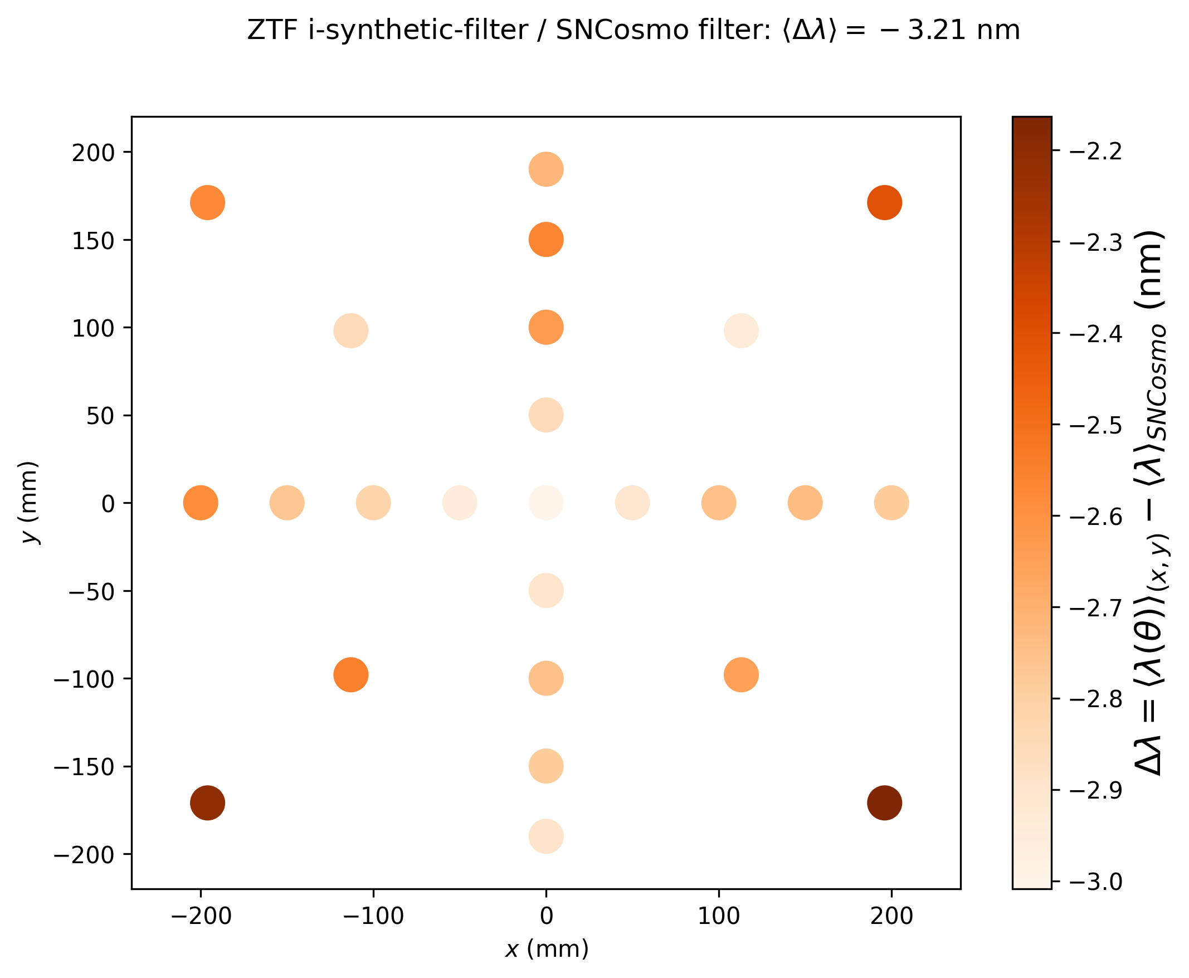
i-band: synthetic filter
Synthetic filters compared to filter in SNCosmo
First-moment mean shift = -3.21 nm

Slide 21
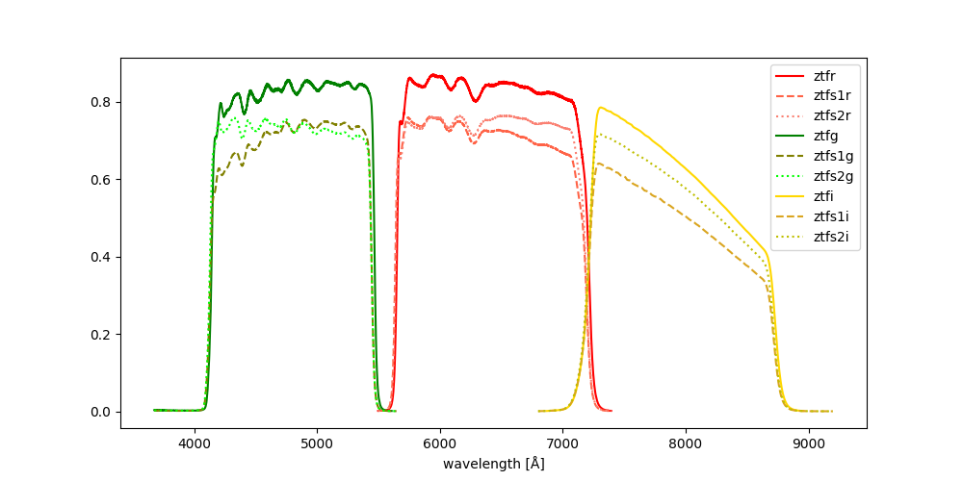
Chloé work: light-curve fit with new filters
New filters = optics + SNCosmo filters extrapolated at 8.8° + QE single/double layers

Slide 22
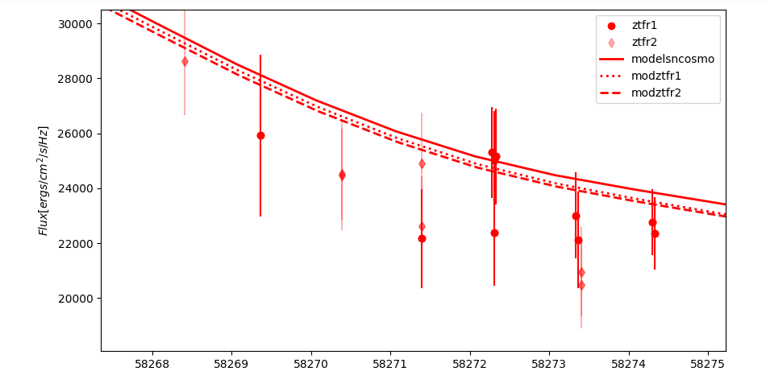
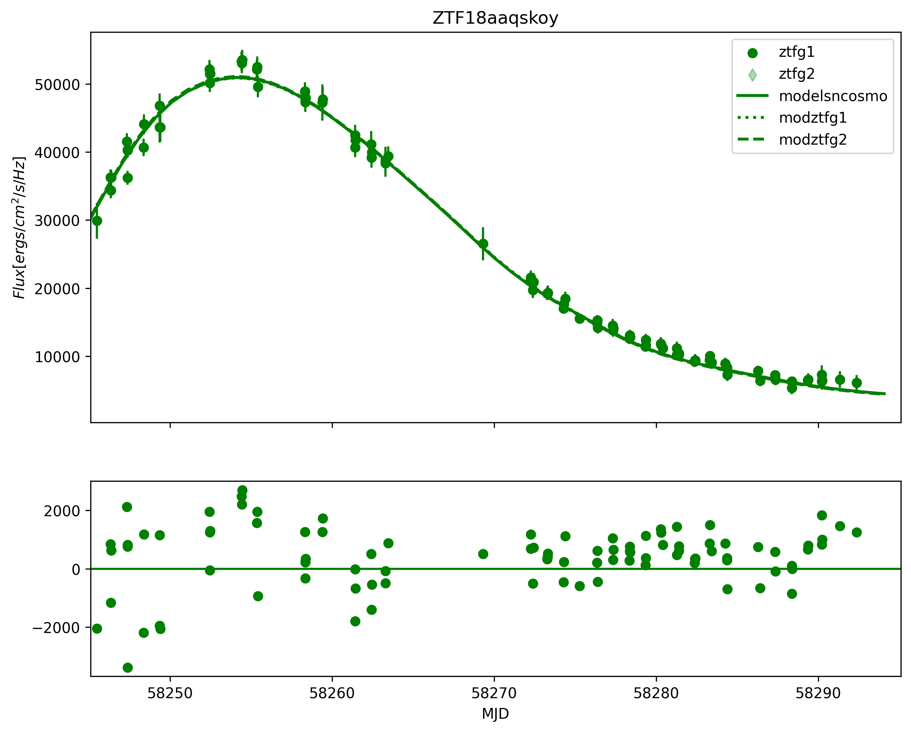
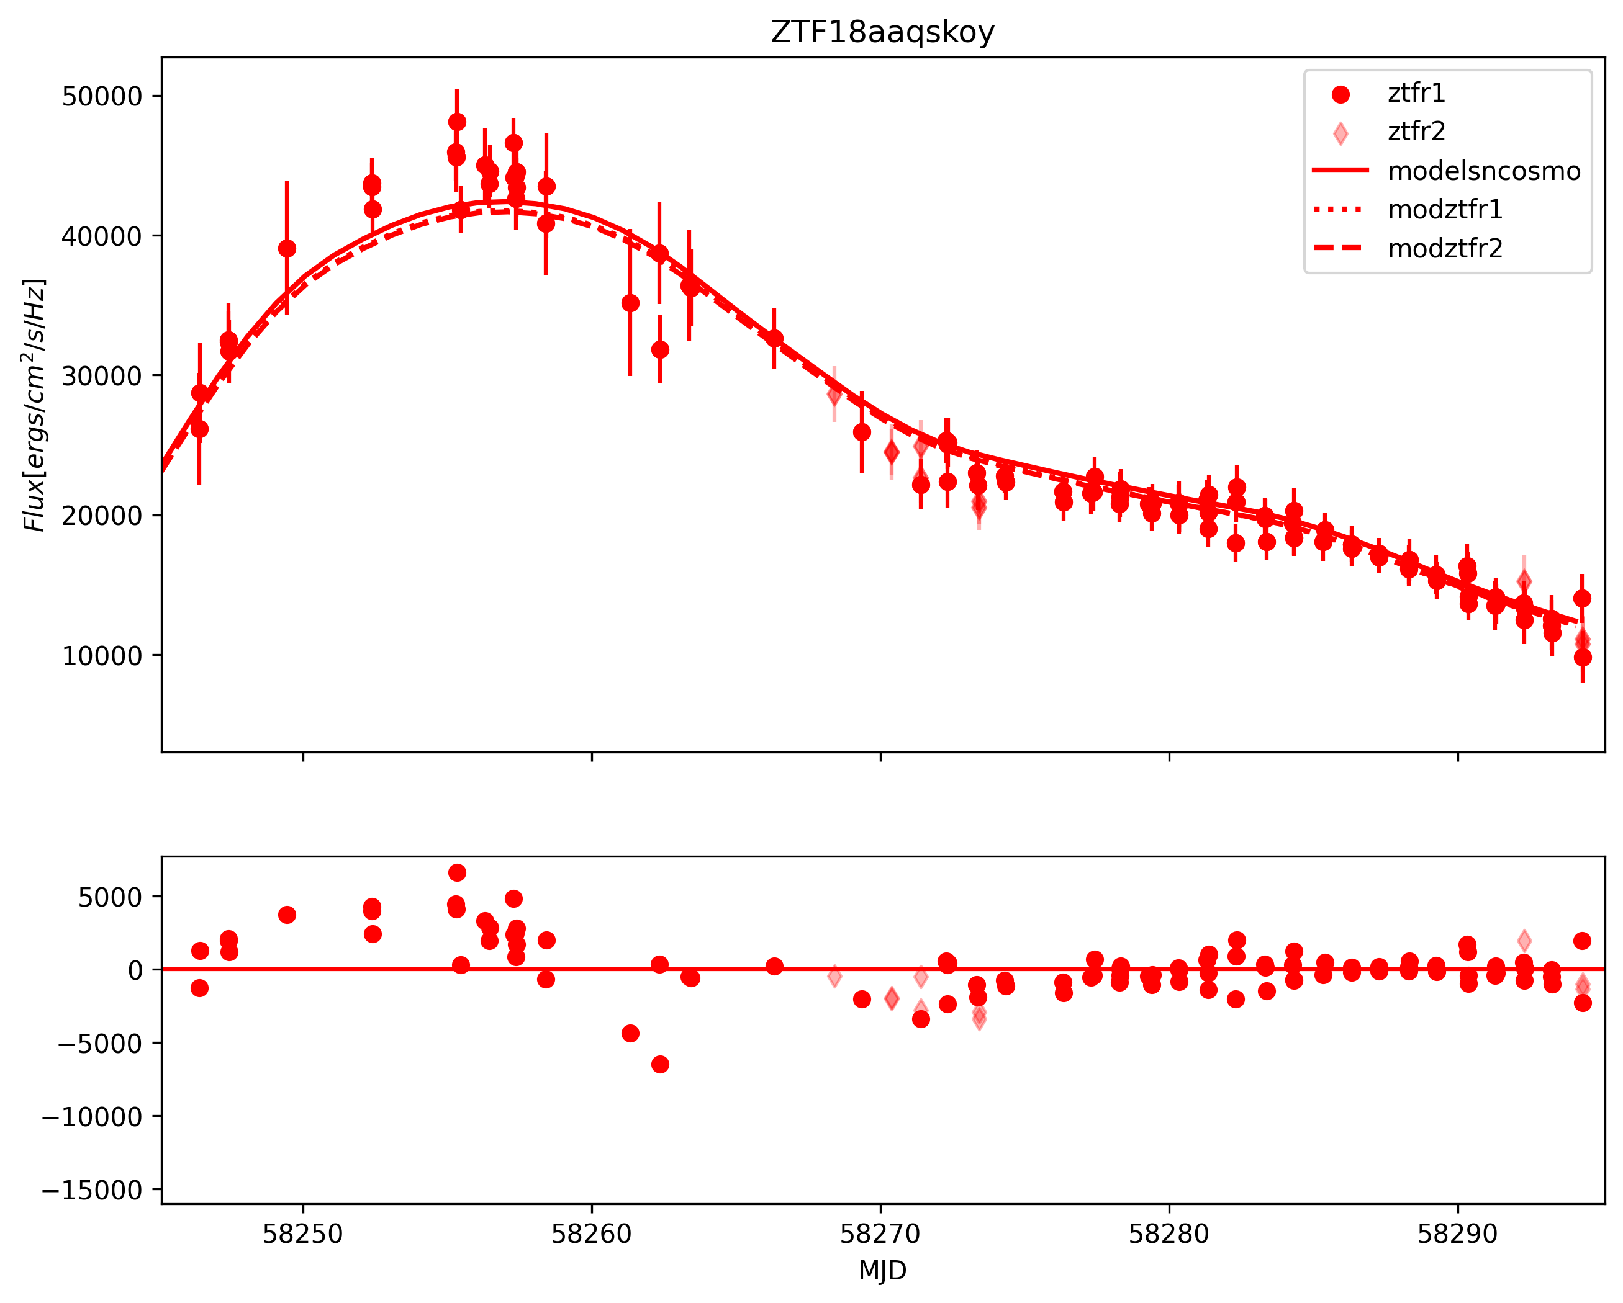
Chloé work: SNCosmo light-curve fitting
New filters setting : sncosmo.bandpass(wavelength, transmission, name)
New filters assigned to every light-curve data point depending on CCD number: single (●) or double (◆) coating layers

Slide 23
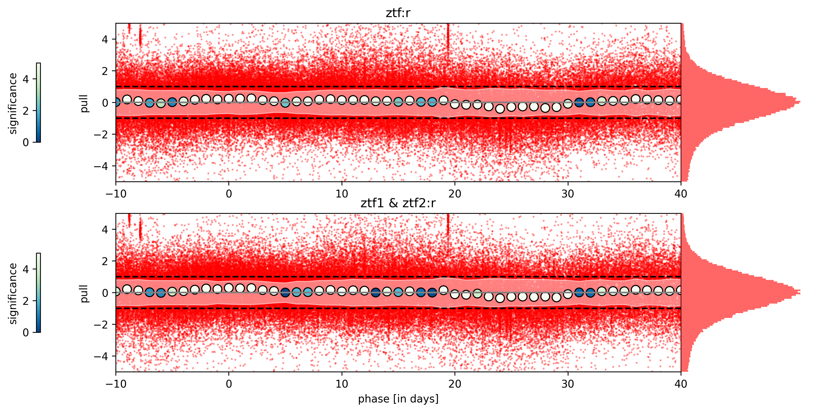
Chloé work: DR2 r-band light-curve residuals
Strange artefacts: only in r-band -> to be understood
Improvement in median residual in some parts of the light-curve

Slide 24
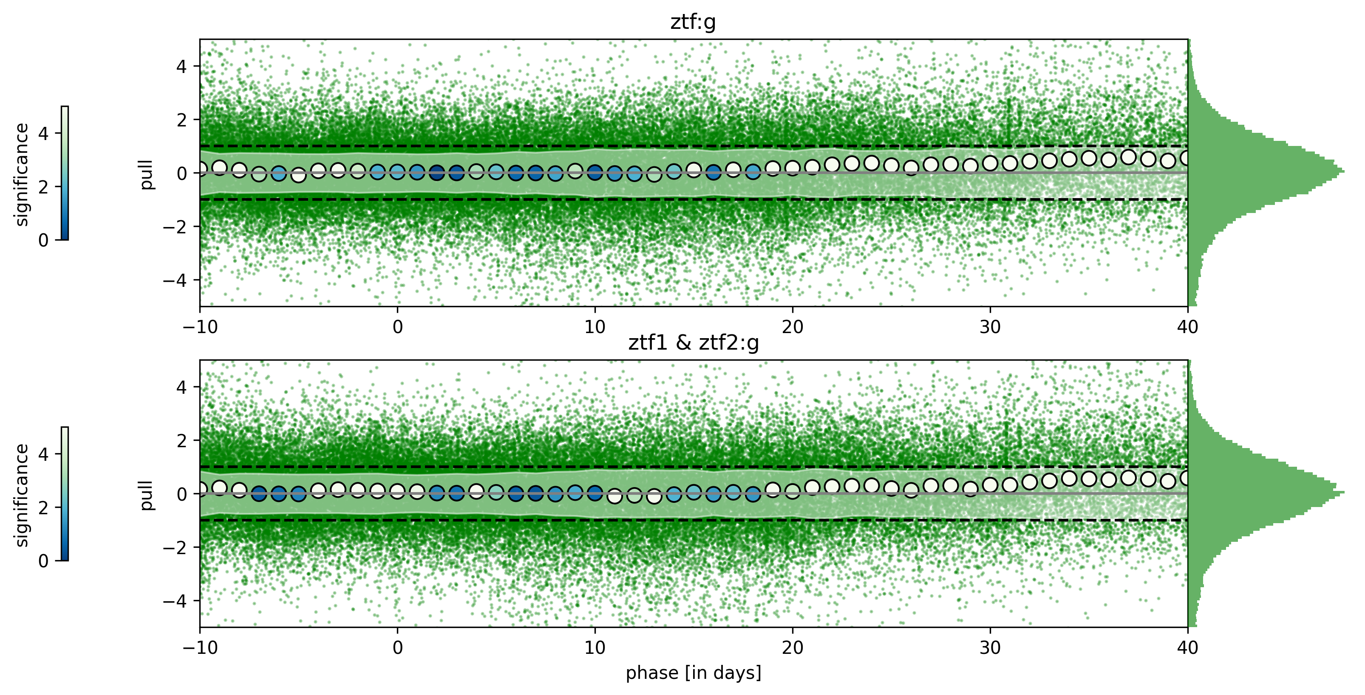
Chloé work: DR2 g-band light-curve residuals
Shift of residual at “high” phase: must be understood
Improvement in median residual

Slide 25
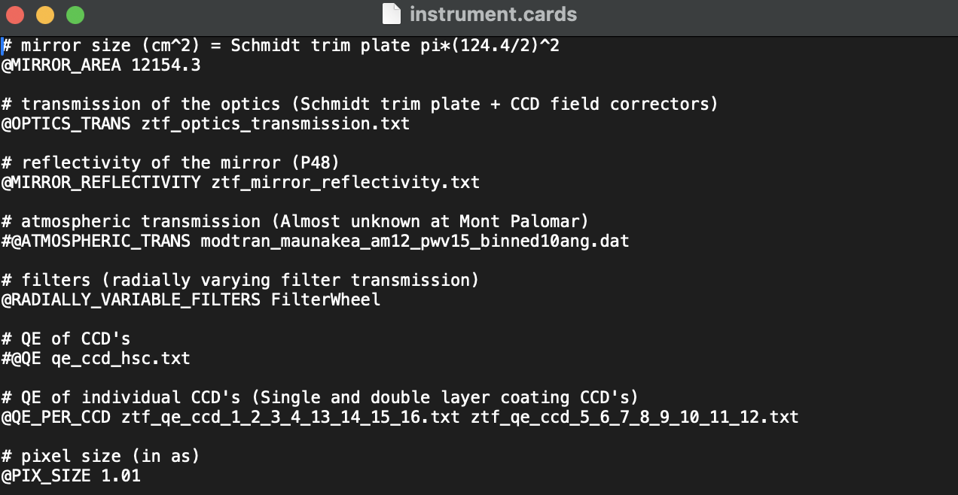
Conclusions and next step
Conclusions
Almost all pieces to build an instrument model
First instrument card for SNCosmo (Nicolas)
Next step: test with Gaia data
Applied synthetic photometry to Gaia spectra
Compare color indexes (g-r, r-I, g-i) to ZTF starflat data

