Slide 1
The SHEXI demonstrator → Upgrade of SIRIUS
GANIL CS 01/02/2024
K. Hauschild for the SIRIUS collaboration

Slide 2
Outline
General motivations for SIRIUS
  Recap on type of measurements
Motivation for the upgrade
Fantasy resolutions
The SHEXI concept
What is needed for a proof-of-principle
Summary of the proof-of-principle funding request
Tow example experiments illustrating the power of full SHEXI

Slide 3
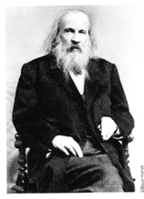
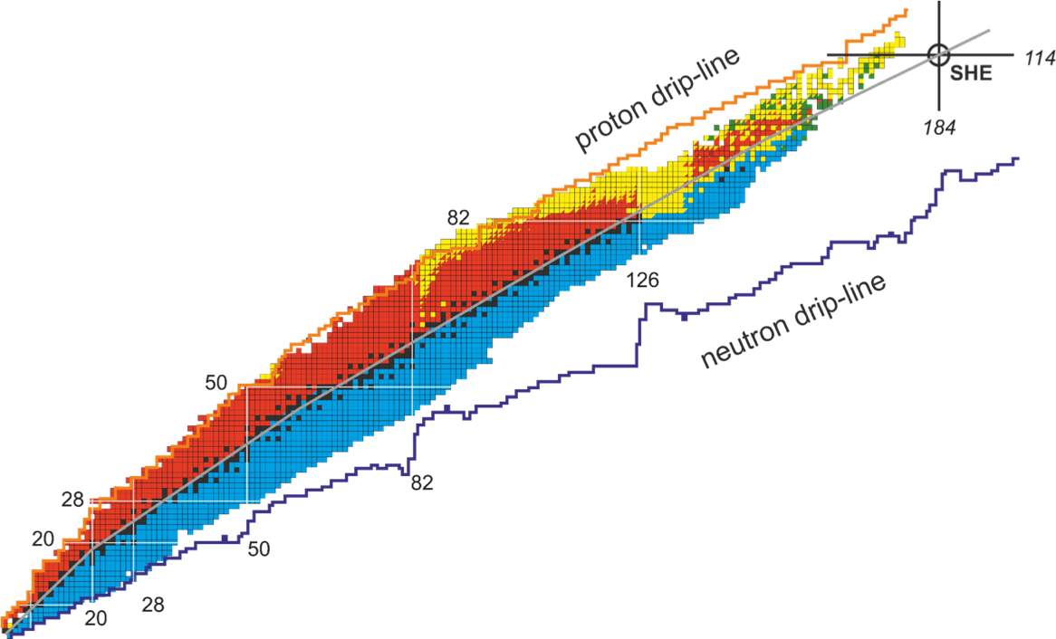
(General) Physics Motivations
What are the limits ?
How many elements ?
(chemistry beyond row 7 ?)
Properties of nuclear matter at extreme Z and A
access through fine-structure α decay
and/or high-K isomeric states
Island of enhanced stability ?
MNT / pxn
Number of protons
Number of neutrons
Notes:
The nuclei of interest int this current session are situated at the very top nuclear chart where the each isotope is represented as a function
of Z and N.
Of interest are the properties of matter in extreme conditions of mass and charge.
The actual limits of this chart corresponds to the basic question of how many elements actually exist.
One of the ways we obtain information on the structure of these nuclei is through fine-structure alpha decay coupled with coincident internal conversion electron and gamma-ray spectroscopy.
In axially deformed nuclei, the K quantum number is approximately conserved. Transitions that involve a change in K larger than the multipole order are usually forbidden and the so-called K isomers are formed. These K isomers can provide a unique fingerprint of the underlying single-particle structure. They also provide an experimental tool to access low-lying states that are not readily populated by alpha decay or difficult to observe at the target in prompt spectroscopy experiments either due to internal conversion or weak population.
Another interest in these K-isomers is that they might provide additional hindrance to fission wrt to the ground state and thus provide a mechanism for enhanced survival probability of super heavy nuclei.
And we are also interested in reaction mechanisms which could broaden the range of nuclei that we can study.

Slide 4
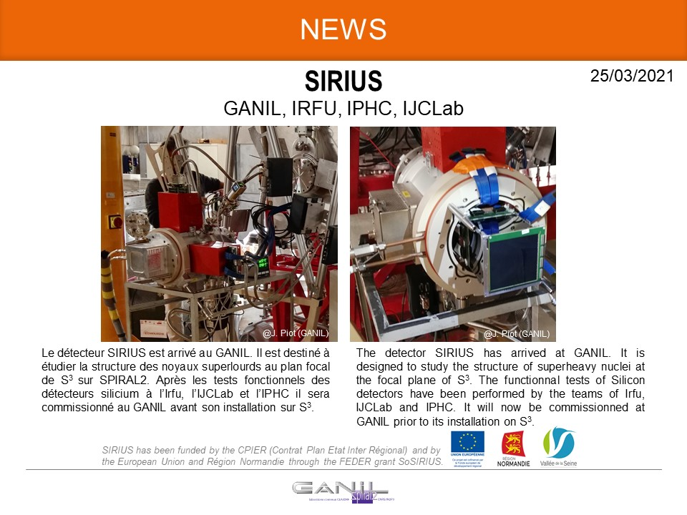
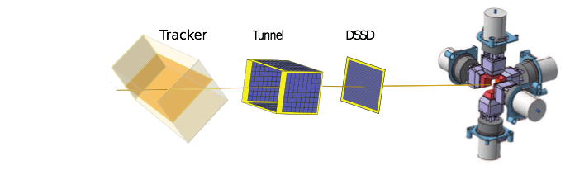
SIRIUS detection system at the focal plane of S3
1) Tracker, T(tr), x(tr), y(tr)
E(implant), T(implant), ID(x,y)
=> ToF,E + recoil marker
ToF and ion tracking
Distance = 110.38 cm
Recoils from S3
Implanted into 128x128 DSSD

Slide 5
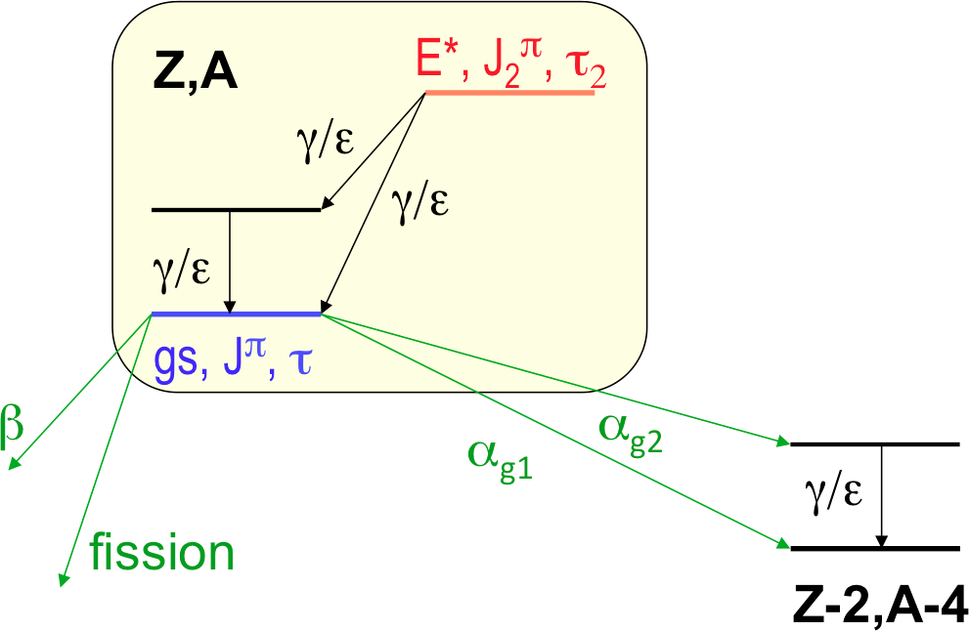
SIRIUS detection system at the focal plane of S3
1) Tracker, T(tr), x(tr), y(tr)
E(implant), T(implant), ID(x,y)
2) E(decay1), T(decay1), ID(x,y)
E(ge), T(ge), ID(ge)
E(tun), T(tun), ID(tun)
=> ToF,E + recoil marker
Position correlated event
(eg isomer decay)
Recoils from S3
Signal in DSSD
(no tracker => decay)

Slide 6
SIRIUS detection system at the focal plane of S3
1) Tracker, T(tr), x(tr), y(tr)
E(implant), T(implant), ID(x,y)
2) E(decay1), T(decay1), ID(x,y)
E(ge), T(ge), ID(ge)
E(tun), T(tun), ID(tun)
3) E(decay2), T(decay2), ID(x,y)
E(ge), T(ge), ID(ge)
E(tun), T(tun), ID(tun)
=> ToF,E + recoil marker
Position correlated event
(eg isomer decay)
Position correlated event
(eg fine structure α decay)
E(decay1), T(decay1), ID(x,y)
E(ge), T(ge), ID(ge)
E(tun), T(tun), ID(tun)
E(decay2), T(decay2), ID(x,y)
E(ge), T(ge), ID(ge)
E(tun), T(tun), ID(tun)
Recoils from S3
Signal in DSSD
(no tracker => decay)

Slide 7
Main Motivation for the upgrade:
Z Identification of the isolated SHE.
X-rays: energies characteristic of atomic number
→ unique identification (historically K X-rays)
S. Hofmann, EPJ Web of Conferences 182, 02054 (2018)

Slide 8
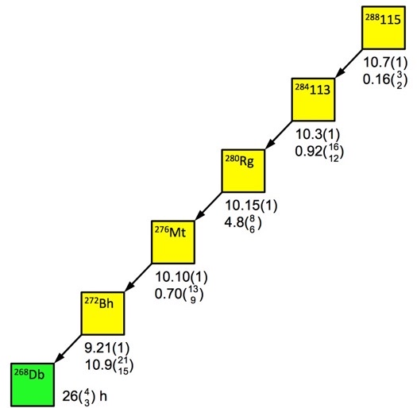
SIRIUS upgrade →SHEXI (Super Heavy Element X-ray Identification) R&D
X-rays: energies characteristic of atomic number → unique identification (historically K X-rays)
⁴⁸Ca+²⁴³Am → ²⁹¹Mc*
Difficulties in SHE:
1) Excitation energies are compressed
→ K X-rays unlikely (E_{B}[Z=109]=178 keV)
2) Some nuclear transitions do not favour K X-rays
Physics Solution:
L X-rays (lower E) and always produced
but E(L,Z+1) – E(L,Z) ~ 0.4 keV for Z~110
α_{K}(194:E1) = 0.099
α_{L}(43:M1) = 244
α_{L}(86:E2) = 84
Based on D. Rudolph et al, Phys. Rev. Lett. 111 (2013) 112502

Slide 9
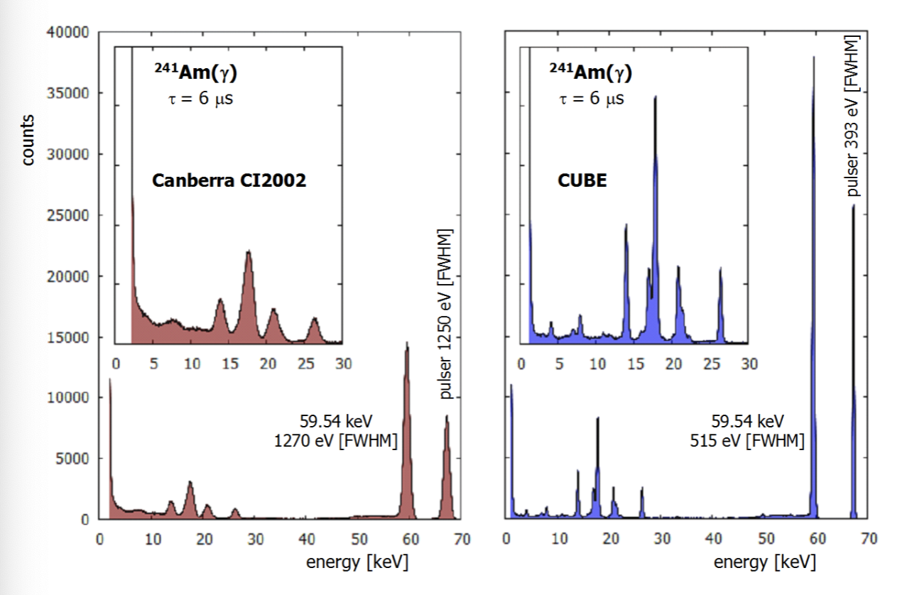
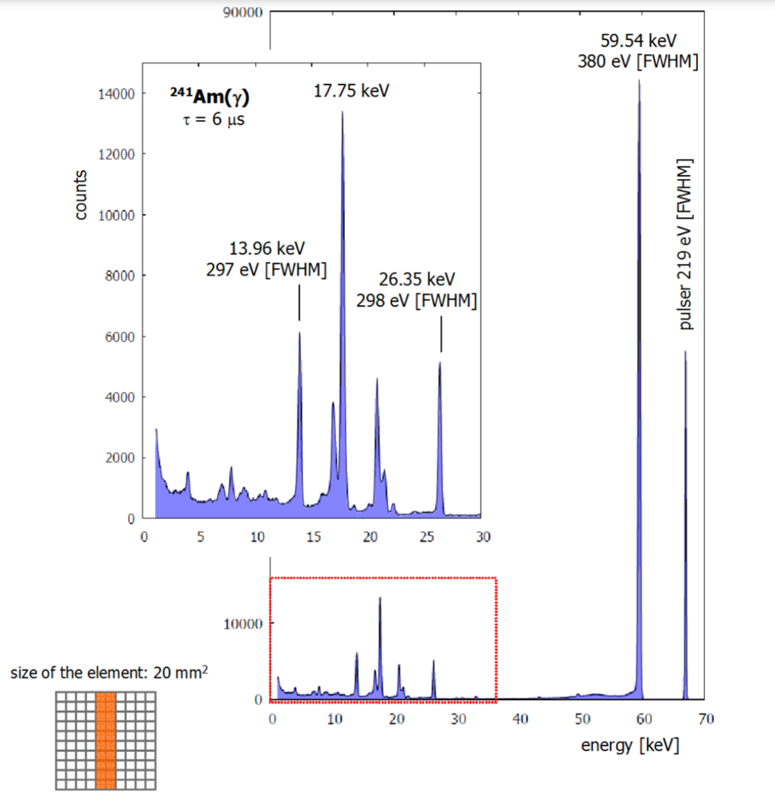
The fantasy 0.4 keV FWHM ?
Krings et al., Journal of Instrumentation 9 (2014) C05050
The “CUBE” ASIC preamplifier… designed for XFS
10 mm thick 39x32 mm² Ge detector: pixel 7x7 mm²
4 mm thick 20x20 mm² Ge detector: pixel 1x20 mm²

Slide 10
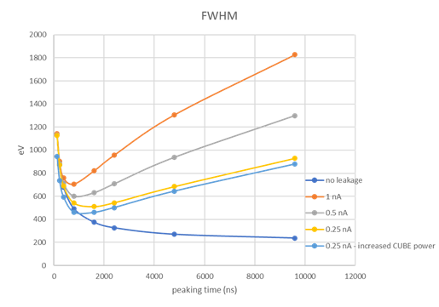
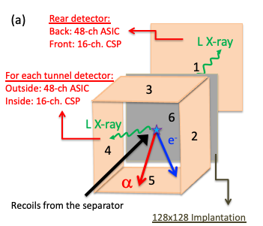
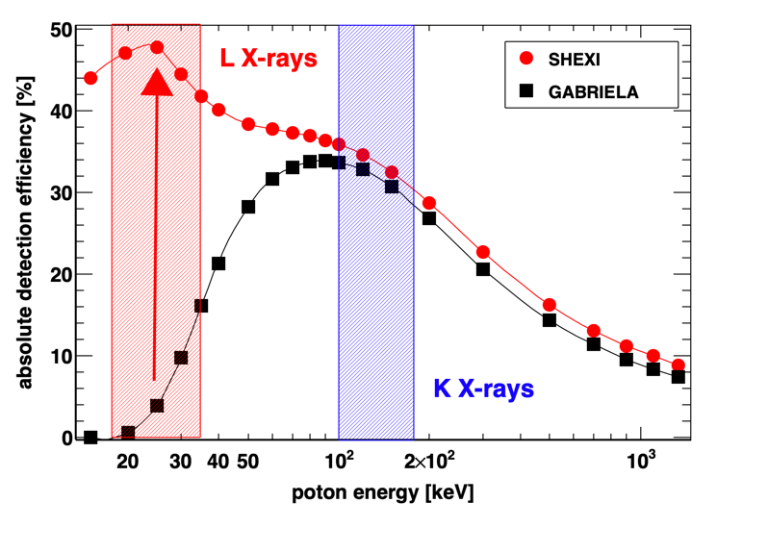
SHEXI Concept
State-of-the-art ASICs from XGLab (0.4 keV FWHM)
→ capacitance-matched DSSDs (1.5 mm thick)
cooling
Z identification of SHE
other side of DSSD:alpha/fission range
16 standard CSPs (HV)
(also needs developing/testing)
(ASIC range ~2.5 MeV: 1000 mV/MeV

Slide 11
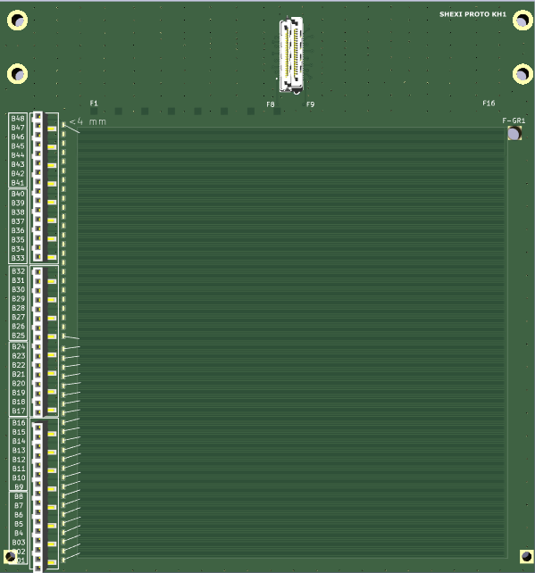
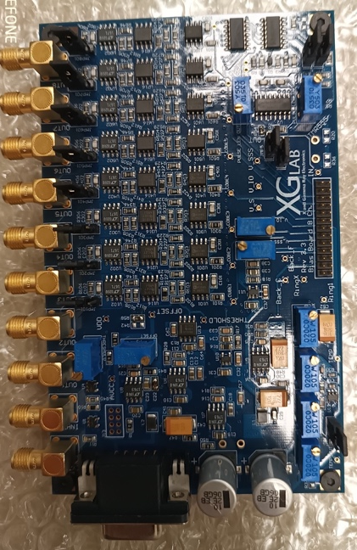
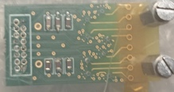
SHEXI Proof-of-principle: one 48x16 DSSD
and status
air
vacuum
  Xray ASIC Status
    24(of 48) ASICS bought
      Placed on 3 carriers boards
    We have the back-end to qualify the
    noise, rise-time, energy, etc.
16 CSP
cold
buffered
signal
Bias + signal
conditioning
Power supply,
Reset logic
x6
digitiser
8 ASIC
signal
DET
3 signal conditioning
boards bought
(but need housing)
16 CSP
24 channels
need to be
instrumented
  TO DO
    Interconnection & adapters
    Vacuum feed-throughs
    EMC for bias boards needed
    Bias board (NUMEXO2 compat.)
Detector PCB
Detector design
approved by
Micronsemiconductor
3x 8-ASIC
boards bought
Cost to complete tasks 34k

Slide 12

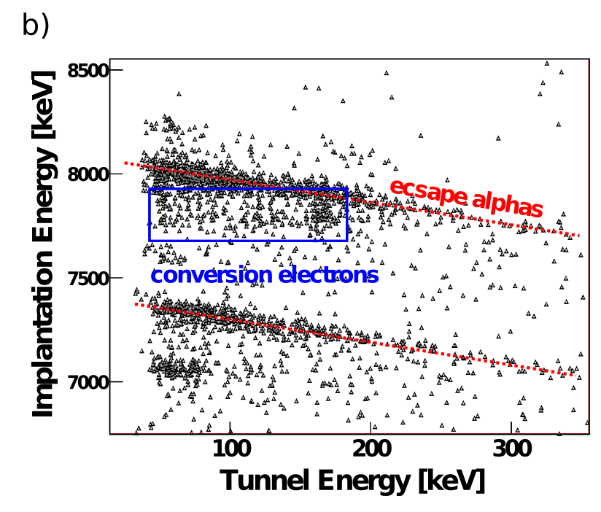
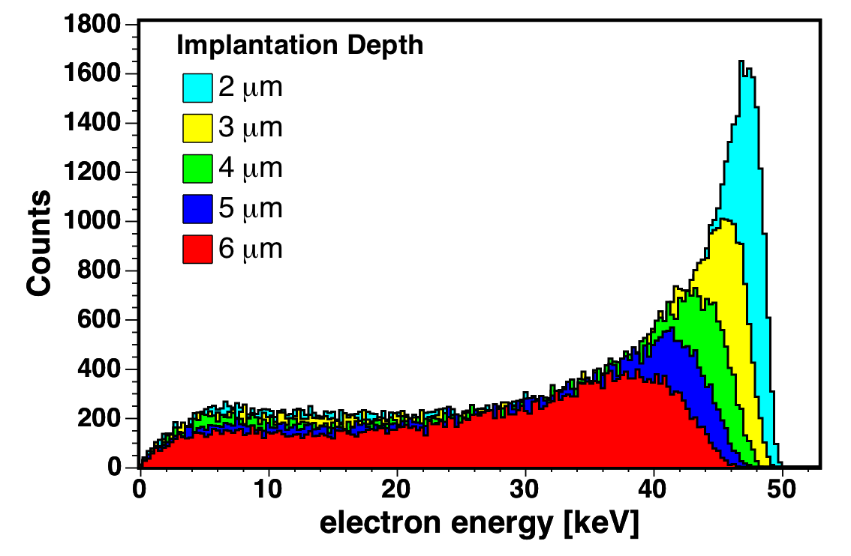
SHEXI Proof-of-principle: one 48x16 DSSD [CSP]
air
vacuum
  Standard CSP
    Apply HV
    Escape alpha and fission fragments
      Range up to 100 MeV
    Ideally: conversion electrons
      Range down to 25 keV ?
      ➔ PIXELS:
16 CSP
cold
x6
8 ASIC
DET
^{254,255}No
K. Hauschild NIM A560 (2008) 388
Can we use PSA to distinguish these event types ?
➔ FAST preamplifier rise time

Slide 13
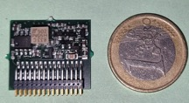
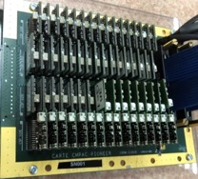
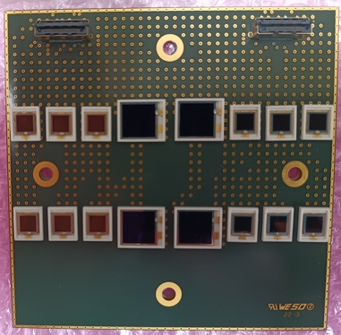
SHEXI Proof-of-principle: one 48x16 DSSD [CSP]
1)
Spin-off from SIRIUS CSP modified for the GABRIELA DSSD ➔ 64 channel board
range ~60 MeV, threshold ~50 keV, FWHM(α) ~14 keV, FWHM(e-) ~6 keV
(initial tests in 2018 following experimental runs)
  TO DO
    CSP motherboards (#1 & #2)
    (1) new CSP version: reduce rise-time
    (2) produce a batch of CSP
    Feedthroughs, Interconnection & adapters (all)
    (#1 & #3) adapter board (NUMEXO)
    Improve trigger → lower threshold (DAQ)
2)
Atomki low-power preamp – fast (<15 ns) (have schematics)
NIM A366 (1995) 146 base-line noise < 2 keV
does not use BF862 FET
3)
NetInstruments: 16-channel CSP - 100 MeV into 2Vpp
10 ns rise-time (<100 pF load)
pulser tests <3.9 keV FWHM
Cost to complete tasks 23k

Slide 14
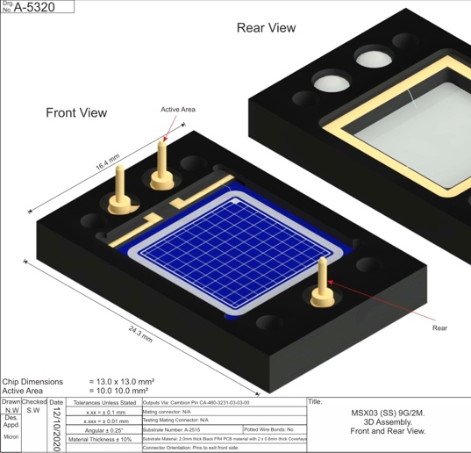
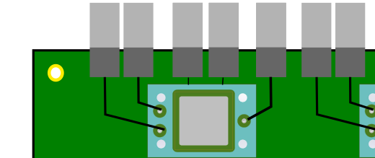
SHEXI Proof-of-principle: one 48x16 DSSD [PSA]
4x MSX03 detectors from Micron
(1.5 mm thick. ~7 pF)
8x CREMAT CR-110 preamps
no load → 2 keV & 3 ns
NEED TO FINALISE DETECTOR PCB
^{254,255}No
Part of S. Kumar’s thesis
250 MHz
Digitiser
500 MHz digitiser ? 23.4 k
work around ? PA >
Can we use PSA to distinguish these event types ?
➔ FAST preamplifier rise time
ch1
ch2
+2 ns
K. Hauschild et al. EXON 2018 Conference Procedings, p. 403

Slide 15
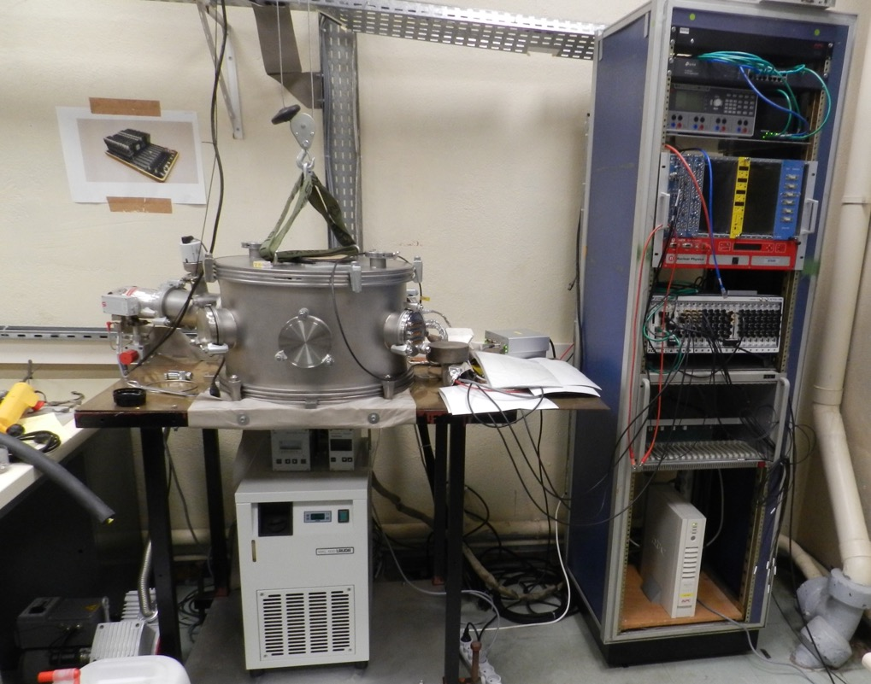
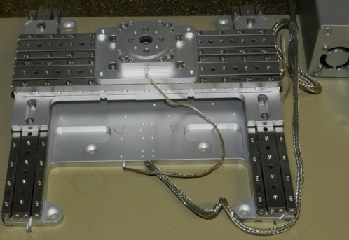
Back-end electronics infrastructure
DAQ Bay
eth
NIM
VME
PXIe
XY-theta table
(sources)
Vacuum chamber
new controller: 15.5k
Storage: 2k
Vacuum pumps
Cooling
^{Digital GABRIELA}
R.S. Mukhin, et al., Part. Phys. Nucl. Lett. 18 (2021) 652.
R.S. Mukhin, et al., Acta Phys. Pol. B Proc. Suppl. 14 (2021) 75.
Recently EMC and shielding have been improved

Slide 16
HR
“CODEC” @IJCLab → Directorate was informed
Partner | Surame | First name | Role & responsibilities in the project | Work Packages (need updating) | ETP
IJCLab | HAUSCHILD | Karl | Coordinator, LabVIEW DAQ and DSP, experimental setup, Data analysis, student supervision | 1,(2.1),2.2,2.3,3.2,4.1,4.2,4.3 | 0.5
IJCLab | LOPEZ-MARTENS | Araceli | Data analysis, student supervision | 4.2,4.3 | 0.2
IJCLab | KARKOUR | Nabil | PCB design, EMC, system integration, student supervision | 2.3,3.1,3.2 | 0.25
IJCLab | GIBELIN | Laurent | PCB design, system integration | 2.3,3.2 | 0.25
IJCLab | LINGET | Denis | Maintenance of local infrastructure |  | 0.20
GANIL | KUMAR | Shayan | Experimental setup and data analysis, PSA. | 1,2.3,4.1,4.2,4.3 | 0.5
GANIL | PIOT | Julien | Ph.D. student supervisor @ GANIL |  | 0.05
GANIL | ACKERMANN | Dieter | Ph.D. student supervisor @ GANIL |  | 0.05
IPHC | DORVAUX | Olivier | Silicon detector Customer Acceptance Tests | 1 | 0.1
IPHC | MATHIEU | Cedric | Silicon detector Customer Acceptance Tests | 1 | 0.1
 |  |  |  | TOTAL (excl. IJCLab interns) | 2.2
Part of Shayan’s thesis

Slide 17
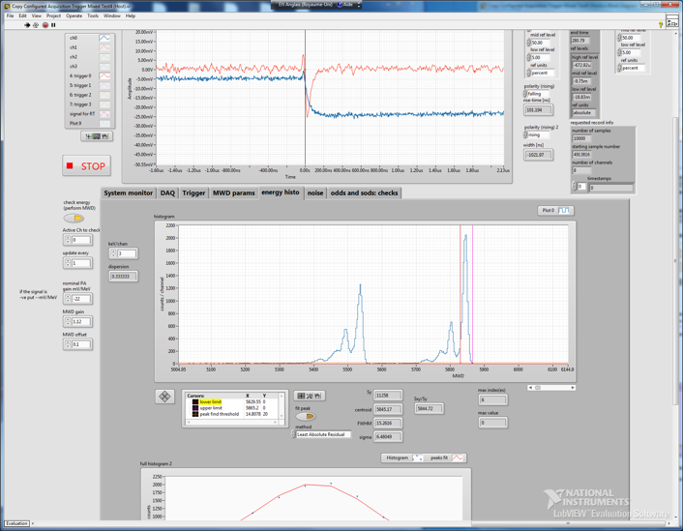
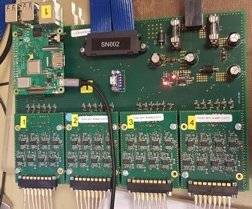
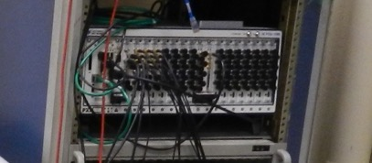
What you get in 2 years: the SHEXI Proof-of-principle: fully instrumented 48x16 DSSD
16 CSP + carrier for alphas/fission frags
48 ASICs
for X-rays
NUMEXO2

Slide 18
Summary of costs
Item | Cost [kE]
ASICs | 33.6
CSP | 23.5
PXIe-controller + storage (DAQ) | 17.5
500 MHz digitiser (PSA) | 23.4
Total | 98.0

Slide 19
Reminder of why: detection efficiency of full array

Slide 20
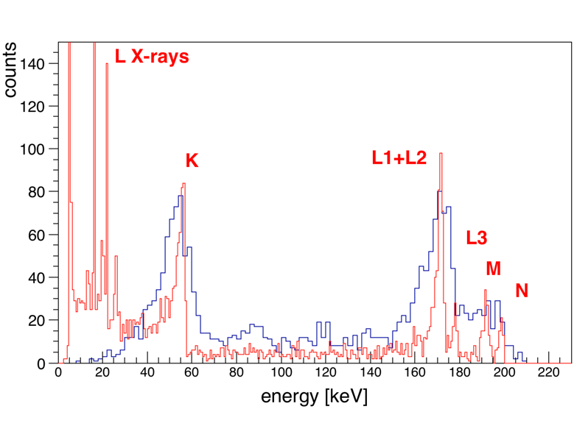
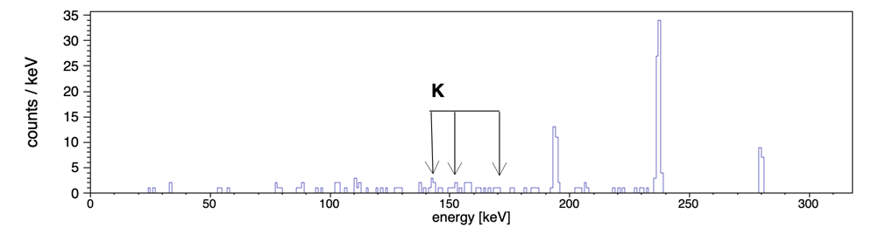
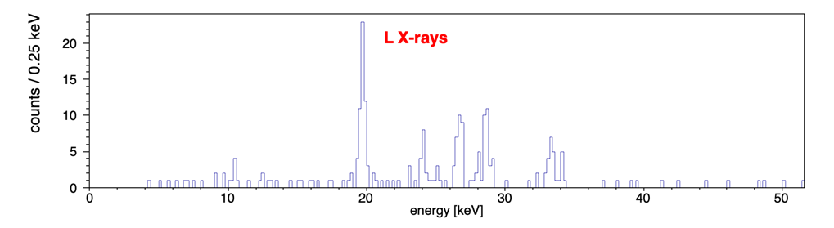
Conclude with two physics examples
Near future: high-resolution conversion electron spectroscopy
²⁵⁵No → ²⁵¹Fm as an example:
GABRIELA data vs SHEXI simul
⁴⁸Ca+²⁴³Am → ²⁹¹Mc*
NEWGAIN@GANIL: 5 pμA x 3.5 pb x 300 μg/cm² x 45%
typo in document
SIRIUS (5xEXOGAM Ge) 180 days → ~500 ²⁸⁹Mc
K. Rezynkina et al., Phys. Rev. C 97 (2018) 054332
SHEXI: 45 days → ~125 ²⁸⁸Mc

Slide 21
Back-up

Slide 22
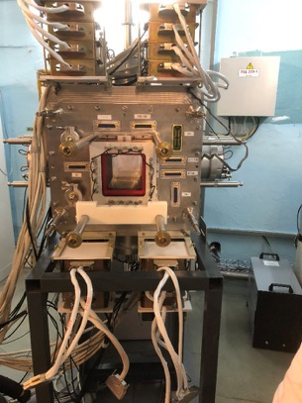
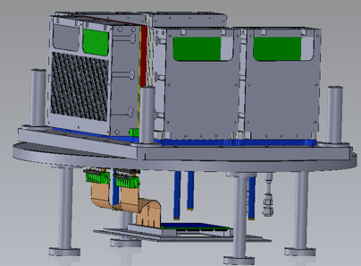
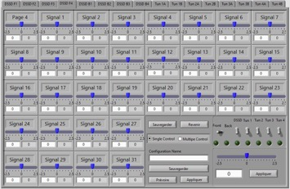
  PIONEER: Particle IdentificatiON for superheavy ElEment Research (ANR)
  → Replace 8x16 channel charge-sensitive GABRIELA preamplifiers
        with faster large dynamic range CSA 180 MeV with adjustable offset compatible with NI-5170 digitisers (DIGITAL GABRIELA)
    Status : 128 voies (sans les PAC) produites installation à IJCLAB Salle Beta 2 électronique retardée sur site (COVID puis plus de collaboration Russe)
Spin-off from SIRIUS CSA
Wassim (UL)
Nicolas, Lucy, Romain, Touria, Nicolas, William, Simon, Rayan, (4e année ESME)
Florian, Romane, Pauline (BTS ESME)

Slide 23
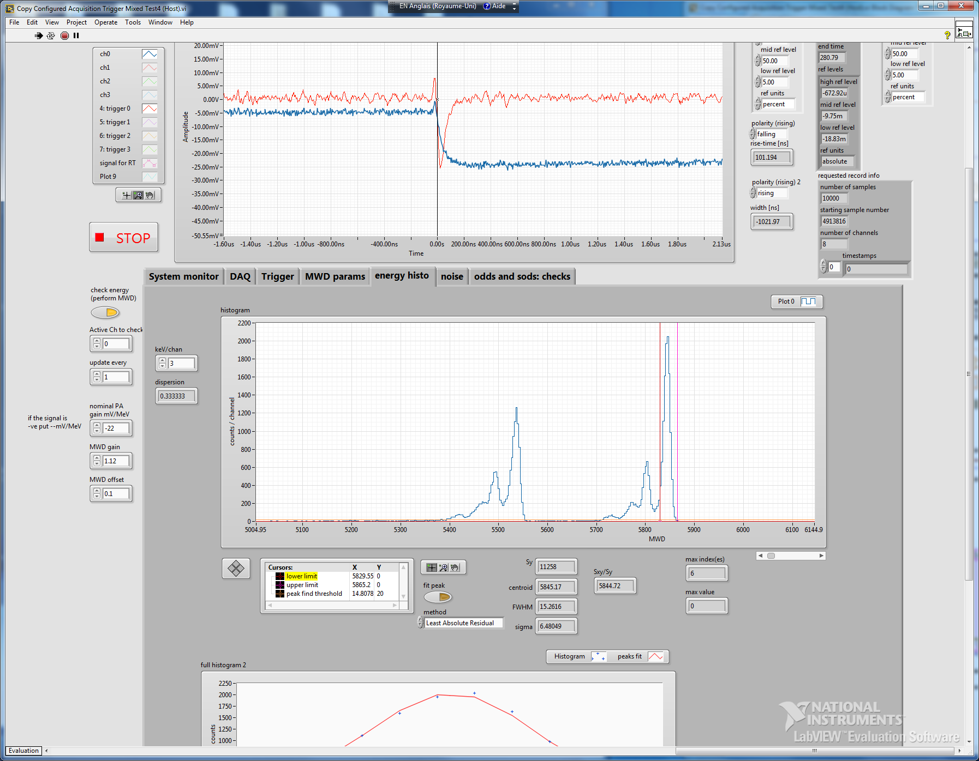
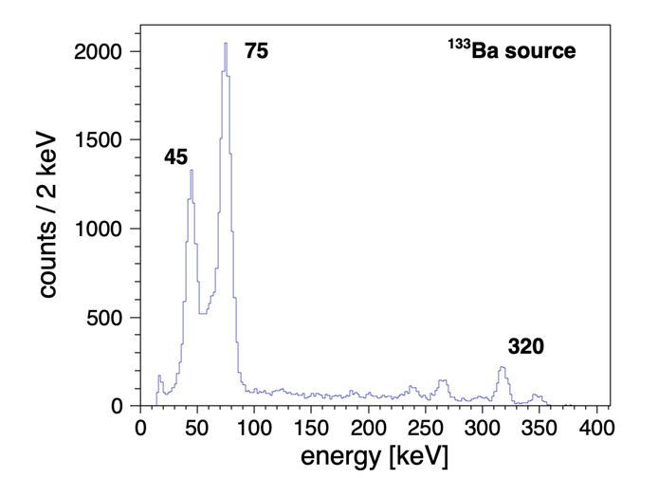
PIONEER-64 @ FLNR
Gain=1.25 → 180 MeV in 5V_{pp}

Slide 24
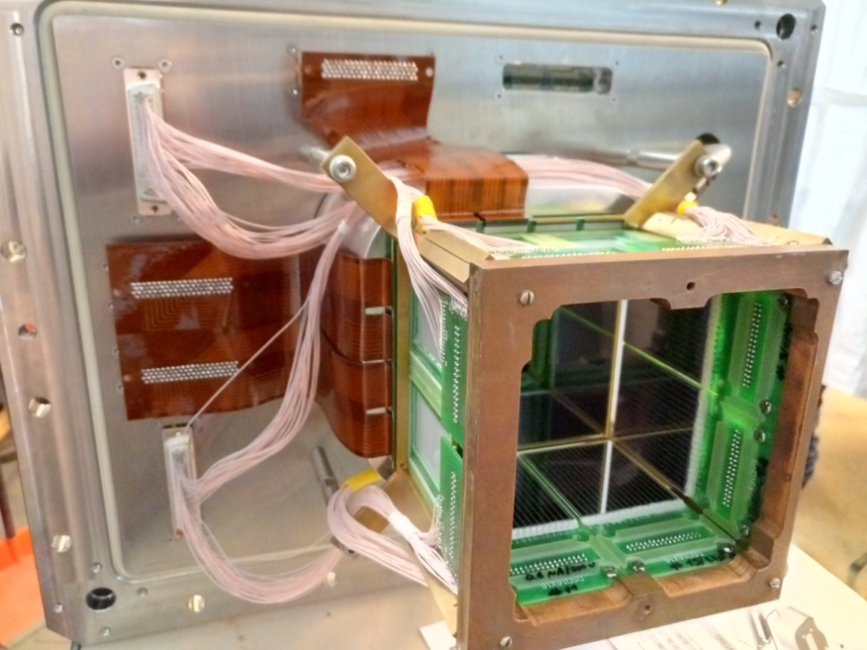
Back-up
2021/2

Slide 25
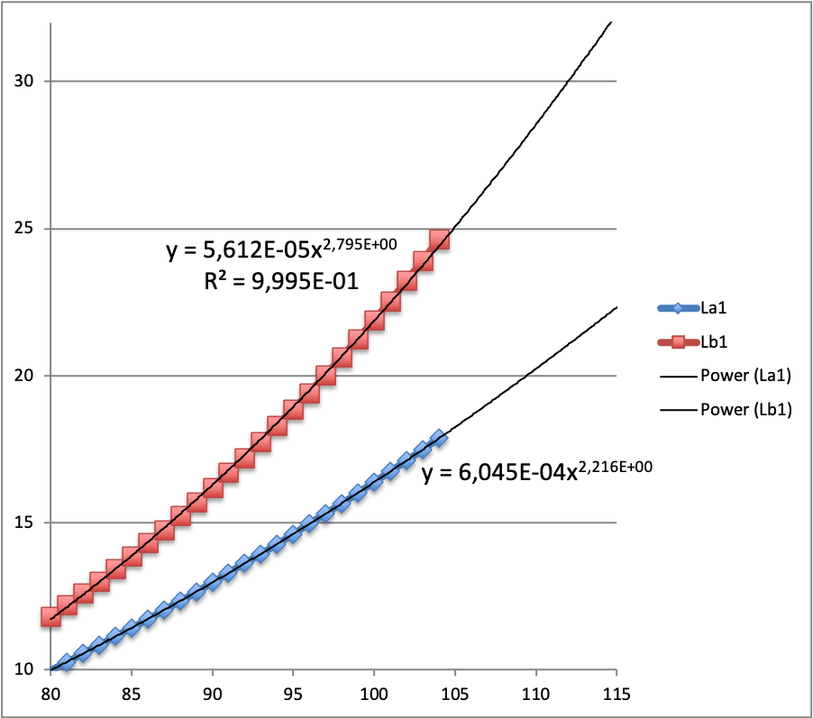
Extrapolation of known X-ray energies
Energy [keV]
Z

Slide 26
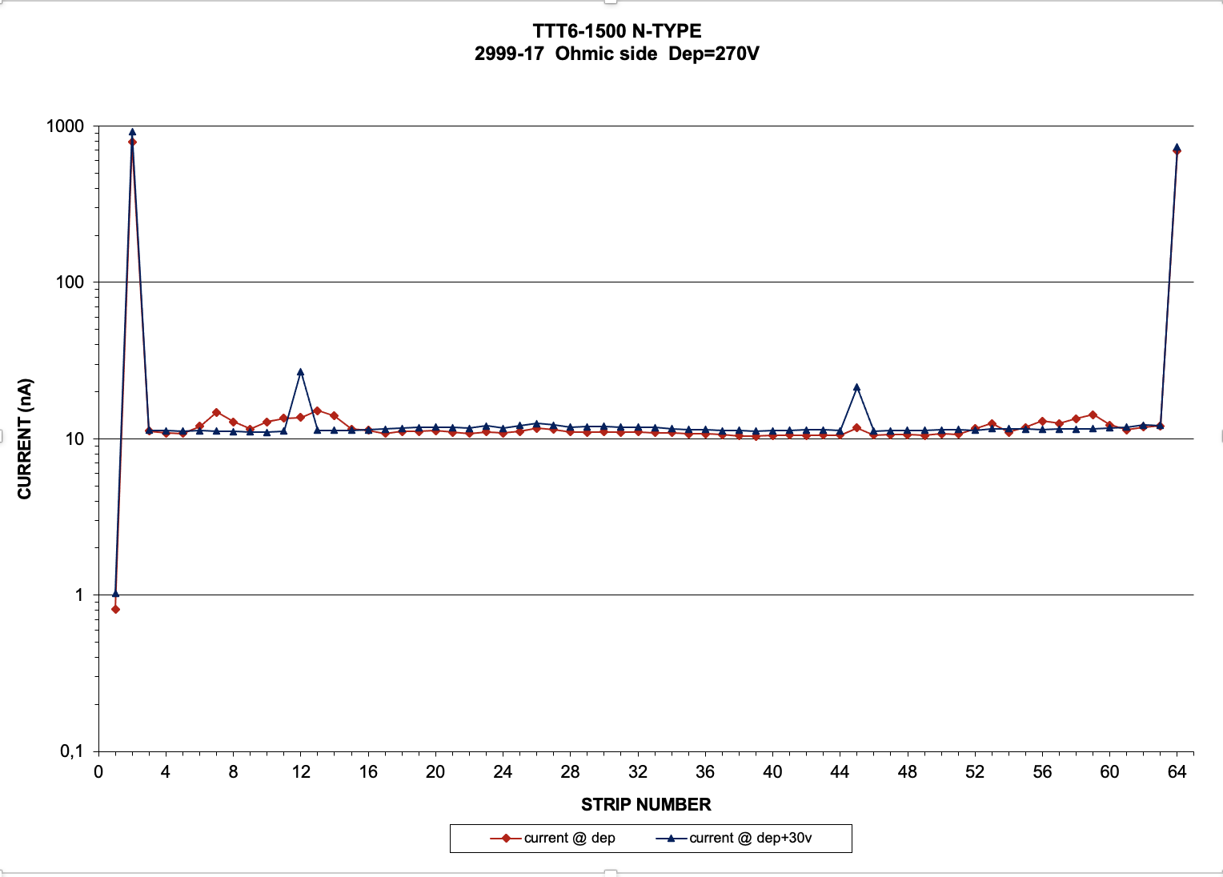
TTT6 leakage current @ 20ºC
I [nA] | T [ºC] | T [ºC]
~10 | 20 | 20
5 | 13 | 10
2.5 | 6 | 0
1.25 | -1 | -10
~0.6 | -8 | -20
0.3 | -15 | -30
0.15 | -22 | -40
Energy [keV]

