Slide 1
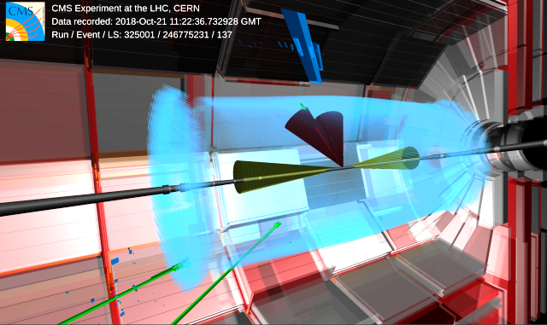
Why we do need the (HL)-LHC: final states with multi-bosons
February 9, 2024
Roberto Covarelli – Università and INFN Torino (Italy)
L.A.P.P., Annecy-le-Vieux (France)

Slide 2
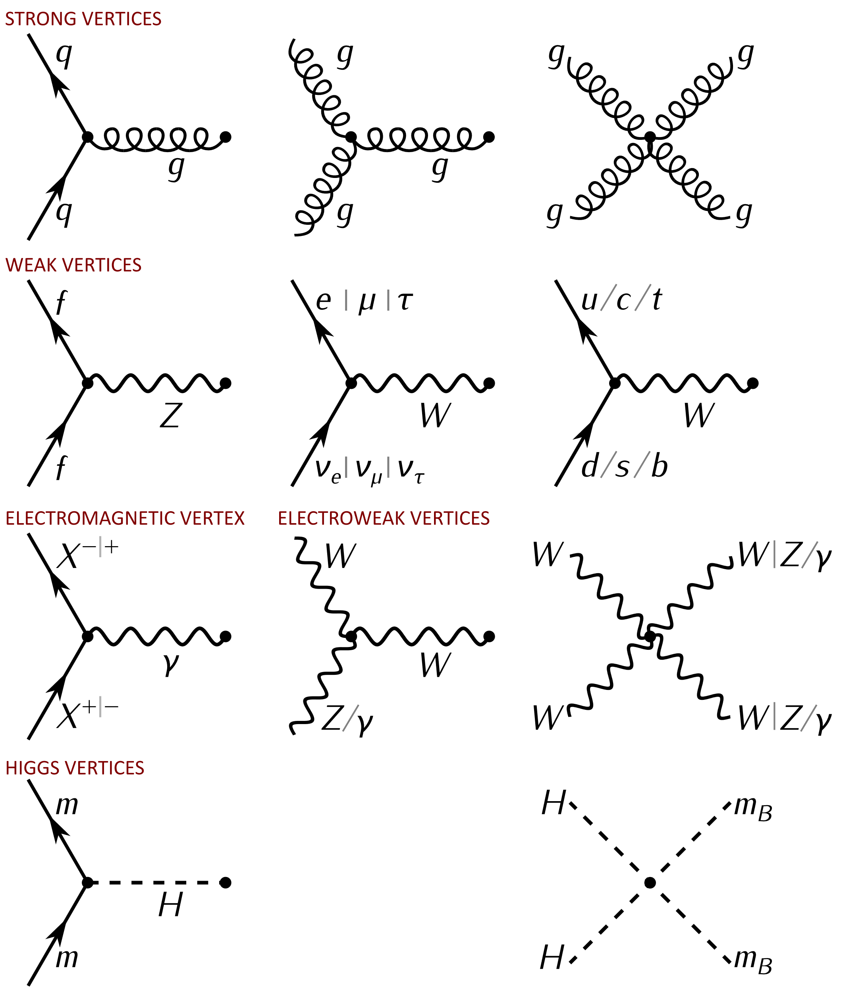
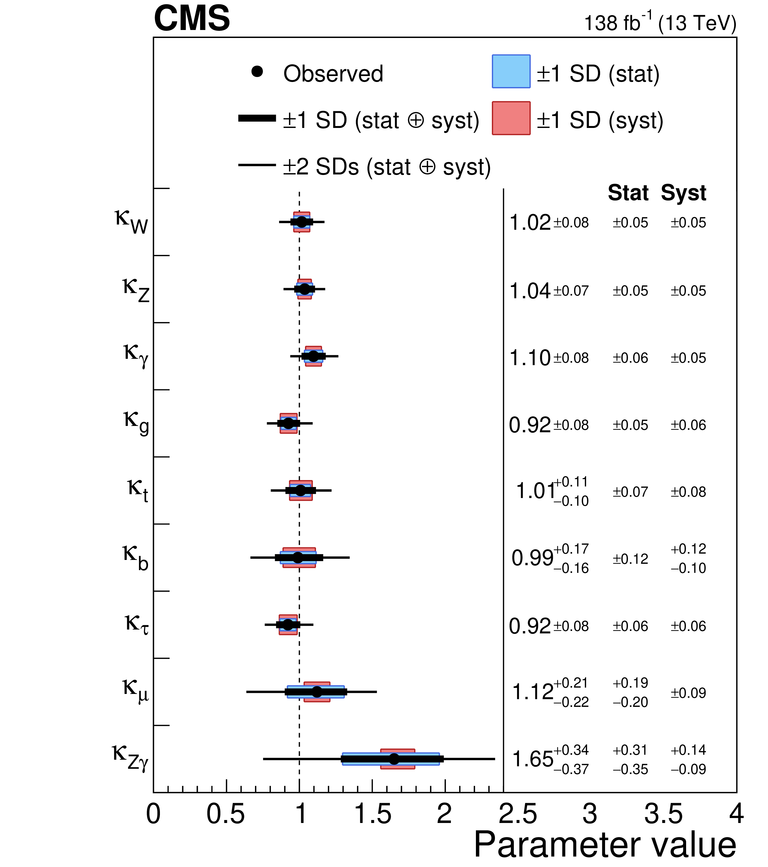
Electro-weak interactions
The electro-weak sector of the Standard Model (SM): an extremely predictive and successful theory
Unified (SU(2)_{L} x U(1)_{Y} group)
Perturbative down to small energy scale
Only very few free parameters
Tested to high precision by last and next-to-last generation of HEP experiments

Slide 3
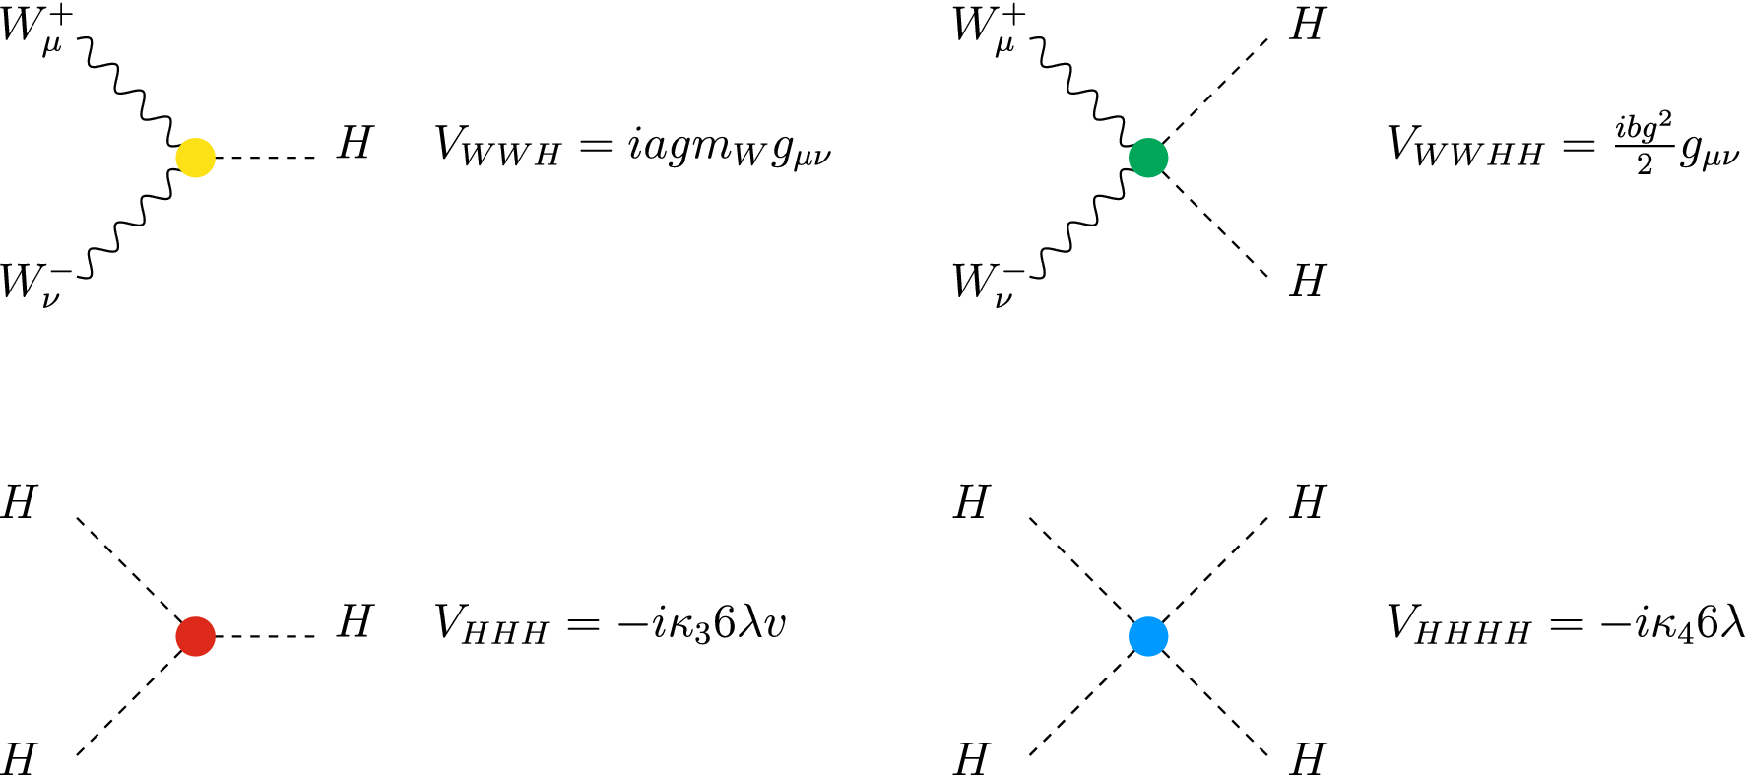
Multiboson couplings
For different reasons, the SM also predicts the existence of multi-boson couplings
Multi-gauge from non-Abelian structure of SU(2)
Gauge invariance of vector-boson kinetic terms enforces triple and quartic vertices
No vertices with only Z/γ, since they both stem from the same field W₃ after GWS mixing
Multi-Higgs from (theoretical) shape of Higgs potential (quartic) and field expansion around the VEV (triple) after symmetry breaking
In common:
In EW theory, all coupling strengths predicted exactly
Very hard to measure experimentally, since relevant processes also occur through competing (dominant) diagrams

Slide 4
Before the LHC: LEP2
Access only to WW and ZZ production
Already interesting constraints on triple-gauge couplings from observation of cancellations
Non-SM effects constrained using parameterization based on effective vertices

Slide 5
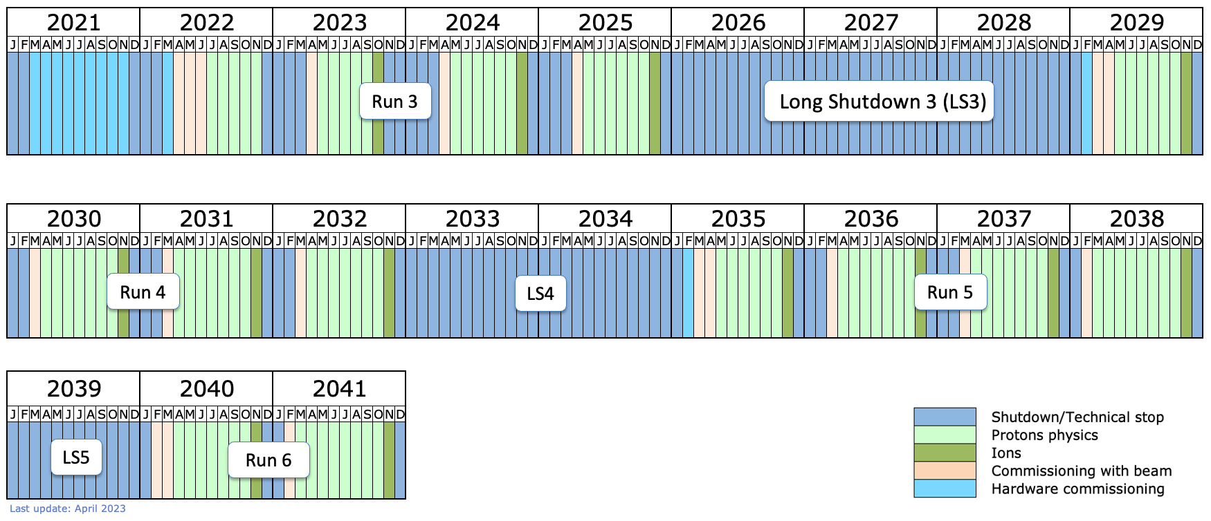
Now and future (experiment)
No CM-energy increase expected in the next years (decades?)
Possibly no direct access to high-energy New Physics (NP) which could modify yet unexplored SM «corners»
BUT LHC experiments have potential sensitivity to all processes involving multi-gauge and multi-Higgs mediated diagrams
First need enough data...
High-luminosity
phase, HL-LHC
(x5 - x7.5 L_{inst})

Slide 6
Now and future (theory)
Effective-vertex approaches replaced by effective field theories
Do not introduce SM modifications of arbitrary magnitude but take into account that the dimensionality of the respective operators must be suppressed by a corresponding power of the NP scale
Standard Model Effective Field Theory (SMEFT):
Advantages:
Model-independent
A variety of measurements can be combined leading to a more stringent / precise result
Drawbacks:
Invalid at energies too close to Λ or above (unitarity violation)
Lot of freedom to choose O’s: power of the data is diluted
Not clear how to estimate uncertainties from missing higher orders (e.g. keep or discard Λ⁴ terms from squared dim-6 amplitudes)

Slide 7
SMEFT in a nutshell
Wilson
coefficient

Slide 8
Triple and quartic
gauge couplings
1A. Dibosons
1B. Vector-boson scattering
1c. Tribosons

Slide 9
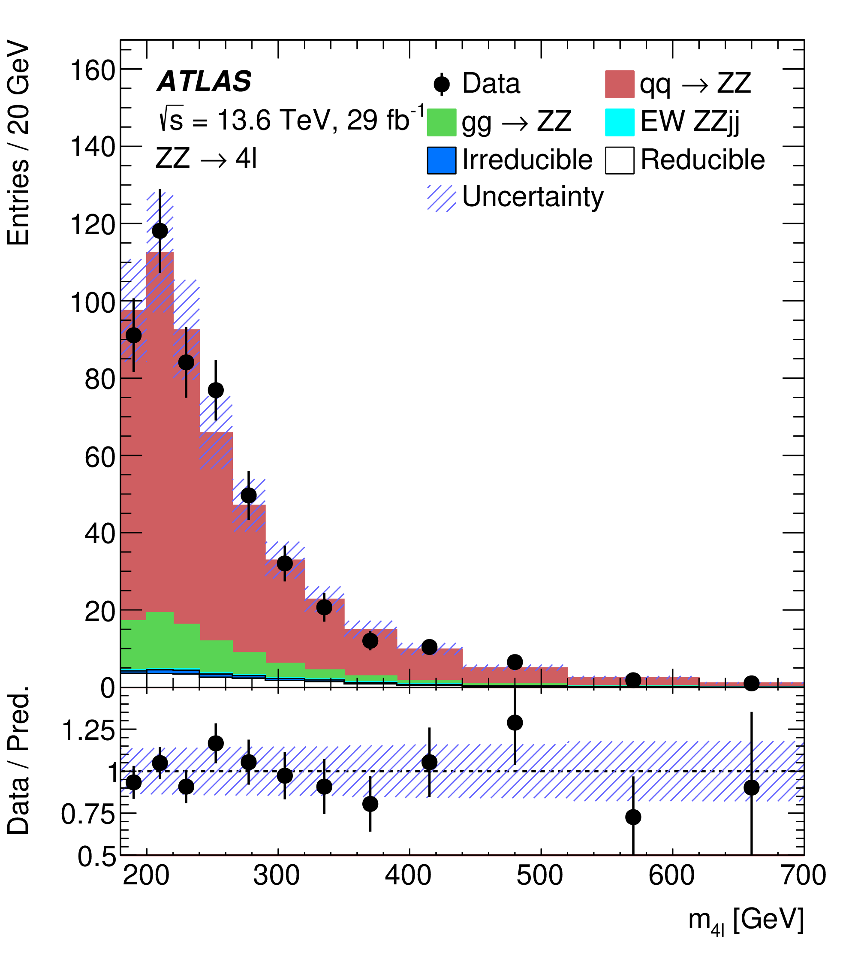
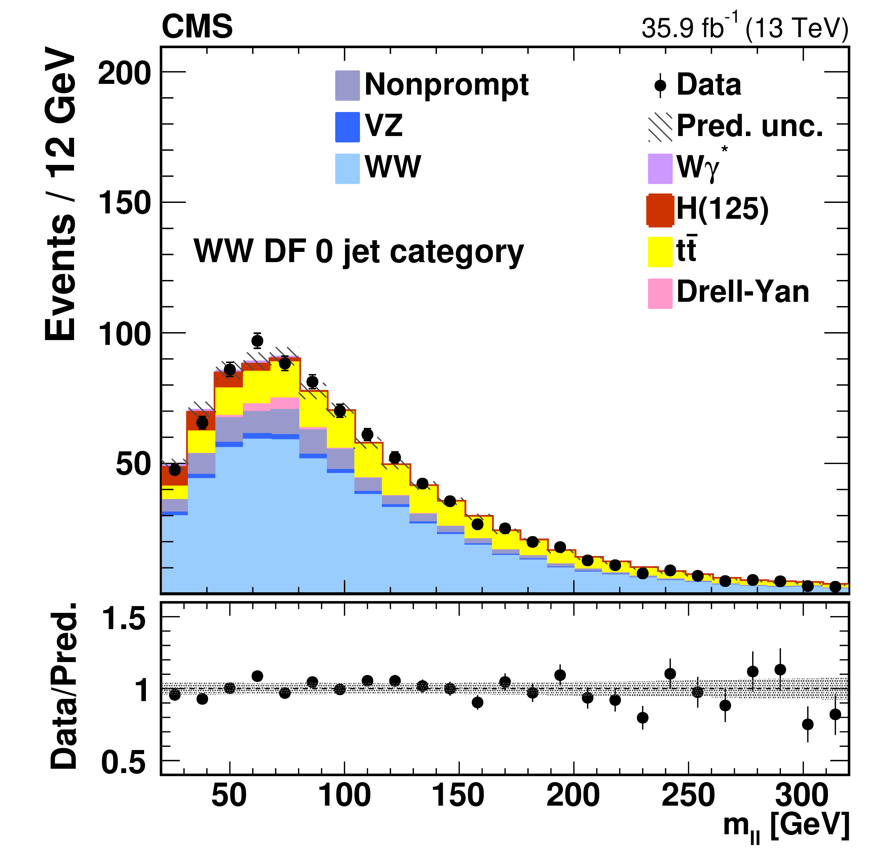
Dibosons
The easiest probe of triple gauge couplings at the LHC
Fairly large cross-sections (~ pb)
Relatively simple signal triggering/selection
γ : stringent identification criteria and isolation, main background is from jets rich in π⁰
W → lν: lepton + p_{T,miss} , main background from tt events
Z → ll: two leptons with m_{ll} = m_{Z} , very clean signature
W/Z →hadrons: larger cross-sections, but also harder to identify at the LHC
ATLAS coll., arXiv:2311.09715
LHC Run3 data!
CMS coll., PRD 102, 092001

Slide 10
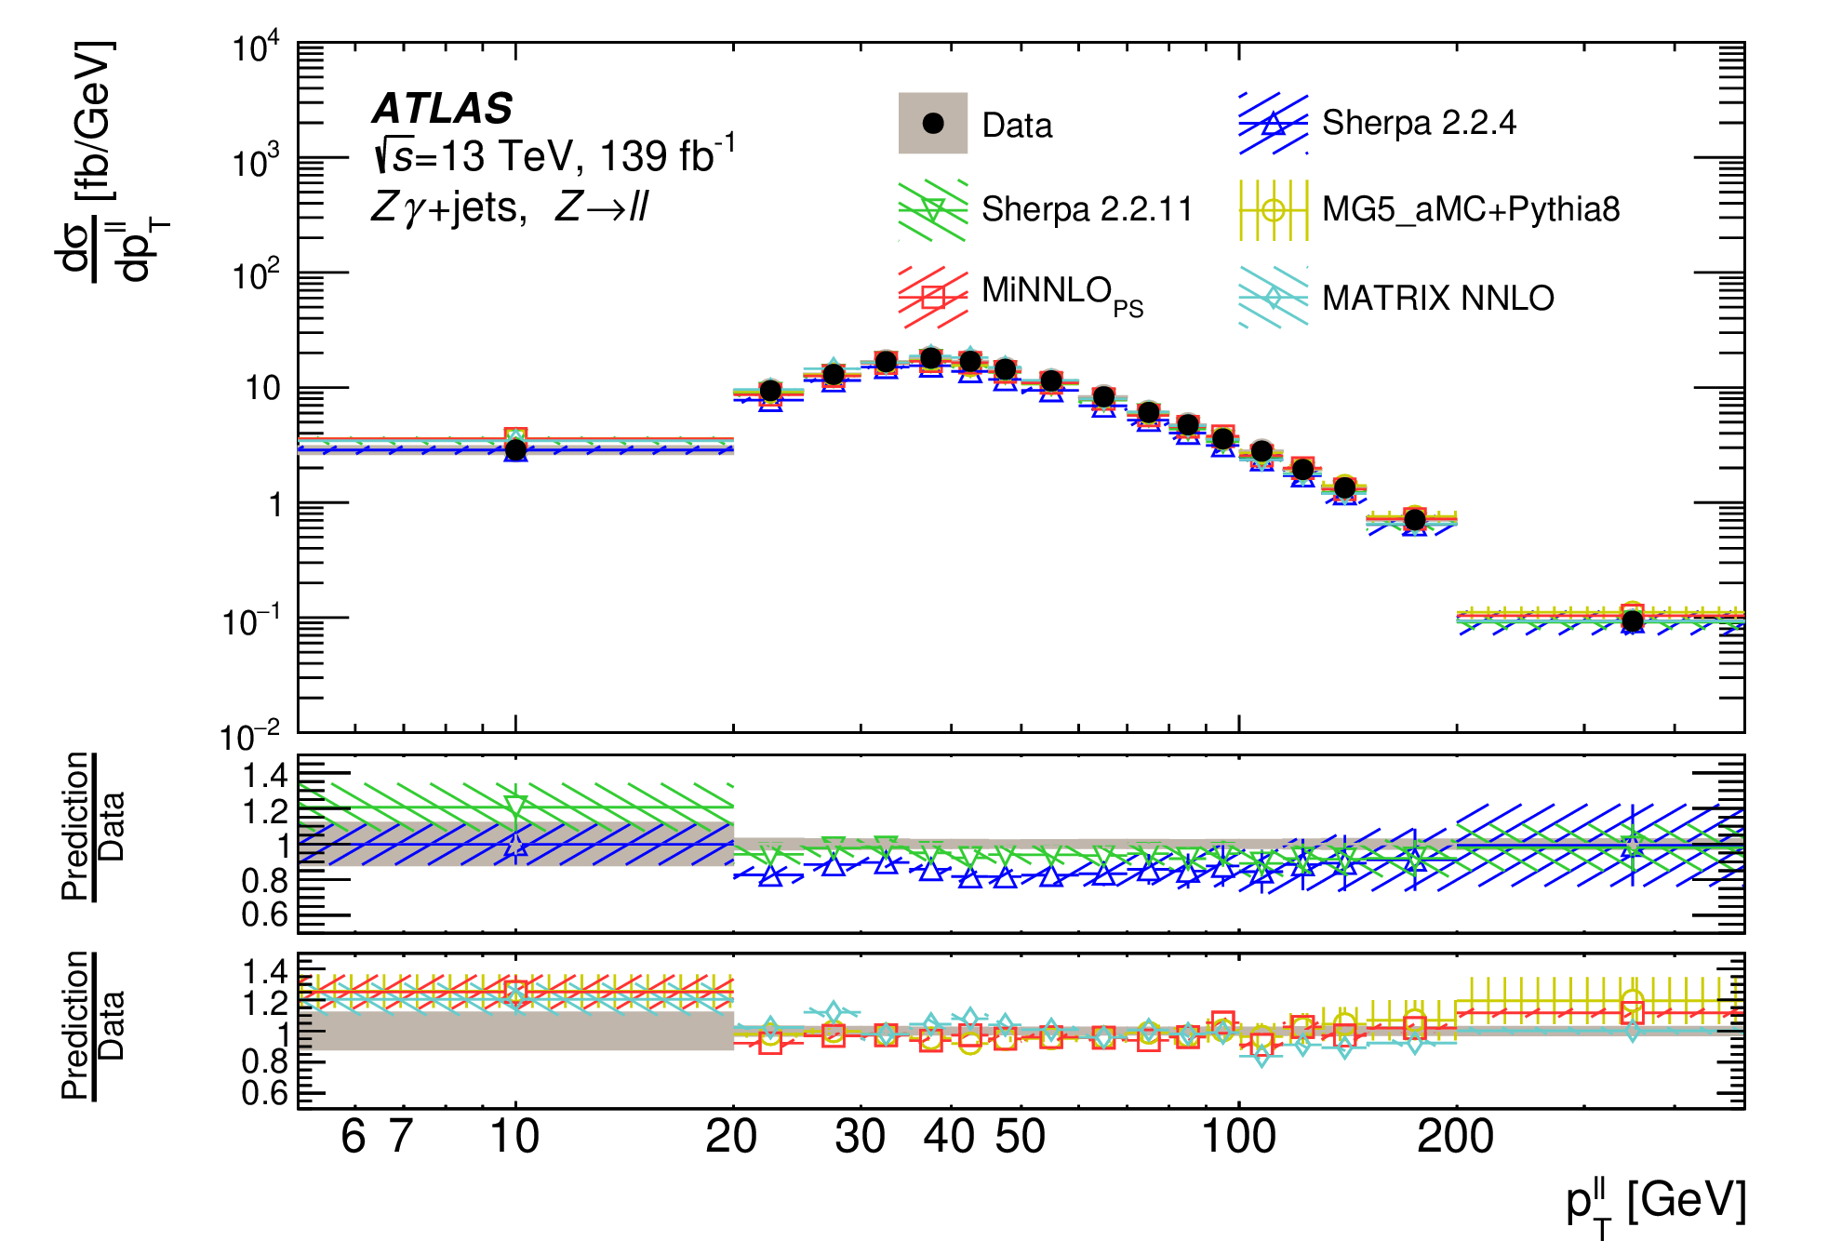
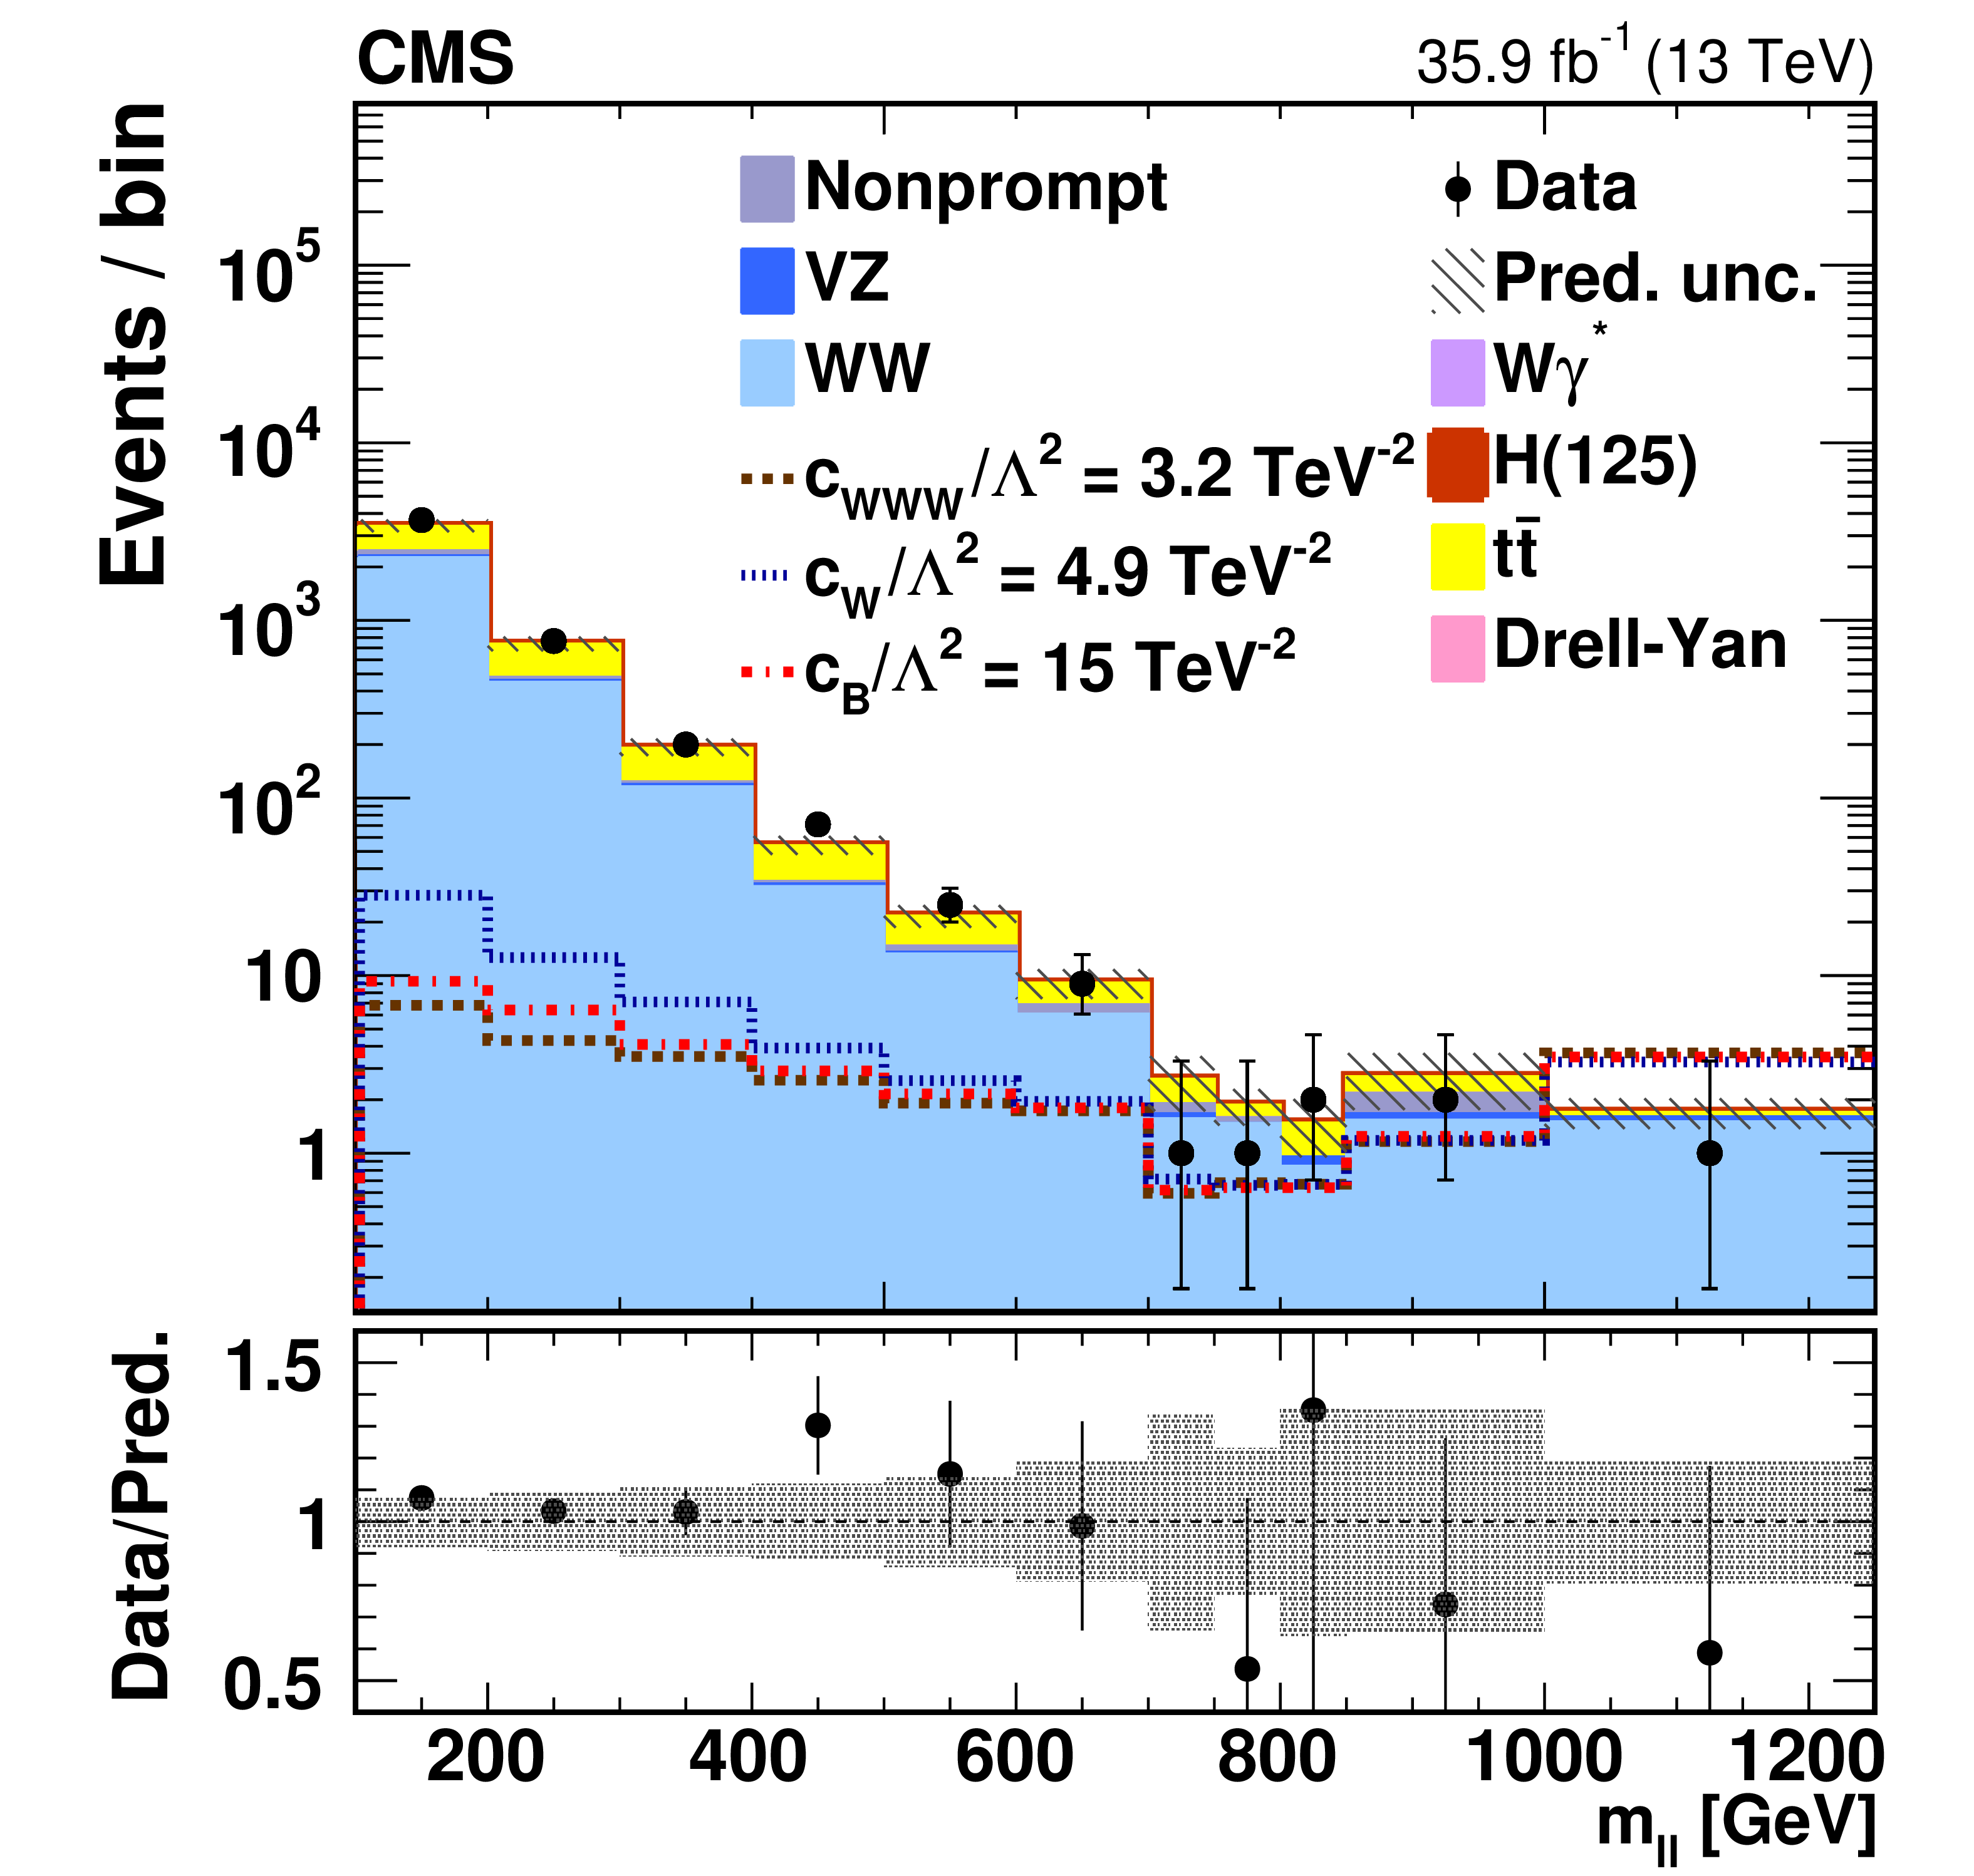
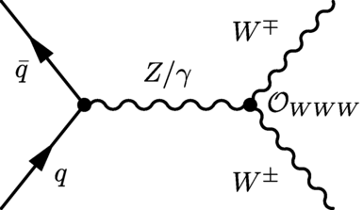

Dibosons
Differential cross-sections available for most channels
They require simulation-based unfolding
Accurate tests of QCD tools (a.k.a. «MonteCarlo generators»)
How to look for beyond SM effects?
The simplest way is to search for excesses at large scattering √s (or proxies thereof)
ATLAS coll., JHEP 07 (2023) 72
^
$$O_{WWW}= ε^{ijk}W_{i}^{μρ}W_{j}^{ρσ}W_{k}^{σμ}$$
CMS coll., PRD 102,
092001
|c_{WWW}|/Λ² < 1.8 TeV⁻²
@95% CL

Slide 11
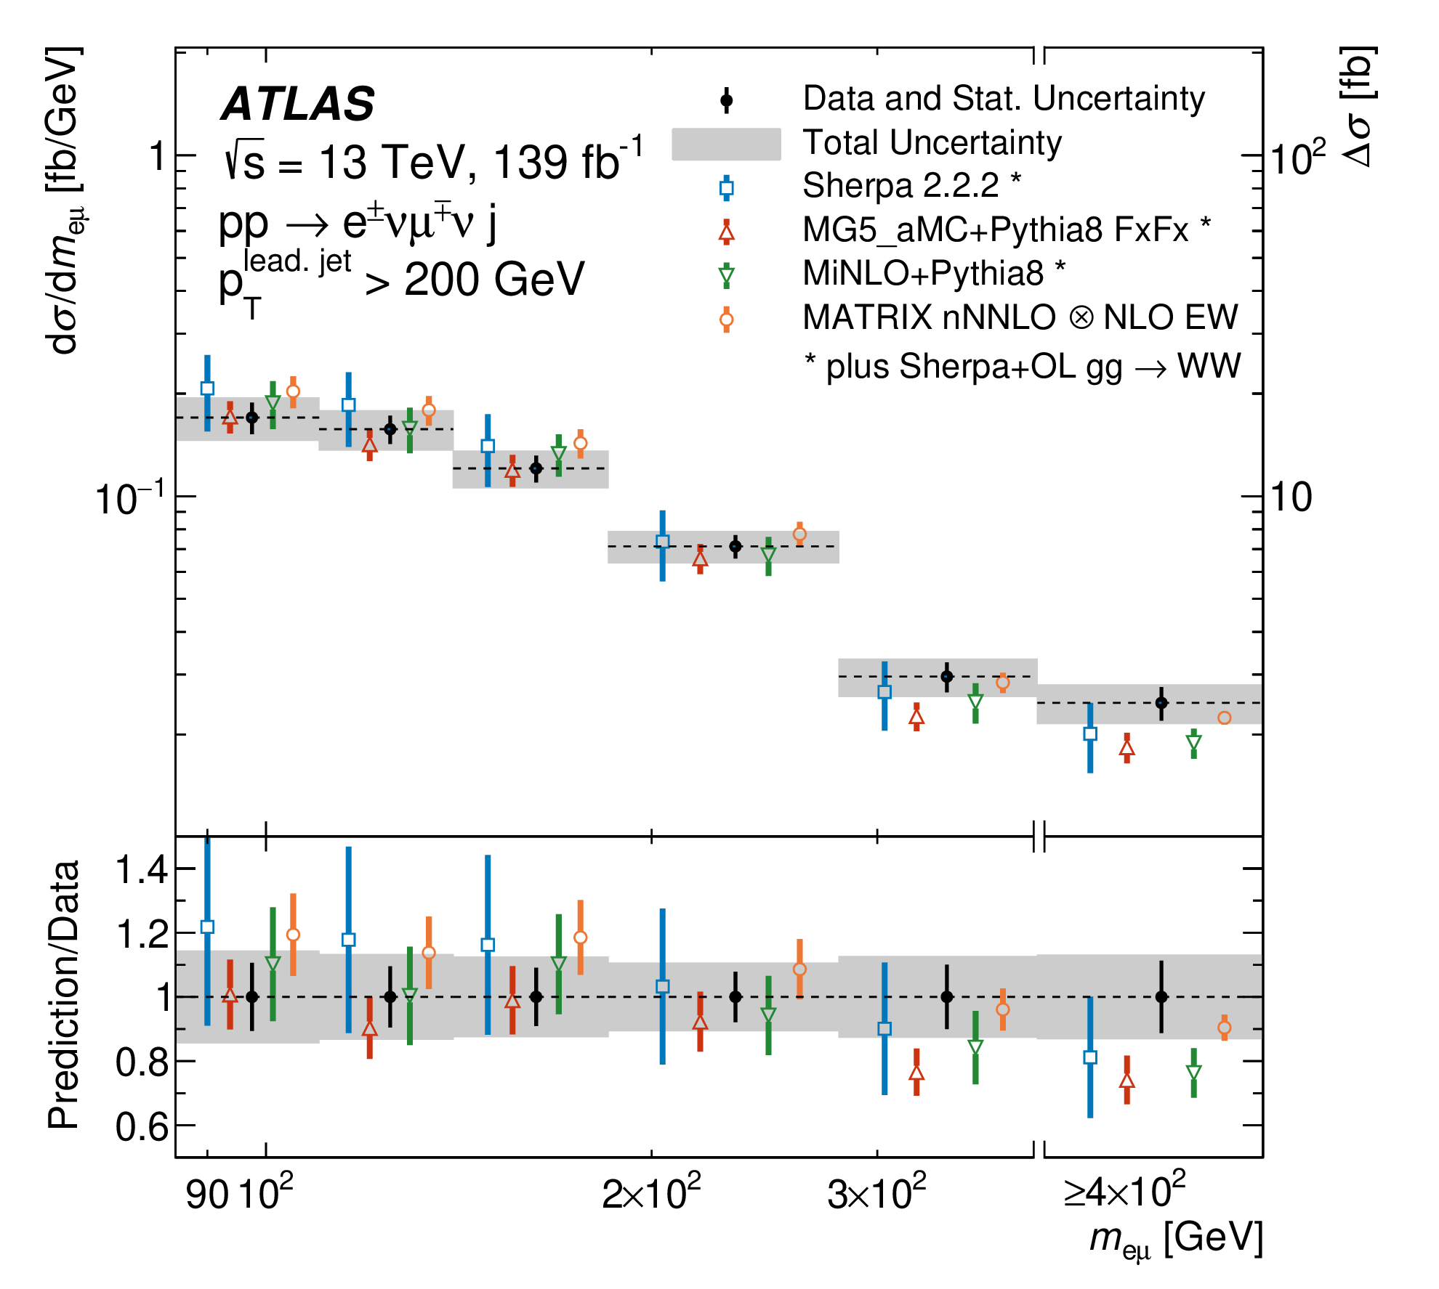
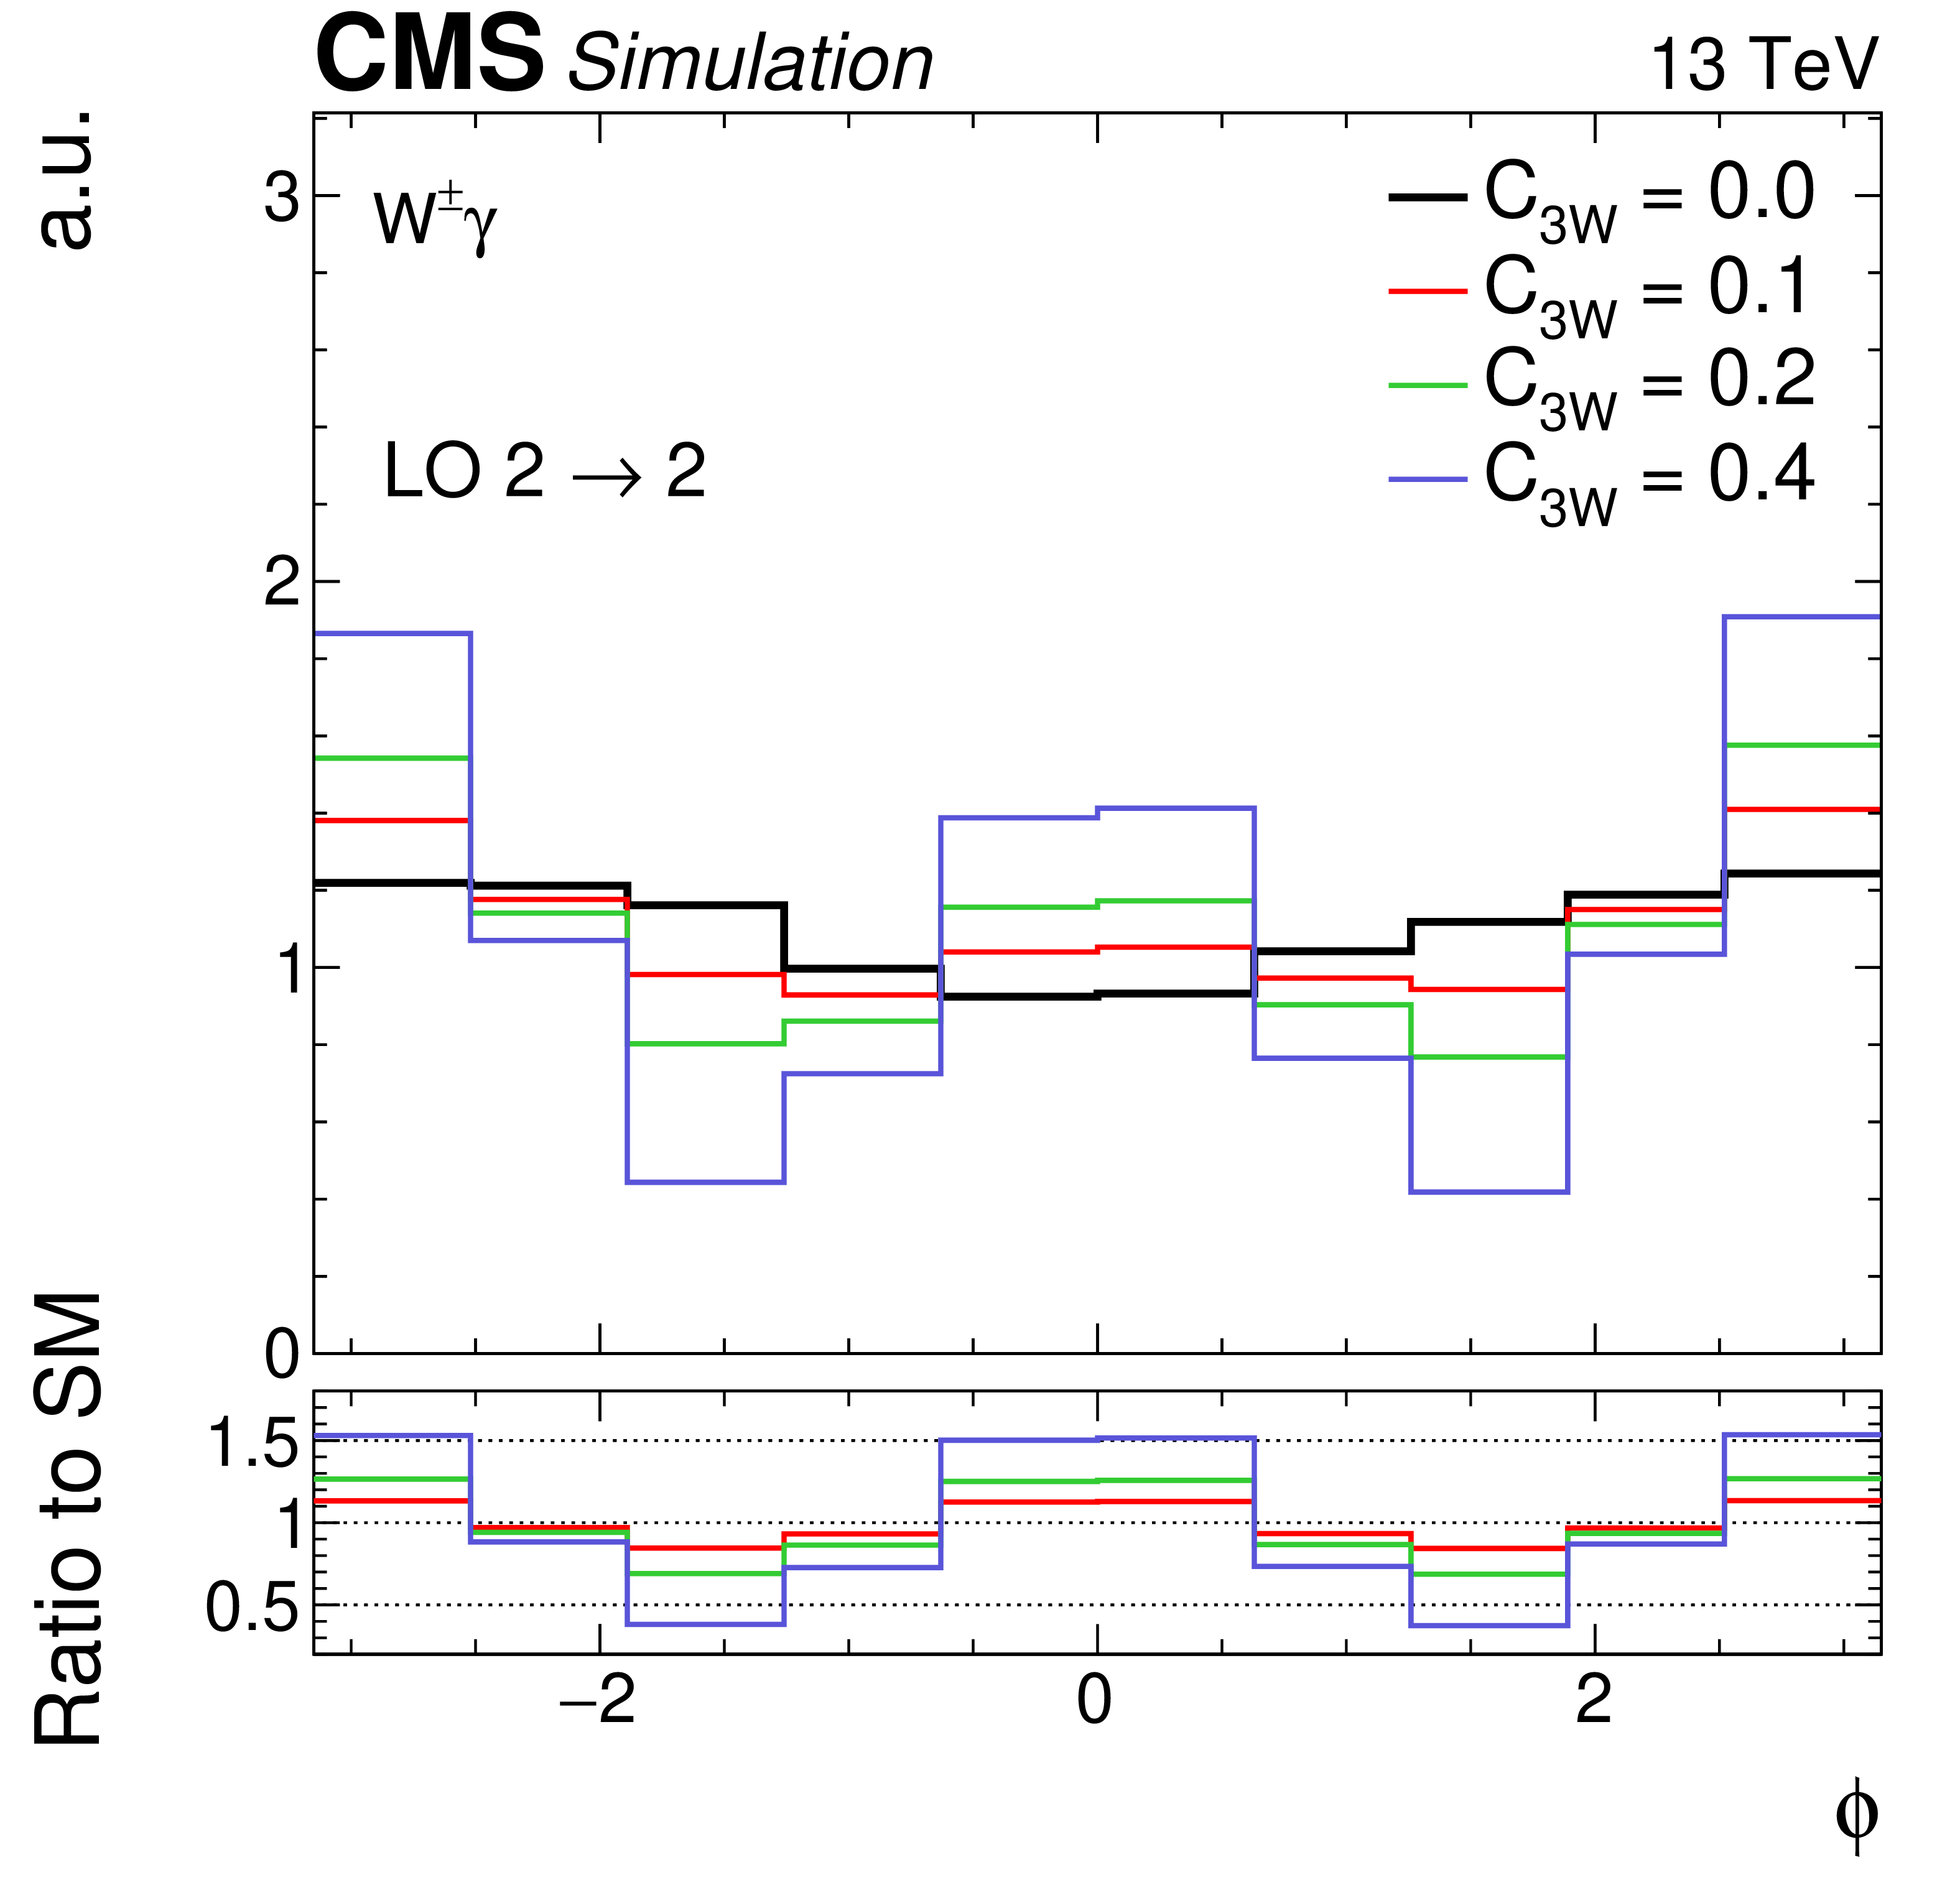
Can we do better on SMEFT?
Use dedicated regions of phase space and/or observables that enhance SM+EFT interference (or cancel destructive effects)
ATLAS: WW → eμ +high-p_{T} jet: selection of highly-boosted WW pairs changes helicity composition (more sensitive to EFT)
-0.60 < c_{WWW}/Λ² < 0.58 TeV⁻²
ATLAS coll., JHEP 06 (2021) 003
CMS coll., PRD 105, 052003
CMS: Wγ. Choose specific frame to compute Δφ between γ and lepton → enhances SM+EFT interference
-0.062 < c_{WWW}/Λ² < 0.o52 TeV⁻²

Slide 12
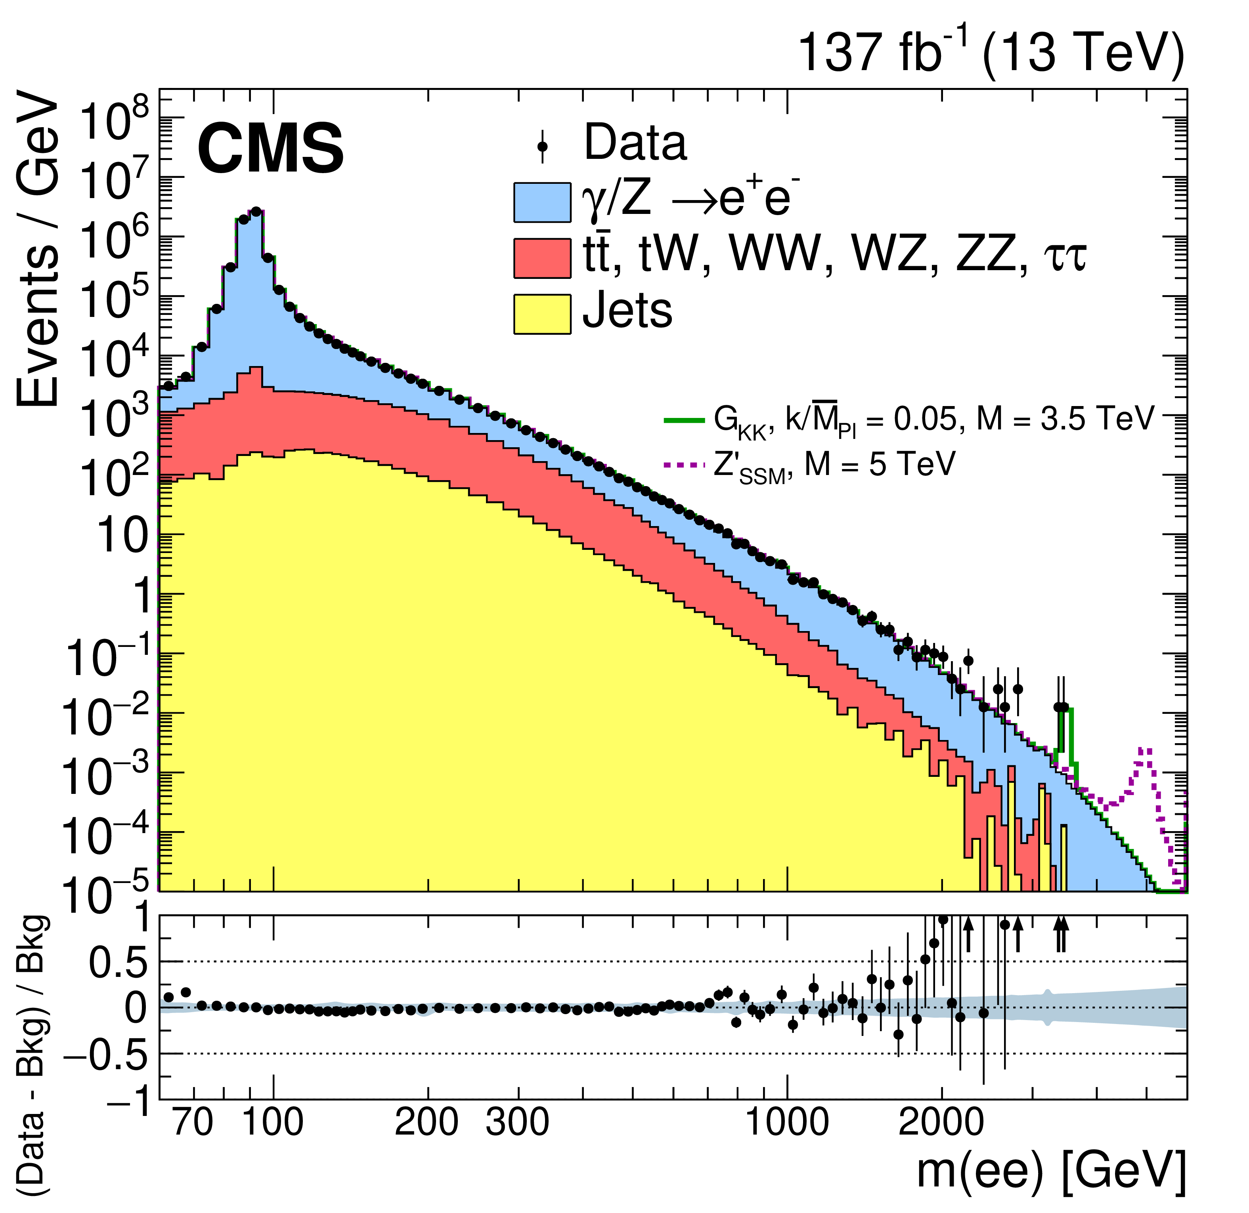
How is SMEFT challenging direct searches?
Use best result on c_{WWW} from CMS Wγ
In an illustrative way, assume that SMEFT becomes relevant when c_{WWW} ~ g ~ 0.63.
c_{WWW}/Λ² < 0.o52 TeV⁻² → Λ > 3.5 TeV
Competitive with direct Z’ searches
Key to best SMEFT limits: smart observables + larger statistics at high VV masses

Slide 13
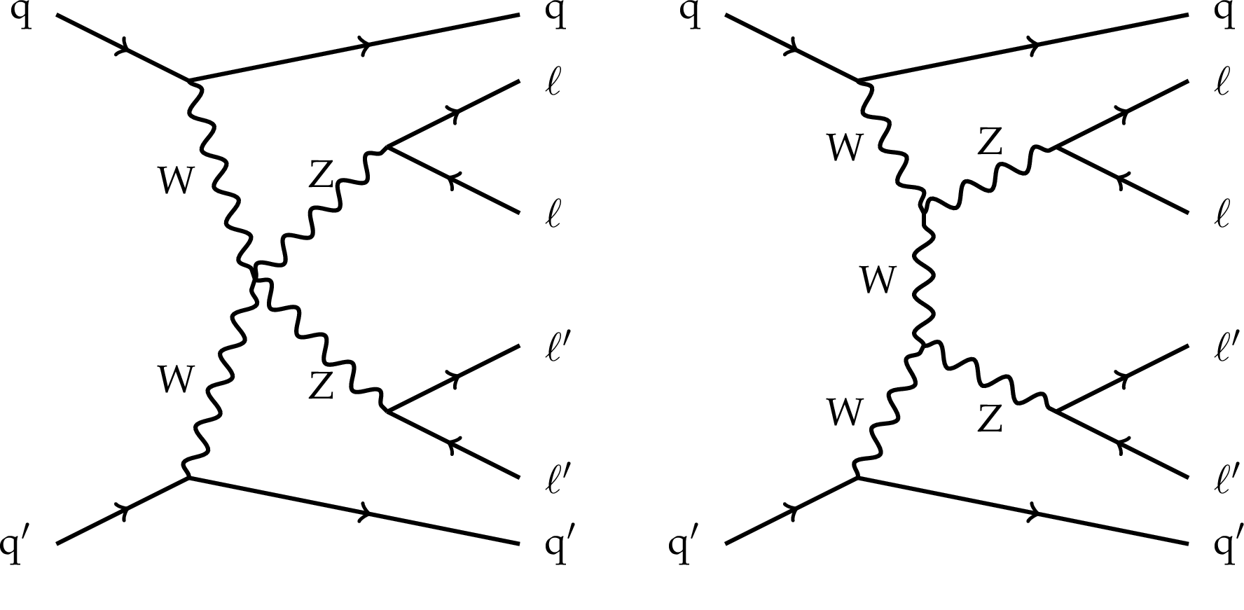
Vector boson scattering (VBS)
A particularly interesting mechanism of diboson production through scattering (final state is VVjj)
Two main reasons:
ALL FINAL STATES: Tree-level contribution of quartic gauge couplings → constraints on specific dim-8 SMEFT operators which only modify those
ONLY MASSIVE VECTORS WITH LONGITUDINAL POLARIZATION: unitarity violation at high energies restored via interference with Higgs-boson diagrams in SM → thorough test of HVV interactions off-peak

Slide 14
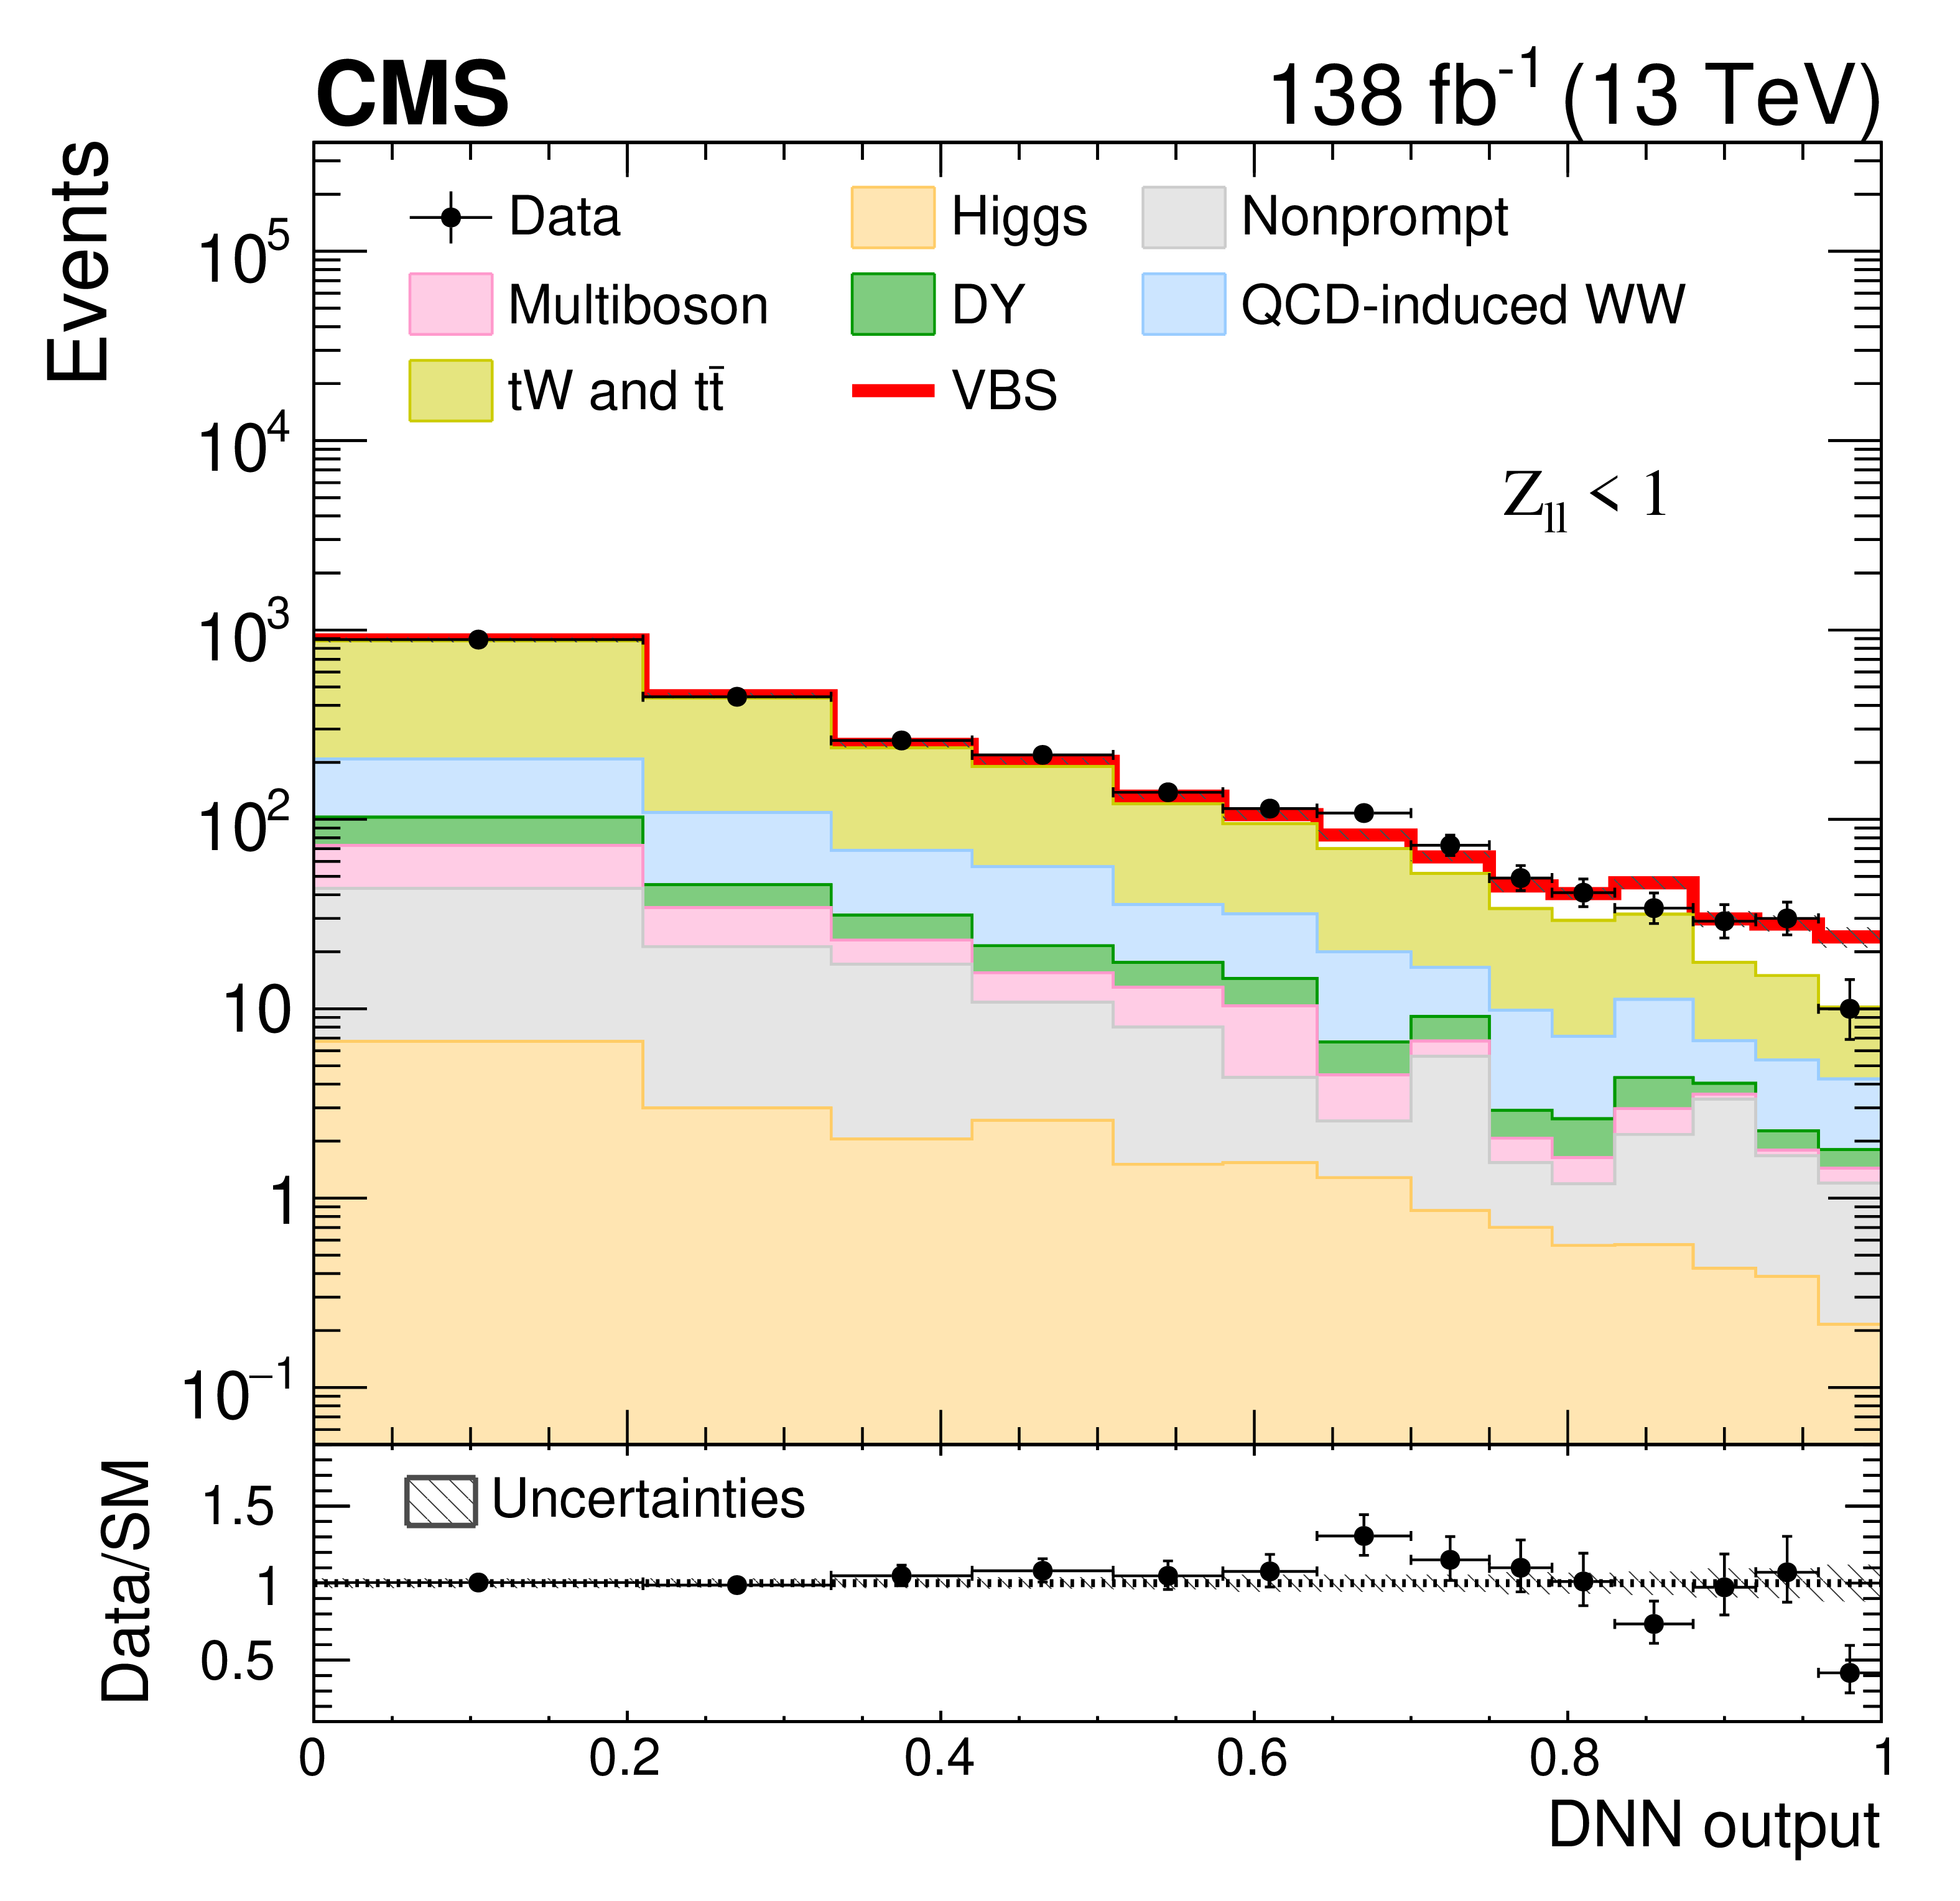
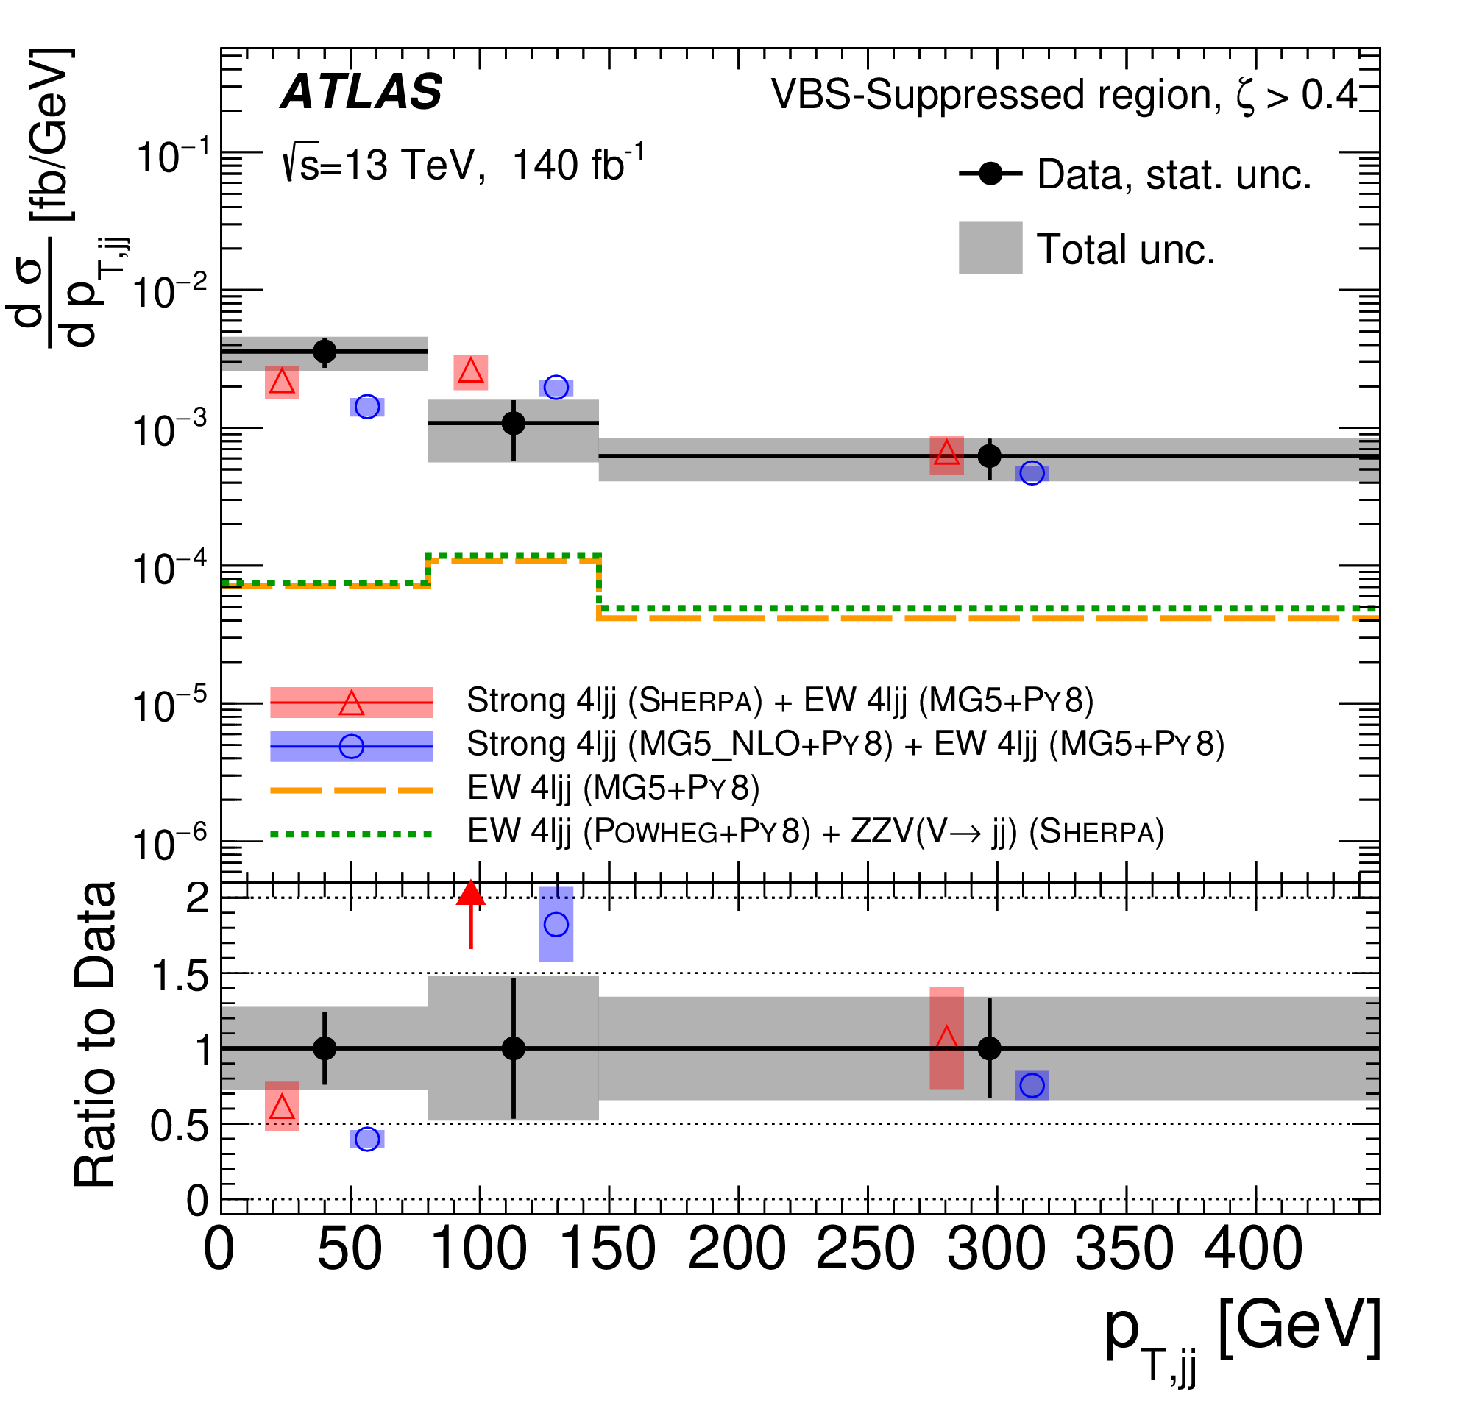
Vector boson scattering (VBS)
Experimentally very challenging
Very small cross-sections (~ fb)
Background from «regular» diboson production in association with 2 jets in the forward region → large and not very well described by MC generators
N.B. True for all final states except W±W ± jj («golden» VBS)
Selection based on machine-learning techniques (e.g. DNNs)
Control regions left free in the fits to cure theory mismodeling
ATLAS coll., JHEP 01 (2024) 004
CMS coll., PLB 841, 137495

Slide 15
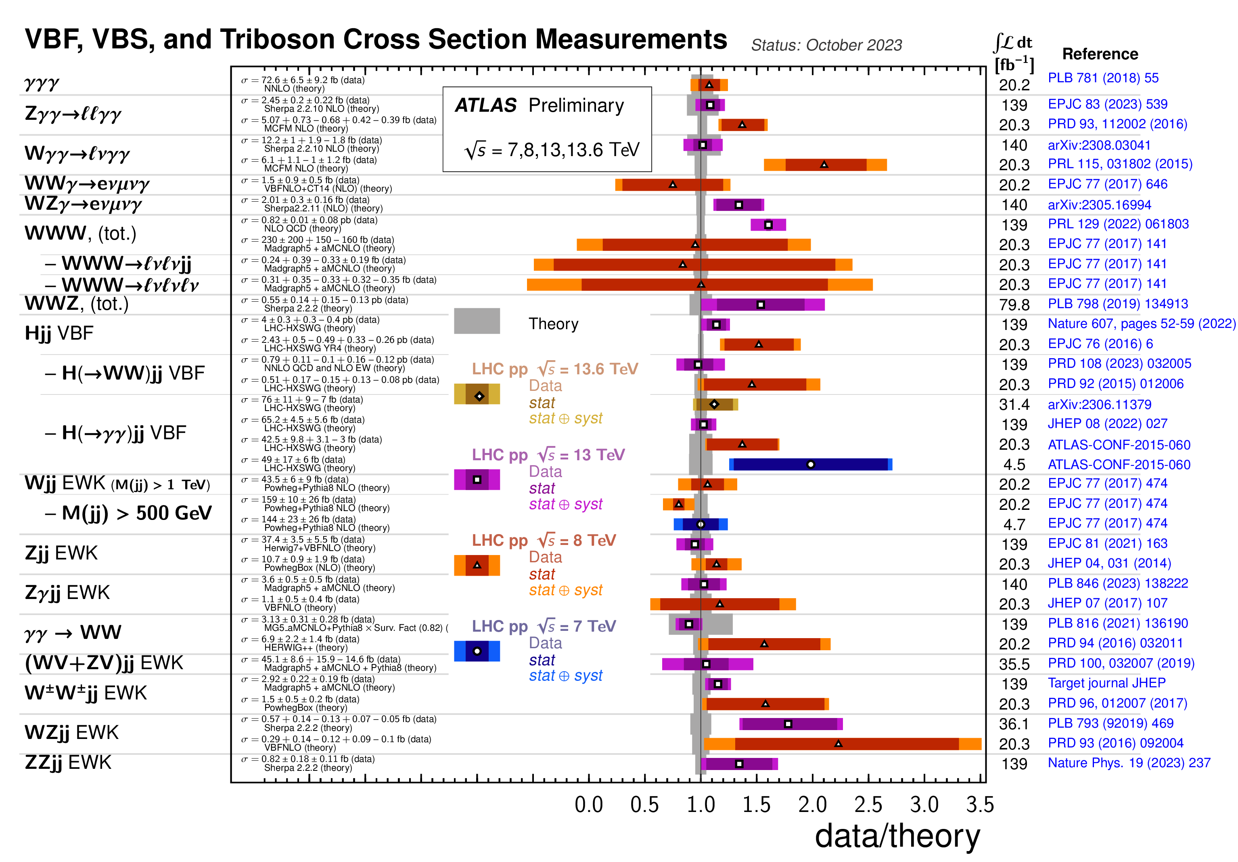
Vector boson scattering (VBS)
Basically all final states observed (or at the edge of 5σ observation) using LHC Run2 data
Fairly good agreement with SM... on the high side?

Slide 16
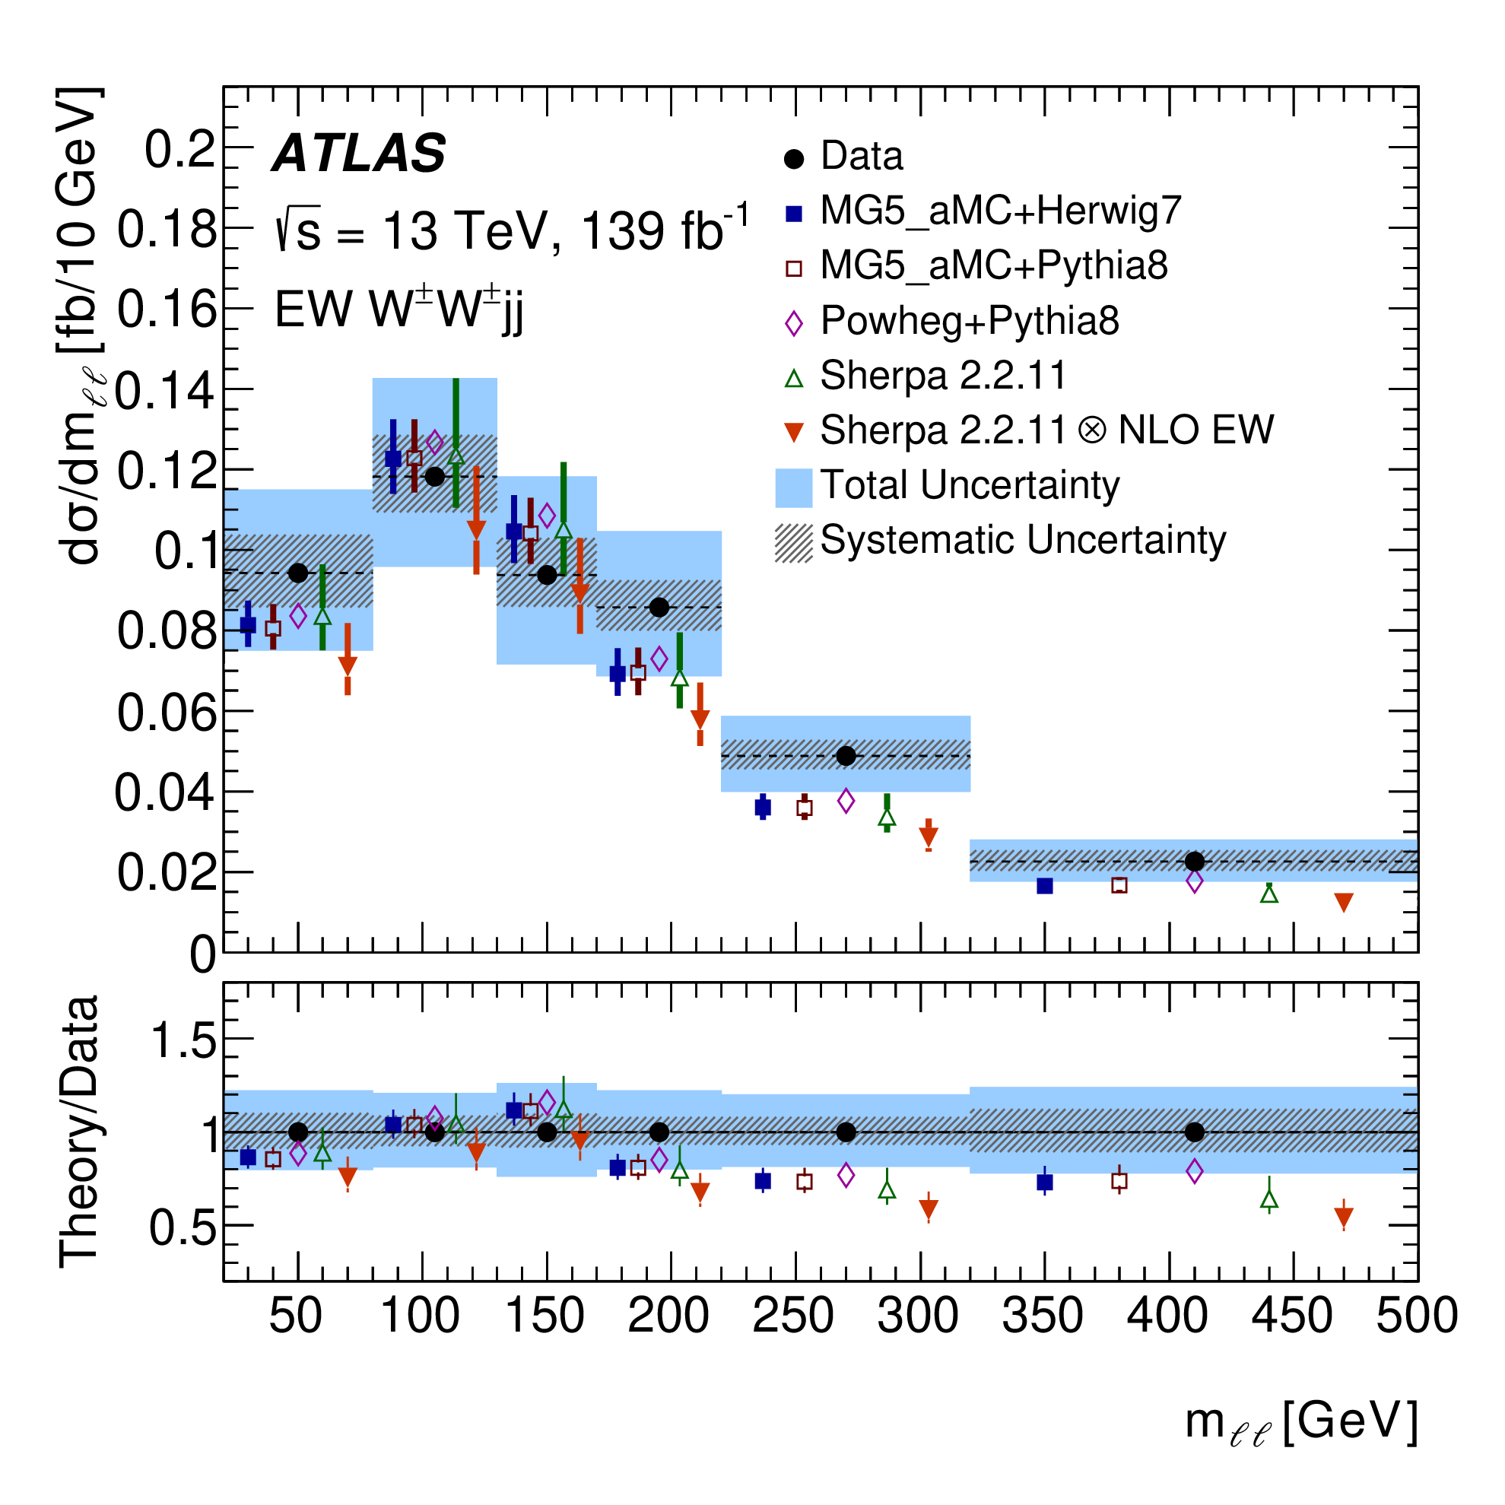
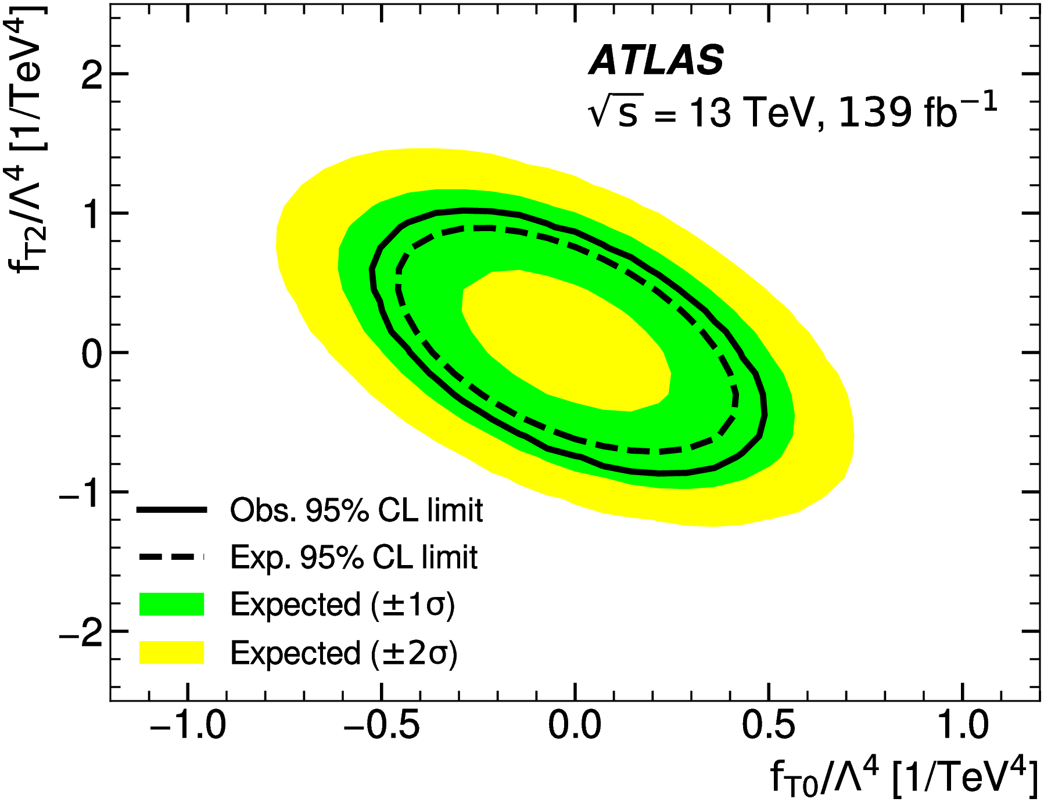
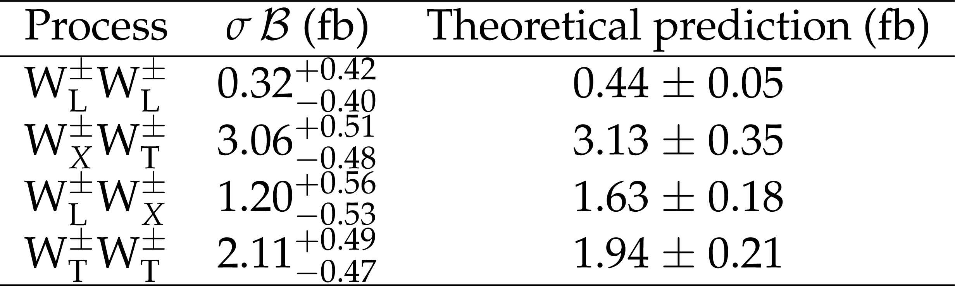
VBS golden channel (W±W± jj)
Only case with very small non-VBS physical production
Background mainly from non-prompt leptons
Finely-binned differential cross-sections already possible
Constraints on
dim-8 SMEFT
ATLAS coll.,
arXiv:2312.00420
CMS coll.,
PLB 812, 136018
First attempt to polarized final states in CMS
Still a long way to W_{L}W_{L}

Slide 17
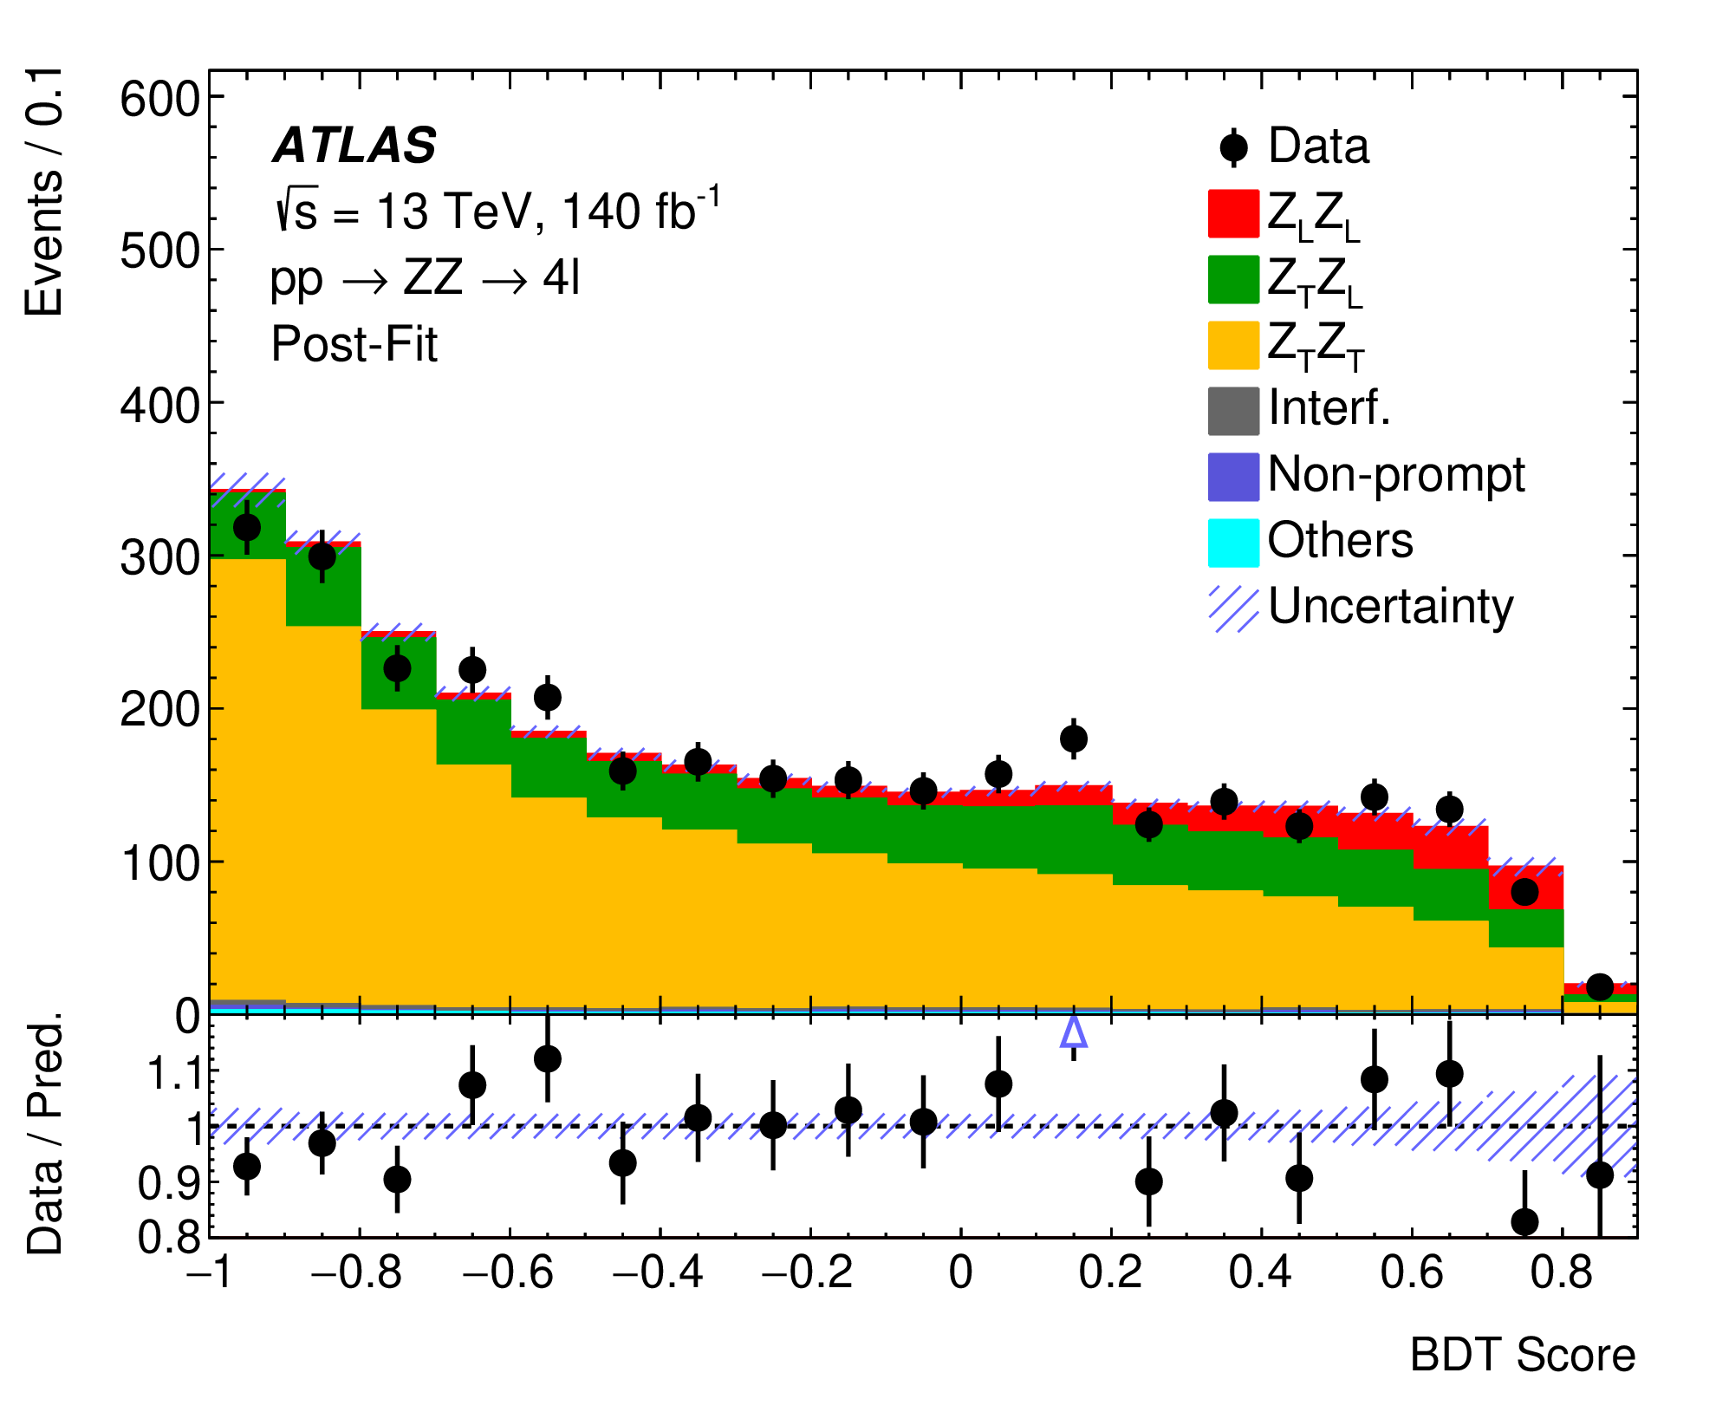
Polarization (now and future)
Sensitivity to longitudinal polarization at the moment possible only on inclusive dibosons
→ Lay the ground for VBS measurements
W±W± jj VBS perspectives
at the HL-LHC
ATLAS coll.,
arXiv:2310.04350
Z_{L}Z_{L} observed at 4.3σ
CMS coll., PAS-FTR-21-001

Slide 18
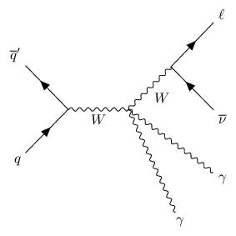
Tribosons
The «natural» probe for anomalies in quartic gauge couplings
Experimentally:
Clean final states → main backgrounds from non-prompt particles
3γ or 2γ1V: generally well established, good agreement with SM
2V1γ or 3V: tiny cross-sections, still mostly within LHC Run2 reach
Recent 5σ observations: ATLAS: WZγ,
CMS: WWγ

Slide 19
Dim-8
SMEFT:
the main
players
Here showing «transverse» operators (containing 4 gauge field tensors)
Not really updated, but shows basic comparisons
VBS and tribosons with γ or leptonic final states have similar sensitivities
Hadronic W/Z final states very hard considering a SM scenario, butin fact dominating SMEFT dim-8 sensitivity (larger cross-sections and relatively clean signals at high invariant masses)

Slide 20
2. Triple and quartic Higgs
couplings
2A. gg → HH production
2B. Vector-boson fusion HH
2c. VHH tribosons

Slide 21
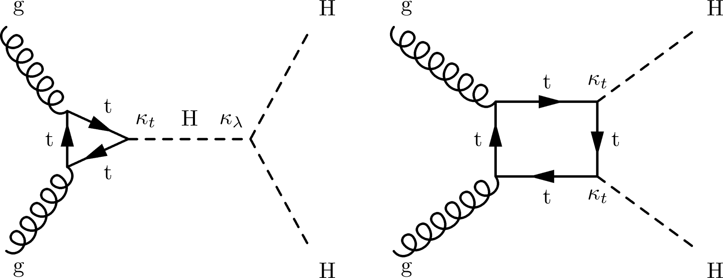
gg → HH production
In the SM:
amplitude from two contributions
known with «high» precision (NNLO QCD): σ_{13 TeV} = 31.1^{+6%}_{−23%} fb (scale+m_{t})
Beyond the SM:
Only the left diagram sensitive to NP in the Higgs potential λ
N.B.: anomalous Yukawa Htt couplings could modify both
Experimentally: need to combine many final states
«Higgs hunter’s rule»: larger BRs correspond to lower purity and viceversa

Slide 22
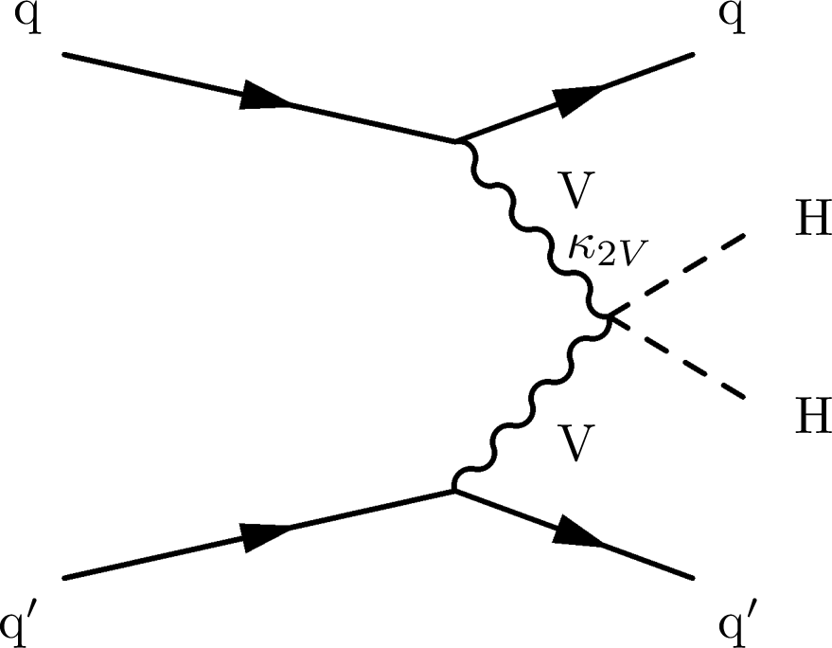
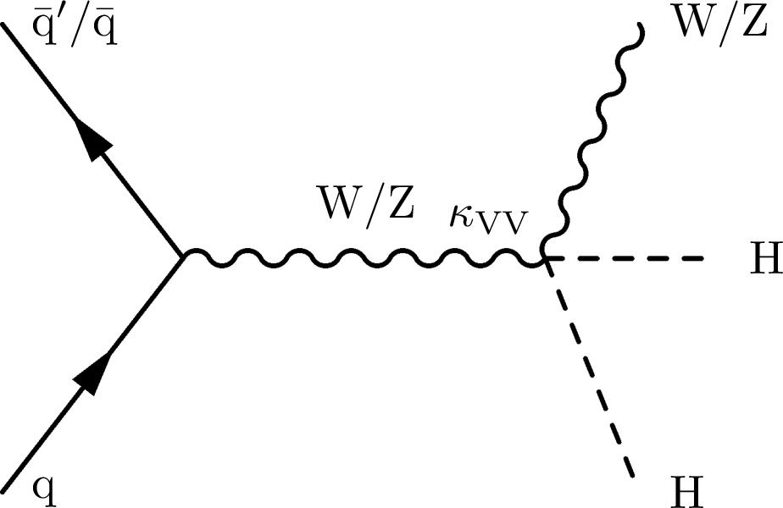
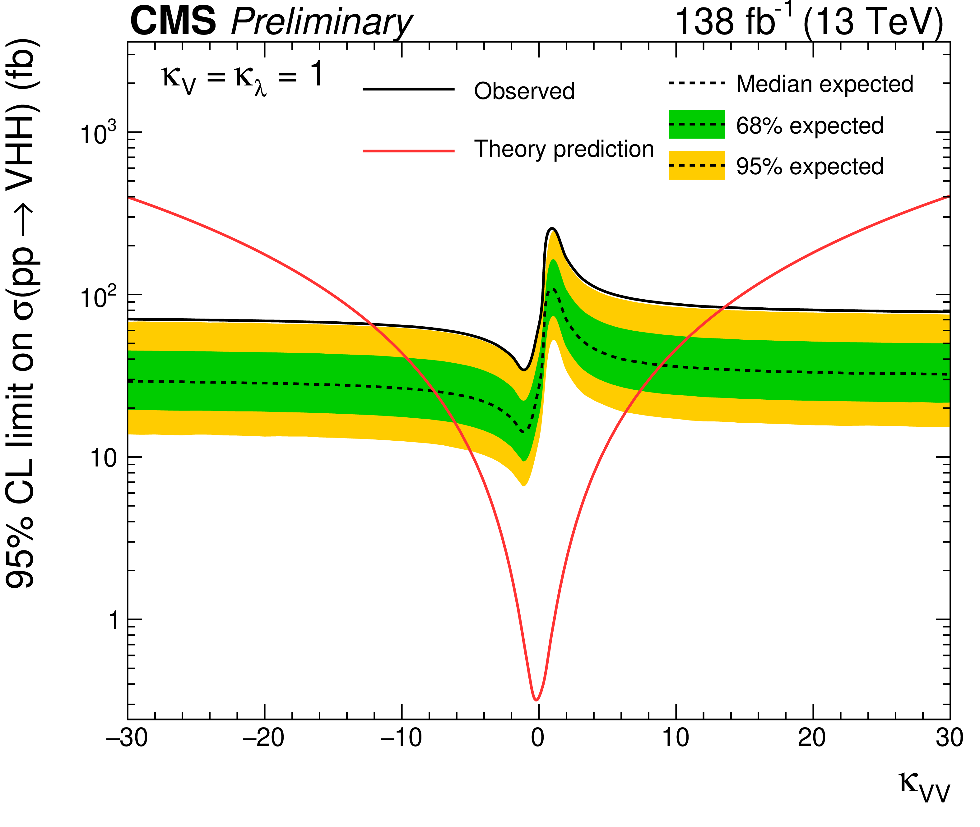
VBF HH and VHH
Parallel of VBS and tribosons in the Higgs sector (likewise: HH ↔ dibosons)
Diagrams (also) involve a different, yet unexplored, coupling (VVHH) → in the SM fixed to c_{VHH}/v
σ_{13 TeV} (VBF HH) = 1.73 fb
σ_{13 TeV} (VBF HH) = 0.87 fb
(percent-level uncertainties)
Experimentally: observation hard even for HL-LHC
basically only bb final states matter
However, SM values coming from extremely fine-tuned cancellations
Even a small modification of VVHH coupling leads to huge changes in σ

Slide 23
Beyond SM and SMEFT
Beyond SM effects parameterized as a mutiplicative modifier of the λ SM parameter: κ_{λ}
... back to LEP times? No, for purely scalar operators, descriptions in terms of Wilson coefficients or modifiers are equivalent:
For HHVV (just for consistency?) beyond SM effects also parameterized as a modifier of the SM coupling: κ_{2V}
This is NOT equivalent to a SMEFT approach (only true for some concrete models)! For combination with other anomalous quartic couplings, need a proper dimension-8 parameterization
κ_{λ}
A. Cappati et al., JHEP 09 (2022) 038

Slide 24
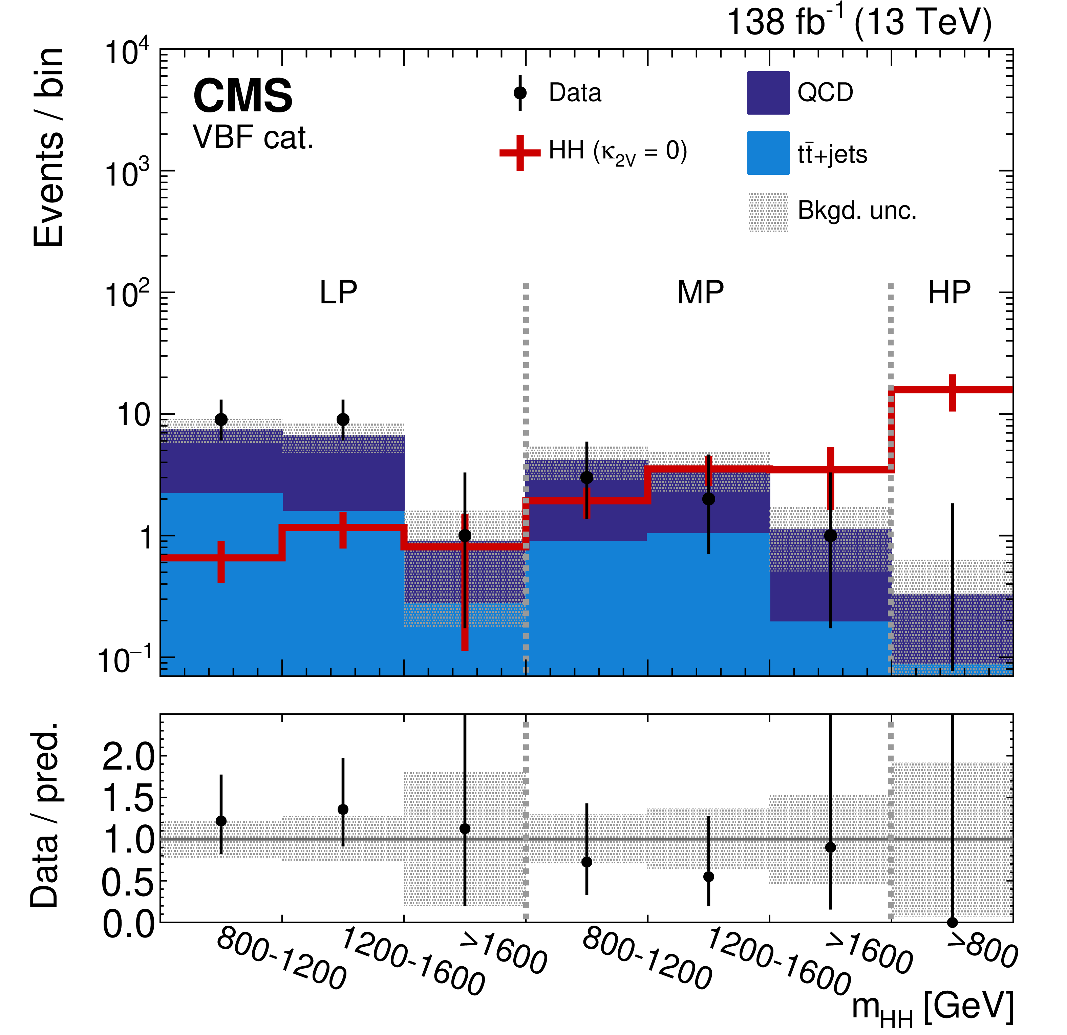
A recent CMS analysis
CMS coll.,
PRL 131, 041803
Use 4b, boosted final state (p_{T,H} > 300 GeV)
Each Higgs boson decay produces a large-radius jet whose constituents’ 4-momenta add up to m_{H}
Large rejection factor of multijet events
Graph-neural network reconstruction algorithm (PNet)
Optimizes b-tagging performances and jet mass resolution
Events analysed in categories
VBF HH (2 more jets with large m_{jj} and Δη_{jj}) or ggHH
b-tagging purity
Limits @ 95% CL
-9.9 < κ_{λ} < 16.9
0.62 < κ_{2V} < 1.41

Slide 25
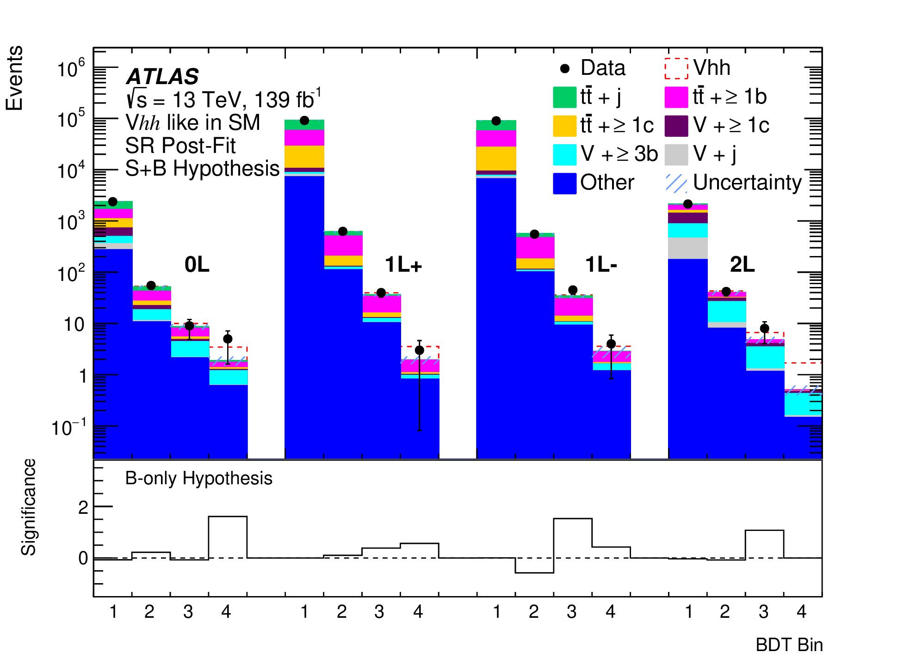
A recent ATLAS analysis
ATLAS coll.,
EPJ C 83, 519
VHH: Use 4b final state + W/Z selection
«0L»: target Z → νν, require very large p_{T,miss}
«1L»: target W → lν, require tight e or μ
«2L»: target Z → ll, require 2e or 2μ with mass close to m_{Z}
Boosted decision trees trained based on:
FSR corrected masses of b-jet pairs
B-tagging scores of b-jets
Number and energy of all jets in the event
Limits @ 95% CL
-34 < κ_{λ} < 33
-8.6 < κ_{2V} < 10.0

Slide 26
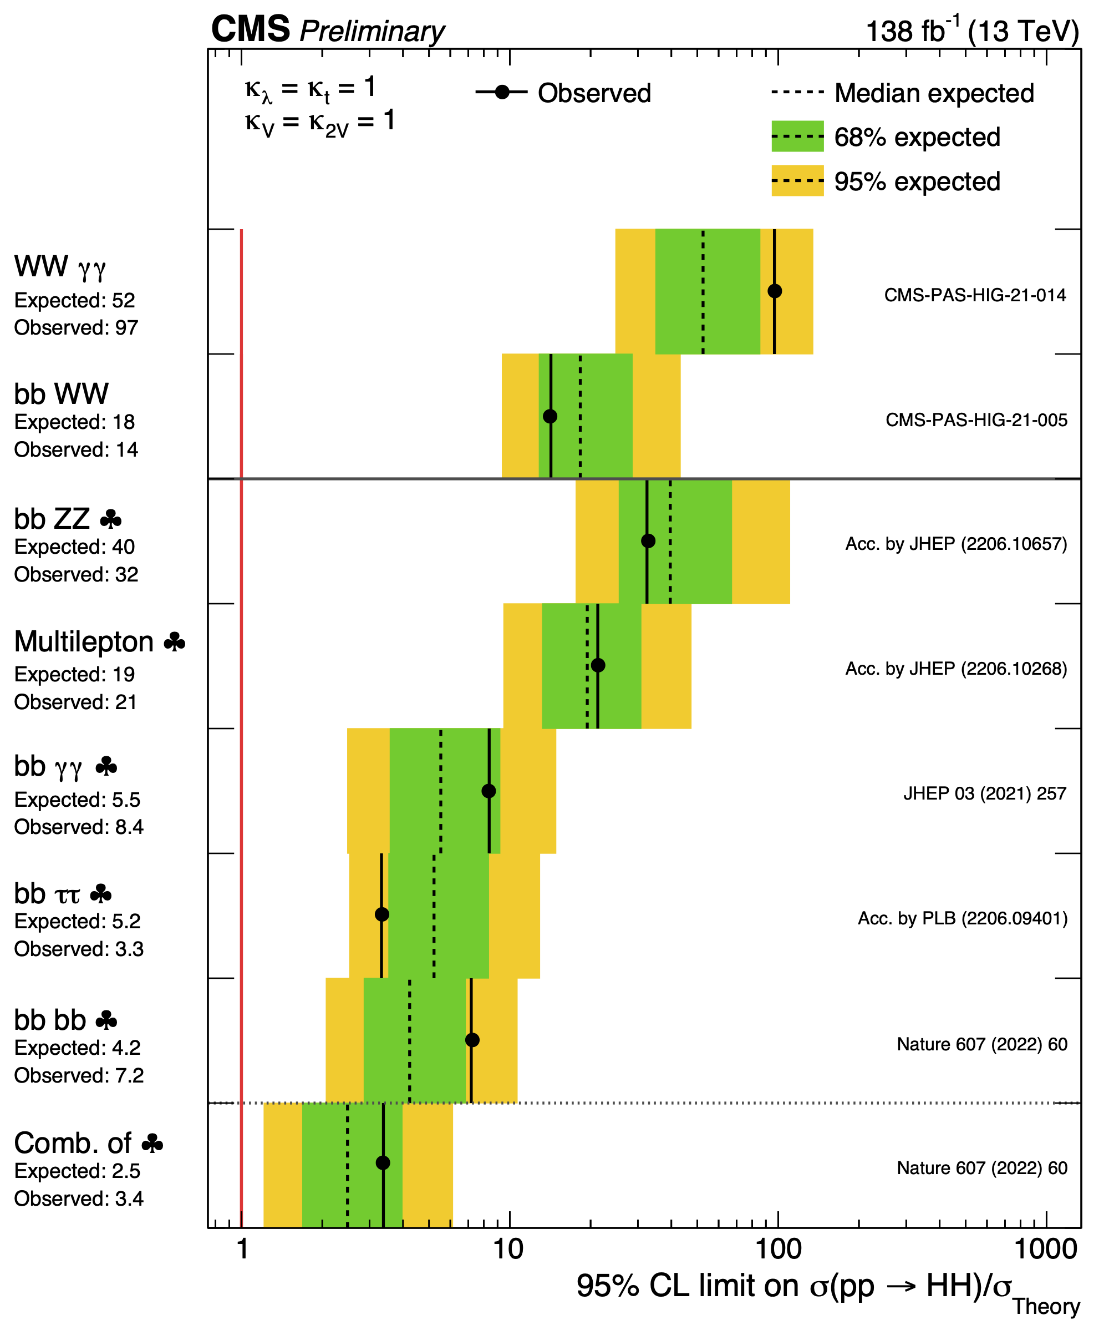
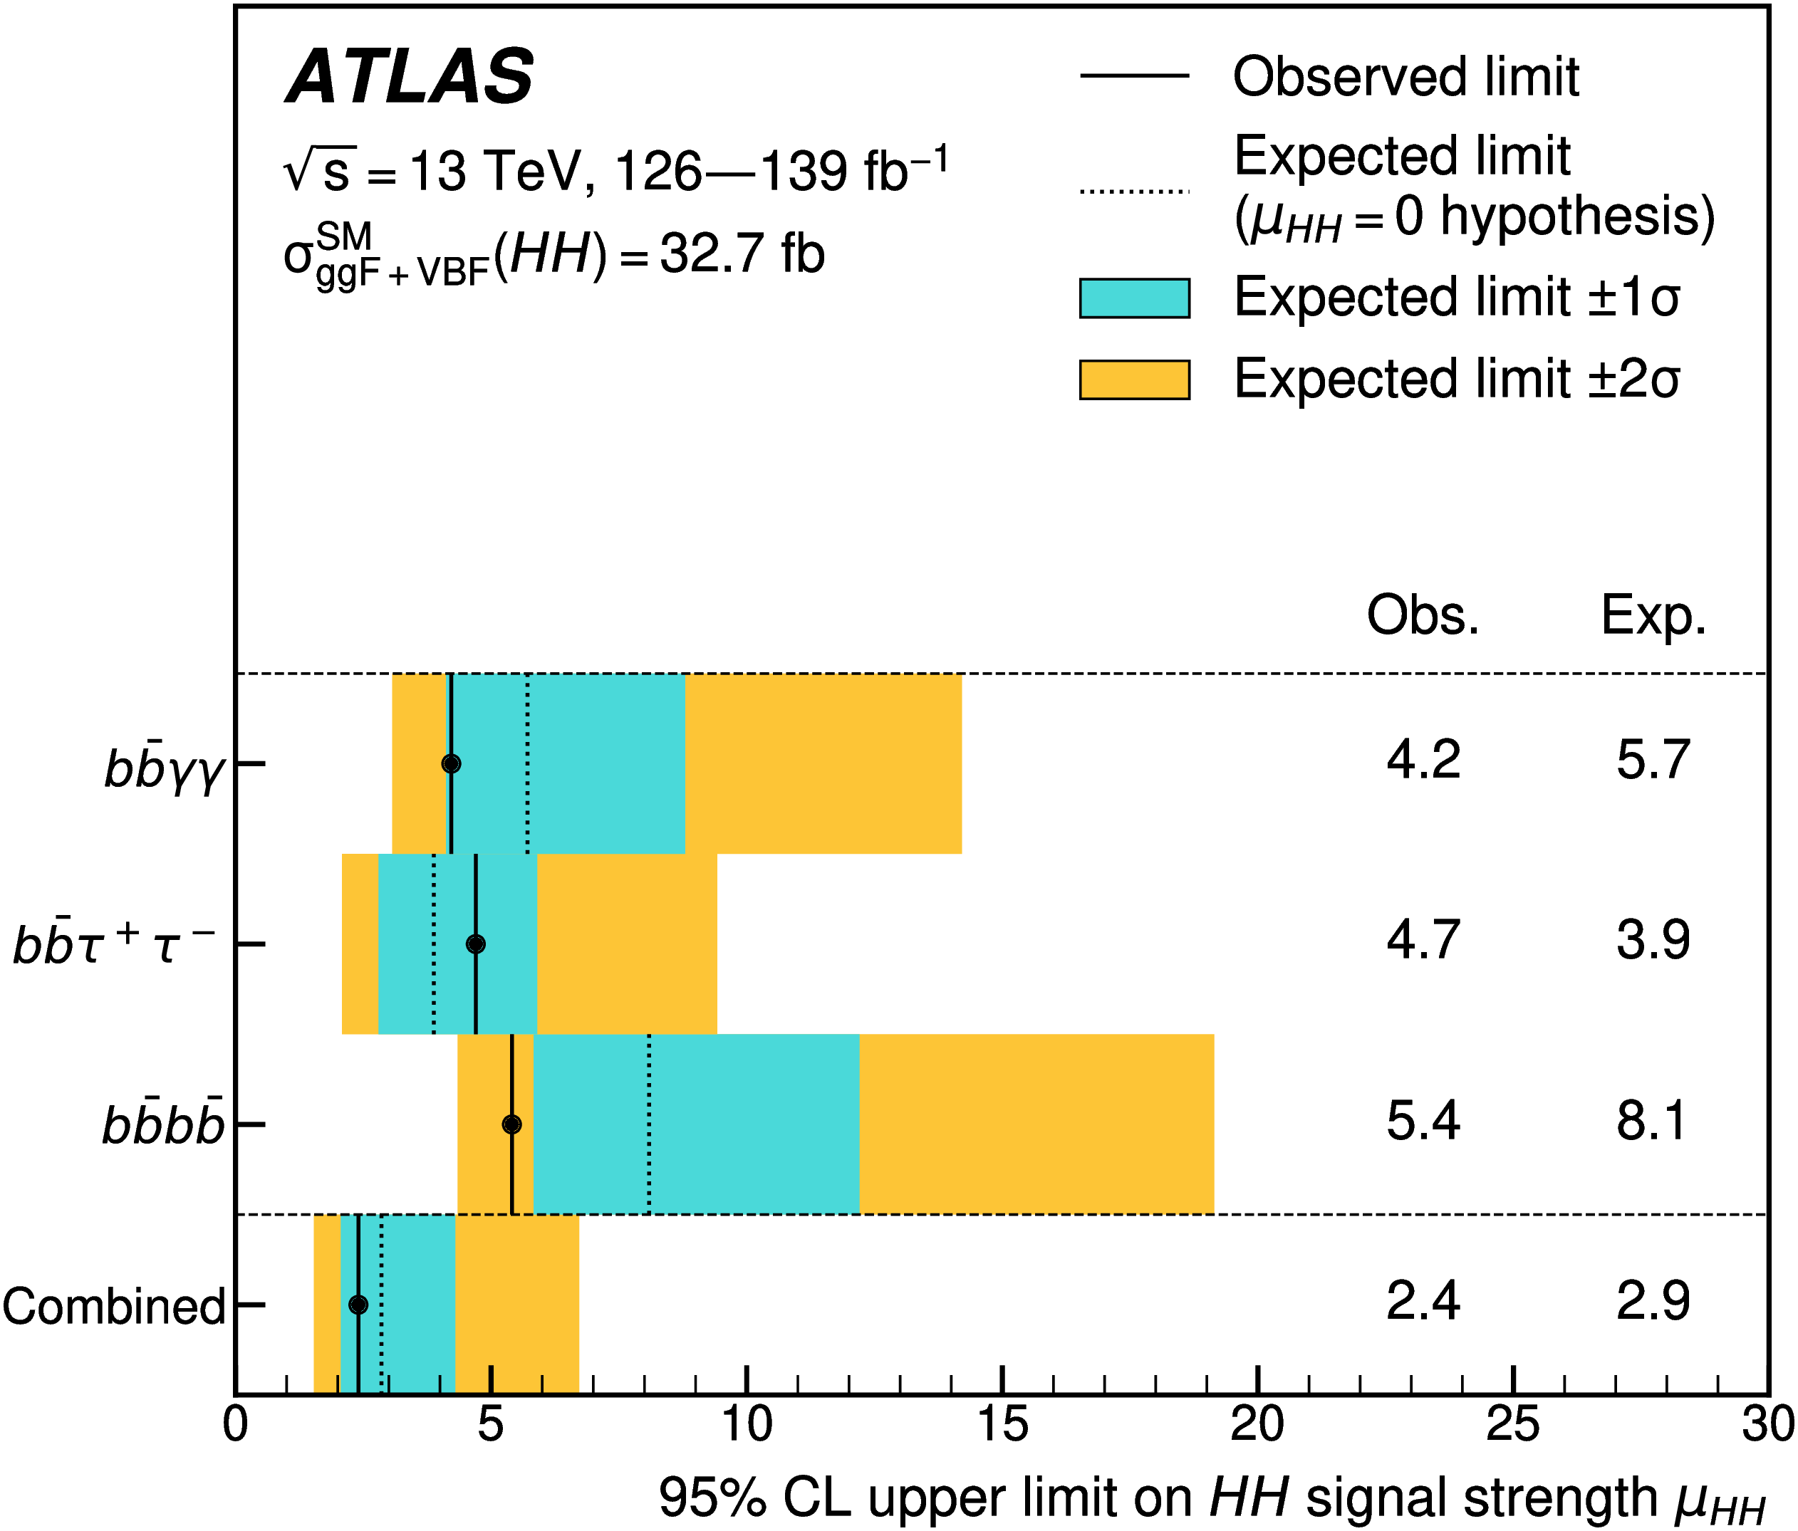
Cross-section limit summary

Slide 27
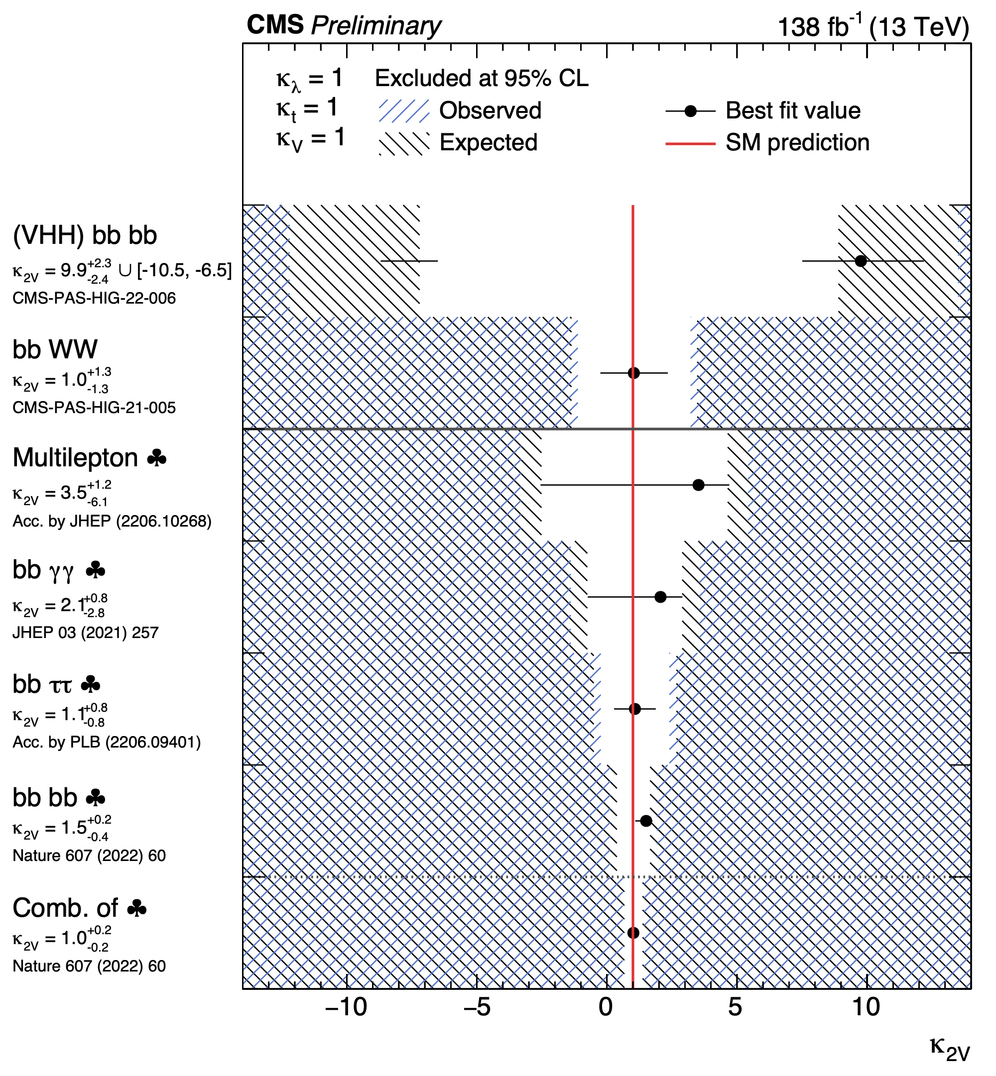
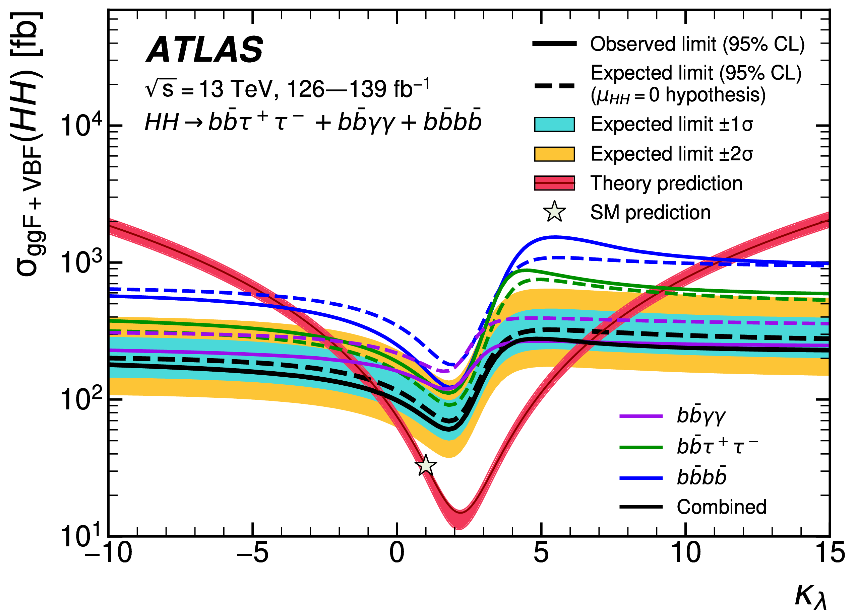
SM modifier limit summary
@ 95% CL
-0.4 < κ_{λ} < 6.6
κ_{2V} = o excluded

Slide 28
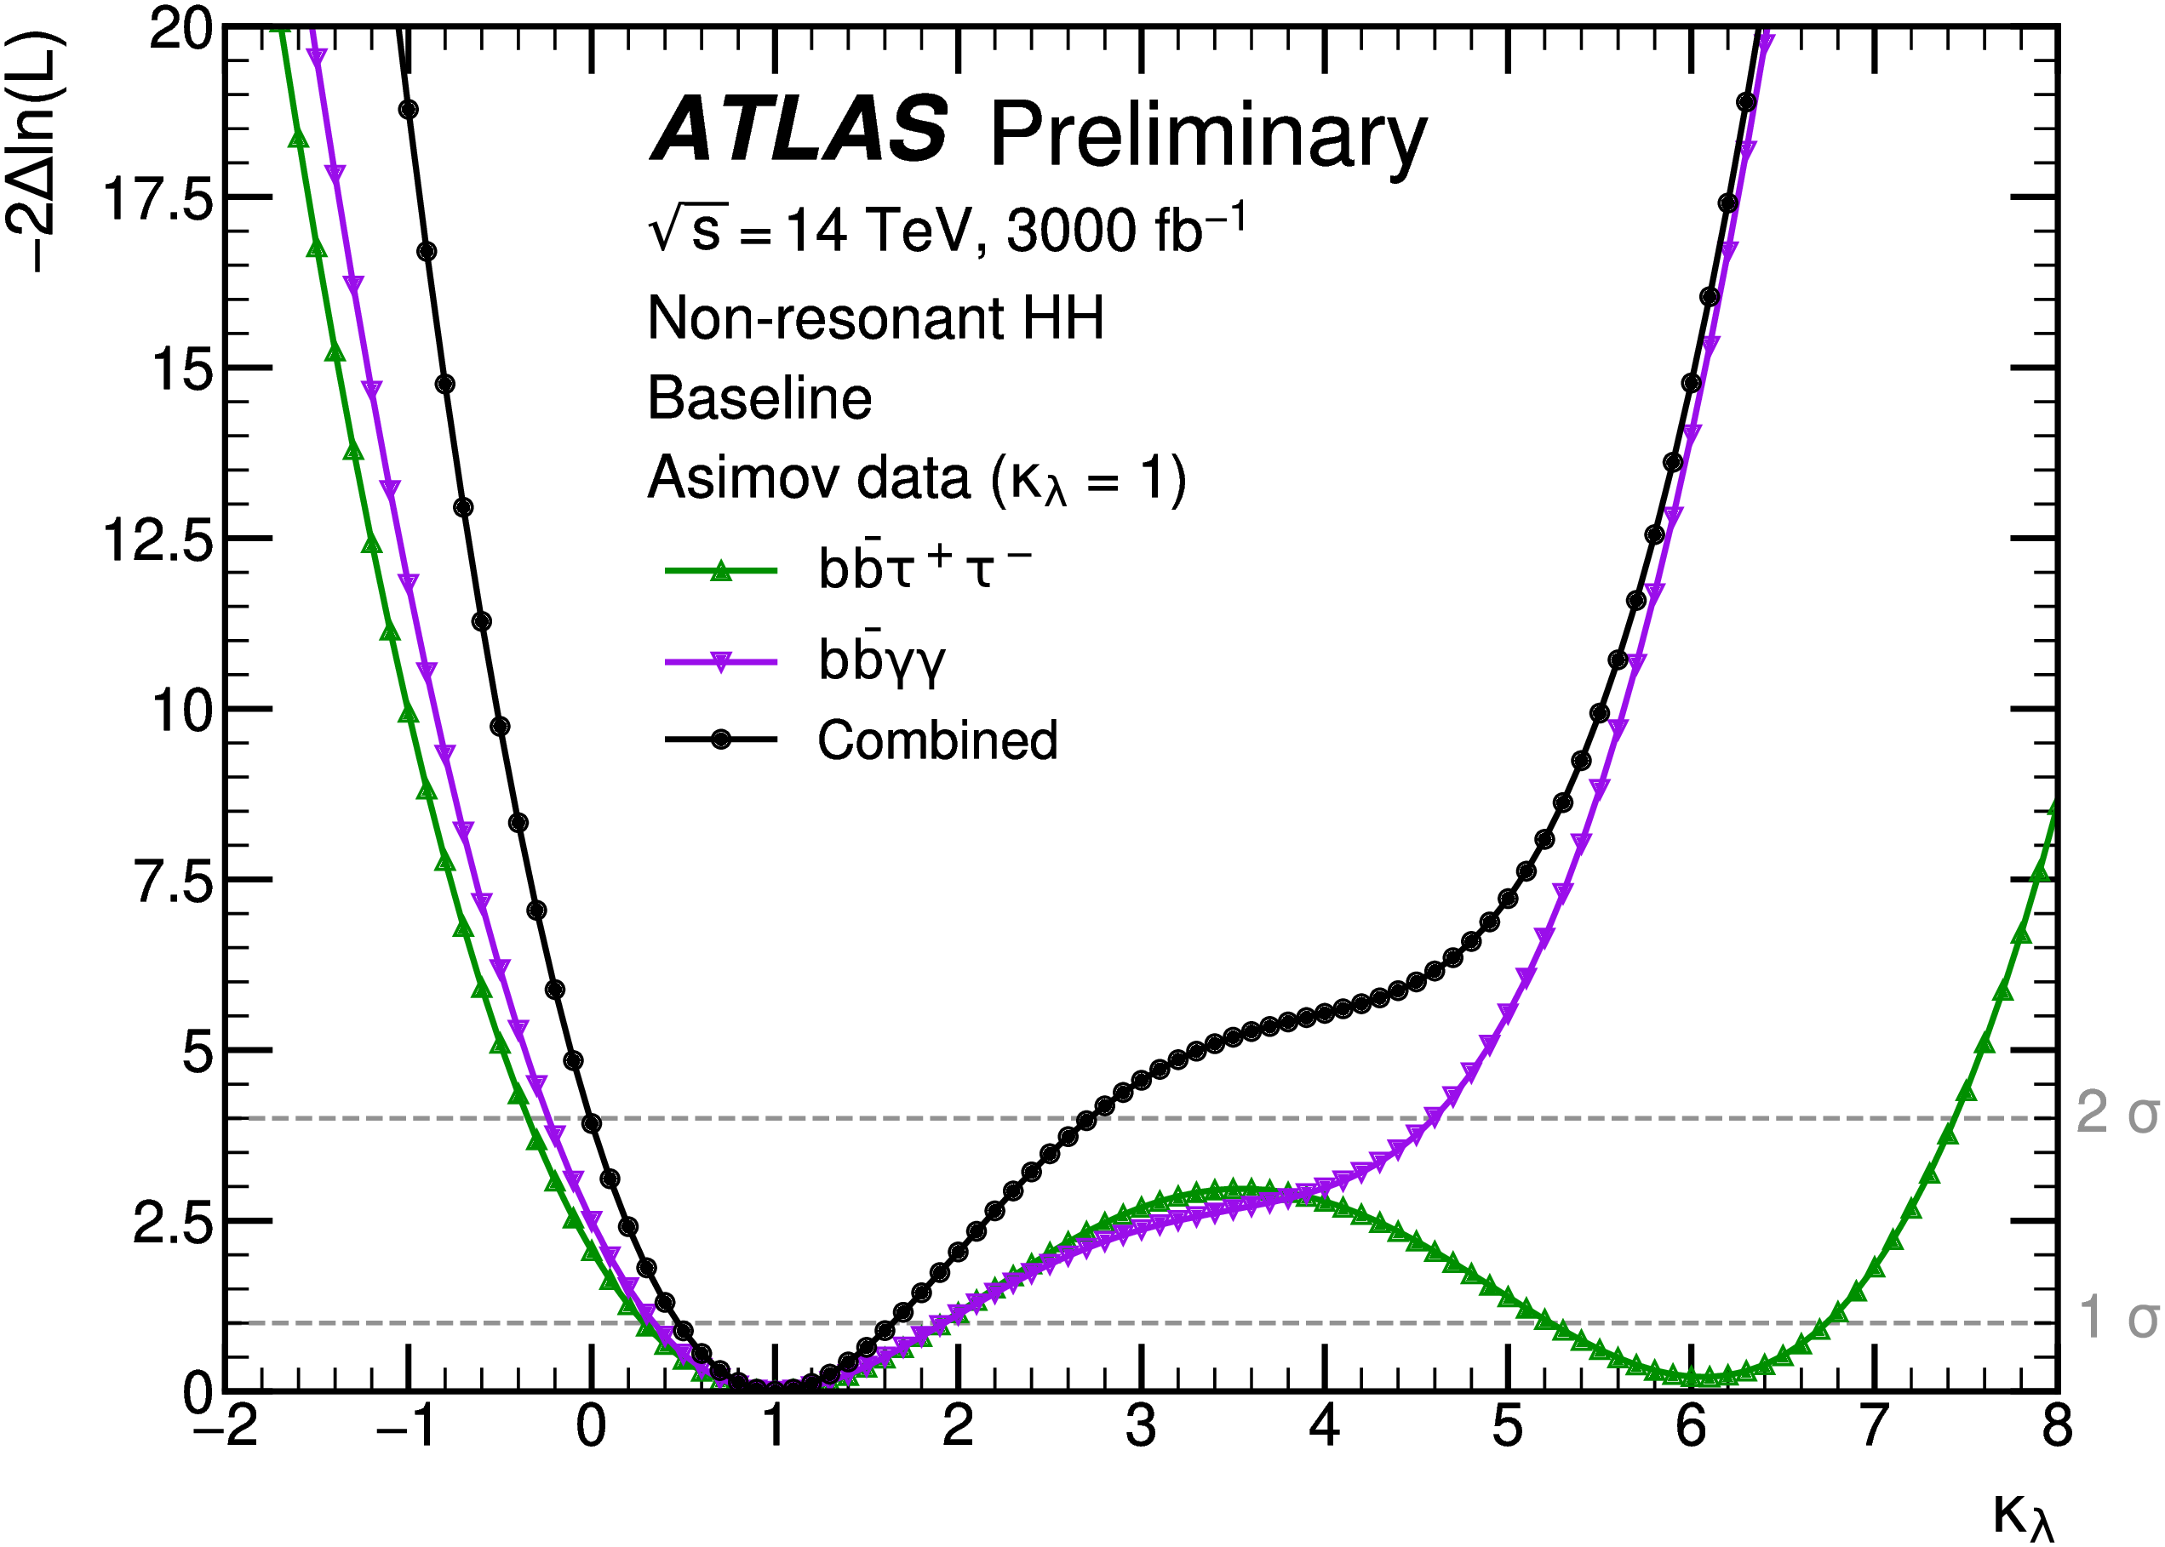
HL-LHC perspectives
Combination of the two most sensitive search channels (bbττ, bbγγ)
Expected significance of gg → HH signal: 3.2-4.6σ
Assess contribution of less sensitive but more pile-up robust channels (WWγγ, ττγγ)
0.22σ significance → room for improvement?
More physics channels can be explored:
New decay modes, e.g. bb4l (σ x BR = o(ab) but pileup-insensitive)
New production modes, e.g. ttHH

Slide 29
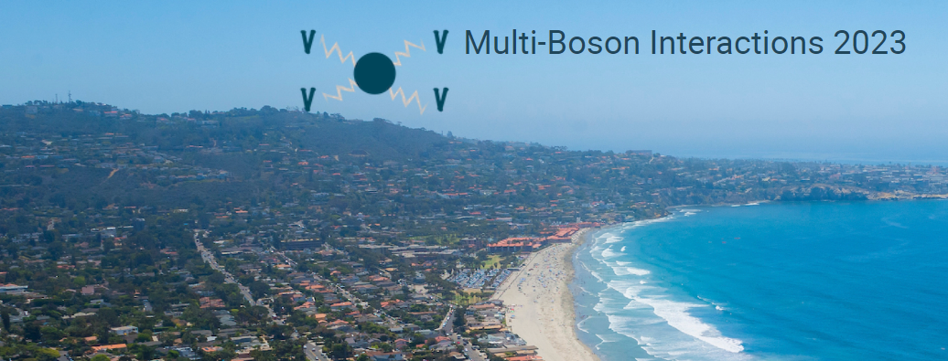
Some ad to conclude...
«Multi-boson Interactions» international workshop
2024 edition to be hosted by France
University of Toulouse, end of September
Stay tuned... and hope to see you there!

