Slide 1
Data Lake : une solution de stockage distribué pour CTA
Frederic GILLARDO LAPP/CNRS
15èmes Journées Informatiques IN2P3/IRFU

Slide 2
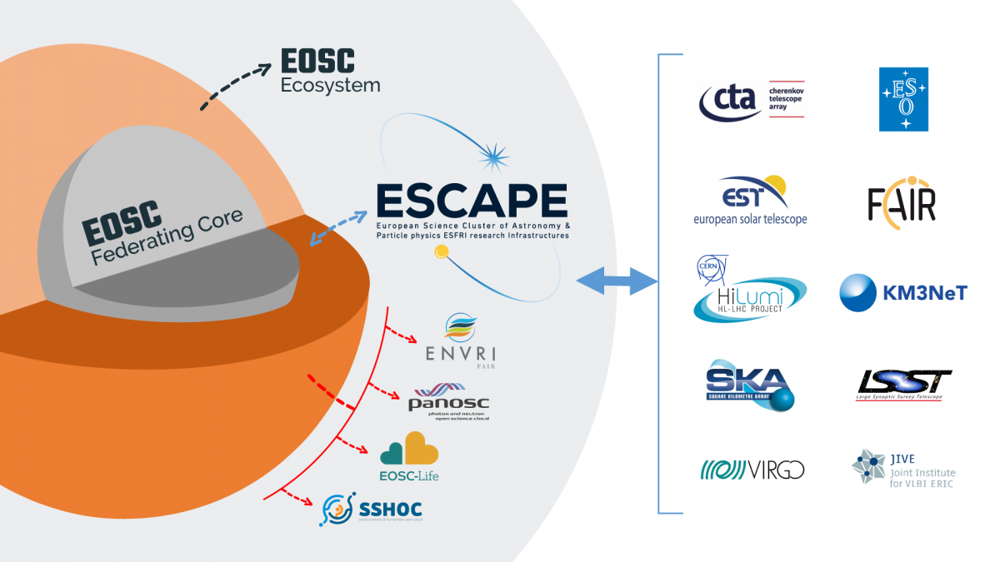
EU’s projects

Slide 3
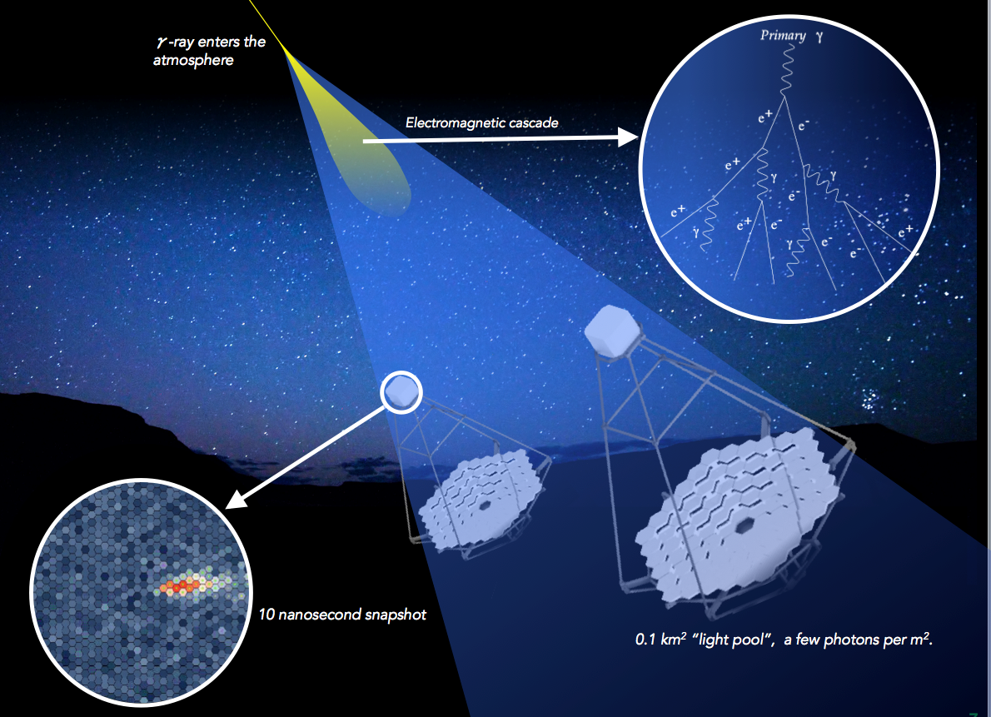
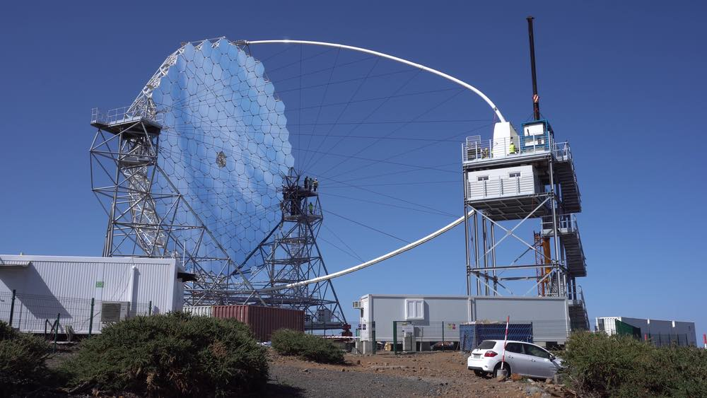
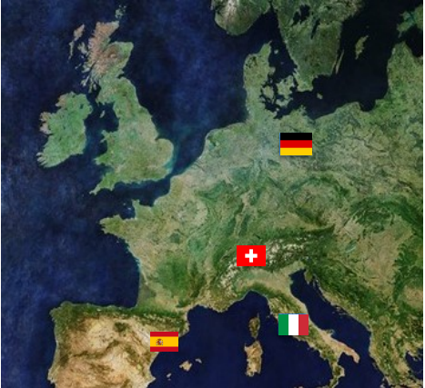
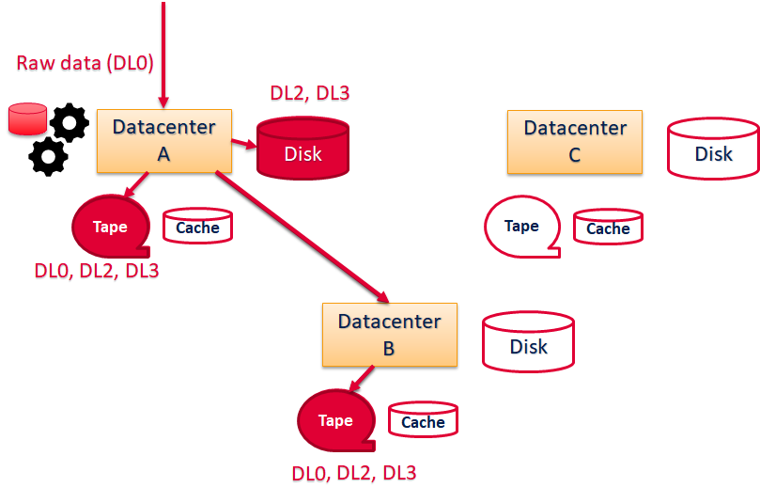
CTA use case
« ON SITE » :
North Site at La Palma (Canary Islands
Spain)
South Site at Paranal (ESO, Chile)
« OFF-SITE » :
CSCS, Lugano in Switzerland
PIC, Barcelona in Spain
DESY, Zeuthen in Germany
INAF/INFN, Frascati in Italy
30 years operation
1 year Embargo Period

Slide 4
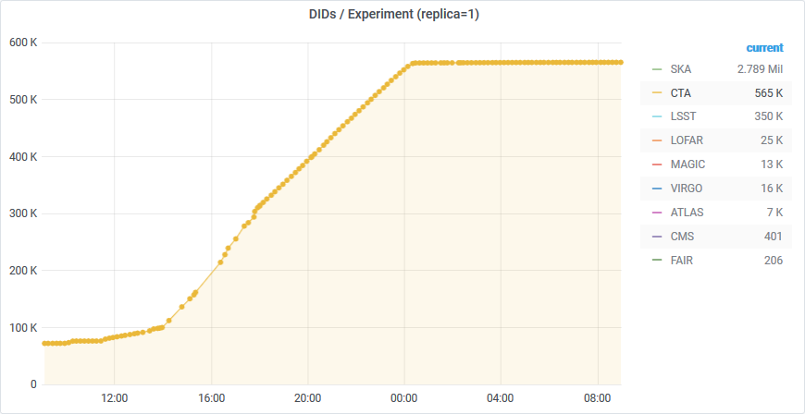
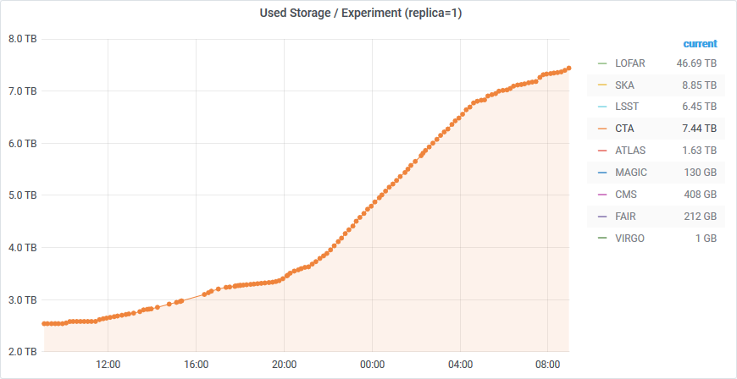
EU projects
From ESCAPE :
ESCAPE Data Lake: a scalable federated data infrastructure as the basis of an open access data service for the ESFRI projects within ESCAPE and concerned by Exabyte-scale data volumes.
SIG Meta Data : https://rucio.github.io/documentation/sig_metadata/
ESCAPE provides support for a converging solution:
Reduced cost for development, testing, and maintenance
Simplified migration path

Slide 5
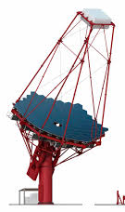
Archive / Data Lake
OFF SITE
Data Orchestration :
New file triggers Rucio.
Make a copy of these files on an « OFF-SITE ».
Make a second copy of these files on a second « OFF-SITE ».
Validates the presence of two copies and deletes the « ON-SITE » base files.
DESY
INAF
1
2
4
3
PIC
CSCS
3
1
4
ON SITE
2

Slide 6
DIRAC
Tape
Checks for unprocessed files.
Launches processes from DL0.
Backs up files from DL0 to DL3 on tape or disk.
Algorithms will evolve and improve over time. It will always be possible to re-process files.
DL0
DESY
INAF
1
DL1
RUCIO FILE CATALOG
DL2
DL3
2
DL0
Calibration
2
3
DL1
DL1
DL1
Tape
PIC
CSCS
Stereoscopie
1
3
DL2
Algorithms
Disk
DL3
Algorithms
ON SITE
Science
DL6

Slide 7
Path to the standardization of CTA’s software
File storage system
dpm
Try to use industry software and standard
Workload management
software distribution
DIRAC File Catalog

Slide 9
Back up
in yellow : methods implemented
in red are the methods required by CTA that are missing from the Rucio catalog implementation
READ_METHODS
"isFile",
"getFileMetadata",
"getReplicas",
"getReplicaStatus",
"getFileSize",
"isDirectory",
"getDirectoryReplicas",
"listDirectory",
"getDirectoryMetadata",
"getDirectorySize",
"getDirectoryContents",
"getLFNForPFN",
"getLFNForGUID",
"findFilesByMetadata",
"getMetadataFields",
"findDirectoriesByMetadata",
"getReplicasByMetadata",
"findFilesByMetadataDetailed",
"findFilesByMetadataWeb",
"getCompatibleMetadata",
"getMetadataSet",
"getDatasets",
"getFileDescendents",
"getFileAncestors",
"getDirectoryUserMetadata",
"getFileUserMetadata",
"checkDataset",
"getDatasetParameters",
"getDatasetFiles",
"getDatasetAnnotation",
"getSEDump",
Science

Slide 10
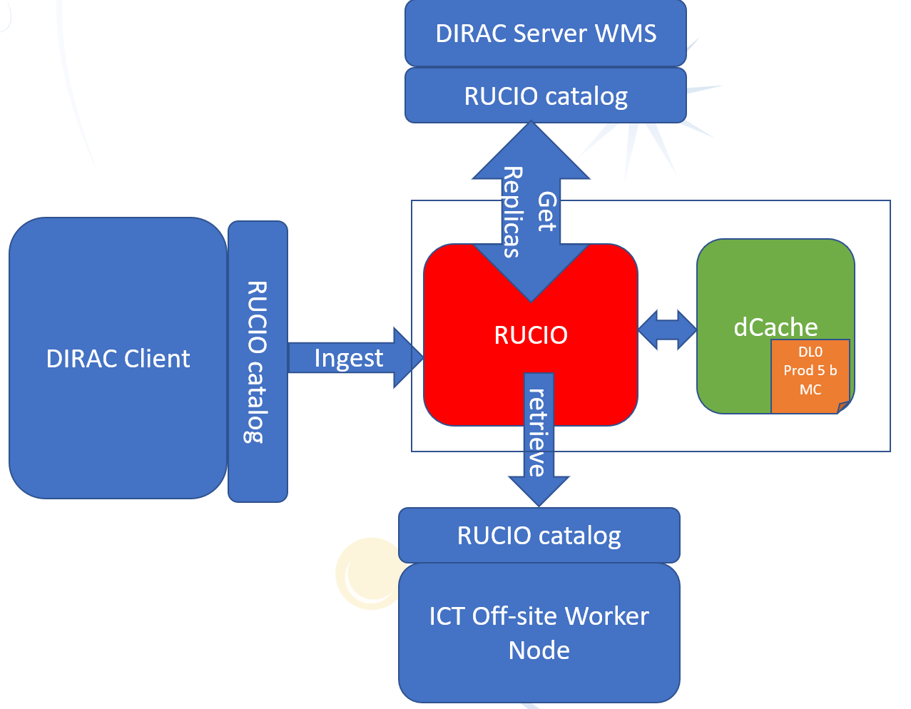
Back up
https://docs.google.com/document/d/1tXLjl9D0yrE7Kgacs5v3eXspXi6LhTzAX0F4JZGl5CM/edit
https://docs.google.com/document/d/16jE-tpU1jdF97pNA8K7-oXJxbAVb52naipTTaNPDE1w/edit#
Science

