Slide 1
Laser spectroscopy: from S3-LEB to DESIR
Sarina Geldhof
for the S3-LEB collaboration

Slide 2
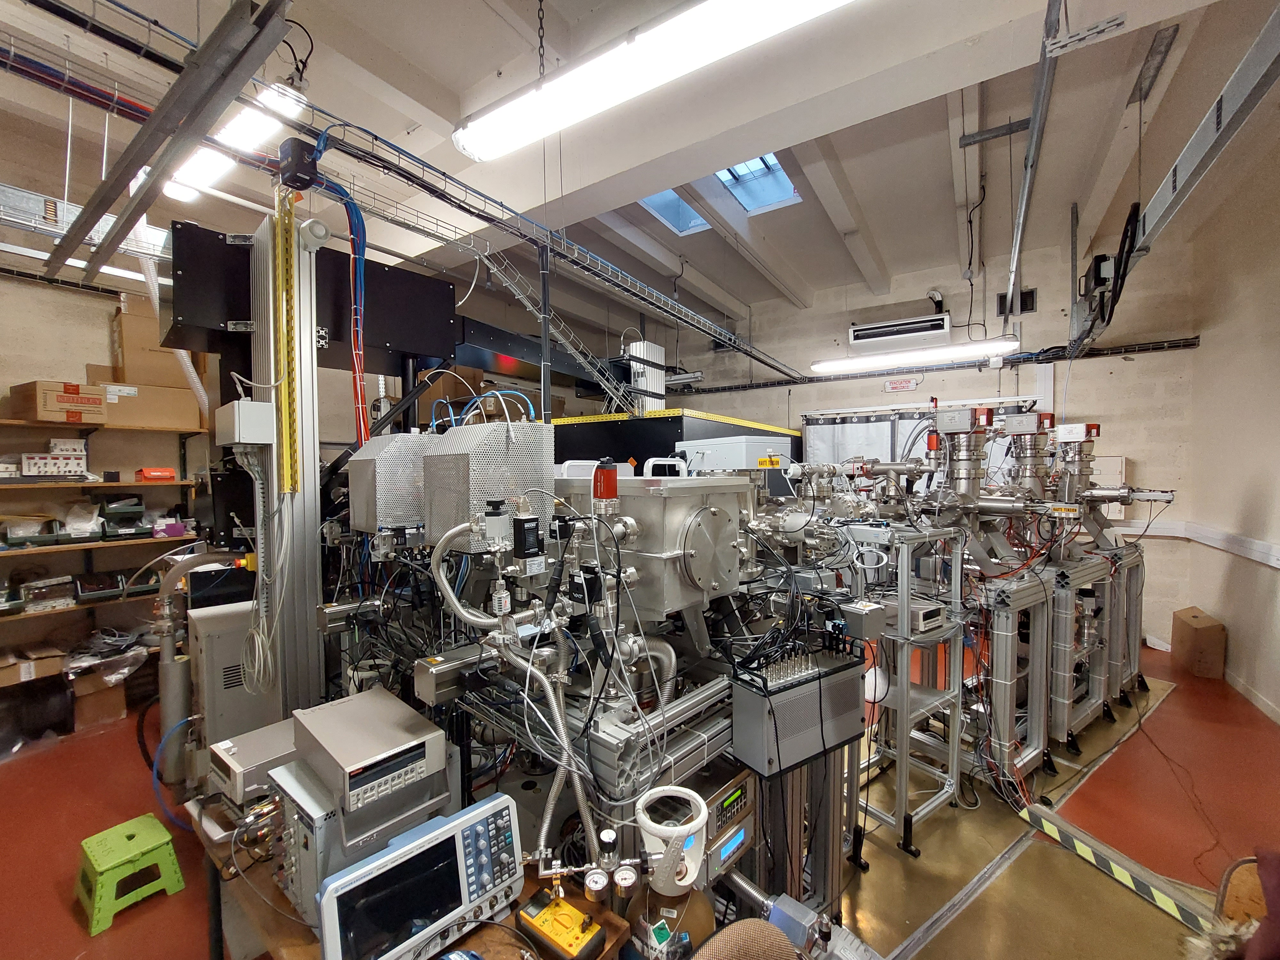
Outline
S3-LEB/GISELE setup and laser system
  Measurements at GISELE
  Er scheme investigation
S3-LEB scientific programme
  N=Z region
  (Super)heavy region
  Neutron-deficient (heavy-)medium mass region
Synergy with DESIR
28/02/2024
DESIR Workshop

Slide 3
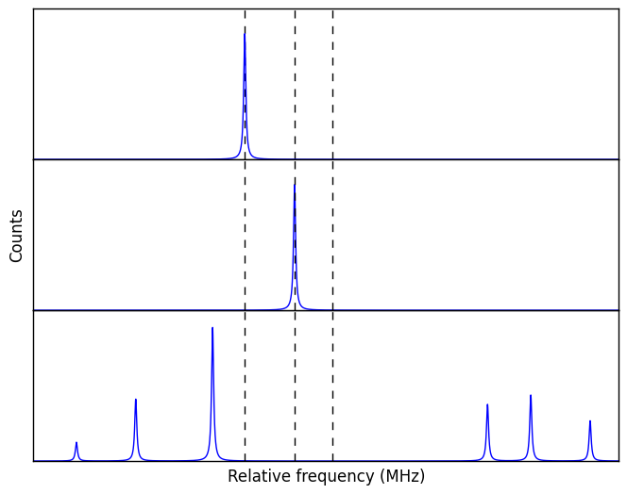

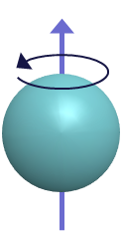
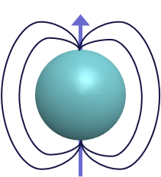

Atomic spectra
Nuclear configuration/ shell model states
Isotope 1
I=0
Isotope shifts
  Changes in rms charge radii
Hyperfine structures
  Nuclear spin
  Magnetic dipole moment
  Electric quadrupole moment
Identification of nuclear states
Isotope 2
I=0
centroid
Isotope 3
I>1/2
$$ν_{0}$$
Static and dynamic deformation
$ν_{F}=ν_{0}+Af\left(I,J,F\right)+Bg\left(I,J,F\right)$ $A=μ\frac{B_{e}}{\left|IJ\right|} B=eQ_{s}\left\langle \frac{∂^{2}V}{∂z^{2}}\right\rangle$
Notes:
Illustration

Slide 4
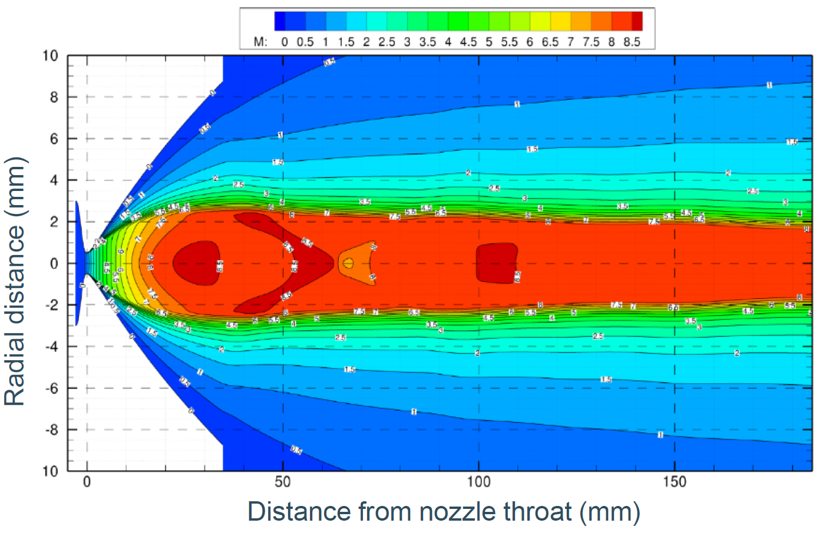
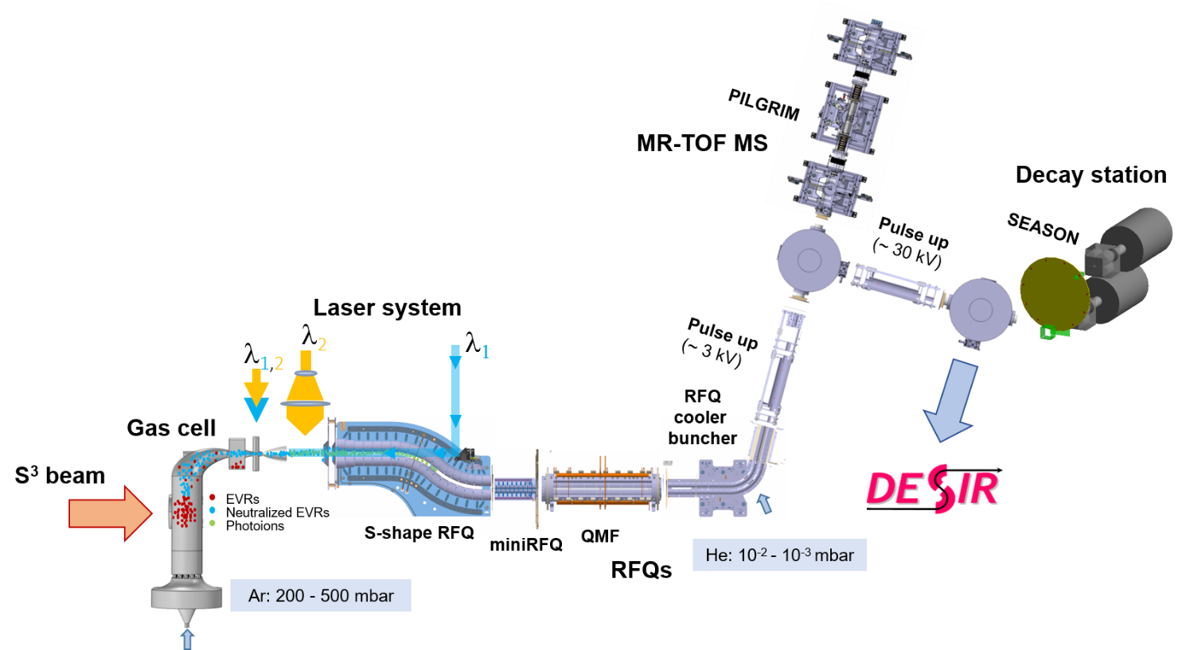
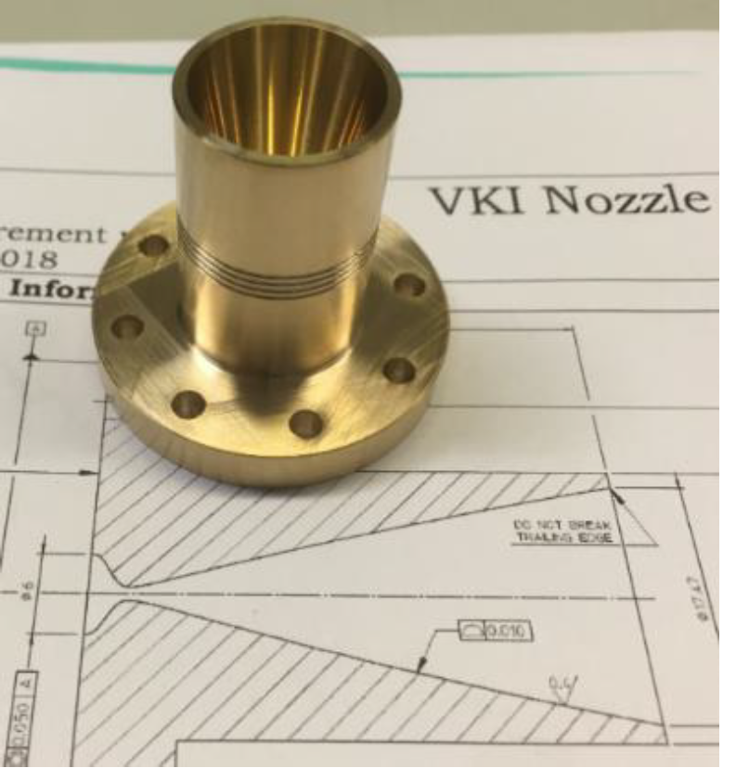
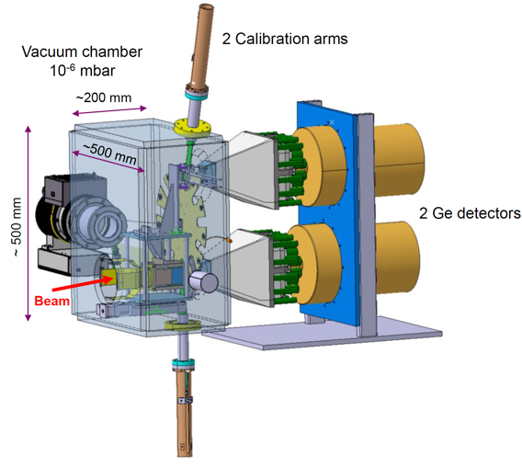
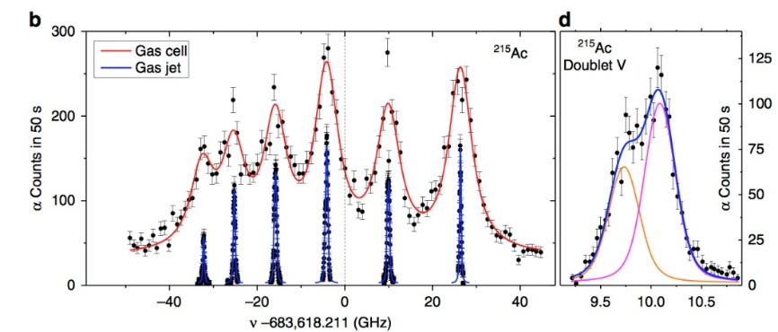
S³ Low Energy Branch (S³-LEB)
2 Ge detectors
Beam
SEASON decay station

Slide 5
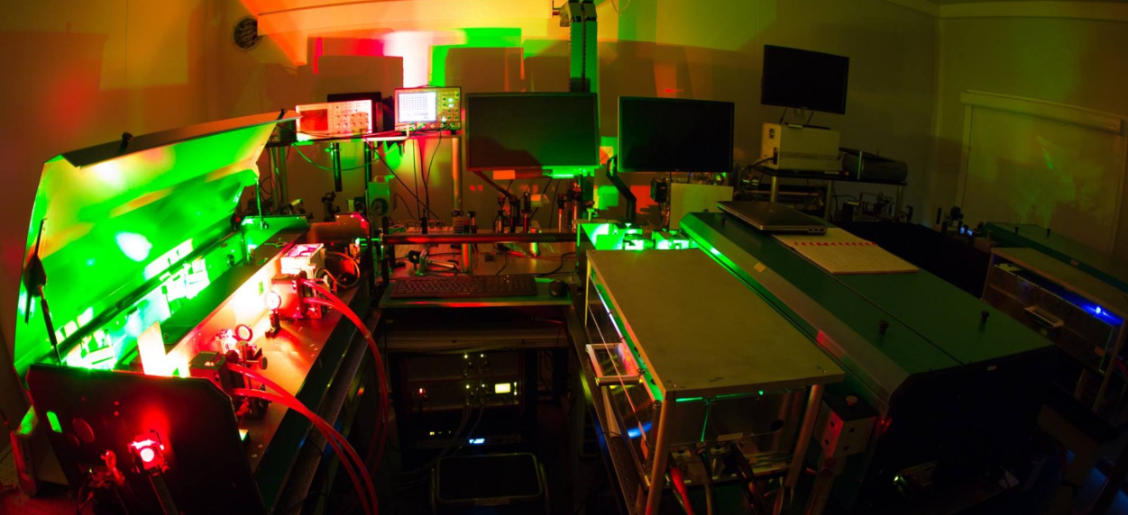
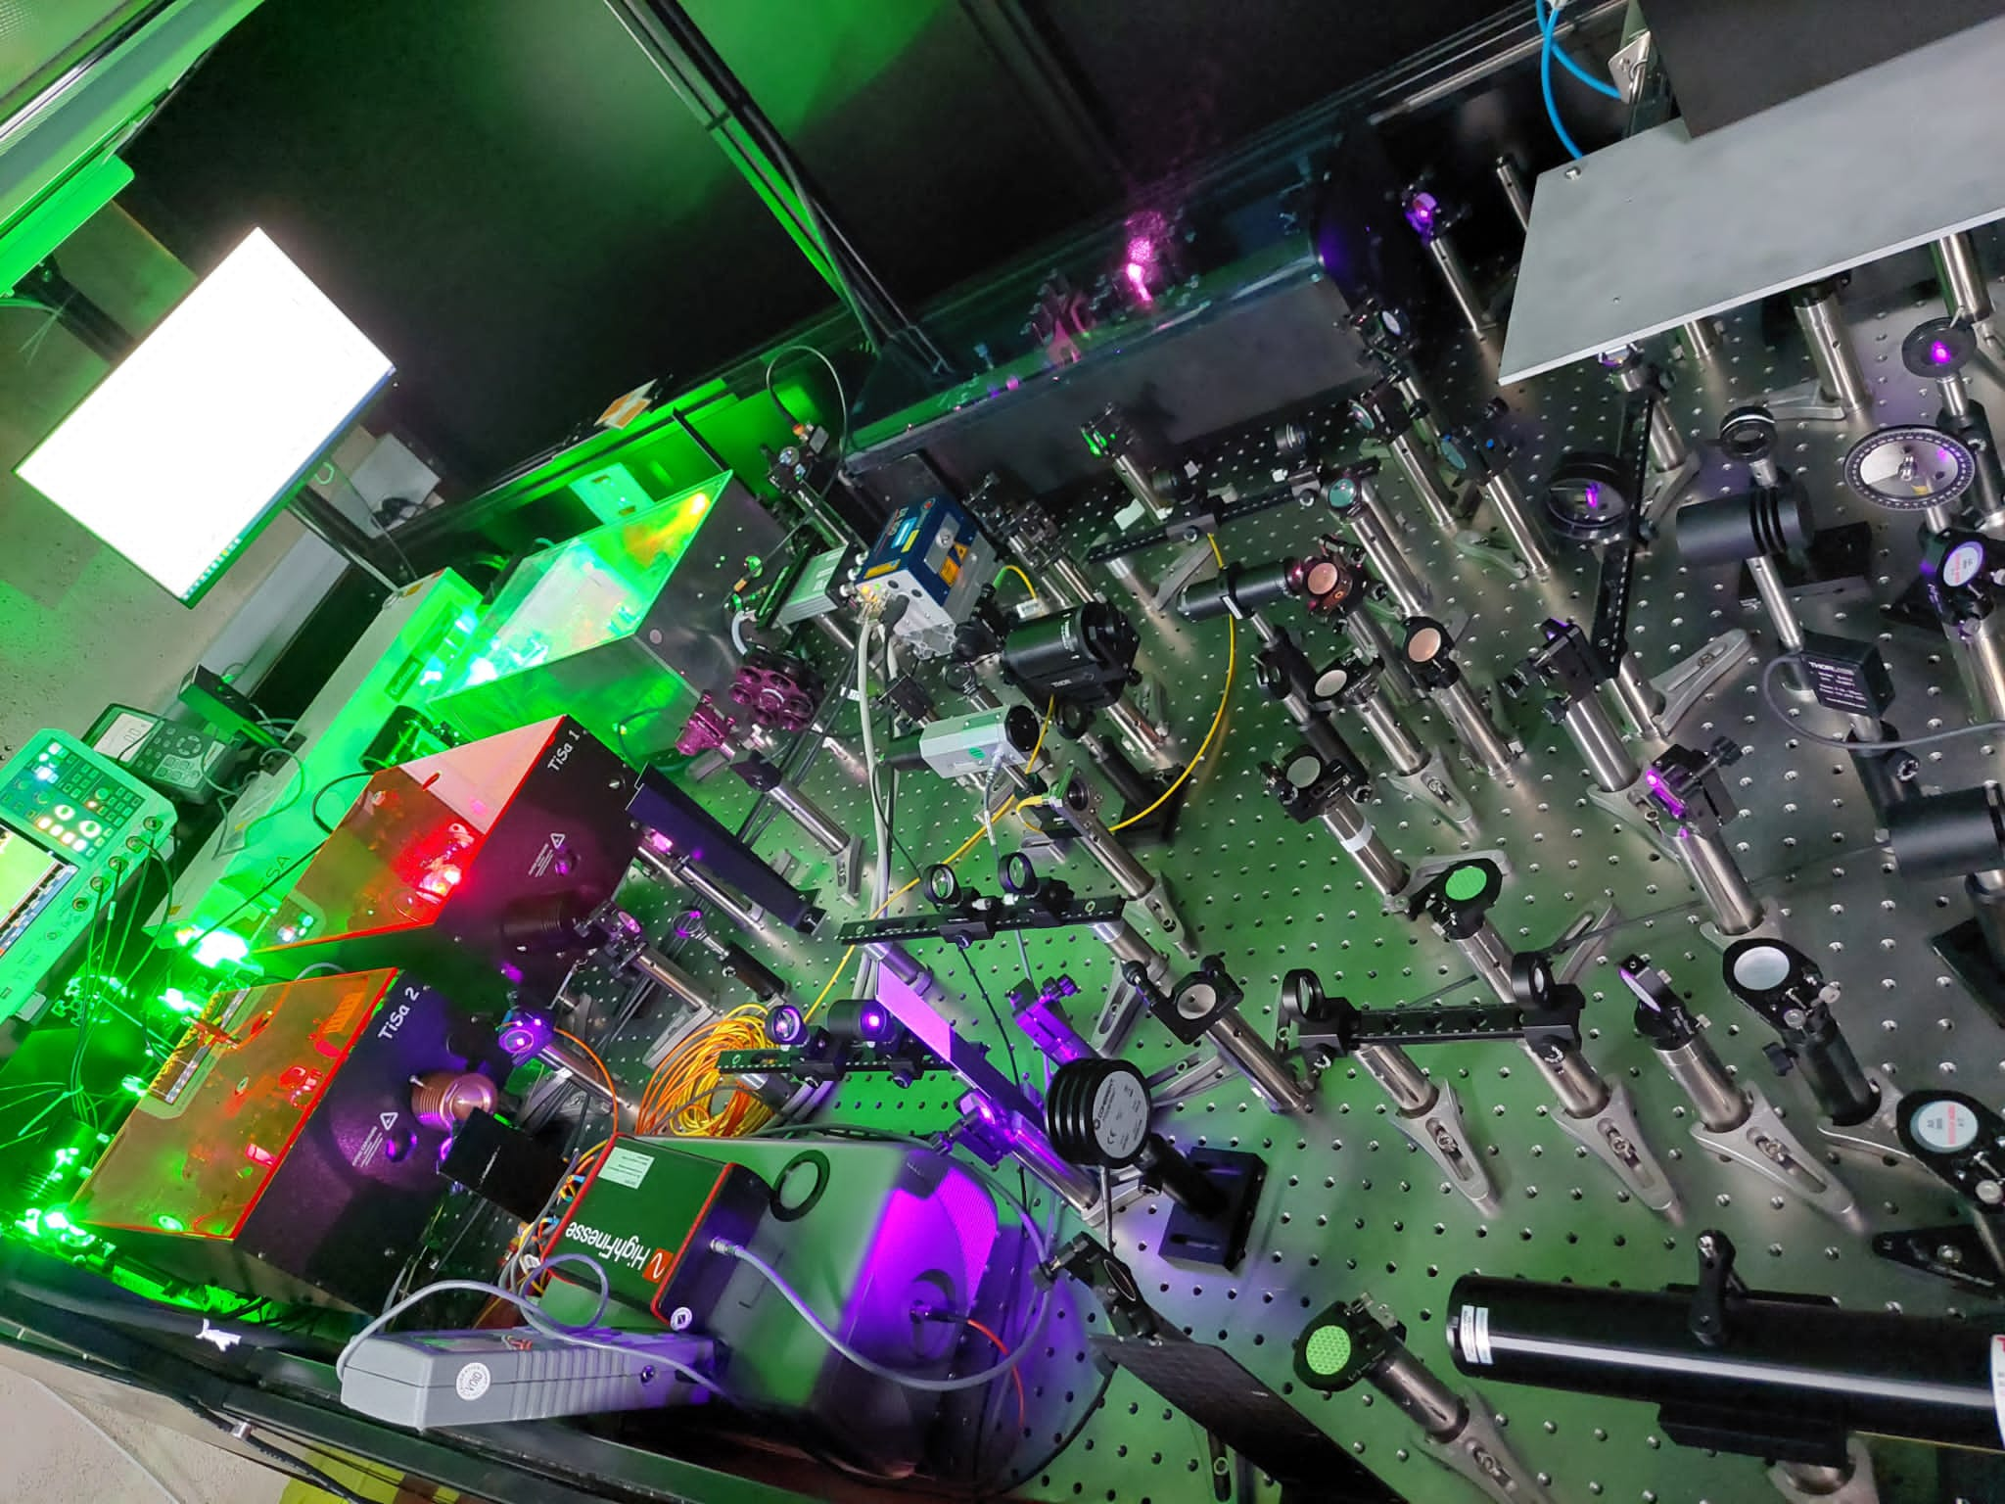
Laser system
Commissioning done with temporary Ti:Sapphire laser setup
  1 dual-etalon & 1 ‘standard’ z-cavity
  Old injection-locked cavity
S³ Ti:Sapphire laser room being installed
  New dual-head pump laser + existing pump laser
  Matisse TS arriving this year
  New ABU under study
S³ dye laser room under study (chemical safety requirements), dye laser system operational at KU Leuven

Slide 6
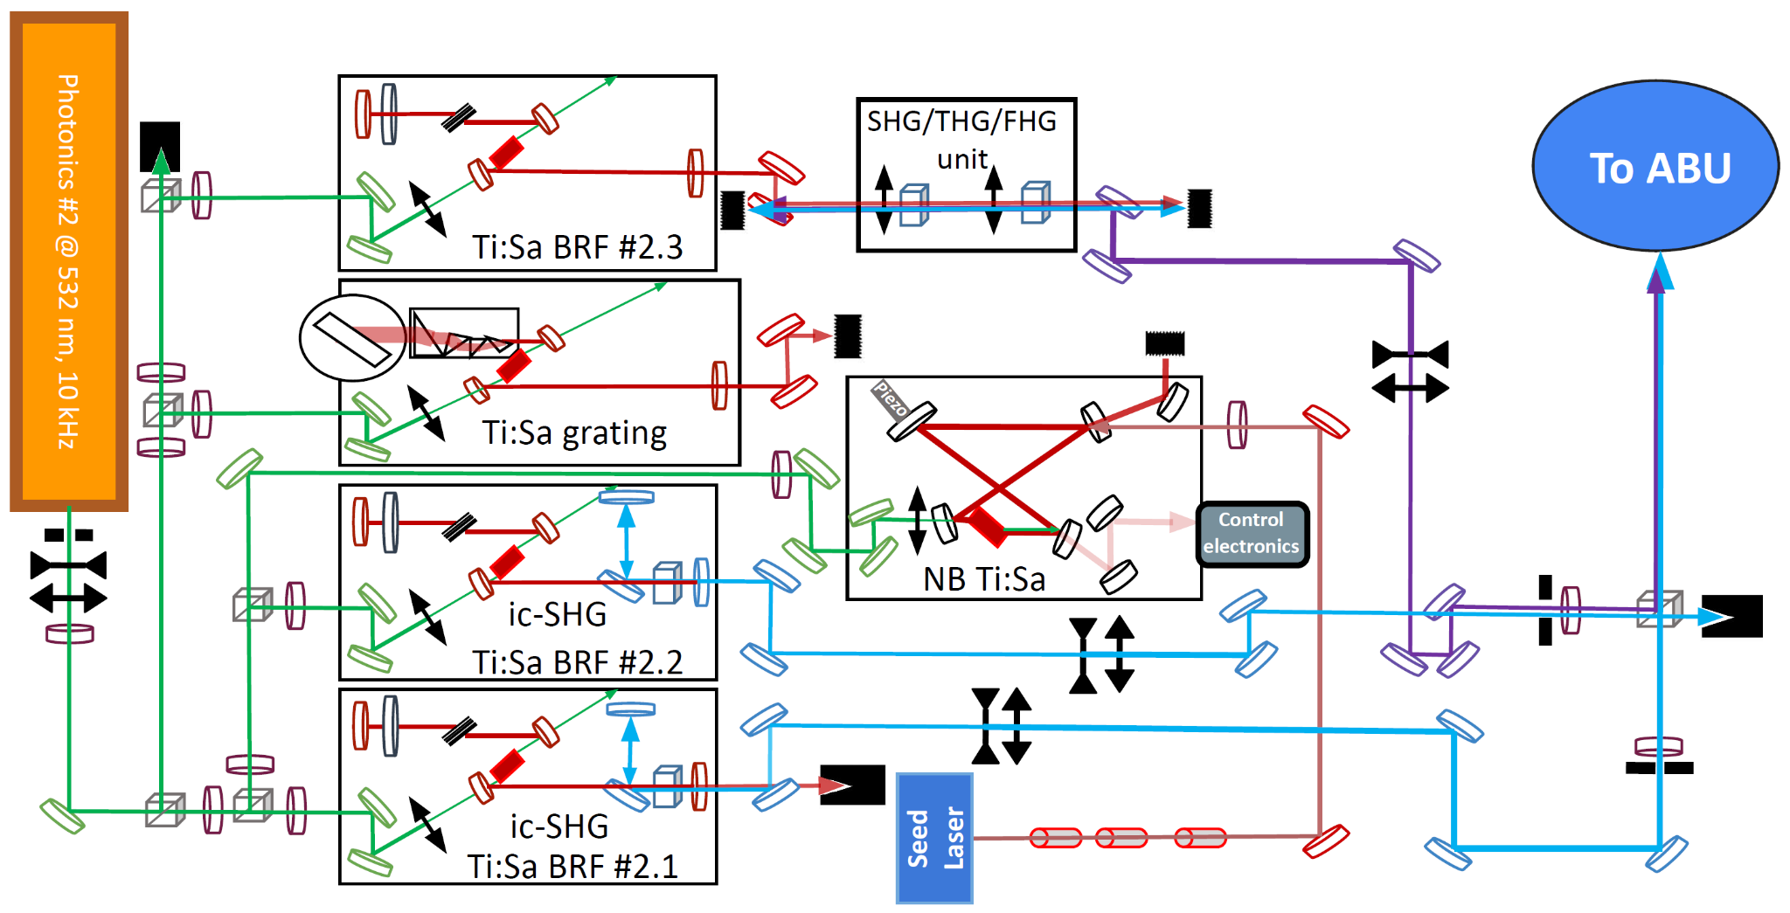
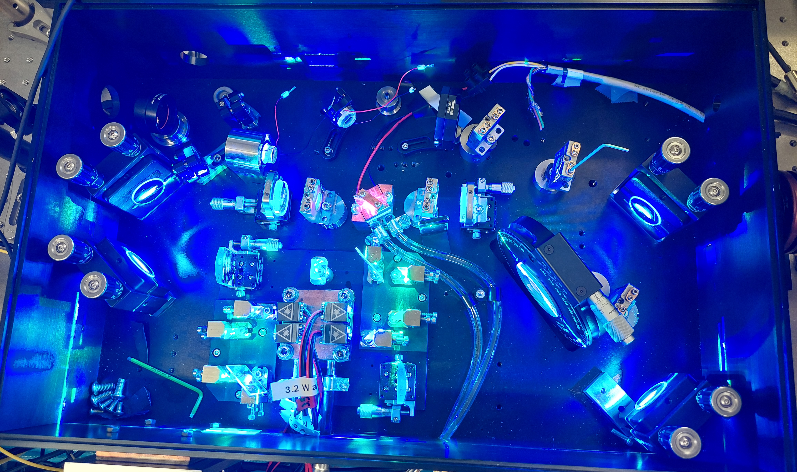
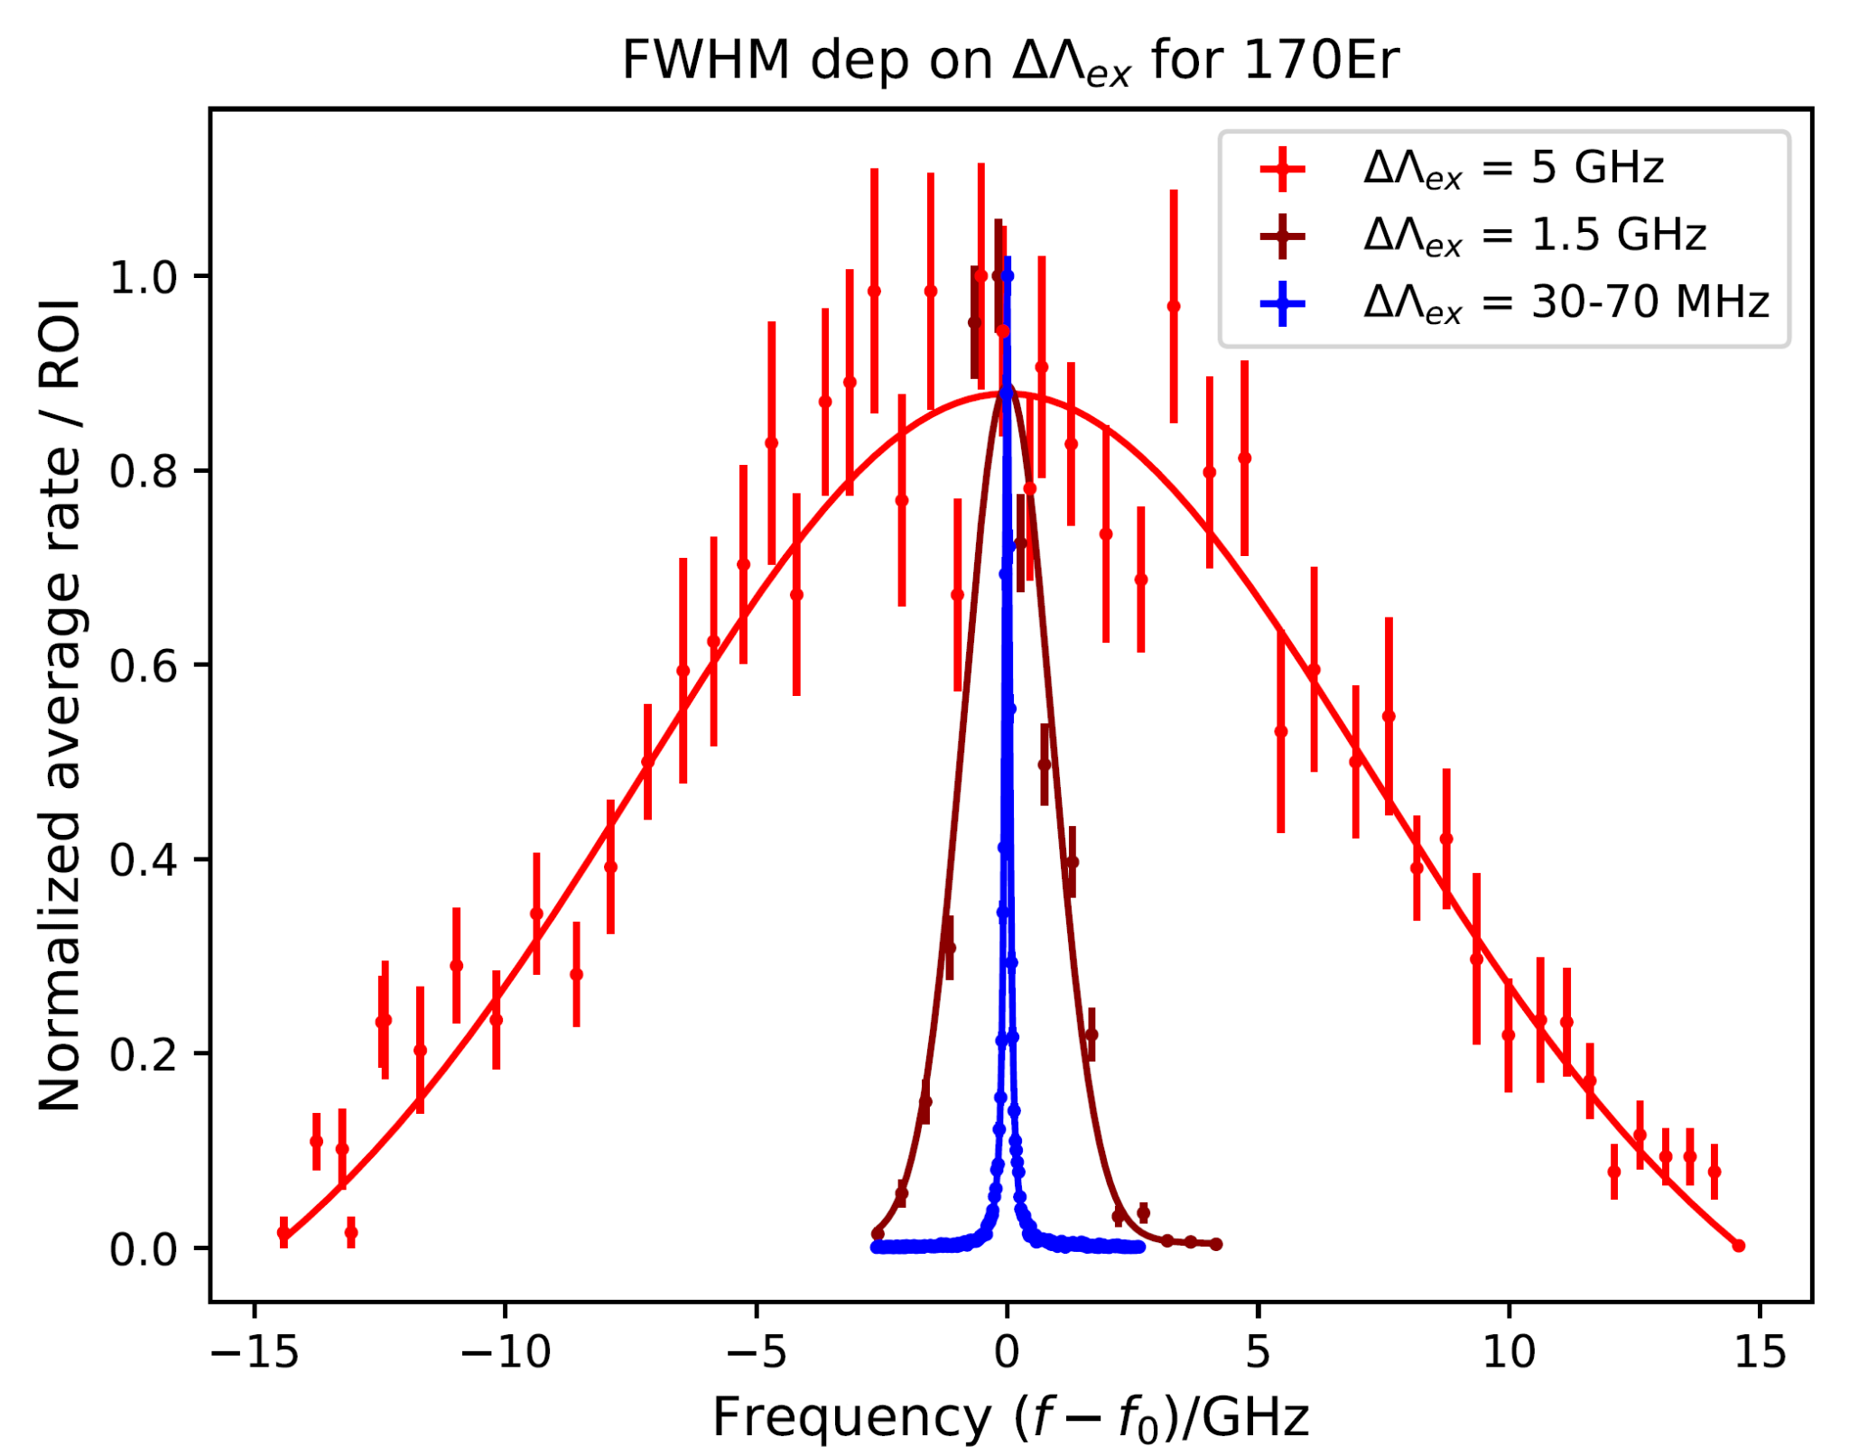
GISELE Ti:sapphire laser laboratory
Development of laser spectroscopy methods
Systems of different linewidths available
Diode pumped cw Ti:sapphire cavity to replace current seed laser in order to expand tuning range
Work of A. Ajayakumar based on V. Sonnenschein et al., NIM B 463 (2020)

Slide 7
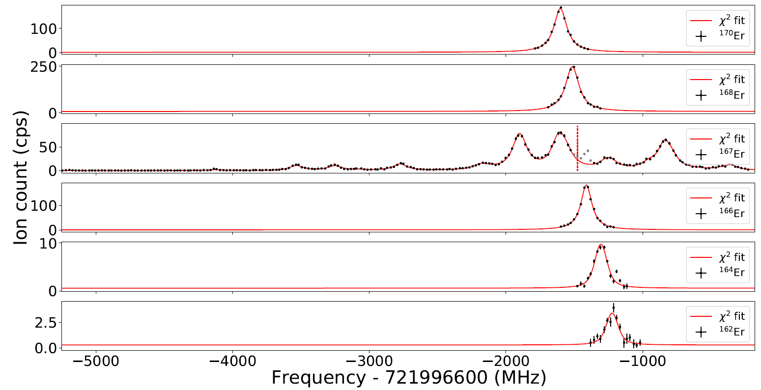
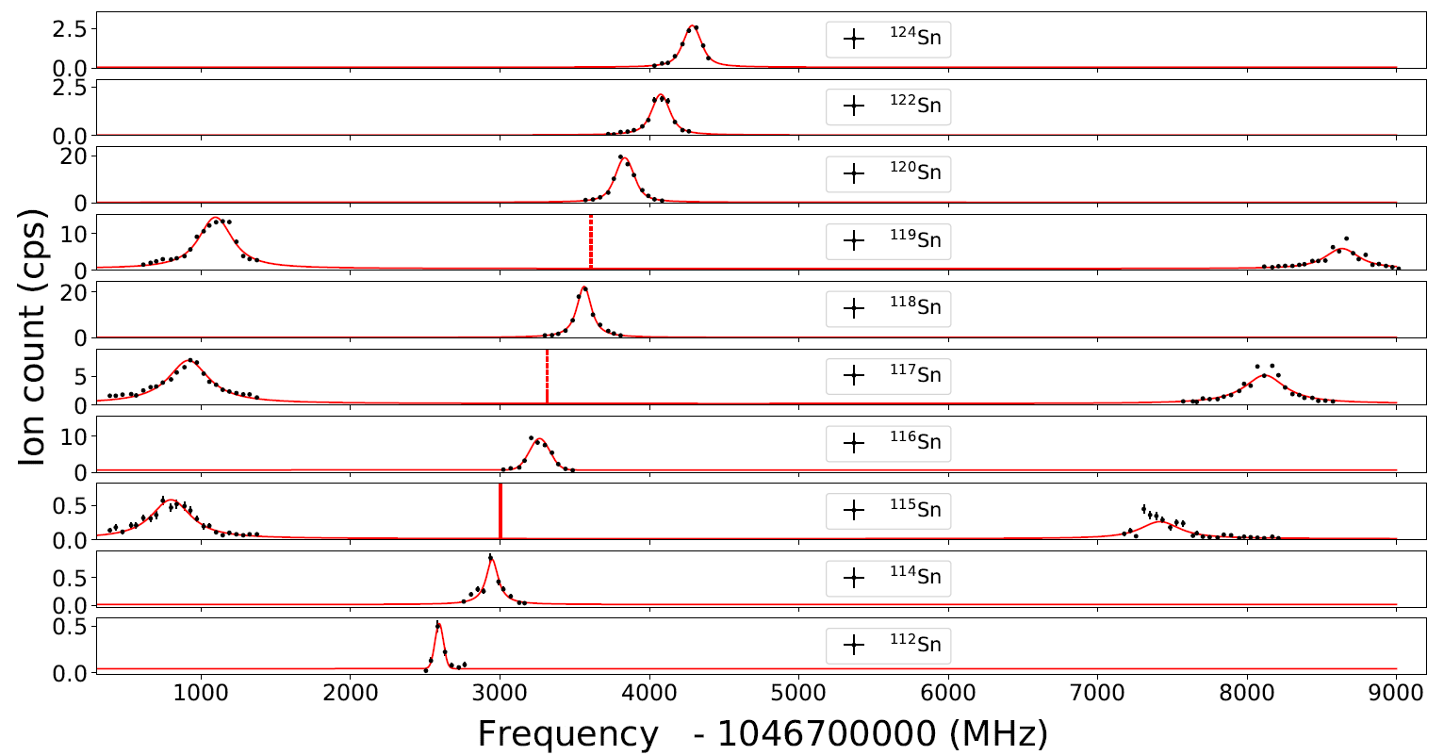
GISELE Ti:sapphire laser laboratory
Er and Sn resonant ionisation spectroscopy measurements for commissioning of laser system and
preparation for first experiments at S3-LEB
¹⁷⁰Er
¹⁶⁸Er
¹⁶⁷Er
¹²⁴Sn
¹²²Sn
¹⁶⁶Er
¹²⁰Sn
¹⁶⁴Er
¹¹⁹Sn
¹¹⁸Sn
¹⁶²Er
¹¹⁷Sn
¹¹⁶Sn
¹¹⁵Sn
¹¹⁴Sn
¹¹²Sn
J. Romans et al., Nucl. Instrum. Meth. B 536 (2023)

Slide 8
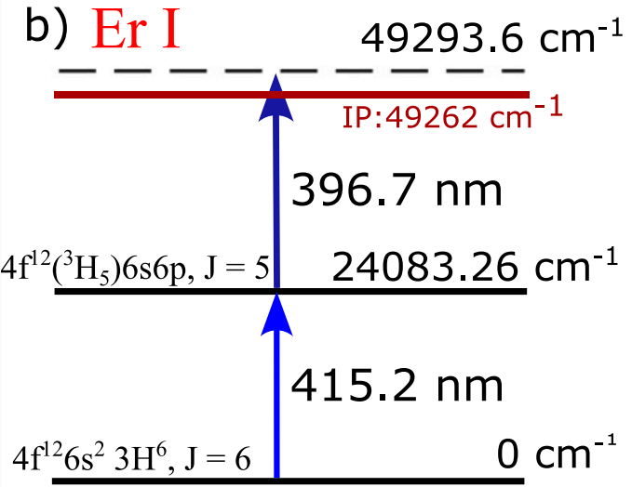
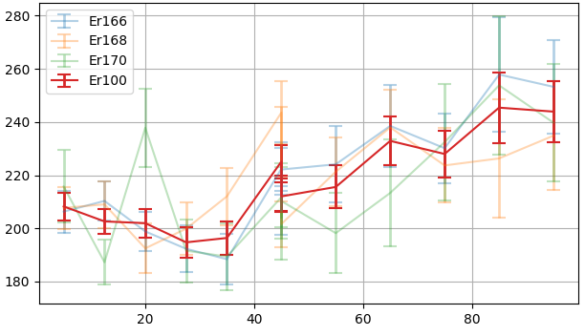
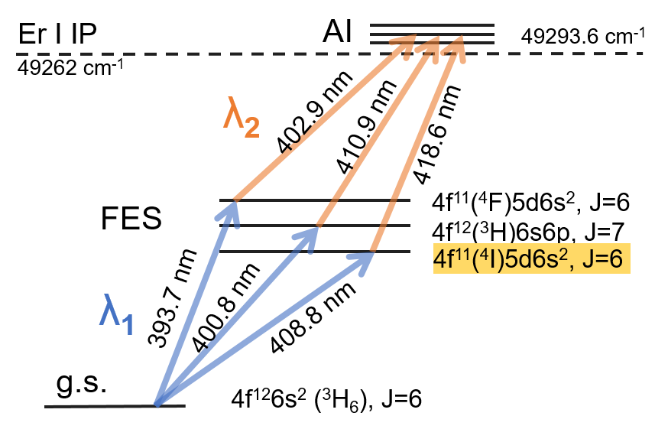
Er scheme investigation
Commissioning of in-gas-jet laser spectroscopy with Er → good agreement with ABU/literature
Isotope shifts in Er scheme used for commissioning of setup
too small to extract nuclear charge radii properly in gas jet.
Investigation of alternative transitions, in gas cell and in gas jet
Resolution: 281(5) MHz, does not match predicted Mach number
Systematic work to improve gas-jet resolution
¹⁷⁰Er
¹⁶⁸Er
¹⁶⁷Er
PhD work of
F. Ivandikov
FWHM (MHz)
¹⁶⁶Er
¹⁶⁴Er
Axial position in jet (mm)
A. Ajayakumar et al., NIM B 539 (2023)
PhD work of W. Dong

Slide 9
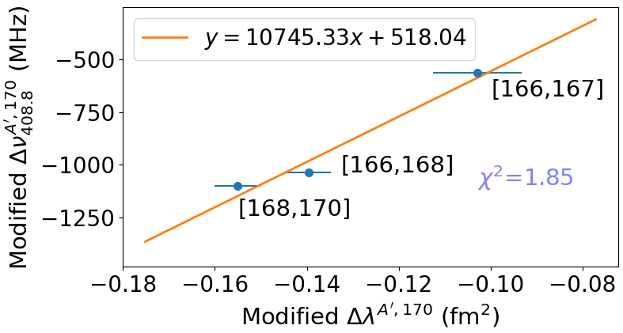
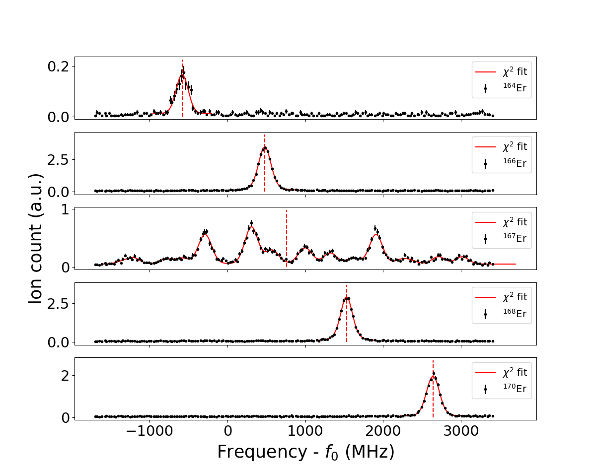
Er scheme investigation
New selected scheme
¹⁶⁴Er
F₄₀₉ = 10.7(3) GHz fm⁻²
(vs F₄₁₅ = 469(322) MHz fm⁻² )
¹⁶⁶Er
¹⁶⁷Er
Atomic states | Method | A(MHz) | B(MHz)
4f¹¹5d6s², J=6 | gas jet | -123.9(4) | 213(23)
4f¹²6s6p, J=5 | gas jet | −148(4) | −2230(200)
 | ABU | −147.7(8) | −1888(58)
4f¹²6s², J=6 (g.s.) | ABU | −121.8(8) | −4563(53)
¹⁶⁸Er
¹⁷⁰Er
PhD work of W. Dong

Slide 10
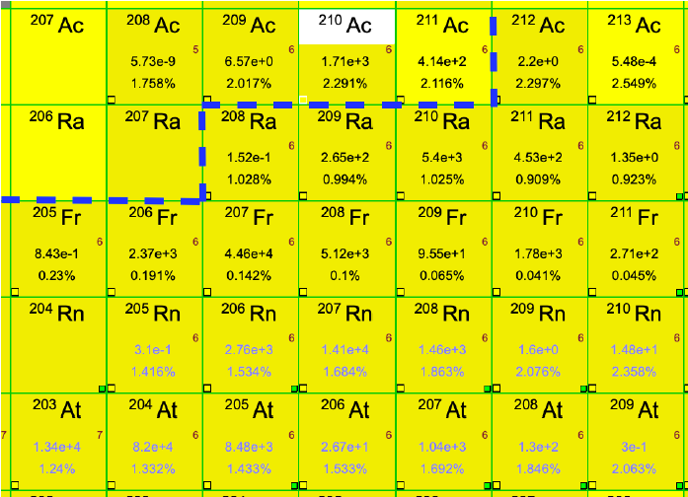
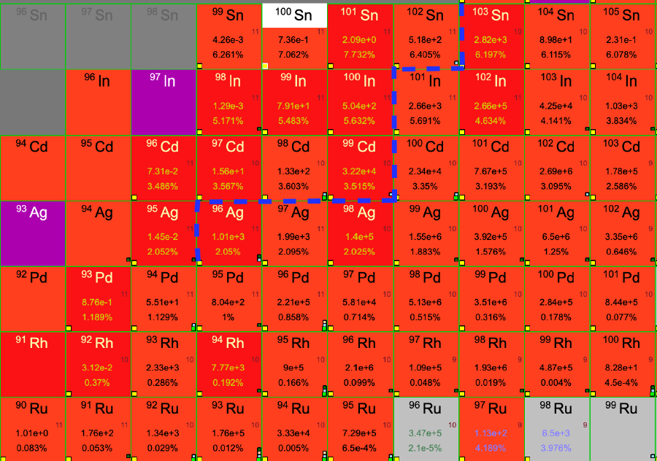
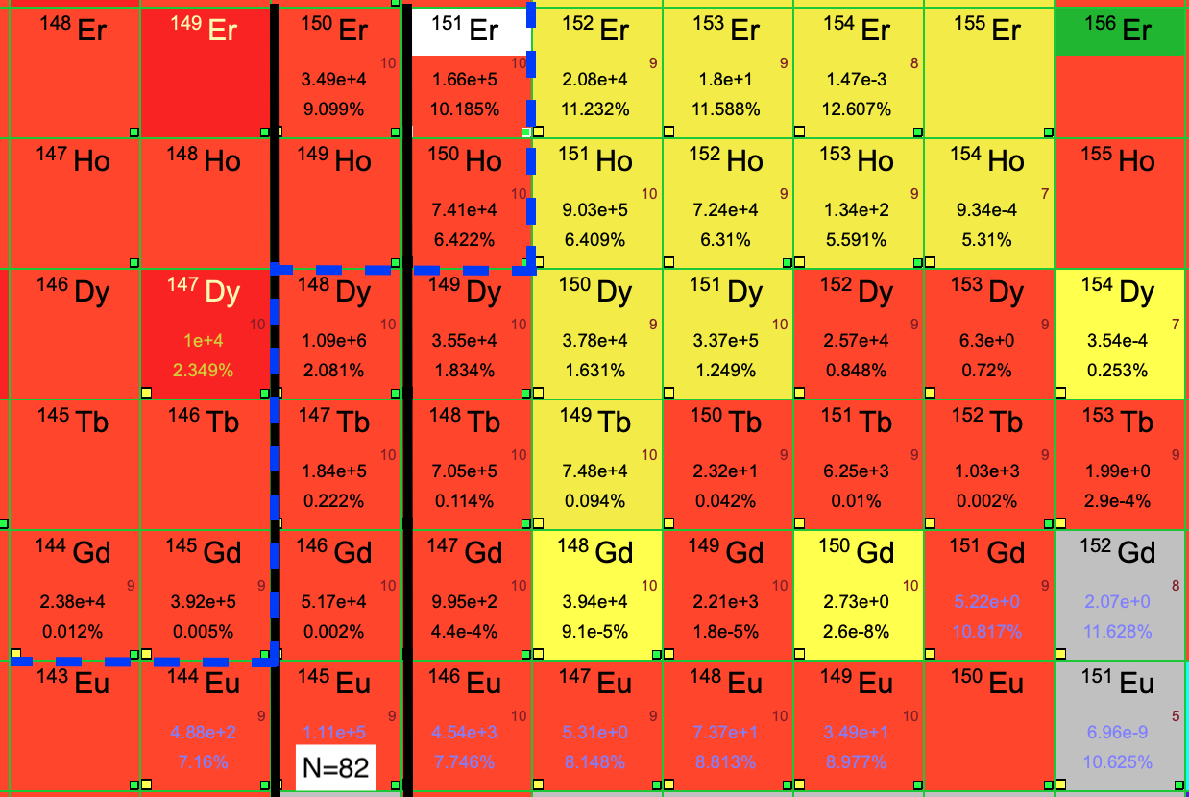
S3-LEB scientific programme
S3 commissioning phase with S3-LEB, 2025-2026
Focus on spectrometer with opportunities for physics
After commissioning, start of scientific programme
⁵⁰Cr + ⁵⁸Ni
⁴⁰Ar + ¹¹⁶Sn
²⁰Ne + ¹⁹⁷Au

Slide 11
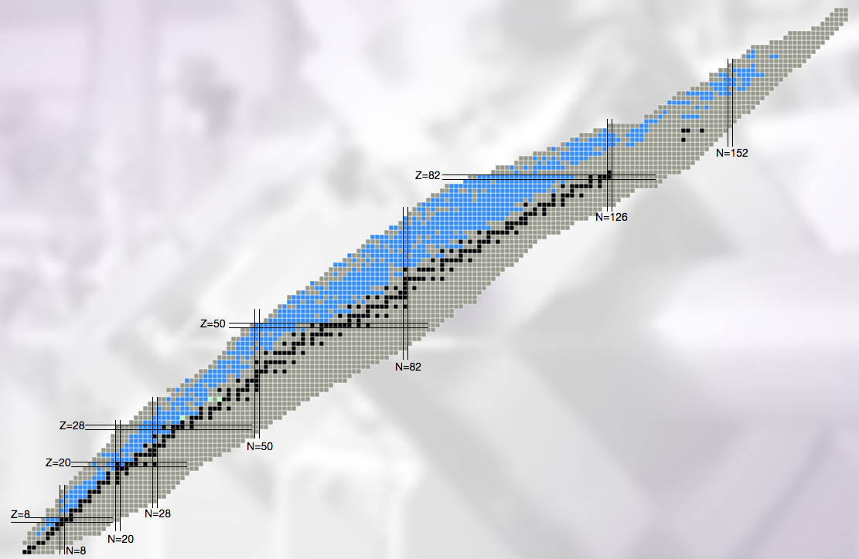
S3-LEB scientific programme
11 pre-proposals/Letters of Intent prepared for workshop back in 2018, re-discussed in 2022
Additional abstracts on neutron-deficient (heavy-)medium mass nuclei (Z = 50 to Z = 82) in 2022
Laser spectroscopy programme:
Shape-coexistence in the
n-deficient lead region
High-spin isomers
N = 82 shell closure
²¹⁰⁻²¹³Ac and ^{213,215}Th
Octupole deformation in ²²⁵⁻²²⁸U
SHE structure (Fm, No, Lr)
Evolution of deformation around ⁸⁰Zr
Sb isotopic chain until the proton drip line
silver isotopes down to (N=Z) 94Ag
¹⁰⁰Sn region (Sn, In, Cd)

Slide 12
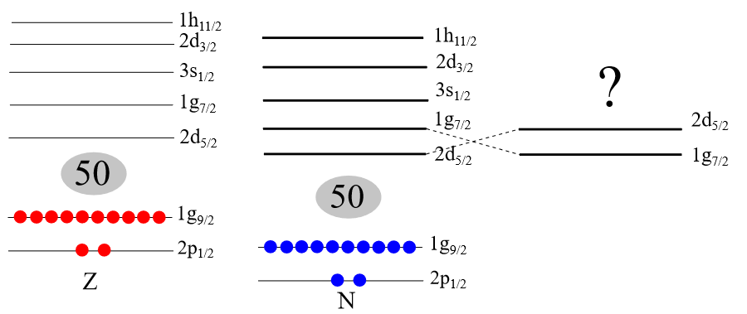
N=Z region
S³ @ SPIRAL2
¹⁰⁰Sn
M. Reponen et al., Nature 12 (2021)
Spins: inversion of the ν d_{5/2} g_{7/2} orbitals?
Electromagnetic moments & mean squared charge radii:
  Shell structure around N=Z=50 and evolution of N=50 shell closure
  Role of T=0 neutron-proton pairs
  Evolution of deformation
  Odd-even staggering
Pd
In
B. Cederwall et al., Nature 469 (2011)
A.R. Vernon et al., Nature 607 (2022)
Notes:
Some options have been discussed within the collaboration and are shown here. 100Sn is an ideal laboratory for testing Shell Model calculations, improving π-ν interaction and related pairing effects. As a reminder, 103Sn is the last known nuclei where laser spectroscopy measurement has been performed, with S3 LEB we will like to go to 100Sn, and the most exotic In, Cd and Ag isotopes to clarify the evolution of nuclear structure approaching the N=Z=50 Shell closure
As an example, we will like to solve the problem of the ground state spin of 101Sn, is there a spin inversion or not, to measure the evolution of charge radii in that region and to measure the quadrupole moment and the stiffness rigidité) of the 100sn core and compare our measurements to coulomb excitation
Thanks to the MR TOF MS, we will be able to measure new masses from 80Zr to 100Sn which are important for nuclear structure but also for the RP process modelling
And finally we will study the evolution of deformation around the refractory 80Zr to see how…

Slide 13
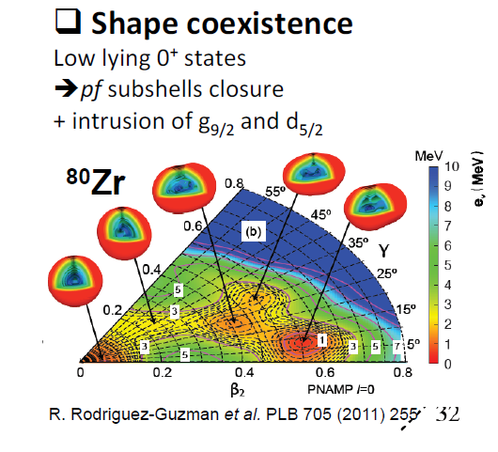
N=Z region
S³ @ SPIRAL2
Evolution of deformation and shape coexistence around ⁸⁰Zr (N=Z=40)
  Influence of π g_{9/2}-ν g_{9/2} interaction
Two neutron separation energy
Mean square charge radii
R. Rodriguez-Guzman et al., Phys. Lett. B 705 (2011)
P. Campbell, I. Moore, M. Pearson PPNP 86 (2016)
High deformation seen in S_{2n} and d<r²> systematics around N=60, region around N=40 poorly known
Notes:
Some options have been discussed within the collaboration and are shown here. 100Sn is an ideal laboratory for testing Shell Model calculations, improving π-ν interaction and related pairing effects. As a reminder, 103Sn is the last known nuclei where laser spectroscopy measurement has been performed, with S3 LEB we will like to go to 100Sn, and the most exotic In, Cd and Ag isotopes to clarify the evolution of nuclear structure approaching the N=Z=50 Shell closure
As an example, we will like to solve the problem of the ground state spin of 101Sn, is there a spin inversion or not, to measure the evolution of charge radii in that region and to measure the quadrupole moment and the stiffness rigidité) of the 100sn core and compare our measurements to coulomb excitation
Thanks to the MR TOF MS, we will be able to measure new masses from 80Zr to 100Sn which are important for nuclear structure but also for the RP process modelling
And finally we will study the evolution of deformation around the refractory 80Zr to see how…

Slide 14
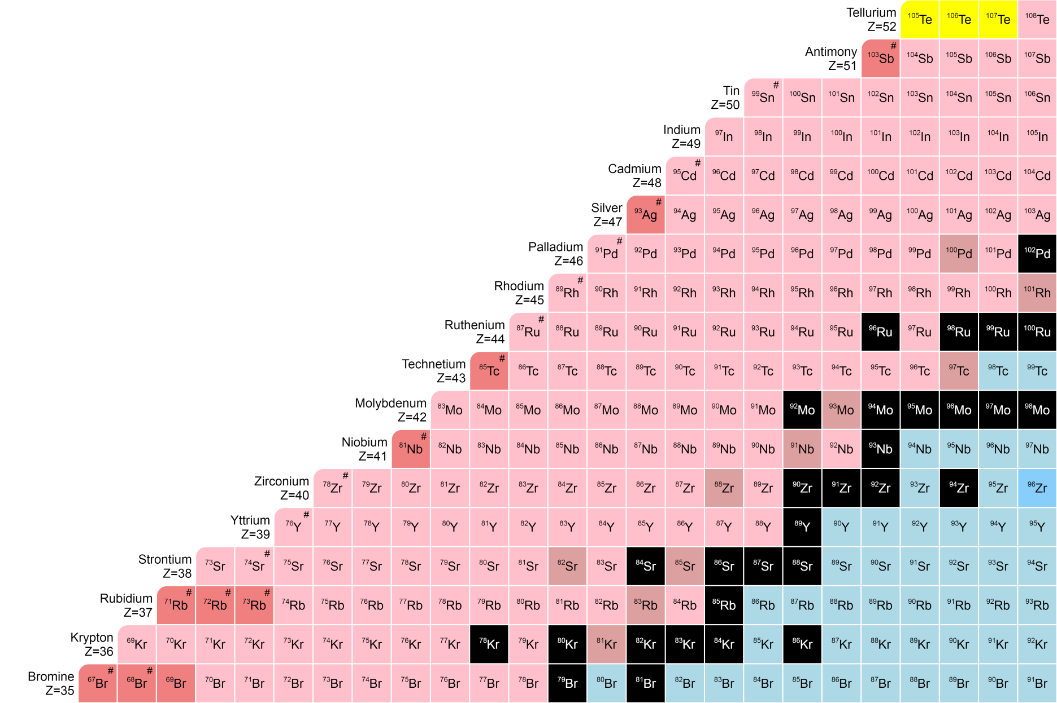

N=Z region
N = Z
Pre-proposals
Known masses
Current injector and gas cell (A/Q = 3 & 300 ms)
A/Q = 3 & ‘Fast LEB’ (50 ms)
New injector (A/Q = 7) & ‘Fast LEB’ (50 ms)
A<80 → DESIR
better suited

Slide 15
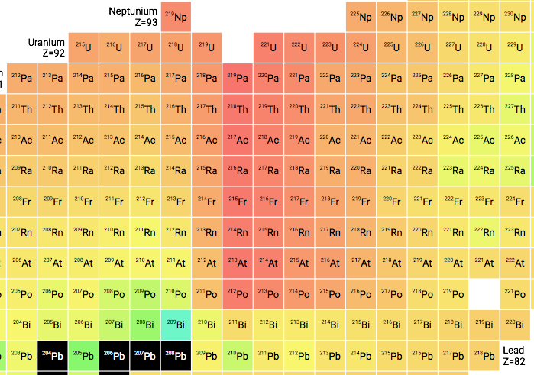
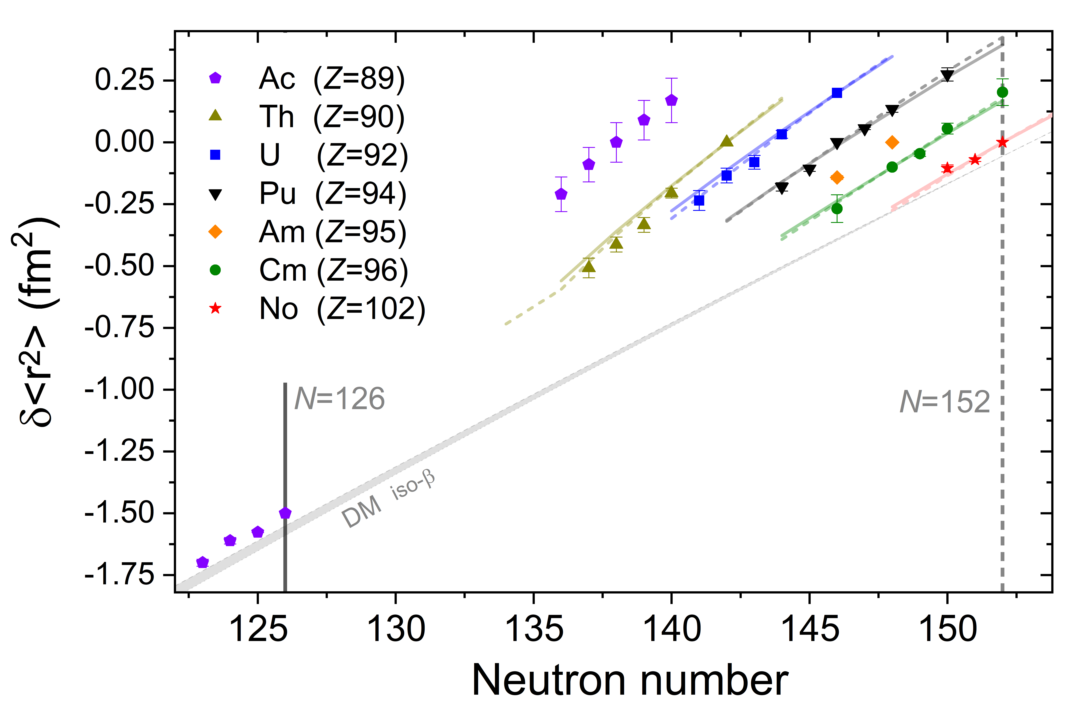
(Super)heavy region
Evolution of nuclear structure near and beyond N=126
→ insight in nuclear forces close to spherical shell closure and proton dripline
d<r²> unknown for ^{211,210}Ac and ^{213,215}Th → test predictive power DFT models
Low resolution (in-gas cell) data on ^{212,213}Ac: tentative spin and no quadrupole moments
Good description by DFT with various Skyrme models
R. Ferrer et al.,
Nat. Commun. 8 (2017)
S. Raeder et al., Phys. Rev. Lett. 120 (2018)
Notes:
combine measurements of mean-charge radius and moments around ²⁵⁴No with nuclear structure information
K isomer is a difficult case, this measurement has been attempted at GSI in 2019 with a very efficient set up, with S3-LEB we should have higher intensities, better detection possibilities, universal system … GSI program help to set the course to the S3-LEB program

Slide 16
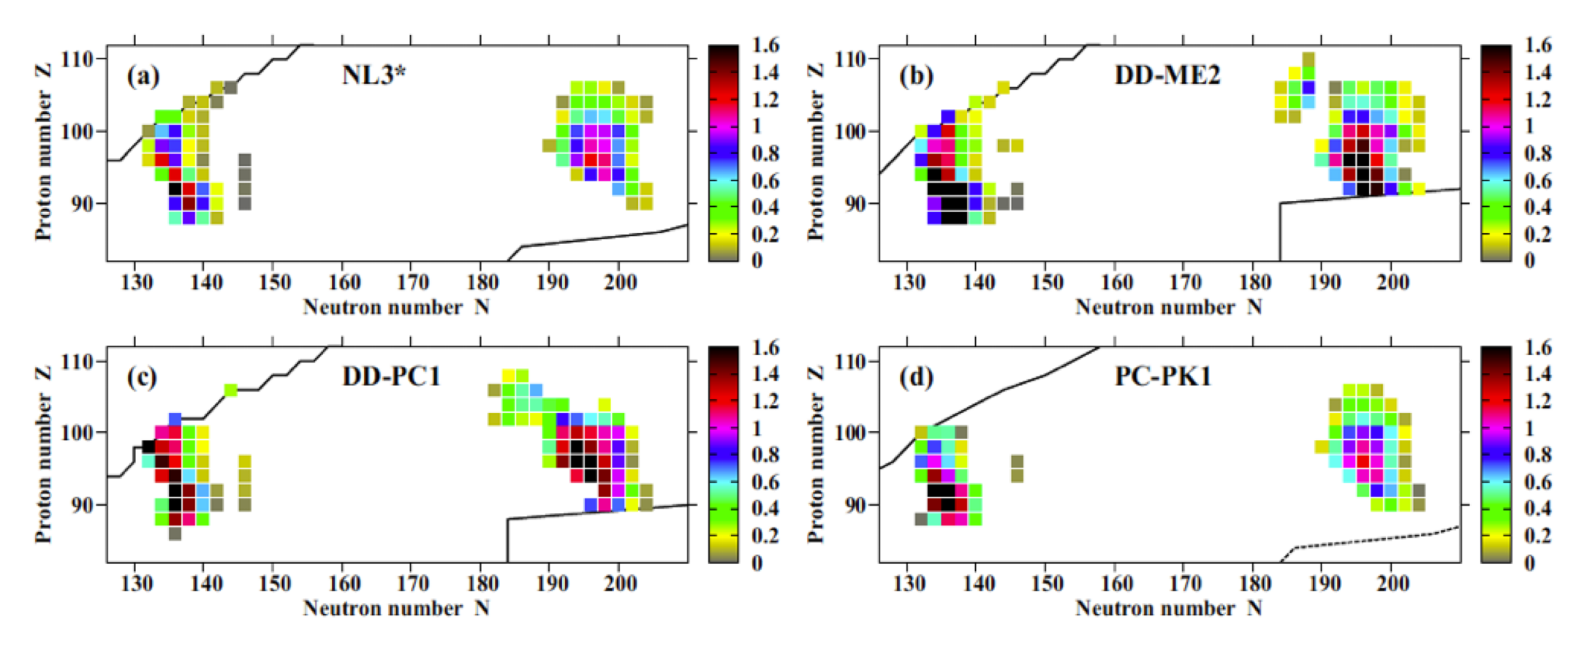
(Super)heavy region
Search for octupole deformation in U region
  Deviation in electric quadrupole moments?
  Change in the charge radii odd-even staggering?
Covariant density functional theory predictions: Octupole deformation in ground state not only in Ra (Z = 88) but also in heavier isotopes like U (Z = 92, N = 134 - 140)
S. E. Agbemava et al. Phys. Rev. C 93 (2016)
E. Verstraelen et al. , Phys. Rev. C 100 (2019) 04431
Notes:
combine measurements of mean-charge radius and moments around ²⁵⁴No with nuclear structure information
K isomer is a difficult case, this measurement has been attempted at GSI in 2019 with a very efficient set up, with S3-LEB we should have higher intensities, better detection possibilities, universal system … GSI program help to set the course to the S3-LEB program

Slide 17
(Super)heavy region
S³ @ SPIRAL2
Complete ground state information of SHE
  Spectroscopic information in Fm (isomers, shapes, moments)
  Measure Odd-Z and Odd-N magnetic moments and compare to spin assignments
  K-isomer in ²⁵⁴No and Lr
How do relativistic effects affect the architecture of the periodic table?
  Measure IP in Rf and Db ?
M. Block, M. Laatiaoui, S. Raeder, PPNP 116 (2021)
Notes:
combine measurements of mean-charge radius and moments around ²⁵⁴No with nuclear structure information
K isomer is a difficult case, this measurement has been attempted at GSI in 2019 with a very efficient set up, with S3-LEB we should have higher intensities, better detection possibilities, universal system … GSI program help to set the course to the S3-LEB program

Slide 18
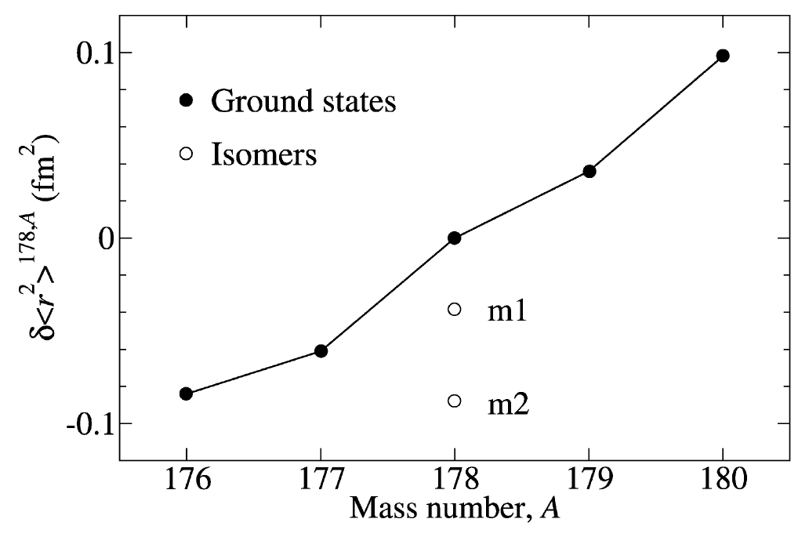

The region between Z = 50 and Z = 82
Shape staggering in Hg region:
  General return to sphericity towards the proton dripline?
  Evolution of deformation towards the proton midshell
High-spin multi quasiparticle isomers
  $Q_{0}^{m}>Q_{0}^{g} but{ \left\langle r^{2}\right\rangle }_{m}<{\left\langle r^{2}\right\rangle }_{g}$
N=82 shell closure
Hf isotopes
𝜹<r²>^{N,N’=82}(fm²)
Q₀ = 6.961
Q₀ = 7.11
I^{π} = 8–
Q₀ = 7.20
I^{π} = 16⁺
Neutron number
M.L. Bissell et al., Phys. Lett. B 645(4) (2007)
X. F. Yang, S.J. Wang, S.G. Wilkins,
R.F. Garcia Ruiz, PPNP 129 (2023)
J.G. Cubiss et al., Phys. Rev. Lett. 131 (2023)
Notes:
→ Higher rigidity + lower surface diffuseness of isomer: blocking effect (link to OES mechanism)?

Slide 19
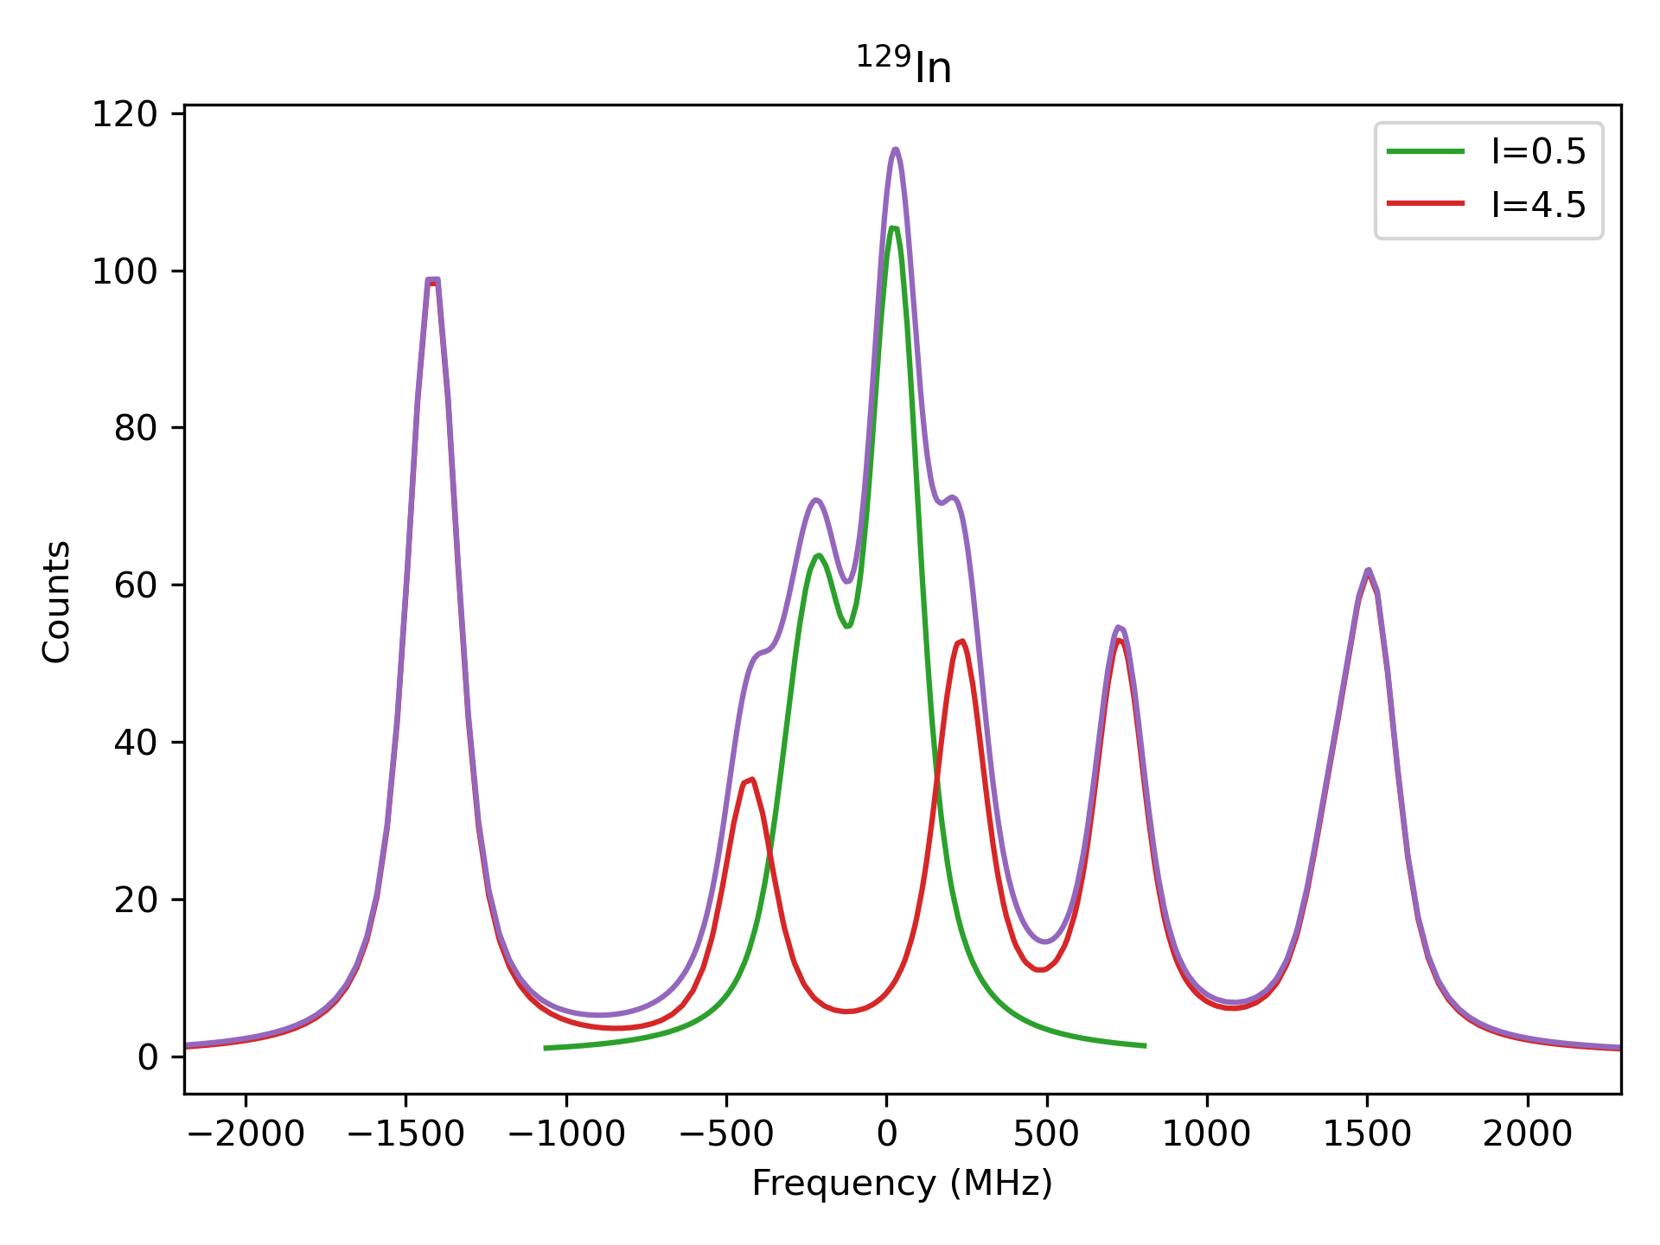
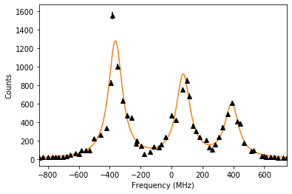
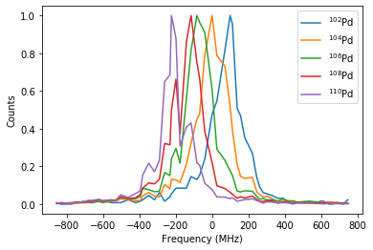
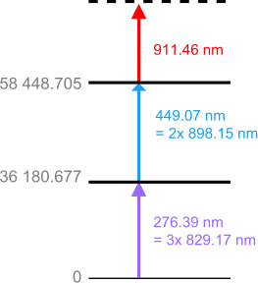
Synergy with DESIR
(Possible) limitations for laser spectroscopy with S3-LEB
  Neutralisation?
  Resolution
  Ionisation scheme options
A.R. Vernon et al., Nature 607 (2022)
Pd
F = 0.5 GHz/fm²
A = -127(3) MHz
B = 4(4) MHz
M = -1025
GHz amu

Slide 20
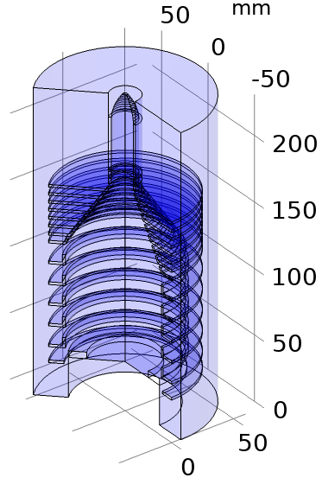
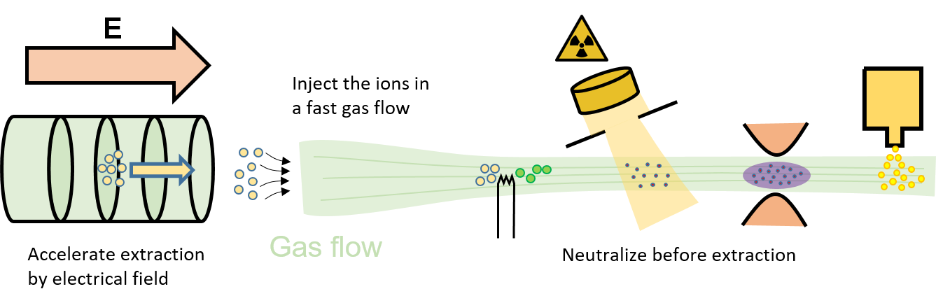
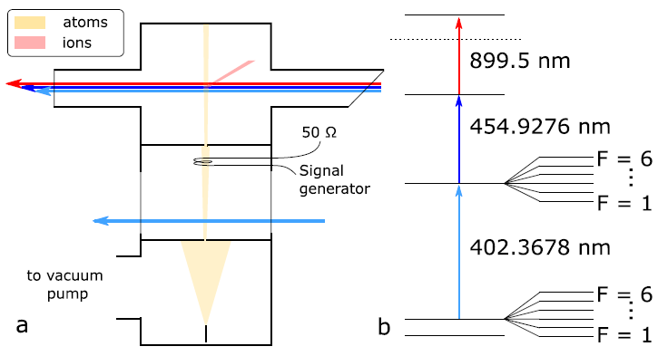
Synergy with DESIR
(Possible) limitations for laser spectroscopy with S3-LEB
  Neutralisation?
  Resolution
  Ionisation scheme options
FRIENDS³ project to improve neutralisation,
RF spectroscopy in gas jet to improve resolution
All limitations can (partly) be overcome in DESIR
Extract, focus, guide the ions
Force neutralization before extraction
See presentation by R. de Groote
R.P. de Groote et al., PLB 827 (2022)

Slide 21
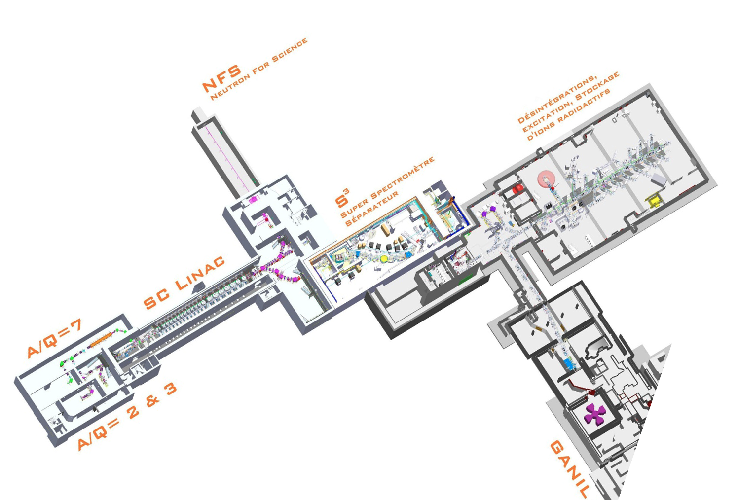


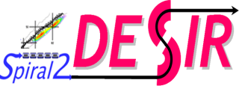
Conclusion and outlook
In-gas-jet spectroscopy with S3-LEB commissioned with Er measurements
  Some remaining optimisation to be done on Mach number/gas jet homogeneity ~ resolution
  Alternative Er scheme development performed
  Continuation of offline testing at focal plane of S3 (neutralisation determination, other elements…)
GISELE offline laser lab for scheme development, laser testing,…
  Will be used for FRIENDS³ test bench
Scientific programme to start after S3 commissioning
  Pre-proposals on N=Z region and (Super)heavy region
  Call for proposals to come later
  Synergy with DESIR

Slide 22

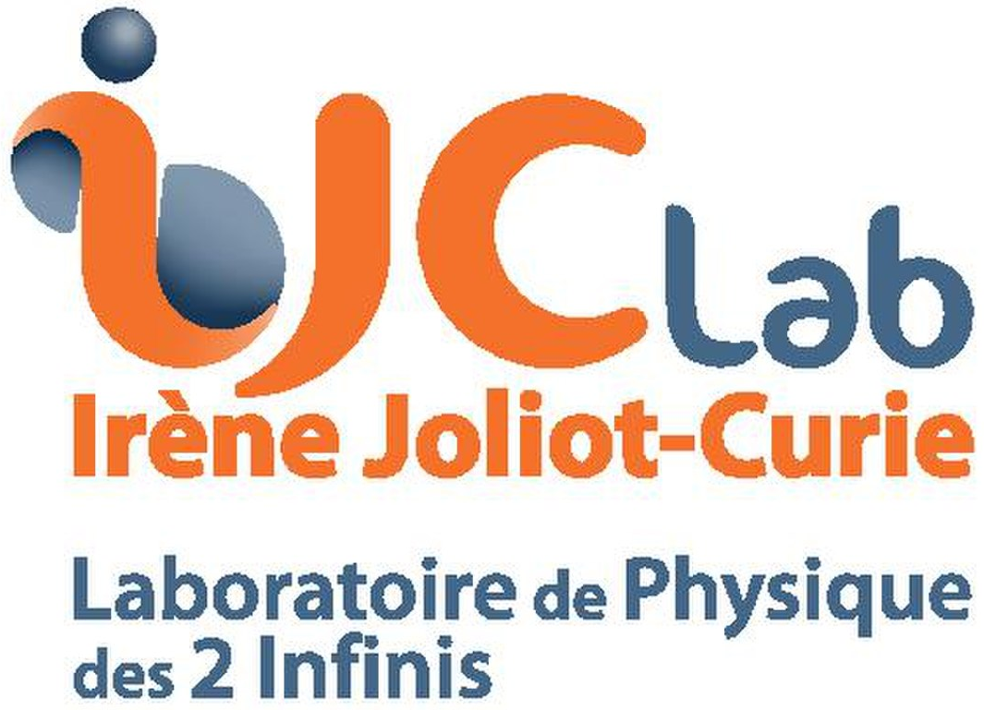



Thank you for your attention!

