Slide 1






Mathias Gerbaux, P. Ascher, Ph. Alfaurt, D. Atanasov, L. Daudin, R. Faure, M. Flayol, S. Grévy,
M. Hukkanen, A. Husson, B. Lachacinski, S. Pérard, E. Rey-Herme, M.Roche, A. de Roubin
DESIR Workshop – February 2024

Slide 2
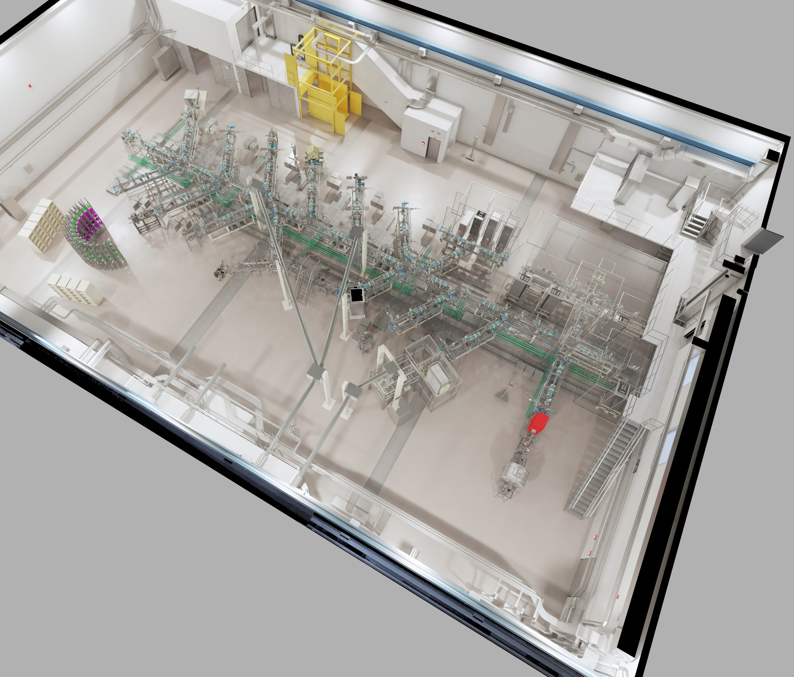



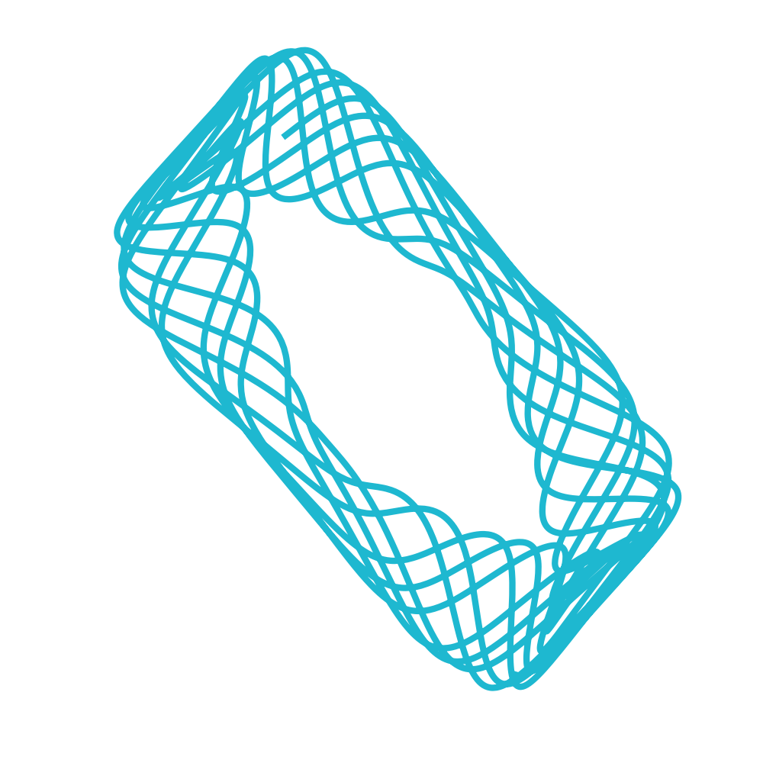
Let’s set the scene
Beams out of the accelerators are "dirty" ones:
Contaminated
Large emittance
Low energy experiments often demanding:
Low emittance needed
Some ask for a bunched beam
Ultra pure beam
HRS
From S3
and SPIRAL1
purifies beam for
Mass measurement
GPIB
prepares beam for
PIPERADE
Other experiments in DESIR
purifies beam for

Slide 3
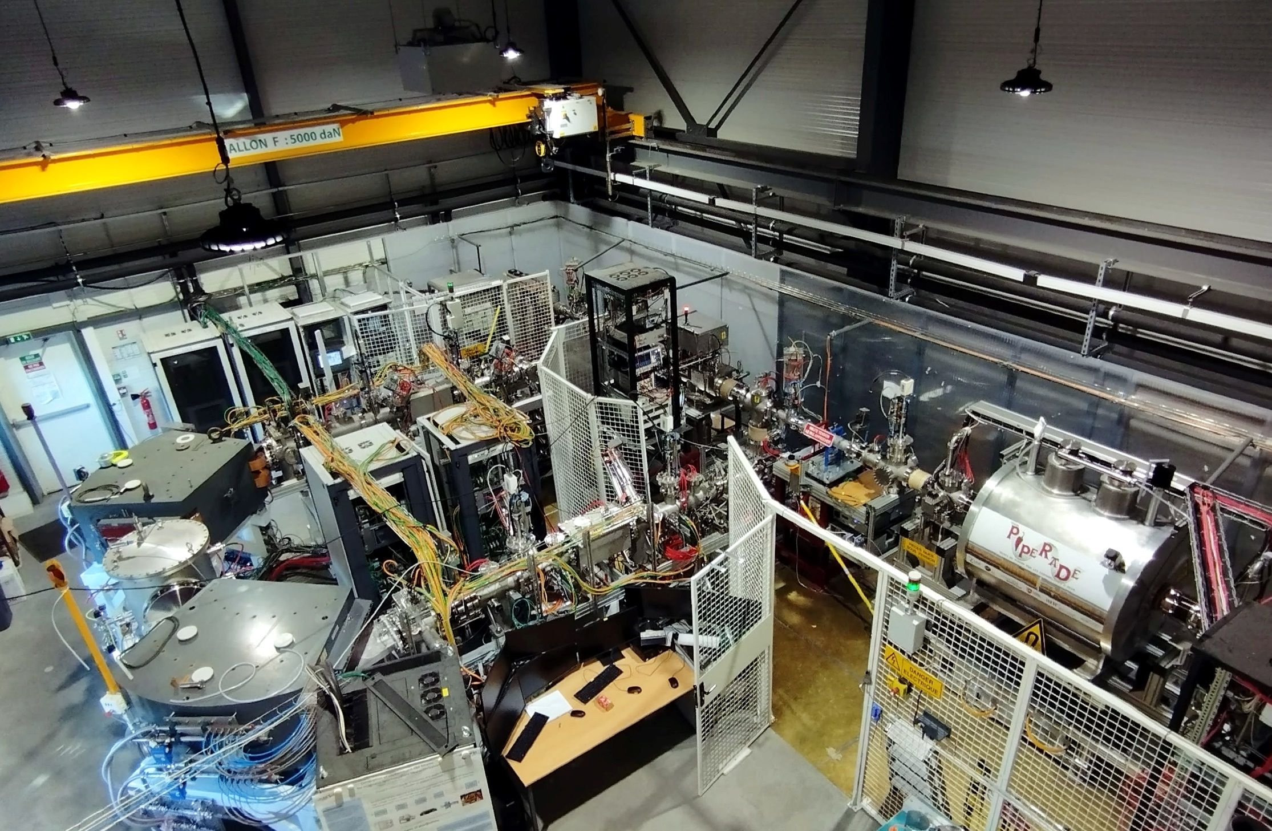



How it looks like at LP2iB
Ion source
3-keV line

Slide 4
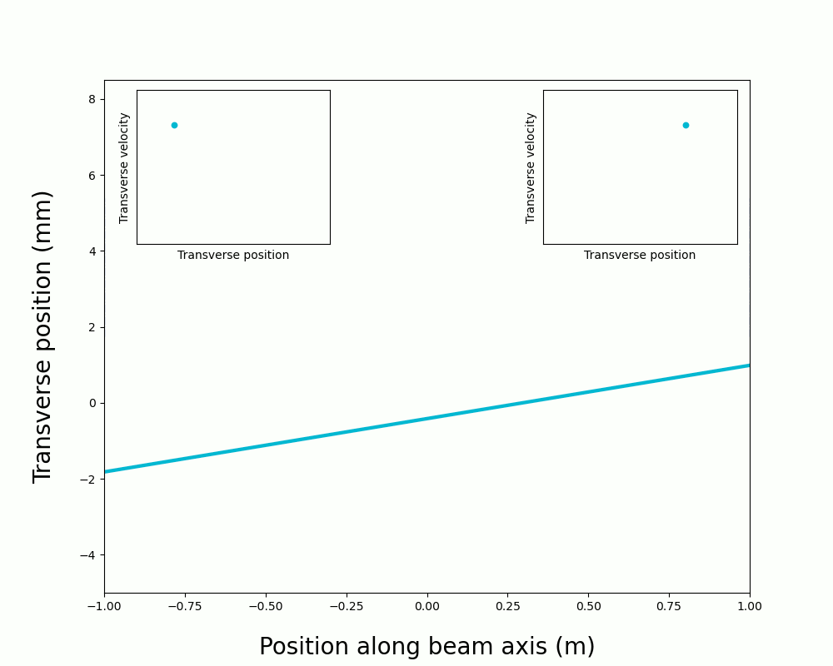
Foreword: emittance for dummies
Emittance
=
spread of the beam in the phase space
In the transverse plane, equivalent to look at position and angle wrt beam axis
In the beam direction, equivalent to look at energy and time dispersion
Low emittance beams are desirable for efficient transmission through the beam lines
In the absence of dissipative forces emittance is conserved

Slide 5
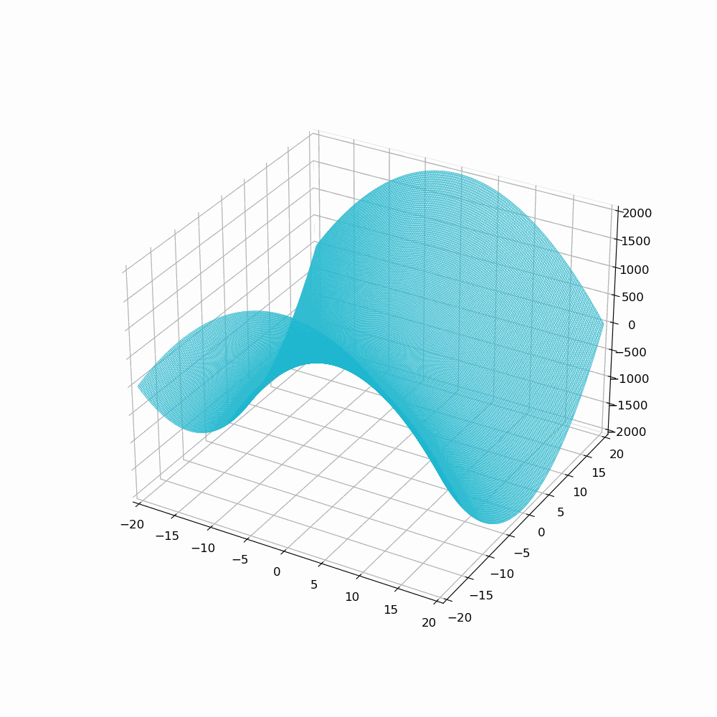

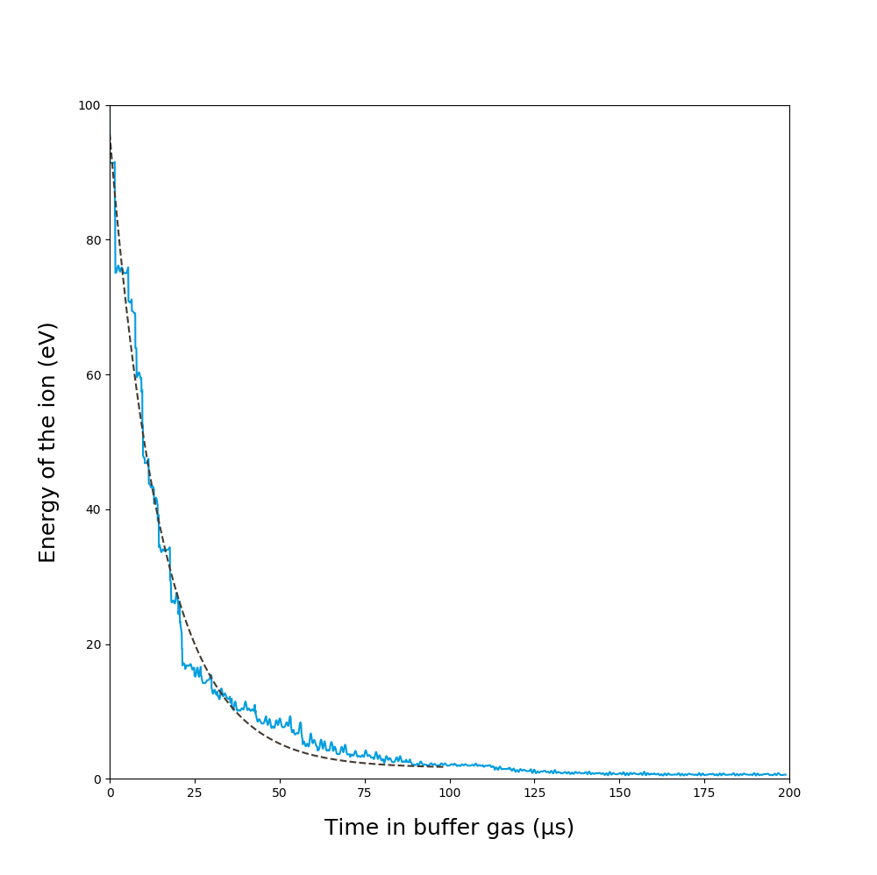

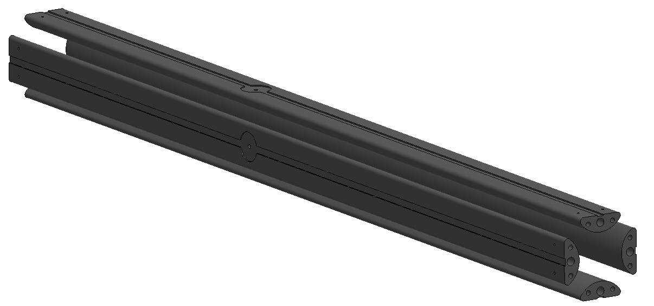
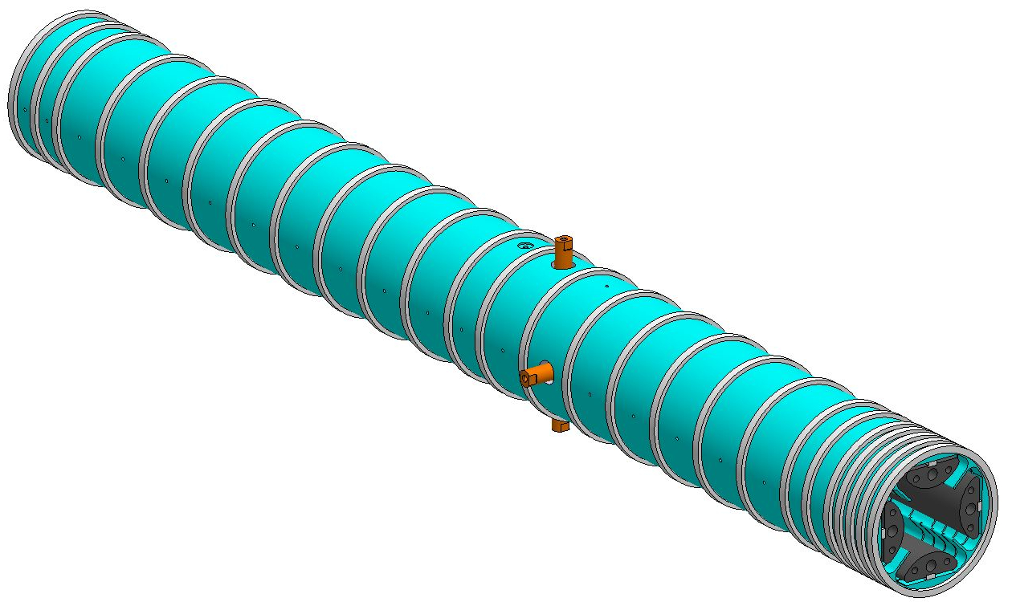

Why to use a radiofrequency cooler?
Emittance of low energy RIB $∼$ several 10 $π$.mm.mrad
Typical needs for traps: a few $π$.mm.mrad
Cooling needed!
z
y
A static electric potential can not confine a charged particle in 3D but an RF one can!
x
Electric potential (V)
z (mm)
y (mm)
25 DC segments surround the RF rods to guide the cooled ions towards the end of the RFQ.

Slide 6
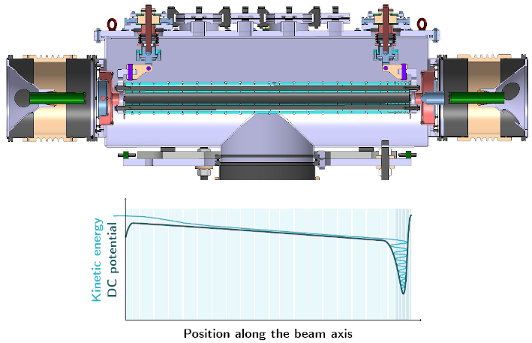

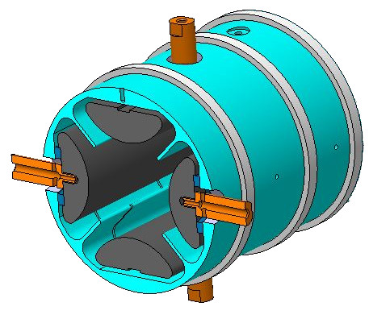
… and buncher
Buffer gas inlet
DC segments
RF rods

Slide 7
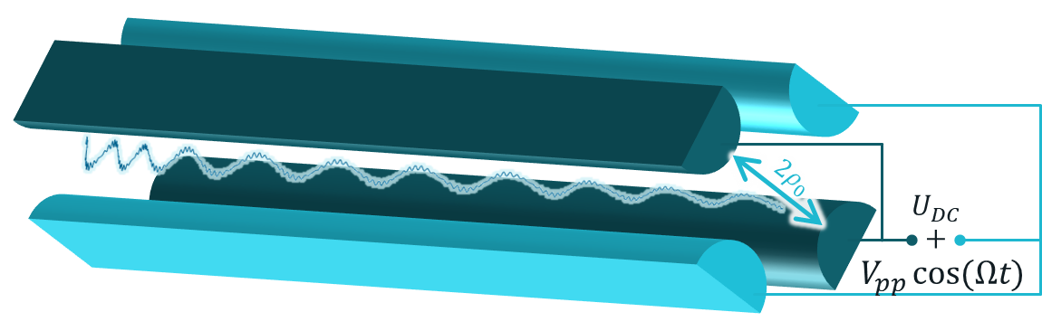
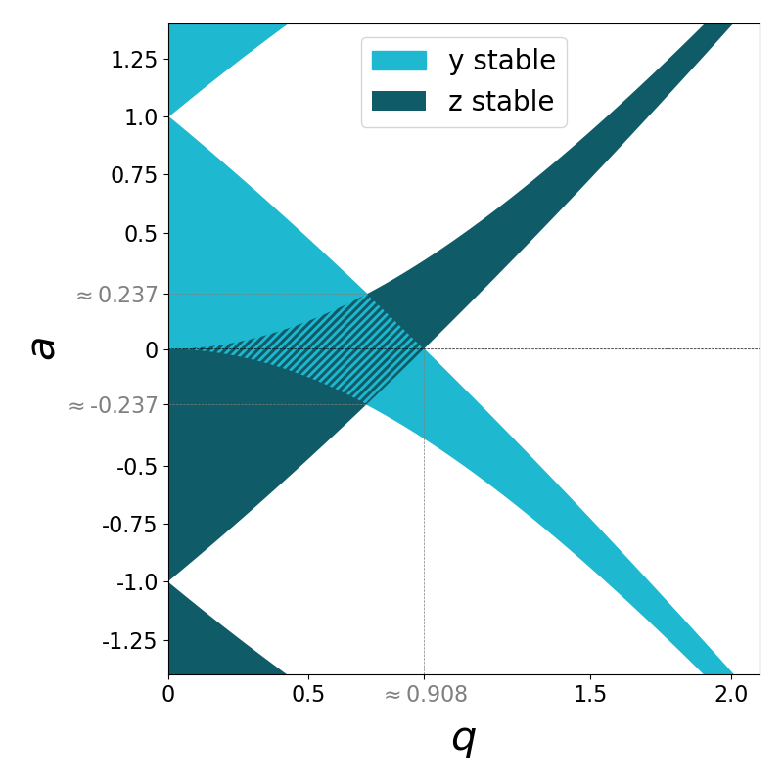
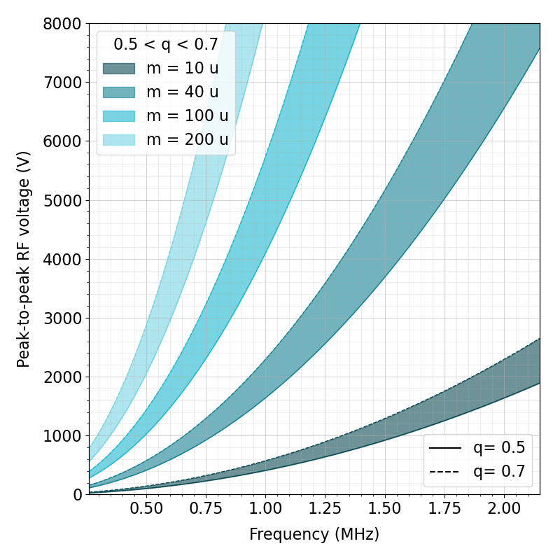
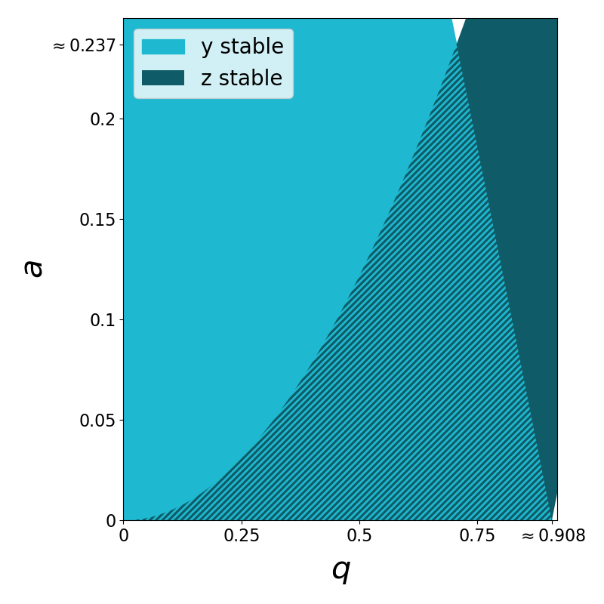
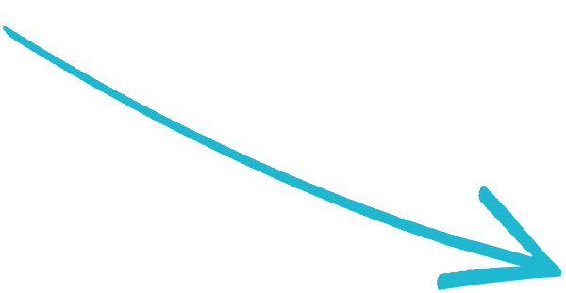

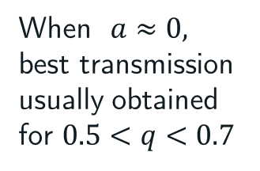
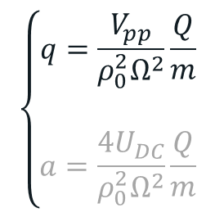
Stability inside the RFQ
Stability of the motion depends on $\frac{Q}{m}$, $ρ_{0}$, $Ω$, $V_{pp}$ and $U_{DC}$
$$\left\{\begin{aligned}q=\frac{V_{pp}}{ρ_{0}^{2}Ω^{2}}\frac{Q}{m} \\ \\ a=\frac{4U_{DC}}{ρ_{0}^{2}Ω^{2}}\frac{Q}{m}\end{aligned}\right.$$
When $a≈0,$
best transmission usually obtained for $0.5<q<0.7$
$≈0$ for the GPIB

Slide 8
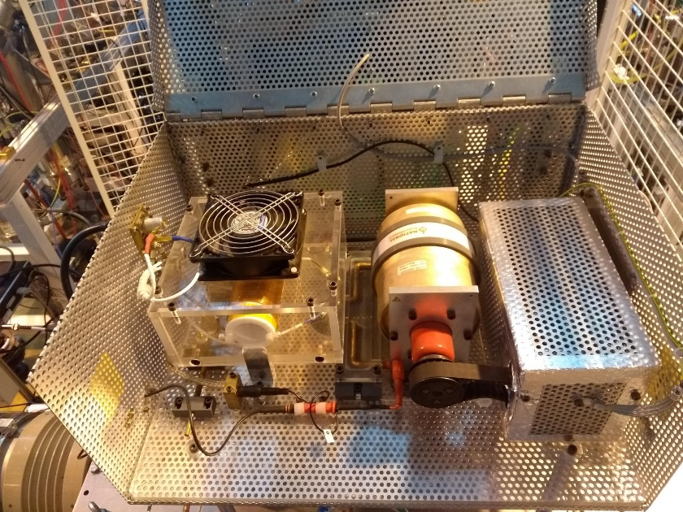
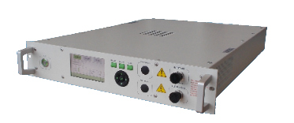
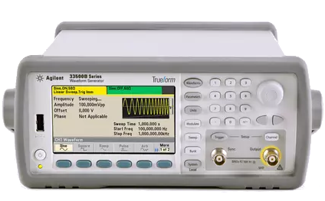

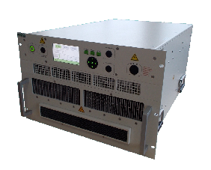
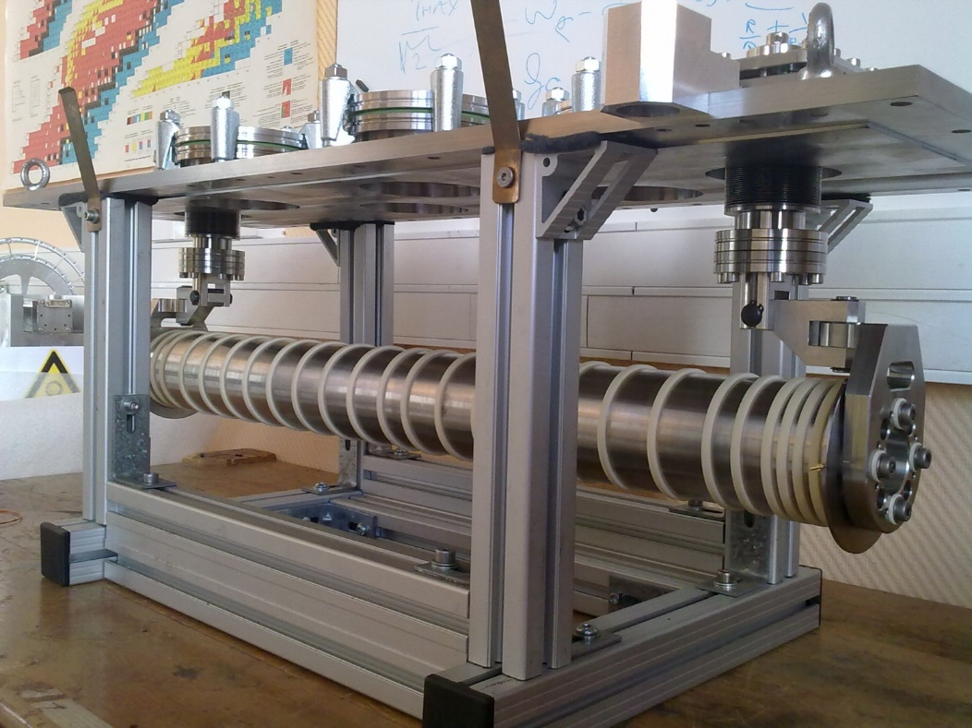
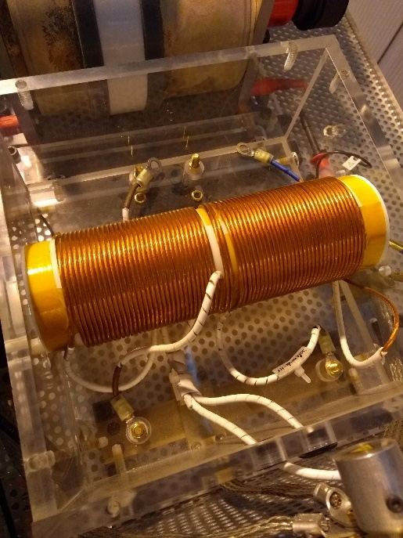
RF system
Class A amplifier
Balun circuit
Waveform
generator
or
To the 2 pairs
of rods

Slide 9
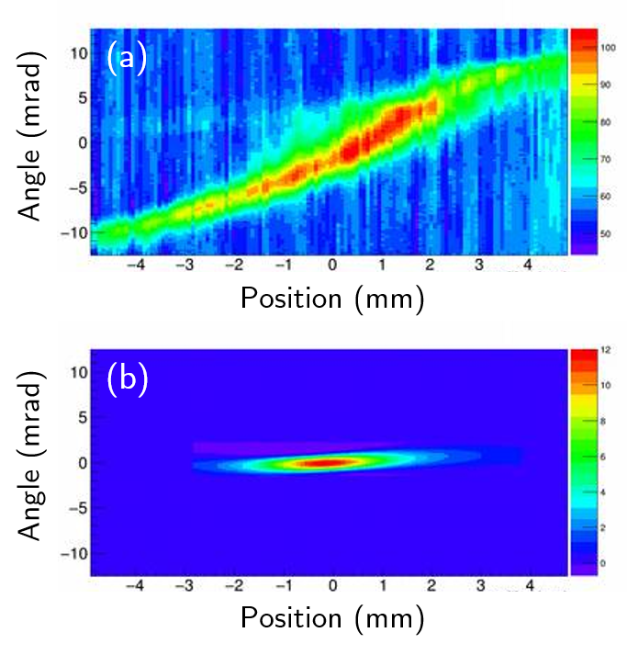

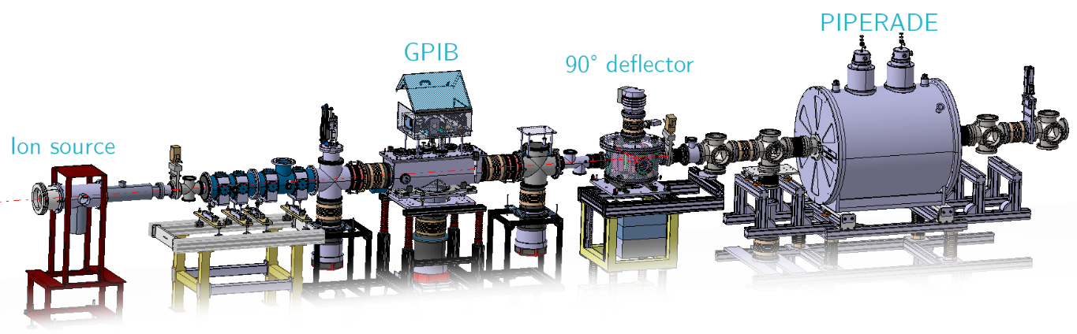




Transverse emittance reduction
Measurements done with an electrical sweep type emittance scanner
  Before the GPIB (30 keV beam)
  After the GPIB at 30 keV and 3 keV
Measurements done with an electrical sweep type emittance scanner
  Before the GPIB (30 keV beam)
$$∼ 20π.mm.mrad$$
Transverse emittance reduction in compliance with expectations for continuous beams
Still to be measured for bunched beam but expected to be better
$∼3 π$.mm.mrad at 30 keV / $∼10 π$.mm.mrad at 3 keV
3$π.mm.mrad$

Slide 10
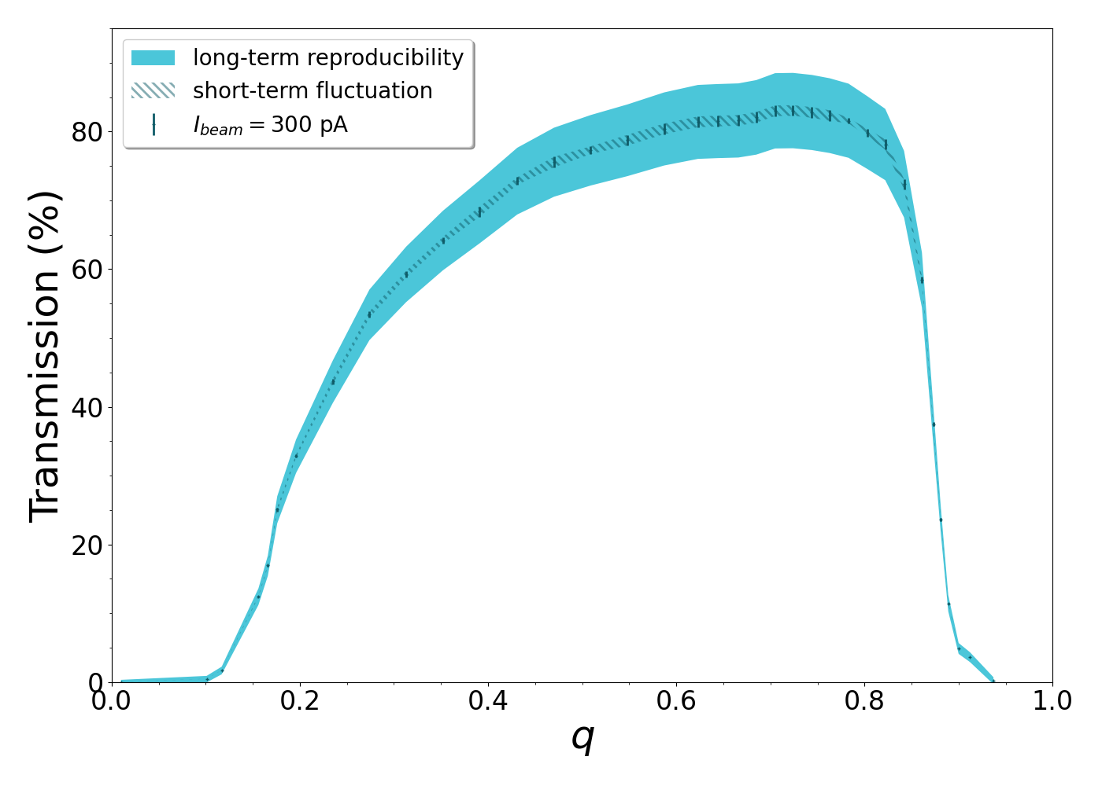

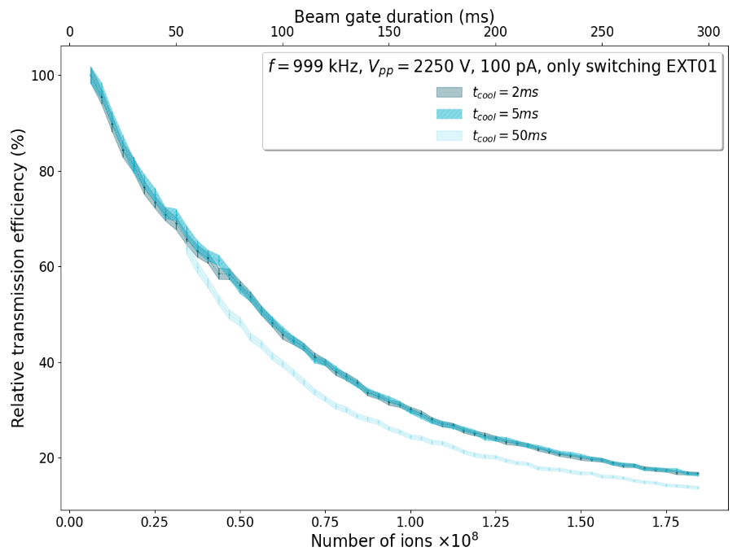
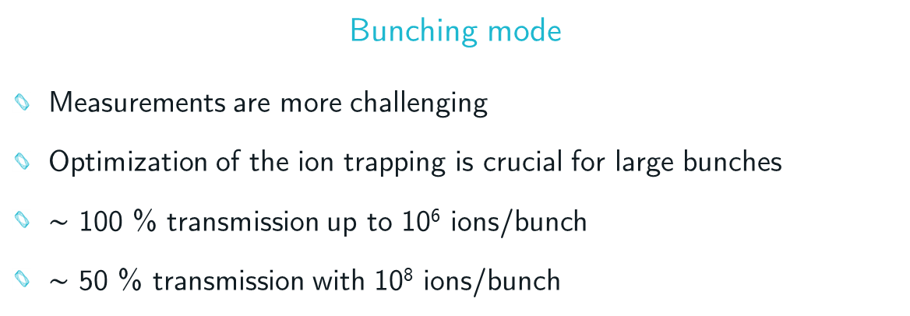
Transmission efficiency
Continuous mode
Transmission for K⁺ ions is routinely over 75 %
Careful optical tuning yields transmission >90 %
Transmission has little dependence on the beam current (up to nA)
Bunching mode
Measurements are more challenging
Optimization of the ion trapping is crucial for large bunches
$∼$ 100 % transmission up to 10⁶ ions/bunch
$∼$ 50 % transmission with 10⁸ ions/bunch
Outdated results

Slide 11
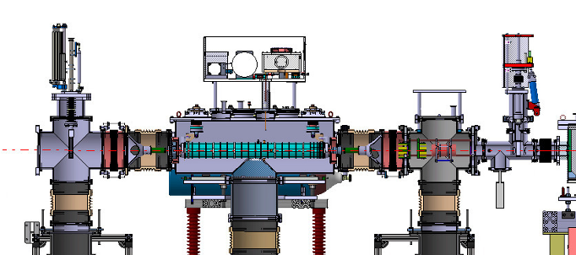
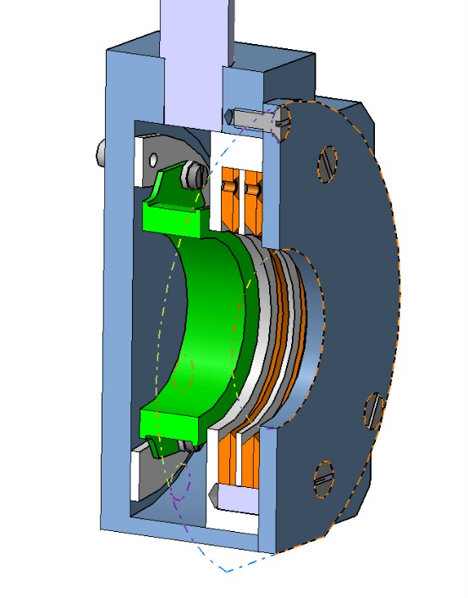
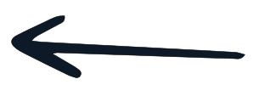

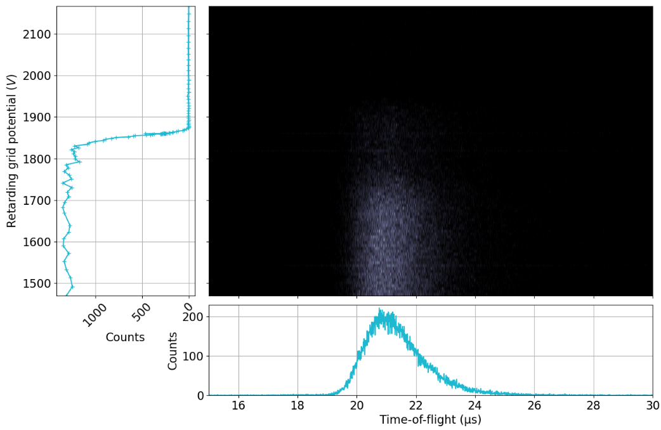
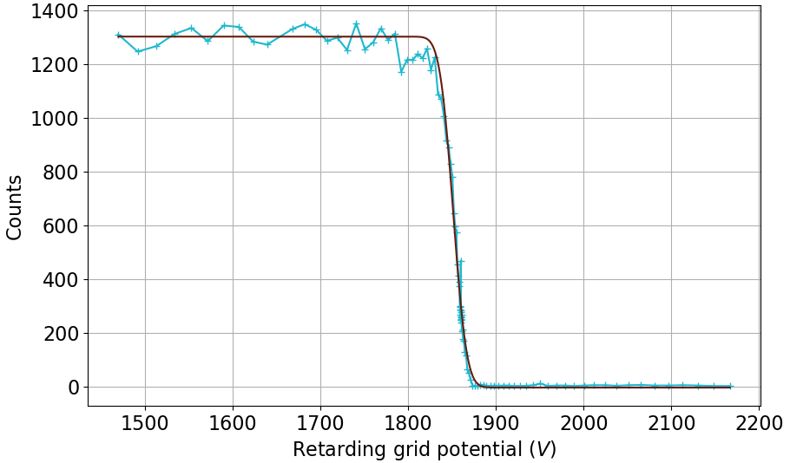
Energy and time dispersion measurement
Faraday
cup
Beam
MCP
Grounded grid
Retarding grid

Slide 12
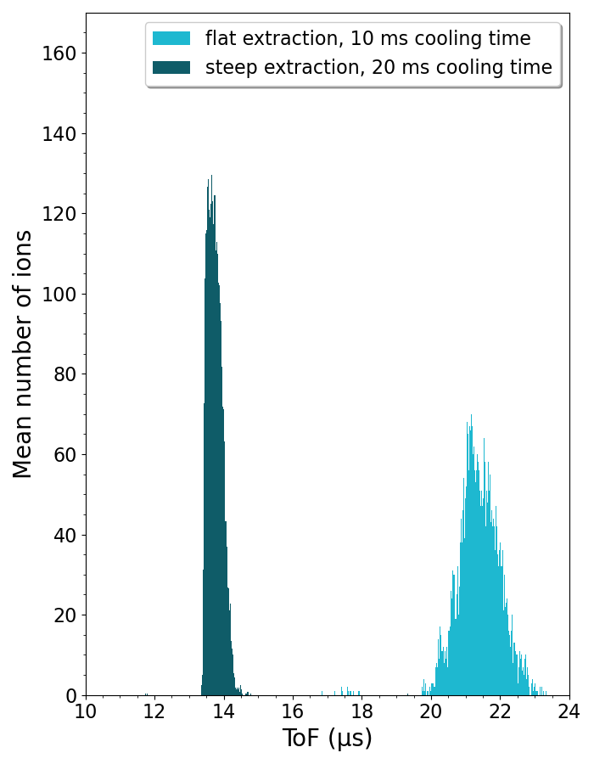
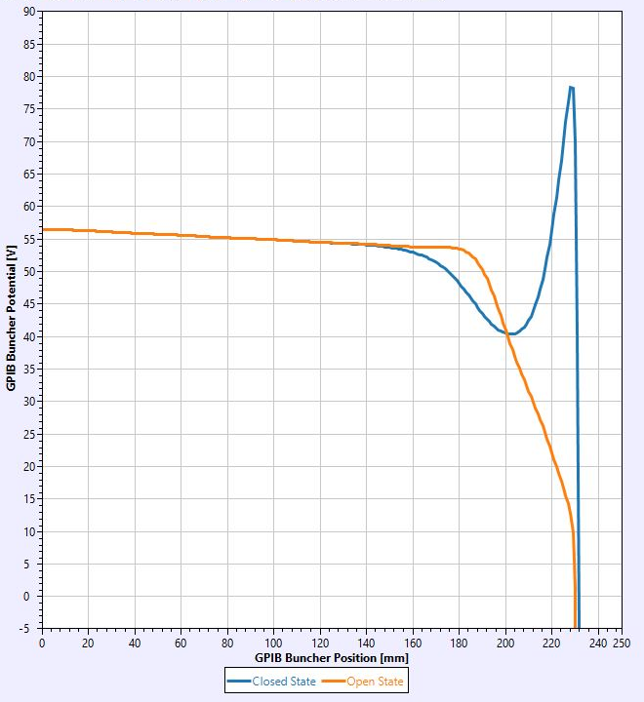
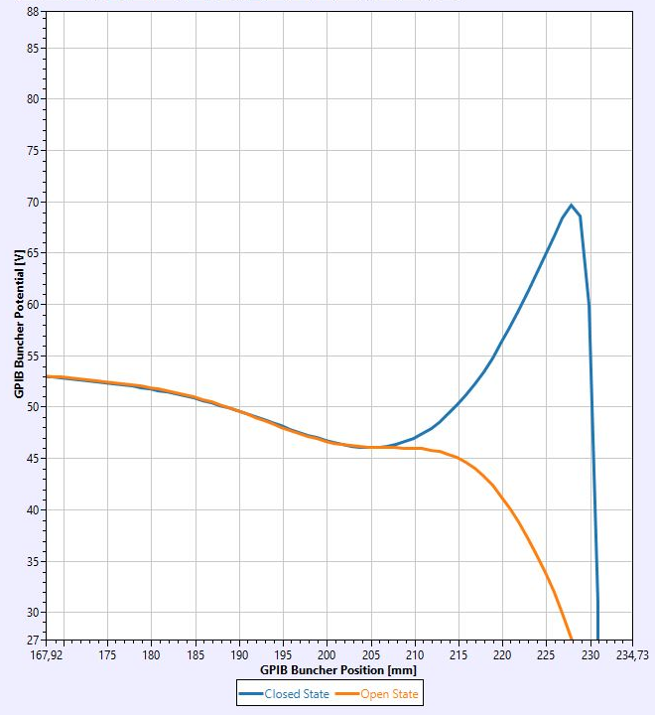

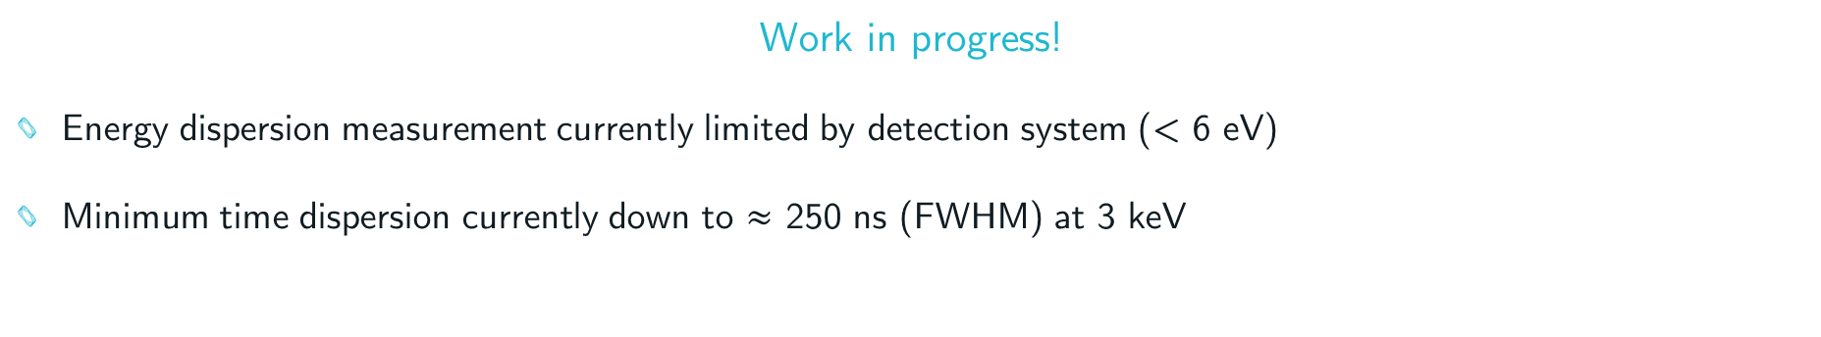
Energy and time dispersion measurement
Work in progress!
Energy dispersion measurement currently limited by detection system (< 6 eV)
Minimum time dispersion currently down to $≈$ 250 ns (FWHM) at 3 keV

Slide 13
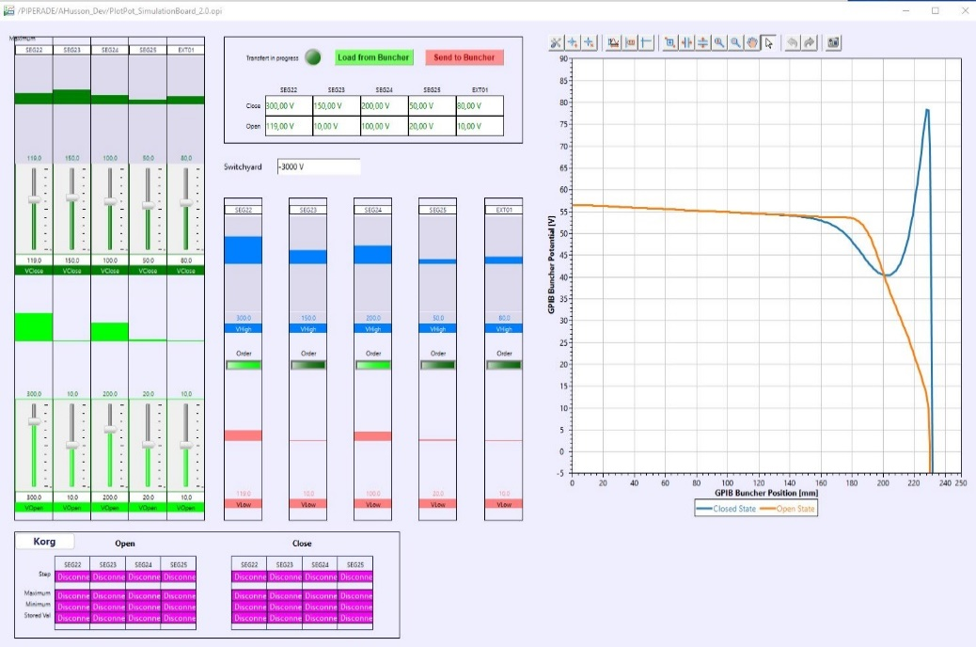
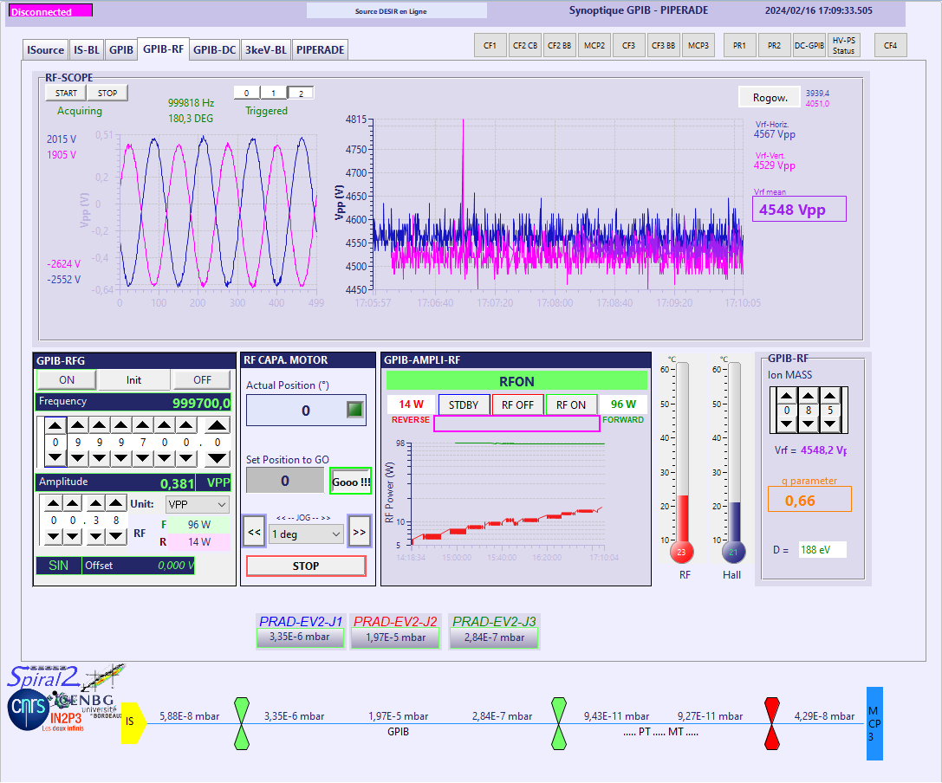
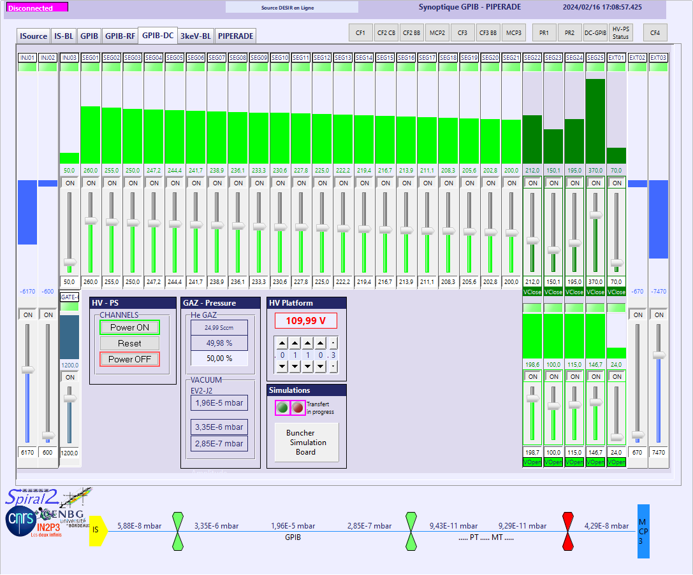
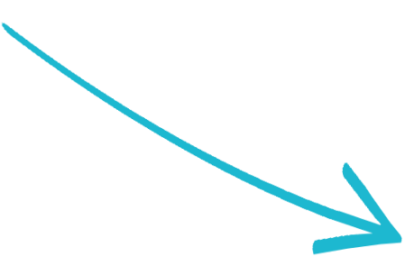
Control and command system
All equipment are now controlled through EPICS PVs
User friendly interface with CSS

Slide 14
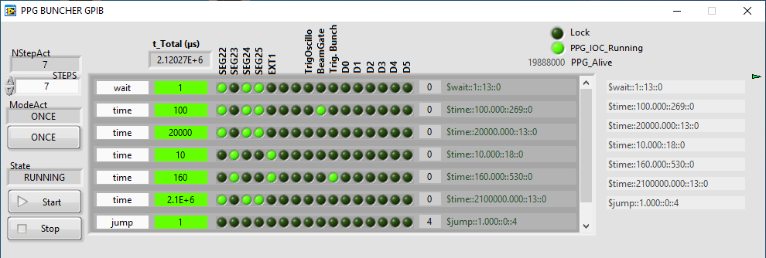
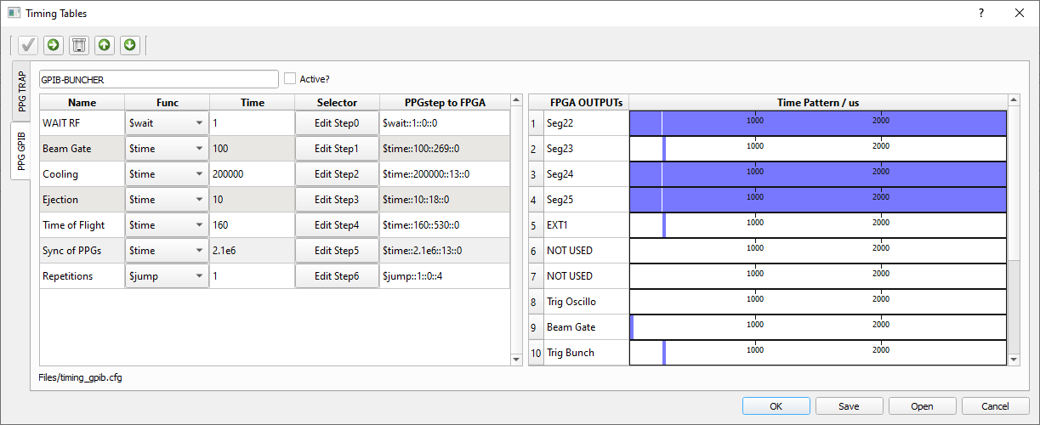
Control and command system
All equipment are now controlled through EPICS PVs
User friendly interface with CSS
Pattern generator for the timing of the switchable electrodes handled for now either by the PTSD program (using EPICS) or old LabView program

Slide 15
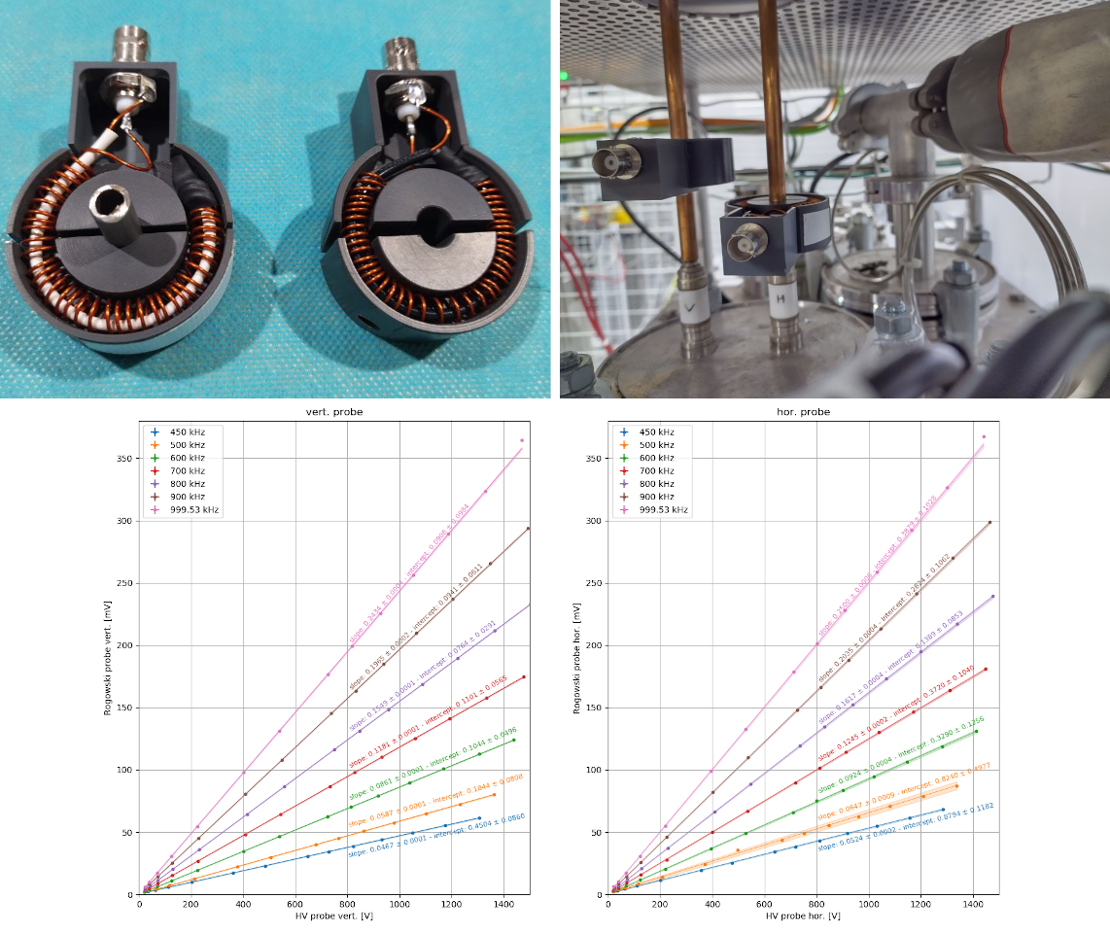
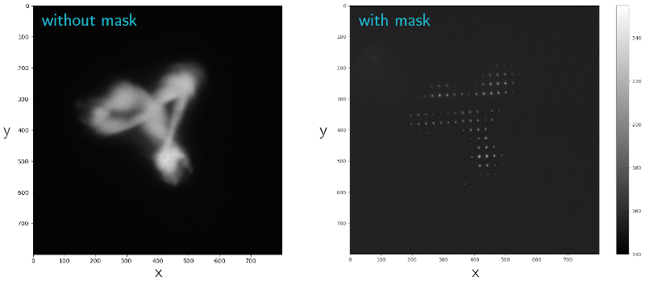
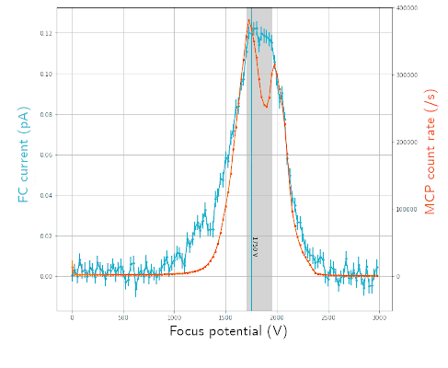

Recent developments
Rogowski probes to measure $V_{pp}>$ 4 kV
Autonomous CC developed for the Pantechnik pepper-pot emittance-scanner (EPICS compatible)
Improvement of the retarding grid system on the MCP

Slide 16
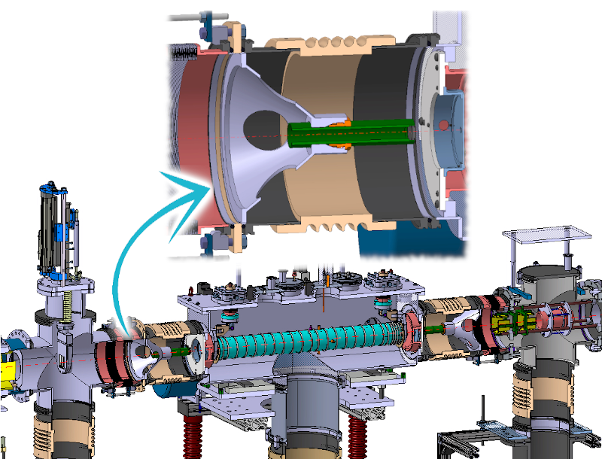
Planned upgrades
New bipolar power-supplies and switches combination for the last DC segments
New insulators and holding systems for the grounded electrodes at entrance and exit of the GPIB
Gas purification system (presently grade 6 He bottle)

Slide 17
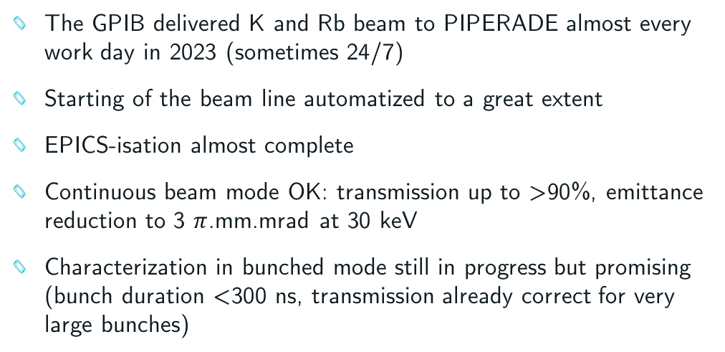
Conclusion
The GPIB delivered K and Rb beam to PIPERADE almost every work day in 2023 (sometimes 24/7)
Starting of the beam line automatized to a great extent
EPICS-isation almost complete
Continuous beam mode OK: transmission up to >90%, emittance reduction to 3 $π$.mm.mrad at 30 keV
Characterization in bunched mode still in progress but promising (bunch duration <300 ns, transmission already correct for very large bunches)
Still to be done:
  Tailor bunches to fit needs of downstream setups
  Increase RF voltage up to 8 kV_{pp} (?) to boost performances with large number of ions
  Reliable measurement of transmission and emittance (transverse and longitudinal) in bunching mode
GPIB should be sent fully operational to DESIR by 2025-2026
M.Gerbaux et al, The General Purpose Ion Buncher: A radiofrequency quadrupole cooler-buncher for DESIR at SPIRAL2, Nucl. Instrum. Methods Phys. Res. A 1046 (2023) 167631

Slide 18

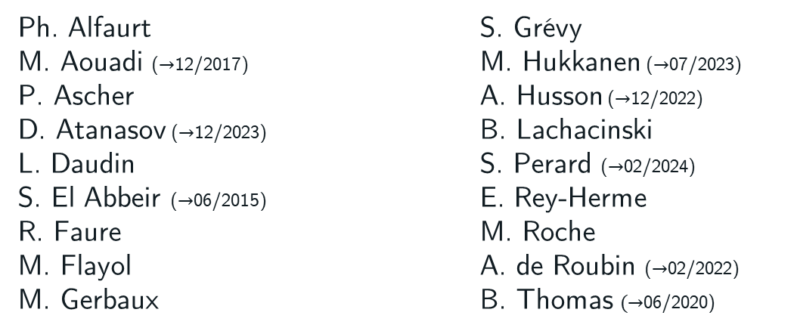
The bunch of cool people working (or having worked) on the GPIB
The GPIB + PIPERADE team at
Ph. Alfaurt
M. Aouadi ($→$12/2017)
P. Ascher
D. Atanasov ($→$12/2023)
L. Daudin
S. El Abbeir ($→$06/2015)
R. Faure
M. Flayol
M. Gerbaux
S. Grévy
M. Hukkanen ($→$07/2023)
A. Husson ($→$12/2022)
B. Lachacinski
S. Perard ($→$02/2024)
E. Rey-Herme
M. Roche
A. de Roubin ($→$02/2022)
B. Thomas $(→$06/2020)
Special thanks to…
D. Lunney (IJClab)
J.-C. Thomas (GANIL)
J.-F. Cam (LPC)
L. Lasne (Univ. Bordeaux)

Slide 20
Back-up

Slide 21
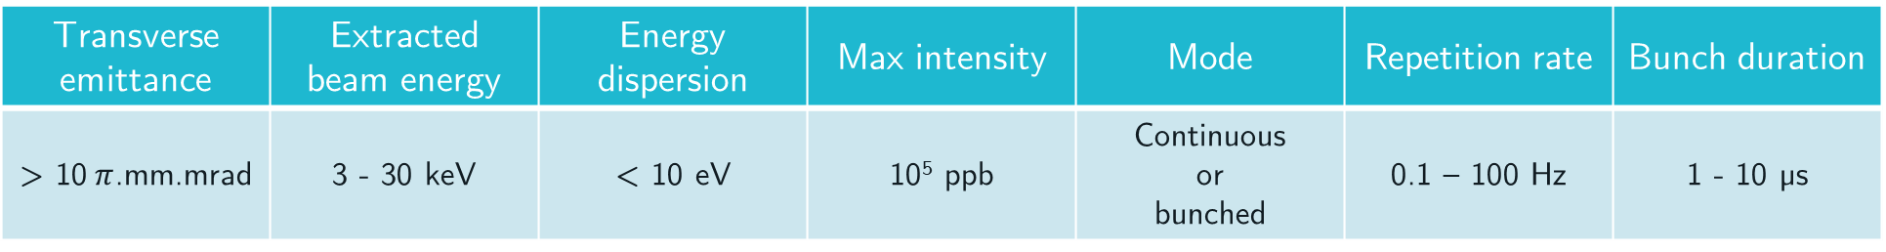
Requirements
What was asked for in the "technical specifications for DESIR beam" document :
Transverse emittance | Extracted beam energy | Energy dispersion | Max intensity | Mode | Repetition rate | Bunch duration
> 10$π$.mm.mrad | 3 - 30 keV | < 10 eV | 10⁵ ppb | Continuous or bunched | 0.1 – 100 Hz | 1 - 10 µs
And of course better if possible…

Slide 22


What has been done / what is still to be done
Extraction 30 keV | Continuous beam
 | Transmission |  | Transverse emittance |  | Energy dispersion
 | Low intensity | High intensity | Low intensity | High intensity | Low intensity | High intensity
 | 70 % < T < 93 % (with ^{(nat)}K) |  | $∼3 π$.mm.mrad (to be repeated) |  | Not accessible
 | Bunched beam
 | Transmission |  | Transverse emittance |  | Energy dispersion |  | ToF dispersion
 | Low intensity | High intensity | Low intensity | High intensity | Low intensity | High intensity | Low intensity | High intensity
 | X | X | Need ongoing developments on emittancemeter |  | X | X | < 10 µs (FWHM) | Need high attenuation
High intensity : >10⁸ ions/bunch or >100 pA (CW)
Extraction 3 keV | Continuous beam
 | Transmission |  | Transverse emittance |  | Energy dispersion
 | Low intensity | High intensity | Low intensity | High intensity | Low intensity | High intensity
 | 70 % < T < 90 % (with ^{(nat)}K) |  | Need ongoing developments on emittancemeter ($∼10 π$.mm.mrad) |  | Not accessible unless coupling with HRS
 | Bunched beam
 | Transmission |  | Transverse emittance |  | Energy dispersion |  | ToF dispersion
 | Low intensity | High intensity | Low intensity | High intensity | Low intensity | High intensity | Low intensity | High intensity
 | Up to 100% | $∼$ 50% (with 10⁹ ions) | Need ongoing developments on emittancemeter |  | < 6 eV (currently limited by detector) | Need high attenuation | 250 ns - 1,5 µs (FWHM) | < 10 µs (FWHM)

Slide 23
Specifications GPIB for DESIR
As in the "specifications techniques pour les faisceaux DESIR" document (2021)

Slide 24





Why to use a cooler ?
Typical emittance of a few 10-keV RIB : several 10 $π$.mm.mrad
Typical needs for traps: a few $π$.mm.mrad
Cooling needed!
Collisions with buffer gas
Damping of the motion in all directions
Confinement needed to avoid Coulomb repulsion

Slide 25



3-keV line
90° electrostatic deflector currently on a separate test-bench
Dedicated ion source
Detector tests (retarding grid, emittance-scanner)
Transmission measurement with low charge bunches
Optimization of energy dispersion measurement
Emittance measurement (aberrations ?)
Feasibility of ToF and energy measurement over whole intensity range ?
High intensity (>10⁴ ions/bunch) → FC with Femto current transimpedance amplifier
Low intensity (<1000 ions/bunch) → MCP

Slide 26



RF system
Adjustable
ground
20 dB
Directional
coupler
6 dB
Primary
winding
Power
amplifier
Secondary
windings
attenuator
attenuator
Tunable
capacitor
Function generator
Osc. ch1
Osc. ch2
Osc. ch3
RFQ
Osc. ch4

Slide 27


A closer look at the mechanical design
DC segment 1$→$25
Grounded
electrode
RF rod
Ext1
RF feeding
Ext2
Ext3
Grounded
electrode
Inj1
Inj3
Inj2

Slide 28


Hard or soft extraction

