Slide 1

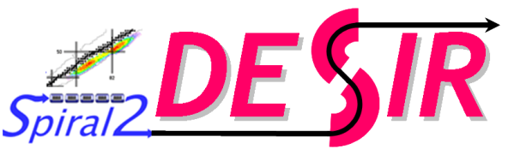

Commissioning of the DESIR HRS
A High Resolution Separator for low energy physics at GANIL
Speaker : Julien Michaud
Authors : J. Michaud, P. Alfaurt, A. Balana, B. Blank, L. Daudin,T. Kurtukian, B. Lachacinski,
F. Méot, L. Serani, F. Varenne

Slide 2
Contents
The DESIR HRS
Optical aberrations : detection and correction
Spectrometer characterisation

Slide 3
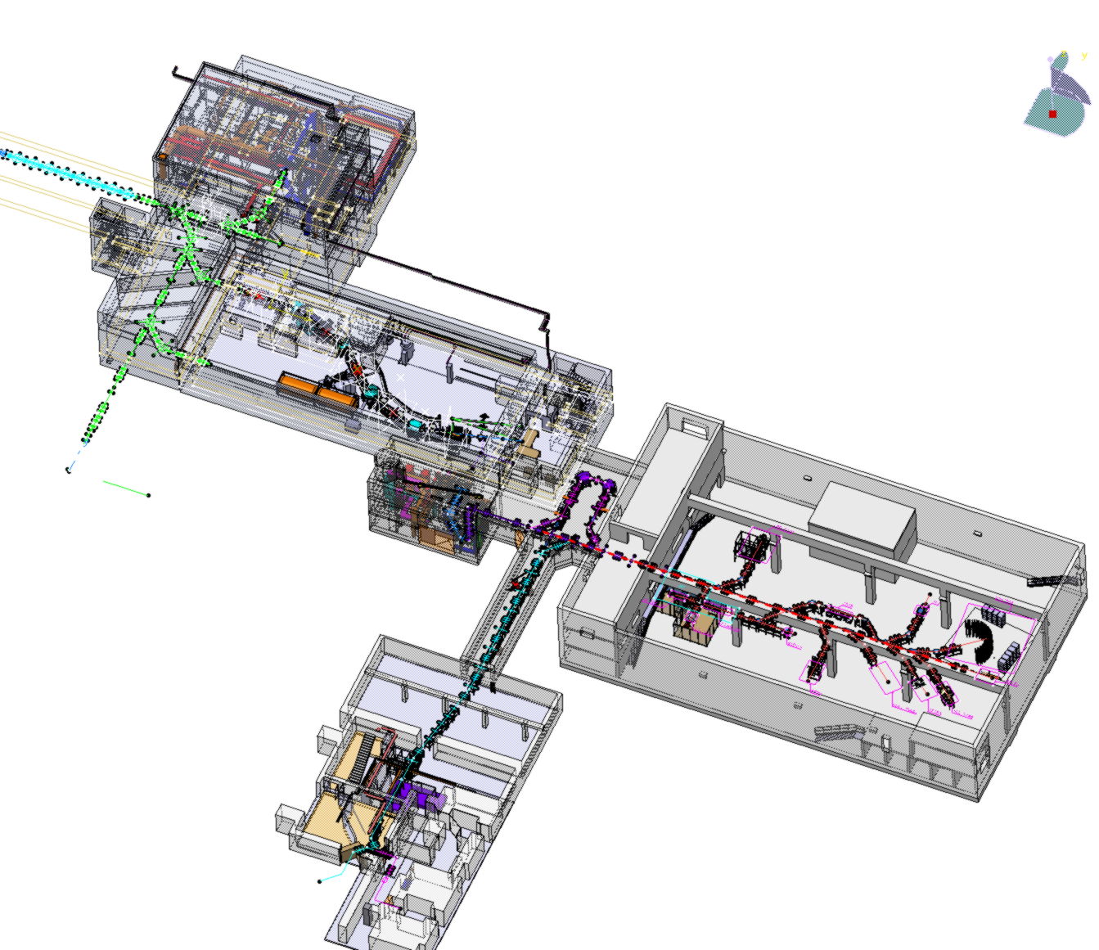


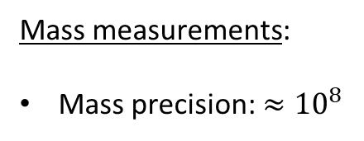
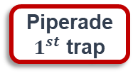
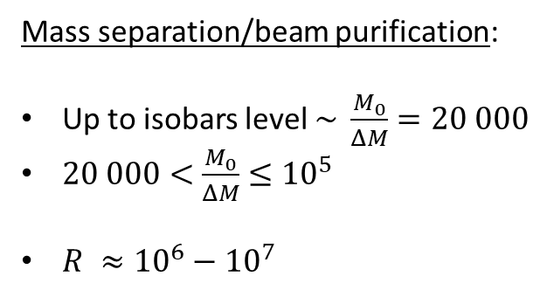
Beam preparation for DESIR – LP2I Bordeaux contribution
High Resolution Separator
HRS
Mass separation/beam purification:
Up to isobars level $\sim \frac{M_{0}}{ΔM}=20 000$
$20 000<$ $\frac{M_{0}}{ΔM}≤{10}^{5}$
$R ≈{10}^{6}−{10}^{7}$
RFQ-Cooler Buncher
GPIB
HRS
Piperade
$1^{st}$ trap
Double Penning Trap
Piperade
2nd trap
Beam preparation:
Cooling and bunching
Accumulation trap
GPIB
Next talk
Piperade
2nd trap
By A. Husson
Mass measurements:
Mass precision:$≈{10}^{8}$
Piperade
2nd trap
Optimal performances can be reached only if a 1st good cleaning is done with the HRS

Slide 4
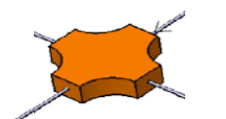
The HRS
HRS: High Resolution mass Separator
Lattice [1] and elements:
D : Two 90° magnetic dipoles (36° entrance/exit angles)
MQ : Matching quadrupoles
FQ : Focusing quadrupoles
FS : Focusing sextupoles
M : A multipole (up to 5th order)
Electrostatic
Configuration: MQ-MQ-FS-FQ-D-M-D-FQ-FS-MQ-MQ
Mirror symetry is imposed to minimize aberrations
[1] T. Kurtukian Nieto, R. Baartman, B. Blank, T. Chiron, C.
Davids, et al.. SPIRAL2/DESIR high resolution mass separator.
Nuclear Instruments and Methods in Physics Research Section
B: Beam Interactions with Materials and Atoms, Elsevier, 2013,
317, pp.284-289.

Slide 5
The HRS at LP2I Bordeaux

Slide 6
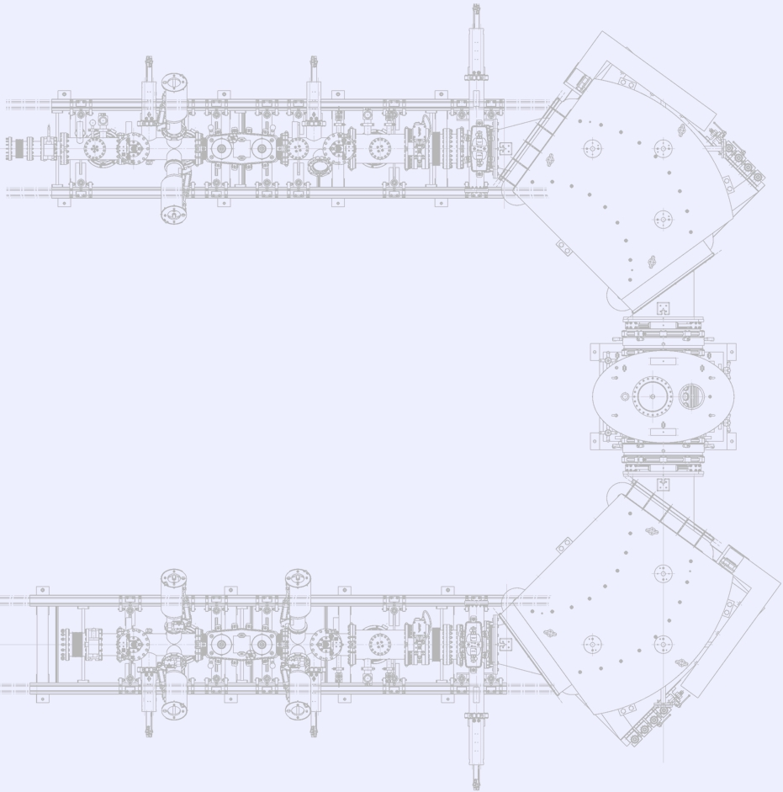


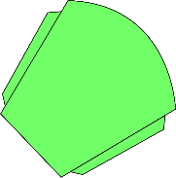





HRS synoptics: a compact beamline
${{}_{}^{133}{Cs}}^{1+}$ ions source
DC11-HO
Q11
Q13
F21
Q22
DC21-HO
F22
PR22
Q23
F31
DC11-VE
Q12
PR21
CF21
Q21
DC21-VE
CF22
H21
D31
PR31
: Magnetic
dipole
: Electrostatic
deflector
: Electrostatic
quadrupole
: Electrostatic
sextupole
Electrostatic multipole
: Beam profiler
: Faraday cup
: Adjustable slits
: Vaccum valve
PR32
D32
CF42
PR42
Q42
CF41
PR41
DC41-VE
Q41
Pepperpot-type
emittance-meter
F42
Q43
F41
DC41-HO
H41
F32

Slide 7
Contents
The DESIR HRS
Optical aberrations : detection and correction
Spectrometer characterisation

Slide 8
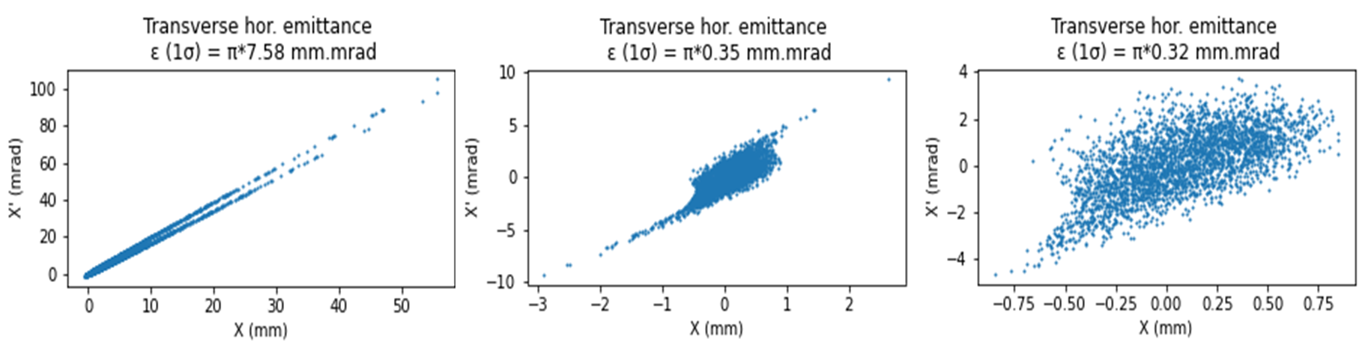
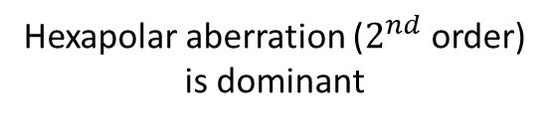
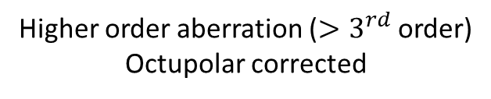
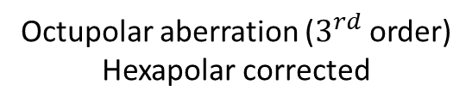
Different levels of aberrations (simulations)
Hexapolar aberration ($2^{nd}$ order)
is dominant
Octupolar aberration ($3^{rd}$ order)
Hexapolar corrected
Higher order aberration (${>3}^{rd}$ order)
Octupolar corrected
Typically « C-shaped »
Typically « S-shaped »
Optical aberrations tend to increase the beam size and need to be corrected

Slide 9
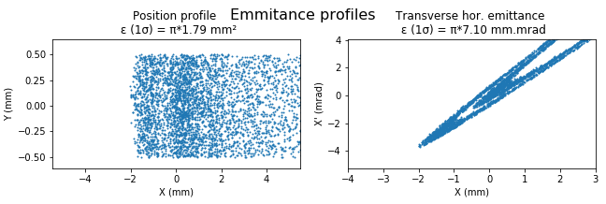
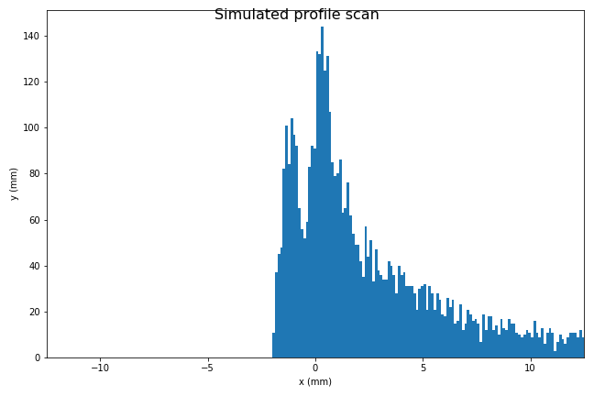
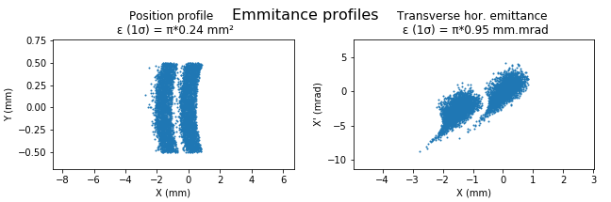
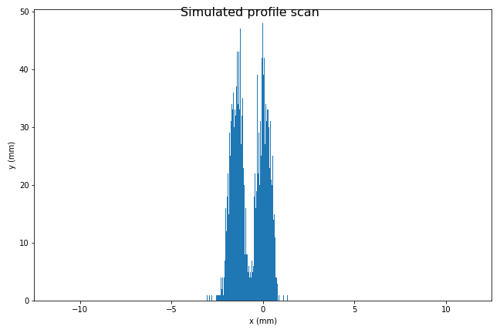
Effect of optical aberrations on beam separation (simulations)
Beam position spectra
Front view of the beam
Emittance profile (XX’)
Hexapolar aberration dominant
(HRS-like)
Corrected beam (few aberrations)

Slide 10
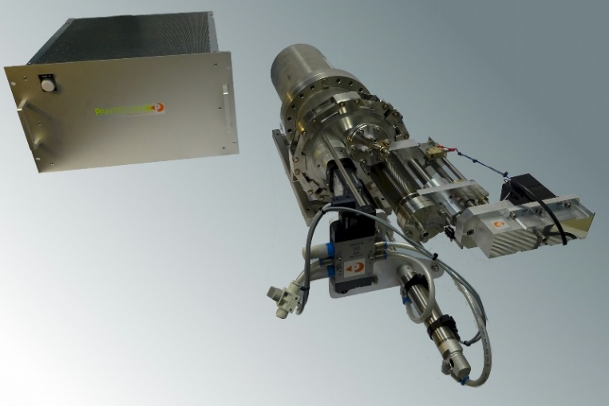
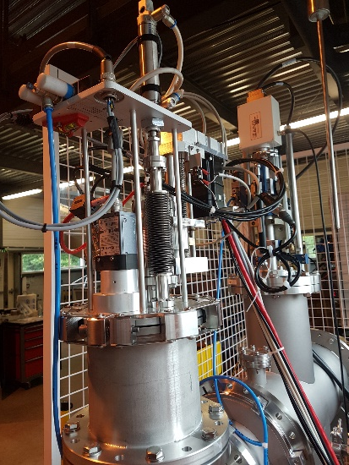
Measurement of aberrations
Front view: tantal mask
Side view:
MCP + Phosphore screen
Front view:
CCD camera
Pepperpot
Emittance-meter
23/02/2024

Slide 11
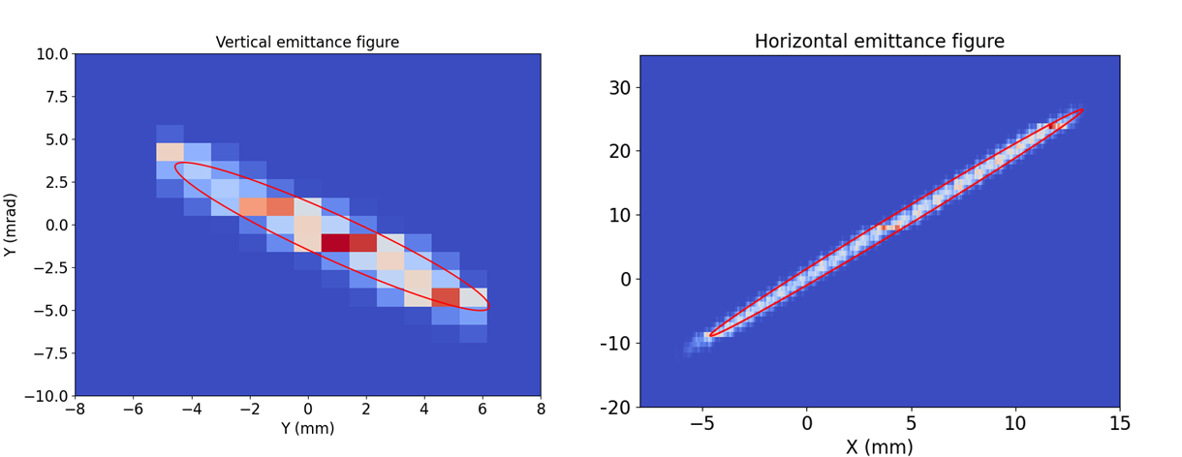

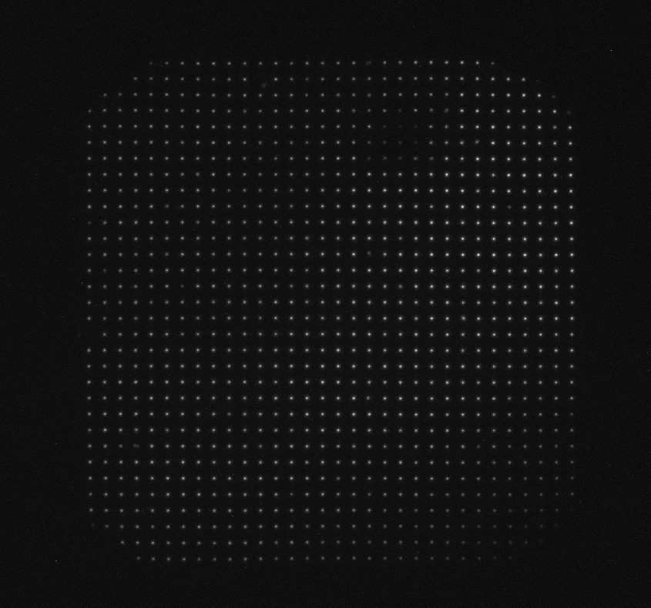
Recent upgrade of the emittance-meter
1D motorized mask
➔
2D motorized mask(!)
Emit vertical : 40 points
Emit horizontal : 400 points
10 steps = 10 points measured
10 steps = 400 points measured
New : motorized 2D mask allows for finer and faster sampling.
Allows for « live » emittance measurements.
Cons : fixed size between the holes. The emitttance-meter must be taylored to the measured beam (beam size and divergence must already be known).

Slide 12
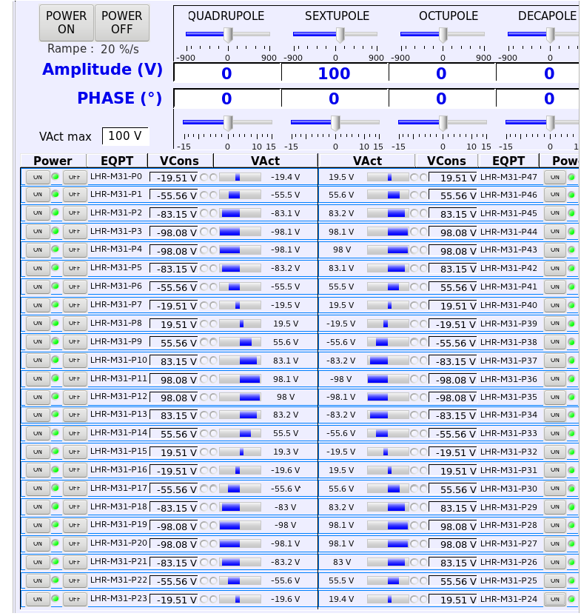
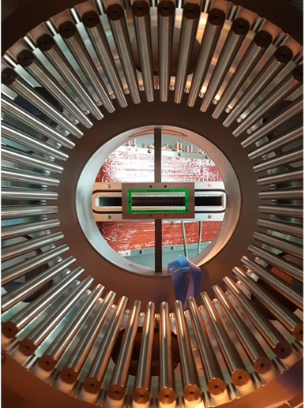
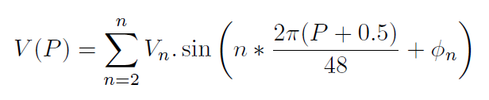
Correct the aberrations with the multipole
The 48-pole electrostatic multipole

Slide 13
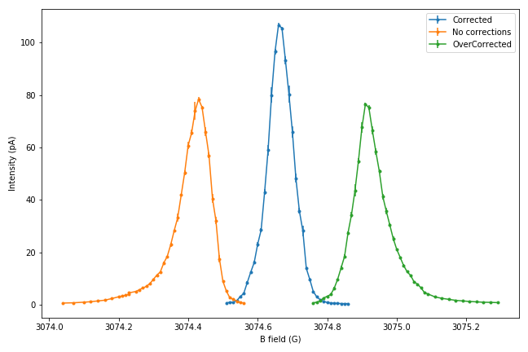
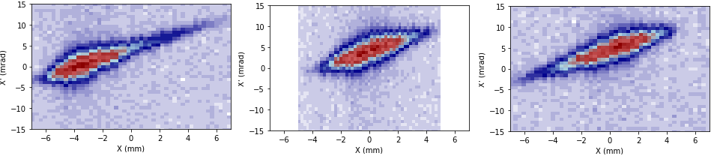
Hexapolar correction (2nd order)
Corrected
-> Shifted left -0,2G
-> Shifted right +0,2G
Not corrected
Overcorrected
Beam profiles obtained by scanning the beam with the dipoles (more precise than wire profilers)
Emittance
measurements
Projection on x axis gives beam profiles

Slide 14
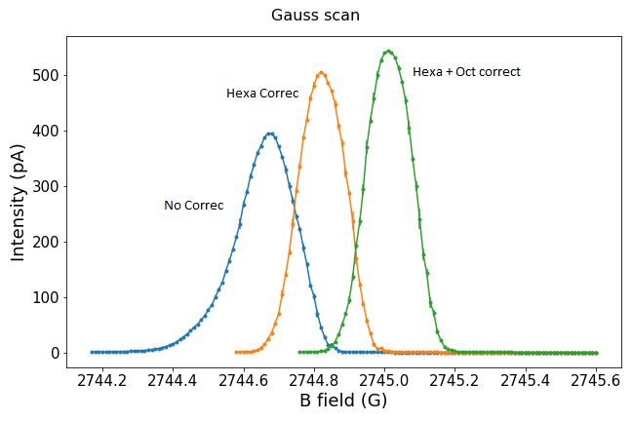
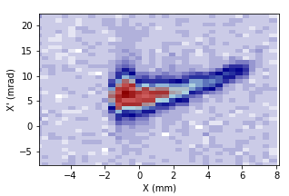
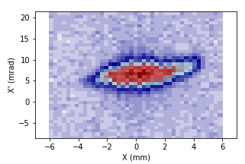
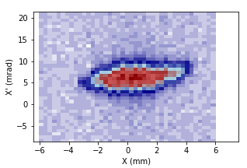
Higher order correction (up to 3rd order)
Hard to see a change, but a computer should

Slide 15
Contents
The DESIR HRS
Optical aberrations : detection and correction
Spectrometer characterisation

Slide 16
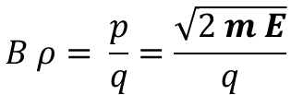
Measuring the resolution of a spectrometer/separator
HRS source: ${}_{ }^{133}{{Cs}^{1+}}⇒\text{monoisotopic} \text{ion} \text{source}\text{: }$no direct mass measurement/separation possible
$$B ρ= \frac{p}{q}=\frac{\sqrt{2 m E}}{q}$$
Dipoles work the same for mass or energy shift (momentum separation) at first order
But :
It can also be observed in the HRS transfer matrices where: {x , $\frac{ΔM}{M}$} = {x , $\frac{ΔE}{E}$} = -31 cm/%
Resolution can be measured by measuring position/size of two beams with close energies

Slide 17
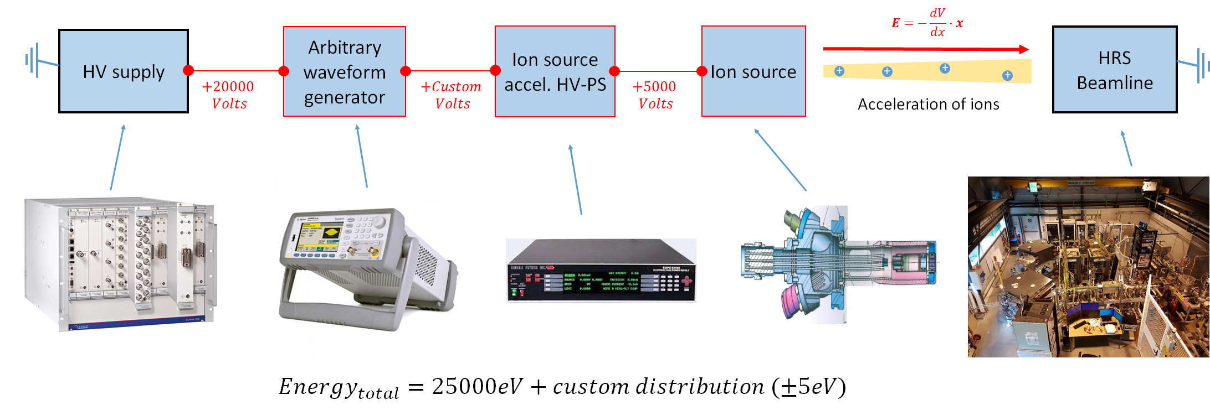
Populate multiple energies of a beam
Acceleration of ions depends on the potential between the source and the beamline
High voltage supplies can’t handle fast and small voltage variations (less than 1V on many kV)
A pulse generator can supply such variations

Slide 18
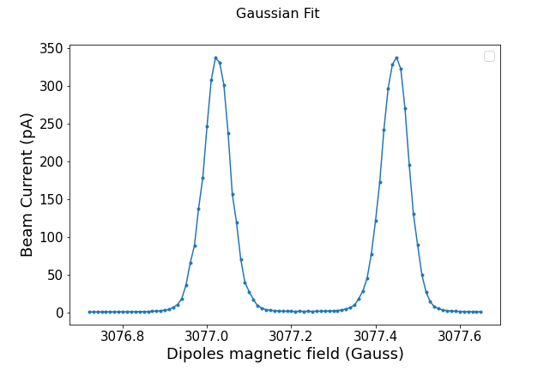
Signal generator : square signal
Square signal
Duplicates the beam into 2 close energies beams
V : +3V
Energy 1 = 25003eV
Populates ONLY
two energies
V : -3V
Energy 2 = 24997eV
Energy separation can be arbitrary set

Slide 19
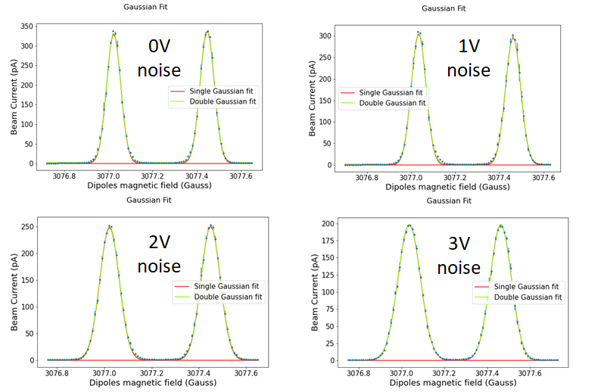
Square signal with noise
A square signal populates two and only two energies.
Adding noise to the signal increases the energy dispersion of the beam.
V : +3V
Energy 1 = 25003eV
V : -3V
Energy 2 = 24997eV

Slide 20
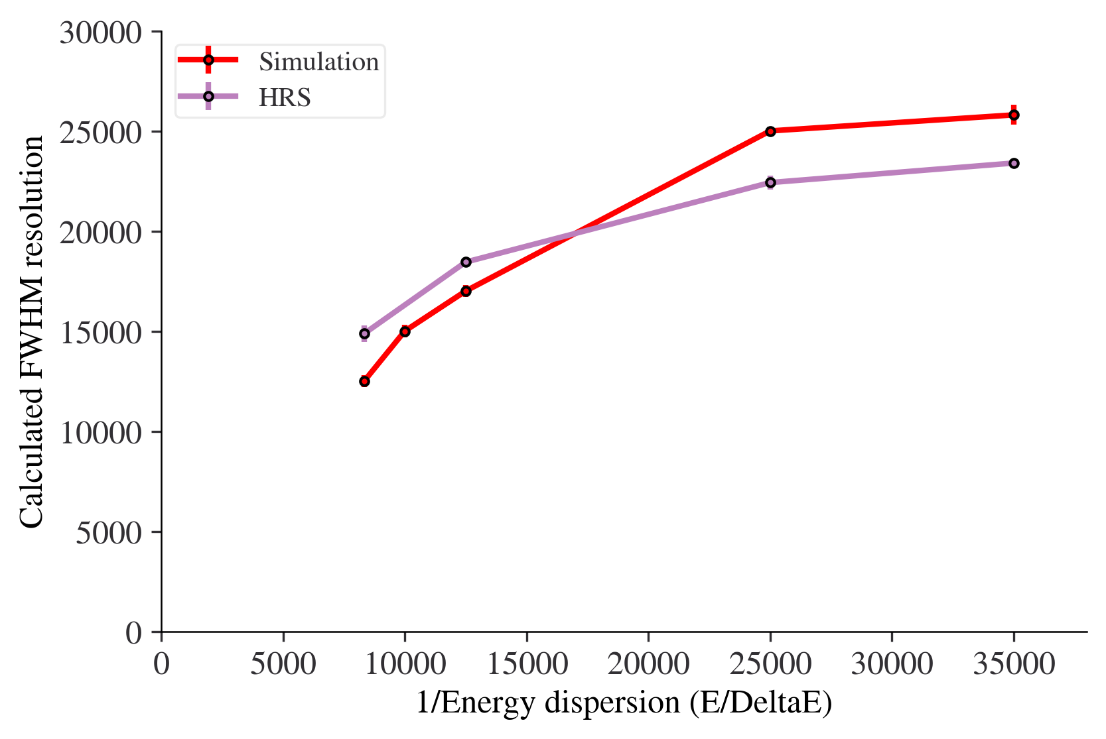

Square signal with noise
A square signal populates two and only two energies.
Adding noise to the signal increases the energy dispersion of the beam.
V : +3V
Energy 1 = 25003eV
V : -3V
Energy 2 = 24997eV
The HRS resolution can be caracterized as a function of the beam energy dispersion

Slide 21
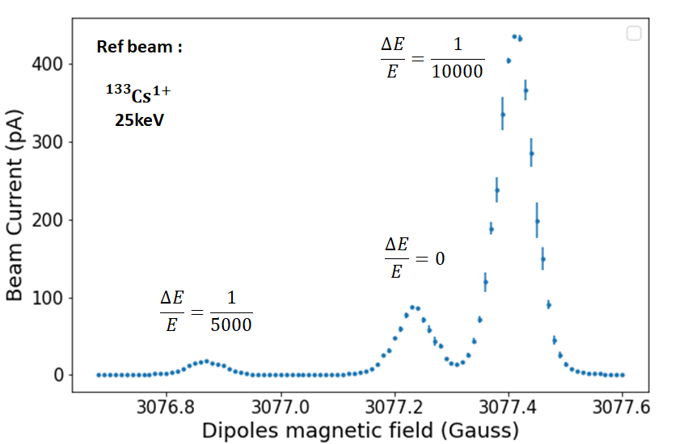
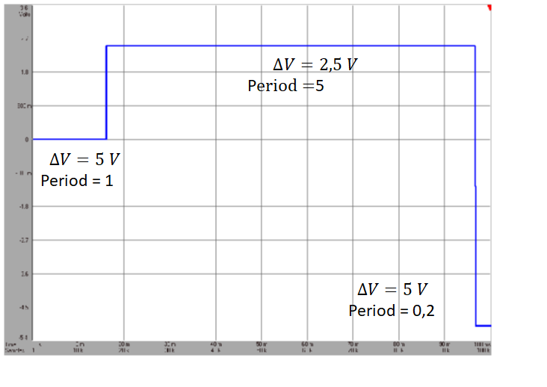



To go further…
A signal with multiple steps with adjustable amplitude and length can create (almost real) beam contaminants
$$∆V=2.5V$$
Period = 5
Create custom beam contaminants
0V
$$∆V=0V$$
Period = 1
$$∆V=−5V$$
Period = 0.2
The HRS can be commissioned in almost real operating conditions, with no radioactive beam and (relatively) high intensities

Slide 22
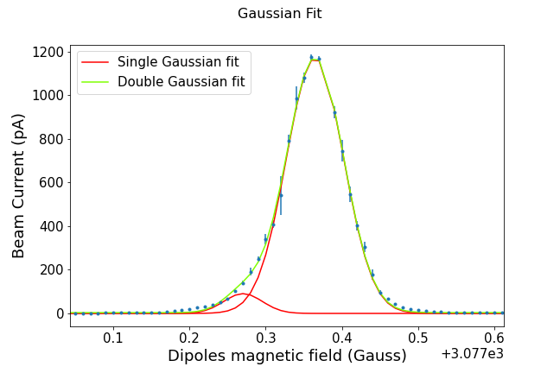
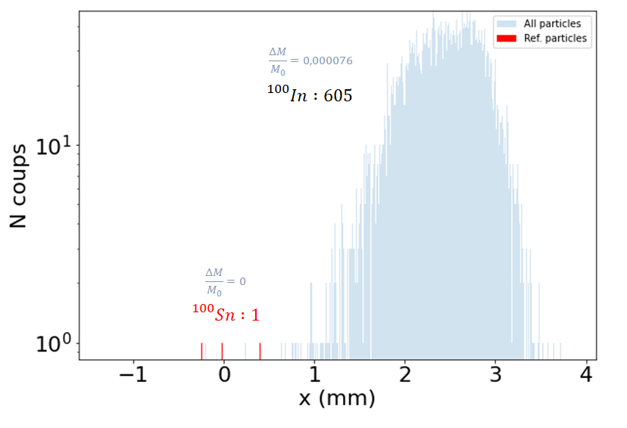

A concrete example : separation of 100Sn and 100In
Simulation (COSY infinity)
Experimental separation
$$\frac{∆M}{M_{0}}=\frac{1}{13157}$$
Prod. Ratio
1:605
Highly produced contaminants with close masses are still difficult to separate, in our case :
The major quantity of the contaminant can be separated.
Beam can be almost totally purified by sacrifying a part of the beam of interest.
Send the beam to a higher-level purification device (Penning trap : PIPERADE).

Slide 23
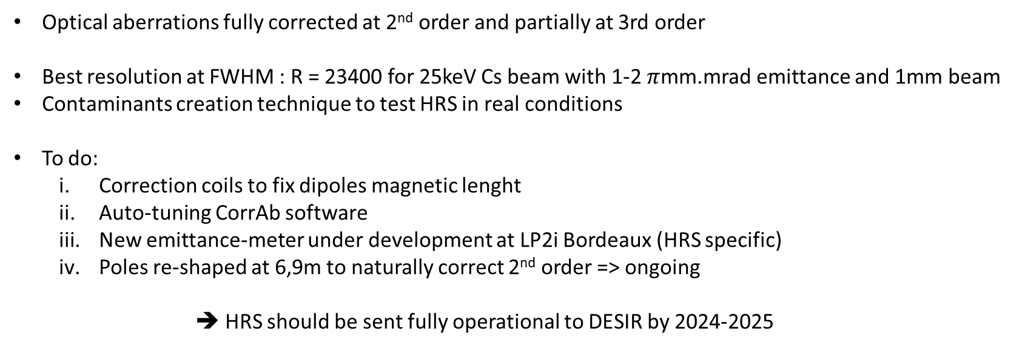
Conclusion
Optical aberrations fully corrected at 2nd order and partially at 3rd order
Best resolution at FWHM : R = 23400 for 25keV Cs beam with 1-2 $π$mm.mrad emittance and 1mm beam
Contaminants creation technique to test HRS in real conditions
To do:
  Correction coils to fix dipoles magnetic lenght
  Auto-tuning CorrAb software
  New emittance-meter under development at LP2i Bordeaux (HRS specific)
  Poles re-shaped at 6,9m to naturally correct 2nd order => ongoing
➔ HRS should be sent fully operational to DESIR by 2024-2025

Slide 24
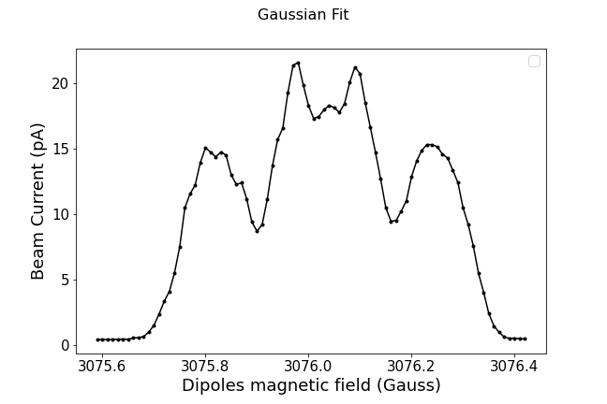
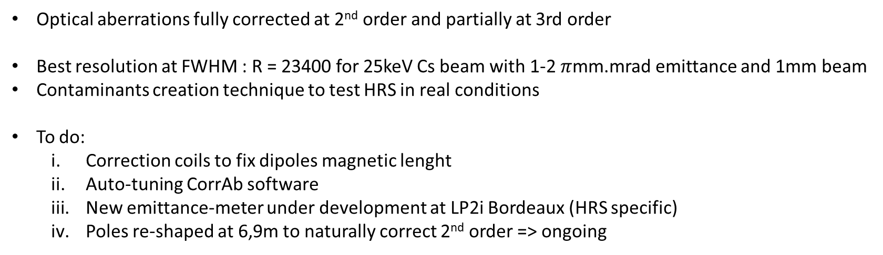
Conclusion
Optical aberrations fully corrected at 2nd order and partially at 3rd order
Best resolution at FWHM : R = 23400 for 25keV Cs beam with 1-2 $π$mm.mrad emittance and 1mm beam
Contaminants creation technique to test HRS in real conditions
To do:
  Correction coils to fix dipoles magnetic lenght
  Auto-tuning CorrAb software
  New emittance-meter under development at LP2i Bordeaux (HRS specific)
  Poles re-shaped at 6,9m to naturally correct 2nd order => ongoing
THANK YOU !
Bonus : the bat-beam

