Slide 1
Analysis Aifira experiment
14 – 23/02/2022

Slide 2
• • • Nuclei from the T=2, A=32, I^{p} = 0+ mulitiplet
³²Ar --- ³²Si:
Mirror nuclei
Same isospin T = 2
Opposite T_{z} -2 versus +2
Tz = (N – Z) / 2
Nuclei in between have
also T = 2 states

Slide 3
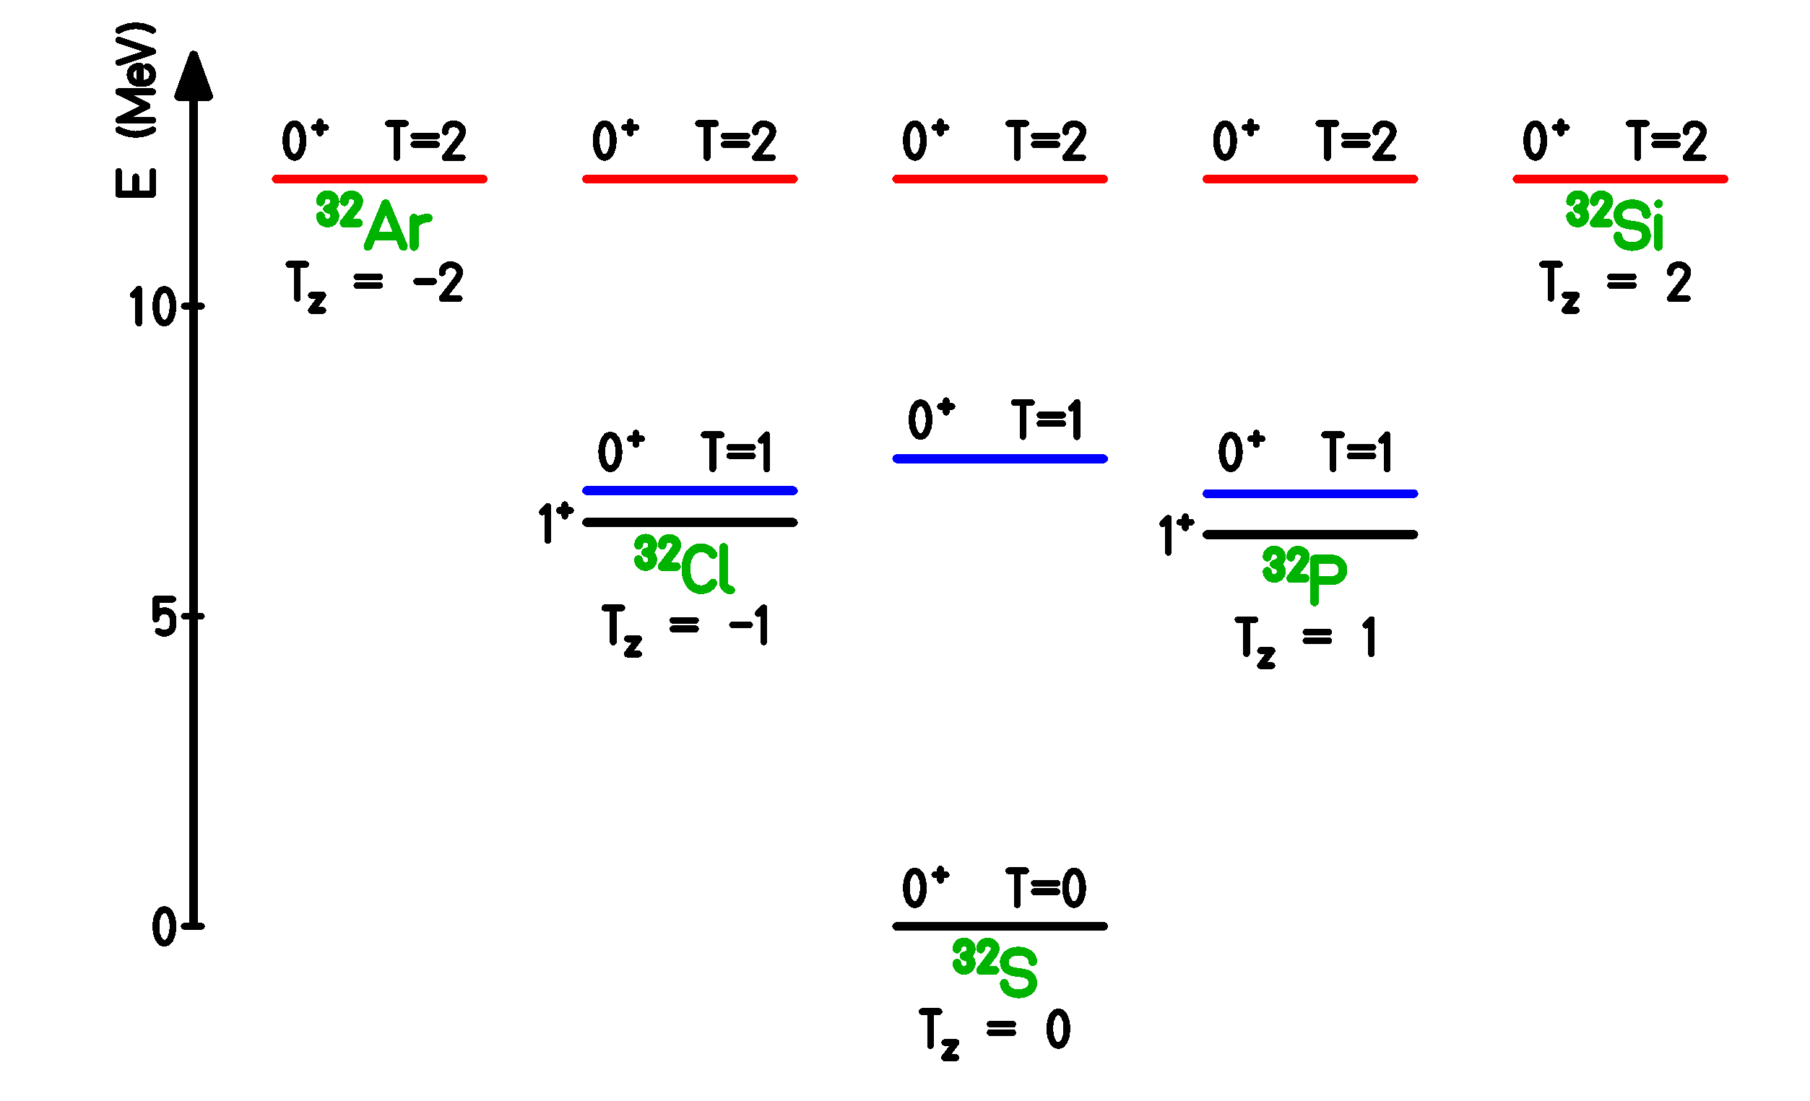
• • • Nuclei from the T=2, A=32, I^{p} = 0+ mulitiplet
All “red” states are linked
via a fundamental formula.
All “blue” states are linked
as well.
They are isobaric analog
states “IAS”
Only difference: T_{z}

Slide 4
• • • Isobaric Multiplet Mass Equation: IMME
Wigner (1957): First order perturbation theory
IMME : M(Tz) = a + bT_{z} + cT_{z}²

Slide 5
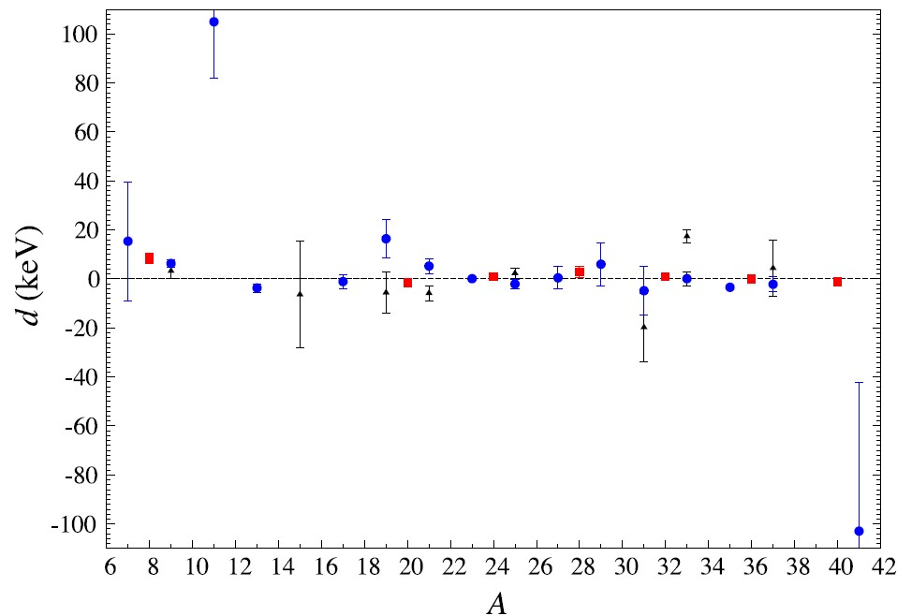
• • • Isobaric Multiplet Mass Equation: IMME
Wigner (1957):
IMME : M(Tz) = a + bT_{z} + cT_{z}² + dT_{z}³ + eT_{z}⁴
T = 3/2
T = 2
T = 3/2 *
non 0 with 8 σ
Y.H. Lam et al., ADNDT 99 (2013) 680

Slide 6
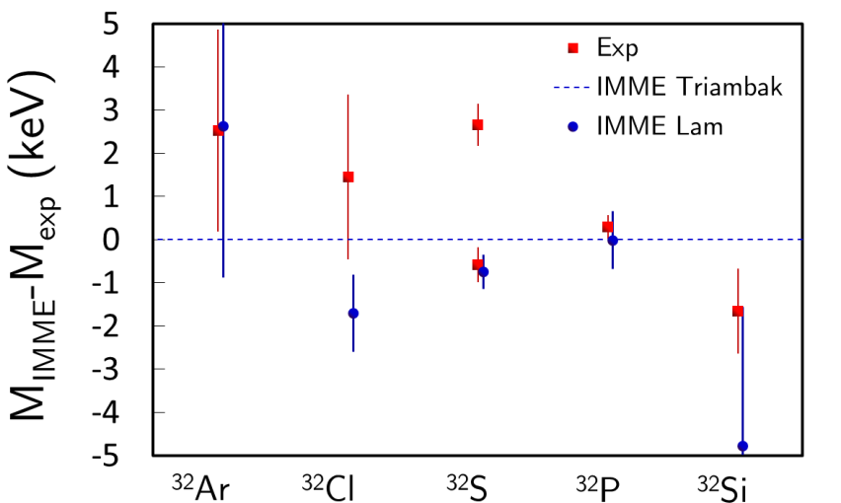
• • • Isobaric Multiplet Mass Equation for A=32, T=2
Wigner (1957):
IMME : M(Tz) = a + bT_{z} + cT_{z}²

Slide 7
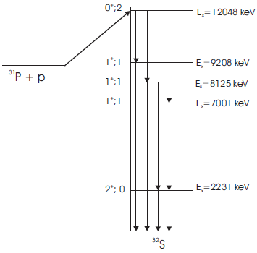
• • • AIFIRA experiment
, IAS
3,285 MeV
Determine precisely the excitation energy of T=2 state at 12.05 MeV by detection of γ-ray cascades
Calibration with
²⁷Al(p,γ)²⁸Si
²³Na(p,γ)²⁴Mg
³⁵Cl(n,γ)³⁶Cl
⁵⁶Co
High electrical stability
High thermal stability
High mechanical stability
8 γ rays
with energies
between
2231 keV and
9208 keV

Slide 8
• • • AIFIRA experiment: set-up
beam

Slide 9
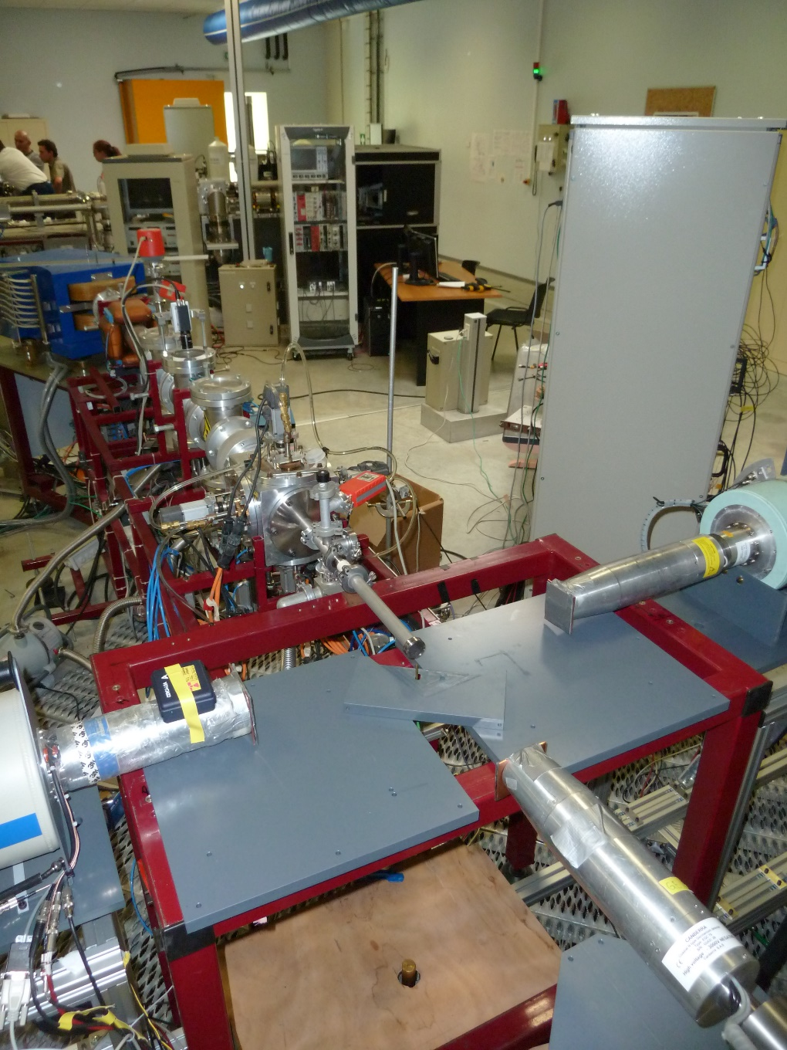
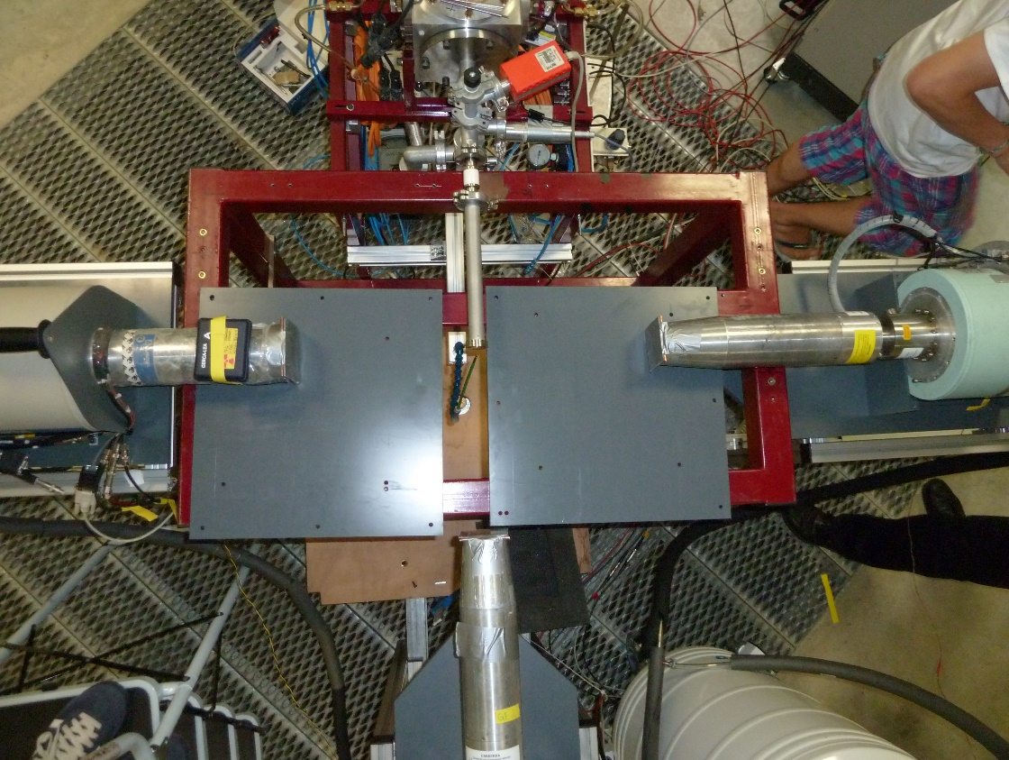
• • • AIFIRA experiment: tests
Several tests to find the correct
beam energy: 2014, 2016, 2018

Slide 10
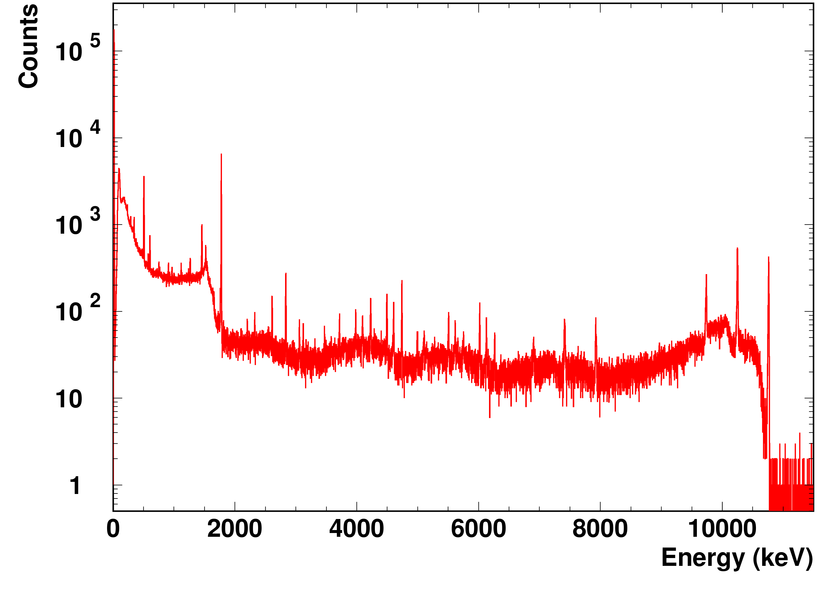
• • • AIFIRA experiment: experimental spectra
²⁷Al(p,γ)²⁸Si at 992 keV
1779.0 keV
2018
10762.9 keV
2614.5 keV
6019.9 keV
Typical precision: 0.1 – 0.5 keV
Time: 1.0 h
Rate: 600 pps ➔ can be increased ?

Slide 11
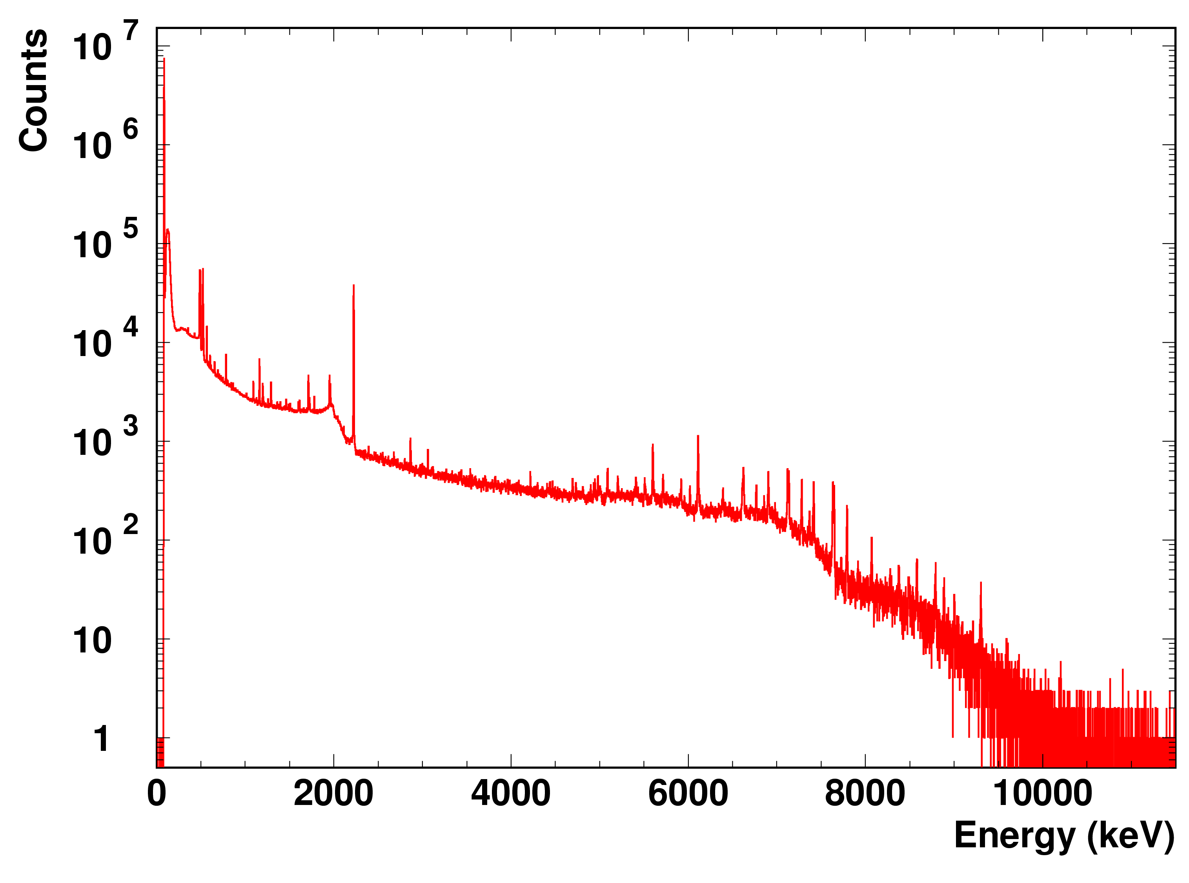
• • • AIFIRA experiment: experimental spectra
³⁵Cl(n,γ)³⁶Cl
2014
1950.9 / 1959.1 keV
1164.7 keV
6110.8 keV
7413.7 keV
7790.0 keV
8578.2 keV
Typical precision: 0.1 – 0.7 keV
Time: 1.5 h
Rate: 8500 pps ➔ lead shielding

Slide 12
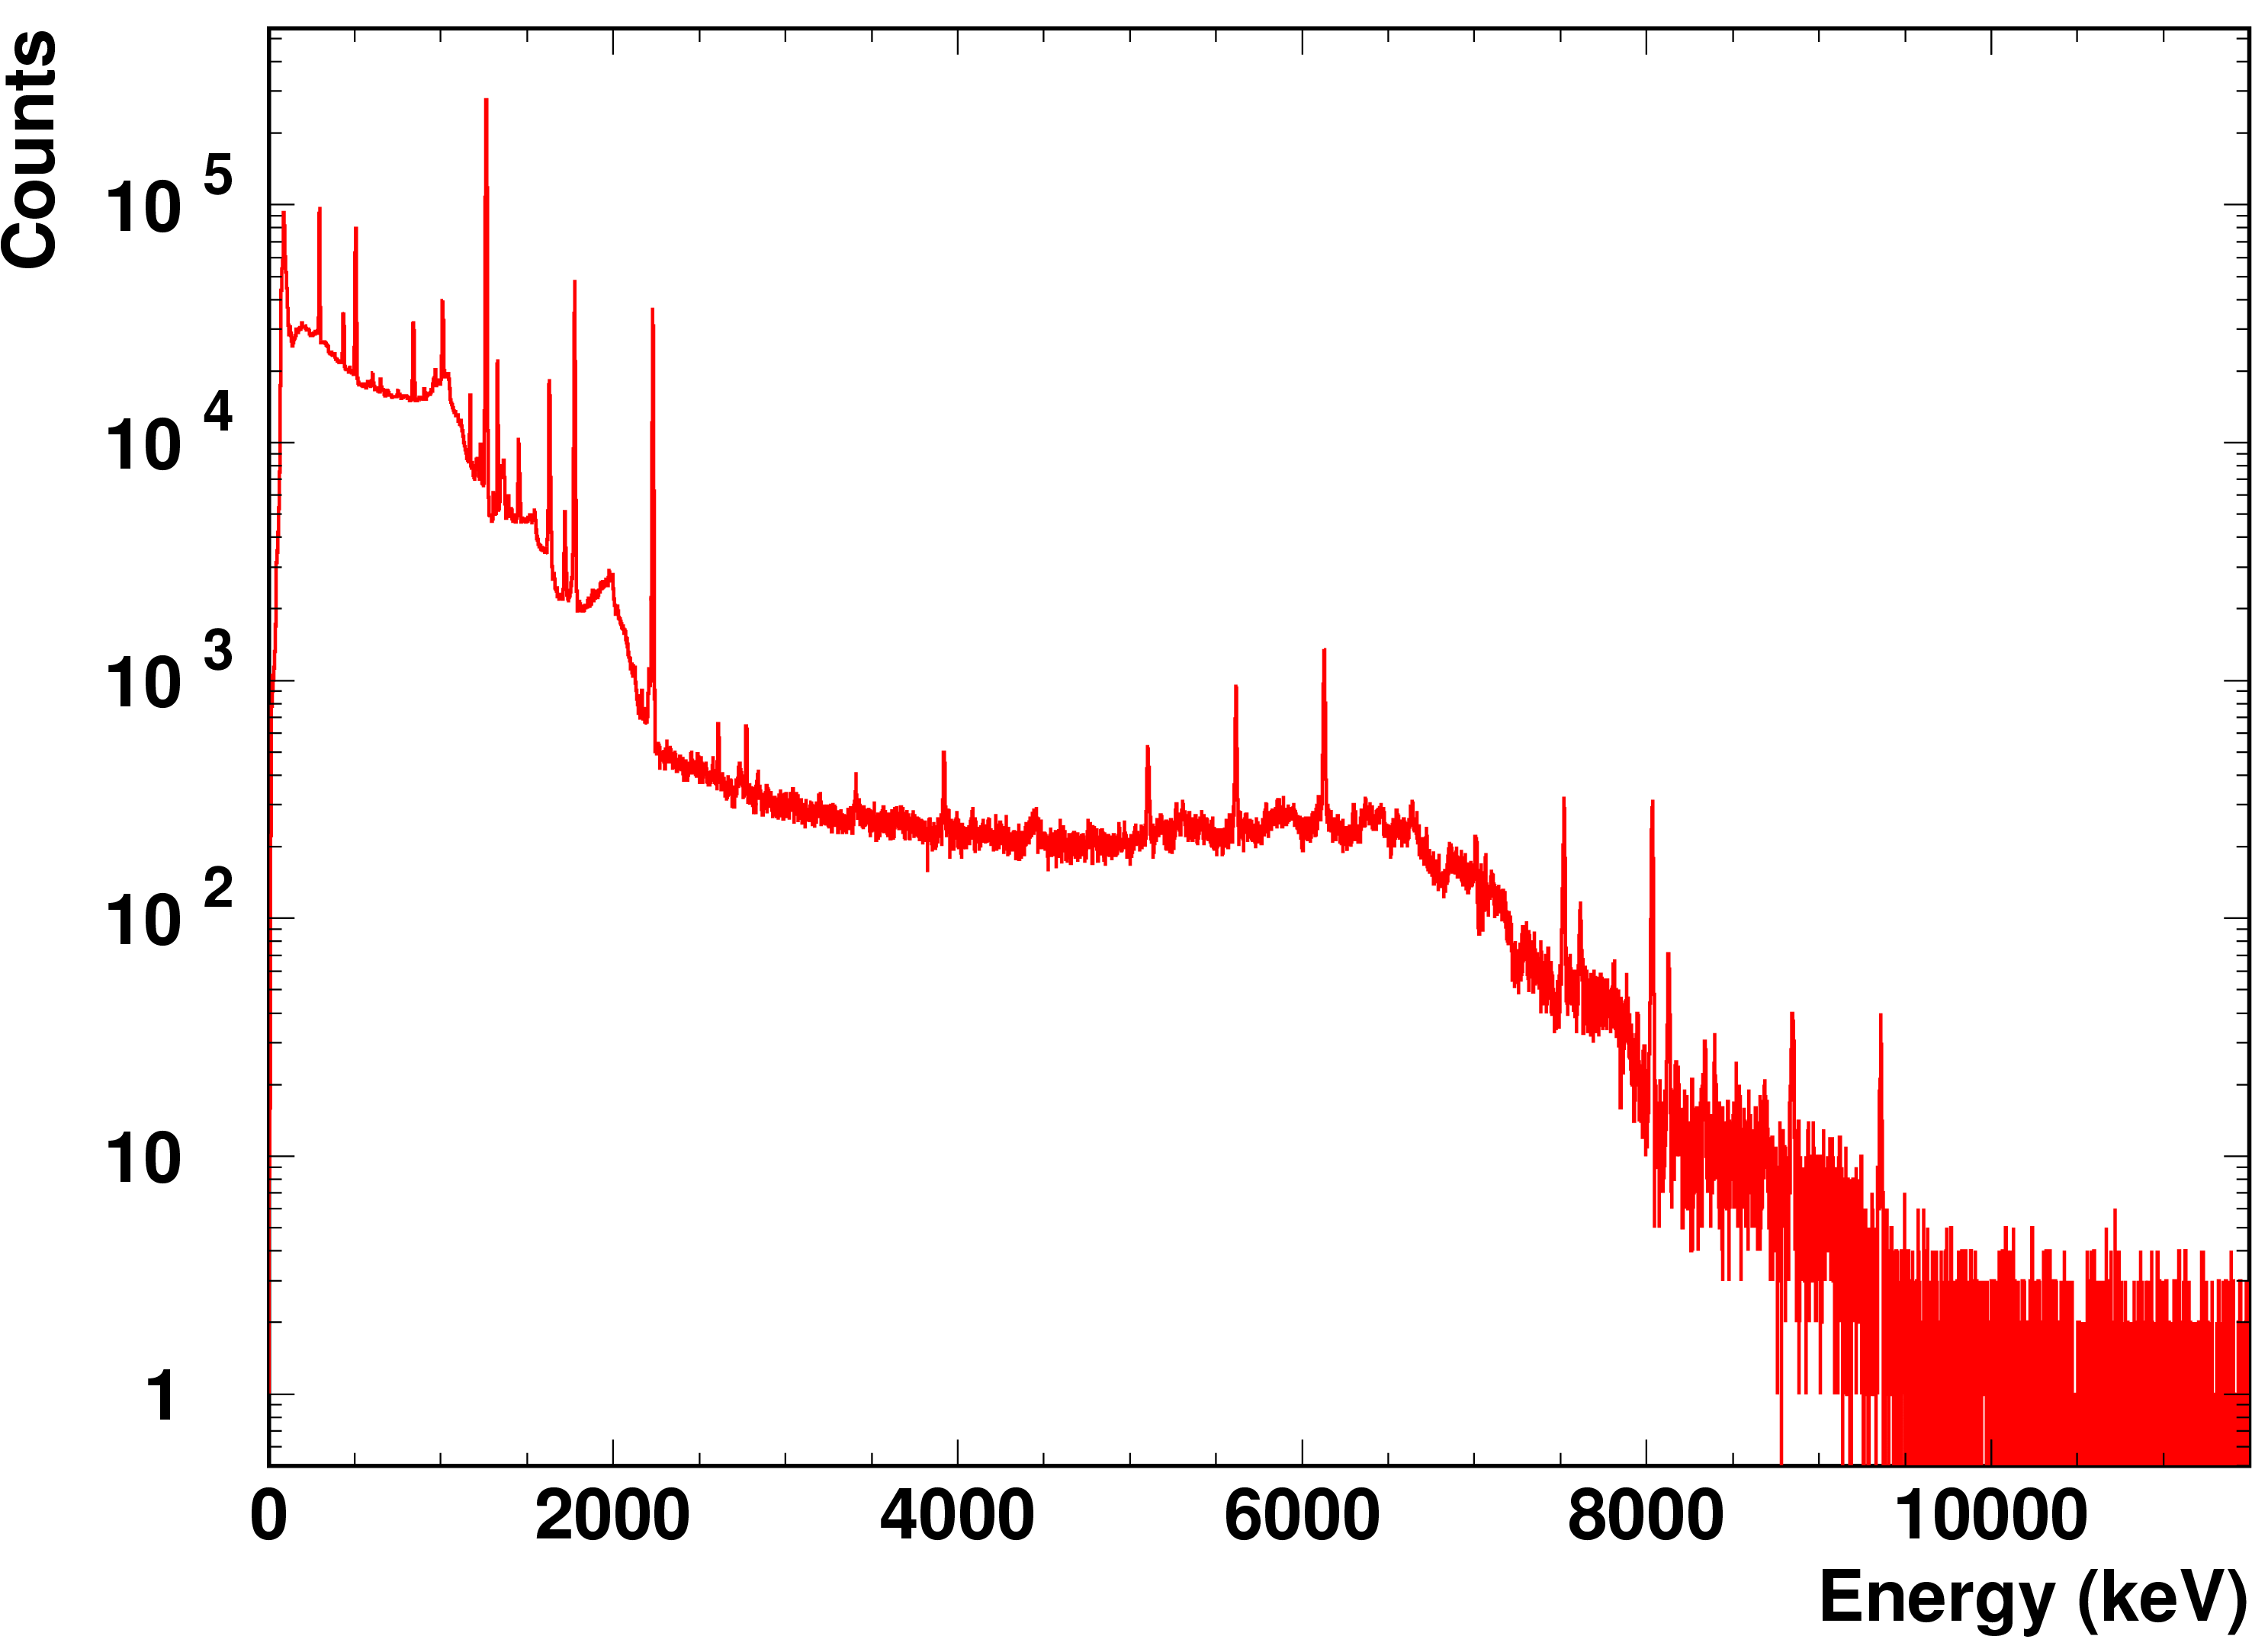
• • • AIFIRA experiment: experimental spectra
³¹P(p,γ)³²S at 3.285 keV
2230.6 keV
2018
3922.4 keV
2840.3 keV
8124.1 keV
Measurement time: 3.6h
P = 2230.68(05) keV, lit = 2230.57(15) keV, 23.8(4) pps
P = 2839.61(51) keV, lit = 2840.32(14) keV, 0.048(6) pps
P = 3922.33(38) keV, lit = 3922.37(15) keV, 0.220(7) pps
P = 8126.53(31) keV, lit = 8124.12(24) keV, 0.059(3) pps
Cascade 3922.33(38) + 8126.53(31) = 12048.86(49) keV

Slide 13
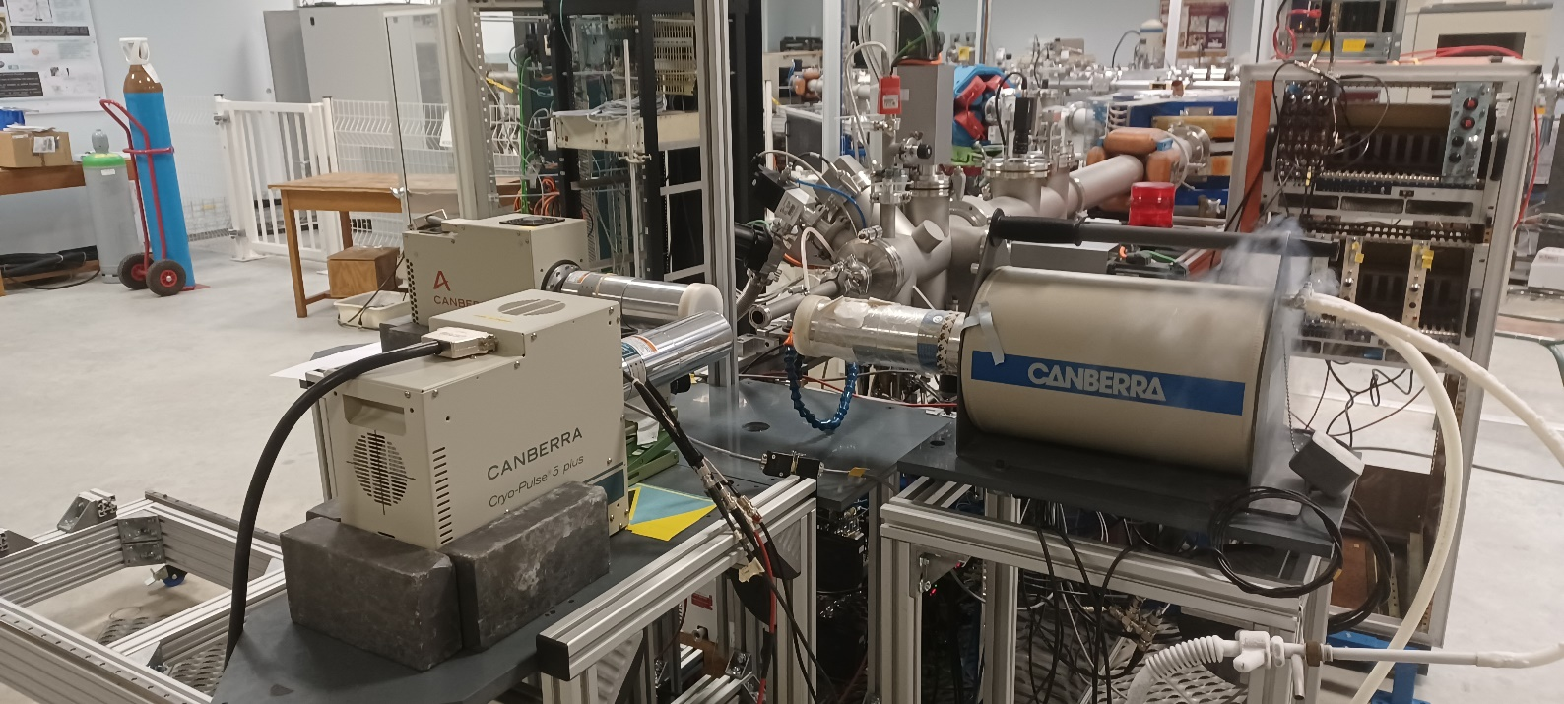
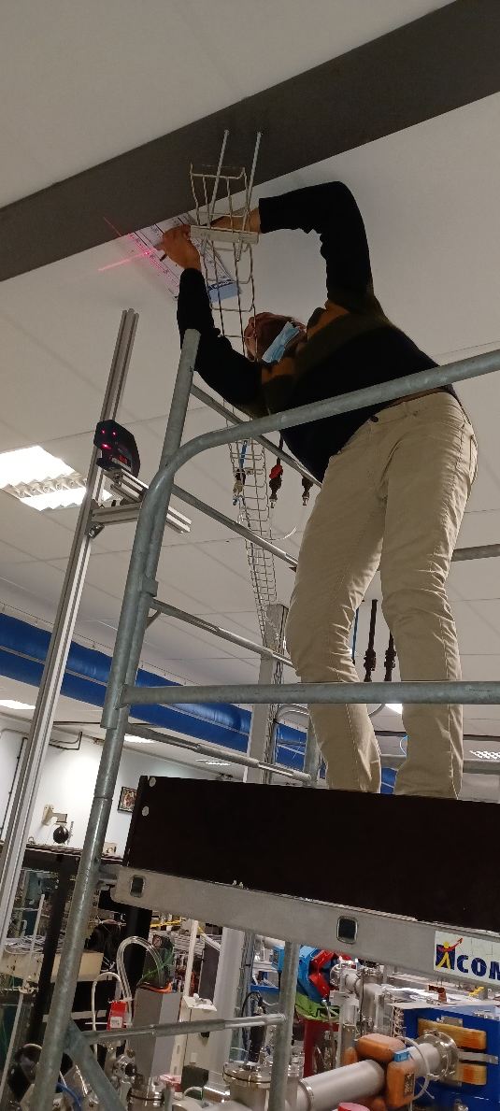
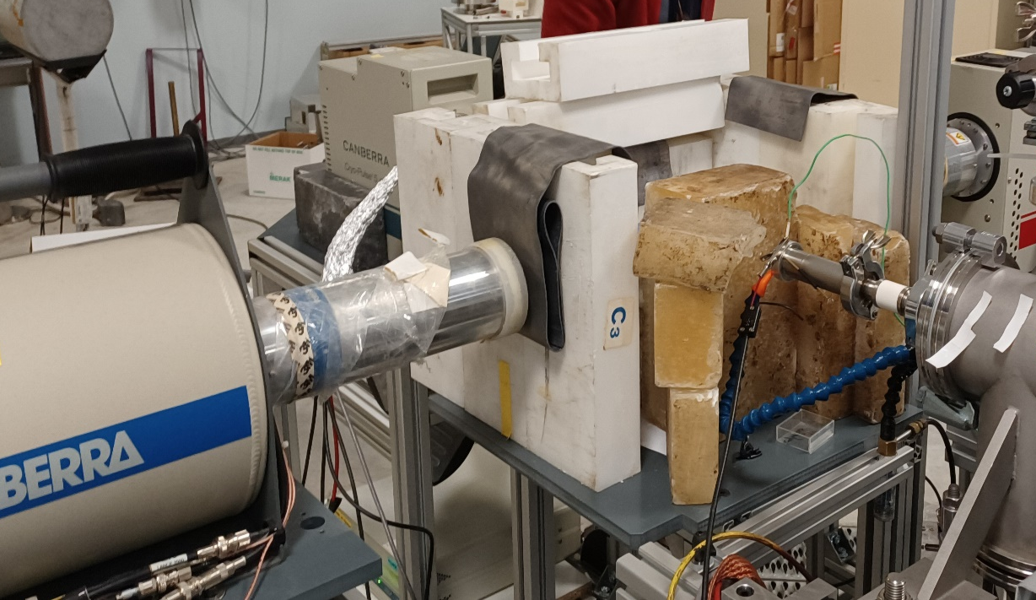
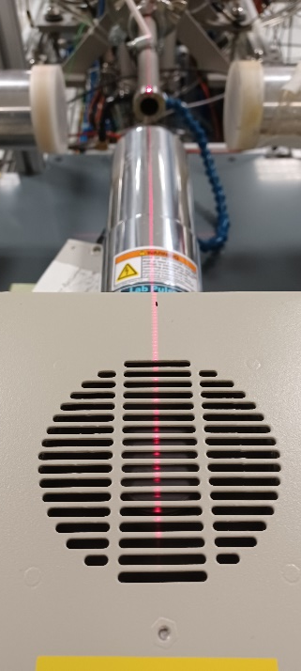
• • • AIFIRA experiment: set-up in 02/2022
3 Ge, laser aligned

Slide 14
• • • AIFIRA experiment
3 HPGe
-90° (detector CENBG - ACEN)
0° (detector GANIL - GC)
+90° (detector GANIL - GX)
2 DAQ:
DAQ AIFIRA (8k)
DAQ FASTER (digital)
Beam time: 14 – 23 Feb. 2022
Reactions used:
³¹P(p,γ)³²S at 3.285 MeV
²⁷Al(p,γ)²⁸Si at 0.992 MeV
²⁷Al(p,γ)²⁸Si at 1.317 MeV
²³Na(p,γ)²⁴Mg at 0.737 MeV
²³Na(p,γ)²⁴Mg at 1.020 MeV
²³Na(p,γ)²⁴Mg at 1.417 MeV
³⁵Cl(n,γ)³⁶Cl at thermal energy

Slide 15
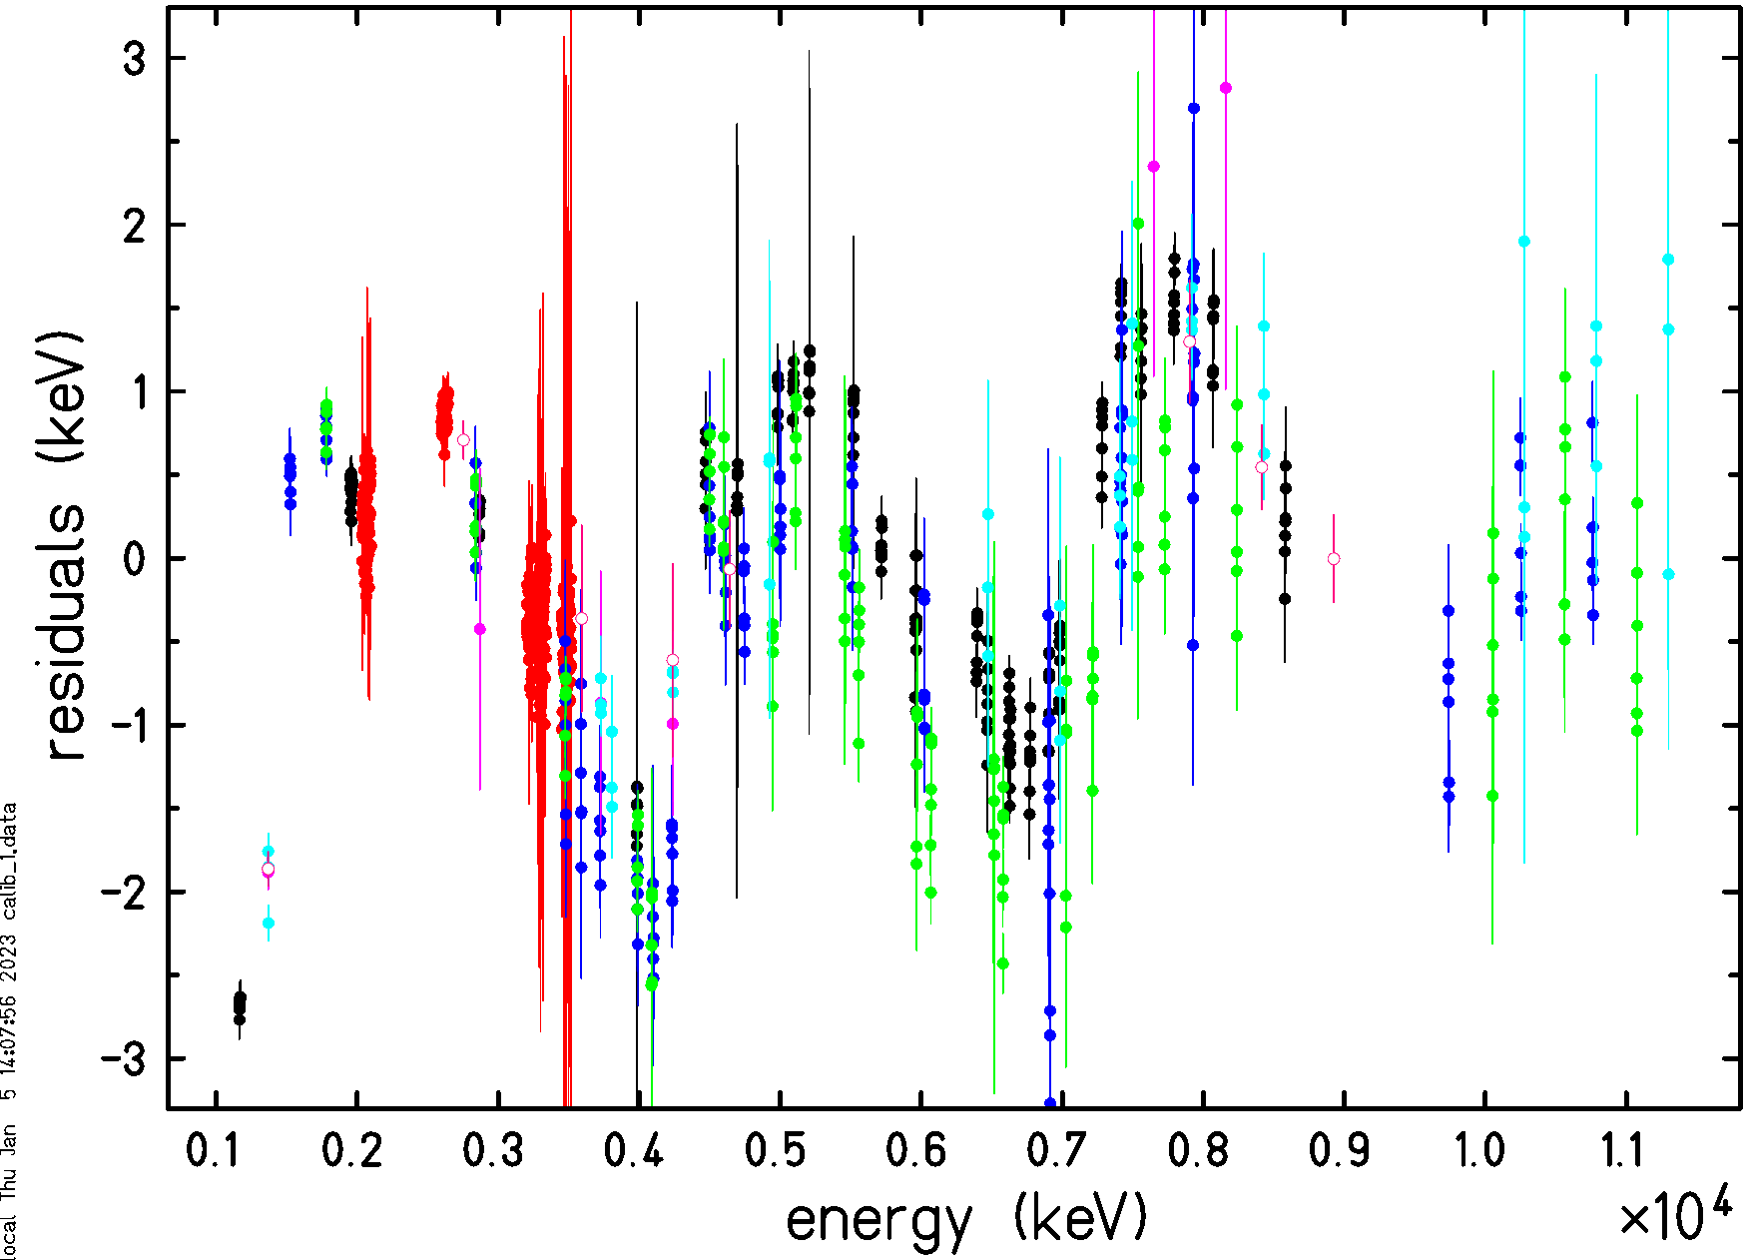
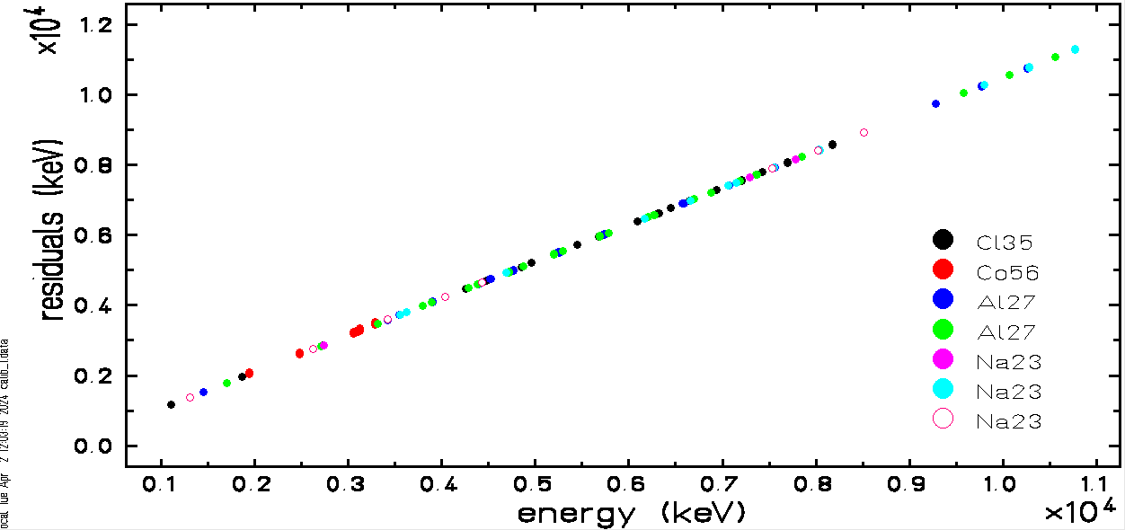
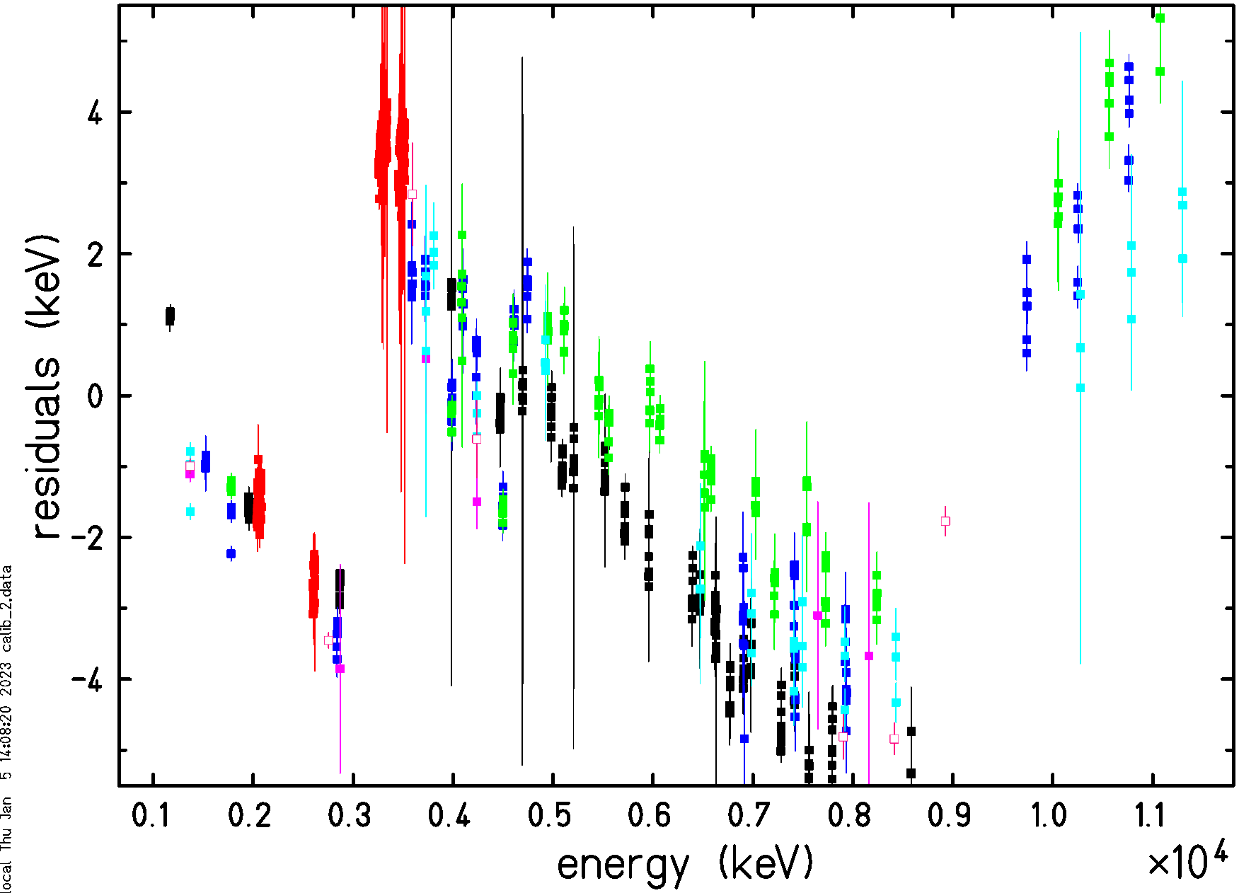
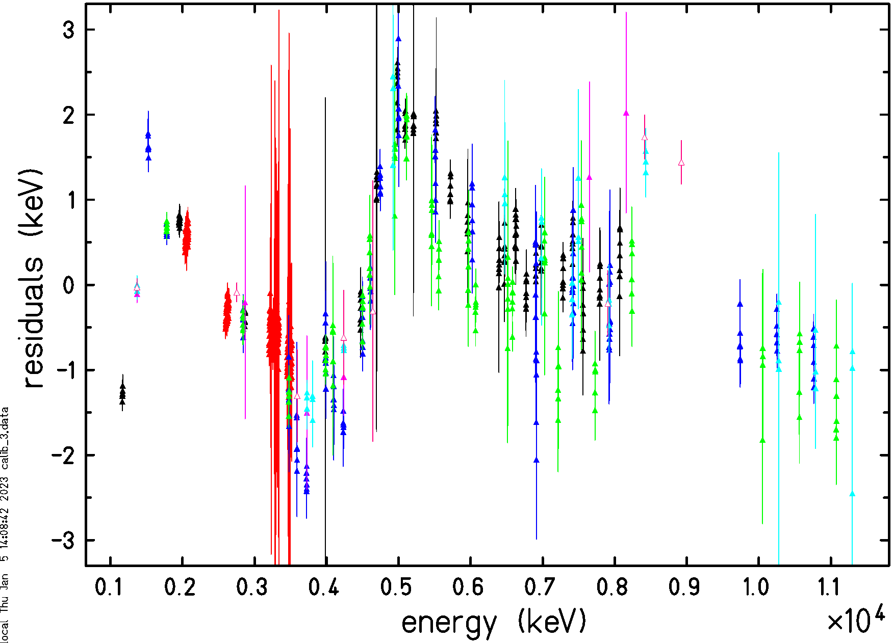
• • • AIFIRA experiment: FASTER calibration
det. 1
residuals from a quadratic fit over the full spectrum
det. 2
det. 3

Slide 16
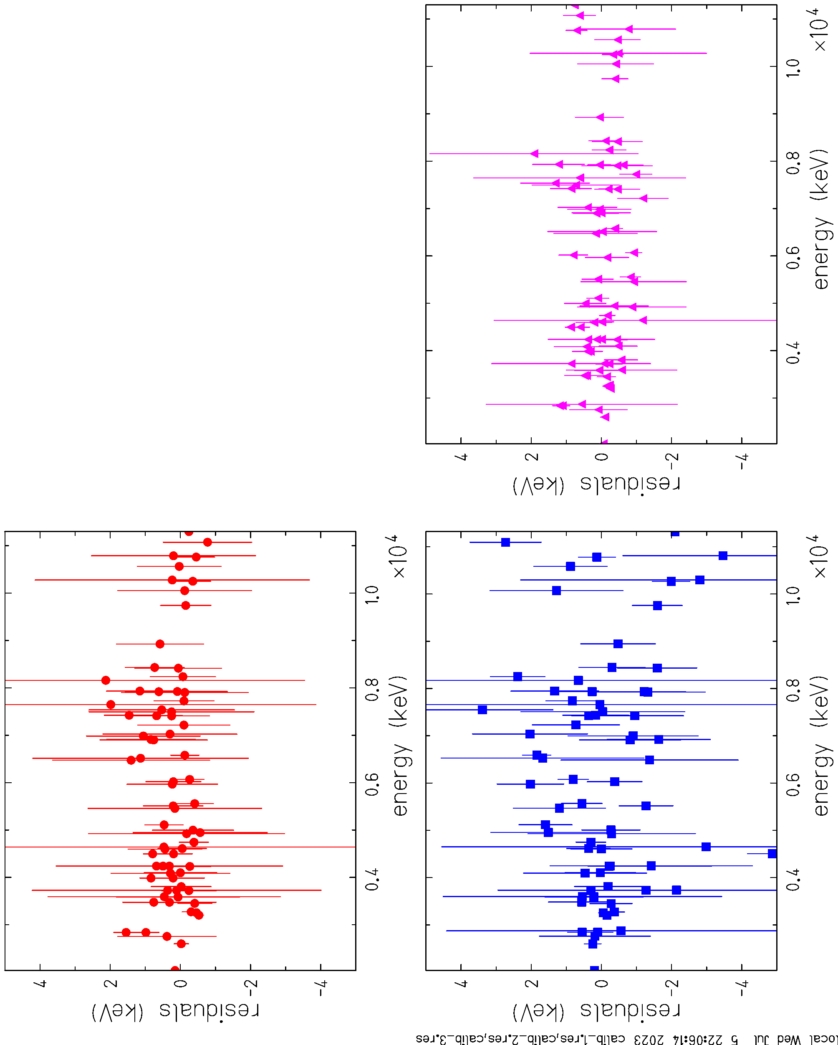
• • • AIFIRA experiment: AIFIRA
det. 1
residuals from a quadratic fit over the full spectrum
(³⁵Cl excluded)
det. 2
det. 3

Slide 17
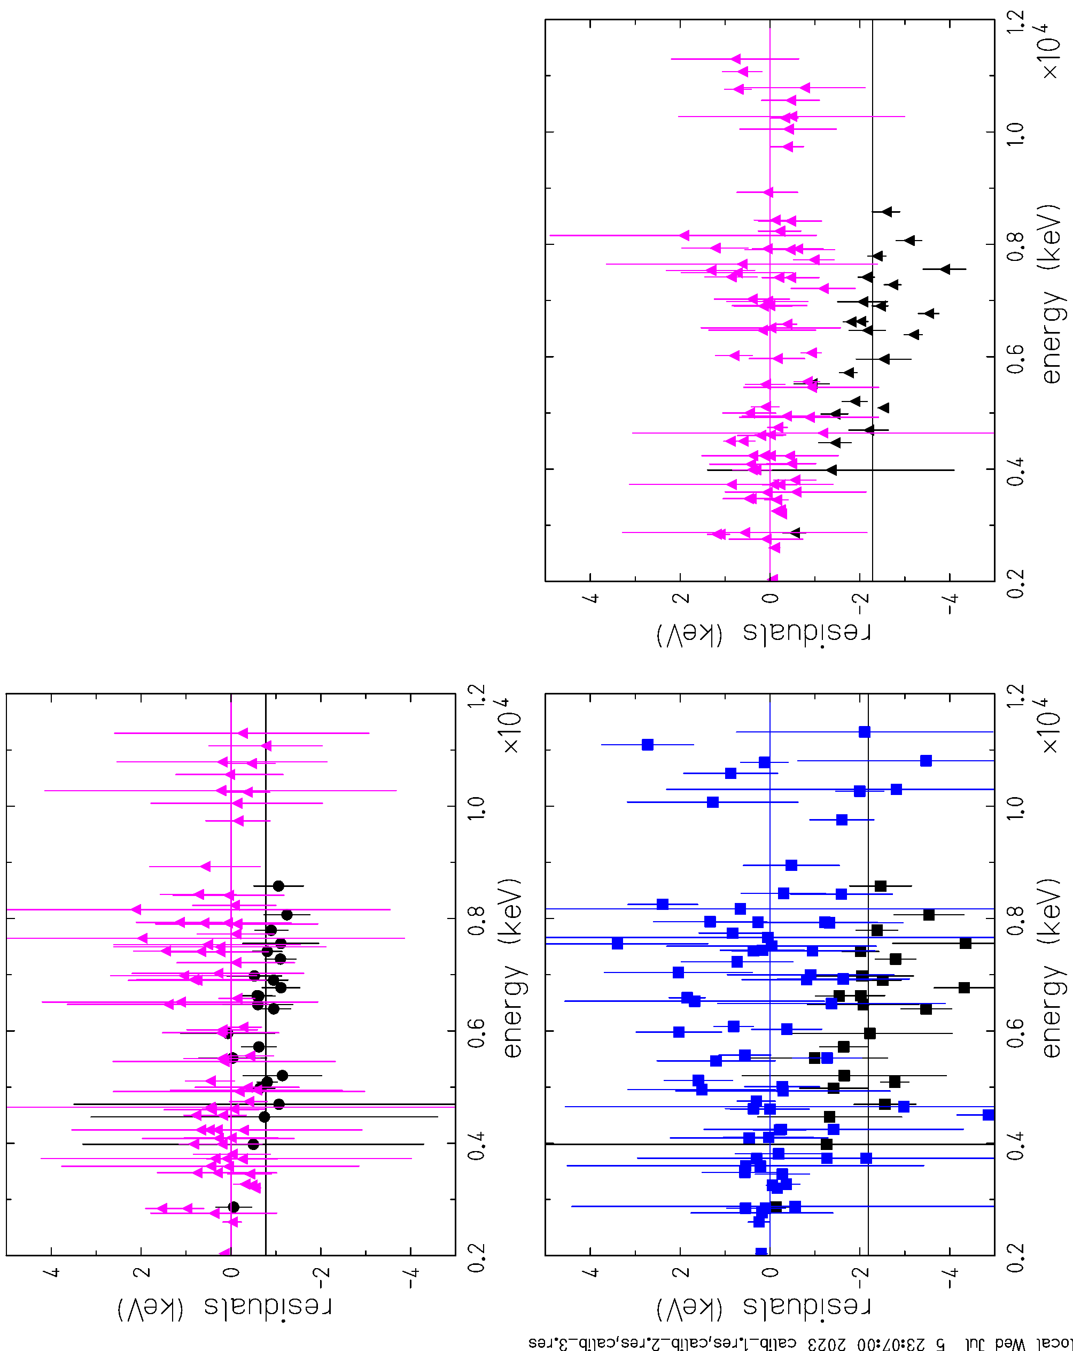
• • • AIFIRA experiment: AIFIRA
det. 1
calibration without ³⁵Cl
no count rate correction
black point are from ³⁵Cl
det. 2
det. 3

Slide 18
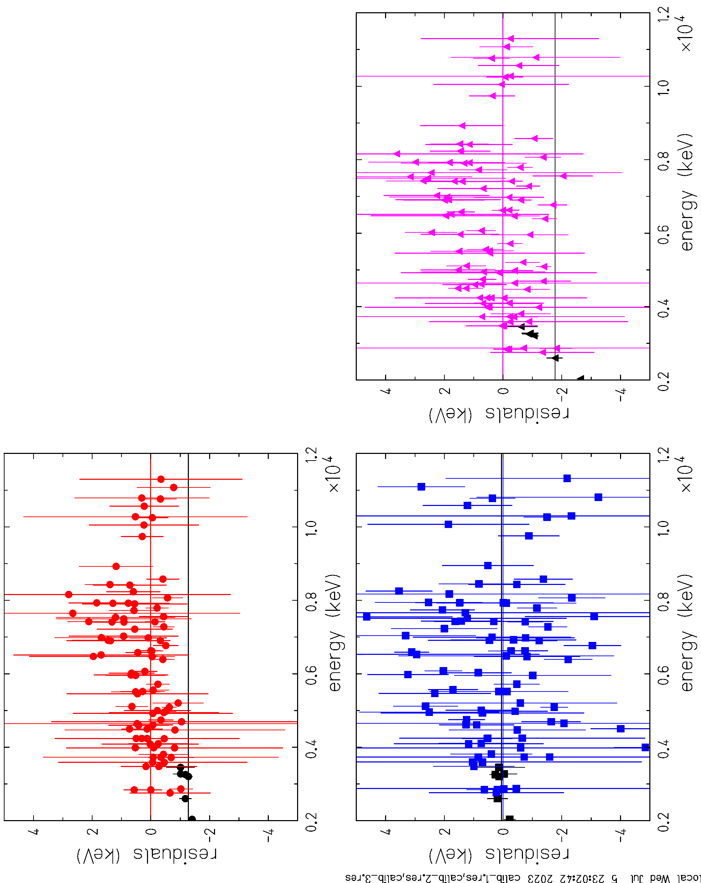
• • • AIFIRA experiment: AIFIRA
det. 1
calibration without ⁵⁶Co
³⁵Cl included
no count-rate correction
det. 2
det. 3

Slide 19
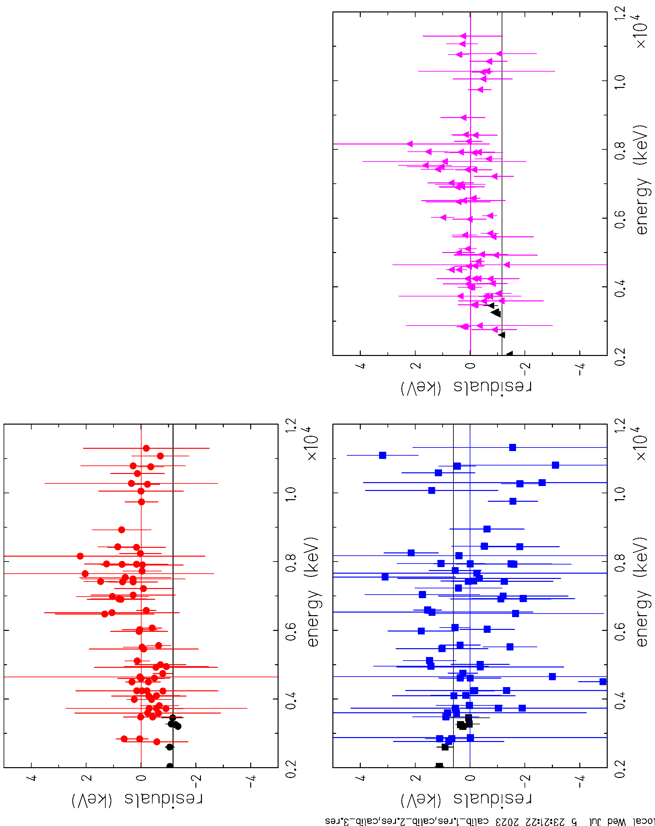
• • • AIFIRA experiment: AIFIRA
det. 1
calibration without ⁵⁶Co,
³⁵Cl excluded
black point are ⁵⁶Co
no rate correction
det. 2
det. 3

Slide 20
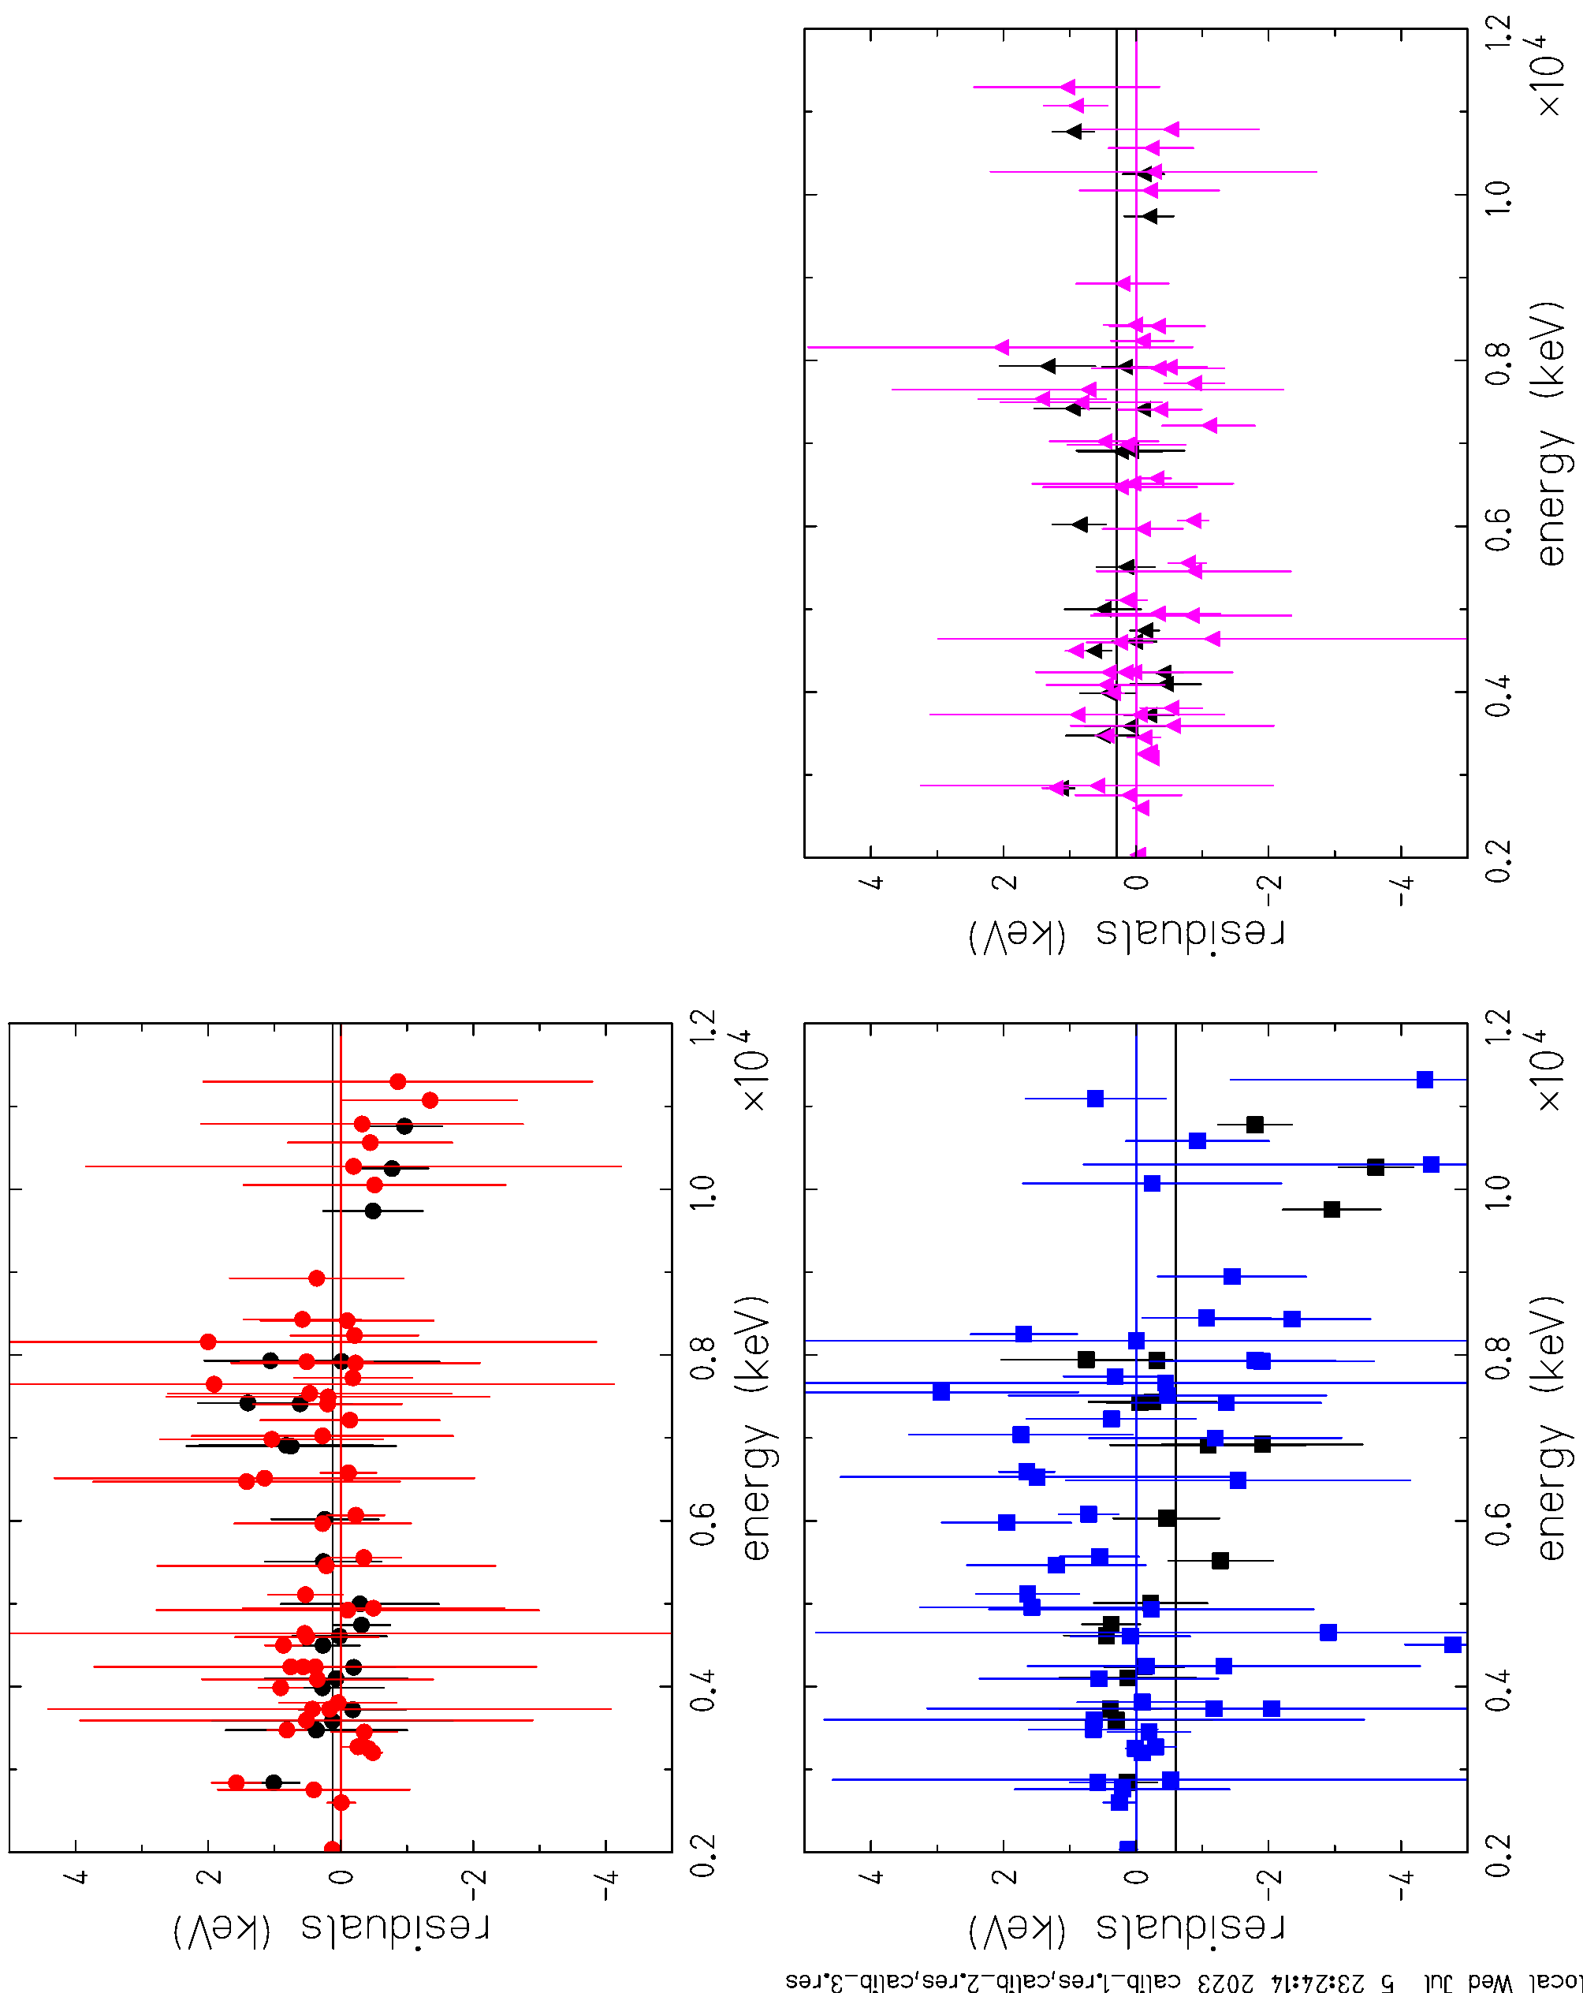
• • • AIFIRA experiment: AIFIRA
det. 1
calibration without ²⁷Al_1,
³⁵Cl excluded
det. 2
det. 3

Slide 21
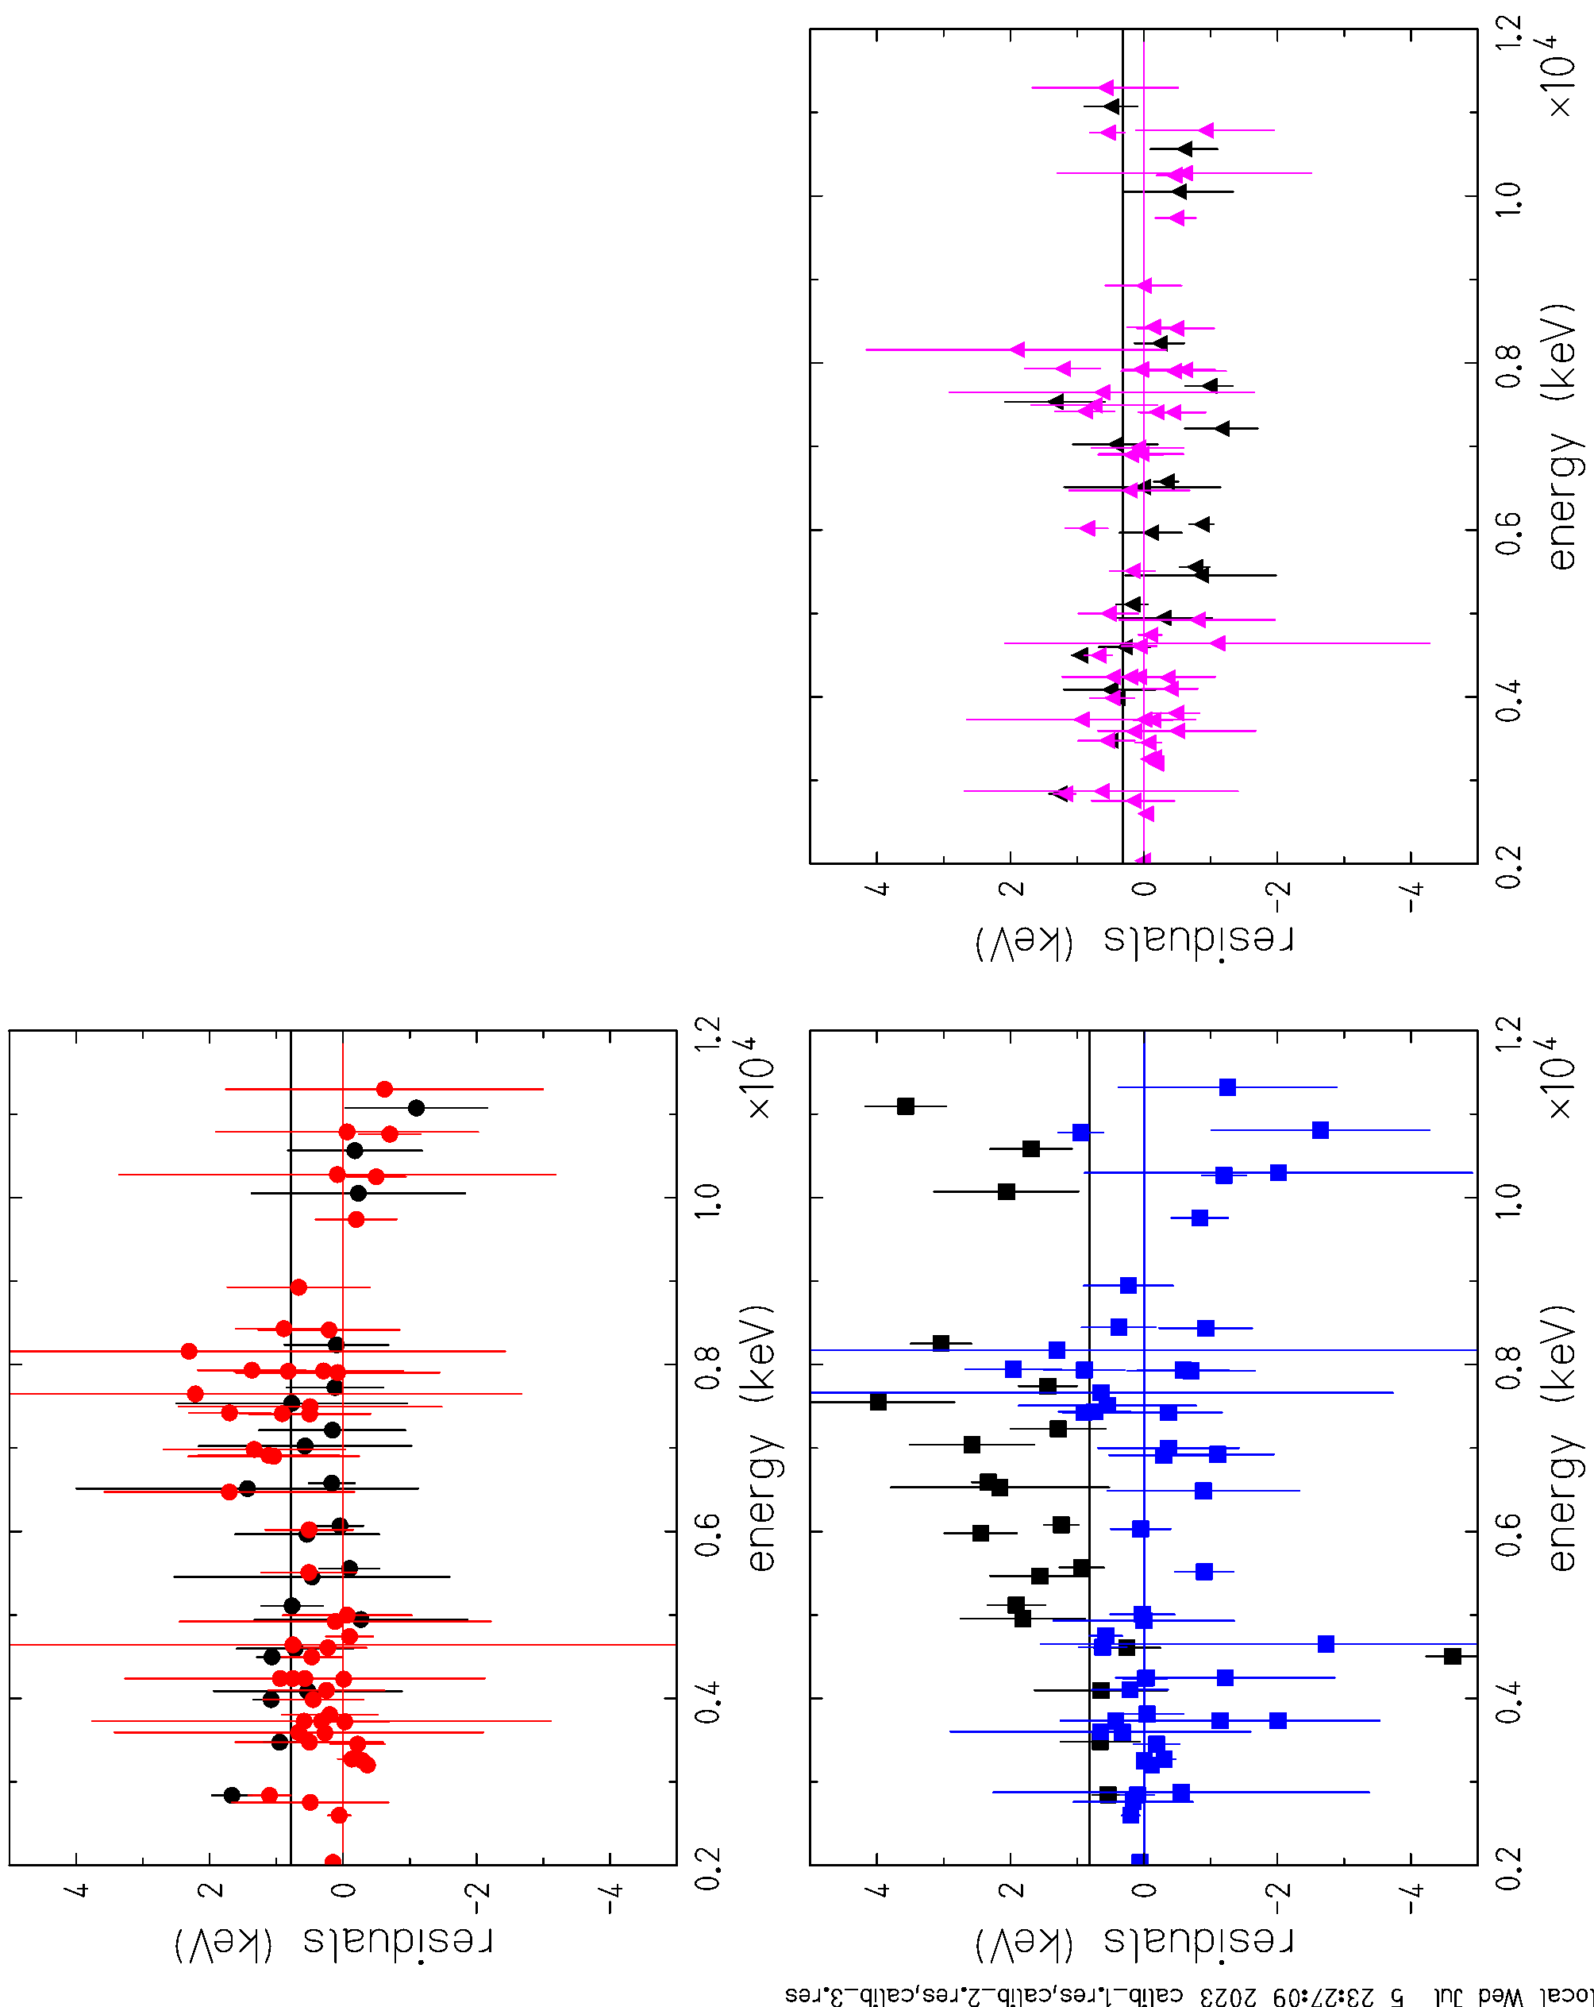
• • • AIFIRA experiment: AIFIRA
det. 1
calibration without ²⁷Al_2,
³⁵Cl excluded
➔ Problem with Doppler correction for this reaction
det. 2
det. 3

Slide 22
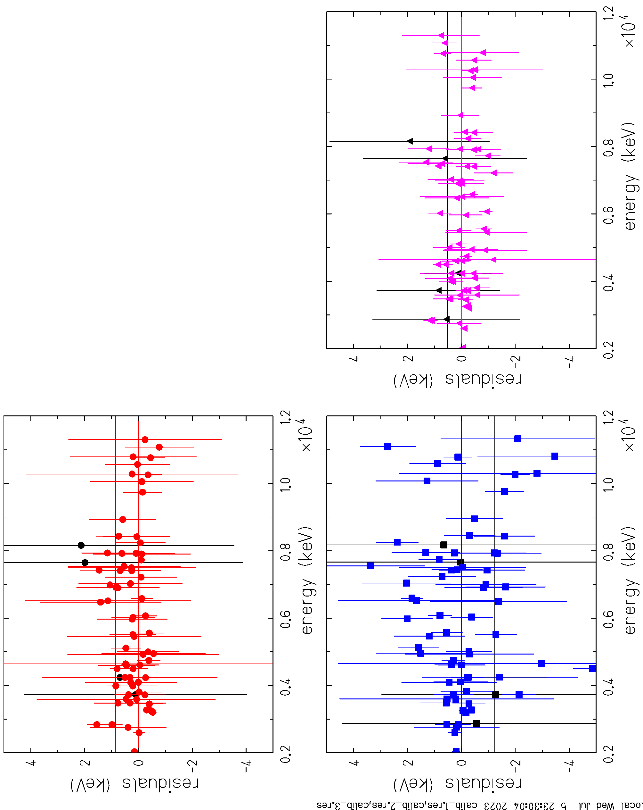
• • • AIFIRA experiment: AIFIRA
det. 1
calibration without ²³Na_1,
³⁵Cl excluded
det. 2
det. 3

Slide 23
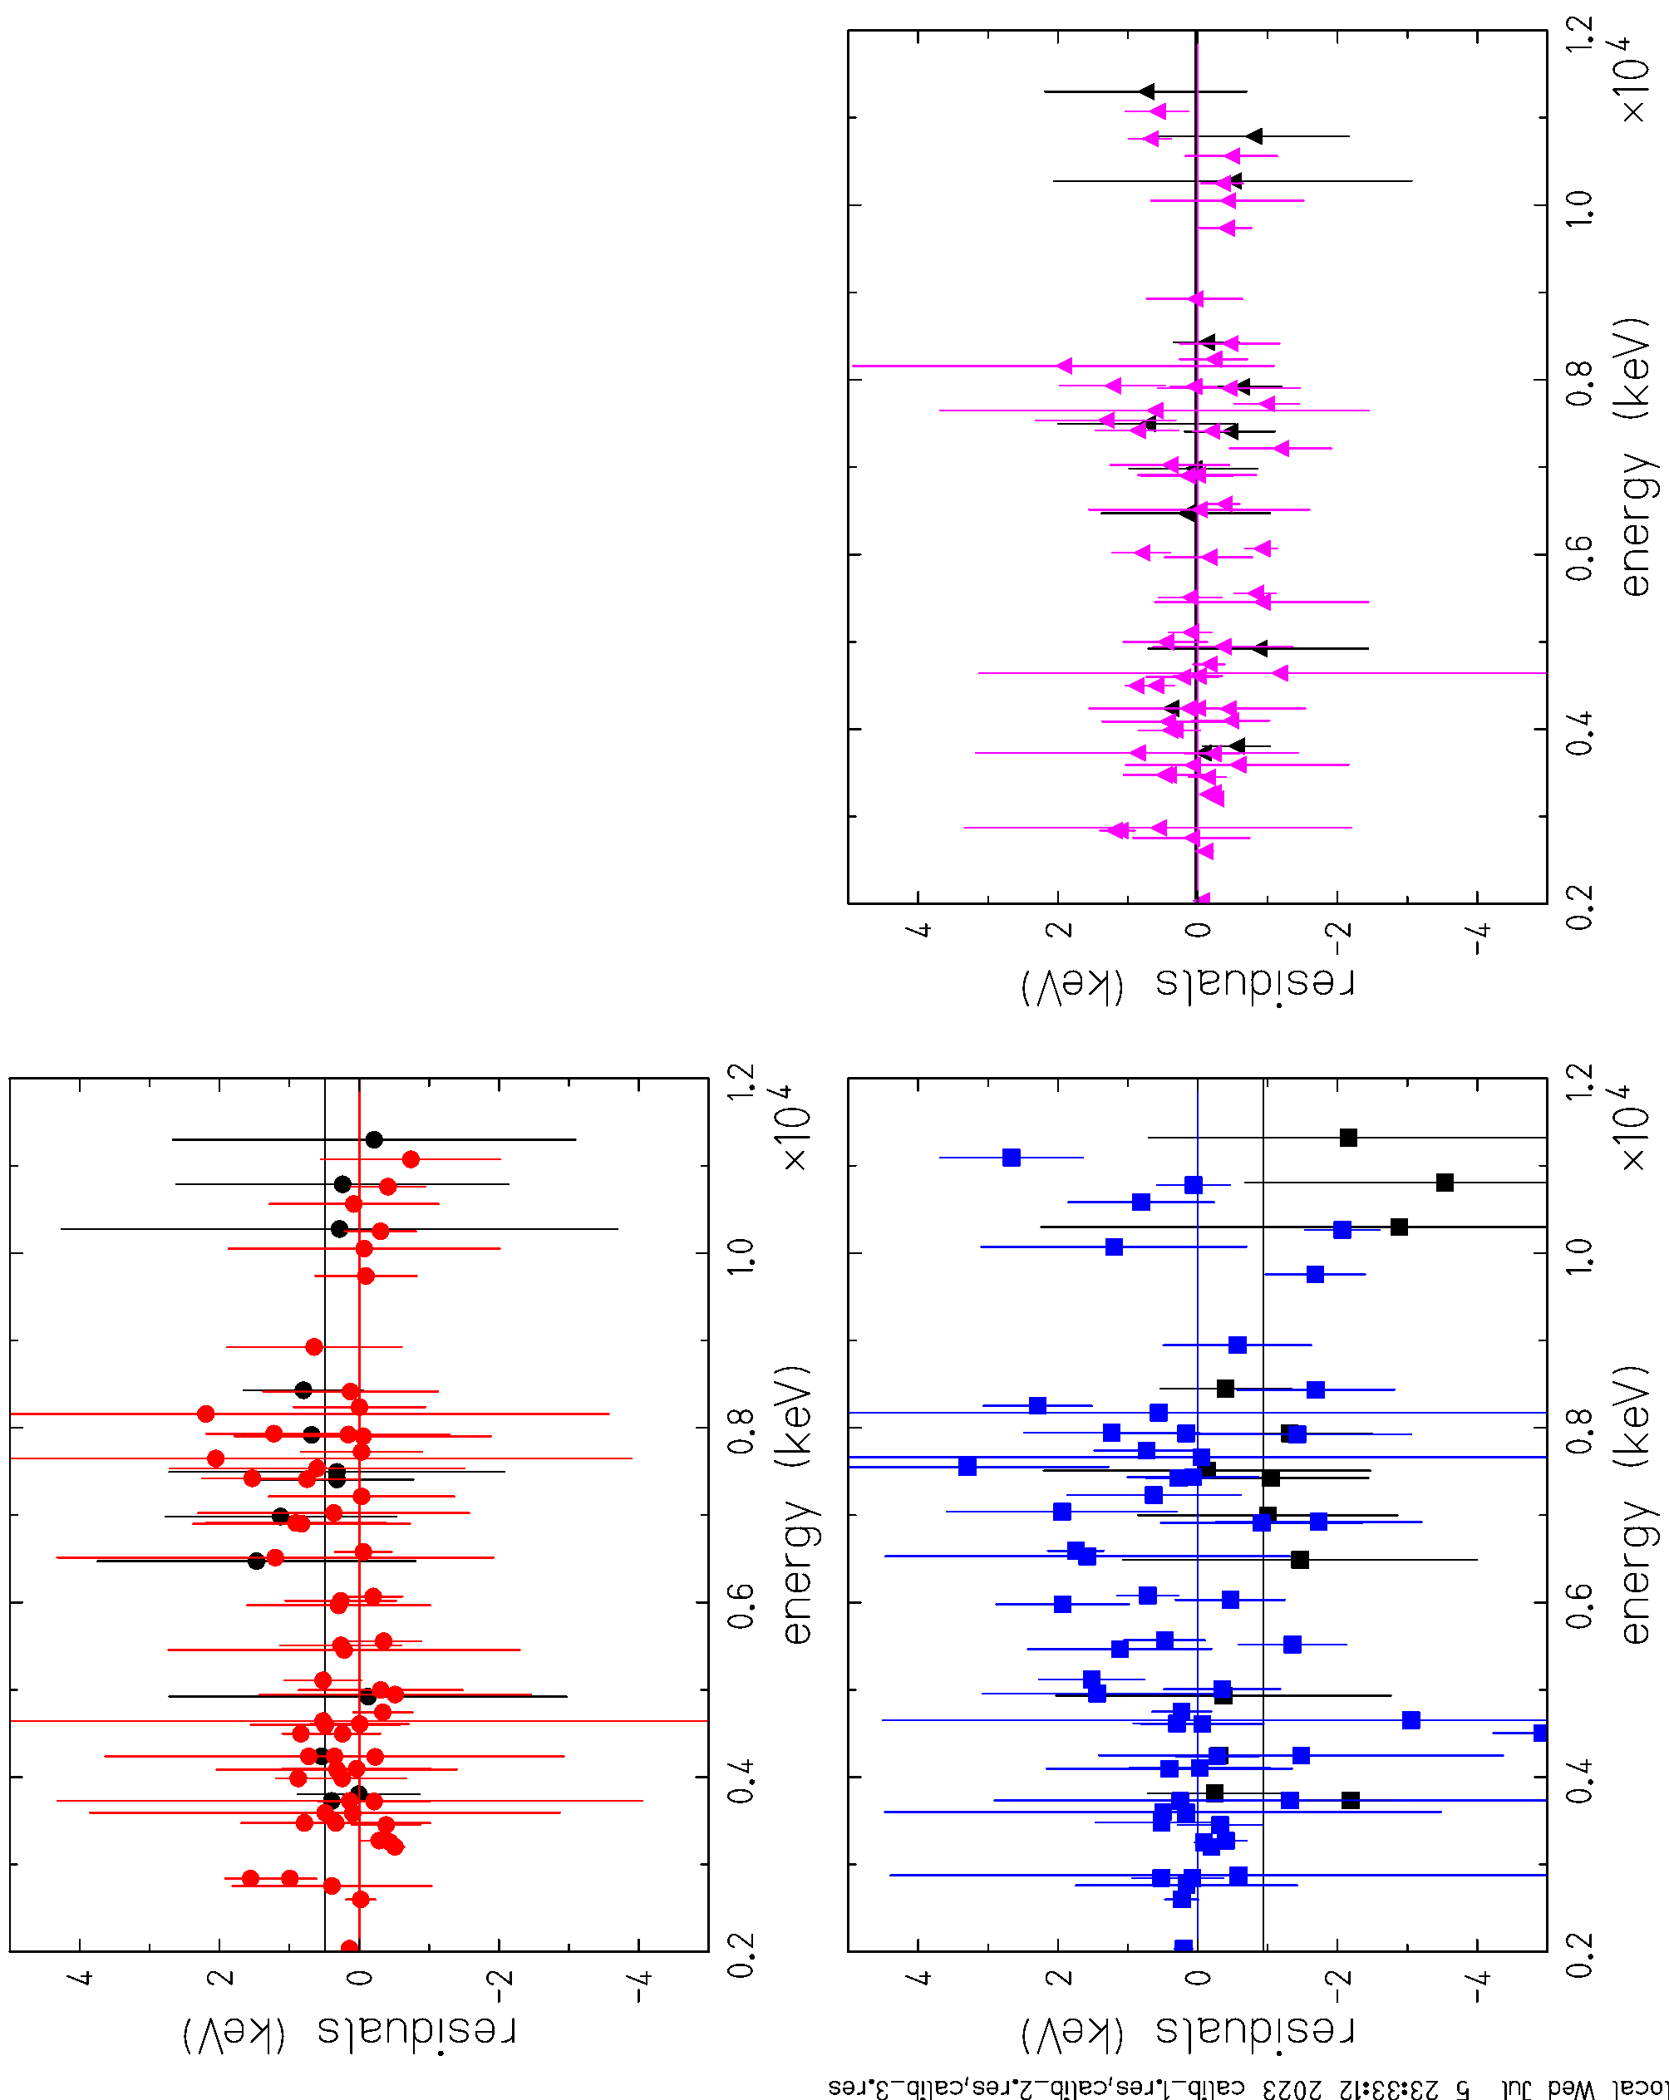
• • • AIFIRA experiment: AIFIRA
det. 1
calibration without ²³Na_2,
³⁵Cl excluded
det. 2
det. 3

Slide 24
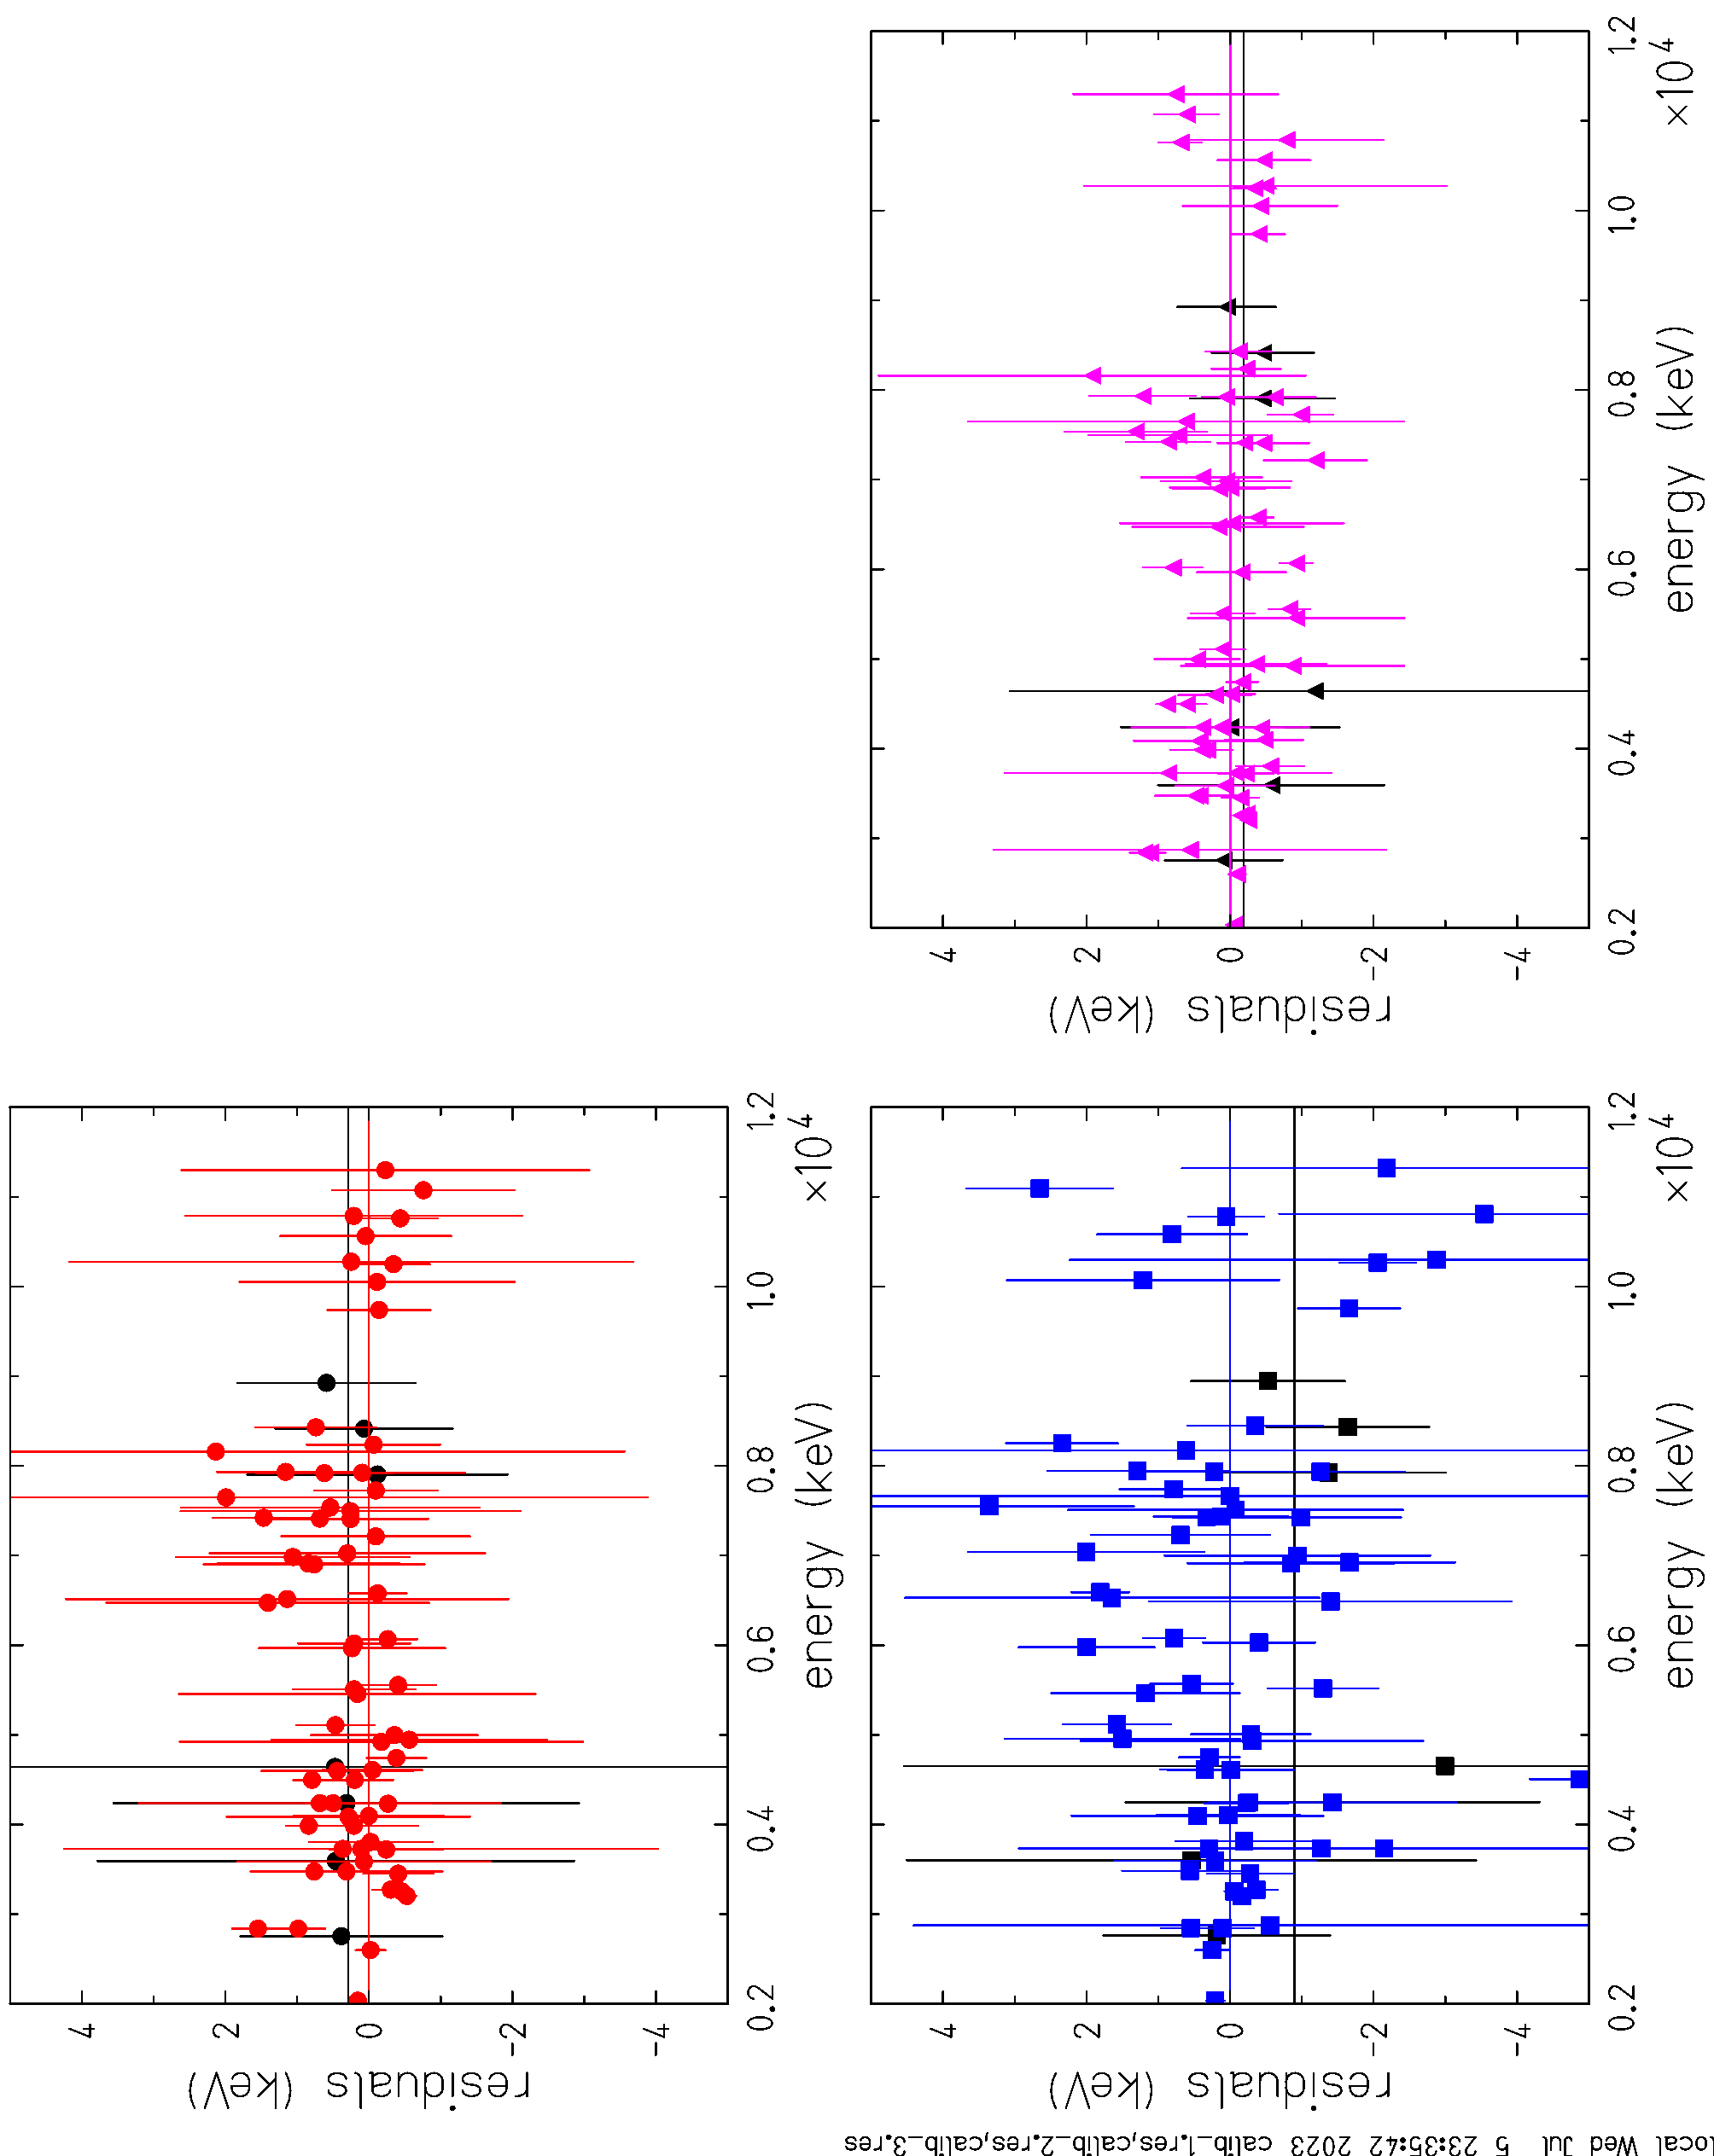
• • • AIFIRA experiment: AIFIRA
det. 1
calibration without ²³Na_3,
³⁵Cl excluded
det. 2
det. 3

Slide 25
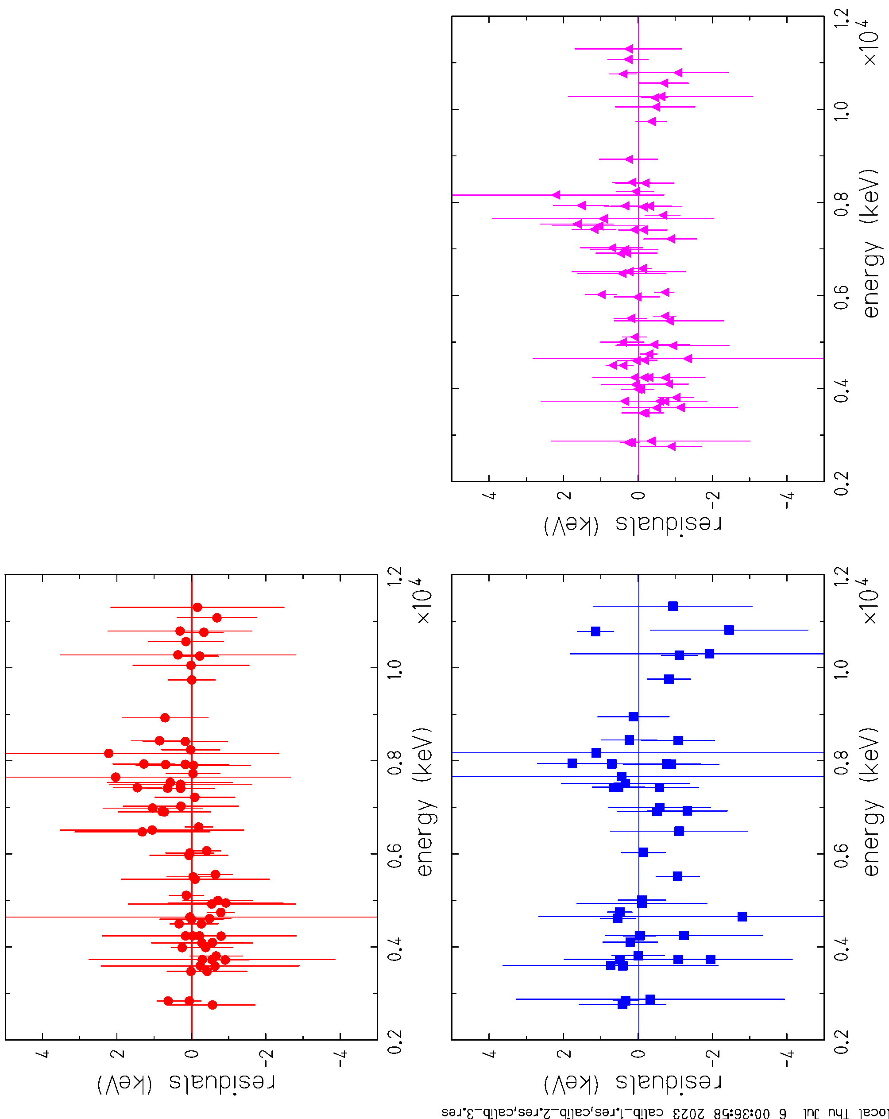
• • • AIFIRA experiment: AIFIRA
det. 1
calibration without ⁵⁶Co,
³⁵Cl, and ²⁷Al_2 for det. 2
χ < 1.0 for det. 1, ± 0.075 keV
χ < 1.0 for det. 2, ± 0.107 keV
χ = 1.4 for det. 3, ± 0.050 keV
det. 2
det. 3

Slide 26
• • • AIFIRA experiment: drift of AIFIRA data
3 ³²S lines for 3 detectors:
2231 keV
3923 keV
8125 keV
there is a jump between run 34 and run 37 and then a steady drift for all detectors and all energies.
the higher the energy, the stronger the drift.
lets remove the first runs and fit the rest…

Slide 27
• • • AIFIRA experiment: drift of AIFIRA data
drift slope:
detector 1:
0.0064(03)
0.0077(20)
0.0256(95)
detector 2:
0.0166(03)
0.0202(33)
0.0457(74)
detector 3:
0.0042(03)
0.0157(35)
0.0390(79)

Slide 28
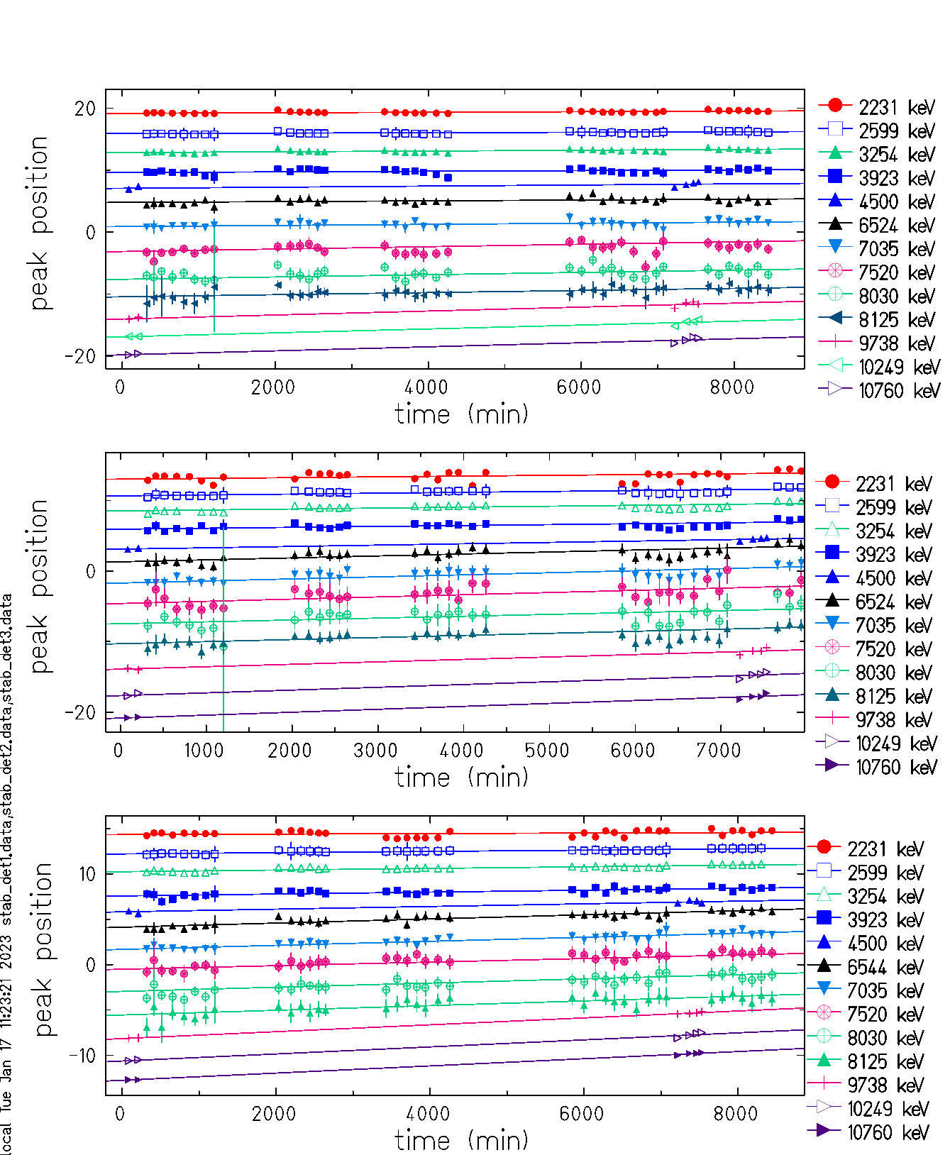
• • • AIFIRA experiment: drift of AIFIRA data

Slide 29
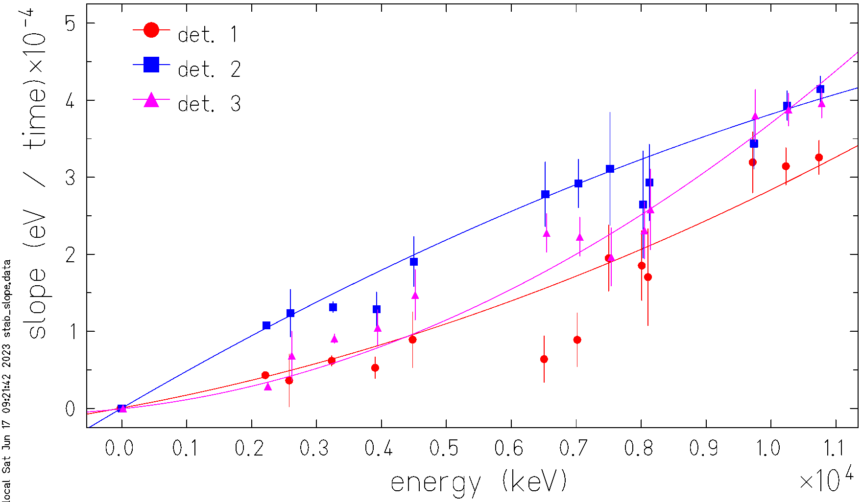
• • • AIFIRA experiment: drift of AIFIRA data
The drift is about 20 eV per hour. Triambak had about 80 eV per hour….

Slide 30
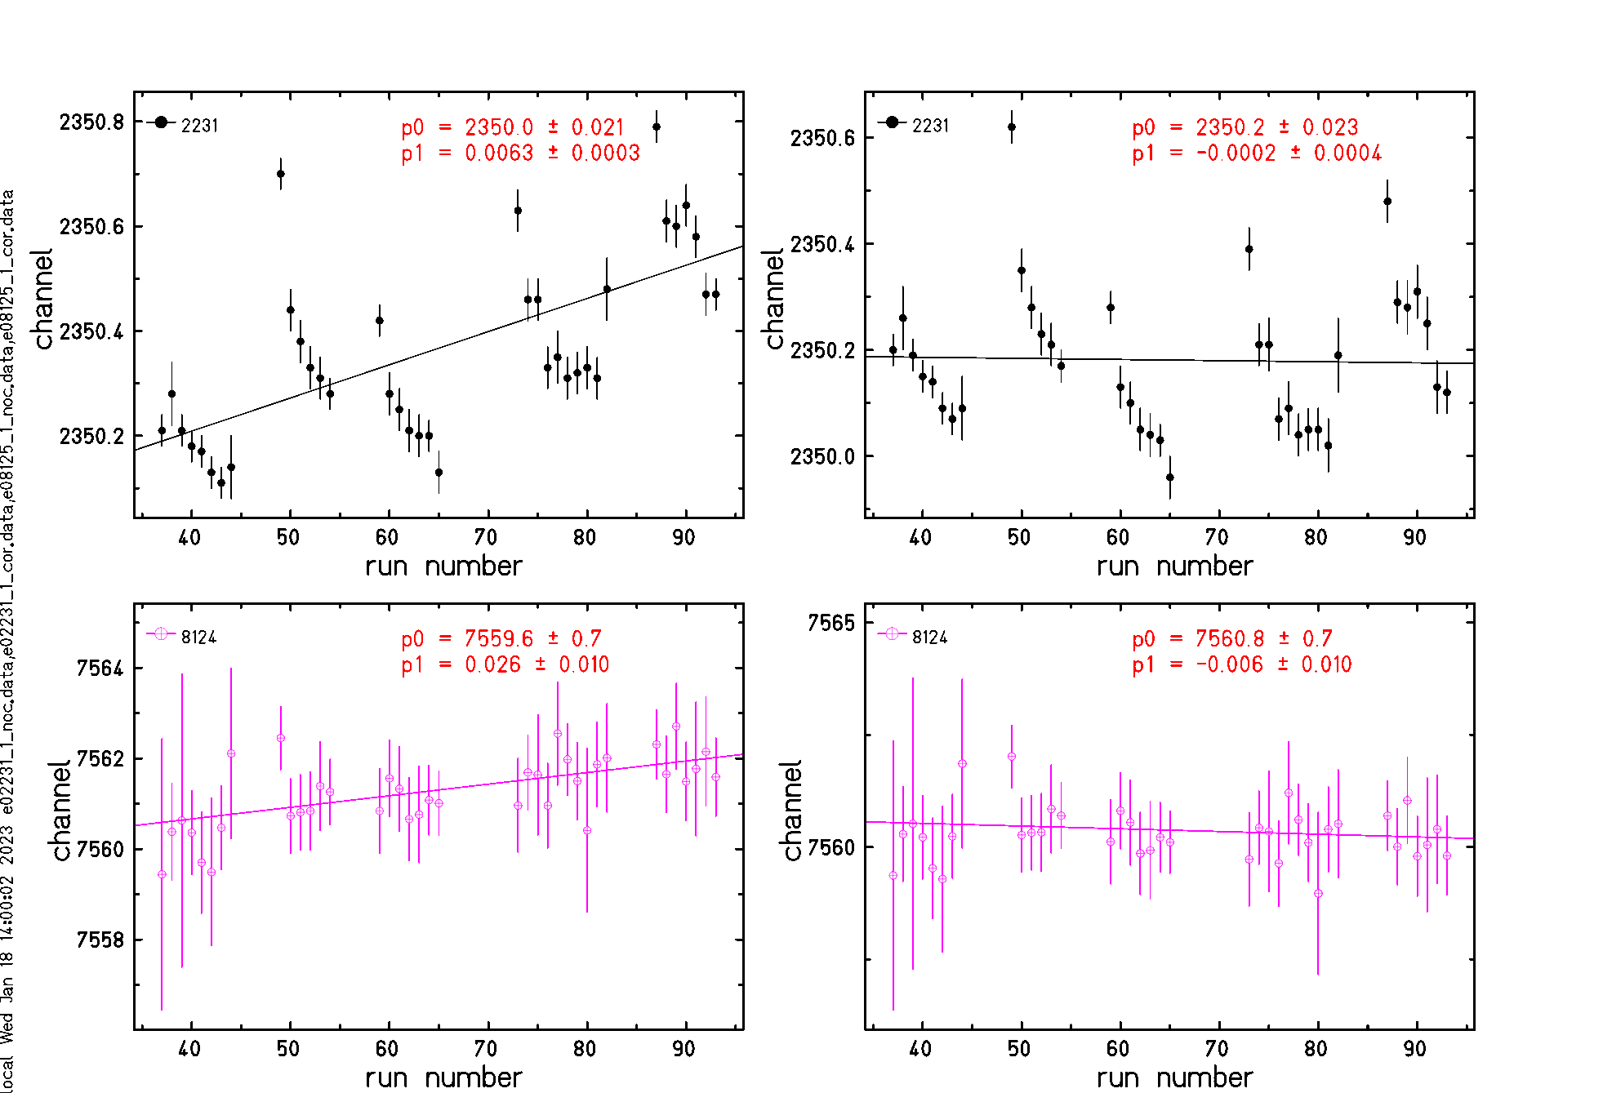
• • • AIFIRA experiment: drift of AIFIRA data corrected

Slide 31
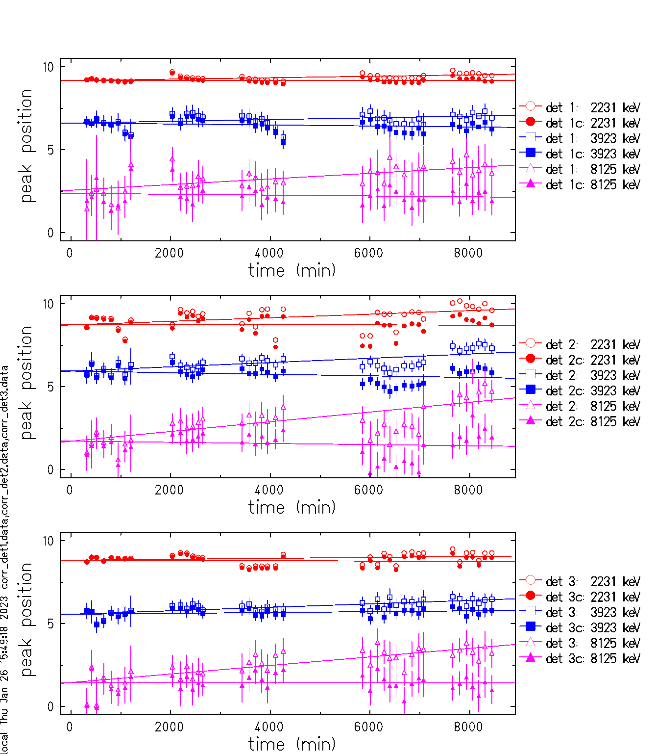
• • • AIFIRA experiment: drift of AIFIRA data corrected

Slide 32
• • • AIFIRA experiment: experimental spectra
²⁷Al(p,γ)²⁸Si at 992 keV
1779.0 keV
2018
10762.9 keV
2614.5 keV
6019.9 keV
Typical precision: 0.1 – 0.5 keV
Time: 1.0 h
Rate: 600 pps ➔ can be increased ?

Slide 33
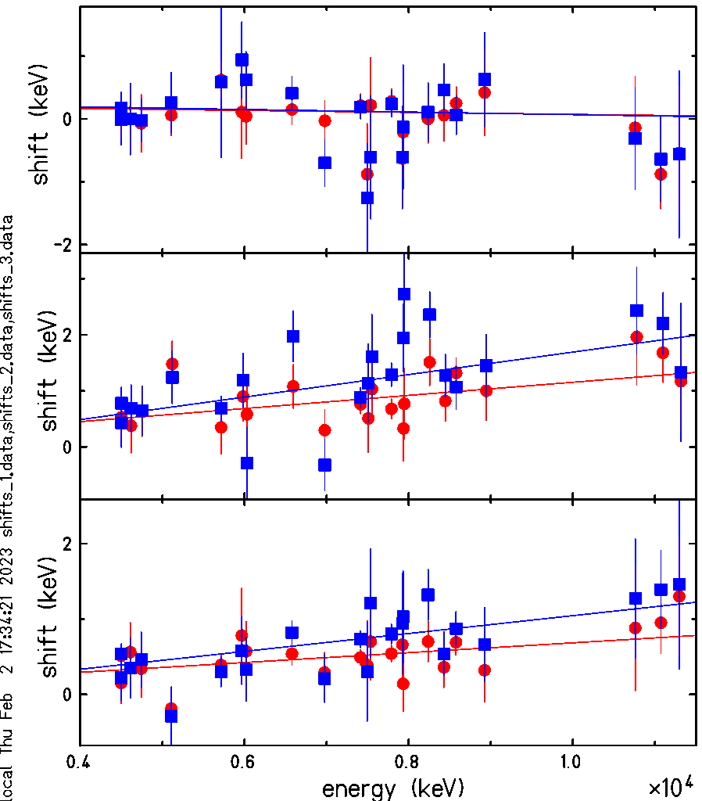
• • • AIFIRA experiment: shift of SE and DE peaks (AIFIRA data)
● SE
■ DE
Det 1:
SE:
p0 = 0.229634 +- 0.303583
p1 = -1.56588E-05 +- 4.33371E-05
chi2=11.5, ndf=23, p=0.0222
DE:
p0 = 0.273227 +- 0.326542
p1 = -2.04499E-05 +- 4.67198E-05
chi2=17, ndf=23, p=0.19
Det 2:
SE:
p0 = -0.0160497 +- 0.327765
p1 = 0.000116962 +- 4.49254E-05
chi2=16.2, ndf=23, p=0.153
DE:
p0 = -0.312676 +- 0.319336
p1 = 0.000200369 +- 4.54966E-05
chi2=36.3, ndf=23, p=0.961
Det 3:
SE:
p0 = 0.0308905 +- 0.211509
p1 = 6.5255E-05 +- 3.00578E-05
chi2=12.7, ndf=23, p=0.0417
DE:
p0 = -0.141041 +- 0.227291
p1 = 0.000118524 +- 3.30958E-05
chi2=15.7, ndf=23, p=0.132

Slide 34
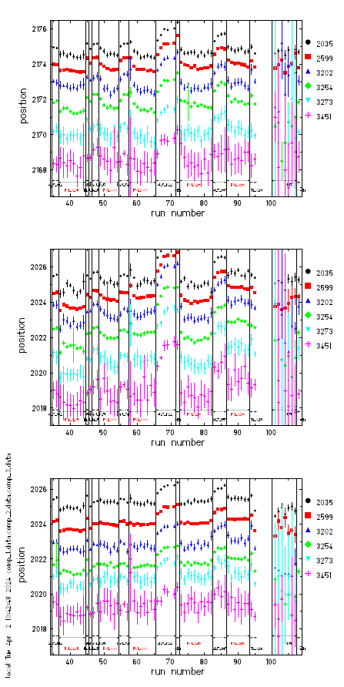
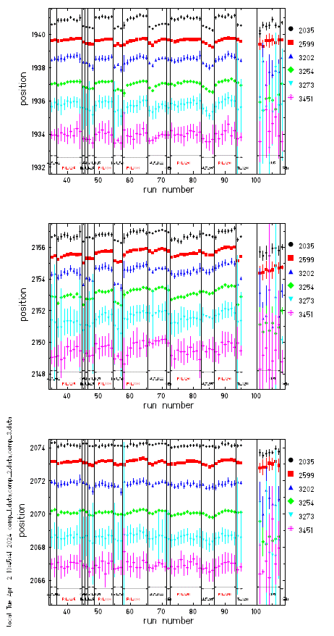
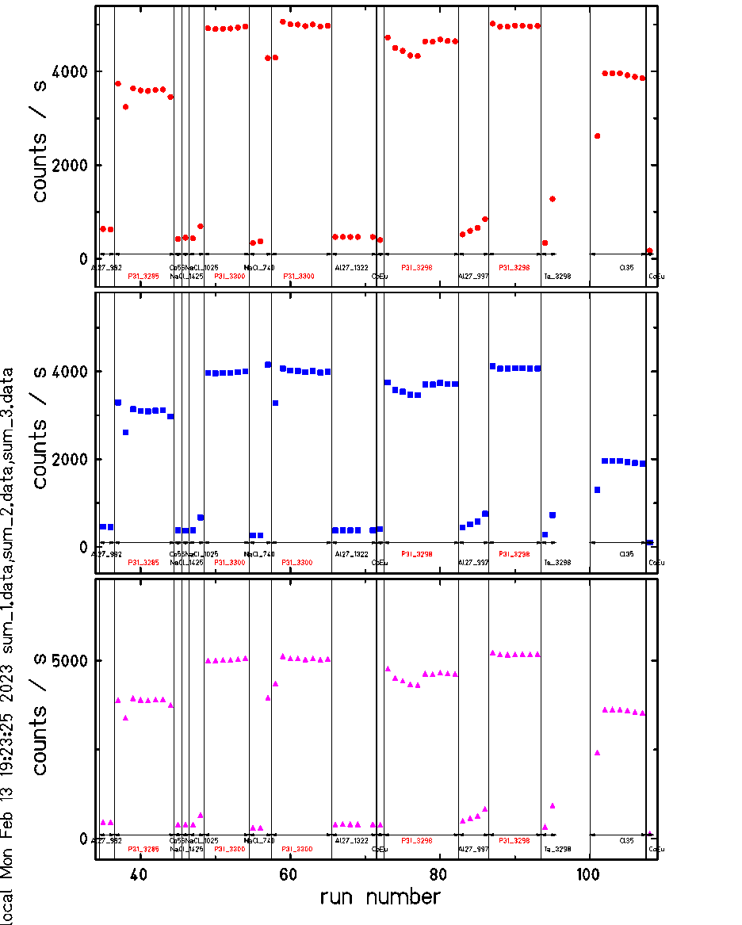
• • • AIFIRA experiment: drifts of AIFRIA and FASTER data: ⁵⁶Co
AIFIRA: FASTER:
Count rate:
day – night difference ?
red: P31_xxxx
Interestingly, the shift is in the opposite direction between the AIFIRA and FASTER data!

Slide 35
• • • AIFIRA experiment: kind of final result (AIFIRA data)
obtained with
an energy fit over the full range
all data except Al27_2 for det. 2
global correction for drift with time (should be fine)
global fit for count-rate correction but not enough data,
because most calibration runs were done with a factor of ~10 less rate

Slide 36
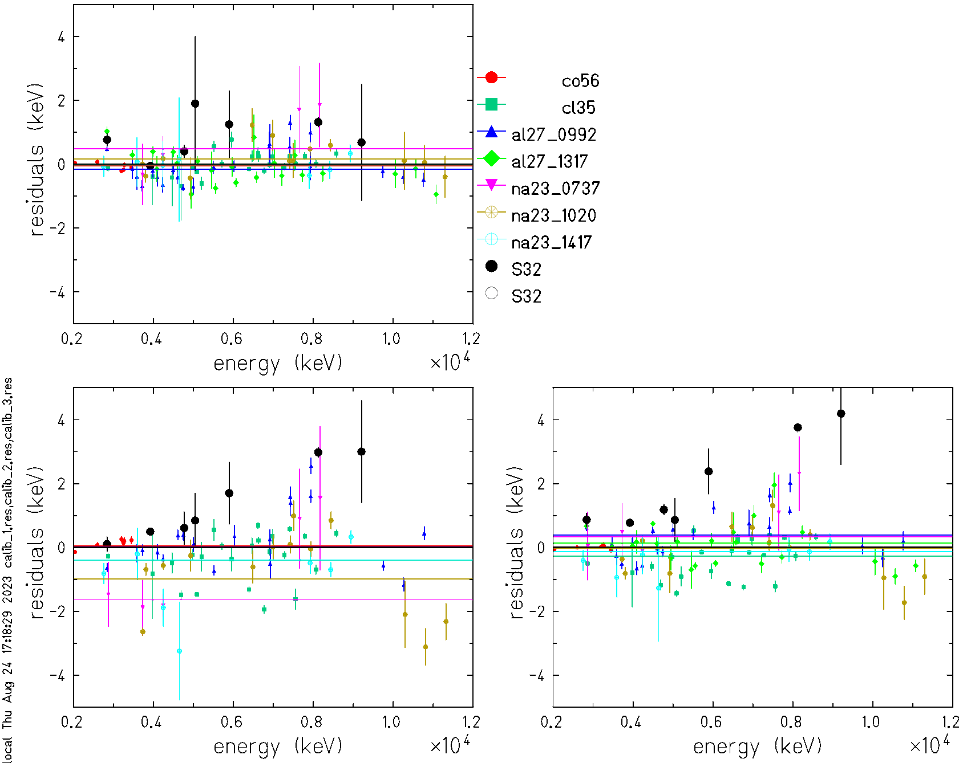
• • • AIFIRA experiment: kind of final result (AIFIRA data)

Slide 37
• • • AIFIRA experiment: if we do it again….
limit rates of ALL runs to less than 500 gammas / s
AIFIRA DAQ is fine, but all offsets should be small
(gain factor 1 for all channels)
check if FASTER non-linearity can be corrected
⁵⁶Co source does not bring a lot, but prevents from fitting the first ³²S peak
➔ use it for odd runs, but not for even runs?
²³Na(p,g)²⁴Mg data are important, but have too little statistics

