Slide 1
RFI Mitigation discussion Intro

Slide 2
When to consider RFI
Site selection
Selection of observing frequencies and design of analog electronics
Trigger design
Signal processing software-- classifying events, applying calibration
Reconstruction and analysis

Slide 3
Two important categories of RFI:
1. Narrowband transmissions—
can raise noise floor, even saturate ADCs if care is not taken
2. Impulsive or transient RFI
can produce false alarm triggers

Slide 4
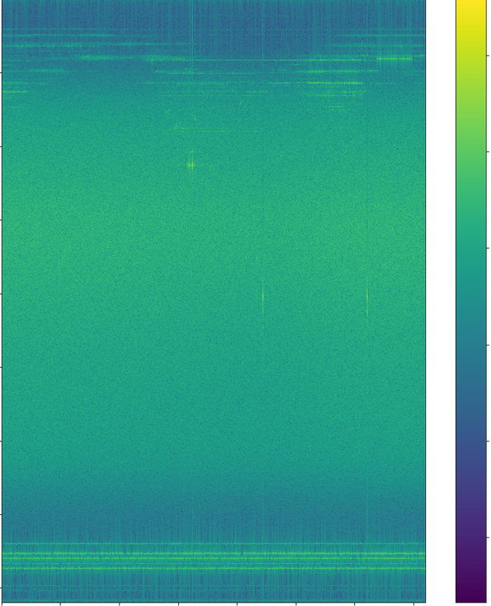
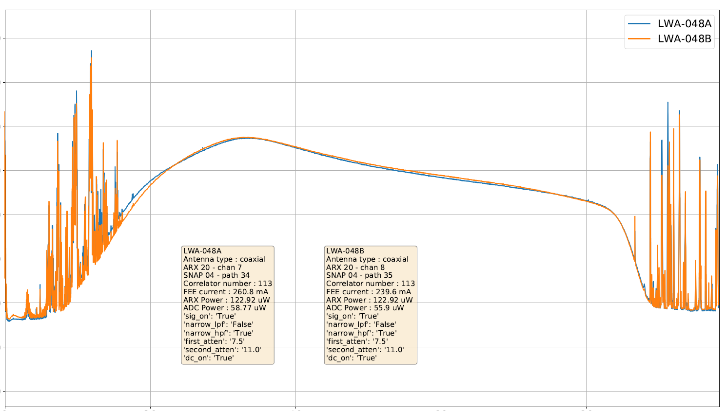
Examples from the OVRO-LWA:
1. Persistent, narrow-band RFI
0
-20
-30
25
-40
-50
Relative Power
Power [dBm]
-60
-70
Frequency [MHz]
50
-80
-90
-100
0
20
40
60
80
Frequency [MHz]
75
Suppressed with analog and digital bandpass filters
Filtering is necessary to stabilize trigger rate
100
200 800 1000 1400
Time [minutes since 22:23 PDT 4-Sep-2021 ]
Notes:
Raw voltages always saved

Slide 5
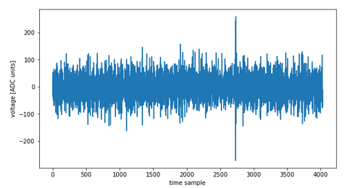
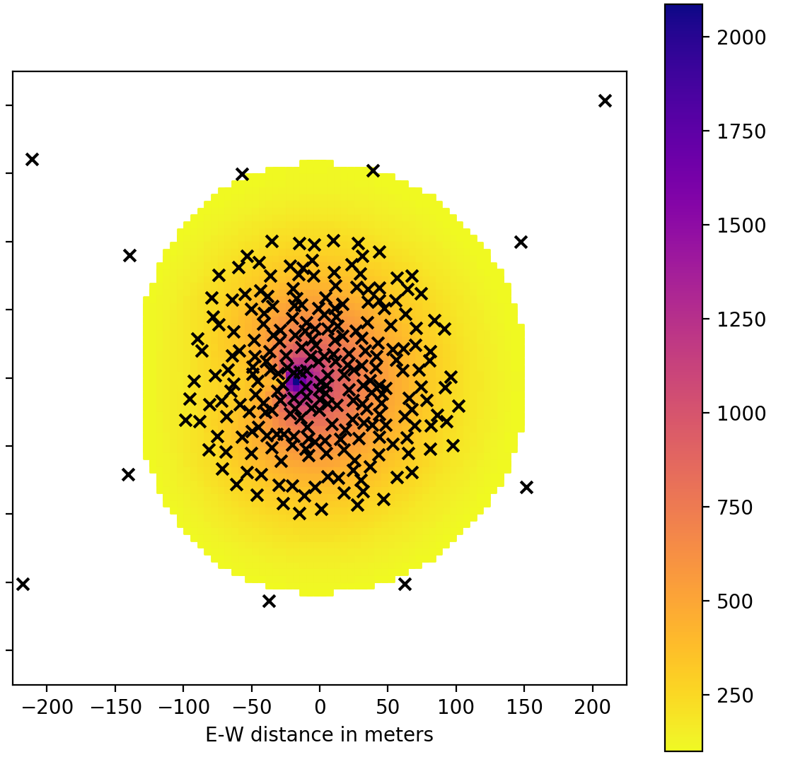
Examples from the OVRO-LWA:
2. Impulsive or transient RFI: rejected by spatial distribution
Distant antennas veto RFI.
Horizon
Airplane reflections
Array layout color-coded by FPGA
a)
1
Simulated emission
2
200
b)
0.5
1.5
N-S position [km]
0
Peak Electric field [millivolts/m]
N-S Position [m]
1
0
c)
c)
0.5
Additionally use polarization, pulse shape
-200
-0.5
-200 0 200
E-W Position [m]
-1
-1.2 -1 -0.8 -0.6 -0.4 -0.2 0 0.2 0.4
E-W position [km]

