Slide 2
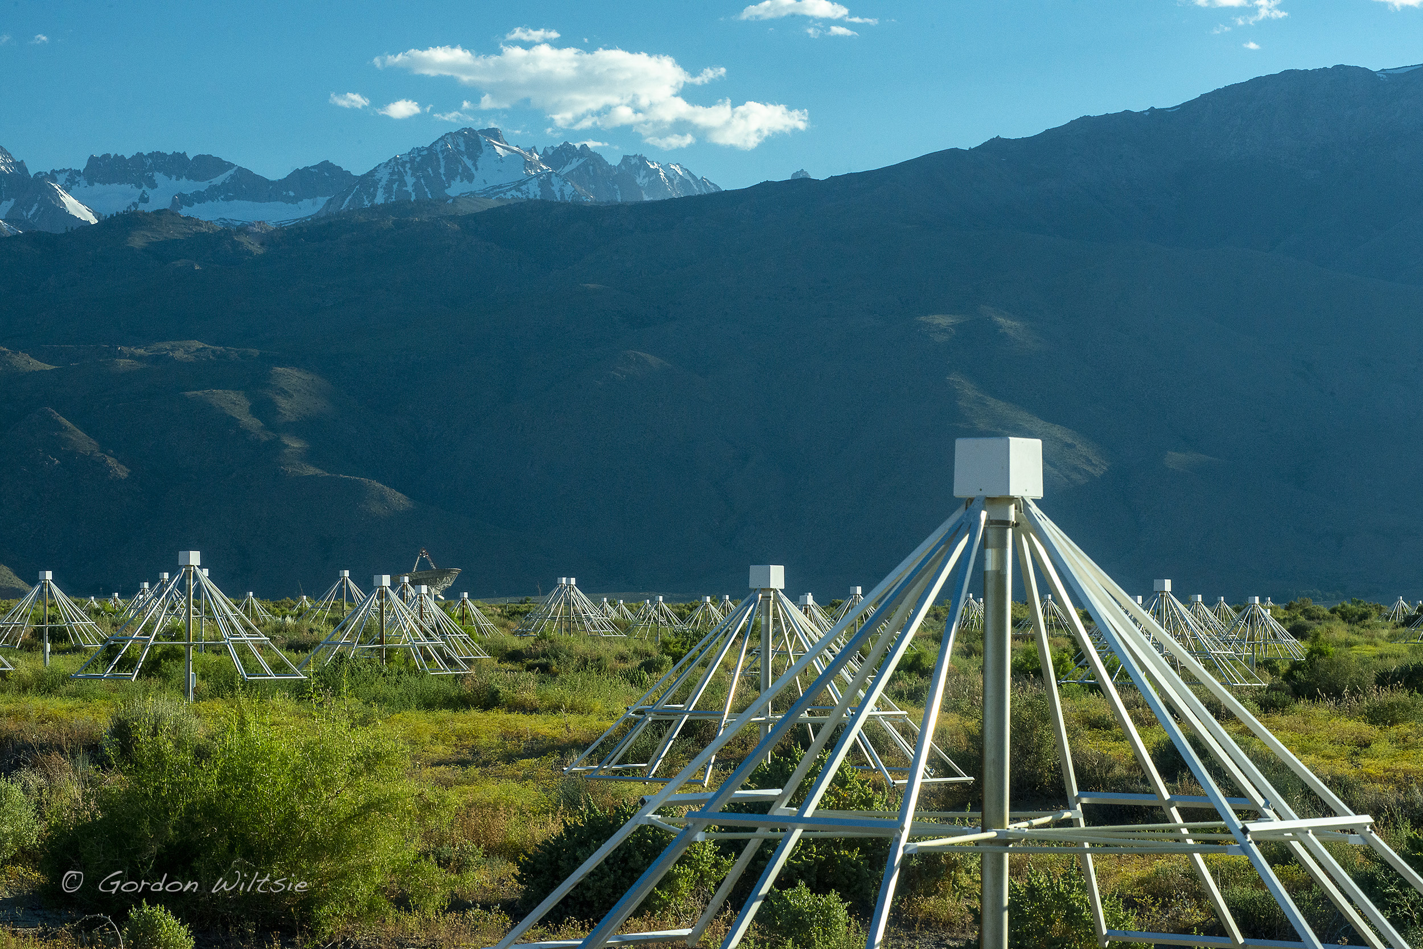
A High-Energy Cosmic Ray Detector for the Owens Valley Radio Observatory Long-Wavelength Array
Kathryn Plant NASA Postdoctoral Fellow, JPL
2
Notes:
Updates from the OVRO-LWA cosmic ray detection system

Slide 3
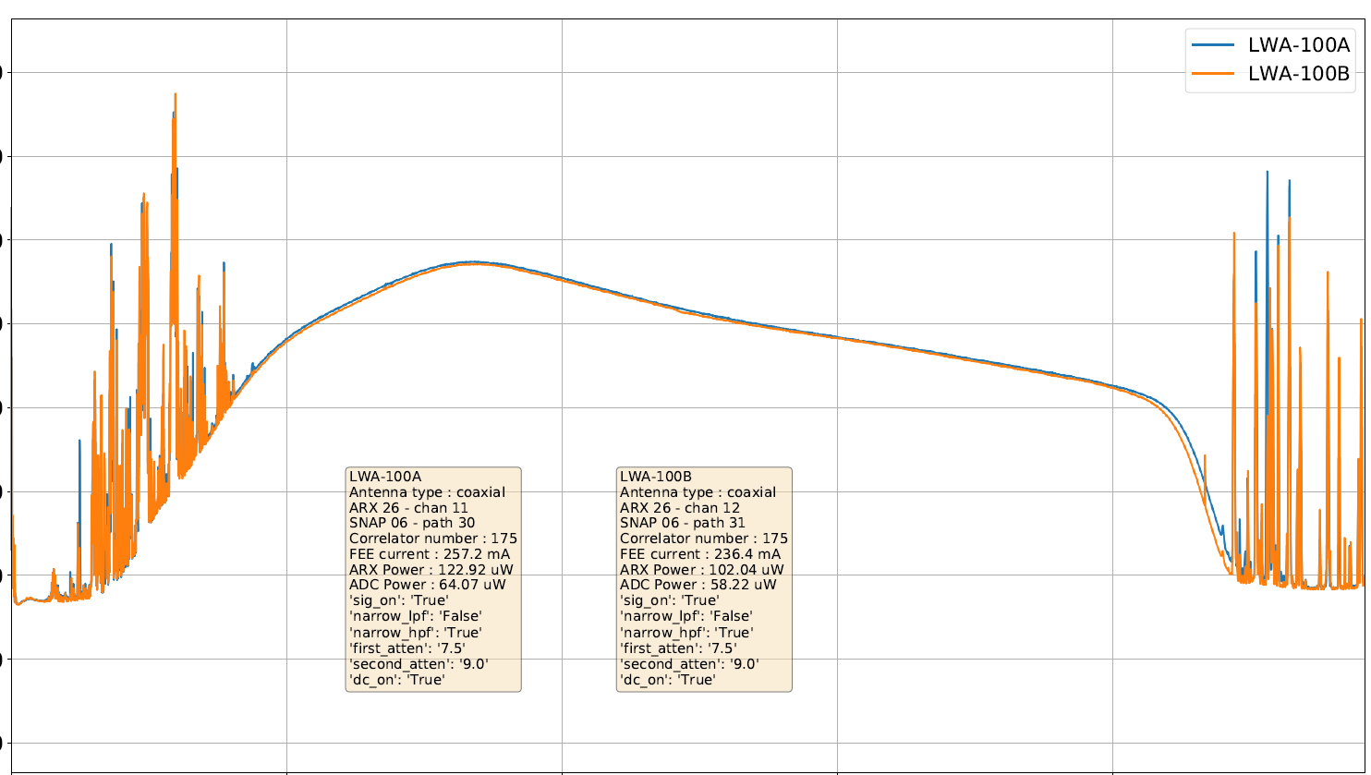
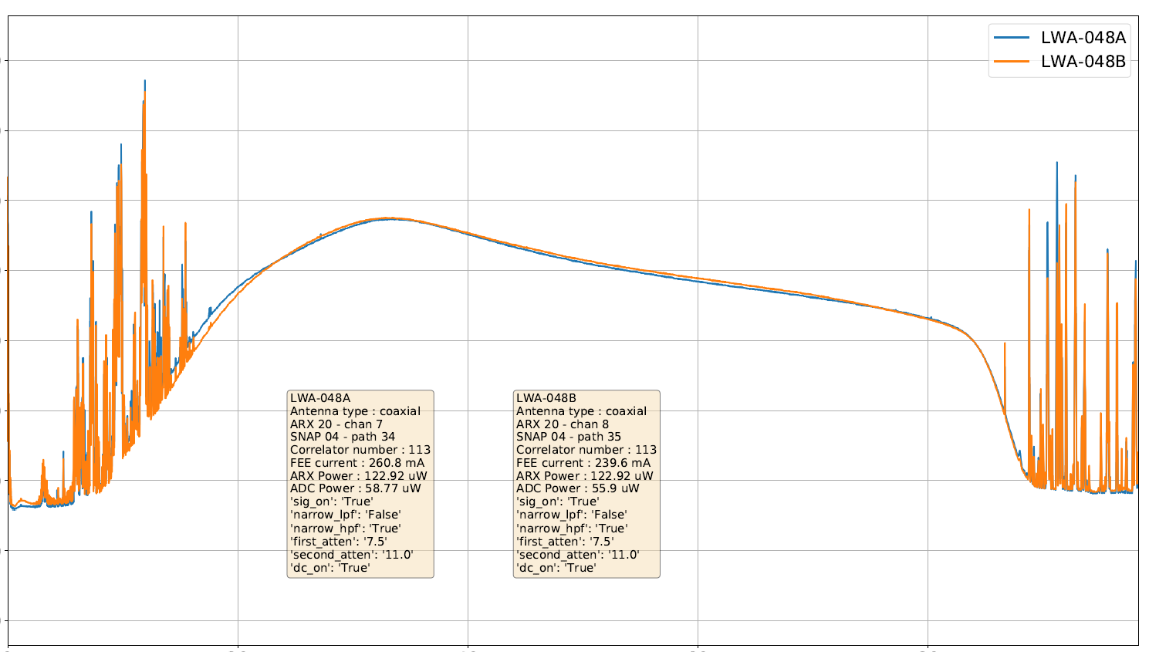
Introduction to the OVRO-LWA
-20
-30
-40
-50
Power [dBm]
-60
-70
-80
-90
-100
0
20
40
60
80
Frequency [MHz]
Extrasolar space weather, epoch of reionization, solar astronomy, cosmic rays and more

Slide 4
Cosmic ray composition measurements are key to understanding the Galactic to extragalactic transition.
Observable by
OVRO-LWA
Schroeder 2019
9 10 11 12 13 14 15 16 17 18 19 20
log (E/eV)
Notes:
This plot combines composition measurements from several experiments. The observation that the heavy element fraction increases near the second knee, and then light elements dominate again at even higher energies is a key piece of evidence about transition to extragalactic sources.
These energies also have more differences between different experiments and so it will be useful for the OVRO LWA to contribute additional measurements.

Slide 5
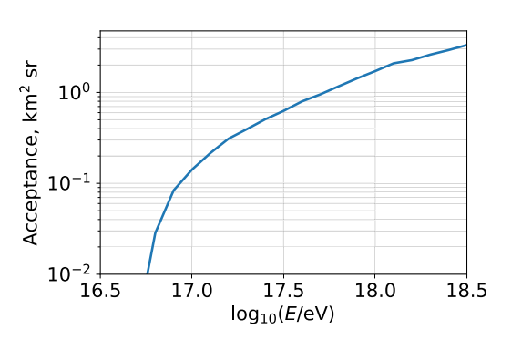
With the stage II array, Monroe et al. 2020 detected 8 cosmic rays with 40 hours of observing.
60
Position North-South [m]
Power [arbitrary units
0
-60
-60
0
60
Antenna Position East-West [m]
Notes:
A previous graduate student Ryan Monroe detected 10 cosmic rays in 40 hours with a dedicated observing run with the earlier version of the array.
The movie on the left shows a cosmic ray arriving across the core array.
The dots mark antenna positions. The size and color of the dot correspond to the power in each antenna.
This demonstration of a radio only technique was a dedicated observing run that just used the core array and required stopping other observations.
I am developing firmware that will allow us to search for cosmic rays all the time, without interrupting other observations.

Slide 6
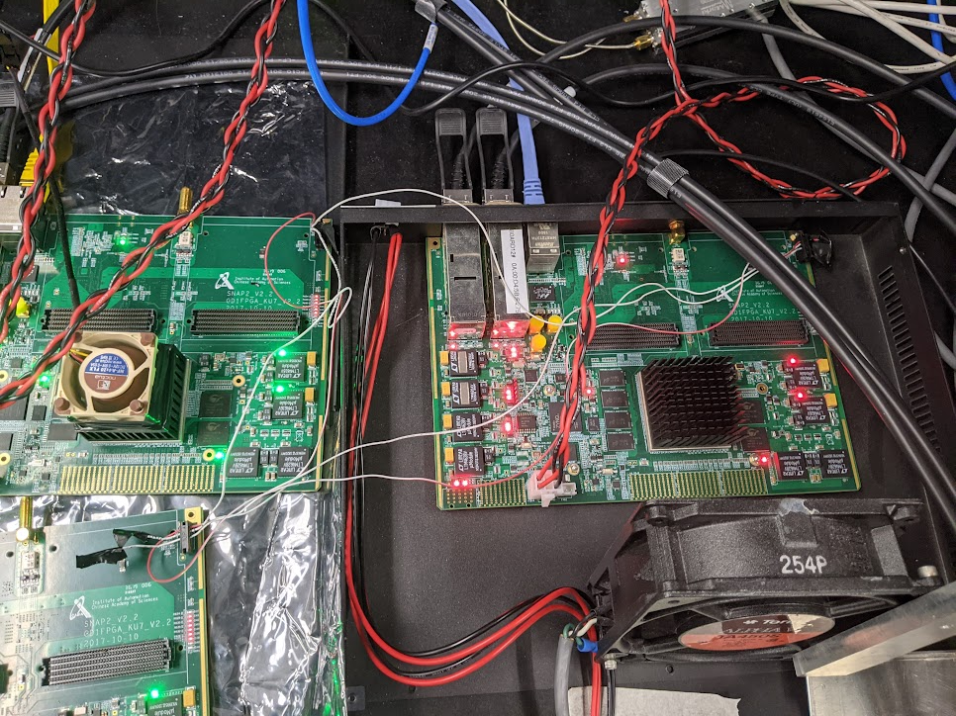
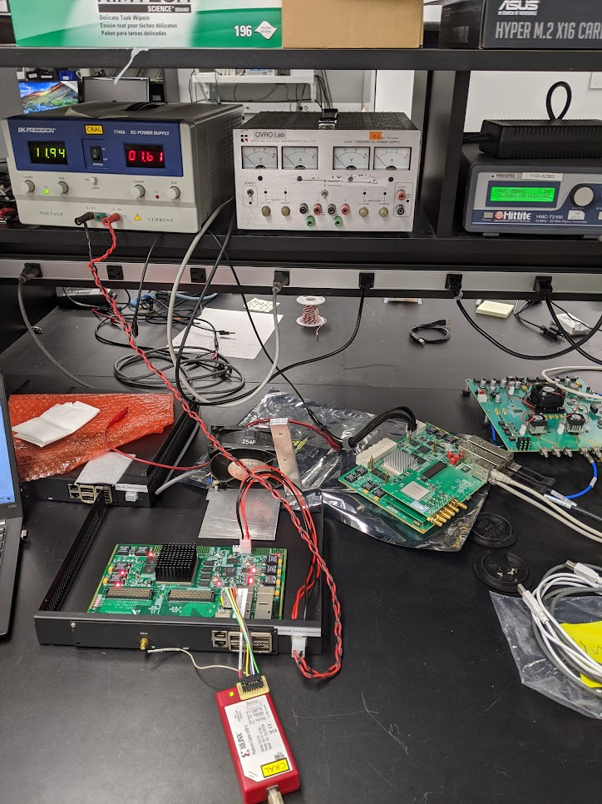
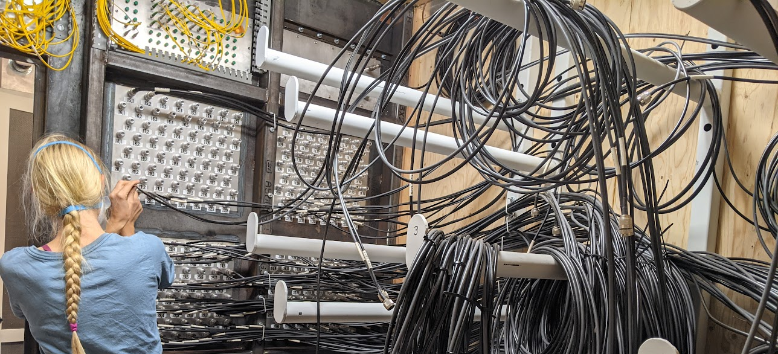
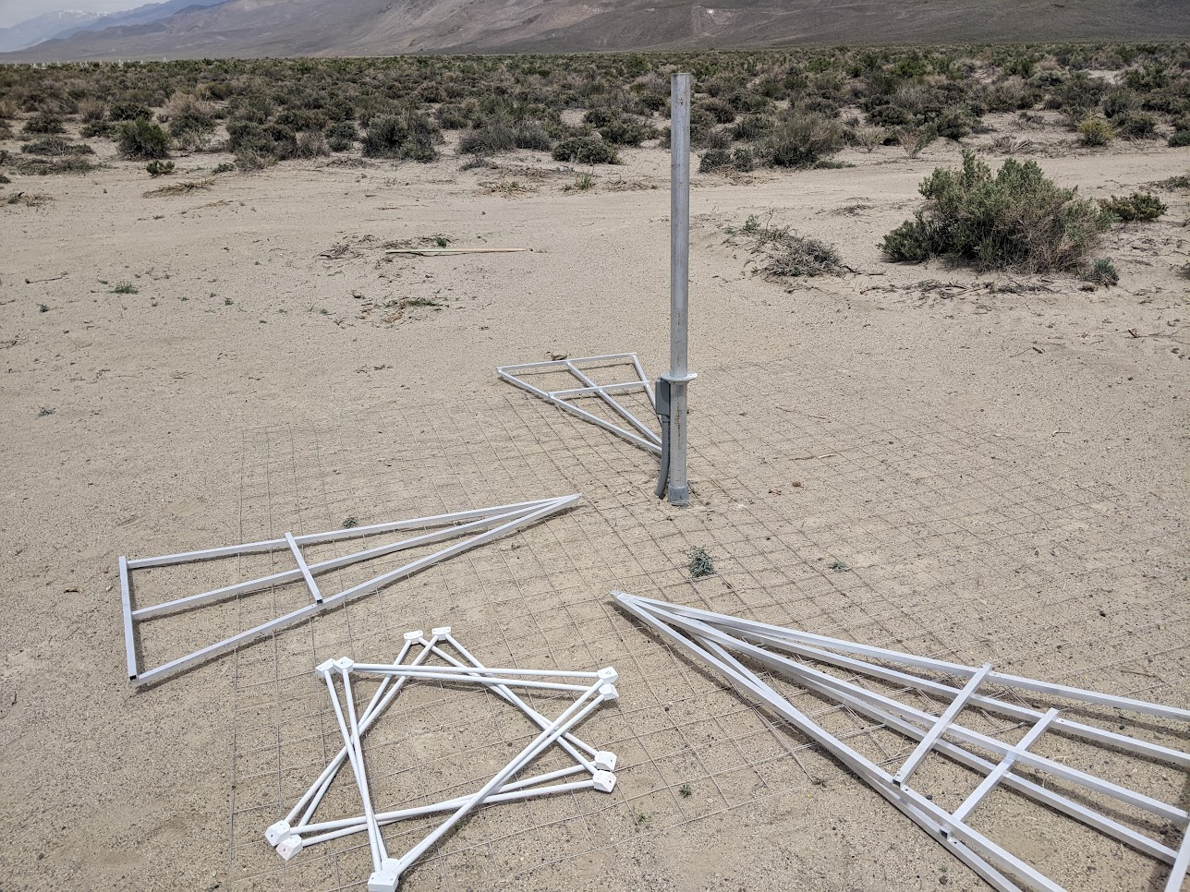
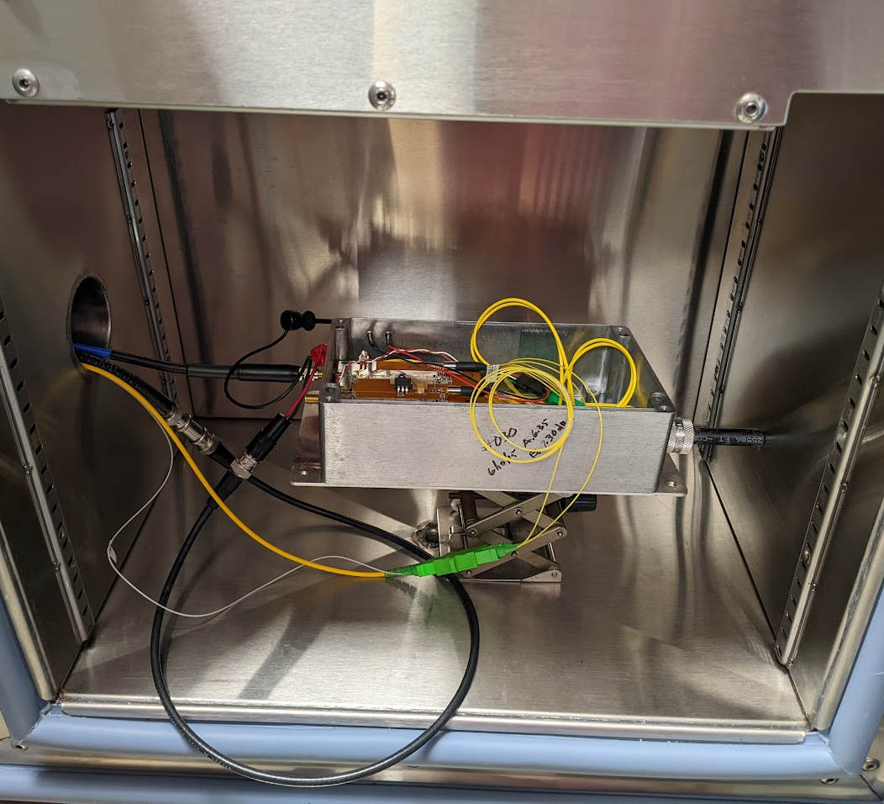
Upgrading The OVRO-LWA
Notes:
Things I had a role in but wasn’t the main person:
Delay calibration
Laser driver testing
Miscellaneous hardware installation

Slide 7
The OVRO-LWA underwent a major upgrade from 2019-2023.
352 dual polarization antennas
Expansion:
288 → 352 dual polarization antennas
1.5 km →2.4 km longest baselines km longest baselines
Junction box
Simplified LWA signal path
Analog receiver electronics
ADC
Digital signal processing

Slide 8
The OVRO-LWA underwent a major upgrade from 2019-2023.
352 dual polarization antennas
Expansion:
288 → 352 dual polarization antennas
1.5 km →2.4 km longest baselines km longest baselines
All front-end electronics cleaned & tested
Junction box
Simplified LWA signal path
Analog receiver electronics
ADC
Digital signal processing

Slide 9
The OVRO-LWA underwent a major upgrade from 2019-2023.
352 dual polarization antennas
Expansion:
288 → 352 dual polarization antennas
1.5 km →2.4 km longest baselines km longest baselines
All front-end electronics cleaned & tested
New RF over optical fiber modules
Junction box
Simplified LWA signal path
Analog receiver electronics
ADC
Digital signal processing

Slide 10
The OVRO-LWA underwent a major upgrade from 2019-2023.
352 dual polarization antennas
Expansion:
288 → 352 dual polarization antennas
1.5 km →2.4 km longest baselines km longest baselines
All front-end electronics cleaned & tested
New RF over optical fiber modules
New analog receiver boards for better signal path isolation
Junction box
Simplified LWA signal path
Analog receiver electronics
ADC
Digital signal processing

Slide 11
The OVRO-LWA underwent a major upgrade from 2019-2023.
352 dual polarization antennas
Expansion:
288 → 352 dual polarization antennas
1.5 km →2.4 km longest baselines km longest baselines
All front-end electronics cleaned & tested
New RF over optical fiber modules
New analog receiver boards for better signal path isolation
All new digital signal processing electronics: opportunity for commensal cosmic ray search
Junction box
Simplified LWA signal path
Analog receiver electronics
ADC
Digital signal processing

Slide 12
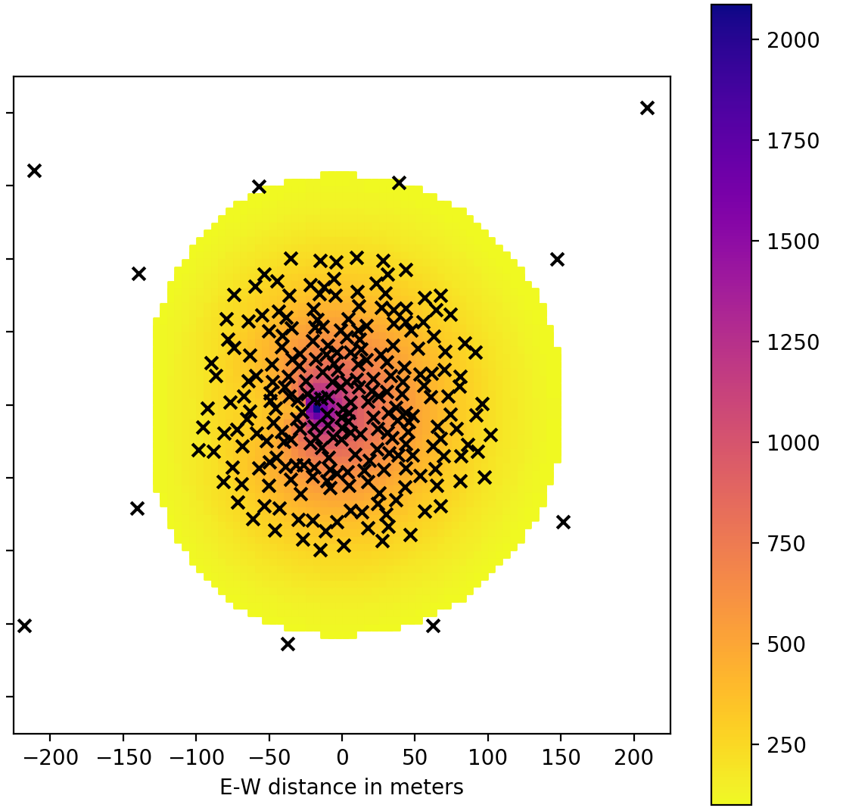
My RFI rejection strategy leverages the array layout.
Array layout color-coded by FPGA
a)
1
Simulated emission
2
Distant antennas veto RFI.
Horizon
Airplane reflections
200
b)
0.5
1.5
N-S position [km]
0
Peak Electric field [millivolts/m]
N-S Position [m]
1
0
c)
c)
0.5
-200
-0.5
-200 0 200
E-W Position [m]
-1
-1.2 -1 -0.8 -0.6 -0.4 -0.2 0 0.2 0.4
E-W position [km]
Notes:
Antennas are color coded by FPGA. Antennas marked X are veto antennas.
These sparser regions of the array are grouped into two higher-energy arrays, each with their own veto antennas.
Mention RFI is mostly from horizon, airplanes, or near field

Slide 13
Overview of the cosmic ray trigger firmware
Buffer 20 microseconds x 64 antennas
Read out buffer and form ethernet packets
To network switch
Extend pulse over coincidence window
Trigger
64 timeseries from ADCs
Apply
cable delays
Filter, square voltages, and smooth power
Threshold pulse detector
Sum over antennas
Transmit trigger to other boards
RFI Veto Logic
Cancel trigger
Notes:
Here is an overview of the cosmic ray detection firmware. The SNAP2s buffer 20 microseconds of the time series output by the ADCs, with 5 ns time resolution.
The buffer is implemented as a circular buffer– whenever it gets to the last address it starts overwriting data from the beginning.
In parallel with the buffer, the firmware searches for pulses above a threshold, on the timeseries for each of the antennas processed by that SNAP2. If a threshold number of antennas have a pulse within the light travel time between those antennas, the detector logic outputs a trigger signal. The trigger can be cancelled by RFI rejection logic that I will describe on the next slide.
If the trigger is not cancelled by the RFI blocker, then the board stops writing new data to its buffer and reads out the buffered timeseries into ethernetpackets which are transmitted to a computer for the next stages of processing. Also, any board triggers all the others to read out their buffered data, so that the computer receives a snapshot from the whole array. Most of the RFI rejection occurs on this computer. The first stage of RFI rejection on the FPGAs only has to do well enough to keep the trigger rate low enough that the receiving computer can keep up and the readout dead time is small.
The readout deadtime is determined by how fast the receiving computer can process the ethernet packets, not the maximum speed that the SNAP2 boards can transmit the data. To avoid overwhelming the receiving computer, readout time takes 920 microseconds. Which we expect to result in less than 5% of observing time lost to dead time.
%Most of the RFI rejection
%Ryan found 500Hz RFI
%Limited to 50Hz, had slower readout on the old network so that was 13% dead time
%We will have 4.6% dead time at 50Hz event rate

Slide 14
Overview of the cosmic ray trigger firmware
64 timeseries from ADCs
Apply
cable delays
Notes:
Here is an overview of the cosmic ray detection firmware. The SNAP2s buffer 20 microseconds of the time series output by the ADCs, with 5 ns time resolution.
The buffer is implemented as a circular buffer– whenever it gets to the last address it starts overwriting data from the beginning.
In parallel with the buffer, the firmware searches for pulses above a threshold, on the timeseries for each of the antennas processed by that SNAP2. If a threshold number of antennas have a pulse within the light travel time between those antennas, the detector logic outputs a trigger signal. The trigger can be cancelled by RFI rejection logic that I will describe on the next slide.
If the trigger is not cancelled by the RFI blocker, then the board stops writing new data to its buffer and reads out the buffered timeseries into ethernetpackets which are transmitted to a computer for the next stages of processing. Also, any board triggers all the others to read out their buffered data, so that the computer receives a snapshot from the whole array. Most of the RFI rejection occurs on this computer. The first stage of RFI rejection on the FPGAs only has to do well enough to keep the trigger rate low enough that the receiving computer can keep up and the readout dead time is small.
The readout deadtime is determined by how fast the receiving computer can process the ethernet packets, not the maximum speed that the SNAP2 boards can transmit the data. To avoid overwhelming the receiving computer, readout time takes 920 microseconds. Which we expect to result in less than 5% of observing time lost to dead time.
%Most of the RFI rejection
%Ryan found 500Hz RFI
%Limited to 50Hz, had slower readout on the old network so that was 13% dead time
%We will have 4.6% dead time at 50Hz event rate

Slide 15
Overview of the cosmic ray trigger firmware
64 timeseries from ADCs
Apply
cable delays
Filter, square voltages, and smooth power
Notes:
Here is an overview of the cosmic ray detection firmware. The SNAP2s buffer 20 microseconds of the time series output by the ADCs, with 5 ns time resolution.
The buffer is implemented as a circular buffer– whenever it gets to the last address it starts overwriting data from the beginning.
In parallel with the buffer, the firmware searches for pulses above a threshold, on the timeseries for each of the antennas processed by that SNAP2. If a threshold number of antennas have a pulse within the light travel time between those antennas, the detector logic outputs a trigger signal. The trigger can be cancelled by RFI rejection logic that I will describe on the next slide.
If the trigger is not cancelled by the RFI blocker, then the board stops writing new data to its buffer and reads out the buffered timeseries into ethernetpackets which are transmitted to a computer for the next stages of processing. Also, any board triggers all the others to read out their buffered data, so that the computer receives a snapshot from the whole array. Most of the RFI rejection occurs on this computer. The first stage of RFI rejection on the FPGAs only has to do well enough to keep the trigger rate low enough that the receiving computer can keep up and the readout dead time is small.
The readout deadtime is determined by how fast the receiving computer can process the ethernet packets, not the maximum speed that the SNAP2 boards can transmit the data. To avoid overwhelming the receiving computer, readout time takes 920 microseconds. Which we expect to result in less than 5% of observing time lost to dead time.
%Most of the RFI rejection
%Ryan found 500Hz RFI
%Limited to 50Hz, had slower readout on the old network so that was 13% dead time
%We will have 4.6% dead time at 50Hz event rate

Slide 16
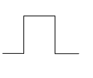
Overview of the cosmic ray trigger firmware
64 timeseries from ADCs
Apply
cable delays
Filter, square voltages, and smooth power
Threshold pulse detector
Notes:
Here is an overview of the cosmic ray detection firmware. The SNAP2s buffer 20 microseconds of the time series output by the ADCs, with 5 ns time resolution.
The buffer is implemented as a circular buffer– whenever it gets to the last address it starts overwriting data from the beginning.
In parallel with the buffer, the firmware searches for pulses above a threshold, on the timeseries for each of the antennas processed by that SNAP2. If a threshold number of antennas have a pulse within the light travel time between those antennas, the detector logic outputs a trigger signal. The trigger can be cancelled by RFI rejection logic that I will describe on the next slide.
If the trigger is not cancelled by the RFI blocker, then the board stops writing new data to its buffer and reads out the buffered timeseries into ethernetpackets which are transmitted to a computer for the next stages of processing. Also, any board triggers all the others to read out their buffered data, so that the computer receives a snapshot from the whole array. Most of the RFI rejection occurs on this computer. The first stage of RFI rejection on the FPGAs only has to do well enough to keep the trigger rate low enough that the receiving computer can keep up and the readout dead time is small.
The readout deadtime is determined by how fast the receiving computer can process the ethernet packets, not the maximum speed that the SNAP2 boards can transmit the data. To avoid overwhelming the receiving computer, readout time takes 920 microseconds. Which we expect to result in less than 5% of observing time lost to dead time.
%Most of the RFI rejection
%Ryan found 500Hz RFI
%Limited to 50Hz, had slower readout on the old network so that was 13% dead time
%We will have 4.6% dead time at 50Hz event rate

Slide 17
Overview of the cosmic ray trigger firmware
Extend pulse over coincidence window
64 timeseries from ADCs
Apply
cable delays
Filter, square voltages, and smooth power
Threshold pulse detector
Notes:
Here is an overview of the cosmic ray detection firmware. The SNAP2s buffer 20 microseconds of the time series output by the ADCs, with 5 ns time resolution.
The buffer is implemented as a circular buffer– whenever it gets to the last address it starts overwriting data from the beginning.
In parallel with the buffer, the firmware searches for pulses above a threshold, on the timeseries for each of the antennas processed by that SNAP2. If a threshold number of antennas have a pulse within the light travel time between those antennas, the detector logic outputs a trigger signal. The trigger can be cancelled by RFI rejection logic that I will describe on the next slide.
If the trigger is not cancelled by the RFI blocker, then the board stops writing new data to its buffer and reads out the buffered timeseries into ethernetpackets which are transmitted to a computer for the next stages of processing. Also, any board triggers all the others to read out their buffered data, so that the computer receives a snapshot from the whole array. Most of the RFI rejection occurs on this computer. The first stage of RFI rejection on the FPGAs only has to do well enough to keep the trigger rate low enough that the receiving computer can keep up and the readout dead time is small.
The readout deadtime is determined by how fast the receiving computer can process the ethernet packets, not the maximum speed that the SNAP2 boards can transmit the data. To avoid overwhelming the receiving computer, readout time takes 920 microseconds. Which we expect to result in less than 5% of observing time lost to dead time.
%Most of the RFI rejection
%Ryan found 500Hz RFI
%Limited to 50Hz, had slower readout on the old network so that was 13% dead time
%We will have 4.6% dead time at 50Hz event rate

Slide 18
Overview of the cosmic ray trigger firmware
Extend pulse over coincidence window
64 timeseries from ADCs
Apply
cable delays
Filter, square voltages, and smooth power
Threshold pulse detector
Sum over antennas
Notes:
Here is an overview of the cosmic ray detection firmware. The SNAP2s buffer 20 microseconds of the time series output by the ADCs, with 5 ns time resolution.
The buffer is implemented as a circular buffer– whenever it gets to the last address it starts overwriting data from the beginning.
In parallel with the buffer, the firmware searches for pulses above a threshold, on the timeseries for each of the antennas processed by that SNAP2. If a threshold number of antennas have a pulse within the light travel time between those antennas, the detector logic outputs a trigger signal. The trigger can be cancelled by RFI rejection logic that I will describe on the next slide.
If the trigger is not cancelled by the RFI blocker, then the board stops writing new data to its buffer and reads out the buffered timeseries into ethernetpackets which are transmitted to a computer for the next stages of processing. Also, any board triggers all the others to read out their buffered data, so that the computer receives a snapshot from the whole array. Most of the RFI rejection occurs on this computer. The first stage of RFI rejection on the FPGAs only has to do well enough to keep the trigger rate low enough that the receiving computer can keep up and the readout dead time is small.
The readout deadtime is determined by how fast the receiving computer can process the ethernet packets, not the maximum speed that the SNAP2 boards can transmit the data. To avoid overwhelming the receiving computer, readout time takes 920 microseconds. Which we expect to result in less than 5% of observing time lost to dead time.
%Most of the RFI rejection
%Ryan found 500Hz RFI
%Limited to 50Hz, had slower readout on the old network so that was 13% dead time
%We will have 4.6% dead time at 50Hz event rate

Slide 19
Overview of the cosmic ray trigger firmware
Extend pulse over coincidence window
Trigger
64 timeseries from ADCs
Apply
cable delays
Filter, square voltages, and smooth power
Threshold pulse detector
Sum over antennas
Notes:
Here is an overview of the cosmic ray detection firmware. The SNAP2s buffer 20 microseconds of the time series output by the ADCs, with 5 ns time resolution.
The buffer is implemented as a circular buffer– whenever it gets to the last address it starts overwriting data from the beginning.
In parallel with the buffer, the firmware searches for pulses above a threshold, on the timeseries for each of the antennas processed by that SNAP2. If a threshold number of antennas have a pulse within the light travel time between those antennas, the detector logic outputs a trigger signal. The trigger can be cancelled by RFI rejection logic that I will describe on the next slide.
If the trigger is not cancelled by the RFI blocker, then the board stops writing new data to its buffer and reads out the buffered timeseries into ethernetpackets which are transmitted to a computer for the next stages of processing. Also, any board triggers all the others to read out their buffered data, so that the computer receives a snapshot from the whole array. Most of the RFI rejection occurs on this computer. The first stage of RFI rejection on the FPGAs only has to do well enough to keep the trigger rate low enough that the receiving computer can keep up and the readout dead time is small.
The readout deadtime is determined by how fast the receiving computer can process the ethernet packets, not the maximum speed that the SNAP2 boards can transmit the data. To avoid overwhelming the receiving computer, readout time takes 920 microseconds. Which we expect to result in less than 5% of observing time lost to dead time.
%Most of the RFI rejection
%Ryan found 500Hz RFI
%Limited to 50Hz, had slower readout on the old network so that was 13% dead time
%We will have 4.6% dead time at 50Hz event rate

Slide 20
Overview of the cosmic ray trigger firmware
Extend pulse over coincidence window
Trigger
64 timeseries from ADCs
Apply
cable delays
Filter, square voltages, and smooth power
Threshold pulse detector
Sum over antennas
Transmit trigger to other boards
RFI Veto Logic
Notes:
Here is an overview of the cosmic ray detection firmware. The SNAP2s buffer 20 microseconds of the time series output by the ADCs, with 5 ns time resolution.
The buffer is implemented as a circular buffer– whenever it gets to the last address it starts overwriting data from the beginning.
In parallel with the buffer, the firmware searches for pulses above a threshold, on the timeseries for each of the antennas processed by that SNAP2. If a threshold number of antennas have a pulse within the light travel time between those antennas, the detector logic outputs a trigger signal. The trigger can be cancelled by RFI rejection logic that I will describe on the next slide.
If the trigger is not cancelled by the RFI blocker, then the board stops writing new data to its buffer and reads out the buffered timeseries into ethernetpackets which are transmitted to a computer for the next stages of processing. Also, any board triggers all the others to read out their buffered data, so that the computer receives a snapshot from the whole array. Most of the RFI rejection occurs on this computer. The first stage of RFI rejection on the FPGAs only has to do well enough to keep the trigger rate low enough that the receiving computer can keep up and the readout dead time is small.
The readout deadtime is determined by how fast the receiving computer can process the ethernet packets, not the maximum speed that the SNAP2 boards can transmit the data. To avoid overwhelming the receiving computer, readout time takes 920 microseconds. Which we expect to result in less than 5% of observing time lost to dead time.
%Most of the RFI rejection
%Ryan found 500Hz RFI
%Limited to 50Hz, had slower readout on the old network so that was 13% dead time
%We will have 4.6% dead time at 50Hz event rate

Slide 21
Overview of the cosmic ray trigger firmware
Extend pulse over coincidence window
Trigger
64 timeseries from ADCs
Apply
cable delays
Filter, square voltages, and smooth power
Threshold pulse detector
Sum over antennas
Transmit trigger to other boards
RFI Veto Logic
Cancel trigger
Notes:
Here is an overview of the cosmic ray detection firmware. The SNAP2s buffer 20 microseconds of the time series output by the ADCs, with 5 ns time resolution.
The buffer is implemented as a circular buffer– whenever it gets to the last address it starts overwriting data from the beginning.
In parallel with the buffer, the firmware searches for pulses above a threshold, on the timeseries for each of the antennas processed by that SNAP2. If a threshold number of antennas have a pulse within the light travel time between those antennas, the detector logic outputs a trigger signal. The trigger can be cancelled by RFI rejection logic that I will describe on the next slide.
If the trigger is not cancelled by the RFI blocker, then the board stops writing new data to its buffer and reads out the buffered timeseries into ethernetpackets which are transmitted to a computer for the next stages of processing. Also, any board triggers all the others to read out their buffered data, so that the computer receives a snapshot from the whole array. Most of the RFI rejection occurs on this computer. The first stage of RFI rejection on the FPGAs only has to do well enough to keep the trigger rate low enough that the receiving computer can keep up and the readout dead time is small.
The readout deadtime is determined by how fast the receiving computer can process the ethernet packets, not the maximum speed that the SNAP2 boards can transmit the data. To avoid overwhelming the receiving computer, readout time takes 920 microseconds. Which we expect to result in less than 5% of observing time lost to dead time.
%Most of the RFI rejection
%Ryan found 500Hz RFI
%Limited to 50Hz, had slower readout on the old network so that was 13% dead time
%We will have 4.6% dead time at 50Hz event rate

Slide 22
Overview of the cosmic ray trigger firmware
Buffer 20 microseconds x 64 antennas
Extend pulse over coincidence window
Trigger
64 timeseries from ADCs
Apply
cable delays
Filter, square voltages, and smooth power
Threshold pulse detector
Sum over antennas
Transmit trigger to other boards
RFI Veto Logic
Cancel trigger
Notes:
Here is an overview of the cosmic ray detection firmware. The SNAP2s buffer 20 microseconds of the time series output by the ADCs, with 5 ns time resolution.
The buffer is implemented as a circular buffer– whenever it gets to the last address it starts overwriting data from the beginning.
In parallel with the buffer, the firmware searches for pulses above a threshold, on the timeseries for each of the antennas processed by that SNAP2. If a threshold number of antennas have a pulse within the light travel time between those antennas, the detector logic outputs a trigger signal. The trigger can be cancelled by RFI rejection logic that I will describe on the next slide.
If the trigger is not cancelled by the RFI blocker, then the board stops writing new data to its buffer and reads out the buffered timeseries into ethernetpackets which are transmitted to a computer for the next stages of processing. Also, any board triggers all the others to read out their buffered data, so that the computer receives a snapshot from the whole array. Most of the RFI rejection occurs on this computer. The first stage of RFI rejection on the FPGAs only has to do well enough to keep the trigger rate low enough that the receiving computer can keep up and the readout dead time is small.
The readout deadtime is determined by how fast the receiving computer can process the ethernet packets, not the maximum speed that the SNAP2 boards can transmit the data. To avoid overwhelming the receiving computer, readout time takes 920 microseconds. Which we expect to result in less than 5% of observing time lost to dead time.
%Most of the RFI rejection
%Ryan found 500Hz RFI
%Limited to 50Hz, had slower readout on the old network so that was 13% dead time
%We will have 4.6% dead time at 50Hz event rate

Slide 23
Overview of the cosmic ray trigger firmware
Buffer 20 microseconds x 64 antennas
Read out buffer and form ethernet packets
To network switch
Extend pulse over coincidence window
Trigger
64 timeseries from ADCs
Apply
cable delays
Filter, square voltages, and smooth power
Threshold pulse detector
Sum over antennas
Transmit trigger to other boards
RFI Veto Logic
Cancel trigger
Notes:
Here is an overview of the cosmic ray detection firmware. The SNAP2s buffer 20 microseconds of the time series output by the ADCs, with 5 ns time resolution.
The buffer is implemented as a circular buffer– whenever it gets to the last address it starts overwriting data from the beginning.
In parallel with the buffer, the firmware searches for pulses above a threshold, on the timeseries for each of the antennas processed by that SNAP2. If a threshold number of antennas have a pulse within the light travel time between those antennas, the detector logic outputs a trigger signal. The trigger can be cancelled by RFI rejection logic that I will describe on the next slide.
If the trigger is not cancelled by the RFI blocker, then the board stops writing new data to its buffer and reads out the buffered timeseries into ethernetpackets which are transmitted to a computer for the next stages of processing. Also, any board triggers all the others to read out their buffered data, so that the computer receives a snapshot from the whole array. Most of the RFI rejection occurs on this computer. The first stage of RFI rejection on the FPGAs only has to do well enough to keep the trigger rate low enough that the receiving computer can keep up and the readout dead time is small.
The readout deadtime is determined by how fast the receiving computer can process the ethernet packets, not the maximum speed that the SNAP2 boards can transmit the data. To avoid overwhelming the receiving computer, readout time takes 920 microseconds. Which we expect to result in less than 5% of observing time lost to dead time.
%Most of the RFI rejection
%Ryan found 500Hz RFI
%Limited to 50Hz, had slower readout on the old network so that was 13% dead time
%We will have 4.6% dead time at 50Hz event rate

Slide 24
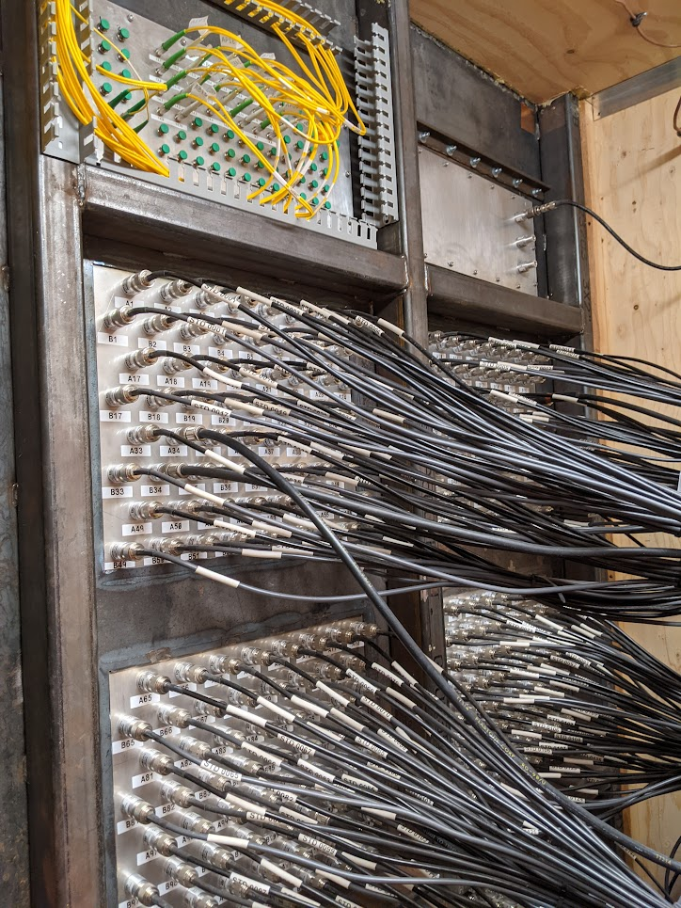
Bringing all signals to a central location is crucial to the cosmic ray detection strategy.
Combination of coaxial cable and RF over Fiber

Slide 25
Goal of commissioning:
Optimize the tradeoff of balancing cosmic-ray sensitivity and RFI-rejection in:
1. Detector settings
2. Real-time event filtering software

Slide 26
Example trigger and veto rates over one night
Known, hourly RFI source
200
Raw events
25000
Raw events
Vetos
Vetos
175
Triggers
Triggers
20000
150
Same data, zoom y-axis
125
15000
Rate [Hz]
Rate [Hz]
100
10000
75
50
5000
25
0 2 4 5 8
0 2 4 5 8
Time [hours since start]
Time [hours since start]

Slide 27
Conclusion
Upgrade is complete
Commissioning in progress
Goal is to observe 1000s of cosmic rays over the next few years to make better composition estimates at the Galactic to extragalactic transition.

