Slide 1
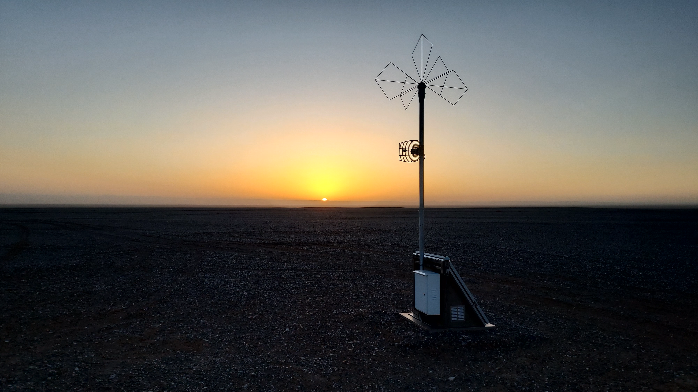

The Giant Radio Array for Neutrino Detection: an overview
Olivier Martineau, LPNHE
GRAND-BEACON workshop
Penn State, January 10-12, 2024

Slide 2
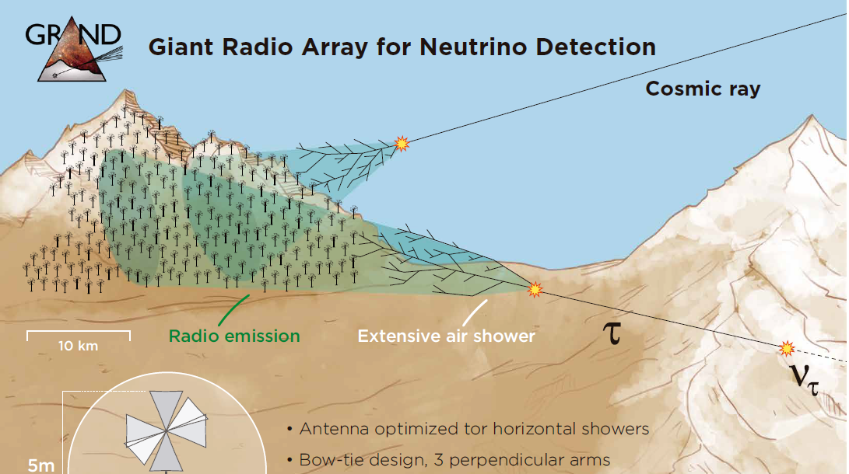
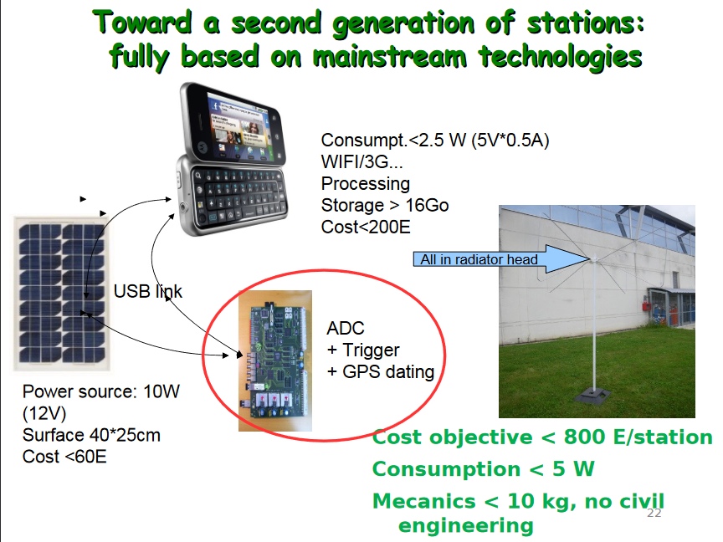
GRAND in a nutshell
Pascal Lautridou (2011)
Very low UHE neutrino fluxes ⊗ very indirect EAS production mechanism
➔ Very rare events
  Very large effective area
    Very cheap detection system ⊗ very large area: GRAND

Slide 3
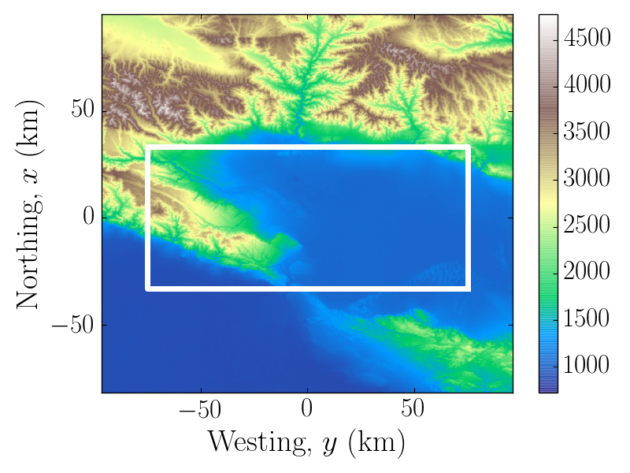
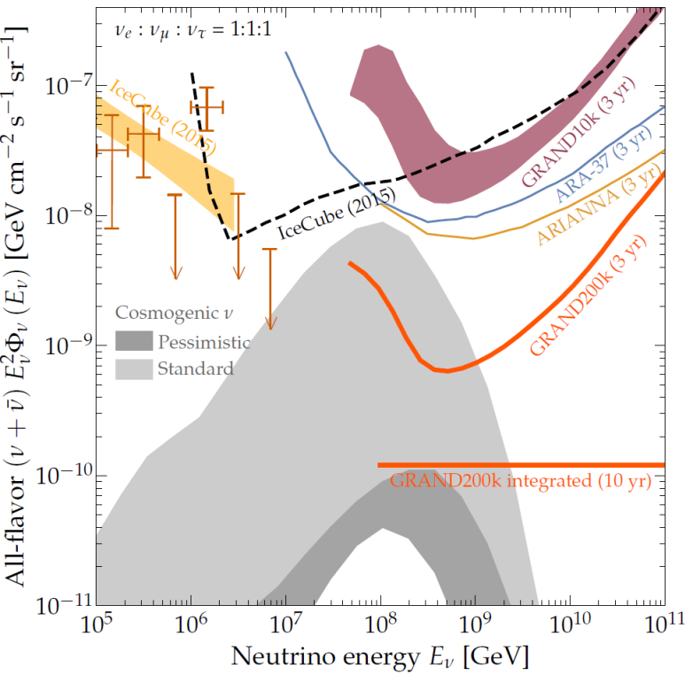
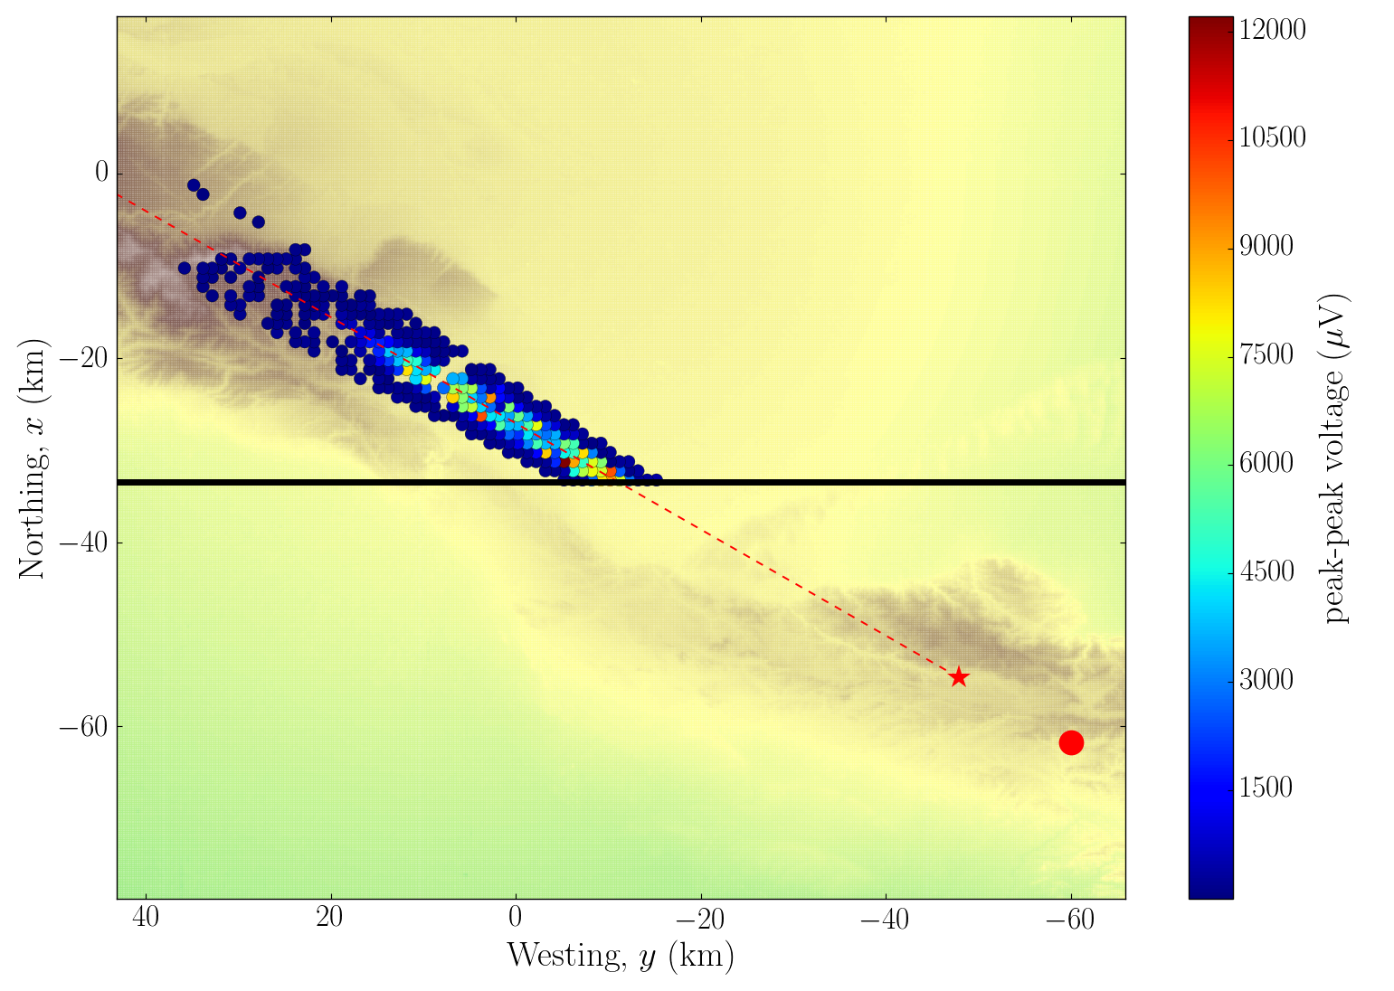
GRAND proposal
Large effort for end-to-end simulation (2015-2018)
DANTON Niess & Martineau-Huynh arXiv:1810.01978
RadioMorphing Zilles et al. arXiv:1811.01750
on a 10’000 antennas hotspot (GRAND10k)
Sensitivity in IceCube2015 range.
Go for x20!! ➔ Network of o(20) subarrays of o(10000) antennas with sparse density (1/km²) at various favorable locations around the world (« hotspots »)
Sensitivity of full array good enough for GRAND to detect cosmogenic neutrinos for standard hypothesis
10 000km²
HotSpot1
A simulated neutrino event in a GRAND hotspot
E_{ν} = 2 10¹⁹eV; θ = 93°
Trigged antennas
Alvarez-Muniz et al., The GRAND collab,
Sci. China-Phys. Mech. Astron. 63, 219501 (2020)
arXiv:1810.09994
τ decay
ν CC interaction

Slide 4
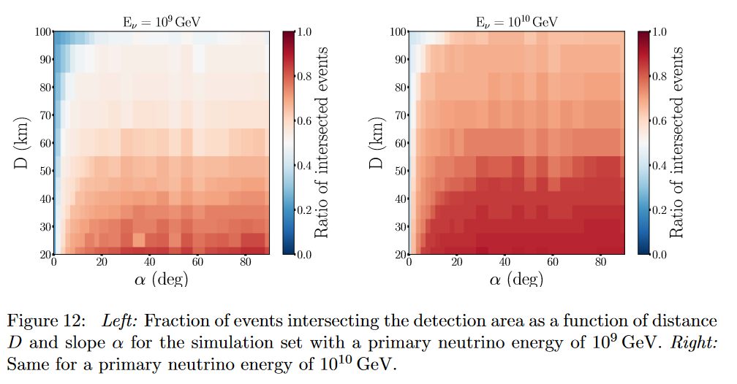
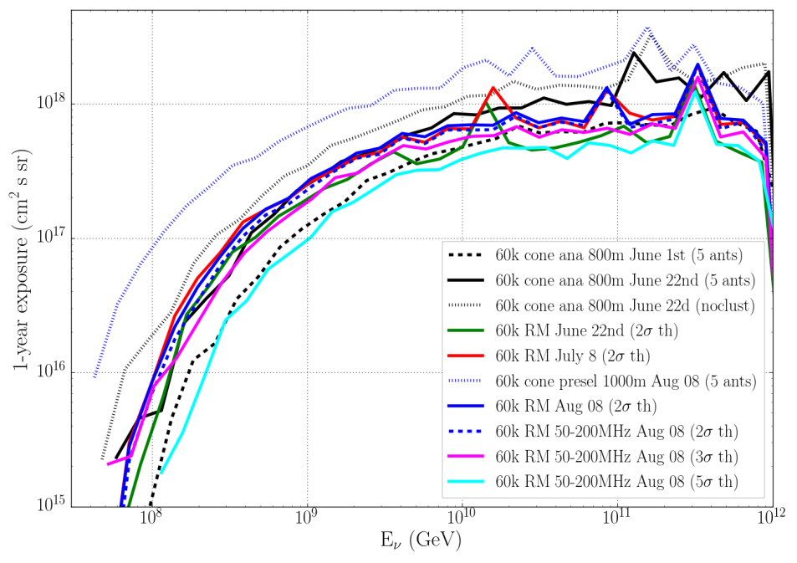
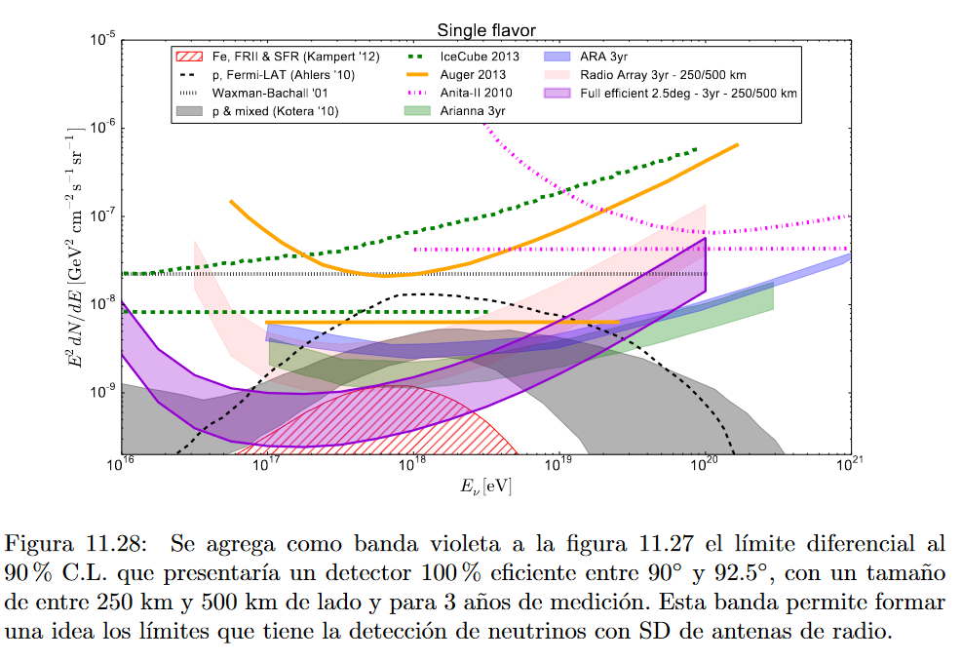
Improving ν sensitivity?
Role of topography: up to x3 (see eg Decoene et al., arXiv:1903.10466)
Trigger threshold improvement could surely allow to increase effective area,
BUT probably by factor of a few only (at least for E_{ν} ≥ 10¹⁷eV)
  GRAND sims: 5σ ➔ 3σ: A_{eff} x 1.6; 5σ ➔ 2σ: A_{eff} x 2.5
Bottom line: ν-induced EAS are seldom!... And we already detect a significant fraction with standard trig (TBC).
  GRAND sims : factor ~2-3 between full efficient & 2σ threshold
  Pieroni PhD with similar results
➔ Discuss more at « effective area » session!
GRAND neutrino sens study (2018)
PhD Pieroni (2015)

Slide 5
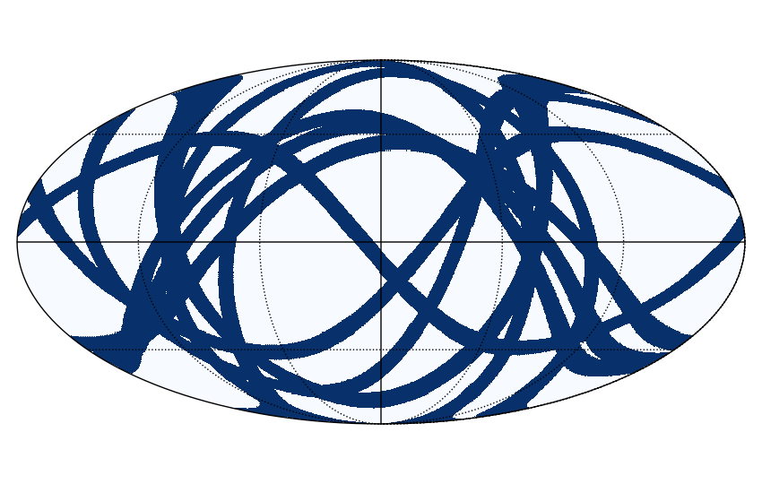
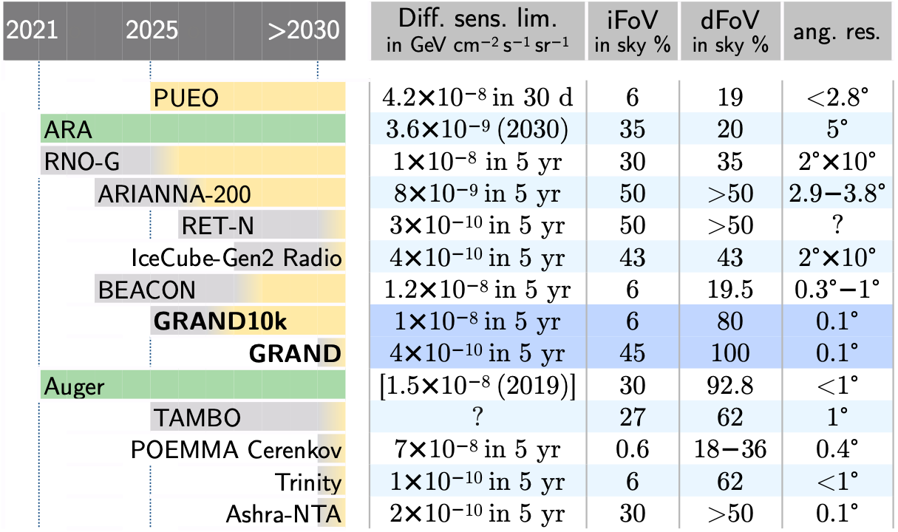

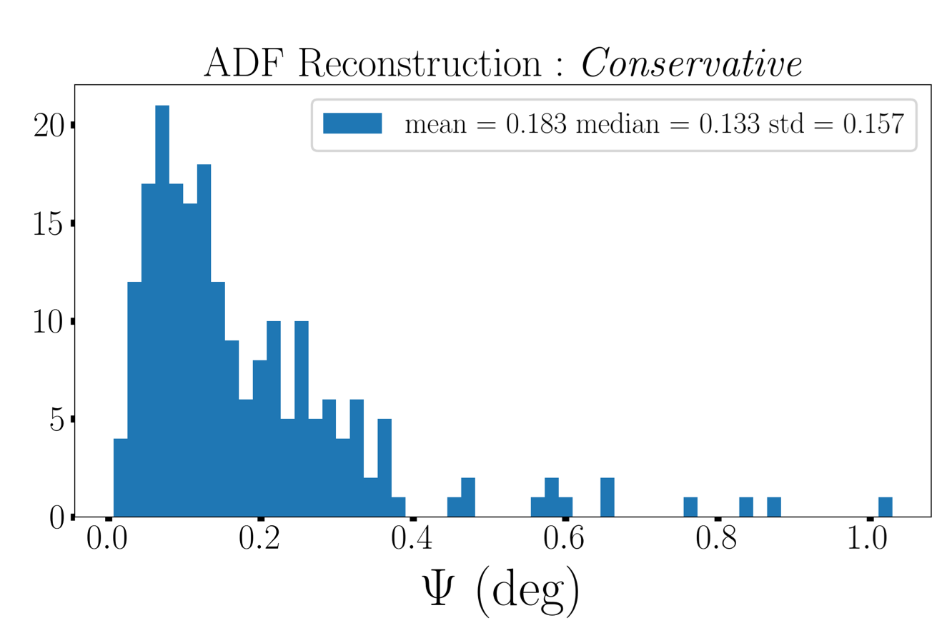
GRAND performances
F. Oikonomou
instantaneous FoV: 45% of sky
(for 10 random* site locations between 40S and 60N)
Angular resolution: 0.1°
~0.1°
Decoene et al., arXiv:2112.07542
Guelfand PhD
adapted from Guépin et al. Nature Phys. Rev. 2022
A competitive proposal for
the detection of UHE neutrinos
angular resolution [deg]
5

Slide 6
A staged approach with self-standing pathfinders
GRANDProtos
GRAND10k
GRAND200k
2023
2028
2032 (?)
autonomous radio detection
of very inclined air-showers
1st GRAND sub-array
sensitive all-sky detector
Goals
Cosmic rays 10^{16.5-18} eV
Galactic/extragalactic transition
muon problem
radio transients
discovery of EeV neutrinos for optimistic fluxes
radio transients (FRBs!)
1st EeV neutrino detection
and neutrino astronomy!
GRANDProto300: 300 antennas over 200 km² in Gobi desert
GRAND@Auger: 10 antennas for cross-calibration
GRAND@Nançay: 4 antennas for trigger testing & setup validation
2 detectors of 5-10k antennas each in each hemisphere: GRAND-North (China) and GRAND-South (Argentina?)
200,000 antennas
over 200,000 km²
20 sub-arrays of 10k antennas
on different continents
Setup
2 M€
100 antennas produced
Funded by China
+ ANR-DFG NUTRIG
(France- Germany)
+ Radboud University
13 M€
1500€/unit
300M€ in total
500€/unit
Budget
to be divided between participating countries

Slide 7

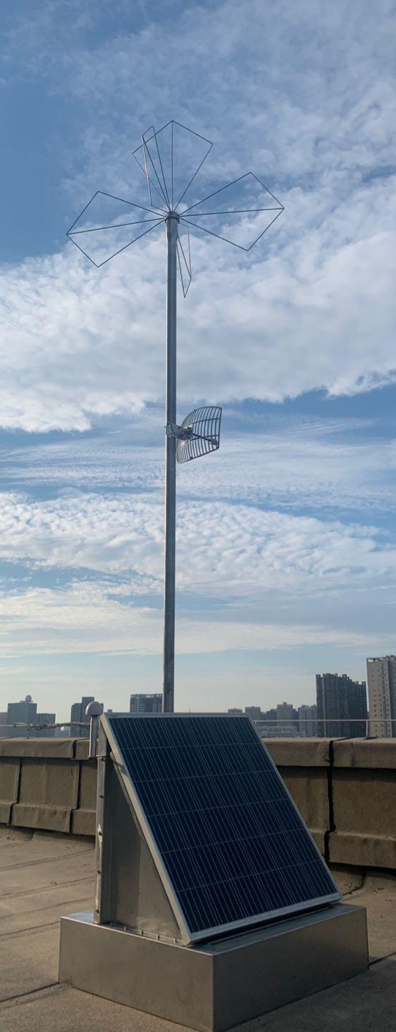
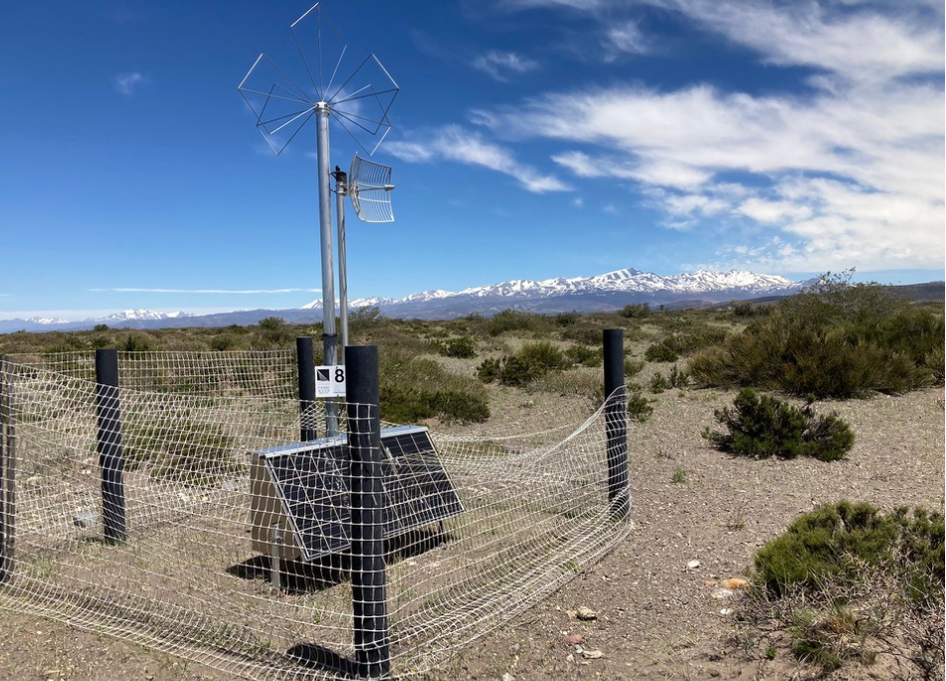
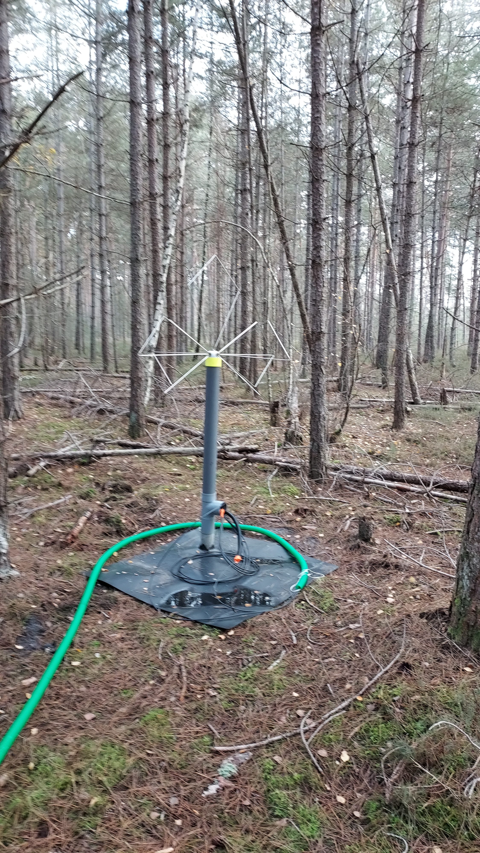

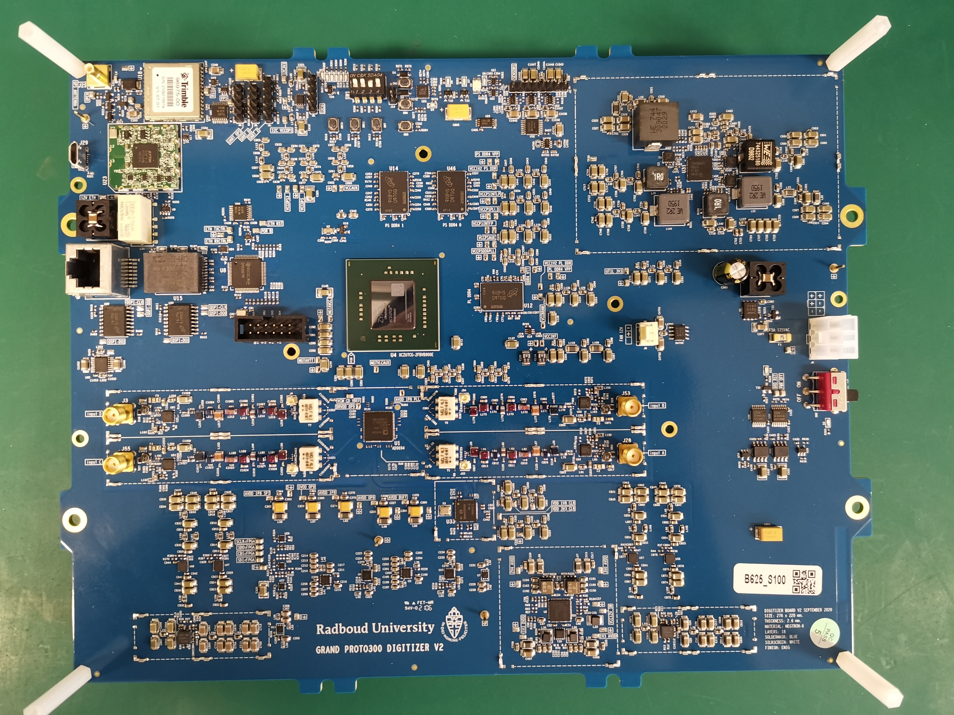
GRANDProto300 & other prototypes: experimental setup
Deployment of 13 antennas in Gansu (China), to be completed by 70 more in 2024, and 200 more later
Deployed Feb 2023
The HorizonAntenna:
3 butterfly arms + LNAs
Deployment of 10 antennas on the Auger site in Malargüe, Argentina (cross-calibration)
Deployed Aug 2023
WiFi antenna connected to bullet
Deployed Oct 2022
Deployment of 4 antennas in Nançay radio observatory (France) for trigger test
50-200MHz analog filtering,
Electronics:
500MSPS sampling
FPGA+CPU
Bullet WiFi data transfert
7

Slide 8
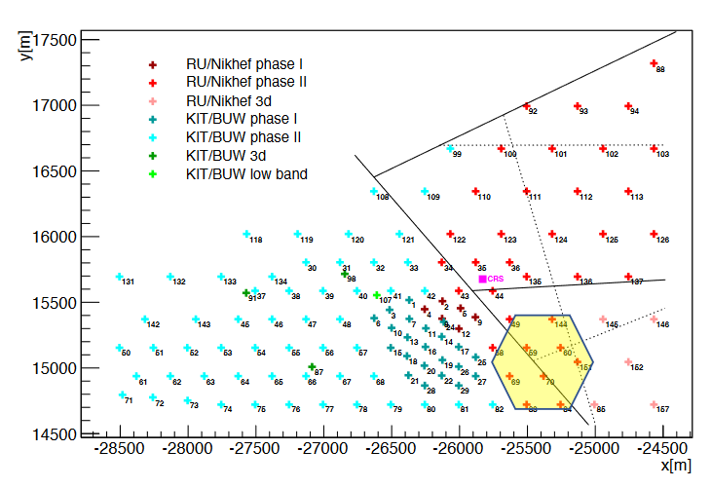
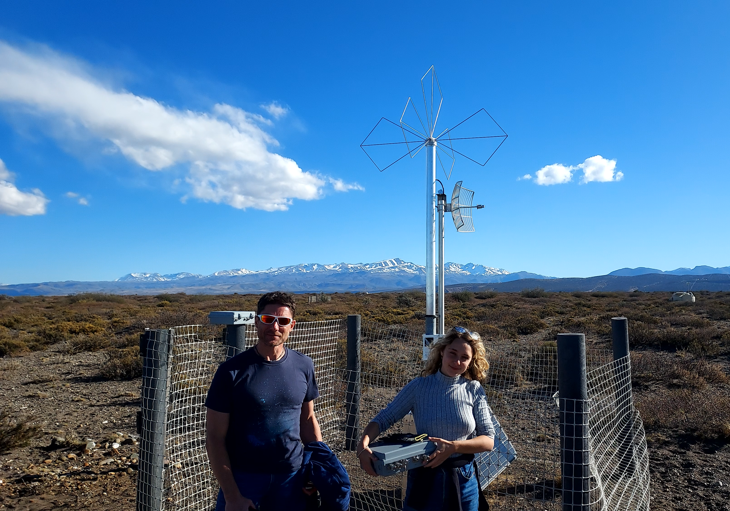
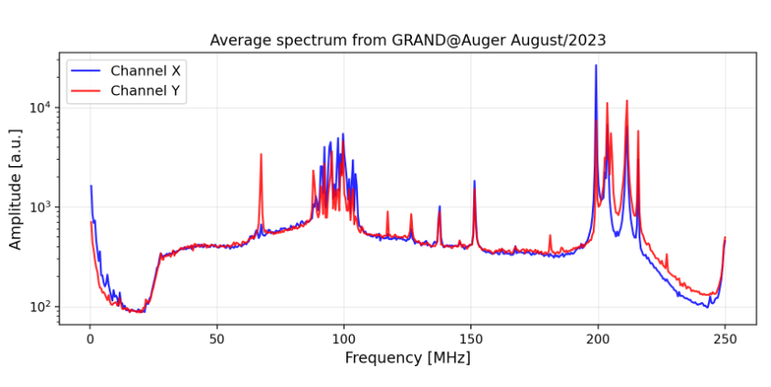
GRAND @ Auger
10 GRAND detection units at location of AERA antennas, using Auger infrastructure.
Run autonomously & offline comparison with Auger data
Expected rate: ~1 EAS/day in coinc with Auger
Present status: commissioning
FM
TV carrier
AERA
beacon
Plane / satellite comms
Fred Magnard & Marion Guelfand on G@A
August 2023

Slide 9
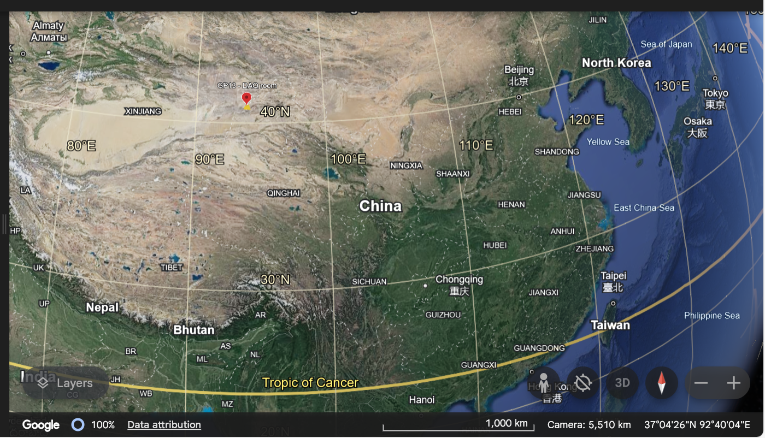
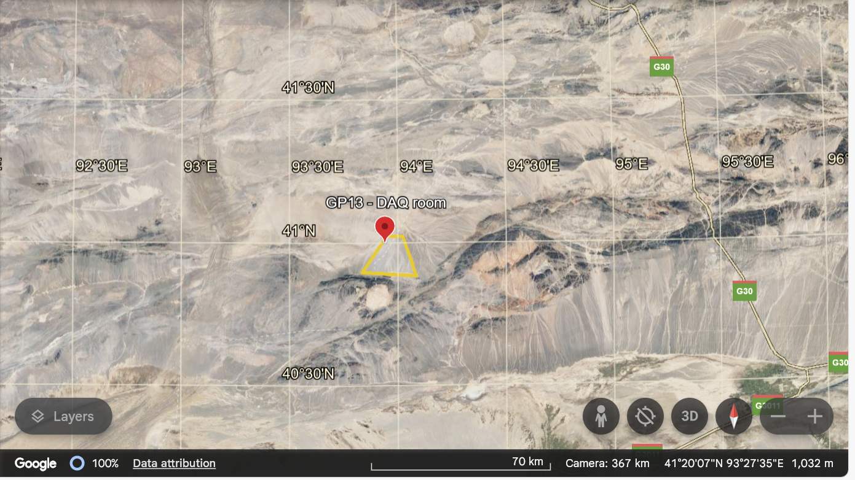
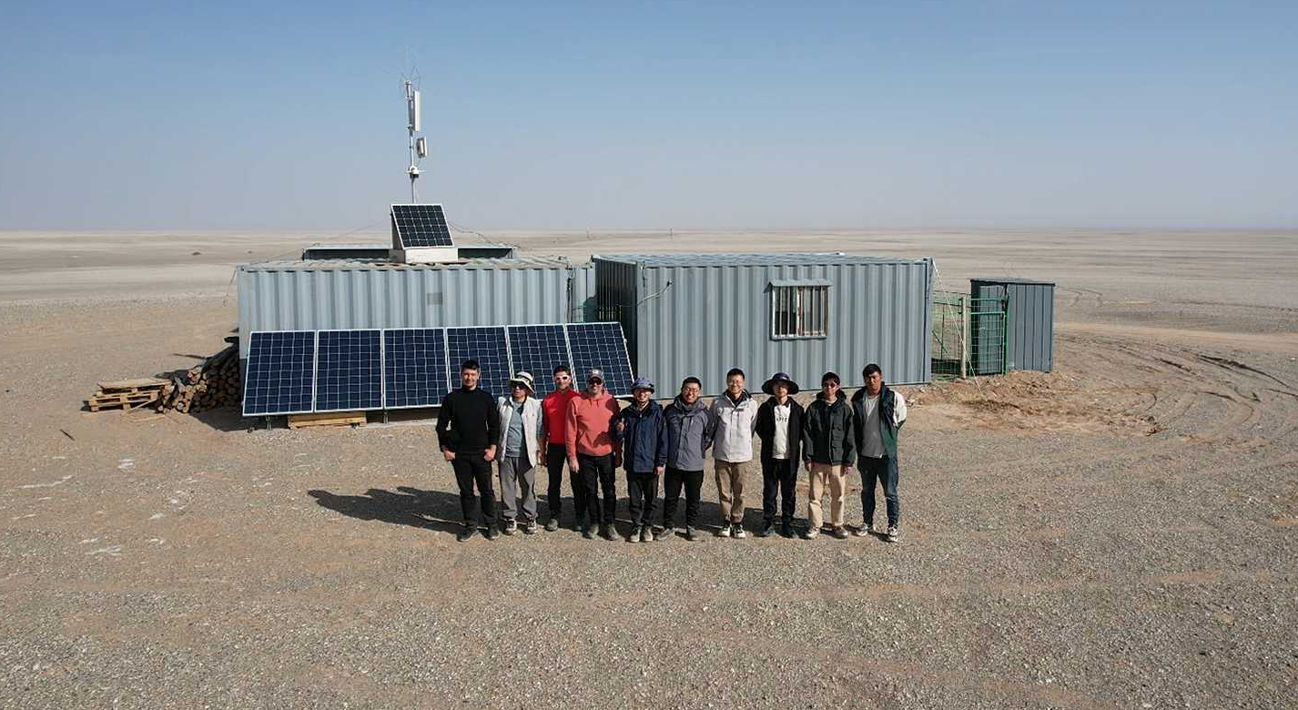
GRANDProto300 in XiaoDuShan
The Gobi desert
The DAQ room (and living quarters)
GP300: ~300 antennas, 200km², 1km step size with denser infill
Erange = 10^{16.5}-10¹⁸eV
AT present 13 antennas
Plan for 80 at summer 2024

Slide 10
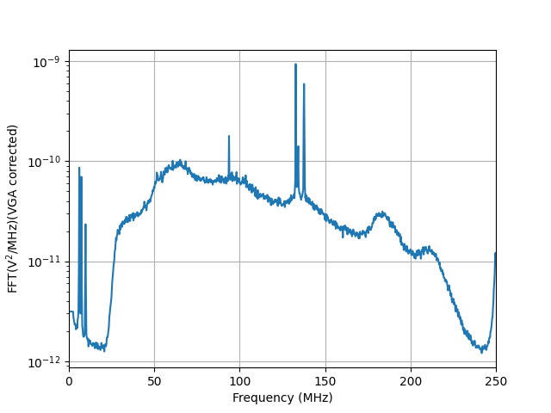
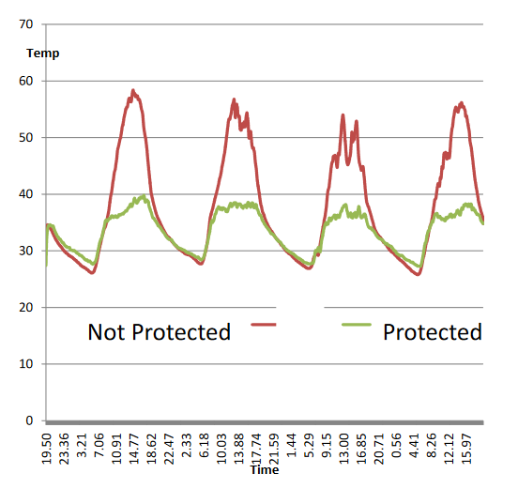
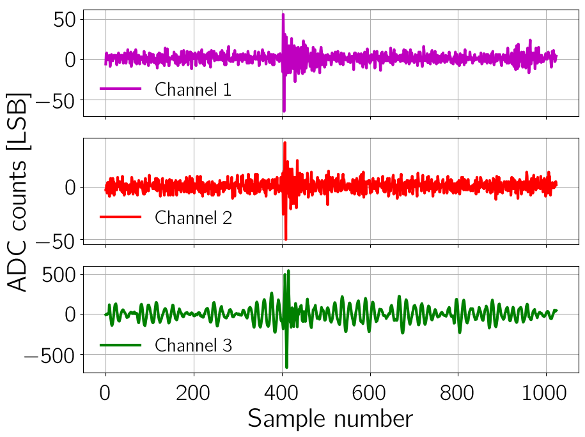
GRANDProto300 in XiaoDuShan
13 antennas deployed in Feb 2023 for design validation
(Xidian U. & Purple Mountain Observatory)
  Thermal regulation ➔ OK
  Control of radio self-emission ➔ OK
  Reconstruction of coincident pulses ➔ OK
  Trigger ➔ in progress
FM
Satellite / plane
comms
Short waves

Slide 11
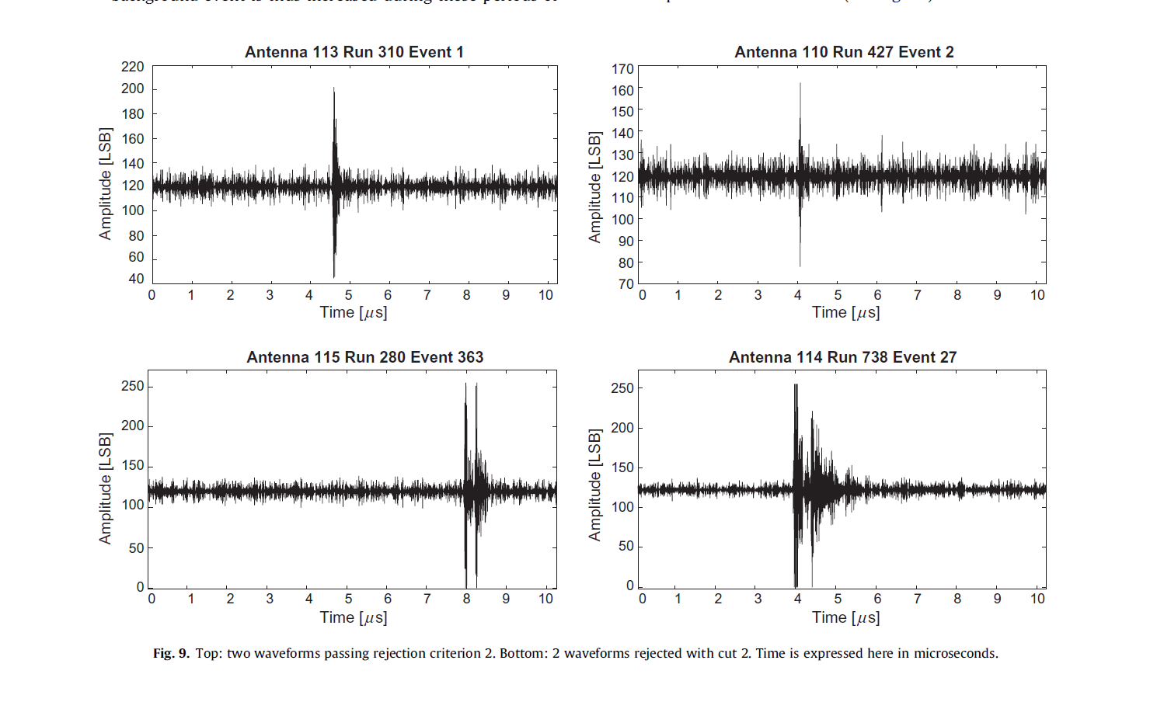
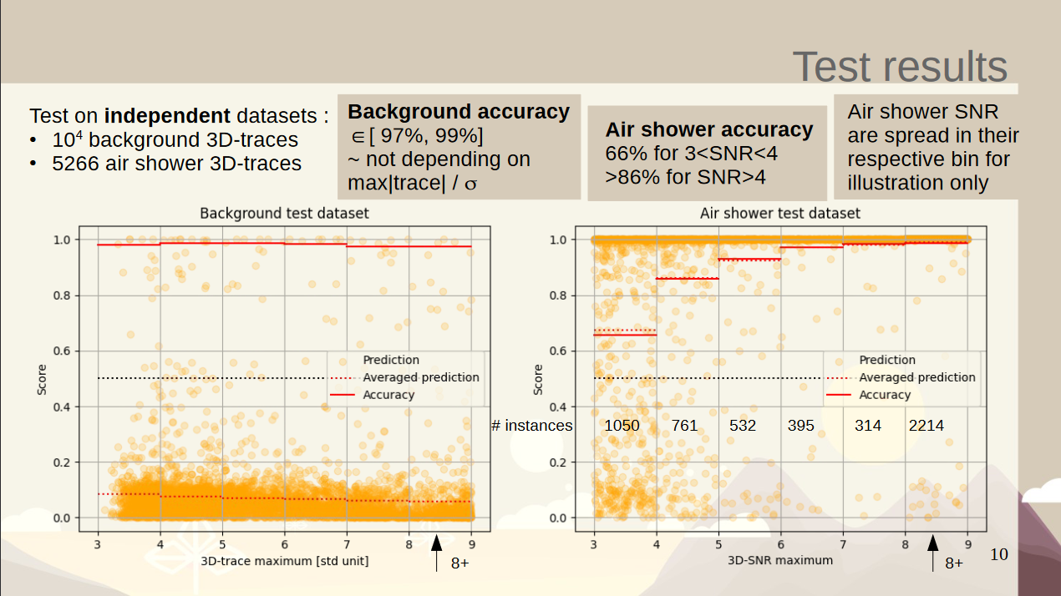
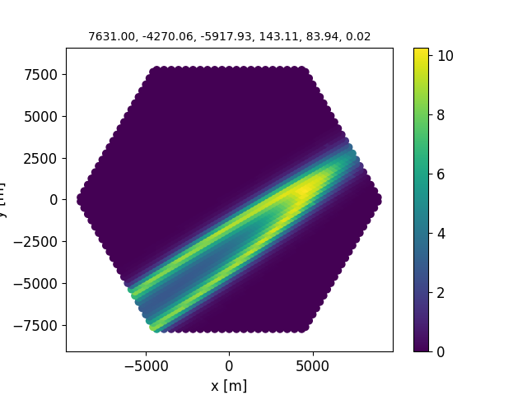
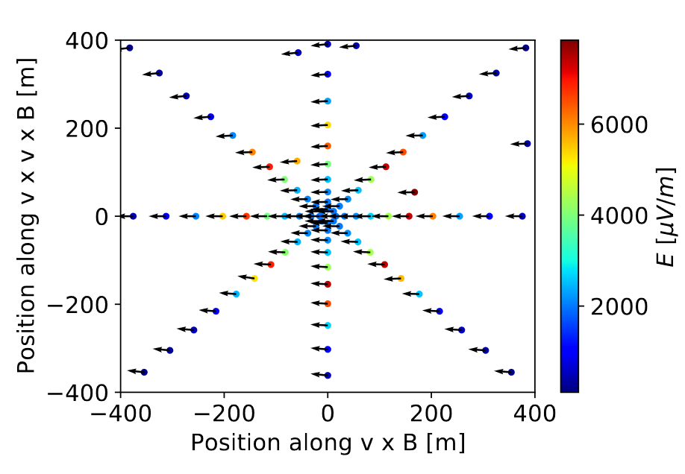
R&D for GRAND10k
Possible EAS
S. Le Coz, ICRC2023
Working towards a cheap, robust & frugal system:
  less mechanics
  less cables
  Cheaper SoC/FPGA
  less power consumption
  less data transfer
To be tested on GP300 starting 2024-26
Trigger as key parameter ➔ NUTRIG project (KIT & Paris): working towards a pure, efficient and scalable methods to trigger over giant arrays, based on specific signatures of signal & background.
  First Level Trigger @ Detection Unit
  Second Level Trigger @ Central DAQ
Likely background
TREND
S. Chiche
A. Benoit-Levy

Slide 12
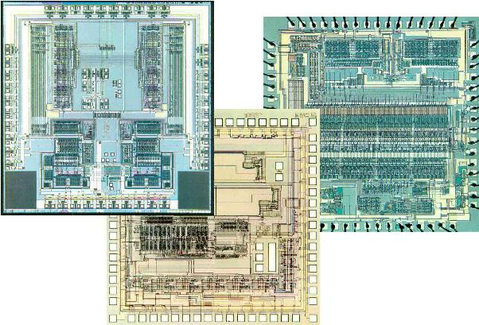
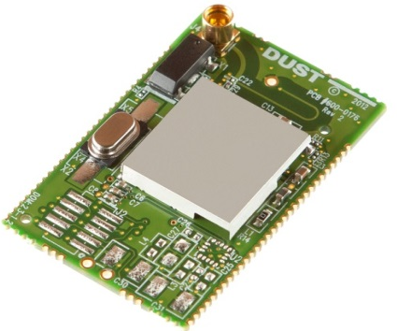
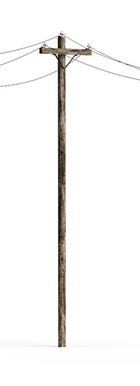
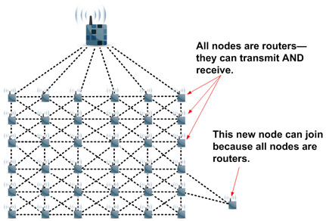
The GRAND200k detector (design freezed in 2030?)
Electronics: going for ASICs?
As basic/robust/cheap as possible
  5W/unit ➔ xx solar pannel
  500€/unit (including deployment)
Apply industrial/validated/off-the-shelf solutions
Many unknowns to be worked out in the next 5+ years
(but that is what we love ☺ ) :
  Antenna design/power supply
  Trigger strategy?
  Comms?
  Information saved?
  Logistics?
  Political aspects?
  Design tailored to different sites/science cases?
~10$/unit
Comms: gooing for SmartMesh? (DustTechnologies)
2.4GHz band.
400By/s on the shelf, 4kBy/s in R&D stage
Mechanics:
going for utility poles?

Slide 13
(Personnal) conclusion
GRAND designed as a network of giant radio arrays.
Staged approach, now into prototype phase (2024 as moment of truth)
Detection unit as simple (ie cheap) as possible to achieve very large detector area
Driver: even the best radio detector can only detect neutrino-induced EAS which exist, and those are very seldom!
BUT
  Very happy to be proved wrong at this workshop!
  GRAND can be a versatile network presently in its early stage of design
  ie combined with other technics / adapted to other designs.

