Slide 1
ESCAPE OSSR
T. Vuillaume, 30/11/2023

Slide 2
eOSSR status
Some troubles after Zenodo backend update
Most bug now fixed in master
all unit tests are passing
CLIs scripts are working
=> main functionnalities recovered
Breaking API changes
Took it as an opportunity to make some refactoring and streamline the API
v2.0.0 coming soon to provide a working release to users (might not be exempt of bugs – tests from other users are still welcome => open issues)
Some changes in the metadata schema
keywords are now subjects in Zenodo, in particular to search for records:
`search_records(‘free text search’, subjects=‘CTA’ )`

Slide 3
codemeta v3
✅
Re-implemented how the codemetatozenodo converter works to
be actually based on the metadata table https://escape-ossr.gitlab.io/eossr/metadata/ossr_metadata.html
this is derived from https://github.com/codemeta/codemeta/blob/master/crosswalk.csv - but codemeta table is not actionable
the converter uses the Property and Type columns to know how to convert
updating the table automatically updates the converter – as less hardcoding as possible
Updated table with codemeta 3.0 (note: no doi for codemeta-3.0?!)
Inclusion of codemeta-1.0 and codemeta-2.0 for backward compatibility
⏳
⏳

Slide 4
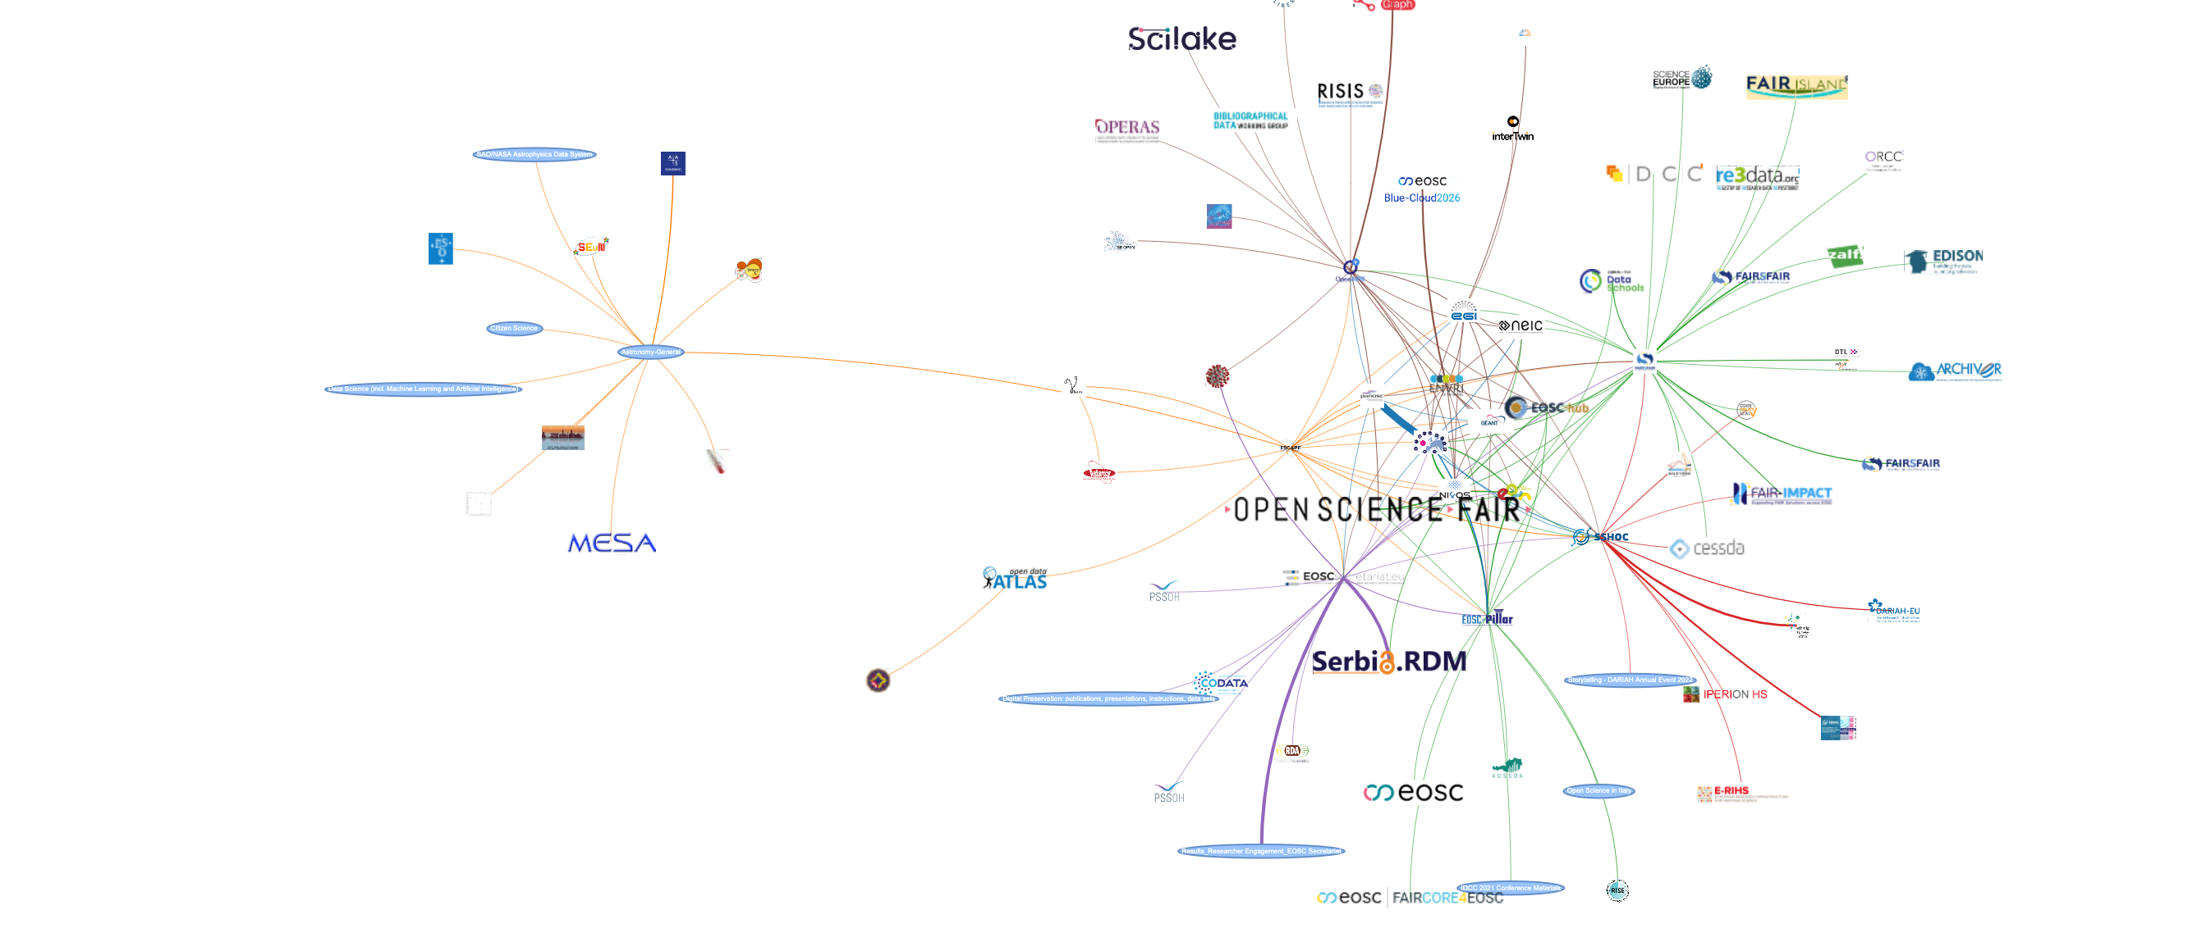
New functionality coming for communities: network graph!
Html version in indico
Records can be part of several communities ➔ use them to link communities
Build a graph with nodes as communities and edges as relations
Node size = number of records in the community
Edge size = number of shared records
Use Louvain algorithm to cluster communities = color coded edges
Algo: start from a community, get its metadata, get list of records, for each record list other communities, repeat
Beware: this is exponential ! - limit to 2 degrees of neighborhood
We are here !
Observation for the OSSR: we are more connected to “FAIR” and “EOSC” communities than to science domain or ESFRIs communities

