Slide 1
LISA
DDPC overview
21/11/2023
APC
Bastien Barthet

Slide 2
DDPC OVERWIEW – NOVEMBER 2023
DDPC Global Overview
Inner DDPC communications
Main DCC Specific Software
Pipeline Runner
Storage
Prototyping Lab
SDK
Planning

Slide 3
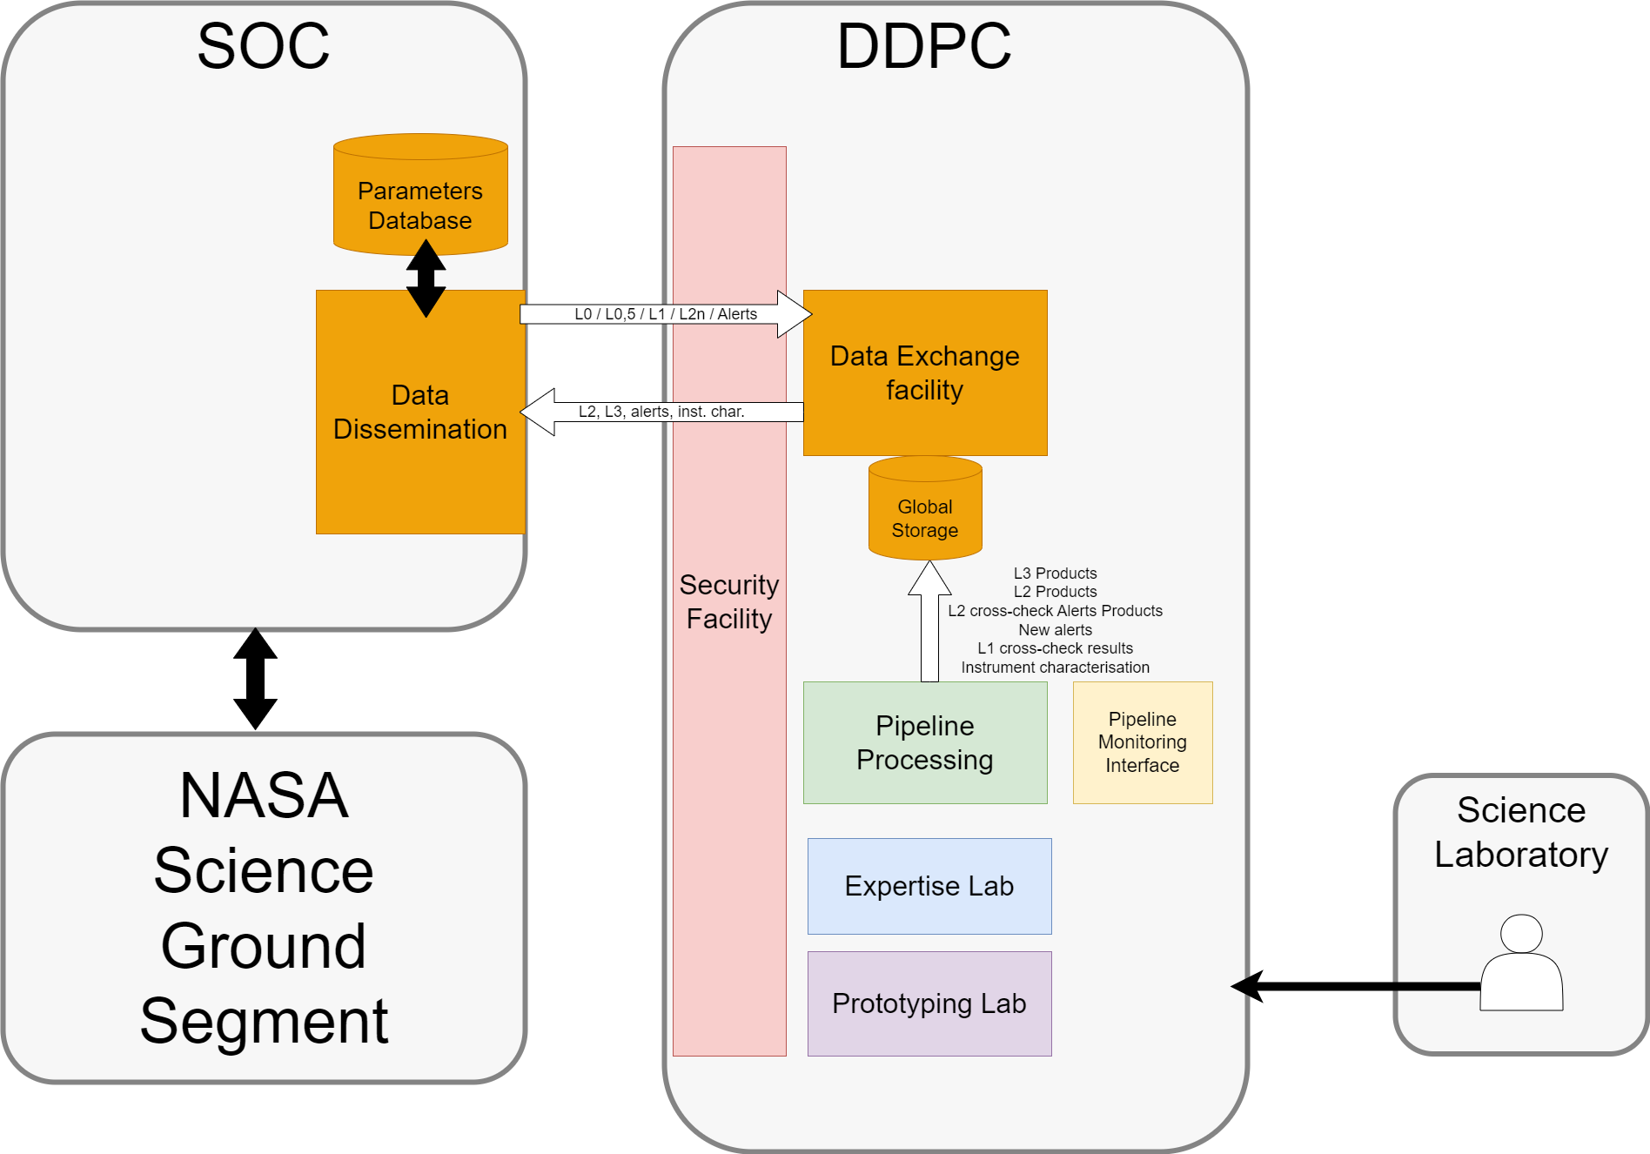
DDPC Global Overview
DDPC OVERWIEW – NOVEMBER 2023
1 interaction with the SOC
1 entry point : Data Exchange facility
In charge of the security of both exchanges and accesses
Holds :
  Storage
  Processing
  Monitoring
  Labs

Slide 4
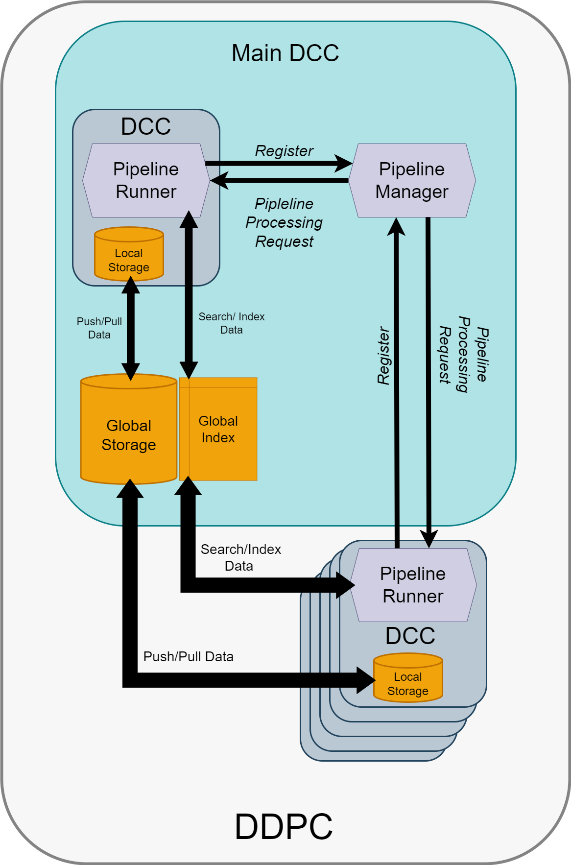
Inner DDPC communications
DDPC OVERWIEW – NOVEMBER 2023
Main DCC content :
  Pipeline Manager
  Own DCC (optional)
  Global Index + Global Storage
Main DCC interfaces :
  Send processing requests to a DCC
Each DCC content :
  Own Pipeline Runner
  Own Local Storage
Each DCC interfaces :
  Register its processing capabilities to the Main DCC
  Search/index data from/to the Global Index
  Push/Pull Data to/from the Global Storage
Notes:
Global storage + index par forcement dans le main DCC (WP à part)

Slide 5
Main DCC Specific Software
DDPC OVERWIEW – NOVEMBER 2023
Knows DCCs processing capabilities
Sends Processing Requests
Monitors Pipeline Processing

Slide 6
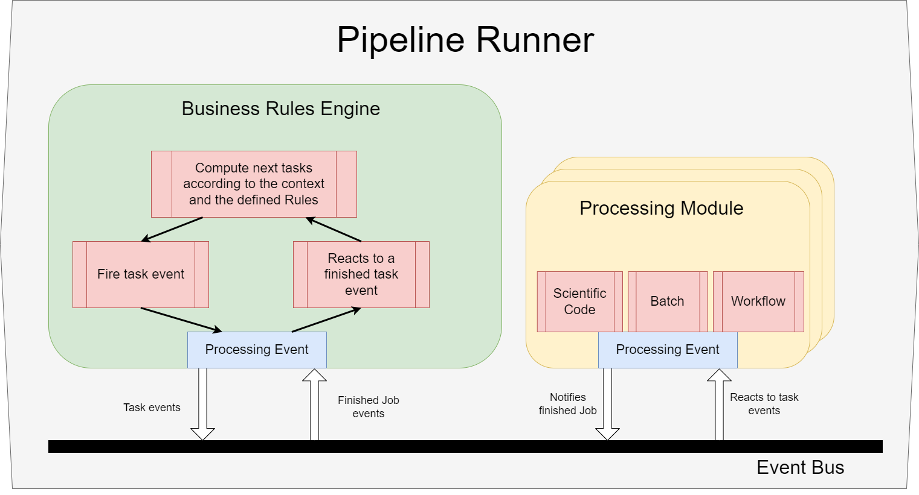
Pipeline Runner
DDPC OVERWIEW – NOVEMBER 2023
Reactive Design
  Each Element gets a processing event
  Each Element reacts to a processing event
  Each Element sends a processing event
Business Rules Engine
  Reacts to processing events (processing modules completion)
  Contains the pipeline orchestration logic
Processing Module
  Reacts to processing events (processing task to perform)
  Contains the scientific algorithm implementation

Slide 7
STORAGE
DDPC OVERWIEW – NOVEMBER 2023
Global Storage
  Data exchange and persistence feature
  Object Storage Technology (in 2023)
  Only accessed by specific Modules (Ingestion and Dispatch) ?
Local Storage
  Posix storage
  Accessed by each Processing module (algorithm)
Global Index
  Both global and local data indexation
CO2 footprint
  Global Storage use for pertinent results persistence only
  Prefer Local Storage for intermediate/temporary Data

Slide 8
Prototyping Lab
DDPC OVERWIEW – NOVEMBER 2023
Local Processing capabilities
  Able to execute a Pipeline on a laptop Prototyping instance
Prototyping Tools
  Pipelines
    development, test and execution
  Data
    visualization, analysis, management, and simulation
Extended Processing capabilities
  User can send a Pipeline processing request to a Prototyping Lab instance (then executed on an HPC like cluster)
Large scale Processing capabilities ?
  User can send a Pipeline processing request to a DDPC like infrastructure (executed on the most capable cluster)

Slide 9
SDK
DDPC OVERWIEW – NOVEMBER 2023
Framework Access Layer
  ProcessingEvent management (event bus communication)
  Dataset payload management (Ingestion & Dispatch Modules)
Algo Control Interface
  Algorithm execution (start, stop)
Data Management
  Libraries based on the Data Model
Development Best Practices
  SDK available for Python and C/C++ (??) languages
  Containers usage → more development opportunities
  Build operations, Quality and Security checks supported by the DevSecOps activities

Slide 10
PLANNING
DDPC OVERWIEW – NOVEMBER 2023
 | 2024 | Q2 | Q3 | Q4 | 2025 | Q2 | Q3 | Q4 | 2026 | Q2 | Q3 | Q4 | 2027 | Q2 | Q3 | Q4 | 2028 | Q2 | Q3 | Q4 | 2029 | Q2 | Q3 | Q4 | 2030
System coordination, Design and Operations |  |  |  |  |  |  |  |  |  |  |  |  |  |  |  |  | V0 |  |  |  |  |  |  |  | V1
DDPC Architecture design | V0 |  |  |  |  |  |  |  |  |  |  |  |  |  |  |  | V1
Data Model for System & Scientist coordination |  |  |  | V0 |  |  |  |  |  |  |  |  |  |  |  |  | V1
DevSecOPS & Deployment |  |  |  |  |  |  |  |  |  |  |  |  |  |  |  |  | V0 |  |  |  |  |  |  |  | V1
Define & code CI/CD pipeline steps |  |  |  | V0
SDK |  |  |  | V0 |  |  |  |  |  |  |  |  |  |  |  |  | V1
DCC Pipeline Runner |  |  |  | V0 |  |  |  |  |  |  |  |  |  |  |  |  |  |  |  |  |  |  |  |  | V1
Prototyping Lab |  |  |  |  |  |  |  |  | V0 |  |  |  |  |  |  |  | V1
Data Storage |  |  |  |  |  |  |  |  |  |  |  |  |  |  |  |  | V0 |  |  |  |  |  |  |  | V1
default data storage solution
metadata storage solution (index)
common access library
Data Exchange Facility |  |  |  |  |  |  |  |  |  |  |  |  |  |  |  |  |  |  |  |  |  |  |  |  | V1
Main DCC Specific Software Components |  |  |  |  |  |  |  |  |  |  |  |  |  |  |  |  |  |  |  |  |  |  |  |  | V1
DCCs installation and configuration |  |  |  |  |  |  |  |  |  |  |  |  |  |  |  |  |  |  |  |  |  |  |  |  | V1
Expertise Lab |  |  |  |  |  |  |  |  |  |  |  |  |  |  |  |  |  |  |  |  |  |  |  |  | V1
Notes:
Expliciter les fonctionnalités disponibles par jalons majeurs (proto, exp)
Security + quality guides dès la V0 du SDK

Slide 11
Thank you for your attention
Any Questions ?

