Slide 1
Neutrino group: contributions and prospects
HCERES Evaluation, 2017-2022 December 5th, 2023

Slide 2
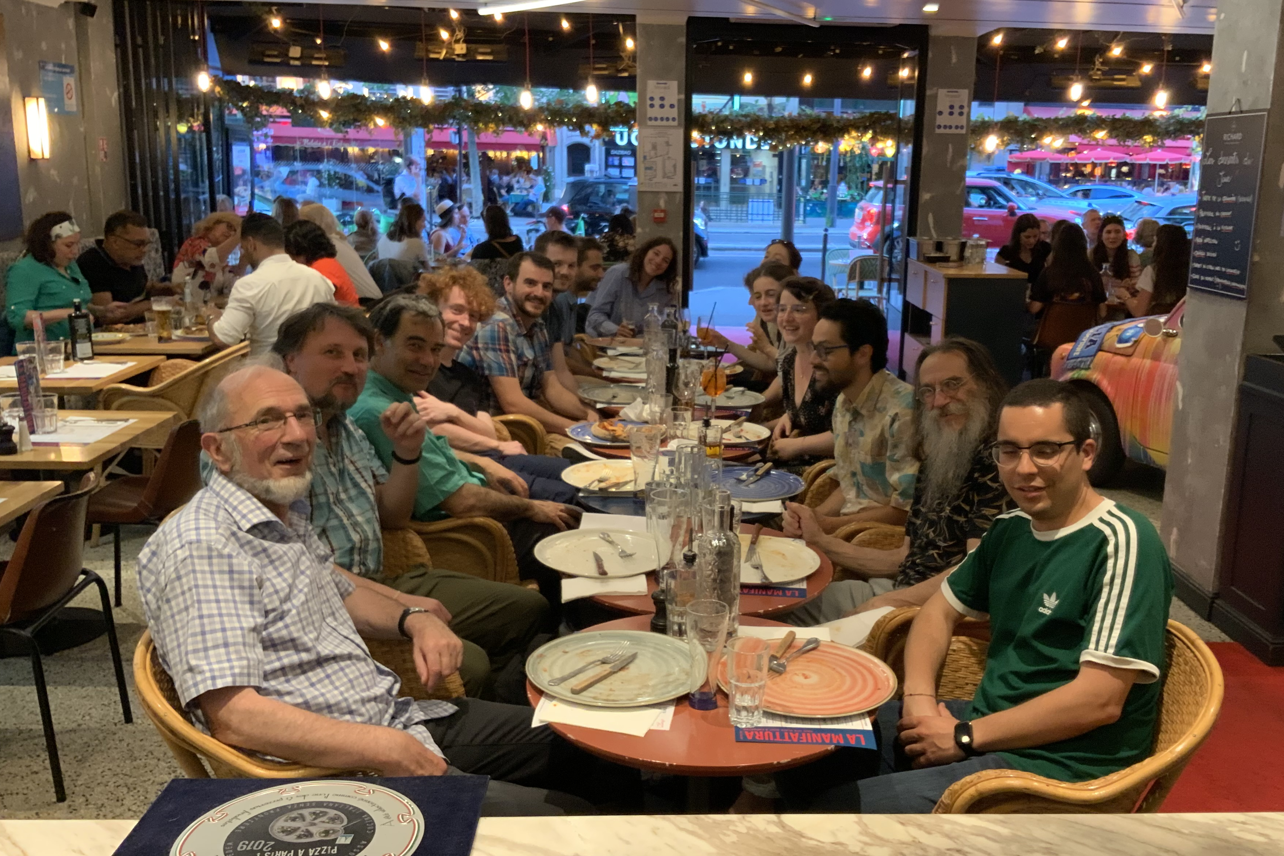
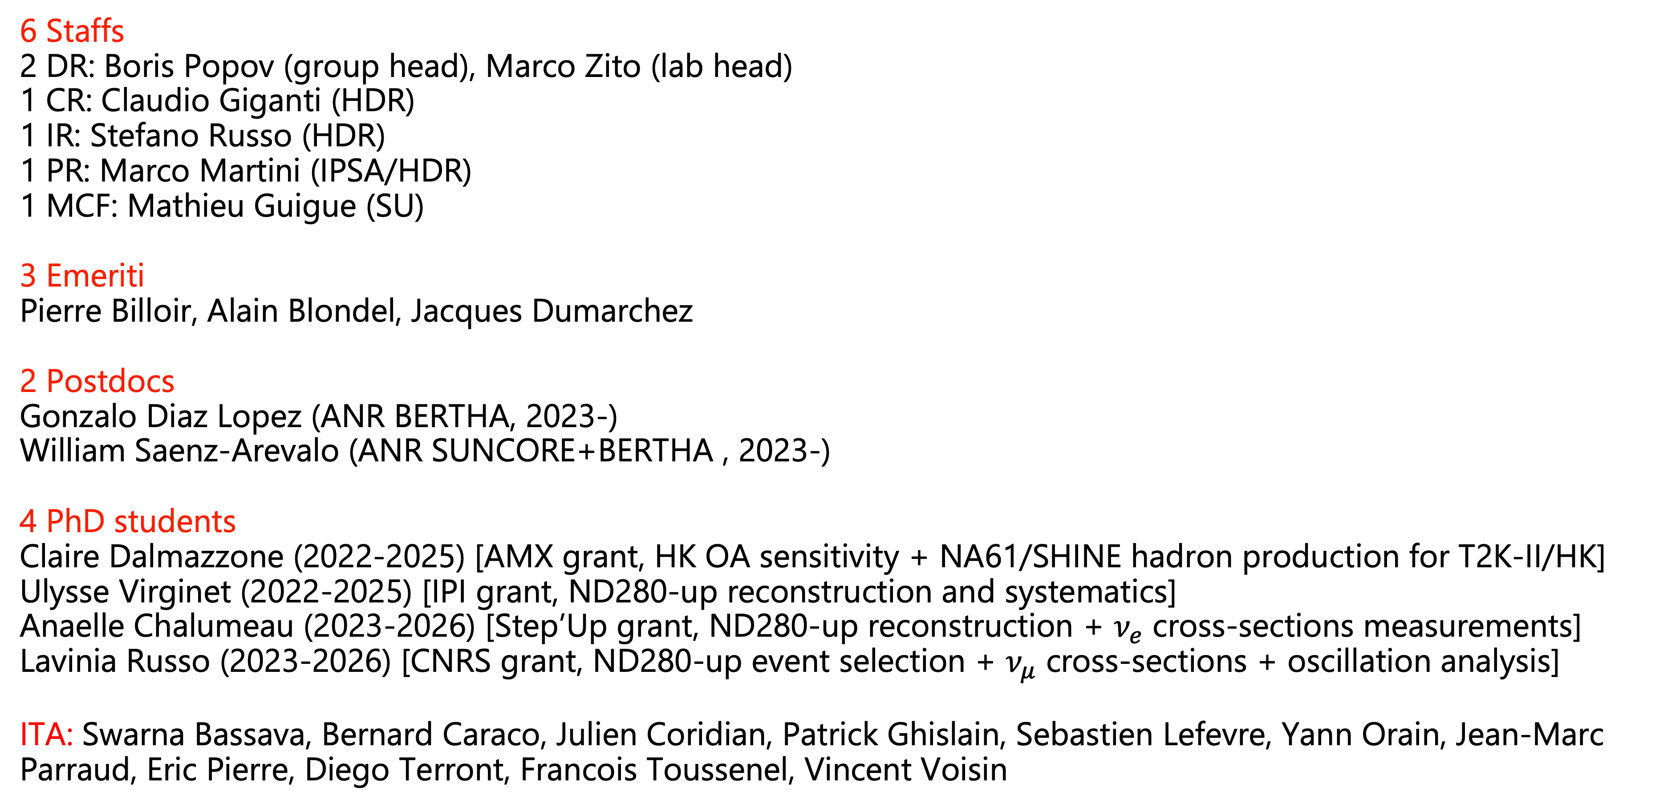
Neutrino group members
6 Staffs
2 DR: Boris Popov (group head), Marco Zito (lab head)
1 CR: Claudio Giganti (HDR)
1 IR: Stefano Russo (HDR)
1 PR: Marco Martini (IPSA/HDR)
1 MCF: Mathieu Guigue (SU)
3 Emeriti
Pierre Billoir, Alain Blondel, Jacques Dumarchez
2 Postdocs
Gonzalo Diaz Lopez (ANR BERTHA, 2023-) William Saenz-Arevalo (ANR SUNCORE+BERTHA , 2023-)
4 PhD students
Claire Dalmazzone (2022-2025) [AMX grant, HK OA sensitivity + NA61/SHINE hadron production for T2K-II/HK]
Ulysse Virginet (2022-2025) [IPI grant, ND280-up reconstruction and systematics]
Anaelle Chalumeau (2023-2026) [Step’Up grant, ND280-up reconstruction + $ν_{e}$ cross-sections measurements]
Lavinia Russo (2023-2026) [CNRS grant, ND280-up event selection + $ν_{μ}$ cross-sections + oscillation analysis]
ITA: Swarna Bassava, Bernard Caraco, Julien Coridian, Patrick Ghislain, Sebastien Lefevre, Yann Orain, Jean-Marc Parraud, Eric Pierre, Diego Terront, Francois Toussenel, Vincent Voisin

Slide 3

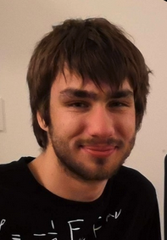
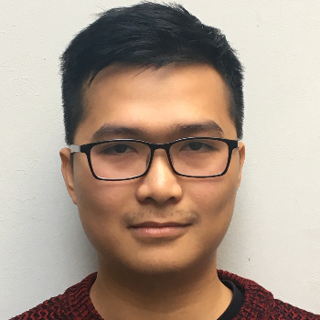
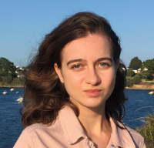
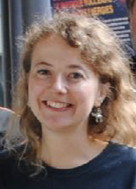
Evolution since last HCERES
Postdocs (ANR SUNCORE, Emergence SU)
Adrien Blanchet (Jan,2020 - Oct,2022) → T2K postdoc @ Geneva Univ
Sergey Suvorov (Oct,2020 - Oct,2022) → private company
PhD students
- Simon Bienstock (2015-2018) [STEP’UP grant, Near and Far detector analysis]
→ Ministry of Defense...
- Viet Nguyen (2019-2022) [CNRS grant, sensitivity studies with ND280-upgrade] → T2K postdoc @ LLR
- Lucile Mellet (2020-2023) [STEP'UP grant, T2K oscillation analysis + R&D timing HK] → T2K/DUNE postdoc @ Michigan State University
- Uladzislava Yevarouskaya (2020-2023) [CNRS grant, HA-TPC for ND280-upgrade] → T2K/DUNE postdoc @ Stony Brook
Recent HDR
- Marco Martini (2020)
- Stefano Russo (2021)

Slide 4

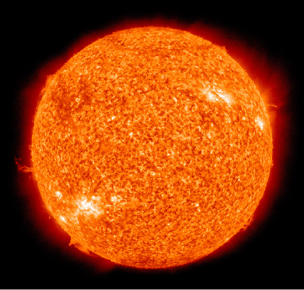
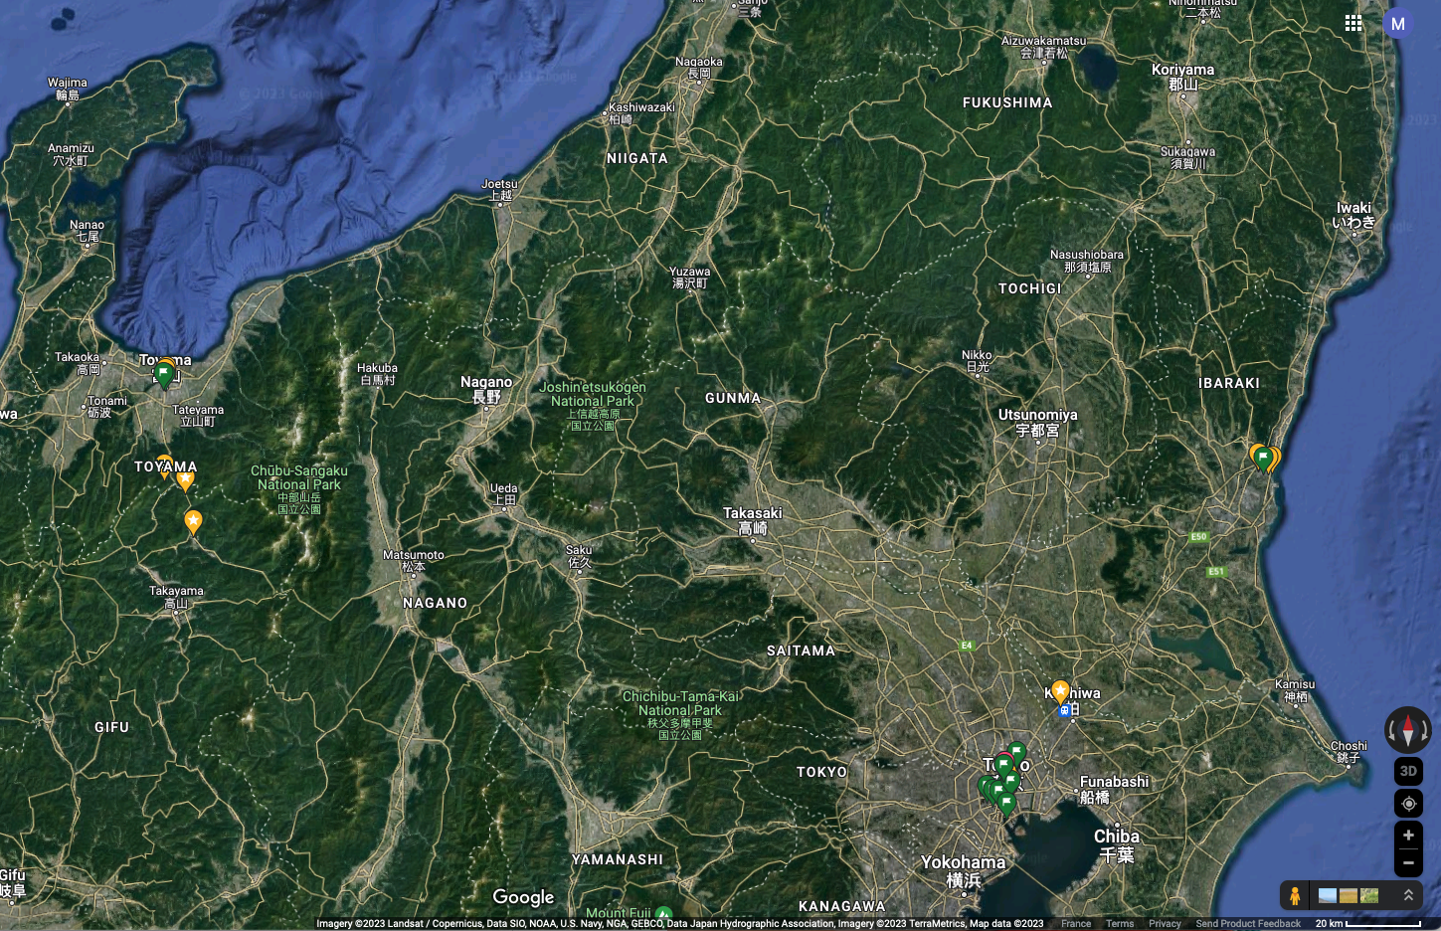




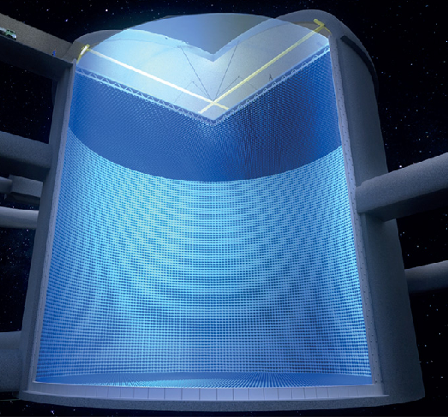


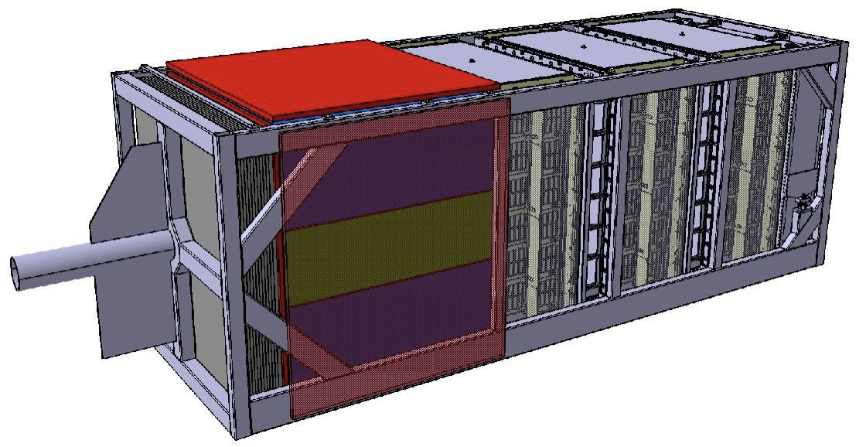





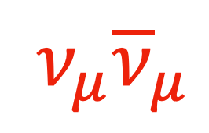


Tokai-To-(Super/Hyper-)KamiokaNDE
$ν_{e}$
295 km @ 2.5° Off Axis
$ν_{e}{\overline{ν}}_{e}$
$ν_{μ}{\overline{ν}}_{μ}$
$ν_{μ}{\overline{ν}}_{μ}$
${\overline{ν}}_{e}$

Slide 5
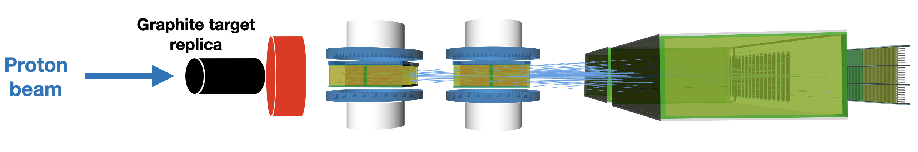
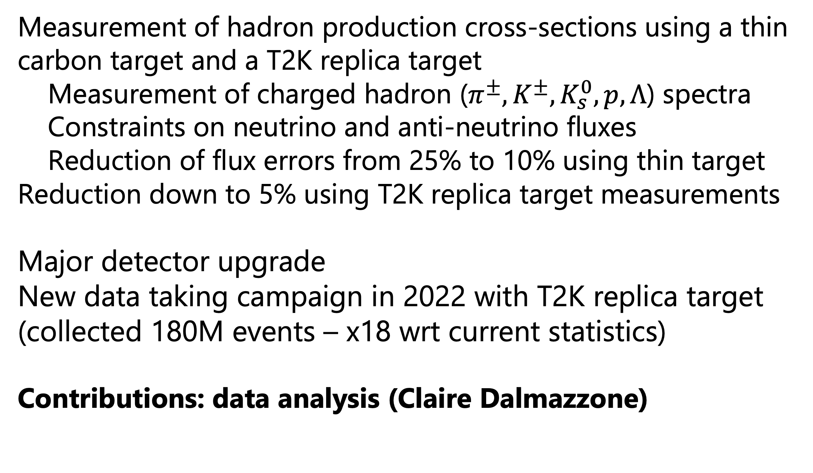
Hadrons measurements with NA61/SHINE
Measurement of hadron production cross-sections using a thin carbon target and a T2K replica target
Measurement of charged hadron ($π^{±}, K^{±}, K_{s}^{0}, p, Λ$) spectra
Constraints on neutrino and anti-neutrino fluxes
Reduction of flux errors from 25% to 10% using thin target
Reduction down to 5% using T2K replica target measurements
Major detector upgrade
New data taking campaign in 2022 with T2K replica target (collected 180M events – x18 wrt current statistics)
Contributions: data analysis (Claire Dalmazzone)

Slide 6
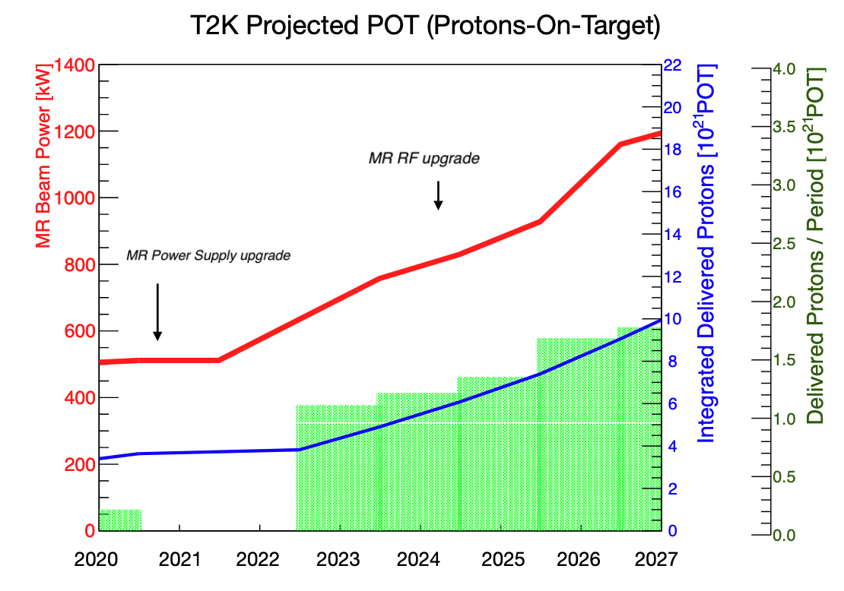
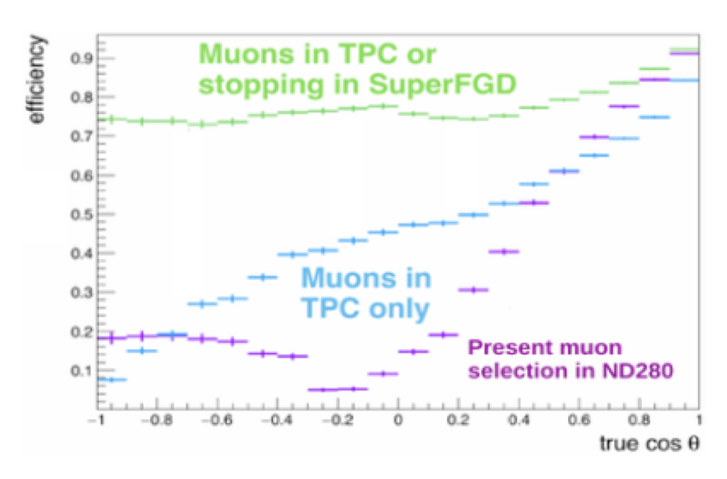
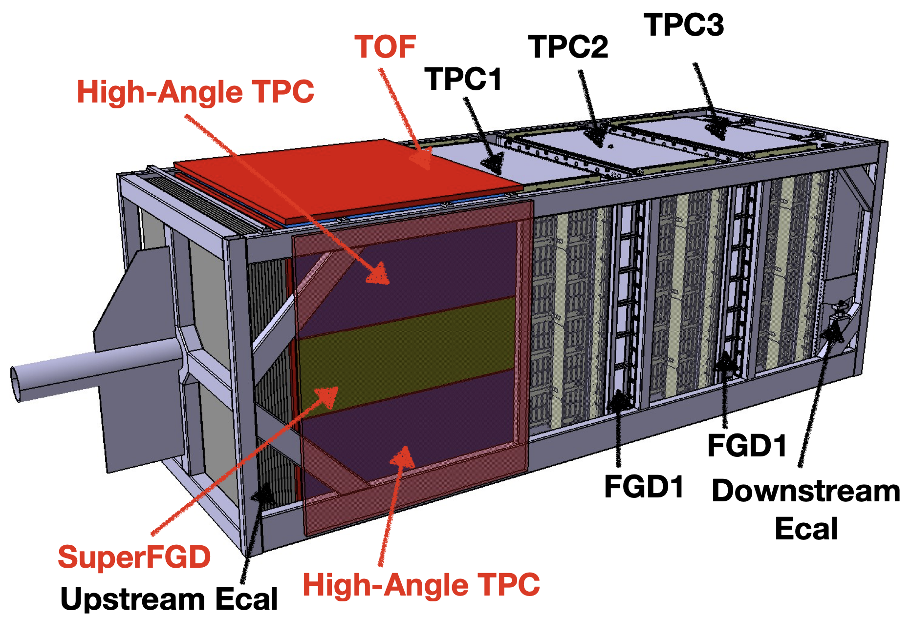
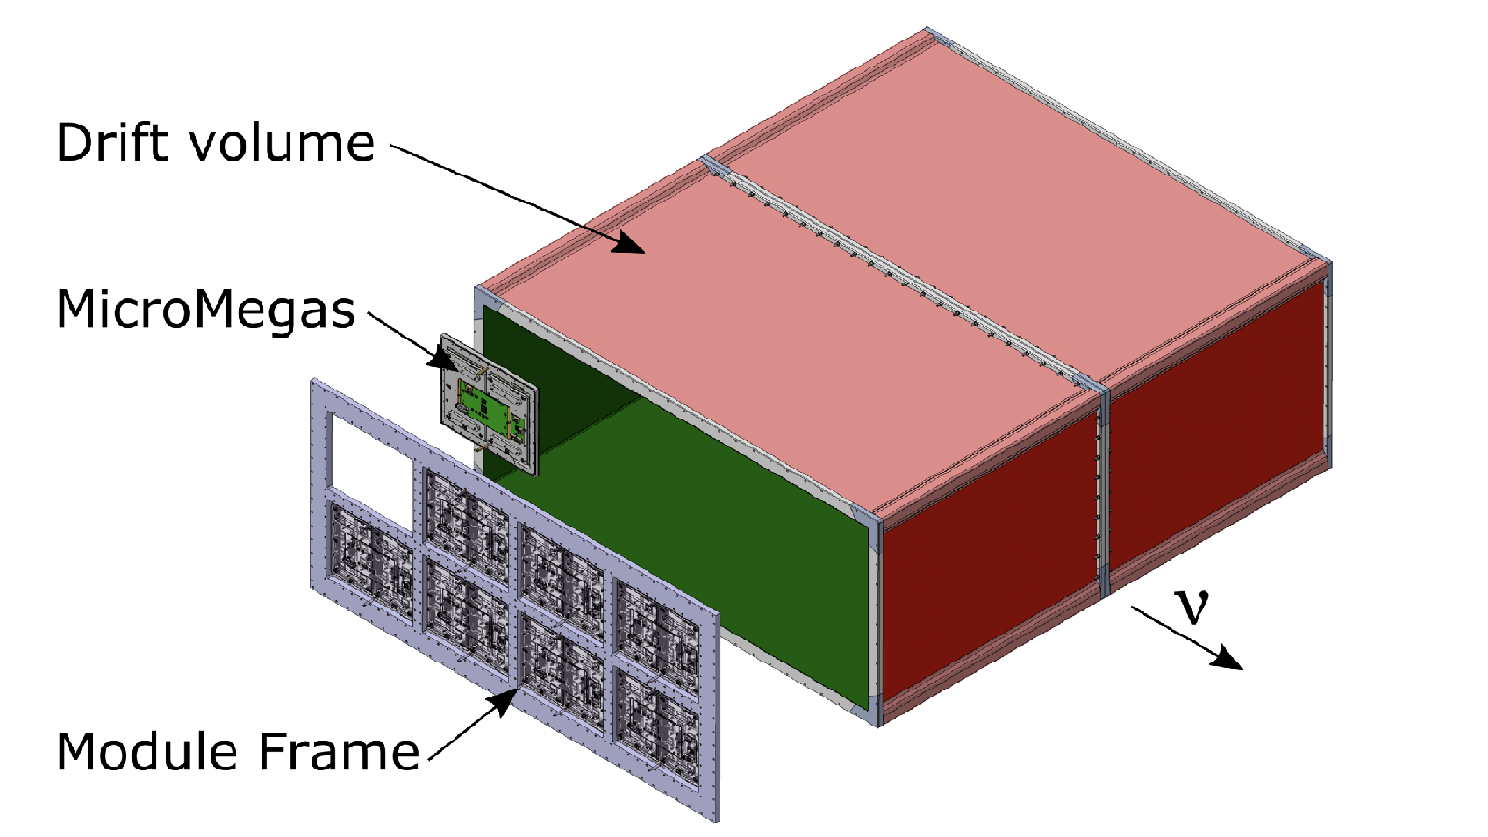
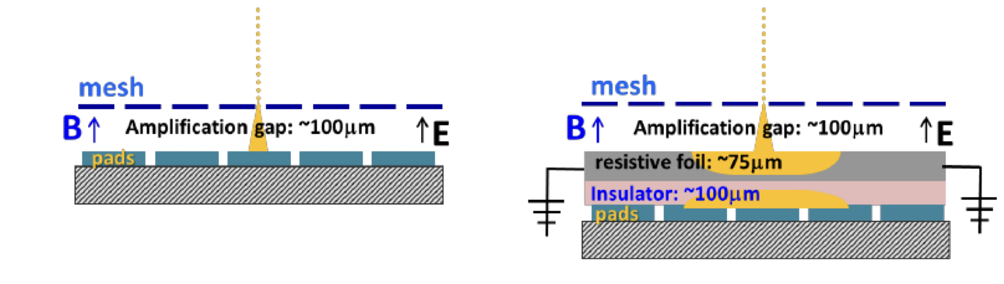


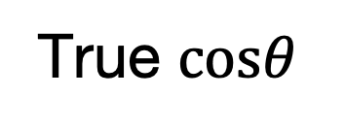
J-PARC and ND280 upgrades for T2K-II/HK
J-PARC main ring upgrades on-going
- 2x more pulse per second (1 pulse every 2.5 s $→$ 1.3 s)
- Increase power from 515 kW to up to 1.3 MW
$→$ 2.7x more statistics
Upgrade of the magnetized Near Detector@280m (ND280)
- SuperFGD (SFGD) $2×{10}^{6}$1$−{cm}^{3}$ scintillator cubes
- High-Angle TPCs (HATs) with Resistive MicroMegas
- Time-Of-Flight detector (TOF)
$→$ Better constraints on cross-sections
$→$ Increase of target mass $→$ Statistical power increase
Efficiency
Backward
Forward
True $cosθ$
Notes:
General context slides: will explain the contributions later

Slide 7
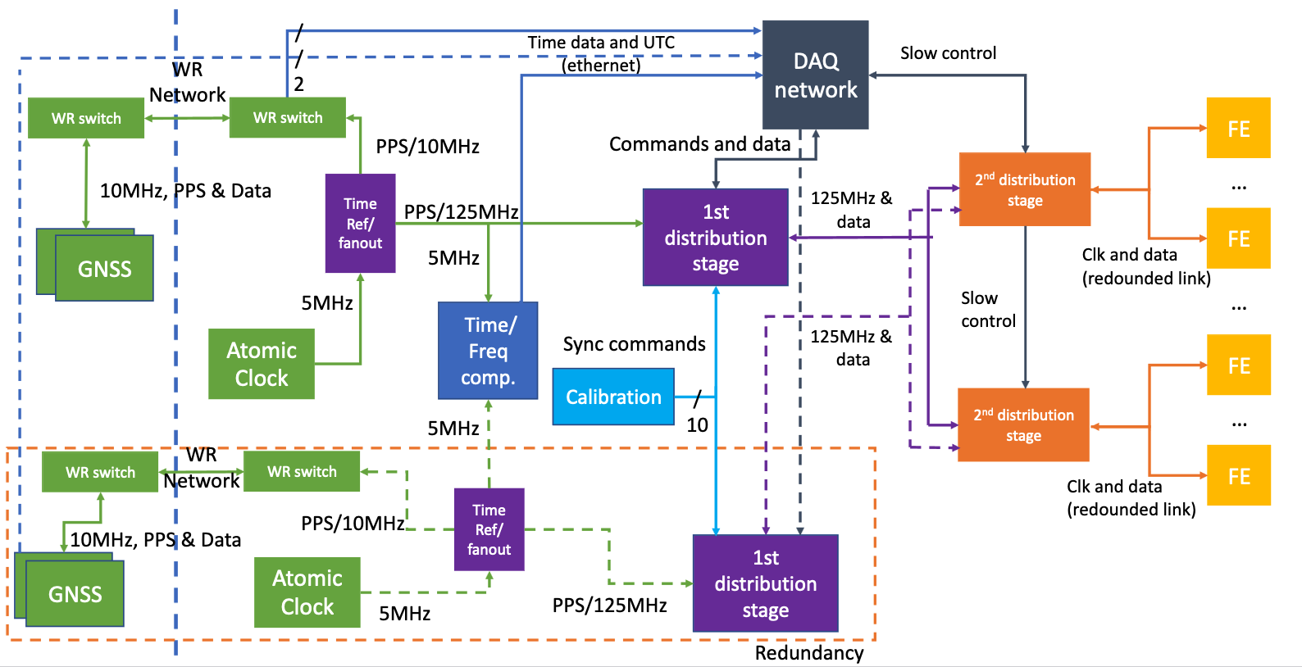
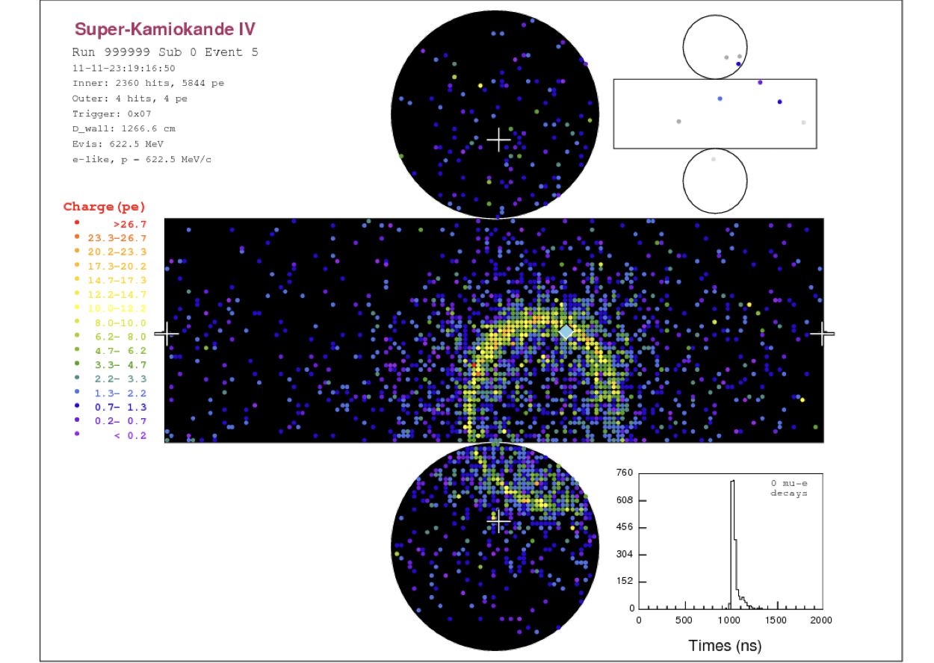
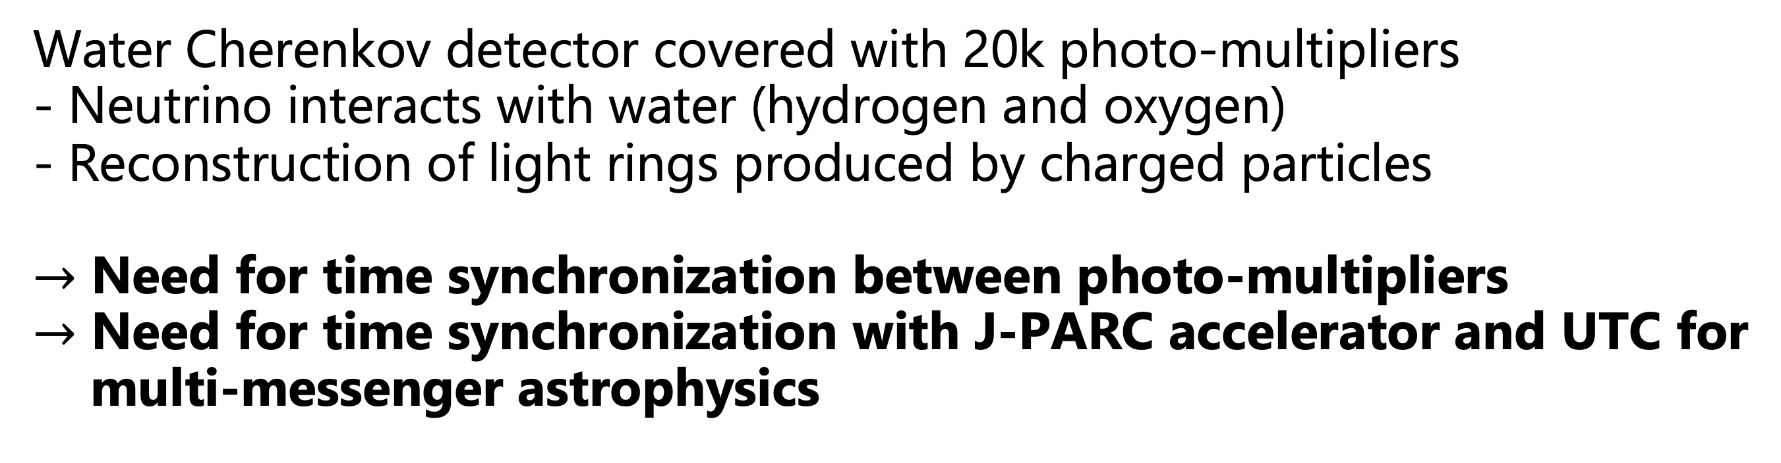
Hyper-Kamiokande
Hyper Kamiokande
Water Cherenkov detector covered with 20k photo-multipliers
- Neutrino interacts with water (hydrogen and oxygen)
- Reconstruction of light rings produced by charged particles
$→$ Need for time synchronization between photo-multipliers
$→$ Need for time synchronization with J-PARC accelerator and UTC for multi-messenger astrophysics
60 m
CAVERN
IN-WATER
74 m
OUTSIDE

Slide 8
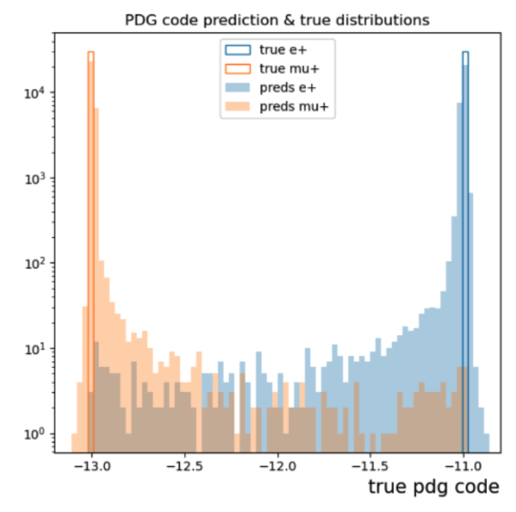
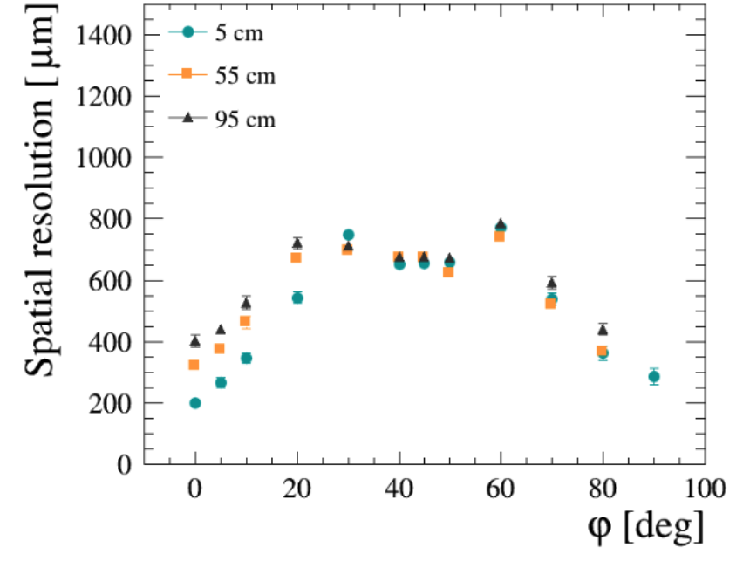
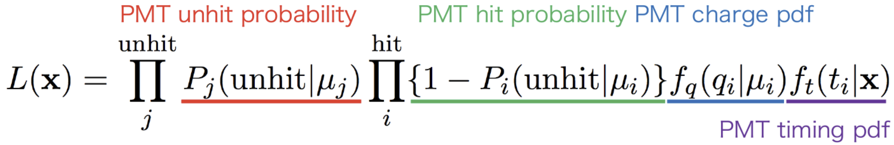
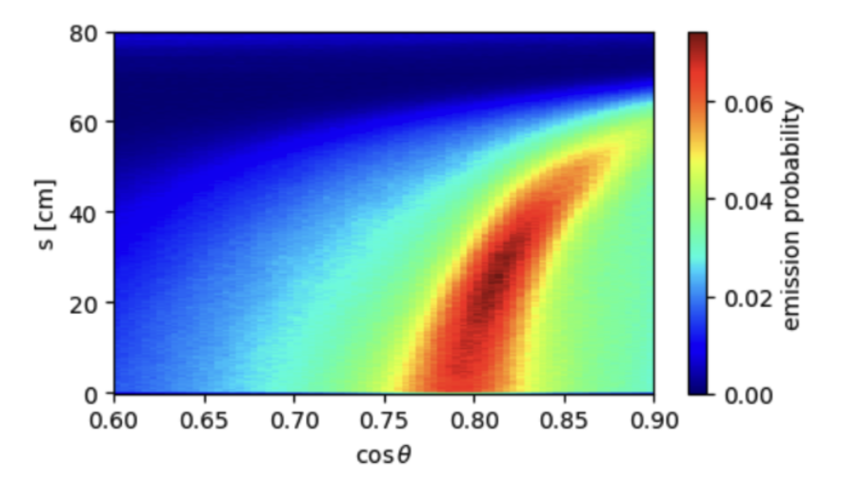
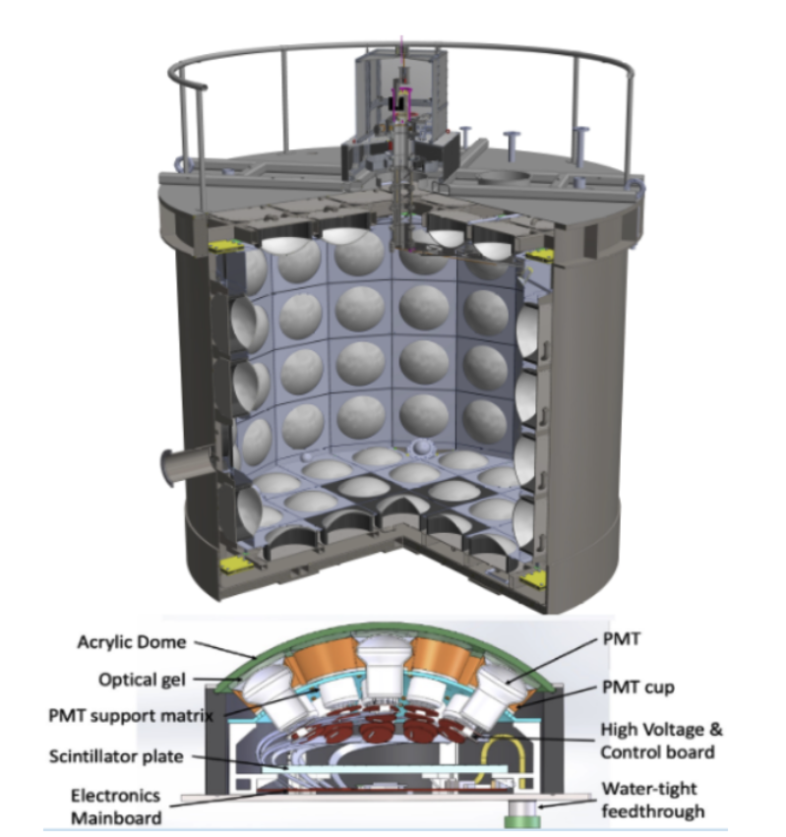
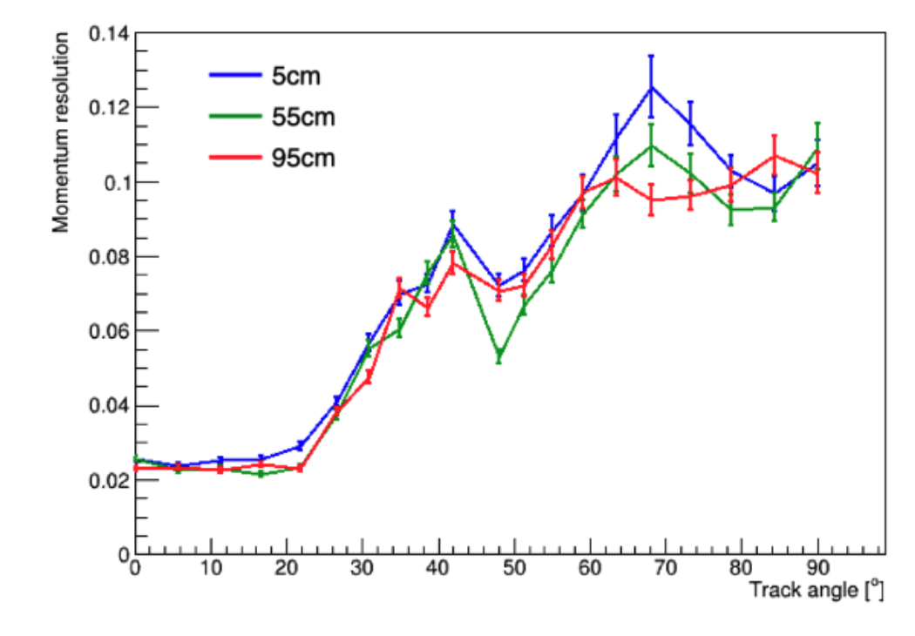
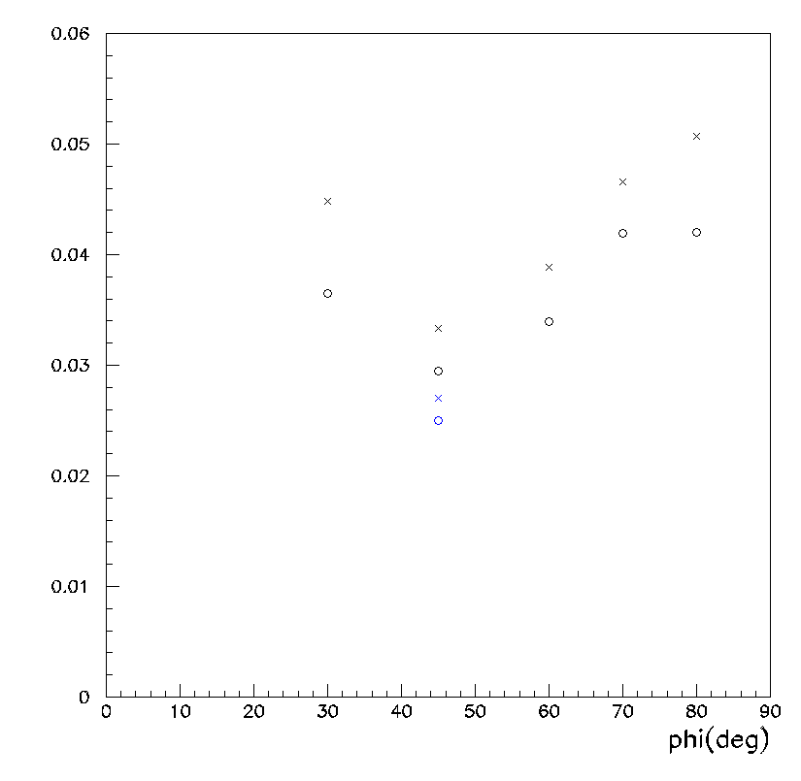
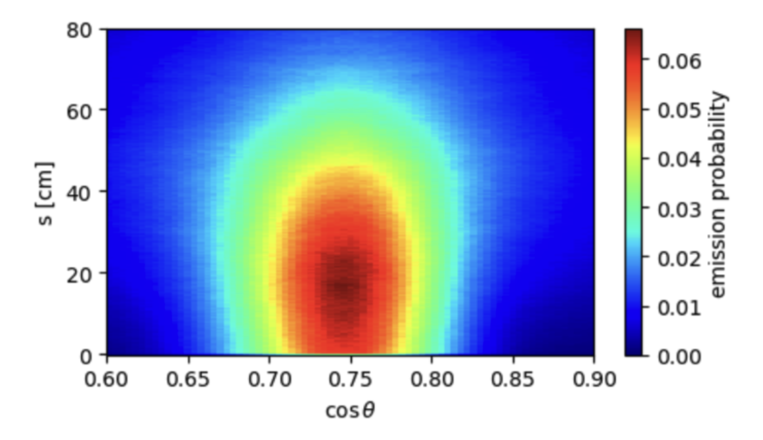
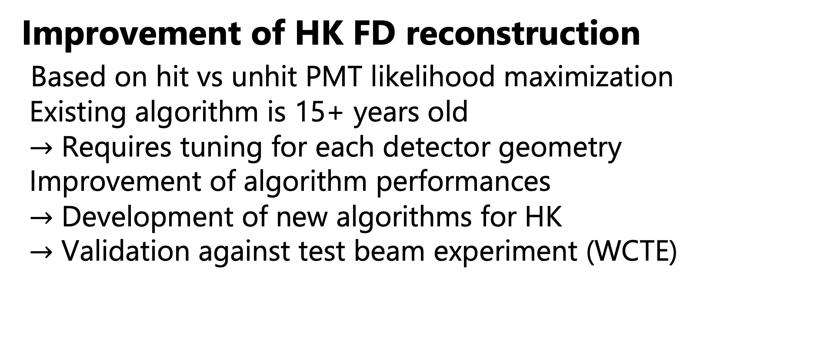


ND280 and Cherenkov Reconstruction
Development of ND280 HA-TPC sim&recon
Strong contributions from the group
Novel reconstruction methods including the detector’s unique physics (charge spreading…)
Performances characterization (peer-reviewed papers)
Improvement of HK FD reconstruction
Based on hit vs unhit PMT likelihood maximization
Existing algorithm is 15+ years old
$→$ Requires tuning for each detector geometry
Improvement of algorithm performances
$→$ Development of new algorithms for HK
$→$ Validation against test beam experiment (WCTE)
PID via Machine Learning
Momentum resolution
Momentum resolution
Target: 10%
Momentum resolution
$$μ^{−}$$
logQ method
x2 better
$$e^{−}$$
Full waveform fit method
P. Billoir, A. Chalumeau, L. Russo, W. Saenz, S. Suvorov, U. Virginet, V. Yevarouskaya
G. Diaz Lopez

Slide 9
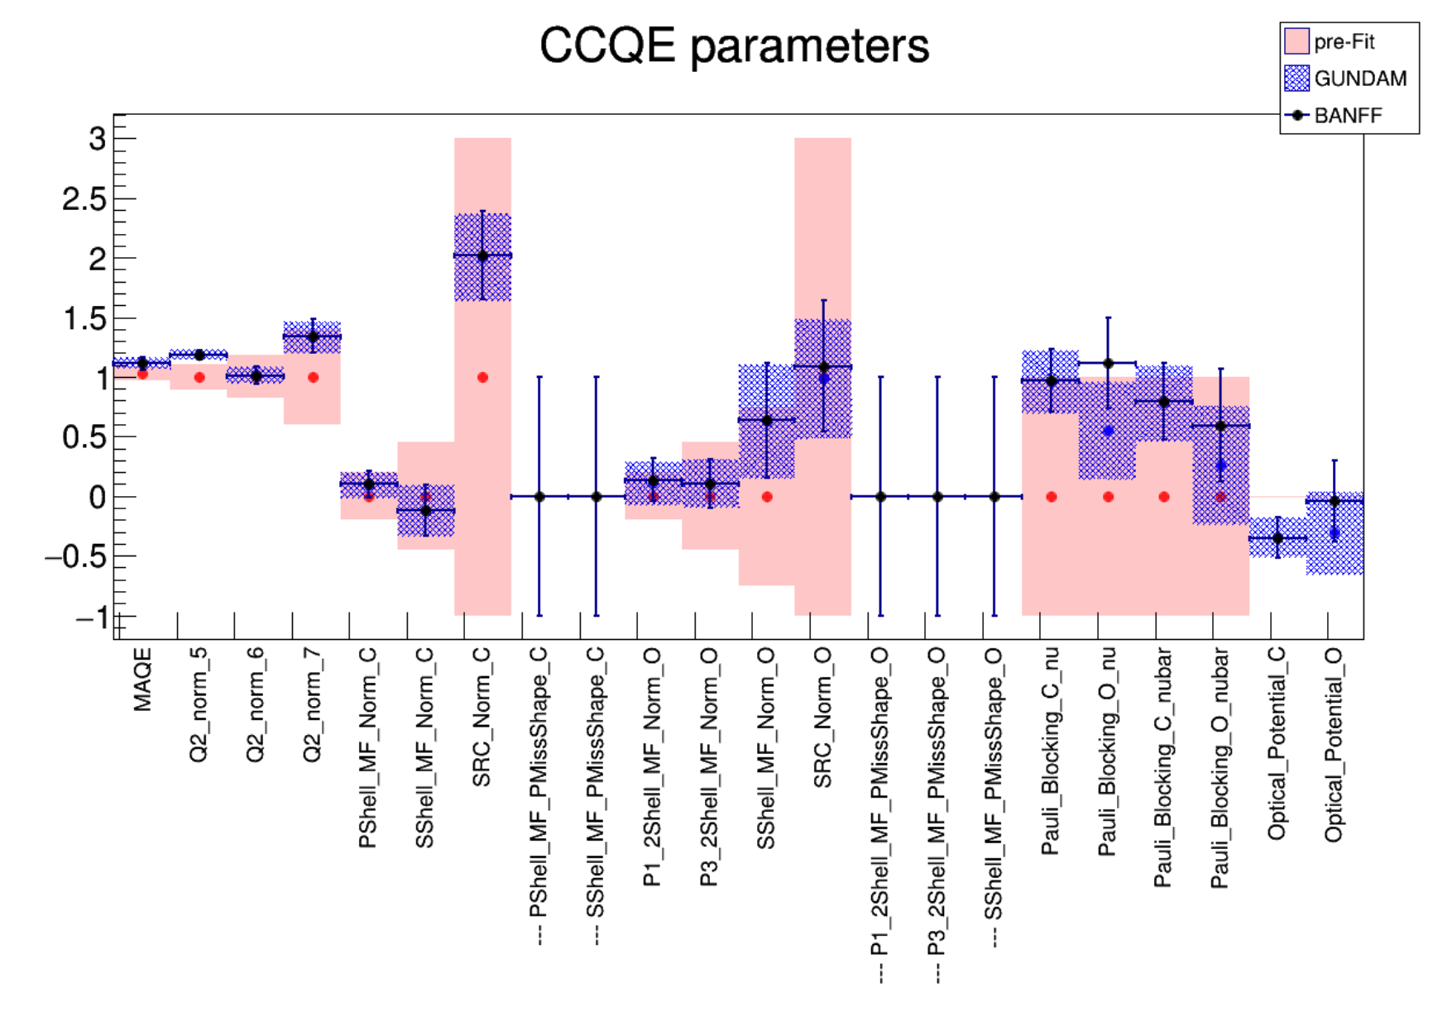
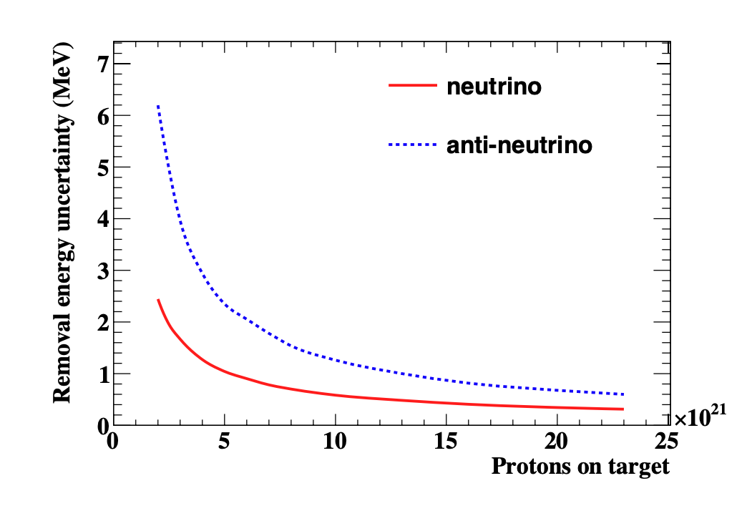
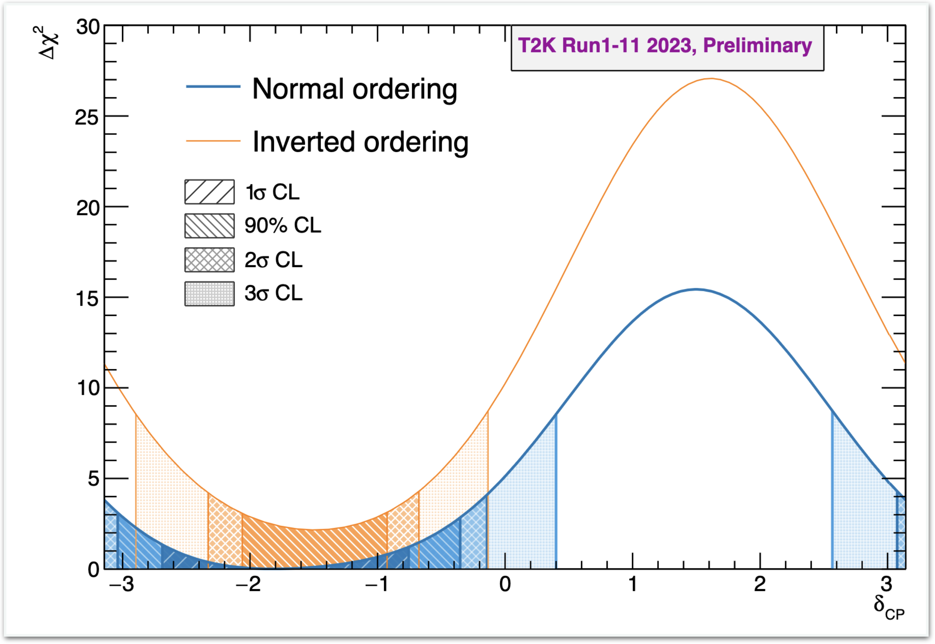
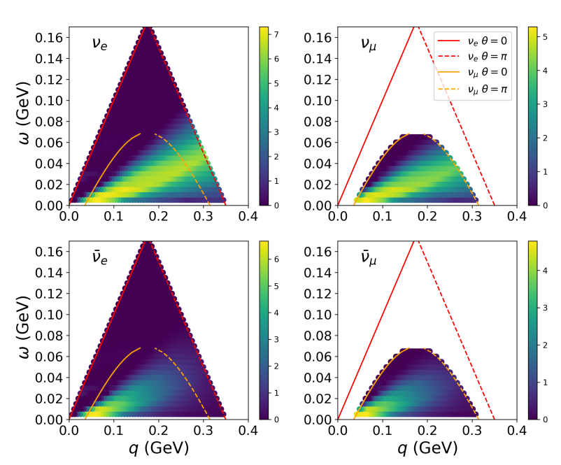
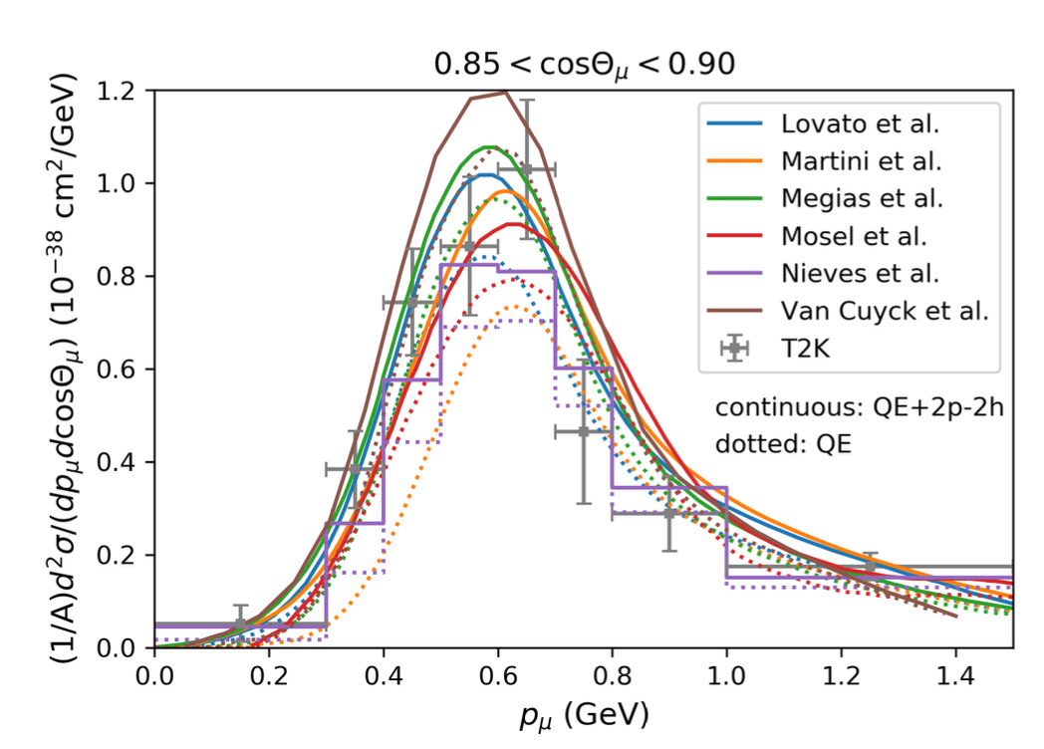
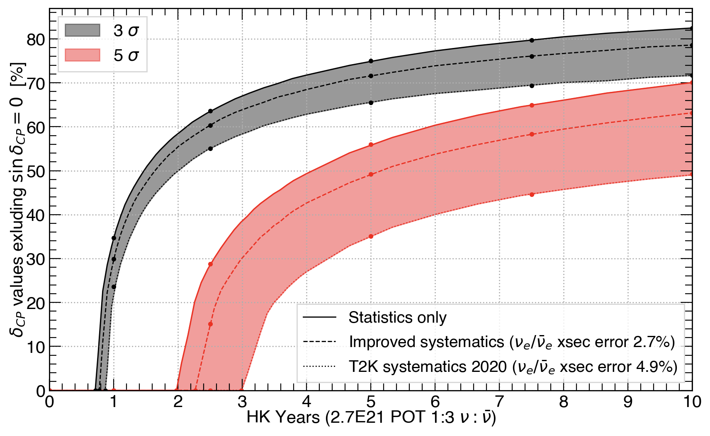

Physics analyses highlights
Gundam: New Near Detector fitter developed at LPNHE
Studies of ND280 upgrade sensitivity and future constraints
Contributions to T2K LBNO analyses (P-Theta)
Extraction of neutrinos oscillation parameters
A. Blanchet, V. Nguyen, S. Suvorov, V. Yevarouskaya
Neutrino cross-sections modelling
Understand outgoing particles’ kinematics and constrain x-sections
L. Mellet
New sensitivity studies for HK LBNO
$$E_{ν} = 175 MeV$$
M. Martini, V. Nguyen, U. Virginet
C. Dalmazzone

Slide 10
From T2K to HK
2018
‘19
‘20
‘21
‘22
‘23
‘24
‘25
‘26
‘27
‘28
T2K-I
T2K-II
HK

Slide 11
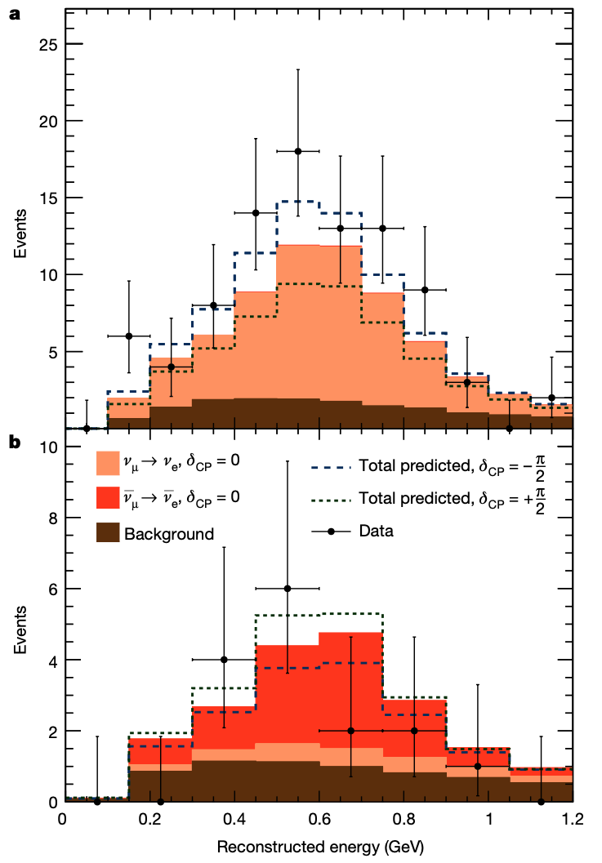
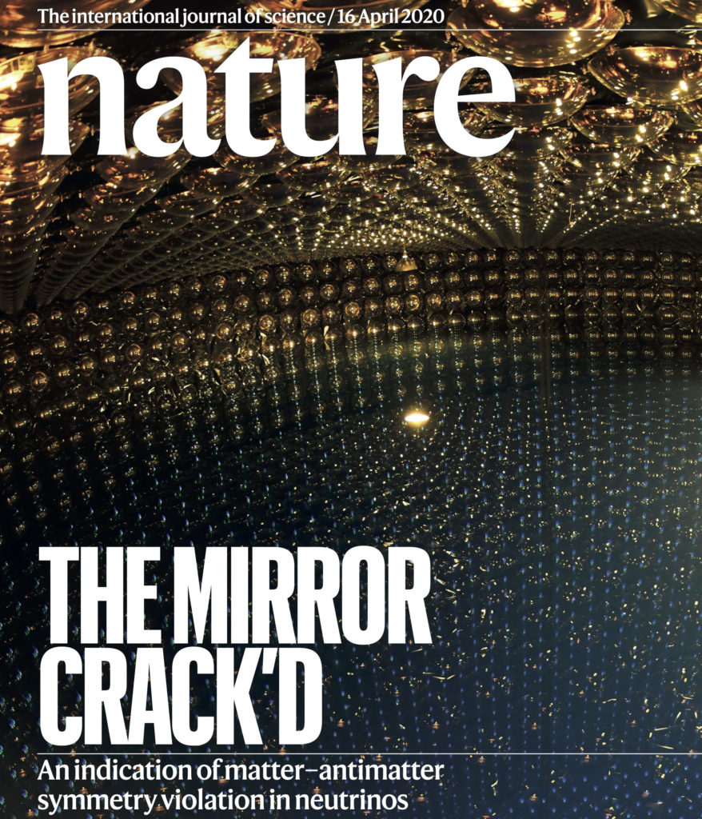
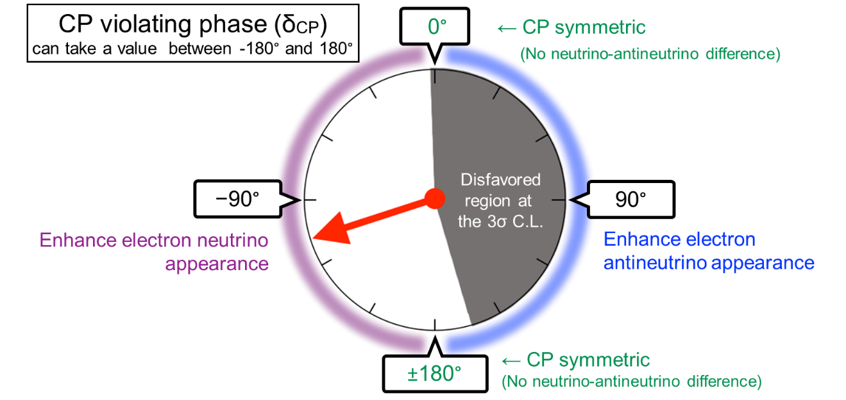
From T2K to HK
2018
‘19
‘20
‘21
‘22
‘23
‘24
‘25
‘26
‘27
‘28
T2K-I
Latest oscillation analysis results!
Nature cover
Last T2K-I run (run 12)
Hints of CP violation!

Slide 12
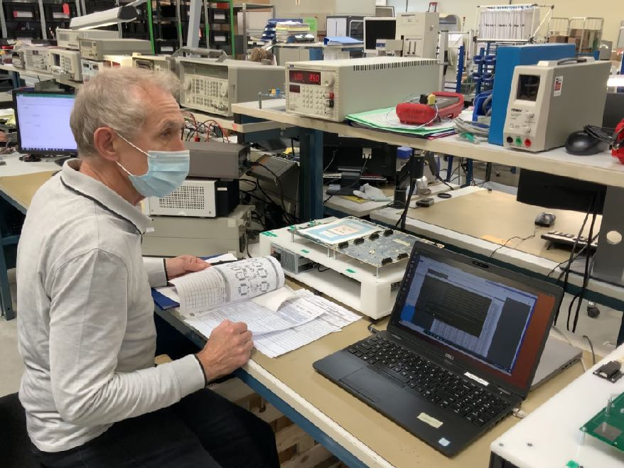
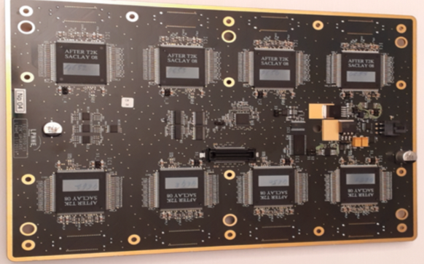
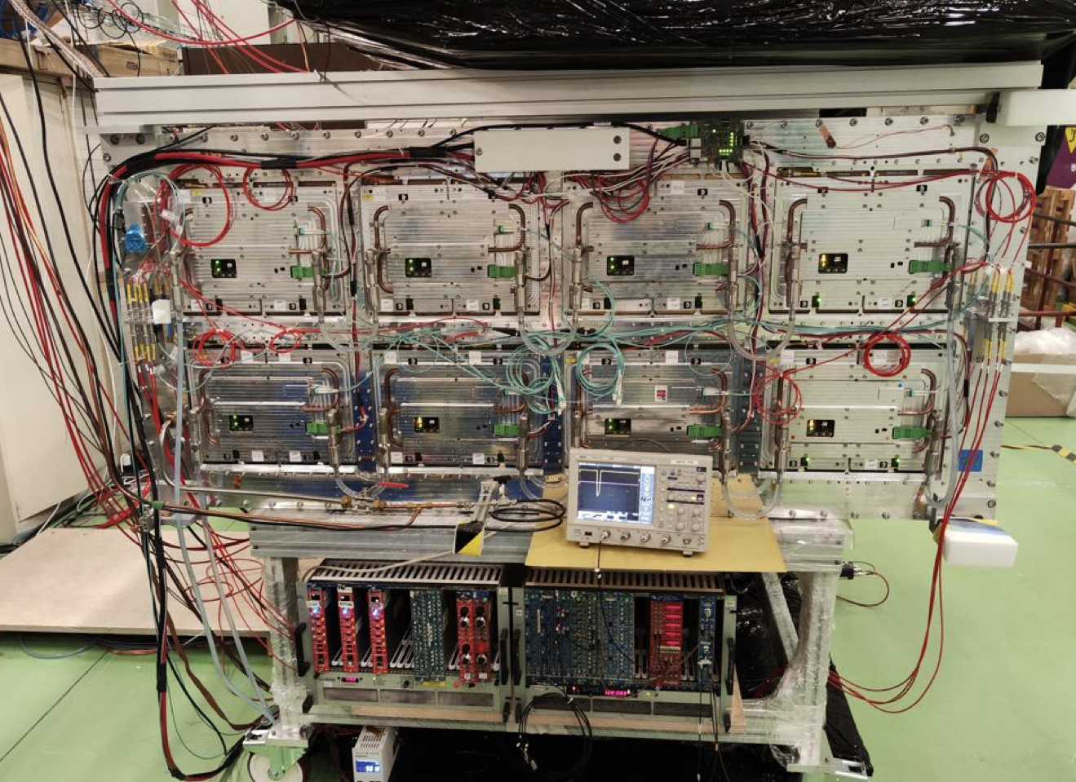
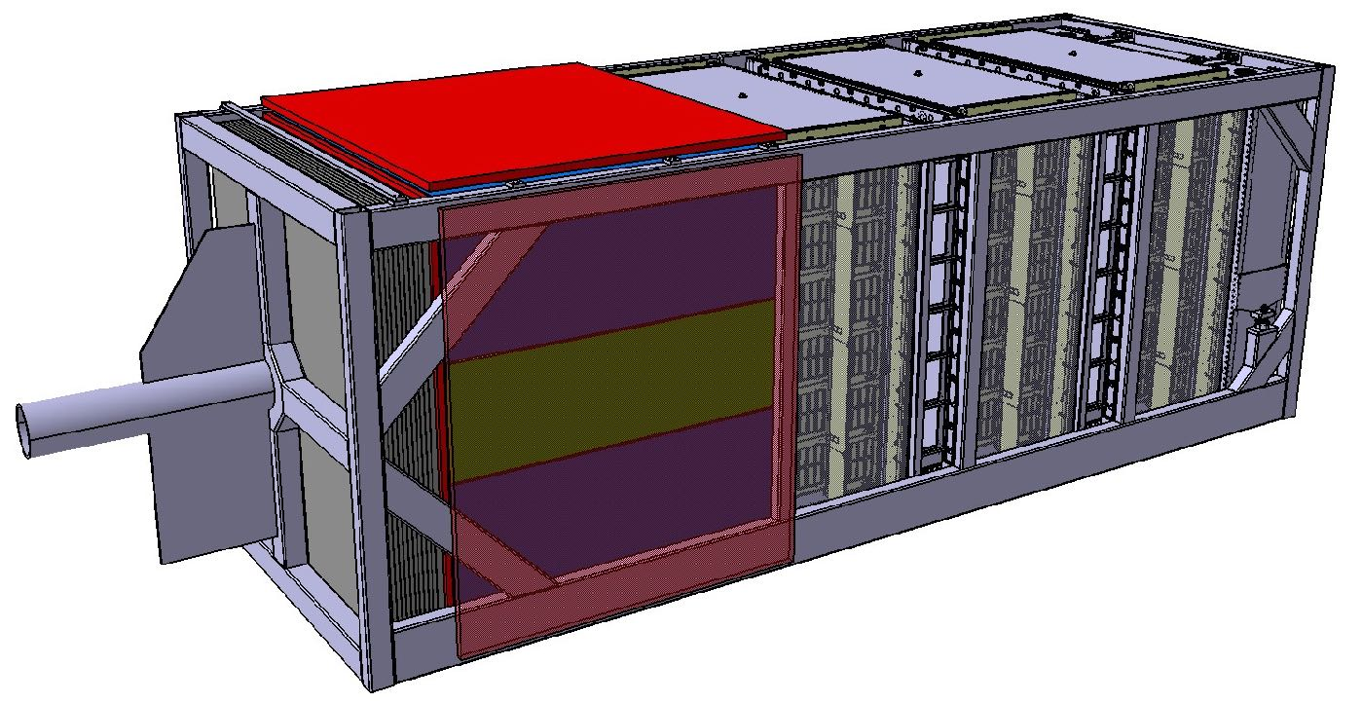


From T2K to HK
2018
‘19
‘20
‘21
‘22
‘23
‘24
‘25
‘26
‘27
‘28
T2K-I
Preparation to T2K-II
T2K-II
June’18 CS-IN2P3
Oct’21 CS-IN2P3
84 HA-TPC readout cards produced
Tests at LPNHE and Ouestronic
72 cooling plates produced
HA-TPC readout cards
Bottom HA-TPC fully instrumented!
TOF
TPC2
TPC3
High-Angle TPC
TPC1
FGD2
$$ν_{μ}$$
FGD1
Downstream Ecal
SuperFGD
ND280 upgrade poster
Upstream Ecal
High-Angle TPC

Slide 13

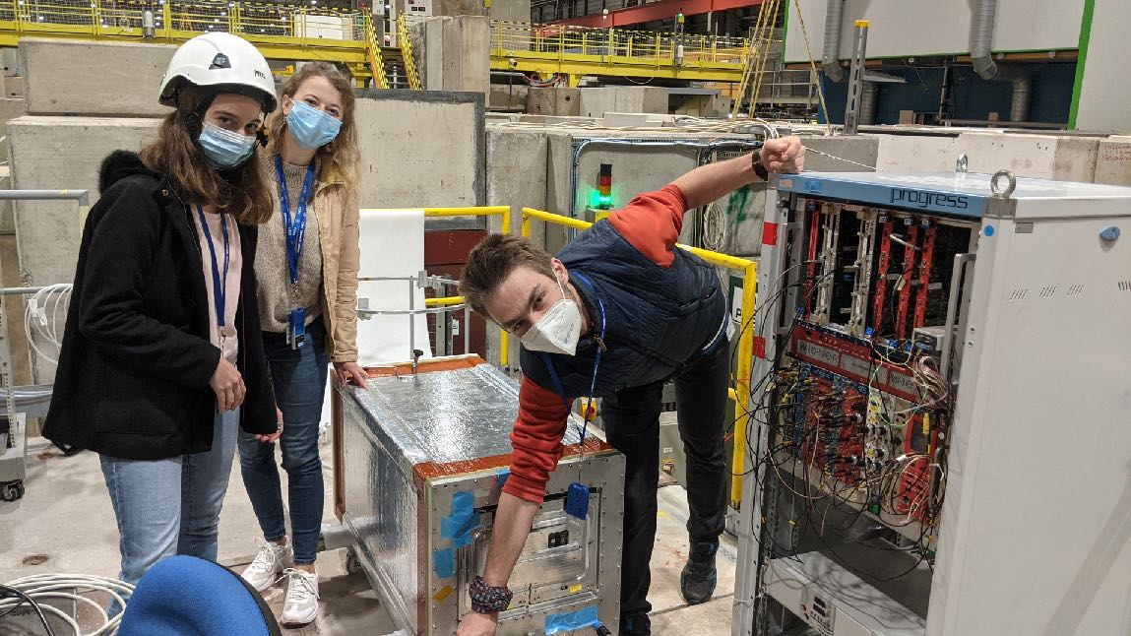



From T2K to HK
2018
‘19
‘20
‘21
‘22
‘23
‘24
‘25
‘26
‘27
‘28
T2K-I
Preparation to T2K-II
T2K-II
DESY test beam
CERN test beam
Cosmics at CERN
TOF
TPC2
TPC3
CERN test beam 2021
High-Angle TPC
TPC1
FGD2
$$ν_{μ}$$
FGD1
Downstream Ecal
SuperFGD
DAQ system ready!
ND280 upgrade poster
Upstream Ecal
High-Angle TPC

Slide 14

From T2K to HK
2018
‘19
‘20
‘21
‘22
‘23
‘24
‘25
‘26
‘27
‘28
T2K-I
Preparation to T2K-II
T2K-II
ND280 upgrade installation at J-PARC
Data taking with full upgrade
First neutrino event in the SFGD!!
First upgrade data
Detectors installed in the ND280 pit
TOF
TPC2
TPC3
High-Angle TPC
TPC1
SFGD
FGD2
$$ν_{μ}$$
FGD1
Downstream Ecal
HA-TPC
SuperFGD
ND280 upgrade poster
Upstream Ecal
High-Angle TPC

Slide 15







From T2K to HK
2018
‘19
‘20
‘21
‘22
‘23
‘24
‘25
‘26
‘27
‘28
T2K-I
Preparation to T2K-II
T2K-II
HK
Preparation to HK
Oct’19 CS-LPNHE
Oct’21 CS-IN2P3
Oct’22 CS-IN2P3
Apr’23 IN2P3 KDP2
Physics dataking in 2027
May’21: Excavation started
July’25: Excavation finished
Aug’26: Far detector filling
Groundbreaking ceremony (May 2021)
Dome excavation completed!
First light in 2027

Slide 16




From T2K to HK
2018
‘19
‘20
‘21
‘22
‘23
‘24
‘25
‘26
‘27
‘28
T2K-I
Preparation to T2K-II
T2K-II
HK
Preparation to HK
First GNSS tests at Kamioka
Vertical slice test at CERN
Cards productions for time distribution system
GNSS campagn in Japan
First-stage <-> second-stage tests
Vertical slice test at CERN
HK timing system poster

Slide 17
Grants, publications and communications
Grants and fundings:
- MSCA-RISE JENNIFER2 (2019-2025): Travels for T2K-II and HK preparation
- ANR JCJC SUNCORE (CG, 2019-2023): ND280 Upgrade, SK+T2K joint analysis
- Emergence SU MULTIPLY (MG, 2019-2021): R&D for HK
- ANR JCJC BERTHA (MG, 2022-2026): HK Timing R&D, WCTE
101+ publications: 15 with direct contributions (corresponding author/paper committee):
- Nature 580 339 (2020) “Constraint on the matter–antimatter symmetry-violating phase in neutrino oscillations”
- NIMA 1052 168248 (2023) “Analysis of test beam data taken with a prototype of TPC with resistive Micromegas for the T2K Near Detector upgrade”
- NIMA 1025 166109 (2022) “Characterization of resistive Micromegas detectors for the upgrade of the T2K Near Detector Time Projection Chambers”
- Symmetry 13(9) 1625 (2021) “A New Generation of Neutrino Cross Section Experiments: Challenges and Opportunities”
Presentations in national and international conferences and workshops:
- Neutrino: SB (2018), LM (2020)
- NuTel21: MG, SS
- NuPhys21: CG
- Rencontres de Blois 2021: AB, SS
- ICHEP22: VY
- NuFact: VN (2021), LM (2022), CD (2023)
- NNN23: CD
- Rencontres du Vietnam: SB (2017), VN (2022)
- GDR/IRN Neutrinos
Notes:
https://inspirehep.net/literature?sort=mostrecent&size=250&page=1&q=%28collaboration%3ANA61%2FSHINE%20and%20author%3Apopov%29%20or%20%28collaboration%3AT2K%20and%20author%3Agiganti%29%20or%20%28collaboration%3AHyper-Kamiokande%20and%20author%3Amellet%29%20or%20author%3AM.%20Guigue&earliest_date=2018--2023&ui-citation-summary=true&ui-exclude-self-citations=true
-> doesn’t include Marco’s!

Slide 18
Scientific life coordination
T2K:
T2K Executive committee (CG) T2K Institutional Board (JD)
ND280 Upgrade coordinator (CG)
ND280 G4 coordinator (BP)
ND280 Sim&Reconstruction convener (MG)
Hyper-Kamiokande:
HK Institutional Board (CG)
Timing system WG Coordinator (SR)
HK-ND280 coordinator (CG)
CERN electronics assembly technical coordinator (SR)
Distributed computing convener (MG)
NA61/SHINE:
Resources coordinator (BP)
Analysis coordinator (BP)
LPNHE:
LPNHE Scientific Council (CG 2019-)
LPNHE Lab Council (LM 2022, MG 2022-)
LPNHE Seminars (MG 2019-2021)
IN2P3:
T2K National Representative (CG) NA61 National Representative (BP)
HK National Technical Coordinator (SR)
Sorbonne Université:
“UFR de Physique” Council (MG 2022-)
National/international-level scientific expertise:
6 peer-reviewed publications
1 SNF (Switzerland), 1 UK-RI, 1 Sonata (Poland)
2 ANR proposals
1 European Master

Slide 19


Teaching and outreach
Organisation of the Ecole de Gif dedictated to Neutrino physics
September 5th-9th, 2022, at LPNHE
Covering history, theoretical and experimental neutrino physics
Local organization committee: JD, CG, MG, BP
Organisation of the CP2023 workshop at Les Houches
February 12th-17th, 2023, at the Ecole des Houches
Bringing together colliders, neutrino and EDM communities
Organizational committee: MG
Rencontres de Moriond, Vietnam, de Blois (JD)
NuSTEC Committee member (MM, 2015-)
NuFact Scientific Program Committee (MM, 2018-)
NNN23 conference’ scientific committee member (BP, 2023)
IRN Neutrino organization (CG, 2019-)
Teaching at IPSA and Sorbonne Université (CD, MM, LM, MG, UV)
Nuclear physics, experimental and numerical physics…
CP2023@Les Houches

Slide 20







Neutrino group activities
TOF
TPC2
TPC3
High-Angle TPC
TPC1
FGD1
FGD1
Downstream Ecal
SuperFGD
High-Angle TPC
Upstream Ecal
Analysis coordination
$→$ Hadrons production measurements
$→$ Neutrino flux predictions
Major detector upgrade
New data taking campaign in 2022
$→$ Analysis in progress
Analyses
$→$ Beam neutrino oscillation
$→$ Joint T2K-SK analysis
$→$ Neutrinos cross-sections
ND280 upgrade (HA-TPCs)
$→$ Readout electronics
$→$ Acquisition system
$→$ Simulation & reconstruction
$→$ Installation at J-PARC!
HK physics analyses
$→$ Far detector reconstruction
$→$ Neutrino oscillation sensitivities
Timing generation and distribution for HK far detector and J-PARC accelerator
$→$ R&D
$→$ Validation @ LPNHE
$→$ Getting ready for installation!
Exciting times ahead of us!

Slide 21
From T2K to HK
2018
‘19
‘20
‘21
‘22
‘23
‘24
‘25
‘26
‘27
‘28
T2K-I
Preparation to T2K-II
T2K-II
HK
Preparation to HK
Data taking WCTE
HK physics poster

