Slide 1
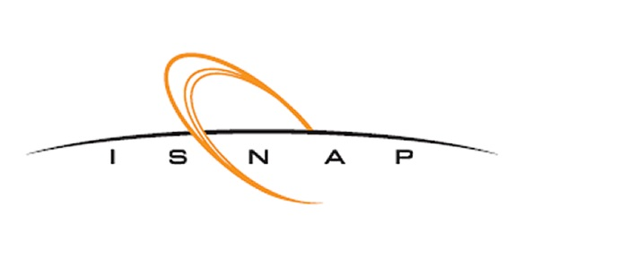
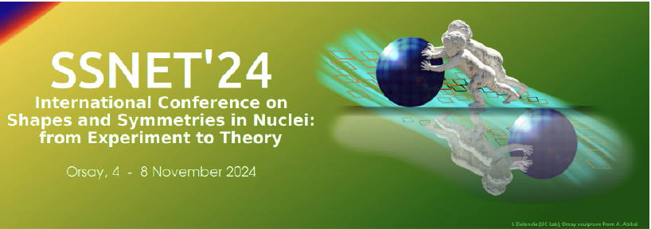

Vibrations or Coexistence?
The Nature of 0⁺ States in Deformed Nuclei
Ani Aprahamian
Institute for Structure & Nuclear Astrophysics
University of Notre Dame
Notes:
Good morning……..i have heard of this conference on shapes and symmetries for many years but it is my first time attending!
We heard Yuri tells us all about the new ideas he has about high precision measurements with stored radioactive ions and I will talk about
My talk is about An open question in nuclear structure physics for decades…..
do deformed nuclei sustain vibrational motion built on the rotational excitations that we observe?

Slide 2
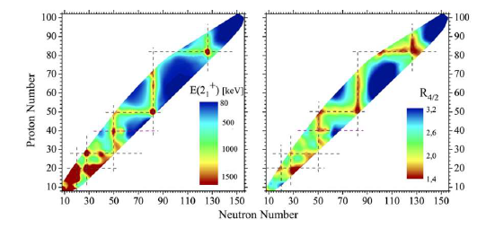
Do Deformed nuclei sustain low-lying vibrational excitations?
Z=50-82
Z=50-82
2⁺_{g.s.}
R= 4⁺ _{g.s.} /2⁺ _{g.s.}
Notes:
We heard a lot of talk about coexistence this week…..How could we tell a vibration from coexistence….

Slide 3
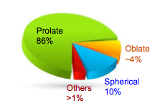
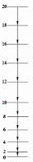
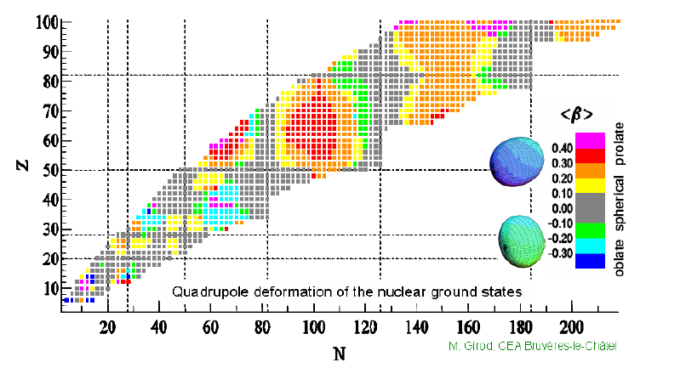
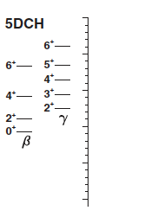
Nature of vibrations vs. coexistence?
How can you differentiate between coexistence and vibrations?
HARTREE-FOCK-BOGOLIUBOV RESULTS BASED ON THE GOGNY FORCE
Delaroche et al. Phys. Rev. C 81, 014303 (2010)
Notes:
Biggest region of deformation….rare earth…
Lowest lying shape oscillation possible on the ground state….are quadrupole in nature….in deformed nuclei….aligned along the symmetry axis and one perpendicular to it
Question unanswered due to lack of data….

Slide 4
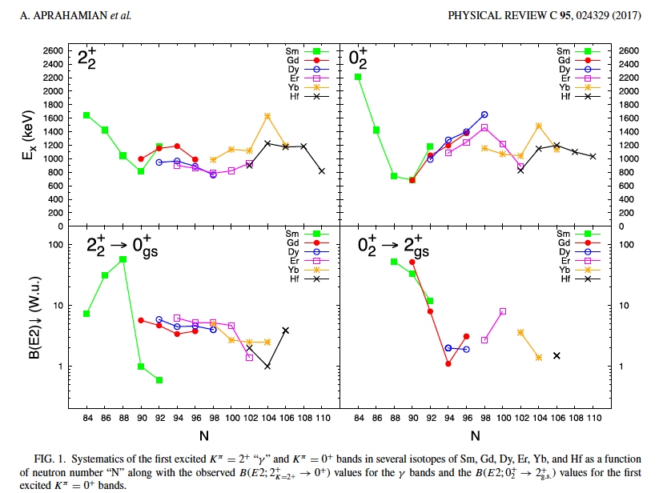
K=2⁺_{γ}
K=0⁺
New Data from
TU Munich

Slide 5
What can you expect from vibrations?
Conjectures:
Coexistence 0⁺ states…
No vibrational collectivity in the low-lying spectra
Beta and Gamma vibrations
Same Deformation as g.s. : dynamic moments of inertia
Intrinsic quadrupole moment from the band to g.s. band: Q₀
Multiple phonons?

Slide 6
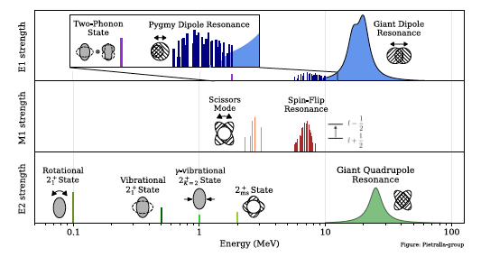
E2, M1, and E1 strengths in nuclear spectroscopy
Notes:
Collectivity….100’s of W.u. for rotational….1-10 W.u. for the oscillations or vibrations….10’s W.u for GQR or DGR

Slide 7
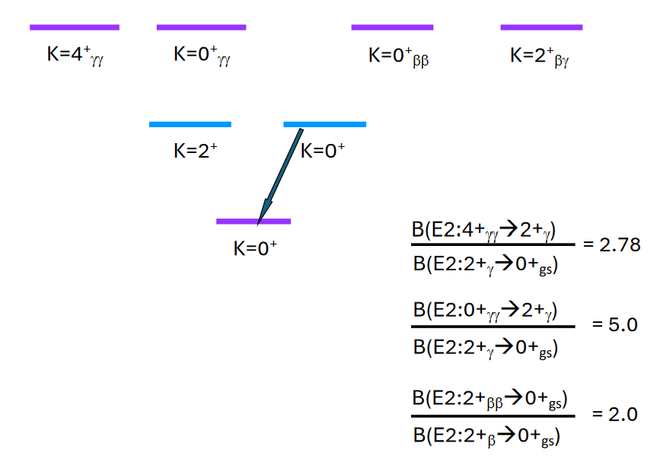
If collective quadrupole vibration built on deformed ground state
What can we expect to see? Energies of phonons of Excitation
γ
β
multiphonons

Slide 8
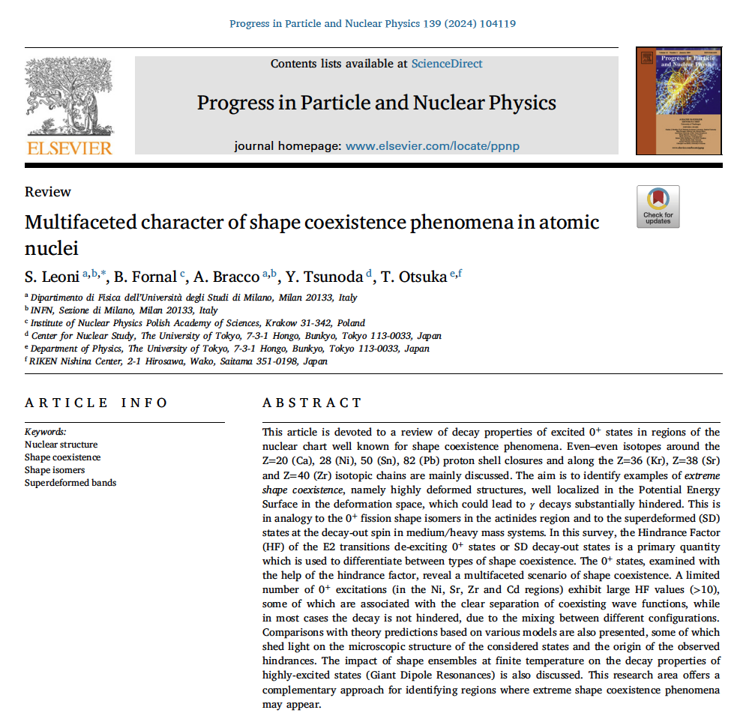
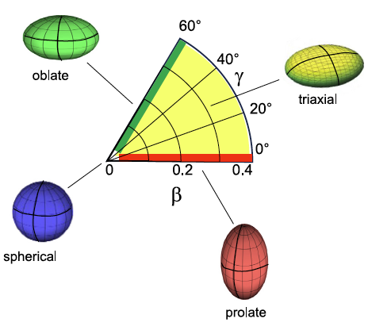
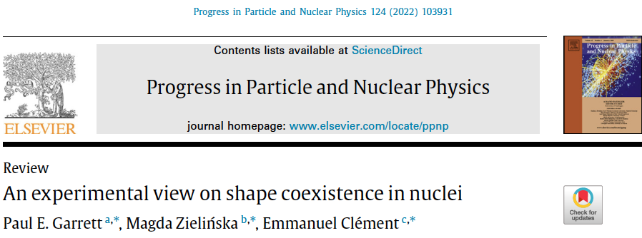

Slide 9
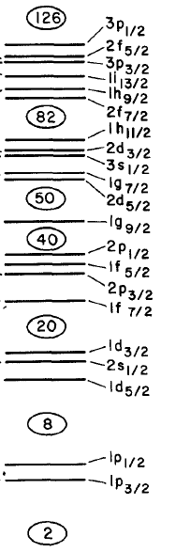
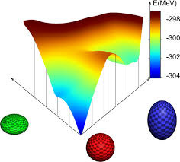
Shape Coexistence:
Near closed shells
O, Ca, Ni,
Zr, Mo
Cd, Sn
Hg,Pb
28
28

Slide 10
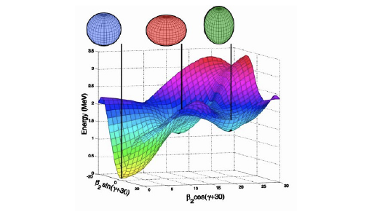
¹⁸⁶Pb

Slide 11
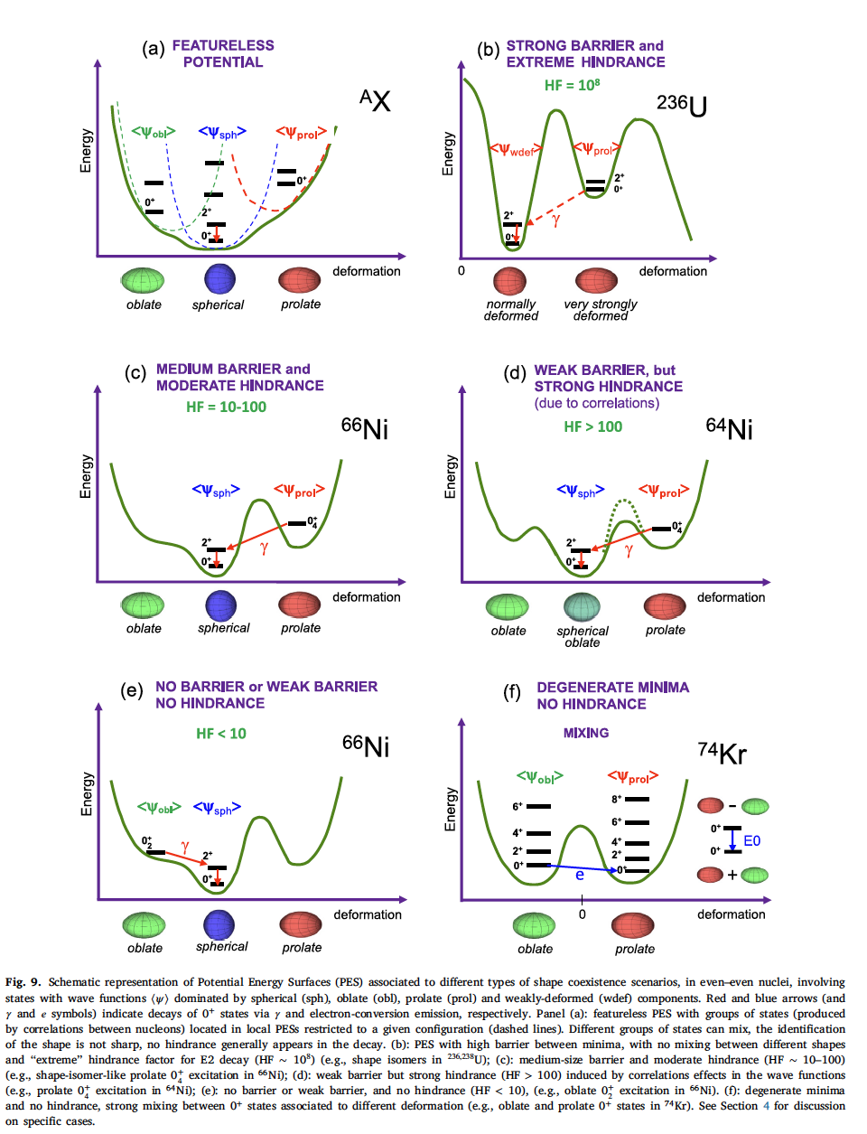
Experimental signatures of shape coexistence
    Energy spectra
    Electromagnetic transition probabilities
    Electromagnetic moments
    E0 transitions
    Population mechanisms
Transfer rxs, E0s, lifetimes etc..
Rev. Mod. Phys. 83, 1467, 2011: Heyde & Wood
S. Leoni, JPPNP Vol. 139, 10419, Nov. 2024

Slide 12
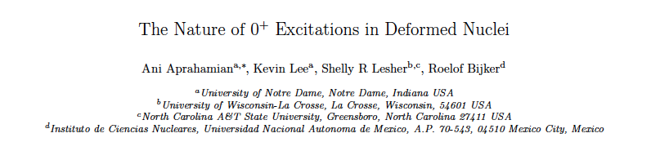
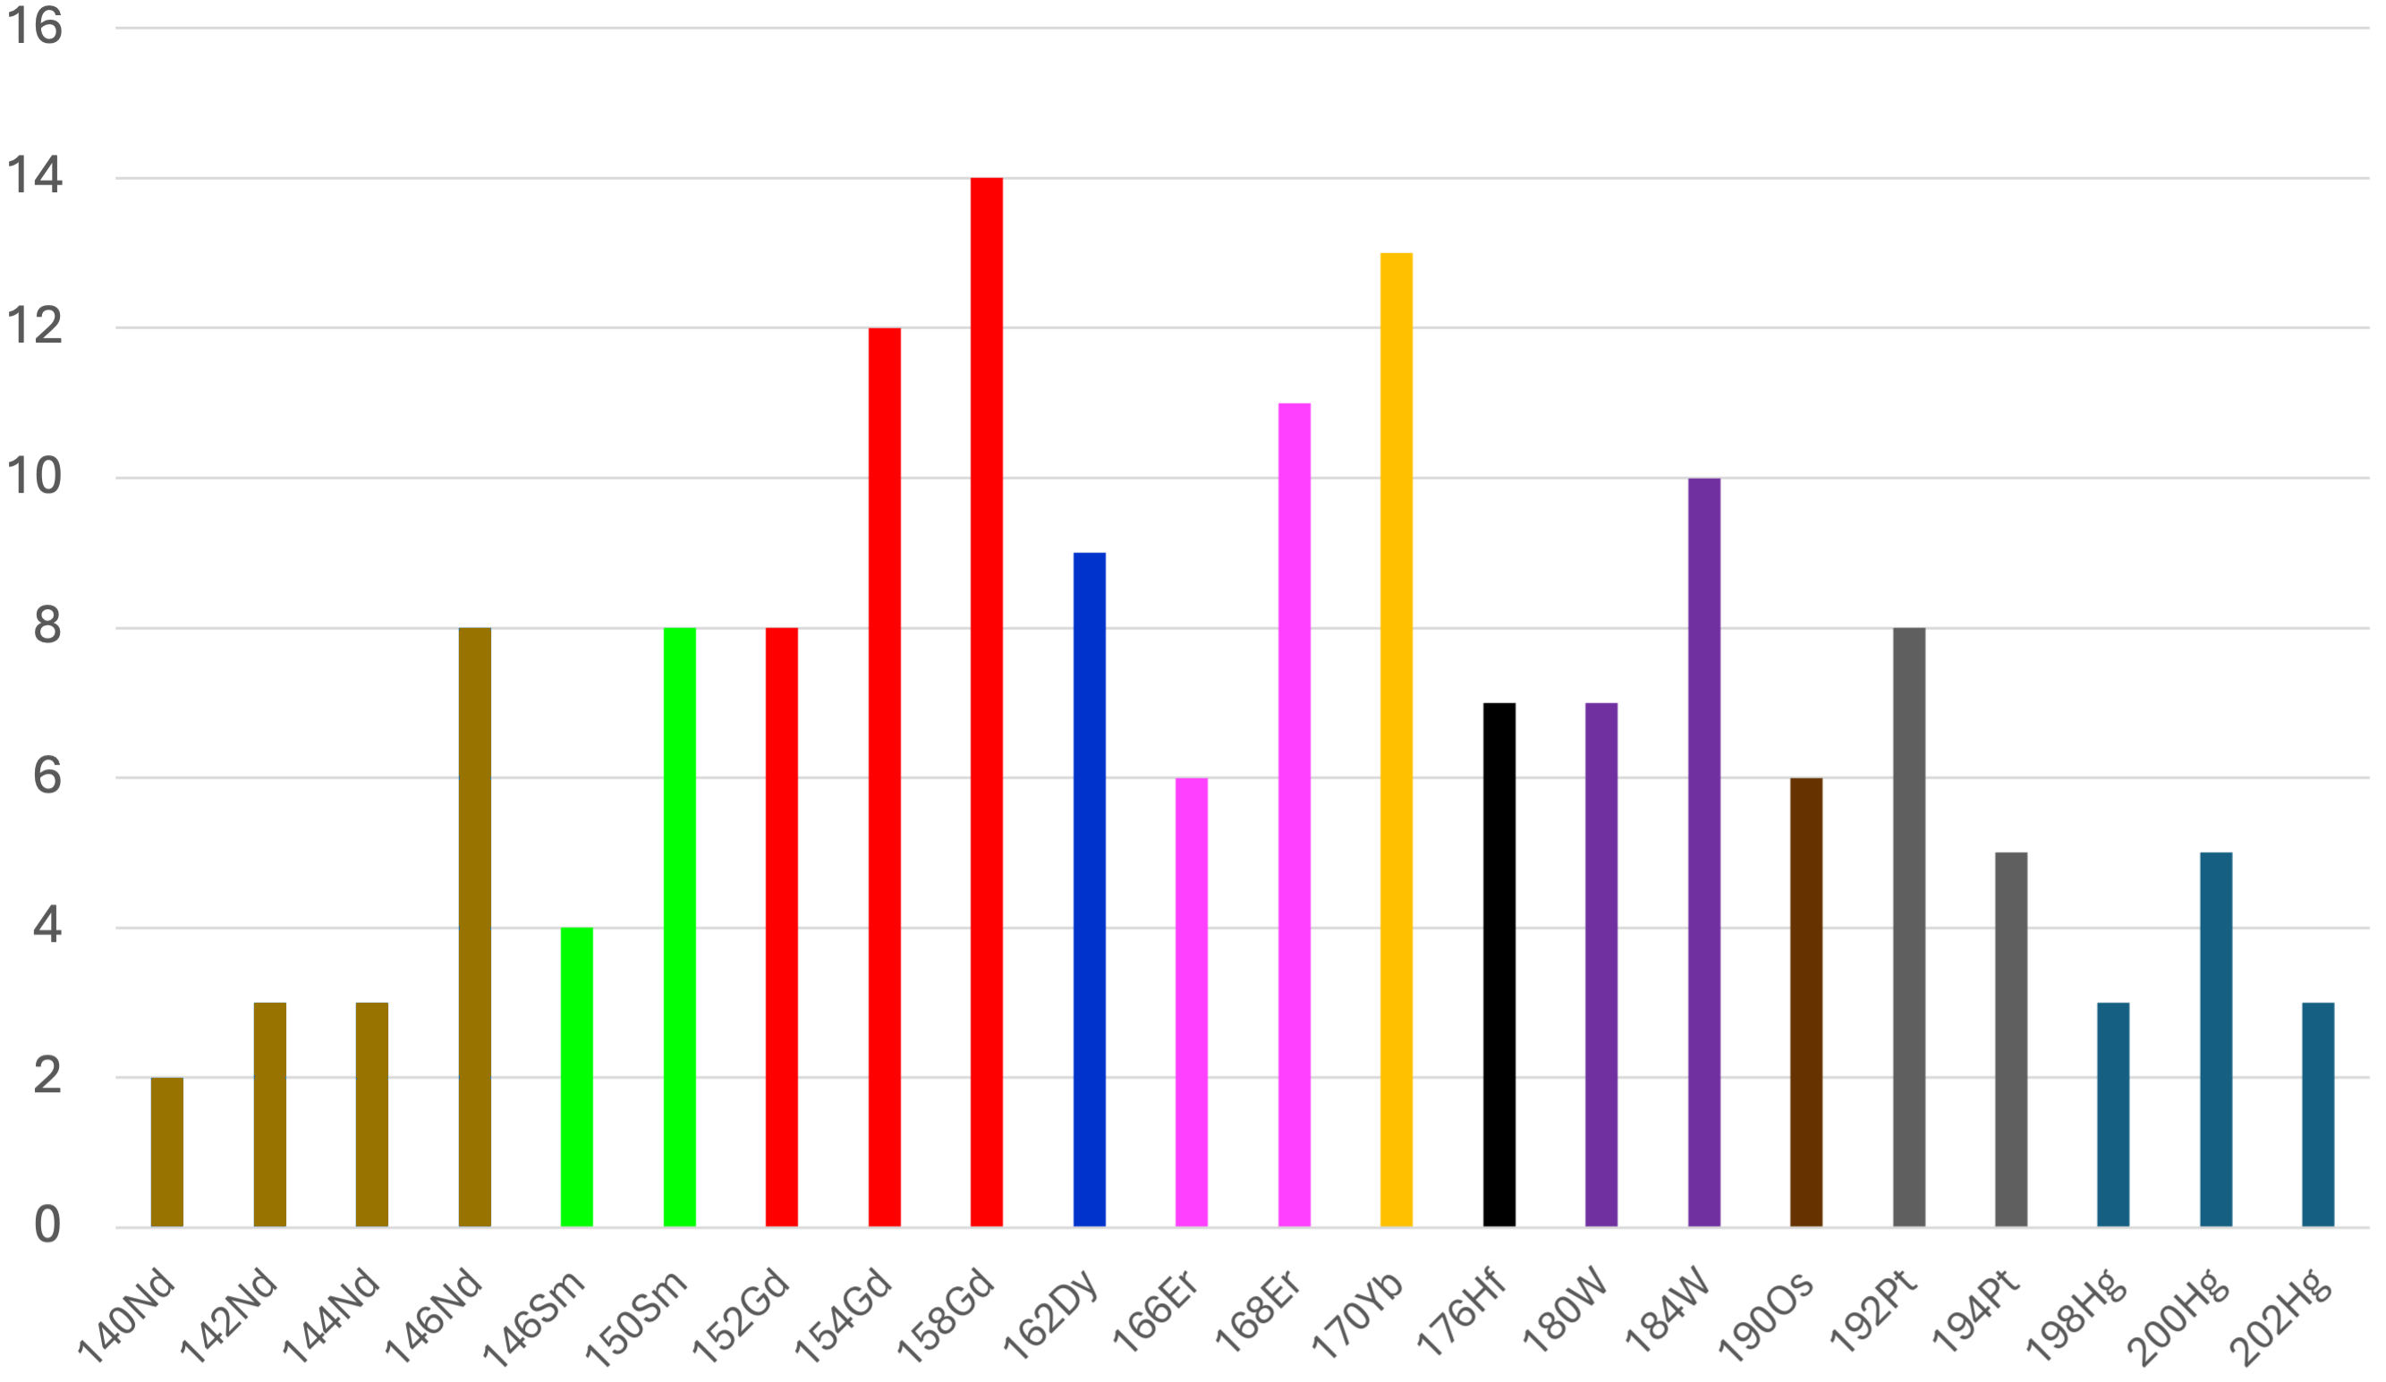
Z=64
Z=60
Z=80
(p,t) TU Munich
Number of 0⁺ states observed in the Z=50-82 Region of Nuclei

Slide 13
GRID, ILL Grenoble
DSAM, U Kentucky
Lifetime Measurements….
Electromagnetic Moments….
Transfer Reactions… (p,t) and (t,p)
E0 components J ->J transitions… fIReball at ND
Theoretical comparisons…
    HFB theory extended by GC method
    IBA
Notes:
For cgs 16…I am going to talk about low lying oscillations of deformed nuclei……. One of my favorite topics

Slide 14
2-proton and 2-neutron separation energies:
2Δp = 8 [16E(N, Z) - 9E(N, Z + 1) + E(N, Z + 3) - 9E(N, Z - 1) + E(N, Z - 3)]
2Δn = 8 [16E(N, Z) - 9E(N + 1, Z) + E(N + 3, Z) - 9E(N - 1, Z) + E(N - 3, Z)]
DelaRoche et al.: Phys. Rev. C 81, 014303 (2010)
HFB theory extended by generator coordinate method and
mapped onto a five-dimensional collective quadrupole Hamiltonian.
Identified the first 0⁺ as β or as coexistence minimum

Slide 15
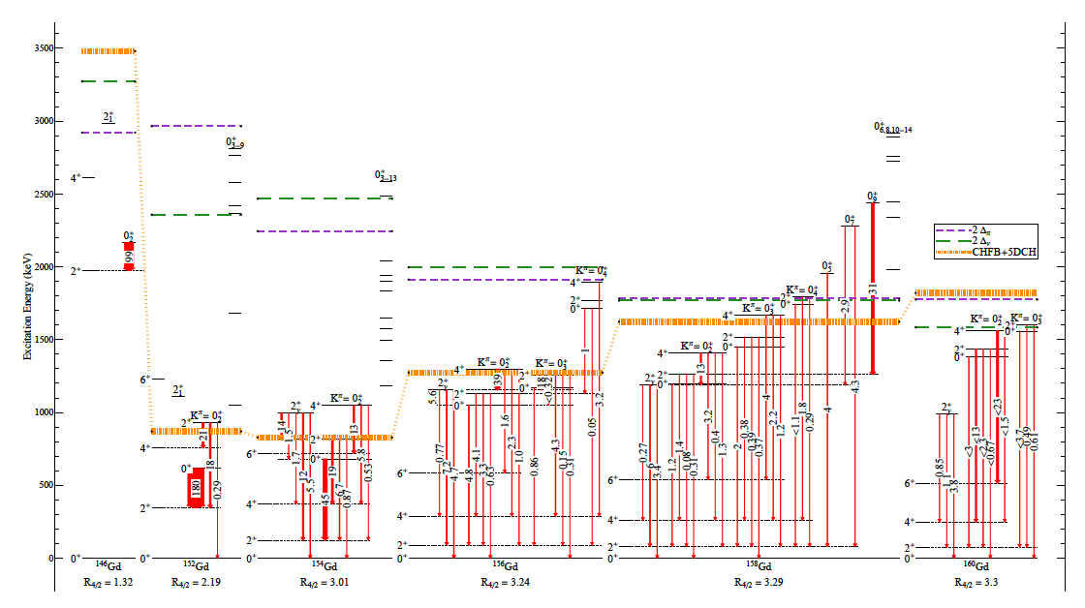
Example 1:

Slide 16
¹⁵⁶Gd: First K=0⁺ below the K=2⁺
2.78
5.0
γγ
γγ
10% t,p
17% p,t

Slide 17
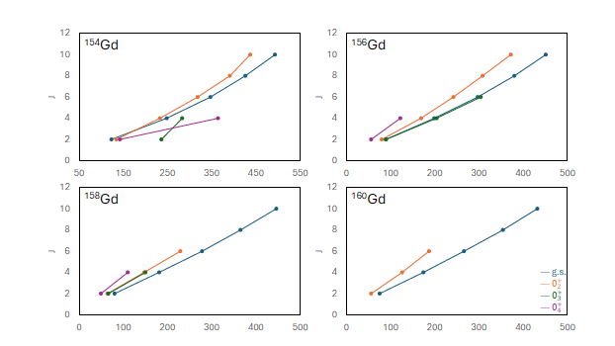
R_{4/2}= 3.01
R_{4/2}= 3.24
R_{4/2}= 3.29
R_{4/2}= 3.3

Slide 18


Intrinsic Quadrupole Moments: ¹⁵⁶Gd
Mikhailov plot
Notes:
Fo

Slide 19
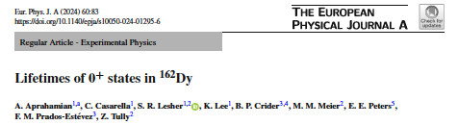
Example 2:

Slide 20
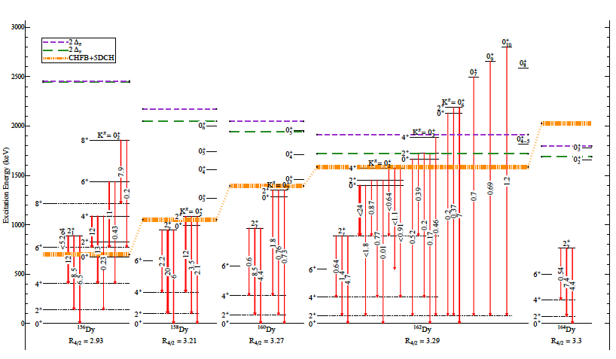
Dy

Slide 21
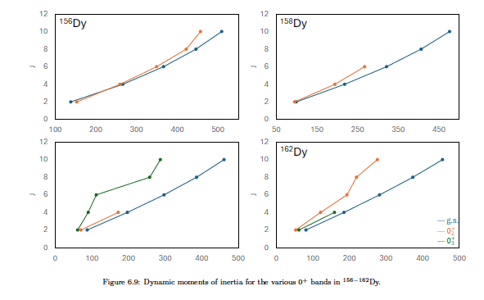
R_{4/2}= 2.93
R_{4/2}= 3.1
¹⁶⁰Dy
R_{4/2}= 3.29
R_{4/2}= 3.27

Slide 22
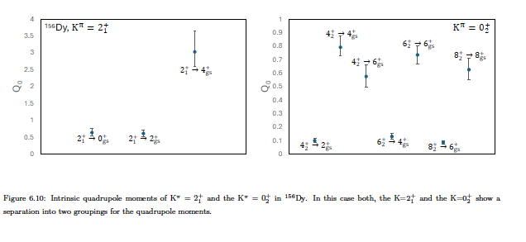

Slide 23
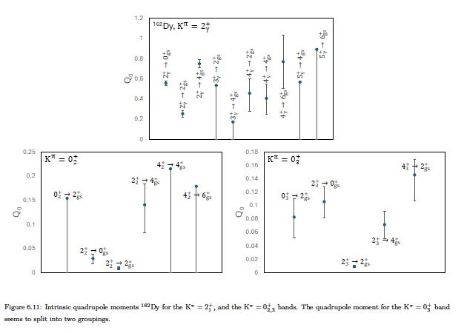

Slide 25
Example 3

Slide 26
DeLaRoche et al.:
H-F-B theory extended by generator coordinate method and mapped onto a five
Dimensional collective quadrupole Hamiltonian
Most coll. 0+
0⁺: 8.8 W.u. to g.s.
0⁺: 4.7 W.u. to g.s.

Slide 27
Er

Slide 28
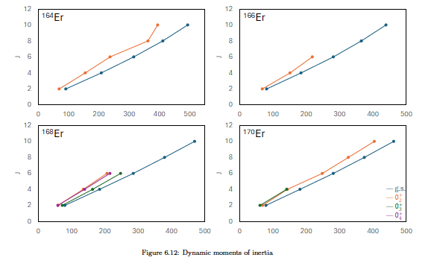

Slide 29
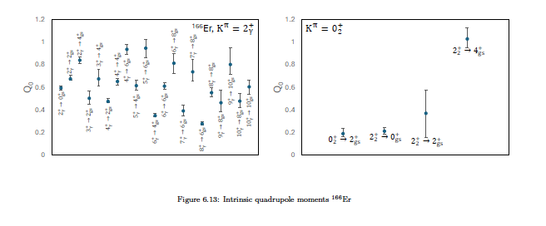

Slide 30
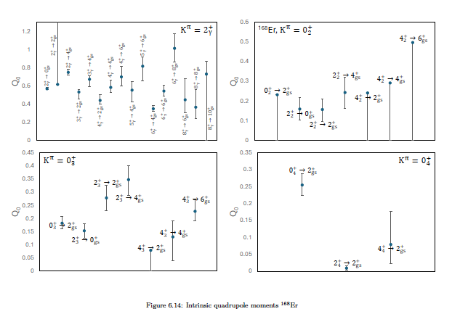

Slide 31


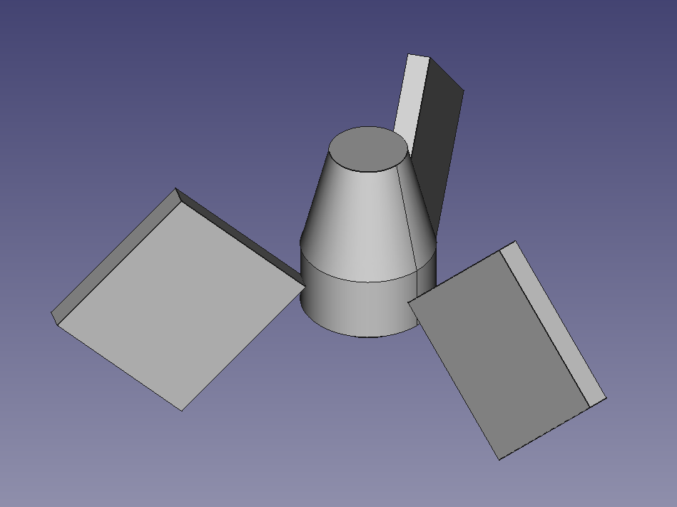

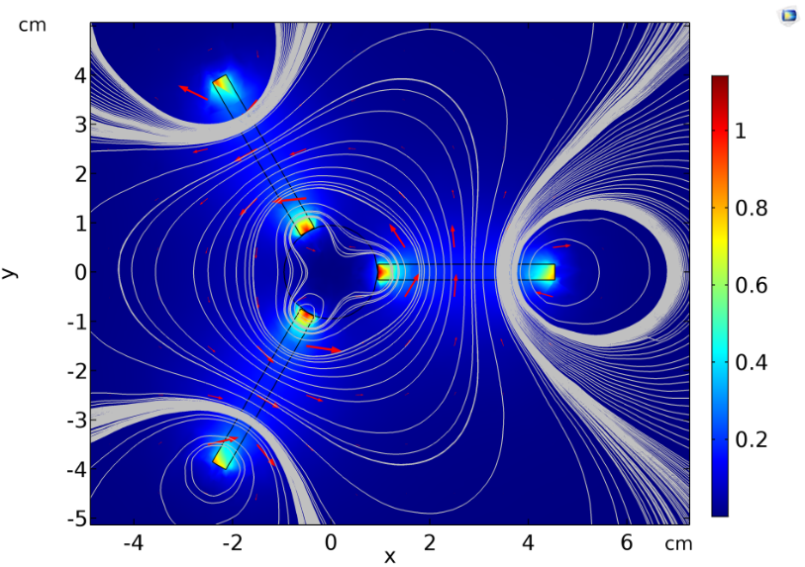



E0 measurements:
Upgrading to
“fabulous” Internal conveRsion Electron Ball Array
Improve efficiency and detect across wider energy range
Replace current set of Si(Li) detectors with new ones
Optimize magnet shapes for ooptimum electron trajectories
Use a combination of FreeCAD, COMSOL, and Geant4

Slide 32
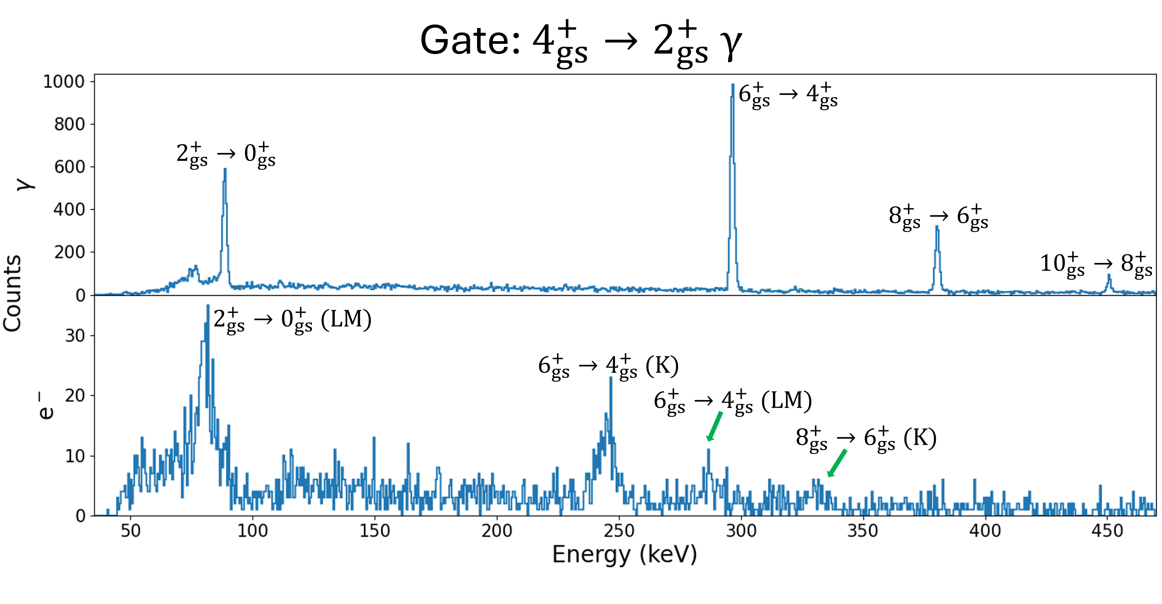
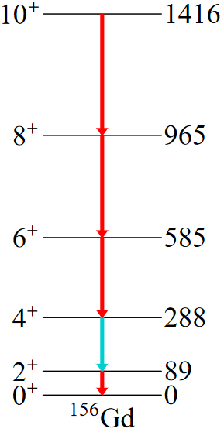

Slide 33
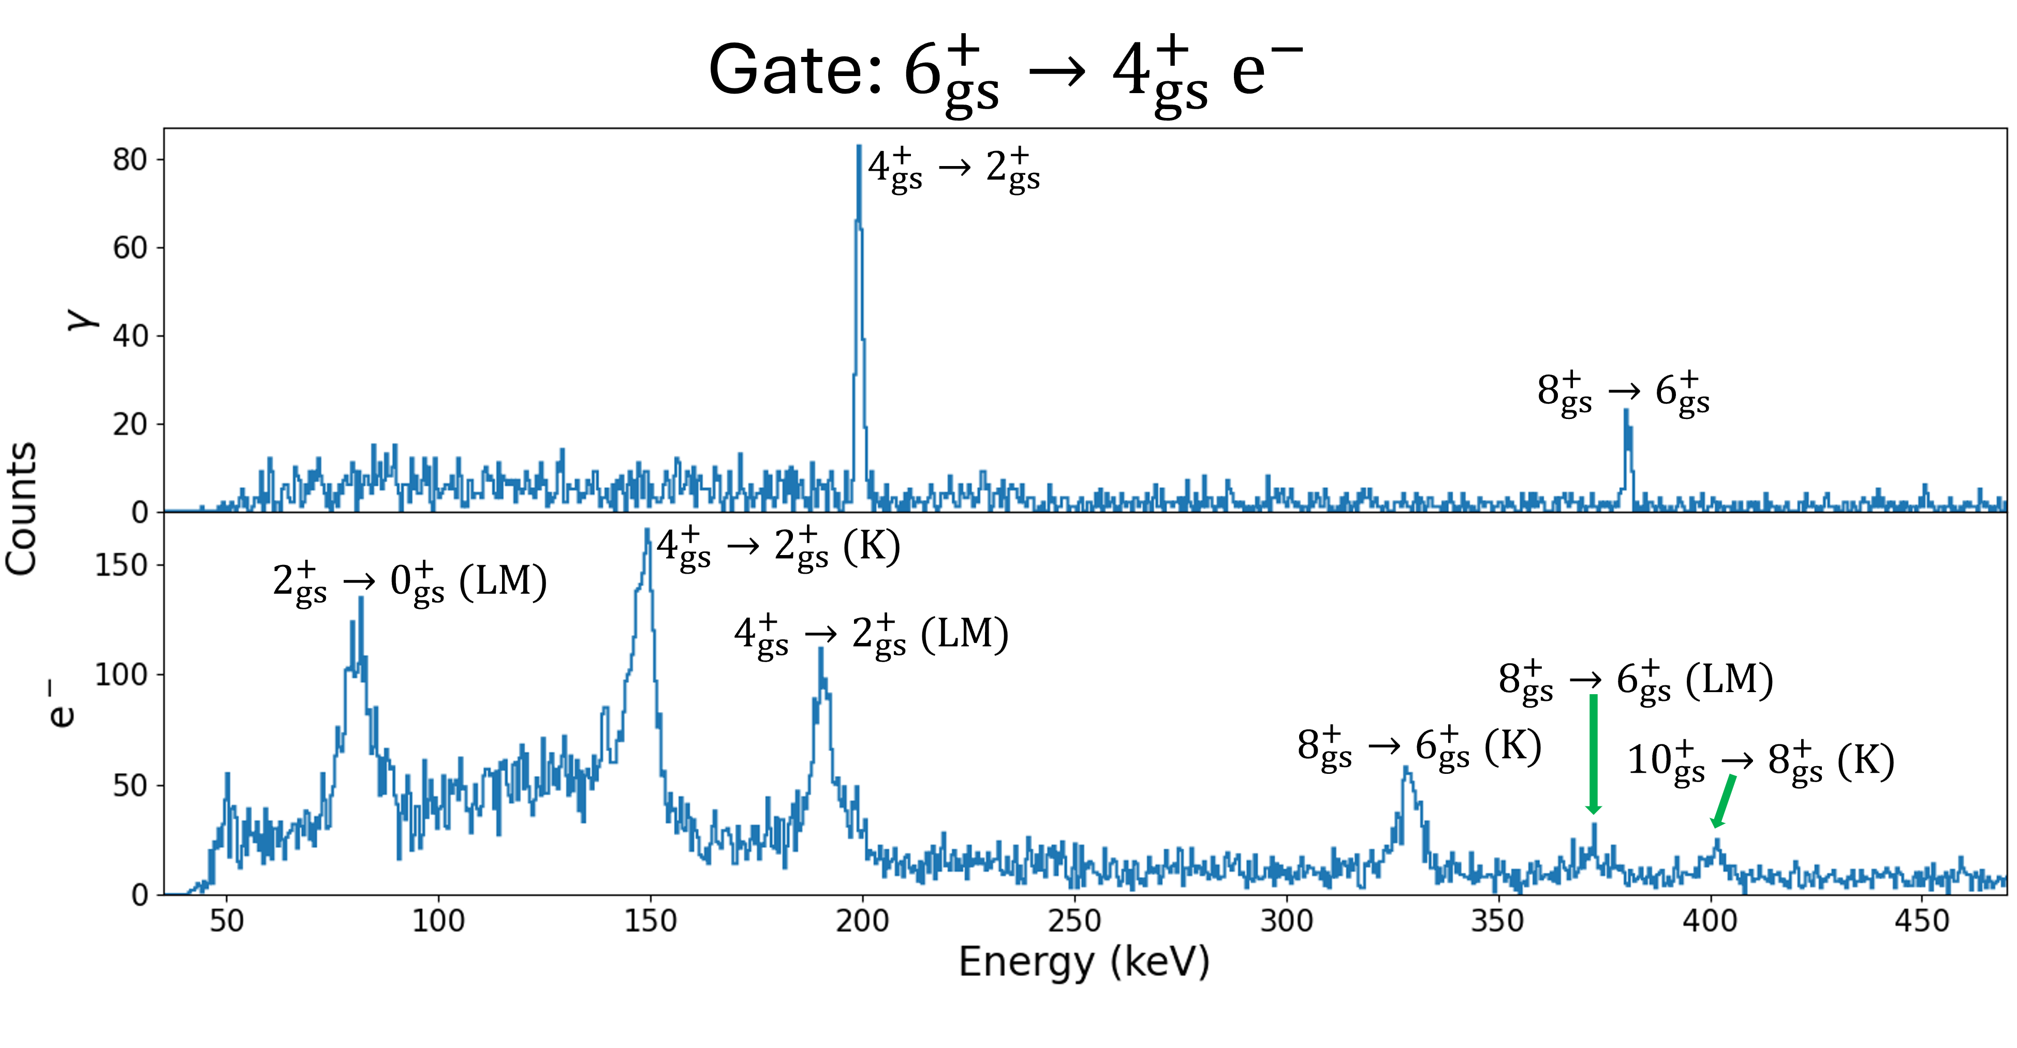
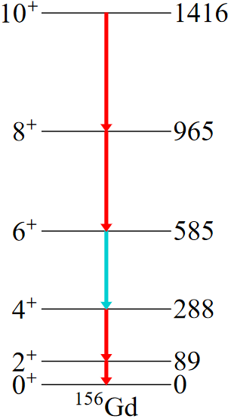

Slide 34
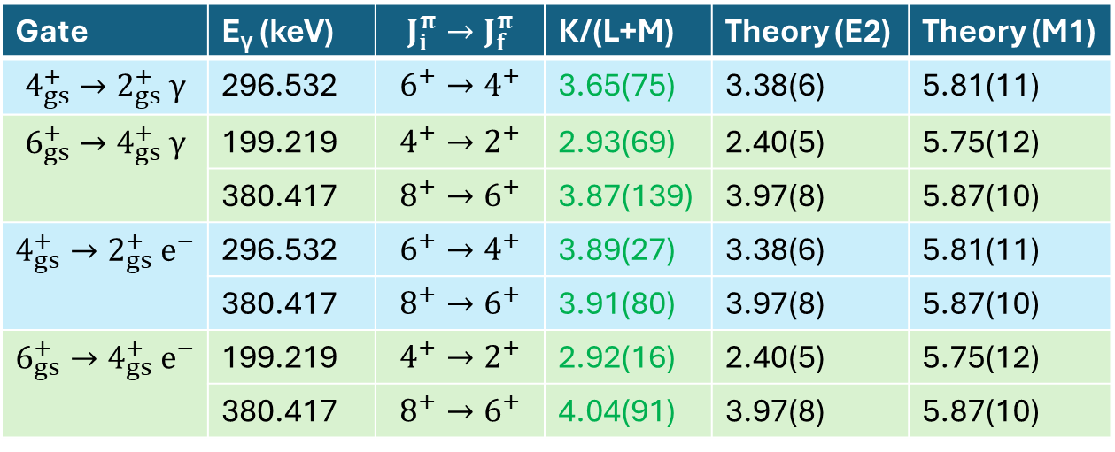
Gate | E_{γ} (keV) | $$J_{i}^{π}→J_{f}^{π}$$ | K/(L+M) | Theory (E2) | Theory (M1)
$$4_{gs}^{+}→2_{gs}^{+} γ$$ | 296.532 | $$6^{+}→4^{+}$$ | 3.65(75) | 3.38(6) | 5.81(11)
$$6_{gs}^{+}→4_{gs}^{+} γ$$ | 199.219 | $$4^{+}→2^{+}$$ | 2.93(69) | 2.40(5) | 5.75(12)
 | 380.417 | $$8^{+}→6^{+}$$ | 3.87(139) | 3.97(8) | 5.87(10)
$$4_{gs}^{+}→2_{gs}^{+} e^{−}$$ | 296.532 | $$6^{+}→4^{+}$$ | 3.89(27) | 3.38(6) | 5.81(11)
 | 380.417 | $$8^{+}→6^{+}$$ | 3.91(80) | 3.97(8) | 5.87(10)
$$6_{gs}^{+}→4_{gs}^{+} e^{−}$$ | 199.219 | $$4^{+}→2^{+}$$ | 2.92(16) | 2.40(5) | 5.75(12)
 | 380.417 | $$8^{+}→6^{+}$$ | 4.04(91) | 3.97(8) | 5.87(10)

Slide 35

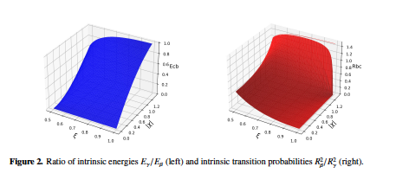
Quantum phase transitions can be studied by varying the control parameter E over the range 0<ε<1
and γ vibrations in the IBM

Slide 36
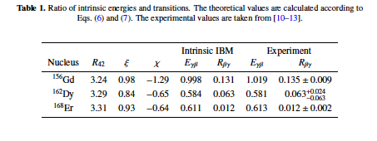

and γ vibrations in the IBM
Intrinsic IBM automatically leads to this result
Roelof Bijker and Javier Mas Ruiz:
DOI: https://doi.org/10.1051/epjconf/202430102001
Notes:
Intrinsic state of the IBM Hamiltonian…a form of boson condensate…a superposition of monopole and quandrupole bosons.

Slide 37
Conclusions
Coexistence dominates over the entire chart of nuclides
There are regions of high deformation where the first 0⁺
is a β vibration and not the minimum of a coexisting shape
If we accept the γ oscillation on the ground state, do we have to
accept the β one as well?
E0 measurements will help further crystalize this aspect.

Slide 38
Thank you for your attention!
GRID (n,n’γ) IBA
ILL Grenoble H. Boerner Univ of Kentucky Roelof Bijker
B.P. Crider
M. Jentschel M. Lowe
E. E. Peters
F.M. Prados-Estevez
T. J. Ross
Z. Tully
Univ. of Brighton A.M. Bruce S.W. Yates
______________________________________________________________________
Univ. of South Carolina A&T S.R. Lesher
Notre Dame K. Lee
A²
Notes:
For cgs 16…I am going to talk about low lying oscillations of deformed nuclei……. One of my favorite topics

Slide 39
Gd

Slide 40
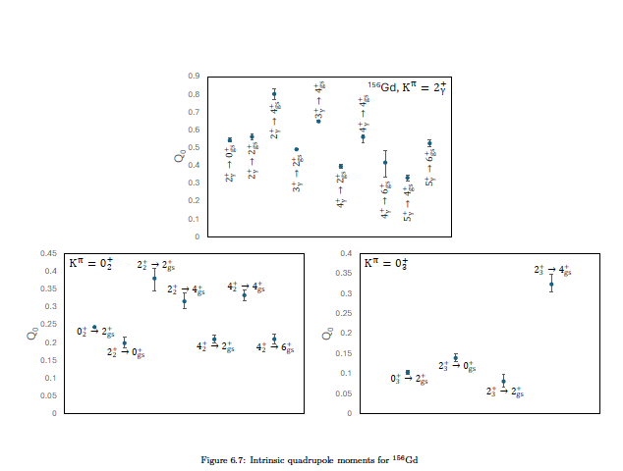

Slide 41
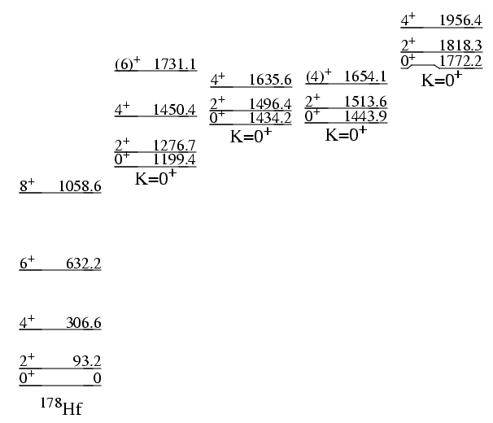
GRID Measurements: E₁₇₇₂/E₁₁₉₉= 1.5
5% p,t
Example 4:
Nature of K=0+ excitations in deformed nuclei
3% p,t
1.3-5.7 W.u.
----------------------------------------
-----------------------------------------
0.3-1.5 W.u.
5 Band Mixing Calculation
0+ g.s.
2+ K=2
0+ 1199.4
0+ 1434.2
0+ 1772.2 keV
---------
Aprahamian, Phys. Rev. C65, 031301R (2002)
Notes:
5 Band mixing calculation…..Energy of double beta to beta ….1.47

Slide 42
Hf

Slide 43
Sm

Slide 44
GRID
ILL Grenoble
DSAM (U KY)
n,n’g
1.5 MeV
N=90
K=0⁺
K=2⁺
K=2⁺
1.0 MeV
K=0⁺
K=2⁺
K=0⁺
0.5 MeV
¹⁵⁴Gd
¹⁵⁶Gd
¹⁵⁸Gd
E_{ratio} 4⁺/2⁺= 3.01
E_{ratio} 4⁺/2⁺= 3.27
E_{ratio} 4⁺/2⁺= 3.30
What is the first excited K=0+?
Notes:
154Gd….Jose-enrigque arcia-Romos….shape coexistence and quantum phase transitions….

Slide 45
Yb

