Slide 1
Development of a decontamination process for radioactive effluents
Mathurin Robin, TOMO SUZUKI, Abdesselam abdelouas, Marcel mokili

Slide 2
Summary
1
2
3
4
5
Synthetic Samples
Surrogate Samples
Active
Samples
Introduction
Perspectives
PREDIS
Context
Objectives
Optimisation
Characterisation
Oxalic acid
Precipitant
Elements
Decontamination factor
2

Slide 3
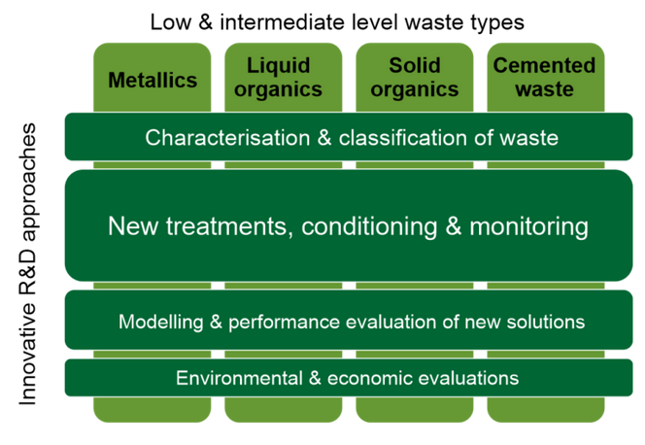
1. Introduction
2. Synthetic samples
3. Surrogate samples
4. Active sample
5. Perspectives
PREDIS Project
SVAFO, Sweden
Idaho National Laboratory, United States
SKB, Sweden
Fortum, Finland
Vattenfall, Sweden
TVO, Finland
Studsvik, Sweden
LLW Repository Ltd, United Kingdom
COVRA, Netherlands
URENCO Ltd, United Kingdom
Belgoprocess, Belgium
NIRAS/ONDRAF, Belgium
ENGIE SA, Belgium
SURAO, Czech Republic
Chornobyl NPP, Ukraine
Andra, France
Nagra, Switzerland
PURAM, Hungary
WP4
WP5
WP6
WP7
ARAO, Slovenia
ITER, France
Campoverde srl, Italy
SERAW, Bulgaria
Copyright © Free Vector Maps.com
https://freevectormaps.com/world-maps/europe/WRLD-EU-01-0002?ref=atr
3
3
3
3

Slide 4
1. Introduction
2. Synthetic samples
3. Surrogate samples
4. Active sample
5. Perspectives
Objectives of WP4
Minimize the amount of Radioactive Metallic Waste (RMW)
Decontamination & Treatment
Task 4.4
Develop a new reference for the storage and final disposal of RMW
Characterisation
Characterisation
Task 4.5
Task 4.5
Estimate the potential opportunity for optimizing European RMW management
Encapsulation
Encapsulation
Task 4.6
Task 4.6
4

Slide 5
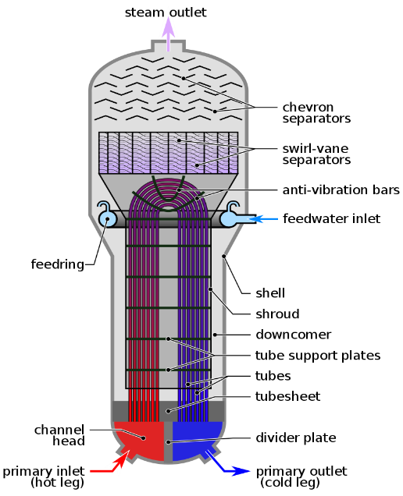
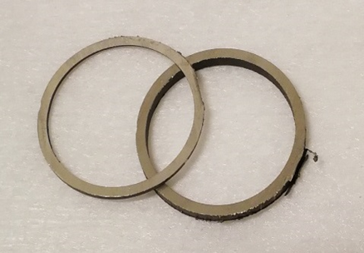
1. Introduction
2. Synthetic samples
3. Surrogate samples
4. Active sample
5. Perspectives
Context
CORD process :
Decontamination by chemical oxidation-reduction
Use of KMnO₄ and H₂C₂O₄
Dissolution of most metals on the surface
Deposition of radionuclides from primary circuit
Non-contaminated metal
Non-contaminated metal
Decontamination
+
Surface contamination
Deep contamination
Radioactive effluent
5

Slide 6
1. Introduction
2. Synthetic samples
3. Surrogate samples
4. Active sample
5. Perspectives
Objectives
Reduction of secondary effluent volume by concentrating radionuclides in solid form
Optimisation of chromatographic separation of residual radionuclides
+
+
Solid waste
Radioactive effluent
Decontaminated effluent
Cationic resin
!
The protocol needs to be cheap, fast and adaptable at large scale.
Reduce the amount of resin required as much as possible
6

Slide 7
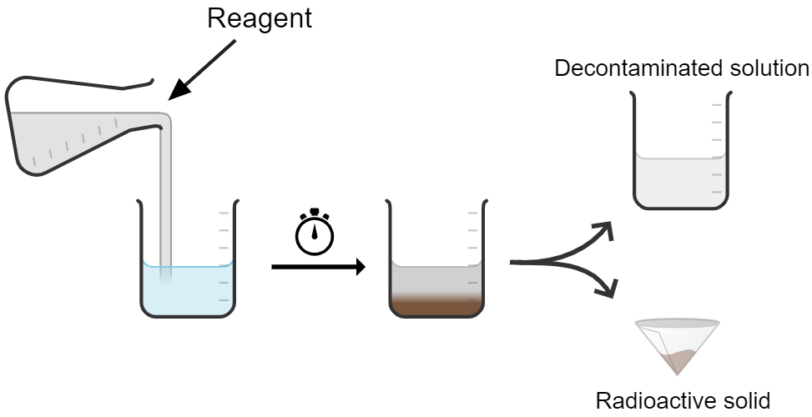
1. Introduction
2. Synthetic samples
3. Surrogate samples
4. Active sample
5. Perspectives
Experimental protocol
Synthetic sample
pH ≈ 1.5 – 2
Fe / Ni / Cr / Co / Zn / Mn / Ce
Precipitation with NaOH 1M
pH 8,5
Fe / Cr / Co / Zn / Ce
Supernatant
Precipitation with NaOH 1M
pH 12
Ni / Co / Zn / Mn
Precipitate
Several types of precipitates are possible :
Oxide
Hydroxide
Sulphide
Precipitate
Supernatant
Oxide
Hydroxide
Sulphide
Phosphate
Chloride
Fluoride
Phosphate
Chloride
Fluoride
Filtration
ICP-MS
Cheap reagent, fine for WAC, safe and fast
Low density sludge, pH dependant
7

Slide 8
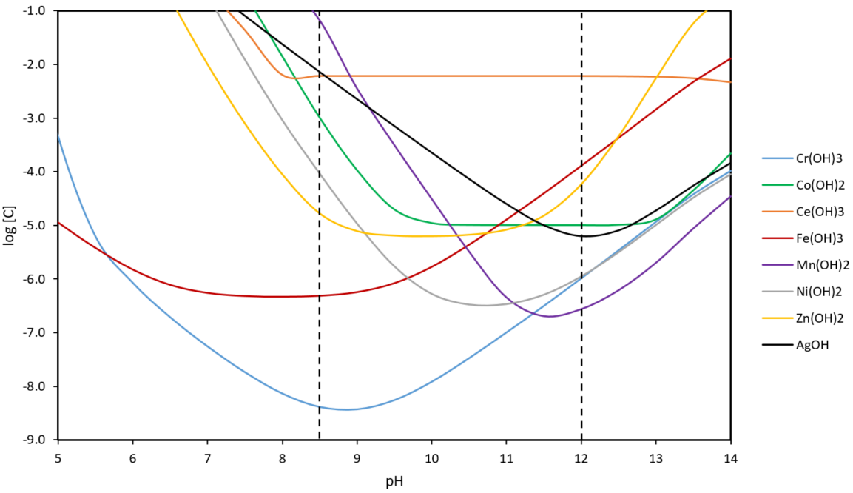
1. Introduction
2. Synthetic samples
3. Surrogate samples
4. Active sample
5. Perspectives
Optimisation
Precipitation pH:
Modelling with PHREEQC software
Study of solubility of metal hydroxides as a function of pH
Precipitation with NaOH
Results :
Two optimum precipitation pH values to precipitate all metals in solution
pH 8.5 (Fe, Cr, Zn, Ce)
pH 12 (Co, Mn, Ni, Ag)
8

Slide 9
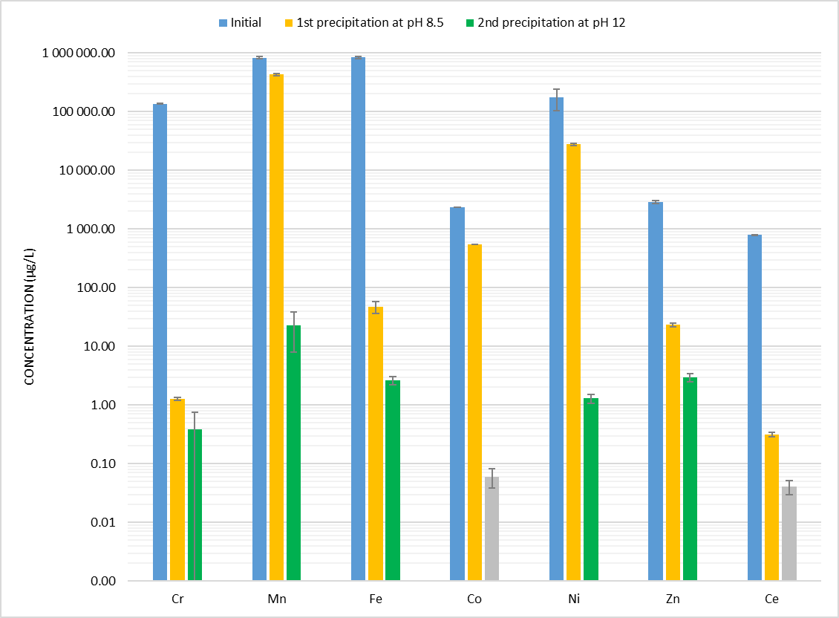
1. Introduction
2. Synthetic samples
3. Surrogate samples
4. Active sample
5. Perspectives
Test on synthetic sample
Elements | % precipitated pH 8.5 | % precipitated pH 12
⁵²Cr | 100.0 | 100.0
⁵⁵Mn | 48.4 | 100.0
⁵⁶Fe | 100.0 | 100.0
⁵⁹Co | 76.8 | 100.0
⁶⁰Ni | 84.3 | 100.0
⁶⁶Zn | 99.2 | 99.9
¹²¹Sb | 100.0 | 99.9
¹⁴⁰Ce | 100.0 | 100.0
Total : | 77.0 | 100.0
9

Slide 10
1. Introduction
2. Synthetic samples
3. Surrogate samples
4. Active sample
5. Perspectives
Characterisation
Fourier-transform infrared spectroscopy (FTIR) :
Metal-Oxygene bonds (M-O)
Hydrogen bonds
Unbound water molecules
Thermogravimetric analysis (TGA) :
Crystallisation pics (hydroxide → oxide)
Changes in the crystalline structure of iron oxide
X-rays diffraction (XRD) :
Amorphous or nano-crystalised solid below 200°C
Iron oxide at high temperature
Manganese oxide at room temperature
Fourier-transform infrared spectroscopy (FTIR) :
Metal-Oxygene bonds (M-O)
Hydrogen bonds
Unbound water molecules
Thermogravimetric analysis (TGA) :
Crystallisation pics (hydroxide → oxide)
Changes in the crystalline structure of iron oxide
X-rays diffraction (XRD) :
Amorphous or nano-crystalised solid below 200°C
Iron oxide at high temperature
Manganese oxide at room temperature
First precipitate :
Fe(OH)_{3·}nH₂O
FeO(OH)·nH₂O
Second precipitate :
Mn₃O₄
MnO.Mn₂O₃
10

Slide 11
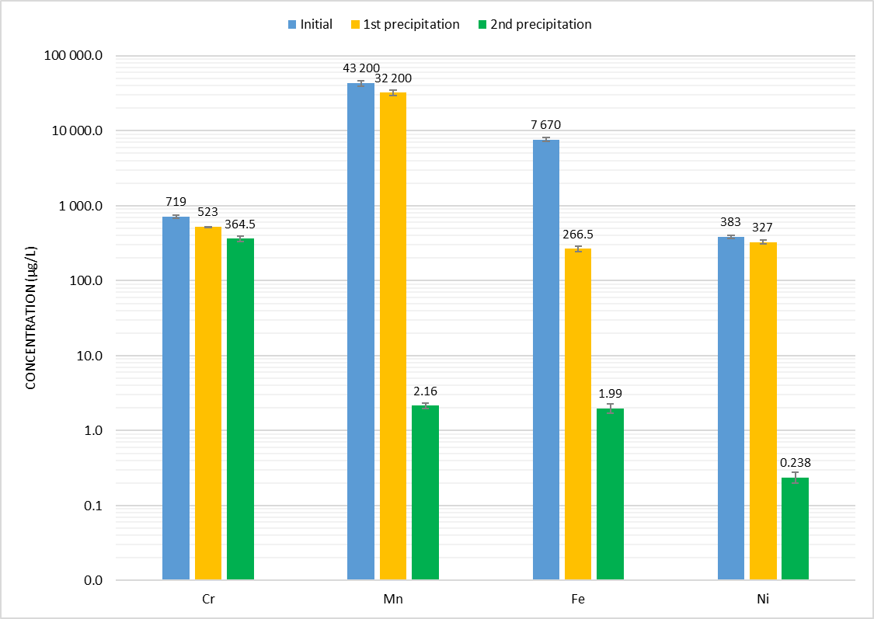
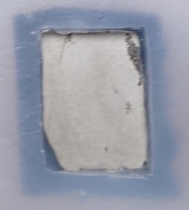
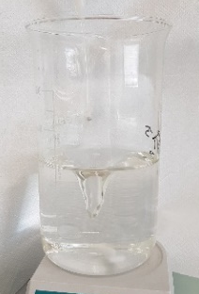
1. Introduction
2. Synthetic samples
3. Surrogate samples
4. Active sample
5. Perspectives
Tests on surrogate sample
CORD process
Precipitation
+
KMnO₄
H₂C₂O₄
pH 8.5
pH 12
Elements | % precipitated
⁵²Cr | 45.43
⁵⁵Mn | 100.00
⁵⁶Fe | 99.97
⁶⁰Ni | 99.93
Total : | 99.29
Competition between chromium hydroxide and oxalate¹ ?
$${Cr}^{3+}+ {3OH}^{−}+C_{2}O_{4}^{2−}→{Cr(OH)}_{3(s)}+{CrC}_{2}O_{4(l)}$$
¹E. Remoundaki (2007)
11

Slide 12
1. Introduction
2. Synthetic samples
3. Surrogate samples
4. Active sample
5. Perspectives
Oxalic acid destruction
Master 2 internship (Cavit Percin) :
Development and optimisation of an oxalic acid destruction protocol
H₂O₂ concentrations: 0.1 / 0.5 / 1 M
Heating time: 1 to 48h
UV light
Temperature : 65 and 80°C
Test on simulated samples to observe the influence of the protocol on chromium precipitation
12

Slide 13
1. Introduction
2. Synthetic samples
3. Surrogate samples
4. Active sample
5. Perspectives
Precipitant
NaOH
KOH
Na₂S
Na₃PO₄
13

Slide 14
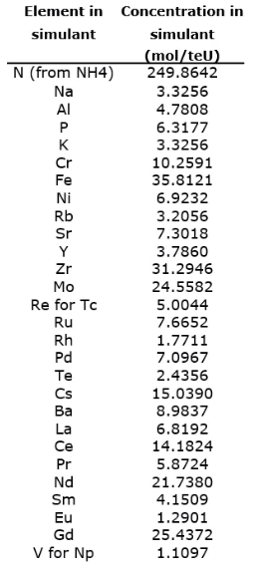
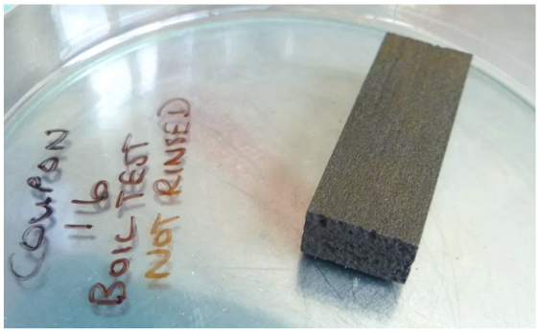
1. Introduction
2. Synthetic samples
3. Surrogate samples
4. Active sample
5. Perspectives
Complex sample
Sample contaminated with a multi-element acid solution (spent fuel simulation)
14

Slide 15
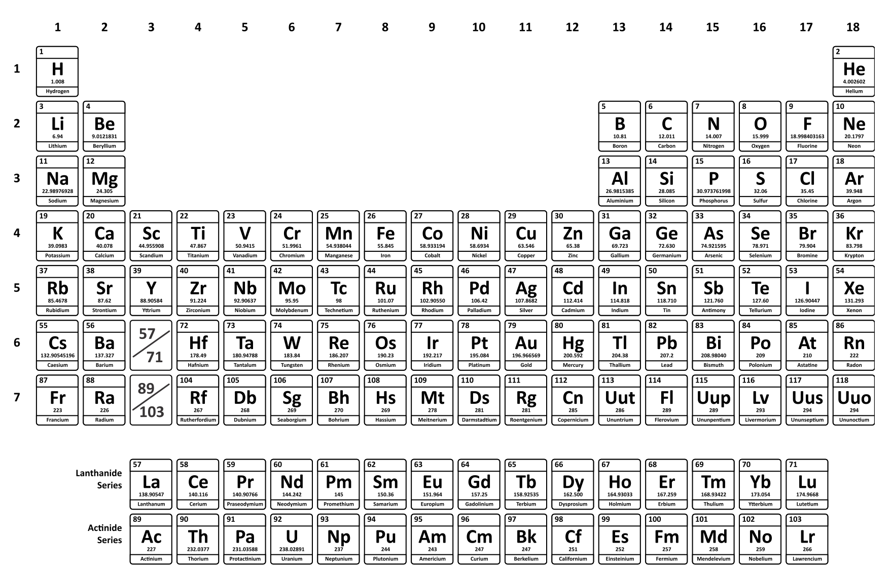
1. Introduction
2. Synthetic samples
3. Surrogate samples
4. Active sample
5. Perspectives
Complex sample
First precipitation (KOH – pH 8.5)
Hydroxide form -> ex : Fe(OH)₃
High efficiency (> 96%)
Second precipitation (KOH – pH 12)
Main component is Mn₃O₄
Really important to remove Mn (0.4 g/L initially)
Second precipitation (Na₂S – pH 12)
Main component is Mn₃O₄ and S₈
Efficient only for chromium
Not precipitated
Requires use of resins
Not measured
15

Slide 16
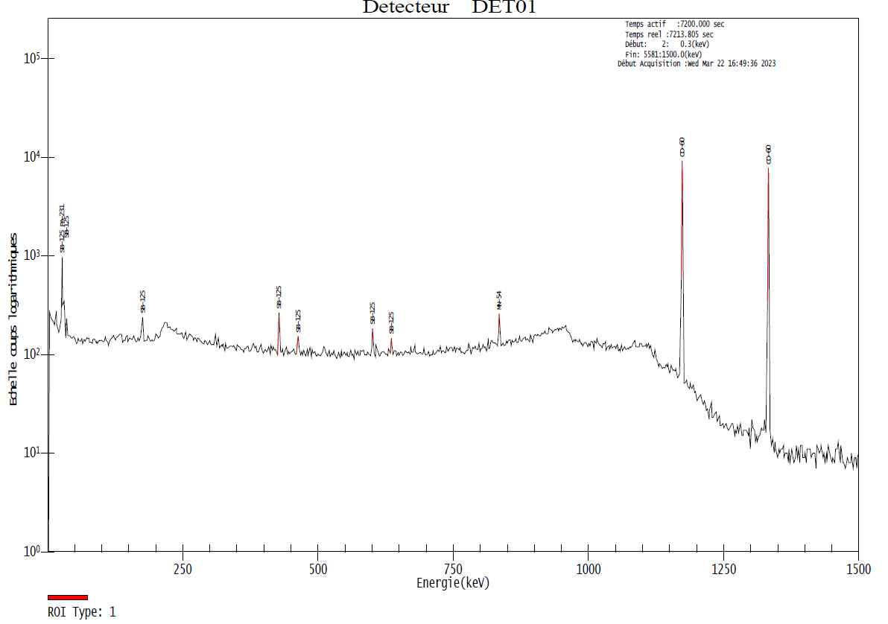
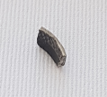
1. Introduction
2. Synthetic samples
3. Surrogate samples
4. Active sample
5. Perspectives
Active sample
Analysis using HPGe Gamma detector
Count time of 15 minutes
Sample weighing 0.48g
Total activity of 24559 ± 1392 Bq/g
99.5% coming from Co-60.
Radionuclide | Energy | Intensity | Average Activity
 | keV | % | (Bq/g) | error
Mn-54 | 834.85 | 99.98 | 112.21 | 22.65
Co-57 | 122.06 | 85.51 | 13.59 | 6.94
Co-60 | 1173.23 | 99.85 | 24442.50 | 1391.60
 | 1332.49 | 99.98
Sb-125 | 427.87 | 29.55 | 116.87 | 31.28
 | 463.36 | 10.48
 | 600.6 | 17.76
Total (Bq/g) |  |  | 24559.37 | 1391.95
Total (Bq) |  |  | 12002.16 | 680.25
SEM
16

Slide 17
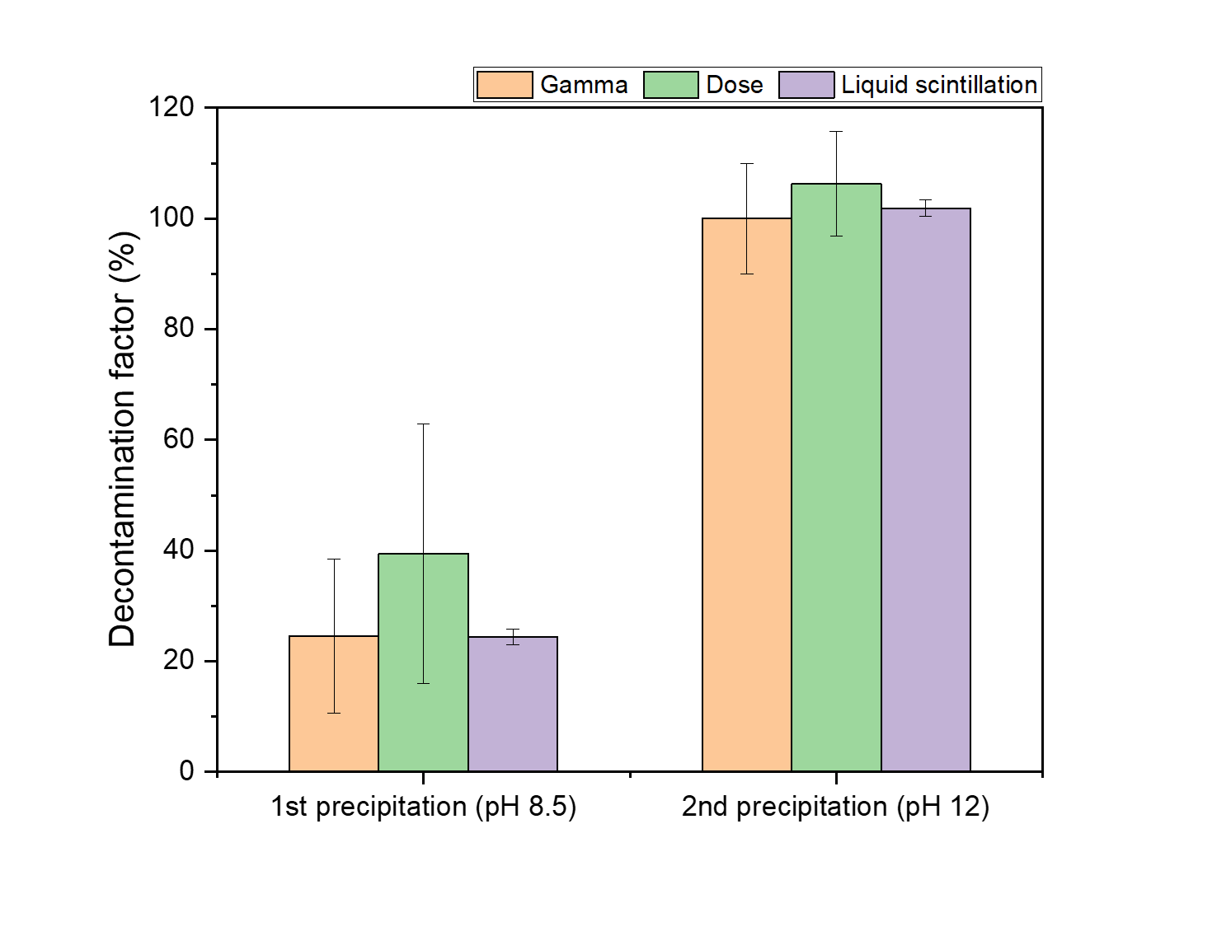
1. Introduction
2. Synthetic samples
3. Surrogate samples
4. Active sample
5. Perspectives
Active sample
Decontamination factors measured with
Gamma spectrometry (HPGe detector)
Dose rate (Gamma and X-ray detectors)
Liquid scintillation (0 – 2000 keV)
First precipitation (KOH – pH 8.5)
% ≈ 29 ± 9
DF ≈ 1.2
Second precipitation (KOH – pH 12)
% ≈ 103 ± 3
DF ≈ 3330
The main contribution in terms of activity is ⁶⁰Co
Cobalt precipitates between pH 10 and 12
17

Slide 18
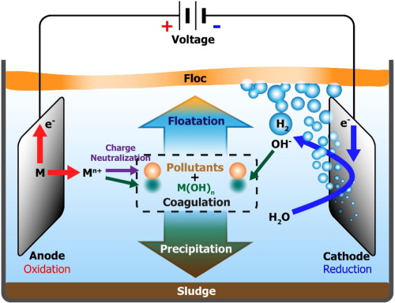
Perspectives
1. Introduction
2. Synthetic samples
3. Surrogate samples
4. Active sample
5. Perspectives
Optimisation of oxalic acid destruction
Reduce the impact on the environment (LCA)
Ratio H₂O₂ concentration / heating time
Hydroxide precipitation by electrocoagulation
Avoid the use of precipitants
Improved efficiency
Optimization of cationic resins in collaboration with Triskem International
Removal of traces of remaining radionuclides
Removal of non-precipitated elements
Articles under formulation
Oxalic acid destruction, in collaboration with NNL
Contaminated SG samples
18

Slide 19
Contact information
robin@subatech.in2p3.fr
SUBATECH (IMT Atlantique, CNRS/IN2P3, Université de Nantes), BP 20722, 44307 Nantes Cedex 3, France
19

Slide 20
Characterisation (FTIR)
First precipitate at pH 8.5
Second precipitate at pH 12
ν = 3000 – 3500 cm⁻¹/ OH bonds and hydrogen bonds^{1,2}
ν = 1650 cm⁻¹/ Corresponds to unbound water molecules^{1,2}
ν = 1350 – 1400 cm⁻¹/ Metal-oxygen bonding
¹ S. Nasrazadani (1997)
²M. S. Seehra (2004)

Slide 21
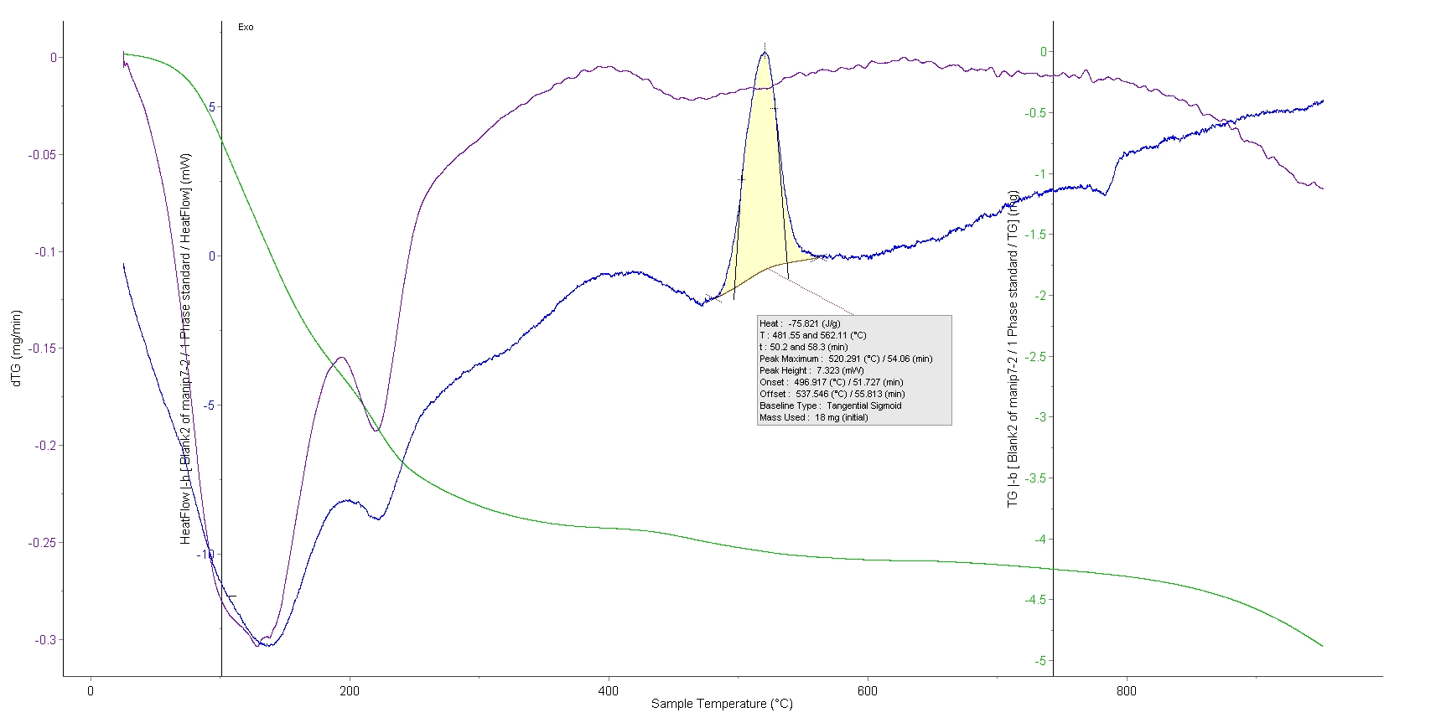
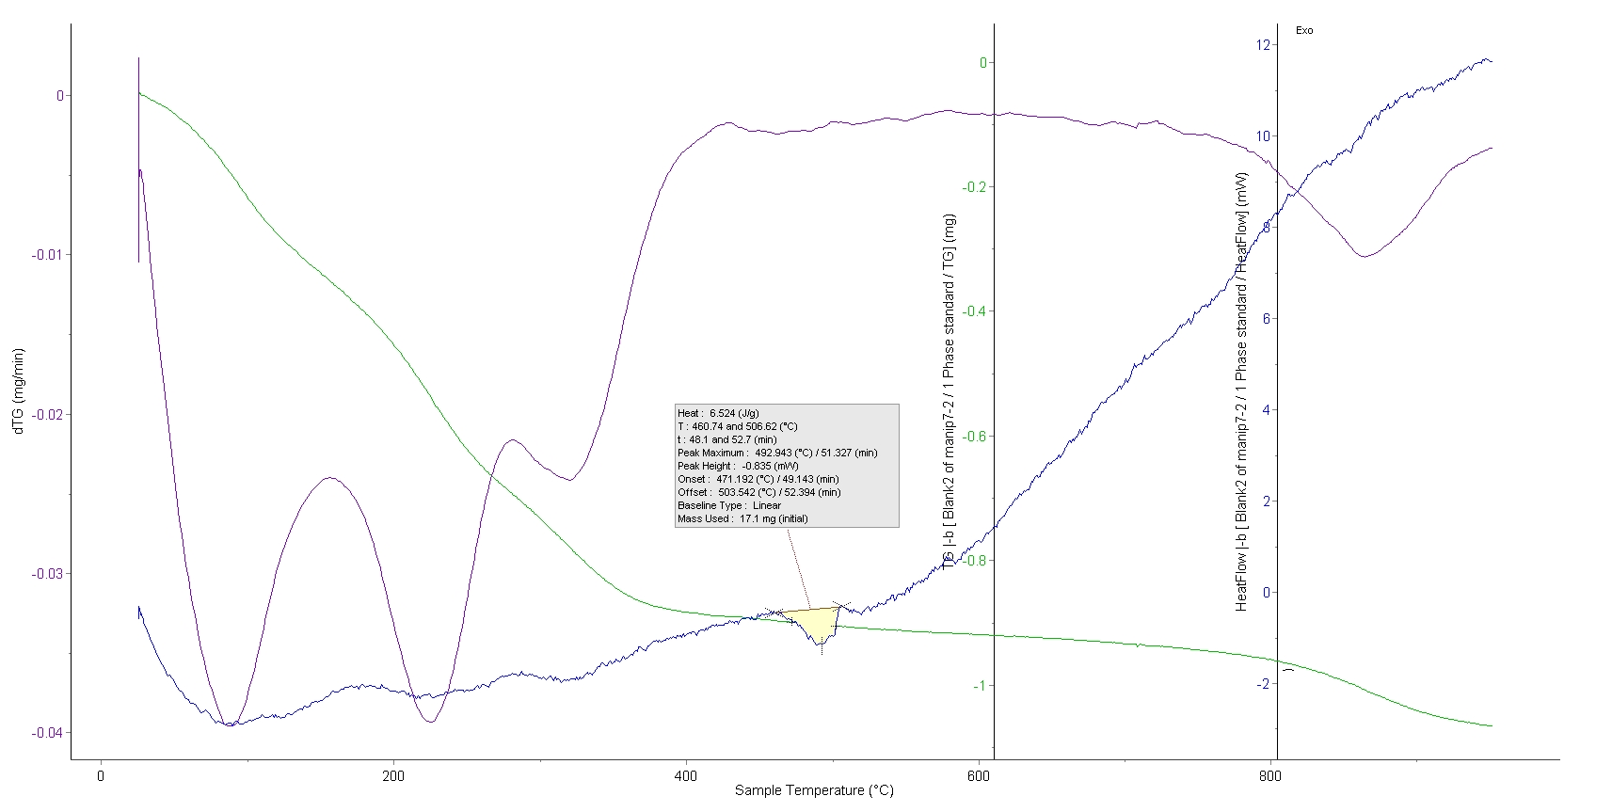
Characterisation (TGA)
First precipitate at pH 8.5
Second precipitate at pH 12
Hypothesis¹ :
Crystallisation from hydroxide to oxide form at around 160, 220°C
Change in crystalline structure at 520°C (γ-Fe₂O₃ -> α-Fe₂O₃)
No crystallisation or change in structure
Endothermic peak at 500°C with no loss of mass
¹C. Vichery (2012)

Slide 22
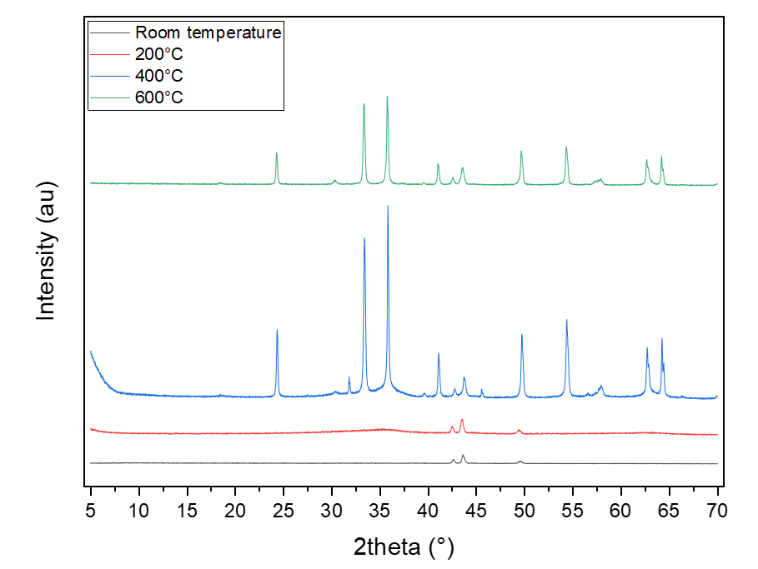
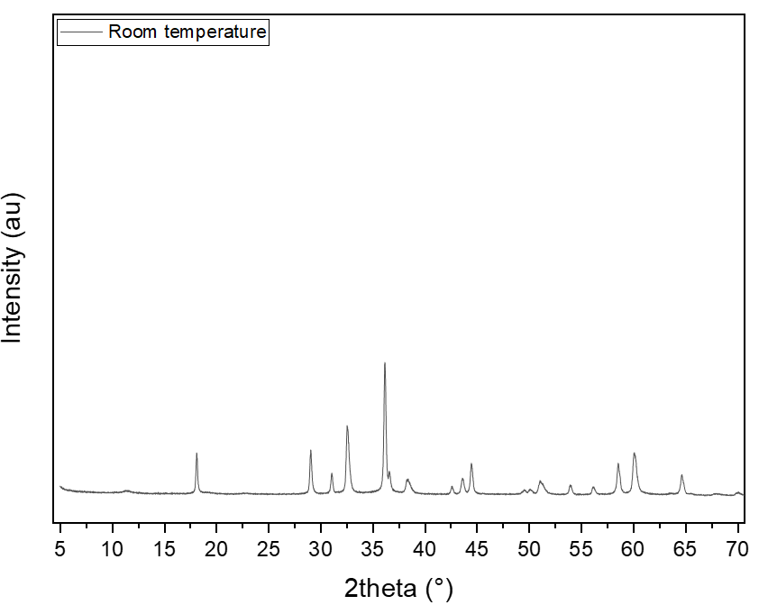
Characterisation (XRD)
1er précipité (pH 8.5)
2nd précipité (pH 12)
α - Fe₂O₃
α - Fe₂O₃
α
γ
γ - Fe₂O₃
α
α
α
Mn₃O₄

