Slide 1
Club Data
23 octobre 2023

Slide 2
IDEFICS – what is it?
Project
with members from LAPP and LISTIC
to promote data science and machine learning, help local companies, increase MUST datacenter capabilities
grant from EU and Rhones-Alpes

Slide 3
Club DATA – what is it?
Goals:
to meet regularly to have informal discussions and exchanges around data science, machine learning and code development
To help each other
Get new ideas
For who?
Anyone interested and working on this subjets
Priority to students / young researchers

Slide 4
Club DATA – what is it?
Organisation and animation
LAPP/LISTIC
1/month
11h-12h : presentations
12h-13h : free time, bring your lunch, IDEFICS offers coffee
Everytime, we’ll need 2 persons to:
Chair
Take notes → that will be uploaded to https://lapp-data.pages.in2p3.fr/pages/en/

Slide 5
General news
Notes from last meeting: https://lapp-data.pages.in2p3.fr/pages/en/posts/20231024/
Looking for topics / presentations for next time
January 2024 – date?
Training on Weights and Biases – a framework to handle ML experiments
Formation utilisation de MUST par Brondon
AOB

Slide 6
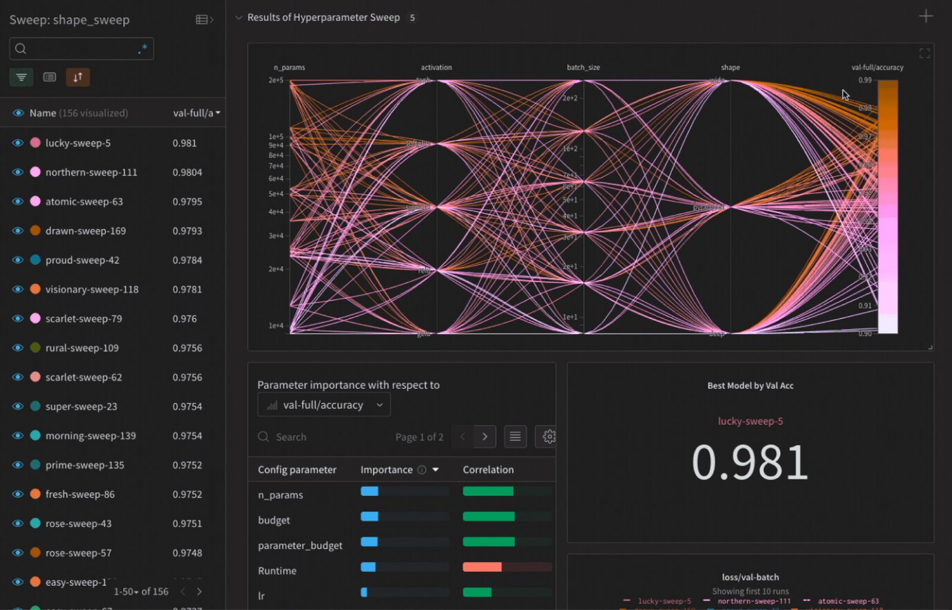
Formation
Thomas Cappelle, de Weights and Biases, viendra nous présenter ce framework pour gérer les expériences ML.
05/12 au LAPP
Inscription aujourd’hui !
https://indico.in2p3.fr/event/31294/overview

