Slide 1
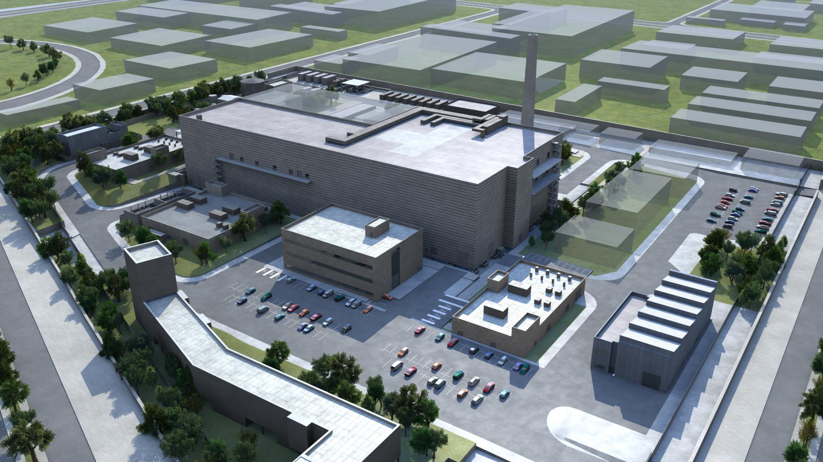
IFMIF-DONES @ ARTIFACT Artifact Preparatory meeting 27-28 November 2023 I. Podadera on behalf of IFMIF-DONES team

Slide 2
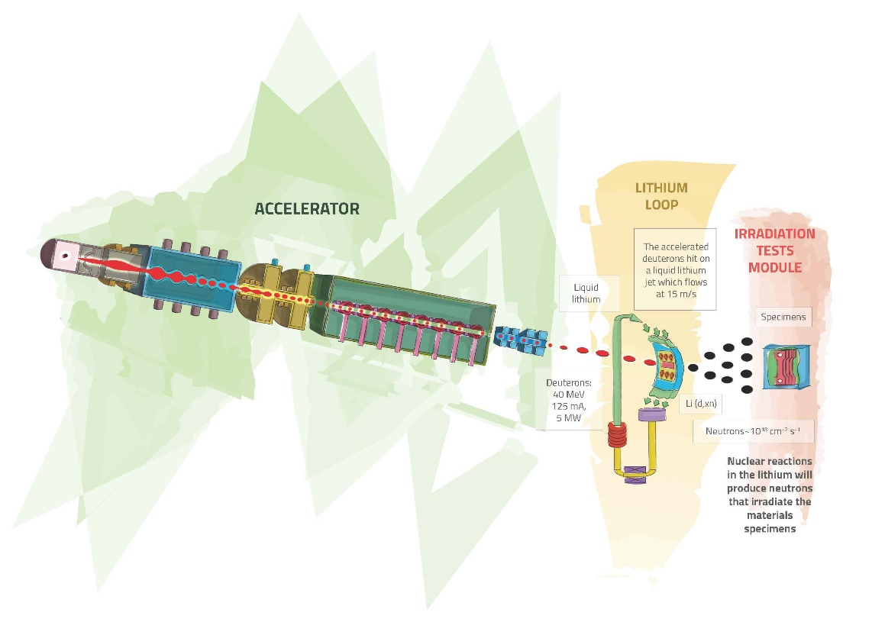
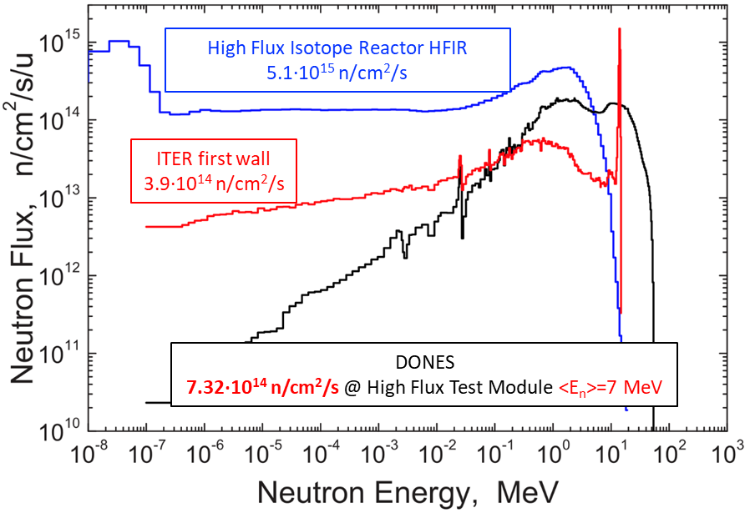
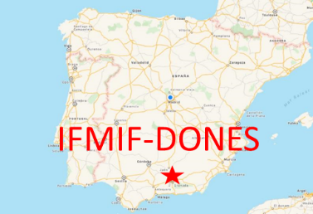
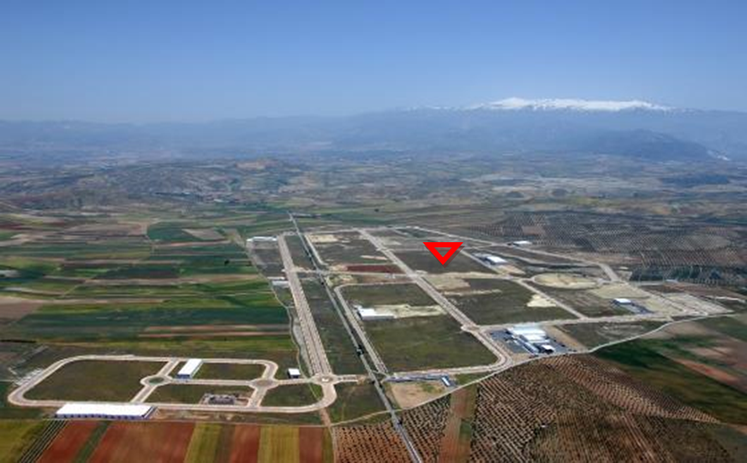
What is IFMIF-DONES?
An accelerator based fusion-like neutron source
to be used for the qualification of the materials to be used in the DEMO Reactor
Stripping reaction
High Flux Test Module:
20 dpa in <2.5 y in 0.1 l
50 dpa in <3 y in 0.3 l
Controlled Temperature:
250 < T < 550 ºC
A neutron source of ~ 10¹⁷ n/s
generated with a neutron spectrum up to 55 MeV energy
15
Heat removal by high velocity Li flux
I. Podadera | ARTIFACT PreP Meeting | 28/11/2023 | Page 2

Slide 3
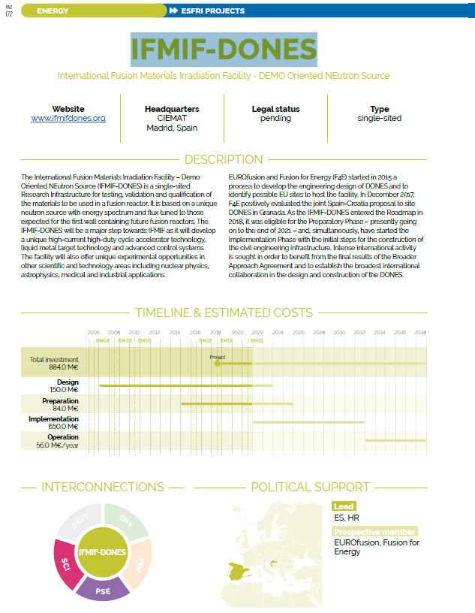
IFMIF-DONES: An ESFRI facility
(…) IFMIF-DONES will play a strategic role in the Energy domain for the implementations of Nuclear fusion solutions to the massive production of energy.
The key mission of the facility is the irradiation and qualification of materials for DEMO and fusion reactors but it has unique characteristics that must be available for other scientific purposes
IFMIF-DONES was recognized in 2018 by the
ESFRI European Strategy Forum on Research Infrastructures
Included in the ESFRI 2018 Roadmap Continued in 2021

Slide 4
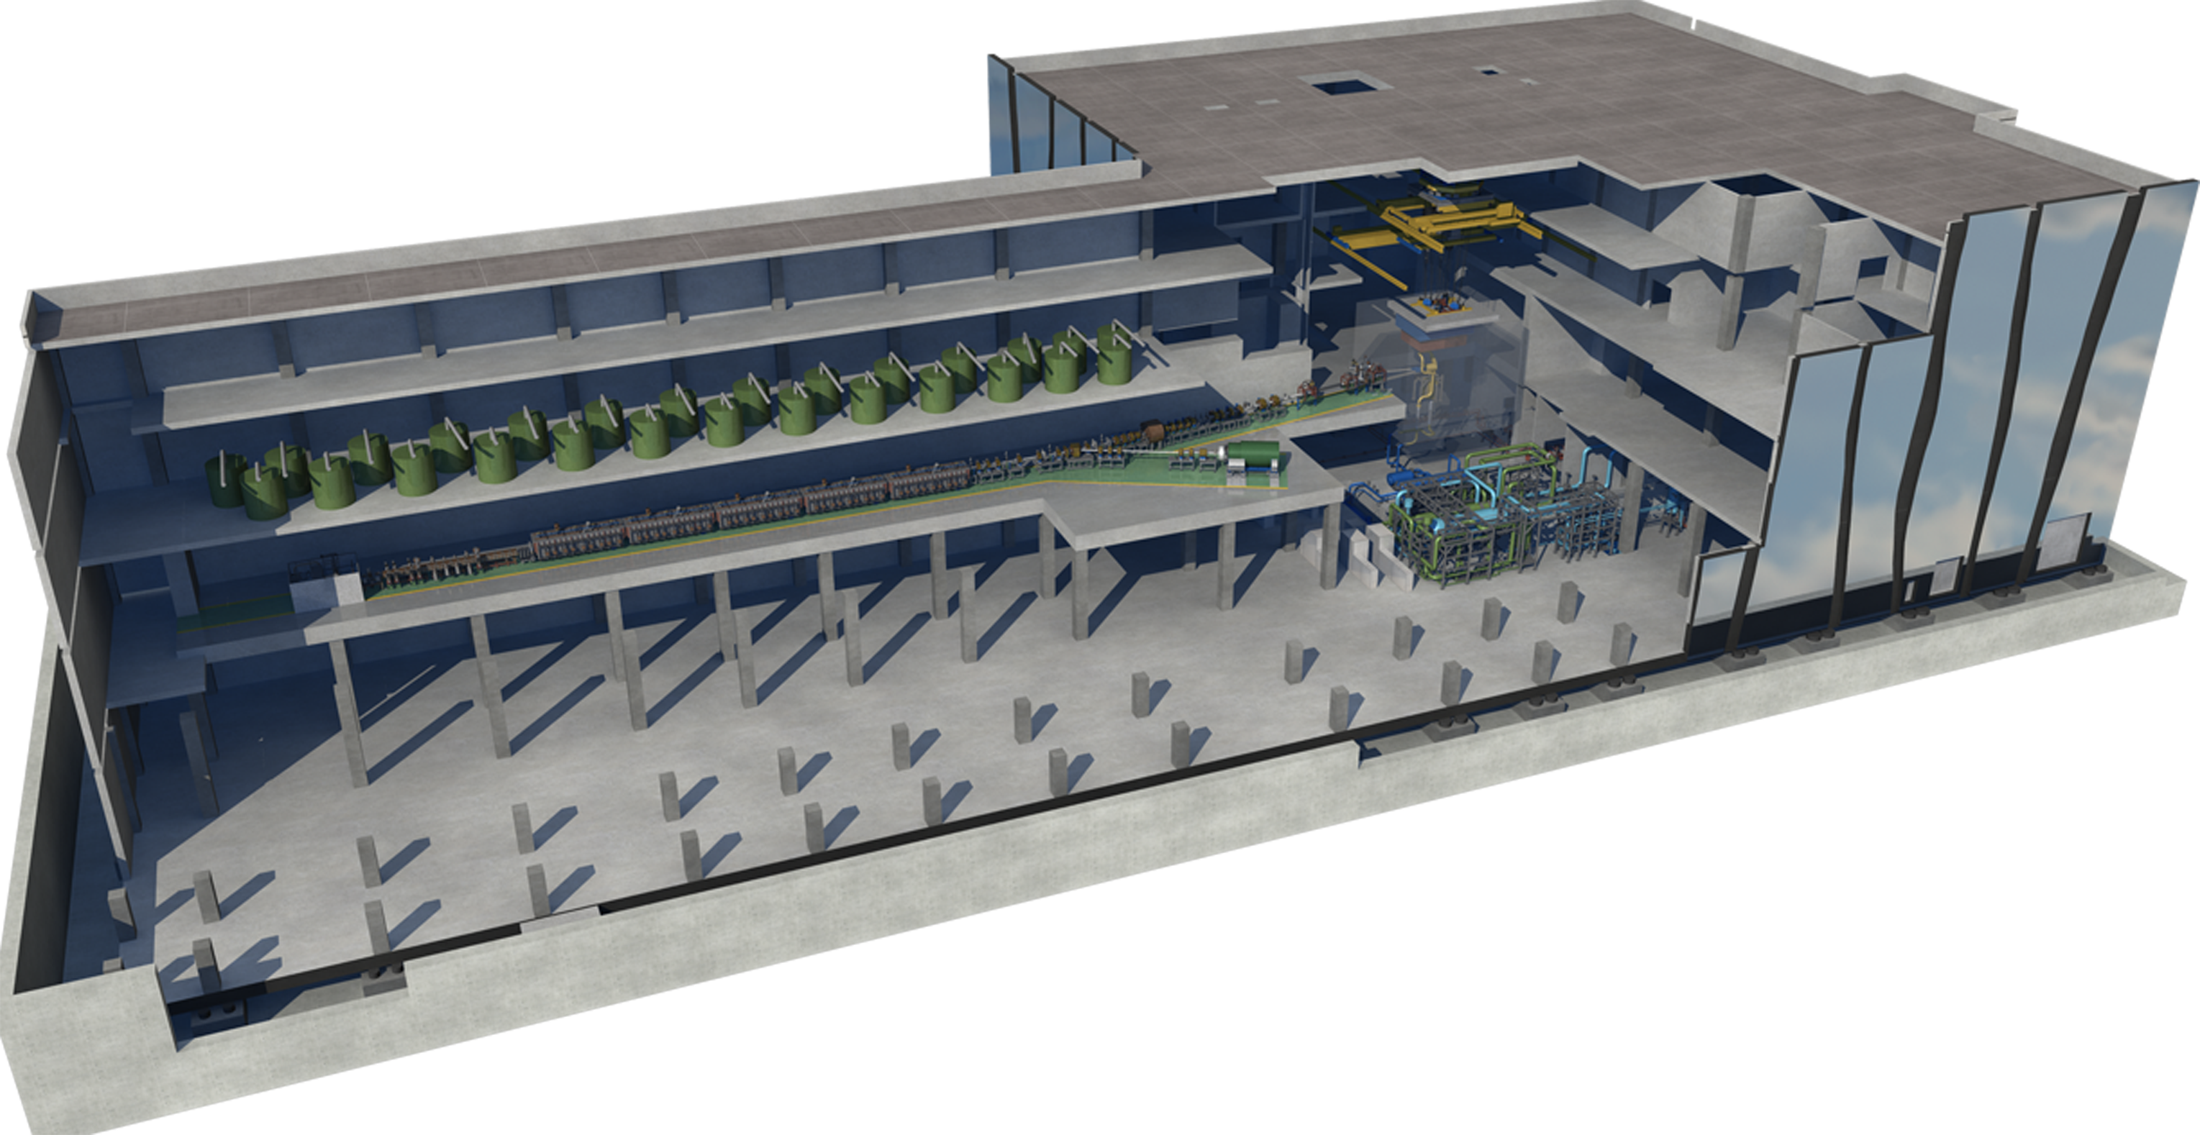
IFMIF-DONES
70% Availability
30 years Operation
Extensive use of RH
Access Cell
TIR
Test Cell (Target + Test Systems)
RF area
Accelerator Vault
Lithium Systems
Complementary experiments area
DONES Programme governed by a SC (03/2023-) formed by Members & Observers
Programme Team with IKC contributions from IA’s in charge of the Design
IFMIF-DONES España is the host and operator of the facility
I. Podadera | ARTIFACT PreP Meeting | 28/11/2023 | Page 4

Slide 5
AI Strategy in DONES
Data strategy
Analytical supervision
Big data for data processing
Cibersecurity and network status analysis
TSN (Time Sensitive Network) + White Rabbit
Predictive Maintenance
Fault detection
Facility states monitoring
Engineering Support (data management)
Facility inspection (image recognizition, physical fault detection…)
Simulation strategy (enabling AI)
Advanced Digital Twin of the Facility
Fusion materials Design and analysis (QS, ID, RL…)
AI Virtual Sensors
Intelligent control of the electrical system load and power peaks
HMI
Advanced communication (voice, image…)
Automatic OPI generation
Visualization Support (scaled plots, signals, 3D drawings, event secuencing…)
Inmersive remote operation
Facility inspection by scanning and data cloud
I. Podadera | ARTIFACT PreP Meeting | 28/11/2023 | Page 5

Slide 6
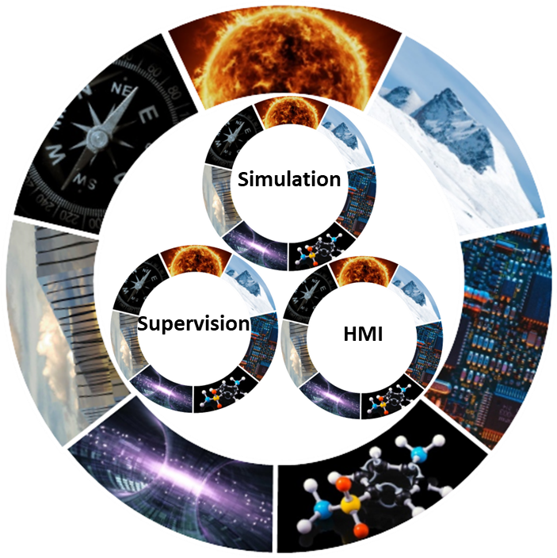
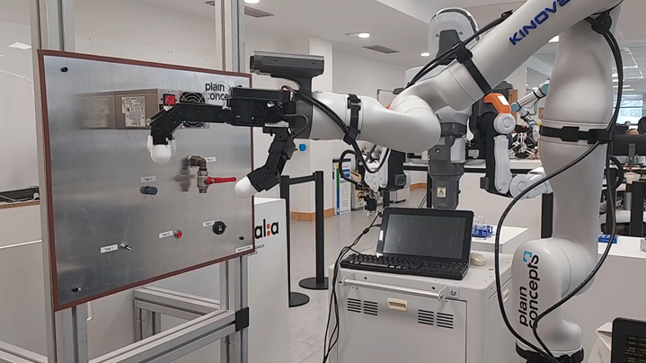
Proposals IFMIF-DONES @ ARTIFACT
Consolidating a Project data framework (IPR, DMP, Remote Access…) for IA → WP4 and WP5
Implementing common IA algorithms to enhance Simulations performance (Beam Physics, Neutronics,…) → WP4 and WP6 (UGR)
Testing algorithms at real Test Benches (UGR LAB, Prototypes, LIPAc –see later-…) & Virtual Developments → WP7 (UGR)
Engaging Industry (H-IBERIA, IZERTIS, PLAIN CONCEPTS…) → WP2
Training & Knowledge transfer (Hackatons,…) → WP3
I. Podadera | ARTIFACT PreP Meeting | 28/11/2023 | Page 6

Slide 7
Applications and Perspectives with LIPAc (Linear IFMIF Prototype Accelerator)
H. Dzitko, Y. Carin, K. Hasegawa, T. Akagi, F. Cismondi, A. De Franco, D. Gex, K. Kondo, K. Masuda, M. Sugimoto, and the LIPAc team
Artifact preparation workshop, 27-28 November 2023, Paris

Slide 8
Neutron Source for Fusion Energy Development
International Fusion Materials Irradiation Facility (IFMIF)
Accelerator-based intense neutron source (D-Li, 40 MeV, 250 mA)
Subjecting candidate materials for fusion reactors to similar conditions (14.1MeV neutrons) expected to be experienced by a future fusion power plant (DEMO)
Deuteron ion source
140 mA, 100 keV
Superconducting RF Linac 40 MeV
(Half Wave Resonators)
Lithium Target
Test Cell
RFQ 5 MeV
Beam footprint shape
200 x 50 mm²
L
M
IFMIF: 40 MeV, 2 x 125 mA/CW, 2 x 5MW
H
High > 20 dpa/y, 0.5 L
Medium > 1 dpa/y, 6 L
Low < 1 dpa/y, > 8 L
Linear IFMIF Prototype Accelerator (LIPAc): 9 MeV 125 mA Continuous Wave

Slide 9
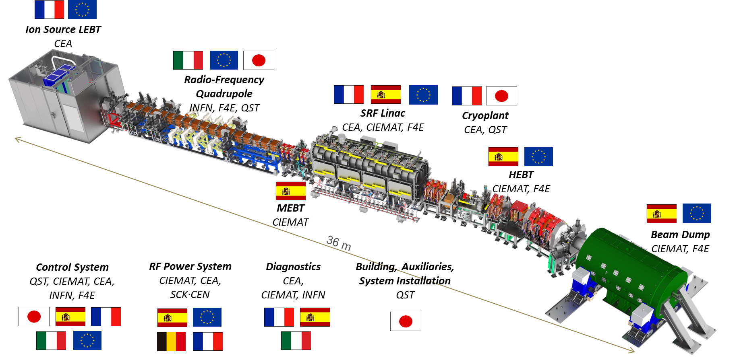
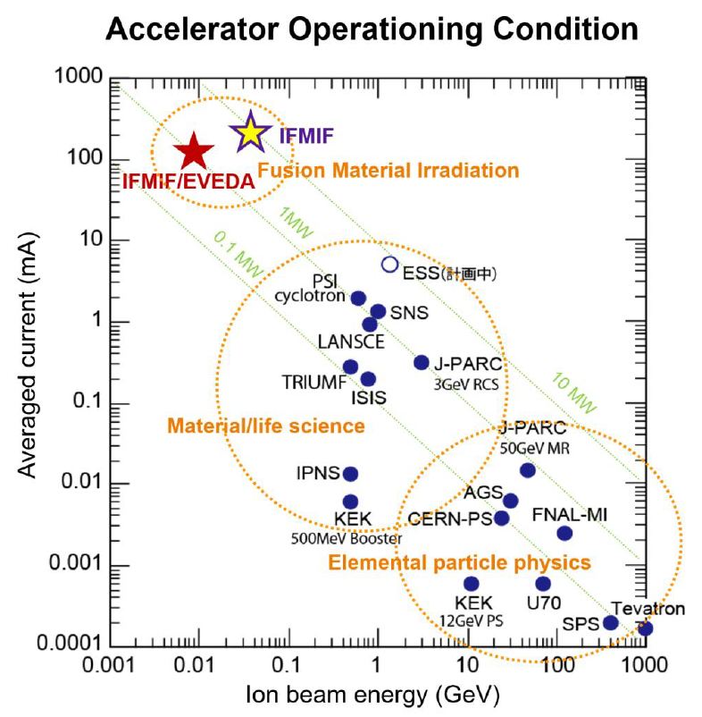
LIPAc Engineering Validation in Rokkasho
Japan-Europe scientific collaboration based on in-kind contributions under the Broader Approach framework

Slide 10
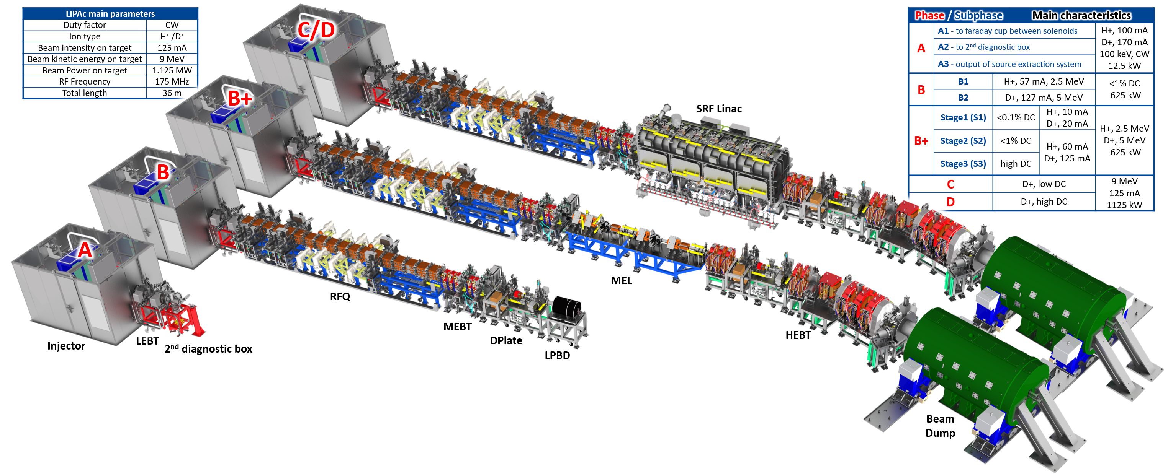
LIPAc Beam Commissioning
5 Phases and 4 configurations
Phases-C and D
Due to start in 2025/Q4
Expected completion in 2027/Q4
Completed in Dec. 2017
Completed in Aug. 2019
Phase-B+ on going
Started in July 2021,
Expected completion 2024/Q2

Slide 11
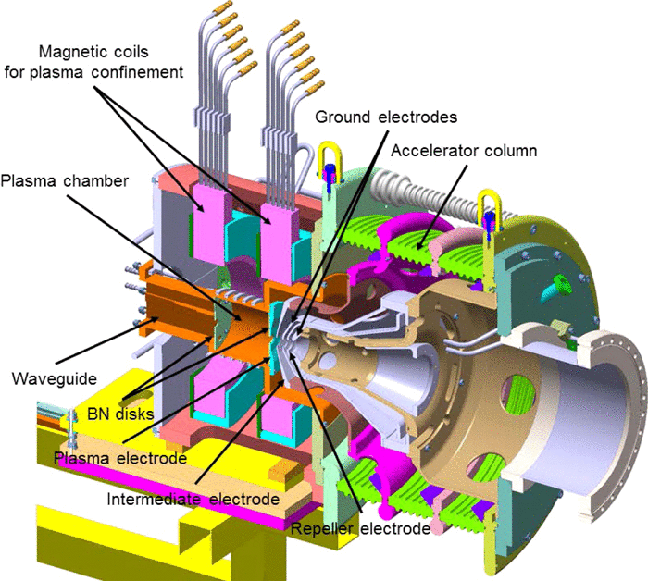
Example of operational parameters optimization
Studies on ML are starting on LIPAc in order to optimize tuning time of key subsystems, starting with the ECR ion source
Tests have been done with Bayesian optimization of LIPAc’s injector starting
With 2 parameters (ion source coils)
Target:
Max beam current measured at faraday cup

Slide 12
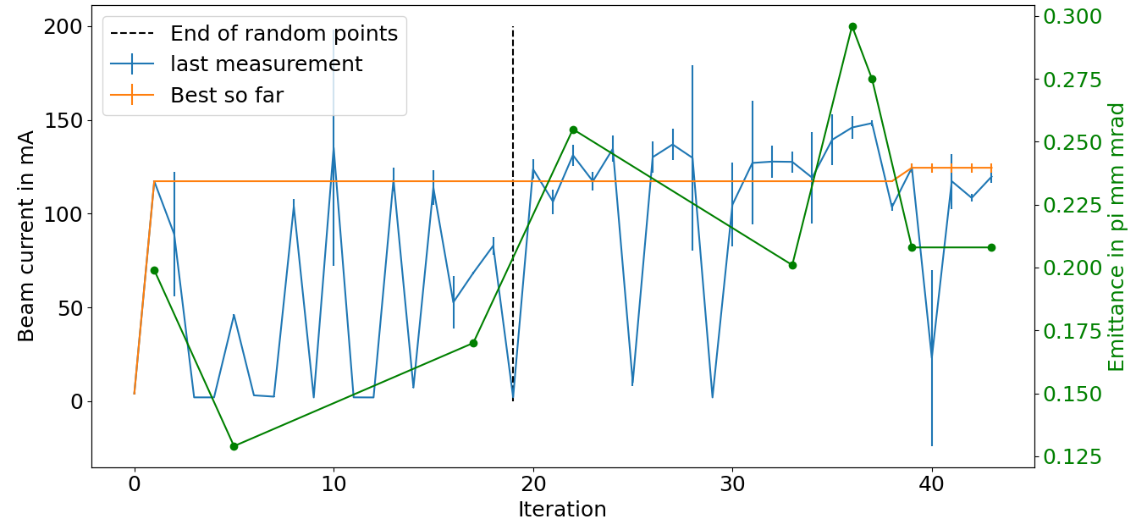
Examples of operational parameters optimization
Tests with Bayesian optimization of LIPAc’s injector extended to 4 parameters
RF power, gas flow, 2x RF tuners.
Then 6 parameters RF power, Gas flow, 2 x RF tuners, 2 x Coils, optimizing Max(Avg I), (Std I < 3mA), and the emittance ( < 0.25 π.mm.mrad)
T. Akagi et al, 2nd Machine Learning for Accelerators Japan forum meeting, RIKEN, 27-29 Nov. 2023
T. Akagi et al, 2nd Machine Learning for Accelerators Japan forum meeting, RIKEN, 27-29 Nov. 2023
6 Variables → Max(Avg I) & Std I < 3mA & Eps < 0.25 π mm mrad

Slide 13
ML-IA development approach
Project Development timeline (subject to approval beyond March 2028)
Now
2024/Q2
2025/Q4
2027/Q4
2030/Q4
2033/Q4
Phase B+: validation at high DC of the complete LIPAc except the SRF Linac,
Initialization phase.
SRF Linac assembly & integration
Data analysis, ML model development for selected subsystems
Phase D: proof of the accelerator concept
Data collection and analysis, model testing on selected subsystems
Enhancement period: Demonstration of reliability and availability.
Data Collection, model training, subsystem Integration and start real-time testing
Optimisation period: support for preparation of DONES/
A-FNS commissioning and production phases
Global cross-subsystem integration of ML solutions, operational tests
1st phase: Initial model development and testing for individual subsystem targeting performance and/or predicting maintenance needs
2nd Phase: Real time and overall accelerator performance optimization and continuous improvement
LIPAc not only the full scale prototype of the IFMIF accelerator concept (DONES/A-FNS), but also the ideal platform to develop and test models for ML and AI.
Objectives:
Streamline operations, improve maintenance efficiency, enhance performance, and support operators in maintaining the operability and safety. LIPAc will be used as a demonstrator for safe early developments and tests of ML/AI models for DONES/A-FNS.
Approach:
Prioritizes safety and focus on a deep understanding of each subsystems (injector, RFQ, SRF-Linac, etc.) before scaling up to the accelerator after completion of phase D.
During the 1st phase develop ML models targeting specific objectives for each subsystem (for performance optimization and predicting maintenance).
Test these models extensively in simulations and controlled environments during operation.
Holistic approach during the second phase: Progressive integration of machine learning models into each subsystem’s LCS, and monitor performance in real-time, ensuring that SAFETY and performance are maintained then improved.
Full accelerator optimization: Optimize the overall performance, balancing individual subsystem optimizations with the global beam performance objectives.

