Slide 1
Applications of Machine Learning for Improving Diagnostics and Controls Anne-Laure Lamure on behalf of RadiaSoft and their collaborators
November 28th 2023
Artifact Preparation Workshop
Boulder, Colorado USA | radiasoft.net
Notes:
Thanks for the invitation.
Short presentation of the company:
- what do they do at Radiasoft, and what are their chore competency.
- examples of active use of ML for accelerators

Slide 2
RadiaSoft is an industry leader in high-level research & design and scientific consulting for beamline physics and machine learning
Diverse staff covering a wide range of scientific and software expertise
Seven full time software developers with expertise in Java, Python, C++, and Perl.
Eleven full time computational scientists and engineers with expertise in a variety of specialty disciplines, including: optics, controls, embedded systems, and computational modeling.
Three administrative staff and one marketing professional.
Regular contributions to more than 20 workshops and conferences annually
Computational Support
User Support
Operational Systems
Sirepo: browser based computational gateway
Image processing: Sample identification and noise reduction
Embedded systems for edge AI and LLRF
Jupyterhub: customized computational environment
Data analysis and visualization workflows
Digital twins and online modeling
Shielding design and radiation transport simulations
https://sirepo.com
Contract R&D / Engineering Services
Notes:
Radiasoft = small contract R&D company, Boulder, Colorado, 2013
Staff: software developers (expertise: Java, Python, C++, Perl…)
Full time computational scientiscs
Bio online.
3 services:
- Computational support (computational physics for accelerators and lasers
- User support (accelerator users, beamline scientists)
- Operational systems: embedded controls, ML on fpga for real-time analysis

Slide 3
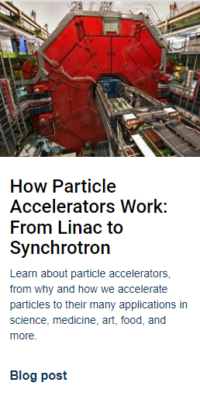
Community Outreach & Support
RadiaSoft’s educational blog is updated regularly, https://www.radiasoft.net/resources
Our monthly webinar series is available on YouTube, https://www.youtube.com/c/RadiaSoft
Notes:
US Particle Accelerator School
Monthly webinar (Sirepo, research…)

Slide 4
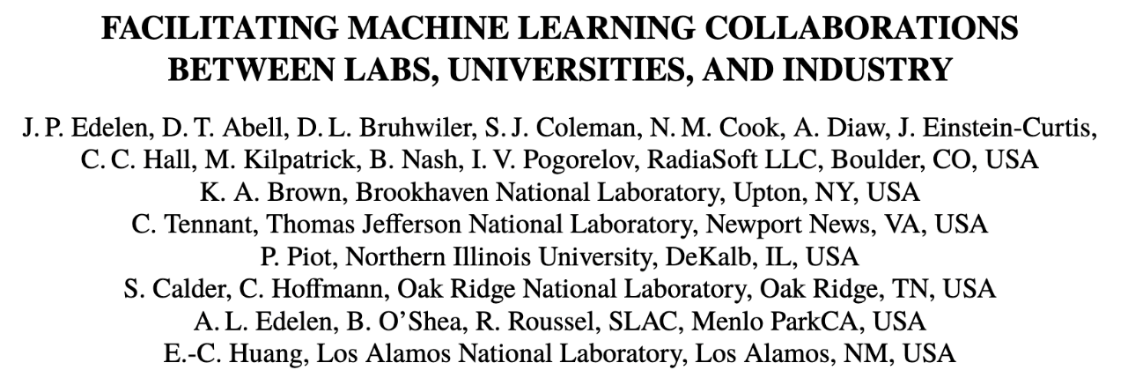
Machine learning at RadiaSoft
RadiaSoft provides client- specific, holistic solutions to data science and modeling problems
Our approach is to explore data, understand the problem, and establish the appropriate solutions
Develop in-house knowledge using state-of-the art methodologies through collaborations, workshop participation, and continuing education
Maintain a unified approach to development and deployment utilizing a common workflow
Support deployment in operational systems where real-time performance, integration with safety systems, and security compliance are required
Notes:
Machine Learning at Radiasoft
Pragmatic approach.
Client specific solution: understand the data to find the best solution (not necessarily ML).
Care about: real time performance, safety, security compliance.
JON:
Software perspective: ML ops a coordinated effort and a system that everyone is using for training and updating models, a templated effort
Josh: Provide client specific solutions, experience in investigating problems and tieing them to client needs. Advocate for overall solutions for ML and AI specifically in the accelerator and beamline control space. Try to stay on the cutting edge, build in-house knowledge to train ourselves and others.
Raven: Everyone finds their own approach, starting a model from scratch and play around to find a solution. Maybe this will change. Seems like there is an attempt to shift from tensorflow to pytorch.
Morgan: Finding tailored solutions. Models and tools for established and novel solutions. Not just models but also the tools. Live applications that have safety and security in mind. Holistic solutions and a platform for deploying them. Application and web-application deployment.
Data driven as opposed to solutions driven, have a solution that fits the data as opposed to focusing on a specific method. Not locked in to machine learning
Development of RSLEarn
Development in both tensorflow and pytorch
“Data analysis is key even before deciding on any sort of ML use. We spend considerable time analyzing and sanitizing datasets and data relationships” - not really any different than other places that do it right, i think, but i guess the key there is “…that do it right.”

Slide 5
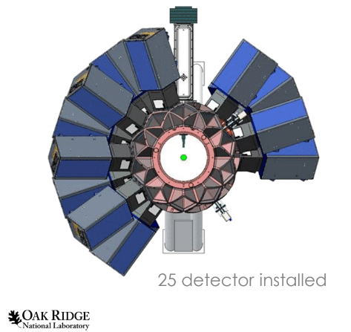
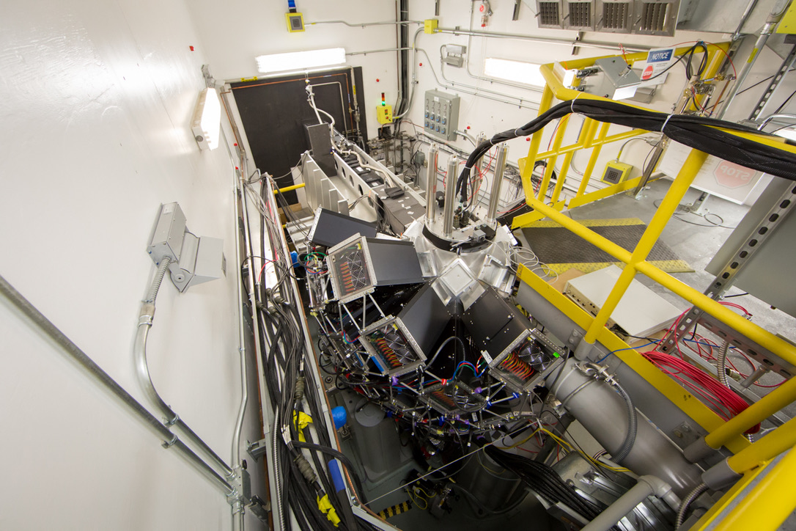
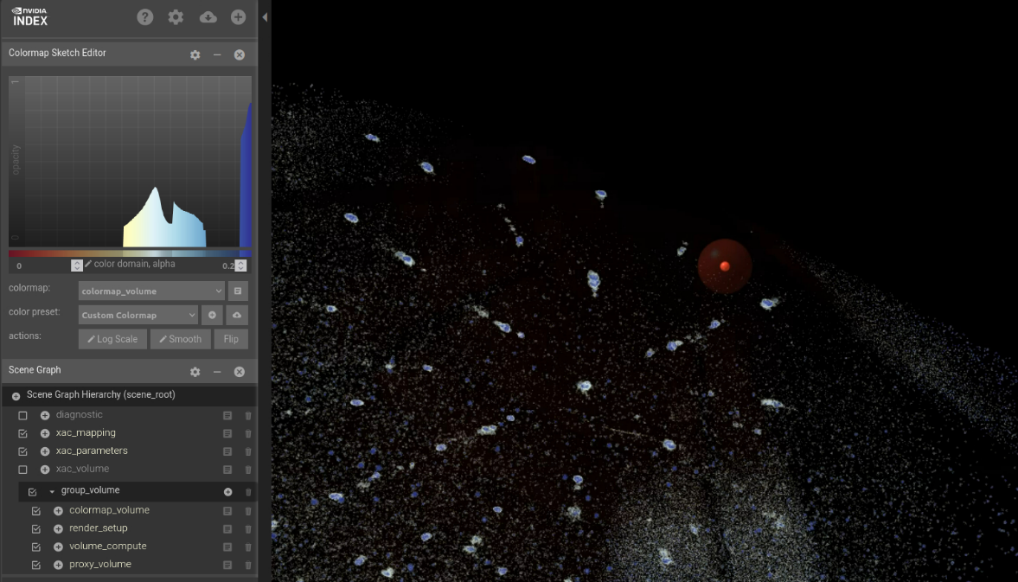
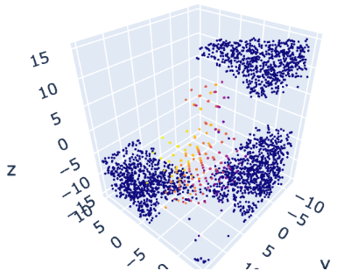
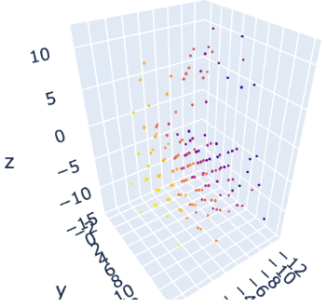
AI/ML automation of neutron scattering data analysis in TOPAZ experiments
TOPAZ is located at ORNL and receives neutrons from the Spallation Neutron Source (SNS)
Scattered neutrons yield high precision data for volumetric sampling in reciprocal space
Unsupervised ML for automated denoising & Bragg peak detection
Using DBSCAN clustering algorithm to leverage legacy MANTID software
Working with NVIDIA to generalize the implementation in cuML
Silicon Cluster ID
Subtract Noise
Live data stream, projected into reciprocal space
RadiaSoft software is deployed in the experimental hall
Leveraged NVIDIA technology via team in Berlin
Notes:
5 different examples that illustrates the work of RS in ML.
Work on large experimental systems in the US.
1st example: automation of data analysis
Oakridge National Lab, Spallation Neutron Source, TOPAZ is a high-resolution single-crystal diffractometer
Implementation of ML to improve the data.
Goal: denoise the data, detection of Bragg peak.
2) Work on visualization with Nvidia, in a near online manner.

Slide 6
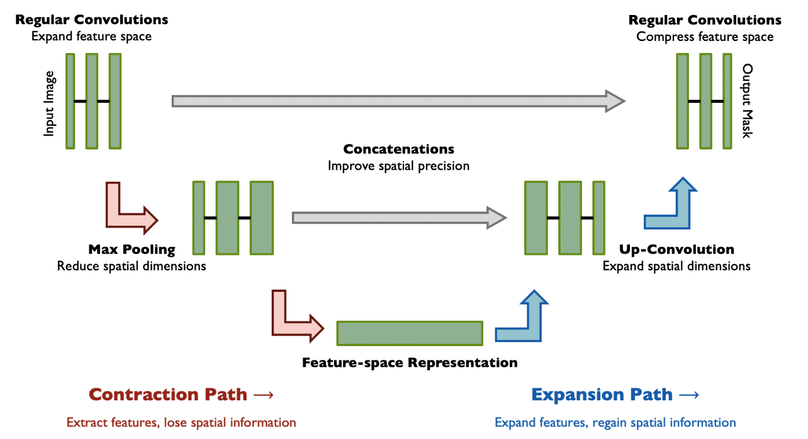
Automated Alignment
Automation of sample alignment makes experiments more efficient and compensates for thermal drift during temperature scans
Utilize image contouring to identify sample location in the environment
Contour images using expert feedback
Train Convolutional Neural Network to compute the sample mask
From sample mask compute center of mass
Implementation using Python based EPICS IOC
Optical image or neutron camera image (optical image shown in the top right)
U-Net computes sample center and serves up the mask to EPICS along with the sample offset from the beam
Motor software moves and rotates the sample for optimal alignment in the neutron beam
Image
Mask
Prediction
Notes:
2nd example: automated alignment, at SNS
Goal: make the experiment more efficient and compensate for thermal drifts during temperature scans.
Identify the position of the sample. It is a contouring problem.
Training data= expert feedback, to contour the sample
Train a conventional neural network, to predict the mask for a given input image.
Compute the center of mass.
Implementation in the control system, using an EPICS Space. Motors moves and rotates the sample for an optimal alignment.

Slide 7
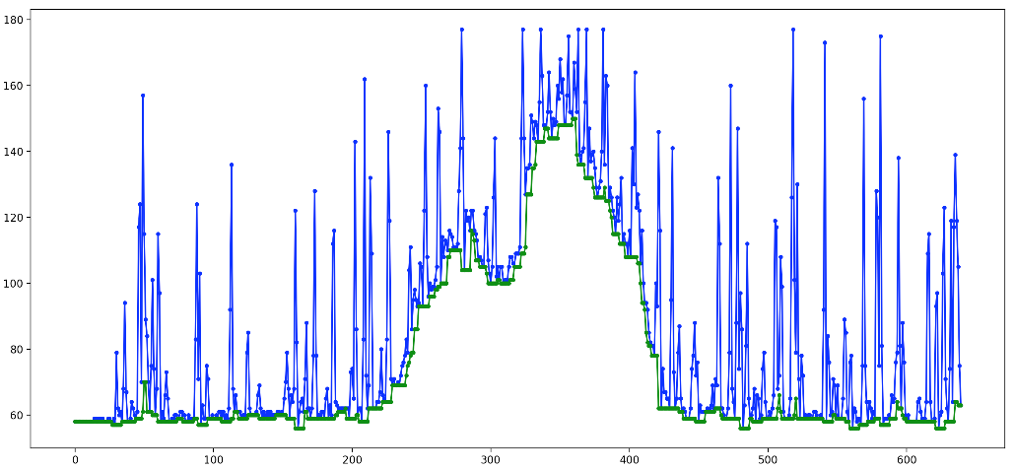
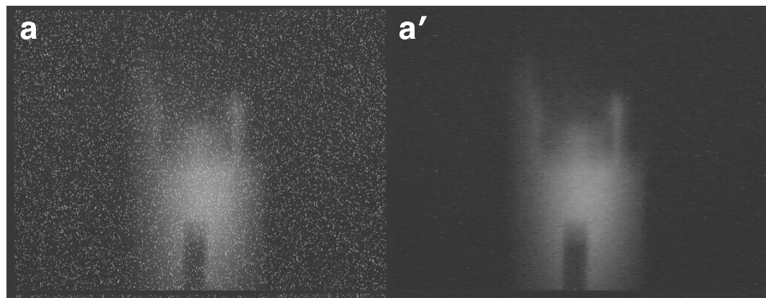
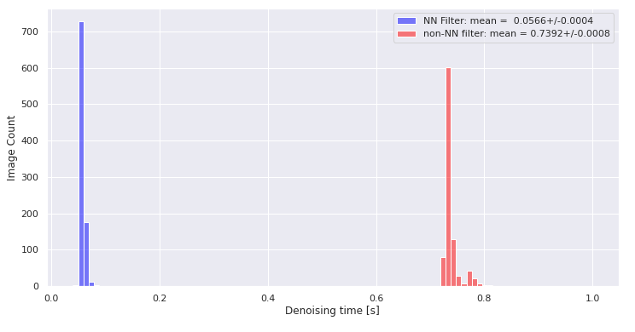
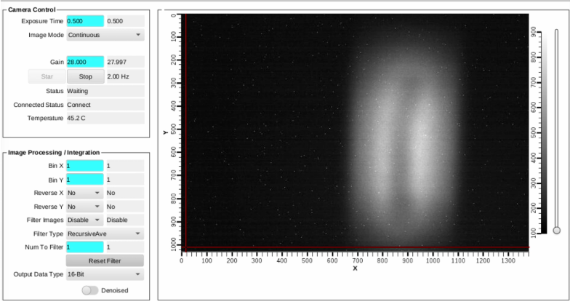
Denoising
Neutron camera noise is a challenge for sample alignment
Speckle noise is all positive. Inscribed envelope reconstructs the noiseless signal (top right)
Comparison of noisy neutron camera images and denoised images (middle right)
U-Net architecture utilized to train image-to-image reconstruction for algorithm speedup
Training data consisted of noisy images and denoised images
Comparison of execution time for neural network and baseline algorithm (bottom right)
Algorithm deployed on an EPICS IOC using a flexible framework developed in Python specifically for fast deployment.
The raw image is made available as a process variable in epics.
Our software loads the image, pre-processes it, applies the neural network, reprocesses it, and then serves the image to an epics PV that can be displayed in the user interface (bottom)
Notes:
3rd example: Another example of noise reduction. For a neutron camera.
Speckle noise for neutron camera is always positive.
Fit an envelope on the lower side. Use that to exstract the noise, line by line, in the image.
Pb: it takes a lot of time to cycle throught the whole image. The goal is to run in real time.
Training offline of a Conventional Neural network, to reproduce the algorithm.
Red= baseline (800ms). Blue <100ms. Fast enough for most applications.
Algorithm deployed on an EPICS IOC.

Slide 8
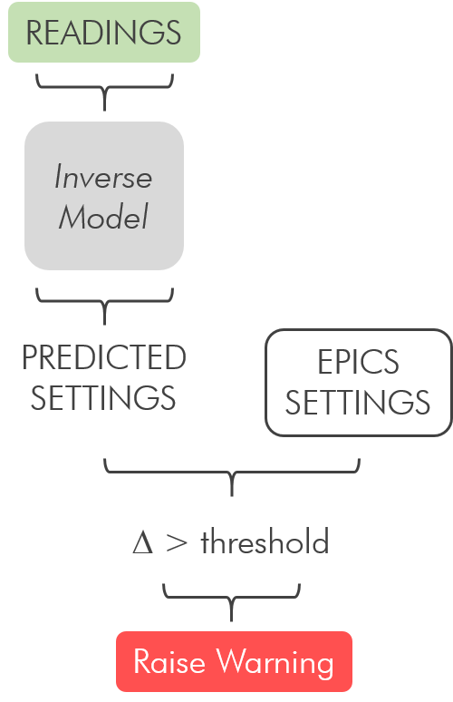
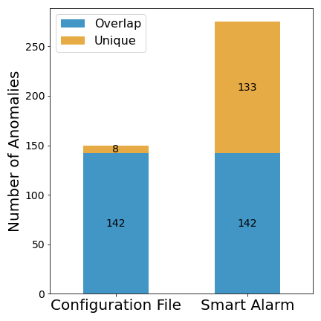
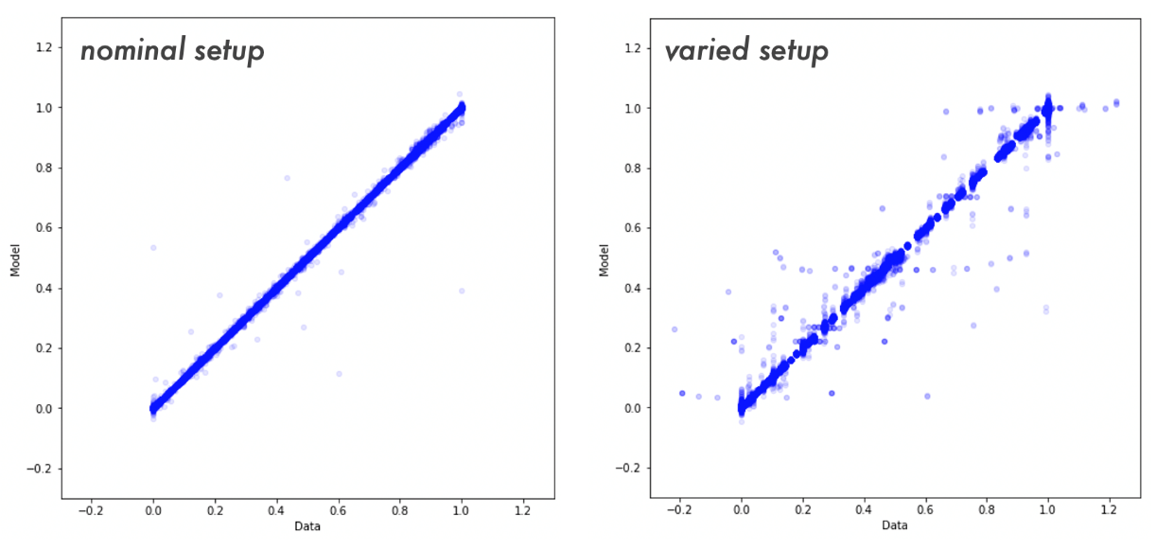
A Smart Alarm System for the CEBAF Injector
Alarm systems typically alert operators when there is a problem with the beam
Often does not provide much information on what caused the alarm
Diagnosing the problems is time consuming for operators
Use machine learning inverse models to predict settings from diagnostic data
Trained on data during normal operation (bottom left)
Tested on data where parameters are systematically varied (bottom right)
ML model correctly identifies 125 additional anomalies as compared to conventional configuration file
Notes:
4th example: ML for anomaly detection, CEBAF injector.
Pb: After an alarm, diagnostics on the issue is time consuming for the operators. Lack on information on what caused the alarm.
Use inverse model to predict settings from any diagnostic data (vacuum gauges, beam diagnostics etc…)
Trained on data during normal operation.
Tested on data, where parameters are systematically varied.
Smart alarm can identify the same than the normal alarm, and 125 additional anomalies.

Slide 9
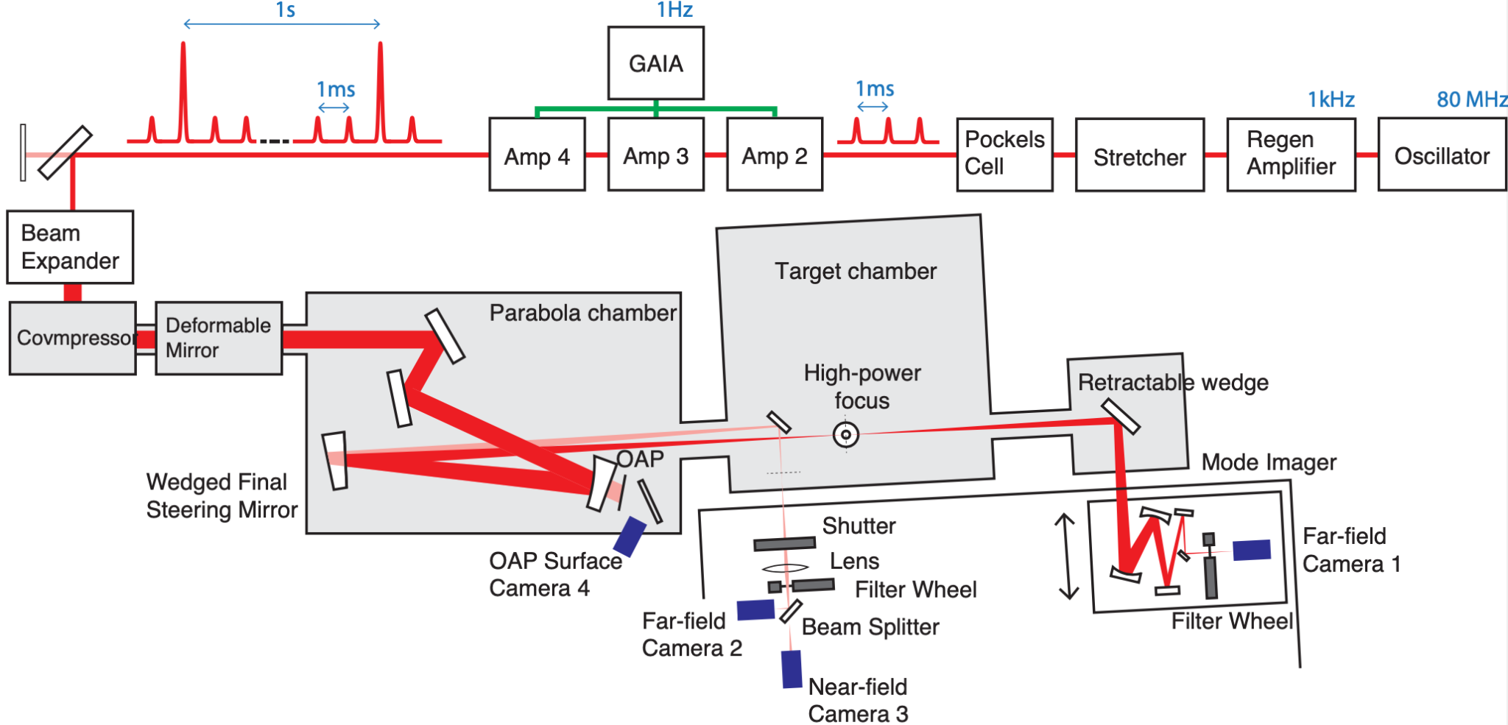
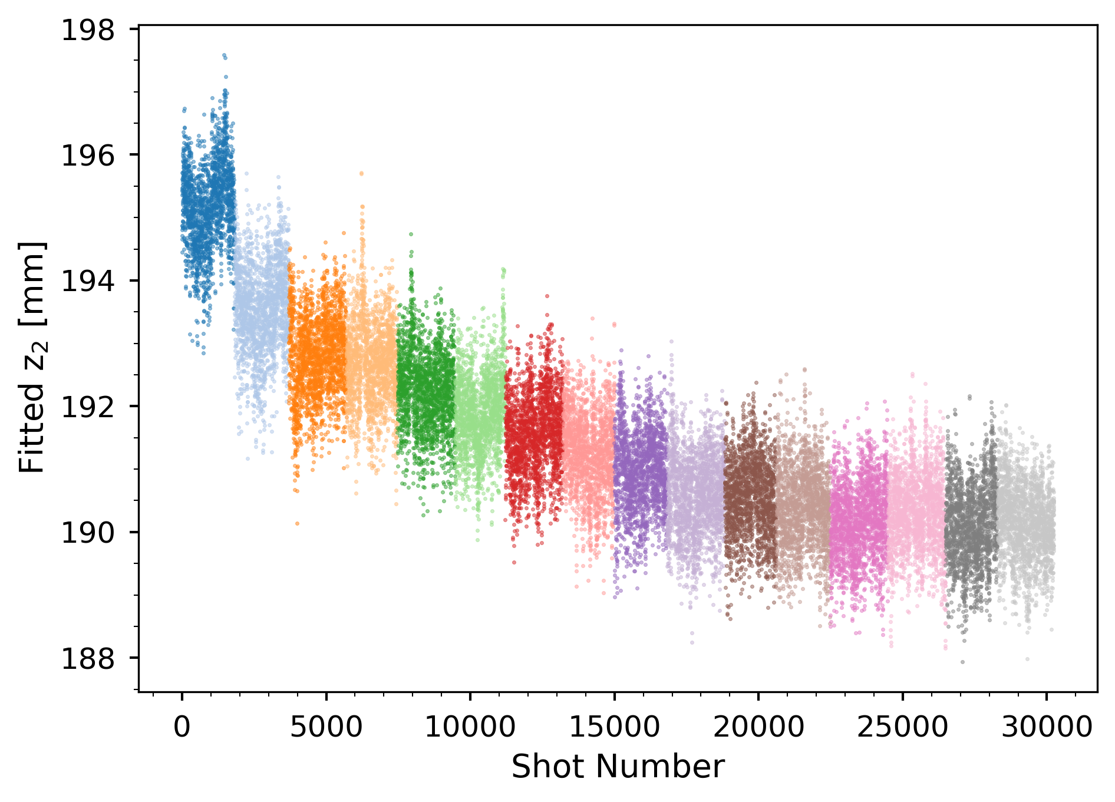
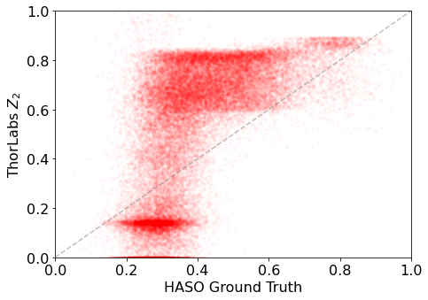
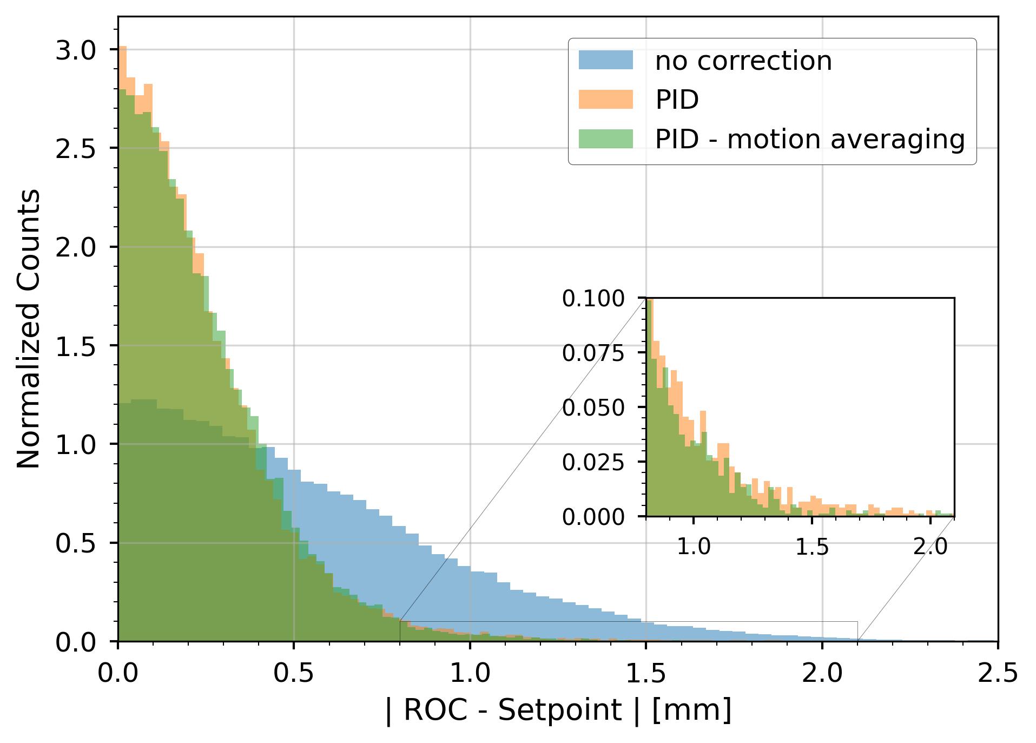
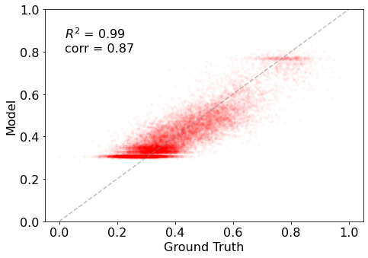
Laser Focal Position Correction Using FPGA-Based ML Models
The HTU beamline is at the LBNL BELLA Center
Electron acceleration using laser-driven plasmas
Highly sensitive to wavefront shape and focal position
Variation over time of laser focal position on several time scales affects performance (middle-left)
ML Model developed for online corrections for better correlation of measurement with ground truth (bottom-right)
Developed custom acquisition system using UDP broadcasts across multiple machines for online monitoring and correction
FPGA-based coaccelerator integrated for higher fidelity and control
Initial tests used traditional control methods (PID) along with device tuning (bottom-left)
Showed immediate improvement in system performance, even before accounting for bad correlation of measurement
Data collection models allow for offline characterization and analysis of new methods
Notes:
Last example: Control system for laser plasma acceleration
HTU Beamline at BELLA, at LBNL.
Step 1: Know the position of the laser beam
diagnostics available all the time, and destructive diagnostics available only part of the time.
ML model for online correction for a better correlation of the measurement with the ground truth.
Use of ML on an FPGA.
Obtain: better prediction of the position of the laser beam.
Step 2: Use the position in a PID
Better stabilization of the focal point.

Slide 10
Contact Information
Jonathan Edelen, President
RadiaSoft LLC
jedelen@radiasoft.net

Slide 11
Disclaimer
This report was prepared as an account of work sponsored by an agency of the United States Government. Neither the United States Government nor any agency thereof, nor any of their employees, makes any warranty, express or implied, or assumes any legal liability or responsibility for the accuracy, completeness, or usefulness of any information, apparatus, product, or process disclosed, or represents that its use would not infringe privately owned rights. Reference herein to any specific commercial product, process, or service by trade name, trademark, manufacturer, or otherwise does not necessarily constitute or imply its endorsement, recommendation, or favoring by the United States Government or any agency thereof. The views and opinions of authors expressed herein do not necessarily state or reflect those of the United States Government or any agency thereof.

