Slide 1
Strategy Board Updates from EB
Ian Bird, LAPP
4th December 2023

Slide 2
Overview
Summary & Updates from Executive Board of 24/11
Agenda and material: https://indico.in2p3.fr/event/31049/
Overview of working group activities since end of project
DM, Software, VO, Analysis tools, CS, TSPs; EOSC-Future interactions
Progress report on preparation of OSCARS project
“ “ ” EVERSE “
Discussion on role of technical coordination
Report from JENA Computing Workshop – coordination with ESCAPE
See previous talk

Slide 3
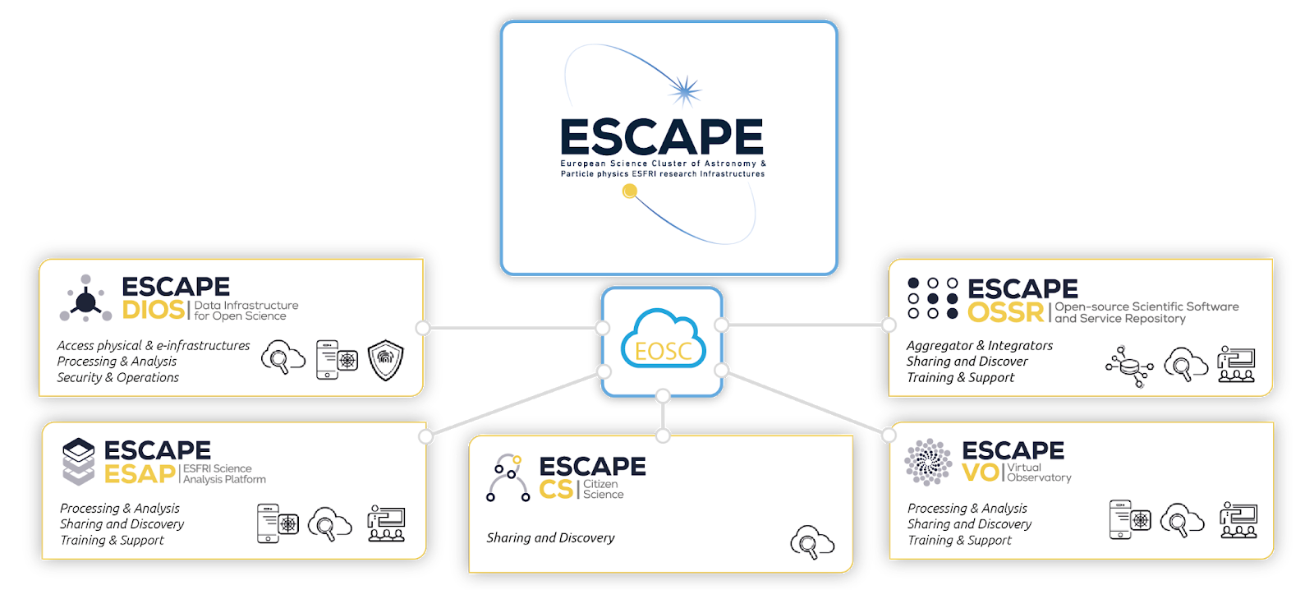
The new ESCAPE Collaboration work programme
Entities
CC
Operating the community-based “Competence Center” for EOSC-alignment, train and support, extended outreach, financial model for services and networking with other SCL-CCs
EVSI
R&I for an “European Virtual Institute for Research Software” for advanced technologies
VRE services
Programmes
COSO
Challenging “Open Science Objectives” by RI commitments in Open Science Projects (OSP) as well as Cross-Cluster Open Science Projects (COSP)
TECH
Bring the FAIRness within technology, R&D and innovation projects as well as explore new “close-to-sensors” low-latency open-data science
CARS
Career development and rewarding for researcher committing in Open Science. Planning, tracking, and assessing scientific knowledge production
SDSS
Building synergies on “Sector Data Spaces” for Society: Green deal, Health, Manufacturing, Education and Skills

Slide 4
Data Management activities
Based on ideas for topics, already presented and discussed at the 1st Open Collaboration meeting: https://indico.in2p3.fr/event/30249/

Slide 5
Software-related activities

Slide 6
Virtual Observatory activities

Slide 7
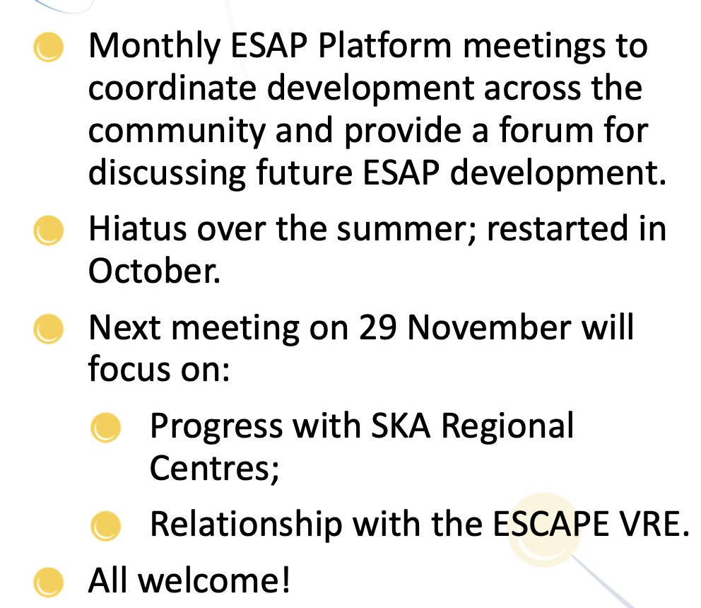
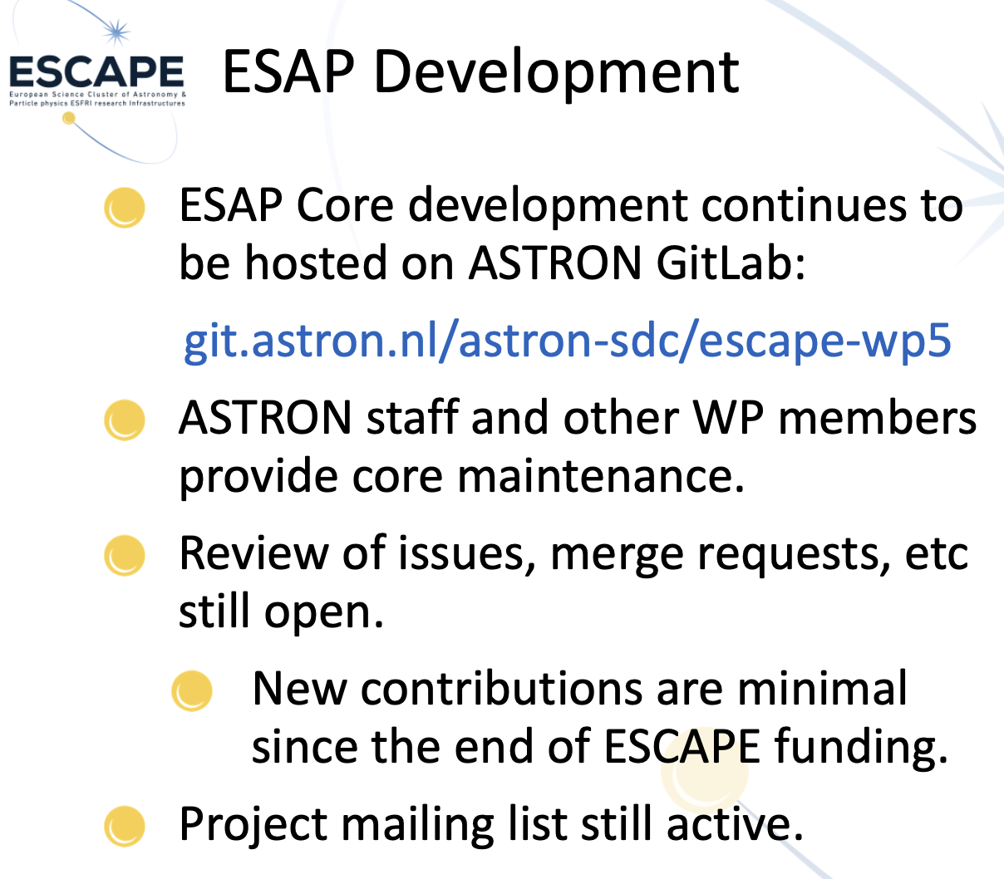
Analysis tools activities

Slide 8
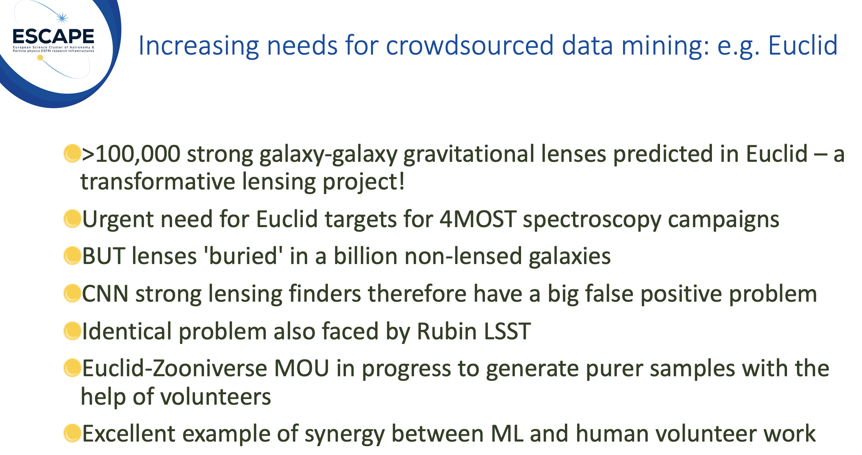
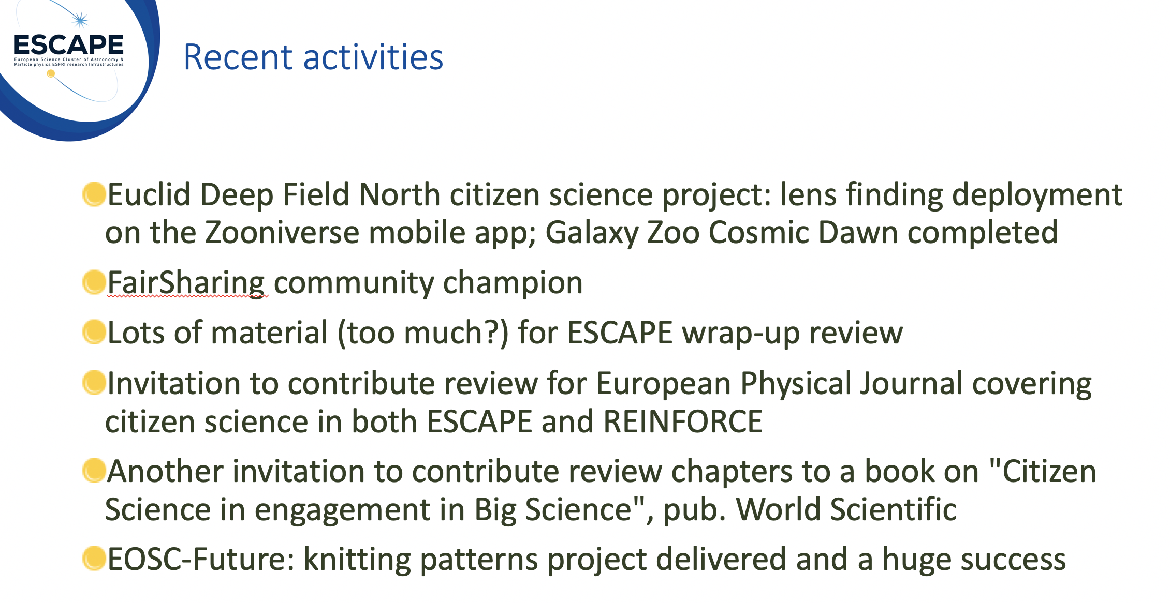
Citizen Science activities

Slide 9
(Test) Science Projects status – DM

Slide 10
(Test) Science Projects status – EU

Slide 11
EOSC Future (1/2)
The project formally finished in September, but
6 month extension → end March 2024
Limited activities in the extension:
Handover, sustainability, communication/dissemination only
Science projects formally ended
Main rationale of extension was to work on the handover
M30 Review (11-12 Dec) will review project as if it finished at M30
i.e. were objectives achieved, etc.
ESCAPE participation in the extension
Funded: CERN 3 PM, ASTRON 1 PM
+ Ad-hoc unfunded effort to finish various aspects
Excellent visibility of ESCAPE via demos of the TSPs
DM demo was 1st demo of AAI federation; EU demo showed full Open Science workflow using EOSC services and tools

Slide 12
Demo at EOSC-Future M24 Review

Slide 13
Demo at EOSC-Future M24 Review

Slide 14
EOSC-Future (2/2)
What is left for ESCAPE to do in the extension?
1) IPR – we had to specify what products etc were concerned
EOSC-F had legal advice on this
For SPs – in the end only ”products” that were really developed using EOSC-F effort were concerned
For ESCAPE we agreed this was limited to VRE
To finish this now, we have only to sign a Joint Ownership Agreement (CERN, CNRS) for the VRE (once template is available)
2) Finish Onboarding:
VO, GWOSC - what is left to finalise?
Remember: OSSR, and HEP portal are onboarded; products can be found from the EOSC portal; many VO & GW products already onboarded (but not portals themselves)
3) Continue dissemination and engagement activities
Within the limits of funding …

Slide 15
JENA Meeting & Outcome
JENA (Joint ECFA [HEP], NuPECC [NP], APPEC [Astroparticle]) Meeting on Computing topics organised on 12-14 June 2023
https://agenda.infn.it/event/34738/timetable/
Follow up from the major JENA Symposium in 2022
Recognising synergies and scaling needs for future experiments; the Goals of the workshop were:
What are the requirements of computing in the next decade and can we find synergies? Synergies in resources (facilities) as well as in software for efficient use of the resources.
Main goals: identify the computing requirements in the next decade and identify synergies that can benefit all the three communities (Particle Physics, Nuclear Physics and Astroparticle Physics) as well as neighbouring research fields like Astrophysics or Cosmology.
Identify where synergies are beneficial for all communities (and funding agencies).
This is an initial kick-off workshop. We aim to set up working groups to explore synergies and cooperation in certain areas. The results will be discussed with representatives of the funding agencies at the next JENA symposium.

Slide 16
Conclusions of JENA workshop
Five areas for follow up and to include in a whitepaper:
HTC, WLCG and HPC (HPC):
Need to engage at a high level with EuroHPC
Shape the evolution and policies of HPC facilities towards the ENA needs
Software and Heterogeneous Architectures (Software):
Challenges: heterogeneous architectures. (ARM, GPU, HPC, … )
Skills retention, investment, sustainability
Federated Data Management, Virtual Research Environments and FAIR/Open Data (Data):
The ESCAPE collaboration should be leveraged to strengthen synergies between the three sciences around data management and federated identities;
Guide the evolution of the tools and services for the next decade
Machine Learning and Artificial Intelligence (AI):
Follow the fast evolving technologies, and analyse the potential impact on the ENA computing infrastructure needs
Quantify the resource needs and define the interfaces and services needed
Training, Dissemination, Education (TDE):
Training: Leverage experience of HSF; find common ground with other sciences. Share/reuse material; common training possible? (→ Also EVERSE)
Dissemination: consider organising a conference on scientific computing similar to CHEP, but embracing more sciences (largely beyond ENA). In Europe refer to science clusters. (→ Also EVERSE)
Education: ECFA has an initiative to set a European master program for detector physics. Similar initiative on scientific software and computing? EuroHPC started a similar initiative in 2022
See also EVERSE

Slide 17
ESCAPE and JENA
JENA recognises that ESCAPE is leading coordination across HEP, NP, Astronomy/Astroparticle, GW
JENA plans a whitepaper on future common directions
(ESCAPE has a role to) Ensure that Astronomy and GW feel represented and engaged too
We (ESCAPE) must ensure that:
JENA, Astronet, GW, and ESCAPE are fully aligned and address the needs of all
How can we ensure this, and avoid divergence in plans where not driven by science??

