Slide 1
First Strategy Board meeting
Giovanni Lamanna
ESCAPE Strategy Board meeting
4th December 2023

Slide 2
Giovanni Lamanna

Slide 3
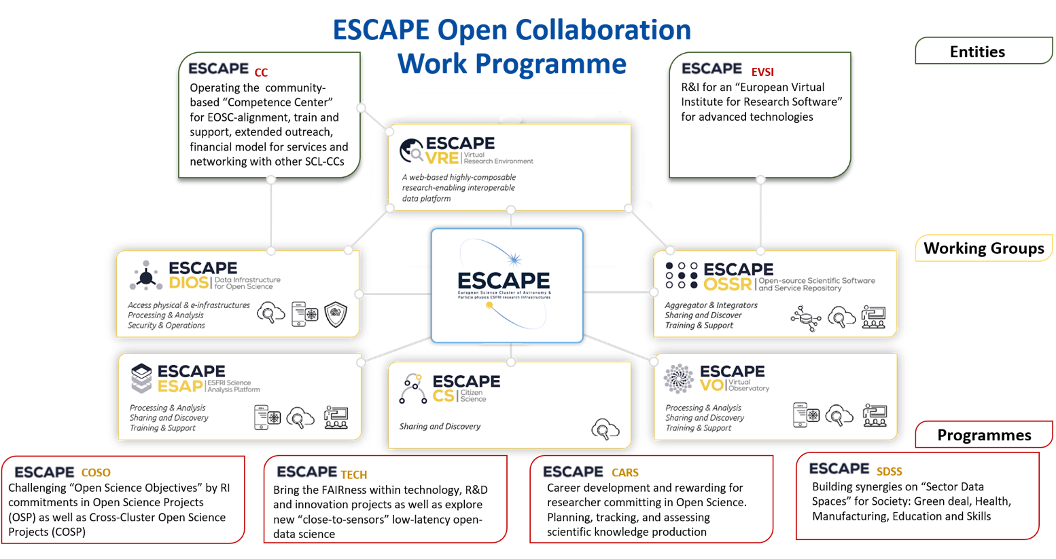
Giovanni Lamanna

Slide 4
Parties memberships and interests in the ESCAPE Open Collaboration (current compiled document is in indico)
RI | RI’s Director (ESCAPE Assembly) | Strategy Board membership | Technical Lead (Executive Board) | Key topics
CERN (HL-LHC) | Joachim Mnich | Bob Jones and Simone Campana | Xavier Espinal | DIOS, OSSR, VRE
CTAO | Federico Ferrini / Stuart McMuldroch | Matthias Fuessling and Roberta Zanin | Matthias Fuessling and Gareth Hughes | DIOS. OSSR, ESAP, VO
EGO-Virgo | Massimo Carpinelli | Elena Cuoco and Rhys Poulton | Stefano Bagnasco and Elena Cuoco | OSSR (?)
ESO (ELT) | Martino Romaniello | … | … | VO (?)
EST | Manuel Collados / Nazaret Bello | Nazaret Bello, Peter Caligari | Gangadharan Vigeesh, Peter Caligari | DIOS (?)
ET | Michele Punturo | Harald Lueck and Stefano Bagnasco | Patrice Verdier | DIOS, ESAP, VRE, VO
FAIR | Paolo Giubellino | Thorsten Kollegger, Johan Messhendorp | Mohammad Al-Turany | DIOS, OSSR, VRE, ESAP, COSO
JIV-ERIC | Agnieszka Slowikowska | Marjolein Verkouter, Giuseppe Cimo | Marjolein Verkouter | OSSR, VO, CARS, VRE, ESAP
KM3NeT | Paschal Coyle | Rosa Coniglione, Cristiano Bozza | Kay Graf | DIOS, OSSR
SKAO | Philip Diamond | Antonio Chrysostomou | Rosie Bolton | DIOS, OSSR, VO, ESAP

Slide 5
AGENDA
Status of the Horizon Europe projects and perspectives (GL)
News from the Executive Board on-going activities (Ian Bird)
Progress about actions listed during the first Assembly meeting (GL)
AoB
Giovanni Lamanna

