Slide 1
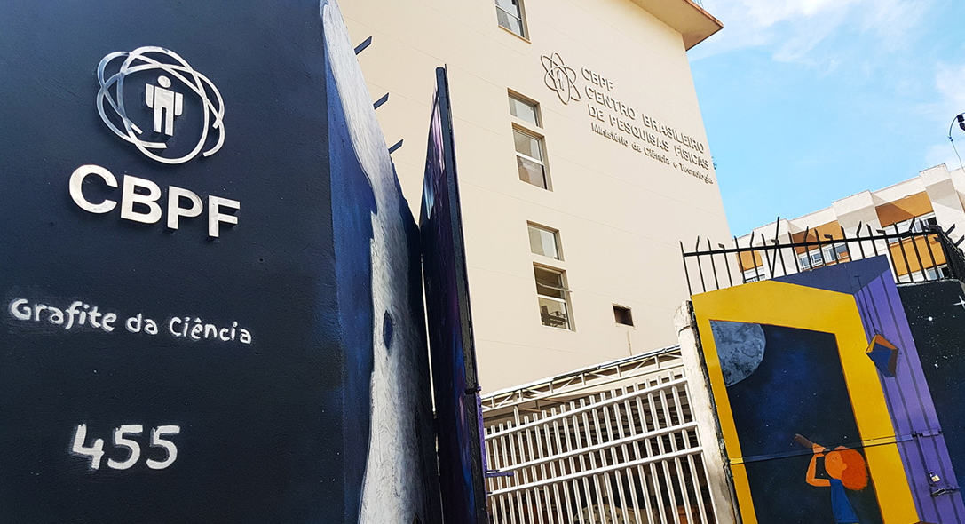
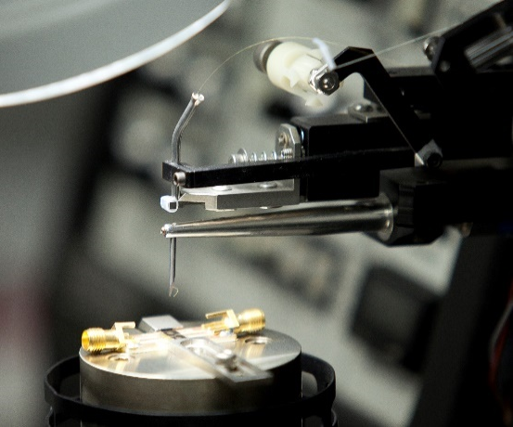
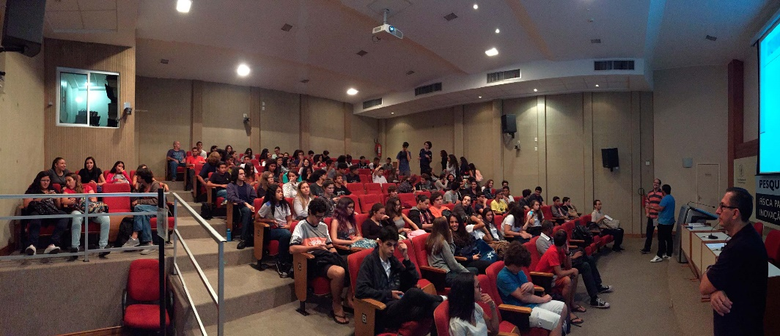
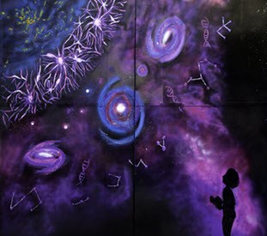
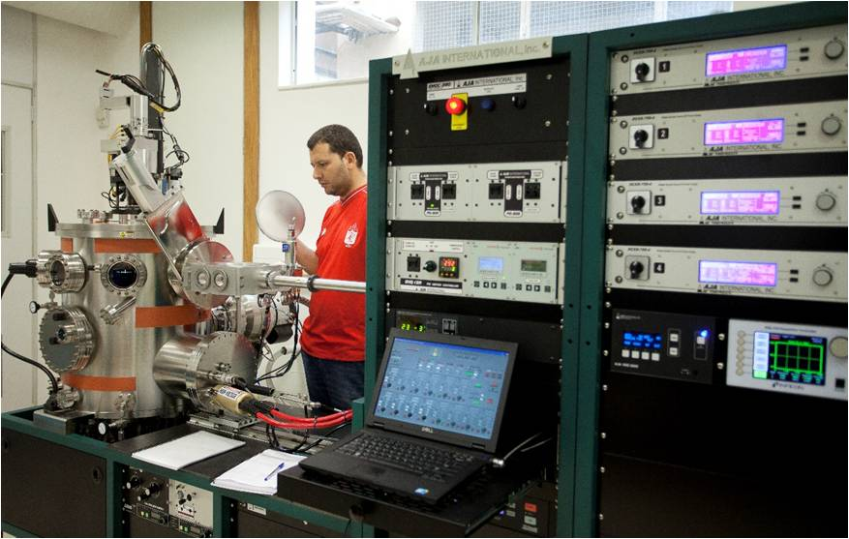
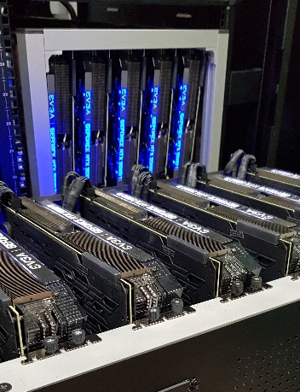
Ministério da Ciência, Tecnologia e Inovações
Centro Brasileiro de Pesquisas Físicas
Gravitational Waves and Time Domain Astrophysics in Brazilian Center for Physics Research:
Synergies with FINK
Clécio R. Bom – debom@cbpf.br
Head of CBPF AI Lab
litcomp.cbpf.br/ai/

Slide 2
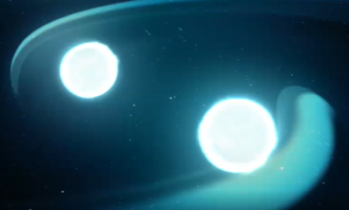
Estrutura da nossa vizinhança
What are we mostly interested here?
Gravitational Wave Follow-up (Image and Spectro)
Supernova (Superluminous) Science Strong Lensed Supernovae
Kilonova Astrophysics
Gravitational Wave Cosmology
GRB follow-ups
Other events (TDEs, AGN Flares, …)
Artificial Intelligence Machinery.. Data, Data and data
Adapted from: https://www.forbes.com/sites/startswithabang/2018/09/11/this-is-why-dark-energy-must-exist-despite-recent-reports-to-the-contrary/?sh=2b776e592356

Slide 3
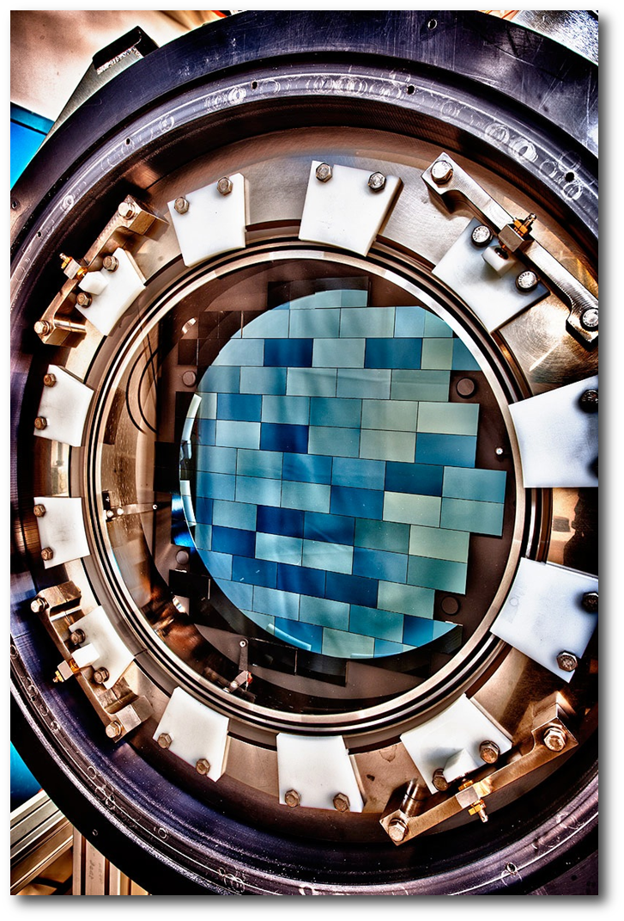
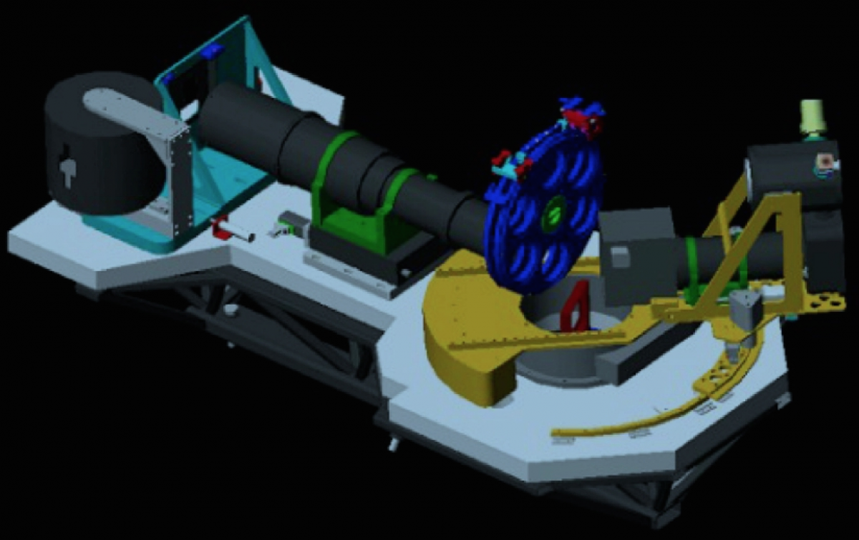
Kilonova Hunting starts…
A DECam resolution is 570 Megapixels with 3 degree squared field of view

Slide 4
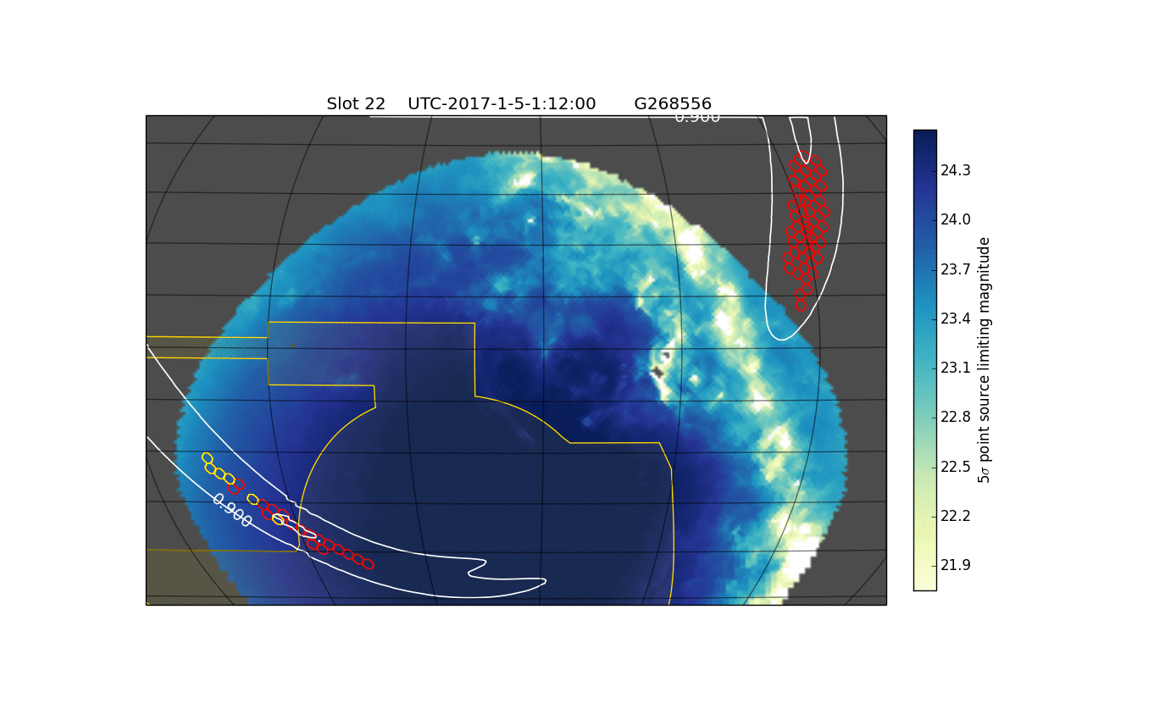
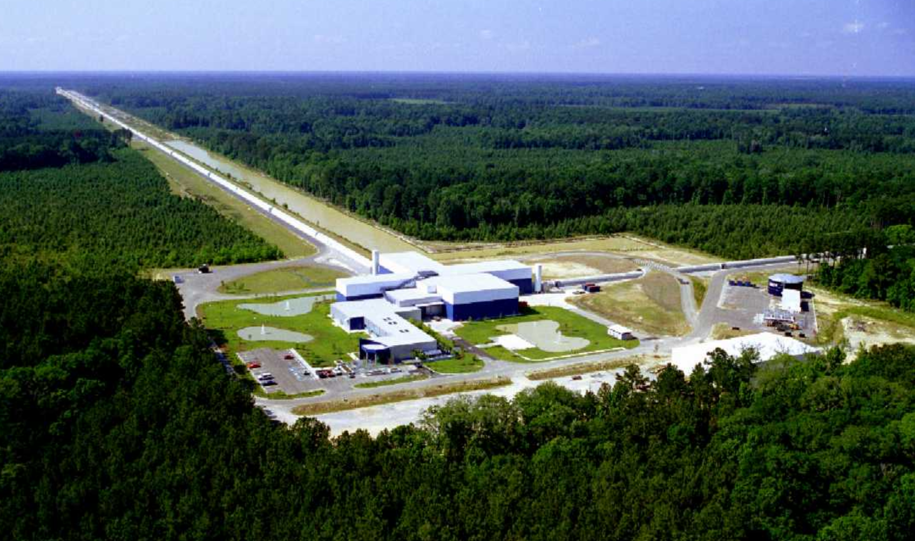
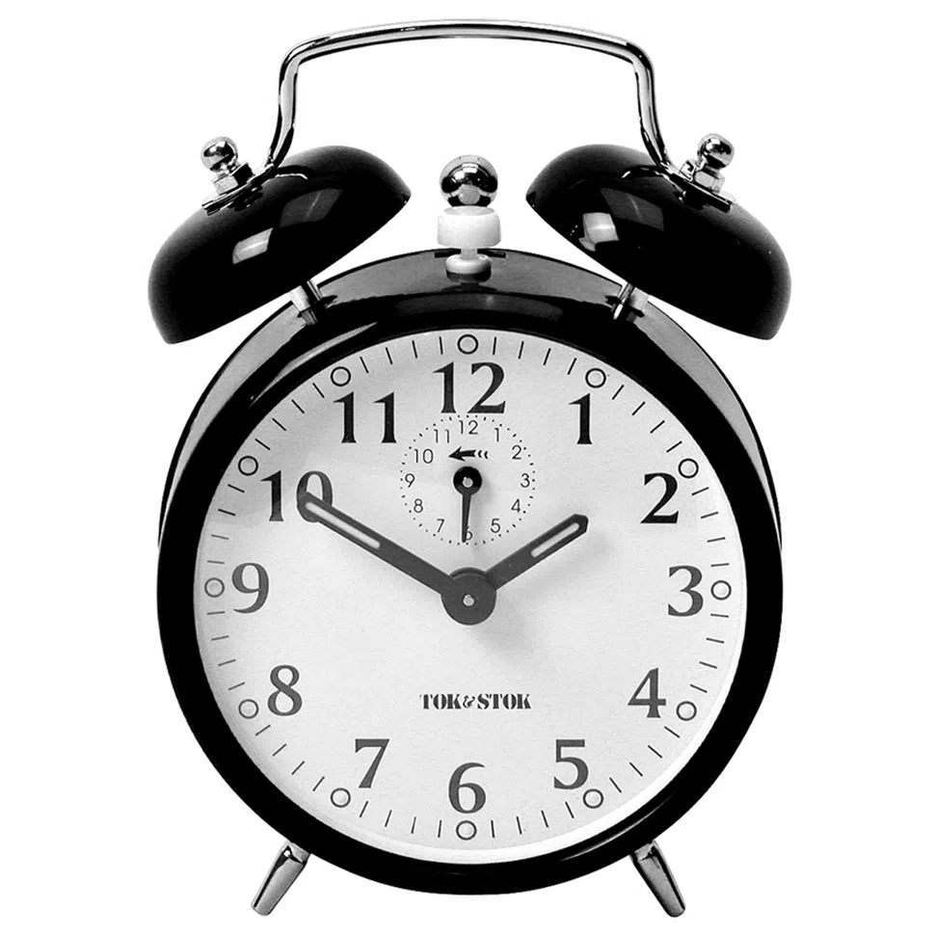
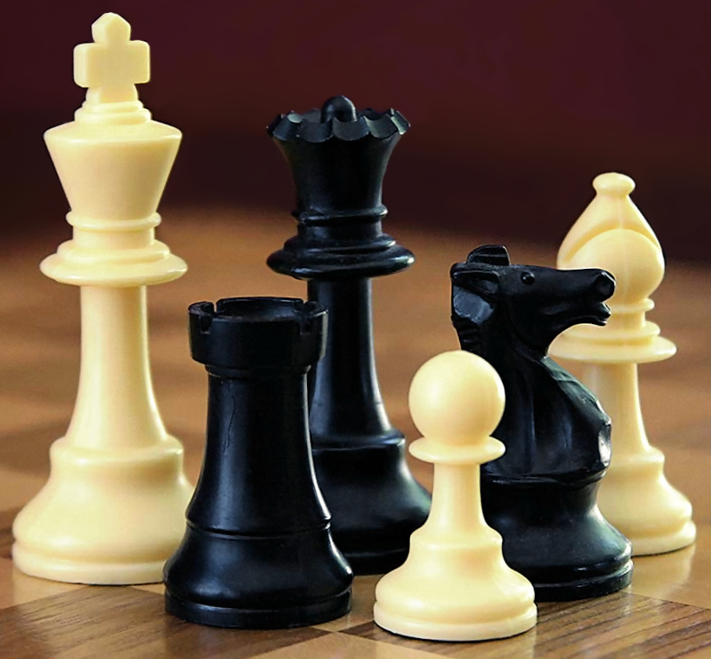
Estrutura da nossa vizinhança
How to find Kilonova?
Credit: SXS Project
Observing Strategy
Is it feasible to find? How are we going to find?
How likely is for us to find? (Bom et al, 2023)
Image Credit: Alan Light

Slide 5
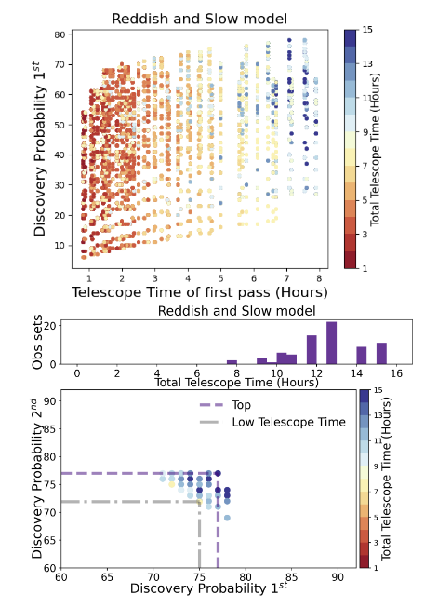
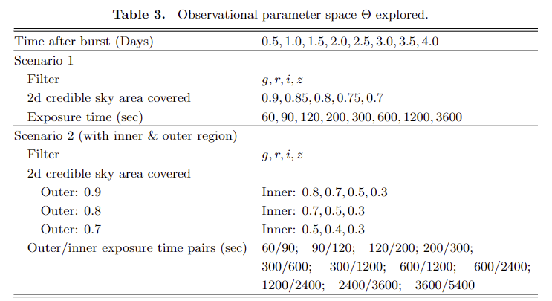
arXiv:2302.04878

Slide 6
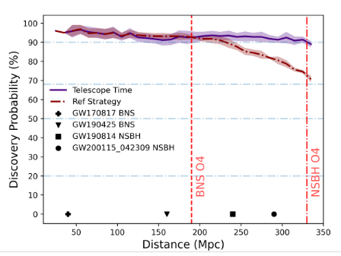
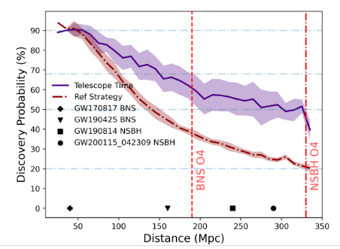
Detected models
Model Bright and Blue
Model Red and Faint
₆

Slide 7
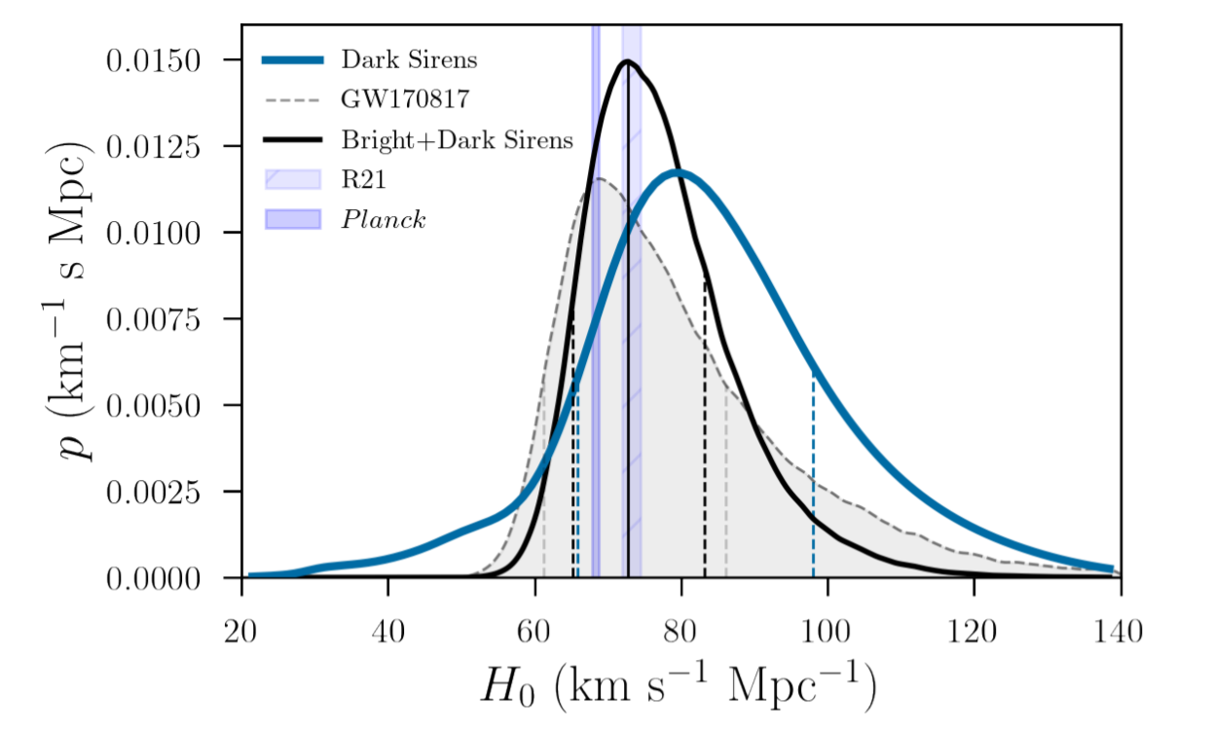

Slide 8
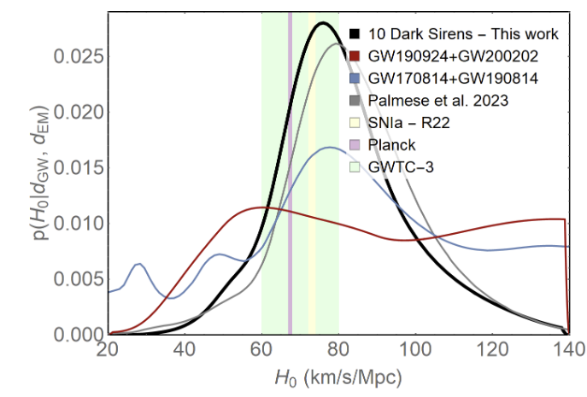
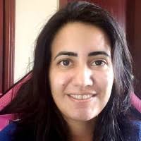

Slide 9
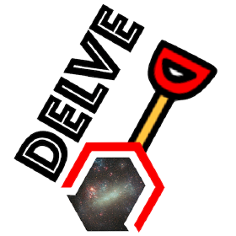
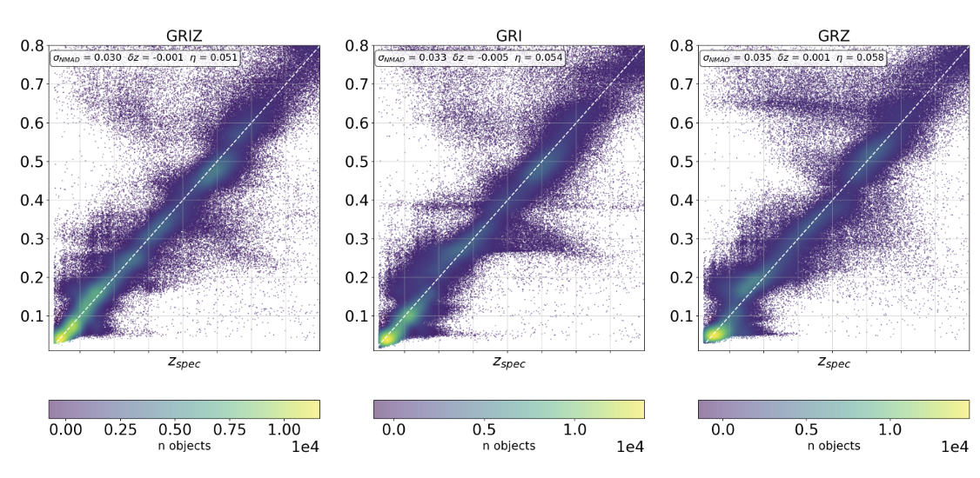
We needed to create our own Photo-z pipeline catalog with full PDF estimation using AI for heterogeneus DECam data Coverage
3 bands only

Slide 10
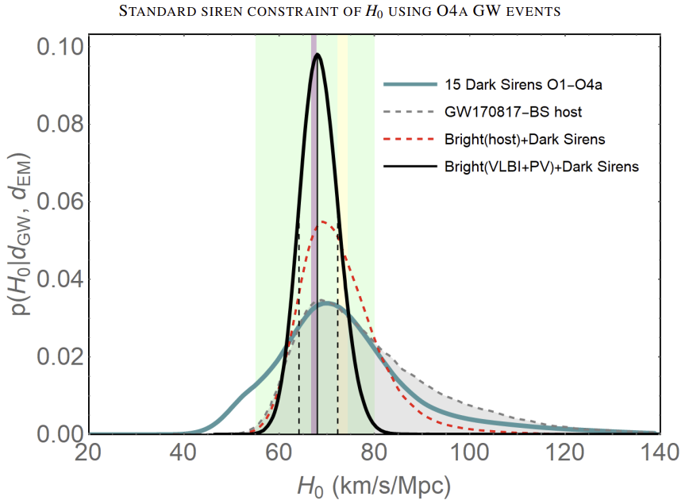
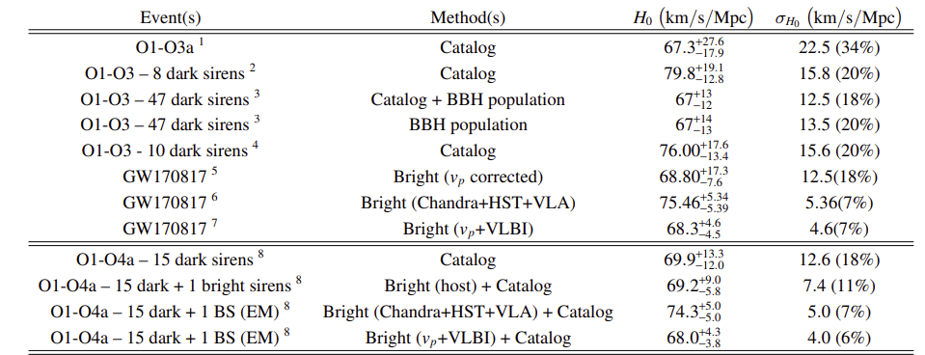

Slide 11
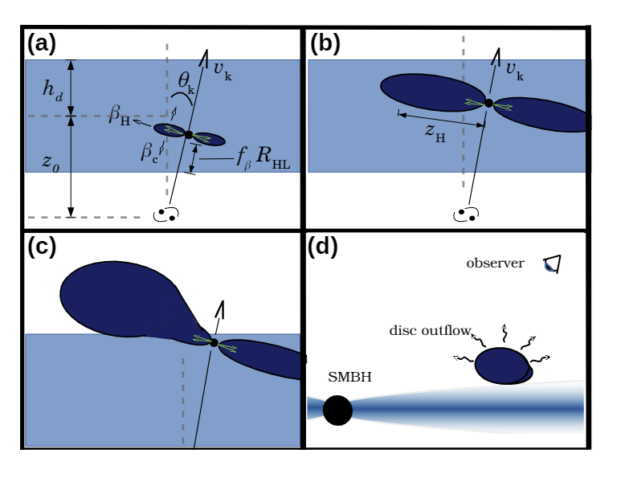
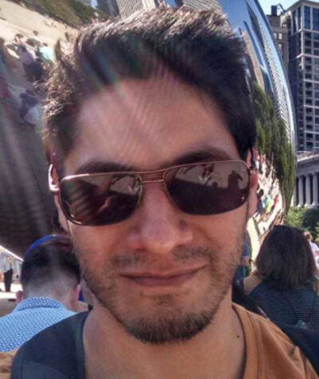
Does Binary Black Holes produces AGN optical flares?
Binary Black Hole Mergers (BBHs) s are more common than Binary Neutron Stars (BNS) Kilonovas ( During O4: ~10 BNS and ~80 BBH) .
BBH mergers in AGN disks can produce EM counterparts (e.g. McKernan et al. 2012; Bartos et al. 2017b; McKernan et al. 2019; Kimura et al. 2021). 25% of BBHs during LVC (O2) preferred an AGN disk origin model (Gayathri et al. 2021).
Between 20%-80% of BBHs are likely to happen in AGN disks (Ford & McKernan, 2021) .
Rodriguez-Ramirez & Bom et al. MNRAS 2024
₁₁

Slide 12
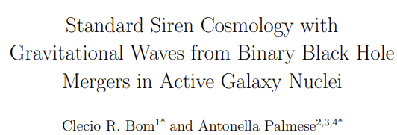
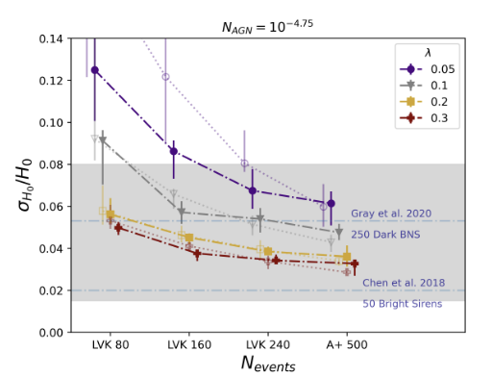
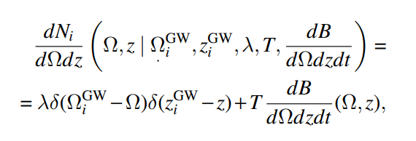
We modelled the problem as a signal versus background problem: for each
GW event from a BBH in an AGN disk we have N expected background flares and N + 1 total expected flares.
Fraction of AGN that host flares induced by BBH
Borhanian et al. 2020
https://doi.org/10.48550/arXiv.2307.01330
₁₂

Slide 13
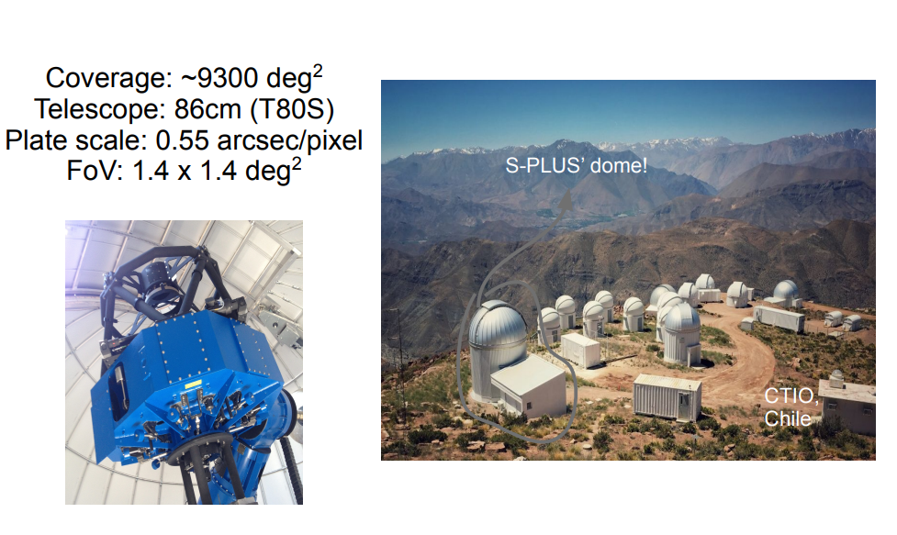
Follow-up Resources … STEP
₁₃

Slide 14
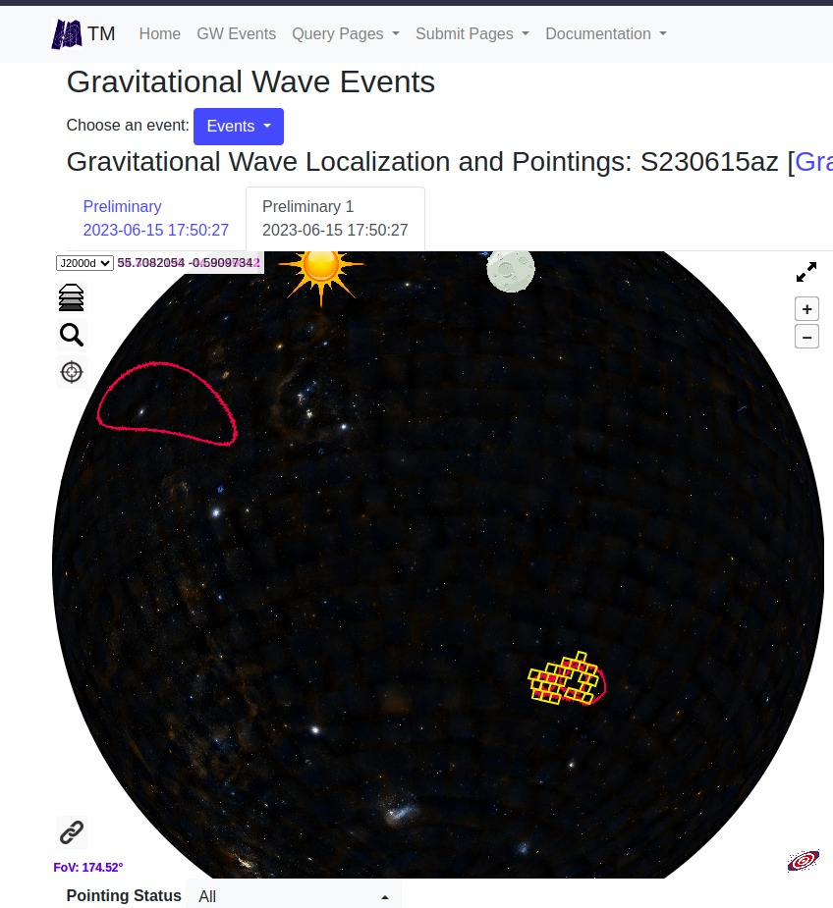
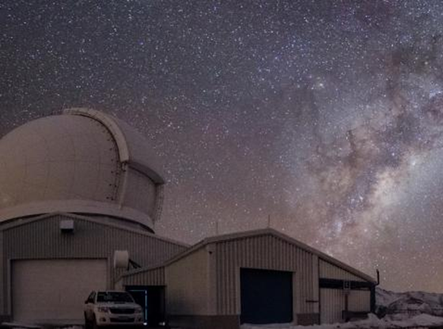
How Kilonova Hunting works?
We followed up a couple of GWs events now... Results are on the way. See Andre´s talk.

Slide 15
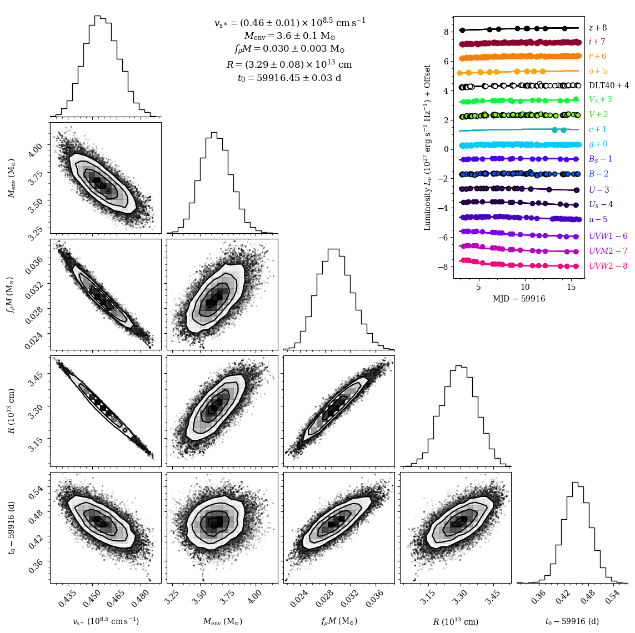
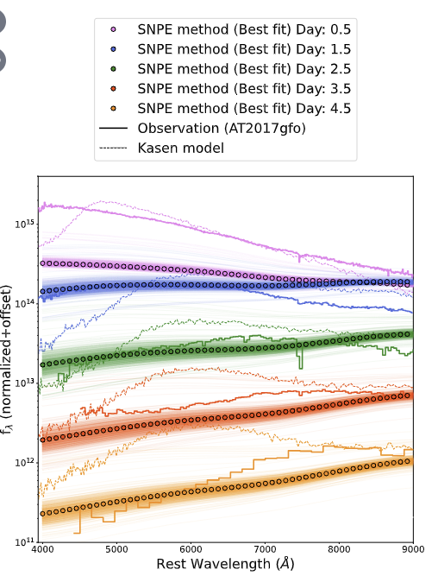
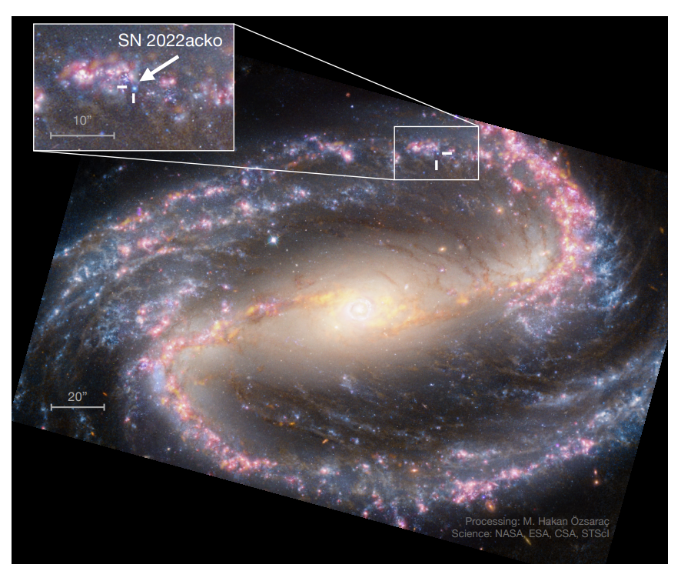
SN 2022acko: Type IIP Supernova
We can study late stages of the STAR. We have progenitor HST data available! See Gabriel Teixeira´s talk.
Notes:
₁₅
₁₅

Slide 16
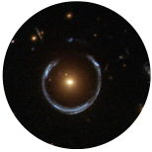
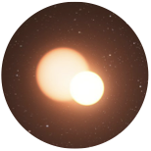
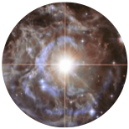
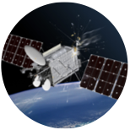
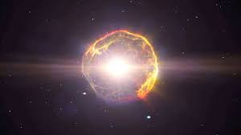
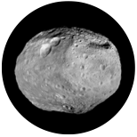
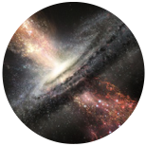
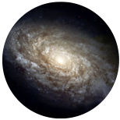
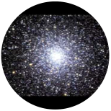
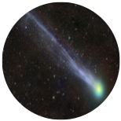
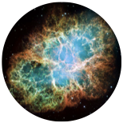
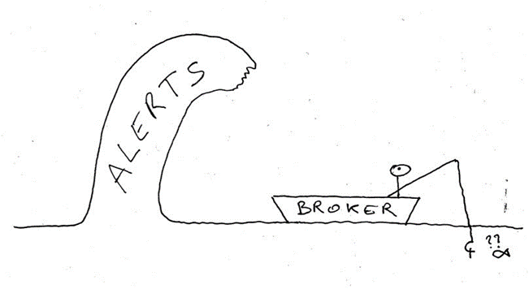
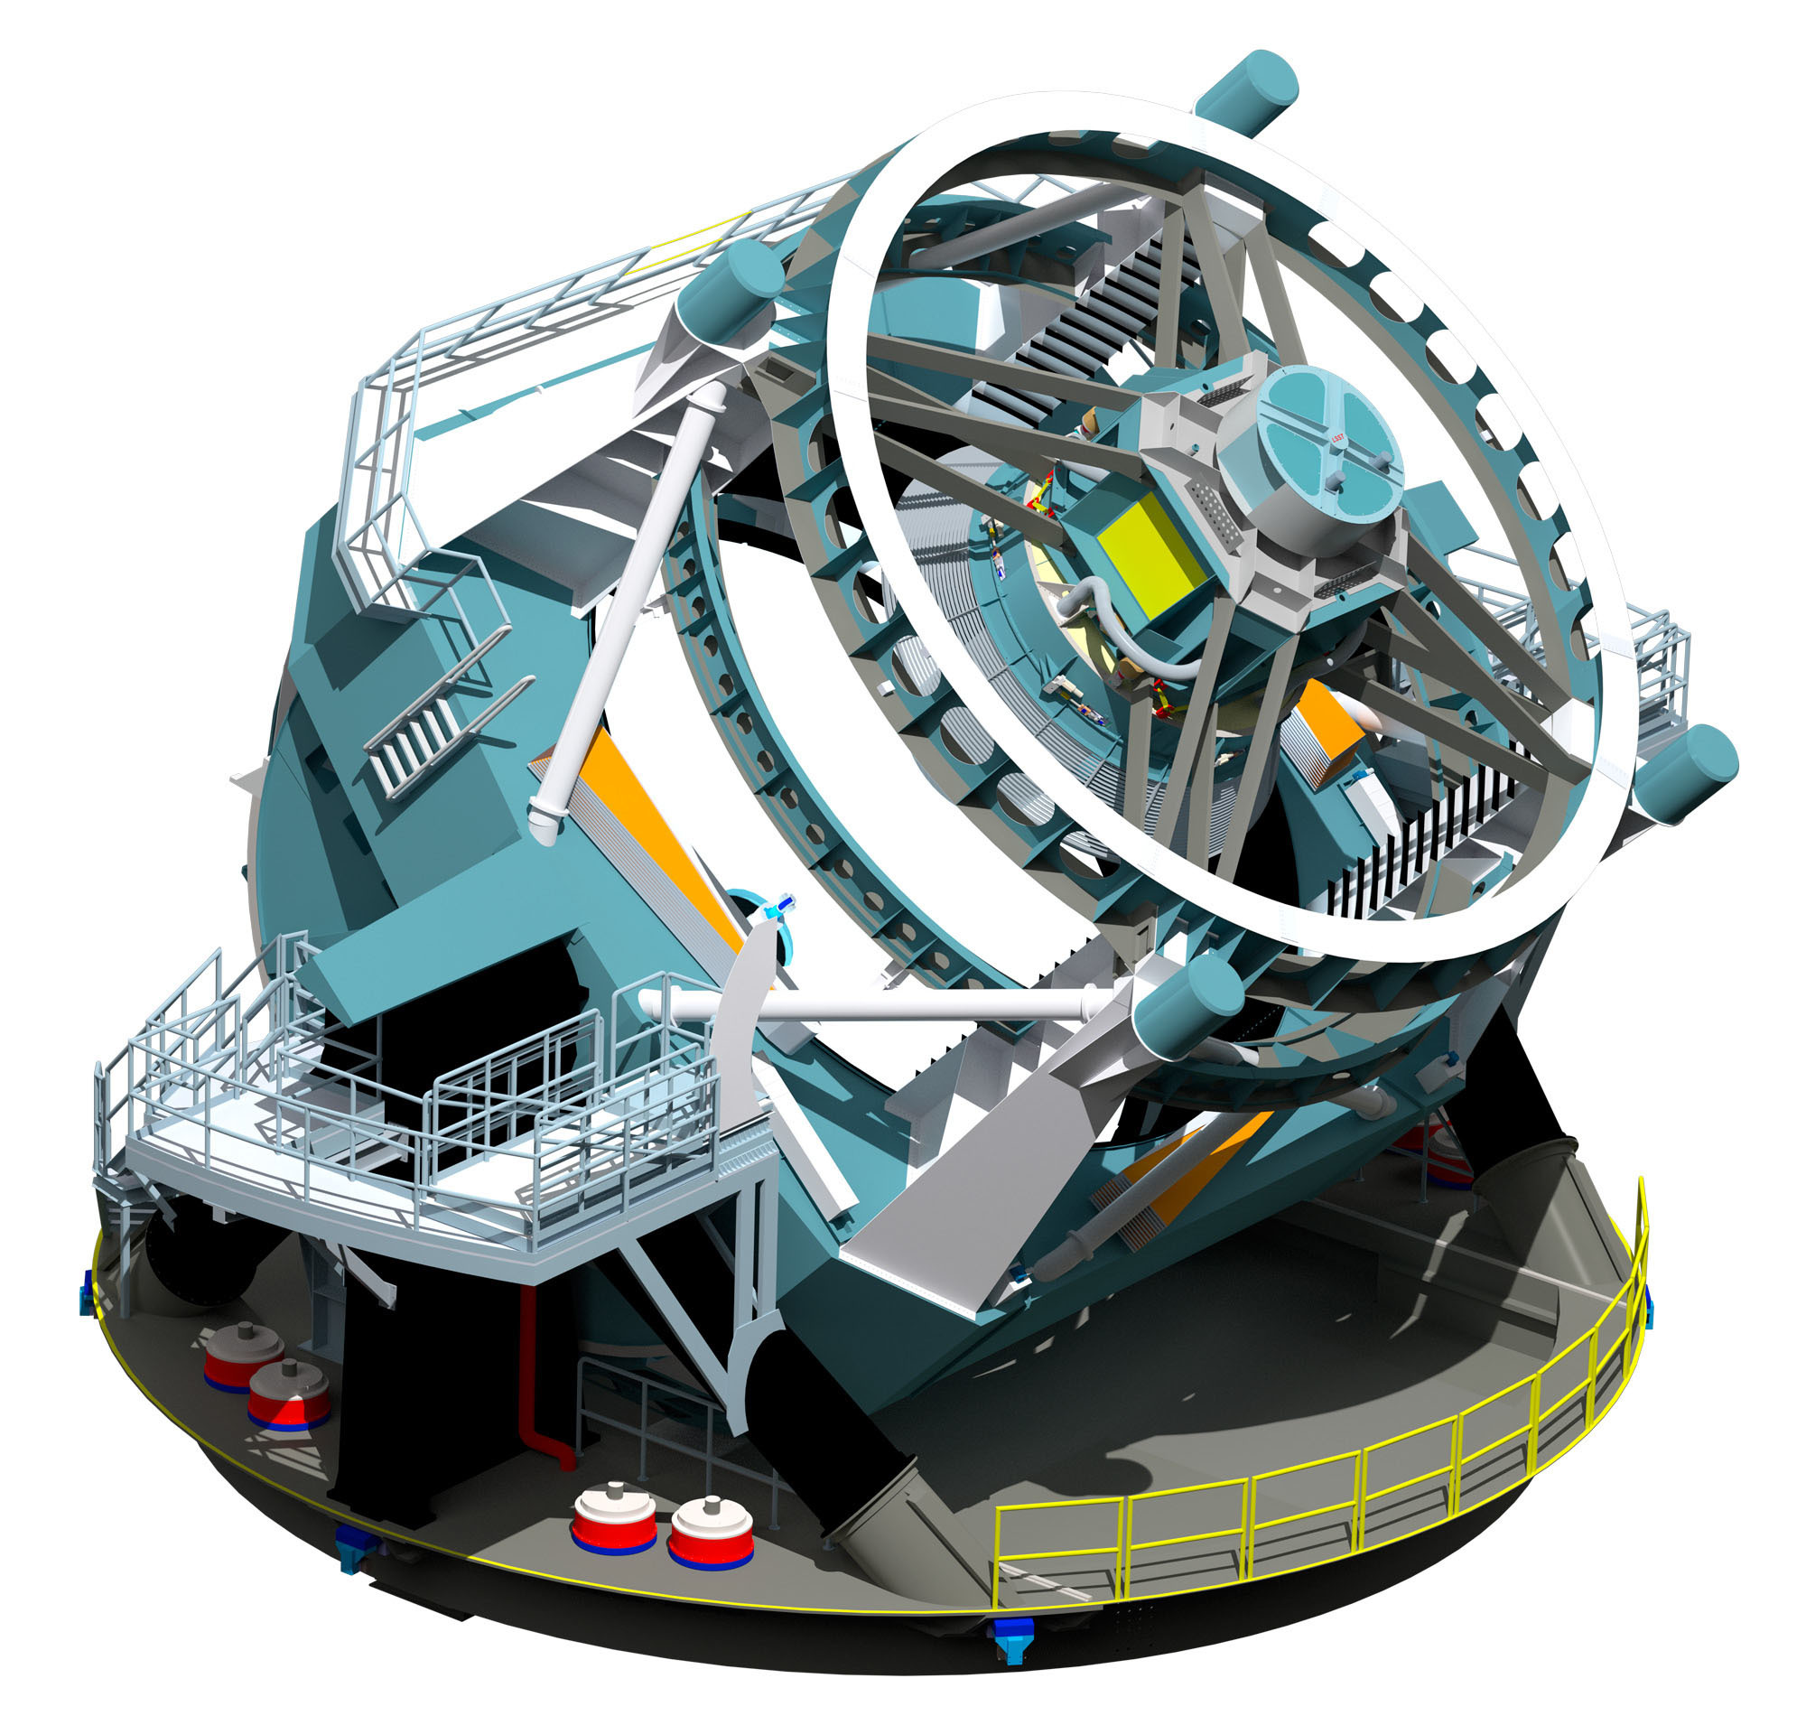
Alert Classification
Machine learning
Catalog association
Streams join
every ~30 seconds down to mag ~24
We would like the interesting ones ...
Notes:
₁₆
₁₆

Slide 17
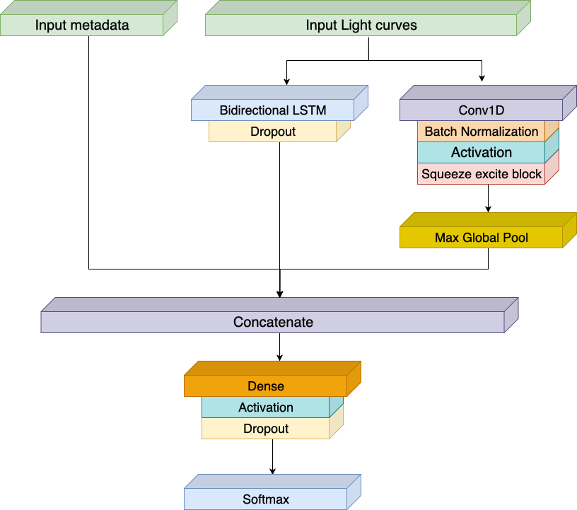
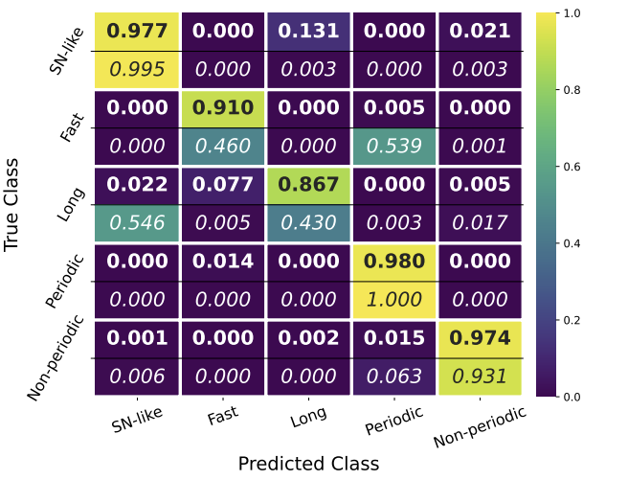
CBPF Alert Transient Search algorithm (CATS)
Broad Classifier: Uses 5 superclasses from the taxonomy for ELLAsTICC challenge
Fraga et al., 2024 - arXiv:2404.08798
Notes:
₁₇
₁₇

Slide 18
AI Lab multiGPUs Technology
We developed our liquid cooling systems allowing us to set-up machines with up to 15 GPUs integrated. Later we developed a solar plant to sustain the machines 24/7 With this fast communicating GPUs at low temperature we are able to Analyse Tbs of images and 3D models for Geophysics.
Made in Brazil
Notes:
Otimizar o uso de sistemas multiGPU para IA e simulações obtendo insights valiosos para a competitividade da indústria
Construção de modelos robustos NextGen AI&DL
Parâmetros computacionais dos sistemas multi-GPU que podem ser otimizados permitindo processar uma maior quantidade de dados ao mesmo tempo: taxas de transferência, clocks, topologia Node-PCIe, topologia NVLink, GPU Direct RDMA, rede de dados, armazenamento, softwares, eficiência energética, refrigeração etc.

Slide 19
Developments of Instruments for IA
Some IA models are limited due to availability of hardware resources for a long training times…
These technologies contribute to the testing, fast prototyping and feasibility study of AI models
Sci.minds allow tunning performance parameters
Notes:
Otimizar o uso de sistemas multiGPU para IA e simulações obtendo insights valiosos para a competitividade da indústria
Construção de modelos robustos NextGen AI&DL
Parâmetros computacionais dos sistemas multi-GPU que podem ser otimizados permitindo processar uma maior quantidade de dados ao mesmo tempo: taxas de transferência, clocks, topologia Node-PCIe, topologia NVLink, GPU Direct RDMA, rede de dados, armazenamento, softwares, eficiência energética, refrigeração etc.

Slide 20
II Strong Lensing Challenge Results
We won the International SL Challenge / 2020

Slide 21
Galaxy Morphology on DELVE
Main Goals:
Provide reliable morphological classification for DELVE galaxies dow to magnitude 21.5.
Investigate galaxy morphology across different environments and redshifts.
Release a catalog with morphological measurements for all galaxies on DELVE (S/N > 5, ~100 million galaxies).
In future we will produce enviroment catalog using morphology + photo-z
Galaxy Selection:
mag_g < 21.5
flags = 0
Extendend_class = 3
S/N > 5
100 million galaxies
Santana-Silva (.in prep)

Slide 22
CNN (model performance)
10000 galaxies.
Binary classification: Disk and Spheroid.
70% (train), 20% (validation), 10% (test).
Santana-Silva (.in prep)

Slide 23
Possible Fink Synergies Beyond CATS Alert classification
We could identify possible host galaxy photo-z from most of alerts before Rubin gives this info right away.
We could study environment of galaxies and host properties around transients. We could classify all possible objects not alerts.
We could quickly classify an stamp over alert of possible SLSN. We could work on massive modelling of subsets of transients with Neural Posterior Estimation techniques.
Follow- up high with high cadency some fields/objects of interest with the T80S / SOAR.
We produced > 20,000 sq deg heterogeneous coverage with high quality photo-zs up to mag r ~22 with full PDF (no gaussian approximation)
We will have morphology catalogs over the same area mag 21-ish We have many GPUs …
We can classify Alerts very quickly

Slide 24
Ministério da Ciência, Tecnologia e Inovações
Centro Brasileiro de Pesquisas Físicas
Gravitational Waves and Time Domain Astrophysics in Brazilian Center for Physics Research:
Synergies with FINK
Clécio R. Bom – debom@cbpf.br
Head of CBPF AI Lab
litcomp.cbpf.br/ai/

