Slide 1
Développement de chambres à fission pour l'étude des actinides avec les détecteurs
4π SCONE@NFS et TAC@n_TOF
M. Aiche⁴, M. Bacak^{1,5}, A. Cahuzac¹, G. Bélier², D. Bernard³, E. Berthoumieux¹, E. Dupont¹,
B. Fraïsse², F. Gunsing¹, L. Mathieu⁴, G. Noguère³, O. Sérot³, G. Tsiledakis¹
¹ Irfu/DPhN, CEA Paris-Saclay; ² DPTA/SPN, CEA DAM Ile de France;
³ IRESNE/DER/SPRC CEA Cadarache; ⁴ LP2i Bordeaux; ⁵ TU Wien
Workshop NACRE – IPHC Strasbourg – 22-23 Janvier 2024

Slide 2
Contents
R&D fission chamber for fission tagging
Measurements performed and in preparation
  2016: ²³³U @n_TOF
  2021: ²³⁸U @NFS
  2023: ²³⁹Pu @NFS
  2025: ²⁴¹Pu @n_TOF
Summary

Slide 3
Fission Chamber for fission tagging
1

Slide 4
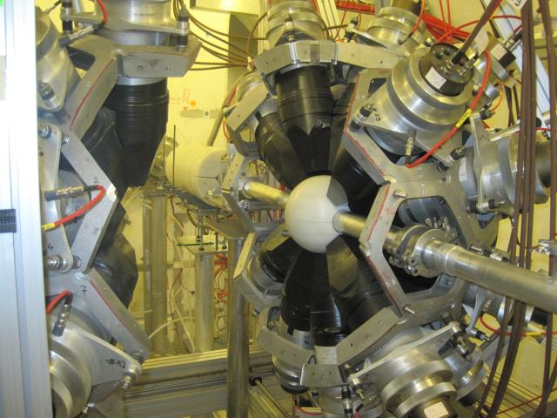
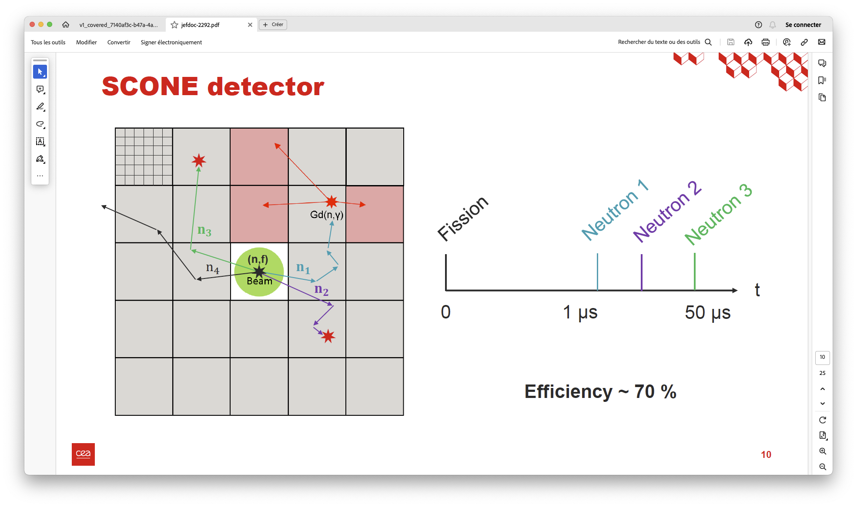
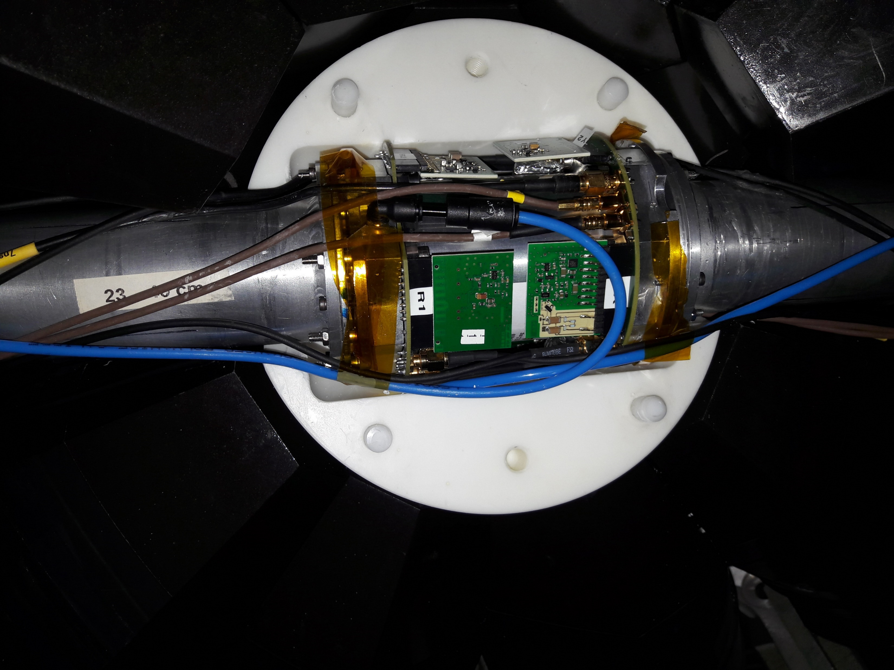
Principle of fission tagging
with the n_TOF TAC
Fission tagging is necessary
  For studying γ from fission (in coincidence mode)
  For studying capture (in anti-coincidence mode)
Samples are inside the fission chamber,
which is inside the TAC
with SCONE
Fission tagging is necessary
  For studying n from fission (in coincidence mode)
  For studying (n,xn) reaction (anti-coincidence)
Samples are inside the fission chamber,
which is inside SCONE
TAC detector (open)
n
γ₁
γ₂
γ₃
Fission chamber

Slide 5
Principle of fission tagging with the n_TOF
Total Absorption Calorimeter (TAC)
Detection of γ-rays by the TAC (4π segmented BaF₂ calorimeter of 40 crystals)
𝐸_{𝑆𝑢𝑚} = 𝐸₁ + 𝐸₂ + 𝐸₃ = 𝑆_{𝑛} + 𝐸_{𝑛}
𝑚_{𝑐𝑟} = 3
E_{Sum} is the total γ-ray energy deposited in the TAC
m_{cr} is the number of crystals detecting a gamma
⇨ Selection cuts on E_{sum} and m_{cr} improve Signal/Bkgd
Fission tagging is necessary
  For studying fission (in coincidence mode)
  For studying capture (in anti-coincidence mode)
  For studying (n,xn) reaction (anti-coincidence)
Samples are inside the fission chamber,
which is inside the TAC
TAC detector (open)
n
γ₁
γ₂
γ₃
Fission chamber

Slide 6

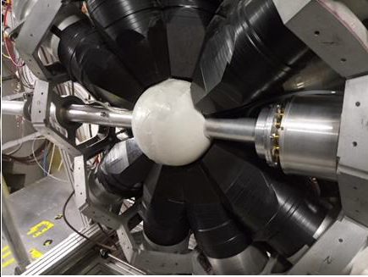
Fission Tagging development for the n_TOF TAC
TAC + FTMG-U235 [C. Guerrero et al., EPJA 48 (2012) 29]
Micromegas (MGAS) detectors / electronics outside the TAC
Background issue due to the MGAS thick Cu mesh in the beam
TAC + FICH-U233 [M. Bacak et al., NIMA 969 (2020) 163981]
Fission chamber
Fast electronics plugged directly on the chamber’s PCB
Minimum amount of material in the beam
TAC + FICH-Pu239 [J. Perkowski et al., in preparation]
Fission chamber with minimum material in the beam
Electronics moved off center (less background)
Additional gas in the beam (more background)

Slide 7
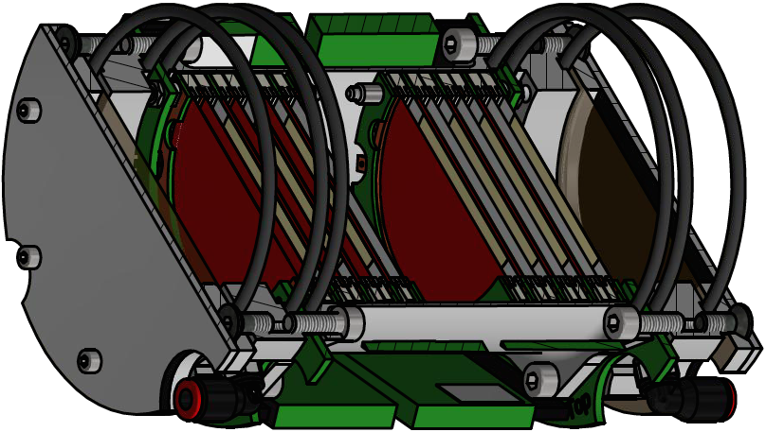
Fission chambers for ²³³U and ²⁴¹Pu
²³³U FICH [M. Bacak, NIMA 969 (2020) 163981]
Compact (L 12 cm x Ø 9 cm) Multi-plate chamber
- Total of ~46 mg of ²³³U
- 14 samples highly enriched in 233U (JRC-Geel)
- 14 ionization cells / Readout from 8 anodes
Fast signals (34 ns FWHM) for high α-count rates (>1 MBq per anode)
- Fast ionizing gas CF₄ / Fast electronics (CEA/DAM/DIF)
New ²⁴¹Pu FICH
Total of ~10 mg of ²⁴¹Pu
6 to 8 samples only (more compact ⇨ less material in the beam)
Lower gas pressure (less material in the beam ⇨ less background)
Less massive (for reducing background from scattered neutrons)
Improved electronics (faster signals for sustaining higher α-count rates)

Slide 8
Comparison/Evolution of fission chambers
 | LANL-Pu241 (2010) [1] | DAM-U238 (2016) [2] | n_TOF-U233 (2016) [3] | n_TOF-Pu239 (2020) [4] | DAM-Pu239 (2023) | n_TOF-Pu241^{(*)} (2024)
Gas and drift velocity | 90%Ar-10%CH₄ 6 cm/us | CF₄ 11 cm/us | CF₄ 11 cm/us | 90%Ar-10%CF₄ 12 cm/us | CF₄ 11 cm/us | 90%Ar-10%CF₄ 12 cm/us
Gap and Voltage | 12 mm 250 V/cm | 2.5 mm 1300 V/cm | 3 mm 1400 V/cm | 4.5 mm 470 V/cm | 3 mm | ~3 mm
Drift time | ~200 ns | 23 ns | 27 ns | 37 ns | 27 ns | ~27 ns
Pressure | 1.65 bars | PA + 50 mbar | 1100 mbar | PA + epsilon | ~100 mbar | < PA
Deposit | ∅ 38 mm ~200 ug/cm2 (+ VYNS film) | ∅ 33 mm 585 ug/cm2 | ∅ 40 mm 264 ug/cm2 | ∅ 20 mm 300 ug/cm2 |  | ∅ 30 mm 265 ug/cm2
Cathodes | 4 (SS 12.5 um) | 19 (Ti 50 um) | 14 (Al 10 um) | 10 (Al 10 um) | 8 (Al 10 um) | 8 (Al 10 um)
Anodes | ? | 18 (Ti 50 um) | 8 (Al 20 um) | 10 (Al 10 um) | 4 (Al 1 or 2 um) | 8 (Al 10 um)
Cat. + An. |  | 1850 um | 300 um | 200 um | 86 um | 160 um
Windows | ? | Titanium (100 um) | Kapton (25 um) | Kapton (25 um) | Titanium (10 um) | Kapton (25 um)
(*) n_TOF-Pu241 with 15 mg samples (10 mg of 241Pu) of 70 MBq alpha-activity (assuming 2% 241Am)

Slide 9
Fission Chamber references
[1] F. Tovesson, T.S. Hill, Cross Sections for 239Pu(n,f) and 241Pu(n,f) in the Range En = 0.01 eV to 200 MeV, Nuclear Science and Engineering 165 (2010) 224; https://doi.org/10.13182/NSE09-41
[2] J. Taieb et al., A new fission chamber dedicated to Prompt Fission Neutron Spectra measurements, NIMA 833 (2016) 1–7; http://dx.doi.org/10.1016/j.nima.2016.06.137
[3] M. Bacak et al., A compact fission detector for fission-tagging neutron capture experiments with radioactive fissile isotopes, NIMA 969 (2020) 163981; https://doi.org/10.1016/j.nima.2020.163981
[4] J. Perkowski et al., Multi-section ionization fission chamber for measurement of 239Pu(n,g) reaction in fission tagging method (paper in preparation)

Slide 10
²³³U @ n_TOF (2016)
2.1
PhD Thesis of Michael Bacak

Slide 11
Measurement of ²³³U @ n_TOF in 2016
Why
U-233 capture cross section is important for reactors using the Th/U fuel cycle
Only two measurements are available because of U-233 radioactivity and low capture cross section with respect to fission
How
Development of a compact fission chamber to be coupled with the TAC
Fission-tagging measurement of the U-233 capture cross section
TAC detector (open)
n
γ
γ
γ
Fission chamber

Slide 12
Measurement of ²³³U @ n_TOF in 2016
Fission Chamber
[M. Bacak, NIMA 969 (2020) 163981]
Compact (L 12 cm x Ø 9 cm)
Multi-plate chamber
  - 14 ionization cells
  - Readout from 8 anodes
Fast signals (34 ns FWHM) for high α-count rates (>1 MBq per anode)
  - Fast ionizing gas CF₄
  - Fast electronics (DAM/DIF)
  - Gap width: 3 mm @ 420 V
14 isotopically enriched (>99.9%) ²³³U samples (JRC-Geel)
    - Ø 4 cm
    - ~46 mg ²³³U total
C
A
CC
A
CC
A
CC
A

Slide 13
Measurement of ²³³U @ n_TOF in 2016
Data Taking
TAC and Fission Chamber operated in coincidence
Six weeks of measurement
950 TB of data
Analysis
Multi-parametric data analysis (coincidences, anti-coincidences, crystal multiplicity, Sum energy, gamma spectra)
Monte-Carlo simulations for various corrections (thresholds, background, efficiency)
Still fine-tuning the analysis while finalizing the publication

Slide 14
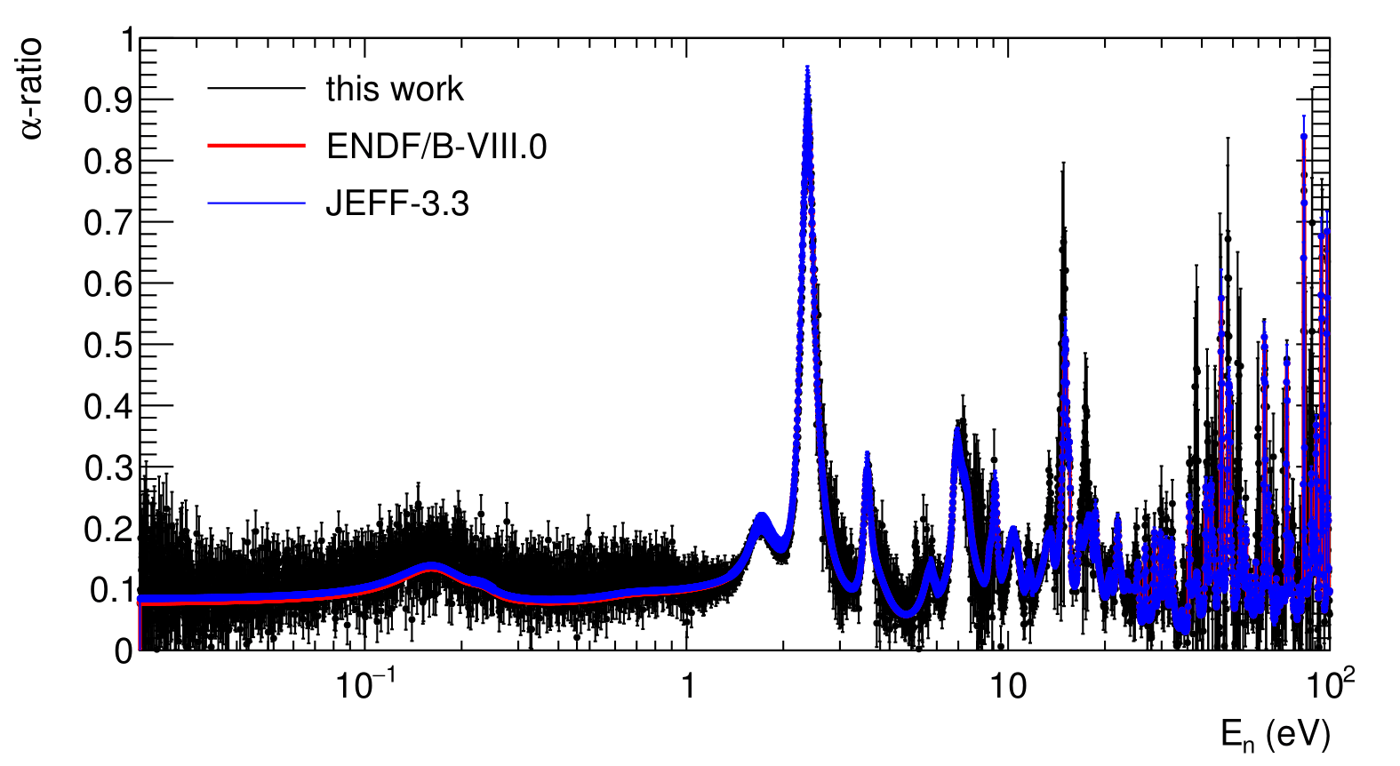
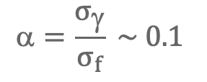
Measurement of ²³³U @ n_TOF in 2016
Preliminary alpha-ratio
[M. Bacak, EPJ Conf 239 (2020) 01043]
Overall consistency with evaluated libraries
Some deviations under investigations
Final paper still to be published
$$=\frac{σ_{γ}}{σ_{f}} \sim 0.1$$
3 ≤ m_{cr} ≤ 7
2.5 MeV ≤ E_{Sum} ≤ 7 MeV

Slide 15
²³⁸U @ NFS (2021)
2.2

Slide 16
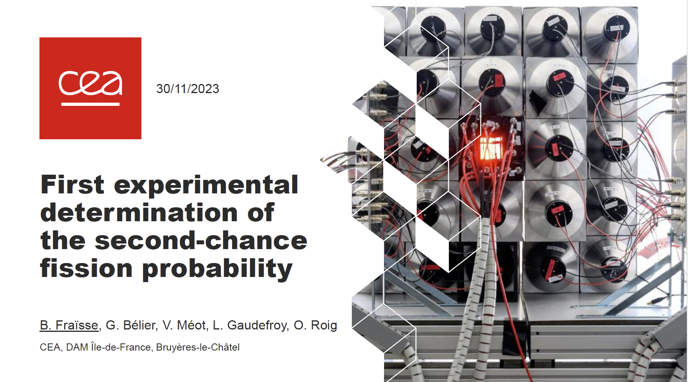
Measurement of ²³⁸U @ NFS in 2021
B. Fraïsse et al, JEFF Meeting, OECD/NEA, November 2023, JEF/DOC-2292

Slide 17
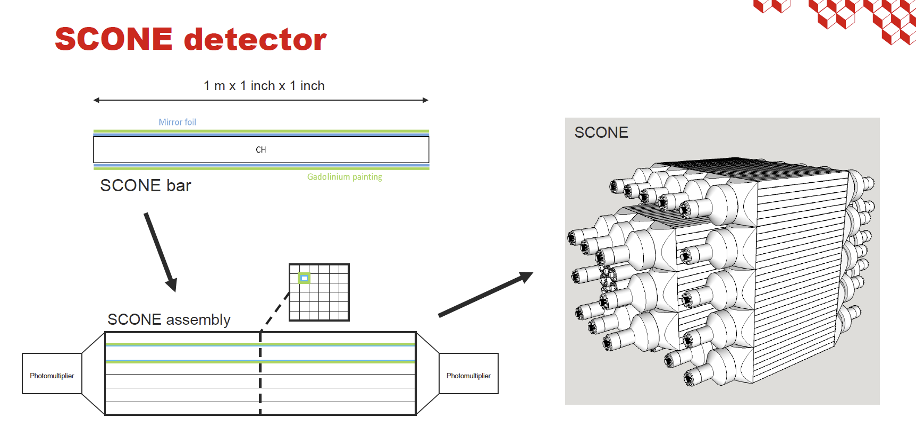
Measurement of ²³⁸U @ NFS in 2021
From B. Fraïsse et al, JEFF Meeting, OECD/NEA, November 2023, JEF/DOC-2292

Slide 18
Measurement of ²³⁸U @ NFS in 2021
From B. Fraïsse et al, JEFF Meeting, OECD/NEA, November 2023, JEF/DOC-2292

Slide 19
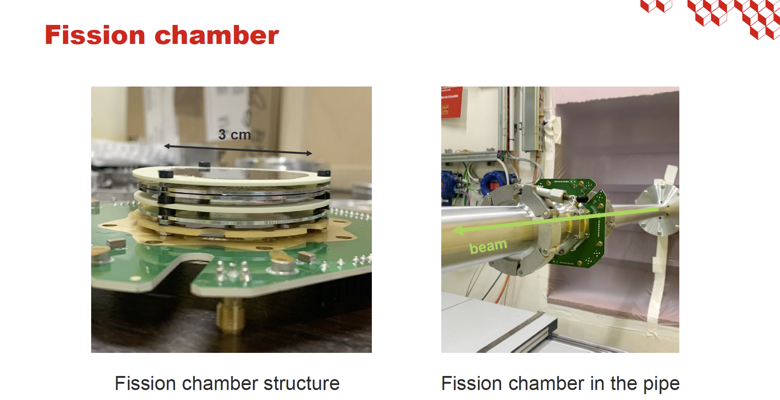
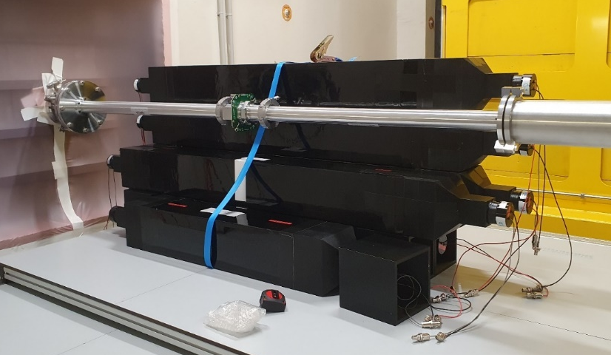
Measurement of ²³⁸U @ NFS in 2021
FICH inside SCONE (open)
From B. Fraïsse et al, JEFF Meeting, OECD/NEA, November 2023, JEF/DOC-2292

Slide 20
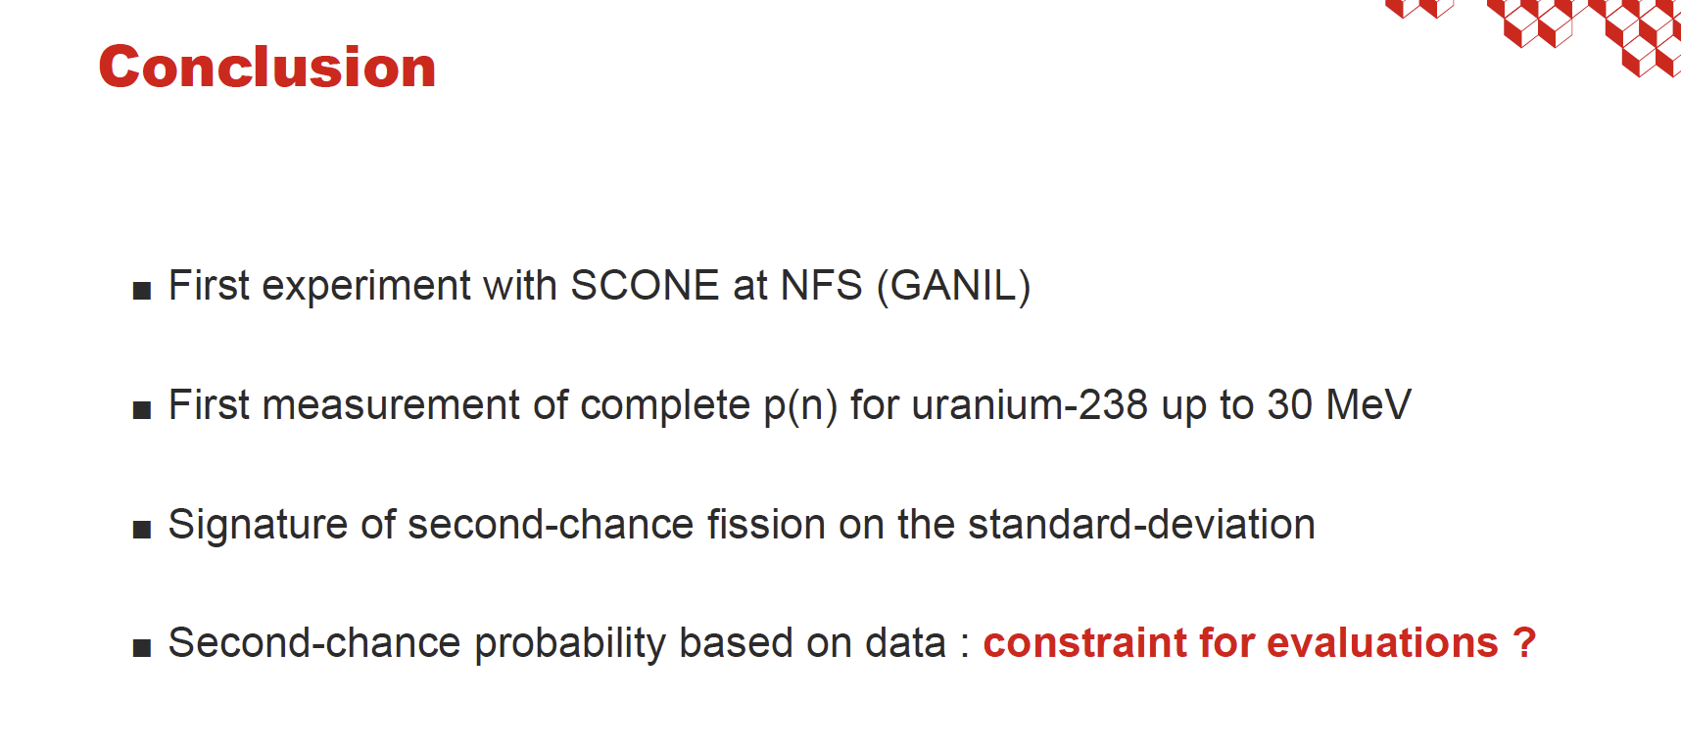
Measurement of ²³⁸U @ NFS in 2021
From B. Fraïsse et al, JEFF Meeting, OECD/NEA, November 2023, JEF/DOC-2292

Slide 21
²³⁹Pu @ NFS (2023)
2.3

Slide 22
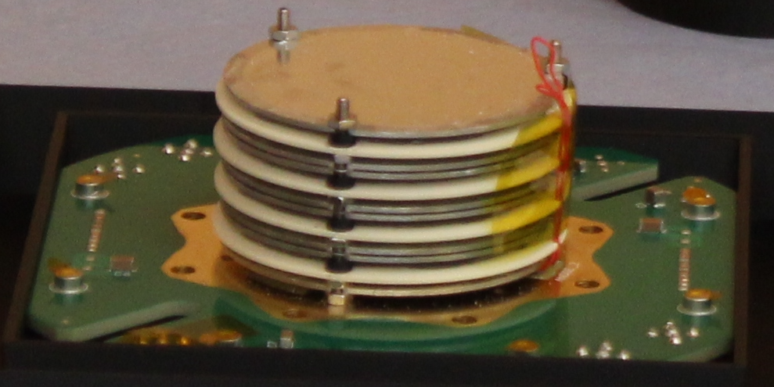
Fission chamber design
FICH DAM-Pu239 (8 deposits and 4 anodes)
Stack of biased anodes (in black) and grounded cathodes with deposit (in red)
Gap of 3 mm => stack of 3 cm

Slide 23
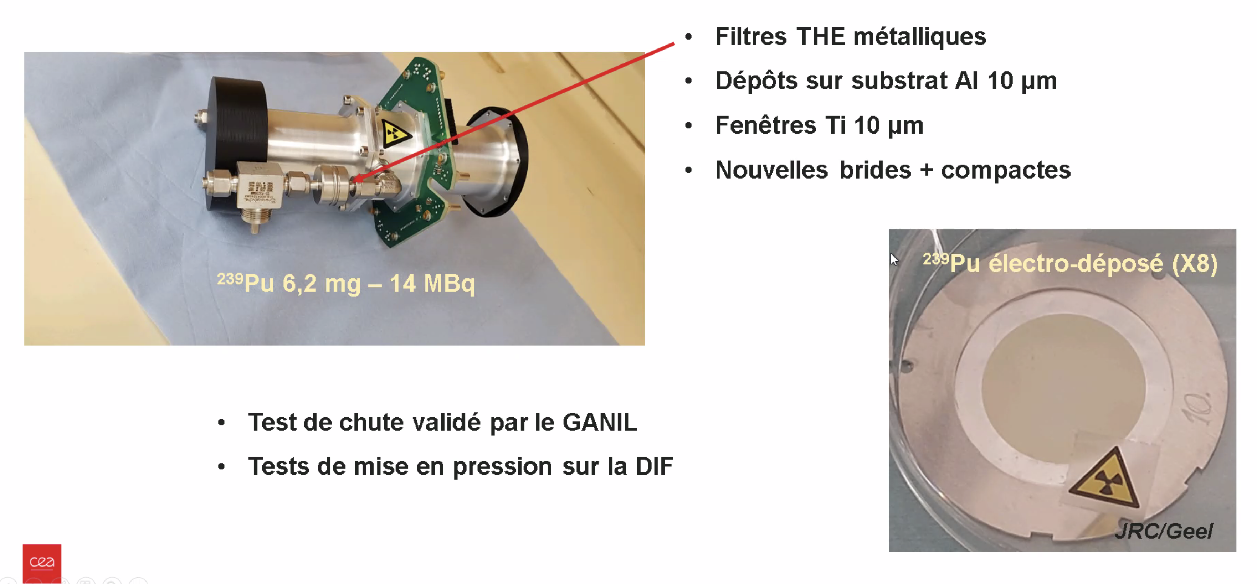
Fission chamber design

Slide 24
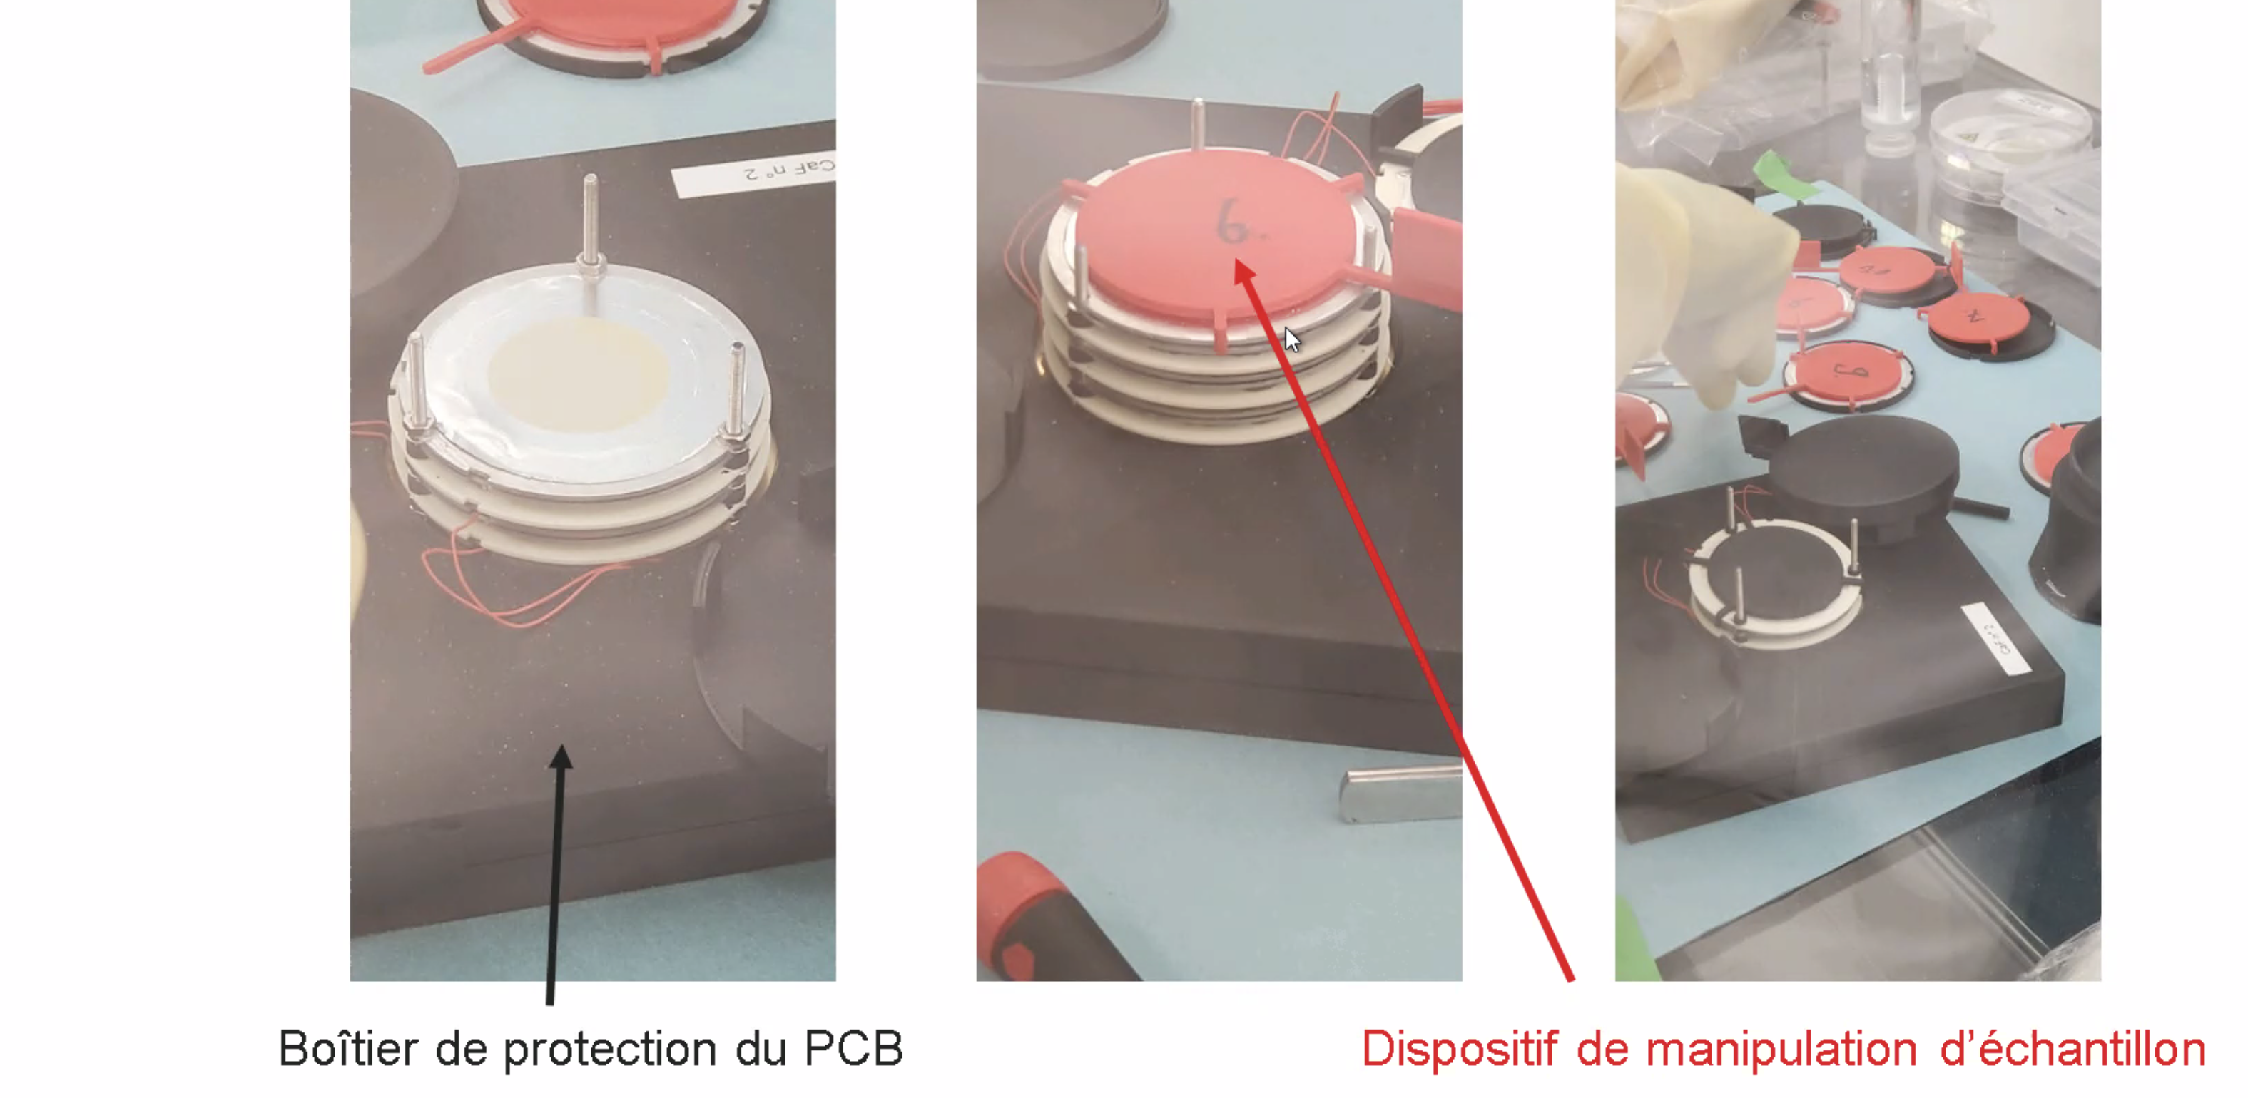
Mounting of the samples at JRC-Geel

Slide 25
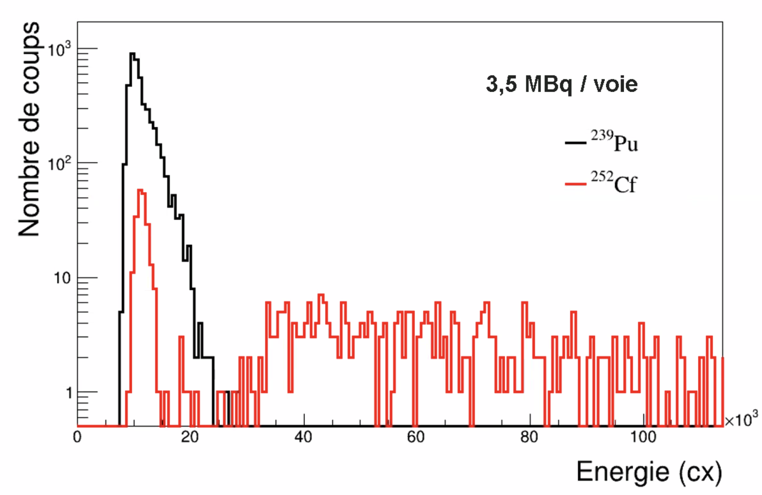
Fission chamber validation test
Gas pressure of 800 mbar
Good α-FF separation

Slide 26
²⁴¹Pu @n_TOF (2025)
2.4

Slide 27
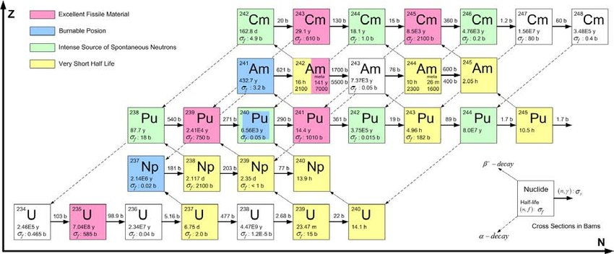
Motivations
Plutonium is produced in reactors, ²³⁹Pu and ²⁴¹Pu both contribute to energy production
²⁴¹Pu xs are not well known because of its short half-life (~14 years) and the ²⁴¹Am build-up

Slide 28
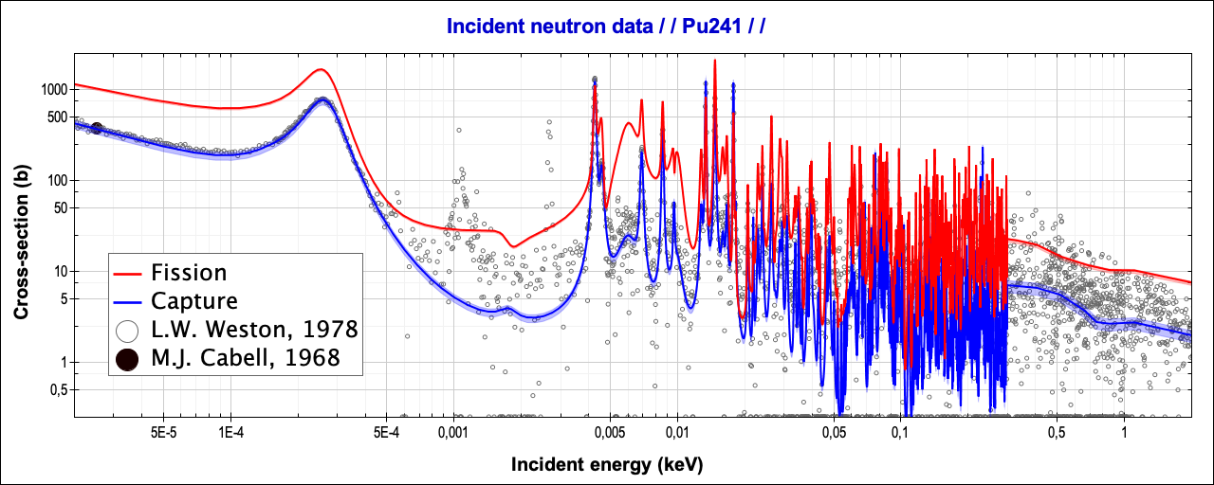
Capture and fission cross sections
The fission cross section of ²⁴¹Pu is at least three times larger than its capture cross section
There is only one time-of-flight measurement for capture, made by Weston at ORNL in the 70’s

Slide 29
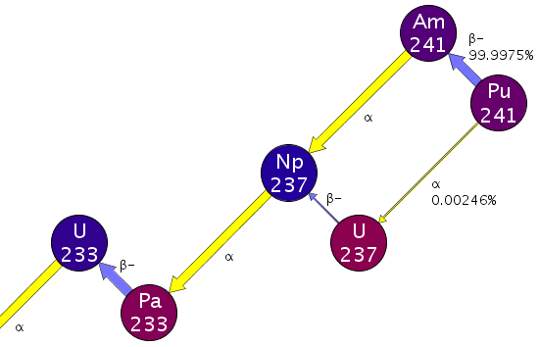
Radioactive decay of Pu and daughters
Parent nucleus | T_{1/2} | Decay mode | Daughter nucleus | T_{1/2}
²⁴¹Pu | 14.3 y | β- (~100%) | ²⁴¹Am | 433 y
²⁴¹Am | 433 y | α (100%) | ²³⁷Np | 2.1 My
High activity (β > 99.99% with Q ~21 keV)
β decay populates ^{241gs}Am only (i.e., no γ)
Possible issue for capture xs interferences
Possible issue for α-background in the FICH
²⁴¹Pu | 14.3 y | α (<<1%) | ²³⁷U | 6.75 d
²³⁷U | 6.75 d | β- (100%) | ²³⁷Np | 2.1 My
²³⁷Np | 2.1 My | a (100%) | ²³³Pa | 27 d
²³³Pa | 27 d | b- (100%) | ²³³U | 159 ky
no γ
Eγ = 60 keV
²³⁸Pu | 87.7 y | α (100%) | ²³⁴U | 245 ky
²³⁹Pu | 24.1 ky | α (100%) | ²³⁵U | 704 My
²⁴⁰Pu | 6.6 ky | α (100%) | ²³⁶U | 23 My
²⁴²Pu | 373 ky | α (100%) | ²³⁸U | ~stable
²⁴⁴Pu | 81 My | α (100%) | N/A
a few γs
Eγ = 149 keV
Eγ = 312 keV
~no γ

Slide 30
Simulation of capture counting rates
Binning adapted to have a statistical precision better than ~3% (~10³ counts/bin)
E < ~20 eV ⟹ 200 bpd (bins per decade) allow for good resolution and statistics
20 eV

Slide 31
Alpha-activity from a 15 mg sample (~10 mg of ²⁴¹Pu)
Composition calculated in 2025 four months after the last Am purification
Significant contributions from ²³⁸Pu, ²⁴⁰Pu, and especially ²⁴¹Am
Total contribution from Pu isotopes is 30 MBq (in 4π)
²⁴¹Am build-up would add between 20 MBq (1% build-up) and 40 MBq (2% build-up)
The new FICH should be able to handle such an α-background, i.e. up to ~5 MBq/channel
(see tests at 14 MBq/channel in Laurent et al., NIMA 990 (2021) 164966)
 | Pu-238 | Pu-239 | Pu-240 | Pu-241 | Pu-242 | Am-241 | Total
Atom % | 0.07% | 4.3% | 16.6% | 65.3% | 12.4% | ~1% | 100%
α-activity (MBq) | 6.5 | 1.5 | 21 | 0.9 | 0.3 | ~20 | ~50

Slide 32
Deposits of ~10 mg of ²⁴¹Pu (15 mg of Pu)
Assuming a maximum activity in 4π of 70 MBq (30 MBq from Pu + 40 MBq from 2% ²⁴¹Am)
- 1 anode for every deposit (on the cathode), i.e. alpha-activity in 2π only
- deposits of diameter 40 mm or 30 mm
=> 8 deposits of ∅ 30 mm should be ok (8 channels is the maximum with the “FICH-U3” design)
 |  | 4 anodes | 6 anodes | 8 anodes | 10 anodes
α-activity/channel |  | 8.8 MBq | 5.8 MBq | 4.4 MBq | 3.5 MBq
Deposit thickness | ∅ = 40 mm | 298 μg/cm² | 200 μg/cm² | 150 μg/cm²
 | ∅ = 30 mm |  | 354 μg/cm² | 265 μg/cm² | 212 μg/cm²

Slide 33
Fission chamber preliminary design
FICH n_TOF-Pu241 (8 deposits and 8 anodes)
Stack of biased anodes (in black)
and grounded cathodes with deposits (in red)
Gap of 3 mm
=> two symmetric half-stacks of 19 mm
NB: the length of the chamber is constrained
by the size of a preamp (which is ~37 mm)

Slide 34
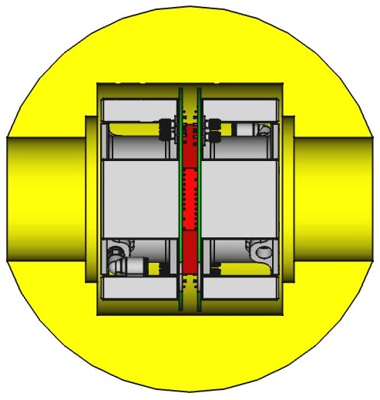
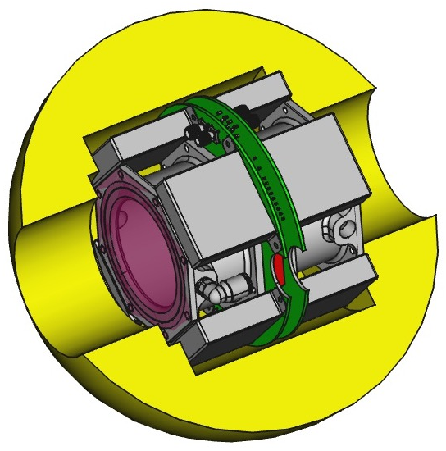
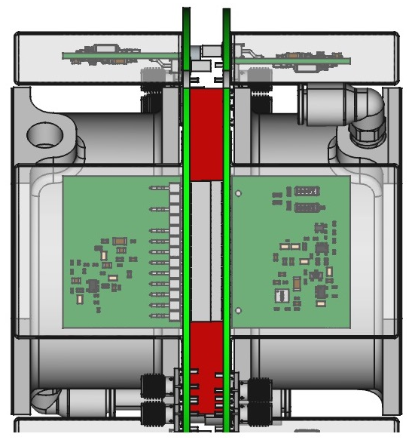
Fission chamber preliminary design
Compact configuration (-7 mm) with bottom connections for PA
-7 mm
-7 mm

Slide 35
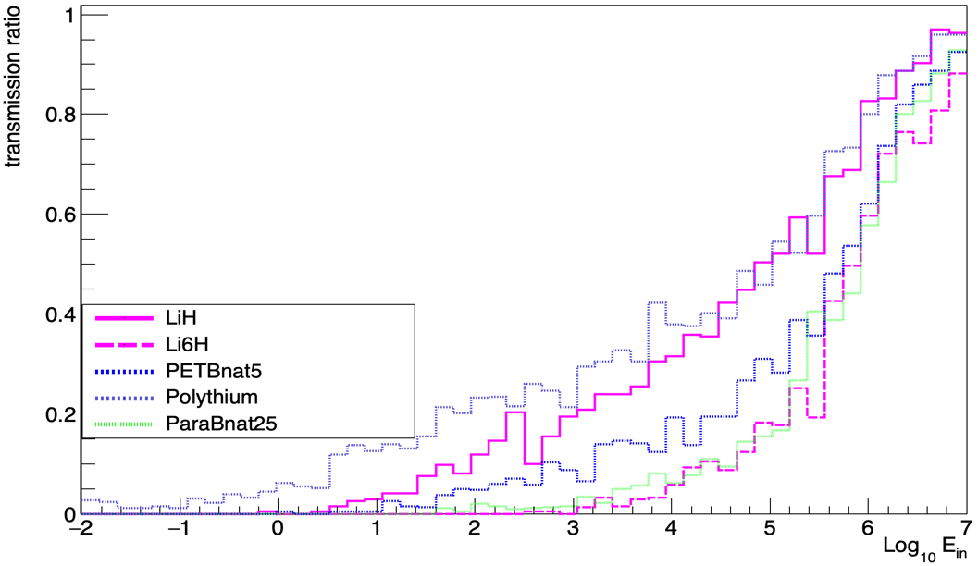
Absorber material preliminary study
The absorber of the TAC should:
moderate/absorb all scattered
(and fission) neutrons
be transparent to gamma
not produce any problematic
secondary gammas
Typical materials:
LiH, Polyethylene (PE) with Li or B
Geant4 simulation shows that 4 cm
B-PE with 5% B-nat is very efficient

Slide 36
Summary
3

Slide 37
Summary
Collaboration between DRF, DAM, DES, LP2i Bordeaux, IRSN (+JRC-Geel)
Development of Tagging Fission Chambers for high counting rates
  Compact FICH-U233 for TAC based on DAM design for high counting rate
  More compact FICH-U238 and FICH-Pu239 for SCONE based on FICH-U233
  FICH-Pu241 for TAC will be based on the latest developments
Measurements making use of these developments
  @n_TOF: ²³³U in 2016 (and ²⁴¹Pu in 2025)
  @NFS: ²³⁸U in 2021 (and ²³⁹Pu…)

Slide 38
Thank you for your attention

