Slide 1
Using FORS2 data to improve templates selection for photometric redshifts
Joseph Chevalier, Sylvie Dagoret-Campagne
Réza Ansari, Johann Cohen-Tanugi, Marc Moniez , Éric Nuss
LSST-France, CC-IN2P3
December 13, 2023
Notes:
Today I will present the follow-up of my work on photometric redshifts, as part of my 2nd year of PhD under the supervision of Sylvie, with FORS2 data and in collaboration with Réza, Johann, Marc and Eric who initiated the project.

Slide 2
Outline
Get raw data : 550 narrow spectra from FORS2 at VLT
Extrapolate observations (Stellar Population Synthesis) → 550 wide spectra, from UV to IR
Select ≈ 30 as templates for photo-z estimation : color indices, clustering, etc.
Run photo-z (LEPHARE++, in-house software) beyond point-estimates :
Identify best model at spectroscopic redshift
Compare to the model and redshift selected IAW photometry
Evaluate and understand the good vs bad templates
Is there a stellar population recipe for good templates?
Notes:
This work has been so far orchestrated as listed here. The first 2 steps were done prior to my involvement by the team in Montpellier ; whereas the following ones have kept me busy over the last year.

Slide 3
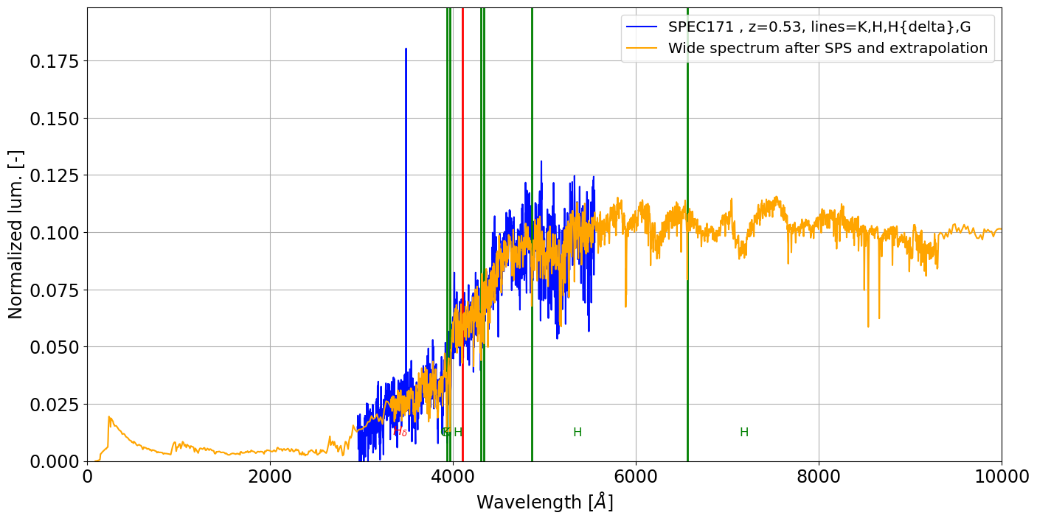
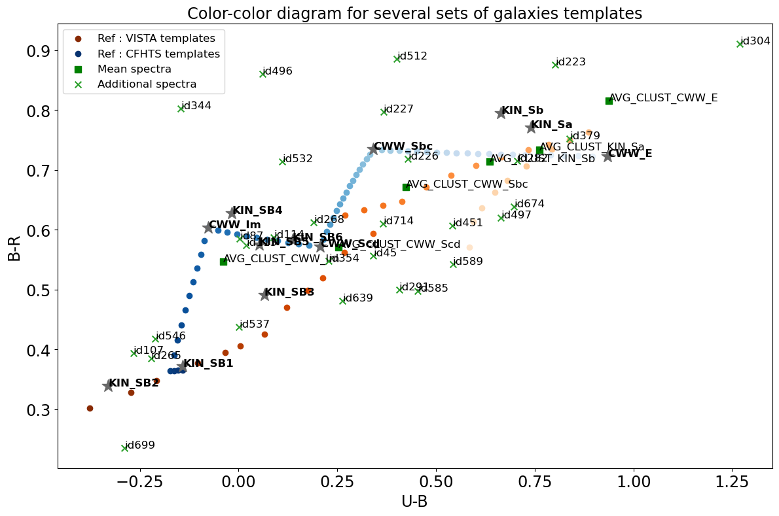
Outline
Get raw data : 550 narrow spectra from FORS2 at VLT
Extrapolate observations (Stellar Population Synthesis) → 550 wide spectra, from UV to IR
Select ≈ 30 as templates for photo-z estimation : color indices, clustering, etc.
LSST-France
Grenoble
June 2023
Notes:
Indeed, some results were presented during the last gathering in Grenoble. As a reminder : I introduced the spectra obtained with observations on FORS2 instrument at the VLT and how they were extrapolated to a wide range of wavelengths. Then I showed a couple of methods to select templates from this pool of spectra and use them to perform photometric redshifts estimation with LEPHARE. Results on COSMOS2020 spectro-photometric dataset were compared to those obtained with « legacy » templates derived from the CWW and Kinney spectra.
On the left plot : raw observation (blue) and extrapolated spectrum (yellow) with main emission and absorption lines.
On the right plot : example of template selection from the bank of spectra (green) and color-color comparison with legacy templates (blue and orange)

Slide 4
Outline
Run photo-z (LEPHARE++, in-house software) beyond point-estimates :
Identify best model at spectroscopic redshift
Compare to the model and redshift selected IAW photometry
Evaluate and understand the good vs bad templates
Focus of today’s presentation
+ glimpse at potential results… if all things went perfectly !
Notes:
Today’s talk will focus mainly on the more recent steps of my work. That is to say : use these templates, and a purposefully-developped photo-z code, to try and gain information on how to improve a template set for template-fitting and, ultimately, use it to improve photo-z estimation. This work is still ongoing and may lead to further developments that are not highlighted here !

Slide 5
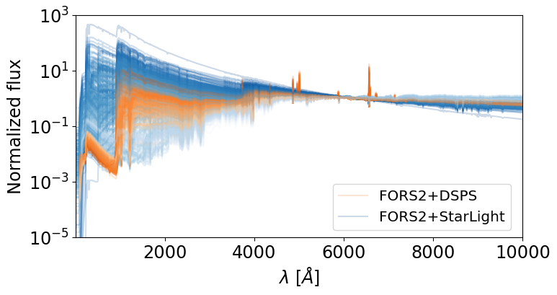
Outline
Is there a stellar population recipe for good templates?
Notes:
For instance : combining SPS and photo-z estimation to try and go further than selecting spectra based on their colours, but instead on their inferred stellar content and properties. Some of this will be the focus of another presentation tomorrow by Sylvie. One can notice, however, that for the same observed spectra, different SPS models will yield very different results. The challenge then is to put the correct constraints on those models to get the best understanding of the physics inside our template.

Slide 6
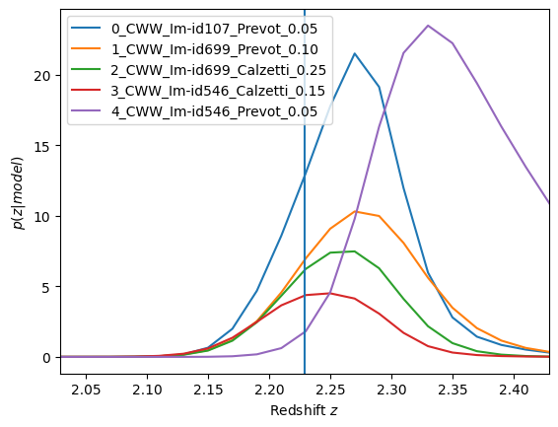
Best model at true redshift
Not a full photo-z estimation :
In LEPHARE++ : ‘-ZFIX YES’ outputs the most-likely model (i.e. min(χ²)) at specified redshift
In EmuLP : full posterior, evaluated at z_{spec} and highest probability wins !
Would not necessarily output z_{spec} as the point-estimate for a given galaxy :
Mode, mean or median of p(z|model) ≠ z_{spec}
Degeneracies (dust vs redshift) → bimodal distributions
Notes:
Now that we are getting to the core of the presentation, I’ll start by saying that I have mostly not been interested in estimating photo-z recently. In fact, I have focussed more on the extraction of the best model for a sample of galaxies with previously known redshifts. This is achievable with both codes at hand, although LEPHARE does not output more than 1 model. On the plot here, we see the results for a randomly-selected galaxy in the sample : the blue curve the probability distribution of redshift for the model that has the highest likelihood at z_spec (vertical line). Orange is the 2nd best, etc. Note that should this model be correctly identified by the photo-z code, the point-estimate of redshift would still not be exactly z_spec. Templates here were the ones selected from FORS2-data.

Slide 7
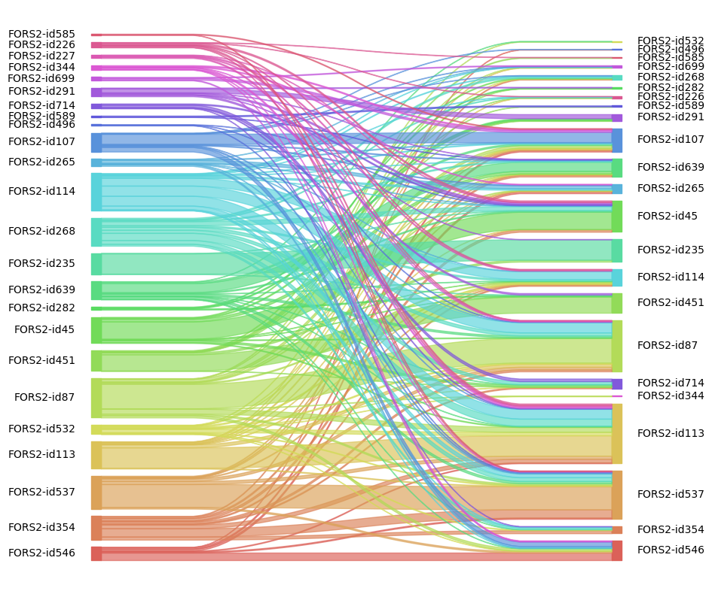
Best model at true redshift
Comparison : best model @ z_{spec} =? model at min(χ²)
1000 galaxies from COSMOS2020 spectro sample, z ≤ 3, ugrizy filters from HSc
Map the results
Statistically determine the “good” and the “bad” templates
Notes:
Well then, how can we quantify and identify what ensures good matches? Here is the beginning of an answer : this graph shows a map connecting the best model at zp-spec, as identified above, to the one that displayed the maximum likelihood (or minimum chi²), thus providing a photo-z estimation. Fortunately, one can notice that most pairings are done correctly (the lines connecting different models are quite thin). It is expected, as this is a run with about 10% of catastrophic outliers…

Slide 8
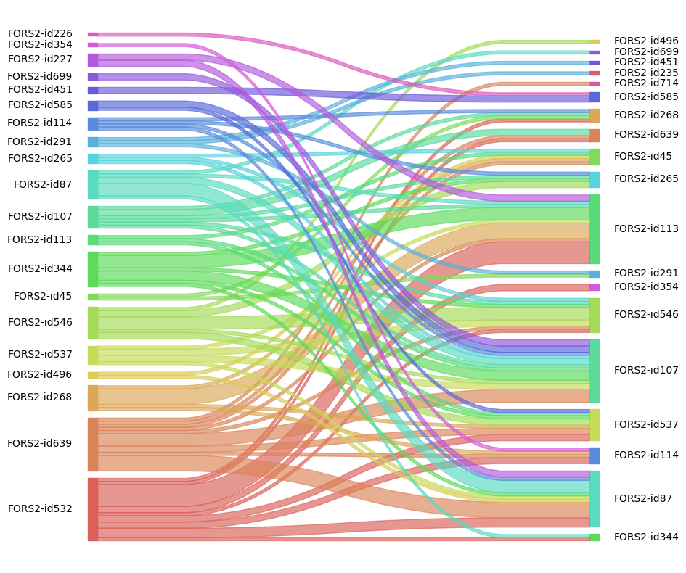
Best model at true redshift
Comparison : best model @ z_{spec} =? model at min(χ²)
1000 galaxies from COSMOS2020 spectro sample, z ≤ 3, ugrizy filters from HSc
Map the results
Statistically determine the “good” and the “bad” templates
Focus on outliers :
Identify patterns of errors and corrections
Iterative process → automation as next step
These steps can be done quickly and efficiently with LEPHARE
Notes:
So let us focus on those. Besides being more readable (the graph now encompasses only about 100 galaxies, vs. 1000 before), we can start to detect patterns here. For instance, the last template, id 532 (in red) is very represented amongst outliers, as a maximum-likelihood model. Whereas it is completely absent from the list of our best models at z-spec. On the other hand, the id 107 and 113 are widely accepted as good depictors of the reality (massive on the right side) but are seldom identified with the maximum-likelihood approach. Such process could help understanding how to build a templates list from observed spectra for photo-z, but requires many iterations (on templates list and observations samples), so would drastically gain from automation (or identifying a recipe).

Slide 9
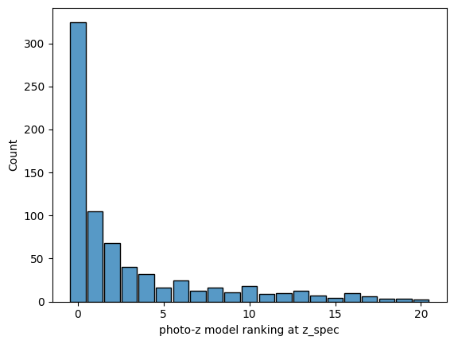
Improve model selection
Not a new issue : BPZ (Benitez, 2000)
Statement : min(χ²) does not output the best point estimate
Idea : rank the models according to their description of the photometry at z_{spec}
Only about 1/3 of perfect matches, i.e. when the model that yields the min(χ²) is also the best one at z_{spec}
Notes:
It also hints, or rather confirms, the fact that pure maximum-likelihood estimation is not a satisfactory photo-z method but bayesian approaches, with the inclusion of priors and marginalization of models, should be preferred. Here is the histogram of the ranking of the max-likelihood model at z_spec : only about a third were also the best template to describe the true redshifts. In a lot of cases though, the difference will not generate a catastrophic outlier.

Slide 10
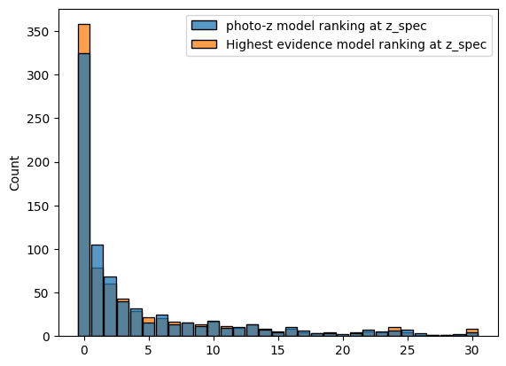
Improve model selection
Not a new issue : BPZ (Benitez, 2000)
Statement : min(χ²) does not output the best point estimate
Idea : rank the models according to their description of the photometry at z_{spec}
Only about 1/3 of perfect matches, i.e. when the model that yields the min(χ²) is also the best one at z_{spec}
Bayesian photo-z : marginalization
Notes:
However, a different approach to identify the most plausible model IAW the photometry has been tested and yields slightly improved results without necessitating prior knowledge of the true redshift : it simply relies on the weight carried by a model at the marginalisation step of computing the bayesian posterior of z.

Slide 11
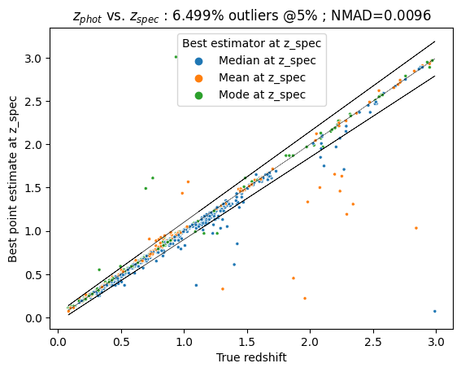
Improve point-estimate selection
Several values can describe a PDF :
Mode (consistent with a min(χ²) selection)
Mean (+/- σ)
Median (works better than the mode in LEPHARE on COSMOS2020 data)
Which one to chose does not seem to follow a rule
Selecting the best model and point estimate can drastically improve photo-z results
These kinds of studies can be done in our in-house photo-z tool
Notes:
Now if everything goes right, if the best model was selected everytime and if the point estimates for photo-z were ideally crafted : here is what TF results of the same run as used in all steps would look like : very narrow dispersion and few outliers despite a restrictive criterion. The big question now is : how to achieve that without cheating?

Slide 12
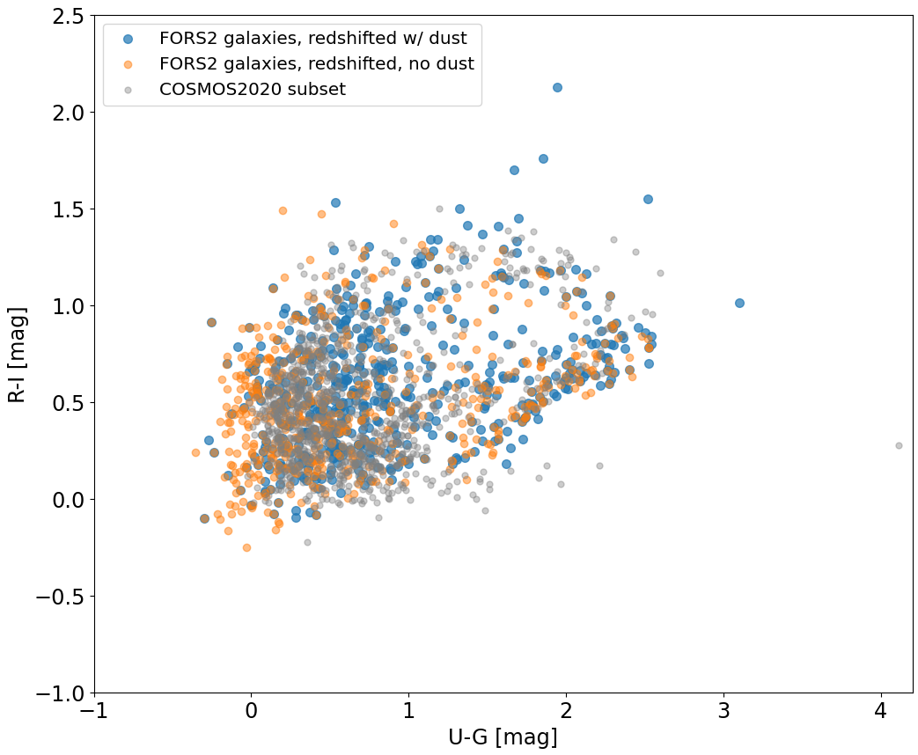
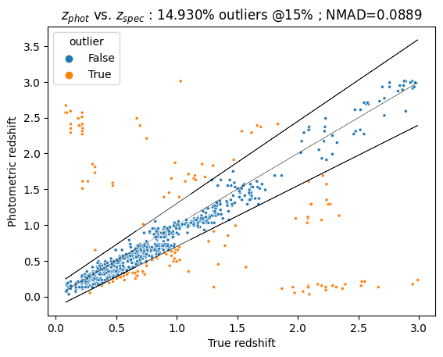
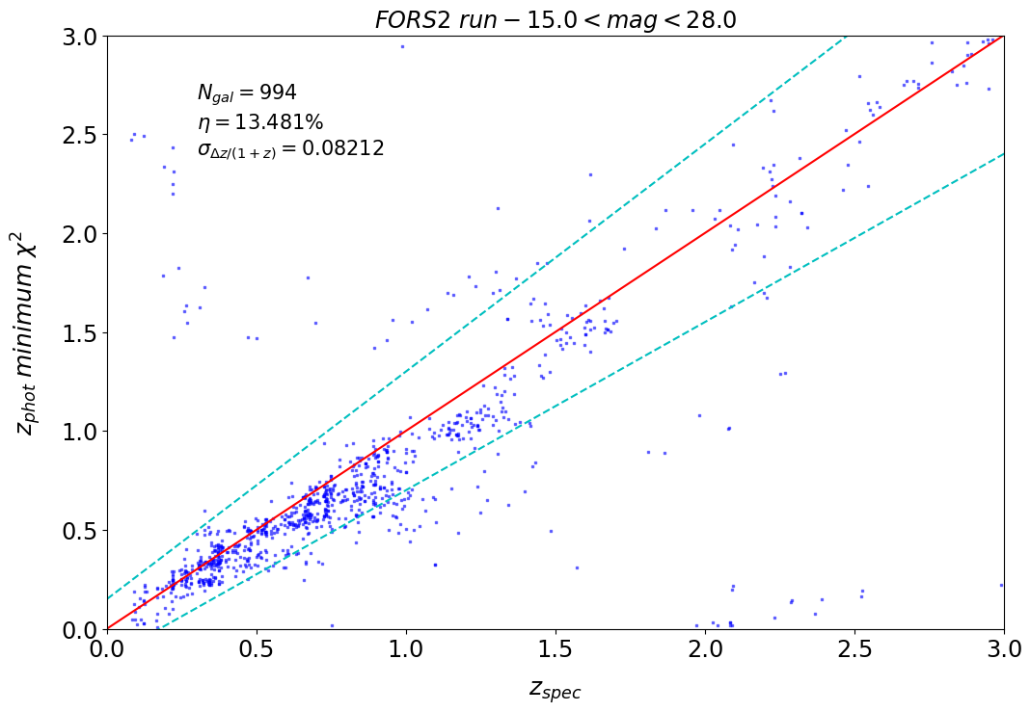
SPS, Dust and photo-z
Dust extinction and SFR determine UV radiation, critical for photo-z estimation at higher z
Two solutions for dust :
Templates that include dust extinction (blue)
Free parameter during photo-z estimation (orange)
Observations in UV can yield SFR and hints to dust.
Observations in infrared can constrain dust (via re-emission).
Spectroscopy (emission lines) can constrain SFR.
FORS2 templates with dust, no extinction in photo-z estimation
← EmuLP | LEPHARE →
Notes:
The answer may lie in the understanding of the astrophysics of galaxies, so that Stellar Population Synthesis tools (such as StarLight, that was used to obtain the our spectra, or DSPS, a more recent and readable code that Sylvie will introduce tomorrow) can be used to generate templates that are the best possible for photo-z codes, or could even be tailored (on the basis of observations like FORS2 + prior knowledge) to a sample of galaxies directly at the time of photo-z to ensure the best coverage. One big battle for photo-z is the effect of dust, that strongly affects the UV light, which is shifted towards the visible bands with increasing redshifts. This UV light is linked to the Star formation rate of a galxy, therefore correctly estimating both dust and SFR, though SPS fitting and additional knowledge (IR filters?) could improve the quality of templates and ultimately photo-z results.

Slide 13
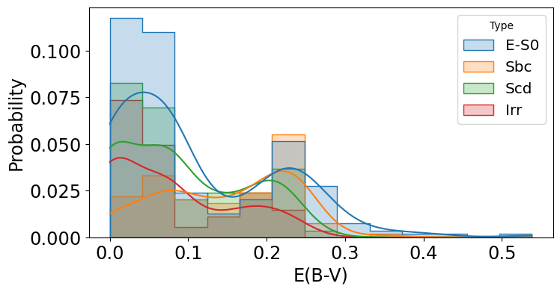
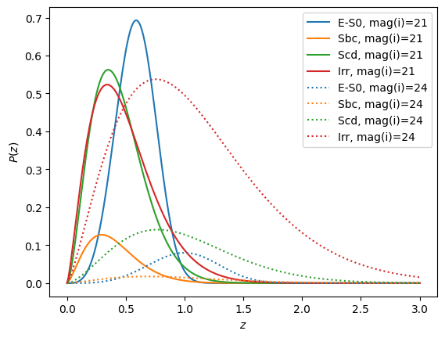
Emulateur LePhare (EmuLP)
Template-fitting photo-z code à la LEPHARE (simplified) :
Min(χ²)
Prior on n(z) based on z-VVDS
Added : prior on dust parameter E(B-V), derived from fit on FORS2 spectra.
Written in Python (JAX for GPU compatibility), inputs in JSON
Able to output the complete redshift probability distribution
Includes data analysis functions (pandas)
Platform for further tests : likelihood functions, priors, GP
Not fast and memory-hungry : limited to small samples (~1000 galaxies) and restricted number of templates.

Slide 14
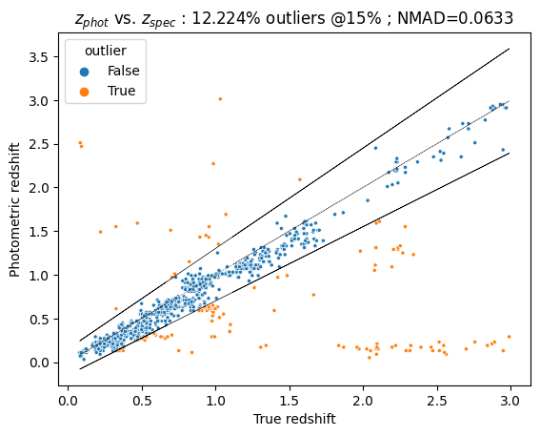
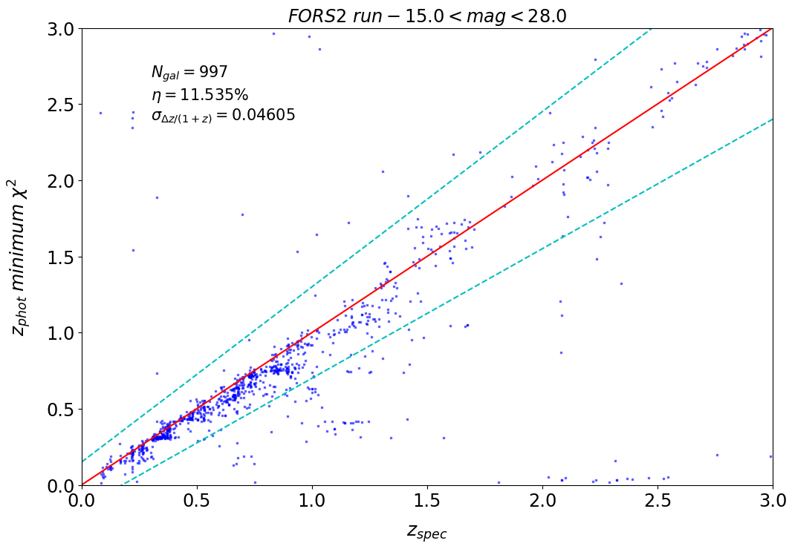
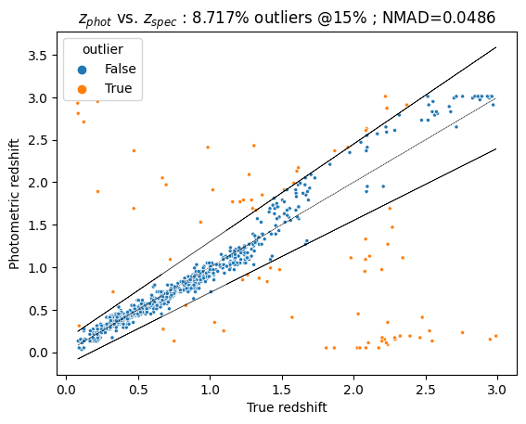
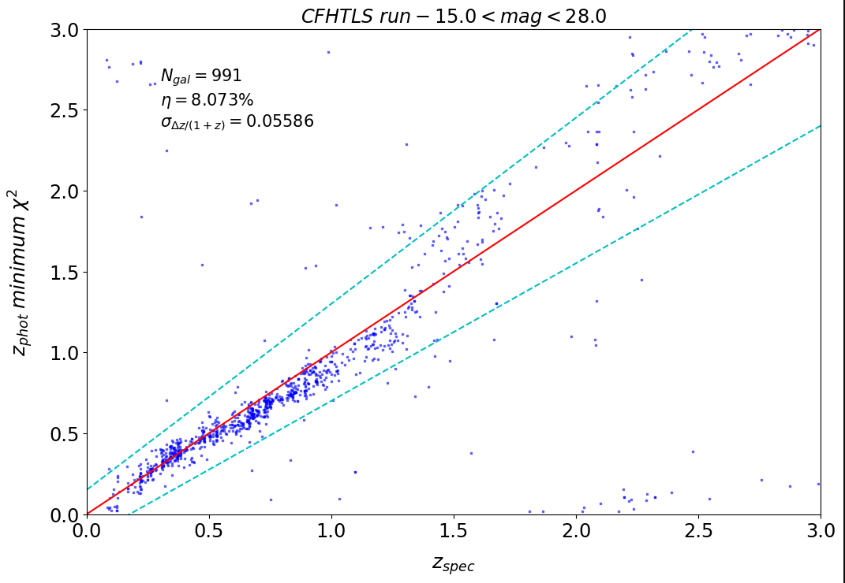
Emulateur LePhare (EmuLP)
FORS2 templates
← EmuLP | LEPHARE →
CFHTLS templates
← EmuLP | LEPHARE →

Slide 15
Takeaways
What we’re trying to avoid :
Aim : improve existing and/or generate new sets of templates for photo-z
Data : FORS2, COSMOS2020, etc.
Tools : LEPHARE++ for proper photo-z, DSPS for stellar population, EmuLP for in-house tests and studies
Ideas and prospects :
identify spectral / stellar properties of good templates (emphasis on UV)
improve model selection within photo-z codes
explore hybrid methods (TF+ML) thanks to numerous spectra + SPS
more are welcome !
PRECISION COSMOLOGY
PHOTOMETRIC REDSHIFTS
LSST
If you have ideas, suggestions or requests related to your particular subject, please come have a chat !
Notes:
In conclusion, this is a reminder of the whole process and targets of this study, with still many more things to do. In particular, since I have developped a mini-laboratory specifically to access underlying data in photo-z estimation, please feel free to come to me with questions, remarks or suggestions about how to make the best of it. Thank you for your attention !

