Slide 1


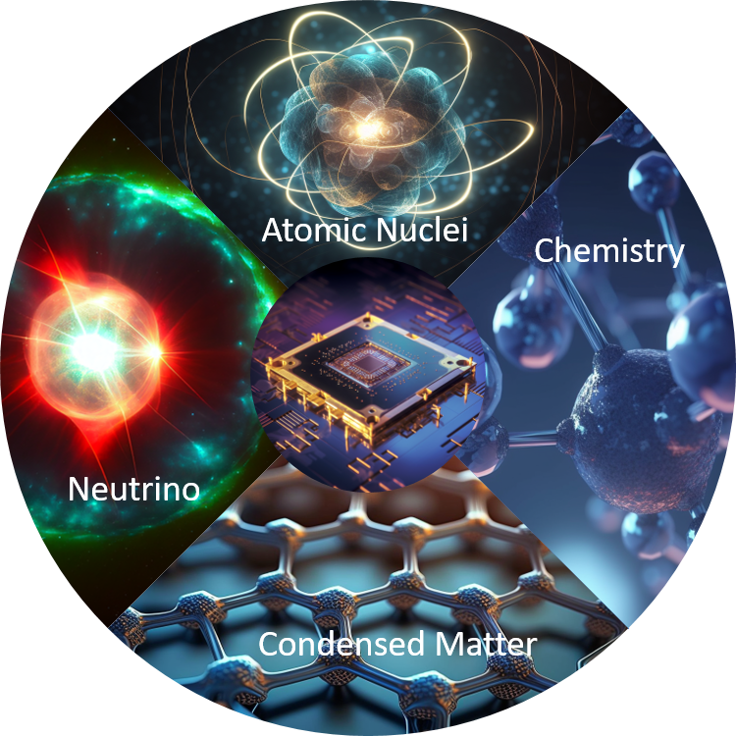


Kick-off Meeting of the IRL-NPA– Dec. 11-14, 2023
Recent advances in quantum computing
nuclear physics @ Orsay
Denis Lacroix (IJCLab, Orsay, France)
T. Ayral, P. Besserve, D. Lacroix, and E.A. Ruiz Guzman , EPJA 59 (2023)
E.A. Ruiz Guzman, PhD thesis, arXiv:2310.17996

Slide 2
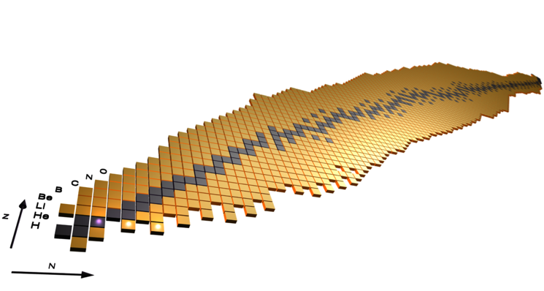
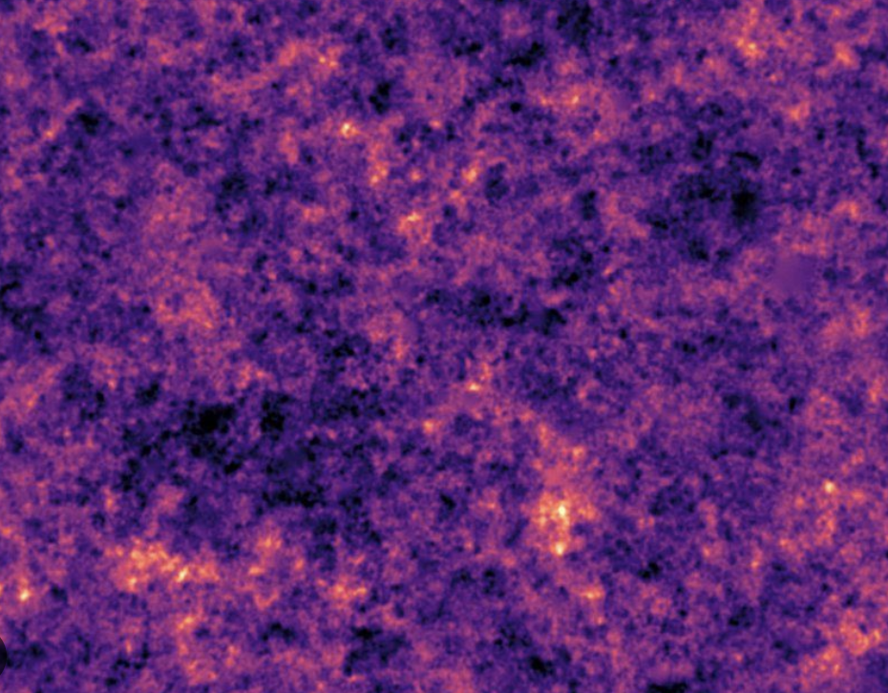
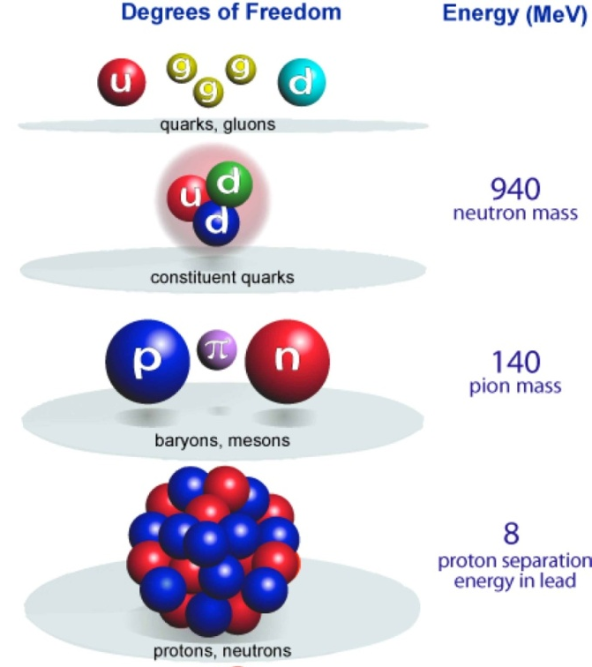
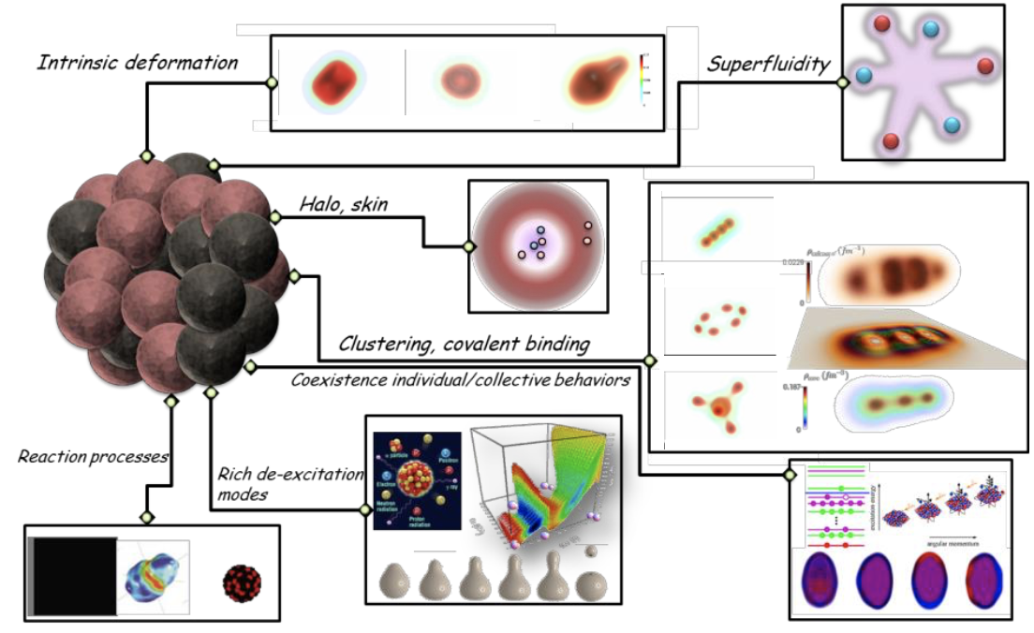
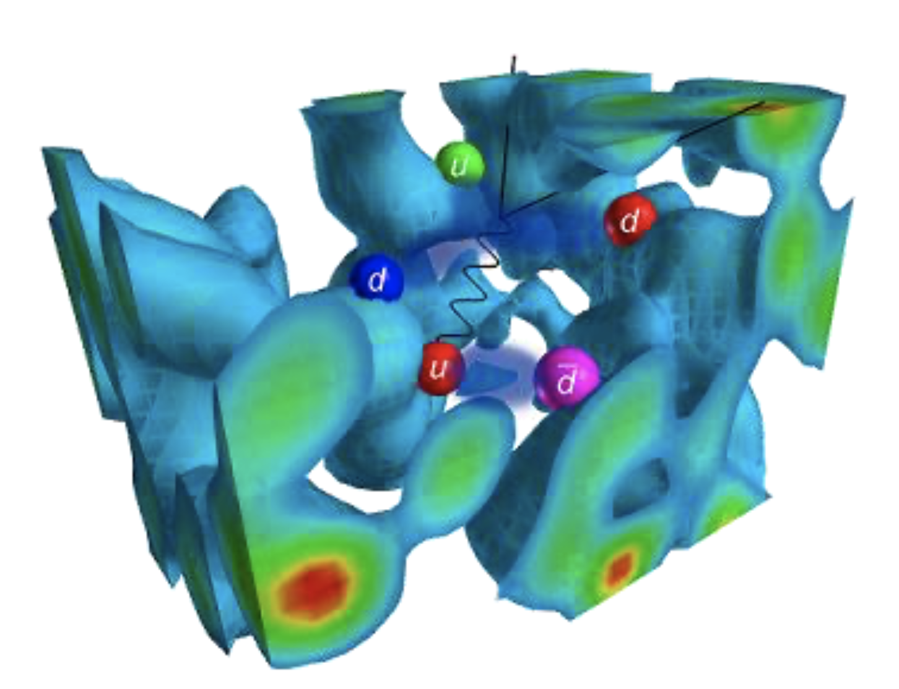
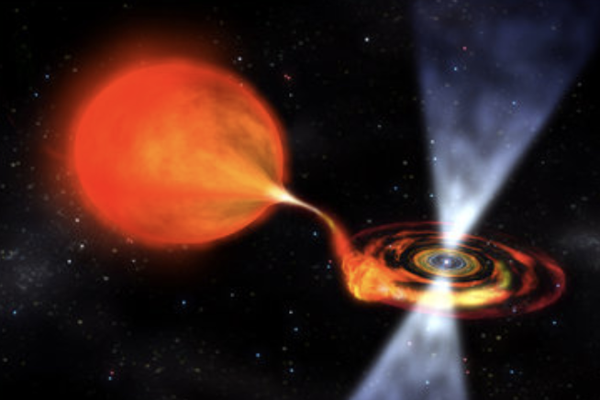
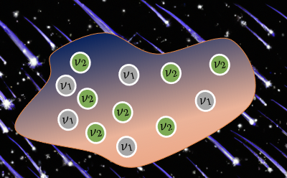
Quantum computers are often themselves many-body interacting systems
to atomic nuclei
to pions
and
nucleons
to stellar
processes
from quark

Slide 3
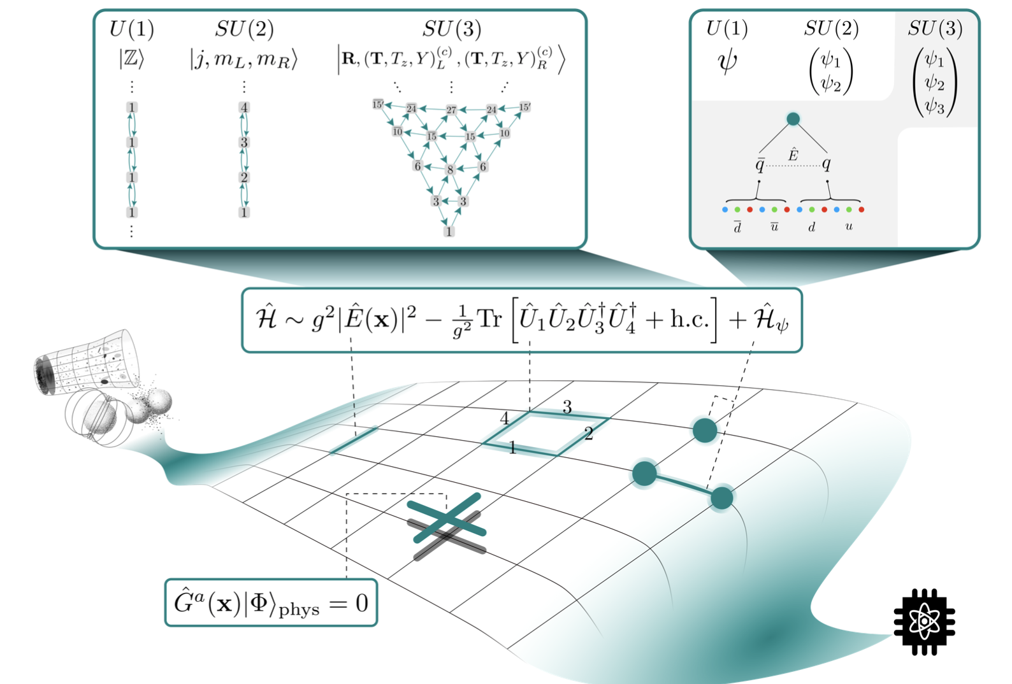
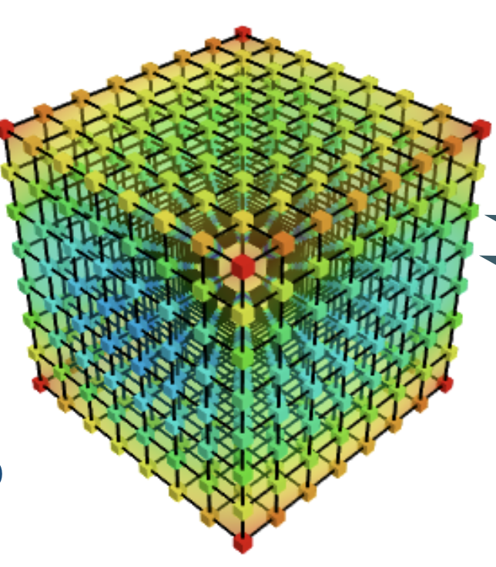
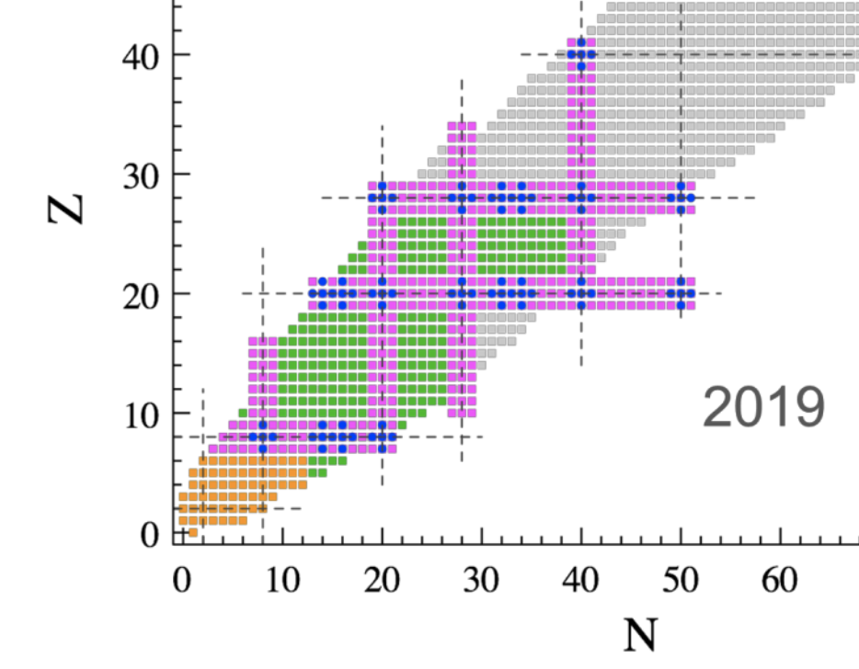
Quantum computers are often themselves many-body interacting systems
Digital QCD
to atomic nuclei
to pions
and
nucleons
to stellar
processes
Nuclear many-body problems
(courtesy M. Savage)
from quark
Astrophysics problems

Slide 4
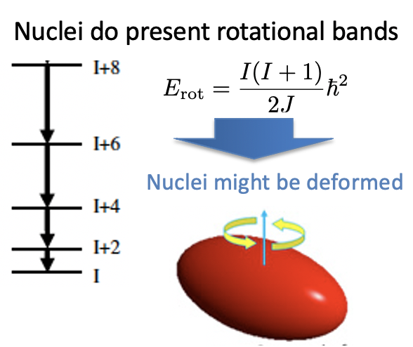
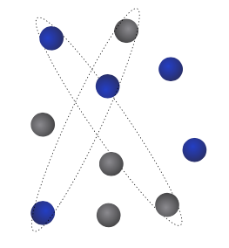
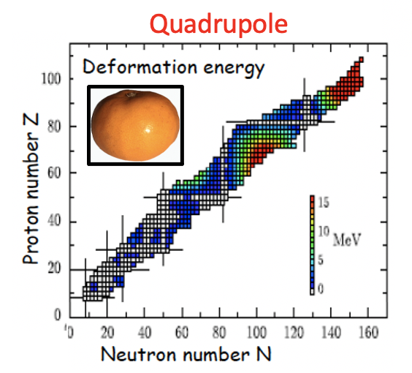
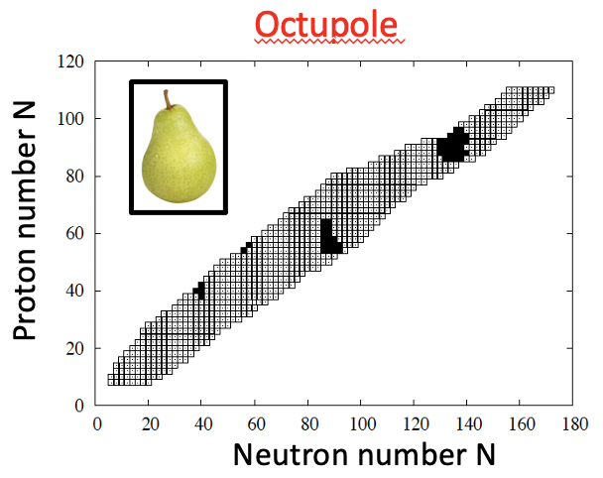
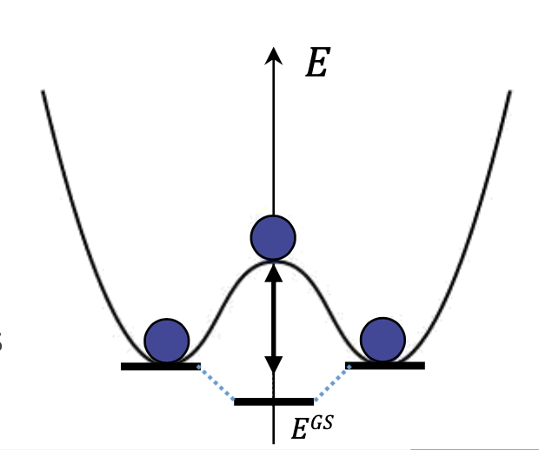
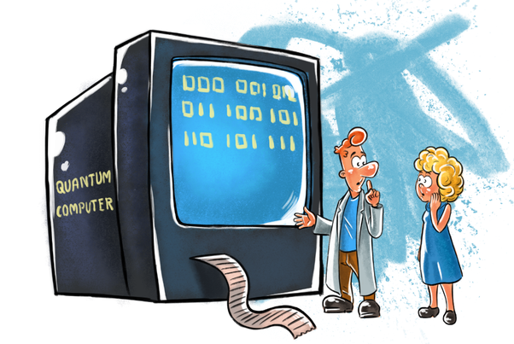
A short highlight of some today’s nuclear physics challenges
Actual tendency : Towards Full configuration-Interaction description ?
Nuclei are small
superfluid systems
Current status
Described by breaking
rotational and/or parity symmetry
Described by
breaking
U(1) symmetry
A specificity:
atomic nuclei like
to break
spontaneously
symmetries
Symmetry
Preserving HF state
Can Quantum computers help?
Symmetry Breaking (SB) state
Symmetry Restored
(SR) state (multi-reference)

Slide 5
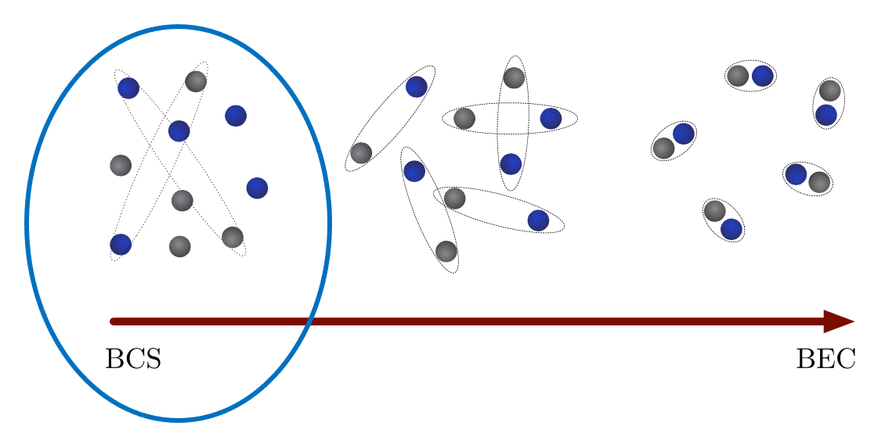

Illustration with small superconductors
Illustration with the Richardson Hamiltonian
This problem is an archetype of spontaneous symmetry breaking.
An “easy” way to describe it is to break the particle number symmetry, i.e.
consider wave-function that mixes different particle number
Example
Mixes states with 0, 2, 4, … particles
The particle number - U(1) symmetry)
is broken
Exact
Correlation energy
BCS
Pert. Theory
But ultimately number of
Particle should be restored !

Slide 6


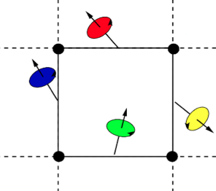
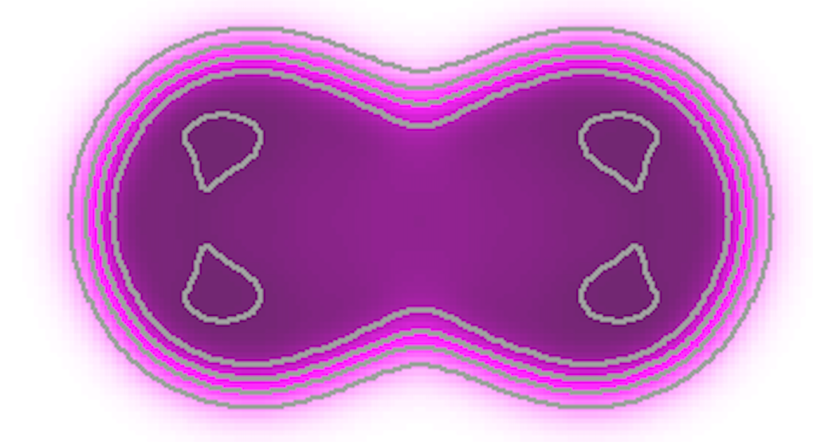
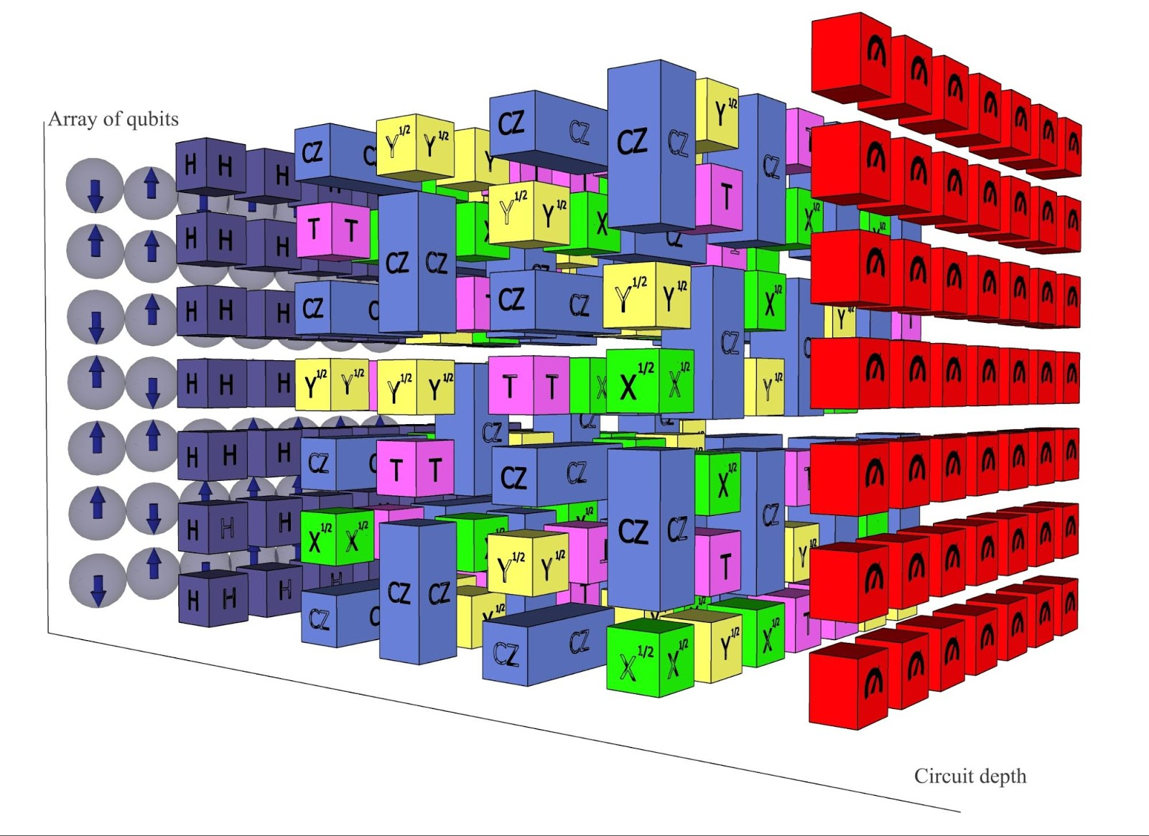




First Strategy
Further
Quantum
or hybrid
Quantum-Classical
Post-processing
1
Preparation of SB states on QC
3
Variational optimization
2
Symmetry restoration on QC
1
Post-processing for
Improved ground state or excited
States (QPE, Quantum Krylov, …)
Symmetry
Breaking (SB)
state
3
2
Symmetry Restored
(SR) state (multi-reference)

Slide 7
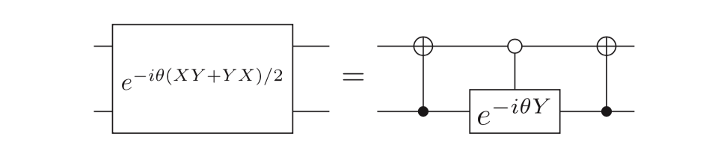
Application to the N-body pairing problem
Hamiltonian and initial state
Pairing Hamiltonian
States labels
…
Qubits labels
0
1
2
…
n+1
Jordan-Wigner transfo:
n
State ordering
is important !
Initial (symmetry breaking) state preparation
Simplified circuit (generalized Bell state)
Equivalent universal gate on pairs
Zhang Jiang et al,
Phys. Rev. Applied 9, 044036 (2018).

Slide 8
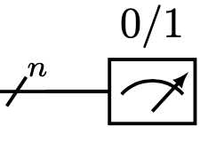
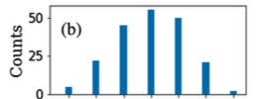

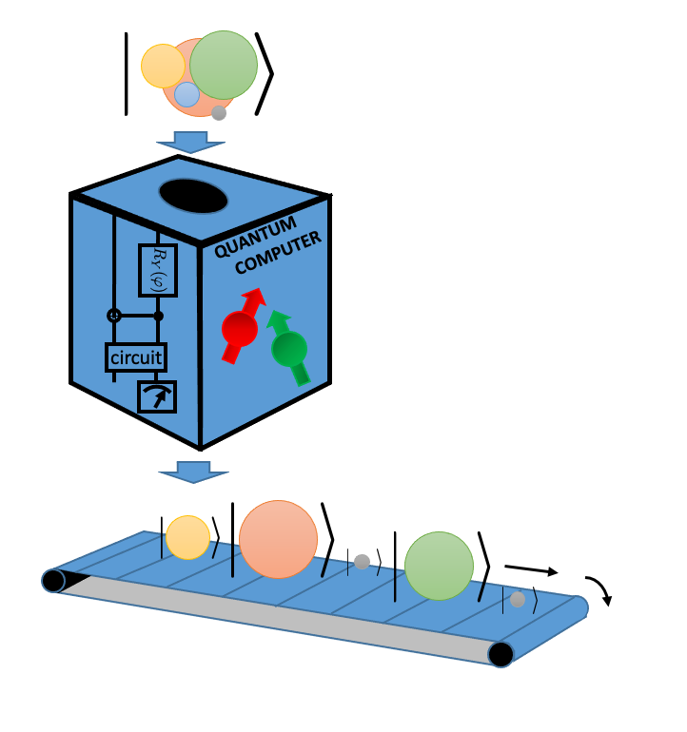
Restoration of particle number symmetry
The counting statistics problem
Direct estimate of Counting statistics
Example of mixing for 12 qubits (with IBM-qiskit)
BCS circuit
0
2
4
6
8
10
12
Projection on particle number
For 2 qubits
Solution: do not measure the system directly
D. Lacroix, “Symmetry-Assisted Preparation of Entangled Many-Body States
on a Quantum Computer”, PRL 125, 230502 (2020).

Slide 9
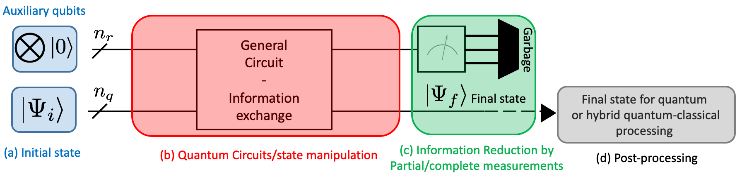
Non-destructive counting on a quantum computer
Non-destructive
Measure
Post Processing
Born’s rule
Measure
Projection
Starting point
Send the information
To additional qubits
That are destroyed after measurement
Initial state
Entanglement

Slide 10
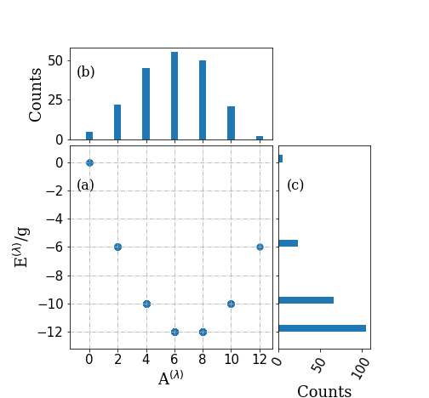
Eigenvalues-Ground state and excited states
Measurement
Example of an event:
BCS/HFB state
6 pairs
Measurement
Projected BCS or with varying number
Of particles
Degenerate case
Exact solution
H was encoded on the full Fock space with
For the degenerate case, this should give the exact solution

Slide 11
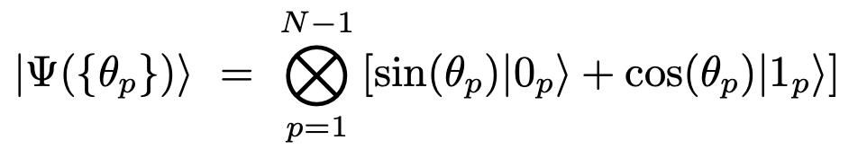
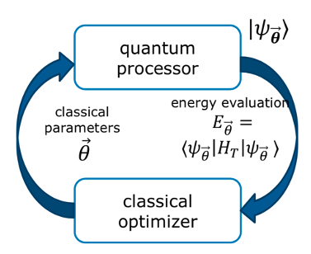
Coming back to our superconducting problem
Combining projection with variational method (VQE)
Possible optimization schemes
Pair occupation are now encoded
Variational
Symmetry-Breaking ansatz
Symmetry
Preserving
(HF)
Quantum-Classical optimizers
SB state
Standard BCS theory
BCS
Q-PAV
Q-VAP
Project after optimization
Q-PAV: Quantum Projection
After Variation
SB state
projection
By QPE
8 particles on 8 equidistant levels
SB+projection
By QPE
Percentage of error
superfluid
The optimization is made on the
Symmetry restored state.
Q-VAP: Quantum Variation
After Projection
normal

Slide 12
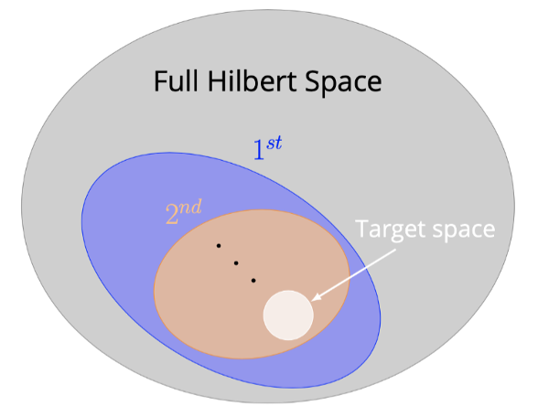
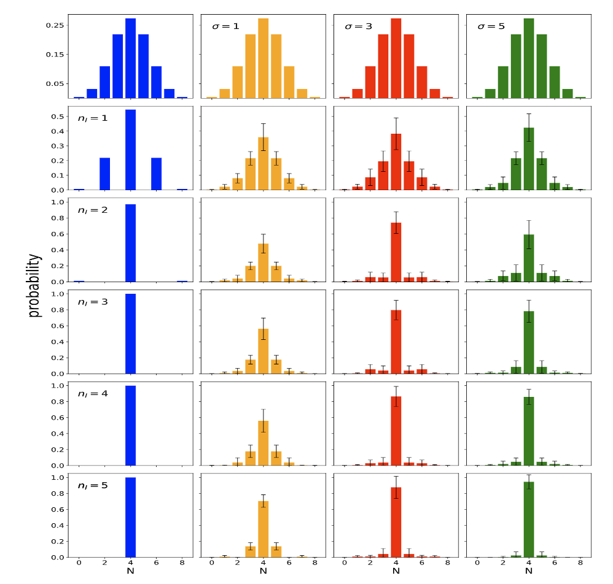
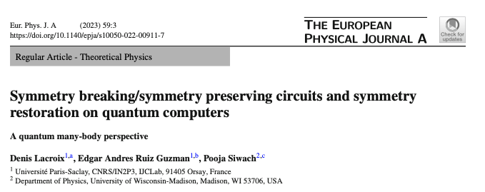
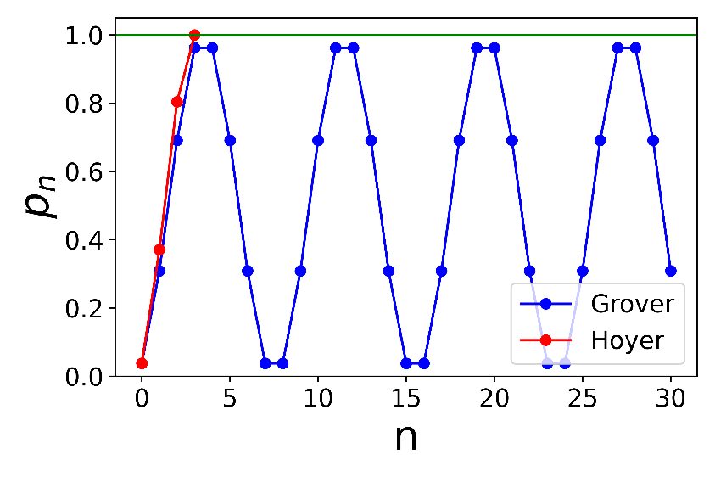
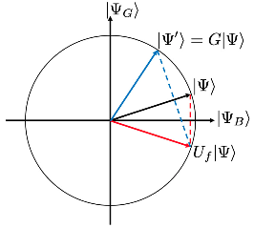
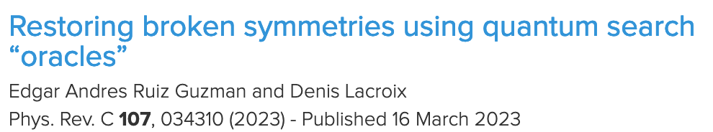
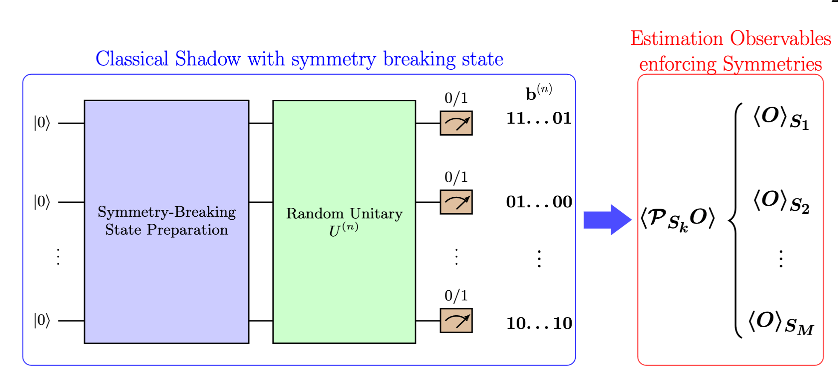
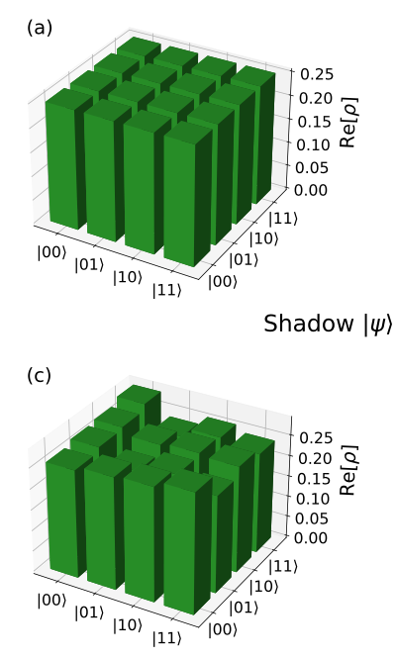
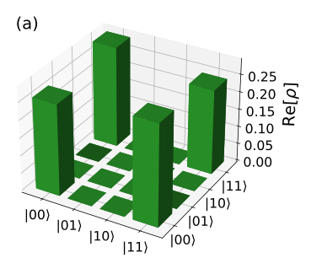
Playing with quantum algorithms
Complete Hilbert space
Systematic Exploration of Iterative
indirect measurements techniques
(Kitaev method, Rodeo algorithms )
Kitaev
Rodeo
Subspace with
proper
symmetry
Use Oracle’s
and Grover-based methods
Use quantum tomography techniques
(Classical Shadow method)
Quantum state
Full tomography
Positive parity
tomography
Ruiz Guzman and DL, arXiv:2311.04571

Slide 13
First Strategy
Further
Quantum
or hybrid
Quantum-Classical
Post-processing
1
Preparation of SB states on QC
3
Variational optimization
2
Symmetry restoration on QC
1
Post-processing for
Improved ground state or excited
States (QPE, Quantum Krylov, …)
Symmetry
Breaking (SB)
state
3
2
Symmetry Restored
(SR) state (multi-reference)

Slide 14
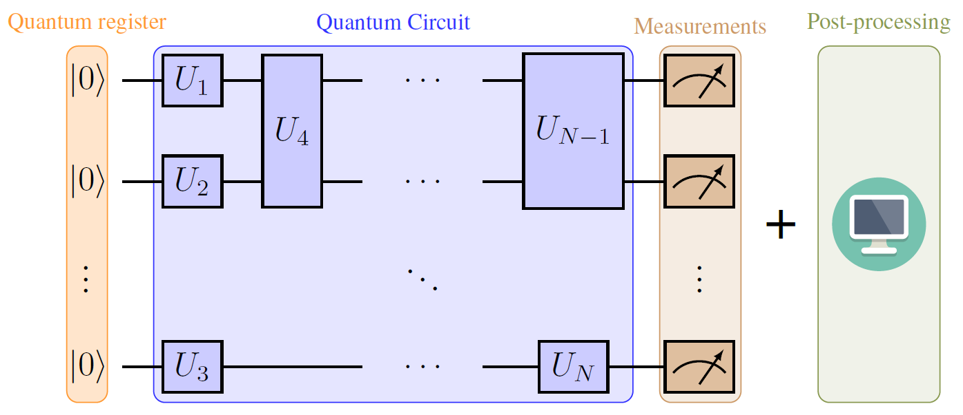
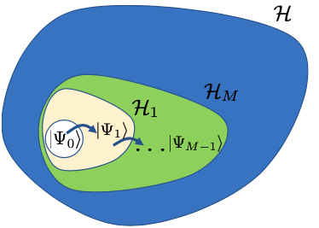
Methods for post-processing quantum computing results on classical CPU’s
Classical post processing
Quantum Subspace expansion
Quantum Krylov
Krylov method
Diagonalize in the non-orthogonal subspace
Generalized eigenvalue problem
E. A. Ruiz Guzman and DL, Phys. Rev. C 105, 024324 (2022)

Slide 15
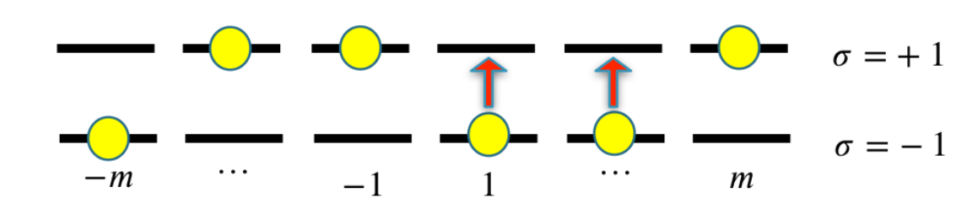
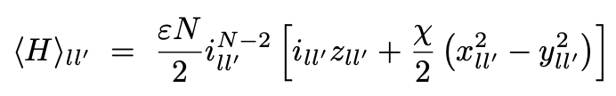
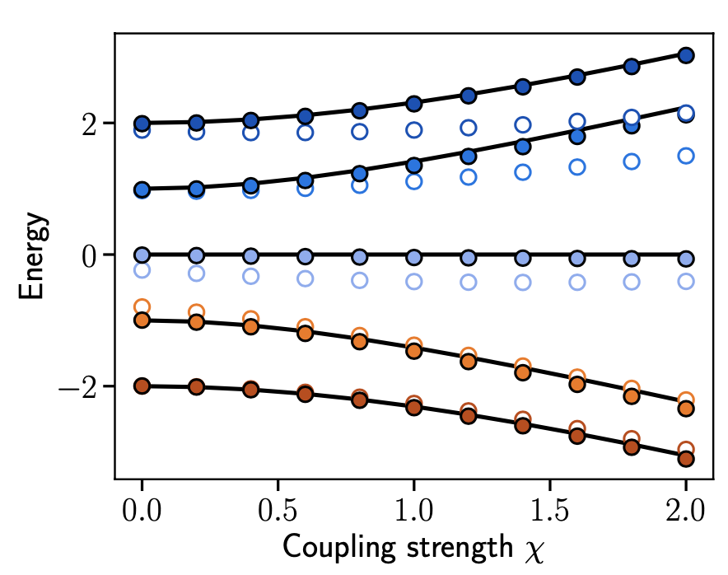
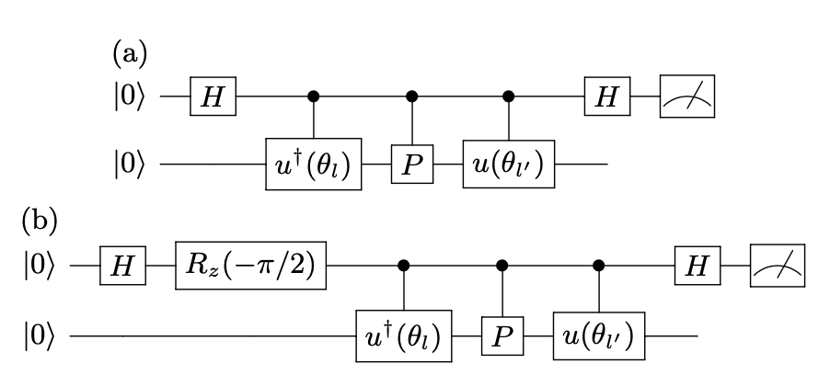
Solving the Lipkin model with using 2 qubits only with hybrid quantum-classical method
Classical post processing
Quantum Generator Coordinate Method
Quantum Subspace expansion
Likpin /perm. invariant
one-body kernels
Illustration of Lipkin model on QC
with noise
Cervia et al, PRC 104 (2020)
Real/Imaginary parts requires 2 qubits
N=4, Nqubit=2
Hlatshwayo et al, PRC 104 (2020)
This work
Y. Beaujeault-Taudière and DL, arxiv:2312.04703

Slide 16
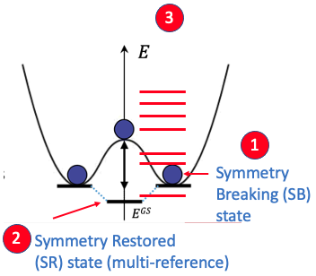
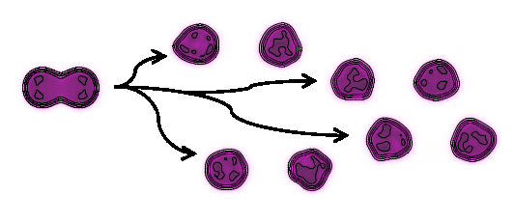
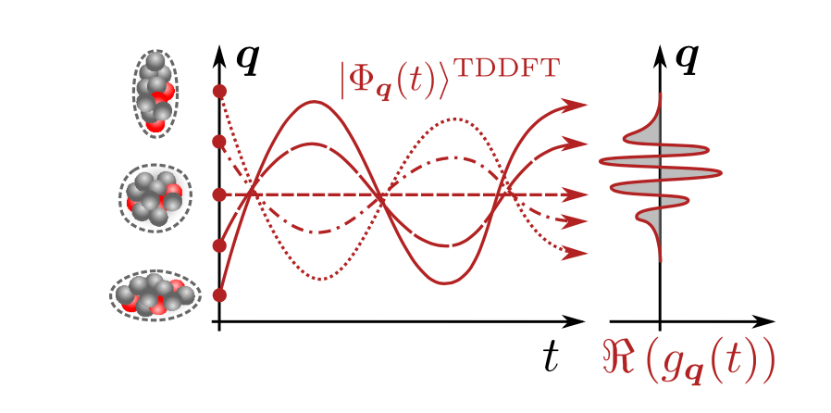
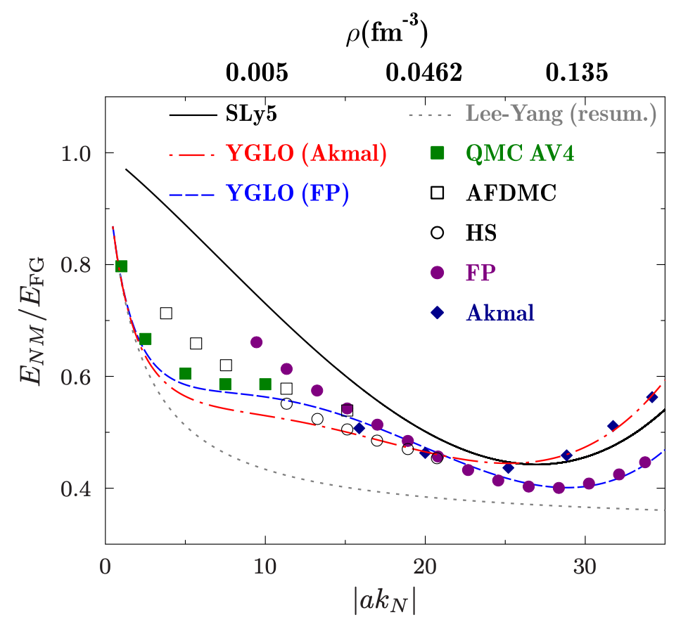
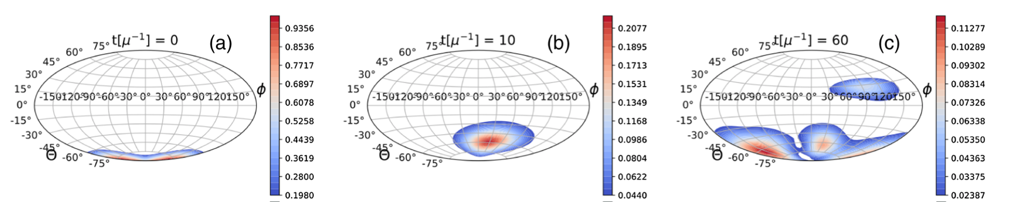
Some summary and prospective
We made a quite extensive focus on the symmetry problem
(symmetry breaking/symmetry restoration
Several techniques have been used to perform
symmetry restoration (QPE, Grover, Shadow)
We also explored a bit of postprocessing to get the ground state
and excited states
Transport theories
What I did not talk about
Phase-space methods
Multi-configuration TDDFT
Non-empirical nuclear
density functional theory
Tanimura, DL, Ayik, PRL 118 (2017)
Marevic, Regnier, DL, PRC 108 (2023)
Neutrino oscillations
Yang, Grasso, DL, PRC 94 (2016)
DL, Balantekin, Cervia, Patwardhan, Siwach PRD 106 (2023)

Slide 17




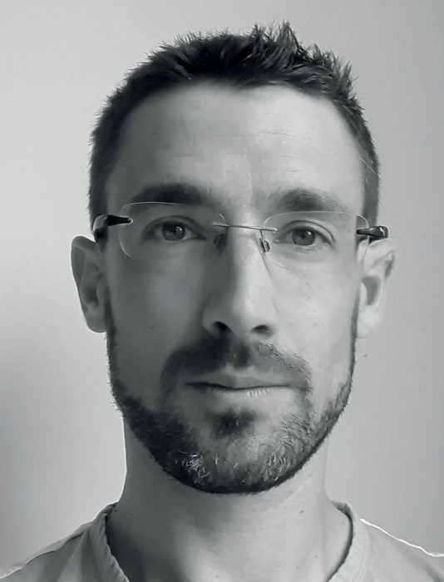










Thanks to my Collaborators
T. Ayral
E. Litivinova
A. Roggero
M. Mangin Brinet
E. A. Ruiz Guzman
J. Zhang
Y. Beaujeault-Taudiere
M. O. Hlatshwayo
P. Siwach

Slide 18




Similar interest in NSCL-FRIB
Rodeo algorithm (Dean)

