Slide 1
Coding with LLM_{s}
Thomas Vuillaume
DALL·E generated photography of a human and a robot pair programming

Slide 2
DISCLAimer
This is not a course nor a seminar.
I don’t intend to be exhaustive nor to be an expert in any way. This is supposed to be an open discussion, please speak-up at any time and share your own views, tips, way of doing etc…

Slide 3
llM_{s}

Slide 4
llM_{s} and code
Code is a form of language
Without surprise, LLMs can input and output code
But then,
For what tasks ?
How to best use them ?

Slide 5
llM_{s} and code
Code generation → « I would like a function to … »
Debugging assistance → « I have this error with the previous function: … »
Code explanation → « What does this function do? … »
Generate dummy / lookup data → « Generate dummy data to test this function » or « Generate a data sample corresponding to the following schema »
Use your own language → « Explique cette fonction en français »
Tests generation → « Generate unit tests for this function »
RegEX generation → « What is the regex to find files of the form ‘{date_isoformat}_{number between 0 and 10}_epic_project_{version}.txt’ »
Translate code to other languages → « Rewrite this function in JAVA »
… ?

Slide 6
Examples
chatGPT
You probably know it :D
But do you know that you can:
set context
Ask for confidence level
use images
For code, I find it very good to have a general view on a project.

Slide 7
Examples
GitHub copilot
Free with GitHub Education program: https://education.github.com/
IDE integration
VSCode: https://marketplace.visualstudio.com/items?itemName=GitHub.copilot
JetBrains IDE
NeoVim
…
more features to come

Slide 8
Examples
Google Bard
I find it less good with code
Much better for internet search (has internet access, and is sometimes able to show what references were used)
Amazon Code Whisperer
Tabnine
… ?

Slide 9
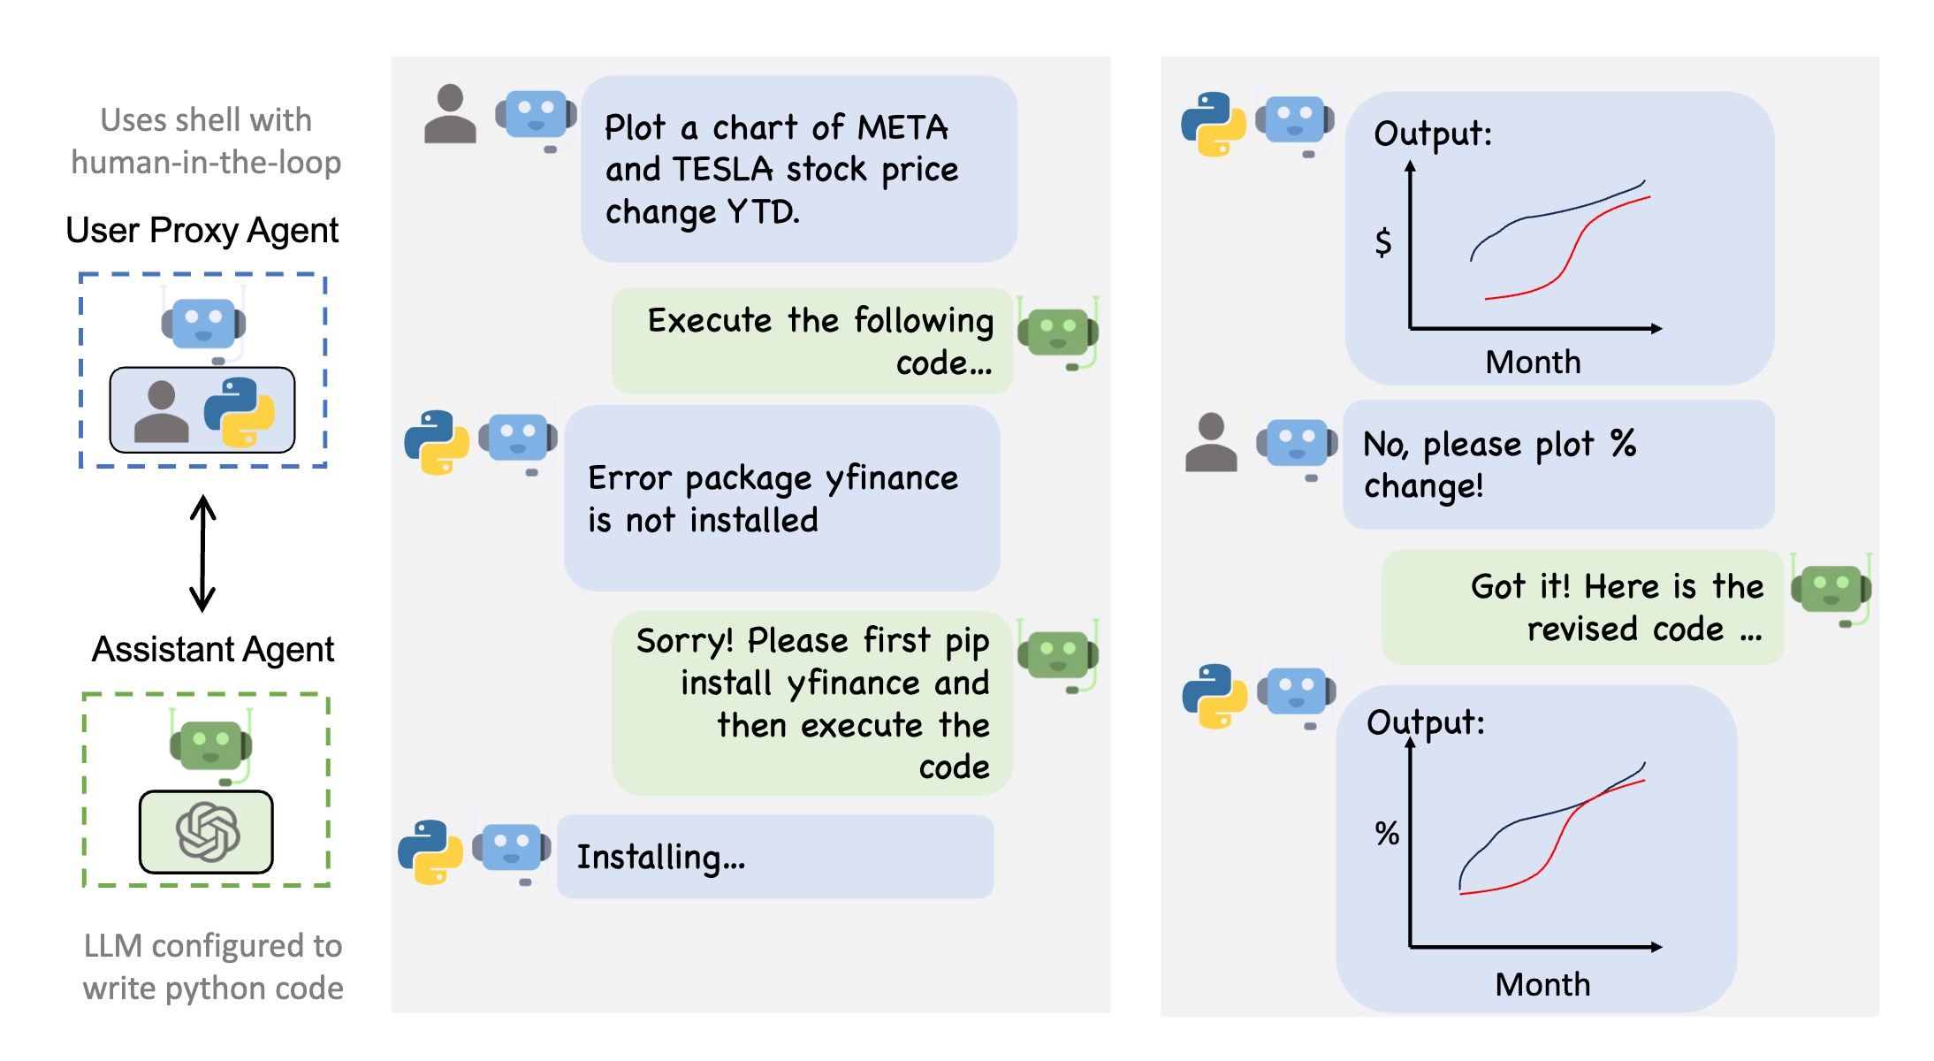
Autogen
https://microsoft.github.io/autogen/docs/Getting-Started/
Next level automation
Open-source project by Microsoft to connect multiple AI agents under a supervisor and get them to work together

Slide 10
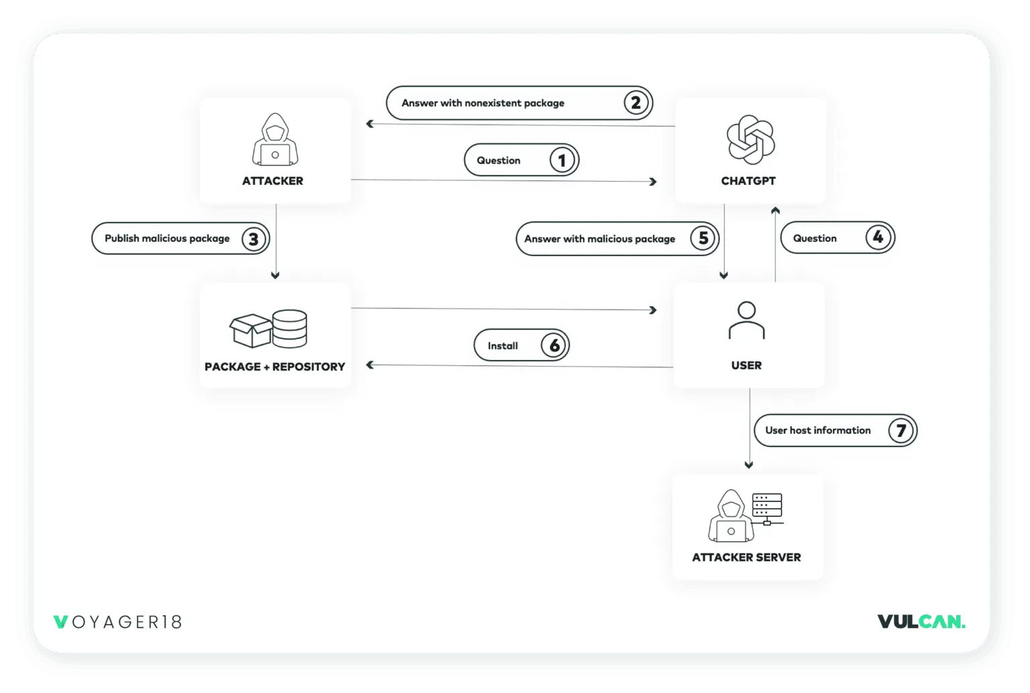
Potential security issues
LLMs package hallucination can be used by hackers to make you install malicious code !
https://vulcan.io/blog/ai-hallucinations-package-risk

Slide 11
Code licensing
GitHub copilot (and chatGPT) are trained on licensed code.
They can generate copy of licensed code. It is not clear who is responsible in this case.
=> https://codeium.com/ ?

Slide 12
MINI project proposal
Make a webpage with the history of the weather in Annecy in 20 minutes using LLMs as coding assistants.

Slide 13
THANK YOU

