Slide 1





Physique des saveurs
Justine Serrano serrano@cppm.in2p3.fr

Slide 2
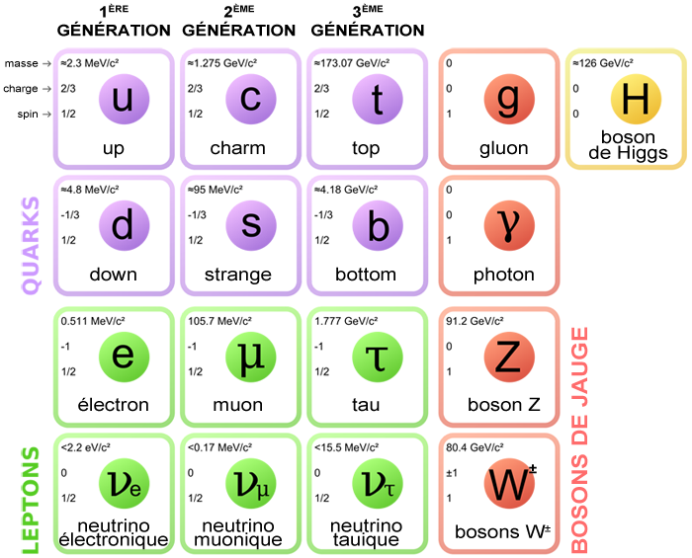
The standard model of particle physics

Slide 3
The standard model of particle physics
Flavour physics
Notes:
Au CPPM on s’interresse surtout au saveurs lourdes (beau, lepton tau), le top est particulier, plus lour et etudié par ATLAS

Slide 4
What we do know
4% of the Universe content: matter, described by the Standard Model
Notes:
let me first start by reminding you that we know only 4% of our universe. These 4% are made of matter, whose fundamental constituents, quarks and leptons, are described by the SM. Actually the matter we have around us is made on the first family, the 2nd and 3rd contains heavier particles that decays in a short time are studied mainly in particle accelerator.

Slide 5
What we don’t know
What we do know
4% of the Universe content: matter, described by the Standard Model
96% of the Universe content: dark matter and dark energy
Why is Universe made of matter and not antimatter
Why 3 families in the SM
….
New Physics

Slide 6
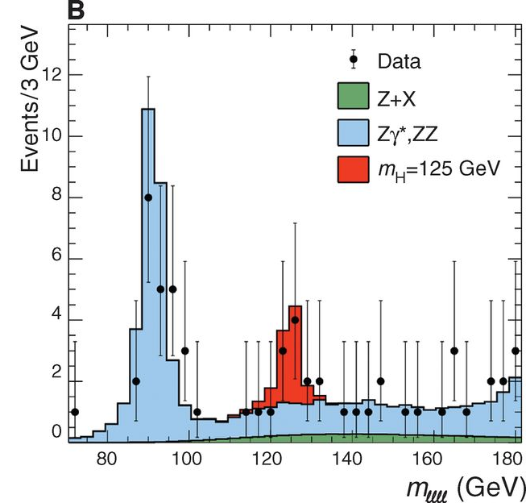
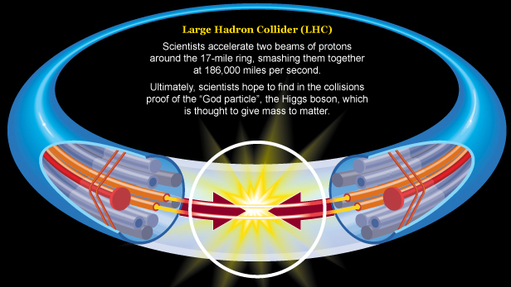
Search for New Physics
Direct search for new particles (LHC experiments ATLAS and CMS)
E=mc²
Particle accelerator
New particles

Slide 7
Search for New Physics
Direct search for new particles (LHC experiments ATLAS and CMS)
E=mc²
High energy needed!
LHC
Particle accelerator
New particles

Slide 8

Search for New Physics
Indirect effects through high precision tests of SM (LHCb, Belle II,…)
New particles can appear during a short time, modifying the property of a decay

Slide 9
Search for New Physics
Indirect effects through high precision tests of SM (LHCb, Belle II,…)
New particles can appear during a short time, modifying the property of a decay
High statistics needed!
LHC, SuperKEKb
Notes:
If these deviations are interpreted as NP, huge enhancement of decays with tay are expected

Slide 10
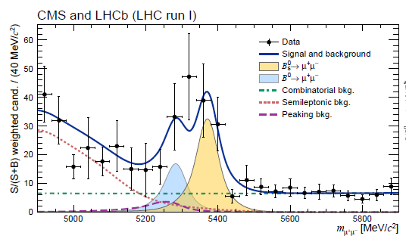
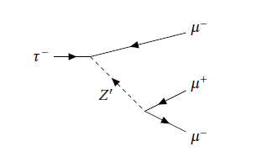
In practice, we can
Measure quantities precisely predicted by the SM, ex : B_{s}→µµ
  SM = (3.65±0.23)x10⁻⁹
^{LHCb latest measurement:}
Look for forbidden decays
  Ex: lepton number violating, lepton flavor violating
Nature 522 (2015) 68
τ→µµµ
Observation would be a clear sign of NP!

Slide 11
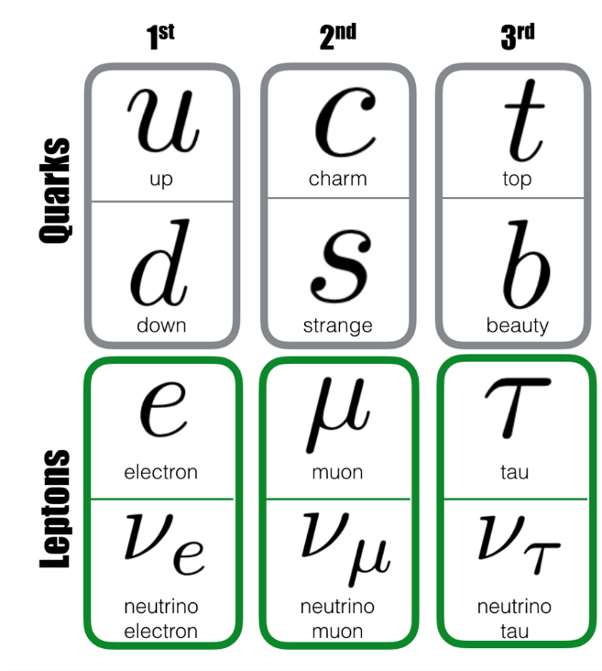

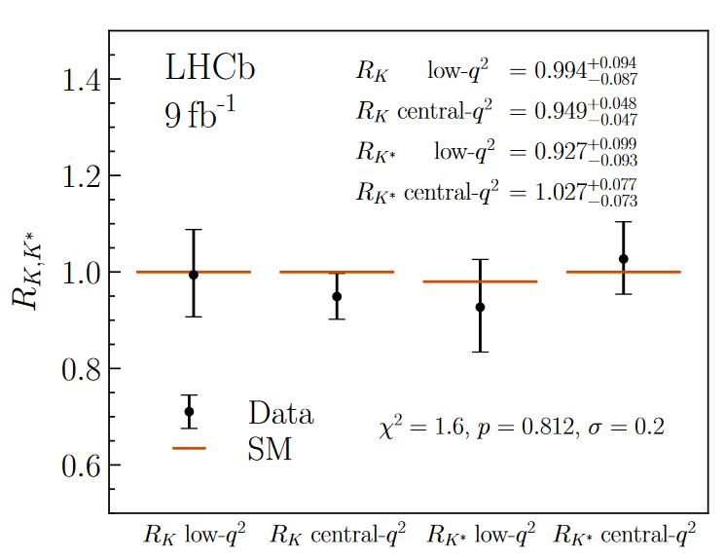
In practice, we can
Test properties of SM
  Ex: lepton flavor universality

Slide 12
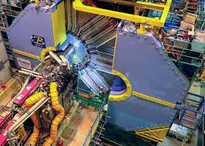

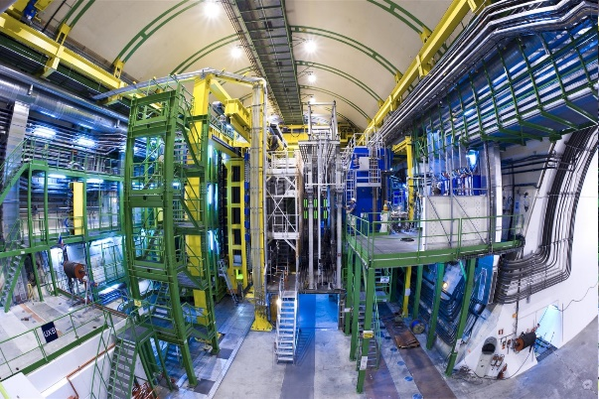
The experiments
Belle II at SuperKEKB
LHCb at the LHC

Slide 13
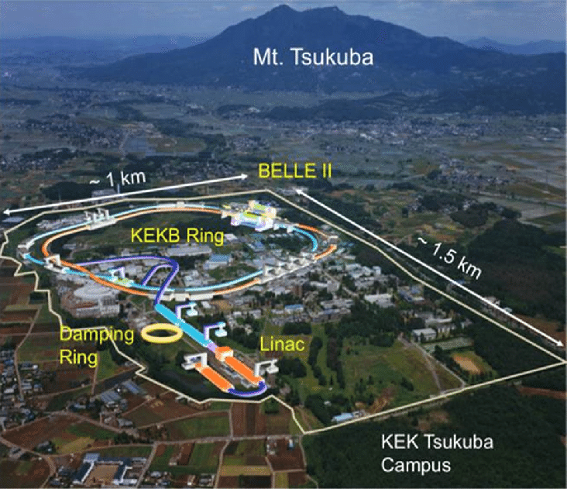
SuperKeKb in Japan
  e⁺e⁻ collider, located at KEK, 60km from Tokyo
  Working at 10.58 GeV to produce b quark pairs
  Started in 2019
  Most intense accelerator!

Slide 14
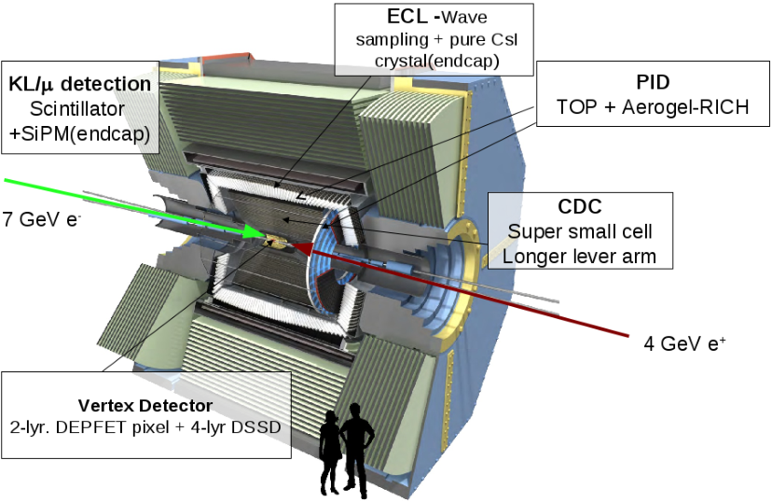
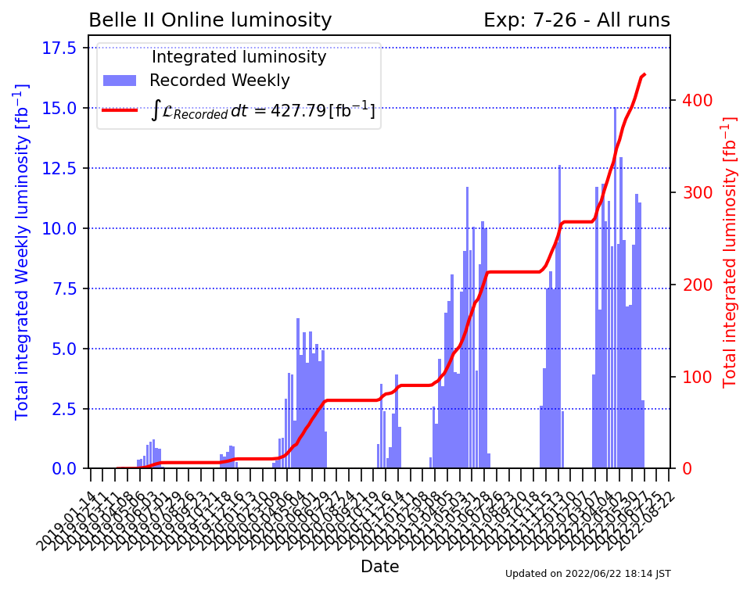
Belle II
Experiment restarting after 1.5 year of shutdown

Slide 15
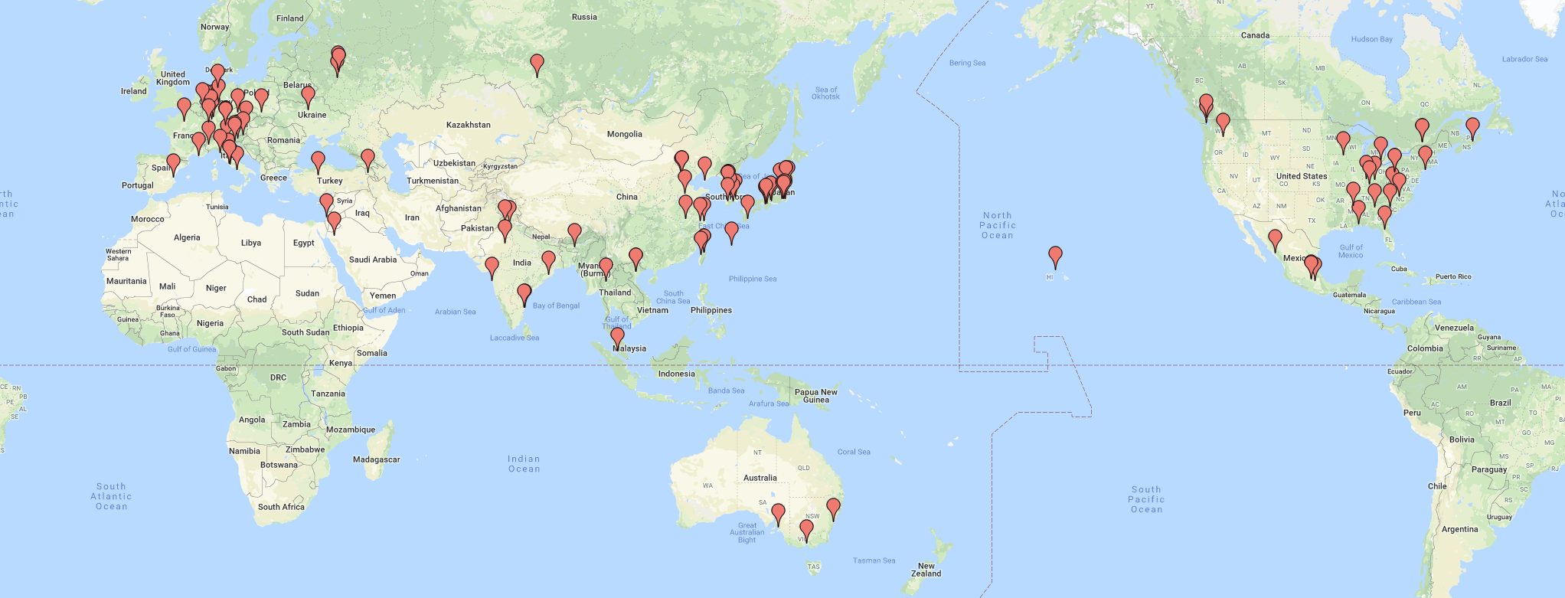
Belle II collaboration
~1000 physicists
In France: Orsay, Strasbourg, Marseille

Slide 16
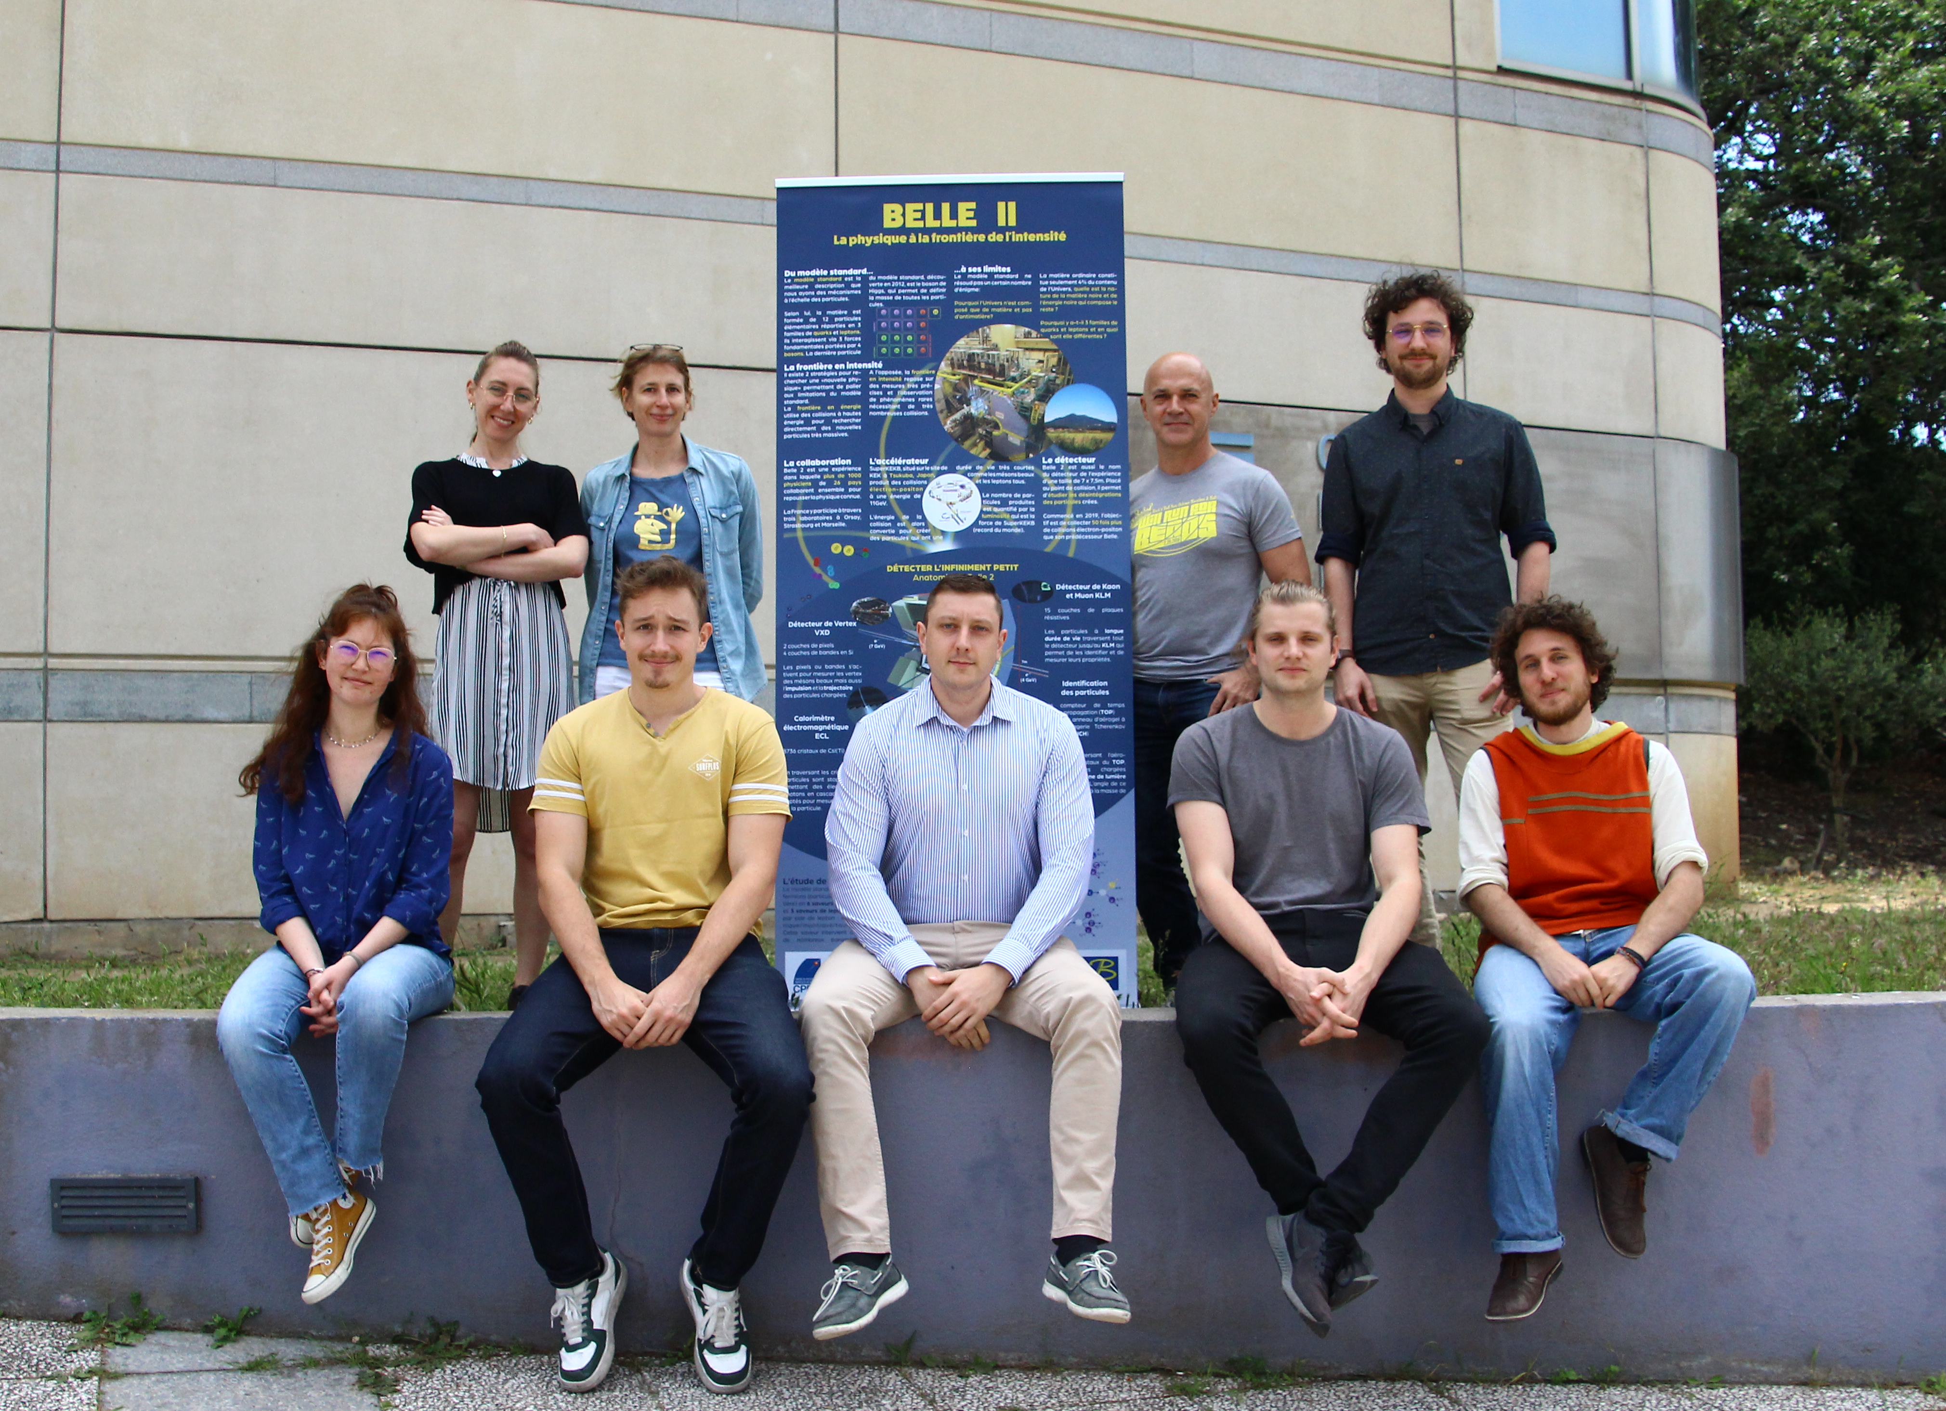
Belle II collaboration
~1000 physicists
In France: Orsay Strasbourg, Marseille

Slide 17
Belle II @CPPM
  Group created in 2019
  3 seniors / 2 postdocs / 3 PhD
  Activities:
    Search for lepton flavor violating decays of τ lepton and B meson
    Tracking performance studies, improvement of tracking algorithms
    Operation of the silicon vertex detector
    Development of new vertex detector
    …
https://www.cppm.in2p3.fr/Belle2/en/
If interested, contact Justine Serrano (serrano@cppm.in2p3.fr)

Slide 18

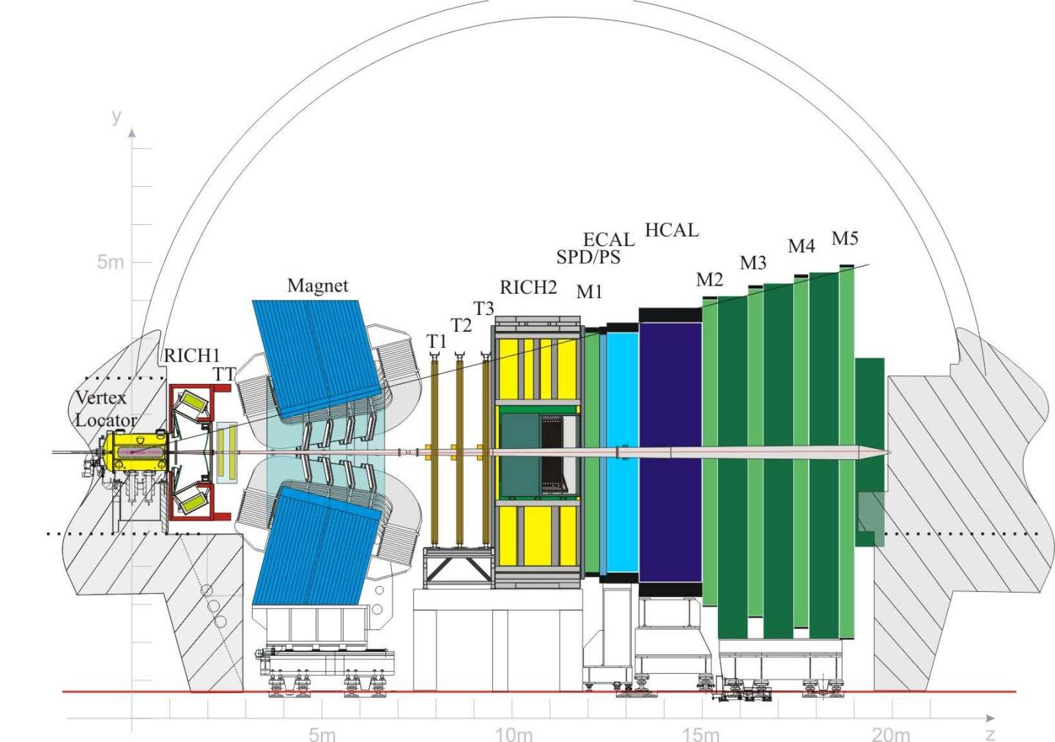
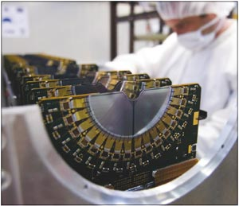
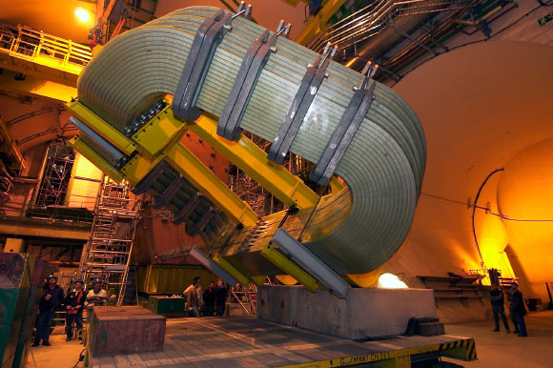
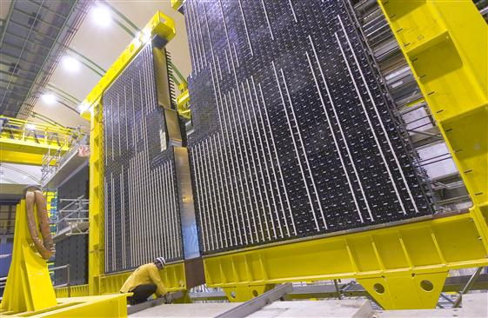
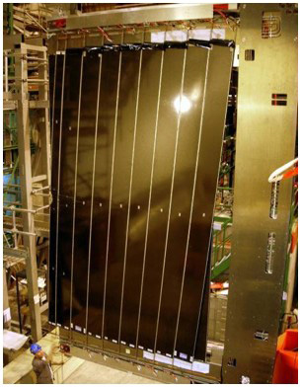
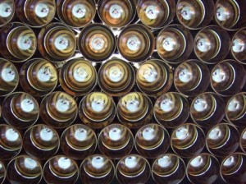
LHCb experiment (2011-2018)
“Light” b and c hadrons are
produced mostly in “backward”
and “forward” directions,
only “forward” is instrumented
Collision
point

Slide 19
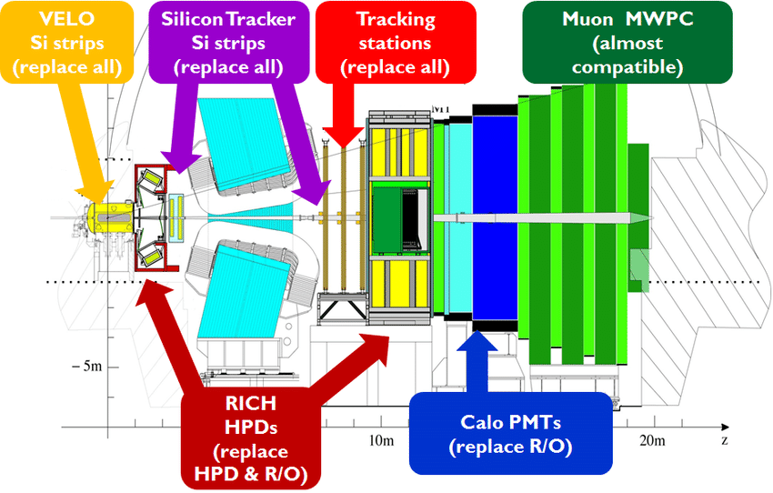
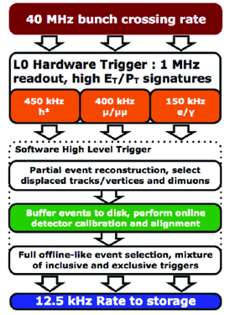
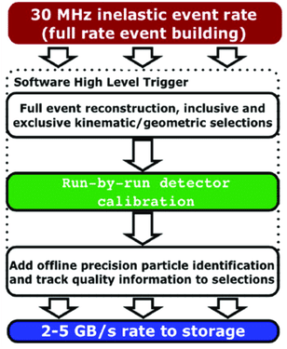

Upgraded LHCb (2022-)
Increase luminosity by ~x5
Major detector, data acquisition
and trigger upgrade
(including fully software trigger on GPU)
~500 ⨉

Slide 20
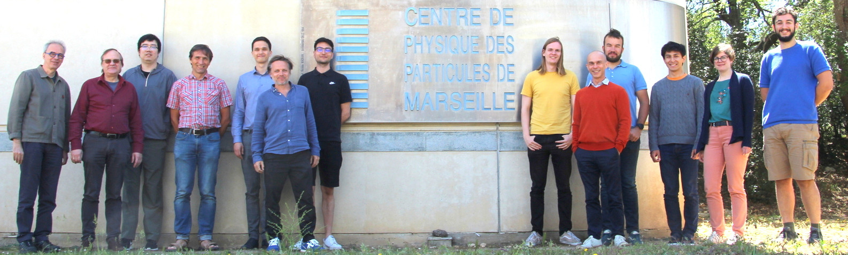
LHCb group at CPPM
Main activities of the group:
Analyses: charged anomalies (semileptonic B decays)
DAQ electronics (PCI readout boards)
Trigger (HLT1 on GPU and HLT2 on CPU)
Preparation for Upgrade II: vertex detector sensors

Slide 21

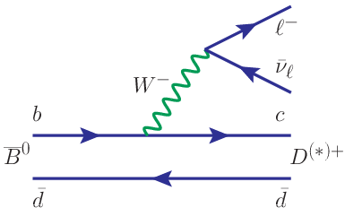
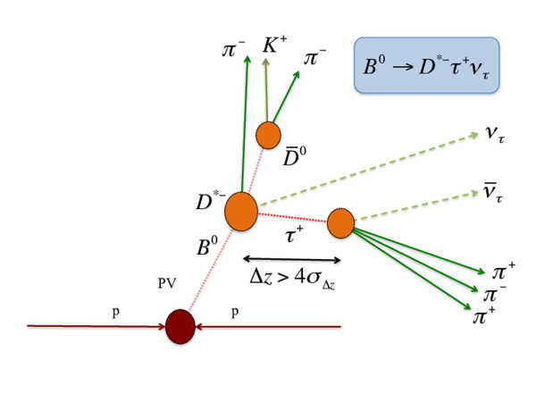
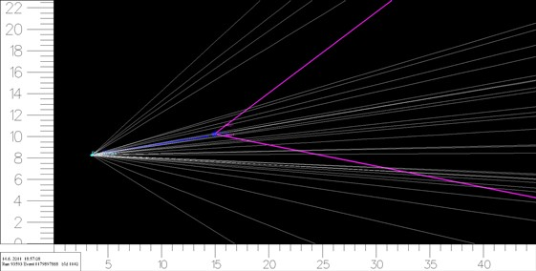
Lepton flavour universality: b→clν
Study charged weak current: e.g.
Tricky: neutrinos are not reconstructed
Use event topology for kinematic constraints
Use machine learning algorithms trained on
simulated signal and backgrounds
Proton
interaction
B meson
decay

Slide 22
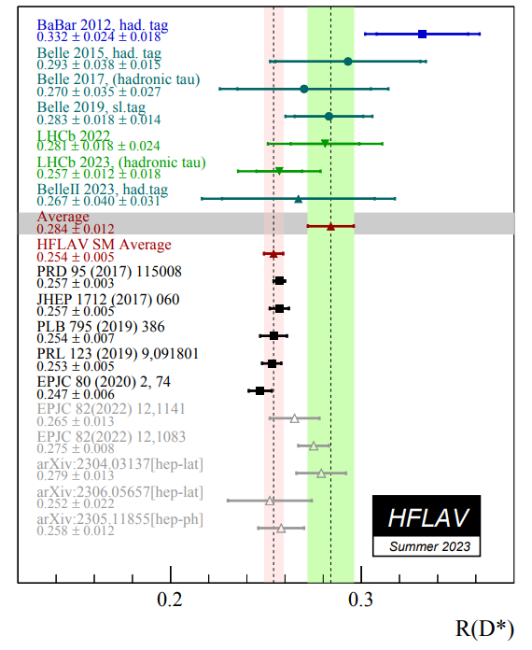
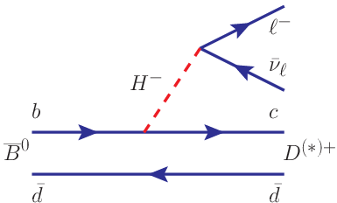
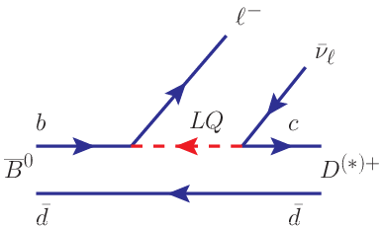
Lepton flavour universality: b→clν
Study charged weak current:
All measurements are systematically above SM!
Can be explained by “New Physics”:

Slide 23
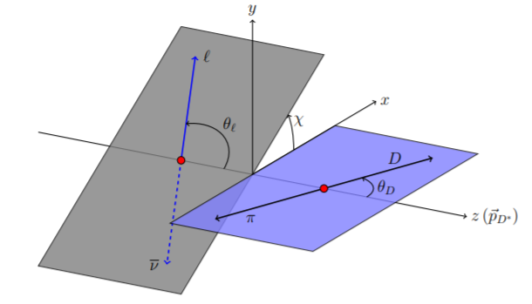
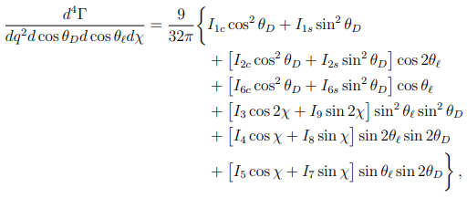
Semileptonic B decays: other than R(D*)
Investigating other observables sensitive to NP:
Angular distributions:
LFU observables with electrons: R_{eτ}(D*), R_{eμ}(D*)
Decay with other D states: orbital D excitations
  Master internship and PhD project in 2024
  Contact Anton Poluektov (Anton.Poluektov@cern.ch)
Parity- and
CP-violating terms
≡ 0 in SM

Slide 24

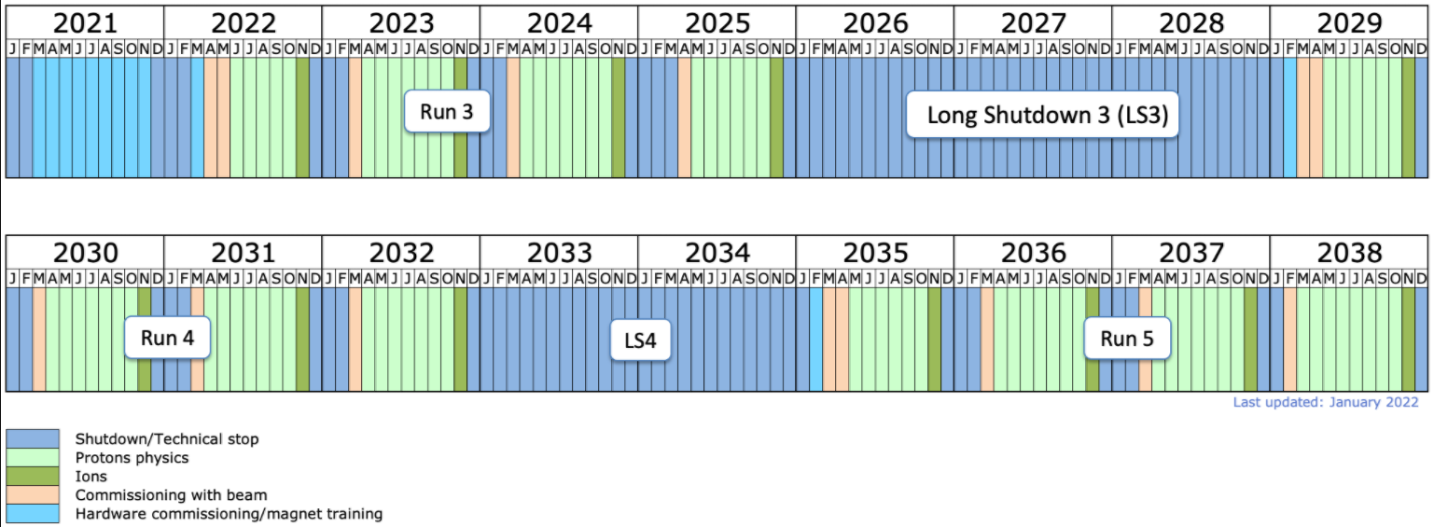
LHC long-term schedule
LHCb Upgrade I
Run 3, 25 fb⁻¹
Run 4
LHCb Upgrade II
Run 5, 300 fb⁻¹
Run 4, 25 fb⁻¹
L = 2x10³⁴, μ=50
~400 Tb/sec at readout
L = 2x10³³

Slide 25
Thanks!

