Slide 1



(T)SDHCAL
I.Laktineh
IP2I, Lyon, France
On behalf of the French groups of
IP2I, LPCC, OMEGA
and 7 other groups from Spain, Belgium, S.Korea, China and Tunisia

Slide 2
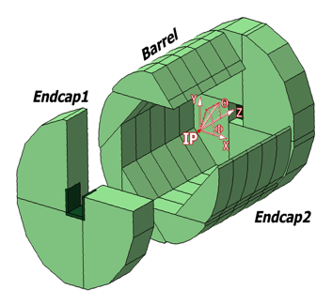
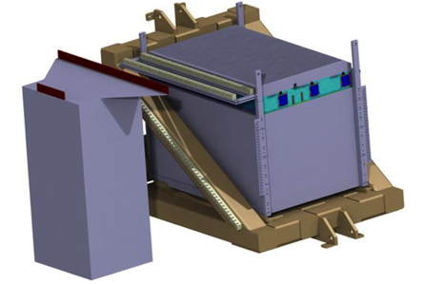
SDHCAL
The SDHCAL concept is based on exploiting Gaseous Detectors high granularity potential
For PFA applications. It was conceived and proposed for ILD@ILC
Semi-digital readout to improve on
power-pulsed electronics to reduce power consumption and eliminate active cooling
self-supporting mechanical structure to serve as absorber as well.
The structure proposed for the SDHCAL :
is very compact with negligible dead zones
Eliminates projective cracks
Minimizes barrel / endcap separation
(services leaving from the outer radius)
SDHCAL Technological Prototype was proposed in 2008 to be
as much as possible similar to the ILD module and able to study hadronic showers
Challenges
-Homogeneity for large surfaces
-Thickness of only few mms
-Lateral segmentation of 1 cm X 1 cm
-Services from one side
-Embedded power-cycled electronics
-Self-supporting mechanical structure

Slide 3
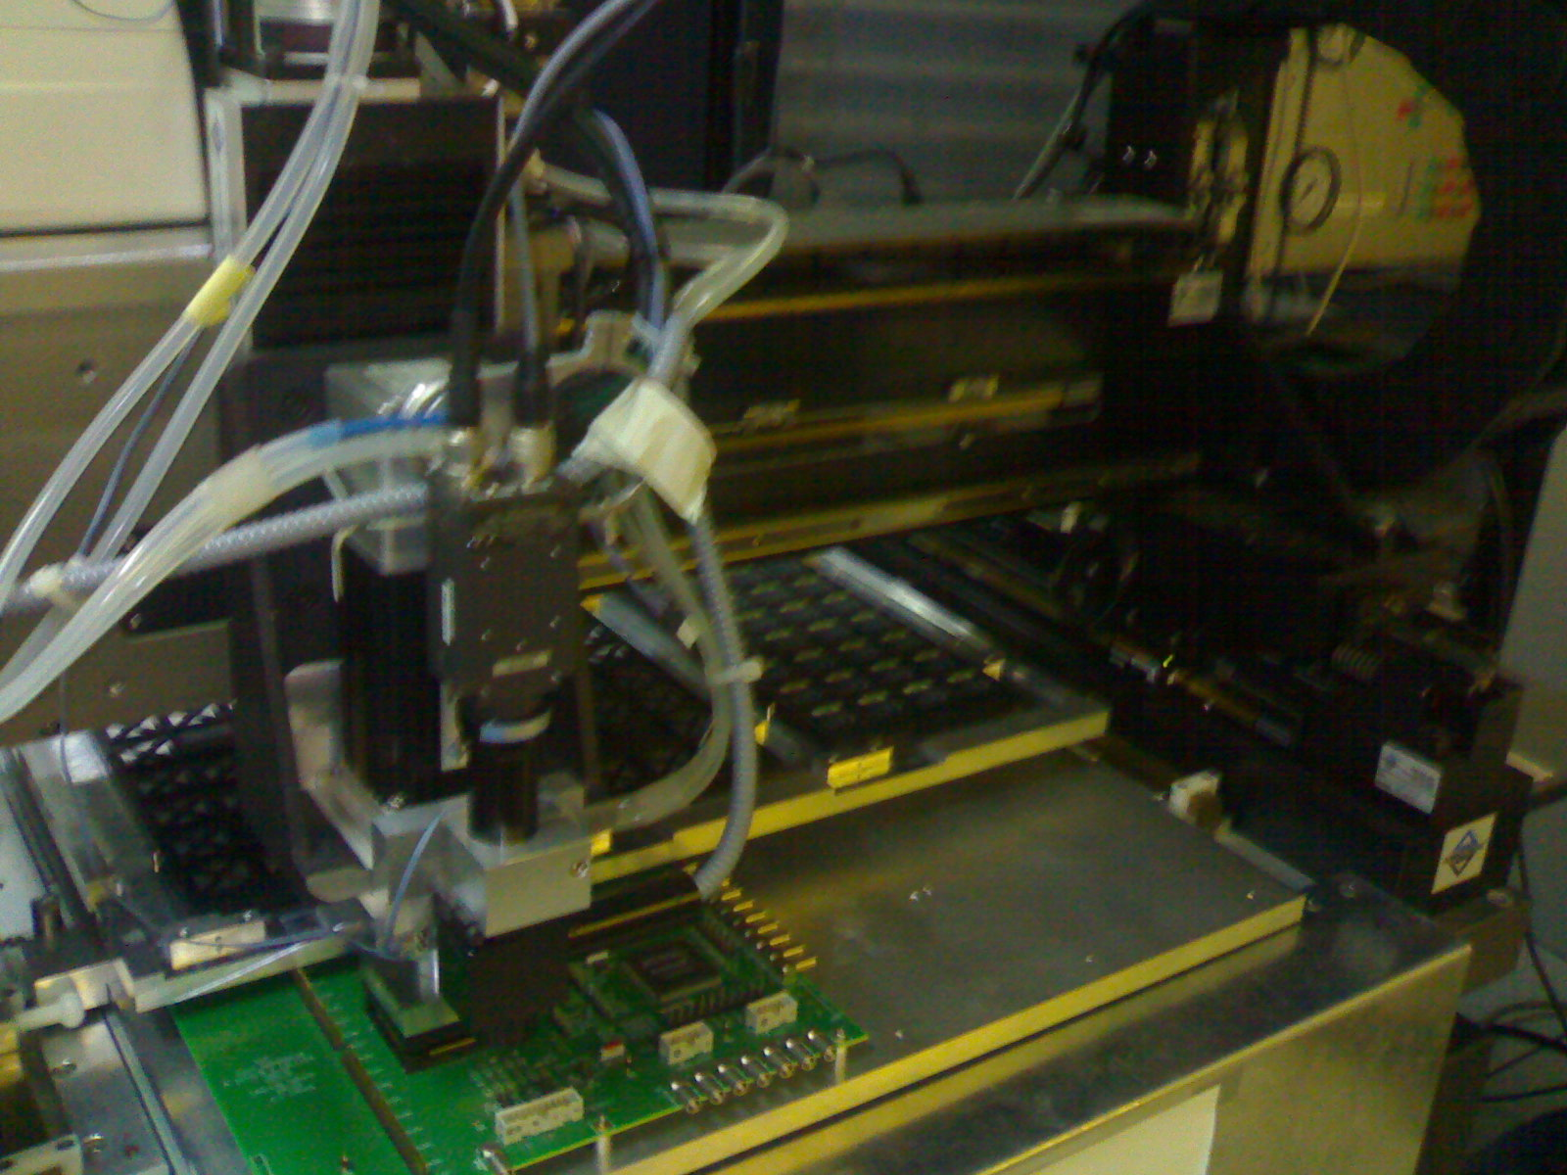
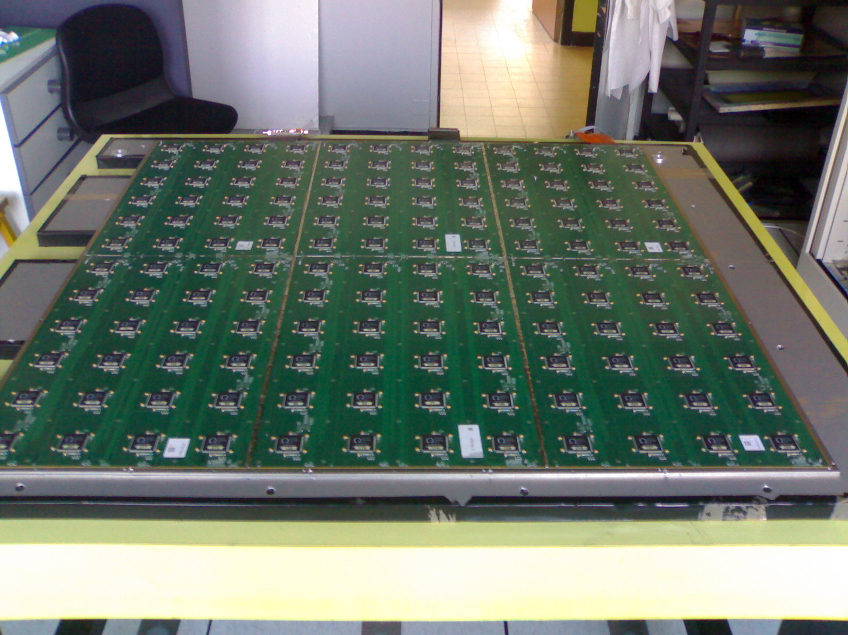
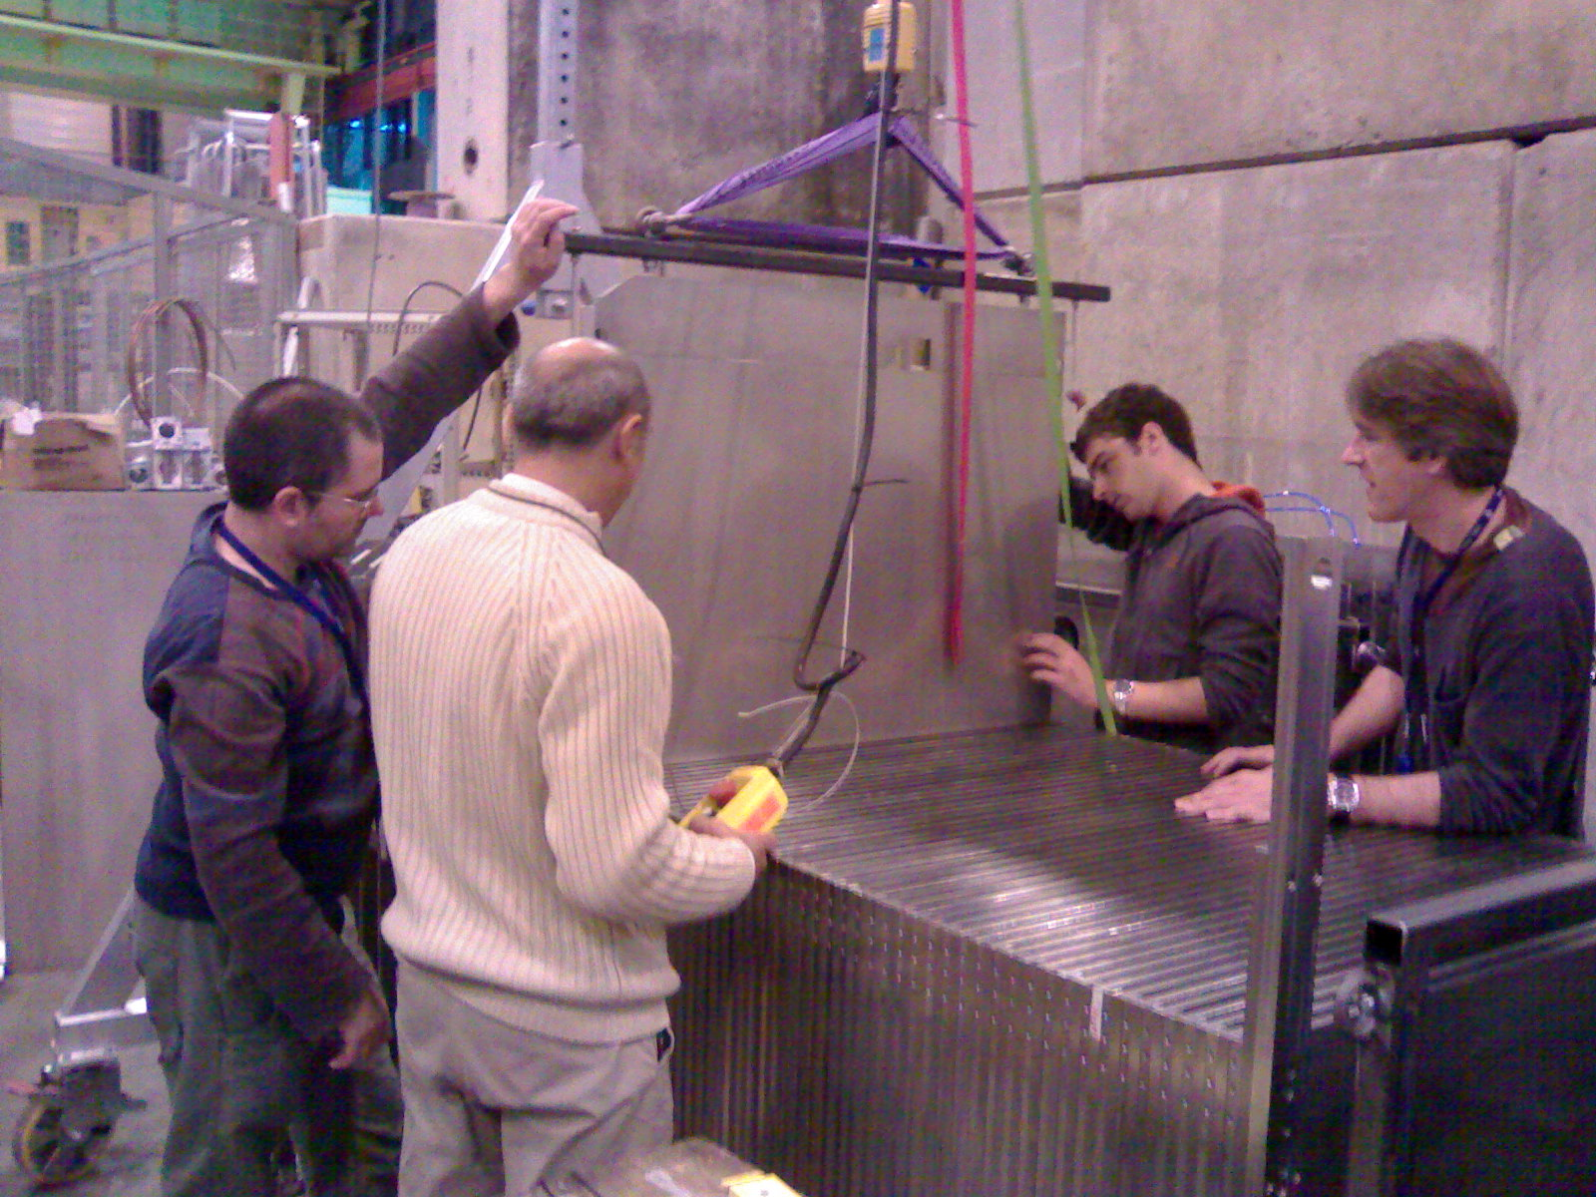
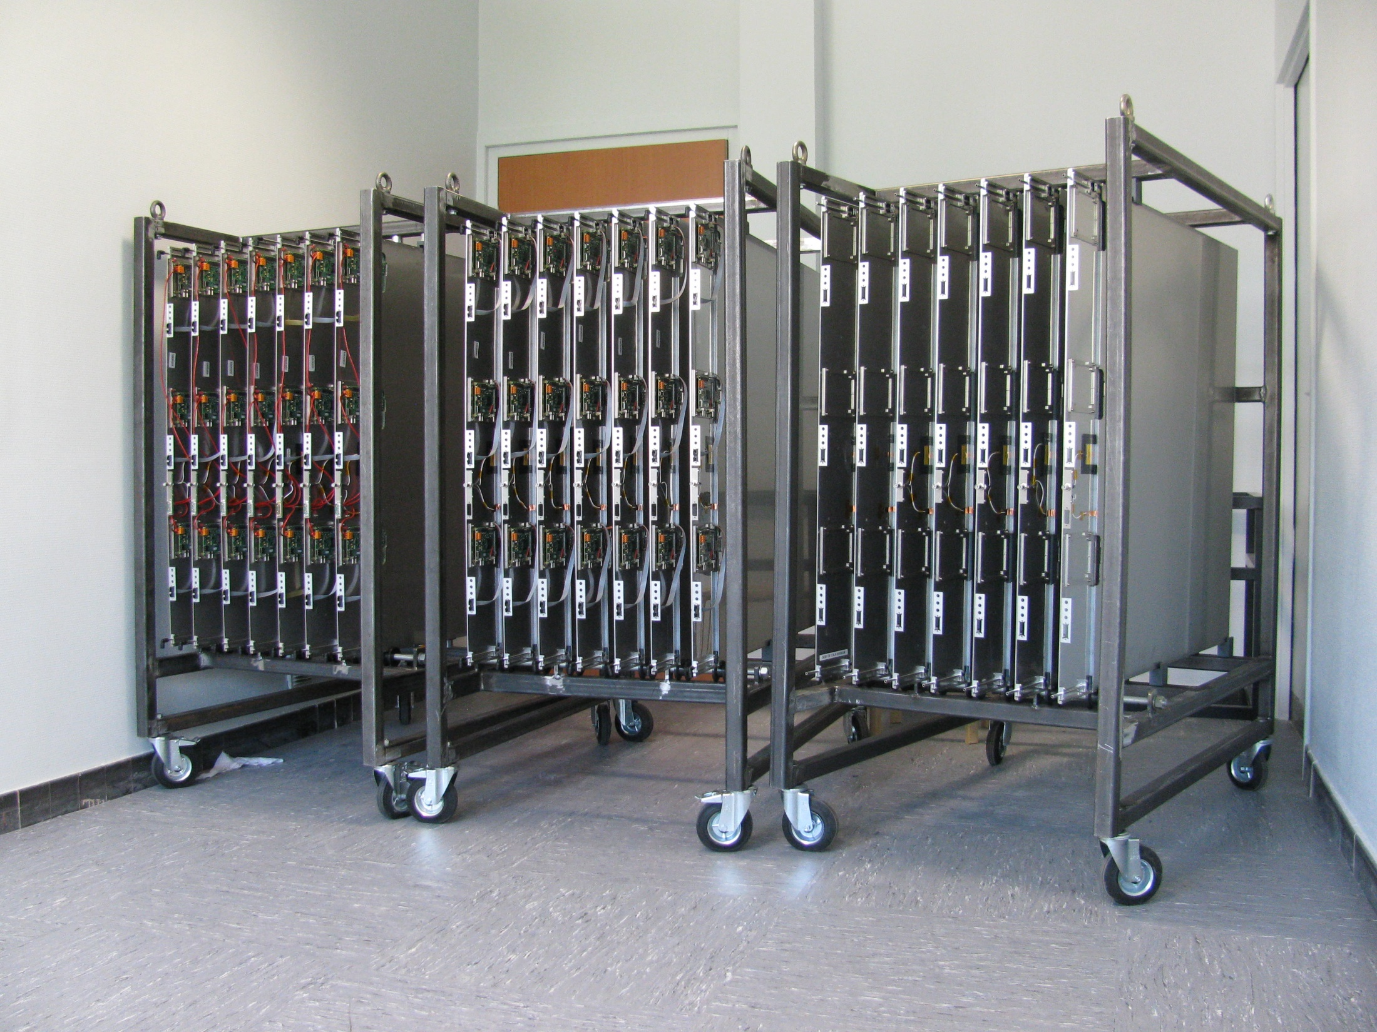
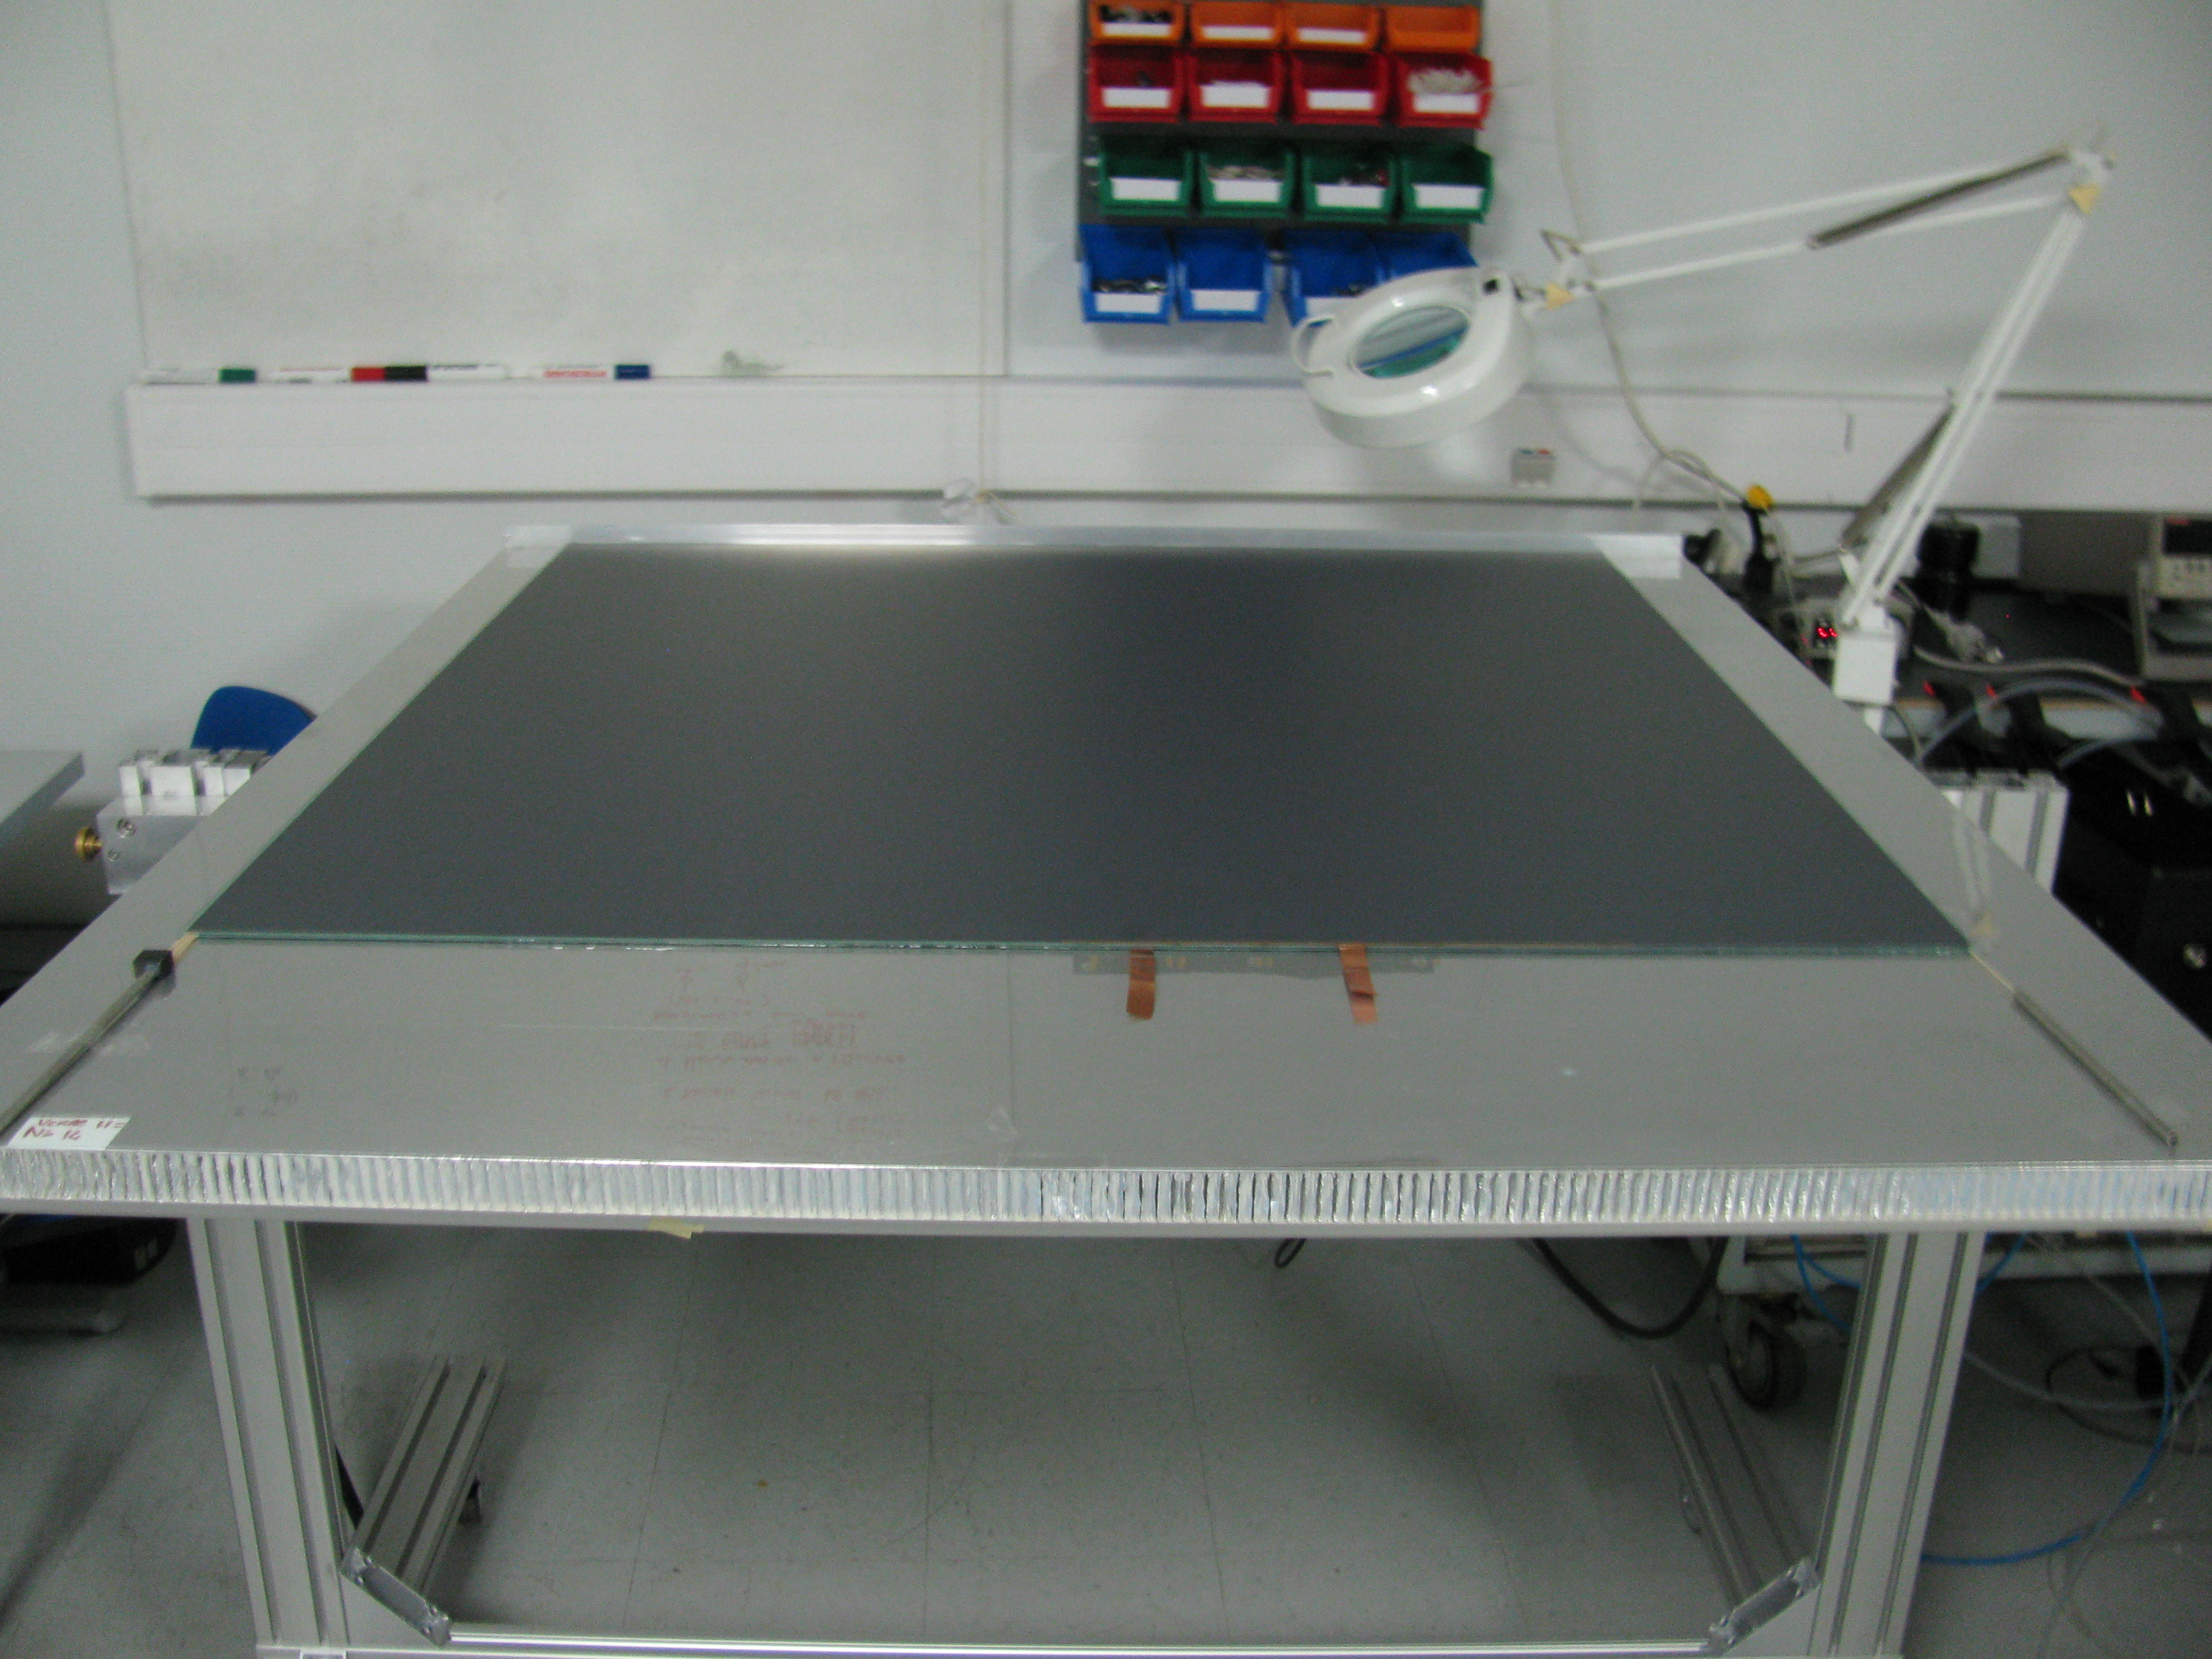
SDHCAL prototype construction
10500 64-ch ASIC were tested and calibrated using a
dedicated (ASICs layout : 93% ).
310 PCBs were produced, cabled and tested.
They were assembled by sets of six to make 1m² ASUs
170 DIF, 20 DCC were built and tested.
50 detectors were built and assembled with
their electronics into cassettes.
Self-supporting mechanical structure.
DAQ system using both USB and HTML protocol
was developed and used.
Full assembly took place at CERN.

Slide 4
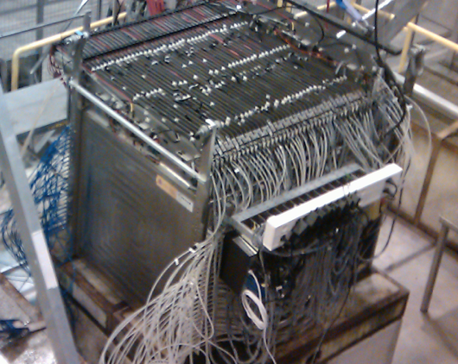
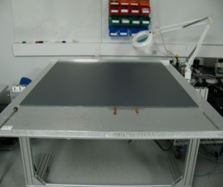
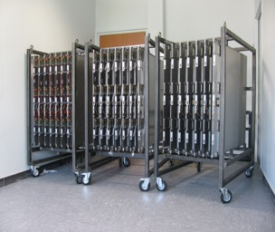
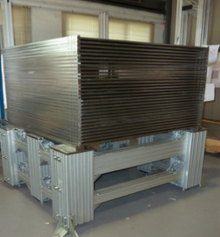

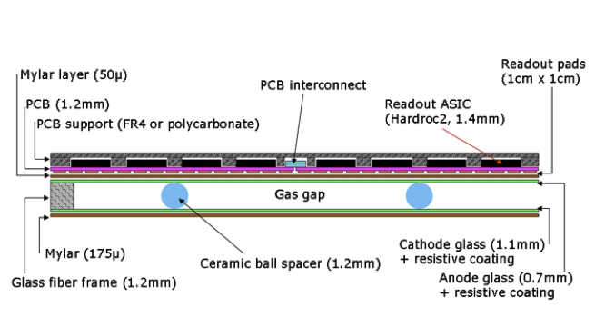
SDHCAL prototype construction
CALICE SDHCAL
Since 2012
10500 64-ch ASIC were tested and calibrated using a
dedicated (ASICs layout : 93% ).
310 PCBs were produced, cabled and tested.
They were assembled by sets of six to make 1m² ASUs
170 DIF, 20 DCC were built and tested.
50 detectors were built and assembled with
their electronics into cassettes.
Self-supporting mechanical structure.
DAQ system using both USB and HTML protocol
was developed and used.
Full assembly took place at CERN.
48 layers (-6λ_{I})
1 cm X 1 cm granularity
3-threshold, 500000 channels
Power-Pulsed
Triggerless DAQ system
Self-supporting mechanical structure
Published: JINST 10 (2015) P10039

Slide 5
SDHCAL performance
Triggerless
Time-based clustering
The SDHCAL prototype was exposed to hadron, muon and electron
beams in 2012, 2015 , 2018 and 2022 on PS, H6 and H8 -SPS lines.
Power-pulsing using the SPS spill structure was used to reduce the
power consumption.
Self-triggering mode is used but external trigger mode is possible
The threshold information helps to improve on the energy rec.
by better accounting for the number of tracks crossing one pad
Data were taken in 2012, 2015, 2017, 2018 and 2022 with
continuously improved DAQ system.
Noise rate
Efficiency
Multiplicity

Slide 6
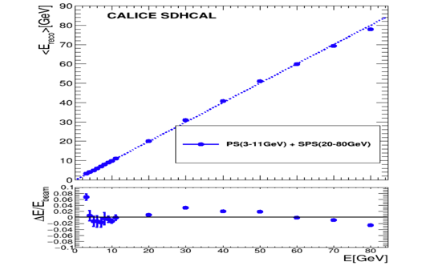
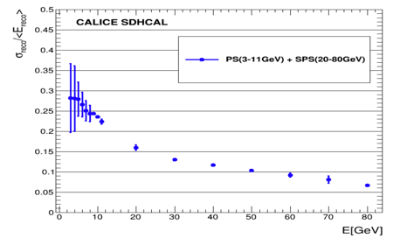
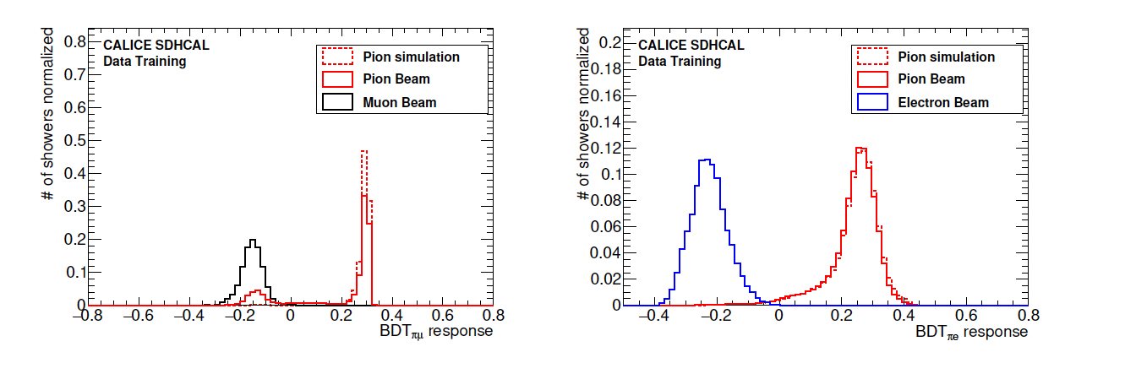
SDHCAL Performance
E_{rec =} α (N_{tot}) N₁ + β (N_{tot}) N₂ + γ (N_{tot}) N₃
Energy reconstruction
JINST 11 (2016) P04001
α , β , γ are quadratic functions of
They are computed by minimizing :
JINST 17 (2022) P07017
χ²= (E_{beam}-E_{rec})²/E_{beam}
Hough-Transform
Track segments reconstruction using 3D-Hough Transform helps
apply different treatment to the hits of these segments.
Particle identification
JINST 15 (2020) P10009
Track segments can also be used as in-situ calibration
and monitoring tools
JINST 12 (2017) P05009

Slide 7
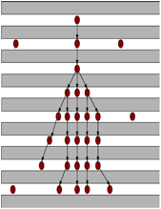
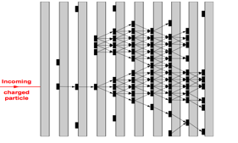
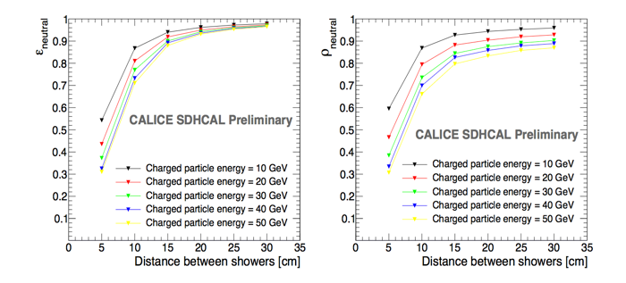
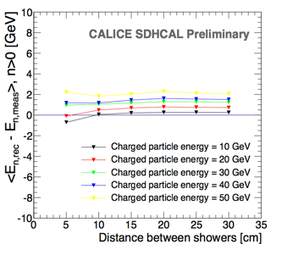
Shower separations
ArborPFA, April algorithms:
they connect hits and then their clusters using distance and orientation information
then user tracker information (momentum)
to improve on the correction
Efficiency
ΔE
Purity
1 neutral of 10 GeV
1 neutral of 10 GeV
1 neutral of 10 GeV
CALICE note CAN054
R. Eté PhD thesis
L. BO (LIO postdoc)

Slide 8
SDHCL for Circular Collider
New readout electronics:
  Continuous readout
  Precise time information → T-SDHCAL
Mechanics & services
  active cooling is mandatory
High rate capability
New friendly gases

Slide 9
SDHCAL→T-SDHCAL

Slide 10
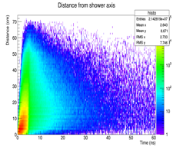
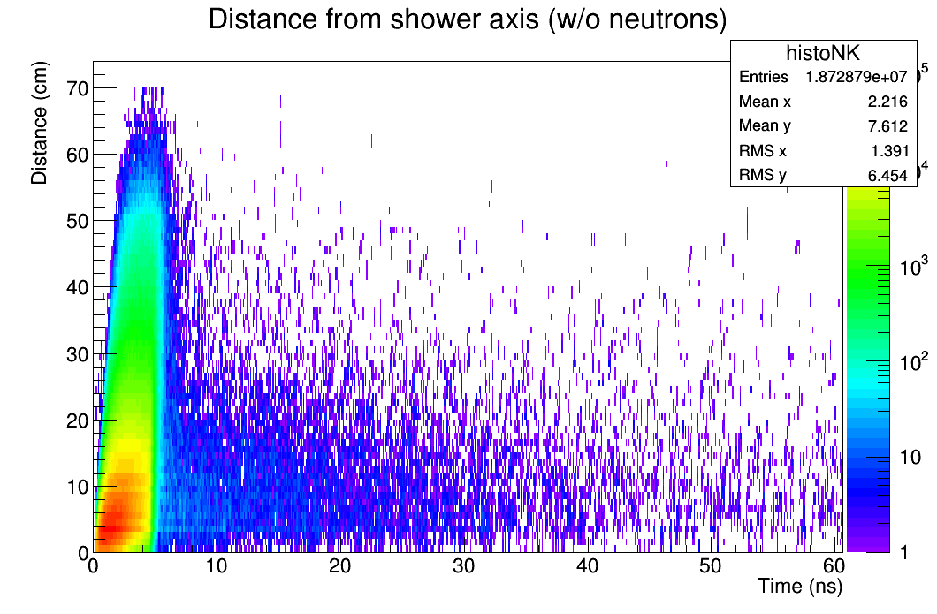
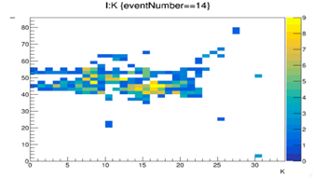
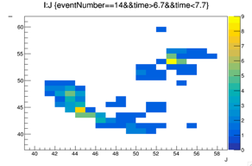
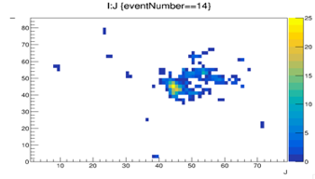
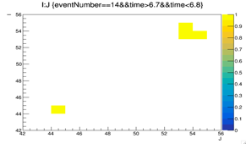
Timing is an important factor to identify delayed neutrons and better reconstruct their energy
Timing can help to separate close-by showers and reduce the confusion for a better PFA application. Example: pi-(20 GeV), K-(10 GeV) separated by 15 cm.
1 ns resolution
Y
Y
Z
X
100 ps resolution
Y
Y
X
X

Slide 11
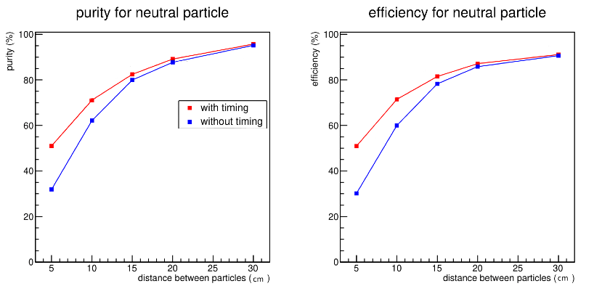
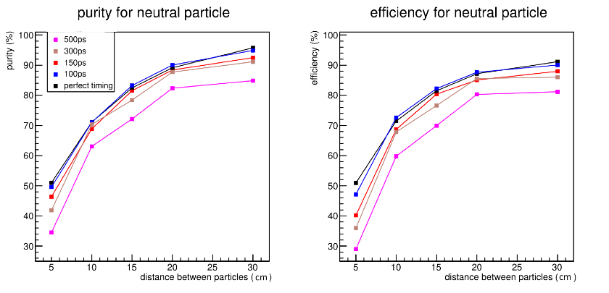
Timing for PFA
Including time information in the simulation to separate hadronic showers ( 10 GeV neutral particle from 30 GeV charged particle) using techniques similar to ARBOR’s ones.

Slide 12
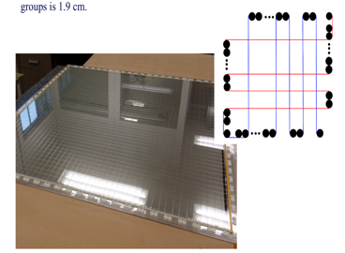
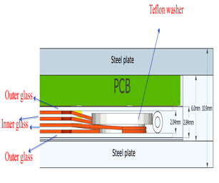
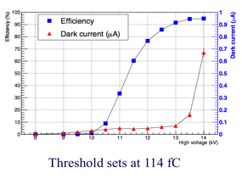
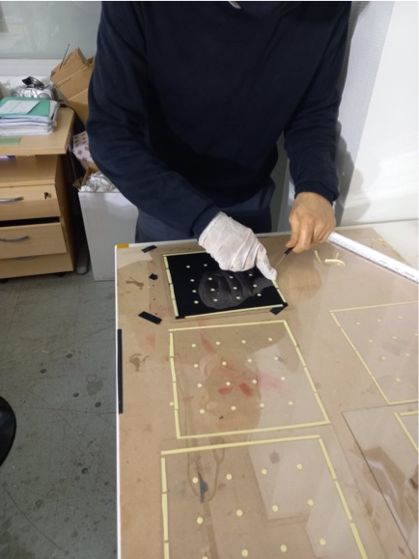
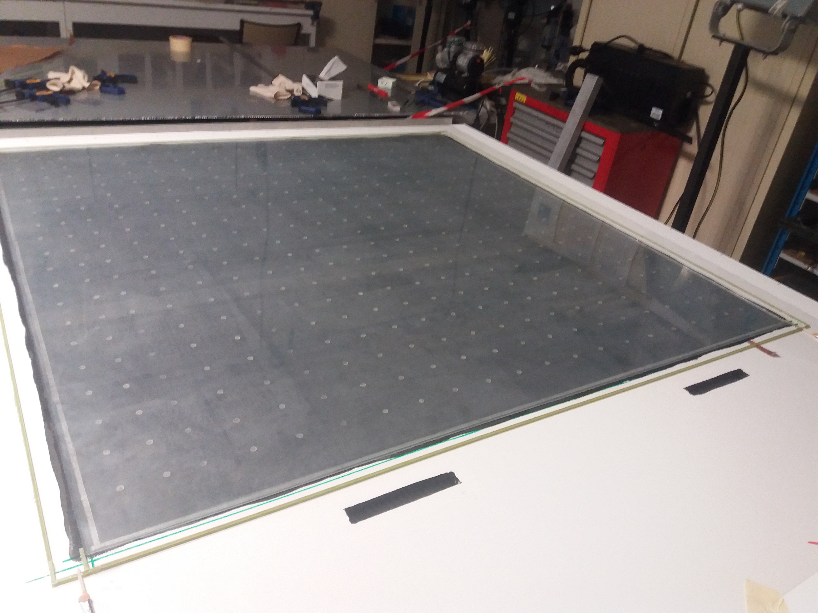
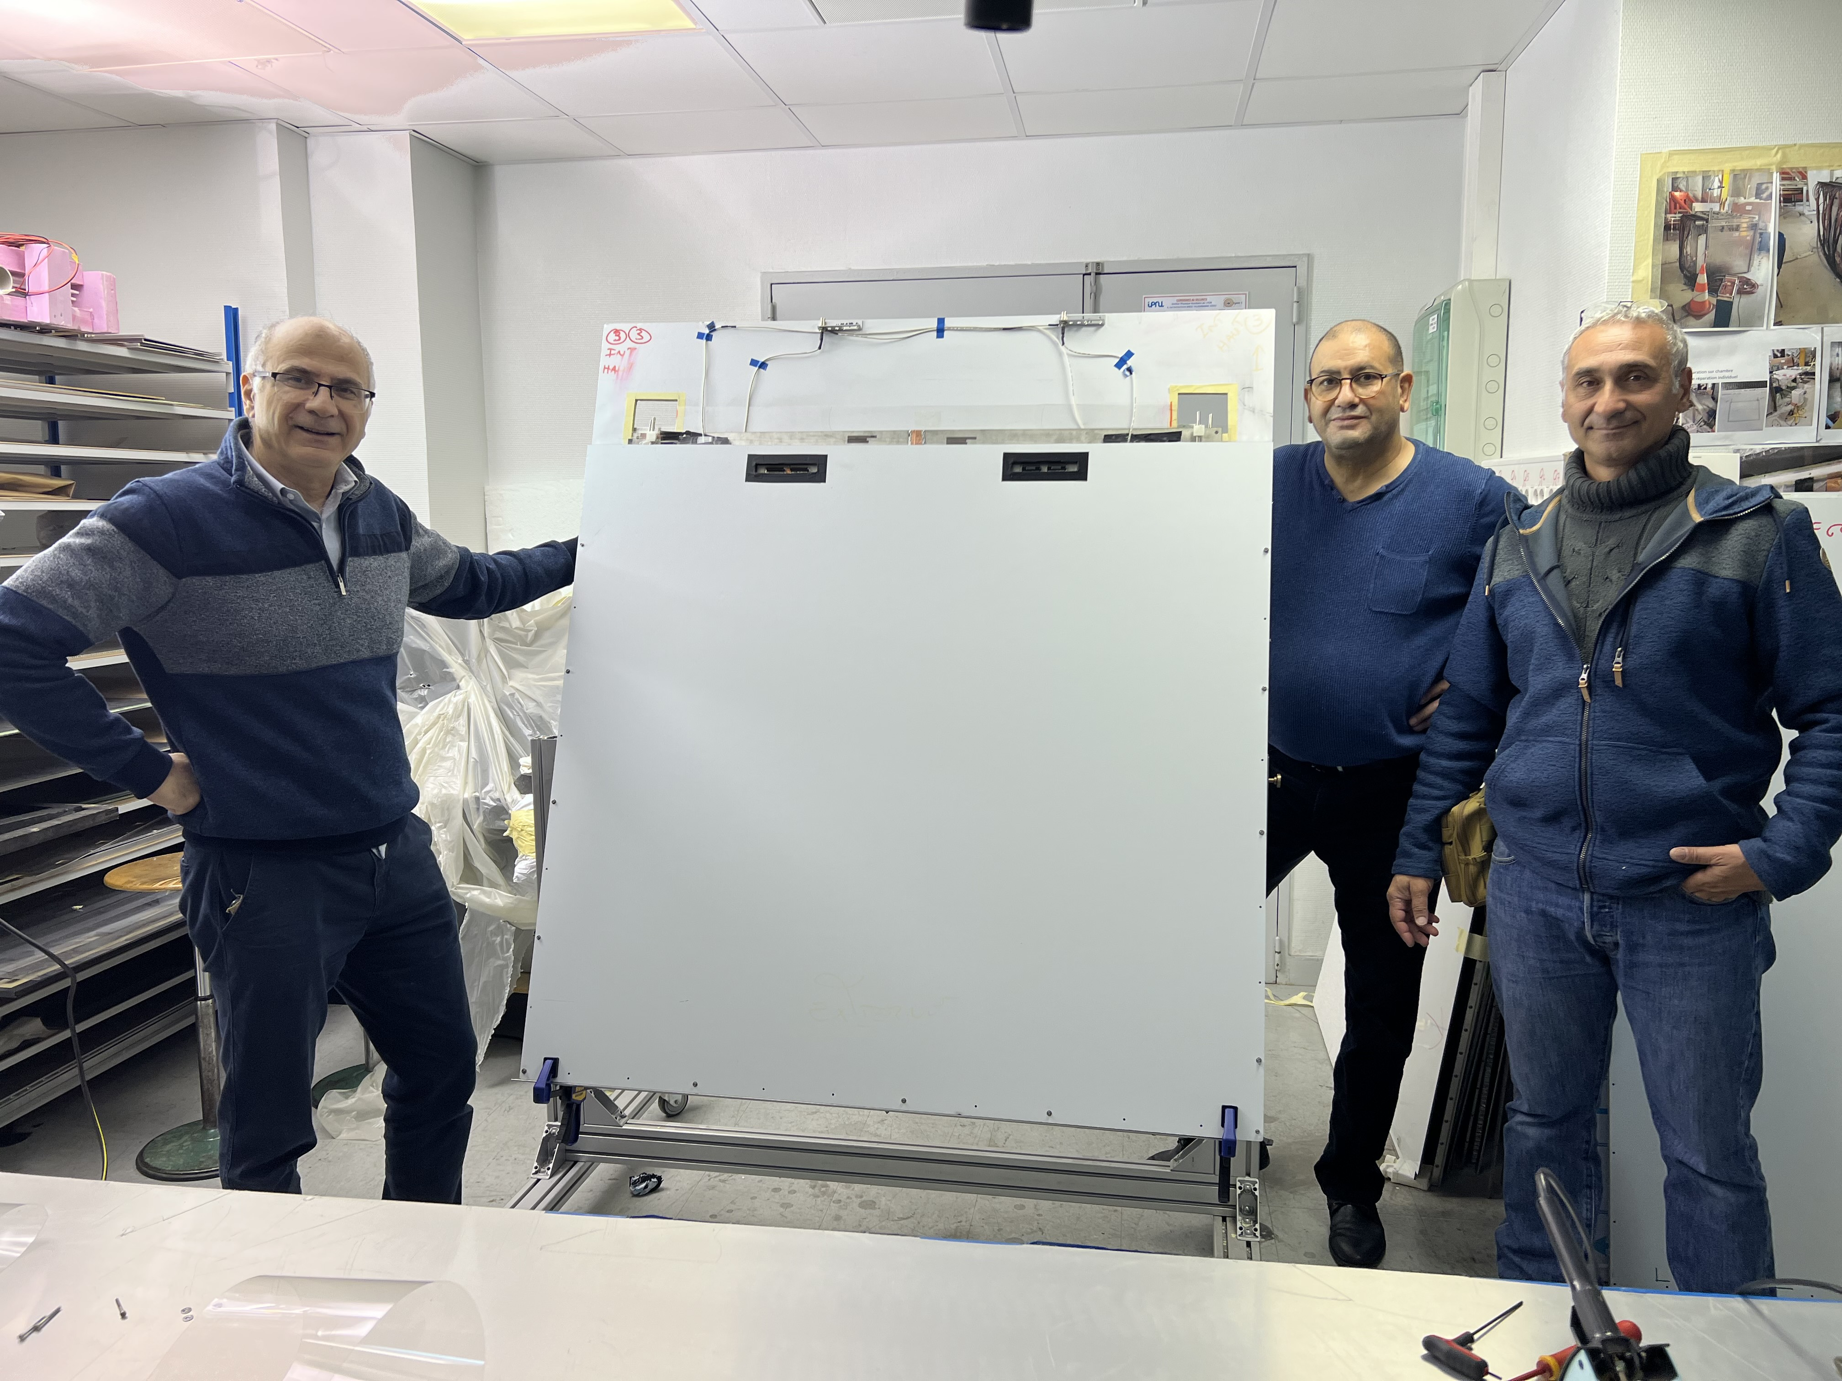
DETECTOR
MultiGAP RPC is an excellent candidate.
5-gap of 200 µm each separating glass plates of 250 µm thick can provide
a time resolution of around 100 ps
The standard method to build MRPC is based on using fishing line
New and easy way to build MRPC was recently developed.
Preliminary results show an efficiency > 93% with 5 gaps

Slide 13
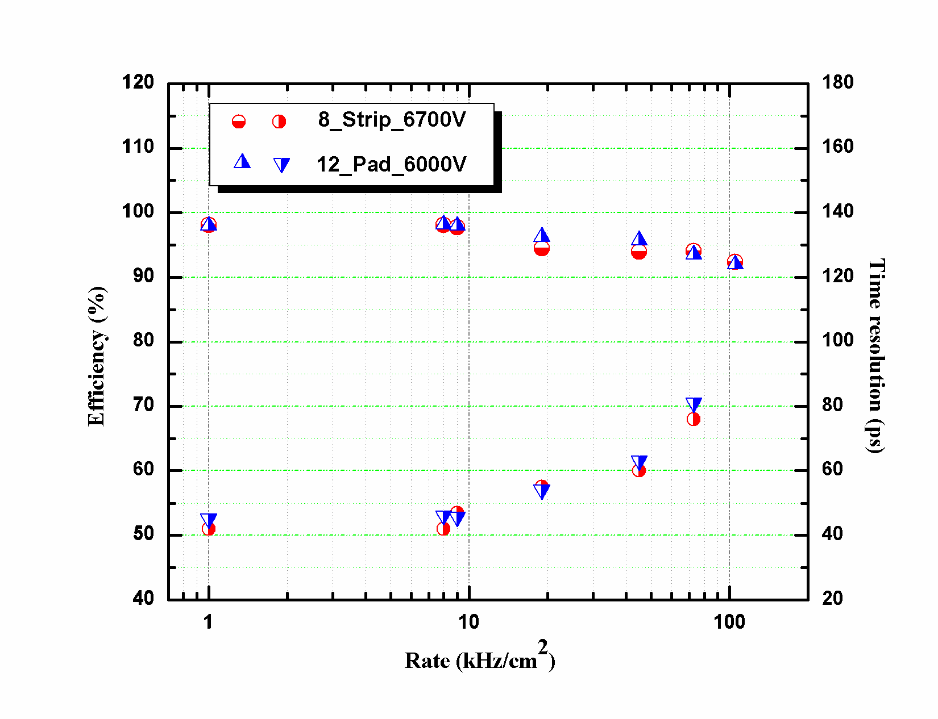
2x 4-gap RPC with low resitivity glass

Slide 14
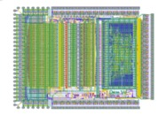
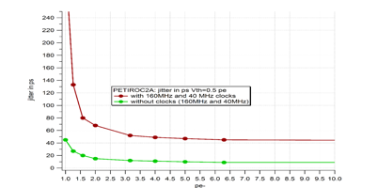
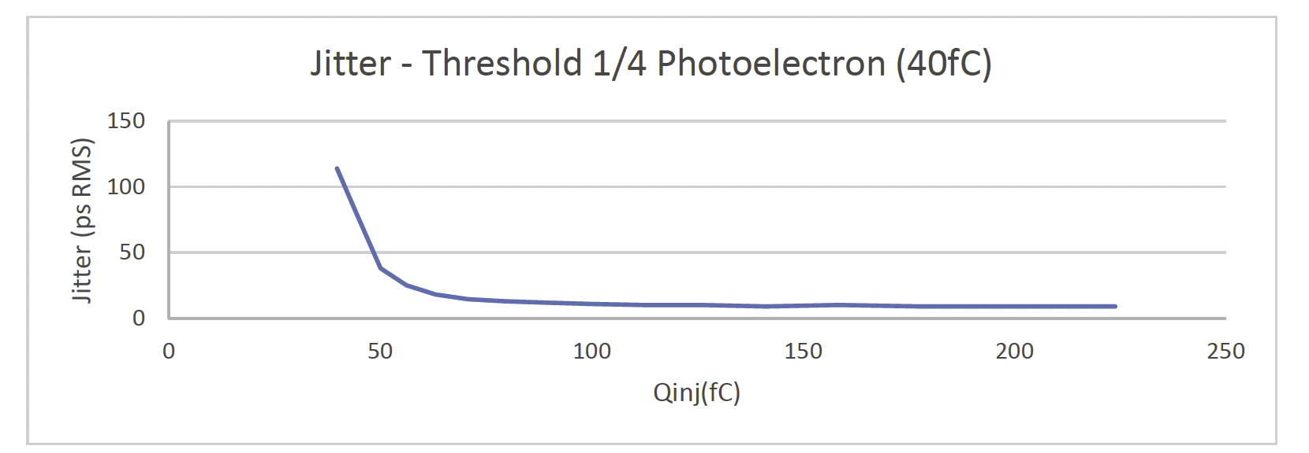
Electronics readout
An ASIC with a fast preamplifier, precise discriminator and excellent TDC is needed
→PETIROC 32-channel, high bandwidth preamp (GBWP> 10 GHz), <3 mW/ch, dual time and charge measurement (Q>50 fC)
jitter < 20 ps rms @ Q>0.3 pC
Internal TDC of 50 ps time resolution.
Another ASIC in TSMC 130 nm developed by OMEGA&WEEROC called LIROC with a time jitter < 10 ps is to be used in the future but it needs to be equipped with an internal TDC before (DRD6).

Slide 15
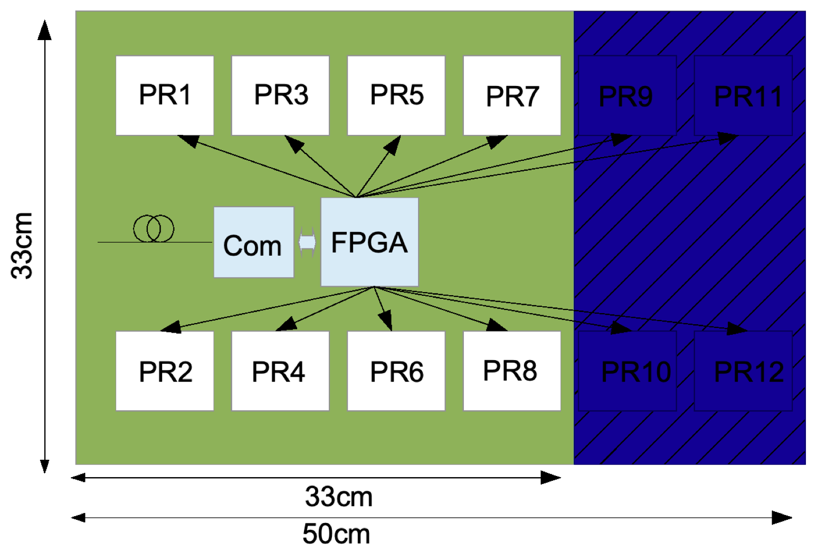
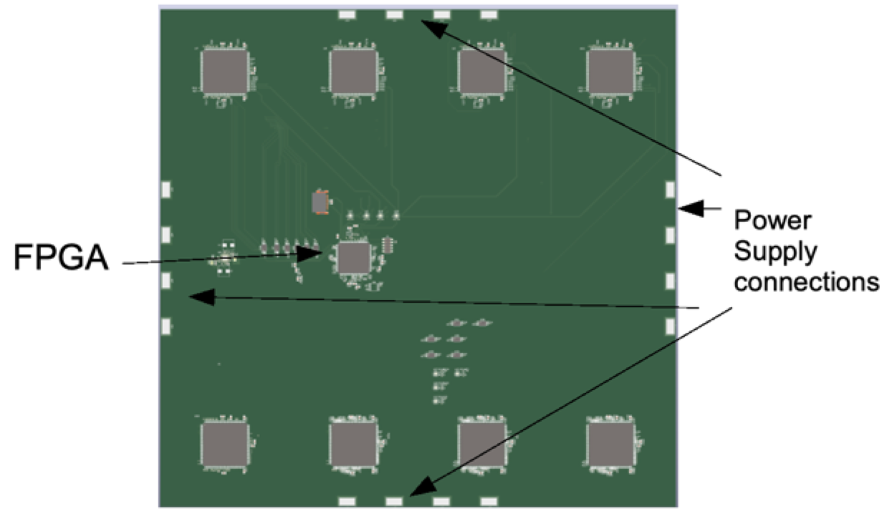

Small ASU
A board with 4 petiroc, 128 pads as well as the whole DAQ system was developed and being tested
Front-End Electronics for MRPC readout with high timing resolution
The system includes a front-end board (FEB), a detector interface card (DIF) and a data acquisition system(DAQ) based on ZCU102.
“Large” ASU
Board with 8 (could be extended to 12) Petircoc2B ASICs are conceived
Pads 2cm x 2cm, 256 channels
Local FPGA (Xilinx Spartan-6 TQFP) embedded on board
50 cm x 33 cm
Top view
Bttom view

Slide 16
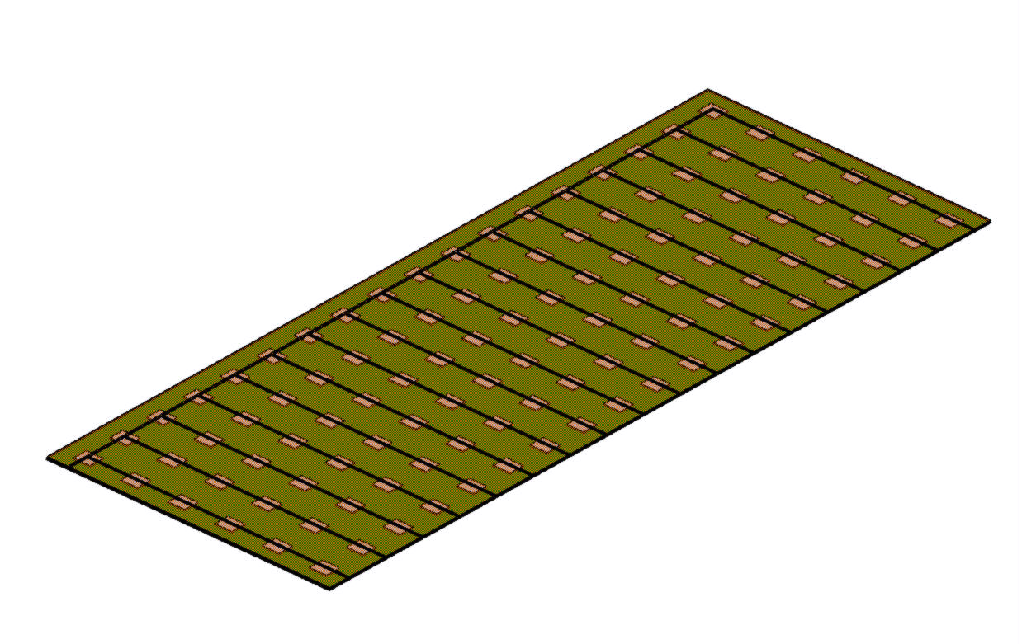
(T)SDHCAL power consumption and cooling
The duty cycle of FCCee/CEPC is different from that of ILC and no power pulsing is possible.
The power consumption is therefore increased by a factor of 100-200 with respect to ILC and active cooling is needed.
Lyon and Shanghai groups worked on a simple cooling system for SDHCAL based on using water circulating into copper pipes
0.8 mW/chips with power pulsing, 80 mW/chips without power pulsing
0.5 m
108 chips
Rectangular section tubes : 2x1 mm
1.5 m
Copper plate over: 1.5 mm
Flow out
symmetry
PCB plate under: 1.4 mm
Flow in

Slide 17
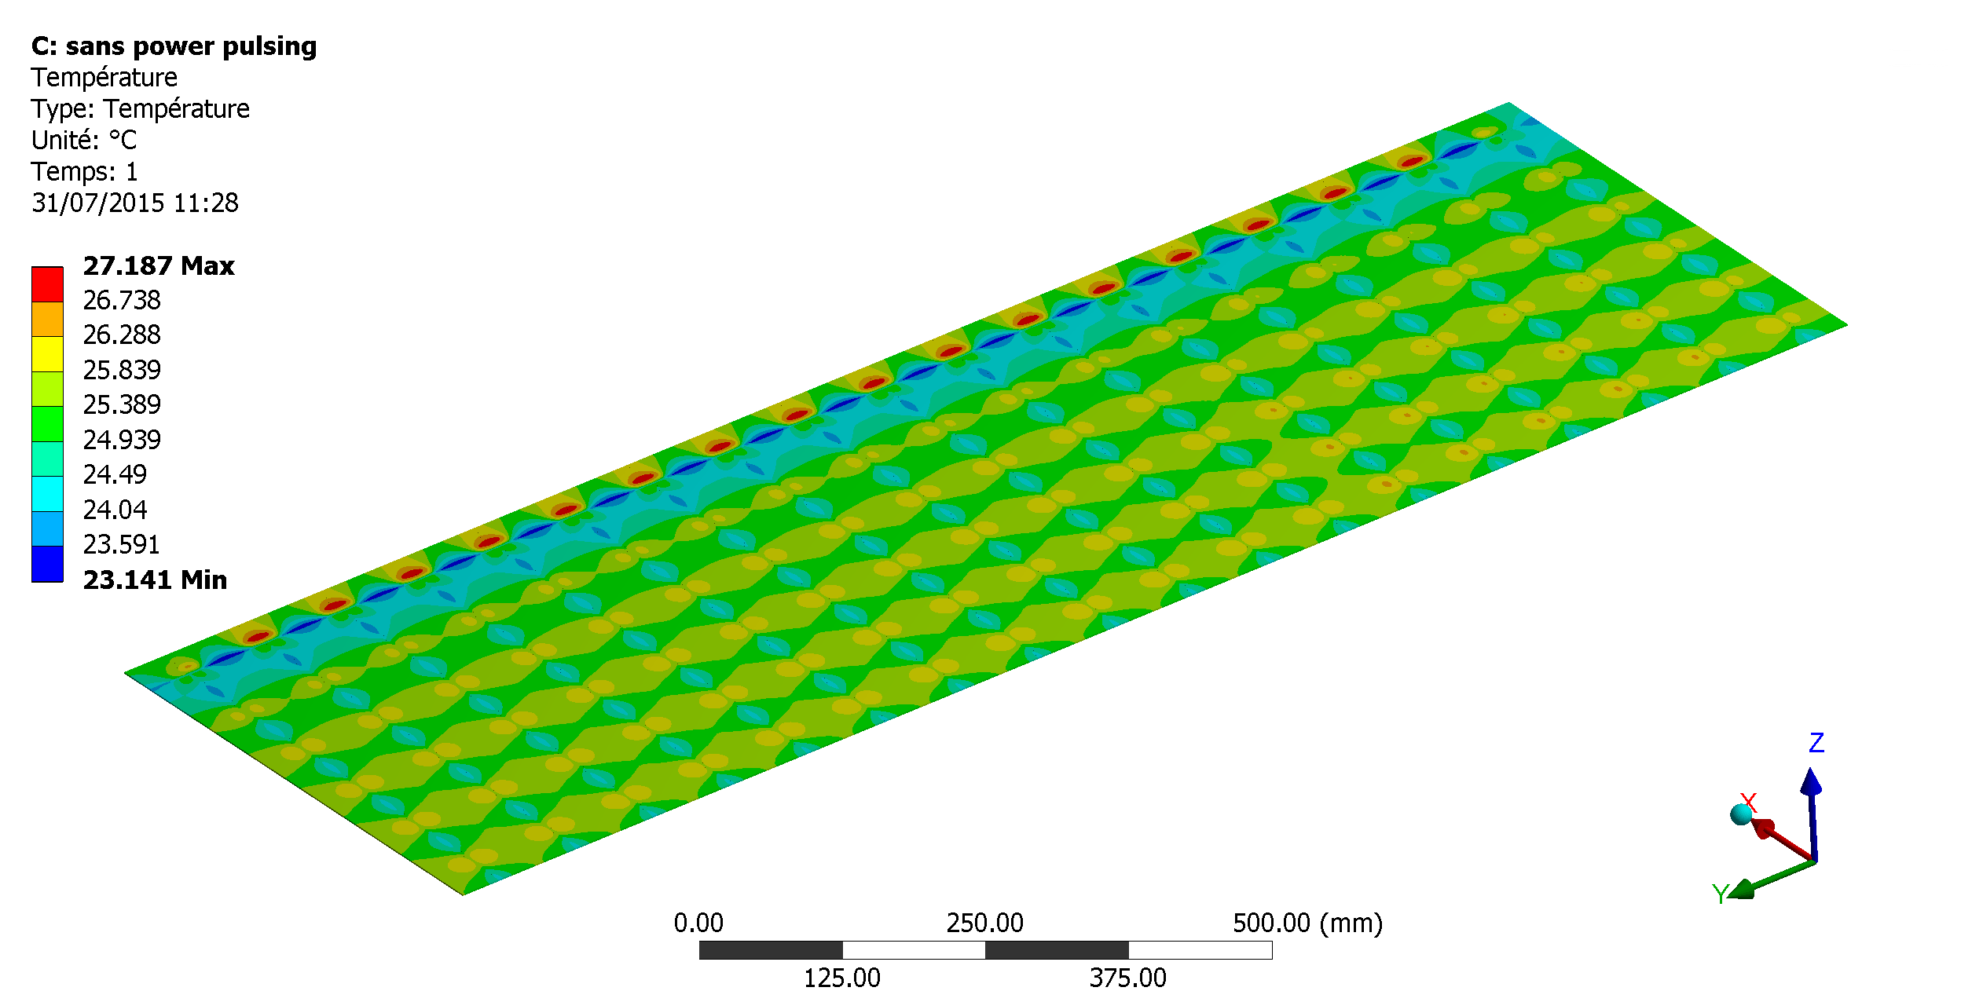
(T) SDHCAL power consumption and cooling
The duty cycle of FCCee/CEPC is different from that of ILC and no power pulsing is possible.
The power consumption is therefore increased by a factor of 100-200 with respect to ILC and active cooling is needed.
Lyon and Shanghai groups worked on a simple cooling system for SDHCAL based on using water circulating into copper pipes.
0.8 mW/chips with power pulsing, 80 mW/chips without power pulsing
Results are very encouraging but we need to confirm by producing a prototype

Slide 18
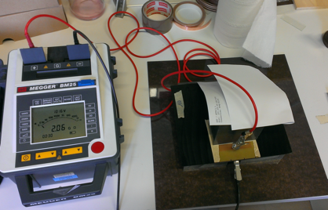
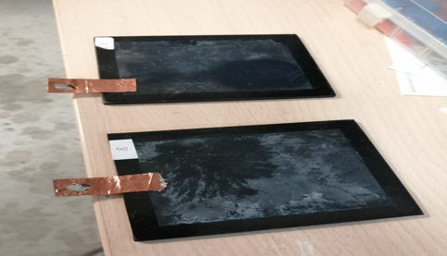
High-Rate capability
(M)RPC are low-rate capability detectors due to the resistive nature of the electrodes. The capability could be significantly increased by developing low resistivity materials.
Dopped glass (by Tsinghua group) could be a solution
PVdF and PEEK are very stable and chemically inert thermoplastic
-New kind of PVdF developed with the help of PolyOne company,
doped with CNT → bulk resistivity of 10¹¹⁻¹² Ω.cm
-New charged PEEK developed with the help of Krefine company.
doped with Black Carbon→ bulk resistivity of 10⁸⁻⁹ Ω.cm was achieved.
A few small detectors were made using doped PVdF plates of 2-3 mm thickness.
High efficiency was obtained with cosmic
Plates made with charged PEEK were produced
Some homogeneity due to extrusion need to be fixed before to have a final material.

Slide 19
New friendly gases
The CERN gas group has identified friendly gases to replace TFE and SF6 for (M)RPC
TFE→ HFO1234ze
SF6→ Nova4710 ( not good for Bakelite but ok for GRPC and MRPC)
Techniques of recycling the gas mixture is being constantly improved (>90%)
Techniques to recover the different exhaust gases (distillation…etc) are being developed and promising results have been obtained.
Recent results by our partners of GWNU showed that HFO1234ZE provides similar performances as TFE with no need to CO2 and SF6

Slide 20
Conclusion
SDHCAL is ready for ILC
Many developments are needed to adapt SDHCAL for FCCee
Adding time information will certainly improve on SDHCAL already excellent performances
Finally, developing T-SDHCAL is also developing excellent muon chambers for FCCee.

