Slide 1
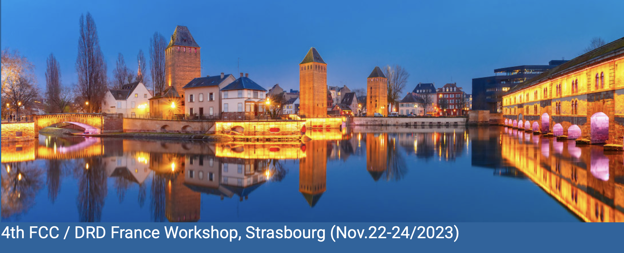
Highlights of French interests in the new DRD collaborations at CERN
D. Contardo IP2I

Slide 2
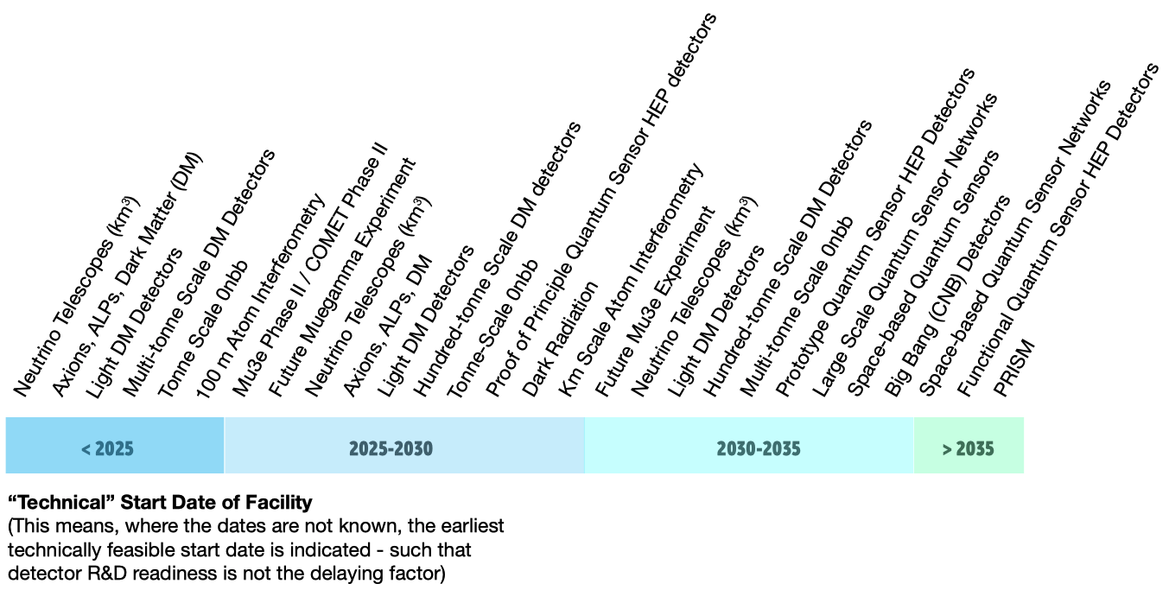
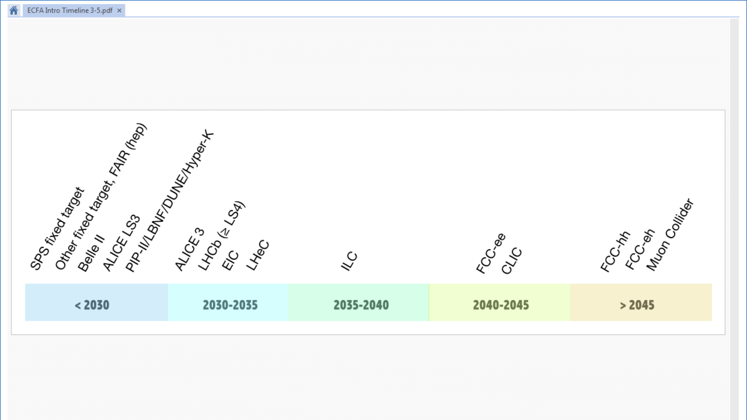
Context of HEP projects for Detector Research & Development
large accelerators
small accelerators, nuclear reactors, cosmic rays
FCC-ee physic now 2048
ongoing
& upgrades
planning at the time of
ECFA DRD roadmap
ongoing
    2 next generations of detectors
TRL >3
Strategic DRD
TRL < 6
shorter cycles of experiment scaling/upgrades
Strategic DRD programs evolve with technical success and increase of TRL*
DRD proposal consider a first phase of about 3-4 year, eg timescale for LS4*
* Technology Readiness Level defined by NASA,, low TRL < 3 also often referred as “blue sky” , TRL > 6 are experiment specific R&D
** Planning of projects is for physics start, end of strategic R&D should consider specific project engineering, construction, and installation time

Slide 3
DRDs areas defined in the ECFA detector roadmap
small accelerators, nuclear reactors, cosmic rays
- shorter cycles experiment scaling/upgrades
Large accelerators - long cycles
DRD1
gaseous
DRD3
solid state
DRD4
photon & PID
DRD6
calorimeter
DRD2
liquid
DRD5
quantum & emerging techno.
DRD7 electronics and on-detector processing - DRD8 integration - DRD9 training and career
Relative match between the DRD areas and the two types of strategic projects
also considering technology versus detector systems

Slide 4
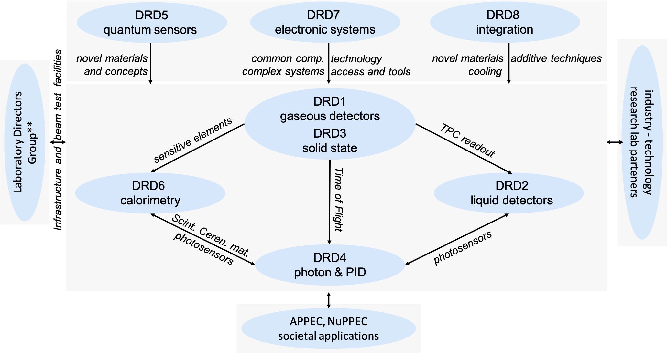
Broad brush links between DRDs and with external partners
DRDs can provide technologies to others and/or share developments of similar components with different performance or operation conditions
can involve participation cross-DRD on a same topic (naturally true for transverse DRD7)
French contact L. Serin
So far DRD1/2/3/4/6 proposals under scrutiny of DRDC* (see L. Serin)
DRD7 provided an interim document with proposal target during summer also for DRD5
DRD8 being investigated community meeting 6 Dec., DRD9 new forum being form
* CERN Detector Research and Development review Committee

Slide 5
DRD proposals content
Scientific program cover about TRL 3 to 6 and consider other DRD programs
  breakdown in Work Packages with Deliverables due to achieve Research Goals/Tasks Milestones
Planning is focused on first R&D period of 3 - 4 years
  stepping stones earlier strategic programs
  iterations toward longer term goals: new technologies - new materials - ultimate radiation tolerance
Human resources and funding
  in public document
    list of institutes willing to contribute to various WPs
    estimate of human and funding resources required to achieve the WP goals
    sums of expected resources
  confidential to DRDC to evaluate feasibility of the programs
    current level of human and funding resources expected to be available/prolongated
    new resources being requested to achieve the strategic scope
    preliminary breakdown of resources per Funding Agency
Basis to establish Funding Agency MoU commitments to DRD WP deliverables (see L. Serin)

Slide 6
French institute interests per DRD
reported as they appear in the proposals Work Packages
* need cross-check by proponents

Slide 7
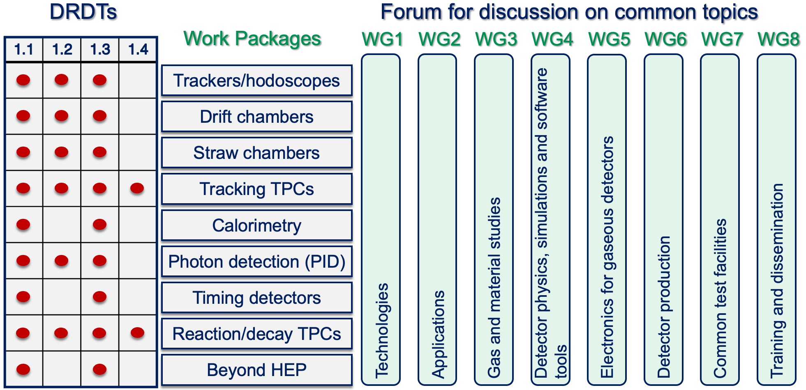
DRD1: Gaseous Detectors
*
all
WP1
IDEA, ALLEGRO
WP2
FCC-ee
detector concepts
ILD’, ALLEGRO
WP4
ILD’, CLD
WP5
all
WP7
IRFU - GANIL - LPSC
WP8
IRFU- LSBB
WP9
WP1 : Micromegas at IRFU large size, high rates… (see F. Janneau)
WP2 : Drift Chamber light wires, drift cell design and weaving procedures at IJCLab, Ganil, LPSC (see N. de Filippis)
WP4 : Time Projection Chamber IBF studies and electronics for MicroMegas readout at IRFU (see D. Jeans)
WP5 : RPCs large size multigap and FE with <100 ps precision at IP2I and Omega (see I. Laktineh)
WP7 : ToF with MicroMegas Picosec project at IRFU (see A. Kallitsopoulou); RPC IP2I, OMEGA
* Detector Research and Development Themes defined in the ECFA detector roadmap

Slide 8
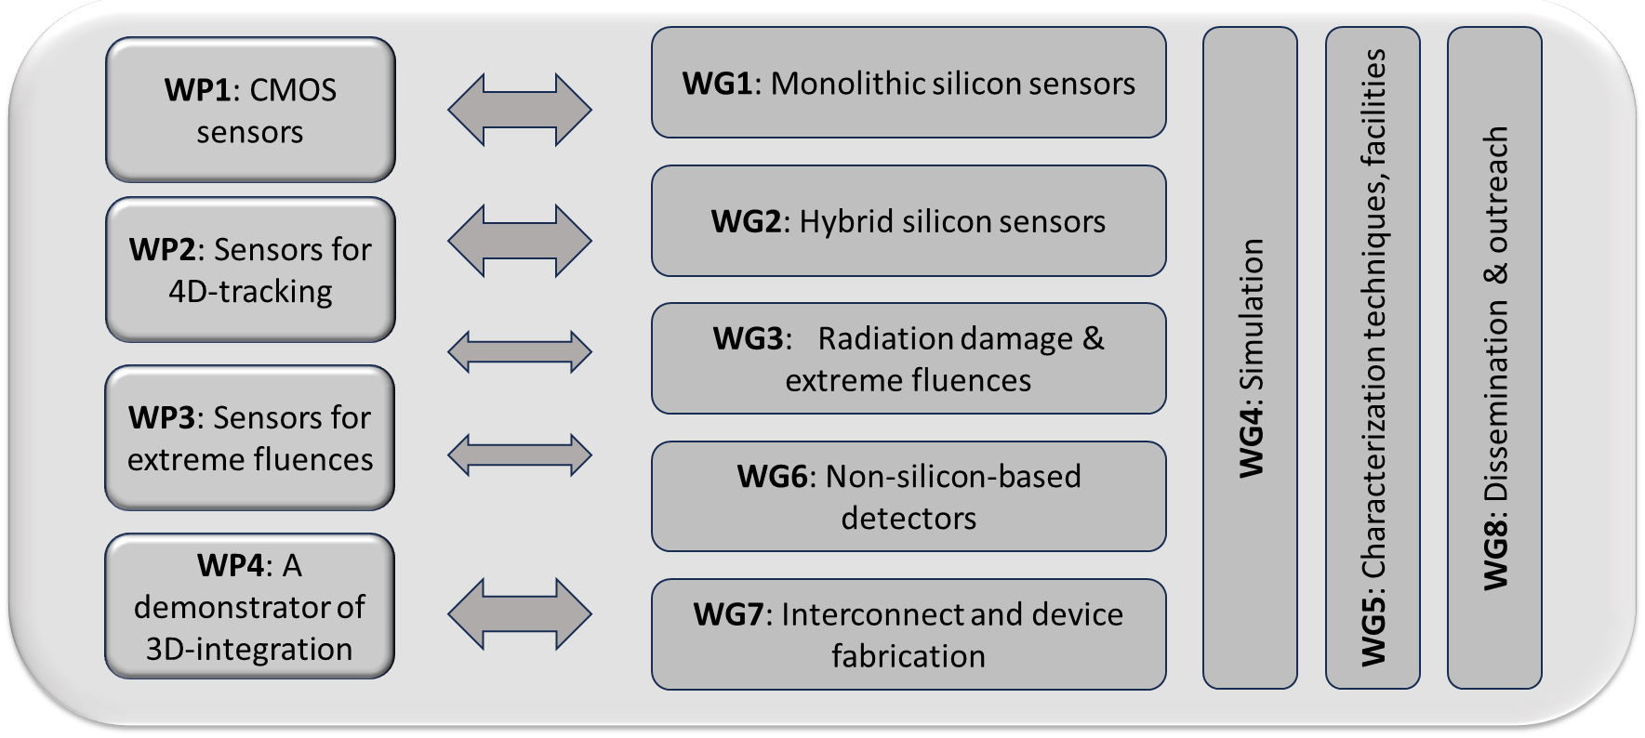
DRD3: Solid State Detectors
VD all concepts - CT CLD - HGC ILD’ & CLD
@ FCC-ee
CT CLD - HGC ILD’ & CLD - TL all concepts
can collapse in monolithic design with
@ FCC-hh
@ FCC-ee
monolithic for FE
+ digital features
WP1 : TJ 65 (180) nm (small electrode design) at APC, CPPM, IPHC, IP2I, LPNHE (see A. Besson);
  LFoundry 150 nm (large electrode design) at IRFU (see P. Schwemling)
WP2 : LGAD at IJCLab , Omega, LPNHE
WP3 : WBG at LPSC, Diamond and Silicon at LPSC, IJCLab; Silicon at APC, IRFU and LPNHE (HL-LHC and FCC-hh)
WP4 : in house interconnect. at CPPM, IJCLab; wafer to wafer interconnect. for MCMOS at IP2I, all interconnection
techniques at LPNHE, mechanics & cooling at CPPM, LPNHE (see M. Winter)
Notes:
In each area identified performance parameters for the different projects, here by detector use in Vertex Detectors, Central Tracker, Calorimeters and for Time of Flight,
and summarized in main Detector R&D Themes to be achieved

Slide 9
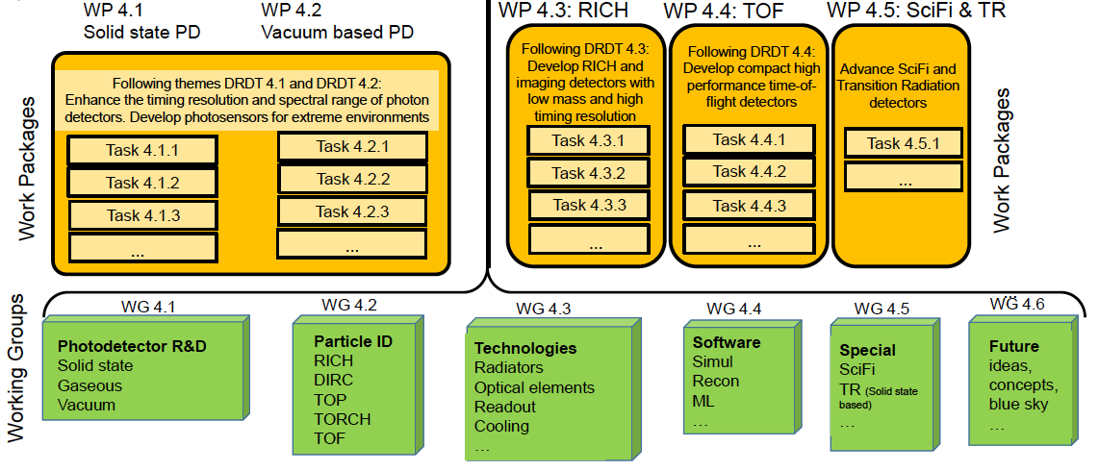
DRD4: Photon detectors and PID
@ FCC-ee : synergies for solid state photodetectors (SiPM/SPAD) for calorimetry
in IDEA, ILD’, CLD, for ARC in ILD’, CLD and optical ToF TL (in all concepts)
WP 4.5.1 : radiation hard scintillating fibers at LPC
WP 4.2.1/4.2.2/4.2.3. : PICMIC nano-PMT photodetector concept at IP2I (low TRL in WG6)
WP 4.3.1/4.4.1/4.4.2 : new radiators materials & components, coupling to single photon SiPM for ToF TL at CPPM
WG 4.1/4.4/4 : IRFU interest not yet assigned to WPs

Slide 10
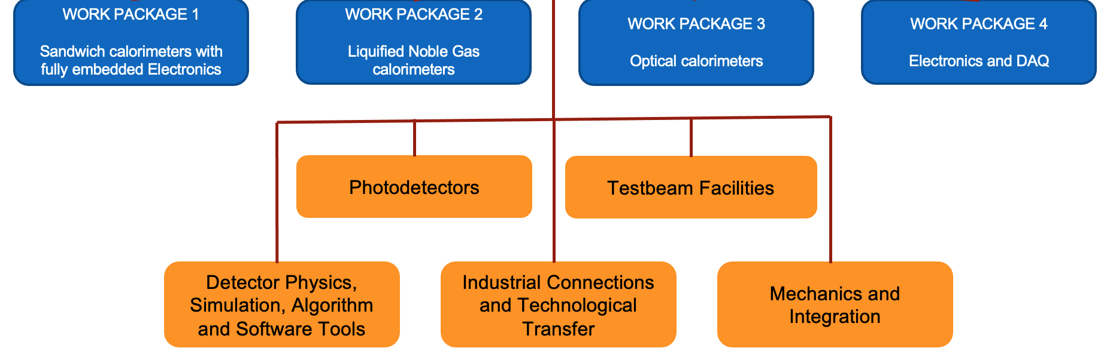
DRD6: Calorimetry
ILD’, CLD
ALLEGRO
IDEA
All
@ FCC-ee
Working Groups
WP1 : .1.1 SiW-ECAL at IJCLab, LLR, LPNHE, Omega, (DMLAB) (see V. Boudry); .2.1 AHCAL at Omega;
.2.3 T-SDHCAL at IP2I, Omega (see I. Laktineh)
WP2 : at IJCLab, APC, CPPM, LPNHE, Omega (see N. Morange)
WP3 : .1.2 IP2I, .2.1 GRAiNITA at IJCLAB, LPC-CF (see M. Schune); .2.2 SpaCal at IJCLAb, IP2I, LPC-Caen, LPC-CF; .3.4 at CPPM, IJCLAb, ILM, IP2I, IRFU (see S. Gascon)
WP4 : at Omega
WG PhotoDetectors : at IRFU, IJCLab
WG Electronics and DAQ : at Omega, IRFU
WG Detector Physics… : at LPC-CF

Slide 11
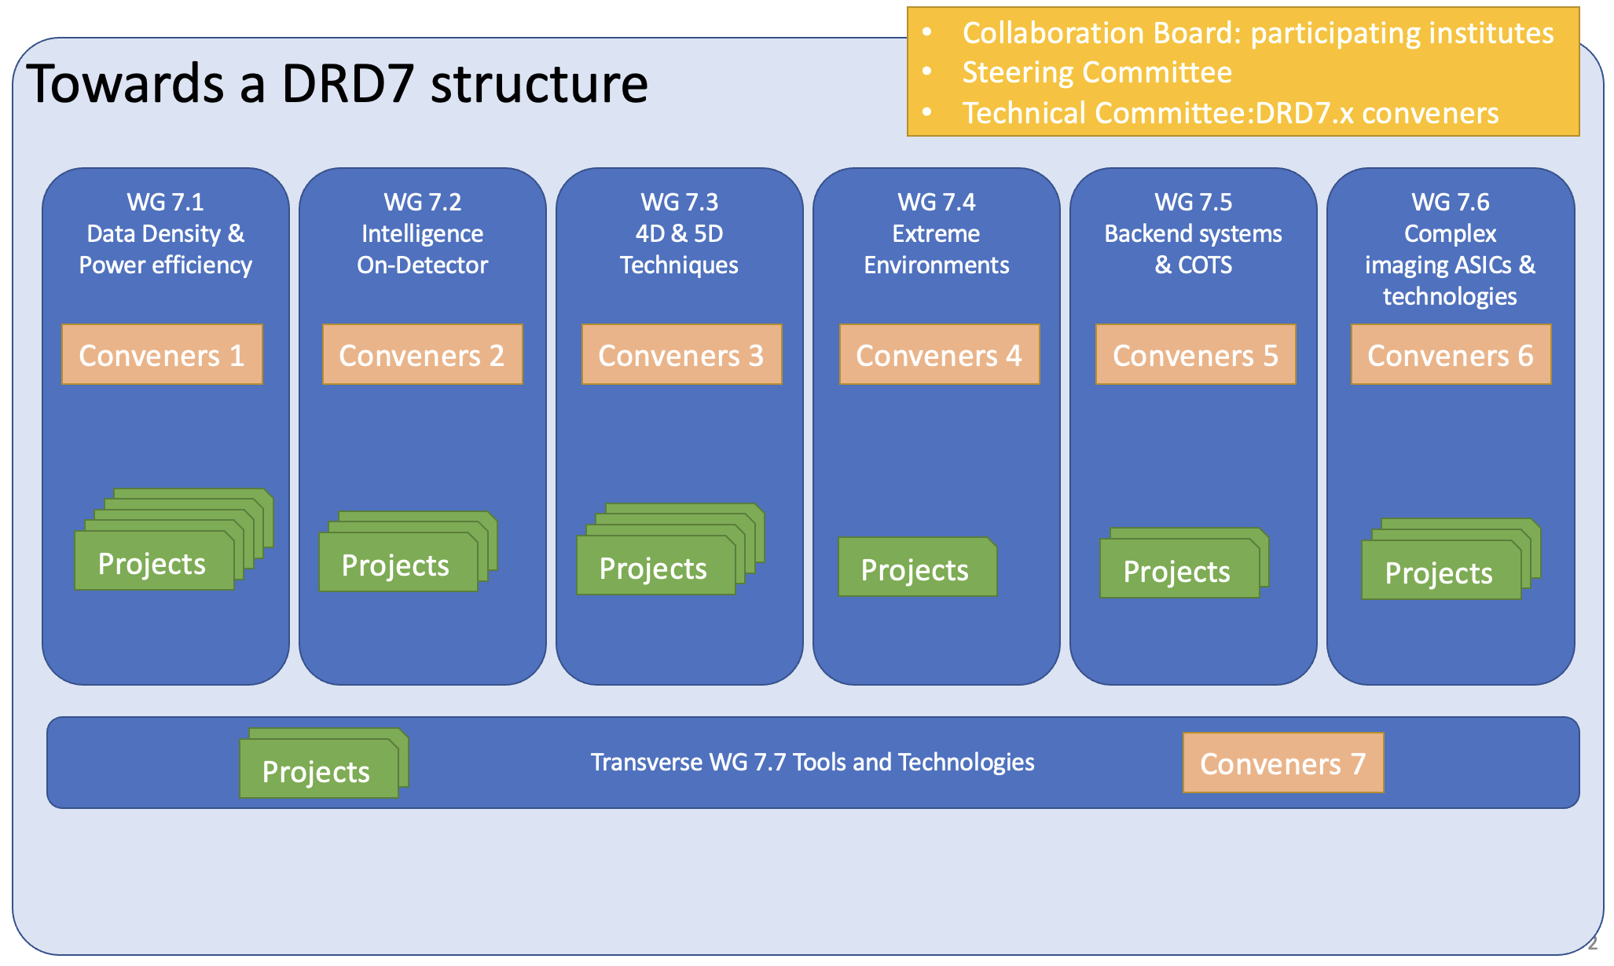
DRD7: Electronic systems
improve and develop further common standards, methodologies, and IP blocks
provide facilities and tools for R&D in the community, with long-term continuity
support development of complex ASICs in other DRDs
FCC-ee
FCC-hh
WP7.1.c : wireless Allowing Data and Power Transmission (WADAPT) at IRFU, LPSC, LETI CEA Gren. (see F.E Rarbi)
WP7.2 : .? at LP2I and IPHC
WP7.3.a : high performance TDC and ADC blocks at ultralow power at CPPM, IP2I, IRFU, Omega*
WP7.3 : .b1 data driven calibration at LPC; .b2 clock distribution techniques at CPPM, .? LPSC
WP7.4 : .b radiation tolerance of advanced CMOS nodes; .c cooling at CPPM
WP7.5 : .b no back-end at CPPM, .c generic backend (TBC)
WP7.6 : common access to .a techno. and IP (IPHC, IP2I, CPPM); .b 3D and advanced integration IP2I
preliminary interim doc.
* ADC in MCMOS at APC not (yet) included in WP7.3a, White Rabbit clock distribution at IJCLab not (yet) included in WP7.3

Slide 12
French institute interests per DRD
reported as they can enter FCC detector concepts*
* exercise, based on system technologies considered or plausible today and assigning some interests not yet attached to a specific systems

Slide 13
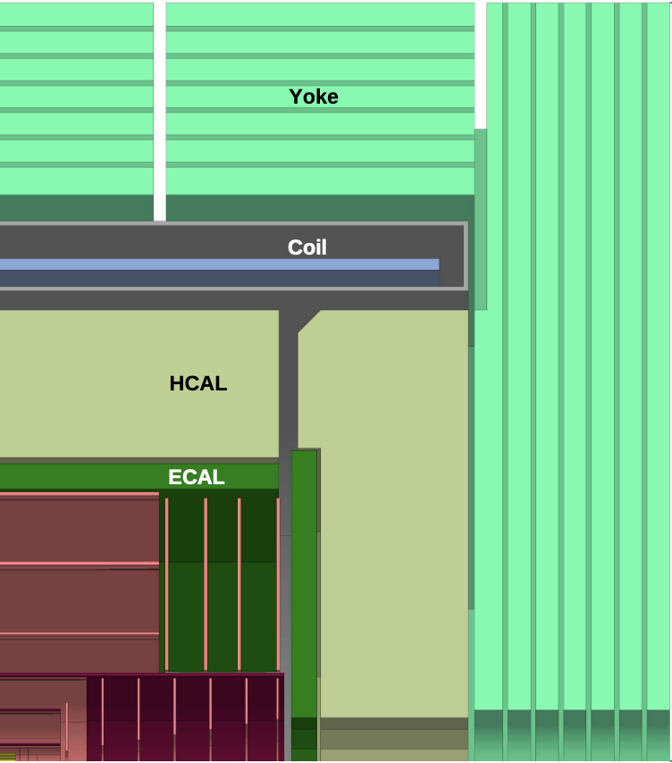
DRD interest links to FCC-ee CLD⁺ (w/ PID) concept
APC, CPPM, IJCLAb, IPHC, IP2I, IRFU, LLR, LPNHE, Omega
Muon hodoscope (HCAL?)
DRD1 - WP1 : Micromegas at IRFU
Sandwich calorimeter
with fully embedded electronics
DRD6 - WP1 (DRD1- WP6) : AHCAL at Omega;
T-SDHCAL at IP2I, Omega
SiW-ECAL at IJCLab, LLR, LPNHE, Omega
Timing Layer DRD1 - WP5 : Picosec at IRFU
DRD3 - WP1 : MCMOS at APC, AMU, CPPM, IPHC, IP2I, IRFU
DRD3 - WP2 : LGAD at IJCLab, CPPM, LPNHE
DRD4 - WP4.2 : nano MCP at IP2I; WP4.3 : materials at CPPM
Tracking (ECAL?)
DRD3 - WP1 : Monolithic CMOS
at APC, CPPM, IPHC, IP2I, LPNHE, IRFU

Slide 14
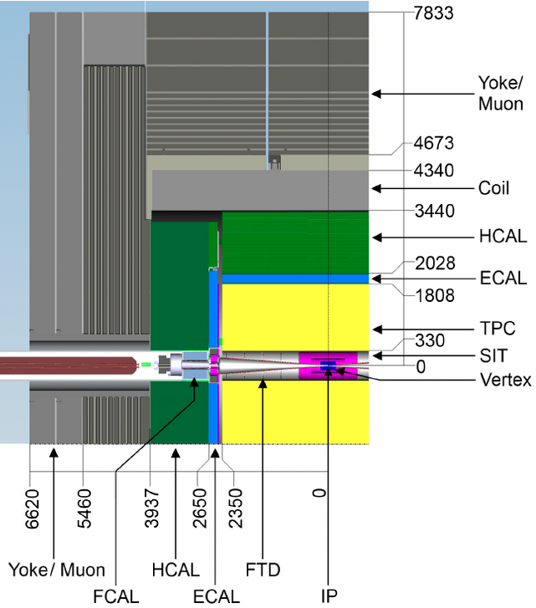
DRD links to FCC-ee ILD‘ concept
APC, CPPM, IJCLAb, IPHC, IP2I, IRFU, LLR, LPNHE, Omega
Muon hodoscope (HCAL?)
DRD1 - WP1 : MicroMegas at IRFU
Sandwich calorimeter
with fully embedded electronics
DRD6 - WP1 : AHCAL at Omega;
T-SDHCAL at IP2I, Omega also DRD1 - WP6
SiW-ECAL at IJCLab, LLR, LPNHE, Omega
HCAL
Timing Layer DRD1 - WP5 : Picosec at IRFU
DRD3 - WP1 : MCMOS at APC, AMU, CPPM, IPHC, IP2I, IRFU
DRD3 - WP2 : LGAD at IJCLab, CPPM, LPNHE
DRD4 - WP4.2 : nano MCP at IP2I; WP4.3 : materials at CPPM
ECAL
TPC
DRD1 - WP4 : IBF studies & electronics for MM RO
at IRFU
Time Projection Chambers
DRD1 – WP4: IBF & MicroMegas readout at IRFU
TPC
TPC
VD - Wrapper – (ECAL?)
DRD3 - WP1 : Monolithic CMOS
at APC, CPPM, IPHC, IP2I, LPNHE

Slide 15
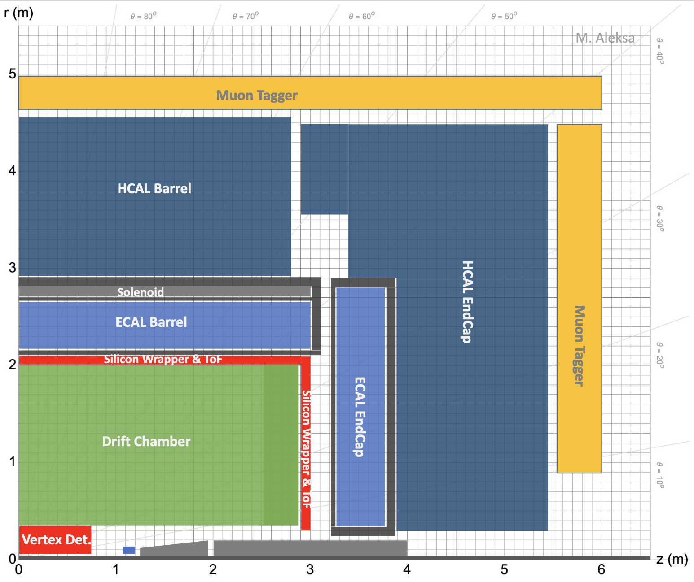
DRD interest links to FCC-ee ALLEGRO concept
APC, CPPM, IJCLab, IPHC, IP2I, IRFU, LPNHE, LPSC, Omega
Muon Tagger
DRD1 - WP1 : Micromegas at IRFU
Liquid Noble Gas DRD6 - WP2 :
at IJCLab, APC, CPPM, LPNHE, Omega
Timing Layer DRD1 - WP5 : Picosec at IRFU
DRD3 - WP1 : MCMOS at APC, AMU, CPPM, IPHC, IP2I, IRFU
DRD3 - WP2 : LGAD at IJCLab, CPPM, LPNHE
DRD4 - WP4.2 : nano MCP at IP2I; WP4.3 : materials at CPPM
DCH OR TPC
Drift or Time Projection Chamber
DRD1 - WP4: TPC IBF & MicroMegas readout at IRFU
DRD1 - WP4: DCH light wires & weaving at IJCLab, Ganil, LPSC
DCH or TPC
DCH
VD - Wrapper
DRD3 - WP1 : Monolithic CMOS
at APC, CPPM, IPHC, IP2I, LPNHE, IRFU

Slide 16
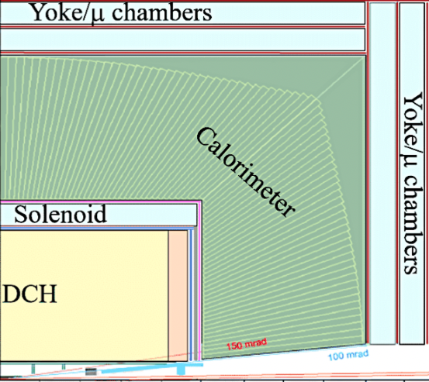
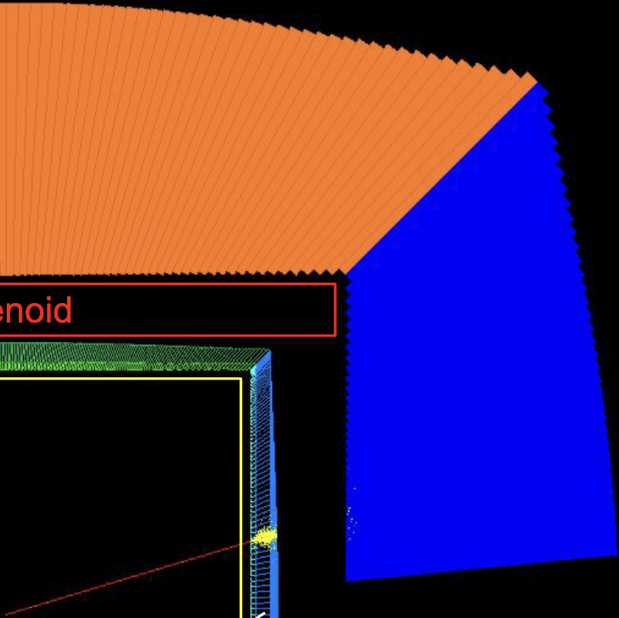
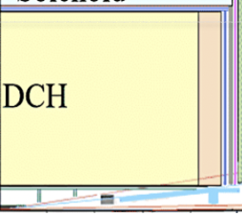
DRD interest links to FCC-ee IDEA⁺ w/ crystal ECAL concept
APC, CPPM, IJCLab, IPHC, IP2I, IRFU, LPNHE, LPSC
Muon Tagger
DRD1 - WP1 : Micromegas at IRFU
DRCAL
ECAL
DRD6 - WP3 : GRAiNITA at IJCLAB, LPC-CF;
MAXICC at IP2I
DRD6 - WG materials : at CPPM, IJCLAb, ILM, IP2I, IRFU
DRD6 - WG Photodetectors : at CPPM, IRFU, IJCLab
ECAL
Timing Layer with crystals
DRD4 - WP4.2 : nano MCP at IP2I; WP4.3 : materials at CPPM ?
Drift Chamber
DRD1 - WP4: DCH light wires & weaving at IJCLab, Ganil, LPSC
DCH
VD, Wrapper
DRD3 - WP1 : Monolithic CMOS
at APC, CPPM, IPHC, IP2I, LPNHE, IRFU

Slide 17
French institute interests per DRD
as a function of systems for FCC-ee
Muon hodoscope/tagger
  Micromegas at IRFU, (RPC experience at IP2I but no specific project)
Sampling calorimetry with fully embedded electronics
  ECAL at IJCLab, LLR, LPNHE; HCAL at IP2I, electronique at Omega
NLG calorimetry
  ECAL at APC, CPPM, IJCLAB, LPNHE, Omega
Optical calorimetry
  ECAL GRAiNita at IJCLAB, LPC-CF, MAXICC at IP2I
Timing Layers
  MicroMegas IRFU, LGAD LPNHE, MCMOS IPHC, IP2I, CPPM, optical CPPM, IP2I
Tracking
  DCH IJCLab, Ganil, LPSC; TPC IRFU; MCMOS APC, CPPM, IPHC, IP2I, LPNHE

Slide 18
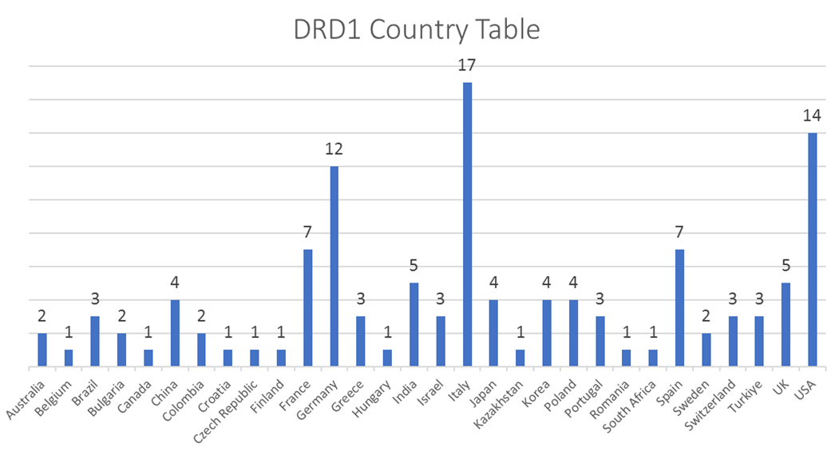
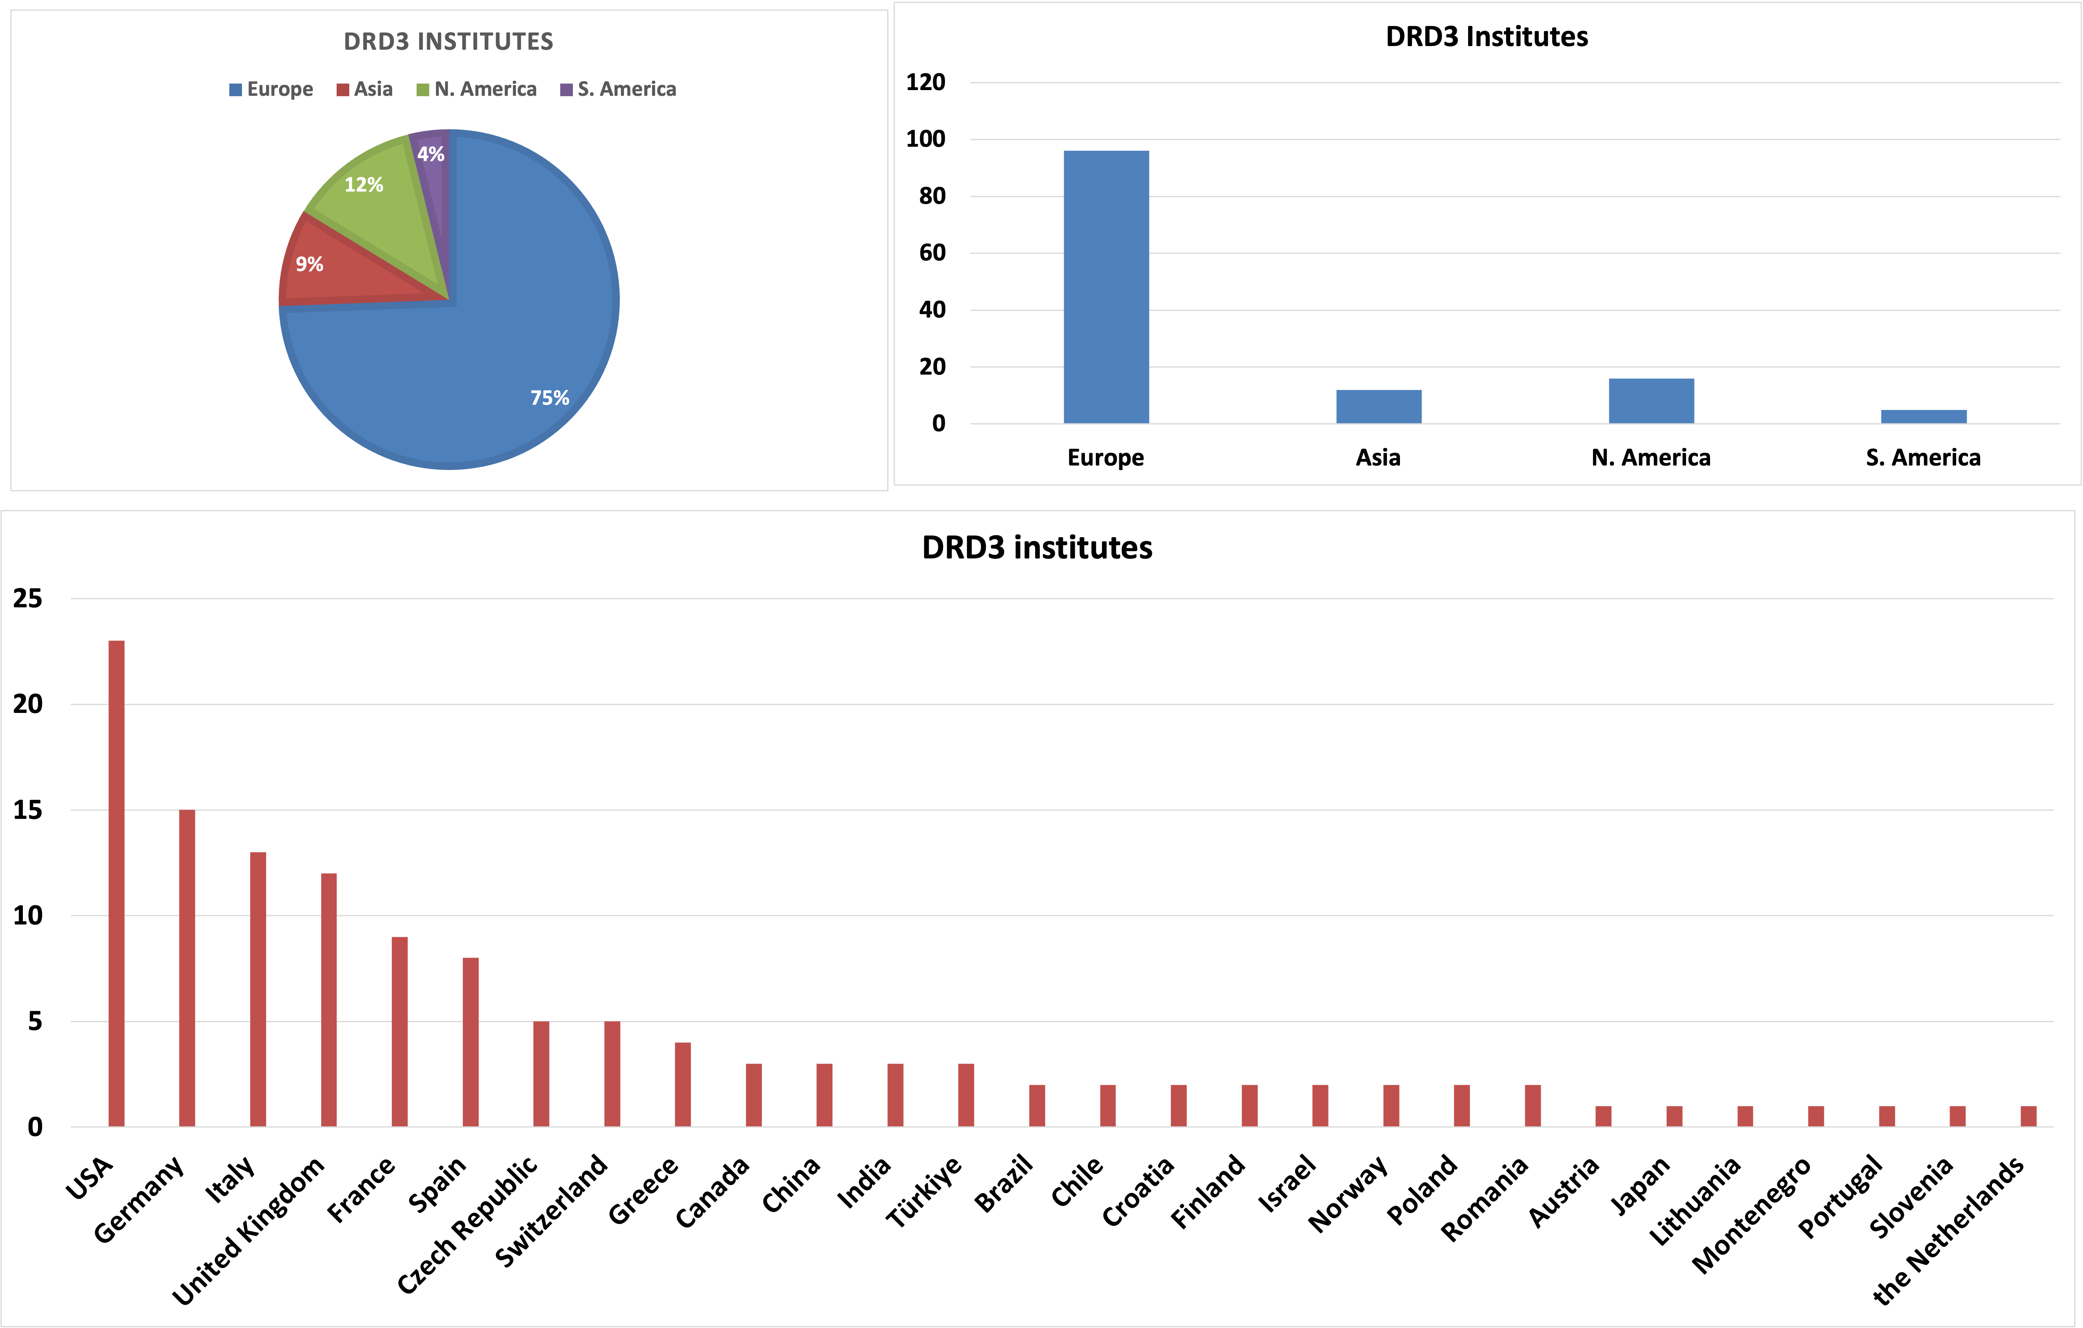
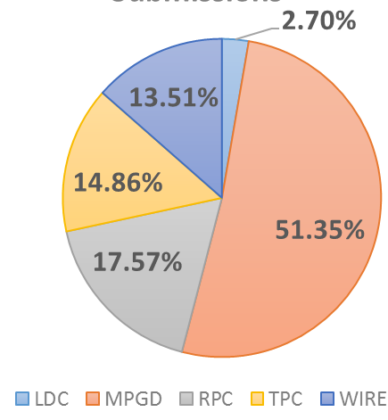
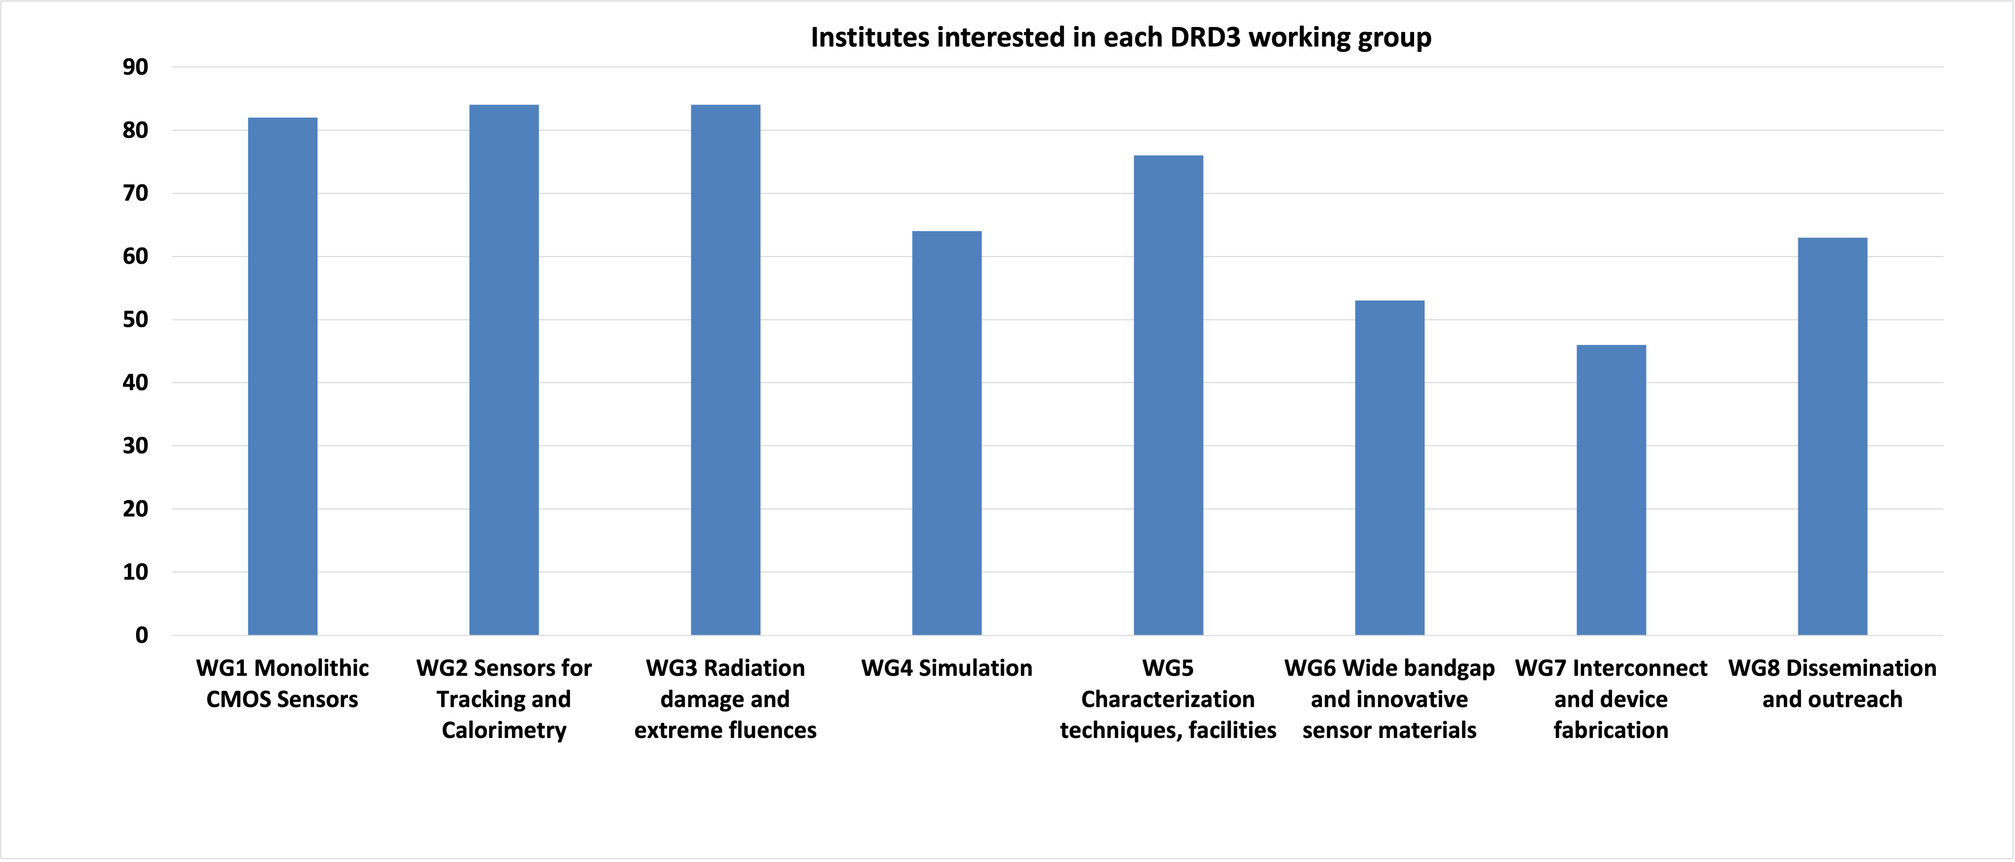
preliminary
France in context of international contributions and interests
DRD1 153 institutes in 31 countries
DRD3 129 institutes in 27 countries
4.6%
6.4%

Slide 19
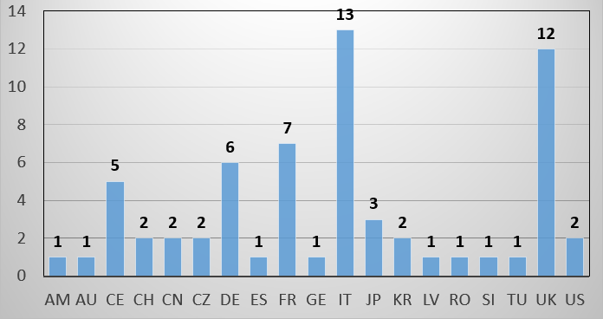
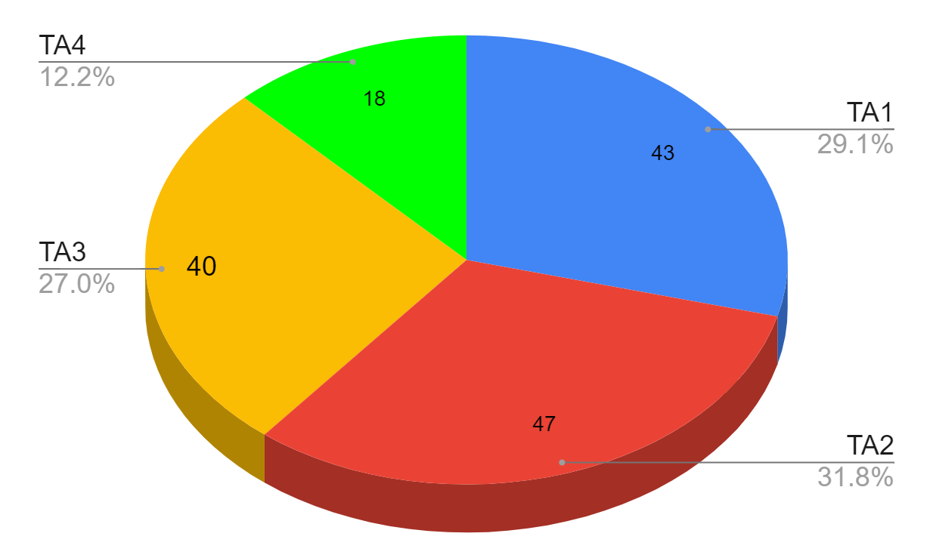
preliminary
France in context of international contributions and interests
DRD4 74 institutes in 19 countries
DRD6 131 institutes in 29 countries
5?

Slide 20
French contributions to DRD implementation teams
DRD1 : G. Charles (IJCLab), M. Gouzevitch, I. Laktineh (IP2I), E. Ferrer Ribas, M. Titov, P. Colas, F. Jeanneau (IRFU)
DRD2 : D. Franco (APC)
DRD3 : G. Calderini (LPNHE)
DRD4 : I. Laktineh (IP2I)
DRD6 : N. Morange, I. Laktineh (IP2I), R. Poeschl (LLR), C. de la Taille (Omega),
DRD7 : J. Baudot (IPHC)

Slide 21
Outlook
Several proposed French contributions to DRDs
  some associated to specific detector concepts at FCC-ee*
    typically DCH, TPC, Calorimetry
  some for systems not directly attached to a detector concepts
    typically PID ToF layers with LGAD, MircroMegas
  some not yet assigned to a system and that can appear in all or specific concepts
    typically MCMOS (for VD, Central Tracking, Calorimetry, possibly w/ precision timing)
  some with possible intermediate targets in LS4 (or similar timescale ex. Belle-2) :
    typically MCMOS and LGADs
  All labs have DRD interests that can enter different FCC-ee detector concepts
Next steps
  DRD approval by DRDC (see L. Serin)
    collaboration will soon form, important to be involved in the key contribution areas
  French R&D projects
    no time in the preparation phase to consider synergies and contributions to common deliverables within and across DRDs - more discussion can happen now considering international context and MoU preparation
    framework for allocation of resources see A. Lucotte
  How to integrate DRD interests in FCC-ee detector LoI in 2025
    discussion this evening
* or at other e-e colliders

Slide 22
Further information

Slide 23
French interests in DRD WPs per institute (FCC-ee only) (1)
APC
  DRD3 - WP1 : MCMOS VD, CT/Wrapper (TL?) - all concepts, ECAL - ILD’,CLD
  DRD6 - WP2 : NLG-ECAL - ALLEGRO
CPPM - AMU
  DRD3 - WP1 / DRD 7.3 : MCMOS VD, CT/Wrapper (TL?) - all concepts, ECAL - ILD’,CLD
  DRD3 - WP2 : LGAD TL - all concepts, ECAL - ILD’,CLD
  DRD3 - WP4 / DRD 7.6 : interconnection - all concepts
  DRD4 - WP4.2 : material optical TL - all concepts (IDEA)
  DRD6 - WP2 : NLG-ECAL - ALLEGRO
  DRD 7.5 : no back-end - all concepts
IJCLab
  DRD1 - WP2 : Drift Chamber at IJCLab, Ganil, LPSC - IDEA, ALLEGRO
  DRD6 - WP1 : SiW-ECAL - ILD’, CLD
  DRD6 - WP2 : NLG-ECAL - ALLEGRO
  DRD6 – WP3 : GRAiNITA - IDEA’
IPHC
  DRD3 - WP1 / DRD 7.6 : MCMOS VD, CT/Wrapper (TL?) - all concepts, ECAL - ILD’,CLD
  DRD7 – WP7.2 : Intelligence On-Detector ? - all concepts

Slide 24
French interests in DRD WPs per institute (FCC-ee only) (2)
IP2I
  DRD1 - WP6 / DRD6 – WP1 : RPC T-SDHCAL - ILD’, CLD; (RPC muon hodoscope/tagger - all concepts ?)
  DRD3 - WP1 / DRD7.3-7.6 : MCMOS VD, CT/Wrapper(TL?) - all concepts; ECAL - ILD’,CLD
  DRD3 - WP4 / DRD 7.6 : interconnection all concepts
  DRD4 - WP4.2 : nano-MCP optical TL - all concepts (IDEA)
IRFU
  DRD1 - WP1 : Micromegas large size, high rates – muon hodoscope/tagger - all concepts, HCAL - ILD’, CLD
  DRD1 - WP4 : Time Projection Chambers IBF with electronics for MicroMegas readout - ILD’, ALLEGRO
  DRD1 - WP5 / DRD 7.3 : Timing Layer with MicroMegas - all concepts
  DRD3 - WP1 / DRD 7.3 : MCMOS VD, CT/Wrapper (TL?) - all concepts, ECAL - ILD’,CLD
  DRD7 – WP7.1 : Wireless Data Transmission And Powering – all concepts
LLR
  DRD6 - WP1 : SiW-ECAL - ILD’, CLD
LPC-CF
  DRD6 - WP2 : GRAiNITA - IDEA’, (precision timing electronics for LHCb SpaCal)
LPSC
  DRD7 – WP7.1 : Wireless Data Transmission And Powering - all concepts

Slide 25
French interests in DRD WPs per institute (FCC-ee only) (3)
LI2P
  DRD6 - WP2 : GRAiNITA - IDEA’, (precision timing electronics for LHCb SpaCal)
  DRD7 – WP7.2 : Intelligence On-Detector ? - all concepts
LPNHE
  DRD3 - WP1 : MCMOS VD, CT/Wrapper(TL?) -all concepts; ECAL - ILD’,CLD
  DRD3 - WP4 / DRD7.6: interconnection - all concepts
  DRD6 - WP1 : SiW-ECAL - ILD’, CLD
  DRD6 - WP2 : NLG-ECAL - ALLEGRO
Omega :
  DRD6 - WP1 / DRD7.3 : SiWECAL, RPC TSDHCAL, AHCAL - ILD’, CLD
  DRD6 - WP2 : NLG-ECAL - ALLEGRO

Slide 26
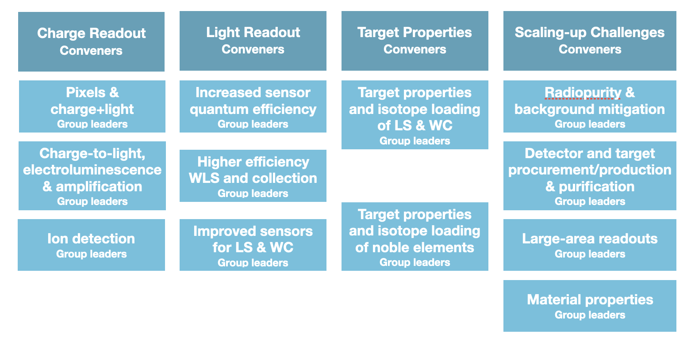
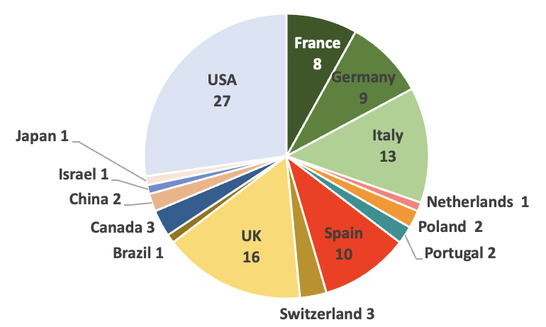
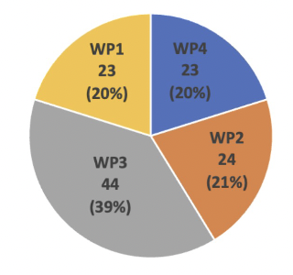
DRD2: Liquid Detectors
Water Cerenkov, Noble Liquids, Liquid Scintillators for DM, Neutrino & rare process (ex. 0𝜈ββ)
@ FCC-ee : synergies for photodetectors (SiPM/SPAD) with DRD4 (RICH PID) and DRD6;
and for cryogenic operation of readout with DRD6 and DRD7
WP1
WP2
WP3
WP4
DRD2 114 institutes in 51 countries
WPi.1
WPi.2
WPi.3
WPi.4
DRDT2.1 and DRDT2.2
DRDT2.3
DRDT2.4
WP1.2 (TA3.2) : double phase TPC XELAB at LPNHE – characterization of charge amplification & scalability
WP3.1 : opaque scintillator TPC LiquidO at IJCLab
WP3.2 : microphysics of NL liquids, characterize and model of light emission and transport at APC
WP4.1 : radio assay and material fabrication and selection at CPPM
WP4.3 : large area readout at LLR, Omega, IRFU (ILANCE)
no direct links to FCC-ee in this contributions
R2D2 new concept of radial HP Xe TPC for 0𝜈ββ not (yet?) part of DRD2

Slide 27
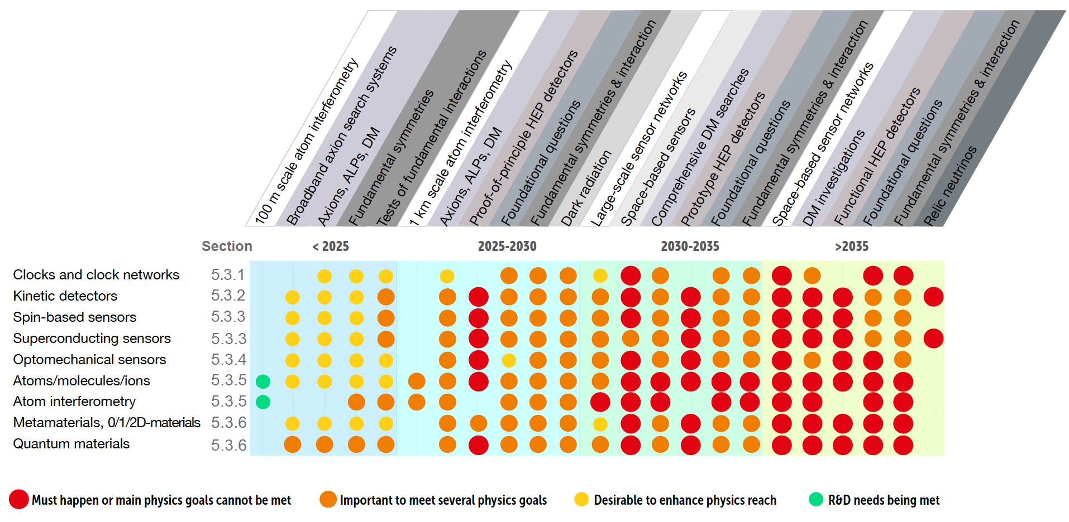
DRD5: Quantum sensors and emerging technologies
sensors with high sensitivity and precision, nano/meta/heterogenous materials
enabling new experimental concepts, so far applications in EDM, DM, neutrino, 0𝜈ββ searches,
fundamental forces, …
TA1
@ FCC-ee :
TA2
WP1 : atomic, nuclear & molecular systems in trap & beam,
TA1 and TA5 (TA4)
WP2 : quantum materials, TA2, TA3, TA4, TA6
WP3 : large ensembles of quantum sensors (multi-modal)
WP4 : scaled-up “quantum for HEP”, (TA2), TA3, (TA4),TA5
WP5 : quantum techniques for sensing, TA1-5
    WP6 : networking, training, shared expertise and infrastructure (all TAs)
TA3
TA4
TA5
TA6
Opening window for new detector concepts?
40 institutes in 15 countries, 25 proposed contributions - French interests (IML Univ. Lyon in TA6) ?

Slide 28
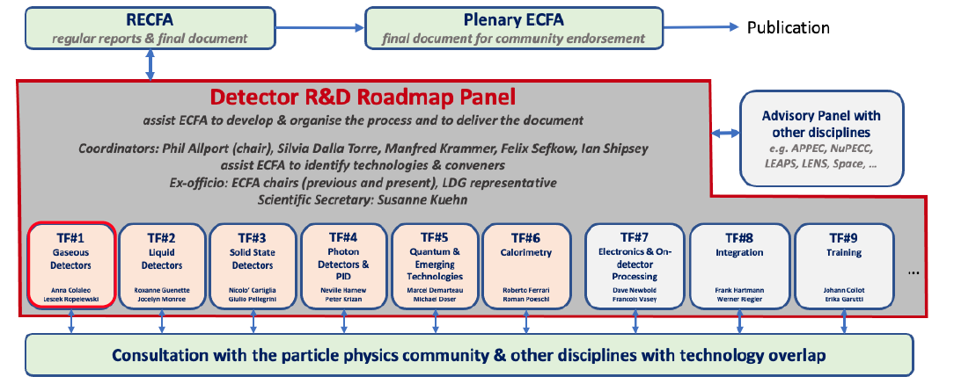
Steps toward a long term detector R&D program
2019
ESPP update
HEP strategic projects
2021
ECFA DRD proposals
2024
ESPP update
Granada Symposium
WGs and Physics Briefing Book
ECFA detector R&D roadmap
TF & workshops community driven
DRD MoUs
collaborations active
2020
2023
2026-27
10 Global Recommendations
GSR4: international coordination & organization of R&D activities
GSR6: establish long term strategic funding program
Form international DRD collaborations
hosted at CERN (CERN/SPC/1190)
an accelerator R&D roadmap was also prepared in 2021 by the Laborartory Directors Group

Slide 29
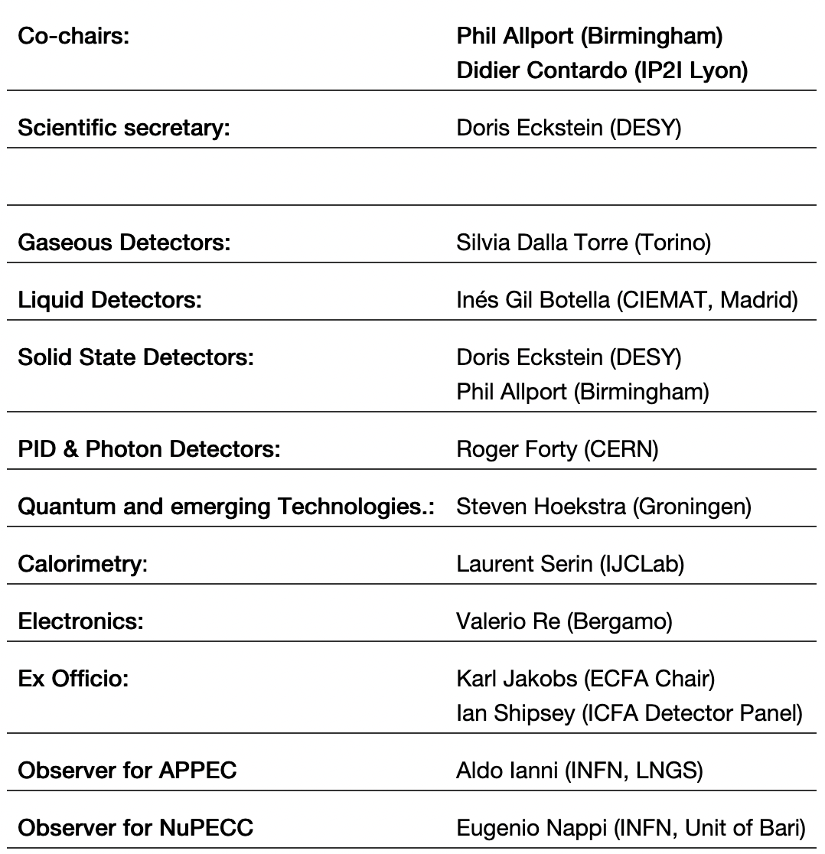
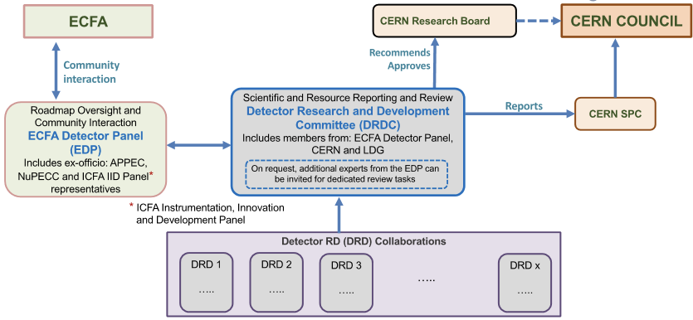
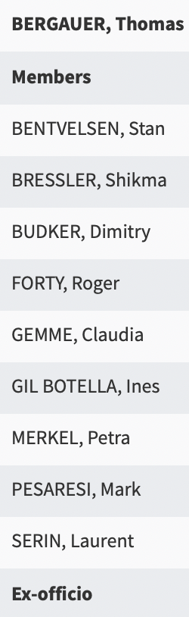
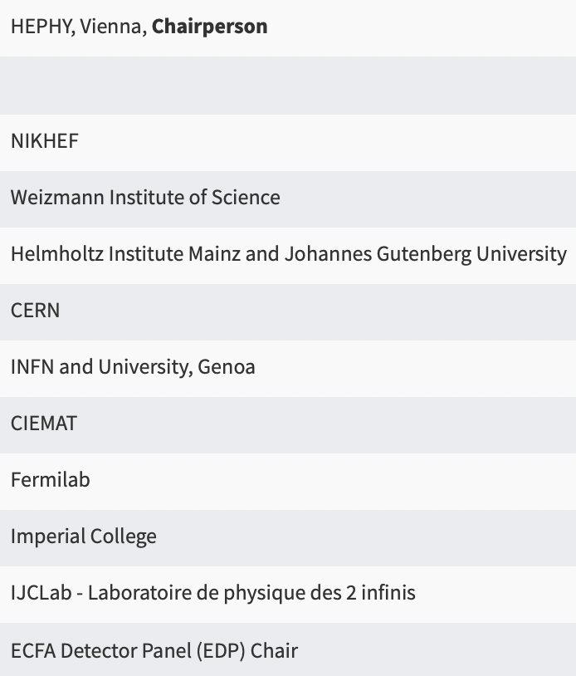
Framework for DRD collaborations
similar to general conditions for execution of experiments at CERN
with a dedicated Detector R&D review Committee and MoU with Funding Agencies
ECFA Detector Panel
DRDC membership
EDP provides input on DRD proposals to the DRDC* in terms of roadmap priorities
it follows up achievements and evolution from experiment concept groups for update of the rodmap
* through its co-chairs, appointed members in the DRDC or via topic-specific experts in the conduct of the DRDC reviews

