Slide 1

Advances for ion beam irradiation
Lydia Maigne, Lydia.Maigne@clermont.in2p3.fr
On behalf of the OpenGATE collaboration

Slide 2

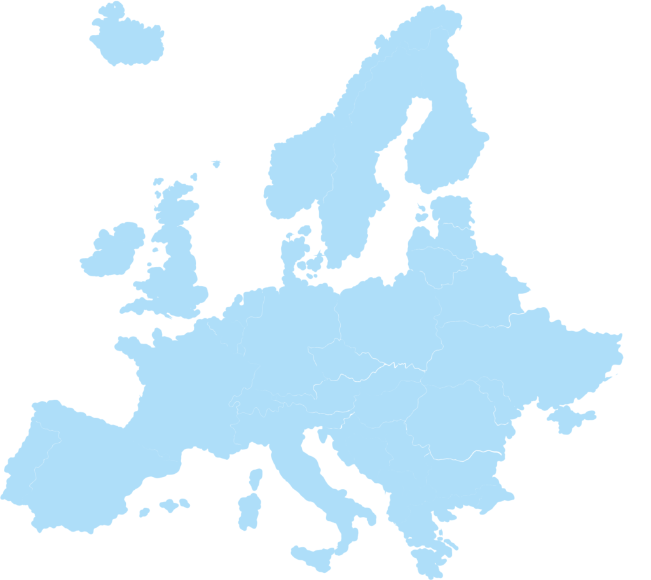








The collaboration
France
10 labs
25 members, public laboratories and companies developing an open source platform
8 members involved in ion beam applications
Spokesperson: Lydia Maigne
Technical coordinator: David Sarrut
CREATIS, Lyon
IP2I, Lyon
LPSC, Grenoble
LPC, Clermont
IPHC, Grenoble
Europe
FH Aachen, University of Applied Sciences, Julich, Germany
Medisip, Ghent University, Belgium
Medical University of Vienna, Wiener Neustadt, Austria
MedAustron, Wiener Neustadt, Austria
Christie Medical Physics & Engineering, Manchester, UK
JPET collaboration, Poland
Institute of Nuclear Physics Polish Academy of Sciences, Poland
Univ. of Patras, Dept of Med. Phys., Greece
BioemTech, Athens, Greece
Paul Scherrer Institute (PSI), Switzerland
Elsewhere
MSKCC, New York, USA
UC Davis, Davis, USA
Sogang University, Seoul, South Korea
QST, Chiba, Japan

Slide 3


Open-source Code – Examples - Tools
Source code - https://github.com/OpenGATE/Gate
Examples - https://github.com/OpenGATE/GateContrib
GATE 9.3 release (April 2023)
Compatible with G4 11
More than 70 contributors (since 2012)
25+ benchmarks
Python tools - https://github.com/OpenGATE/gatetools
Docker + VM - https://opengatecollaboration.org
GATE 10 - https://github.com/OpenGATE/opengate
Official release Mid 2024
GATE USERS MAILING LIST - Information, job offers, bug reports, help http://opengatecollaboration.org/mailinglist

Slide 4
GATE 10 (beta) - Try it
Create a Python environment (optional, but highly recommended)
pip install opengate
opengate_tests
See: https://github.com/OpenGATE/opengate
Docs https://opengate-python.readthedocs.io (wip)
More than 100 tests & examples available

Slide 5

GATE 10 - The source code
g4_bindings/ Geant4 binding from C++ to Python
(expose functions, classes) ; pybind11
opengate_lib/ Core classes (running): source, scorers etc
opengate/ User UI (initialisation)
One main object : Simulation
4 sub-main concepts: volume source physics actors
All users parameters like “dictionary” structure
Stored in user_info object

Slide 6
GATE 10 - STATUS
60% already developed
Core system almost done
Additional features (compared to version 9.x) : multithread, parallel world, boolean volume, faster embedable, easier to use
Ready for dose computation (photon, proton, hadron, internal/external radiation therapy)
Still missing: dose2water, biological dose,
Ready for SPECT imaging
PET imaging : before coincidence sorter (singles) ; some digitizer modules still work in progress (dead time, pile up)
Still missing : STL volumes, EM fields
First beta release planned in 2024, but already usable
https://github.com/OpenGate/opengate

Slide 7
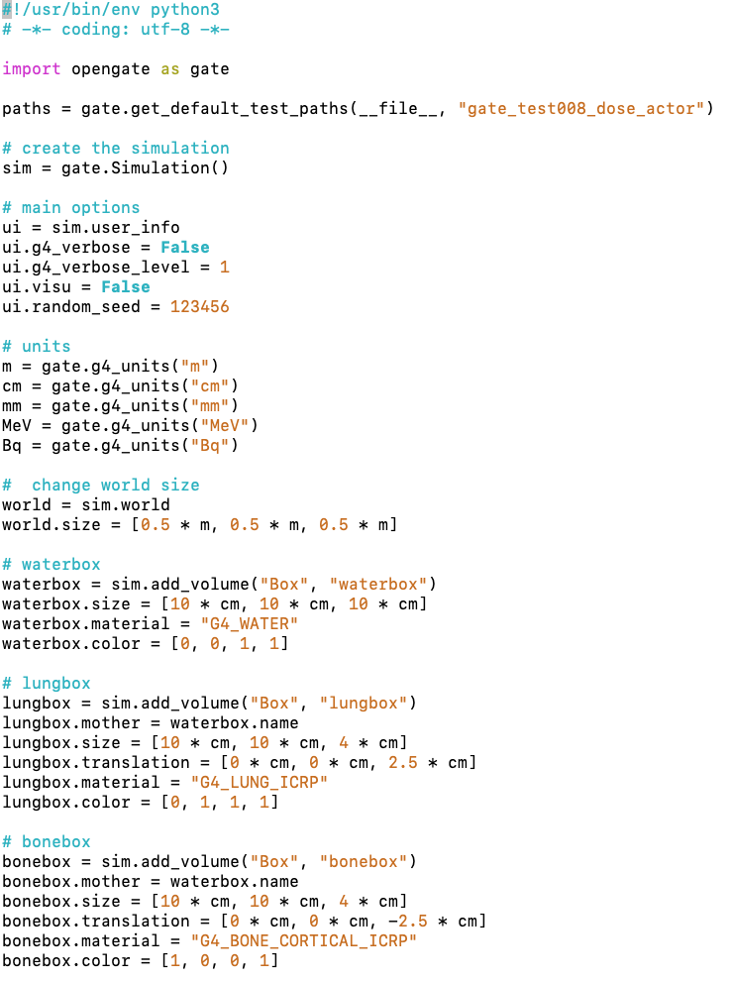
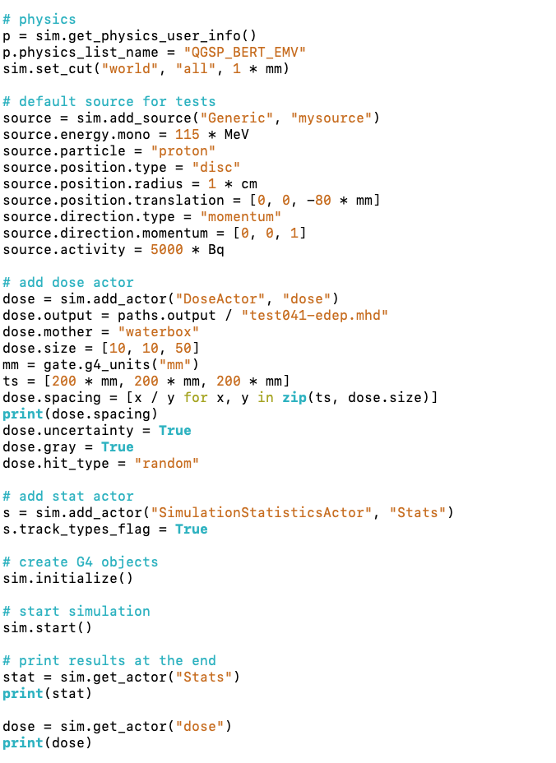
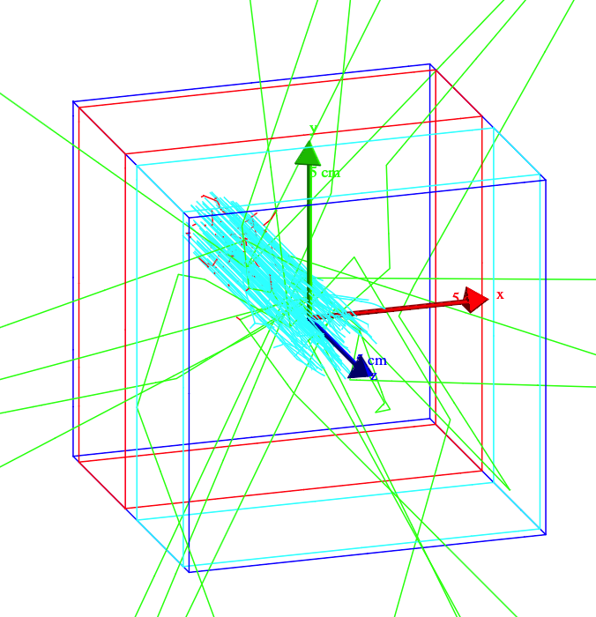
GATE 10 Simulation example

Slide 8
BioDose actor
Jointly developed by:
LPC, IP2I and MedAustron

Slide 9
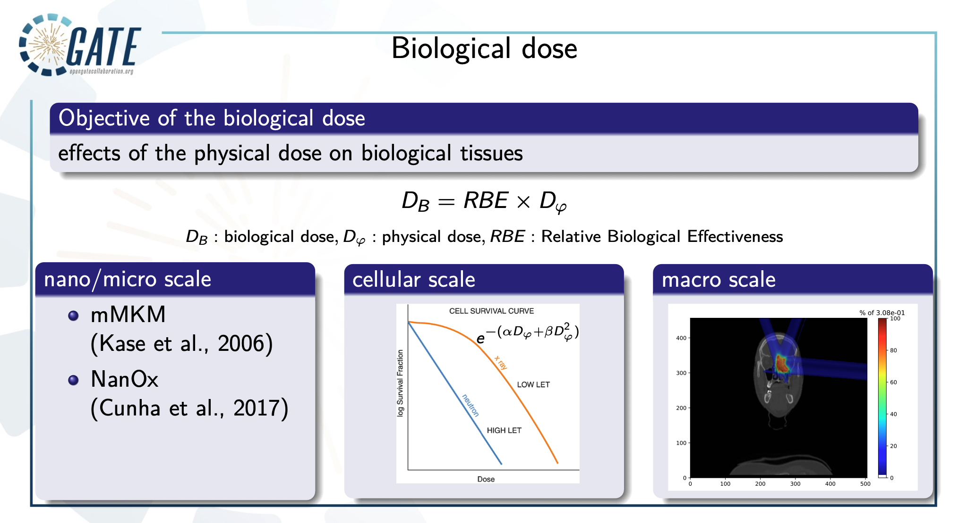
Other models ?

Slide 10
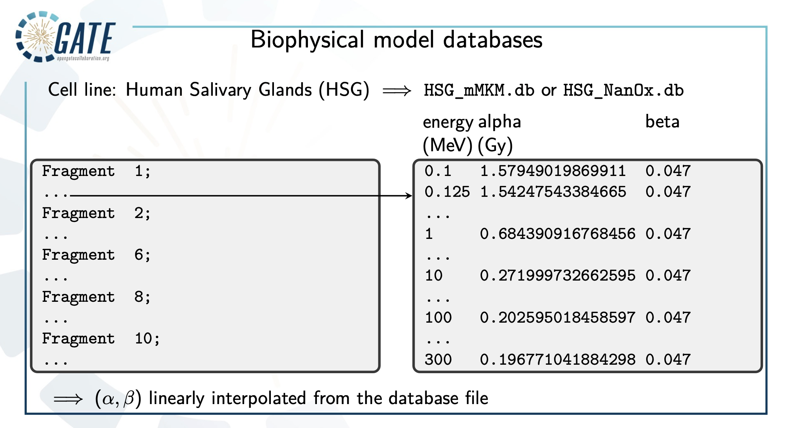
Work in progress for other cell lines

Slide 11
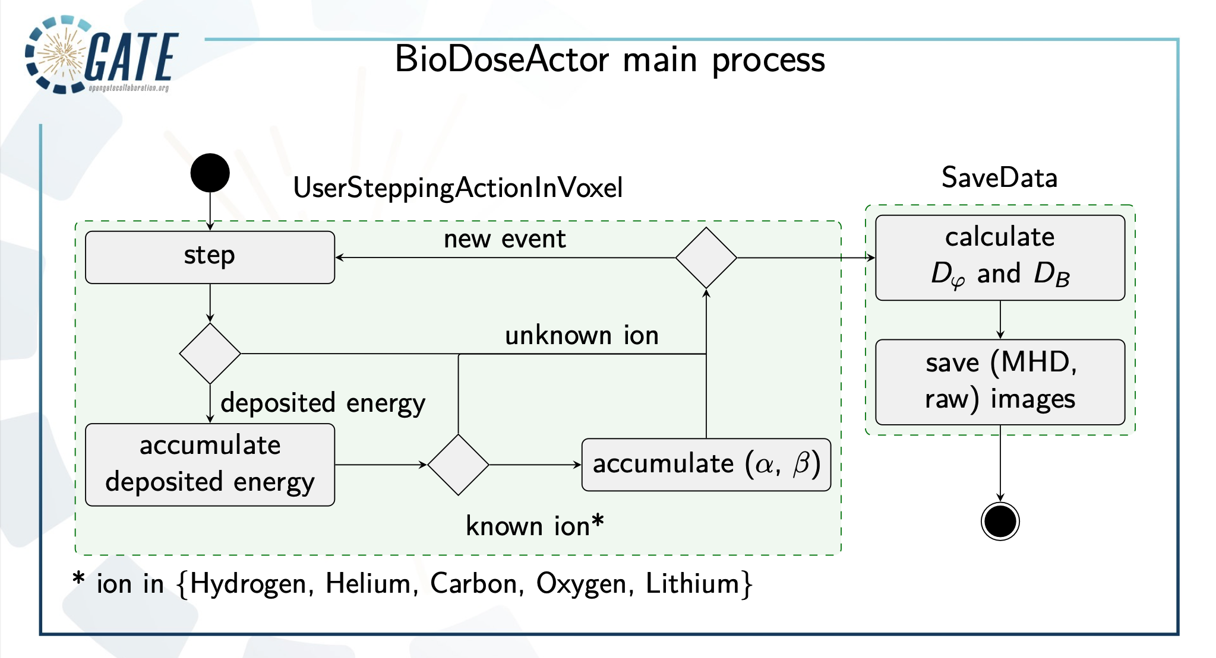

Slide 12
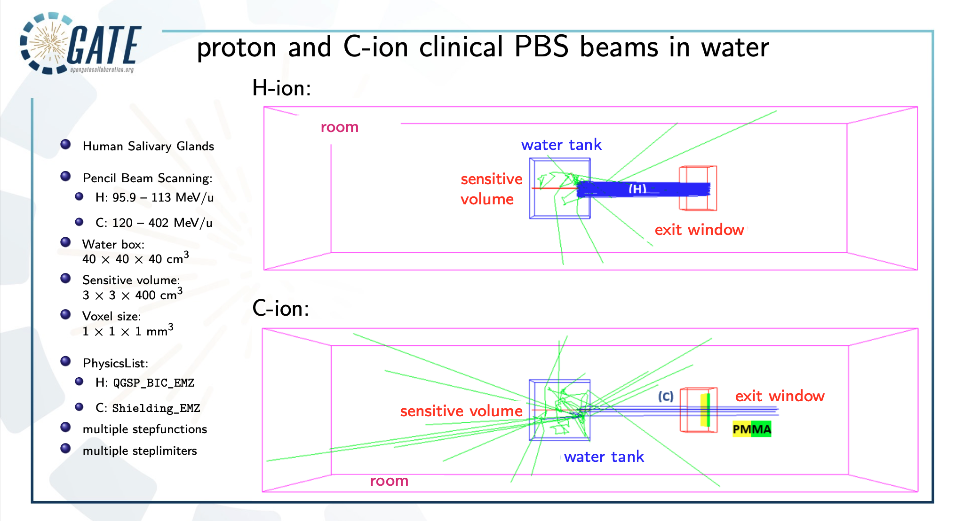

Slide 13
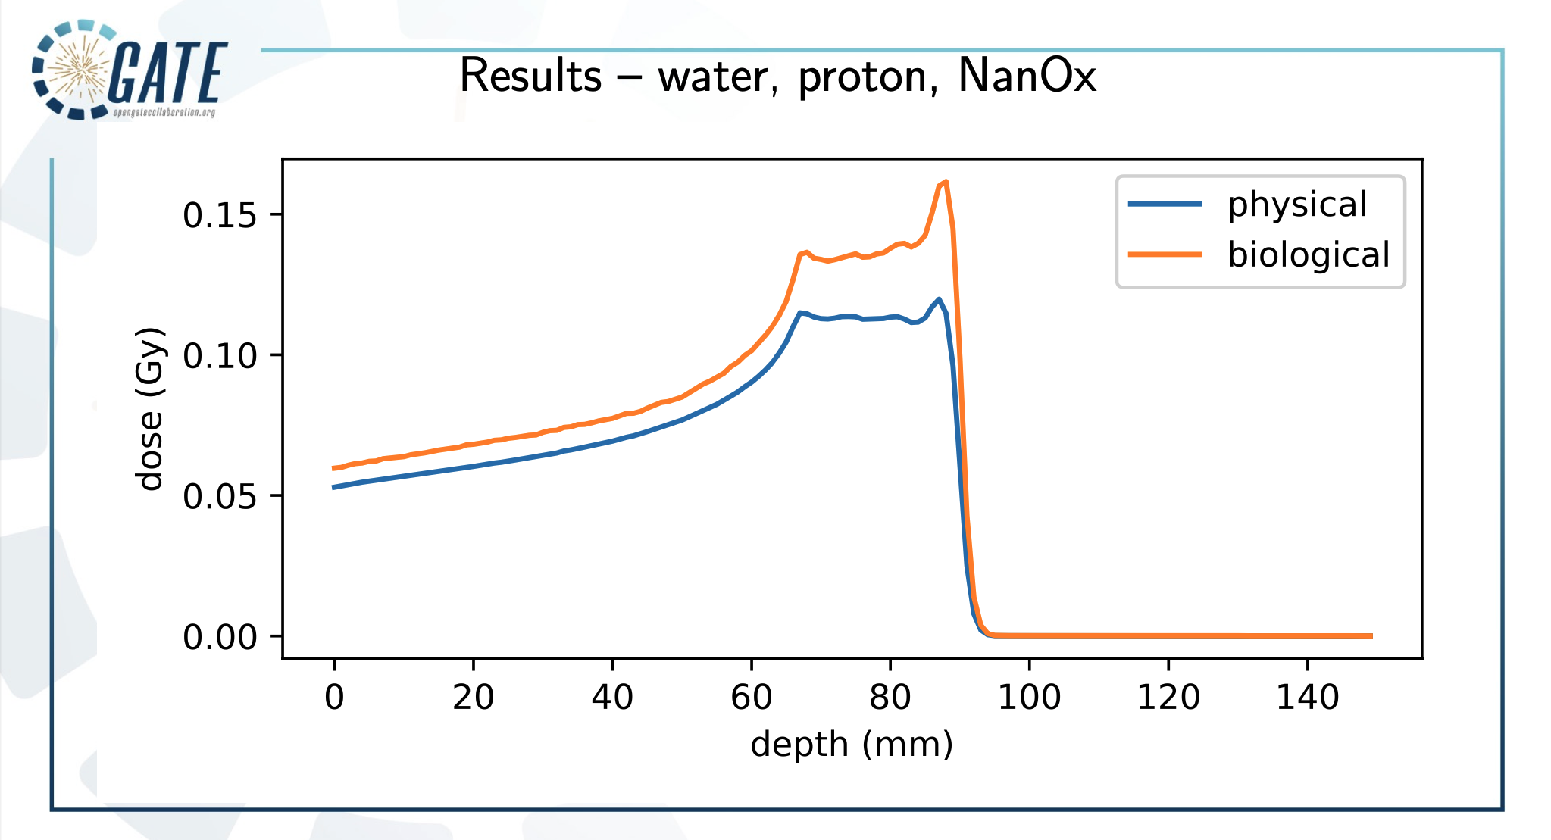

Slide 14
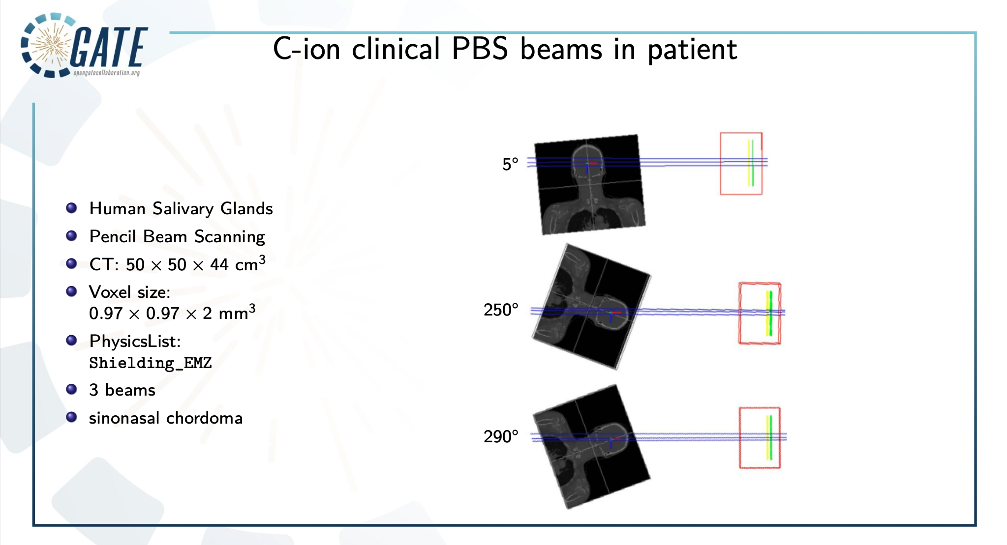

Slide 15
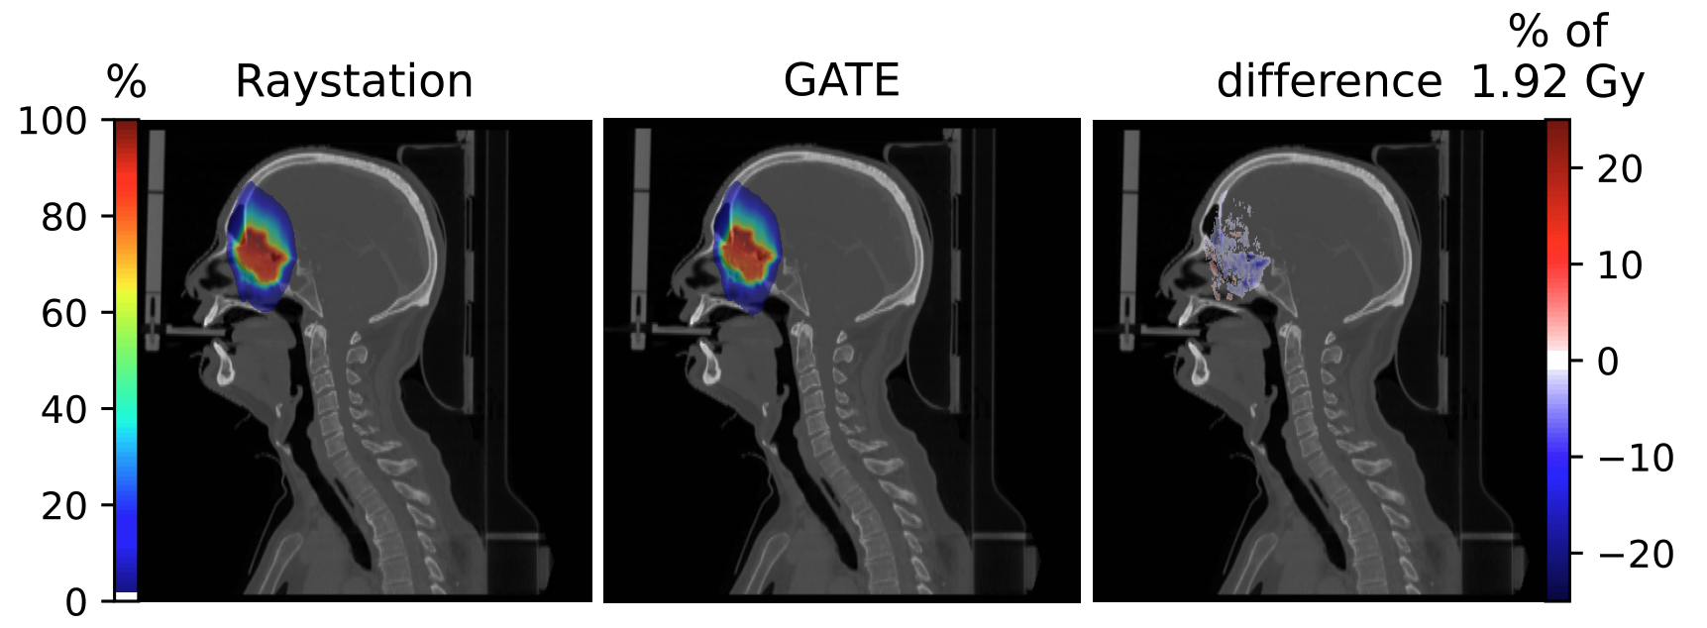

Validation, C-ion , physical and biological dose using mMKM
Physical dose
Biological dose

Slide 16
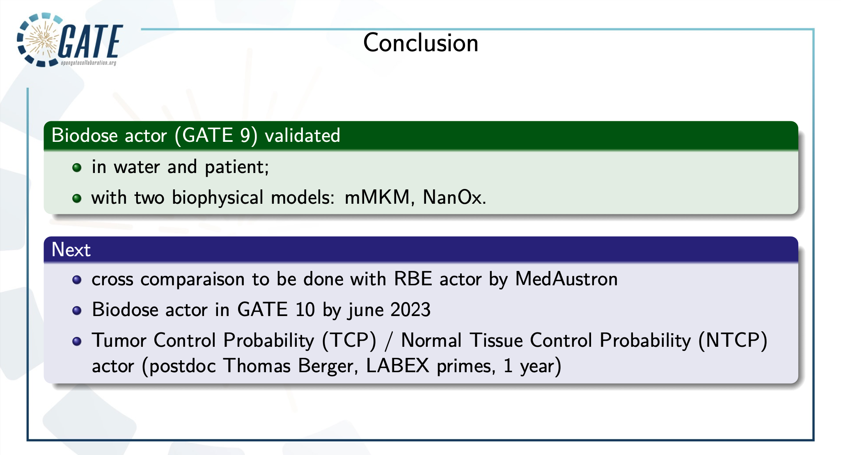

Slide 17
GATE for radiation biology applications
CPOP & water radiolysis chemistry
Joint collaboration: LPC, LP2IB, LPSC

Slide 18
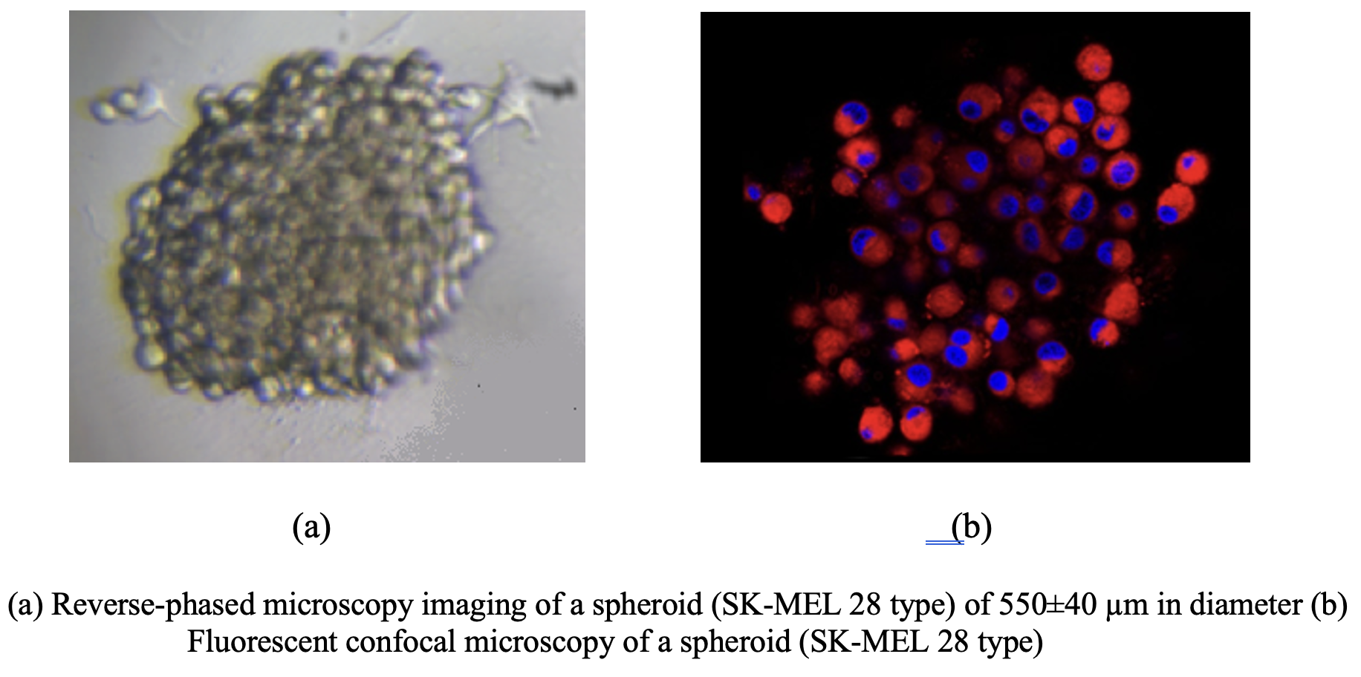
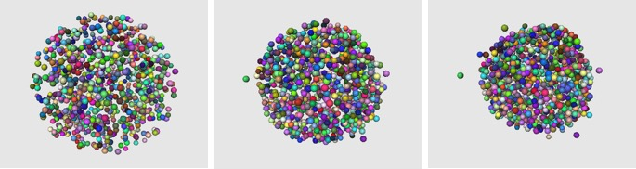
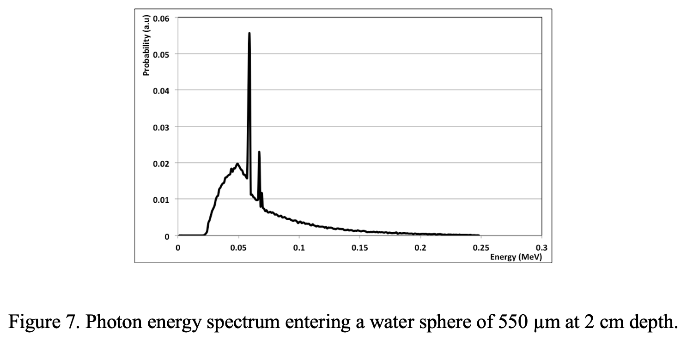
CPOP: a C++ cell population modeler coupled with Geant4
L. Maigne, et al. 2021, https://doi.org/10.1016/j.ejmp.2021.07.016
https://github.com/lpc-umr6533/cpop
3 shells: Necrosis, Intermediary, External
Cells sampled per zone
NPs positionning: membrane, cytoplasm, nucleoplasm or nuclear membrane
Energy spectra of particles:
  With and without Gd NP
  Different levels
G4 PhysicsList: Penelope, Geant4-DNA…
Energy deposited to cells and sub-cellular compartment
Tested in targeted alpha therapy
SPECT
32
Dosimetry
40
PET
34

Slide 19
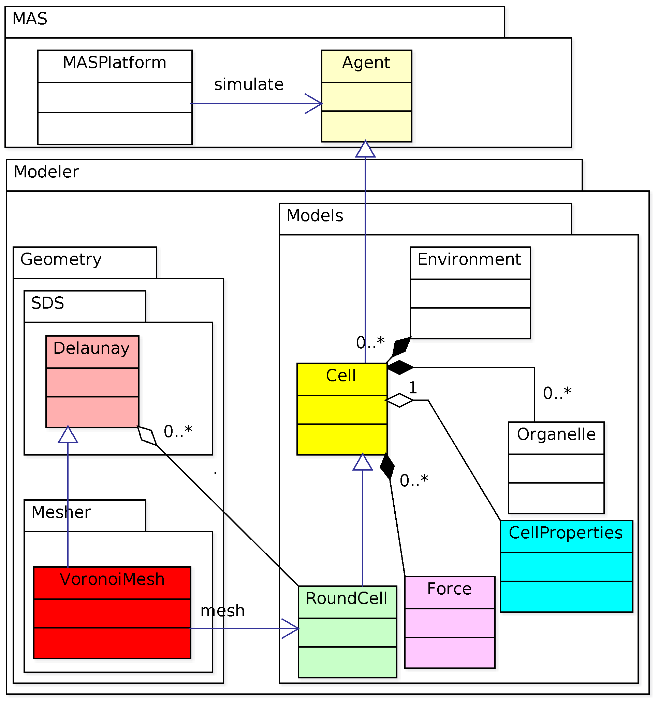
How to use the platform
Mandatory libraries:
Geant4 (11.1)
Qt5
CGAL 5.5.1 (=> Boost, Mpfr, Xerces)
CLHEP (2.4.6.1)
Root (6.26.10)
Compilation and installation
Using cmake and make
4 examples to test
Soon available in Geant4 release
https://github.com/lpc-umr6533/cpop

Slide 20
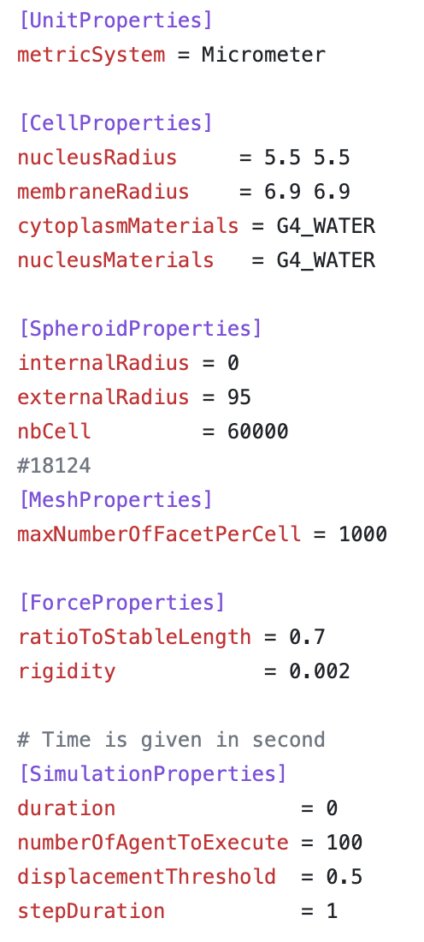
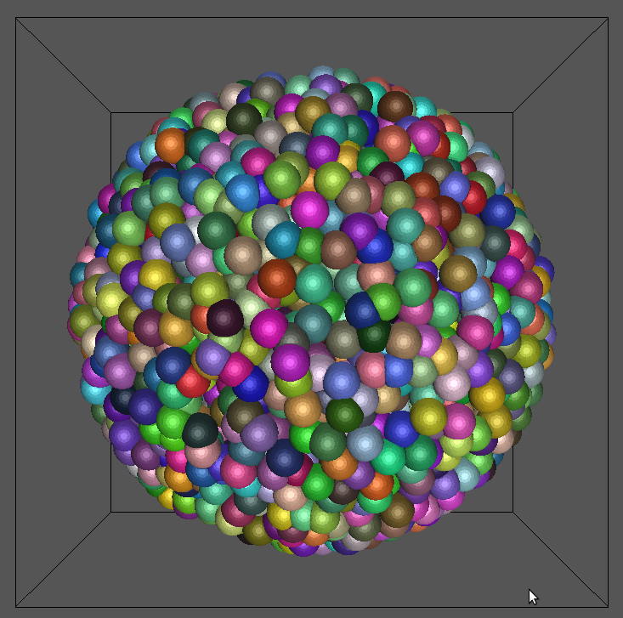
Example 1: Generate a cell population
./generatePopulation -f data/exampleConfig.cfg –vis
geomview data/exampleConfig.cfg.off &

Slide 21
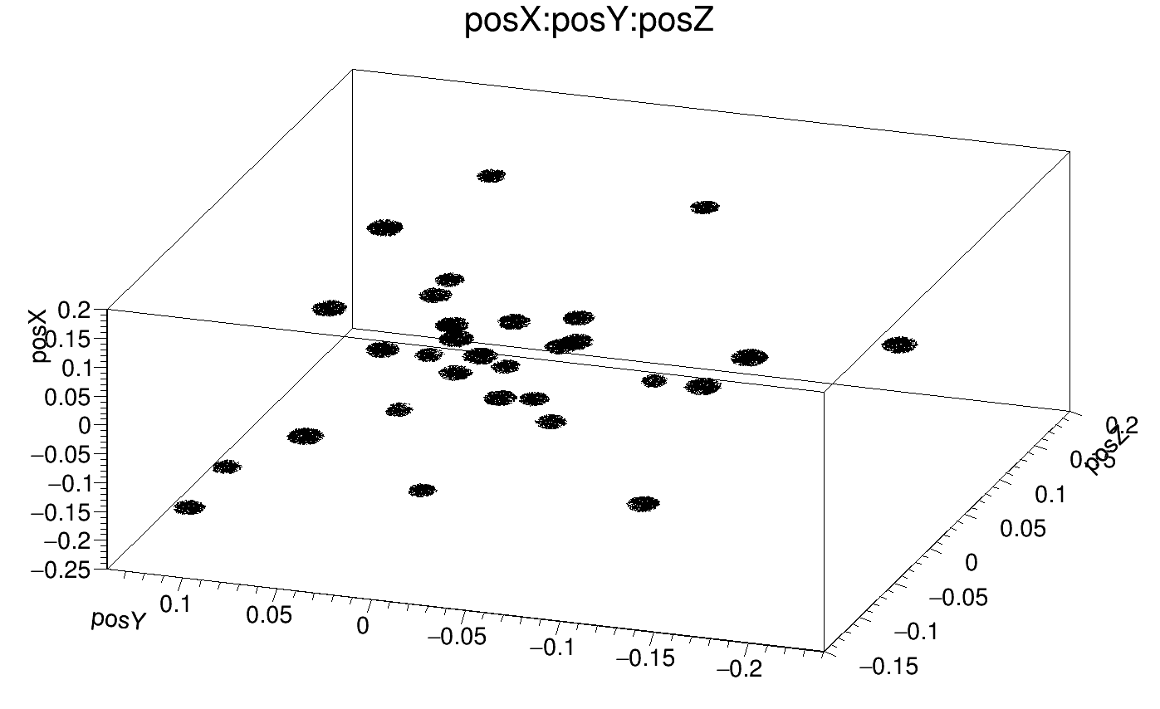
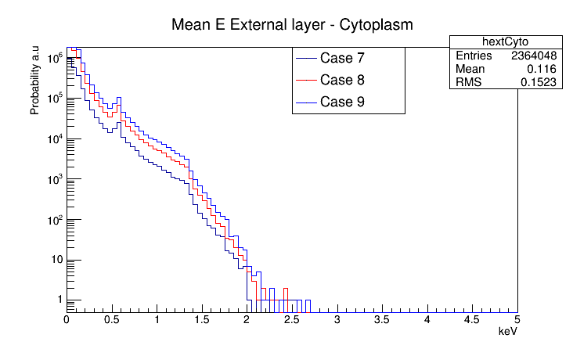
Example 2: uniform radiation
./homogeneousRadiation -m data/run.mac -t 4
/cpop/population/input data/population.xml
/cpop/population/numberFacet 100
/cpop/population/internalRatio 0.25
/cpop/population/intermediaryRatio 0.75
/cpop/population/sampling !
/cpop/population/init
/run/initialize
# add a gamma source using a user defined spectrum
/cpop/source/addUniform gamma
/cpop/source/gamma/particle gamma
/cpop/source/gamma/spectrum data/phspectrum_spheroid.txt
/cpop/source/gamma/totalParticle 10000
/analysis/setFileName output.root
/run/beamOn 10000

Slide 22
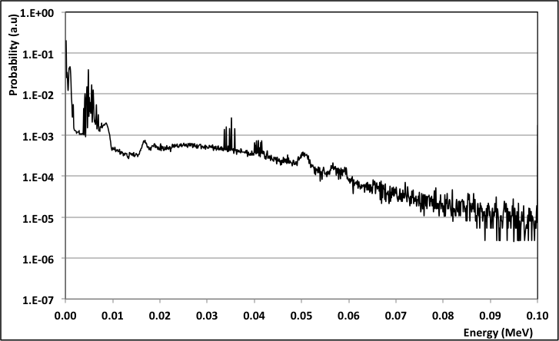
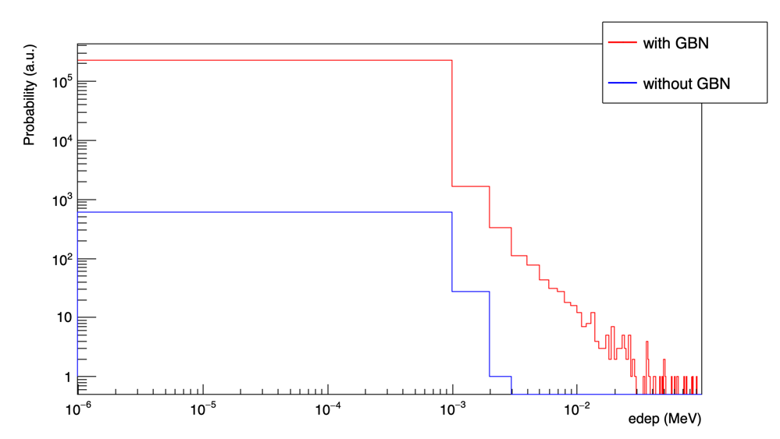
Example 3: complex radiation
./complexRadiation -m data/run.mac -t 4
/cpop/source/addDistribution gadolinium
/cpop/source/gadolinium/particle e-
/cpop/source/gadolinium/spectrum data/eSpectrumGBN_550um.txt
/cpop/source/gadolinium/totalSource 30
/cpop/source/gadolinium/particlesPerSource 1
/cpop/source/gadolinium/distributionInRegion 10 10 10

Slide 23

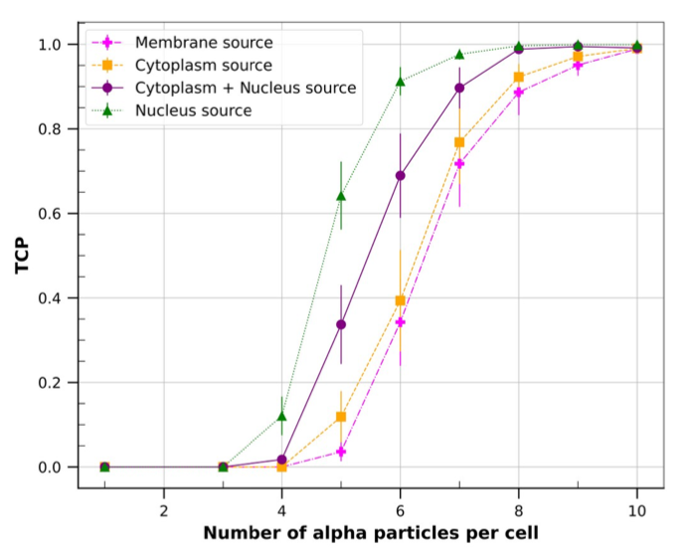
Example 4: alpha targeted therapy
./targetedAlphaTherapy -m data/run.mac -t 4
/cpop/source/addDistribution radionuclide
/cpop/source/radionuclide/particle alpha
/cpop/source/radionuclide/spectrum data/At211.txt
/cpop/source/radionuclide/totalSource 2000
/cpop/source/radionuclide/particlesPerSource 1
# set to 1 to have all sources in a cell located in the same place
# set to 0 for a random distribution of sources in a cell
/cpop/source/radionuclide/only_one_position_for_all_particles_on_a_cell 0
# set the source distribution in each region
/cpop/source/radionuclide/distributionInRegion 0 0 2000
/cpop/source/radionuclide/distributionInCell 1 0 0 0
# Activate diffusion of radionuclide's daughter (for At-211 only)
/cpop/source/daughterDiffusion no
/cpop/source/radionuclide/maxSourcesPerCell 0 10000 10000
/cpop/source/radionuclide/cellLabelingPercentagePerRegion 100 100 100
Credit: Victor Levrague, PhD student, LPSC

Slide 24

Implementation in GATE 10
Generation of cell population geometry
opengate_lib/
GateCellPopulation.h GateCellPopulation.cpp
3 actors to analyze energy deposited in cell population
opengate_lib/
GateCellUniformActor.h GateCellUniformActor.cpp
GateCellNanoActor.h GateCellNanoActor.cpp
GateCellAlphaActor.h GateCellAlphaActor.cpp
Generation of cell population geometry
opengate/
CellPopulation.py
3 actors to analyze energy deposited in cell population
opengate/
CellUniformActor.py CellNanoActor.py CellAlphaActor.py

Slide 25
Geant4-DNA water radiolysis
Chemistry module

Slide 26
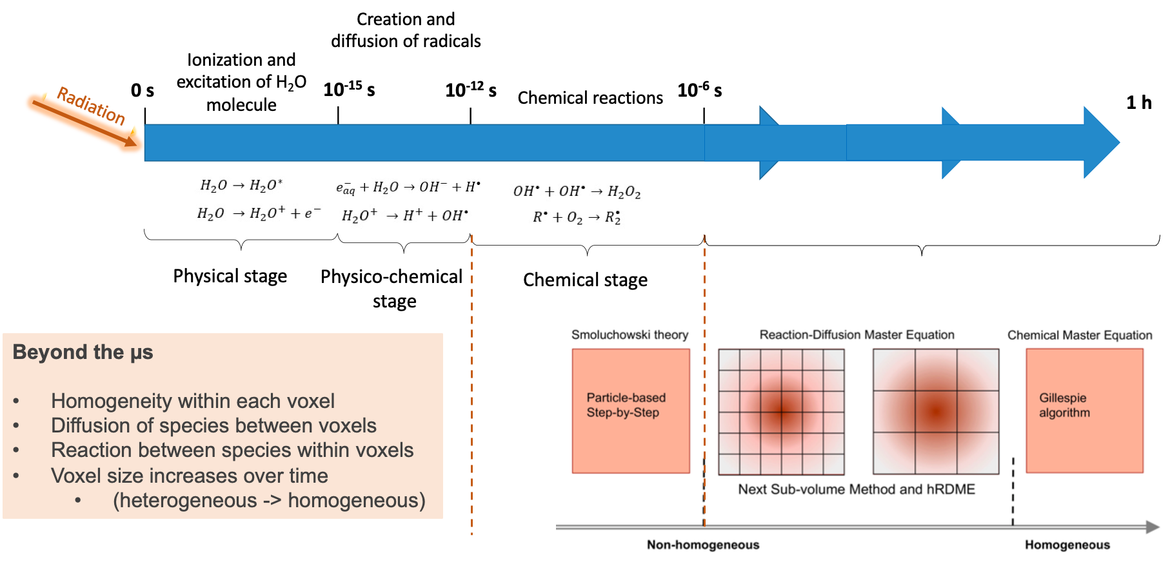
Handle water radiolysis chemistry in Geant4-DNA

Slide 27
The 4 Geant4-DNA « chemistry constructors »
Chemistry constructor | Description | Approach
G4EmDNAChemistry | First constructor implemented in Geant4- DNA for the chemistry processes with parameter values from Karamitros et al. (2014) – from PARTRAC | SBS
G4EmDNAChemistry_option1 | Implements a revisited set of chemistry parameters from Shin et al. (2019) – from TRACs + Burns et al. (1981) + Rowe et al. (1988) | SBS
G4EmDNAChemistry_option2 | Includes chemistry parameters for simulating reactions with DNA components – from Buxton et al. (1988) | SBS
G4EmDNAChemistry_option3 | Implements the IRT approach from Ramos-Mendez et al. (2020) – from RITRACKS & Elliot et al. (1994) | IRT
Phys. Med. 88 (2021) 86-90 (link)
Med. Phys. 47 (2020) 5920-5930 (link)

Slide 28
The FLASHMOD collaboration
PhD student Daeun Kwon (CNRS) 2023-2026

Slide 29
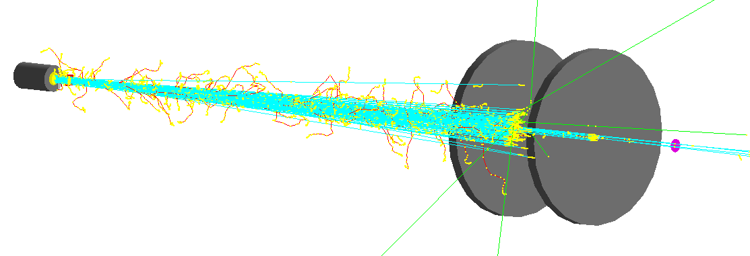
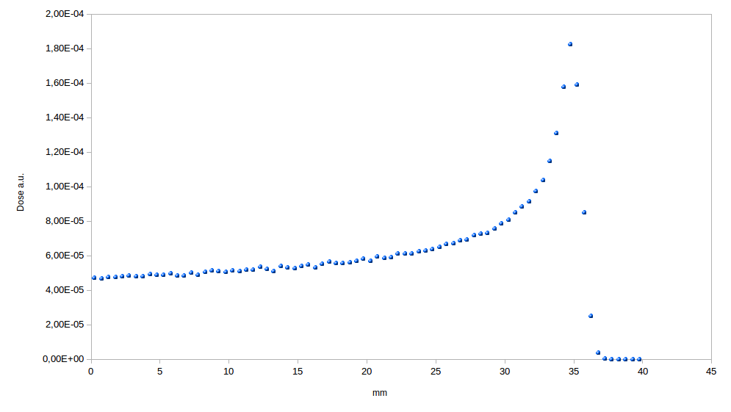
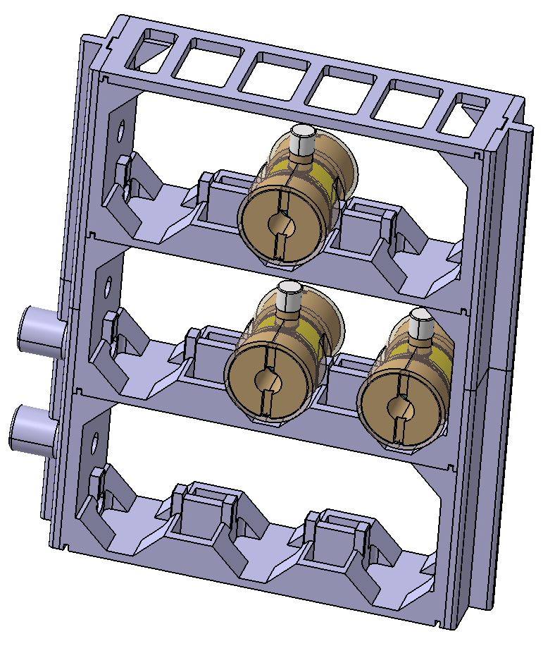
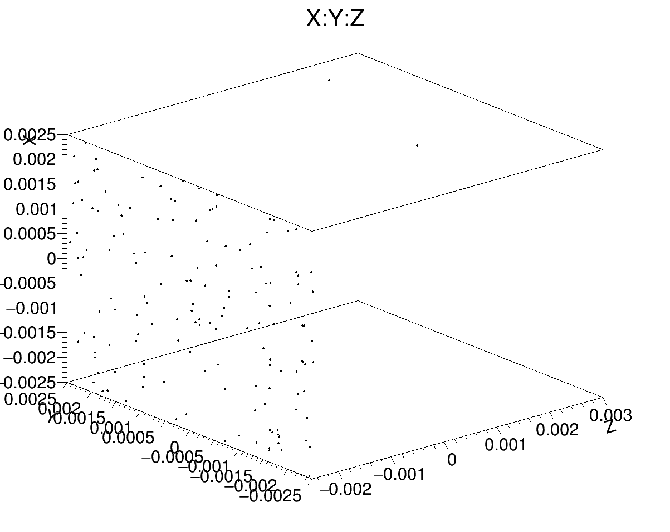
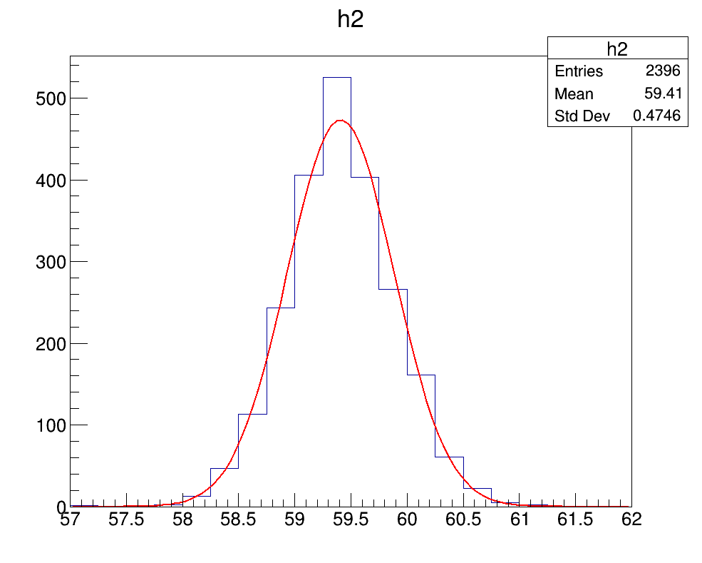

Beam line simulation
Proton Energy: 67.5 +/- 0.35 MeV
LET 1.2 keV/$μ$m
1,5 m
PhaseSpace around the target box
Kinetic energy in MeV

Slide 30
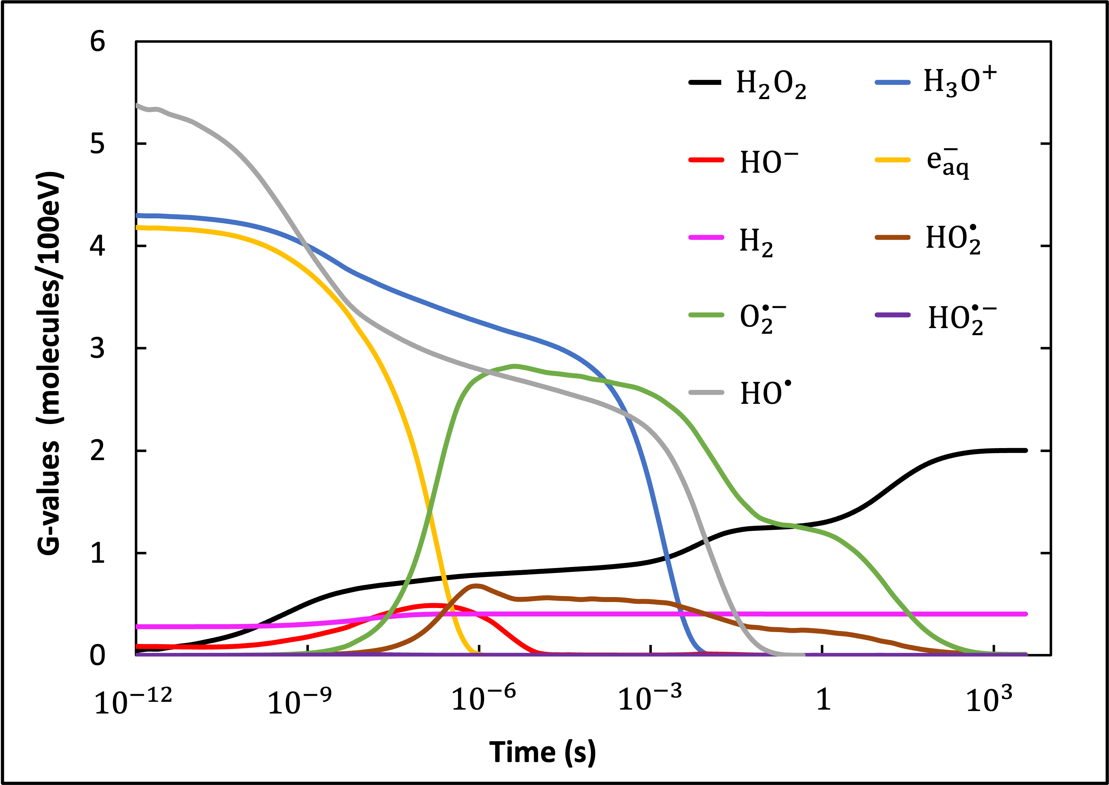
Radiolytic species yields under radiation
Simulated time dependent yields (from 10⁻¹² s to 1 hour) of different chemical species obtained in a 3.2 µm side cubic liquid water volume (19% of oxygen) irradiated with a monoenergetic 59.41 MeV proton beam.
Parameters that can be changed
  O2 concentration
  pH
  scavengers

Slide 31
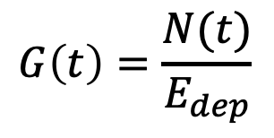
The Geant4-DNA « chem » examples
Six examples are available in Geant4-DNA in extended examples/medical/dna
  chem1: activating chemistry
  chem2: how to set minimum time-step limits
  chem3: user interactivity and visualization
  chem4: extraction of radiochemical yields (G) in a range of deposited energy
  chem5: same with alternative physics and chemistry constructors
  chem6: example for IRT approach
Note
  Slow simulations: examples can be run in MultiThreading mode
Number of molecules at time t
$$G\left(t\right)=\frac{N(t)}{E_{dep}}$$
Time-dependent radiochemical yield
Deposited energy scaling to 100 eV

Slide 32
Access in GATE 10
Chemistry constructors
g4_bindings/
pyPhysicsList.h pyPhysicsList.cpp
1 actor to score species along time
opengate_lib/
GateScoreSpecies.h GateScoreSpecies.cpp
1 actor to score species along time
opengate/
ScoreSpecies.py

Slide 33


Events 2023-2024
2023 IEEE NSS-MIC conference
7/11 - GATE 10 training & 9/11 - GATE workshop
31 Jan- 2 Feb. 2024 (Lyon) , GATE 10 beta Hackaton
March 2024 (Osaka, Japan), Geant4 Asia & Pacific International User Conference at the Physics -Medicine -Biology frontier
Scientific meetings:
25-26 April 2023, in Krakow (Poland)- https://indico.in2p3.fr/e/gate2023
Next GATE trainings
GATE training for beginners November 2023
Python data analysis for GATE simulations March 2024
GATE trainings in master programs (on demand)

Slide 34
Useful links
Information
Web site http://www.opengatecollaboration.org
GATE user mailing list https://listserv.in2p3.fr/cgi-bin/wa?A0=OPENGATE-L
GATE documentation
To install GATE https://opengate.readthedocs.io/en/latest/installation.html
To use GATE https://opengate.readthedocs.io/en/latest/
Accessible through Github
Scientific meetings:
May 2022 https://indico.in2p3.fr/e/gate2022
25-26 April 2023, in Krakow (Poland) https://indico.in2p3.fr/e/gate2023
Source code https://github.com/OpenGATE/Gate
Examples https://github.com/OpenGATE/GateContrib
Analysis tools https://github.com/OpenGATE/gatetools
Trainings & Workshops
1 workshop @ main conferences : IEEE NSS-MIC, AAPM, MCMA, PTCOG…
Trainings : 2/year
  GATE training (beginner level): 22-24/11/23
  Python data analysis for GATE simulations: March 2024

