Slide 1
Clinical and clinical research activities @CNAO
Ester Orlandi
Radiotherapy Clinical Department
National Center for Oncological Hadrontherapy (CNAO)
University of Pavia
Ester Orlandi
Radiotherapy Clinical department
Italian National Center for Oncological Hadrontherapy (CNAO)

Slide 2
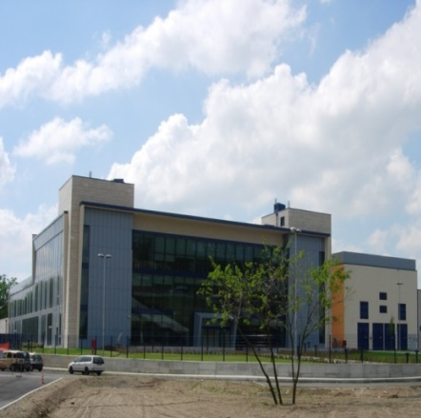



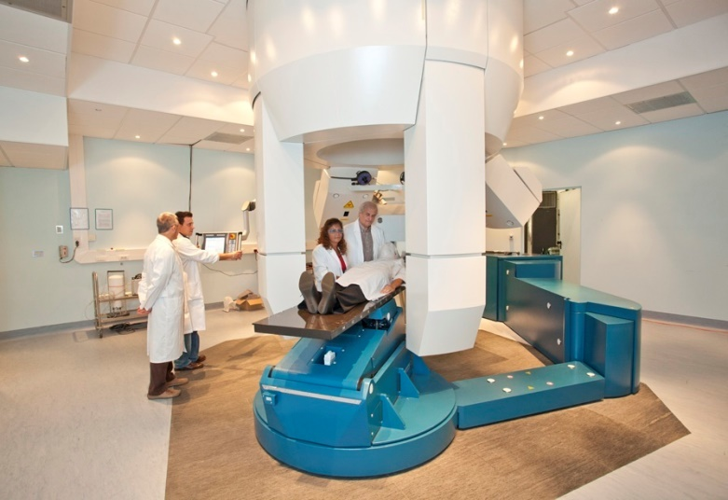
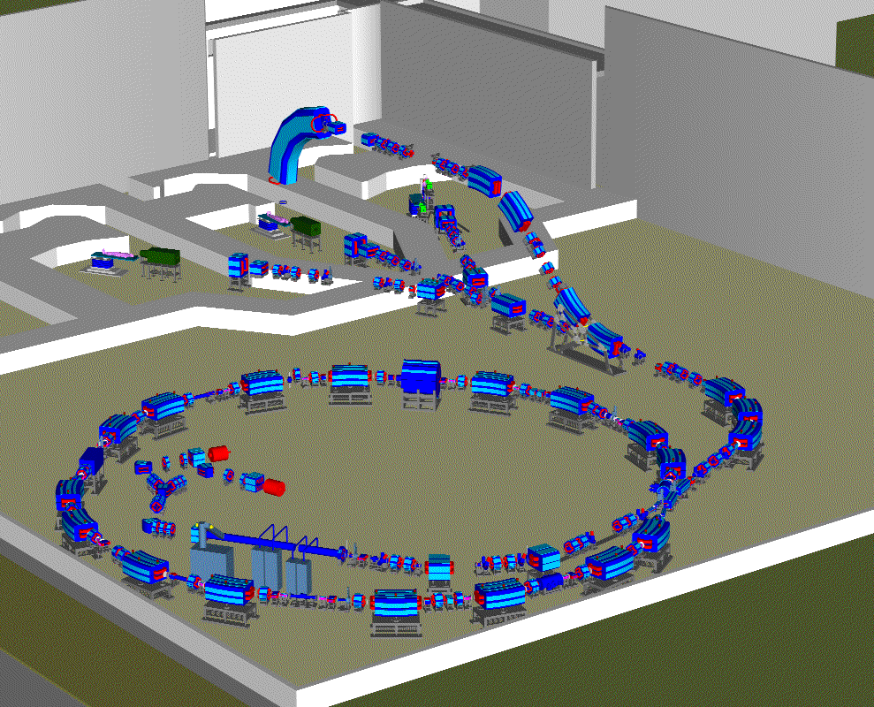
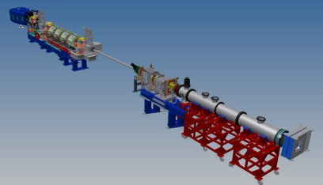
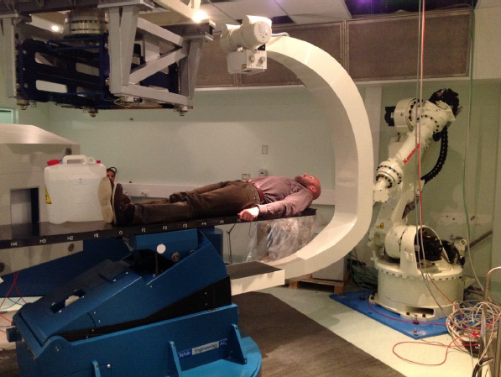
Experimental Phase
179 patients
September 2011- December 2013
CNAO in Pavia
dual center
active scanning
Protons /Carbon Ions
2
3
4
1
experimental room (2017)
in room 3D imaging
Clinical Phase
(National Health System)
Started since January 2014
Synchrotron P-C 400 meV/u

Slide 3
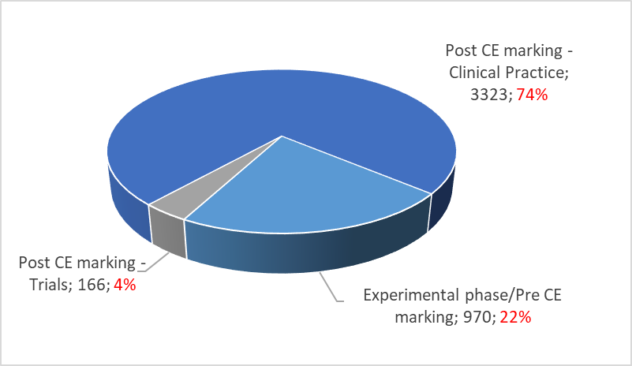
Clinical activity in CNAO: a handful of numbers
May 2023

Slide 4
Summary of the rationale for using hadrontherapy
Tumor characteristics
Patient characteristics
Biological constraints
resistance (innate or acquired) to XRT because of histology, genetic background and/or the local microenvironment, including hypoxia
slow proliferation
Need of integral dose sparing effects (paediatric –young adult pts)
High individual radiosensitivity
based on genetic background e/o local
microenvironment
Anatomical constraints
proximity of vital organs
unresectable, recurrent
or “residual” disease
Carbon ion therapy
Proton therapy

Slide 5
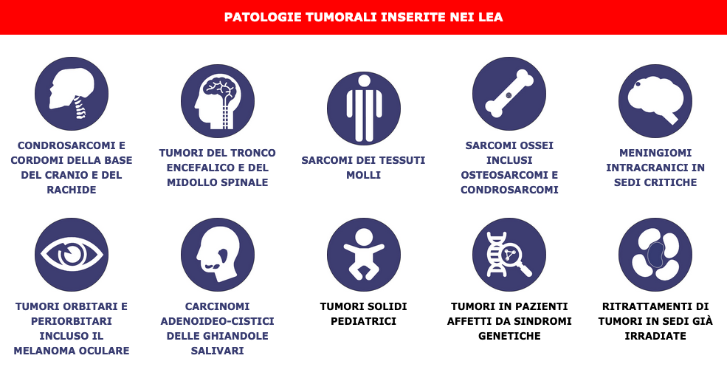
Livelli Essenziali di Assistenza _ Adroterapia :
Decreto ministeriale Gazzetta Ufficiale 18.3.2017

Slide 6
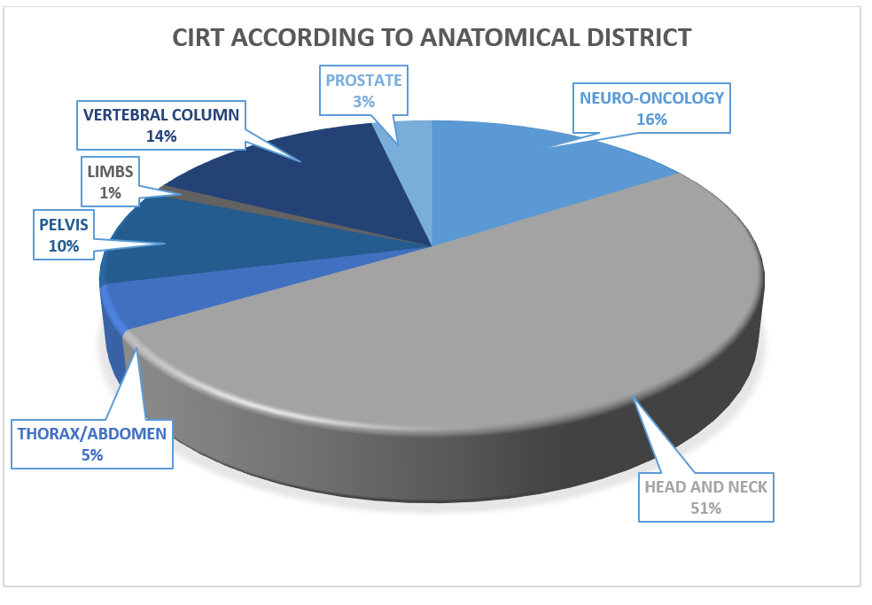
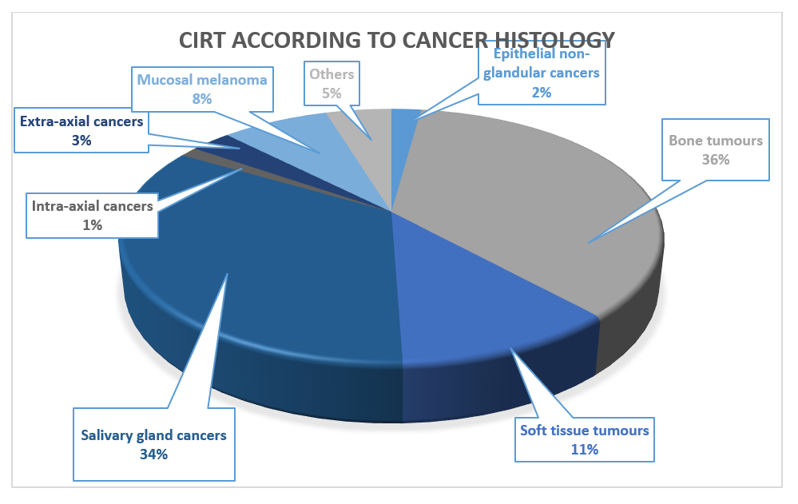
Clinical activity

Slide 7
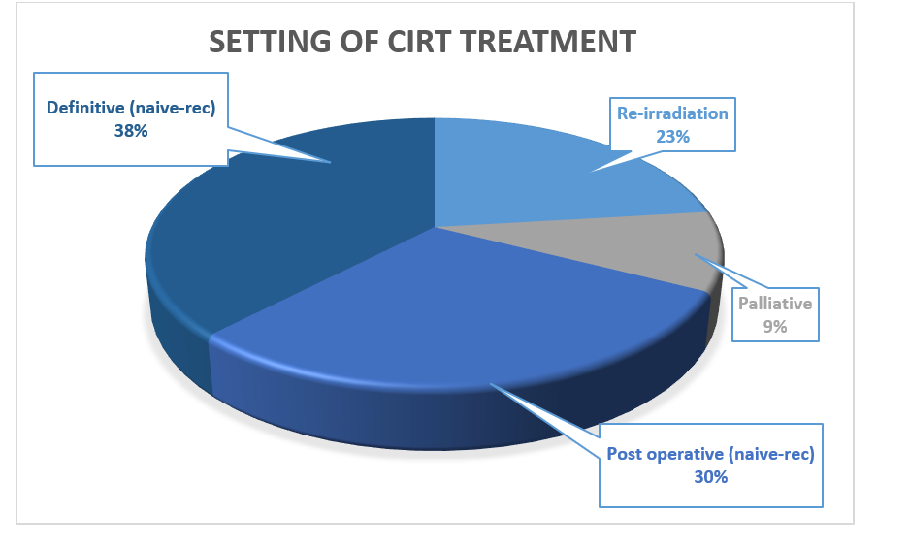
Setting of CIRT/PT treatments
27% concurrent CT(with PT)

Slide 8
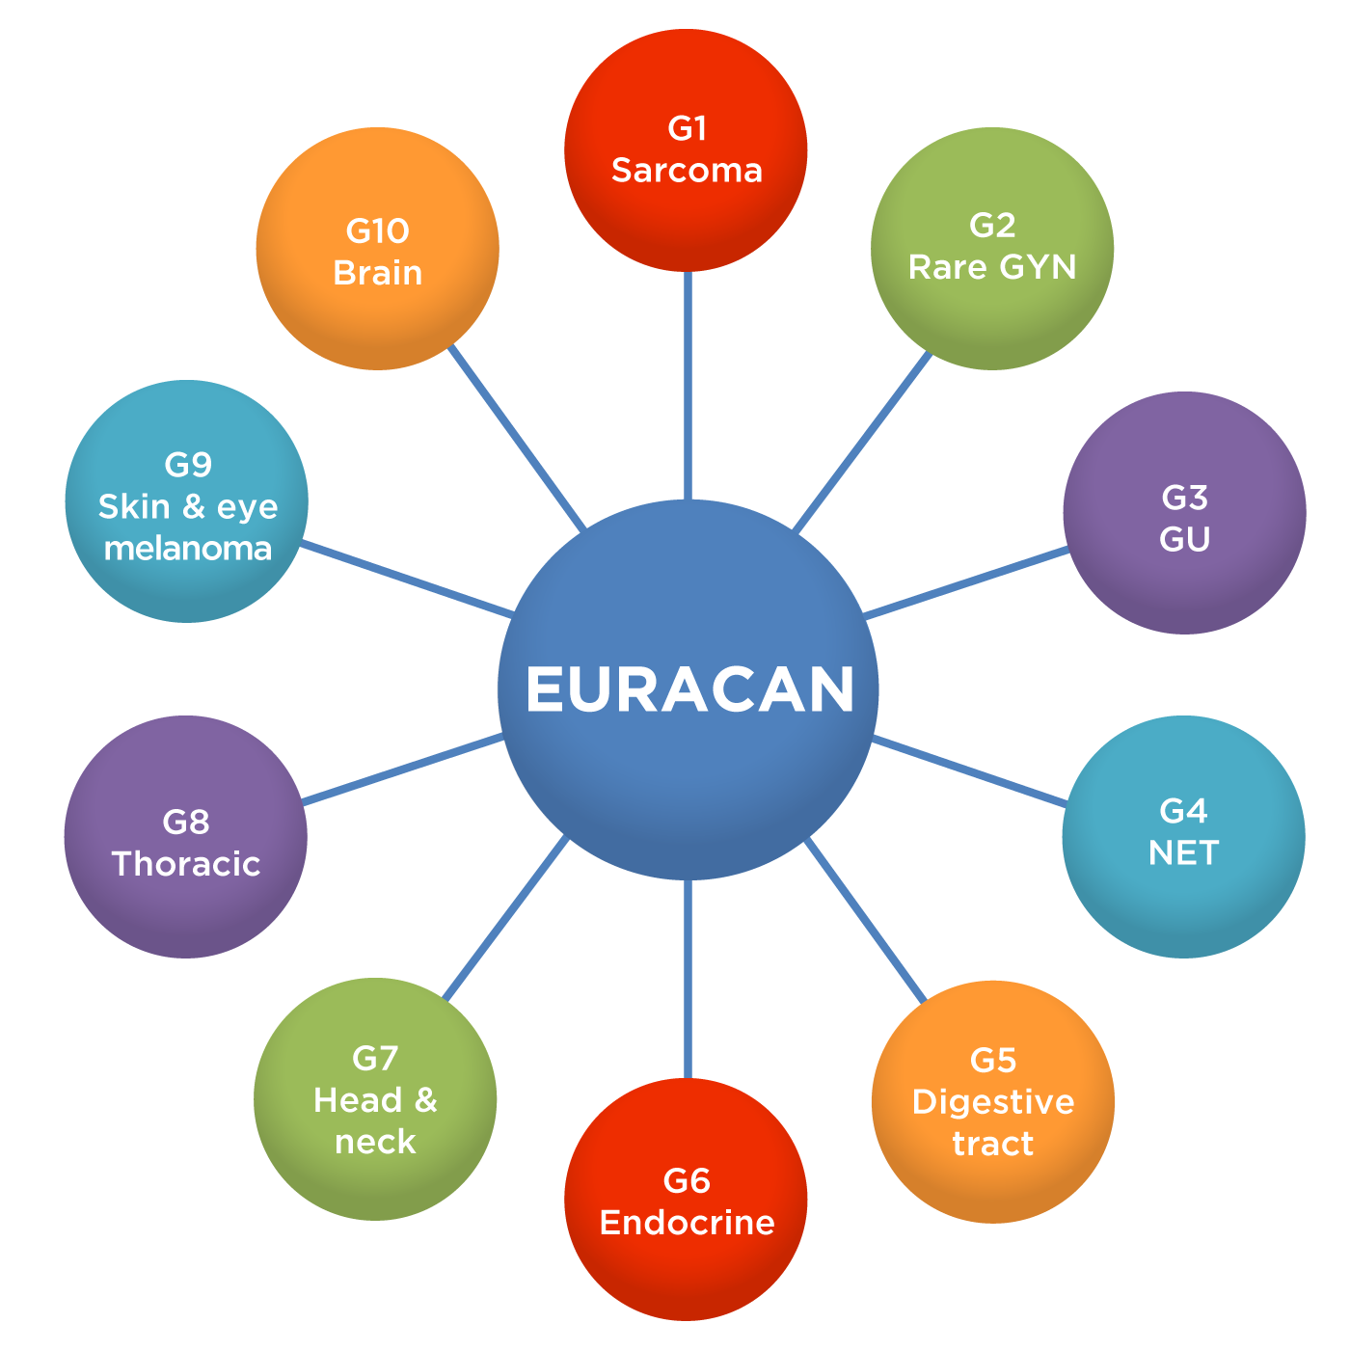

CNAO is within the EUROPEAN REFERENCE NETWORK ON ADULT CANCERS
EURACAN (Approval in December 2021)
NPC, SGC, PNSC

Slide 9
The clinical research @ CNAO: main aims
To collect real world data of patients treated with particles
To assess the effectiveness and safety of CIRT in selected gynecological tumors
To compare surgery and CIRT in sacral chordoma
To clinically test a simoultaneously integrated boost with CIRT in a selected
To combine CIRT/PT and immunotherapy
To search predictive biomarkers for outcome and tox following particle therapy
To prospectively longitudinally assess QOL and financial tox in patients managed with particle
to assess the effectiveness and safety of de-escalating elective nodal volume with protons in NPC pts
All trials have been registered on Clinical Trials.gov.

Slide 10
CNAO registry – REGAL (NCT05203250)
Study Design | This is a longitudinal registry which will include both retrospective and prospective collection of clinical data derived from diagnostic tests and treatments performed by CNAO for patient management. Only data available from routine clinical practice will be collected. Intervention is not assigned.
Promotor | CNAO
Objectives | Primary objective: To collect real world data of patients treated with radiotherapy, to support particle radiotherapy and to provide evidence of the role of radiation oncology within the multidisciplinary approach. Secondary objectives: • To analyze the disease course and treatment performed by collecting demographic, disease characteristics and delivered treatment • To collect details about the radiation treatment and radiobiological parameters to develop predictive models (outcome and toxicity) • To collect outcome data (in terms of overall survival, progression free-survival and local control) and to correlate them with the delivered treatment • To define acute, intermediate and late toxicities, according to CTCAE v 5.0 and to correlate it with the delivered treatment • To collect data on standardized QoL questionnaires and PROMS (e,g EORTC C30, EQDL) at 6, 12. 18, 24, 36 months and to correlate them with the delivered treatment • To generate hypotheses for further research

Slide 11
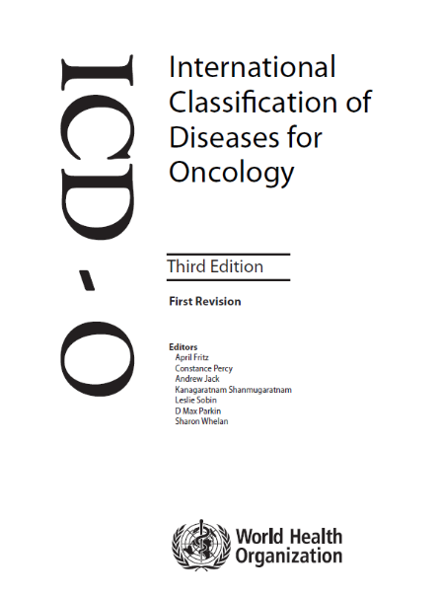
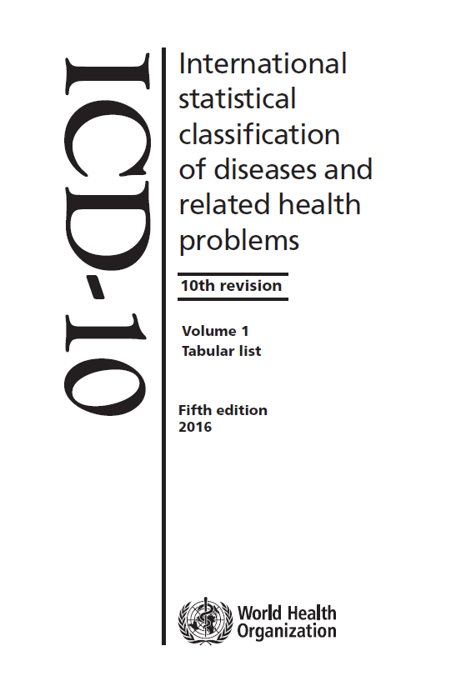
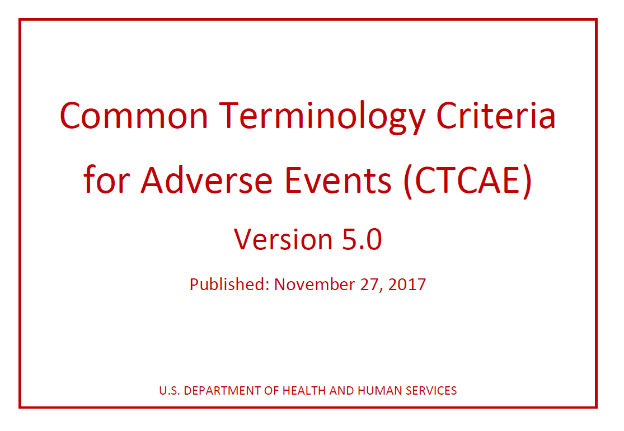


SEMANTICS IN REGAL
Histology and Topography
Diagnosis
Toxicities
Comorbidities
Concomitant Medications

Slide 12

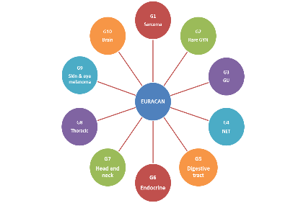


NATIONAL AND INTERNATIONAL REGISTRIES
AIOCC Italian Registry on
Head and Neck Carcinoma
Registry of the European Reference Network on Rare Adult Solid Cancer “EURACAN”
RARITY
AIR Study
Heavy Ion Therapy Research Integration plus
HITRIPlus
REGAL
  CNAO REGistry TriAL

Slide 13
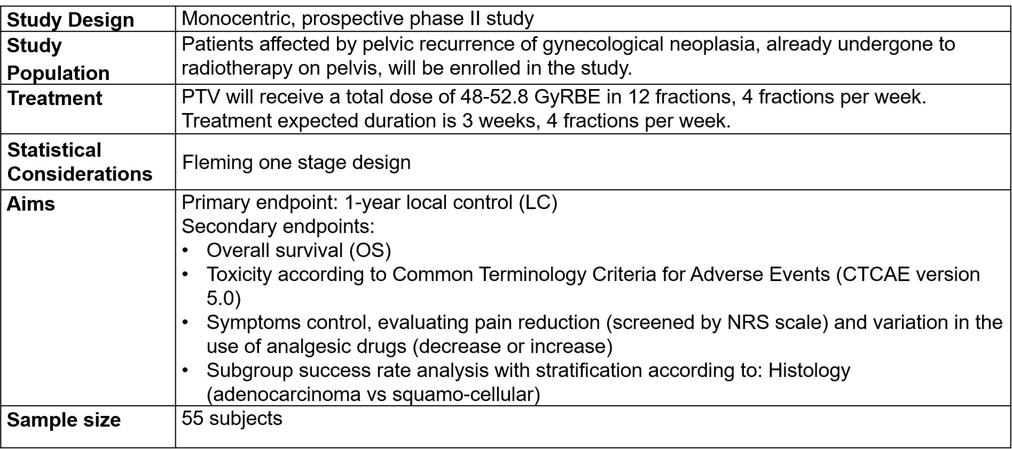
Phase II clinical study on the re-irradiation of lateral pelvic recurrences of gynecological malignancies (CYCLOPS)

Slide 14
Inclusion Criteria
Patients ≥ 18 years of age
Karnofsky Index ≥ 70
Histological or radiological diagnosis of pelvic recurrence
Contraindications for radical surgery
No other distant progression or stable disease (SD) of known secondarisms (≥6 months)
Previous radiation therapy on pelvis
Distance ≥ 10 mm between tumour and close intestinal tract (small intestine), radiologically evaluated
Possibility to perform a surgery to space the intestinal loops, in case of distance < 10mm
If needed, spacer in biocompatible material (silicon, goretex) or anatomical material (omentum, muscle patch), non-absorbable.
DICOM images of the previous treatment plan availability
Exclusion criteria
prosthesis, metal prostheses or any other condition that prevents adequate imaging to identify the target volume and calculate the dose in the treatment plan
Intestinal infiltration
Bladder infiltration
Vessel infiltration
Previous therapy with anti-angiogenesis drugs
Psychic or other disorders that may prevent informed consent
Previous invasive tumor, with the exception of skin cancer (excluding melanoma) unless disease-free for at least 3 years
Spacer in absorbable material (i.e. vycril)
Distance < 10 mm between tumour and close intestinal tract (small intestine), radiologically evaluated
Impossibility to assess MRI
Enrolled patients: 5
Ongoing emendament with inclusion criteria changes (oligoprogrssive disease not only in the plevis or in reirratition setting) in order to improve the accrual)

Slide 15
Simultaneous Integrated Boost (SIB) planning Approach in Carbon Ion RadioTherapy for head and neck adenoid cystic carcinoma (SIBACIRT)
Study Design | Monocentric, single arm prospective phase II clinical trial
Promotor | CNAO
Objectives | Primary objective: To assess acute (within 3 months after treatment conclusion) and midterm toxicity (from 3 to 6 months after treatment end) of SIB in CIRT and to compare it with the historical series of patients treated with CIRT using a SEQ approach and the same total dose prescription at CNAO. Secondary objectives: are equivalence in terms of Local Control compared to the historical series treated in CNAO, predictive factors for various toxicity endpoints, and Quality of Life evaluation.

Slide 16
Inclusion Criteria | Histologically-proven primary head and neck ACC; unresectable stage or residual macroscopic disease after surgery or multiple microscopic margins after surgery; patient with resectable tumor but refusing surgery cN0/pN0 – cN1/pN1 patients (only ipsilateral neck levels I and II) Absence of distant metastases or oligometastatic status (patients with ≤ 3 metastatic lung or bone lesions, excluding other sites; No previous radiotherapy in head and neck region; Karnofsky Performance Status ≥ 70; Age ≥ 18 years; Written informed consent Patients’ ability to understand the characteristics and consequences of the clinical trial.
Exclusion criteria | local conditions contraindicating CIRT (e.g., active infection or previous history of recurrent infections in or close to the tumour site; intratumoral necrosis in strict proximity of vessels; pre-existing skin, bone or soft tissue fistula; extended mucosal involvement by the tumor; previous surgery with flap reconstruction); tumor site in nasopharynx, pharynx and tongue base (where an exclusive CIRT treatment could be at high risk of toxicity); tumor disease involving ≥ 50% of the palate with consequent high risks of serious anatomical damage in case of significant and rapid disease response to CIRT nodal involvement > cN1/pN1 or cN1/pN1 outside ipsilateral levels I and II tumor surrounding carotid artery > 180° or infiltrating the vessels Titanium surgical implants or metal prostheses or any other condition that prevents adequate imaging to identify the target volume and may determine uncertainties in CIRT dose distribution during treatment planning Presence of any comorbidity deemed to impact on treatment toxicity; Psychic or other disorders that may prevent informed consent active autoimmune disease (e.g. systemic lupus erythematosus, systemic sclerosis, rheumatoid arthritis) Contraindication to MRI Pregnancy or breastfeeding in progress

Slide 17
Immune checkpoint inhibitors and Carbon iON radiotherapy In solid Cancers with stable disease (ICONIC)
Study Design | Non-randomized, open label, single arm, phase II clinical trial
Promotor | CNAO
Objectives | Primary objective: to estimate the effect, in terms of clinical response, of immunotherapy associating carbon ion treatment in the palliative setting across different malignancies, for which immunotherapy is currently the standard of care. Secondary objectives: to describe the safety profile of the association of carbon ion radiation therapy and systemic immunotherapy in the palliative setting across different malignancies, for which immunotherapy is currently the standard of care; to estimate the effect, in terms of survival, of immunotherapy with the association of carbon ion radiation treatment in the palliative setting across different
Enrolled patients: 2/27

Slide 18
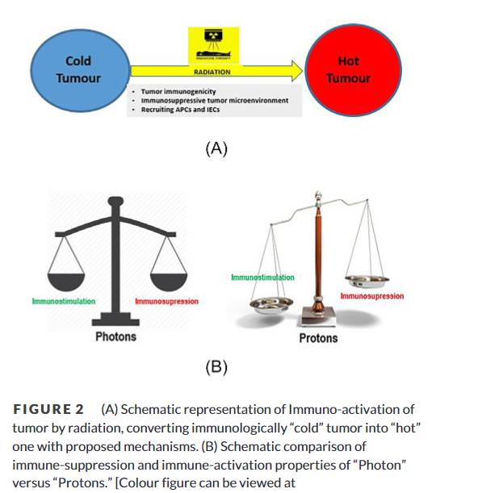
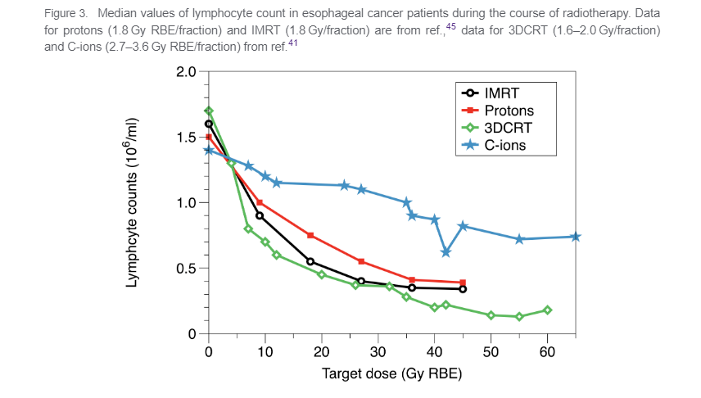
Durante M, 2019
Durante M 2019
In vitro:
Higher LET and RBE have greater impact on antigen release and less immune suppression increasing sensitivity to CTLs and induction of MDSC/T_{reg}
PBT induces long-term inhibition of cell migration
Lower severe lymphopenia with protons
Gaikwad U 2023
Notes:
In addition to its different dose deposition profile, proton beams also have a higher linear energy transfer (LET) than photon radiation which translate to a different biologic effect. LET is defined as the amount of energy per particle transferred per unit distance, and the increased number of ionization events delivered in a shorter distance increases the probability for double strand DNA breaks in addition to other effects in a tumor cell. This is related to the biological damage delivered per unit dose by calculated comparison to an equivalent photon dose, and is described by the term relative biological effectiveness (RBE). In vitro work has suggested that higher radiation-induced immunogenicity may be correlated with higher LET (57,58). Much of the pioneering work in particle radiotherapy has been performed in Japan and Germany using carbon ions, a form of particle therapy with dose distributive effects similar to protons but with higher LET (59).
A major question is the degree to which these differences in biological effect may translate to a clinical benefit. In combination, the dose-distribution benefit and increased RBE 2 to 3 times that of photon irradiation (for carbon ions) act through a predominantly direct DNA damage mechanism that is relatively cell-cycle and oxygenation independent compared to conventional X-ray therapy. This may have applications in radioresistant and hypoxic tumors (60). Clinically, although proton therapy dose is converted to photon therapy dose by simple multiplication of an RBE of 1.1, it is known that the actual RBE of a proton beam varies with beam depth and increases nonlinearly beyond the Bragg peak, leading to a small region with increased RBE at the end of the beam. Preclinical work supports the immunogenic potential of proton therapy and suggests that it may in fact have broader immunogenic applications than photons.

Slide 19
ICONIC: Study intervention
Advanced disease
SD
PD
Immunotherapy
Immunotherapy (1st line)
STOP
Carbon ion
Inclusion of cancer pts:
Under treatment with pembrolizumab per clinical practice (AIFA)
If best response = SD after at least 9-12 weeks from pembro start
ICONIC study

Slide 20



Neopesino Project: aims
Neopesino Project: aims
Studio di fase II avente come obiettivo primario la dimostrazione della sicurezza ed efficacia dell’immunoterapia (Pembrolizumab) in associazione a chemioterapia neoadiuvante, chemio-radioterapia con protoni e immunoterapia adiuvante nei pazienti affetti da carcinoma dei seni paranasali indifferenziati (SNUC), localmente avanzati.
Gli obiettivi secondari dello studio sono:
  Durata della risposta;
  Sopravvivenza libera da malattia;
  Sopravvivenza globale;
  Profilo di sicurezza;
  Tasso di chirurgie con risparmio d’organo;
  Validazione di modelli di tossicità provenienti da radioterapia convenzionale
Gli obiettivi traslazionali sono:
indagare il comportamento dei linfociti T CD8+ in risposta a pembrolizumab e le relazioni tra cluster di cellule T. Approcci innovativi di single-cell RNA sequencing saranno eseguiti nel tumore e a livello periferico, prima e dopo pembrolizumab.
valutare la persistenza di cloni di cellule T tumore-specifici dopo il trattamento del cancro primario, che potenzialmente contribuiscono a una risposta immunitaria duratura. Ai campioni di sangue prelevati verrà applicato il sequenziamento single-cell.
16 novembre 2023 – premiazione vincitori bando Unmet Medical Needs

Slide 21
Neopesino Project: potential impact
Lo studio propone un nuovo approccio terapeutico per i pazienti affetti da SNUC, localmente avanzato. Si tratta di un tumore raro del distretto cervico-cefalico, caratterizzato da ottima chemio-radiosensibilità ma con una prognosi molto severa (PFS a 5 anni, < 15%). A livello preclinico, questi tumori si distinguono dagli altri tipi istologici dei carcinomi dei seni paranasali, per un profilo immunitario arricchito da linfociti CD8+ [De Cecco L, 2019 https://doi.org/10.1016/j.oraloncology.2019.02.003]. La radioterapia con protoni ha mostrato migliori profili di tossicità e qualità di vita per i pazienti con tumori della testa collo, con un potenziale pro-immunogenico e ridotta linfopenia rispetto alla radioterapia convenzionale con fotoni.
L’innovazione portata da questo studio deriva dal:
  uso dell’immunoterapia in questo sottotipo di tumore;
  schema di trattamento basato su immunoterapia in neoadiuvante in combinazione con chemioterapia e immunoterapia adiuvante;
  uso della radioterapia con protoni in associazione a chemioterapia, dopo immunoterapia;
Non esistendo uno standard di trattamento per questi pazienti, lo studio ricerca un nuovo approccio di terapie combinate per garantire il maggior successo terapeutico, minimizzando gli effetti avversi.
16 novembre 2023 – premiazione vincitori bando Unmet Medical Needs

Slide 22
Neopesino Project
Screening
Neoadjuvant pembrolizumab
plus chemotherapy
Surgery
Radiotherapy
Adjuvant pembrolizumab
Day 1, 21, 42
Day 63
(+/- 10 days)
No more than 90 days after surgery
Q3wks for 14 courses
Pembrolizumab
200 mg + cisplatin 75mg/mq and docetaxel 75 mg/mq
Resectable patients with ORR < 50%
Concomitant platinum-based chemotherapy according to pathological report and clinical characteristics
Dosing
Collection of blood samples; pretreatment
biopsy
Collection of
blood samples at d1, d42
Collection of blood samples
Before and after surgery
Collection of blood samples
d1, d15 and d30
Collection of blood samples
each 3 courses
Procedures
Baseline Head Neck MRI/PET whole body
Head and Neck MRI
d42 -7 days
Assessments
Follow-up assessments*
Survival assessments
* Loco-regional assessment with HN MRI q12wks; PET whole body q24wks
16 novembre 2023 – premiazione vincitori bando Unmet Medical Needs

Slide 23
Health related quality of life (HRQoL) in patients with solid tumors treated with hadrontherapy (HadroQoL).
Study Design | This is a mono-institutional, longitudinal prospective trial.
Promotor | CNAO
Endpoint | Primary objective: To assess QoL in subjects treated with curative hadrontherapy at different timepoints investigated by global score according to SF-12 and to compare it with SF-12 results in healthy population (cohort A and B) Secondary objectives: to assess QoL in subjects treated with curative hadrontherapy at different timepoints investigated by global score according to EORTC QLQ-C30 and to compare it with EORTC QLQ-C30 results obtained from relevant literature in similar study population if available (cohort A and B). to investigate QoL determinants in relation to clinical patients characteristics (age, gender, site of primary tumor), type of received radiation, prevalence of late toxicity recorded according to CTCAE scale v 5.0; (cohort A and B). to investigate QoL determinants in relation to: 1. psychological variables (anxiety and depression according to HADS questionnaire, optimism, self-esteem, life satisfaction and coping according to BRIEF-cope questionnaire) (cohort A). 2. socio-cognitive factors (presence of caregiver and social support) (cohort A and B). 3. resilience according to Brief Resilient Copy Scale (BRCS) (cohort A and small sample of Cohort B). to investigate feasibility and acceptability of pts study engagement by means of teleconsultation and ad hoc designed surveys (cohort A). to explore financial toxicity through administration of PROFFIT questionnaire (cohort B). to compare the QoL pre-treatment and 1 year after therapy in a patients’ cohort (cohort B).

Slide 24
Inclusion Criteria | Cohort A (“survivors”): Patients with at least a follow up of 5 years with head and neck, skull base and brain tumors and no evidence of progressive disease. Patients ≥ 18 years of age The patient is able to give consent Cohort B: Histological and/or radiological diagnosis of head and neck tumors Patients candidate for curative intent hadrontherapy Patients ≥ 18 years of age The patient is able to give consent
Exclusion criteria | Cohort A (“survivors”): Re-irradiation. Second tumor. Known cases of any psychiatric and neurological diseases leading to disability (eg, manic disorder, schizophrenia etc..), which could impair compilation of questionnaires or affect quality of life. Cohort B: Re-irradiation. Second tumor Known cases of any psychiatric and neurological diseases leading to disability (eg, manic disorder, schizophrenia etc..), which could impair compilation of questionnaires or affect quality of life Presence of diffuse metastasis
Enrolled patients
Cohort A: 12
Cohort B: 7

Slide 25

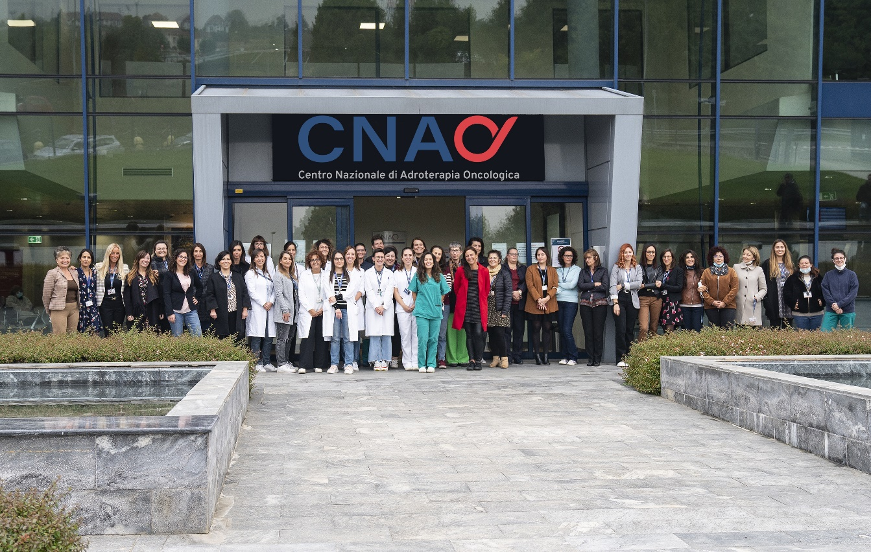
ester.orlandi@cnao.it

