Slide 1


Neutrino Oscillation
Computational Aspects
João Coelho
APC Laboratory
15 November 2023

Slide 2
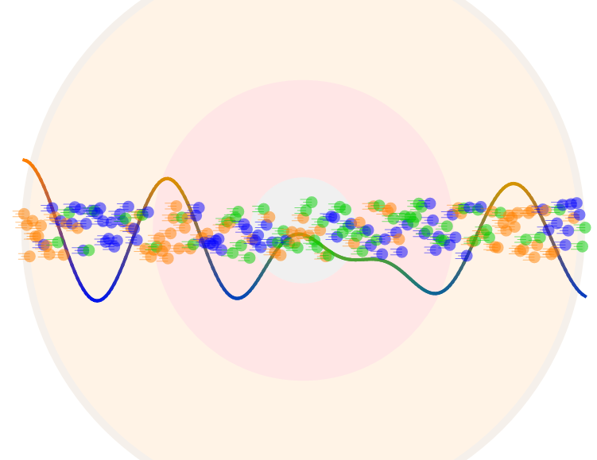

Neutrino Oscillations
Neutrinos are created in a superposition of mass states
Time evolution generates flavour oscillations
Quantum Mechanics
ν_{e}
ν_{μ}
ν_{τ}

Slide 3
Neutrino Oscillations
μ⁻
e⁻
π⁻
ν_{μ}
ν?
ν_{e}
n
p⁺

Slide 4
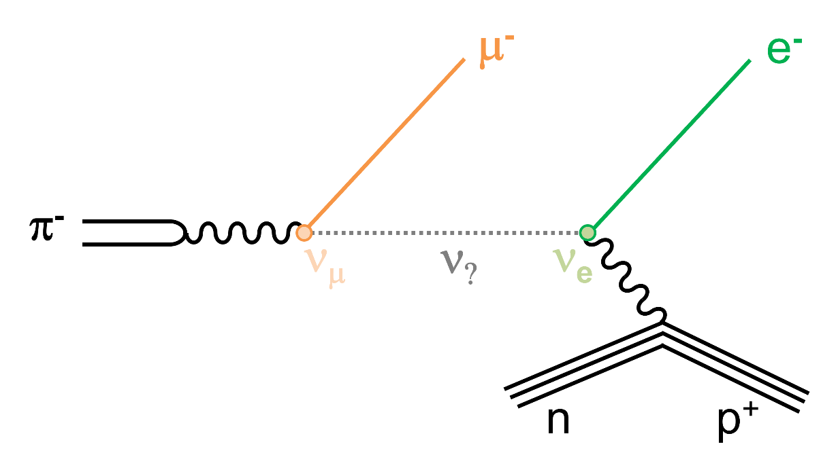

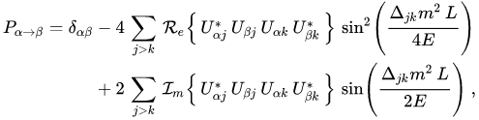
Neutrino Oscillations

Slide 5
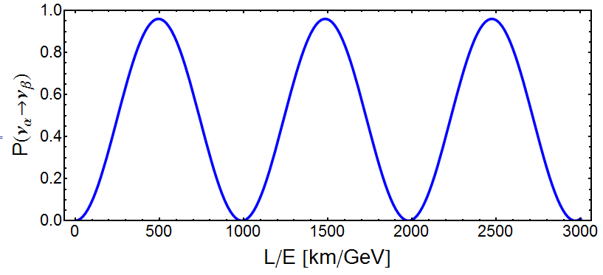
Neutrino Oscillations
α (Δm²)⁻¹
sin²2θ

Slide 6
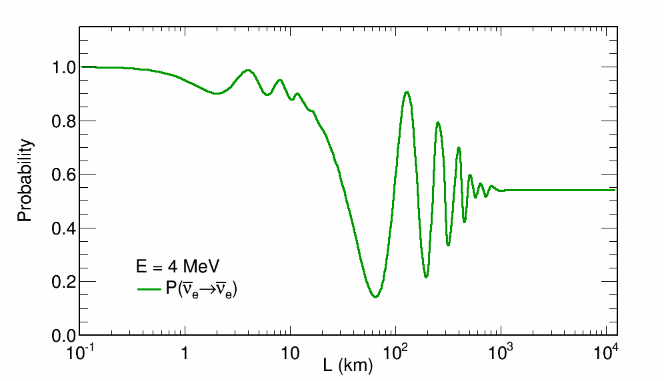
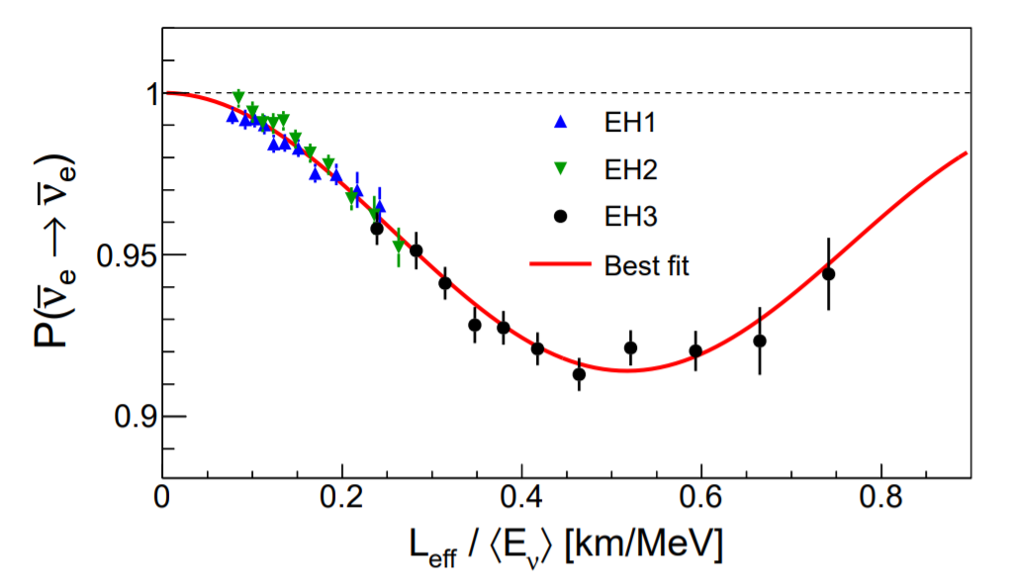
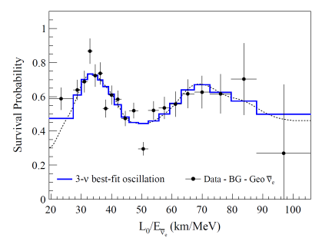
The Data: Reactor Neutrinos
Daya Bay
KamLAND

Slide 7
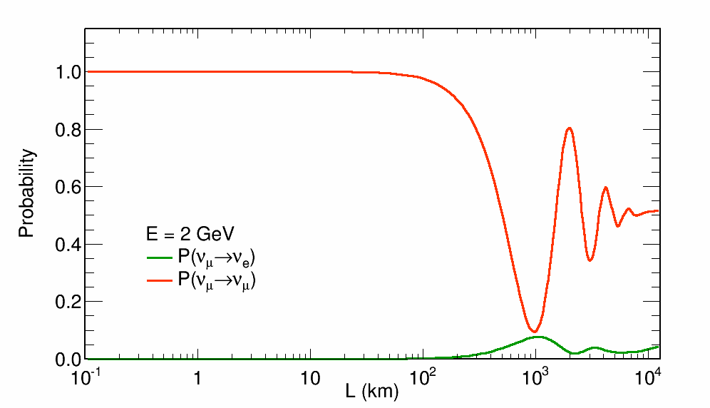
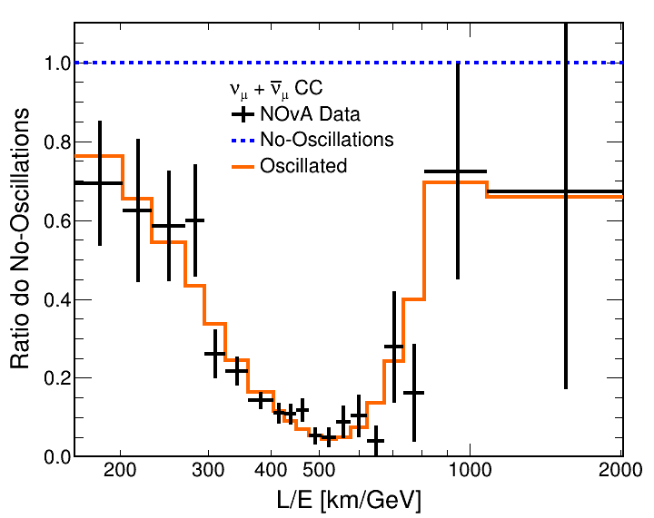
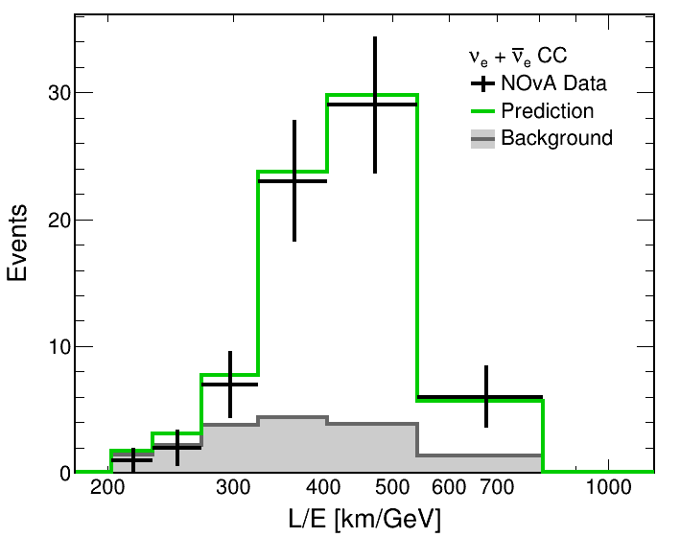
The Data: Accelerator Neutrinos
NOvA
T2K

Slide 8
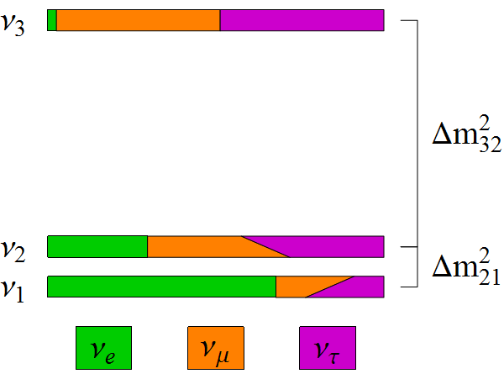
Neutrino Oscillations
There are 3 neutrinos, so things are a bit more complicated
Two independent differences in mass-squared (Δm²₂₁, Δm²₃₂)
3 mixing angles (θ₁₂, θ₁₃, θ₂₃) and 1 CPV phase δ_{CP}
|U_{e3}|² = sin²θ₁₃
sin²θ₂₃ ~ |U_{μ3}|²
|U_{e2}|² ~ sin²θ₁₂
cosδ_{CP}

Slide 9
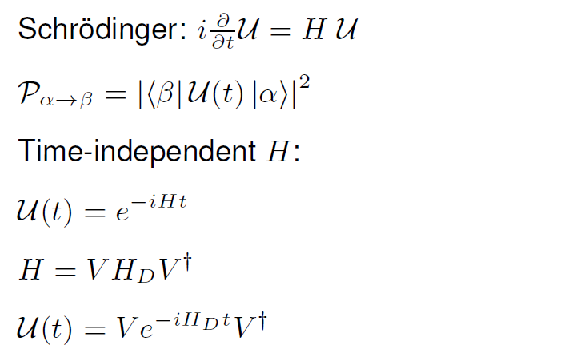

Quantum Evolution
Eigenvectors
Eigenvalues
Main problem
Easy to compute

Slide 10
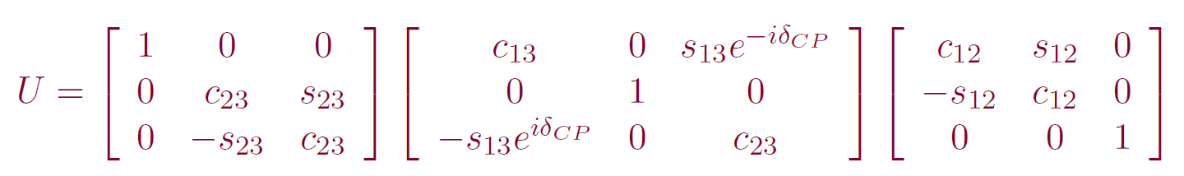
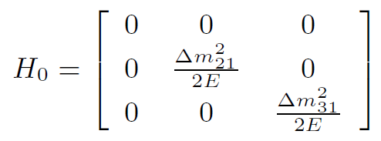

Neutrino Hamiltonian in Vacuum
PMNS Matrix = Vacuum Eigenvectors
Mass basis
Flavour basis
Easy to solve
Already know diagonalisation
(Eigenvectors and Eigenvalues)

Slide 11
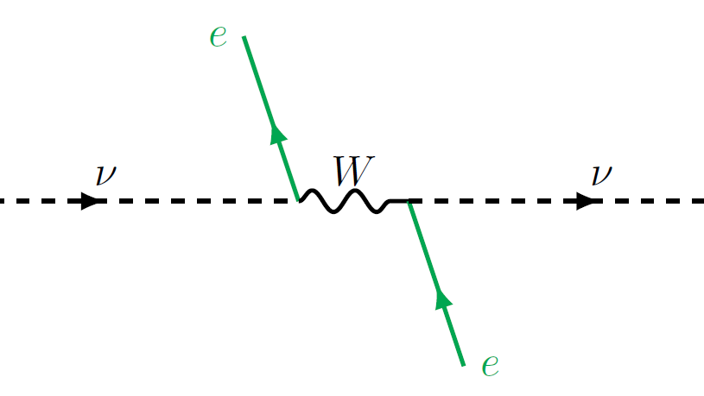
Neutrinos in Matter

Slide 12
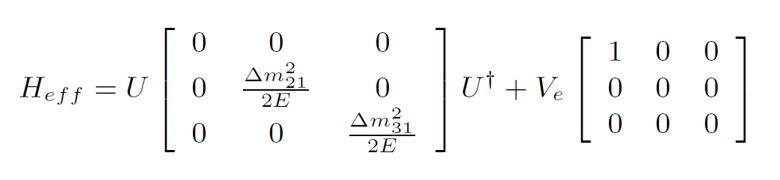

Matter Effects
H₀
V
Effective Mixing
Effective Masses

Slide 13
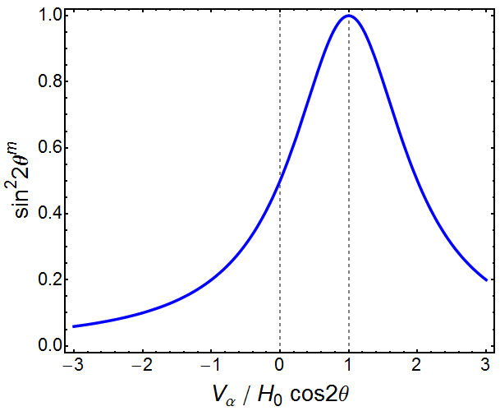
Resonance

Slide 14
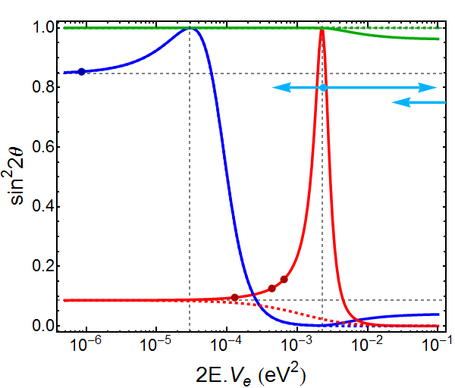
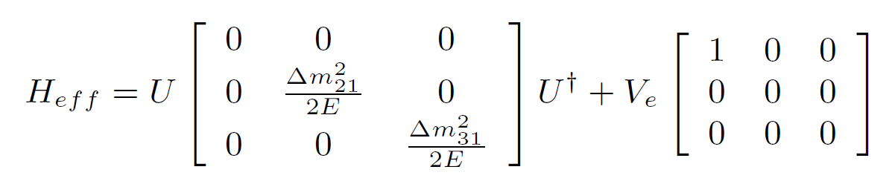
Resonances
θ₂₃
Δm²₂₁ cos2θ₁₂
Δm²₃₁ cos2θ₁₃
θ₁₂
θ₁₃

Slide 15
Resonances
θ₂₃
NH
θ₁₂
θ₁₃
IH

Slide 16
Resonances
θ₂₃
Atm. ν
JUNO
ν Telescopes
θ₁₂
DUNE
LBL
θ₁₃
NOvA
T2K

Slide 17
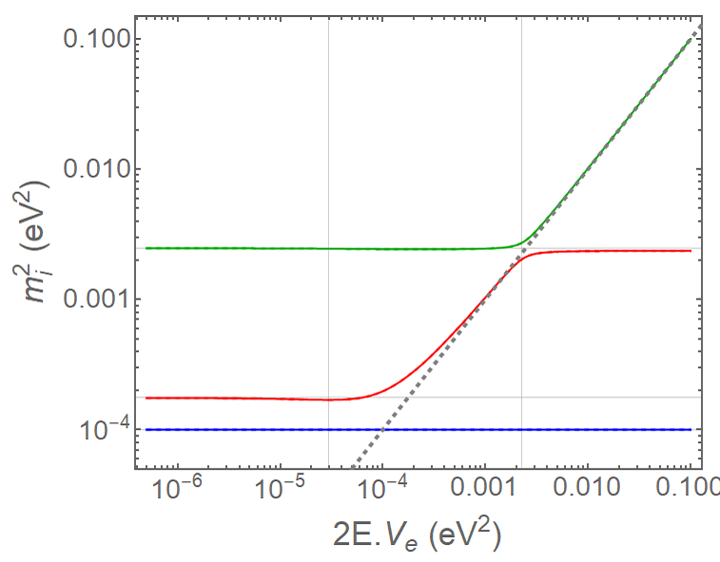
Resonances
m₃²
m₂²
V_{e}
m₁²

Slide 18
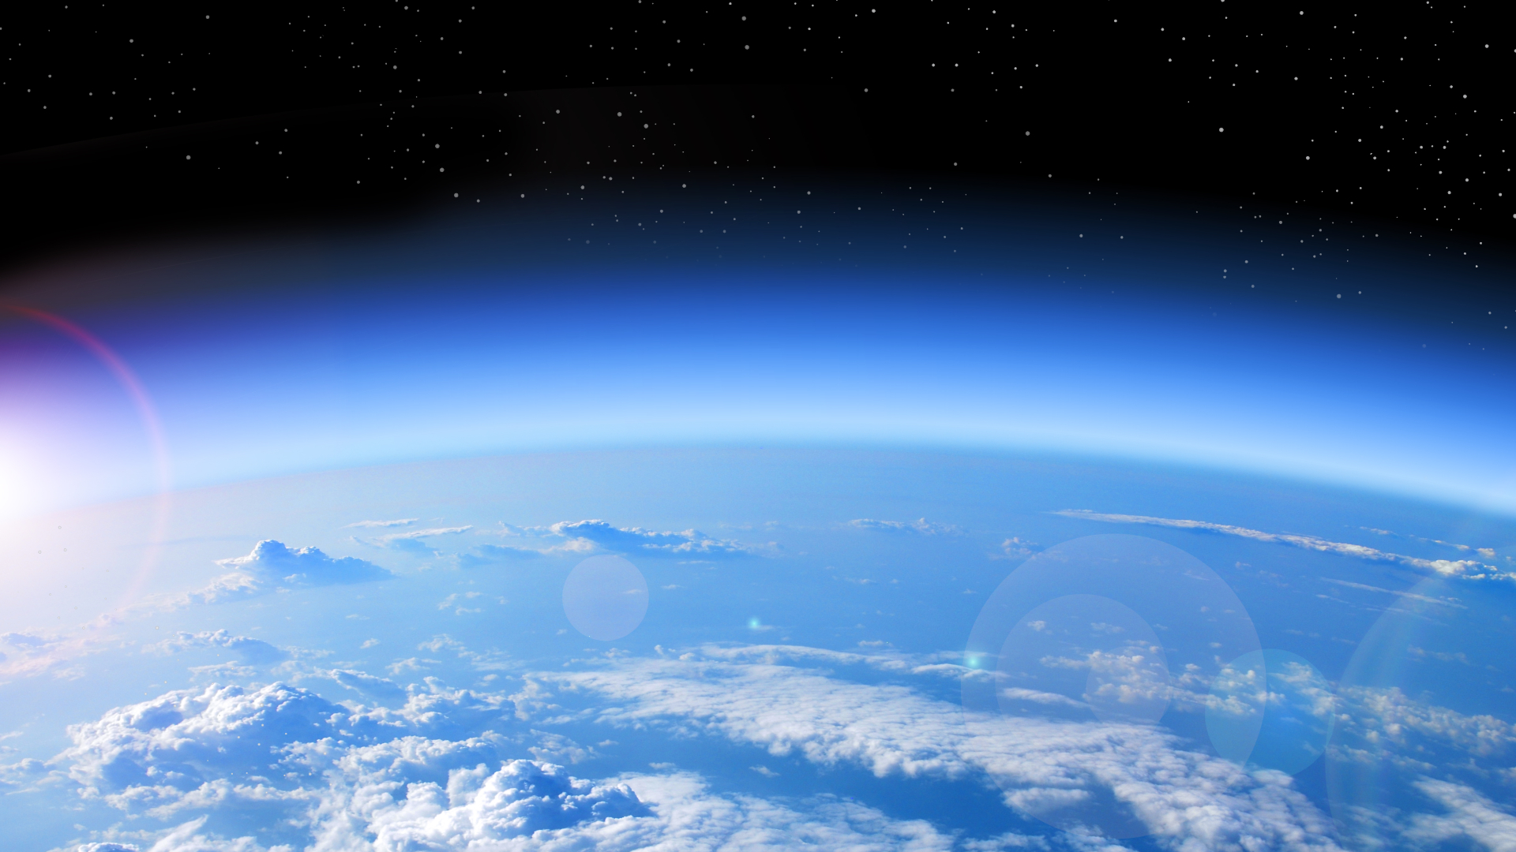
Atmospheric Neutrinos
Cosmic
Ray
π⁺
π⁻
μ⁻
μ⁺
e⁺
ν_{e}
e⁻
ν_{μ}
ν̅_{e}
ν̅_{μ}
ν̅_{μ}
ν_{μ}

Slide 19
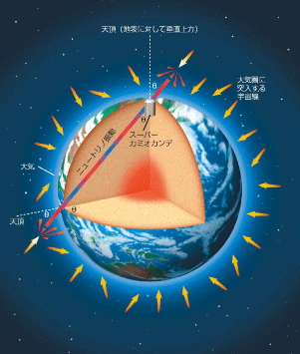
Atmospheric Neutrinos

Slide 20
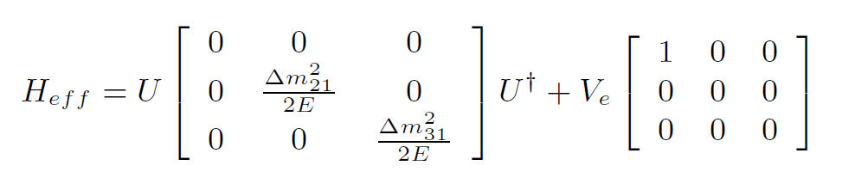
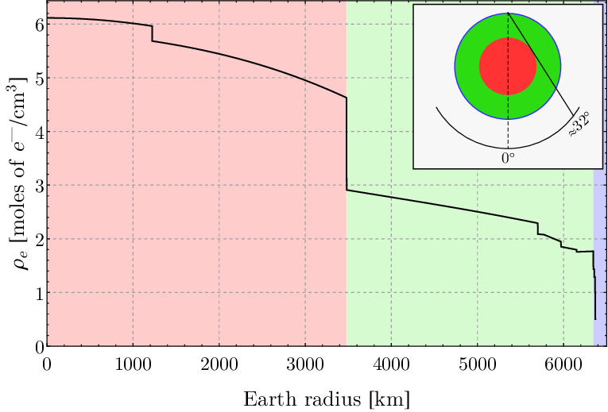
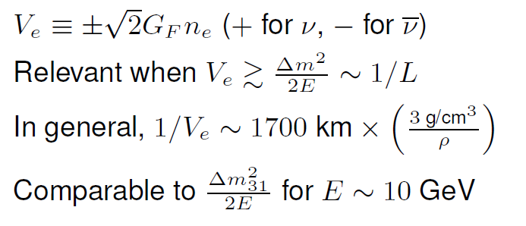
Neutrino Hamiltonian in Matter
Time Dependent

Slide 21
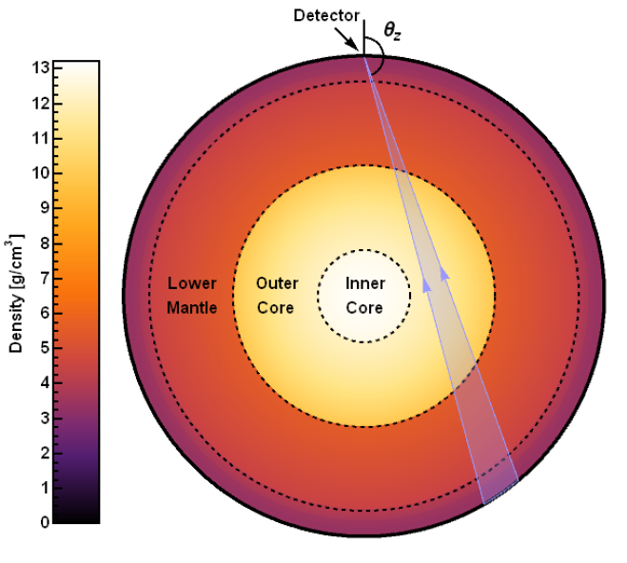
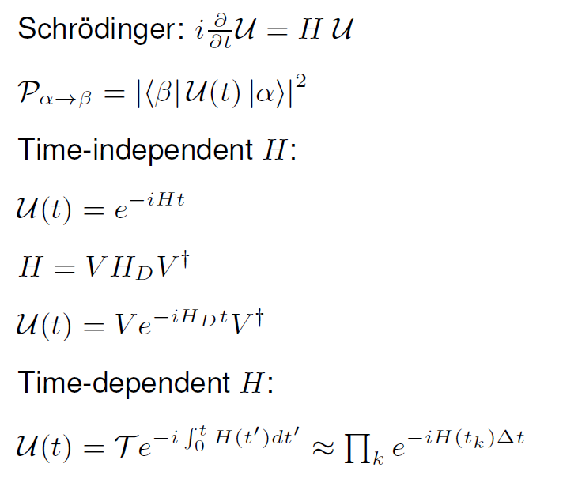
Quantum Evolution
Trace neutrino path through the Earth
Break path into N segments of similar electron density
Compute evolution through each segment with constant density assumption

Slide 22
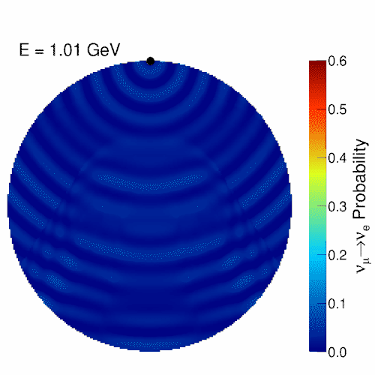
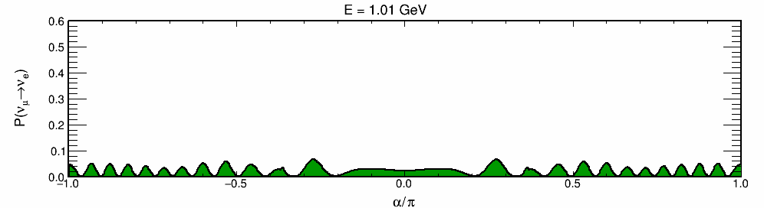
Atmospheric Neutrinos
Oscillations are resonant at certain energies
E_{res} ~ 7 GeV in Mantle
E_{res} ~ 3 GeV in Core
Nue appearance at the surface

Slide 23
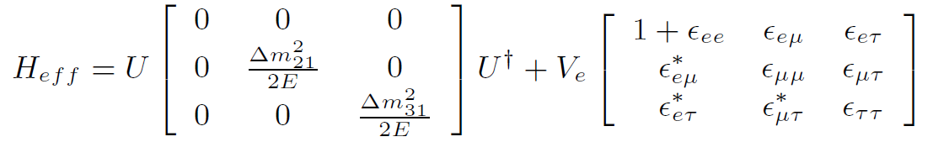
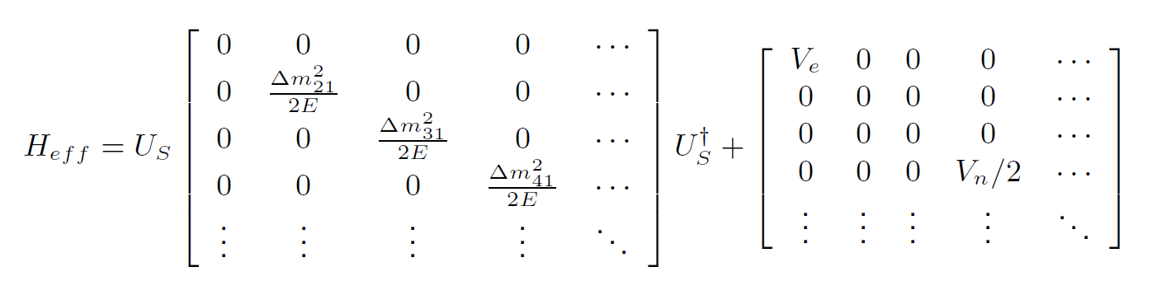
Extended Models
Non-Standard Interactions (NSI)
Sterile Neutrinos (3+N Flavours)

Slide 24
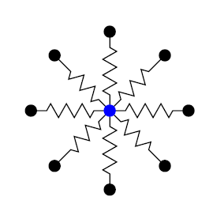
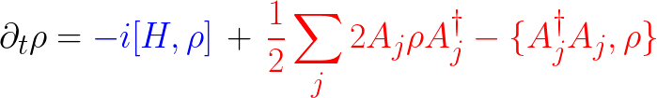
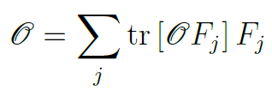
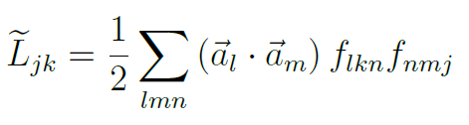

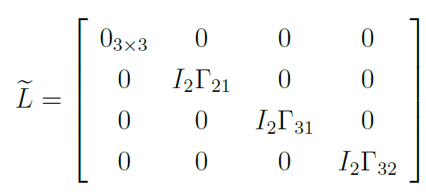
Extended Models
HELP Needed
Decoherence
Unitary
Non-Unitary
Operators as sum SU(3) of generators
In general* 36 parameters!
Diagonal w/ energy conserv.
System of 9 coupled equations

Slide 25
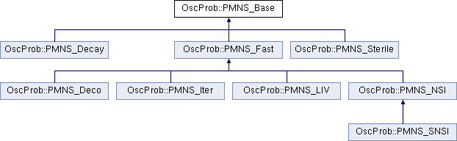
OscProb Package
Diagonalises Hamiltonian to obtain exact probabilities
Three step process:
  Build Hamiltonian from parameters
  Solve Hamiltonian
    Fast algorithm from GLoBES for 3 neutrinos*
  Propagate neutrino state
Repeat for each step of constant matter in neutrino path
PremModel class has built-in Earth layers model
https://github.com/joaoabcoelho/OscProb
† Up-going (42+2 layers)
*J. Kopp, Int. J. Mod. Phys. C, 19, 523 (2008)

Slide 26
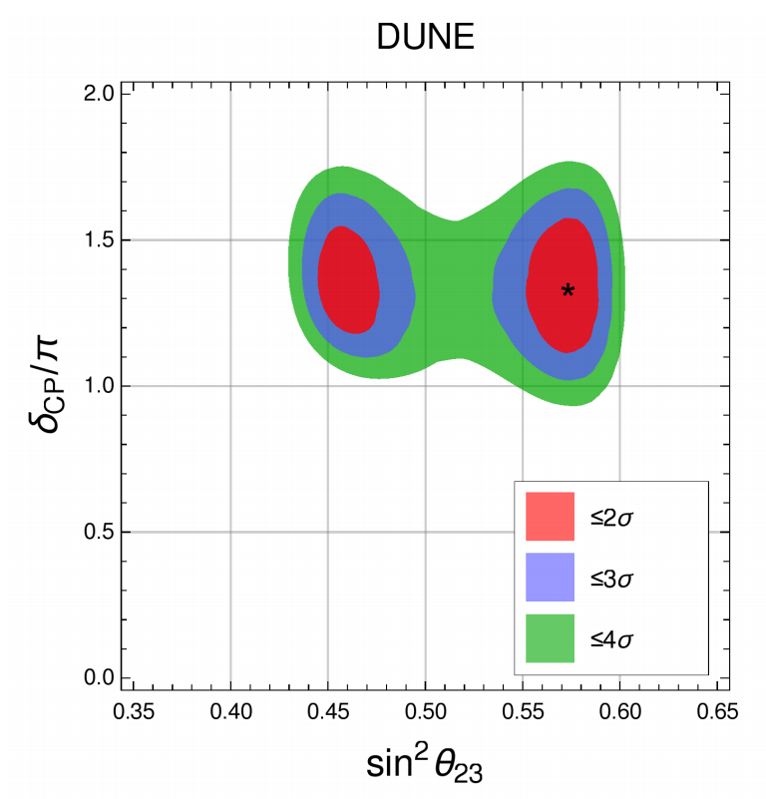
Why Performance Matters
Computing oscillation probabilities is a big part of CPU time
Total computations: F_{p} × F_{d} × CP × E_{b} × Θ_{b} × L × C × Pn × M
  Fp: Initial flavours produced (2)
  Fd: Flavours detected (3+NC)
  CP: Nu and nubar (2)
  E_{b}: Energy bins (~100)
  Θ_{b}: Direction bins (~100)
  L: Earth layers to cross (~40)
  C: Δχ² surface points (e.g. contour: ~50x50)
  P_{n}: Nuisance parameters (e.g. syst.: ~20)
  M: Minimisation steps (~100)
Typically ~10¹³ computations to obtain a full likelihood surface
At 1µs / comp.: ~1 CPU-year
M typically grows with P_{n}
Feldman-Cousins corrections would require ~10k contours

Slide 27
Main Optimisations
Use a fast algorithm for solving eigensystem
  J. Kopp, Int. J. Mod. Phys. C, 19, 523 (2008)
  Uses analytical solutions for 3x3 matrix
  Developed for GLoBES
Some BSM models need different methods: Eigen library
  PMNS_Sterile class solves NxN matrices
  PMNS_Decay class solves non-Hermitian matrices
Reduce number of operations when computing Hamiltonian
  Take into account known form of PMNS matrix
Caching of eigensystem for reusing known solutions

Slide 28
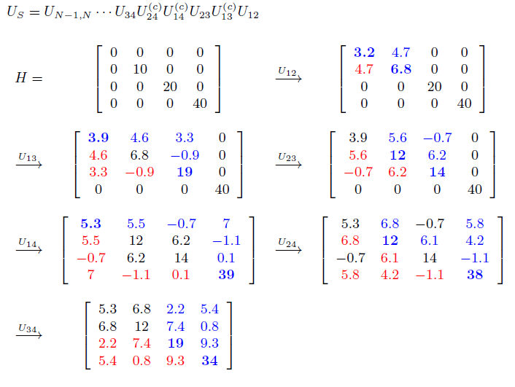
Hamiltonian Optimisation
# of Operations
 | Opt. | Std.
2x2 | 3 | 8
3x3 | 13 | 54
4x4 | 34 | 192
5x5 | 70 | 500
6x6 | 125 | 1080
Each rotation only affects some columns and rows
Hermitian, so only upper triangle
Total of O(n³) operations
Std. matrix mult. → O(n⁴)

Slide 29
Extra Considerations
Caching of eigensystem solutions
  Often we have to solve the same eigensystem multiple times
  E.g.: Neutrinos cross same Earth layer from different angles
  OscProb can save these to avoid repeated computations
  Balance between hashing overhead and eigensystem
Earth models can be too detailed for our needs
  Default is 44 layers of constant density
  Can easily go down to 15 layers
  Even better, OscProb can dynamically merge similar layers
Parallelise oscillation propagations
  Usually we need to compute 2x3 transitions (ν_{e,μ} -> ν_{e,μ,τ})
  OscProb can compute all of these in parallel
  Avoids some extra propagation costs

Slide 30


Iterative Approximation
Zassenhaus Formula
If t is small, we can ignore higher order terms
Everything is already diagonal. No need for solving eigensystems
…

Slide 31
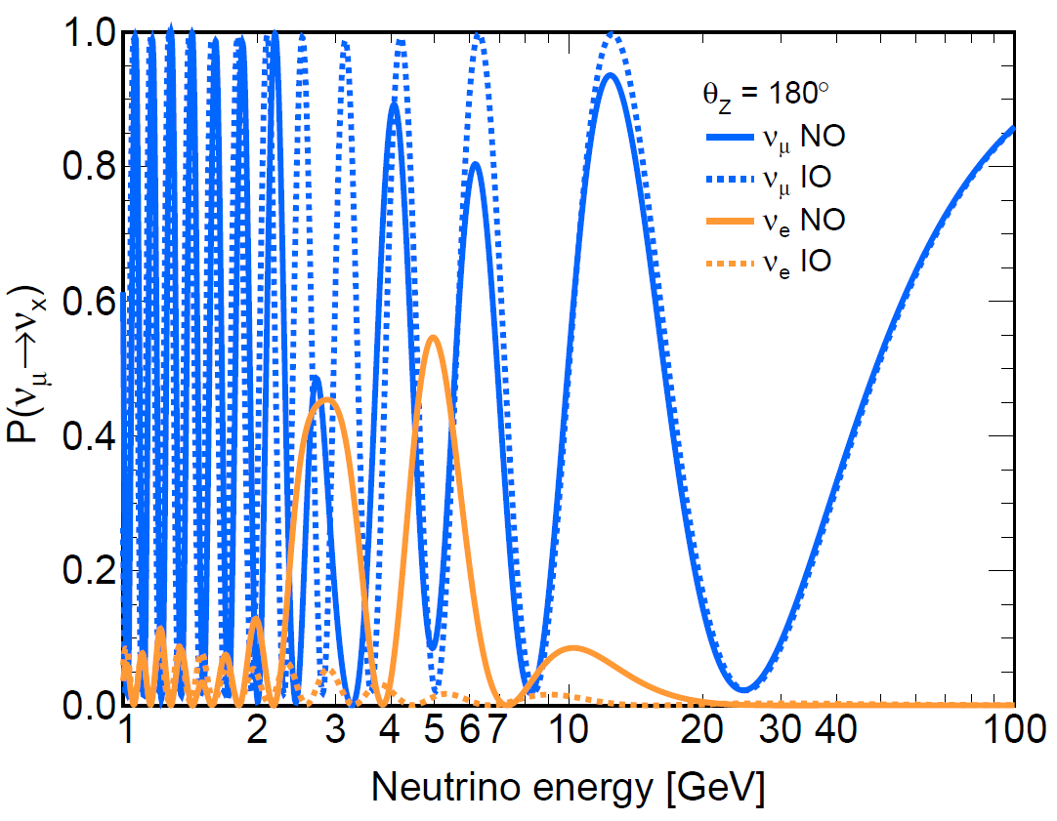
Interpolation?
HELP Needed
θ₂₃
NH
θ₁₂
θ₁₃
IH
Interpolating oscillation probabilities can be difficult due to fast oscillations at some energies
One idea would be to instead interpolate the eigensystem solutions
Equivalent to interpolating the effective mixing parameters

Slide 32
Oscillation Averaging
Another problem with fast oscillations is computing the average oscillation over a bin
Simply taking the bin center value is equivalent to a linear approximation of the function

Slide 33
Oscillation Averaging
Another problem with fast oscillations is computing the average oscillation over a bin
Simply taking the bin center value is equivalent to a linear approximation of the function

Slide 34
Oscillation Averaging
Another problem with fast oscillations is computing the average oscillation over a bin
Will fail if function is not approximately linear
Gaussian quadrature improves this to 3rd order polynomial

Slide 35
Oscillation Averaging
Another problem with fast oscillations is computing the average oscillation over a bin
But also fails for oscillating functions
Can be extended by moving from polynomial to trig functions

Slide 36
Oscillation Averaging
Another problem with fast oscillations is computing the average oscillation over a bin
Works even at high frequencies, but requires known freqs
Also, only valid for single frequency

Slide 37
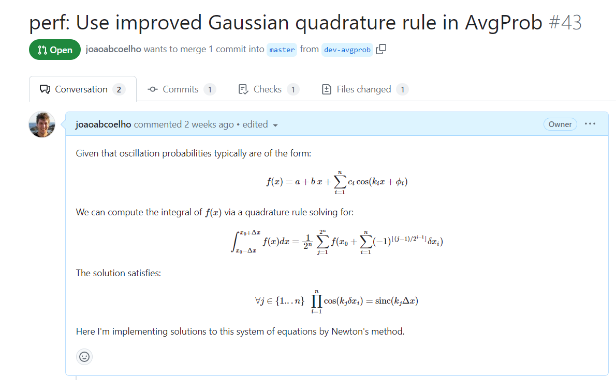
Oscillation Averaging
HELP Needed
Solution can be generalized for multiple frequencies
However, no analytical solution and hard to solve numerically
Current implementation approximates by assuming frequencies are hierarchical and can be solved independently
Numerical solution improves on this, but doesn’t work reliably

Slide 38
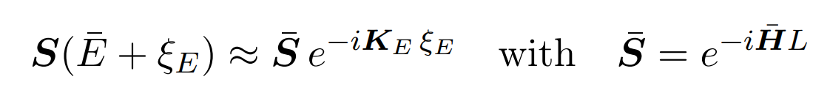
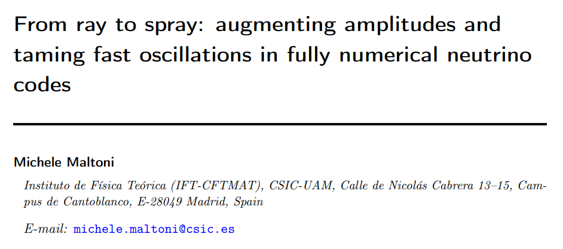
Alternative Approach
HELP Needed
Use perturbation theory to approximate evolution:
Based on very interesting new paper:
  https://arxiv.org/abs/2308.00037
MaCh3 does something similar adapted from SK

Slide 39
AvgProb Precision
HELP Needed
Whatever the solution, we need to be able to estimate the approximation error
Current estimates are too conservative
Default precision set to 0.01% but samples too many points
At analysis level, one needs to optimize the balance between precision and speed in these calculations

Slide 40
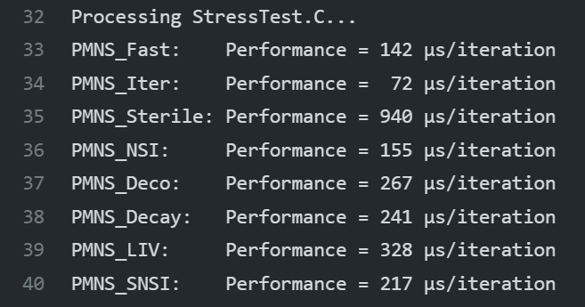
Benchmarking
HELP Needed
Compute 100x20 oscillograms for ν_{μ} -> ν_{e}
Using AvgProb to remove fast oscillations
Would be great to have some comparisons with other tools

Slide 41
Conclusion
HELP Needed
Oscillation calculations are the core of many analyses
Computations are fast, but need to be done trillions of times
OscProb is an open source option for computing oscillations
Goal is to be fast and cover many BSM models
If you have ideas or would like to help with current issues, you are very welcome to contribute to the project in Github
Integrating OscProb into DUNE tools like MaCh3 would also be very much appreciated
Joao Coelho, Rebekah Pestes, Alba Domi, Simon Bourret, Ushakrhmn, lmaderer, & vicacuen. (2023). joaoabcoelho/OscProb: v2.0.12 (v2.0.12). Zenodo. https://doi.org/10.5281/zenodo.10104847

Slide 42
Backup

Slide 43
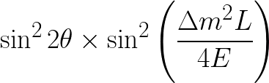
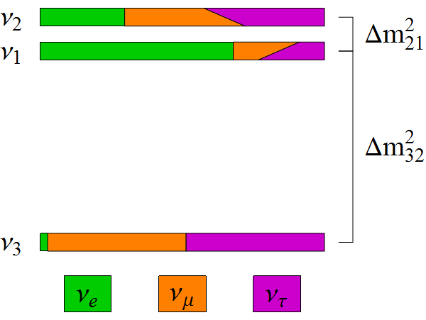
Missing Pieces
symmetries
Is θ₂₃ = π/4? Underlying symmetry?
Do neutrinos violate CP? (δ_{CP})
What is the mass ordering? (Mass Hierarchy)
Normal Hierarchy
Inverted Hierarchy
same?
Δm²₃₂ < 0 ?
(Δm²₃₁ < Δm²₃₂ ??)
JUNO
δ_{CP} ?

Slide 44
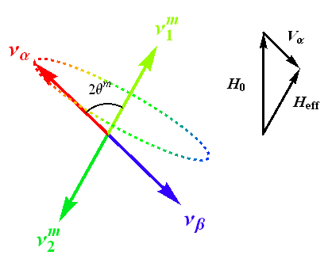
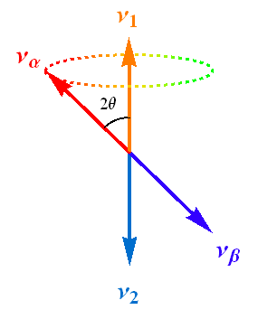
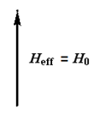
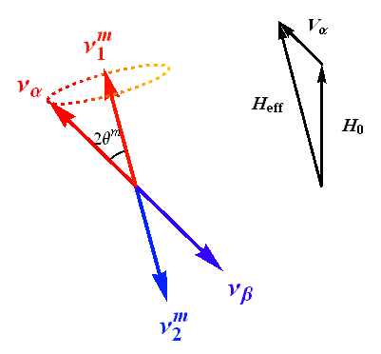
Matter Effects
H_{eff} = H₀ + V_{α}
H_{eff} = H₀ - V_{α}

