Slide 1
Three years of experience in radiotherapy on a Halcyon 2.0 linear accelerator at the Muk and Maseb radiotherapy center in Kinshasa (Democratic Republic of Congo)
Dr. Mahomed YESSOUFOU, Dr Arnold SULU

Slide 2
Presentation plan
Introduction
Patients et methods
Results
Comments
conclusion

Slide 3
Introduction
cancer is a real public health issue in world:
Reached millions of people every year
Responsible for the death of millions of people
Affects millions of people (burden)
What numbers do we have?

Slide 4
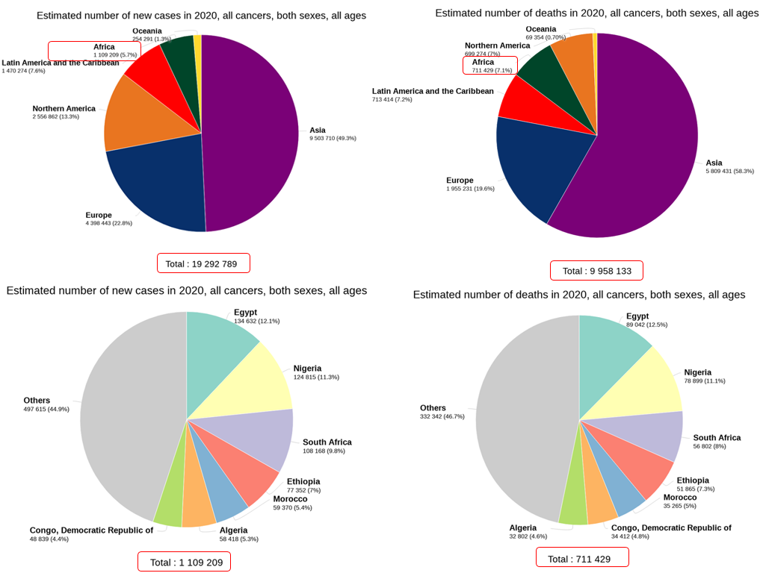

Slide 5
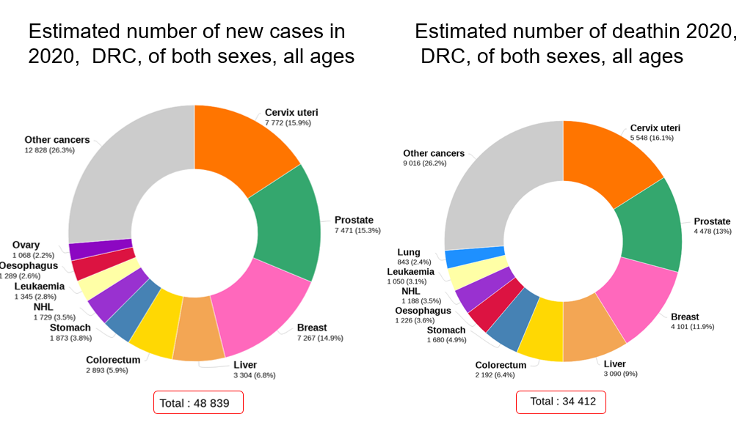
Cancers of the cervix are the most frequent and the most deadly, followed by those of the prostate and the breast; radiotherapy plays a major role in the treatment of these cancers.
Notes:
Les cancers du col utérin sont les plus fréquents et les plus mortels suivis de ceux de la prostate et du sein; la radiothérapie a une place majeur dans le traitement de ces cancers,

Slide 6
Introduction: reminders
Cancer treatment:
surgery
Systemic treatment
Cancer chemotherapy
Targeted therapy
Immunotherapy
Hormone therapy
Supportive care
Radiotherapy (EBRT, brachytherapy, metabolic radiotherapy)
Notes:
Ce sont les mêmes modalités de traitement que nous avons au centre hospitalier Nganda qui abrite le centre de radiothérapie Muk et Maseb

Slide 7
Introduction : Historic
-Muk & Maseb radiotherapy center is the leading of cancer treatment center in the DRC.
Since 2002, more than 2,000 cases of cancer have been treated.

Slide 8
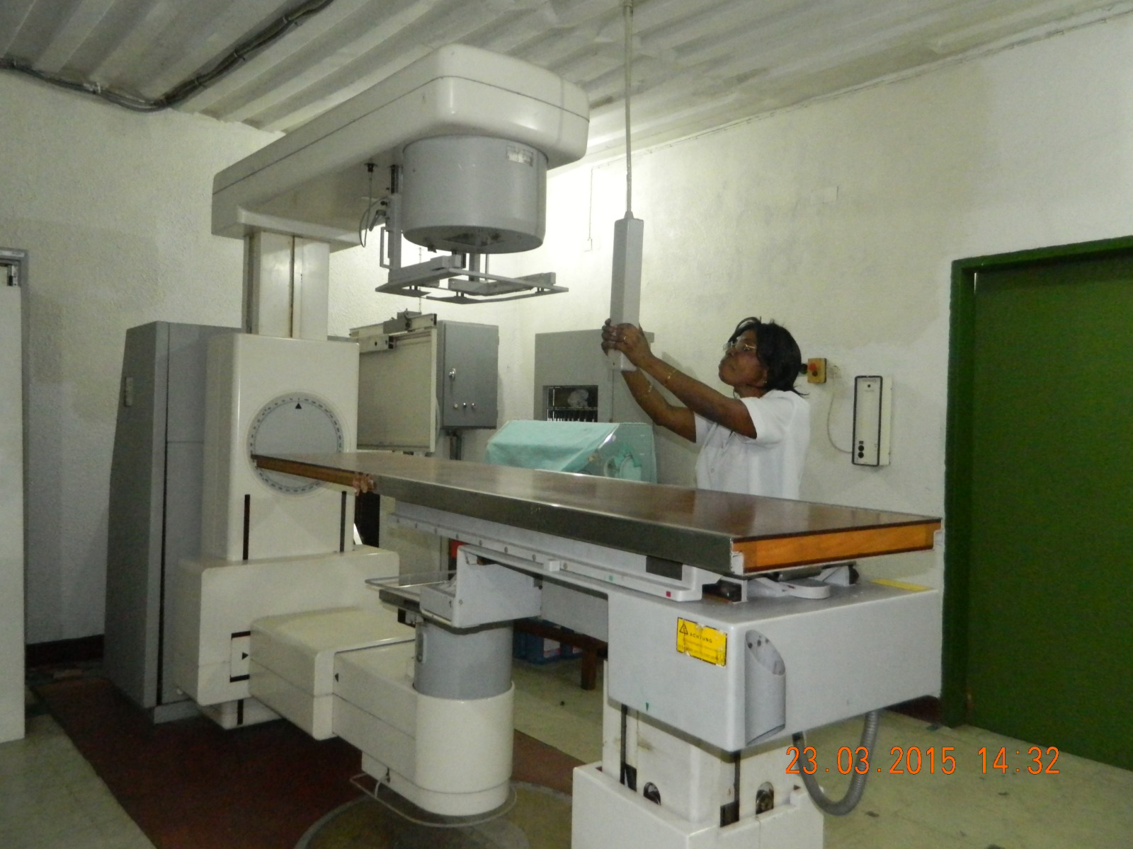
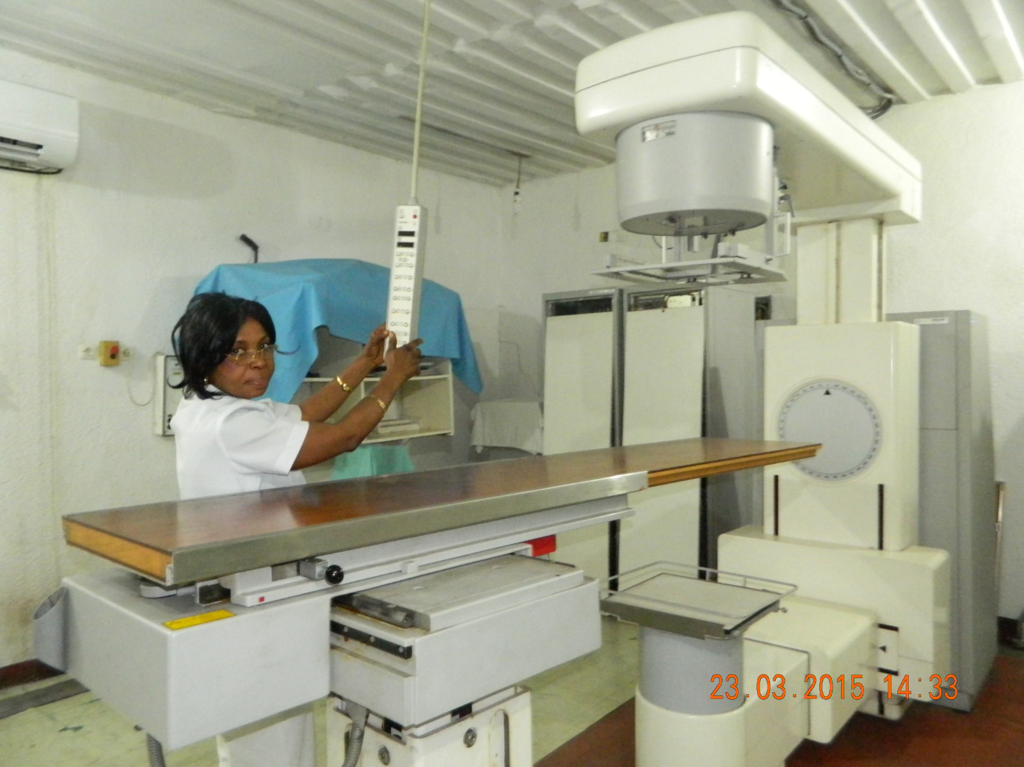
A

Slide 9
Introduction: problematic
On March 8, 2020, the Muk and Maseb radiotherapy center was inaugurated by the highest authority of DRC.
It is the first and only radiotherapy center:
in this vast (2,345,410 km2)
and populated country (105 044,646 inhabitants in 2021)
Three years after this inauguration, what assessment can we make of our practice?

Slide 10
The Muk et Maseb radiotherapy center Equipment
The center is equipped with a dedicated General Electric for simulations
It has a large bore(80 cm in diameter)
A flat table for positionning
It is equipped with built-in laser and mobile lasers and special software for virtual simulation.
Simulation Scanner

Slide 11
1: touch screen;
2: orders of shift;
3: tunnel
4: camera
5: detector of table collisions
6: emergency stop button
The Treatment Planning System (TPS) is the combination of software and hardware used to generate the geometry of the treatment beam and calculate the expected dose distribution in the patient's tissues.
Notes:
Treatment planning is a process in which the healthcare team defines the personalized characteristics of radiation therapy technique for a patient. Treatment planning involves many steps, including proper patient diagnosis and staging, image acquisition for treatment planning, locating volumes of interest, beam layout and optimization, and treatment simulation. The Treatment Planning System (TPS) is the combination of software and hardware used to generate the geometry of the treatment beam and calculate the expected dose distribution in the patient's tissues. Numerous software (dose calculation algorithms) and hardware configurations are possible, making the TPS a highly configurable device.

Slide 12
Goal of the study
To describe the clinical and pathological profile and therapeutic results obtained from patients admitted between febrary 27, 2020 to december 31, 2022

Slide 13
Patients et method
cohorte study with retrospective collection data
Period: february 27, 2020 to december 31, 2021;
Inclusion: all irradiated patients
Exclusion: irradiation not carried out after simulation
Analysed on SPSS 21.

Slide 14
Legal compliance
The construction of the bunker
Importation and installation of machines: CNPRI authorization (radiation protection authority)
Operation of machines: CNPRI authorization
Staff trained (handlanding) and accredited by CNPRI
2 Radiotherapists
2 Medical physicists
3 Radiotherapy technicians
1 medical secretary
2 Nurses

Slide 16
Techniques available at the Muk and Maseb center
Three-dimensional conformal radiotherapy with intensity modulation (IMRT)
good tolerance
but with potential digestive, urinary and hematological toxicity.
Good coverage of the target volume sparing the OARs (abdominal cavity, bladder and bone marrow)
VMAT: volumetric modulated arc therapy
dose distributions similar to IMRT;
Decrease in treatment delivery time < 5 min

Slide 17
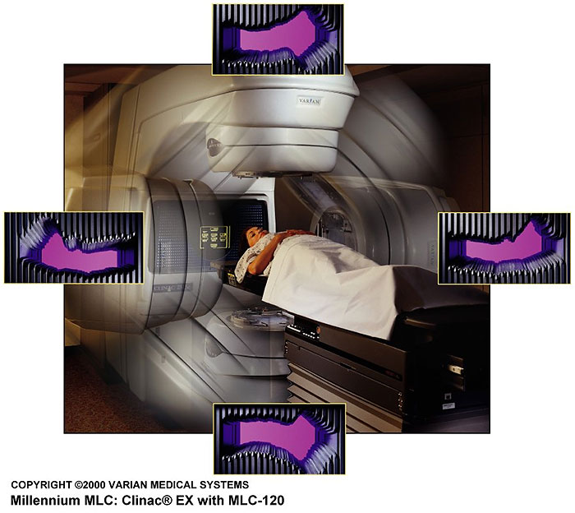
Volumetric intensity modulated arctherapy ( VMAT)
continuous dose delivery over a full 360° arc
Arc= 177 control points
Checkpoint :
Variable speed rotation
dynamic movement of the MLC at variable speed
Variable dose rate

Slide 18
Radiotherapy steps for all patients
Treatment consultation
Simulation on dedicated scanner
Contouring target volumes and OAR
Dosimetric planning: VMAT, IMRT (palliative case)
Curative dose-fractionation: according to histological types and organs; 2G/fraction, 5 fraction per week
Palliative dose fractionation: 30 Gy, 20 Gy, 8 Gy
Validation of the plan
Daily treatment with CBCT every day
Treatment monitoring

Slide 19
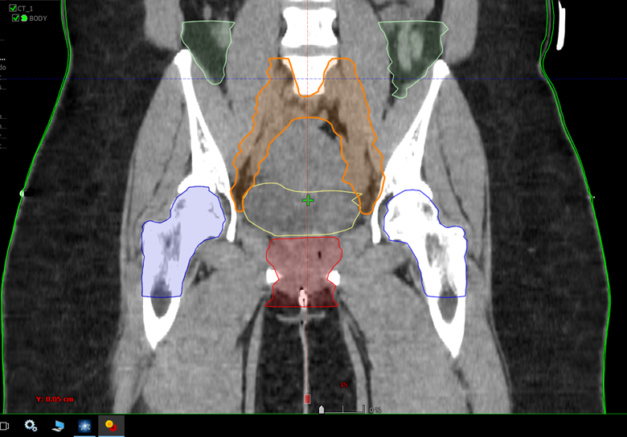
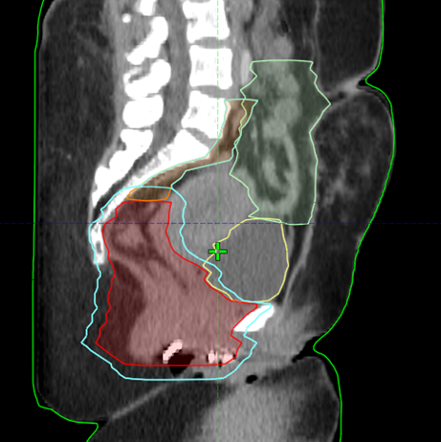
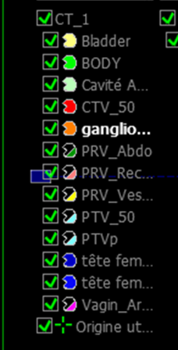
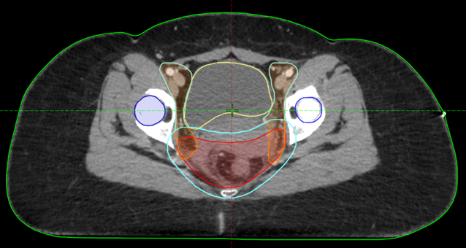
Contouring target volumes and OAR/Rectum
CTV-T=rectum
CTV-N=pelvic LN
PTV=CTV+margin
Bowell bag:
bladder:
Femorals head and neck

Slide 20
Dosimetric-treatment planification
PTV
bladder
femoral head and neck
bowel bag
Notes:
95% of the PTV must receive at least 95% of the prescribed dose; strict compliance with constraints on the bladder, intestine and femoral heads

Slide 21
Results

Slide 22
General Features
During three years of treatment,
Number: 289 patients were irradiated
women 75% of patients
Average age 55 years with extremes of 80 and 3 years
Country of residence: DRC (90%) and Congo (10%)

Slide 23
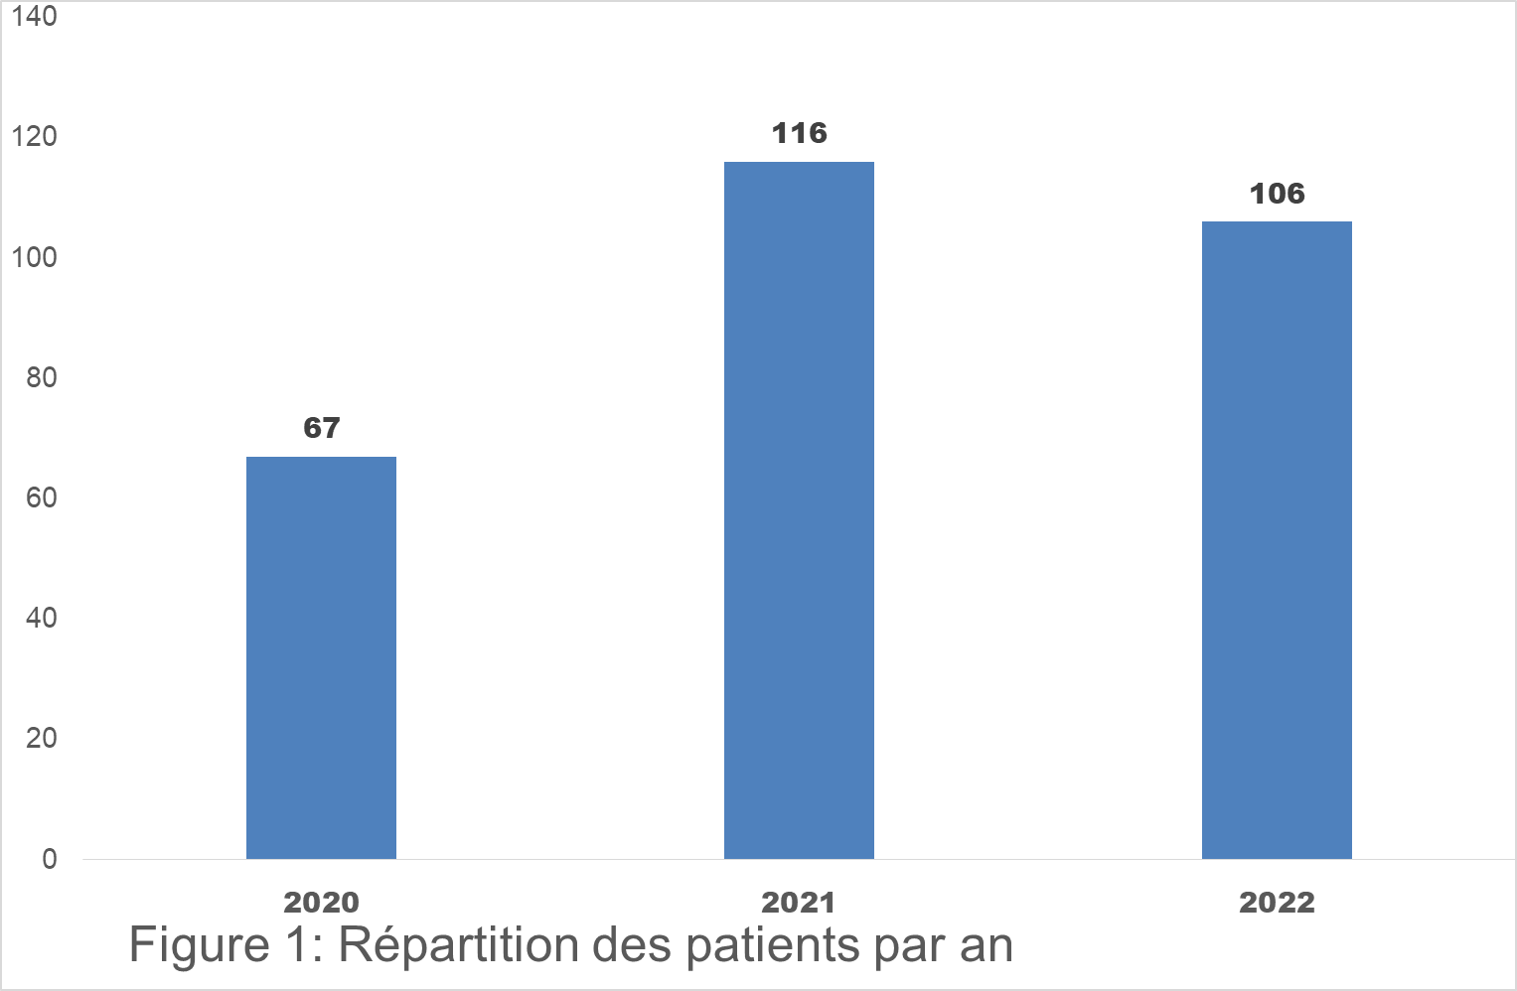
Figure 2: distribution of patients per year

Slide 24
Table I: distribution of patients by year and by site
Site | 2020 | 2021 | 2022 | Total
Breast | 16 | 33 | 28 | 77
Cervix | 23 | 29 | 21 | 73
Prostate | 5 | 16 | 10 | 31
Rectum | 7 | 4 | 5 | 16
Head and neck | 0 | 12 | 7 | 19
CNS | 0 | 2 | 1 | 3
Anus | 1 | 3 | 2 | 6
Sarcoma | 1 | 2 | 3 | 6
Orbital | 2 | 3 | 2 | 7
Palliative | 11 | 8 | 14 | 33
Lungs | 0 | 2 | 0 | 2
Autres | 1 | 2 | 13 | 16
Total | 67 | 116 | 106 | 289

Slide 26
Table II: distribution of patients according to condition at the date of last news (DLN)
CONDITION DLN | Number | Frequency (%)
Survival without disease | 240 | 83
survival with progressive disease | 6 | 2
Survival with stable disease | 10 | 3
Patients death | 33 | 11

Slide 27
Les effets secondaires rapportés étaient minimes sous formes de radiodermites ou radiomucites grade I
Image 1: Photo d’un enfant de sexe féminin, montrant une volumineuse masse intraoculaire et extra orbitaire avant le traitement (1A) puis une cavité orbitaire vide avec radiodermite grade 1 (1B) sur les paupières et enfant une cavité orbitaire avec cicatrisation complète
A Dao, et al, arthérapie volumique avec modulation d’intensité d’un cas de rétinoblastome au centre de radiothérapie Muk et Maseb à Kinshasae, Jaccr Africa 2023; 7(2): 116-121

Slide 28
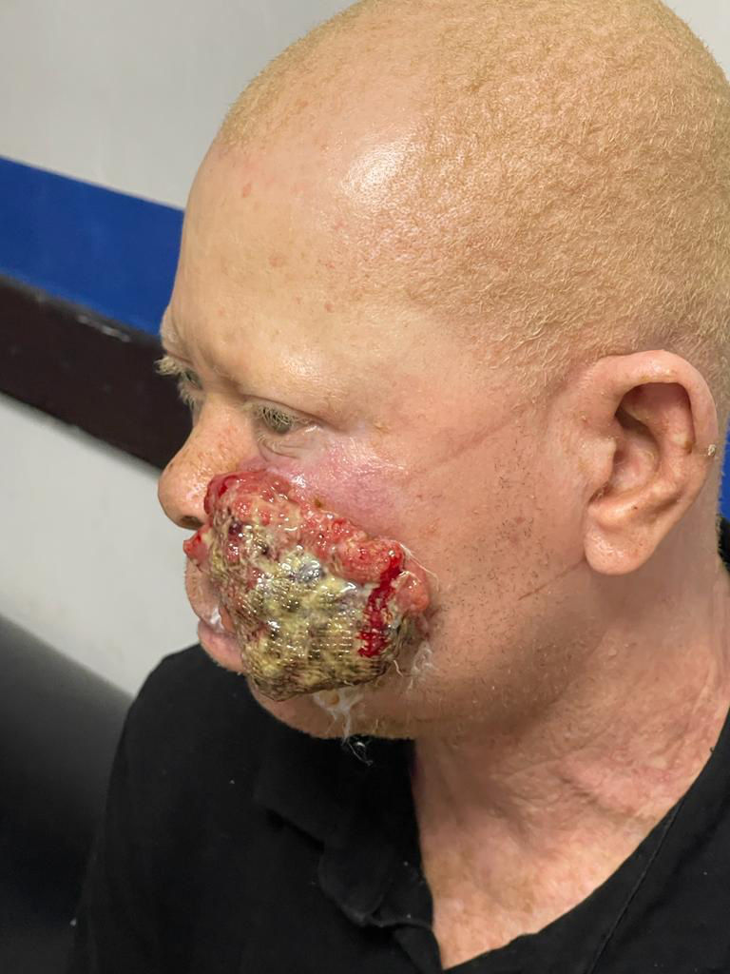
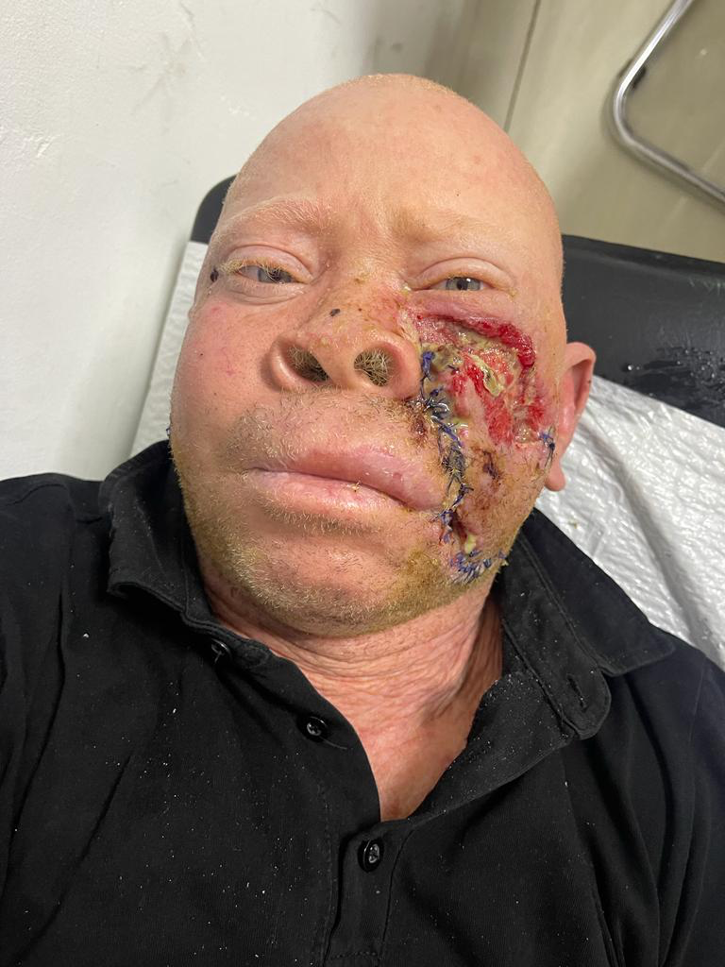
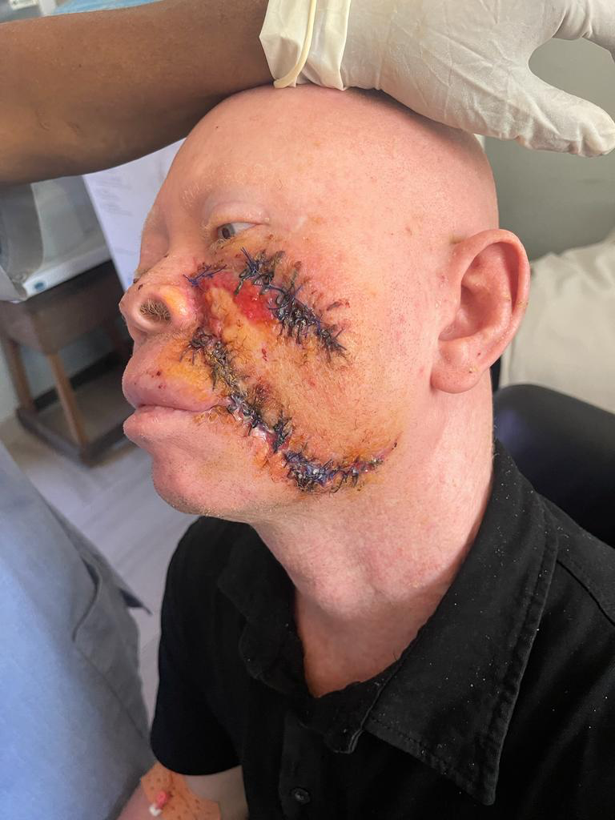
Image d’un CE avant la Radiothérapie

Slide 29
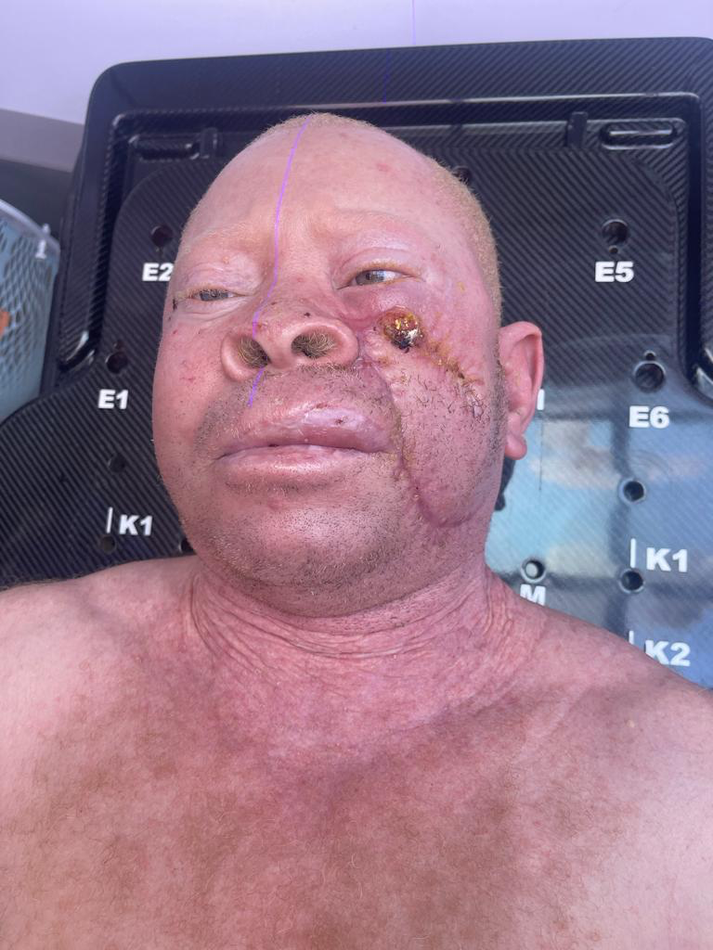
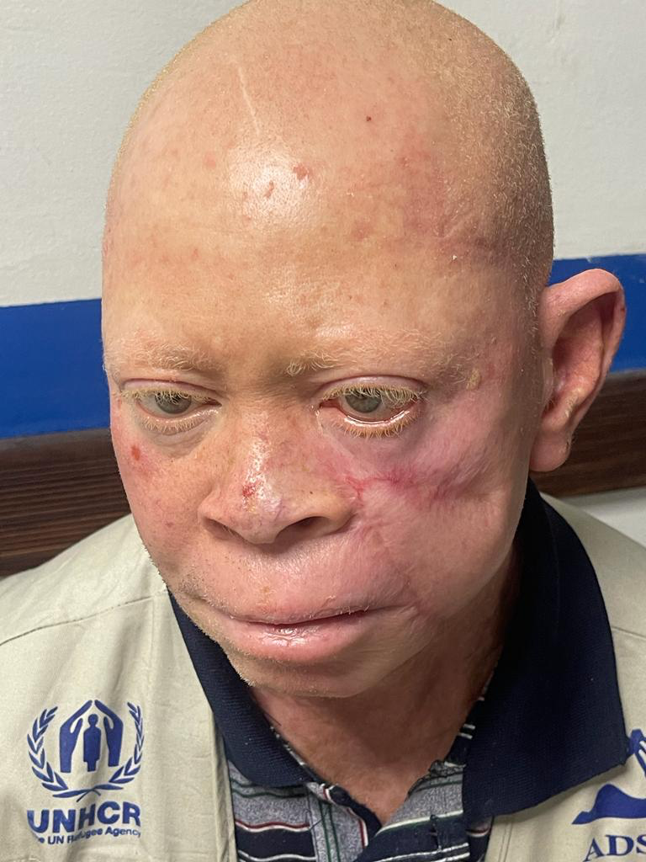
Image d’un CE en cours de RTE au CHNGANDA
Image d’un CE 6 MOIS après la fin de RTE au CHNGANDA

Slide 30
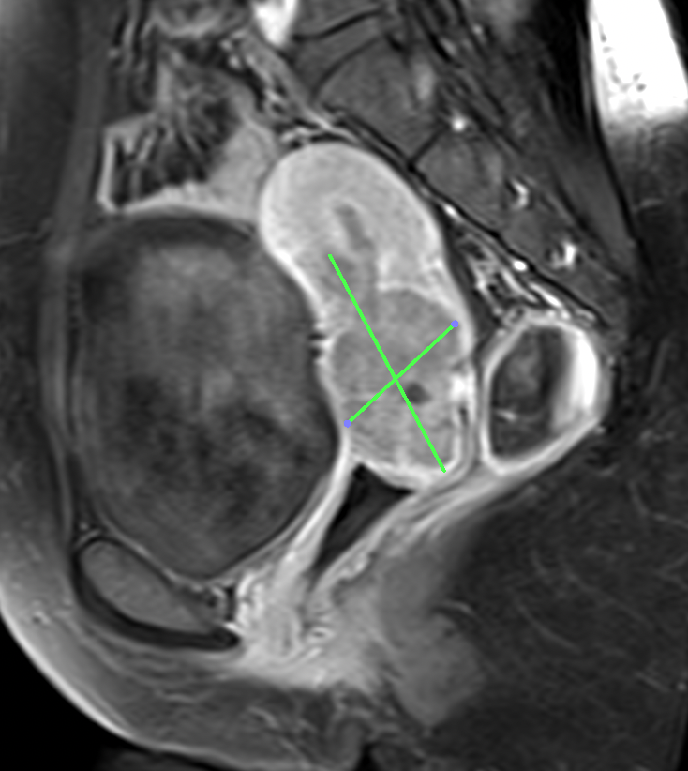
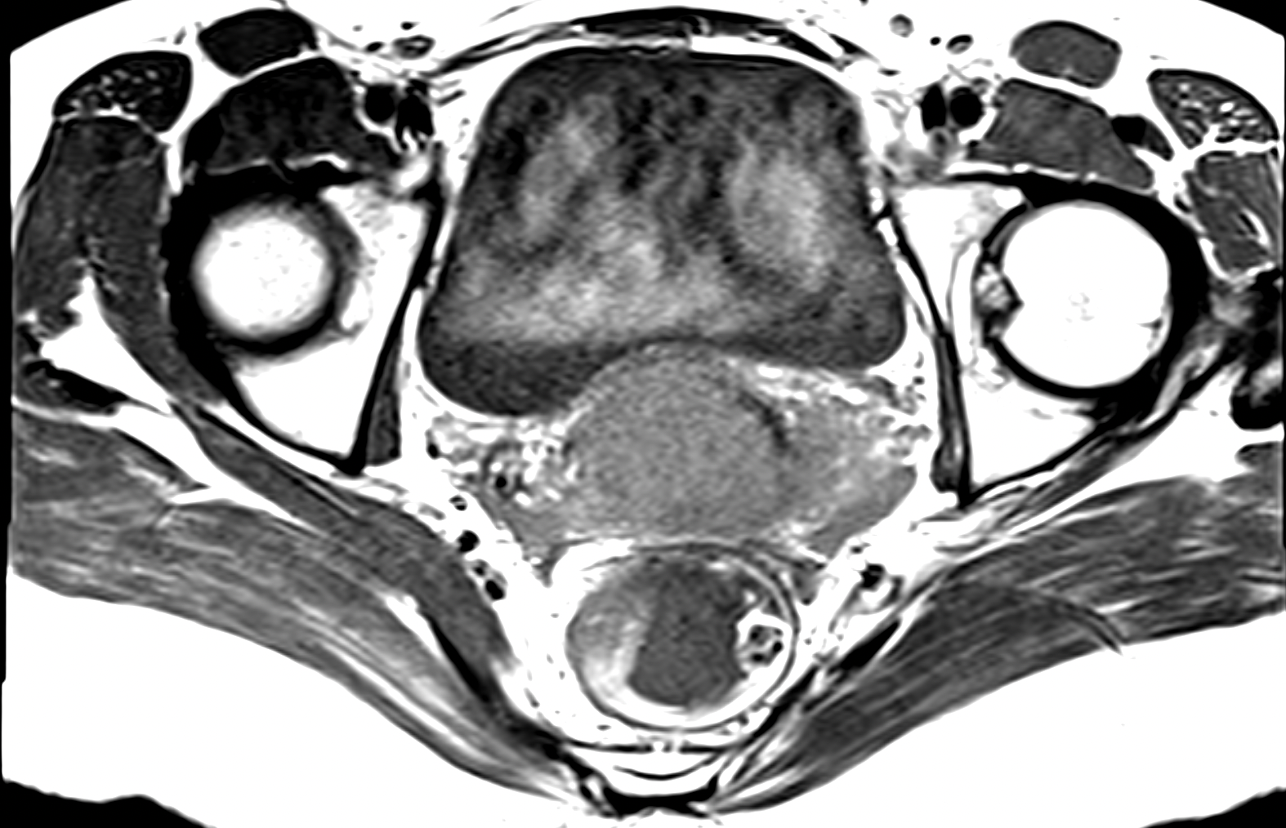
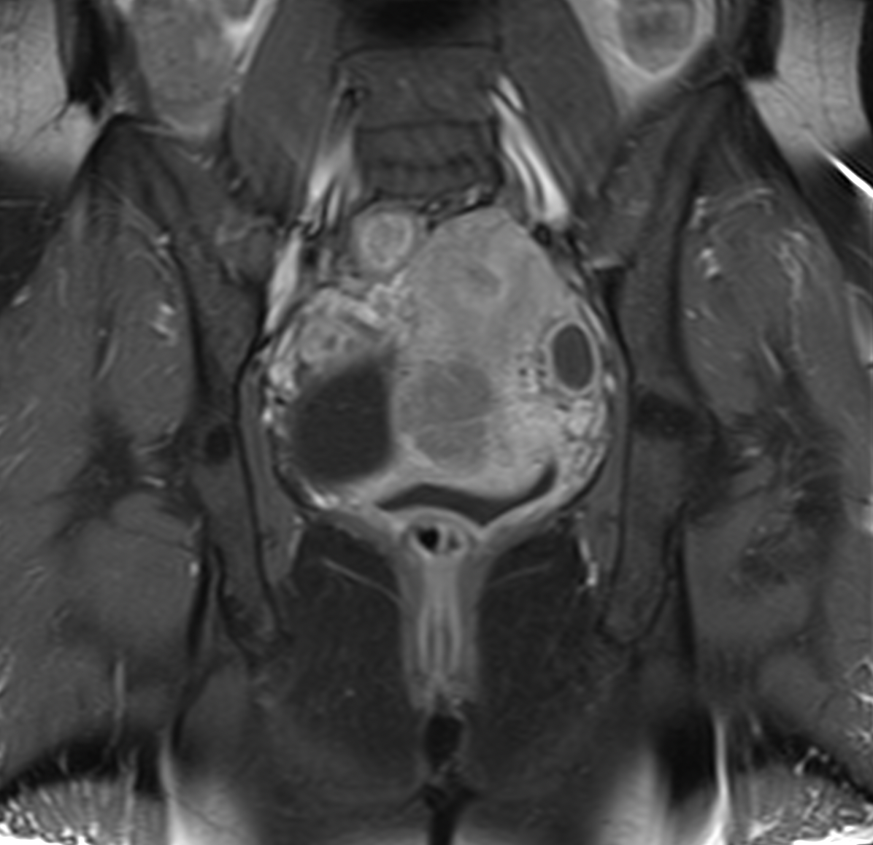
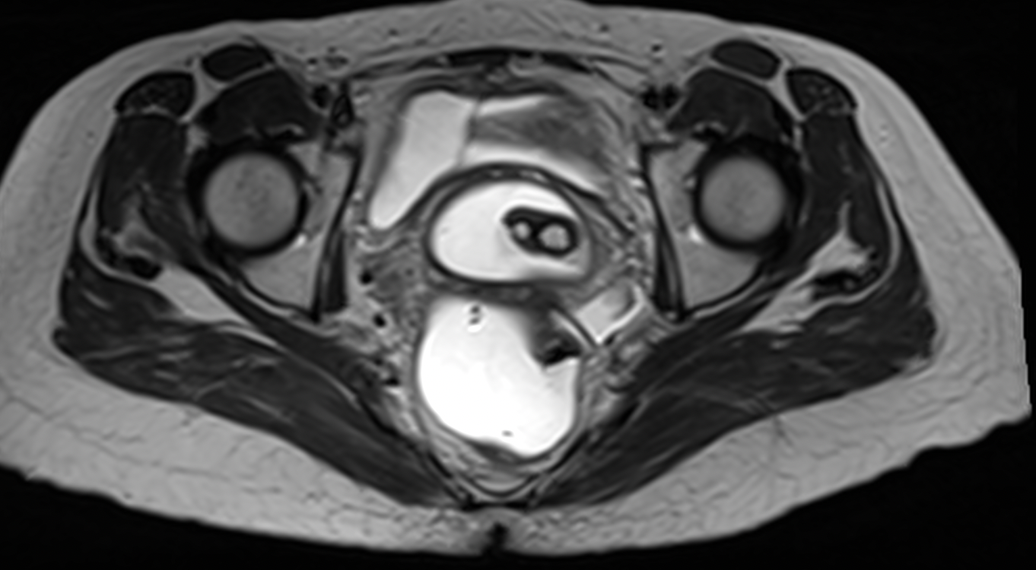
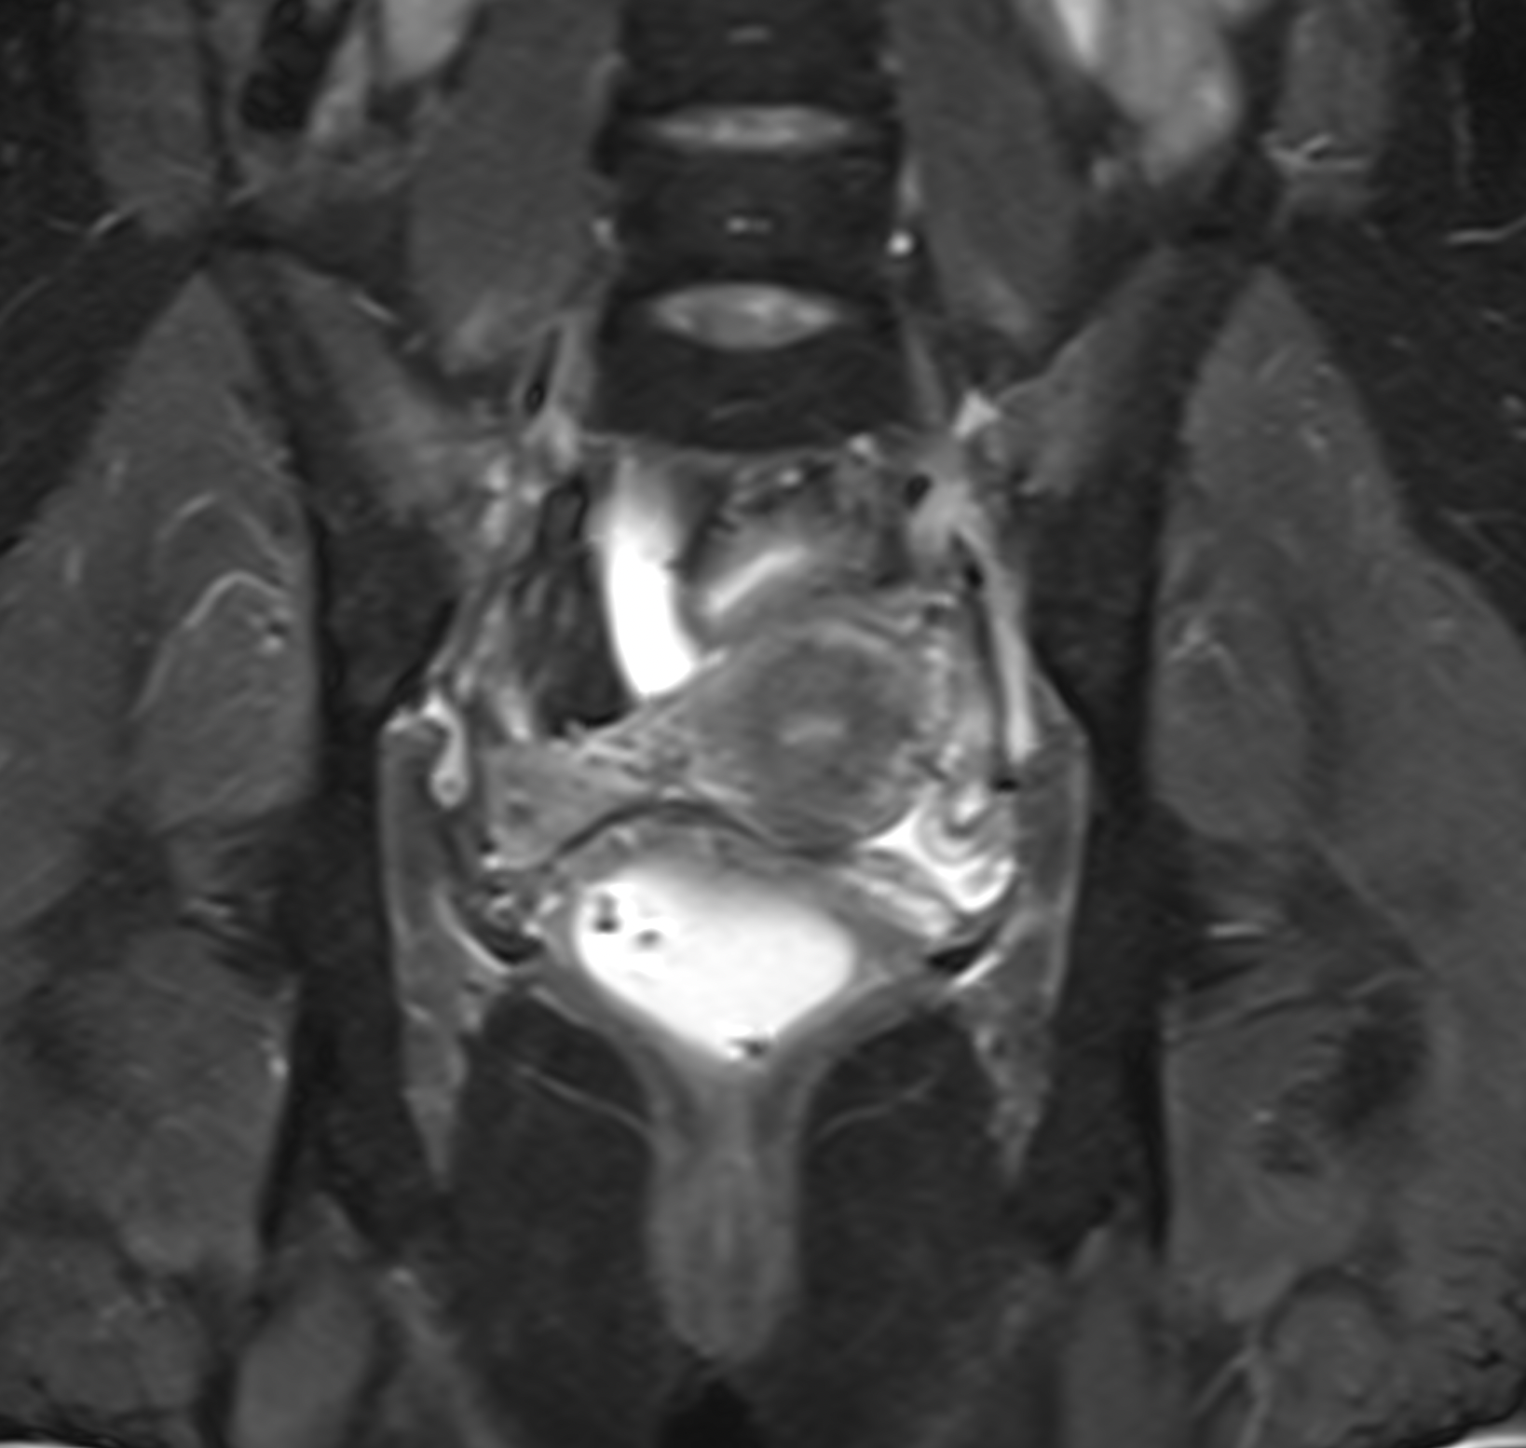
Avant la RCC+ CURIETHÉRAPIE
Réévaluation à 06 semaine RCC
Notes:
Utérus retroversé, sans lésion complète; restitution de l’hyposignal du col sans prise de contraste après injection de gado. Présence de deux formations kystiques du col en hyper T1 T2 non rehaussé après contraste en rapport probable avec des kystes de nabot;

Slide 31
Comments
For the start-up of a radiotherapy centre:
take all technical, clinical and legal measures [Ferrand, 2016].
The challenge: to start and stabilize the supply of modern radiotherapy care to cancer patients.
Access to radiotherapy care remains limited;

Slide 32
Commentaires
This could be explained
the covid19 pandemic;
lack of medical insurance
Ignorance of the role of radiotherapy.
indisputable advantages EBRT by halcyon
simplicity of treatment planning,
speed of irradiation,
and the excellent protection of OARs [Yossi et al., 2019; Yossi et al., 2018].

Slide 33
PERSPECTIVES

Slide 35
Nbre d’hopitaux classés par pays parmi les 50 meilleurs en Afrique (Ecofin,2017) | Total
Egypte | 12
RSA | 11
Kenya | 6
Maroc | 5
Tanzanie | 3
Maurice | 3
Swaziland (Gambo Healthcare: 1er centre en Afrique; 598è mondial | 1

Slide 37
Perspectives (Fight against cancer)
Upgrade halcyon to the latest Elite version
Acquisition of a new-generation AL
First brachytherapy unit to open soon
Opening of a nuclear medicine department
Acquisition of the elements required for 4D acquisition
Acquisition of the restraint systems required for radiotherapy in stereotactic conditions
Developing research

Slide 39
Perspectives (Hospital)
- Increase bed capacity
- Invest in the training of students and healthcare professionals through partnerships with universities.
- Develop cooperation between health authorities and health institutions for the well-being of the population.

Slide 40
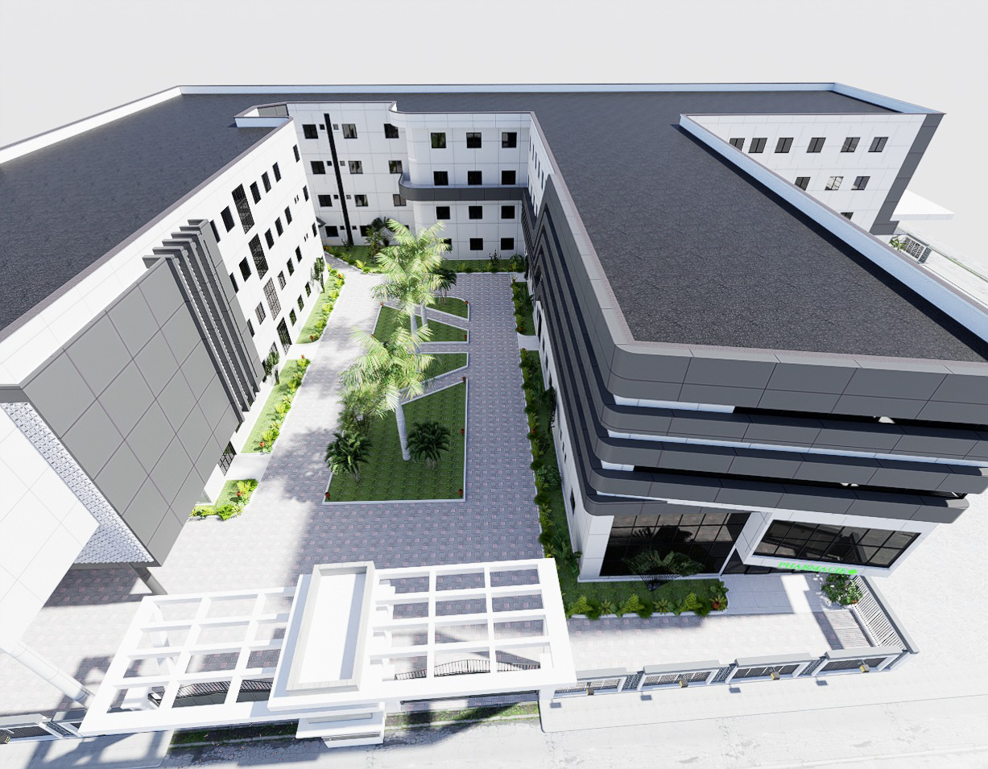
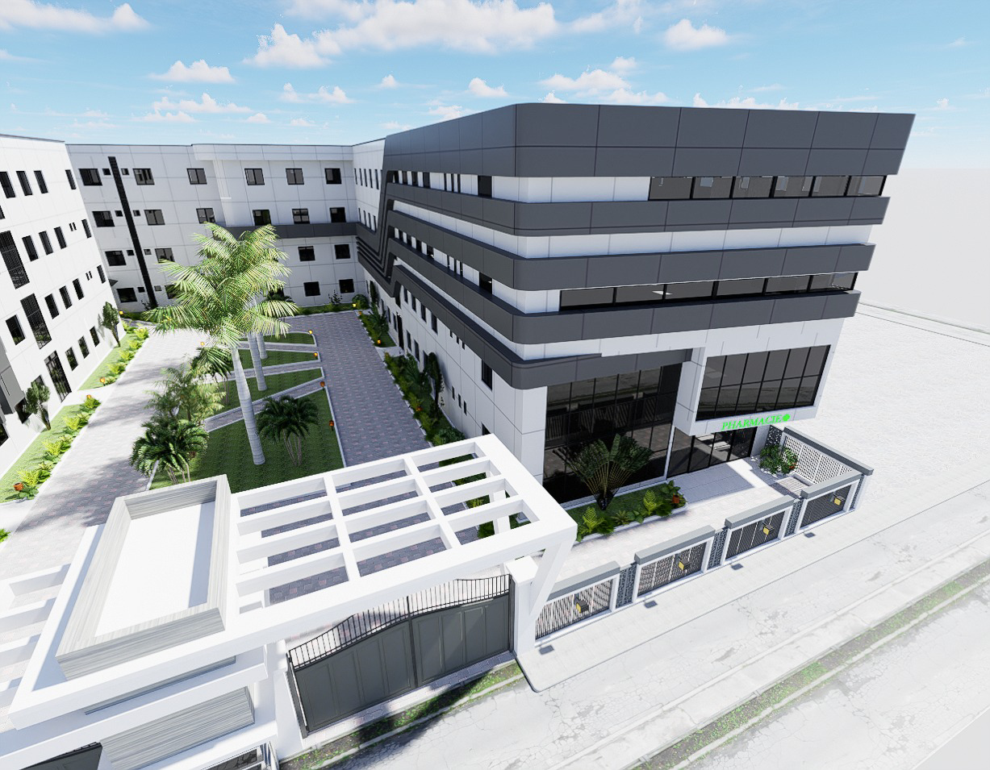

Slide 41
Conclusion
the availability of HALCYON in the DRC is a godsend for comprehensive cancer care;
With IMRT and VMAT, we were able to offer modern radiotherapy care with few side effects
Current challenges:
Accessibility

Slide 42
Bibliography
A Dao, et al, arthérapie volumique avec modulation d’intensité d’un cas de rétinoblastome au centre de radiothérapie Muk et Maseb à Kinshasae, Jaccr Africa 2023; 7(2): 116-121
G. Klausner a,b, E. Blais a,b, C. Martinc et al: De la construction du bunker à la prise en charge du patient : contrôles qualité des techniques modernes de radiothérapie From bunker construction to patient treatment: quality controls applied to modern radiotherapy techniques; Cancer/Radiothérapie 23 (2019) 248–254
Ferrand, R. (2016). Aspects techniques de la protonthérapie : Installation, appareils, radioprotection. Cancer/Radiothérapie, 20(6‑7), 519‑522. https://doi.org/10.1016/j.canrad.2016.07.091
Yossi, S., Lamberth, F., Marchand, V., Cervellera, M., Mammar, V., Khodri, M., … Barbet, N. (2018). Radiothérapie par modulation d’intensité des cancers du sein sur Halcyon : Résultats préliminaires. Cancer/Radiothérapie, 22(6‑7), 715‑716. https://doi.org/10.1016/j.canrad.2018.07.062
Yossi, S., Nguyen, D., Khodri, M., Lorchel, F., Bernard, V., Portier, N., … Barbet, N. (2019). Gestion des changements morphologiques lors des traitements avec modulation d’intensité pour les cancers du sein sur HalcyonTM guidés par l’imagerie conique quotidienne de basse ou de haute énergie . Cancer/Radiothérapie, 23(6‑7), 815. https://doi.org/10.1016/j.canrad.2019.07.063

Slide 43
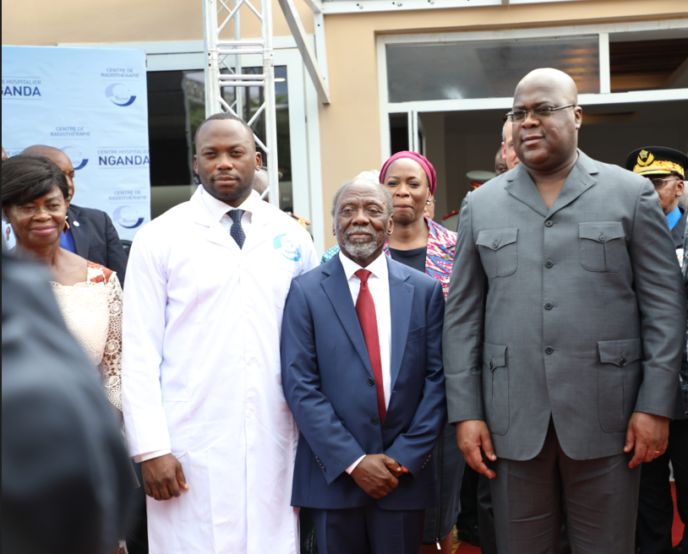
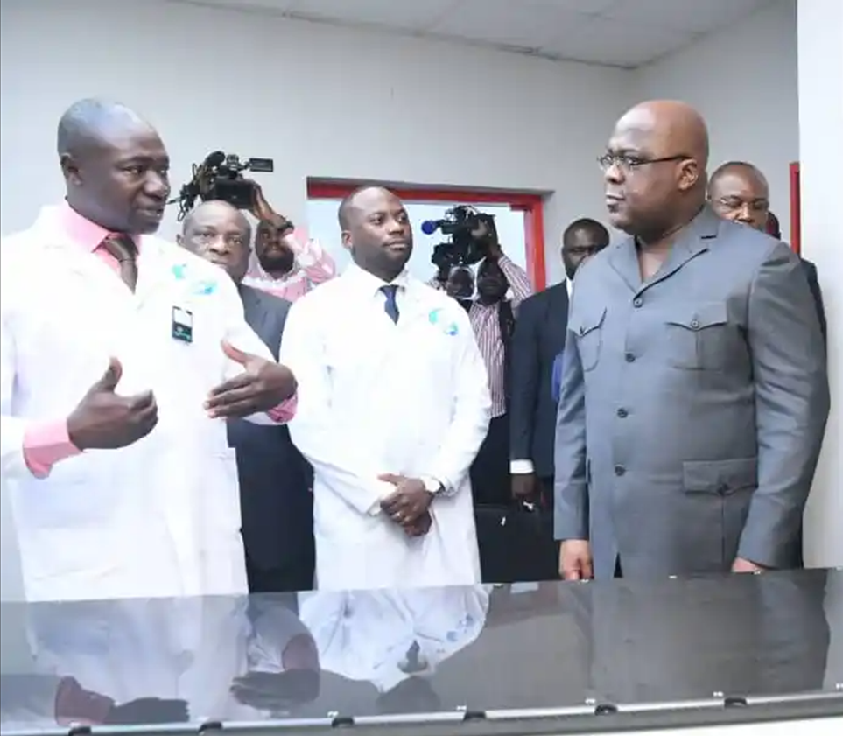
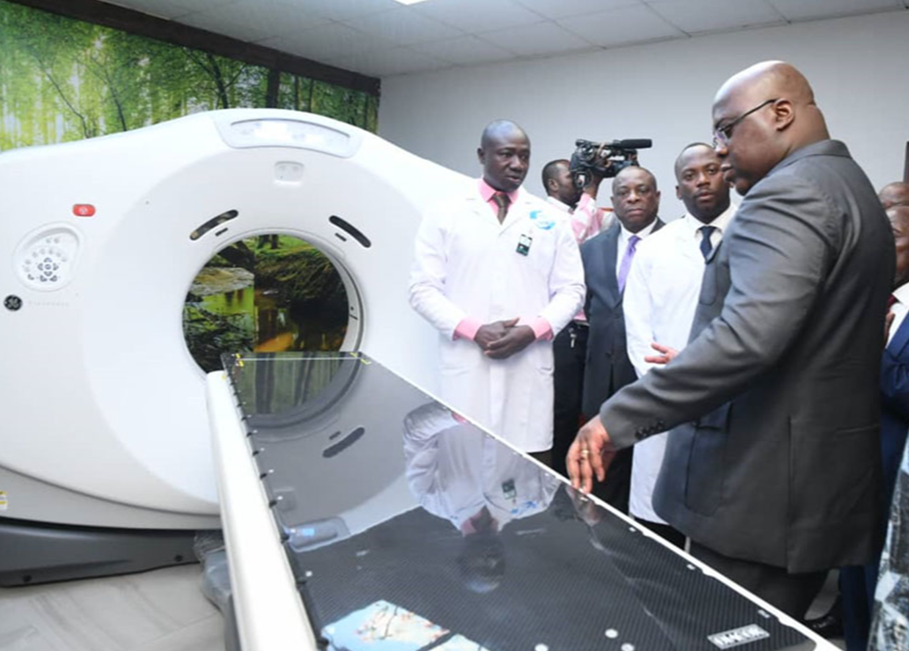

Slide 44
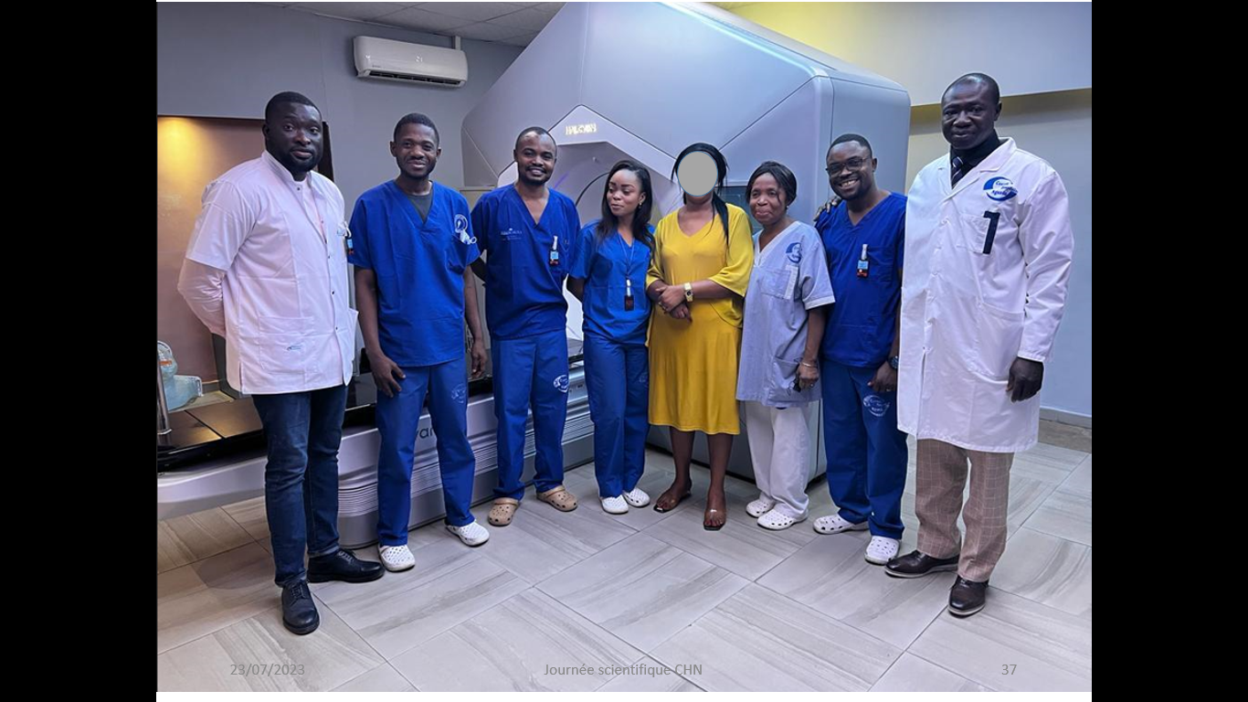

Slide 45
Notes:
L’équipe de radiothérapie avec une patiente traité par radiothérapie (lymphome non hodgkinien cervical refractaire après chimiothérapie

Slide 46
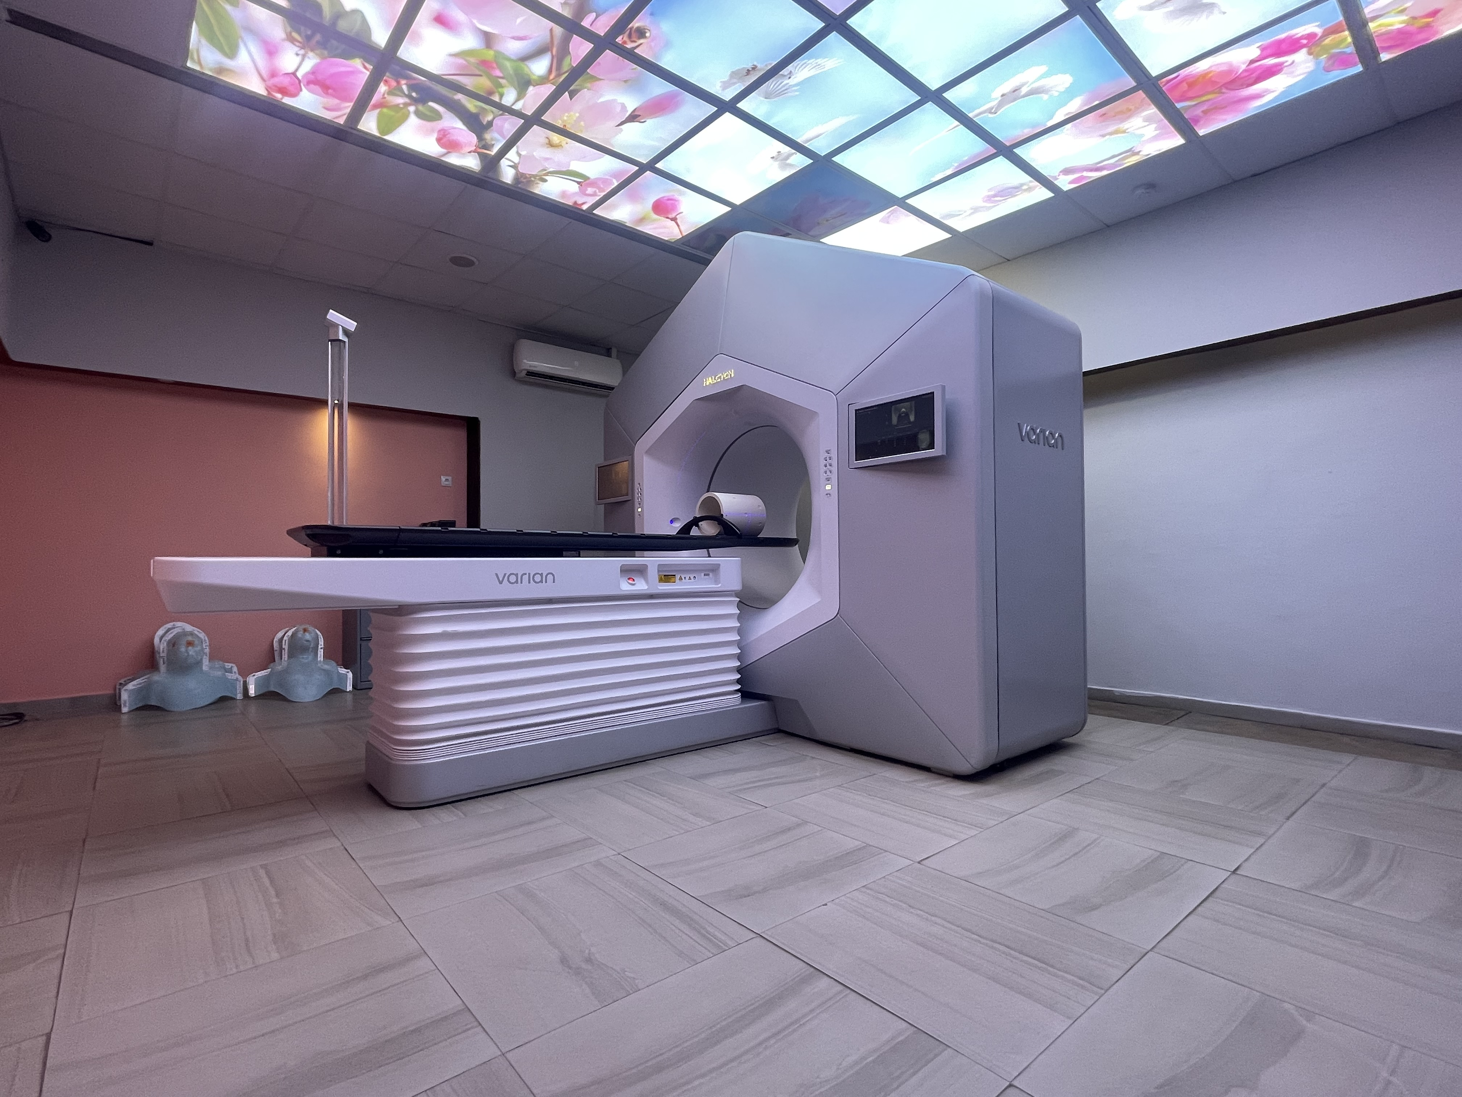
MERCI !

