Slide 1
“CGEA fer de lance de la lute contre le Cancer en RDC” October 2-4, 2023 Thierry M Muanza, BA, MSc, MD, FRCPC A. Professor Dept. Oncology, Neurosurgery & Exp. Medicine McGill University Montreal, Canada

Slide 2
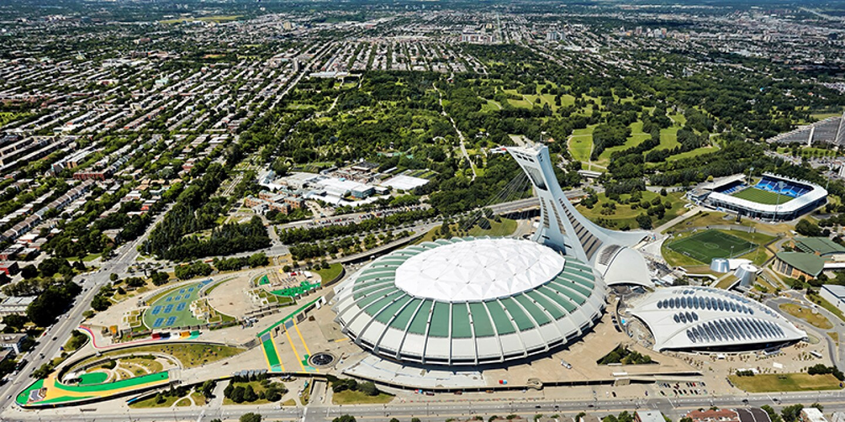
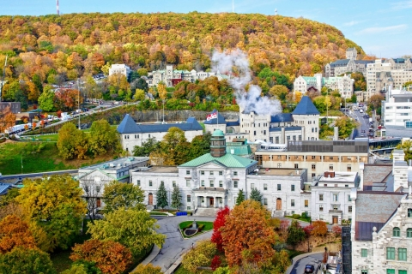
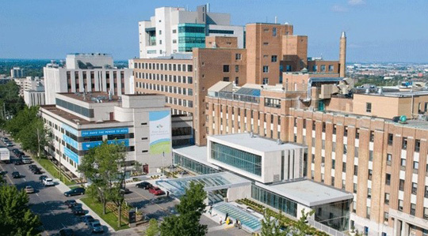

Slide 3
Disclosure
none

Slide 4
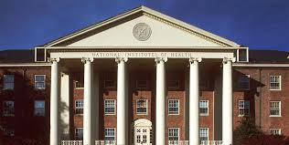
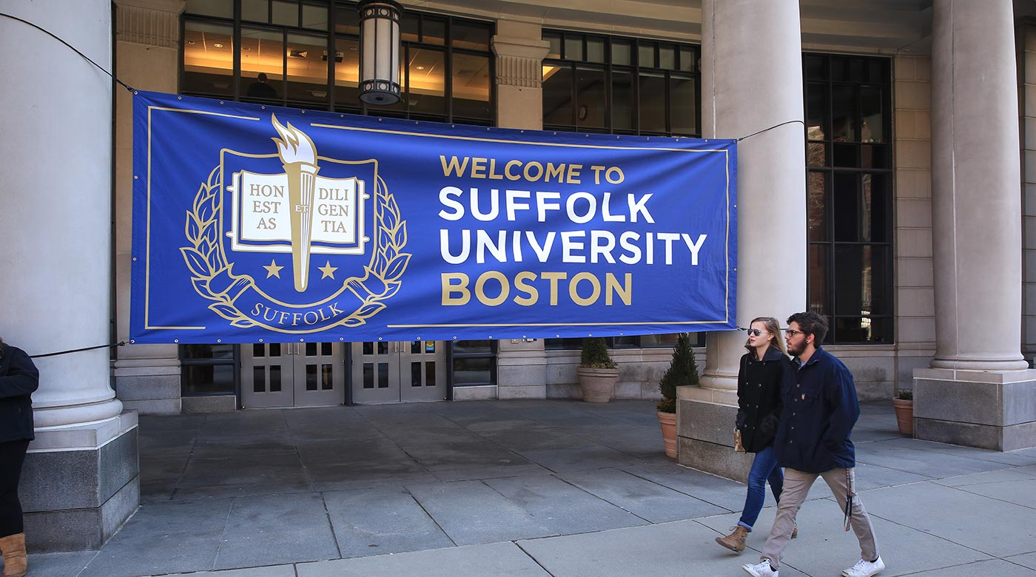
Outline
Background:
Education
Career
Extra-curricular

Slide 5
EDUCATION
Undergraduate B.A., Biology, Suffolk University, Boston, MA. USA, 1986
Graduate M.Sc., Biomedical Sciences, Northeastern University, Boston, MA, USA, 1993
Medical M.D., Université de Sherbrooke, QC, Canada, 1997
Post-Graduate Training Internship, Internal Medicine, McGill University, 1997-1998
Radiation Oncology, McGill University, 1998-2002
Radiation Oncology, ASTRO-NCI Fellow, National Institutes of Health, Bethesda, MD USA, 2002-2004

Slide 6
PROFESSIONAL CERTIFICATES
Fellow of Royal College of Physicians and Surgeons, FRCP (C) Radiation Oncology, 2003
SCQ (specialist certificate) Radiation Oncology, Collège des Médecins du Québec, 2004
United States Medical Licensing Examination,
USMLE ID 40719577, 1997-1999
Federation of State Medical Boards, FSMB ID 213276645, 1999
Medical Council of Canada, LMCC ID 85944, 1999

Slide 7
APPOINTMENTS
UNIVERSITY:
McGill University – Department of Oncology, division of Radiation Oncology: Associate Professor
McGill University –Department of Neurology & Neurosurgery: Associate member
McGill University – Department of Experimental Medicine: Associate member
McGill University – CHIR, Drug Development Training Program: Mentor
McGill University – Adolescents and Young Adults (AYA) Oncology Program: Co-Medical Director
McGill University – McGill Black Alumni Association (MBAA): Mentor for the McGill Black Mentorship Program

Slide 8
TEACHING
Pre-graduate 09/00 – 05/01 Seminar lecturer
Clinical Oncology (142-313-76)
CEGEP Dawson College – Radiation Therapy Technologist’s Program, Montreal, QC, Canada.
05/05 ICM - Principles of Oncology (INDS 307) - McGill University, Montreal, QC, Canada.
Post-graduate 01/00 – 05/00 Seminar Lecturer Clinical Radiotherapy for Master level Medical Physics (563-603B)
Medical Physics Unit – McGill University, Montreal, QC, Canada.
2004-present Radiation Oncology residency training program, clinical instructor
01/05 Experimental & Clinical Oncology: Radiation Therapy clinical issues & basic research (516-635D) – McGill University, Montreal, QC, Canada.
11th Annual national Canadian Preparatory Course in Clinical and Radiation Oncology
01/07 Radiobiology lecture
12th Annual national Canadian Preparatory Course in Clinical and Radiation Oncology
03/07 McGill Educational Initiative on Interprofessional Collaboration: Partnerships
For Patient and Family-Centered Practice.
05/07 McGill University Radiation Sciences Research Retreat: Stratagems for combining targeting molecules with radiation
11/12 MORE, McGill Friday teaching, CNS subjects
06/15 MORE, McGill Friday teaching, High Grade Glioma
06/15 McGill University radiobiology, http://www.mcgillradiobiology.ca/lectures/: chemoradiation
02/16 Radiation Oncology journal club Regional Nodal Irradiation in Early-Stage Breast Cancer, Radiation Oncology journal club
05/16 McGill Friday teaching, Meningioma: recurrent/high grade
02/17 Radiation Oncology journal club Preoperative or postoperative radiotherapy versus surgery alone for retroperitoneal sarcoma: a case-control, propensity score-matched analysis of a nationwide clinical oncology database, Radiation Oncology journal club
11/18 McGill University CORE lecture on Radiotherapy for clinicians. Jewish General Hospital
10/19 Mock Tumor Board on Multidisciplinary Management of Early Stage Breast Cancer, MUHC Glen Site at the MORE series, on behalf of McGill’s Gerald Bronfman Department of Oncology. (facilitator)
02/06 Radiobiology lecture

Slide 9
TEACHING
Supervisory Experience
Hamdy Elhateer Postdoctoral Fellow, Radiation Oncology Visiting Fellow, 07/06 – 06/08
Mitra Heravi Graduate student, Human Genetics, Master of Science
Atta Goudarzi BIOC49, Independent Research, 01/08, McGill University
Ava Schlisser Summer student, 07/08, McGill University
Philip Wong Radiation Oncology resident research elective, 2009, McGill University
Gary Mok Radiation Oncology resident research elective, 01/-0/6 2009, McGill University
Fulin Lee Summer student, 06/09, McGill University
Azusa Madea Summer student, 06/09, McGill University
Hani A-Halabi Radiation Oncology research elective, 01- 06/2010, McGill University
Osama Maria Graduate student, Experimental Medicine, PhD student, 2011-present McGill University
Mitra Heravi Graduate student, Human Genetics, PhD candidate, 2009- 2014 McGill University
Slawomir Kumala Postdoctoral Fellow, Translational Radiation Oncology, 2012-2016
McGill University
Fleur Gallant Postdoctoral Fellow in Radiation Oncology, MSc. Clinical Epidemiology, 2013-2014, McGill University
Maryam Gashgahei Graduate student, Experimental Medicine, PhD candidate, 2013- 2019
Prabhas Chaudri Graduate student, Experimental Medicine, PhD candidate, 2013- 2017
Osmar Barbosa Postdoctoral Fellow, Neuro-Oncology / Pediatric Fellowship. Visiting Fellow (April – May 2016)
Alex Alborz Jooya Experimental Medicine, M.Sc. student, (2018 - 2019)
Catalina Dumut. Experimental Medicine, M.Sc. thesis, “Optimal delivery of therapeutics to prostate cancer based on magneto-aerotactic MC-1 bacterial agents”. (2018 – 2019)
Helena Beugre Medical Student, Université de Sherbrooke, April 23-May 3, 2019
Nicole Wong Medical Student, Université de Sherbrooke, April 23-May 3, 2019
Shaheenah Dawood Postdoctoral Fellow, Medical oncology Fellow
Elena Parvez Surgical Oncology Fellow, (2019-2020)
Adam Farhat Student, Collège international Marie de France, February 19-21, 2020
Gemini Ramasamy Experimental Medicine, M.Sc. student, (2021 - present)
Jackie Girgis Experimental Medicine, Ph.D., student, (Sept. 2021 – Aug. 31, 2023). Project: “Predictive Radiomics biomarkers for Brain Metastasis”
Catalina Dumut Supervisory Committee Member for Doctoral thesis at McGill. 2023

Slide 10
External examiner
2004 – present Examiner for the McGill-U. Montreal in-training exams
08/07 Thusanth Thuraisingam, PhD Thesis “Macrophage regulatory genes NRAMP1 and MK2: Implication in Inflammation and Cutaneous wound healing”, Human Genetics, McGill University
10/08 Mitra Heravi, PhD Qualifying Examination, Human Genetics, McGill University
09/09 Nahid Golabi, MSc. Thesis committee, Experimental Medicine, McGill University
09/10 Vinvent Siu, Master of Science thesis, “MGMT promoter methylation and expression in glial tumors and peripheral blood mononuclear cells”, Graduate Program in Neurological Sciences, McGill University
05/10 Roberta Guimares de Oliveira, PhD Thesis, Graduate Program in Neurological Sciences, McGill University
06/10 Hani Al-Halabi, Department of Experimental Medicine, McGill University. Master of Science thesis “Gene Expression Profiling in Adult Medulloblastoma”
04/16 Minghan Shi, PhD, “CED delivery of platinum drugs and their liposomal formulations plus radiation therapy in glioblastoma treatment”, department of radiation sciences and biomedical imaging University of Sherbrooke.
05/16 Gina Bouchard, PhD, “Prévention de la migration radio-induite des cellules cancéreuses du sein”, department of radiation sciences and biomedical imaging University of Sherbrooke
04/17 Laurent-Olivier Roy, Développement d’un traitement pour inhiberle TGF-β dans les glioblastome: une nouvelle utilisation de la chloroquine, department of Pharmacology University of Sherbrooke
18/01/09 External examiner for Masters Thesis. Ahmed Ayman Habis, Master of Science, Division of Surgery, McGill University
06/06/19 McGill Pro-Dean for the Doctoral Oral Examination in the Department of Economics (Xian Zhang). McGill University
19/06/19 Maryam Ghashghaei, PhD Oral Defence. Experimental Medicine, McGill University
20/06/30 Prabhas Chaudhari, PhD Oral Defence. Experimental Medicine, McGill University
21/02/22 McGill Pro-Dean for Thesis Oral Defence. Ahmed Al-Subaie, Dentistry, McGill University
21/11/08 Alaa Omar Barryan, PhD Oral Defence. Experimental Medicine, McGill University
22/03/14 McGill Pro-Dean for PhD Oral Defence. Rika Tsushima, Department of Mechanical Engineering, McGill University
22/04/04 McGill Pro-Dean for Thesis Oral Defence. Antoine Durocher, Department of Mechanical Engineering, McGill University

Slide 11
AWARDS
03/05/85 Beta Beta Beta Biological Honor Society
04/18/86 Sigma Zeta Honorary Science Society
10/05/95 Assembly of Researchers Award, 24th Scientific day, University of Sherbrooke Medical School.
06/09/01 AROQ Resident Award $1,000.
01/10/03 ASTRO/NCI Translational Fellowship Award (Salt Lake City) $80,0000
9/08/04 CARO Travel Award $1000.
01/10//04 The Thelma L. Adams Fellowship Award, Research Institute of the McGill University
Health Center $30,000.
01/10/05 The Thelma L. Adams Fellowship Award, Research Institute of the McGill University
Health Center. $30,000.
01/09/06 The Cedars Cancer Institute Fellowship $20,000.
01/10/06 The Simone & Morris Fast Award for Oncology $30,000.
07/09-13 Fond Recherche en Sante du Quebec (FRSQ), Clinician scientist $35,000.

Slide 12
ADMINISTRATIVE RESPONSIBILITIES
Hospital
2004- present Jewish General Hospital: breast tumor board
2004- present Jewish General Hospital: neuro-oncology board
2004 - 2010 Montreal Neurological Institute: neuro-oncology tumor board
2006 - present Lakeshore General Hospital: oncology tumor board
2008- present Jewish General Hospital: AYA oncology rounds
2013- present Jewish General Hospital/CIUSSS: Ethics Review Board (ERB)
2015- present Jewish Genral Hospital: Radiation Oncology Mortality & Morbidity Rounds (chair)
Group
McGill University
2005- 2019 Residency Program Committee,
2005- 2015 Radiation Oncology Fellowship program Director
2005- 2016 Neuro-Oncology Committee
2005- 2016 Breast Cancer Group
2006- 2008 Consent Form Committee (MGH)2007- 2009 Health and Safety committee (MGH)2007- 2016 Women’s Cancer committee2010 - present Medical School Admission Committee2014/12 Judge, Poster and Oral presentation competition at the DDTP Research Retreat 20142017- present Rossy Cancer Network, Breast Cancer Group Rossy Cancer Network, Lung Cancer

Slide 13
Advisory Boards2014 – April 2021
Board of Directors, Brain Tumor foundation of Canada (BTFC)2014 - present
Board of Directors, Canadian Brain Tumor Consortium (CBTC)
09/15 – present
Executive Director of Amis des Universites de MbujiMai (AUM)
11/18
Advisory Board, Abbvie Oncology. Depatux-M SNO Scientific Exchange Meeting. New Orleans, LA11/22 – 10/23
Lady Davis’ EDI Advisory Committee
QuebecEvaluator, Fight against cancer program (PQLC), Hotel Dieu QuebecEvaluator, Fight against cancer program (PQLC), Centre Hospitalier Universitaire LavalNational2007- 2012 Canadian Association of Radiation Oncology (CARO), Rapid AstraZeneca (RAZCER) & Evaluation of Radiomodifiers Advisory Group2007 - 2014 CARO annual scientific meeting abstracts reviewer 2008- present Canadian Brain Tumor Consortium (CBTC)2008- present National Cancer Institute Canada (NCIC) CTG Locally AdvancedBreast Cancer sub-Committee2012 - present National Cancer Institute Canada (NCIC) Brain Tumor Committee2016 - present Scholarship Committee, Brain Tumor Foundation of Canada2016 - present Advocacy Committee, Brain Tumor Foundation of CanadaInternational1999- present The American Society for Therapeutic Radiology and Oncology(ASTRO)2009- present European Society of Radiation Oncology (ESTRO).2010- present The Society for Neuro-Oncology2016 - present NRG Oncology, Breast cancer committee2017- present Society of Neuro-Oncology (SNO)-SSA, Steering Committee2020 – present SNO CWD Committee2020 – present JGH, Institutional Representative at the RTOG

Slide 14
Editorial Review
05/06 International Journal of Radiation Oncology Biology and Physics
ROB-D-06-00290 Invited reviewer
05/09 Current Oncology Invited reviewer
10/10 Current Oncology Invited reviewer
07/12 Journal of signal Transduction, 902854.v1, Invited reviewer
02/13 Current Oncology Invited reviewer, 1457-11629-1-RV
01/16 Frontiers in Oncology, Review Editor in Radiation Oncology
01/17 Cureus, Invited reviewer, DOI: 10.7759/cureus
06/17 International Journal of Radiation Oncology, Biology, Physics, Invited
reviewer, Ref.: Ms. No. ROB-D-17-00654
11/17 Plos One, Invited reviewer, Ref.: Ms. No. PONE-D-17-35115
06/19 Scientific Reports, Invited reviewer, Ref: SREP-19-03198
03/20 – present Associate Editor, Frontiers in Oncology
05/20 Neuro-Oncology Practice, Invited reviewer, NOP-D-20-00043

Slide 15
Scientific Review
International
11/10 International Grant reviews
Evaluation ANR “Equipment of excellence” (French Research Funding Agency. France, EQUIPEX 2010
National
2014 - present Brain Tumor Foundation of Canada
2008 - present Canadian Brain Tumor Consortium
2004 - 2010 CARO Annual scientific meeting abstract reviews
2018 – present Alberta Cancer Foundation. Scientific reviewer for Early Detection call in liquid biopsy and biomarkers.2020 – present Chair, Brain Tumour Foundation of Canada’s ISEC Committee
Local
2006, 2007, 2008 MUHC for IRB
2005 - present Lady Davis internal grant review
2013 - CCOMTL Scientific review board
2023/04 Study reviewer for MBM meeting (2023-3684 – ARASTEP)

Slide 16
COMMITTEES
2004 - present Member, Medical, Dental and Pharmacy Evaluation Committee (MUHC)
2004 – 2016 Member, Breast Oncology, McGill University
2004 – 2016 Member, Neuro-Oncology, McGill University
2008 - present Member, Medical, Dental and Pharmacy Evaluation Committee (JGH)
2008 – present Member, Breast cancer clinical research group (JGH)
2013 - present Member, Research Ethics Committee (JGH)
2016- present Member, NRG Oncology clinical research (JGH)
Clinical Research
Radiation Oncology CRU Lead: 2018-2023

Slide 18
www.snossa.org

Slide 19
Acknowledgments
Our Patients
McGill_Students/Trainees
JGH Neuro-Oncology Team
?/Questions
THANK YOU

