Slide 1
“CGEA fer de lance de la lute contre le Cancer en RDC” October 2-4, 2023 Thierry M Muanza, BA, MSc, MD, FRCPC A. Professor Dept. Oncology, Neurosurgery & Exp. Medicine McGill University Montreal, Canada

Slide 2
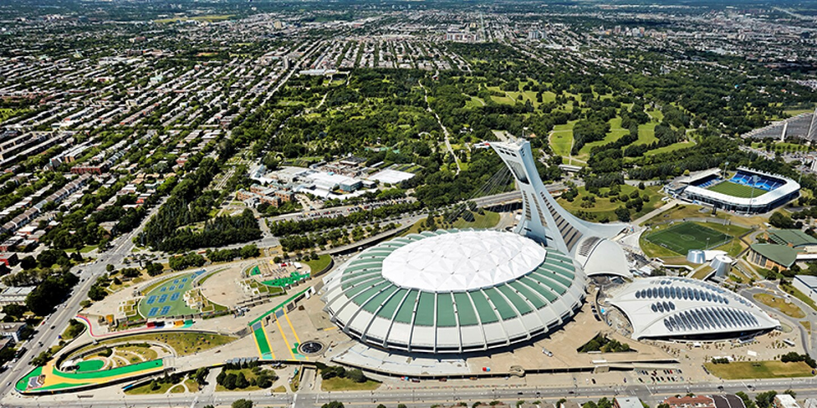
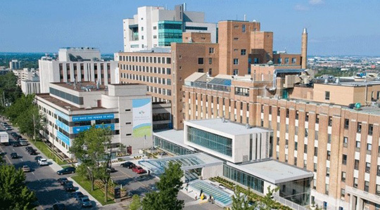

Slide 3
Disclosure
none

Slide 4
Outline
Statistics: mortality rates
Hallmarks of cancer
Physics & Chemistry of Radiation Absorption
Radiobiological basis of Radiotherapy
Treatment Planning
Charged particles

Slide 5
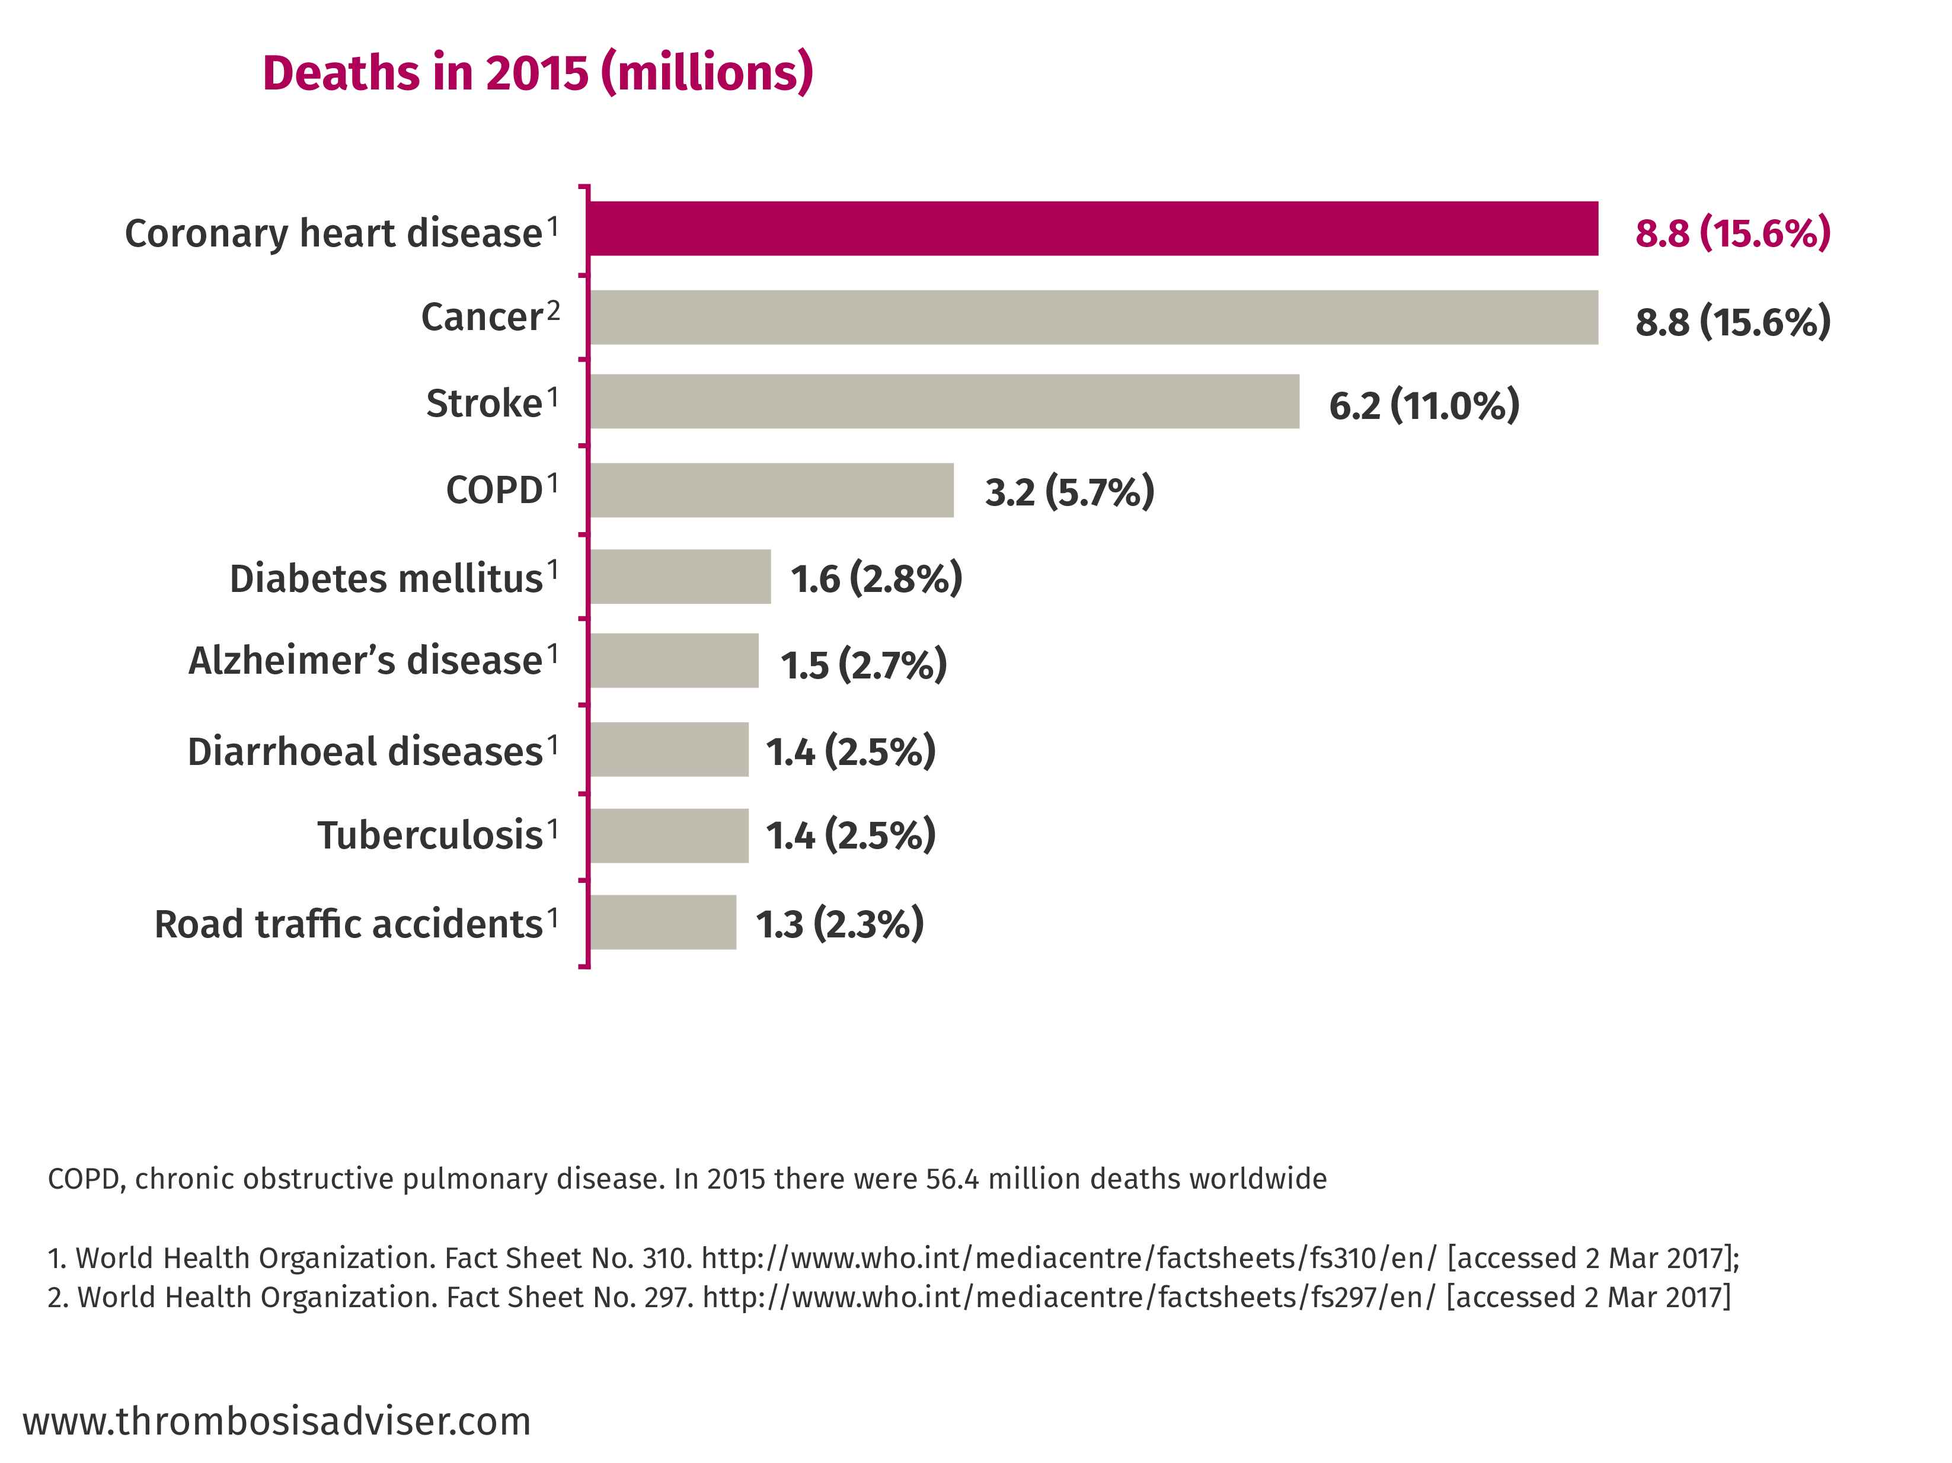
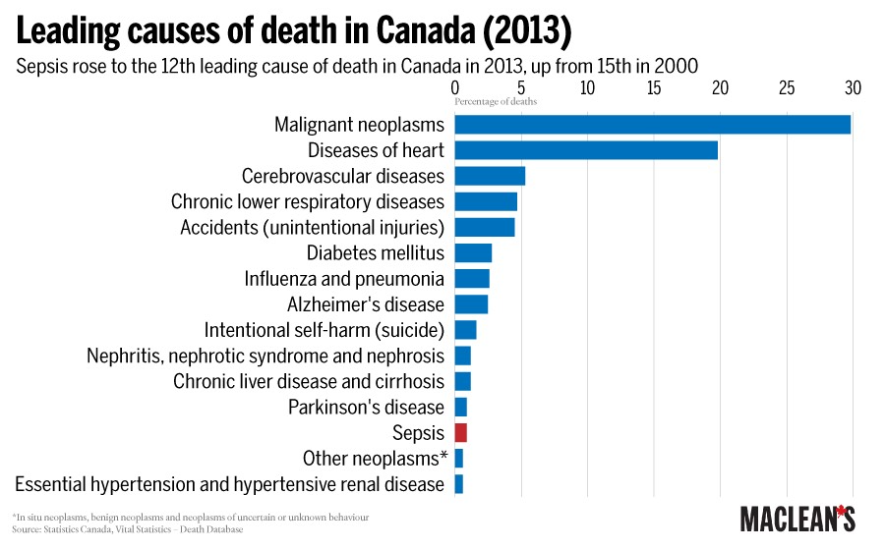
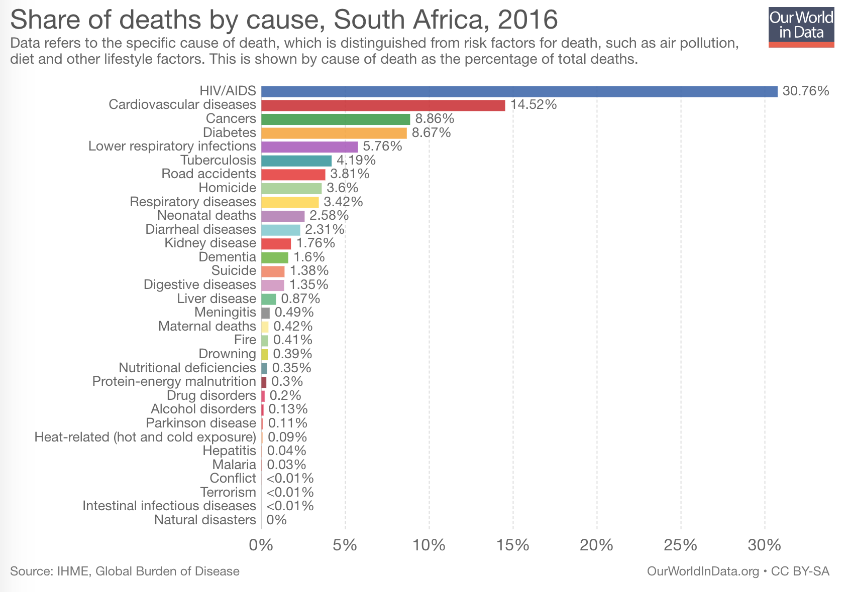

Slide 6
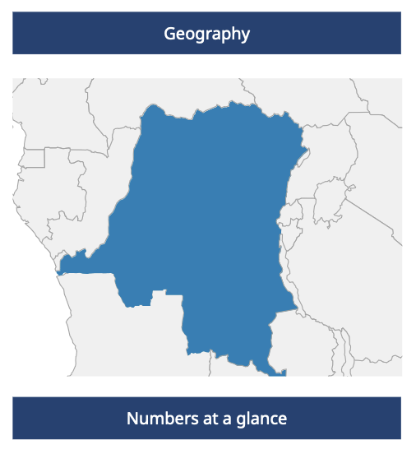
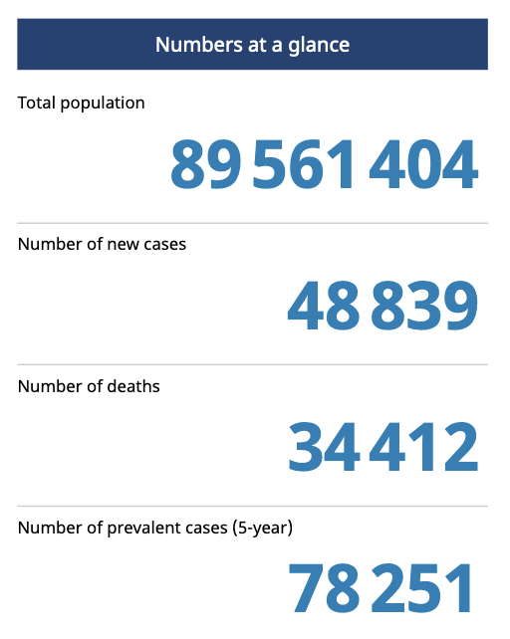
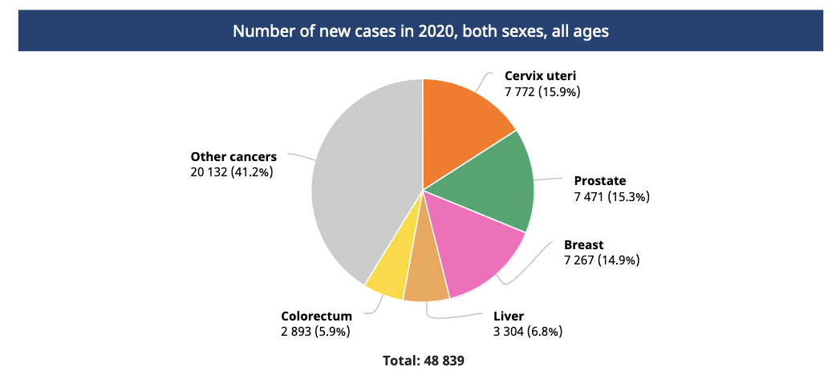

Slide 7
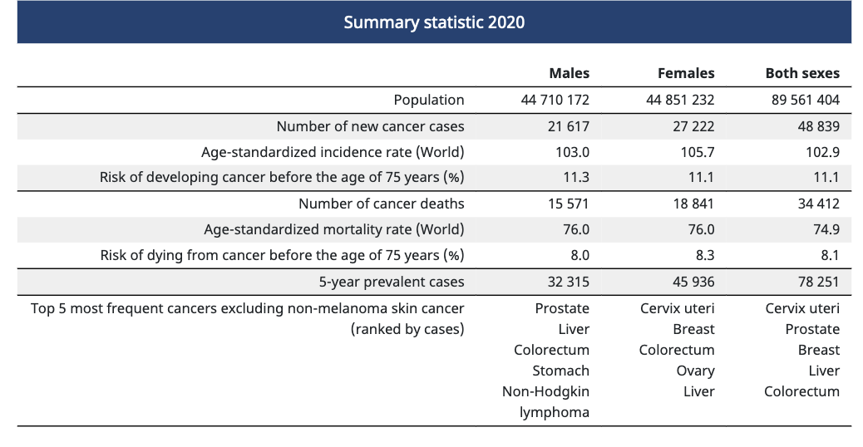

Slide 8
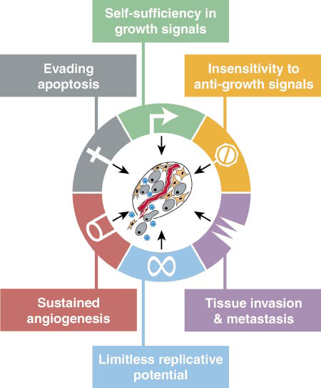
Hallmarks of Cancer
Cell, Vol. 100, 57–70, January 7, 2000, Copyright ã2000 by Cell Press

Slide 9
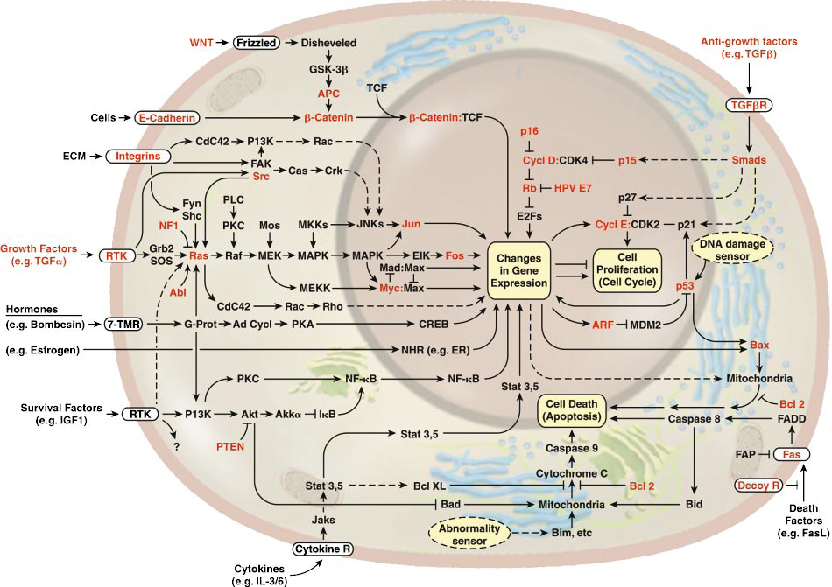
Cell, Vol. 100, 57–70, January 7, 2000, Copyright ã2000 by Cell Press

Slide 10
Radiobiology & Radiotherapy
The study of the interaction of ionizing radiation on living things
excitation or ionization
The medical use of ionizing radiation to treat malignant disease.

Slide 11
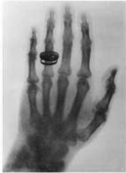
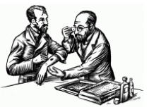
X-rays
1895 Roentgen discovery of X-rays
1896, 1st medical use reported in Lancet (Dx)
X-ray of sailor’s backbone to remove piece of a knife
1896, L. Freund treatment of a hairy mole before Vienna Medical Society

Slide 12
1st Therapeutic use
1896, , L. Freund treatment of a hairy mole before Vienna Medical Society
A-H Becquerel discovery of radioactivity emitted by uranium compounds
Becquerel INADVERTENTLY left radium container in his vest pocket
1901, Pierre Curie “radiation burn”

Slide 13
Radiobiology & Radiotherapy
IR: local release of large amount of energy
~ 33eV dissipated / ionizing event, enough to break strong chemical bond
energy associated C=C bond is 4.9 eV
Types:
Electromagnetic
particulate

Slide 14
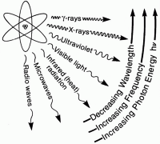
Electromagnetic Radiations
X-rays and γ-rays
extranuclear and intranuclear production
X-rays
electrical & magnetic energy
λv=c
Streams of photons/”packets” energy
hμ
λA=12.4/E(keV)

Slide 15
Radiobiology
Concept of X-rays composed as photons is central in radiobiology
Energy is deposited in tissues & cells unevenly in discrete packets culminates in biologic change

Slide 16
Particulate Radiations
Electrons, protons, α-particles, neutrons, -π mesons, heavy charged ions
small - charged particles accelerated to high energy (betatron or linear accelerator)
+ charged particles, relatively massive, accelerated to high energy (cyclotron)
mass like protons, no electrical charge
C, Ne, Fe + charged
α-particles (+charged, decay) lung cancer in smokers (10-20,000 cases/year)

Slide 17
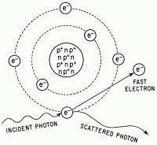
Absorptions of X-rays
Absorption of an x-ray photon by the Compton process (Co & linac).
The photon interacts with a loosely bound planetary electron of an atom of the absorbing
material. Part of the photon energy is given to the electron as kinetic energy. The photon, deflected from its original direction, proceeds with reduced energy.

Slide 18
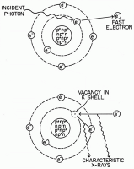
Absorption of a photon of x- or γ-rays by the Photoelectric process. The interaction involves the photon and a tightly bound orbital electron of an atom of the absorber. The photon gives up its energy entirely; the electron is ejected with a kinetic energy equal to the energy of the incident photon less the binding energy that previously held the electron in orbit (top). The vacancy is filled either by an electron from an outer
orbit or by a free electron from outside the atom (bottom). If
an electron changes energy levels, the difference in energy is
emitted as a photon of characteristic x-rays. For soft tissue
these x-rays are of very low energy.

Slide 19
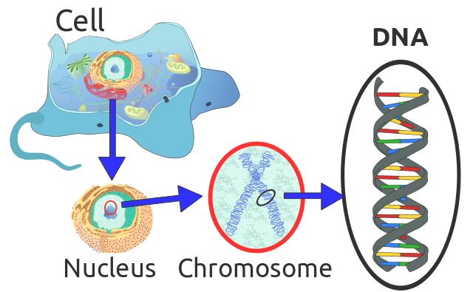
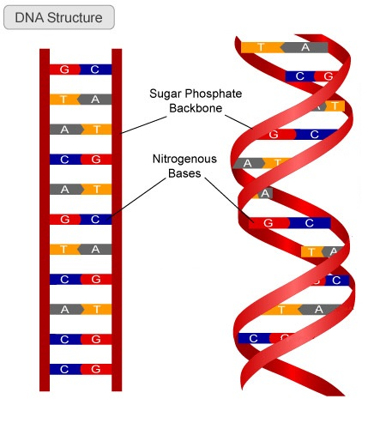

Slide 20
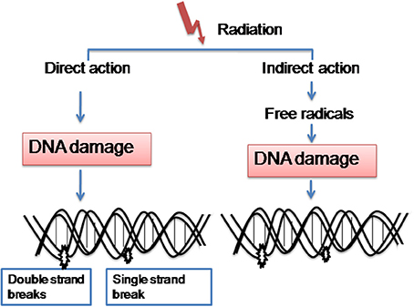
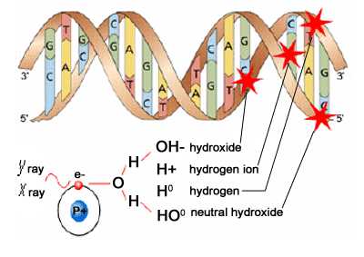
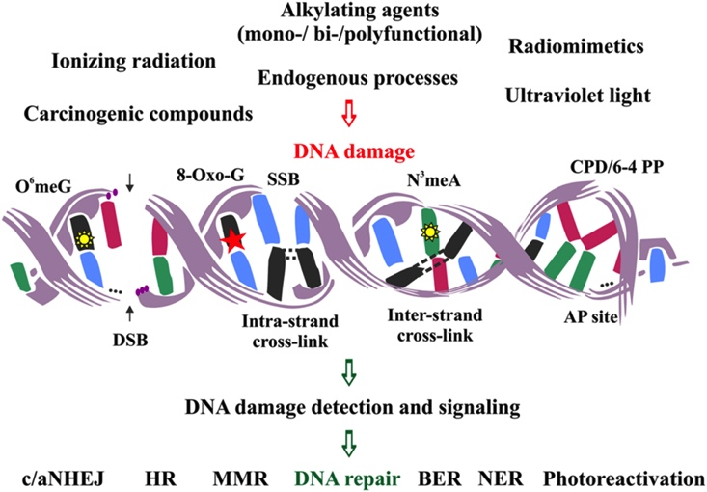

Slide 21
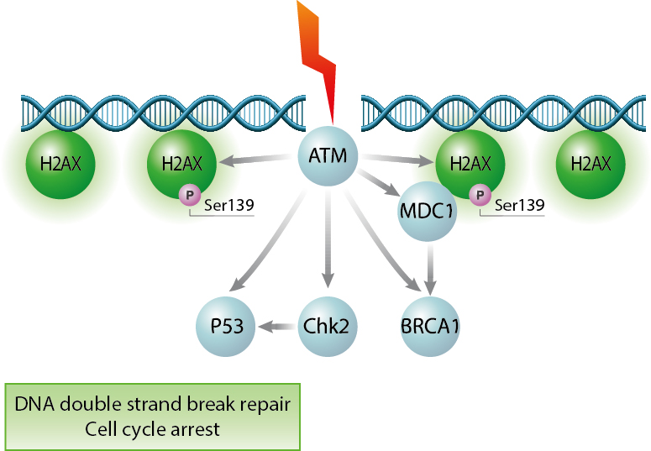
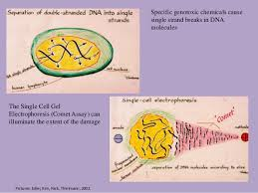
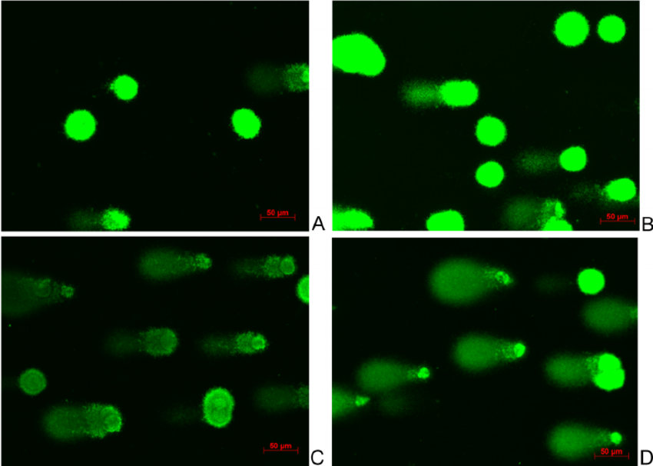
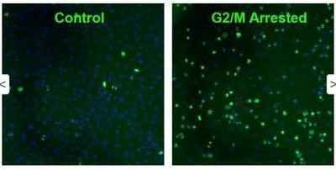

Slide 22
How much damage needs to be repaired?
1 Gy of RT causes approximately 10⁵ ionizations
>1000 damages to DNA bases
1000 single strand breaks
20-40 double strand breaks (DSBs)
Kills approximately 30% of human cells, as a consequence of efficient DNA repair

Slide 23
Percent Depth Dose

Slide 24
Interactions of Charged Particles
Electrons small masses thus multiple scattering and changes in direction of motion resulting in a “smearing out” of the Bragg peak effect

Slide 25
Relative Biological Effectiveness
RBE = Dose from reference radiation /
Dose from test radiation, DT
Type and Energy Range | Radiation Weighting Factors
X and Gamma rays | 1
Electrons | 1
Neutrons (energy dependent) | 5-20
Protons | 5
Alpha Particles | 20

Slide 26
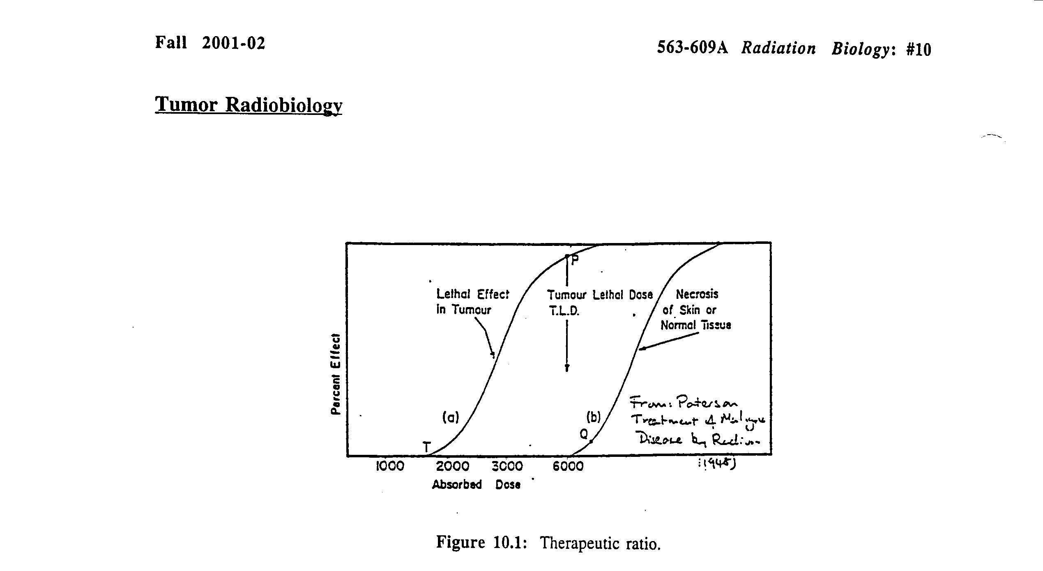
Dose Response Curves
TCP
NTCP

Slide 27
Why Daily treatments? Four R’s of radiotherapy:
Repair of sub-lethal damage
Re-oxygenation
Repopulation
Redistribution

Slide 28
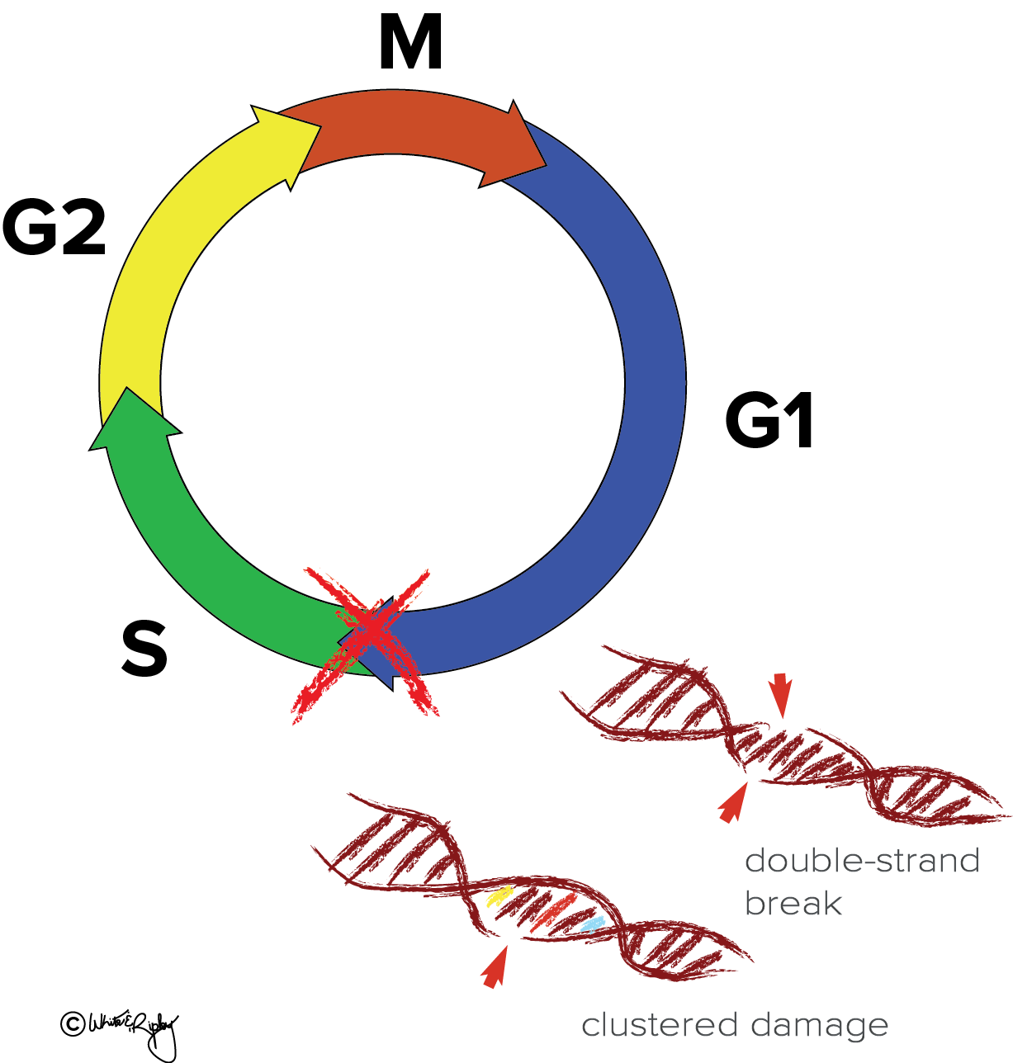
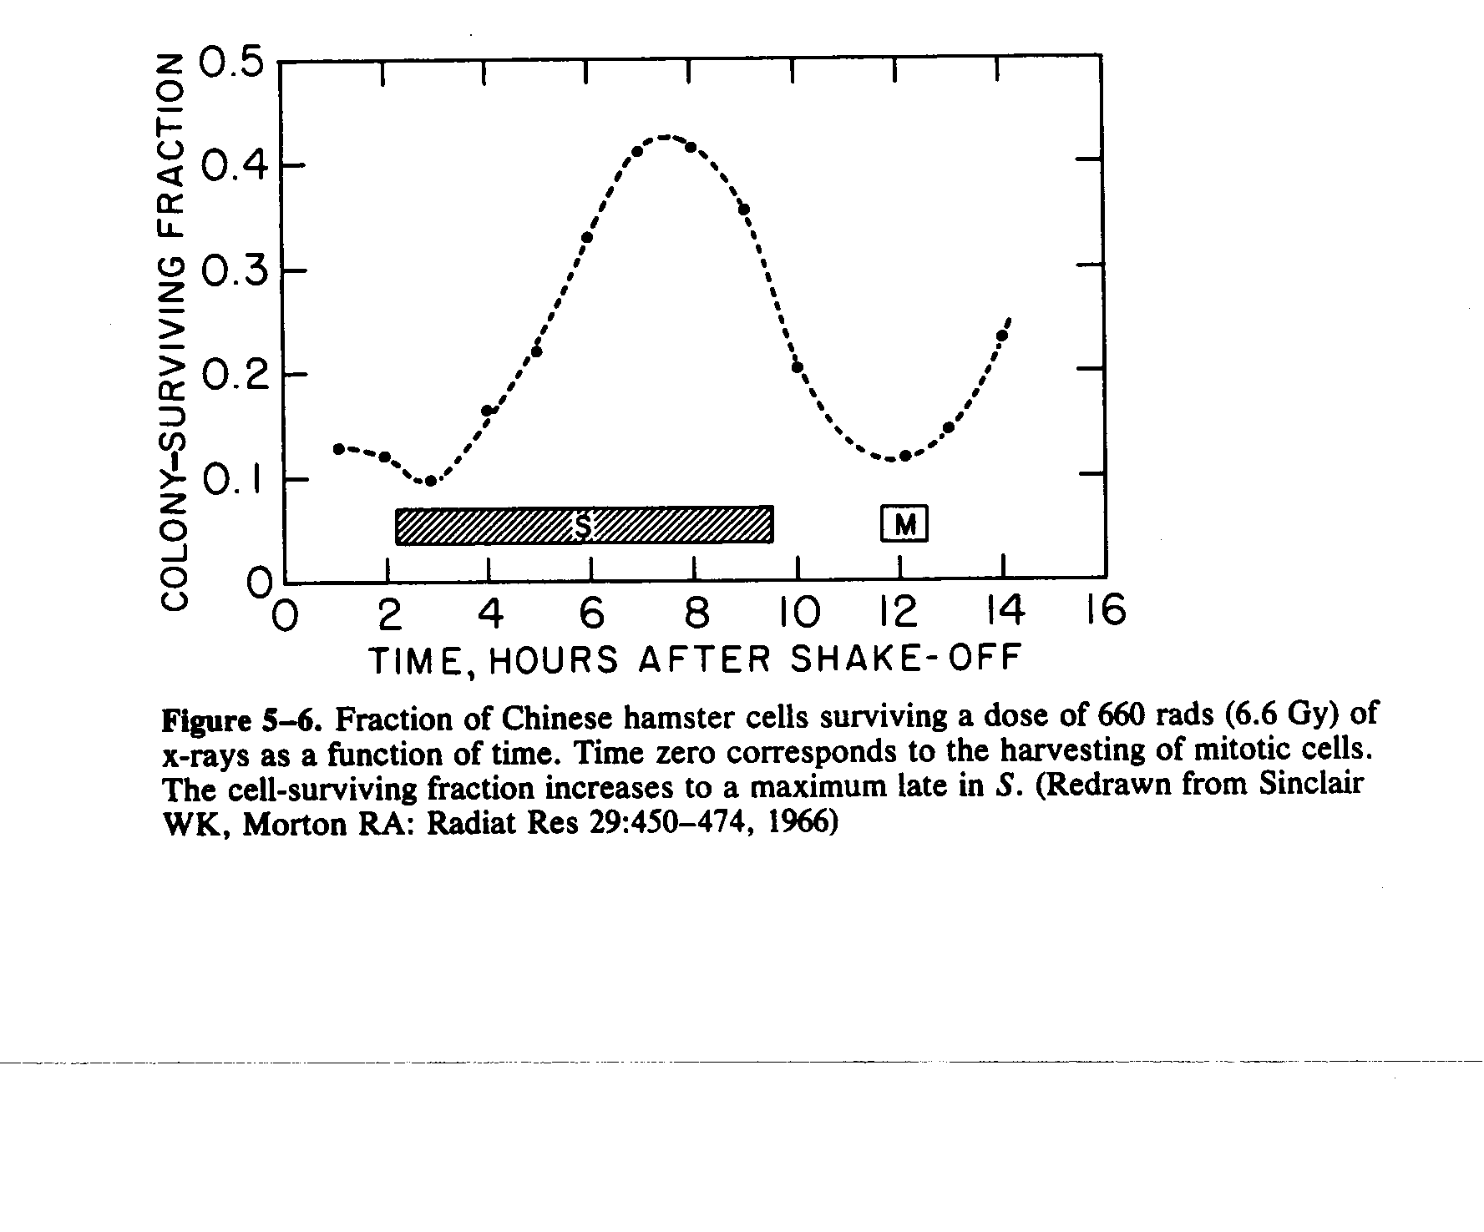
Repair of DNA damage: of “sublethal” damage human tumors/normal tissues difference in radiosensitivity and radiocurability is based on differences in capacity to repair of sublethal damage.
Redistribution in the cell cycle.
G1 (gap, inactivity, before S), S (DNA synthesis) , G2 (2nd gap between S and M) and M (mitosis).
Radiosensitivity varies along the cell cycle, S being the most resistant phase, and G2 and M the most sensitive.
Cells surviving an exposure are synchronised in a resistant cell cycle phase low sensitivity (G1). Followed by together into S and then to the more sensitive G2 and M phases.
Repopulation.
Surviving cells keep proliferating, increasing the number of clones, i.e. the number that must eventually be sterilised to eradicate cancer.
Detrimental in tumor: “resistance”
Normal tissues stem cells also proliferate, repairing sublethal damage
Reoxygenation
Of hypoxic core, “onion peel effect” of fractionated RT

Slide 29
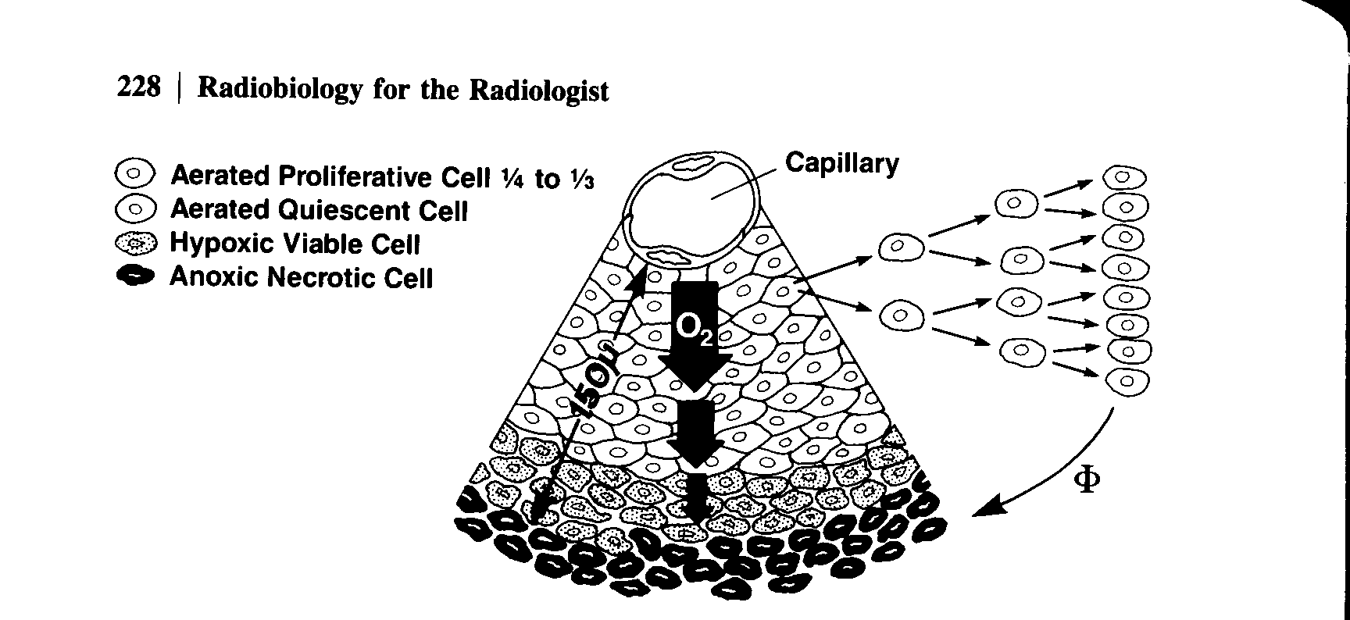
Tumor Oxygenation

Slide 30
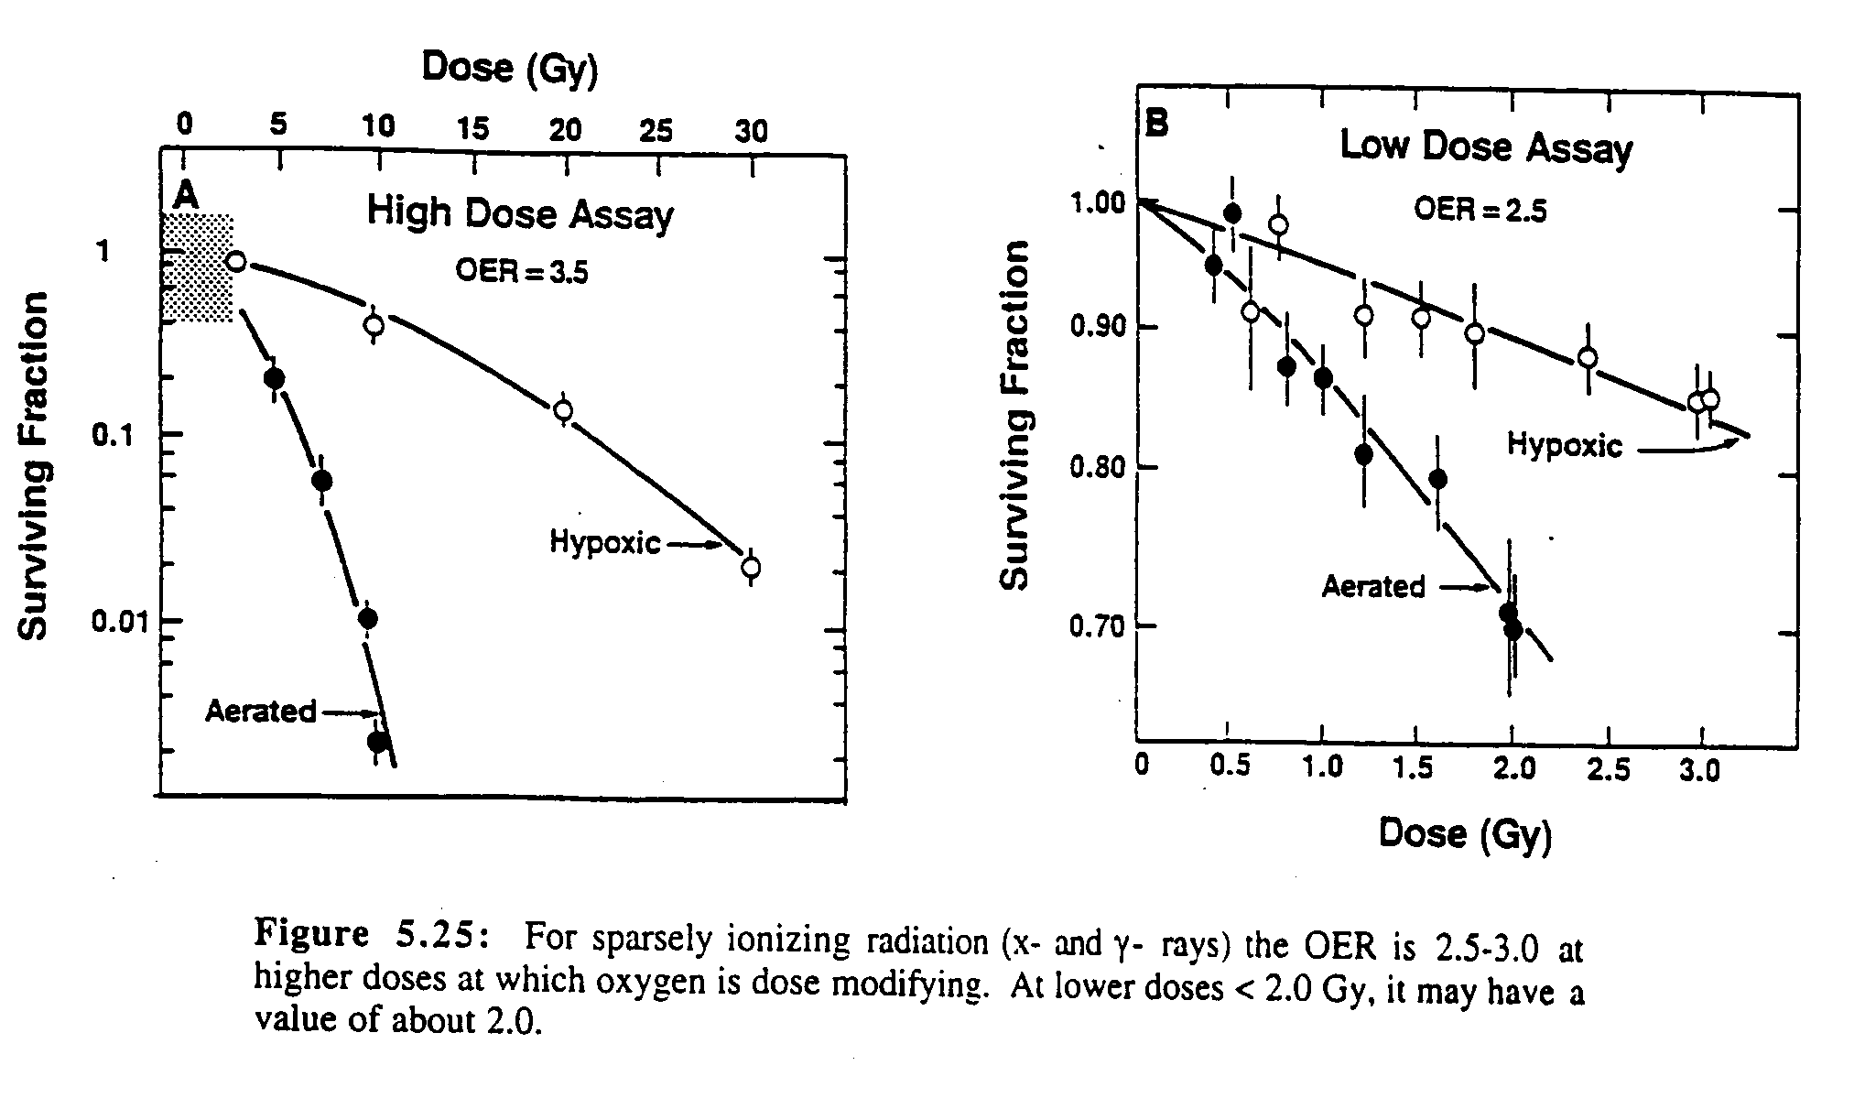
Effect of Oxygen

Slide 31
Re-oxygenation

Slide 32
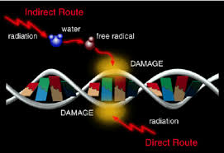
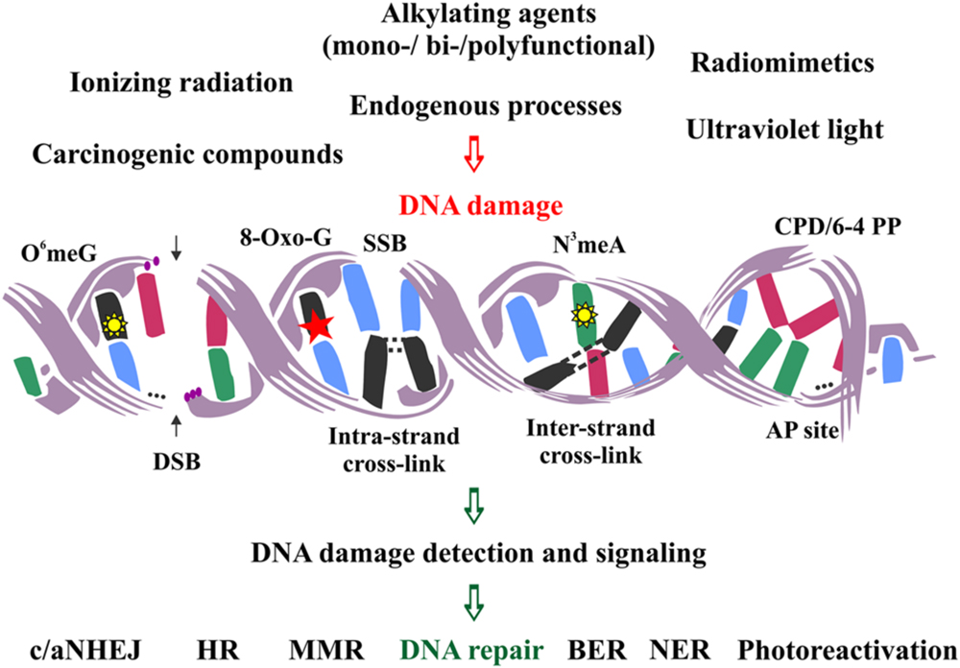
Mechanism of cytotoxicity

Slide 33
Interactions of Charged Particles
Ionization and excitation
Mediated by Coulomb force (electric fields of particle & material)
Heavy charged particles give rises to nuclear reactions (positrons emitters)
Rate of energy loss proportional to square of charged particle and inversely to square of its velocity “Bragg peak”

Slide 34
Chromosomal Damage
Apoptosis
Reproductive death
Necrosis

Slide 35
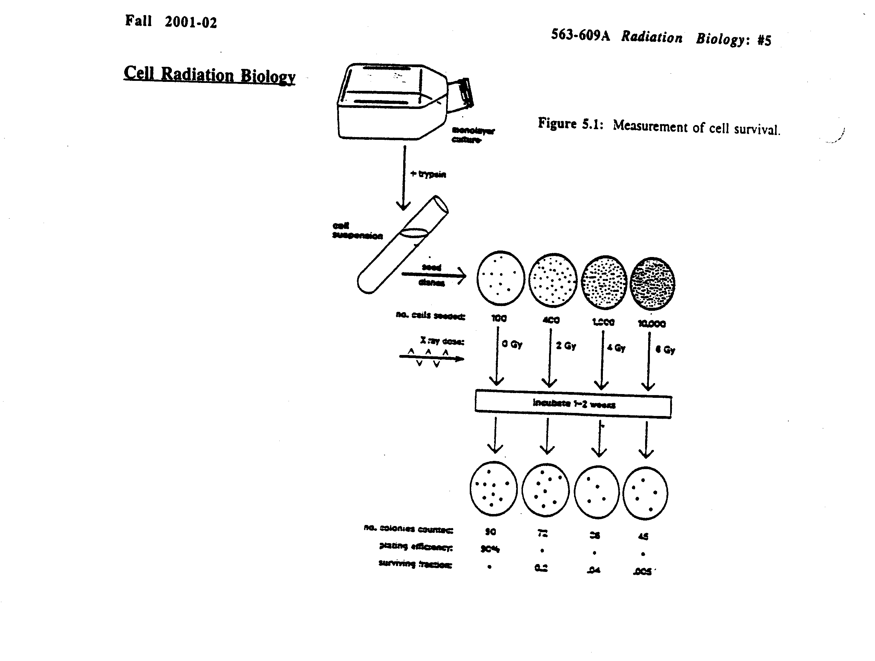
Cell survival curves

Slide 36
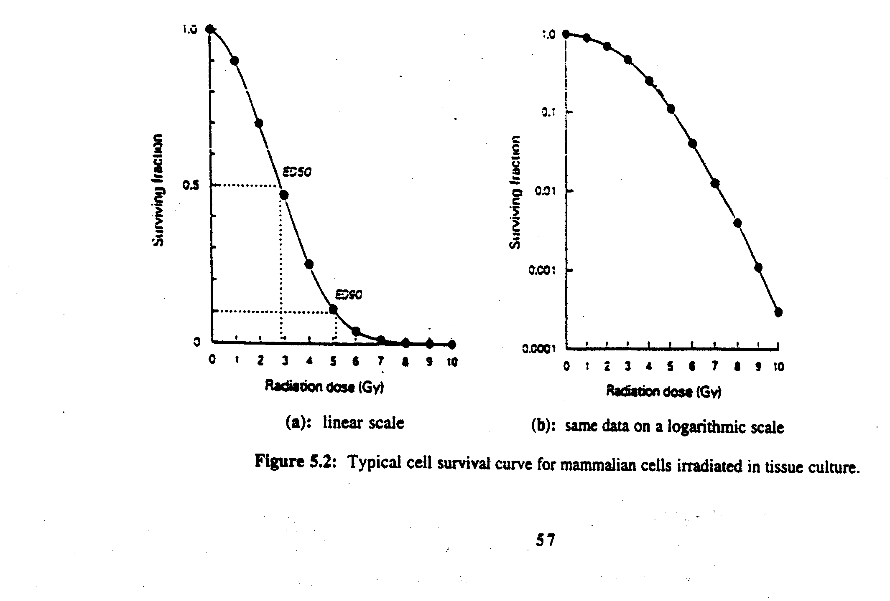
Cell Survival Curves

Slide 37
Hum! What do I make of
IR, DNA, RBE, OER…
lets see?

Slide 38
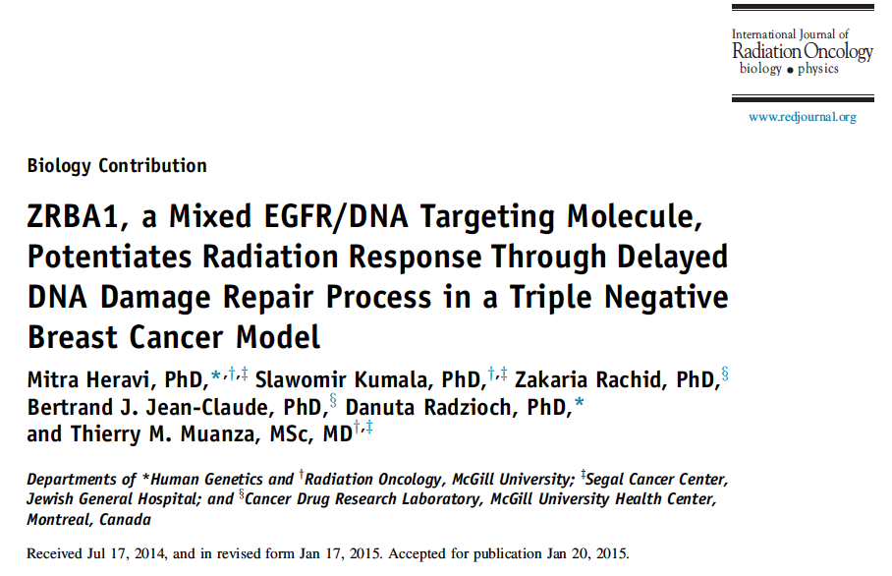
Experimental

Slide 39
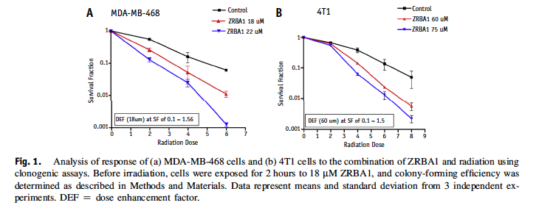

Slide 40
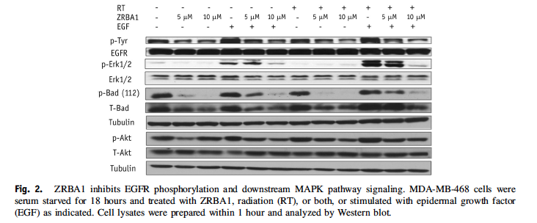

Slide 41
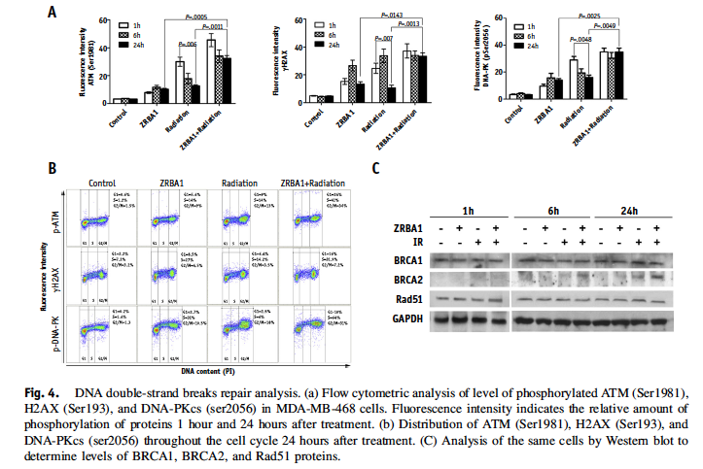

Slide 42
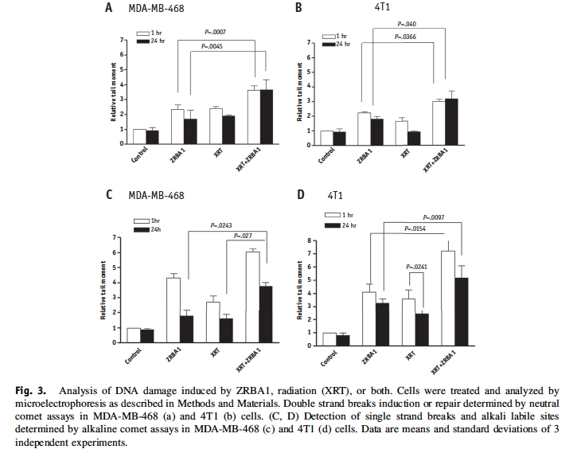

Slide 43
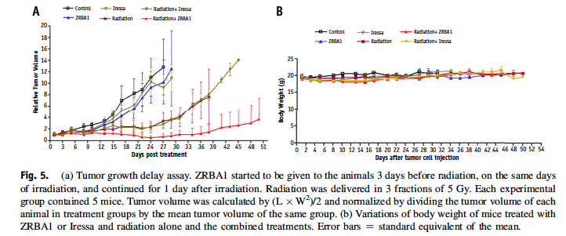
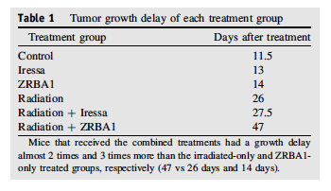

Slide 44
Radiotherapy delivery :
External beam radiotherapy:
Photons:
X-rays: Linear accelerators.
γ-rays: Cobalt machines.
Particles:
Electrons.
Neutrons.
Protons.
Brachytherapy:
Interstitial.
Intracavitary.
Intraluminal.

Slide 45
Linear Accelerator
Modern linacs:
changed in technology: beam generation and beam collimation
Increased beam energy: 6-10-15-18-21 MV
Real time imaging: CBCT

Slide 46
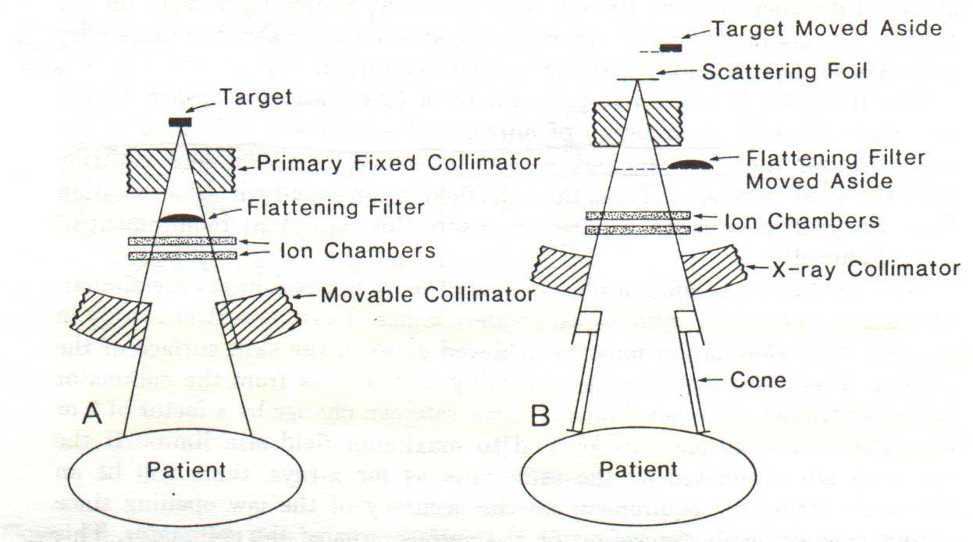

Slide 47
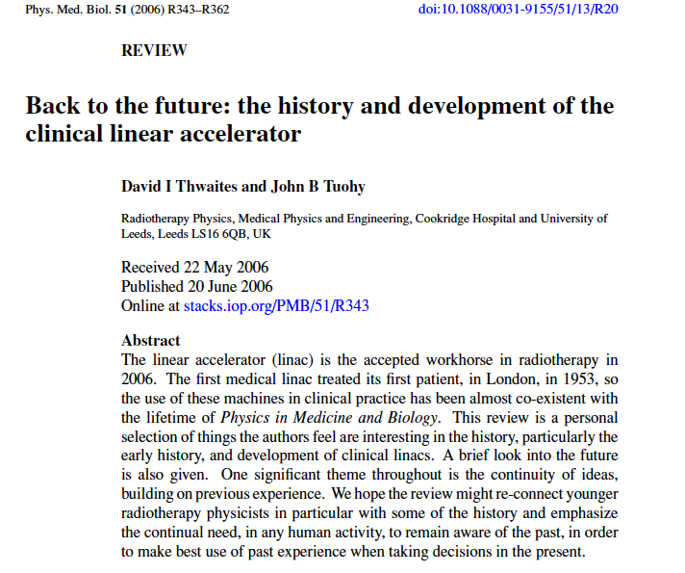

Slide 48
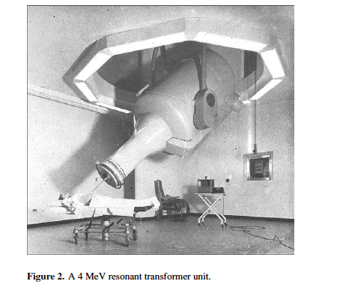

Slide 49
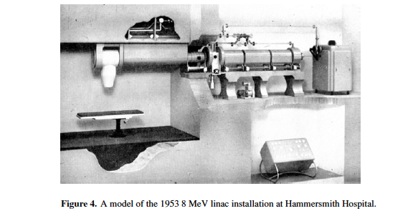

Slide 50
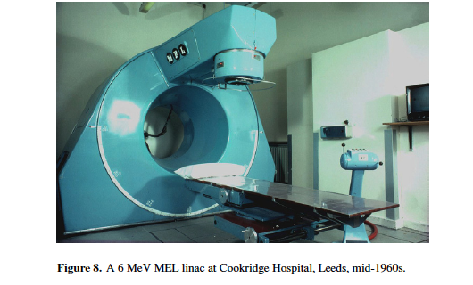

Slide 51
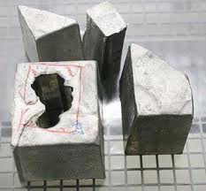
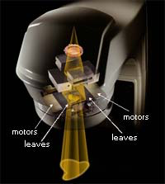
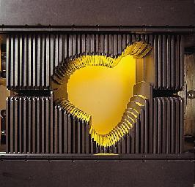

Slide 52
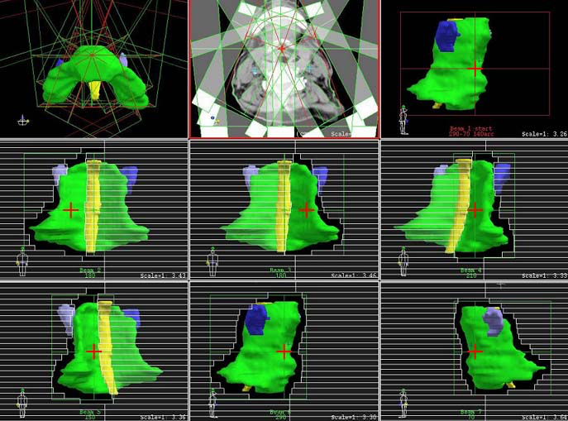

Slide 56
All high level radiosurgery linear accelerators (Novalis Tx, Axesse, TrueBeam and CyberKnife…) and cobalt machines (Gamma Knife) are both robotic and image guided.

Slide 57
201 cobalt-60 sources

Slide 59
XRT Treatment Volumes

Slide 60
Treatment Sequence
Patient referral to oncology
Investigations | History, physical examination, imaging, biopsy, pathology
Cancer staging | T = tumor size N = lymph node extension M = metastasis
Multidisciplinary Tumor Board | Surgeon, radiation oncologist, medical oncologist, pathologist & radiologist | Treatment recommendations / clinical trials
Radiotherapy | CT simulation: immobilisation, isocenter, marking CT planning: image fusion (US/MRI/PET) Target volumes delineation Treatment planning/dosimetry/Physics - QA

Slide 62
EBRT
2D
TV: GTV, CTV, PTV
OAR: organs at risk: normal critical structures within the radiation fields that required protection during treatment planning
IGRT
3D conformal radiation therapy is a cancer treatment that shapes the radiation beams to match the shape of the tumor
The goal of three-dimensional conformal radiotherapy (3D-CRT) is to deliver a conformal dose distribution to tumors, while sparing surrounding normal structures. The use of patient specific 3D images in the treatment planning process distinguishes 3D-CRT from conventional radiotherapy.
IMRT
Intensity-modulated radiation therapy (IMRT) is a type of conformal radiotherapy that uses a linear accelerator to deliver an advanced type of high-precision radiotherapy that shapes the radiation beam to closely fit the area of the tumour. The linear accelerator has a device called a multileaf collimator which is made up of thin leaves which move independently and form shapes that fit precisely around the treatment area. This means that the tumour receives a high dose and normal healthy cells nearby receive a much lower dose. IMRT allows the dose to be shaped to the tumour by modulating—or controlling—the intensity of the radiation beam. This allows different doses of radiation to be given across the tumour.
VMAT
Volumetric Modulated Arc Therapy (VMAT) is a new type of IMRT. The linear accelerator rotates around the patient during treatment. The machine continuously reshapes and changes the intensity of the radiation beam as it moves around the body. Giving the radiotherapy in this way makes it very accurate, shortens the treatment time, and uses a lower overall dose of radiation.
DVH

Slide 67
Positron emission tomography. Positron-emission tomography (PET) is a nuclear medicine functional imaging technique that is used to observe metabolic processes in the body as an aid to the diagnosis of disease.
The uptake of ¹⁸F-FDG by tissues is a marker for the tissue uptake of glucose, which in turn is closely correlated with certain types of tissue metabolism. After ¹⁸F-FDG is injected into a patient, a PET scanner can form two-dimensional or three-dimensional images of the distribution of ¹⁸F-FDG within the body.
Other tracers:
18-FLT
FMISO
Choline
PSMA…

Slide 82
An MRI or magnetic resonance imaging is a radiology techinque scan that uses magnetism, radio waves, and a computer to produce images of body structures. The MRI scanner is a tube surrounded by a giant circular magnet. The patient is placed on a moveable bed that is inserted into the magnet. The magnet creates a strong magnetic field that aligns the protons of hydrogen atoms, which are then exposed to a beam of radio waves. This spins the various protons of the body, and they produce a faint signal that is detected by the receiver portion of the MRI scanner. A computer processes the receiver information, which produces an image.
MRI image and resolution is quite detailed, and it can detect tiny changes of structures within the body. For some procedures, contrast agents, such as gadolinium, are used to increase the accuracy of the images.

Slide 83
Brain Metastasis
Most common intracranial tumours
170,000 – 200,000 new diagnoses per year in US alone but precise incidence unknown.
Occur 25% - 30% of cancer patients
Incidence increasing
Aging population, increase in cancer
Better treatment leading to prolonged survival and emergence of brain mets
Mean age at presentation is 55-65 years
Kaye A, Laws E. London, NY: Churchil Livingstone; 2001

Slide 84
Epidemiology
Most common source of brain mets: Lung cancer
Primary Tumor
Relative Prevalence of Brain Metastases
Colon: 5%
Melanoma: 9%
Unknown primary: 11%
Other known primary: 13%
Breast: 15%
Lung: 48%
Wen PY, et al. In: DeVita VT Jr, et al (eds). Cancer: Principles & Practice of Oncology. 2001:2656-2670
Notes:
Most common source of brain mets: Lung cancer comprises almost 50% of all intracranial metastases.
Other sites:
Breast 15-20%
Melanoma 10-15%
Tumors of unknown origin 10-15%
Colorectal 2-12%
Kidney 1-8%

Slide 85
Pathophysiology
Metastasis via hematogenous spread
Tend to occur directly beneath the gray-white junction where blood vessels decrease in diameter, or the terminal “watershed areas” of arterial circulation
Distribution according to relative blood flow
Cerebral hemispheres (~80%)
Cerebellum (15%)
Brain stem (5%)
Areas receiving more blood tend to have more mets
Notes:
The distribution of brain mets correlates with relative weight and blood flow:

Slide 86
Treatment options
Surgery +WBRT
WBRT + SRS
Surgery or SRS alone
Surgery SRS
Best supportive care
Chemotherapy

Slide 90
SRS

Slide 99
BRACHYTHERAPY
Brachytherapy is a form of radiotherapy where a sealed radiation source is placed inside or next to the area requiring treatment.
Intracavitary/intraluminal/interstitial
LDR: 0.4 and 2 Gy/hr
HDR: >12 Gy/hr
Inverse Square Law:
The tissues around the treated tumour receive a much lower dose than anticipated by other radiation methods.

Slide 104
BRACHYHDR remote afterloader

Slide 108
Role of Radiotherapy:
Cancer treatment:
Curative Primary:
Prostate cancer.
Cancer of the head and neck region (early stage)
Hodgkin’s disease.
Cervix cancer.
Curative as part of a combined approach:
Lung cancer.
Non-Hodgkin Lymphoma.
Cancer of the Head and Neck Region (advanced stage)
GI malignancies

Slide 109
Role of Radiotherapy:
Cancer treatment:
Curative Adjuvant to surgery:
Breast cancer.
Sarcoma.
Cancer of the Head and Neck region.
Carcinoma of the rectum.
Tumors of the Central Nervous Systems

Slide 110
Role of Radiotherapy:
Cancer treatment:
Palliative treatment:
Pain: Bone metastasis
Bleeding: Hemoptysis, Hematuria.
Obstructive or compressive symptoms:
Superior vena cava
Spinal cord compression
Brain metastasis.

Slide 111
Role of Radiotherapy:
Treatment of begnin disease:
Prophylaxis of heterotopic bone formation.
Arterio-venous malformation.
Grave’s disease.
Keloids.
Pterygium.

Slide 112
Timing and clinical manifestation of radiation injury
1. Acute clinical period 0-6 months
2. Sub-acute period 6-12 months
3. Chronic clinical period 1-5 years
4. Late clinical period

Slide 113
Acute versus late injury
Timing depends on cell cycle kinetics
Clinical importance: reversible versus irreversible
Correlation between acute and late complications

Slide 114
Factors affecting radiation damage
1. Volume to be irradiated
2. Total dose
3. Fraction size
4. Concomitant treatment

Slide 115
Total body irradiation
Dose Effects
Group I 0.5-1.5 Gy Minimal
Group II 1.5- 4 Gy Mild N/V
Group III 4- 6 Gy Hemopoietic
Group IV 6- 14 Gy GI
Group V > 50 Gy CNS

Slide 118
Radiation-Induced Malignancy
1. There is no threshold
2. Long latent period
3. Within the radiation ports
4. Different organ sensitivity
Thyroid, breast, lungs
Skeletal muscle

Slide 120
Charged Particles Therapy

Slide 121
Advantages
Superior dose distribution vs. photons
Hypothesis
Improvement in treatment-related toxicity
Would allow for dose-escalation studies
Should improve local control
May improve overall survival

Slide 127
Charged-particle therapy in cancer: clinical uses and future perspectives
Radiotherapy with high-energy charged particles has become an attractive therapeutic option for patients with several tumour types because this approach better spares healthy tissue from radiation than conventional photon therapy. The cost associated with the delivery of charged particles, however, is higher than that of even the most elaborate photon-delivery technologies. Reliable evidence of the relative cost-effectiveness of both modalities can only come from the results of randomized clinical trials. Thus, the hurdles that currently limit direct comparisons of these two approaches in clinical trials, especially those related to insurance coverage, should be removed. Herein, we review several randomized trials of charged-particle therapies that are ongoing, with results that will enable selective delivery to patients who are most likely to benefit from them. We also discuss aspects related to radiobiology, including the immune response and hypoxia, which will need to be taken into consideration in future randomized trials to fully exploit the potential of charged particles.

Slide 130
Charged-particle therapy in cancer: clinical uses and future perspectives
charged particles, which include protons and heavy ions (typically carbon).
approximately two-thirds of patients with cancer who are treated with radiotherapy
>80% receive X‑rays vs. ~0.8% receive radiation from high-energy charged particles
FIG.1: geographical distribution of CPT

Slide 132
CPT energy deposited per unit track increases with depth reaching a sharp & narrow maximum peak close to the end of the range, Bragg Peak (BP)
CPT lower dose to none-malignant normal tissue(s) & OAR (organs at risk)

Slide 133
To cover the 3D geometry of a tumor the BP has to be widened: spread out Bragg Peak (SOBP)
SOBP is achieved by:
Passive scattering of monoenergetic beam
PBS: pencil beam scanning
IMPT: intensity modulated proton therapy

Slide 134
RBE
relative biological effectiveness: ratio of biological effectiveness of one type of ionizing radiation relative to another, given the same amount of absorbed energy

Slide 140
With CPT a given tumor radiation dose (TCP: tumor control probability) can be achieved at lower integral dose to nonmalignant tissue(s) and OAR (reducing NTCP: normal tissue complication probability)

Slide 143
Clinical Trials
Challenges:
Superiority of CPT based on outcomes: morbidity (treatment related toxicity), QOL(quality of life) requiring long follow-ups and surveillance…cost
Ethics: access, pediatrics
Insurance coverage: access to CPT
Limited # CPT centers: patients QOL: travel/accommodations
Different beam-delivery technologies: PS vs. PB

Slide 146
Radioresistant/Hypoxic tumors:
Hit & ETOILE trials

Slide 147
Figure 1 The tumour promoting and inhibitory effects of anticancer agents: Yin and Yang effects
Shaked, Y. (2016) Balancing efficacy of and host immune responses to cancer therapy: the yin and yang effects
Nat. Rev. Clin. Oncol. doi:10.1038/nrclinonc.2016.57
Notes:
Figure 1 | The tumour promoting and inhibitory effects of anticancer agents: Yin and Yang effects. The illustration provides examples describing the antitumour activity (the 'Yang') of anticancer drugs, and the protumorigenic and pro-metastatic activities (the 'Yin') resulting from the host response to therapy.

Slide 148
Fig. 1. An 85-year-old patient received 50.4 GyE in 12 fractions for an ascending colon carcinoma at National Institute of Radiological Sciences, Chiba, Japan (A). At the time of treatment the patient had mediastinal lymph node metastasis, at computed tomography and methionine positron emission tomography imaging (B). Six months after treatment, resolution of both the irradiated lesion (A) and the metastasis occurred (B).
Courtesy of Dr Shigeru Yamada
Durante, M., Brenner, D. J. & Formenti, S. C. Does heavy ion therapy work through the immune system? Int. J. Radiat. Oncol. Biol. Phys. 96, 934–936 (2016).

Slide 149
Abscopal Effect
Before ipilimumab
Progression on Ipi
1 month after RT
4 months after RT
10 months after RT
9.5 Gy x 3 f
Postow et al. N Engl J Med 366:925-31, 2012
Notes:
White arrows indicate the paraspinal mass, red circles indicate the right hilar lymphadenopathy and spleen, and black arrows indicate an incidental hepatic hemangioma.
B) enlargement of the paraspinal mass (top), stable right hilar lymphadenopathy (middle), and new splenic lesions (bottom).
C) images 1 month after RT, when the response to RT had not yet occurred, with apparent continued worsening disease at all three sites.
D) Several months after RT, the targeted paraspinal mass showed a response (top). Furthermore, disease response outside of the radiation field was seen with decreased right hilar lymphadenopathy (middle) and resolution of splenic lesions (bottom).
E) The response was durable, as shown in Panel E
The isodose lines represent total doses of 2850 cGy (pink), 2000 cGy (orange), 1000 cGy (green), and 200 cGy (blue).
Immunologic correlates: Tumor shrinkage with antibody responses to the cancer–testis antigen NY-ESO-1, changes in peripheral-blood immune cells, and increases in antibody responses to other antigens after radiotherapy.

Slide 151
Radiotherapy Fight against Cancer

Slide 152
Radiotherapy Fight against Cancer
RT mainstay of cancer care along with surgery and systemic therapy
Local: surgery & RT
Systemic: chemotherapy/hormonotherapy/molecular targeted therapy/immunotherapy/vaccines
~50% of cancer patients will receive RT during the course of their cancer care
RT contributes to 40% curative treatment of care

Slide 153
AACR 2023 Report
Cancer in 2023
In this section, you will learn:
In the United States, the overall cancer death rate has been steadily declining since the 1990s, with the reductions between 1991 and 2020 translating into more than 3.8 million cancer deaths avoided.
The decline in overall U.S. cancer death rates is driven by steady declines in mortality from cancers of the breast, colon and rectum, lung, and prostate.
More than 18 million cancer survivors were living in the United States as of January 1, 2022.
Progress has not been uniform against all cancer types or all subtypes and stages of a given cancer type.
There are stark inequities in the cancer burden among many sociodemographic groups within the United States; these inequities occur across the cancer continuum and are driven largely by social factors.
The economic burden of cancer both on individuals and the U.S. health care system is expected to rise in the coming decades, highlighting the urgent need for more research to accelerate the pace of progress against cancer.

Slide 154
Conclusions
Radiotherapy is main stay of cancer treatments
~ 50% require radiotherapy in course of their cancer care
Radiotherapy contribute to 40% of cancer
Synergy and optimization of combined therapy: chemo/targeted/immune/vaccines
Fight against cancer: moral/ethical/noble goal
AACR 2023 annual report: decrease mortality and increased survivorship from integrated (multi & interdisciplinary) programs and clinical trials
Great vision and ongoing efforts in RDC: CNLC & CGEA …

Slide 155
?
Thank you

Slide 156
Some References
Podgorsak, E.B., Radiation Physics for Medical Physicists, 2nd ed., 2010, XXXIII, 745 p. 190 illus., 16 in color., HardcoverISBN: 978-3-642-00874-0
Khan, F.M. The Physics of Radiation Therapy, Williams & Wilkins, Baltimore
Hall, E.J. Radiobiology
https://ascopost.com/news/september-2023/aacr-issues-annual-cancer-progress-report/
https://www.afro.who.int/sites/default/files/2017-06/WHOCancerBrochure2007.FINAL_.pdf

