Slide 1
OSSR Open Collaboration Meeting
16/17th of November 2023
Kay GRAF
ECAP, Erlangen Centre for Astroparticle Physics, Friedrich-Alexander-Universität Erlangen-Nürnberg

Slide 2
Slides for Session:
Policy & Strategy

Slide 3

Points for the next 1.5 days
Policy & Strategy:
  Thursday:
    Introduction - ESCAPE Collaboration
    RSD - as front page of OSSR: automatic or opt-in model, push & pull approach
    Onboarding: who to intensify and incentivise
  Friday:
    OSCARS, EVERSE introduction
    Gathering of interests and needs of ESFRIs (along task areas - provide guiding questions before)
      alignment with OSCARS calls
      alignment with EVERSE tasks
Technial Discussions:
  Zenodo Update
  Hackaton:
    Onboarding Workflow
    Issue & MR Closing on eOSSR Library
Onboarding:
  onboarding talks - no current new onboardings

Slide 4
Future of ESCAPE
reminder
ESCAPE transforms into the ESCAPE Open Collaboration
  Partners use reasonable endeavours to achieve the objectives
  Work managed according to workplan and current organisational structure
  Partners contribute the time and effort necessary to complete the work
Work Plan (currently) with 12 points
  Common infrastructure, repository and catalogue for software, VRE, collaborative operations, citizen science, advanced technologies, HPC community, virtual software institute, career development, science projects, European Strategy for Data
Strive to include new partners
(e.g. for onboarding following “train the trainers”)

Slide 5
ESCAPE EOSC to cell evolve to
reminder
G. Lamanna,
ESCAPE to the Future
Notes:
Data Lake:
Build a scalable, federated, data infrastructure as the basis of open science for the ESFRI projects within ESCAPE. Enable connection to compute and storage resources.
Software Repository:
Repository of "scientific software" as a major component of the “data” to be curated in EOSC. Implementation of a community-based approach for the continuous development of shared software and for training of researchers and data scientists.
Virtual Observatory:
Extend the VO FAIR standards, methods and to a broader scientific context; prepare the VO to interface the large data volumes of next facilities.
Science Platforms:
Flexible science platforms to enable the open data analysis tailored by and for each facility as well as a global one for transversal workflows.
Citizen Science:
Open gateway for citizen science on ESCAPE data archives and ESFRI community

Slide 6
ESCAPE Collaboration: Current Status and
Next Steps
Collection of interests and contact persons from all participating ESFRIs/institutions done
ESCAPE Review Paper in Draft – currently on hold
(was planned for Summer in as open letter to ORE)
First common meeting of (old) ESCAPE Executive Board and new E-C Executive Board on 27/11
    participants: coordinator of a working group or scientific-technical coordinator-representative of one of the ESCAPE Research Infrastructure members;
    This meeting will be mainly dedicated to share information about the activities and organisation of the working groups, interfaces with Horizon Europe/other projects funded in support of ESCAPE's work programme, and to organise the election of the Technical Coordinator (who will be the EB chairperson).
ESCAPE Project Scientist vacancy

Slide 7
ESCAPE Collaboration: Current Status and
Next Steps
Executive Board (EB) - tasks from the collaboration agreement
The EB reports to the Strategy Board (SB).
The members of the EB are the technical coordinators (or equivalent) of the RIs in the collaboration and leaders of implementation working groups. The chairperson will be nominated by the members. The chairperson will become the Technical Coordinator of the collaboration, and will have a term of 2 years, renewable.
The role of the EB is to
  Propose to the SB and coordinate agreed technical collaborative projects between the RIs;
This can include but is not limited to work on common software, infrastructure, services, etc.
The work will be executed through setting up and overseeing working groups with members drawn from the RI's as needed, and leaders of any eventual work package structure who would also be members of the EB.
  Technical coordination with the EOSC and EOSC-related projects.
The EB will meet monthly or as required.

Slide 8

OSSR Current Status
Entry page
Repository:
  Zenodo Community
  EOSC Portal Explorer
  OpenAIRE
Development Platform:
  https://gitlab.in2p3.fr/escape2020/wp3
  https://gitlab.com/escape-ossr

Slide 9
Current Activities
OSCARS and EVERSE: see presentations tomorrow
Events: CERN Open Source Programme Office (OSPO) Inauguration https://indico.cern.ch/event/1327562/, 28/11
SciCodes activities continue (e.g. CodeMeta v3 crosswalks)
OSSR paper
  Has been submitted and published: https://open-research-europe.ec.europa.eu/articles/3-46/v2

Slide 10
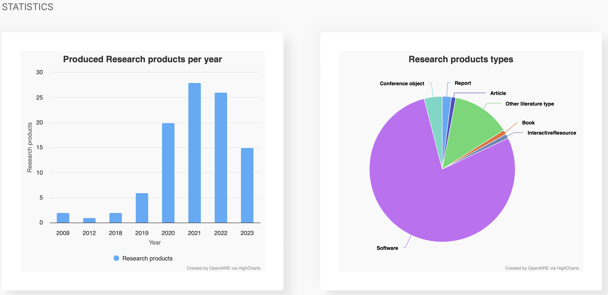
OSSR Onboarding
Statistics from EOSC Portal
How to intensify the onboarding and incentivise colleagues to onboard software?
  Outreach material
  Reach into the collaborations/RIs
Are all Onboarding steps still valid and necessary?

Slide 11
Onboarding incentives
Why?
Visibility → need to increase
Credibility → need to certify
Community → need to intensify
Interconnectivity → do we build towards this?
Who?
ESCAPE partners
Other collaborators
Wider community
What?
Provide XXX for YYY

Slide 12
Onboarding procedure
Register
Issue
Present
Talk
Integrate
Push
Verify
Curation
OSSR
entry
Community
Credibility
Visibility
Create extended form?
Forum in collaboration meetings?
…?
Certification?
Check also presentation of software
Gallery?
Interfaces?
…?

Slide 13
What to provide
For members
…?
For community
…?
… and how to distribute?

Slide 14
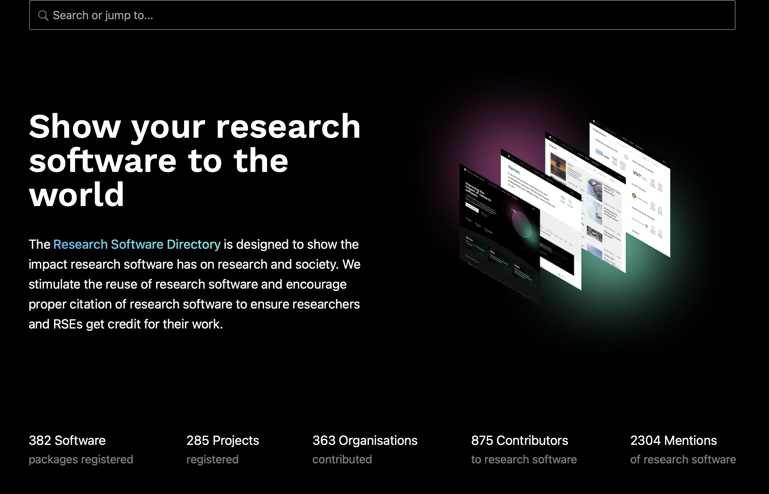
RSD as OSSR Frontend
Also an instance at https://helmholtz.software/software
OSSR-related:
FairMQ Example entries:
  RSD: https://helmholtz.software/software/fairmq
  CodeMeta: https://github.com/FairRootGroup/FairMQ/blob/master/codemeta.json
https://research-software-directory.org

Slide 15
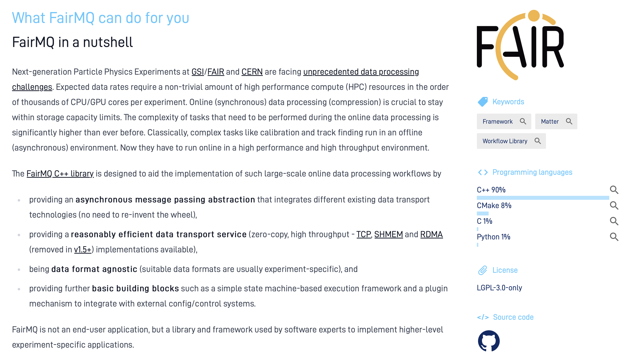
RSD as OSSR Frontend
Also an instance at https://helmholtz.software/software
OSSR-related:
FairMQ Example entries:
  RSD: https://helmholtz.software/software/fairmq
  CodeMeta: https://github.com/FairRootGroup/FairMQ/blob/master/codemeta.json
RSD developers supportive (3 meetings)
  Generation of community
  Metadata cross-walk
  Development of API and pull mode
https://research-software-directory.org

Slide 16
RSD as OSSR Frontend: Decisions
Use RSD as OSSR Frontend in general?
Should the usage be opt-in?
Use in push mode or pull mode?

Slide 17
Slides for Session:
OSSR future, relation with other projects

Slide 18
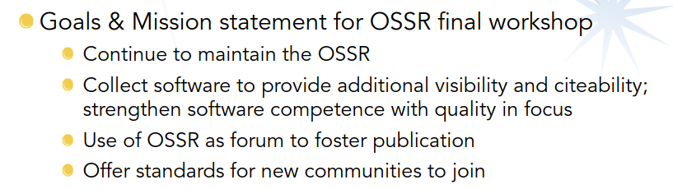
Mission goals
By software curation & standards
Sharing best practices
Enable sustainability by encouraging open source software
Foster co-development of software

Slide 19
Discussion Topics
What are the priorities for the future activities of OSSR (policy/strategy, onboarding or technical developments)?
Are there additional activities that you want to lead or want to see followed in the OSSR context (e.g. software optimisation)?
In which projects or activities related to the work of OSSR are you involved and how could those be harmonised? How could OSSR activities profit from those?
What are the incentives for your members to join OSSR and onboard software, how could those be strengthened?

Slide 20
OSSR Additional Topics
Innovative Approaches
Best practices
Software quality
Training
Software Efficiency
Organisation

