Slide 1




OSCARS project
Open Science Clusters’ Action for Research and Society
Giovanni LAMANNA
Director of the ESCAPE Open Collaboration
Director of LAPP (CNRS - IN2P3)

Slide 2

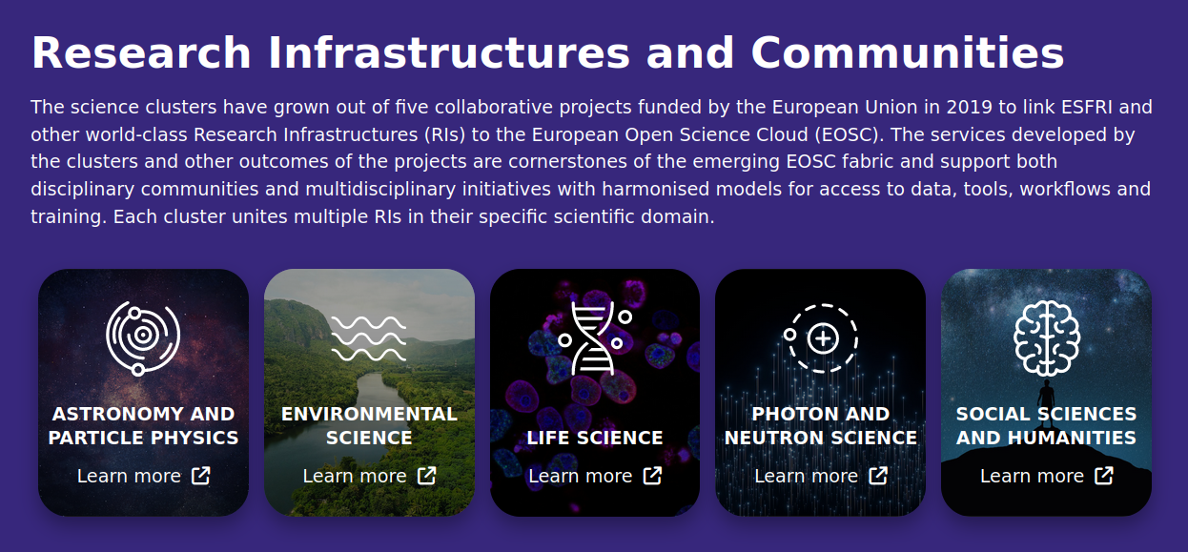

In response to the EU call on EOSC HORIZON-INFRA-2023-EOSC-01-01
Building on the Science Cluster approach
to ensure the uptake of EOSC by research communities
Partners
Coordinator: CNRS - LAPP
15 partners, 2-3 representing each Science Cluster community
https://science-clusters.eu/
Budget and timeline
Starting date: 2024-01-01
Duration: 4 years
EC funding: 25 M€ (100%)
Science Clusters fostering the uptake of Open Science in Europe

Slide 3
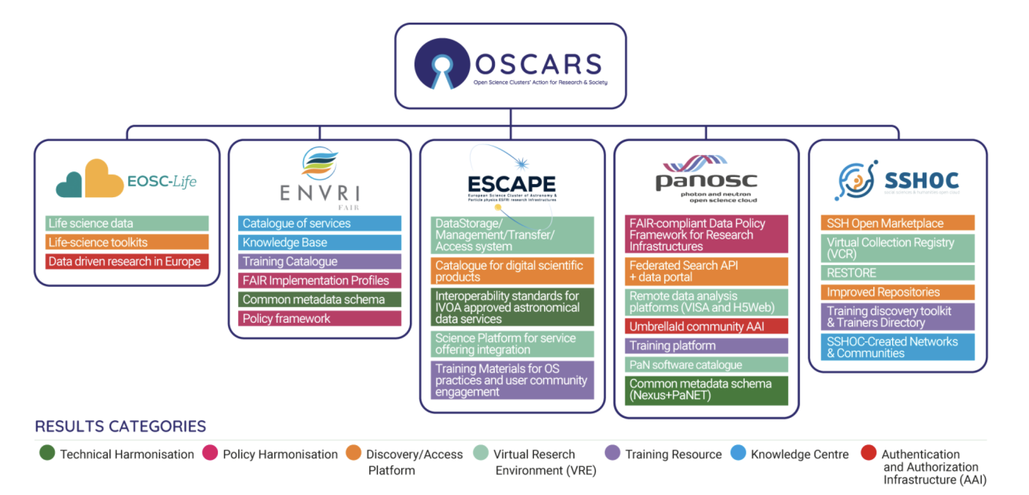
Clusters’ results

Slide 9
OSCARS’ Objectives
A) consolidating achievements from the five H2020 INFRA-EOSC-2018-01-04 projects into lasting interdisciplinary services and working practices towards:
More cohesion;
Leveraging cross-domain approach and cooperation with e-infrastructures;
Cross-fertilization for shared solutions of key services for researchers in all domains;
Cooperating and supporting the EOSC partnership.
(B) Leading and fostering the involvement of a broad range of research communities in EOSC via the development of new Open Science projects to drive the uptake of FAIR-data-intensive research throughout the ERA by:
Contributing to a data space for science, research and innovation, integrated into the other data spaces described in the European Strategy for Data.
Pursuing the creation of pan-European research-enabling value-added services;
Fostering the coordination of national activities, European RIs and the scientific community at large, including the long tail of science;
Fostering interdisciplinarity for achieving challenging new science pathways.

Slide 10
EXPECTED RESULTS
EXPECTED OUTCOMES
Open Science practice: increased scientific impacts via the support of Open Science projects;
Community-based Competence Centres (CCC), contributing to the sustainability of the Science Cluster actions, fostering their impacts, supporting and aligning operations of ESFRI and other RIs and involving the long tail of science.
Composable Open Data and Analysis Services (CODAS) onboarded into the EOSC Exchange platform, fostering the alignments of practices in scientific data analysis and enhancing researchers’ participation in Open Science.
An established inter-cluster web-based “scientific social network” in Europe. Training, mentoring, cross-disciplinary events and cross-cluster developments.
Operational Competence Centres
Uptake of web-based highly composable platforms for Open Science data analysis;
Stronger involvement of scientific communities in Open Science and the shaping of EOSC;
Enhancing and further structuring of the successful cross-fertilization work built by the Science Clusters;
Economy of scale of (cross-cluster) services;
Enable a largely participative research ecosystem, promoting provenance tracking to research outputs and contributing to the evolution of research assessment methodologies.

Slide 11
OSCARS project – OPEN CALLS
16 / 25 M€
GOAL:
Build on the science cluster approach to ensure the uptake of EOSC, i.e., consolidate FAIR services of the five Science Clusters and, more broadly, perform excellent science and pursue societal benefits by leveraging an Open Research approach.
TARGET USER COMMUNITIES:
Science Clusters and wider community (RIs, Universities, Institutes, either consortia, or individual researchers)
Submission process
Opens: ~ March 2024 / Nov. 2024
10 pages max
Submission within 60 days
Project start: Sept-Dec. 2024 / Aug-Oct. 2025
Limits
Budget: 100 - 250 k€ / project
Duration: 1 - 2 years
Evaluation criteria for the independent expert panel
Project description: clear objectives, towards FAIR and open
Scientific impacts: multiple RIs / cross-cluster
Digital resources: use of EOSC services / new EOSC service
Implementation: realistic within budget

Slide 12
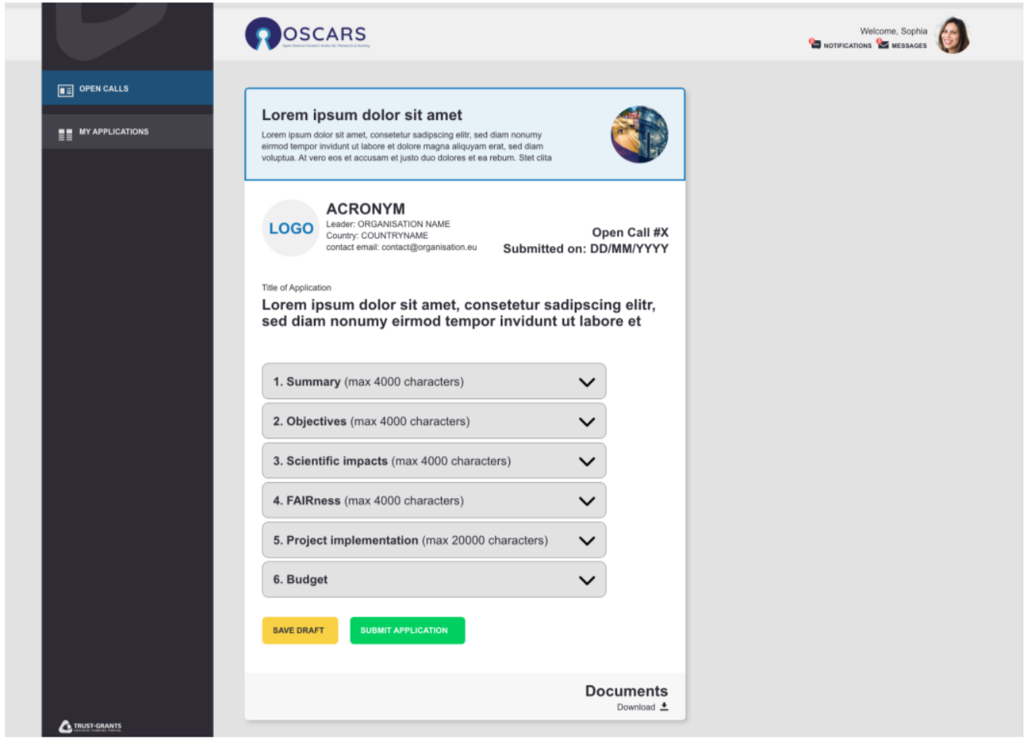
OSCARS project
OPEN CALLS – Proposal guidelines
10 pages max
Language: English
Proposals’ structure
Proposal Title and Acronym
Open Science/Data FAIRNESS challenge(s)
Domain
Consortium composition
Duration and financial support
Summary
Project description
Scientific impacts
Digital resources
Project Implementation, Budget Breakdown and Final Deliverables
MOCK-UP of cascading grants platform
Deliverables for public dissemination:
A final project summary in PDF format of maximum 5000 characters, including spaces.
A presentation
A “scientific journal or journal-type” article summarising the main project results and methodology used to achieve them.

Slide 13
EVERSE
European Virtual Institute for Research Software Excellence
Further actions are led by the Science Clusters, e.g. EVERSE
In response to the EU call on EOSC HORIZON-INFRA-2023-EOSC-01-02
Building on the Science Cluster approach
The catalogue of software will continue to be populated with new collaborative cross-border software, workflows and methods and for the benefit of the community at large.
Development of community-based approaches for ensuring and improving quality of scientific software and code highly relevant to all Science Clusters.
Establish the Virtual Research institute (VRI)
Science Clusters fostering the uptake of Open Science in Europe

Slide 14
Conclusions
OSCARS (EVERSE and others) to support the ESCAPE work plan within Horizon Europe
The 5 Science Clusters pursuing together a common programme:
      General Objectives :
    - consolidation of thematic data infrastructures (cluster VREs, platforms and a “few core services”) as parts of a federation.
    Specific Objectives:
    - relevant scientific results from clusters;
    - increased number of RIs;
    - enhance researchers uptake of OS and widening dimension.
    Operational Objectives:
    - sustainable operation of the deployed cluster as a “platform infrastructure” (e.g. CCC and VRI);
    - continuous promotion and hosting of inter-domain FAIR Science Projects.
    - domain-based (new RIs’) challenges and new Open Science Objectives (with a new cluster destination action…)

