Slide 1
Detector Development at the MPG - HLL
Alexander Bähr on behalf of the MPG-HLL

Slide 2
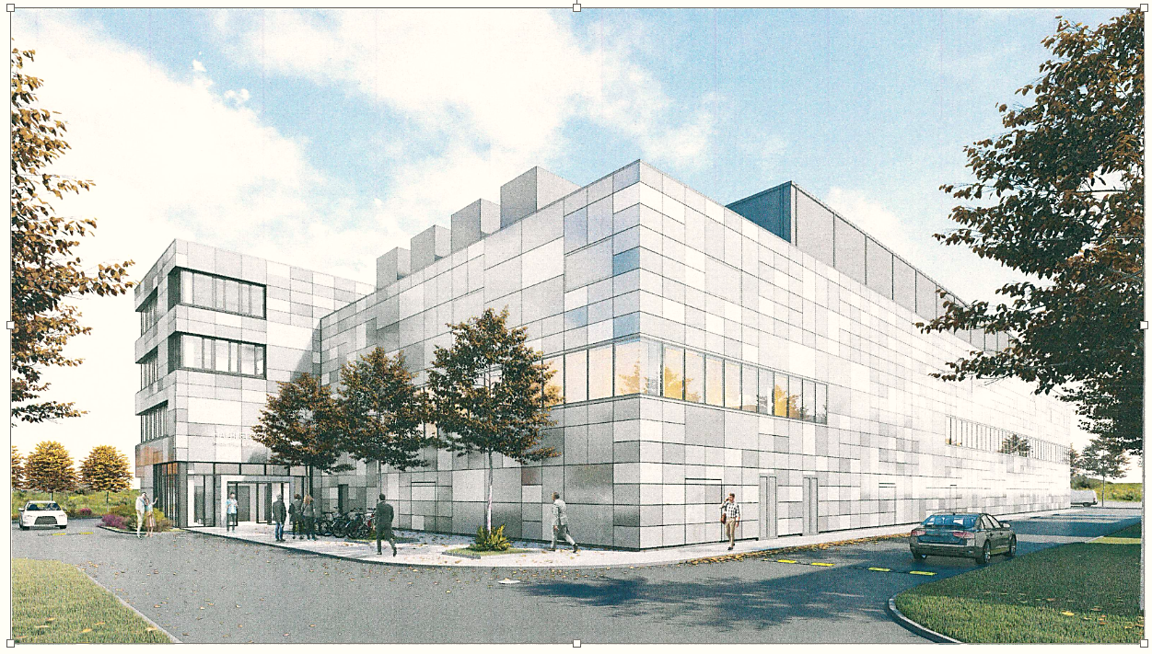
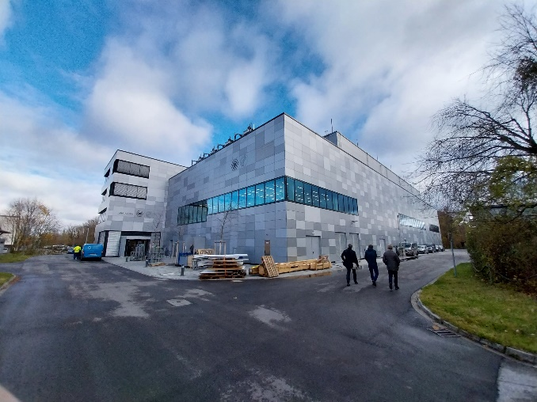
Semiconductor laboratory of the Max-Planck Society
At present @ Siemens Campus Neuperlach Munich
IPP Campus Garching
New building in autumn 2023 – move started
1000m² of clean room area
330m² of ISO3 area
Full 6 inch silicon process line
1500m² of clean room area
600m² of ISO3 & ISO4 area
8 inch silicon process line
HLL will be part of Munich Quantum Valley
Central facility of the Max Planck Society
with 40 employees: scientists, engineers and technicians + guest scientists, engineers and students

Slide 3
HLL in a nutshell
Idea for a scientific experiment
within the research institutes
Optimal sensor for the given science case
MPG HLL
Ideas, simulations,
development
Fabrication,
operational parameter extraction
quality control
Testing,
system development,
qualification
MPG HLL R&D
Assembly ,
integration,
test, verification
Scientific experiment
performed by the institute

Slide 4
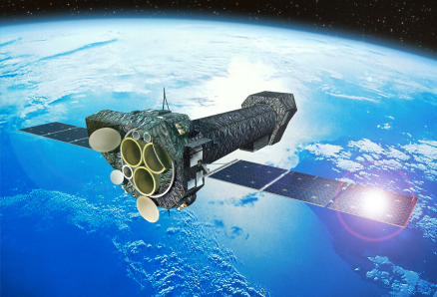
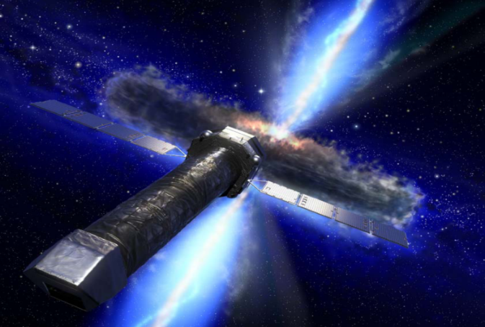
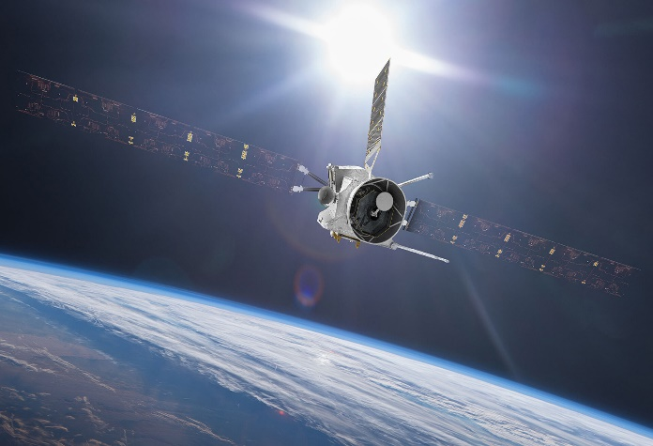
(some) HLL Sensor examples
XMM-Newton
DePFETs at KEK - Japan
electron (7GeV)
WFI aboard Athena
positron (4GeV)
  pnCCD
  X-ray imaging spectroscopy
  curtesy ESA
Vertex Detector
2 layers DEPFET
+ 4 layers DSSD
MIXS abouard BepiColombo
DePFET particle tracking
DePFET - X-ray imaging spectroscopy
curtesy ESA
We also produce
-SDD (silicon drift detectors)
-Diodes
-Avalanche Diodes
-etc.
DePFET -planetary science
curtesy ESA

Slide 5
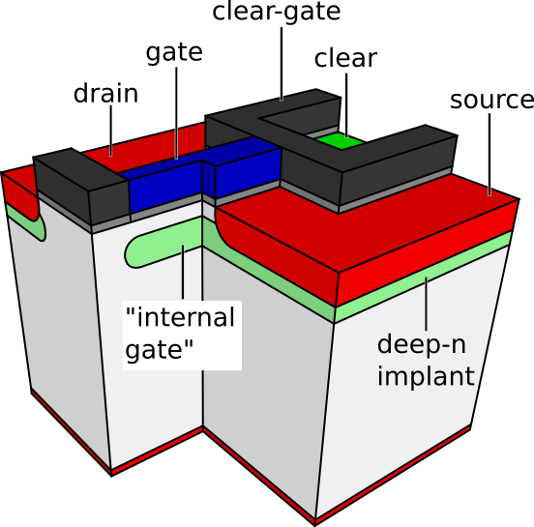
The DePFET
  MOSFET on n-substrate
  deep-n implant below gate
    positive potential
    „internal gate“ (IG)
    conductivity modulated by electrons
  reset via clear and clear gate
  good signal to noise
  unobstructed backside contact
  typical charge gain values ~420 pA/e⁻
source
clear gate
gate
Q(t)
signal(t)
drain
  Applications:
    Belle II, BepiColombo, Athena, EDET, etc.

Slide 6
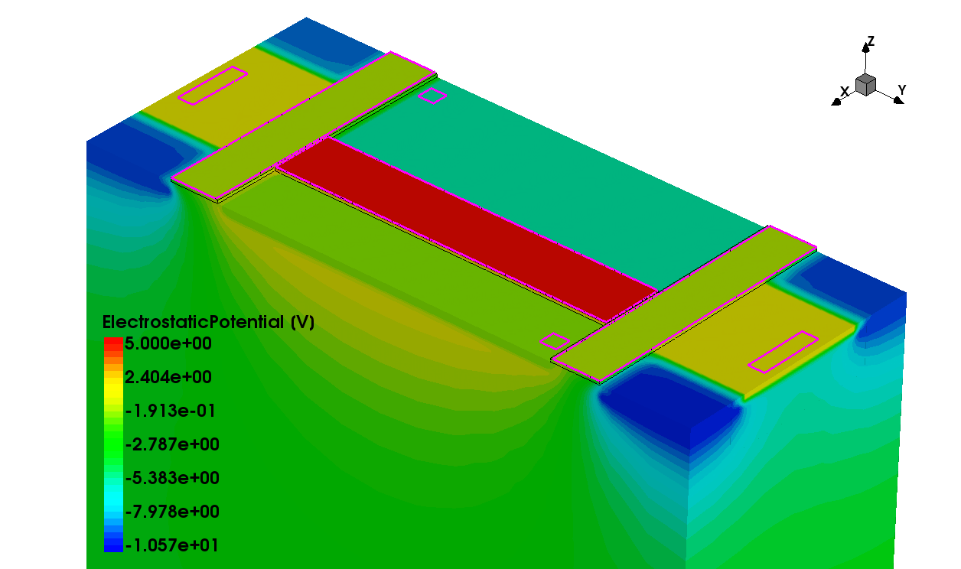
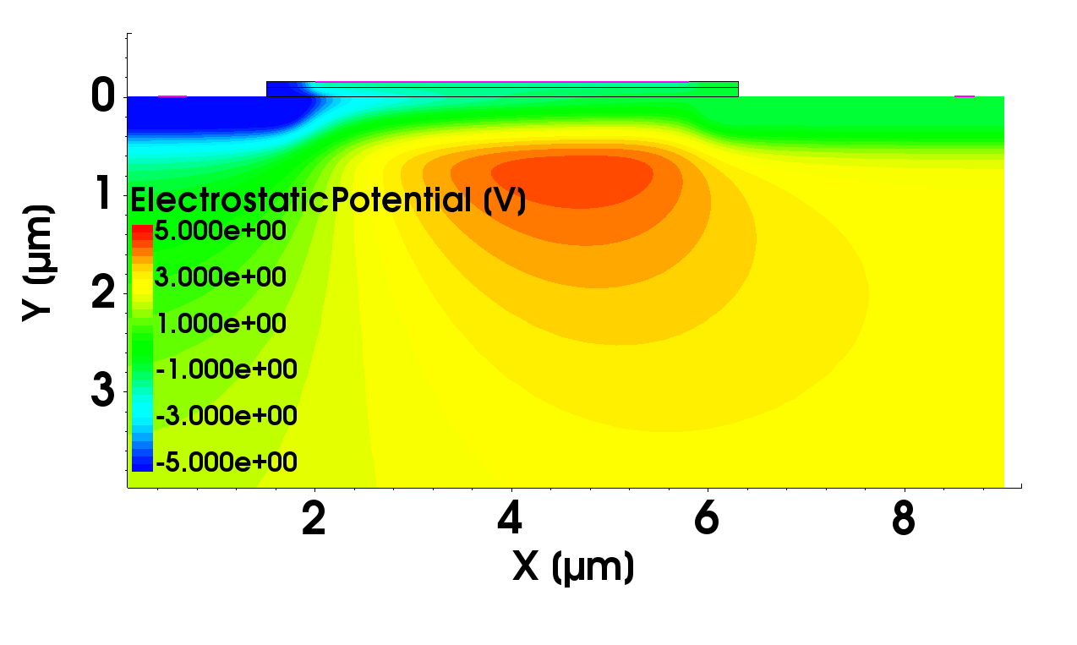
Device Simulations
gate
gate
drain
source
drain
source
clear gate
clear
internal gate
3D device simulation - study complex geometries
charge collection, clear, etc
2D device simulation – DePFET transistor properties
charge gain, noise, impact ionization, etc

Slide 7
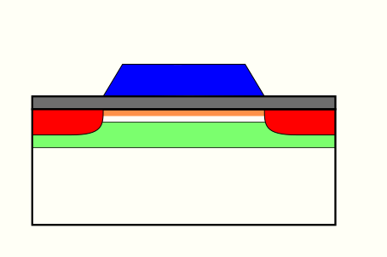
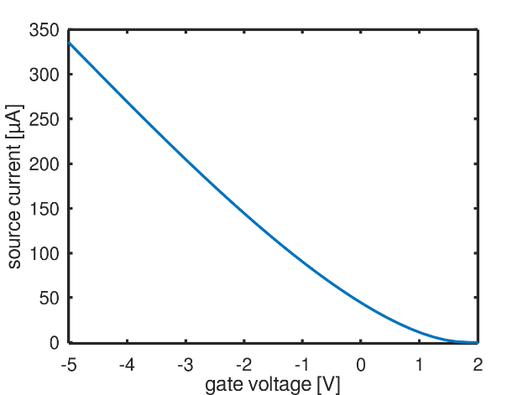

2d simulation flow
Signal Response
Process
Simulation
Electrical
Simulation
I-V characteristics
operation point
charge gain (current readout)
gain (source follower)
gate
source
Noise
drain
at the moment only white noise
$$g_{m}\left(100µA\right)=\frac{dI}{dV}$$
Impact Ionization
cause additional electrons in
the internal gate

Slide 8
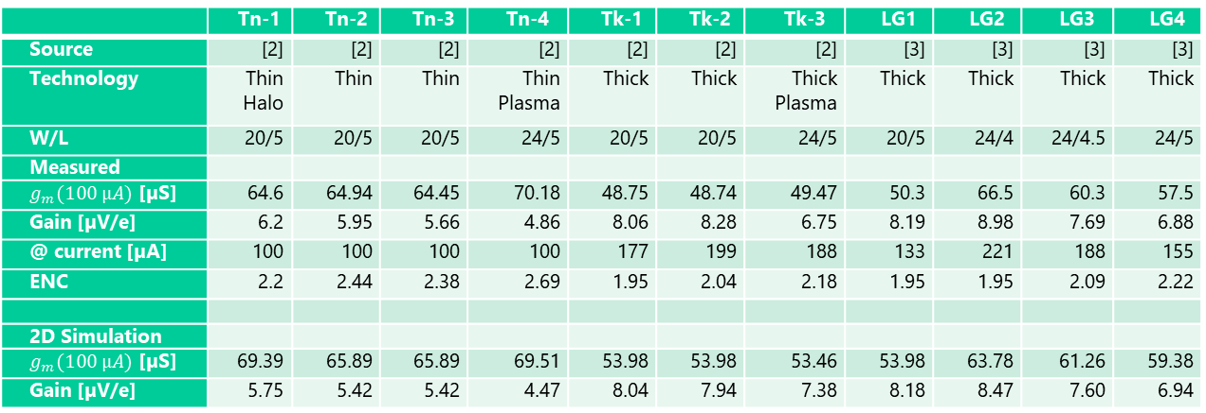
Comparing Measurements and Simulations – 2D
Measurements on Athena prototype DeFPETs
different technology, different geometry
 | Tn-1 | Tn-2 | Tn-3 | Tn-4 | Tk-1 | Tk-2 | Tk-3 | LG1 | LG2 | LG3 | LG4
Source | [2] | [2] | [2] | [2] | [2] | [2] | [2] | [3] | [3] | [3] | [3]
Technology | Thin Halo | Thin | Thin | Thin Plasma | Thick | Thick | Thick Plasma | Thick | Thick | Thick | Thick
W/L | 20/5 | 20/5 | 20/5 | 24/5 | 20/5 | 20/5 | 24/5 | 20/5 | 24/4 | 24/4.5 | 24/5
Measured
$g_{m}(100 µA)$ [µS] | 64.6 | 64.94 | 64.45 | 70.18 | 48.75 | 48.74 | 49.47 | 50.3 | 66.5 | 60.3 | 57.5
Gain [µV/e] | 6.2 | 5.95 | 5.66 | 4.86 | 8.06 | 8.28 | 6.75 | 8.19 | 8.98 | 7.69 | 6.88
@ current [µA] | 100 | 100 | 100 | 100 | 177 | 199 | 188 | 133 | 221 | 188 | 155
ENC | 2.2 | 2.44 | 2.38 | 2.69 | 1.95 | 2.04 | 2.18 | 1.95 | 1.95 | 2.09 | 2.22
2D Simulation
$g_{m}(100 µA)$ [µS] | 69.39 | 65.89 | 65.89 | 69.51 | 53.98 | 53.98 | 53.46 | 53.98 | 63.78 | 61.26 | 59.38
Gain [µV/e] | 5.75 | 5.42 | 5.42 | 4.47 | 8.04 | 7.94 | 7.38 | 8.18 | 8.47 | 7.60 | 6.94
$∆g_{m}$ % | 7.41 | 1.46 | 2.23 | -0.95 | 10.72 | 10.75 | 8.06 | 7.32 | -4.09 | 1.59 | 3.27
$∆Gain$ % | -7.26 | -8.91 | -4.24 | -8.02 | 1.49 | -1.21 | 9.33 | -0.12 | -5.68 | -1.17 | 0.87
W. Treberspurg et. al, “Measurement results of different
options for spectroscopic X-ray DEPFET sensors”, JINST 13, P09014, 2018
W. Treberspurg et. al “Layout options of spectroscopic X-ray DePFETs”, JINST 14, 2019

Slide 9
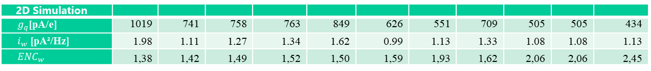
Comparing Measurements and Simulations – 2D - Noise
Measurements on Athena prototype DeFPETs
different technology, different geometry
at the moment only white noise
1/f noise is not included
 | LG2 | LG1 | Tk-1 | Tk-2 | LG3 | Tk-3 | Tn-1 | LG4 | Tn-3 | Tn-2 | Tn-4
Source | [3] | [3] | [2] | [2] | [3] | [2] | [2] | [3] | [2] | [2] | [2]
Technology | Thick | Thick | Thick | Thick | Thick | Thick Plasma | Thin Halo | Thick | Thin | Thin | Thin Plasma
W/L | 24/4 | 20/5 | 20/5 | 20/5 | 24/4.5 | 24/5 | 20/5 | 24/5 | 20/5 | 20/5 | 24/5
Measured
ENC | 1.95 | 1.95 | 1.95 | 2.04 | 2.09 | 2.18 | 2.2 | 2.22 | 2.38 | 2.44 | 2.69
2D Simulation
$g_{q}$[pA/e] | 1019 | 741 | 758 | 763 | 849 | 626 | 551 | 709 | 505 | 505 | 434
$i_{w}$ [pA²/Hz] | 1.98 | 1.11 | 1.27 | 1.34 | 1.62 | 0.99 | 1.13 | 1.33 | 1.08 | 1.08 | 1.13
$${ENC}_{w}$$ | 1,38 | 1,42 | 1,49 | 1,52 | 1,50 | 1,59 | 1,93 | 1,62 | 2,06 | 2,06 | 2,45
W. Treberspurg et. al, “Measurement results of different
options for spectroscopic X-ray DEPFET sensors”, JINST 13, P09014, 2018
W. Treberspurg et. al “Layout options of spectroscopic X-ray DePFETs”, JINST 14, 2019
with one exception
increasing measured noise
increasing simulated white noise

Slide 10
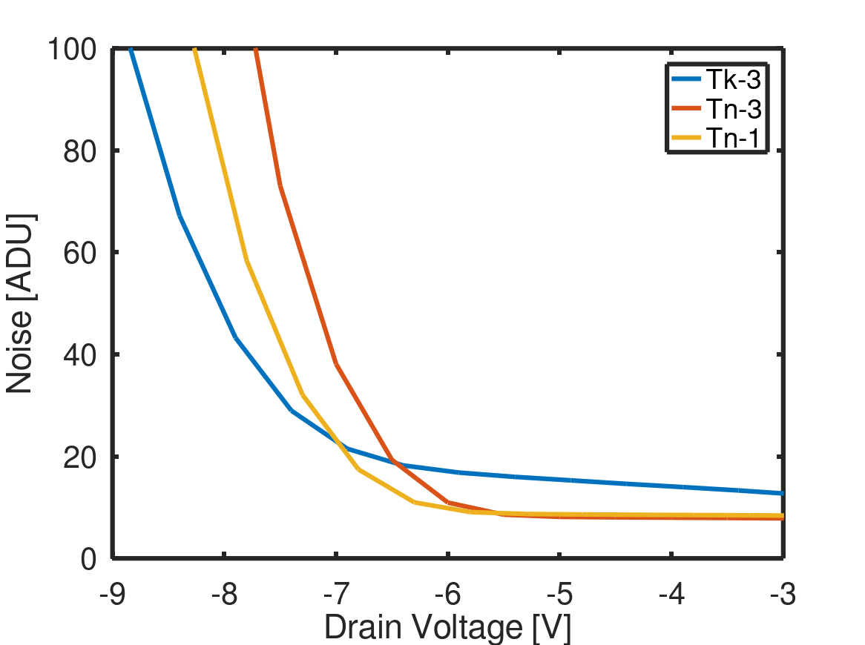
Comparing Measurements and Simulations – 2D - Impact Ionization
measured

Slide 11
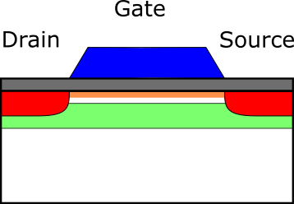
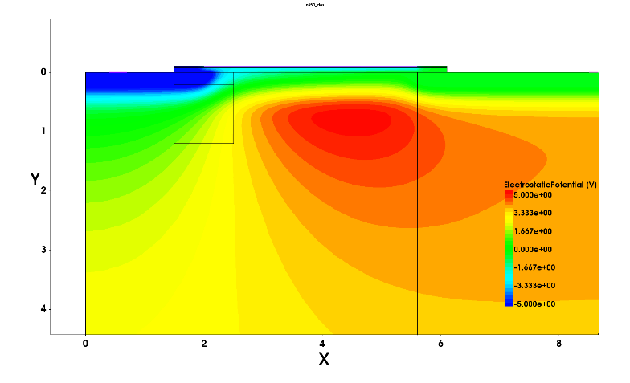
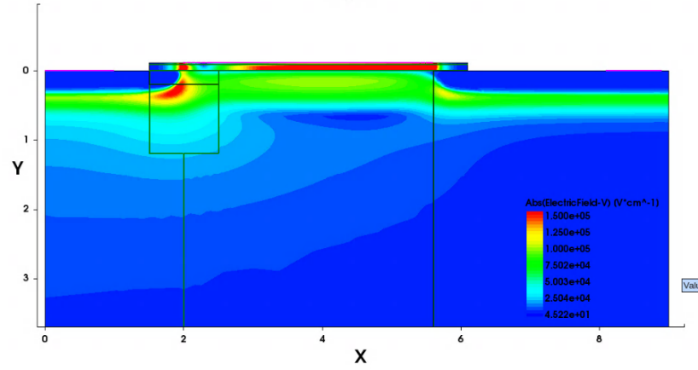
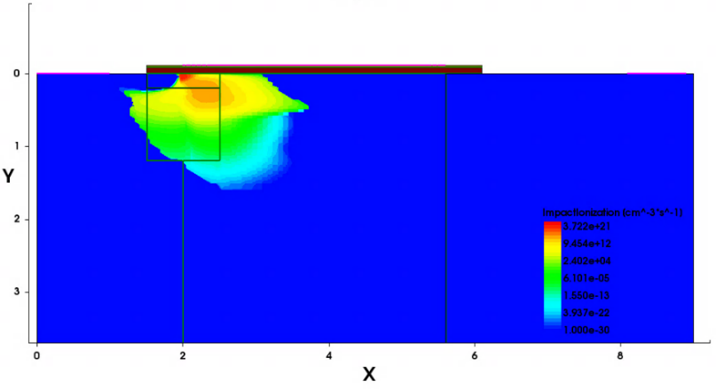
Comparing Measurements and Simulations – 2D - Impact Ionization
Potential Distribution
Gate
Drain
Source
Electric Field
Impact Ionization
Gate
Gate
Drain
Source
Drain
Source

Slide 12
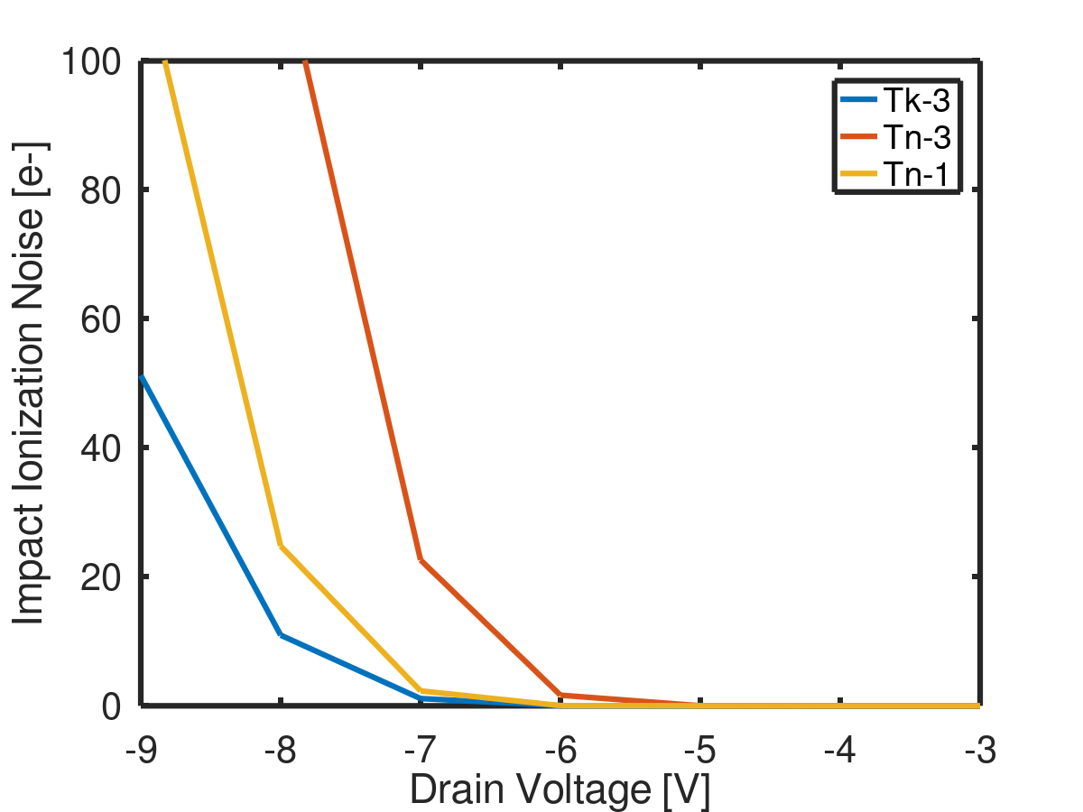
Comparing Measurements and Simulations – 2D - Impact Ionization
measured
simulated
good qualitative agreement of onset

Slide 13
Verification of Simulations
Measured g_{m} and gain met within ±10%
Measured noise correlates with simulated white noise
qualitative agreement of impact ionization between simulations and measurements
overall good agreement between simulations and measurements
utilize simulations for study of DePFET improvements

Slide 14
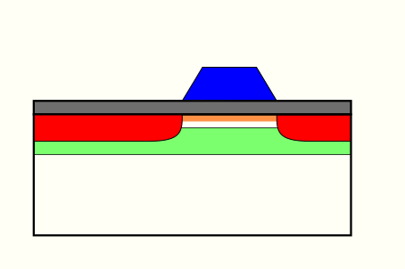
Improving the DePFET - Scaling
gate
gate
drain
source
drain
source
reduce gate length to minimize the internal gate and increase charge gain

Slide 15
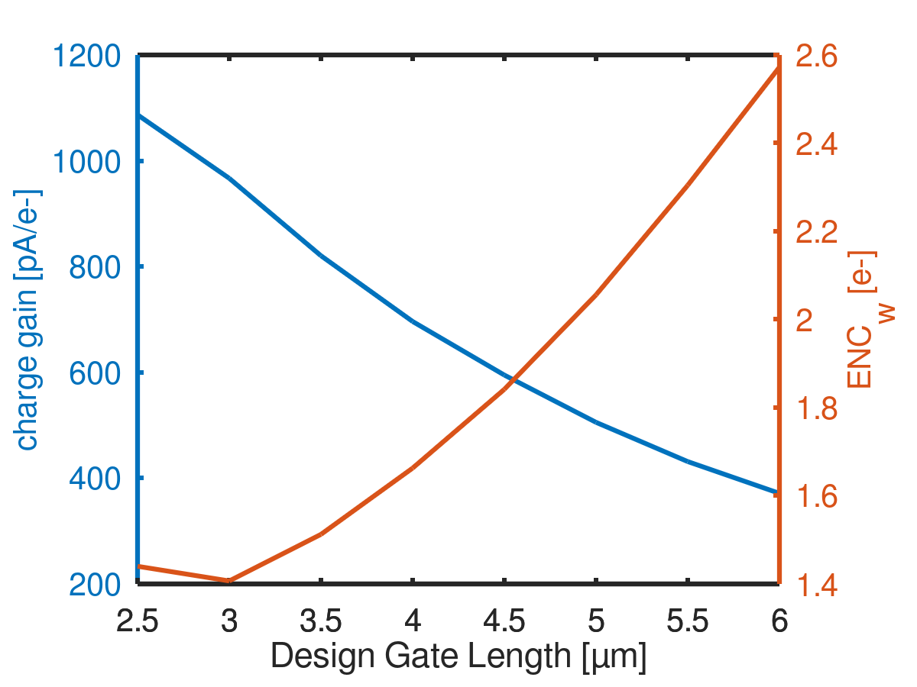
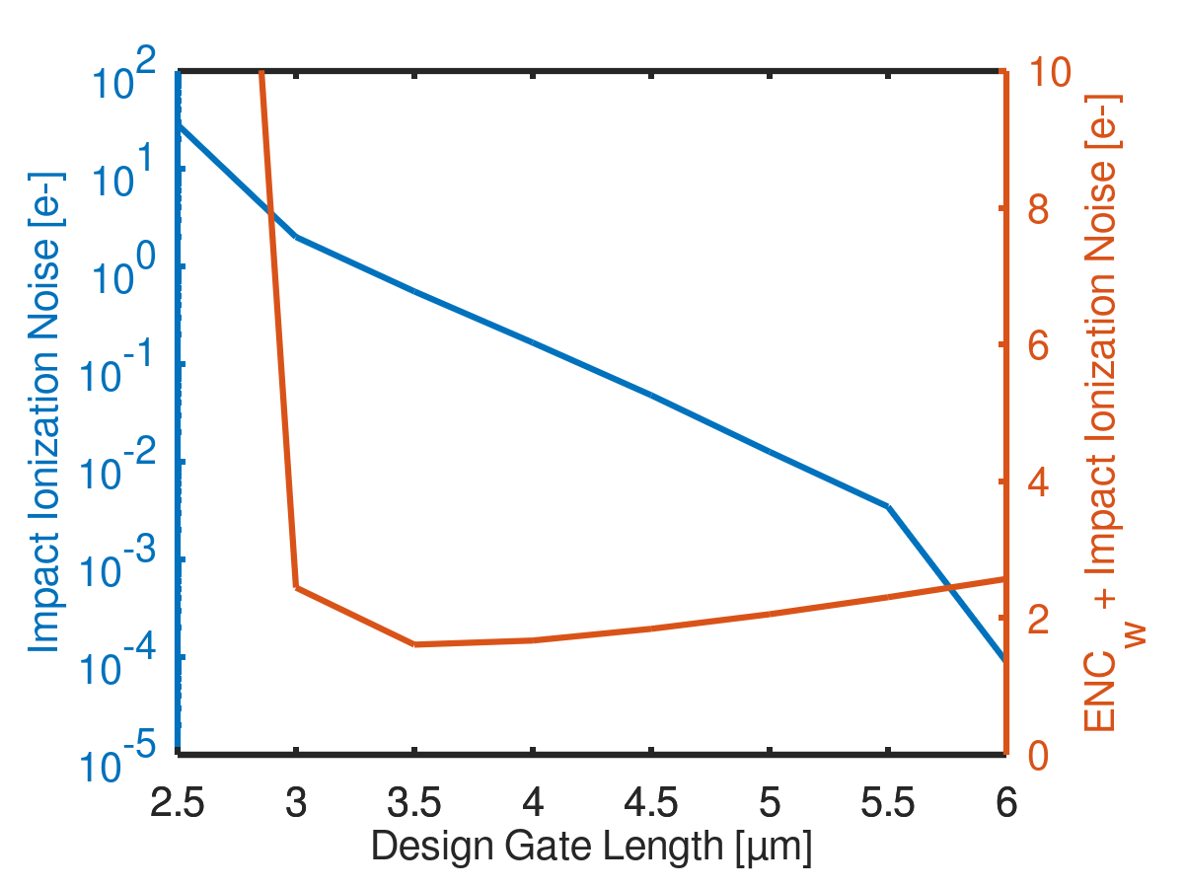
Improving the DePFET - Scaling
gate width of 20µm
readout time of 5 µs
gate width of 20µm
readout time of 5 µs

Slide 16
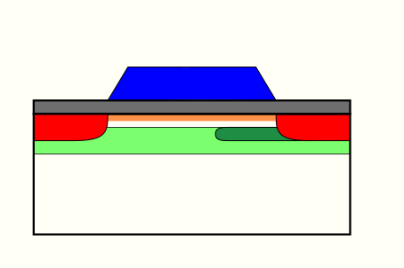
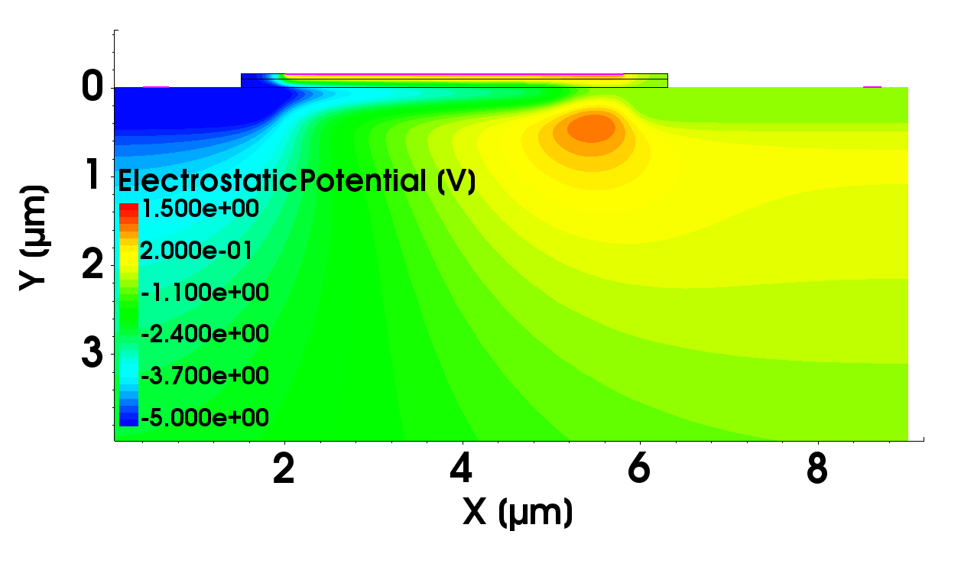
Improving the DePFET - Super g_{q}
gate
gate
drain
source
drain
source
additional n-implant
internal gate

Slide 17
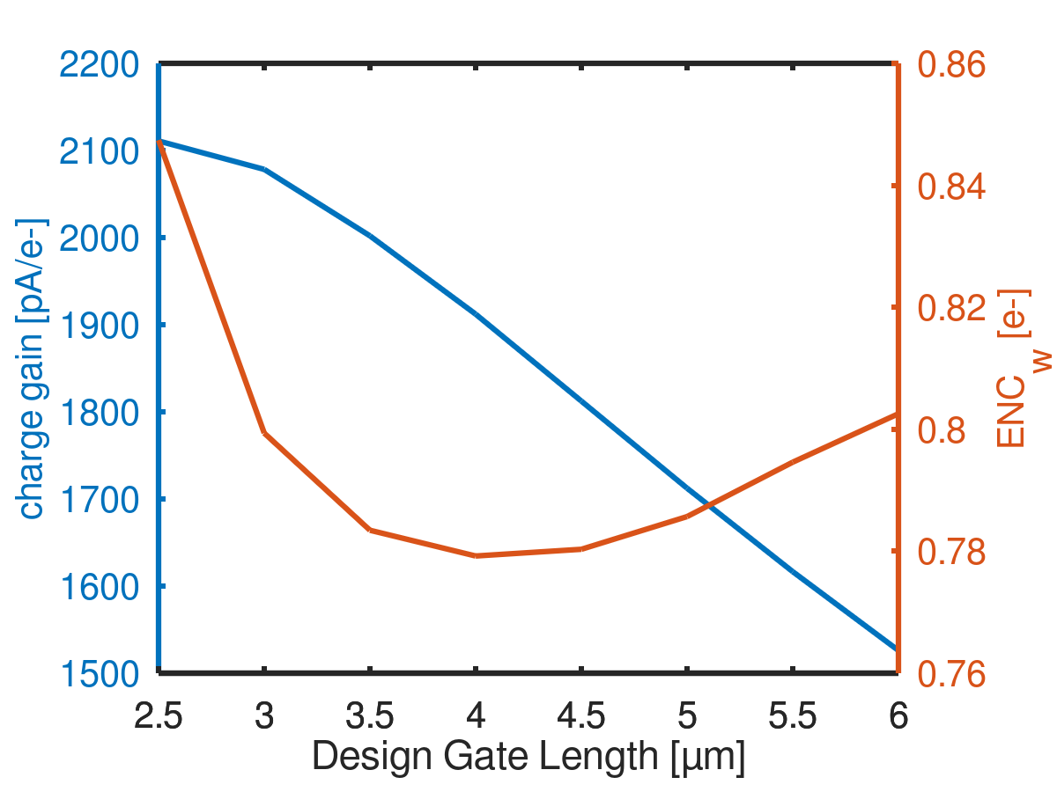
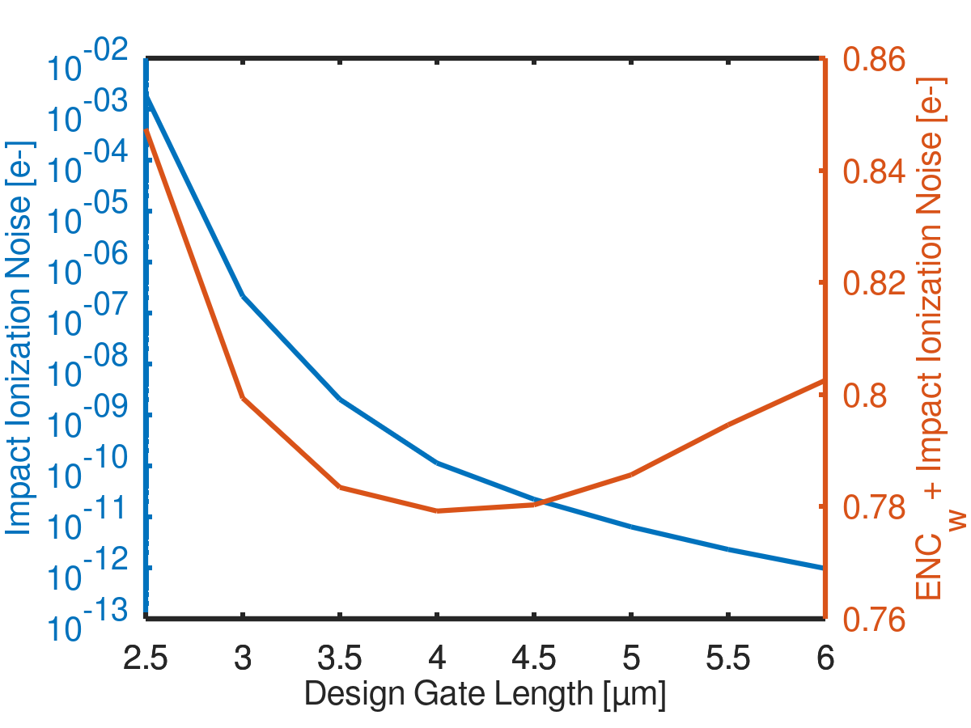
Improving the DePFET - Super g_{q}
gate width of 20µm
readout time of 5 µs

Slide 18
2D simulations - recap
we verified our simulations against measurements
  overall good agreement
we studied the effects of scaling on the DePFET
  overall improvement but limits due to impact ionization
we developed a new DePFET technology
  decoupling internal and external gate size
  improving g_{q}
  reducing impact ionization

Slide 19
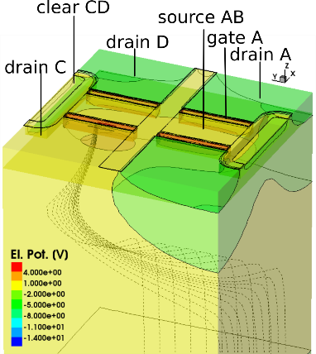
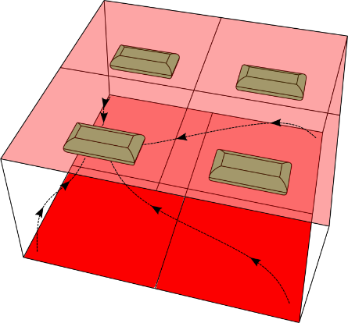
One example of 3d Simulations - Quadorpix
Quadropix: combination of 4 DePFETs into a Superpixel structure
Designed for the use in fast optical polarimetry
functional principle
Layout scetch
device simulation

Slide 20
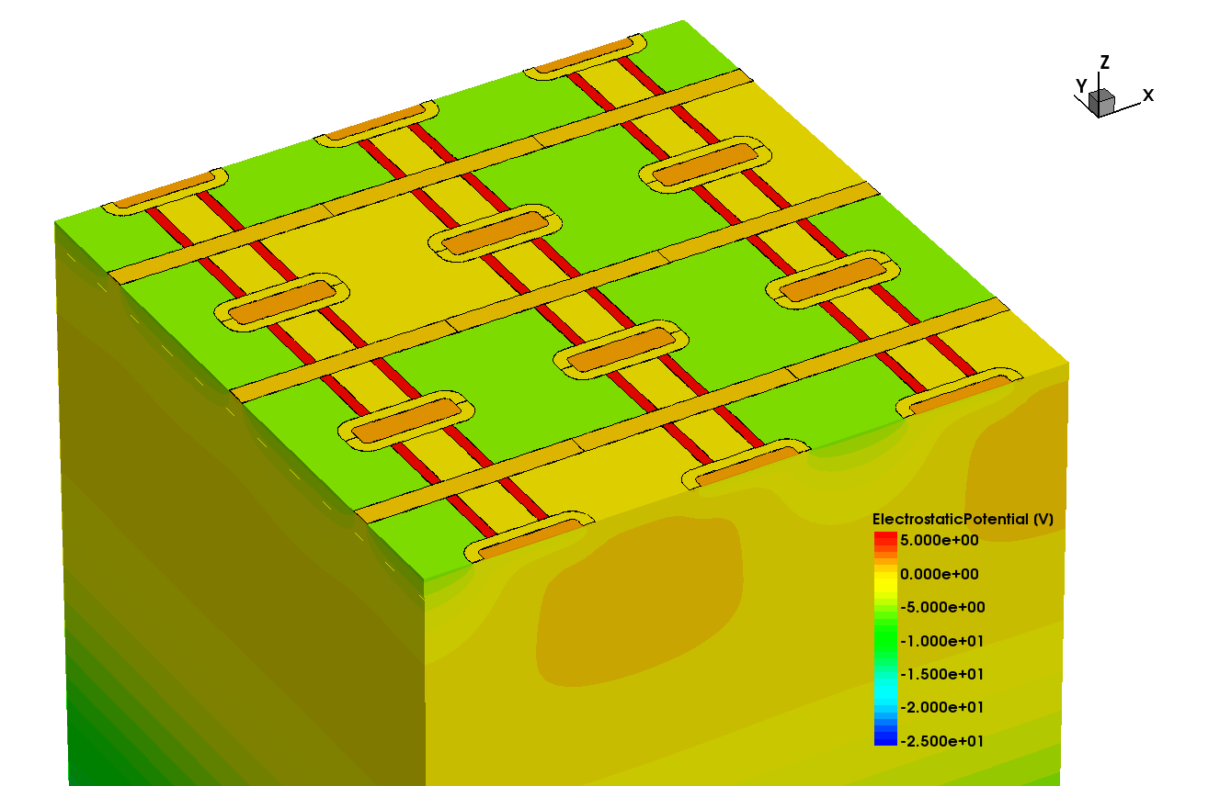
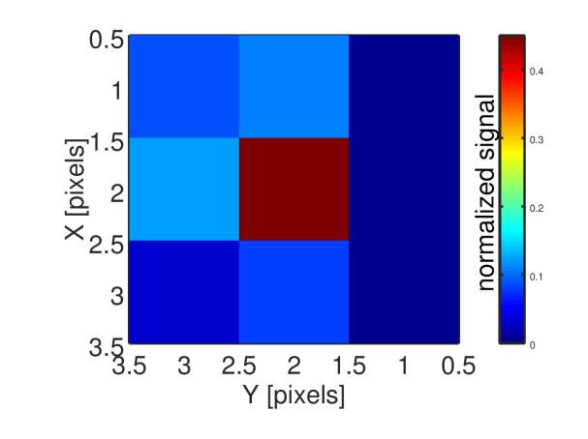
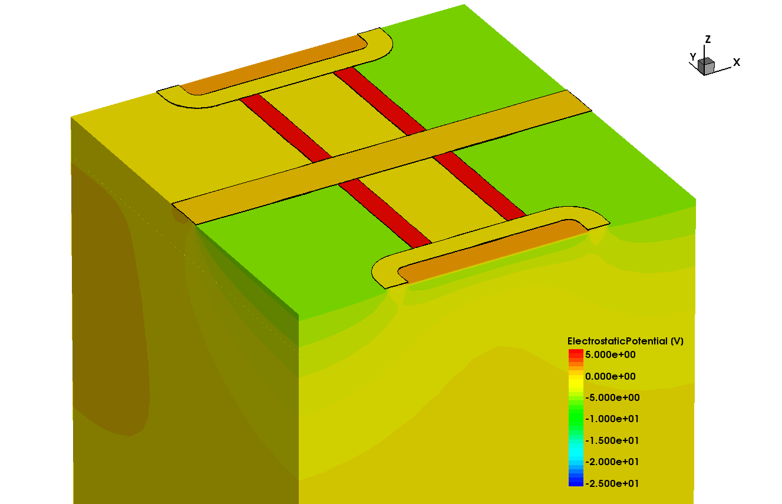
Quadropix - Asymmetrie of charge collection
3x3 Array
1 Superpixel
(4 DePFETs)
charge spreading
D
D
C
A
B
C
A
B

Slide 21
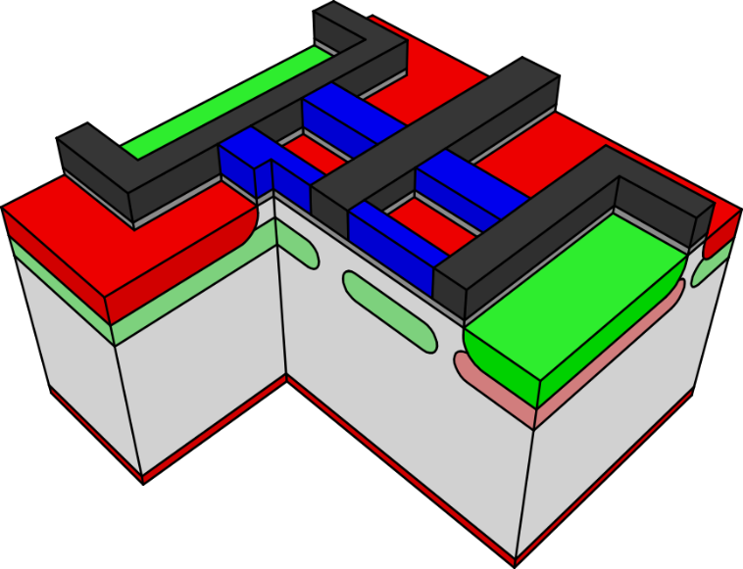
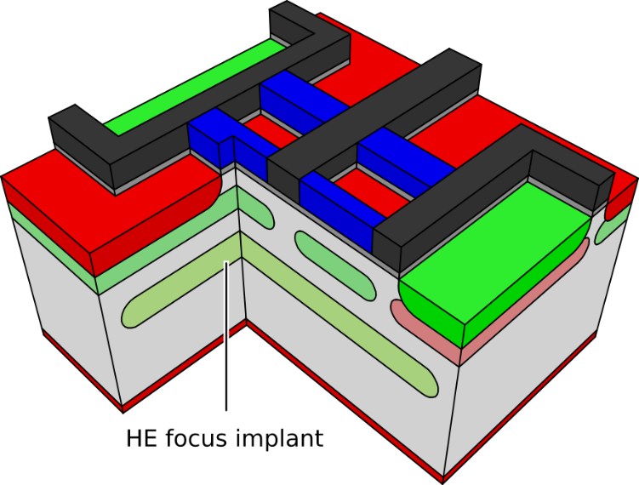
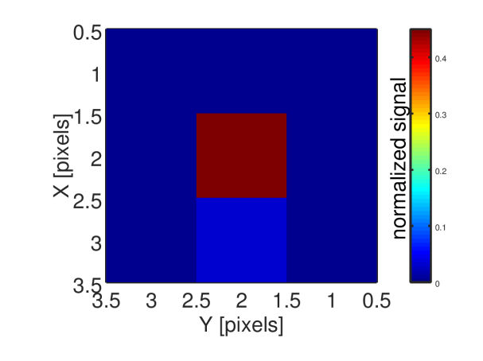
Quadropix - Improvements
charge spreading

Slide 22
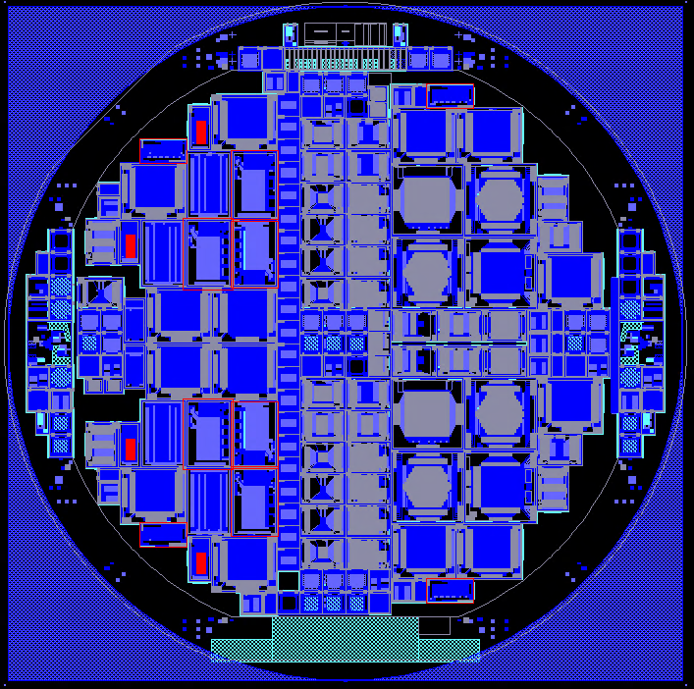
DePFET test production
Test of new DePFET technologies
reference (2)
reference + HE (2)
optimized (4)
super g_{q} (2)
DePFET Layouts
Belle DePFET | fast readout
Athena DePFET | spectroscopy
Small DePFET | 15 – 30 µm test devices
Infinipix | 2 storage nodes per pixel
Quadropix | 4 storage nodes per pixel
RNDR DePFET | low noise (subelectron)
Production started October 2022
Production finished recently

Slide 23
Summary
Simulations are a useful tool to gain „insight“ into devices
Simulations can be a tool to predict the behaviour of devices
for well tested and known regions, quantitative agreement within 10% is possible
for less well known regions at least qualitative agreement is possible
Simulations are a crucial part of sensor development
Outlook
Lab is currently moving into a new building
reassembly and qualification until mid to end of 2024
Test of prototyping run start of 2024
cross check between measurements and simulations
-> next SimDet

Slide 24
Thanks for your attention
Alexander Bähr on behalf of the MPG-HLL

Slide 25
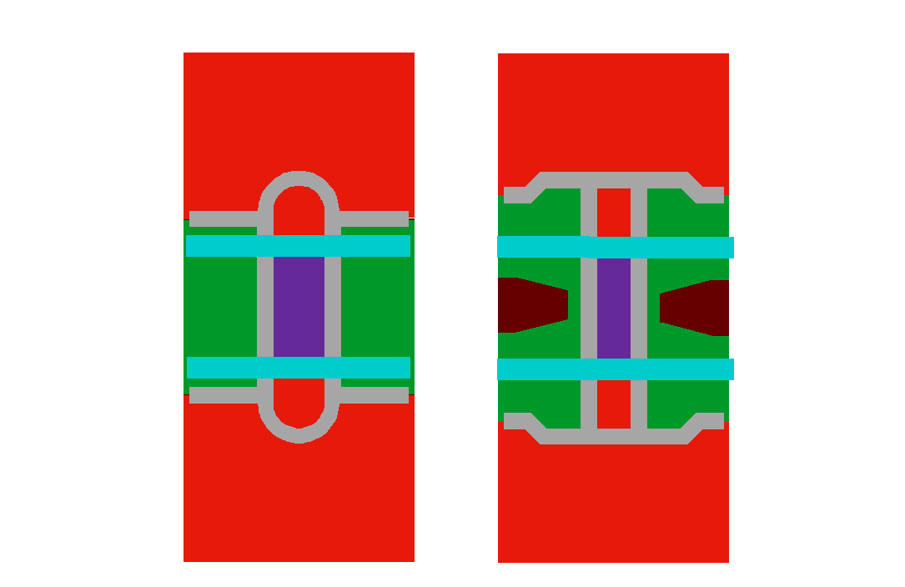
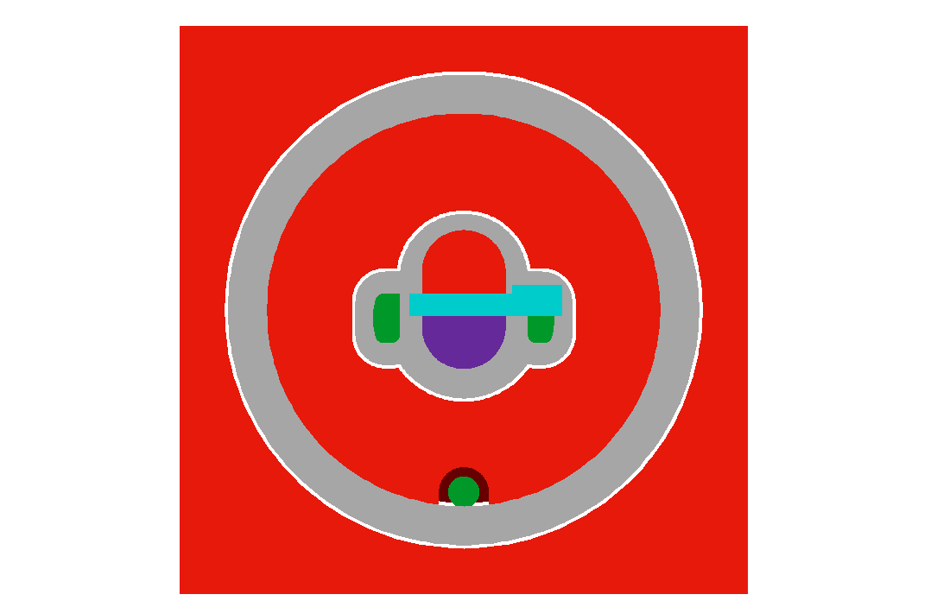
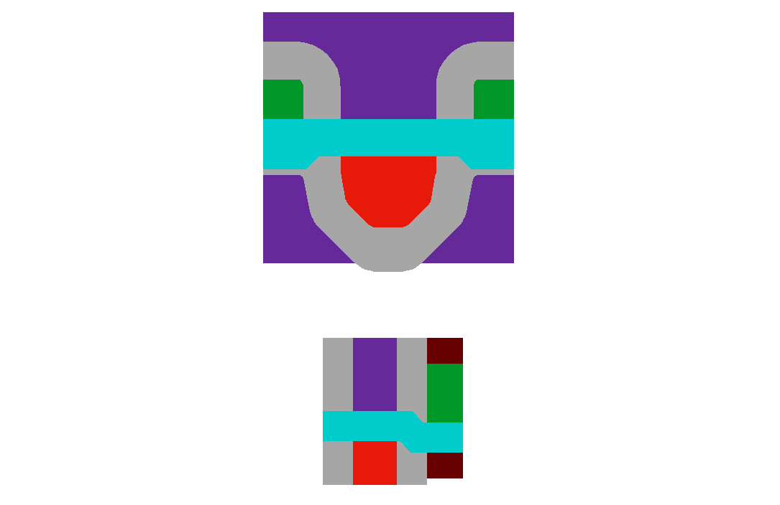
DePFET layouts
Standard
drift
drift
drift 2
S
CG
drift 1
G
D
D
G
G
D
D
S
CL
S
CL
CL
G
S
CG
S
CL
G
D
Belle Type
55 x 50 µm²
fast readout
Athena Type
130 x 130 µm²
imaging spectroscopy
Small Pixels
15 x 15 µm² to 30 x 30 µm²
“limit” test

Slide 26
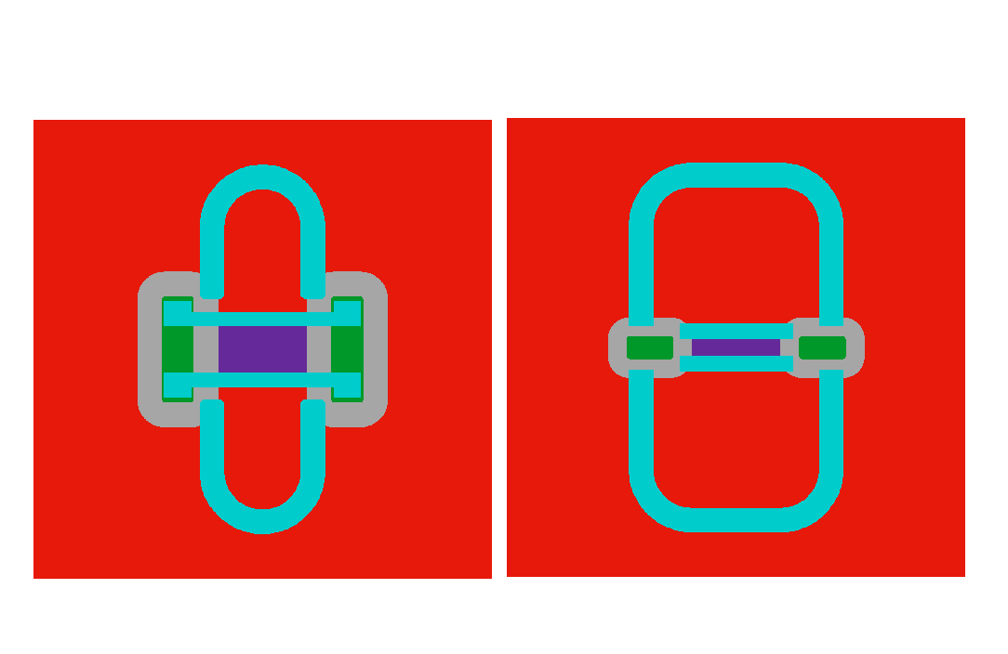
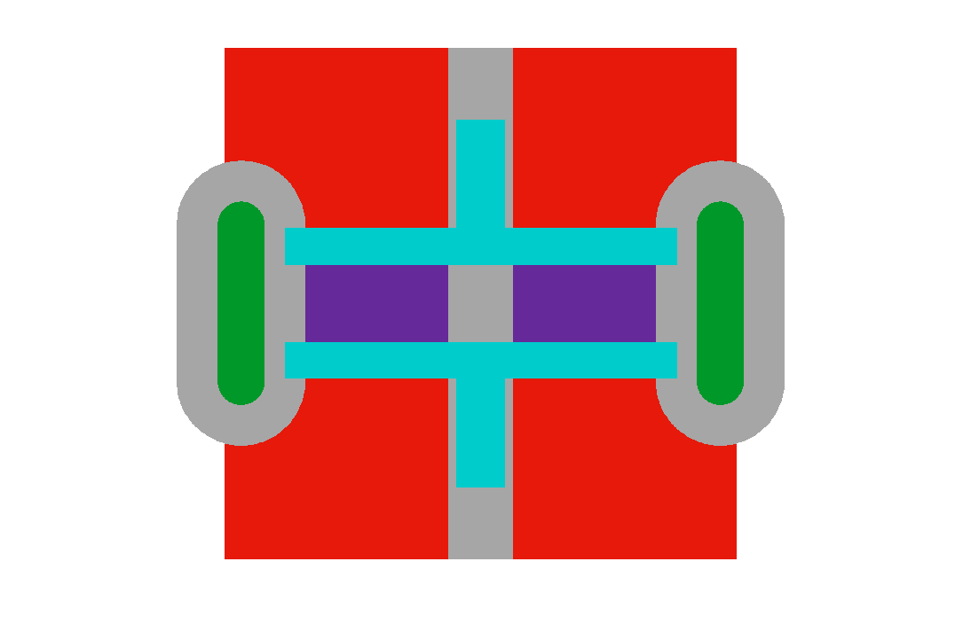

DePFET layouts
Multiple storages
RNDR DePFETs
D1
D4
D1
S
G1
G1
G1
CL
S
CL
S
CG
G2
TG
D
CL
G2
D2
CG
G2
CG
D2
D3
Infinipix
2 storage nodes
selectable charge collection
suppress rolling shutter effects
Quadropix
4 storage nodes
selectable charge collection
suited for high precision polarimetry
repetitive non destructive readout (RNDR)
subelectron noise
single electron resolution

