Slide 1


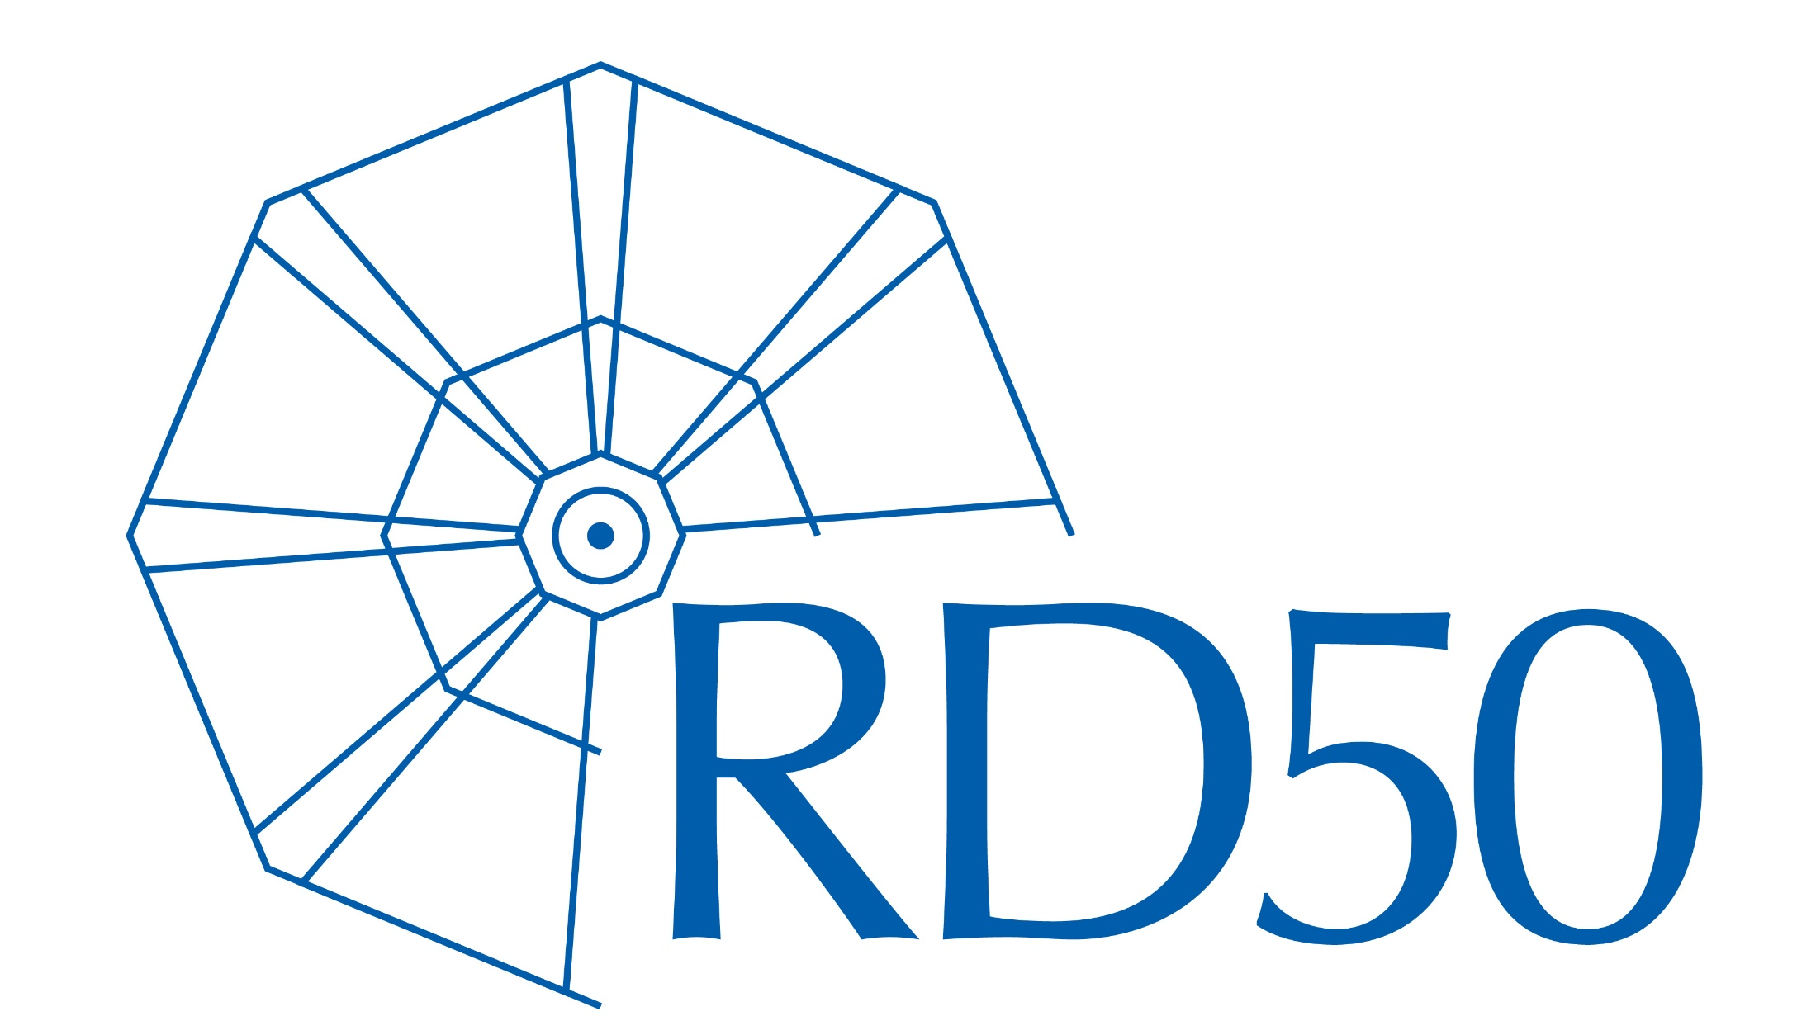
Introduction to Semiconductor Detectors with focus on applications at Hadron Colliders
Michael Moll, CERN EP-DT, Geneva, Switzerland
SIMDET 2023, 22-24 November 2023, LPNHE Paris
https://indico.in2p3.fr/event/30704/

Slide 2
OUTLINE
The Large Hadron Collider (LHC) at CERN
  Where are the silicon detectors?
Silicon Detectors for High Energy Physics Applications
  The basic concept of Semiconductor Detectors: A reverse biased pn-junction
  Strip and Pixel Detectors at the Large Hadron Collider (LHC) at CERN
  Recent developments in Silicon Detectors
Radiation Damage to Silicon Detectors
  Upgrade of the Large Hadron Collider (HL-LHC)
  Radiation damage mechanisms
    Microscopic defects and macroscopic damage
  Mitigation techniques: What can we do against radiation damage?
    Examples of radhard devices for the HL-LHC: p-type strip sensors and 3D sensors
Why do we need (TCAD) device simulations (introduction)?
Summary & Further reading
Details in following presentations:
Marco Bomben; Arianna Morozzi;
Matteo C.Vignali; Jairo Antonio Villegas Dominquez; Li Long; Alexander Bähr

Slide 3

CERN & LHC - Large Hadron Collider
CERN (2023):
  23 member states
  ~13400 scientists (users)
  ~ 2660 personnel (staff) + 900 Fellows
  Budget ~1230 MCHF (France: 13.2%)
LHC: 27 km tunnel
  ≈ 4600 MCHF + 1200 MCHF (accelerator + experiments)
  1232 dipoles B=8.3T (959
  Design: pp √s = 14 TeV (L_{design} = 10³⁴ cm⁻² s⁻¹)
  heavy ions (e.g. Pb-Pb; 5TeV)
Circulating beams:
  2008: first beam
  2009-13: Run 1 at 2 x 4 TeV
    2012: Higgs Boson “discovered”
  2015-18: Run 2 at 2 x 6.5 TeV (10³⁴cm⁻²s⁻¹ reached)
  2018-22: Long Shutdown 2 (LS2)
  2022-26: Run 3 at 2 x 6.8 TeV
  2026-28: Long Shutdown 3 (LS3)
  2028: HighLumi-LHC (Run 4, ….)
    collect 3000-4000 fb⁻¹ until ~ 2042 (20 times more than today)
Alps
Geneva
27 Km
CERN
p
p
CERN Large Hadron Collider (LHC) - 27 km accelerator ring
proton-proton beams of 6.8 TeV each collide in 4 experiments
today
also a program with Pb beams at up to 5.36 TeV per nucleon
Notes:
https://en.wikipedia.org/wiki/Large_Hadron_Collider

Slide 4
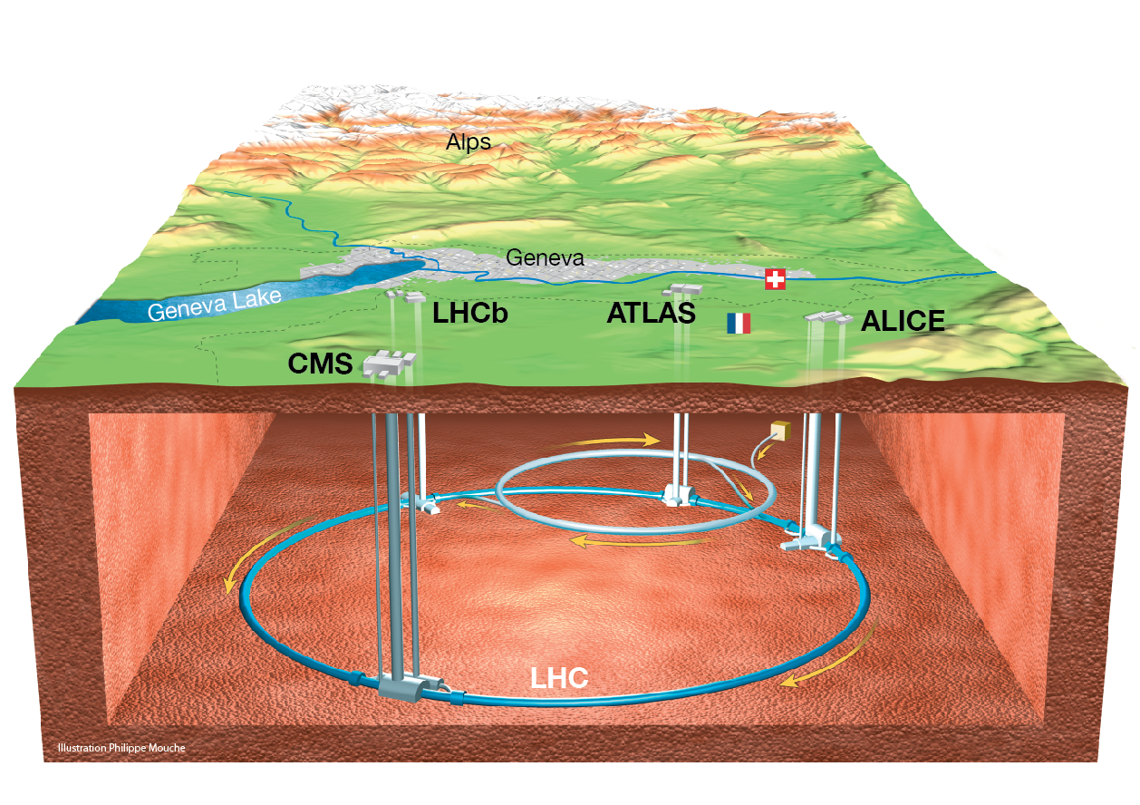
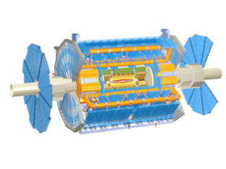
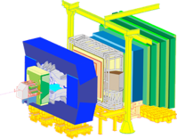
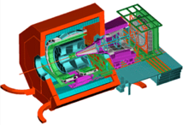
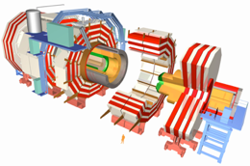
The LHC Experiments
ATLAS
LHCb
Alps
Geneva
CERN
ALICE
CMS
Notes:
2023: LHC 6.8+6.8 TeV Large Hadron Collider, 27 km in circumference; 9 active experiments: ALICE, ATLAS, CMS, FASER, LHCb,
LHCf, MoEDAL-MAPP, SND and TOTEM

Slide 5
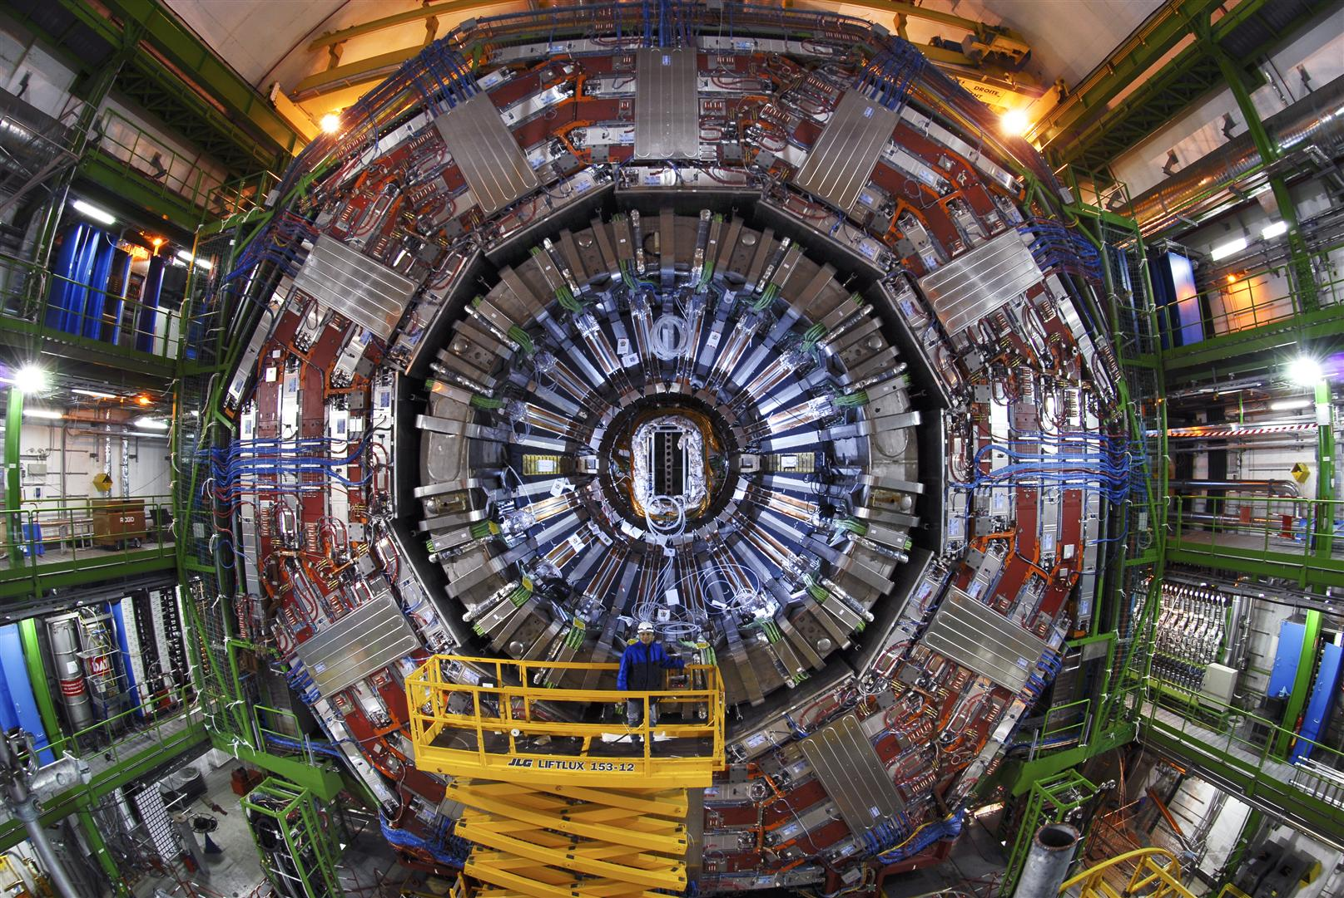
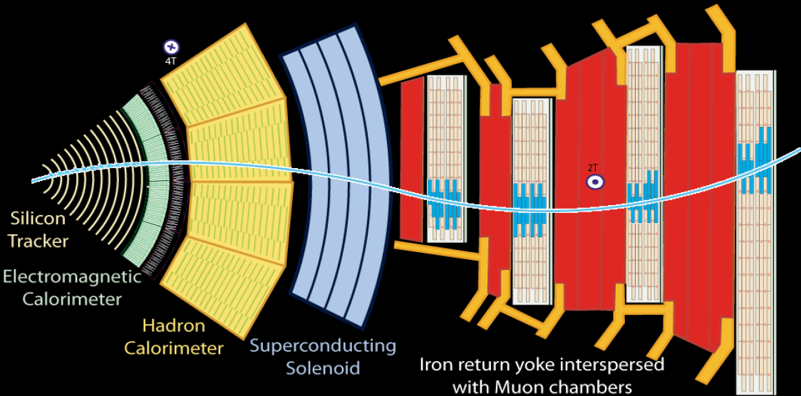
Collisions in the LHC
every 25ns (40 MHz)
CMS
CMS DETECTOR
Weight: 14000 t
Diameter: 15.0 m
Length: 28.7m
Field: 3.8T
Electromagnetic Calorimeter
Hadron Calorimeter
Muon chambers
Silicon Tracker
Superconducting Solenoid
Iron return yoke
event seen in 2011
Higgs → 2 photons

Slide 6
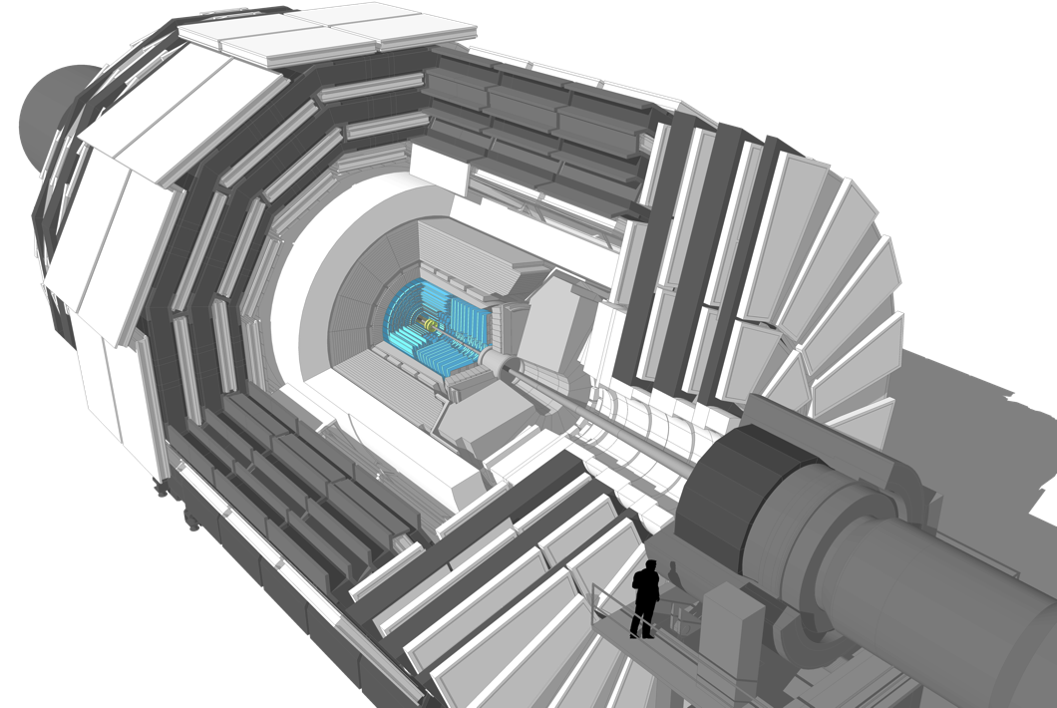
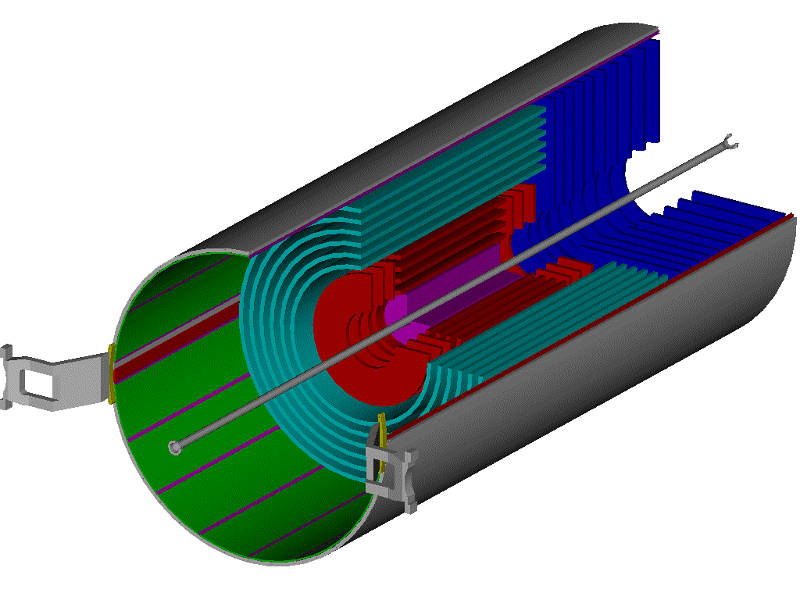
Silicon Tracking Detector
LHC example: The CMS DETECTOR
Inner Tracker
Outer Barrel (TOB)
Inner Barrel (TIB)
Inner Disks
(TID)
End Cap (TEC)
2.4 m
CMS DETECTOR
Weight: 14000 t
Diameter: 15.0 m
Length: 28.7m
Field: 3.8T
5.4 m
scientist
Pixel Detector
CMS – Inner Tracker & Pixel Detector
  Micro Strip:
  ~ 214 m² of silicon strip sensors, 11.4 million strips
  Pixel:
  4 layers & 2 x 3 disks: silicon pixels (~ 1m²)
  124 million pixels (100x150μm²)
  Resolution: σ(rφ) ~ 10 μm, σ(z) ~ 25μm
32 cm
104 cm

Slide 7
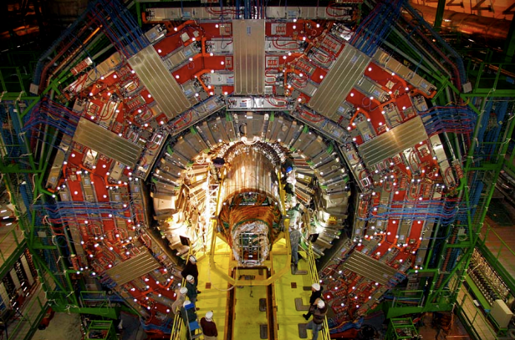
Present LHC Tracking Sensors
December 2007
CMS Tracker insertion

Slide 8
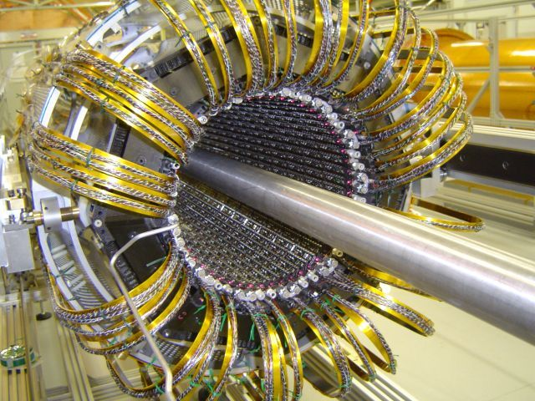
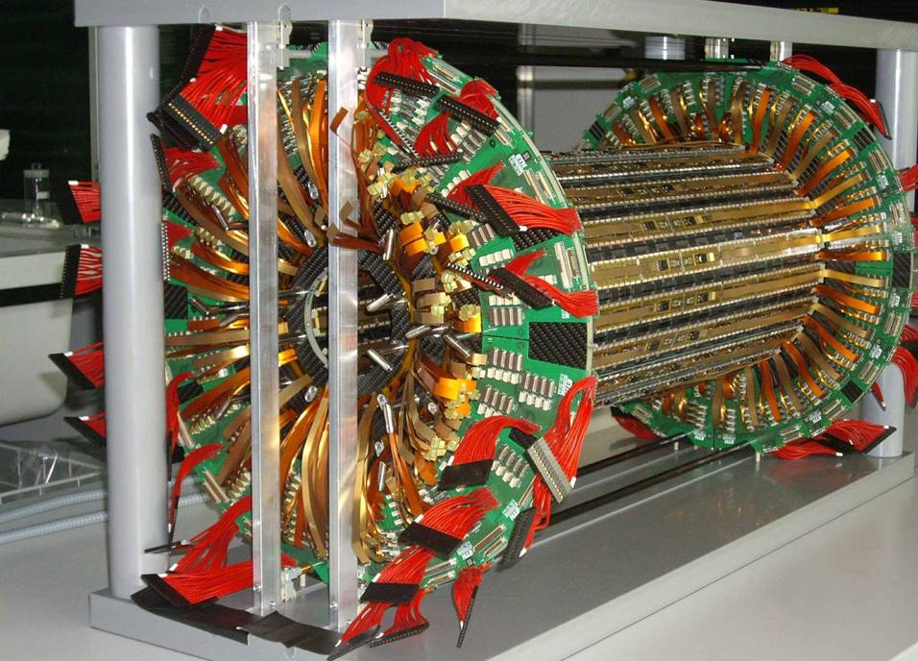
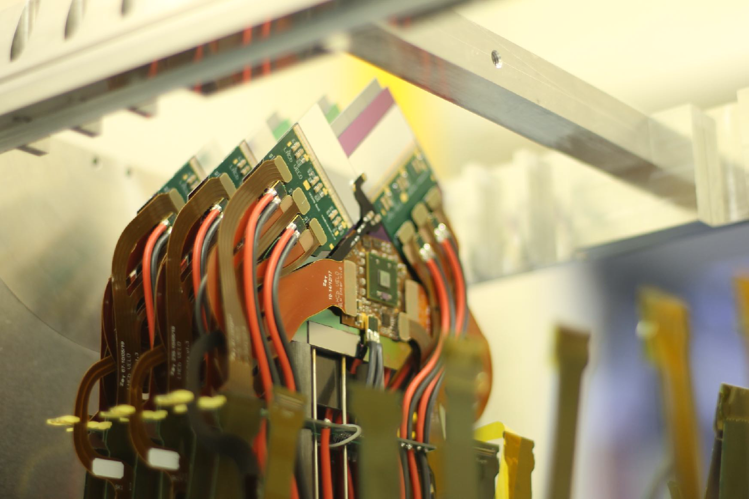
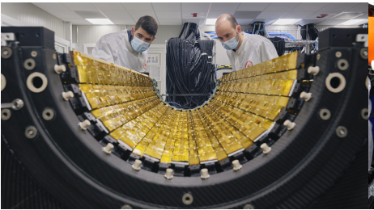

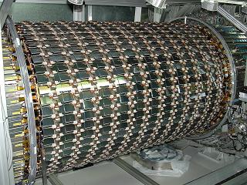
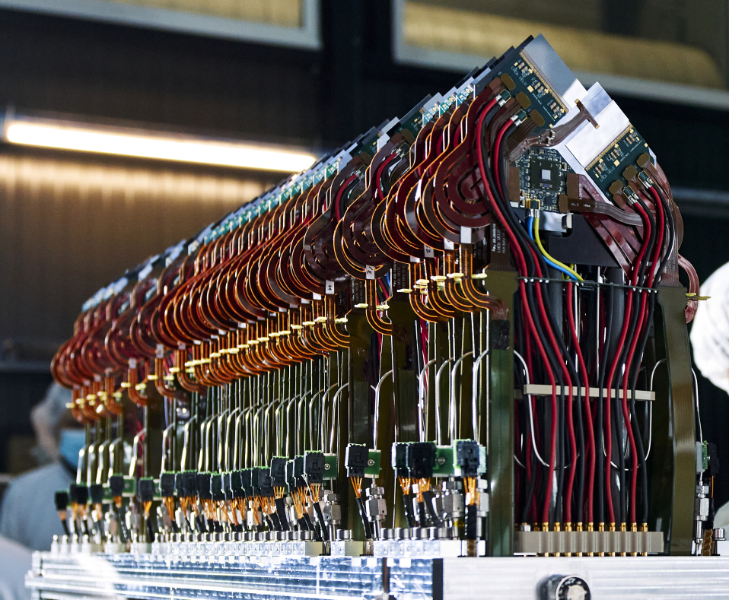
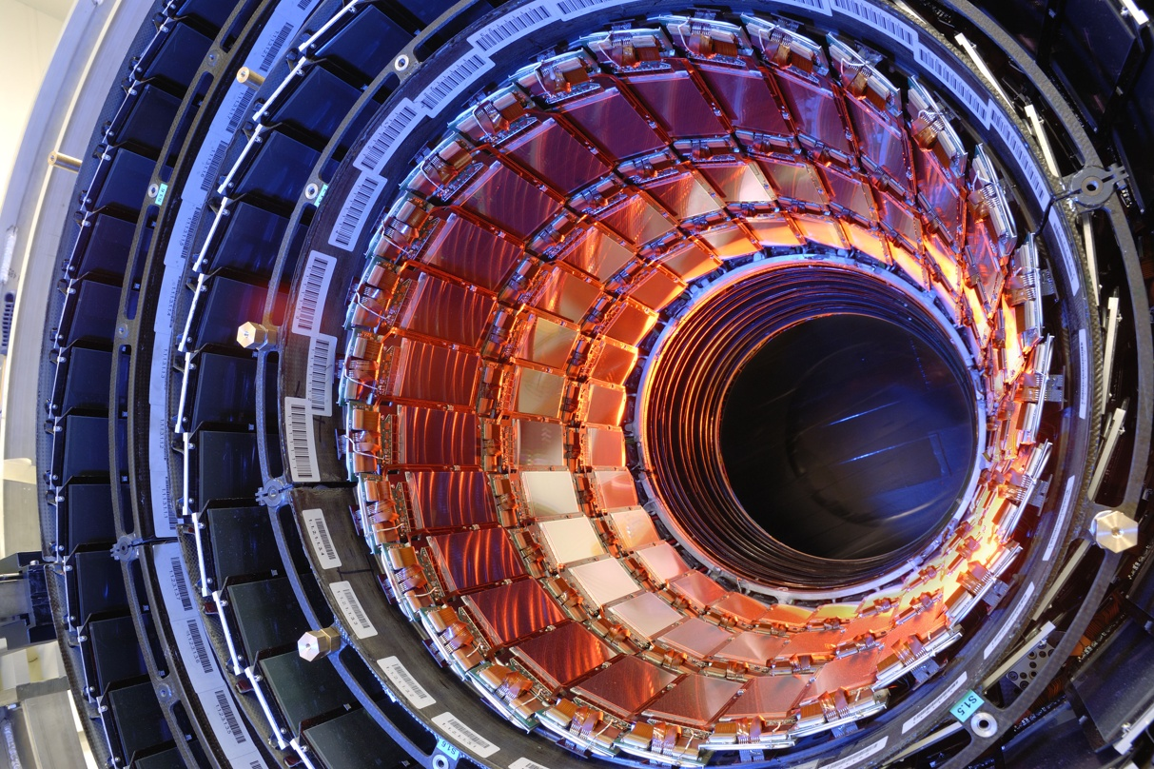
Silicon Tracking Detectors
Silicon tracking detectors are used in almost all HEP experiments:
Different sensor technologies, designs, operating conditions,….
ALICE ITS Barrel
New ITS for Run3:2022
ATLAS Pixel Detector
CMS Pixel Detector
LHCb VELO (New VELO for Run3:2022)
ATLAS SCT Barrel
CMS Strip Tracker IB
ALICE ITS Outer Barrel
(Foto:Insertion Test 2021)
LHCb VELO (New VELO for Run3:2022)

Slide 9
Silicon Sensors

Slide 10
Solid State Detectors – Why Silicon?
Some characteristics of Silicon crystals
  Small band gap E_{g} = 1.12 eV ⇒ E(e-h pair) = 3.6 eV (≈ 30 eV for gas detectors)
  High specific density 2.33 g/cm³ ; dE/dx (M.I.P.) ≈ 3.8 MeV/cm ≈ 106 e-h/μm (average)
  High carrier mobility μ_{e} =1450 cm²/Vs, μ_{h} = 450 cm²/Vs ⇒ fast charge collection (<10 ns)
  Very pure < 1ppm impurities and < 0.1ppb electrical active impurities
  Rigidity of silicon allows thin self supporting structures
  Detector production by microelectronic techniques
  ⇒ well known industrial technology, relatively low price, small structures easily possible
Alternative semiconductors
  Diamond
  Gallium arsenide (GaAs)
  Gallium nitride (GaN)
  Silicon Carbide (SiC)
  Germanium (Ge)

Slide 11
How to obtain the signal?
In a pure intrinsic (undoped) semiconductor the electron density n and hole density p are equal.
E
conduction band
e
For Silicon: n_{i} ≈ 1.45⋅10¹⁰ cm⁻³
E
f
h
valence band
4.5 ⋅10⁸ free charge carriers in this volume,
but only 3.2 ⋅10⁴ e-h pairs produced by a M.I.P.
⇒ Reduce number of free charge carriers, i.e. deplete the detector
⇒ Most detectors make use of reverse biased p-n junctions

Slide 12
Doping, resistivity and p-n junction
e.g. Phosphorus
Doping: n-type silicon
  add elements from Vth group
  ⇒ donors (P, As,..)
  electrons are majority carriers
Doping: p-type silicon
  add elements from IIIrd group
  ⇒ acceptors (B,..)
  holes are majority carriers
Si
Si
Si
Si
P
Si
Si
Si
Si
resistivity ρ
  carrier concentration n, p
  carrier mobility μ_{n}, μ_{p}
p-n junction
There must be a single
Fermi level!
⇒ band structure deformation
⇒ potential difference
⇒ depleted zone
 | detector grade | electronics grade
doping | ≈ 10¹² cm⁻³ | ≈ 10¹⁷ cm⁻³
resistivity ρ | ≈ 5 kΩ·cm | ≈1 Ω·cm

Slide 13
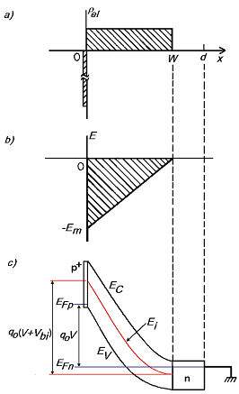
Reverse biased p-n junction
Positive space charge, N_{eff} =[P]
(ionized Phosphorus atoms)
Poisson’s equation
Depleted zone growth with increasing voltage ( )
neutral bulk
(no electric field)
Electrical
charge density
Electrical
field strength
Electron
potential energy
Full charge collection only for
fully depleted detector (V_{B}>V_{dep})
depletion voltage V_{dep}
detector thickness d
effective space charge density N_{eff}

Slide 14
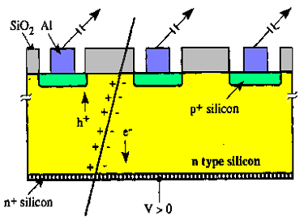
Single Sided Strip Detector
Segmentation of the p⁺ layer into strips (Diode Strip Detector) and connection of strips to individual read-out channels gives spatial information
pitch
typical thickness: 300μm (150μm-500μm used)
using n-type silicon with a resistivity of
ρ = 2 KΩcm (N_{D} ~2.2.10¹²cm⁻³)
results in a depletion voltage ~ 150 V
Resolution σ depends on the pitch p (distance from strip to strip)
- e.g. detection of charge in binary way (threshold discrimination)
and using center of strip as measured coordinate results in
typical pitch values are 20 μm– 150 μm ⇒ 50 μm pitch results in 14.4 μm resolution

Slide 15
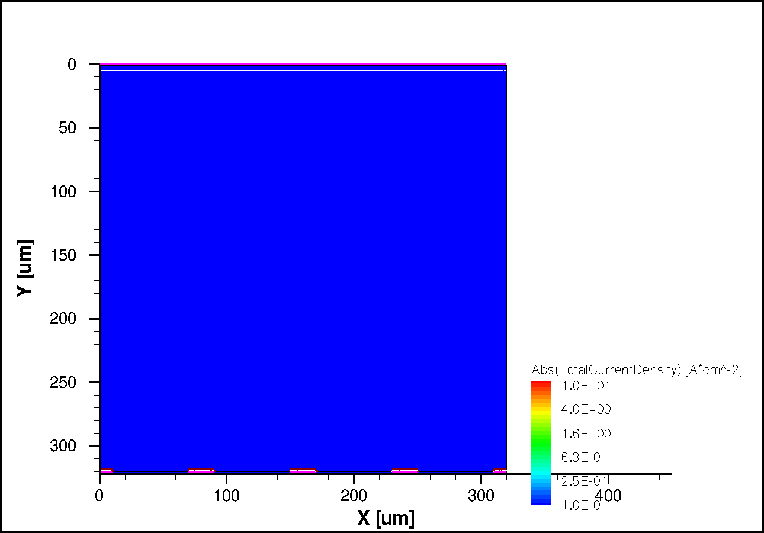
Signal Formation in a strip sensor
TCAD simulation: minimum ionizing particle traversing the sensor
  with typical dimensions for presently operating large LHC trackers (p-in-n devices)
electrons
n-type bulk
p⁺ readout electrodes
TCAD
holes

Slide 16
Signal Formation in a strip sensor
TCAD simulation: minimum ionizing particle traversing the sensor
  with typical dimensions for presently operating large LHC trackers (p-in-n devices)
electrons
n-type bulk
p⁺ readout electrodes
TCAD
holes

Slide 17
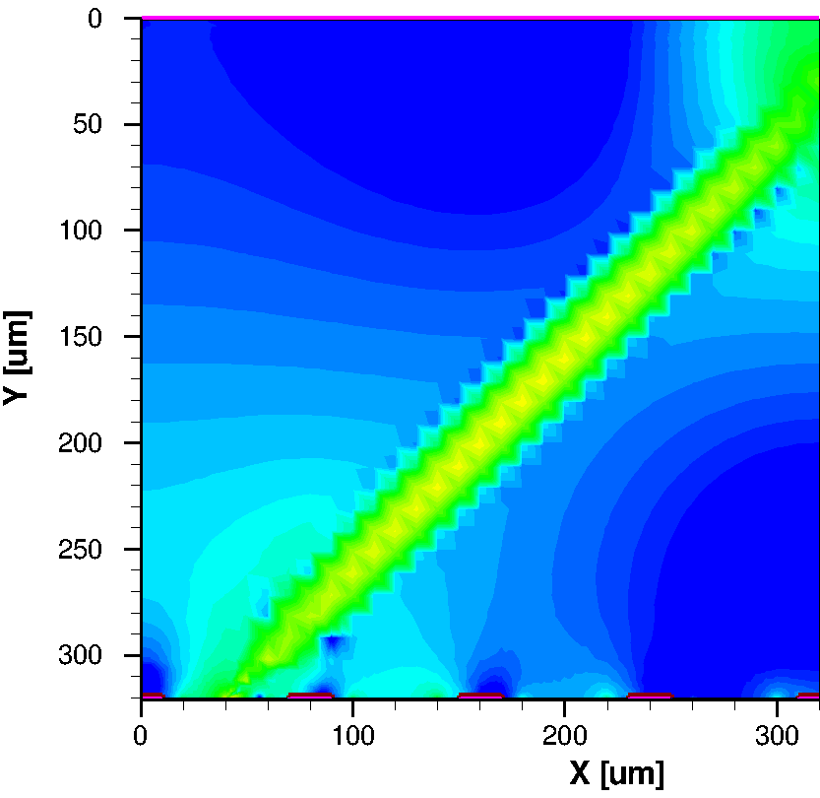
Signal formation in a strip sensor
Simulation:
  Current density
  mip, 45° angle
holes
electrons
t = 1 ns
Simulation: Thomas.Eichhorn@kit.edu

Slide 18
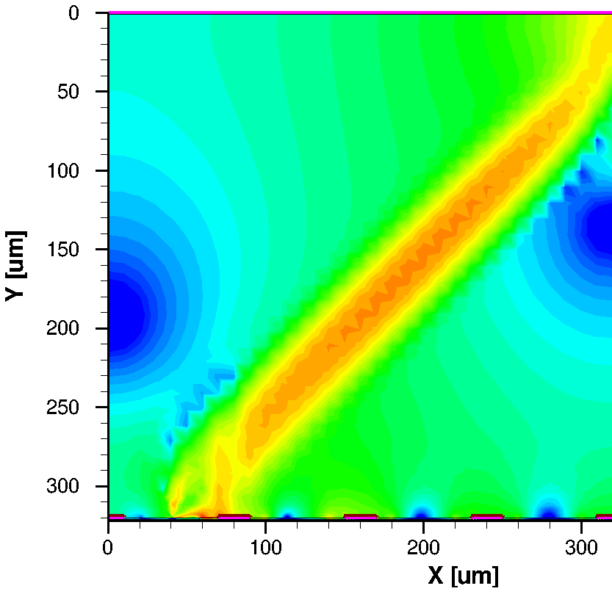
Signal formation in a strip sensor
Simulation:
  Current density
  mip, 45° angle
holes
electrons
t = 1.2 ns
Simulation: Thomas.Eichhorn@kit.edu

Slide 19
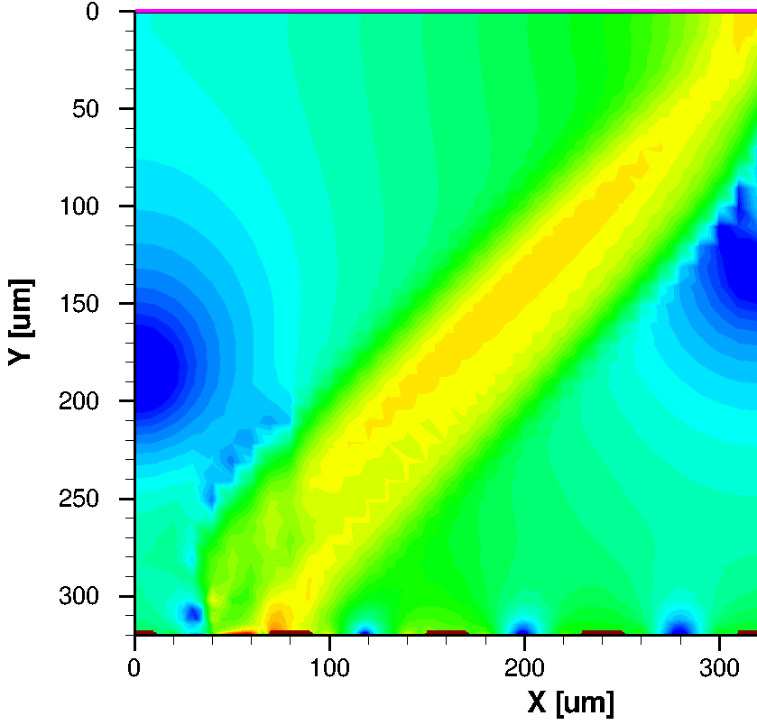
Signal formation in a strip sensor
Simulation:
  Current density
  mip, 45° angle
holes
electrons
t = 1.4 ns
Simulation: Thomas.Eichhorn@kit.edu

Slide 20
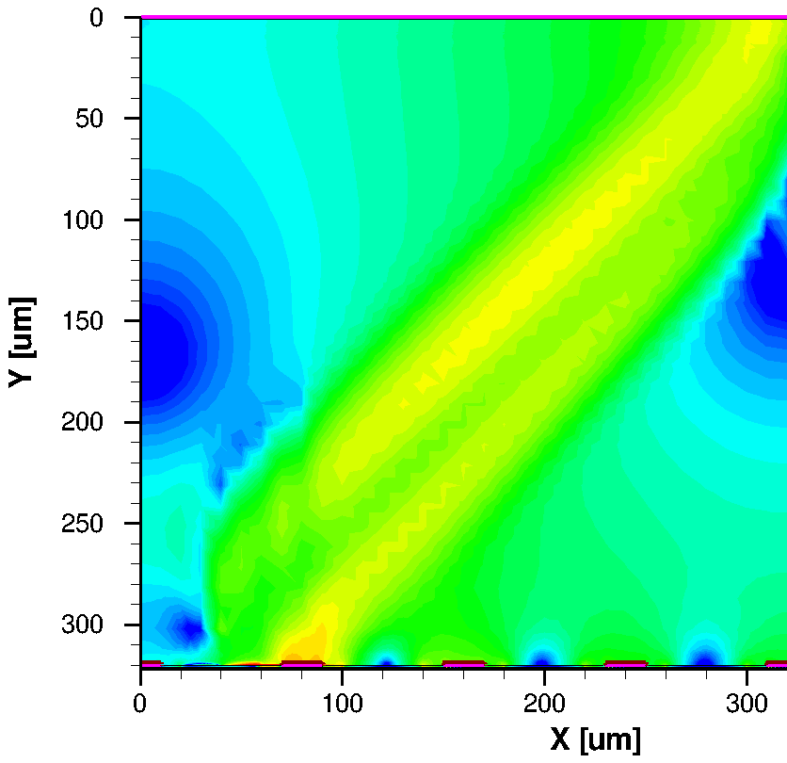
Signal formation in a strip sensor
Simulation:
  Current density
  mip, 45° angle
holes
electrons
t = 1.6 ns
Simulation: Thomas.Eichhorn@kit.edu

Slide 21
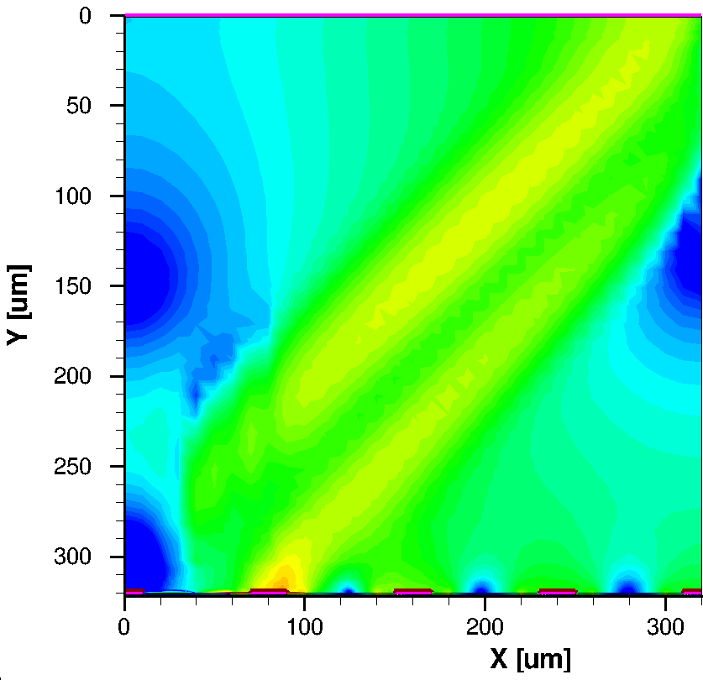
Signal formation in a strip sensor
Simulation:
  Current density
  mip, 45° angle
holes
electrons
t = 1.8 ns
Simulation: Thomas.Eichhorn@kit.edu

Slide 22
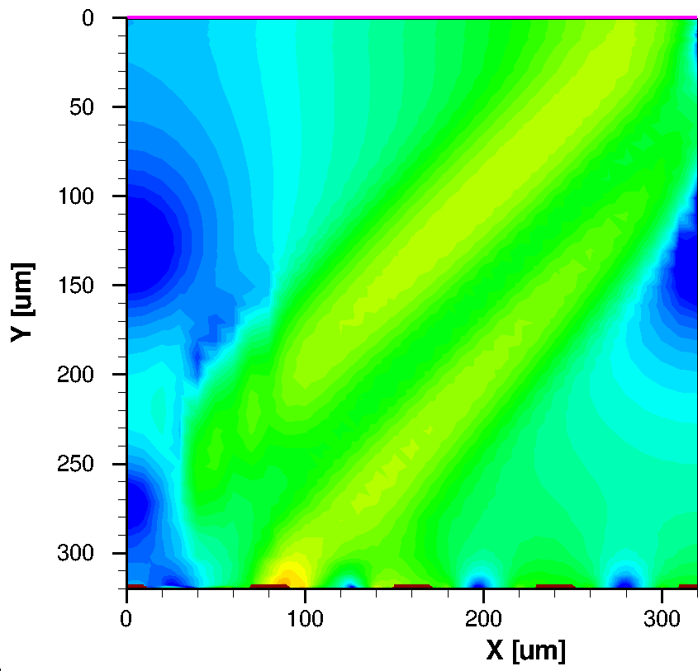
Signal formation in a strip sensor
Simulation:
  Current density
  mip, 45° angle
holes
electrons
t = 2.0 ns
Simulation: Thomas.Eichhorn@kit.edu

Slide 23
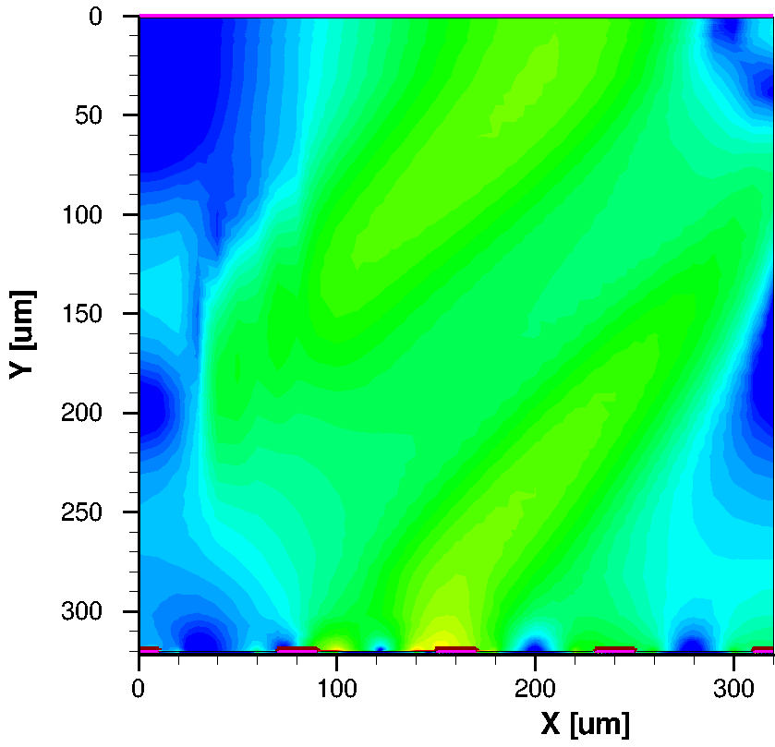
Signal formation in a strip sensor
Simulation:
  Current density
  mip, 45° angle
holes
electrons
t = 3.0 ns
Simulation: Thomas.Eichhorn@kit.edu

Slide 24
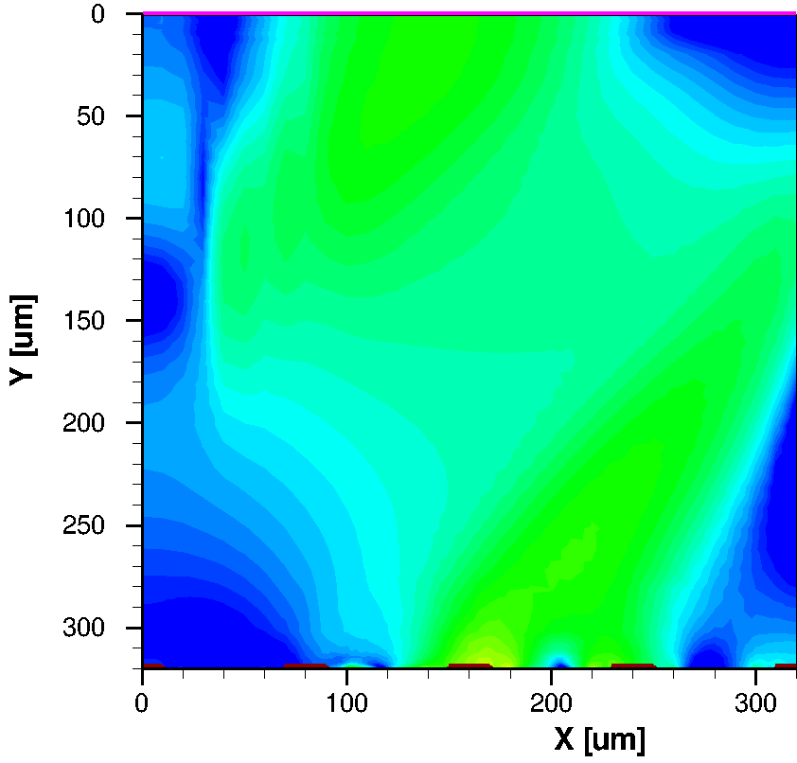
Signal formation in a strip sensor
Simulation:
  Current density
  mip, 45° angle
holes
electrons
t = 4.0 ns
Simulation: Thomas.Eichhorn@kit.edu

Slide 25
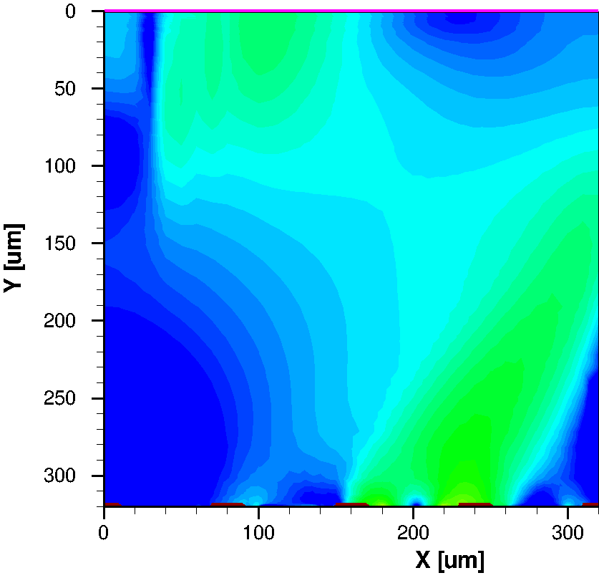
Signal formation in a strip sensor
Simulation:
  Current density
  mip, 45° angle
holes
electrons
t = 5.0 ns
Simulation: Thomas.Eichhorn@kit.edu

Slide 26
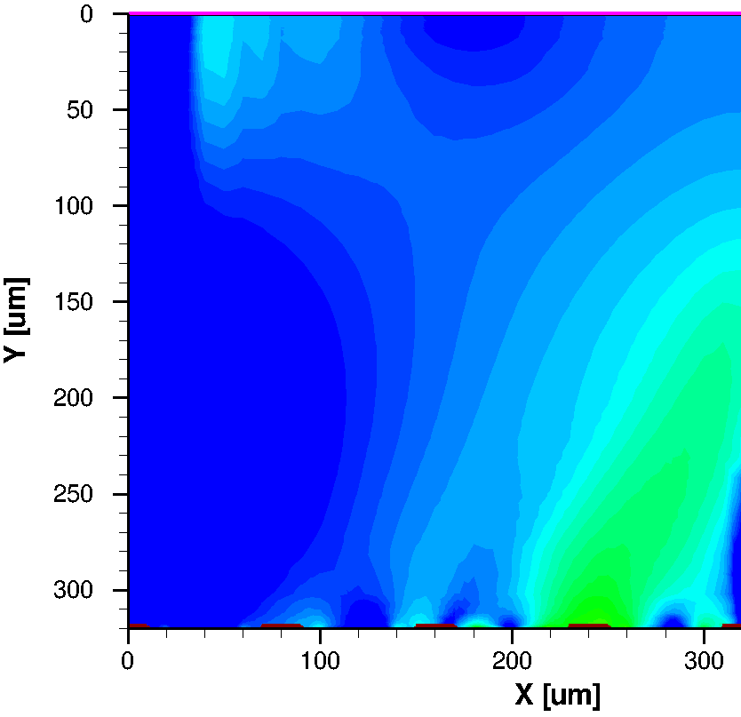
Signal formation in a strip sensor
Simulation:
  Current density
  mip, 45° angle
holes
electrons
t = 6.0 ns
Simulation: Thomas.Eichhorn@kit.edu

Slide 27
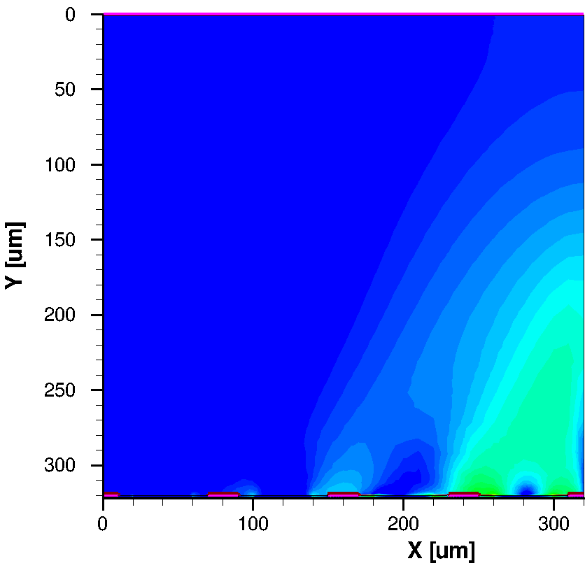
Signal formation in a strip sensor
Simulation:
  Current density
  mip, 45° angle
holes
electrons
t = 7.0 ns
Simulation: Thomas.Eichhorn@kit.edu

Slide 28
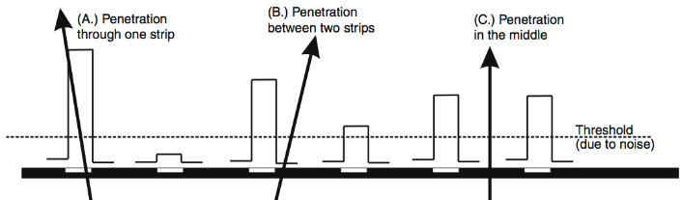
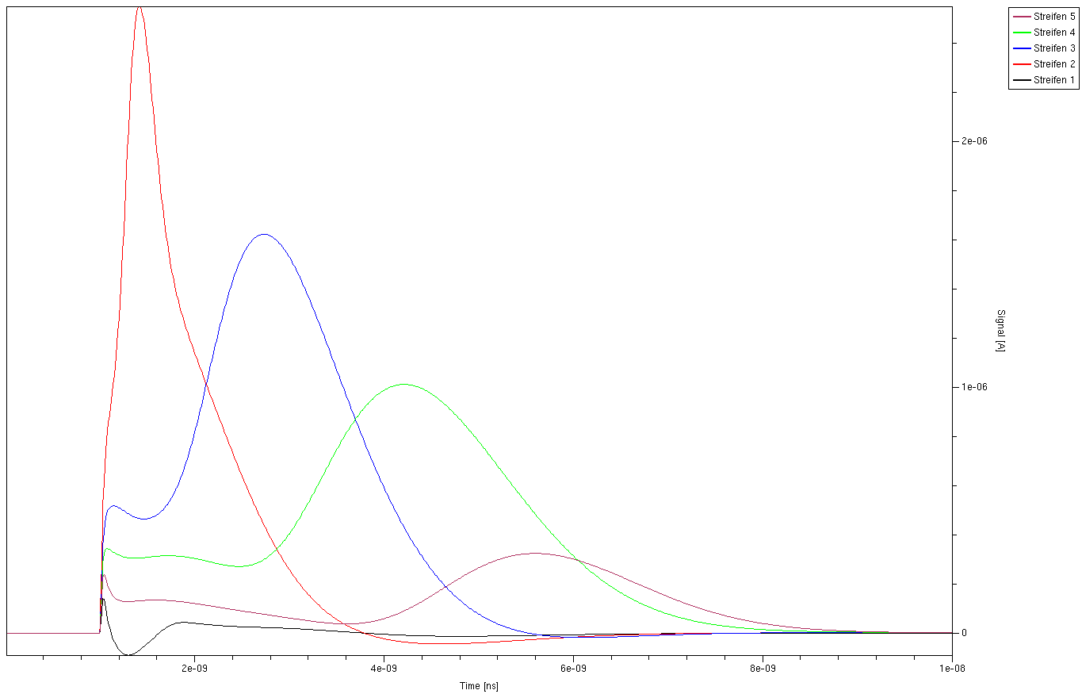
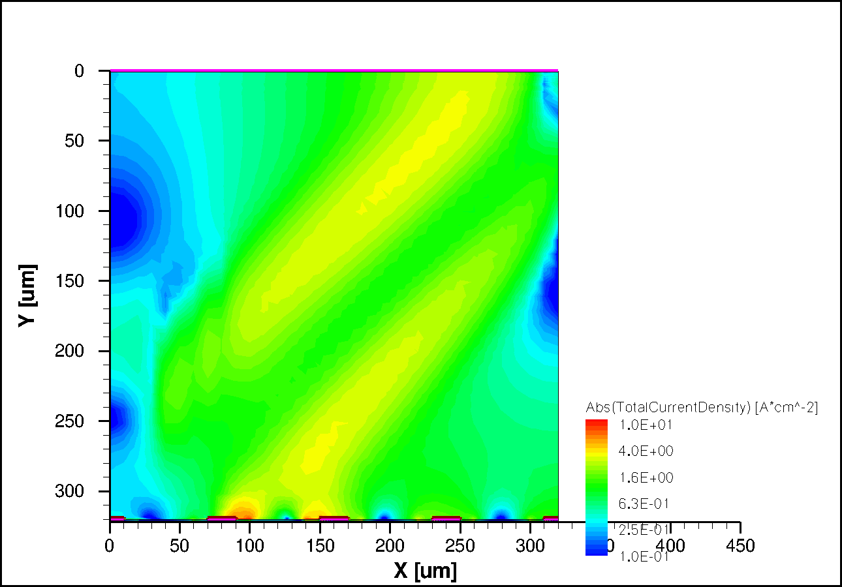
Signal formation in a strip sensor
Simulation:
  mip, 45° angle
Plot:
  Signals induced on electrodes
  Integration gives collected charge
t = 2.0 ns
2,27e-15C
Strip 1
3,04e-15C
1 2 3 4
Strip 2
3,27e-15C
Simulation: Thomas.Eichhorn@kit.edu
Strip 3
Strip 4
1,08e-15C
2ns
4ns
6ns
8ns

Slide 29
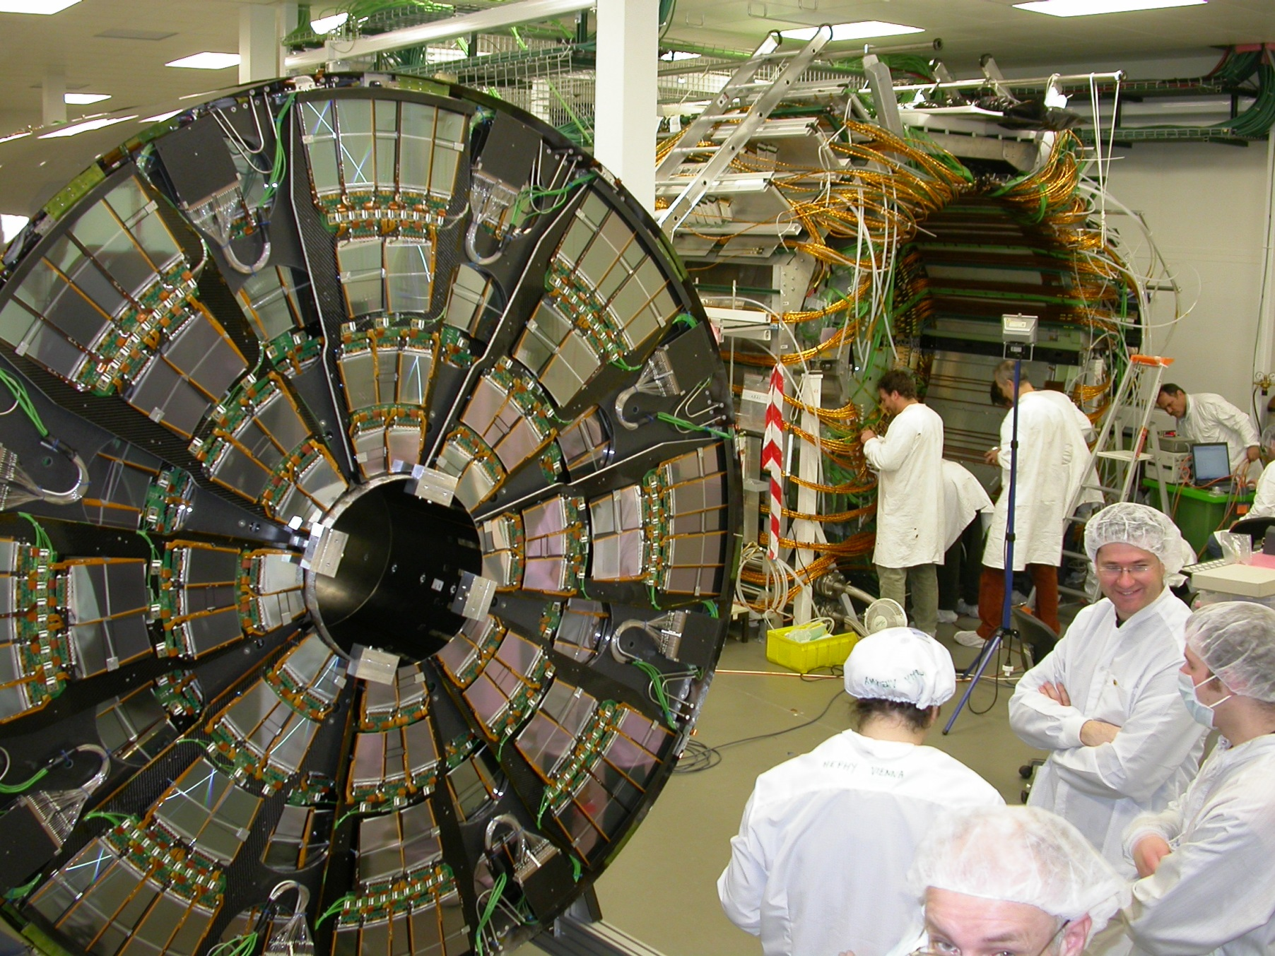
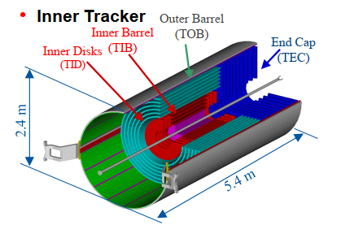
Present LHC Tracking Sensors
CMS Tracker
M.Krammer, ICFA School, Bogota, 2013

Slide 30
Present LHC Tracking Sensors
CMS Tracker
… 11.4 million strips
M.Krammer, ICFA School, Bogota, 2013

Slide 31
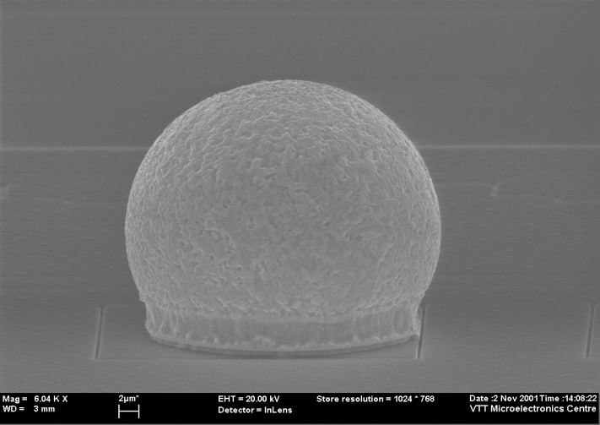
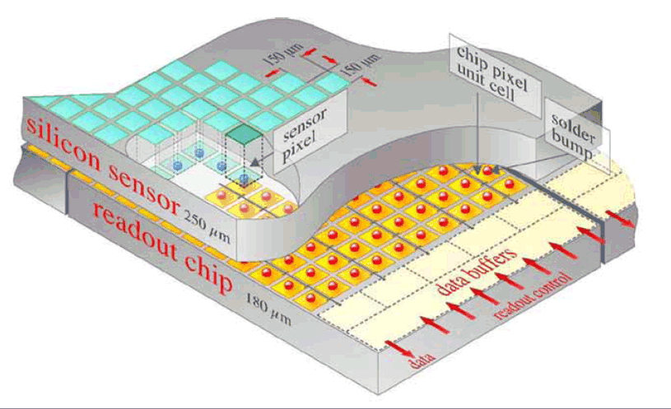
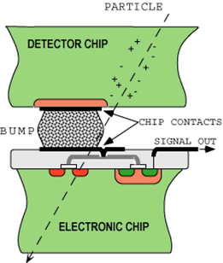
Hybrid Pixel Detectors
HAPS – Hybrid Active Pixel Sensors
    segment silicon to diode matrix with high granularity
    (⇒ true 2D, no reconstruction ambiguity)
    readout electronic with same geometry
    (every cell connected to its own processing electronics)
    connection by “bump bonding”
    requires sophisticated readout architecture
    Hybrid pixel detectors are used in LHC experiments:
    ATLAS, ALICE (from Run3 monolithic), CMS and LHCb (from Run 3)
Solder Bump: Pb-Sn
~ 15μm
(VTT/Finland)
Flip-chip technique

Slide 32
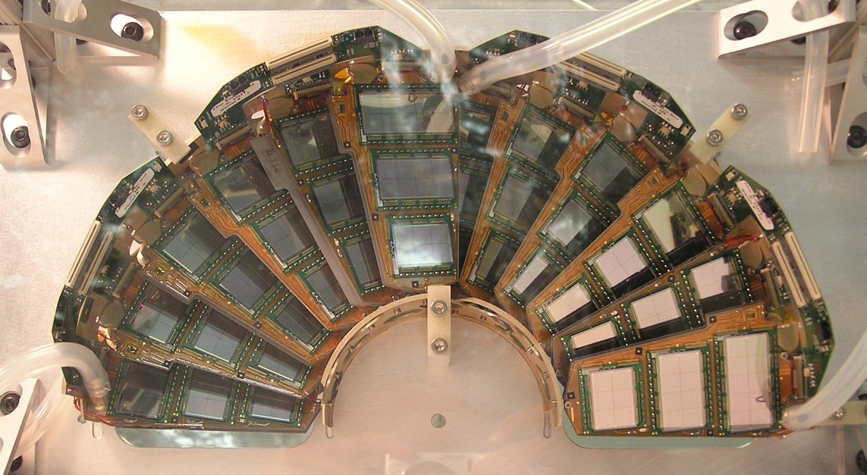
Present LHC Tracking Sensors
CMS Pixel (Half disk forward pixel)
M.Krammer, ICFA School, Bogota, 2013

Slide 33
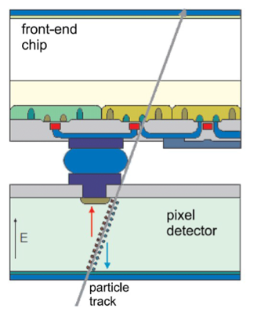
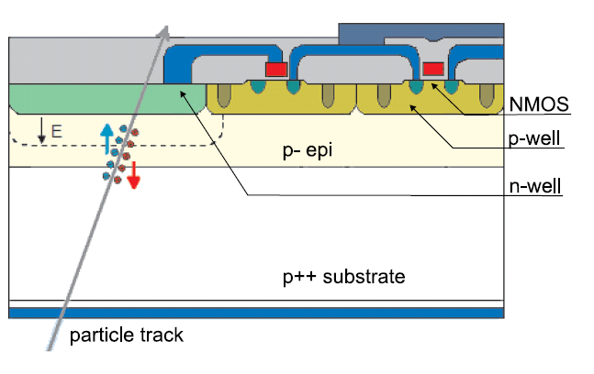
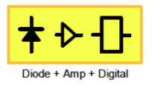

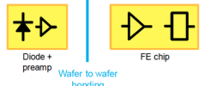
Hybrid Pixels - Monolithic Pixels
s
s
Hybrid Pixel
Monolithic Pixel
Example: ALICE – Alpide Chip
  TowerJazz 0.18µm CMOS imaging process
N-well collection electrode in high resistivity epitaxial layer
State-of-art: based on quadruple well allows full CMOS
High resistivity (> 1kΩ cm) epi-layer
(p-type, 20-40 μm thick) on p-substrate
Moderate reverse bias => increase depletion region
around N-well collection diode to collect more charges by drift
or
Charge generation volume integrated into the ASIC, but many different variants!
Thin monolithic CMOS sensor, on-chip digital readout architecture
Separately optimize sensor and FE-chip for very high radiation environment
Fine pitch bump bonding to connect sensor and readout chip

Slide 34
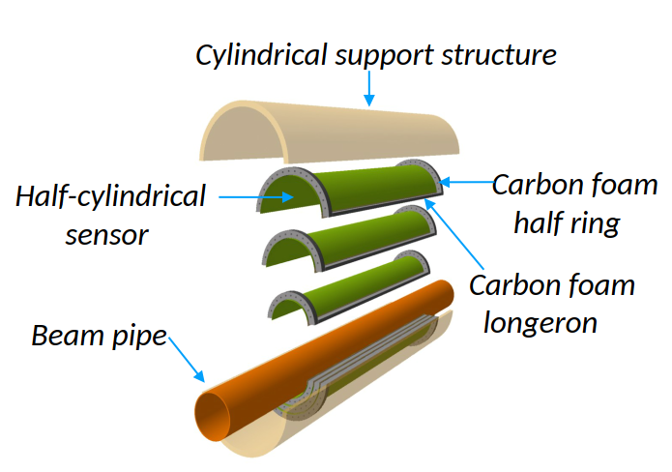
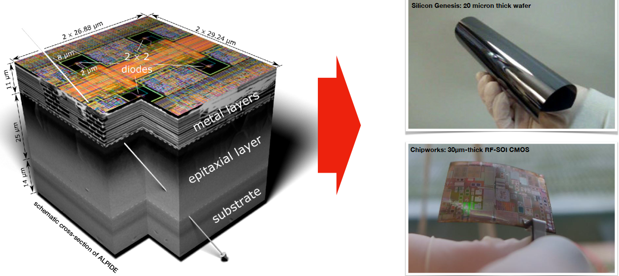
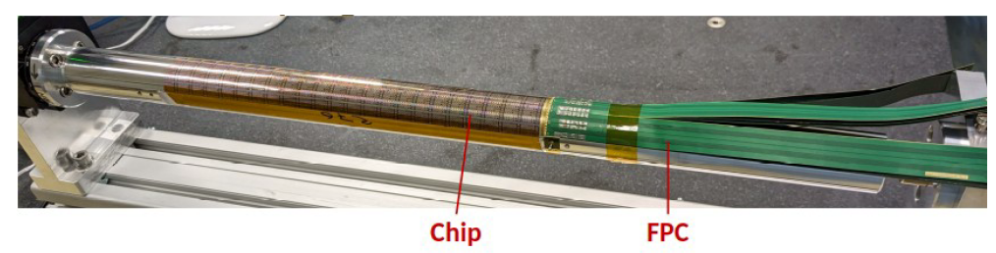
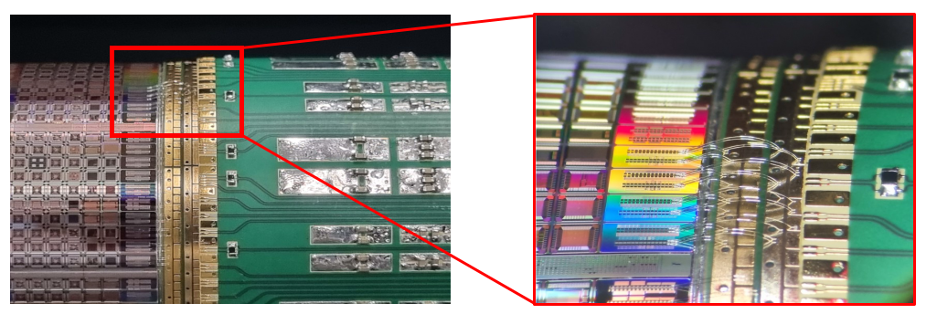
The future: Going full wafer monolithic!
ALICE ITS3 project (targeting installation in LS3 2026-2028)
  Use of 300mm wafer-scale MAPS chips in 65 nm CMOS !
    thinned down to ≤ 50 um making them flexible
    sensor length 266 mm x width 55 / 74 / 93 mm
    spatial resolution requirement 5 μm
  ITS3 detector comprised of 6 chips only!
  Mechanically held in place by carbon foam spacers
full scale chip
(50 μm thick)
bent to
19 mm radius
[Filip Krizek, VERTEX 2023]
Notes:
20-40um thick → 0.02X to 0.04% X0

Slide 35
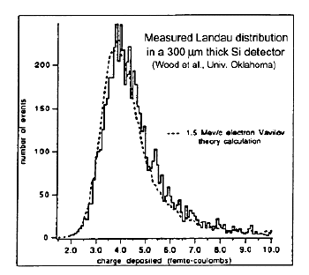
The Charge Signal
Collected charge for a Minimum Ionizing Particle (MIP)
  Mean energy loss
  dE/dx (Si) = 3.88 MeV/cm
  ⇒ 116 keV for 300μm thickness
  Most probable energy loss
  ≈ 0.7 ×mean
  ⇒ 81 keV
  3.6 eV to create an e-h pair
  ⇒ 108 e-h / μm (mean)
  ⇒ 72 e-h / μm (most probable)
  Most probable charge (300 μm)
  ≈ 22500 e ≈ 3.6 fC
Most probable charge ≈ 0.7× mean
Mean charge
number of events
charge deposited [fC]

Slide 36
The Charge Signal
Collected Charge for a Minimum Ionizing Particle (MIP)
Landau distribution has a low energy tail
  becomes even lower by noise broadening
  Noise sources: (ENC = Equivalent Noise Charge)
  - Capacitance
  - Leakage Current
  - Thermal Noise
  (bias resistor)
  Good hits selected by requiring N_{ADC} > noise tail
  If cut too high ⇒ efficiency loss
  If cut too low ⇒ noise occupancy
  Figure of Merit: Signal-to-Noise Ratio S/N
  Typical values >10-15, people get nervous below 10.
  Radiation damage severely degrades the S/N.
Signal
Cut (threshold)

Slide 37



Summary: Silicon Sensors in HEP
Main sensor concepts:
(Mini) Strip Detector [AC coupled]
p-in-n
strip
n-in-p
pixel/pad
Need inter strip isolation!
Hybrid Pixel Detector
Monolithic CMOS Pixel Detector

Slide 38
The LHC Upgrade

Slide 39


LHC upgrade
today
[HL-LHC schedule – Feb.2022]
Example
ATLAS:
[G.Calderini Vertex 2021]

Slide 40


Phase 2 upgrades – High Lumi LHC
s
s
CMS Phase-2 upgrade
About 800 m² of silicon sensors for the phase 2 upgrades of ATLAS & CMS (RUN 4 ≥ 2029)
..and all based on p-type silicon and no longer n-type silicon. Why? … let's see
Notes:
600m2 HGCAL
13m2 ATLAS Pixel
165m2 ATLAS Strip
200m2 CMS outer Tracker

Slide 41
Radiation Damage
Damage to dielectric layers and interfaces (not covered)
Damage to the semiconductor bulk (introduction)
Radiation damage is just one of the many challenges in conceiving a High Energy Physics detector for hadron colliders.
Constraints like needs for high granularity, low mass, efficient cooling and low power consumption, low cost, high rate capability, precision timing capability, …. are adding up to the challenge of building a detector.

Slide 42

Motivation and Challenge
Silicon detectors upgrades and operation
- Radiation Hardness -
LHC operation
HL-LHC (High Luminosity LHC)
  detector developments for HL-LHC
    starting after LS3 (~2026-28);
    expect 4000 fb⁻¹ (nominal LHC was 300 fb⁻¹)
HL-LHC operation & upgrades
  operation of HL-LHC
    damage modelling, evaluation, mitigation
  ATLAS Pixel replacement, LHCb upgrade, …
FCC – Future Circular Collider
  ..also FCC-ee
[I. Dawson, P. S. Miyagawa, Sheffield University, Atlas]
Increasing radiation levels
  Semiconductor detectors will face >10¹⁶ n_{eq}/cm² (HL-LHC) and >7x10¹⁷ n_{eq}/cm² (FCC-hh)
  → detectors used at LHC cannot be operated after such irradiation
New requirement and new detector technologies
  New requirements or opportunities lead to new technologies (e.g. HV-CMOS, LGAD,…)
  which need to be evaluated and optimized in terms of radiation hardness and/or 4D tracking capabilities

Slide 43



Displacement Damage
particle
Si_{S}
E_{K}>25 eV
V
Vacancy
+
Interstitial
….. a wide range of point defects
I
E_{K}>5 keV
point defects and clusters of defects
s
Can we see the defects?
HRTEM on Si: n-irradiated 10¹⁹ n_{eq}/cm²
High Resolution Transmission Electron Microscopy
V
I
I
V
example of point defect reactions:
V: V+O → VO; V+P →VP
I: I+C_{S} → C_{i} → C_{i} + O →C_{i}O_{i}
I+B_{S} → B_{i} → B_{i} + O →B_{i}O_{i}
… many more reactions!
“dopant removal”
[van Lint 1980]
[C.Besleaga et al. arXiv 2021]

Slide 44

Impact of Defects on Detector Properties
Shockley-Read-Hall statistics
s
Defect spectroscopy
e.g. DLTS, TSC
allows to measure the
defect properties
(see backup)
Extracted parameters
serve as input to
TCAD simulations
(see backup)
charged defects
⇒ N_{eff} , V_{dep}
e.g. donors in upper half, acceptors in lower half
of the band gap
trapping (e and h)
⇒ CCE
shallow defects do not contribute at RT due to fast de-trapping
generation
⇒ leakage current
levels close to midgap
most effective
Impact on detector properties can be calculated if defect parameters are known:
σ_{n,p} : cross sections ΔE : ionization energy N_{t} : concentration

Slide 45
Radiation Damage Summary
Macroscopic bulk effects:
Depletion Voltage (N_{eff}) Leakage Current Charge Trapping
Signal to Noise ratio is quantity to watch (material + geometry + electronics)
signal
noise
Cut (threshold)

Slide 46
Summary: Basics of Radiation Damage in Silicon Sensors
Two general types of radiation damage to the detector materials:
• Bulk (Crystal) damage due to Non Ionizing Energy Loss (NIEL)
- displacement damage, built up of crystal defects –
  Change of effective doping concentration & acceptor/donor removal
  (higher depletion voltage, under- depletion)
  Increase of leakage current (increase of shot noise, thermal runaway)
  Increase of charge carrier trapping (loss of charge)
• Surface damage due to Ionizing Energy Loss (IEL)
- accumulation of positive in the oxide (SiO₂) and the Si/SiO₂ interface –
affects: interstrip capacitance (noise factor), breakdown behavior, …
Impact on detector performance and Charge Collection Efficiency
(depending on detector type and geometry and readout electronics!)
Signal/noise ratio is the quantity to watch
⇒ Sensors can fail from radiation damage !
Influenced by impurities
in Si – Defect Engineering
is possible!
Same for all tested Silicon materials!
Can be optimized!
Notes:
46
46
efficacité de collection de charge influencé par deux mécanisme
piégeage – porteurs de charge sont pièges par les défaut profond
déficit de collection de charge augmente en fonction de la fluence

Slide 47
Radiation Hard Detectors

Slide 48

RD50 Collaboration (2002-2023)
RD50 (Nov.2023): 65 institutes and 440 members
Last RD50 Workshop: 28.11.-1.2.2023
51 European institutes
Austria (HEPHY), Belarus (Minsk), Czech Republic (Prague (3x)), Finland (Helsinki, Lappeenranta ), France (Marseille, Paris, Orsay), Germany (Bonn, Dortmund, Freiburg, Göttingen, Hamburg (Uni & DESY), Karlsruhe, Munich (MPI & MPG HLL)), Greece (Demokritos), Italy (Bari, Perugia, Pisa, Trento, Torino), Croatia (Zagreb), Lithuania (Vilnius), Montenegro (Montenegro), Netherlands (NIKHEF), Poland (Krakow), Romania (Bucharest), Russia (Moscow, St.Petersburg), Slovenia (Ljubljana), Spain (Barcelona(2x), Santander, Sevilla (2x), Valencia), Switzerland (CERN, PSI, Zurich), United Kingdom (Birmingham, Glasgow, Lancaster, Liverpool, Oxford, Manchester, RAL)
..followed by a new collaboration called DRD3
Full member list: www.cern.ch/rd50
LPHNE, UPMC; Université Paris-Diderot; CNRS/IN2P3, Paris
Marco Bomben, Giovanni Calderini, J.Chauveau, F.Crescioli, Giovanni Marchiori
IJCLab - Laboratoire de Physique des 2 Infinis, Irène Joliot-Curie
L.Iconomidou-Fayard, Abdenour Lounis, C.Nellist
CPPM Marseille; Marlon Barbero, P.Barrillon, P.Breugnon, A.Habib, P.Pangaud, M.Zhao
8 North-American institutes
Canada (Ottawa), USA (BNL, Brown Uni, Fermilab, LBNL, New Mexico, Santa Cruz, Syracuse)
7 Asian institutes
China (Beijing-IHEP, Dalian, Hefei, Jilin, Shanghai),
India (Delhi), Israel (Tel Aviv)

Slide 49
Device engineering example: n-in-p sensors
Why will we use p-type strip/pixel sensors (n-in-p)
for the LHC upgrade in ATLAS and CMS instead of p-in-n sensors?
Why are segmented sensors⁽*⁾ build
on p-type silicon sensors radiation harder than n-type sensors?
⁽*⁾ 300 μm
p-in-n
Need inter strip isolation!
n-in-p

Slide 50

Sensor Signal: Pad vs. Strip/Pixel
Signal = Induced charge on read-out electrode
  Described by Shockley-Ramo Theorem
  Charged induced on electrode by moving charge
  can be calculated from the weighting potential (field)
Pad
Strip
  Total collected charge in both cases 100% (Q = q) when charges have reached the electrodes, however
    Diode: 50% from (+q); 50% from (-q)
    Strip: 87% from (+q); 13% from (-q)
  In a p-in-n strip sensor the holes give a higher contribution to the (m.i.p.) signal than the electrons!

Slide 51
Device engineering: p-in-n vs. n-in-p (or n-in-n)
n-type silicon after high fluences:
(type inverted)
p-type silicon after high fluences:
(still p-type)
p⁺in-n
n⁺in-p
p-in-n silicon, under-depleted:
Charge spread – degraded resolution
Charge loss – reduced CCE
n-in-p silicon, under-depleted:
Limited loss in CCE
Less degradation with under-depletion
Collect electrons (3 x faster than holes)
Comments:
- Instead of n-in-p also n-in-n devices could be used
- Reality is much more complex: Usually double junctions form leading to fields at front and back! (next slide)

Slide 52




E-Field after irradiation: “double junctions”
Investigation by measurement
n-in-p sensor still “p-type” (i.e. highest field at front electrode) after high level of radiation
…to add more complexity
different particle irradiation
on identical sensors
[G.Kramberger et al, 2014 JINST 9 P10016]
neutron irradiated 7×10¹⁵ n_{eq}/cm²
Dominant junction close to n+ readout strip for FZ n-in-p
proton irradiated 7×10¹⁵ n_{eq}/cm²
[S.Pape, 43rd RD50 Workshop, 29. November 2023]

Slide 53


Double Junction
Double Junction = Polarization Effect
Double junction in TCAD
(see e.g. M.Bomben, SIMDET 2020 in Nov. 2021)
[V.Eremin et al., NIMA 476 (2002) 556-564]

Slide 54
Device engineering example: n-in-p sensors
p-in-n
Need inter strip isolation!
n-in-p
Sensors in LHC trackers today HL-LHC trackers tomorrow (2028)
(ATLAS/CMS) (… in production now)

Slide 55




ATLAS Phase II
Strips & Pixel
all n-in-p
F.Hartmann, Last RD50 Workshop, Nov.2023

Slide 56



CMS Phase II
Outer Tracker modules in final configuration
– n-in-p
Pixel Tracker module
– n-in-p
High Granularity Calorimeter
– n-in-p
F.Hartmann, Last RD50 Workshop, Nov.2023

Slide 57

Device engineering example:
3D Hybrid Pixel Detectors
Array of narrow electrode columns (~ 5-10μm) passing through the silicon thickness (micromaching):
Depletion voltage prop. spacing²
Collection time prop. spacing
Reduced charge sharing
→ More suited to high radiation environment
Connected to standard pixel ASIC – hybrid pixel detector
Installed 2014 in ATLAS IBL
(Inner b-layer)
&
inner pixel layers
for LHC phase II (2028)

Slide 58
TCAD simulations

Slide 59


TCAD simulations
Why do we need TCAD simulations for understanding (irradiated) sensors ?
  Complexity of the problem: Coupled differential equations (semiconductor equations)
  Complex device geometry and complex signal formation in segmented devices ….
  Evaluation of new an innovative design approaches
  Impact of defects depending on local charge densities, field-strength, … (“feedback loop”)
  Interplay of surface and bulk damage..
Details in the following presentations
3D detector
Vbias
n⁺
Electric field distribution in 3D detector (Al & oxide layer transparent for clarity)
Doping profiles
N_{p,n} = 5e18 cm⁻³
Vbias
V=0
p⁺
Vbias
3D sensor: T.Peltola (HIP, Helsinki): CMS & RD50
Column depth
=
bulk thickness
N_{bulk} = 1.7e12 cm⁻³
n+
n+
Vbias

Slide 60
Device simulation: TCAD & signal simulators
Status of TCAD device simulations
  Required by complexity of the problem:
    solve semiconductor equations with physics properties, complex geometry and radiation damage
    mainly commercial tools used (Silvaco and Synopsis)
  Excellent tools for sensor optimization
Radiation damage TCAD: enormous progress over recent years
  getting predictive power but need further optimization!
  “effective” defect levels (2 to 5 levels) are used
Signal simulators
  TCAD simulations for signal formation are complex (time consuming, TCAD is not a fitting tool!)
  Custom build signal simulators (open code) developed: sensor optimization, parameter fitting
    ..using E-Field and other parameters (e.g. charge trapping) from TCAD as input
Measured defects TCAD input
needs more work !
PixelAV, KdetSim, Garfield++, Weightfield2, TRACS,
(unpublished codes), ...

Slide 61
Summary
Silicon Sensors are based on reverse biased pn-junctions (silicon sensors are reverse biased diodes)
Silicon Detectors at the LHC and upgrade of LHC
  Inner tracking at LHC and HL-LHC done by silicon detectors
  Hybrid-pixel (planar and 3D) and strip sensors implemented in LHC experiments (ALICE upgraded to monolithic sensors)
  Radiation Hard Monolithic sensors under development (competing beyond LS3 for HL-LHC upgrades)
Radiation Damage in Silicon Sensors
  Damage: displacement damage that is evidenced as defect levels in the band gap of the semiconductor
  (+ some impact of surface damage in segmented sensors)
  Modification of internal electric field (space charge distribution, depletion voltage, “type inversion”, reverse annealing, loss of active volume, …), defect engineering possible!
  Increase of Leakage Current and Charge Trapping (same for all silicon materials)
  Signal to Noise ratio is quantity to watch (material + geometry + electronics)
Radiation tolerant silicon sensors
  Several examples of successful Material and Device Engineering (mitigation strategies)
  oxygenation, 3D sensors, p-type (n-readout) sensors
“Hot topics” in R&D on radiation hard silicon sensors
  Sensors for timing (i.e. LGAD with intrinsic gain, acceptor removal); monolithic sensors; CMOS; re-evaluation of SiC and Diamond sensors
  Reliability of TCAD simulations with defects; characterization of damage beyond 10¹⁶ cm⁻²

Slide 62
Acknowledgements & References
Most references to particular works given on the slides
  RD50 workshop presentations: http://www.cern.ch/rd50/
  Conferences: VERTEX, PIXEL, RESMDD, …
Instrumentation Schools
  ICFA, EDIT, ESI, CERN & DESY Summer Student Lectures
Books about silicon tracking detectors (and radiation damage)
  Helmuth Spieler, “Semiconductor Detector Systems”, Oxford University Press 2005
  C.Leroy, P-G.Rancoita, “Silicon Solid State Devices and Radiation Detection”, World Scientific 2012
  Frank Hartmann, “Evolution of silicon sensor technology in particle physics”, Springer 2009 & 2017 (2023: writing on new edition)
  L.Rossi, P.Fischer, T.Rohe, N.Wermes “Pixel Detectors”, Springer, 2006
  Gerhard Lutz, “Semiconductor radiation detectors”, Springer 1999
  Hermann Kolanoski and Norbert Wermes, “Particle Detectors – Fundamentals and Appilcations”, Oxford University Press 2020
Review Articles
  2018: Garcia-Sciveres and Wermes, A review of advances in pixel detectors for experiments with high rate and radiation, https://doi.org/10.1088/1361-6633/aab064
  2018: M.Moll, Displacement Damage in Silicon Detectors for High Energy Physics https://doi.org/10.1109/TNS.2018.2819506
  2021: Radiation Effects in the LHC-Experiments, 154 pages, CERN Yellow Report https://cds.cern.ch/record/2764325
Research collaborations and web sites
  CERN RD50 collaboration (http://www.cern.ch/rd50 ) - Radiation Tolerant Silicon Sensors
  CERN RD42 collaboration – Diamond detectors
  Inter-Experiment Working Group on Radiation Damage in Silicon Detectors (CERN) – CERN Yellow Report
  ATLAS IBL, ATLAS and CMS upgrade groups

Slide 63

Backup Slides

Slide 64



Collisions in the LHC
2012 – Discovery of the Higgs Boson

Slide 65
Microscopic Damage
Formation of Defects and Impact on Detectors

Slide 66

Radiation Damage – Microscopic effects
Spatial distribution of vacancies created by a 50 keV Si-ion in silicon.
(typical recoil energy for 1 MeV neutrons)
V
I
I
V
M.Huhtinen 2001
van Lint 1980
Si_{S}
V
Vacancy
+
Interstitial
point defects
(V-O, C-O, .. )
particle
E_{K}>25 eV
I
E_{K} > 5 keV
point defects and clusters of defects

Slide 67



NIEL – Non Ionizing Energy Loss
Displacement Damage Function
  Normalization of radiation fields to
  1 MeV neutron equivalent damage (n_{eq})
NIEL Hypothesis:
  Assumption: NIEL scaling
  of damage parameters
  Applied to predict damage
  of radiation fields in HEP
  NIEL violation observed:
    Material dependence
    Proton vs. neutron damage
    …
    Acceptor removal ?
1 MeV
$Φ_{eq}=$ ${κ_{x }Φ}_{x}$
1
$κ_{p }=$ 0.62 (23 GeV protons)
$κ_{p }=$ 1.85 (26 MeV protons)
$κ_{p }=$ 2.20 (23 MeV protons)
$κ_{π }=$ 1.14 (192 MeV pions)
$κ_{n }=$ 0.92 (TRIGA reactor neutrons)
[Data: A.Vasilescu and G.Lindstroem]
Simulation: Vacancies in (1μm)³ after 10¹⁴ particles/cm²
[M.Huhtinen, NIMA 491(2002), 194]
10 MeV protons 23 GeV protons 1 MeV neutrons
Notes:
Allport 2019

Slide 68

Radiation induced defects with impact on device performance
RD50 map of most relevant defects for device performance near room temperature:
BD: positive charge
higher introduction after proton than after neutron irradiation, oxygen dependent
E30: positive charge
higher introduction after proton irradiation than after neutron irradiation
Phosphorus: shallow dopant
(positive charge)
BiOi
(acceptor removal)
Leakage current: V₃
leakage current
& neg. charge
current after γ irrad,
V₂O (?)
Reverse annealing
(negative charge)
Boron: shallow dopant
(negative charge)
  Trapping: Indications that E205a and H152K are important (further work needed)
  Converging on consistent set of defects observed after p, π, n, γ and e irradiation.
  Defect introduction rates are depending on particle type and energy, and some on material!

Slide 69

Some TCAD models from literature
Several models
available
(non exhaustive list):
Table: M.Moll, Displacement Damage in Silicon Detectors, doi.org/10.1109/TNS.2018.2819506

Slide 70
Macroscopic Damage
Degradation of Detector Performance

Slide 71
Summary: Basics of Radiation Damage in Silicon Sensors
Two general types of radiation damage to the detector materials:
• Bulk (Crystal) damage due to Non Ionizing Energy Loss (NIEL)
- displacement damage, built up of crystal defects –
  Change of effective doping concentration & acceptor/donor removal
  (higher depletion voltage, under- depletion)
  Increase of leakage current (increase of shot noise, thermal runaway)
  Increase of charge carrier trapping (loss of charge)
• Surface damage due to Ionizing Energy Loss (IEL)
- accumulation of positive in the oxide (SiO₂) and the Si/SiO₂ interface –
affects: interstrip capacitance (noise factor), breakdown behavior, …
Impact on detector performance and Charge Collection Efficiency
(depending on detector type and geometry and readout electronics!)
Signal/noise ratio is the quantity to watch
⇒ Sensors can fail from radiation damage !
Influenced by impurities
in Si – Defect Engineering
is possible!
Same for all tested Silicon materials!
Can be optimized!
Notes:
71
71
efficacité de collection de charge influencé par deux mécanisme
piégeage – porteurs de charge sont pièges par les défaut profond
déficit de collection de charge augmente en fonction de la fluence

Slide 72
Radiation Damage in the LHC Experiments
(Silicon Detectors)

Slide 73


Radiation Effects in LHC Experiments
5 workshops on “Radiation Effects at LHC Experiments and Impact on Operation and Performance” organized (2011 - 2019)
  Common Workshop: (ALICE), ATLAS, CMS, LHCb, RD50
    Sensor Measurements
    Electronics/Optoelectronics
    Radiation Simulation and Monitoring
    Sensor Simulation
Outcome and follow-up:
  Generally good agreement between RD50 damage prediction models (e.g.“Hamburg model”) and radiation damage observed by the LHC experiments.
  More coherent approach in data analyses agreed and documented.
  Modelling will have to be refined in some areas for run 3 !
CERN Yellow Report written and edited by a team from RD50 & all LHC experiments has been published (154 pages, Radiation effects in the LHC experiments https://cds.cern.ch/record/2764325) summarizing observations, comparing results from different experiments against each other, listing open questions and outlining further work towards Run 3.
  [https://indico.cern.ch/event/769192]
  [https://cds.cern.ch/record/2764325 ]

Slide 74





Radiation Effects in LHC Experiments
Review of radiation effects in the LHC Experiments in several workshops [INDICO]
  Common working group: RD50 & LHC experiments → Publication of a summary report in April 2021 [CERN Yellow Report link]
Leakage currents in ATLAS SCT
and CMS tracker and model predictions
LHCb Velo depletion voltage
reduced by annealing;
according to model
ATLAS B-layer
data vs. MC&NIEL
strong z-dependence;
unexpected
CMS pixel layers;
deviation of V_{dep} from
modelling at high fluences
Plots: Radiation Effects Workshop Feb.2019
K.Mochizuki(ATLAS SCT) J.L.Agram (CMS Tracker), Aiden Grummer (ATLAS Pixel) , G.Sarpis (LHCb Velo) , F.Feindt (ATLAS Pixel)

Slide 75
How to increase the radiation hardness?

Slide 76
Approaches to develop radiation harder solid state tracking detectors
Defect Engineering of Silicon
Deliberate incorporation of impurities or defects into the
silicon bulk to improve radiation tolerance of detectors
  Needs: Profound understanding of radiation damage
    microscopic defects, macroscopic parameters
    dependence on particle type and energy
    defect formation kinetics and annealing
  Examples:
    Oxygen rich Silicon (DOFZ, Cz, MCZ, EPI)
    Oxygen dimer & hydrogen enriched Si
    Pre-irradiated Si
    Influence of processing technology
New Materials
  Silicon Carbide (SiC), Gallium Nitride (GaN)
  Diamond (CERN RD42 Collaboration)
  Amorphous silicon, Gallium Arsenide
Device Engineering (New Detector Designs)
  p-type silicon detectors (n-in-p)
  thin detectors, epitaxial detectors
  3D detectors and LGAD - Low Gain Avalanche
  Cost effective detectors
  Monolithic devices – HV-CMOS
Scientific strategies:
Material engineering
Device engineering
Change of detector
operational conditions
CERN-RD39 (closed, now part of RD50)
“Cryogenic Tracking Detectors”
operation at 100-200K to reduce charge loss

