Slide 1
SIMDET 2023 LPNHE-Paris
Application of the SILVACO program to the development of silicon detectors for the detection of high-energy particles
Li Long
llong@cismst.de
CiS research institute for Microsensor system
Konrad-Zuse-Str.14, 99099 Erfurt, Germany
22-24.Nov. 2023

Slide 2

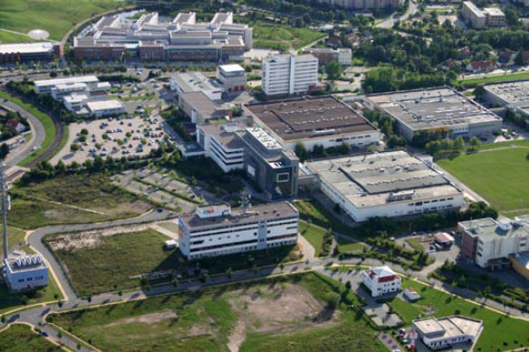

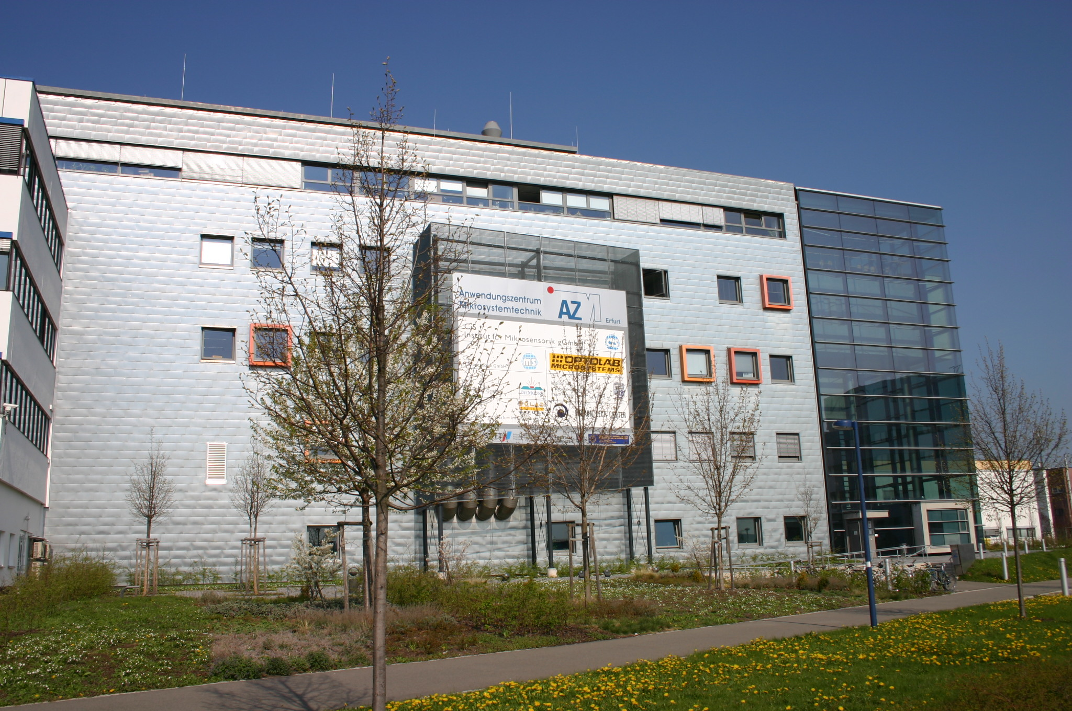

CiS Research Institute for Microsensor system
Location
Hamburg
Berlin
Erfurt
Frankfurt/Main
Munich

Slide 3
CiS Research Institute for Microsensor system
Organisation
Business Units
MEMS
MOEMS
Departments
Technology
Simulation & Design
Wafer Processing
Backend / Assembly
Test & Analytics
Process Development
System
Micromechanical Sensors
Microoptoelectronical Sensors
Silicon Detectors

Slide 4
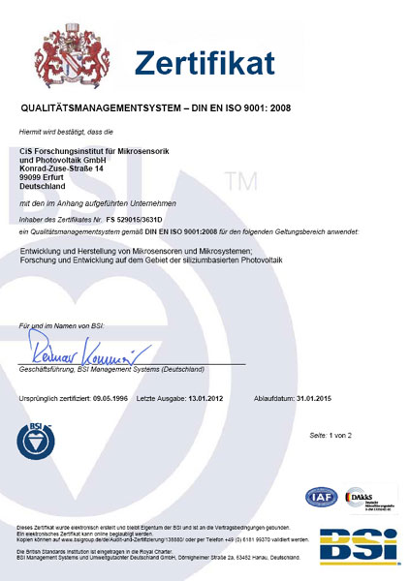
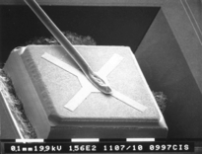
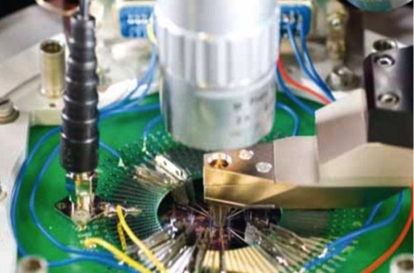
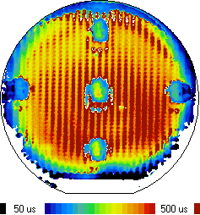
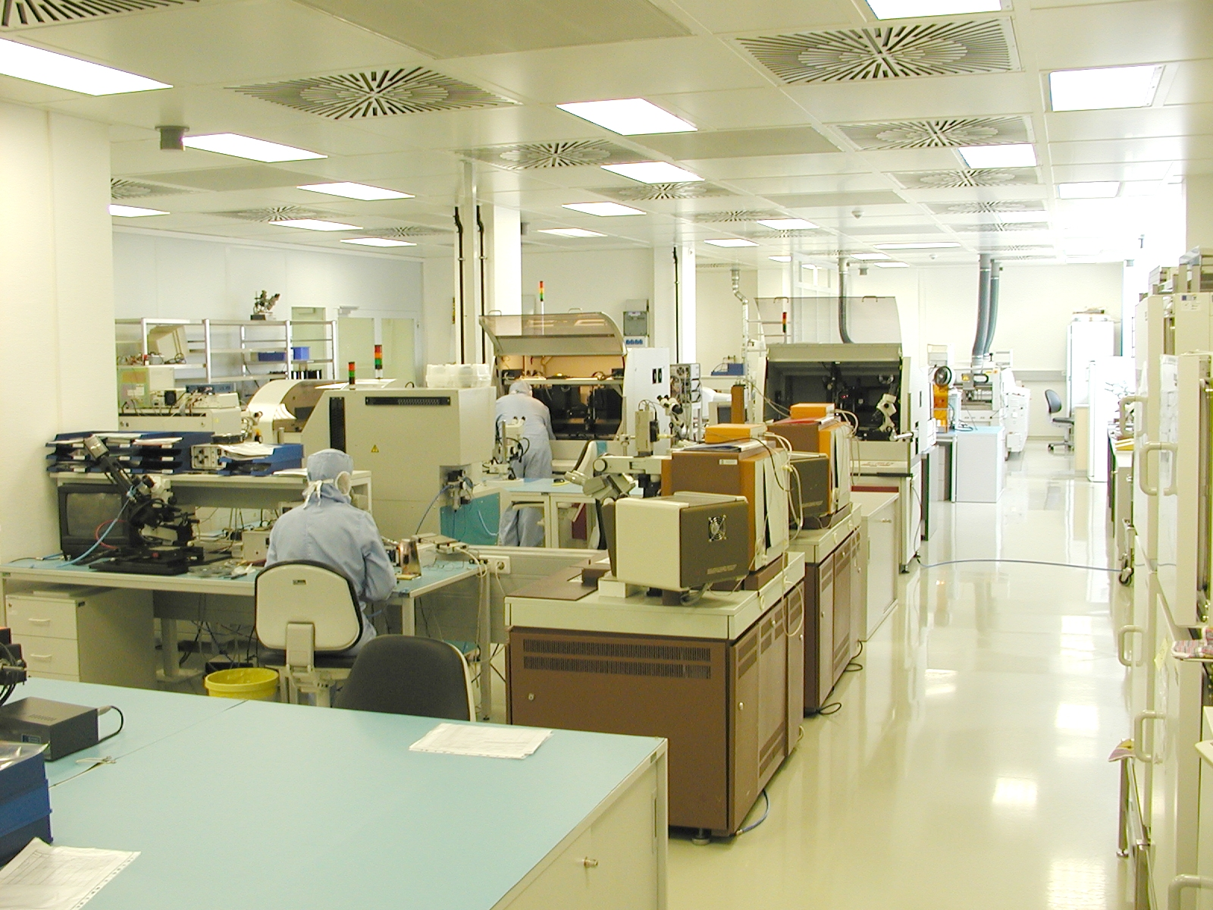
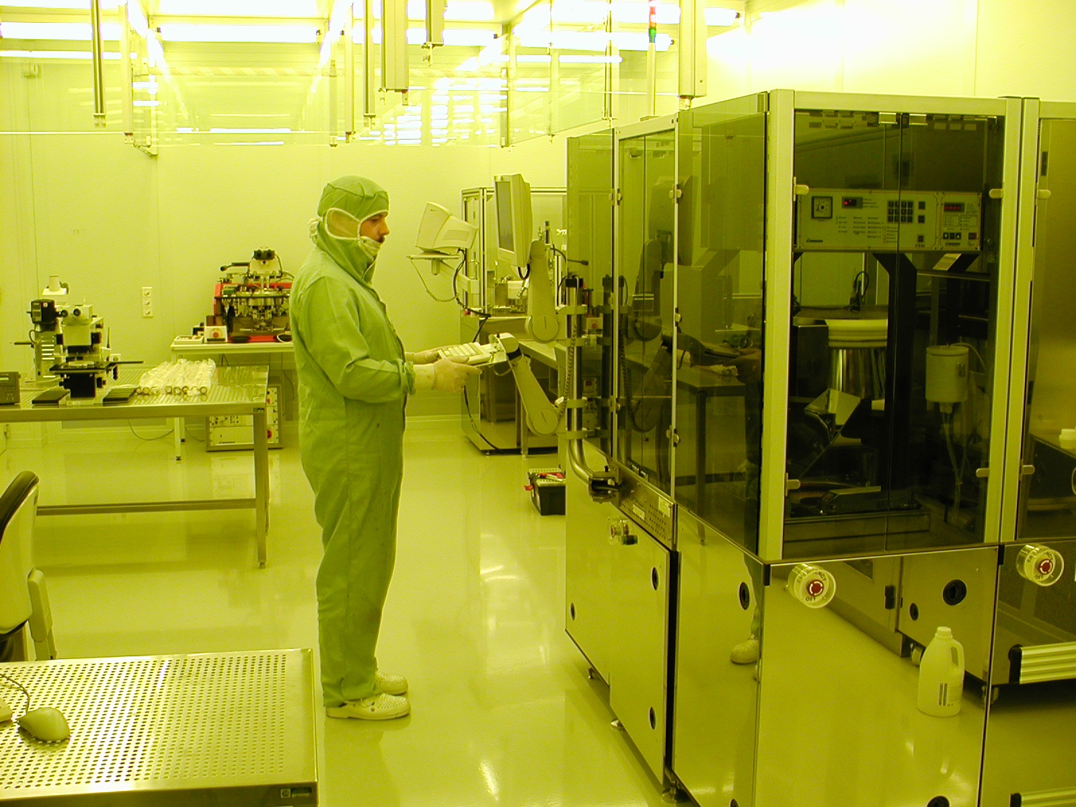
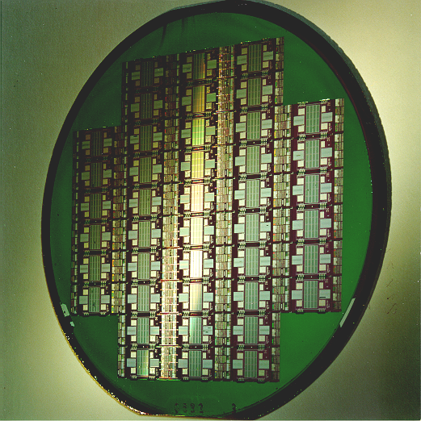
Complete technology chain for R&D and production of
high-performance micro-sensor systems
- Layout
FEM-Simulation
Process-Simulation
- Device-Simulation
- Circuit-Simulation
Simulation
and design
Wafer technology
Certified QM System
DIN EN ISO 9001
Assembly and packaging
Device characterization and analysis

Slide 5
Simulation and design
Layout and DRC: Layed, ICED, Tanner, Klayout
Electrical, mechanical and thermal simulation: ANSYS, COMSOL
Semiconductor simulation: Athena 5.26.1.R, ATLAS 5.34.0.R
Circuit simulation: HSPICE, free spices, and ORCAD

Slide 6
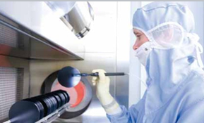
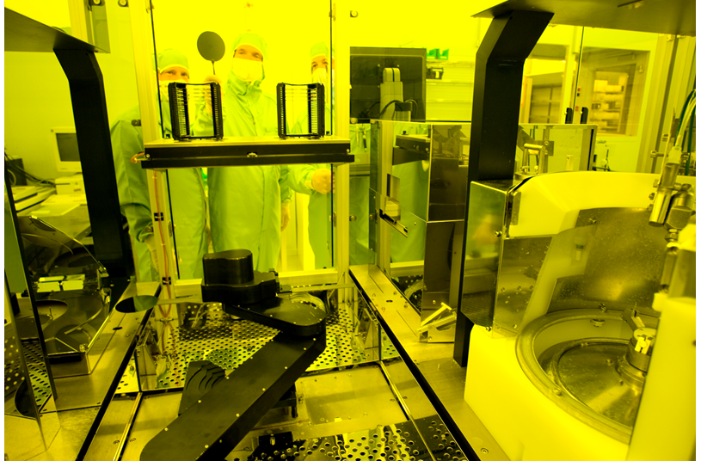
CiS Research Institute
Wafer processing
Structuring by using
UV-Photolithography
<1um
- 4“ and 6” Wafer line, front and backside processing,
- Spray-Coating for 3D-MEMS/MOEMS
RIE- and Plasma etch, Wet-Bench
High temperature processes
LP/PE-CVD, Magnetron sputtering
Si-direct bonding, anodic bonding

Slide 7

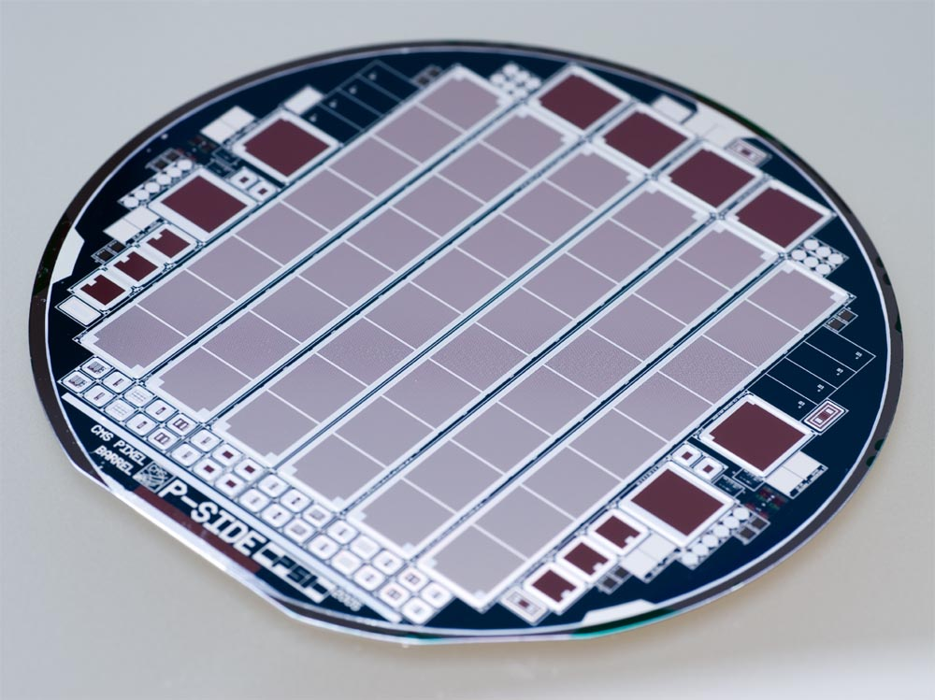
Radiation and particle detectors for high-energy physics
Radiation- and Particle-Detectors for HEP
  Micro-strip detectors
  Micro-pixel detectors
  X-Ray detectors
  Beta ray detectors
  Ion detectors
  Silicon photomultiplier
  DSSS

Slide 8
Silicon detectors for HEP
Silicon detectors for particle detection
High granularity: high spatial resolution, microstrip, micropixel, single or double sided, AC or DC coupled
Big sensitive volume: full depletion
Low mass: thin substrate
Small dead area: edge region should be small
Low noise: low interstrip capacitance, high coupling capacitance for ac coupling
Good channel isolation
High operation voltage: sensitivity
Radiation hard: 10¹⁵cm⁻² Fluence of 1MeV equivalent neutron
Good CCE, MIPS pulse height distribution
Specifications
Low and homogenous leakage current over all channels
Very few hot or defect channels, dielectric pin holes, defect poly resistors or metal lines
High breakdown voltage and no micro discharge
High dielectric breakdown voltage for ac coupling (double sided sensor)
Design rules and robust design
1. Patterning size limitation and mask alignment precision: Minimal structure size, minimal structure separation and overlap
2. Statistical deviation of film growth or deposition: Safety margin of process parameters
© CiS Research Institute, 2023
Notes:
8

Slide 9
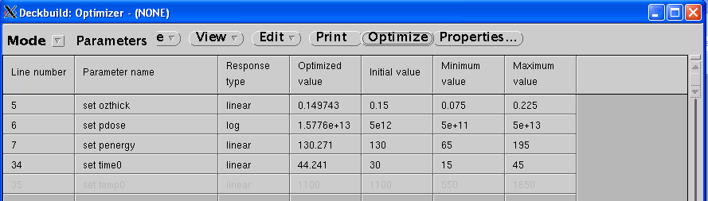
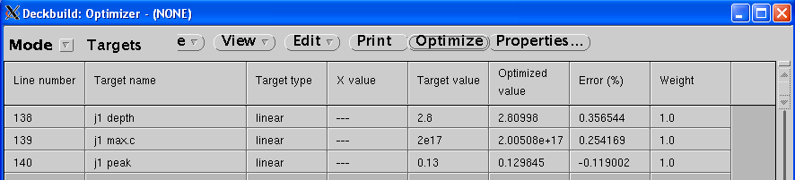
Process simulation
The fixed positive charge in the Si/SiO2 interface creates a conductive channel between adjacent strips or pixels, isolation is required.
Pspray or Pstop are used.
They have effects on interstrip
resistance, capacitance,
breakdown voltage and CCE.
Pstop profile
peak concentration 2.0E17, peak position 0.13um, depth 2.8um.
Deckbuild Optimizer
© CiS Research Institute, 2023
Notes:
9

Slide 10
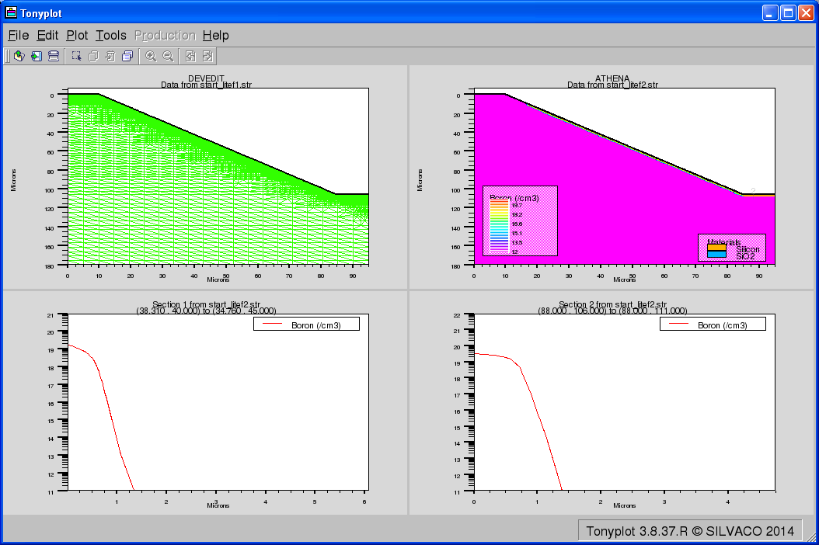
Process simulation
Ion implant on the KOH etched cavity
Deveidt structure
Athena
go athena
init infile=start_litef1.str
method fermi
deposit oxid thick=0.15 divisions=8
deposit photores thick=2 divisions=8
etch photores right p1.x=17
implant boron dose=2.0e15 energy=70 crystal
diffus time=60 temp=975 nitro press=1.00
diffus time=180 temp=975 nitro press=1.00
etch photores all
struct outfile=start_litef2.str
slope 5.42E14/cm2
flat 1.65E15/cm2
© CiS Research Institute, 2023
Notes:
10

Slide 11
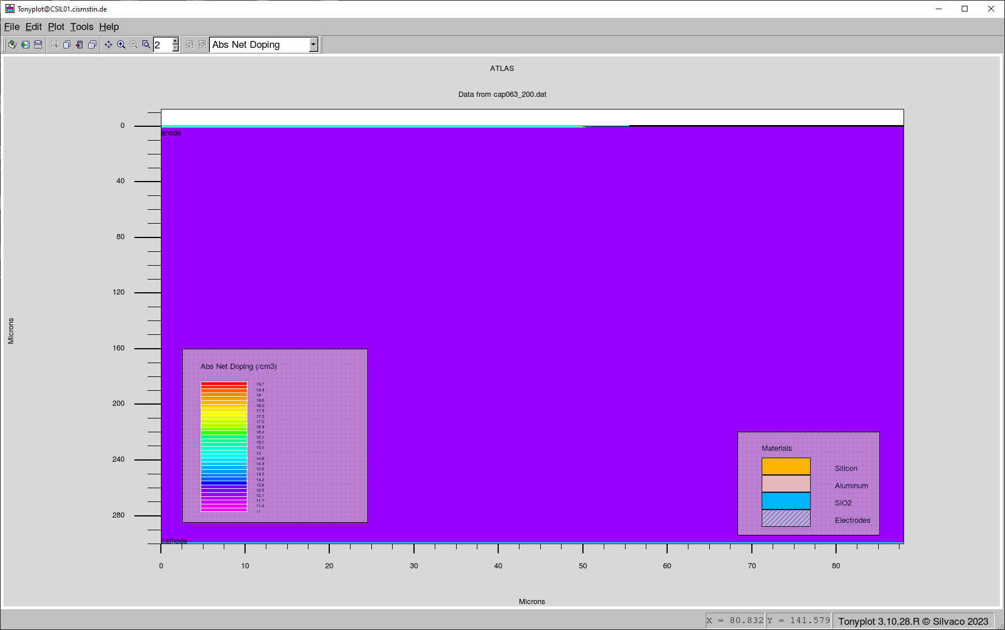
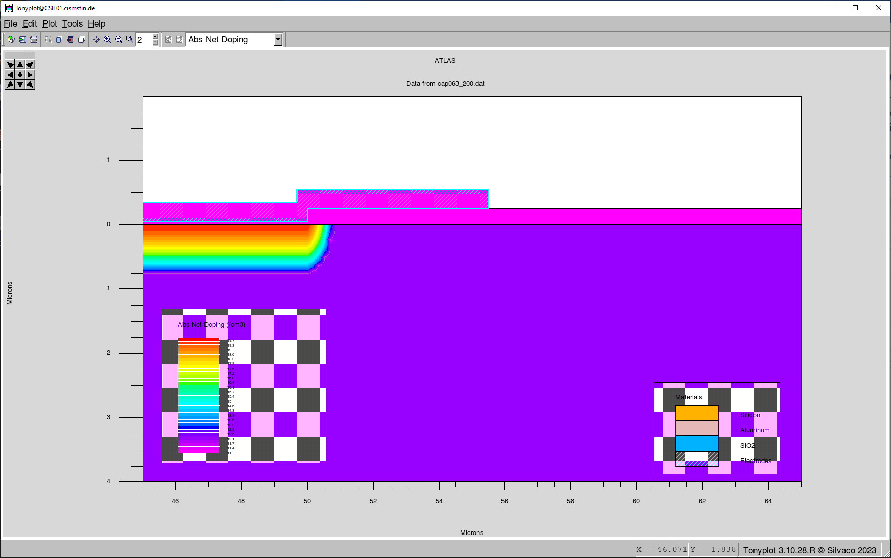
Device simulation, field plate
A field plate over the edge of an active zone can reduce the electric field strength and increase the breakdown voltage. The following simulation is performed to obtain the design rule.
Metal thickness: 1 µm, Scatter oxide thickness: 50 nm, Ground oxide thickness: 250 nm, Step in oxide (width of scatter oxide over active zone beside the contact opening): 10 µm.
© CiS Research Institute, 2023
Notes:
11

Slide 12
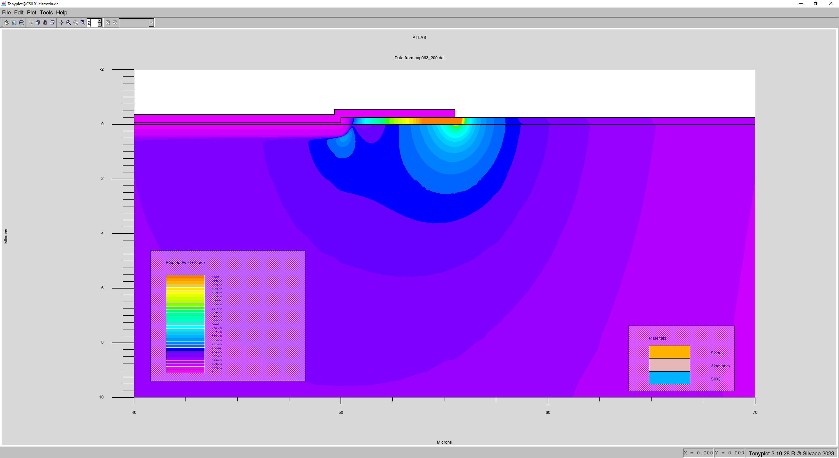
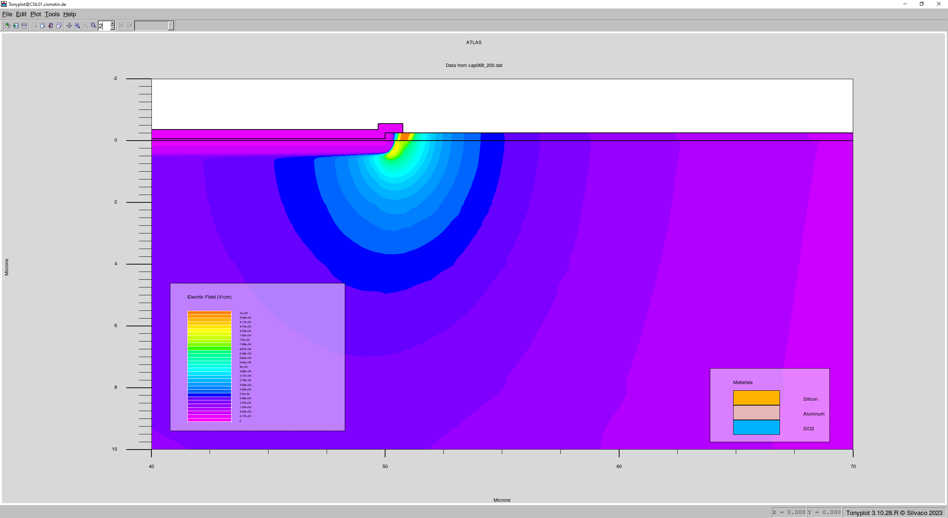
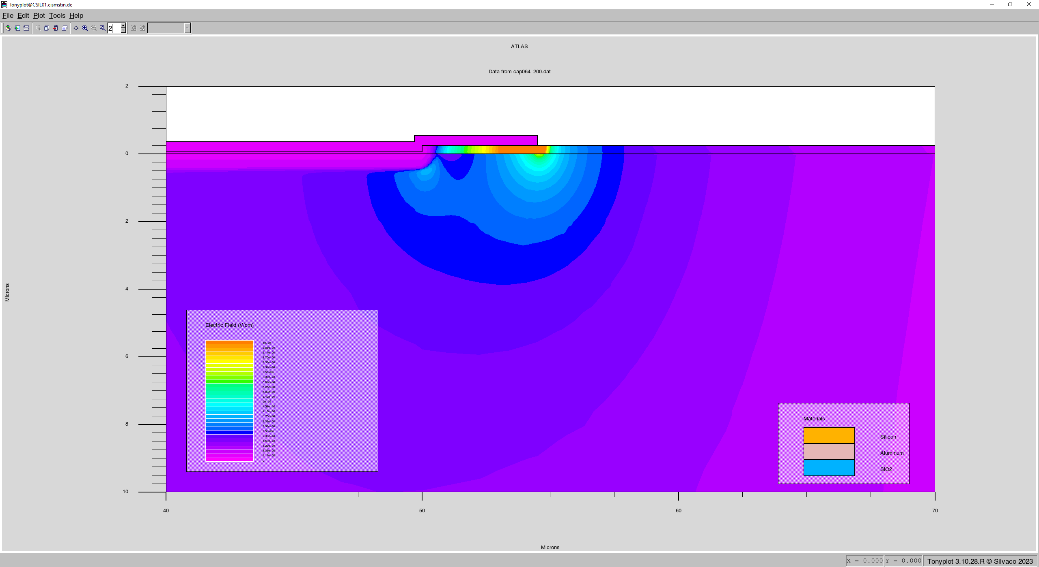

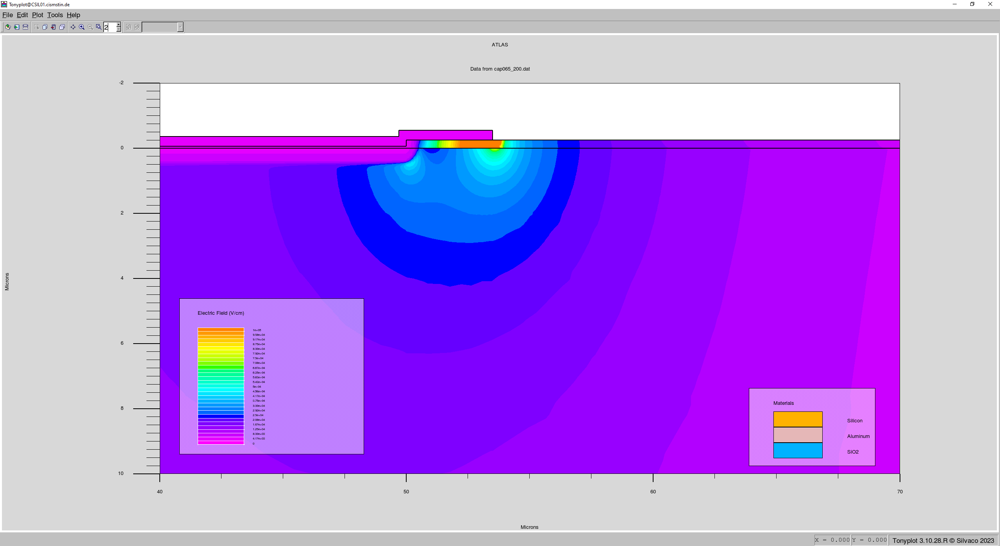



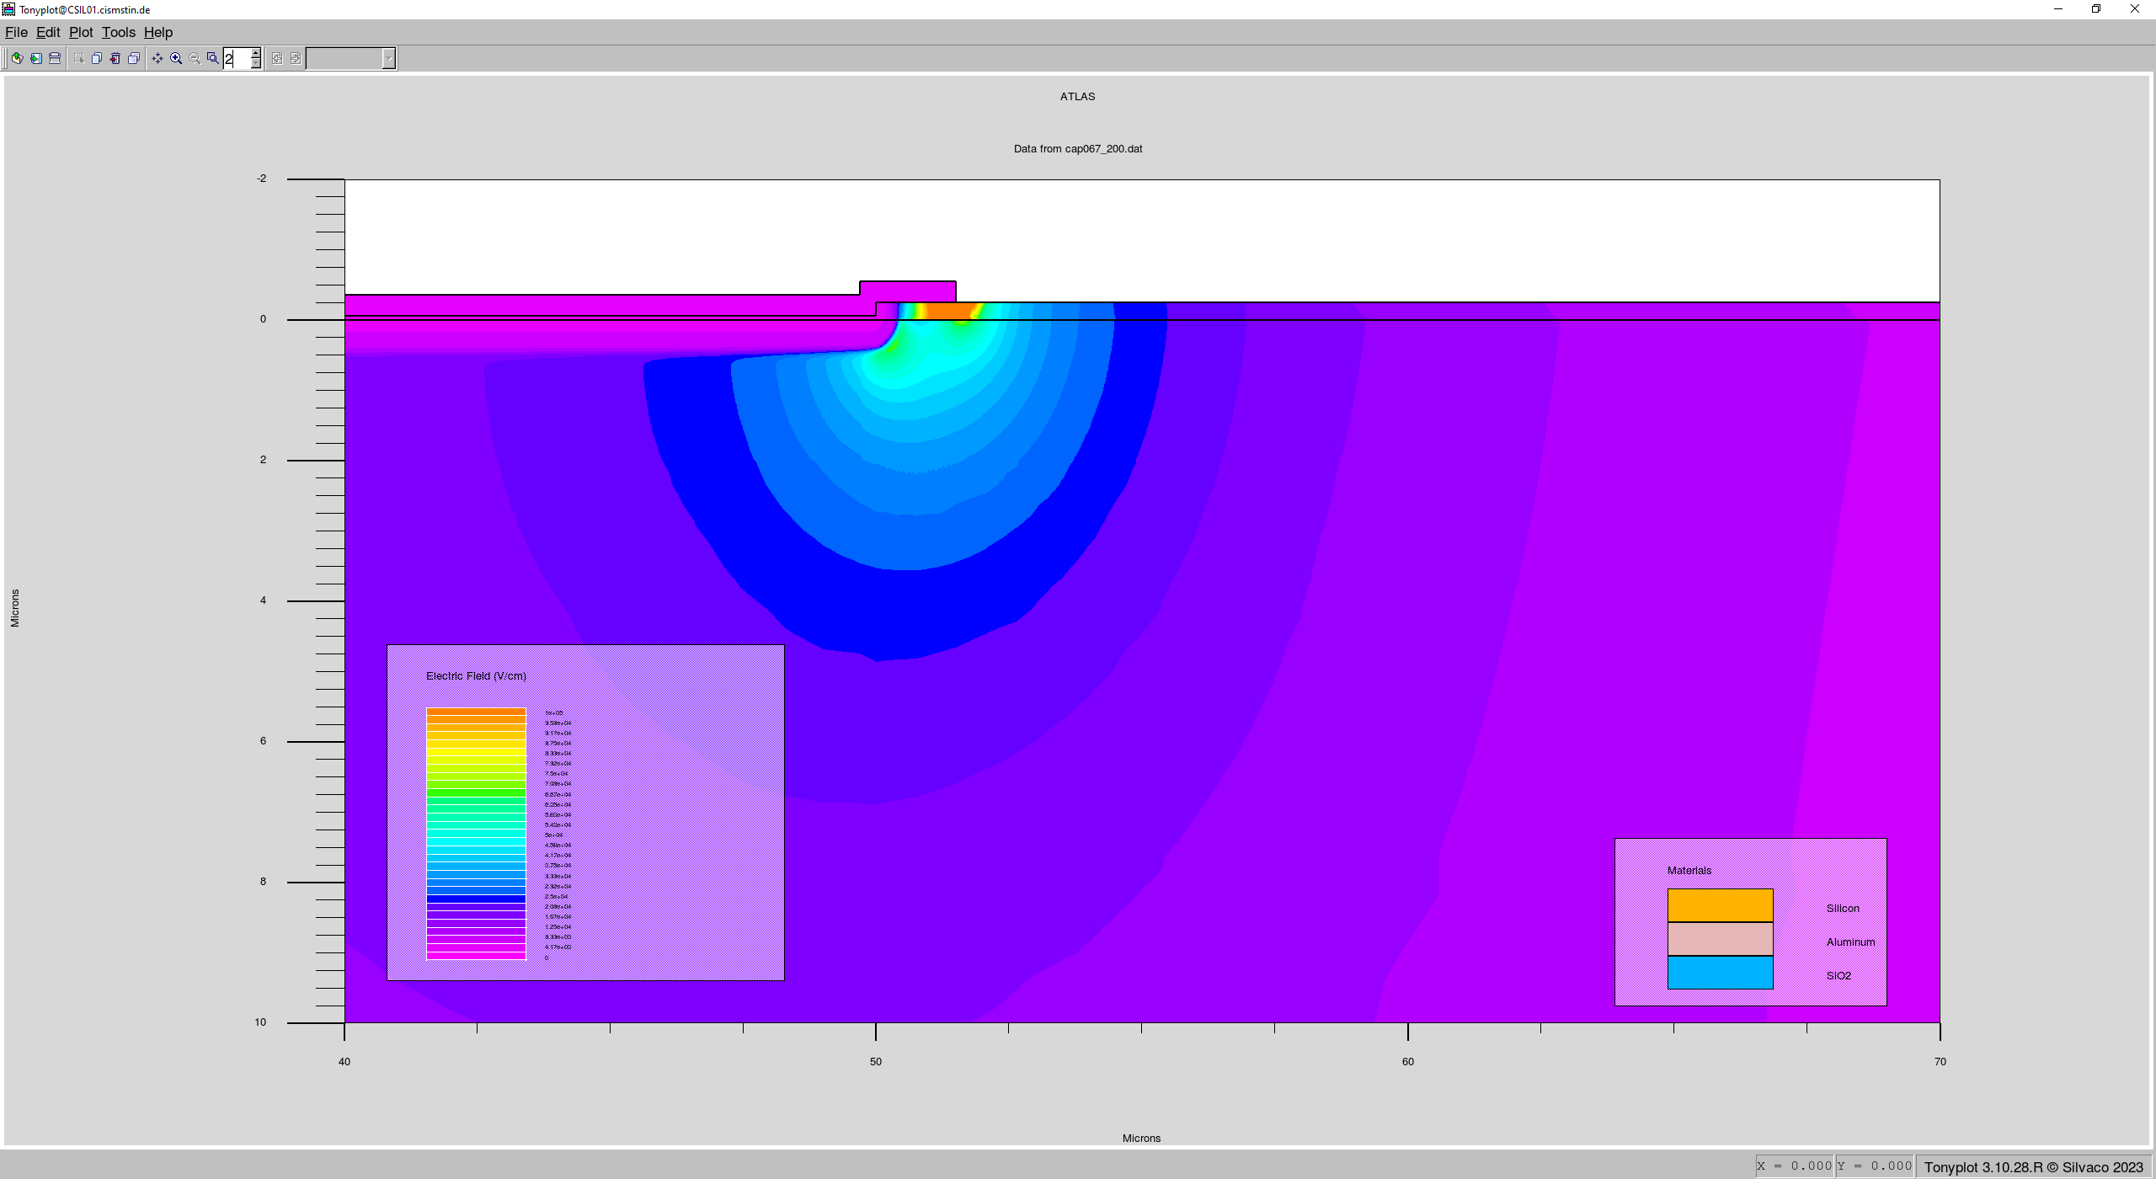

Field plate, Electric field distribution @200V vs. overlap sizes
5.5µ
0.75µ
4.5µ
0µ
3.5µ
-0.75µ
2.5µ
-1.5µ
1.5µ
-2.5µ
© CiS Research Institute, 2023
Notes:
12

Slide 13
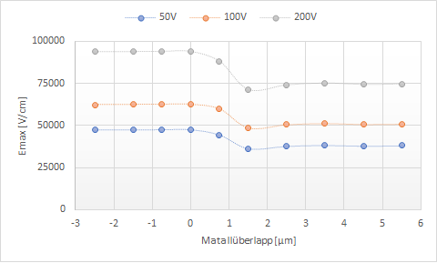
Field plate, maximal electrical field strength @different bias vs. overlap
For three different biases, the maximum E-field strength is calculated for different metal overlaps.
With 2.5µ overlap you already get the smallest Emax.
Larger overlaps will increase the interstrip capacitance.
© CiS Research Institute, 2023
Notes:
13

Slide 14
Field plate
The maximum electric field strength of the sensor is (in lateral direction) at the edge of the active zone.
The maximum electric field strength of the sensor is lower if the metal overlaps the substrate region.
Find the smallest possible metal overlaps that produce the smallest E-field peak.
© CiS Research Institute, 2023
Notes:
14

Slide 15
Dicing edge
There are many deep defects at the dicing edge. When the space charge region touches the edge,
the leakage current will increase rapidly with bias. The effect of the dicing edge is simulated with this
modeling structure.
To compare the effect of a floating implant, we use a model with and without floating implants.
Dist is the distance to the dicing edge, sep=20um,strip=50um.
© CiS Research Institute, 2023
Notes:
15

Slide 16
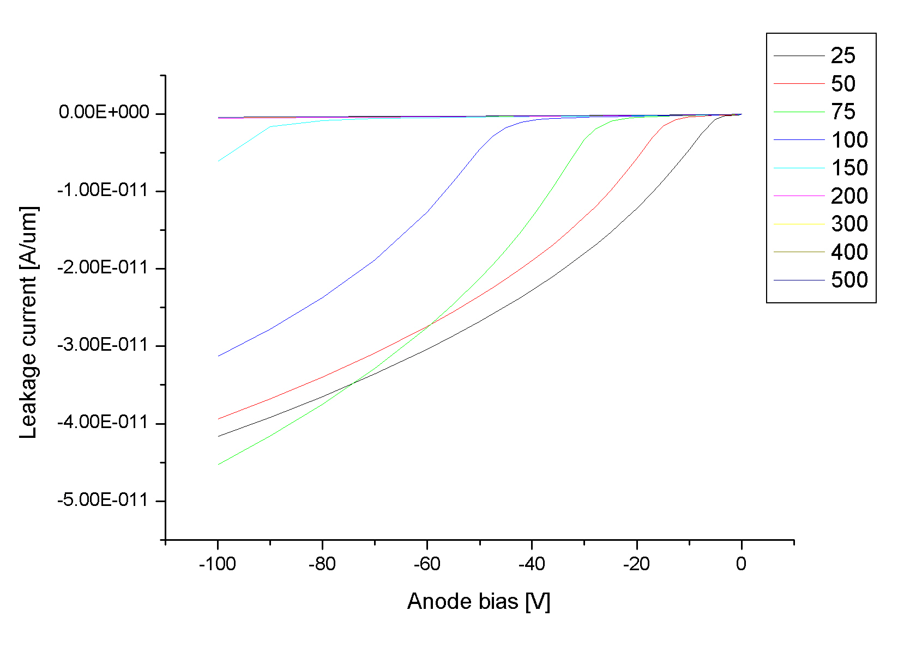
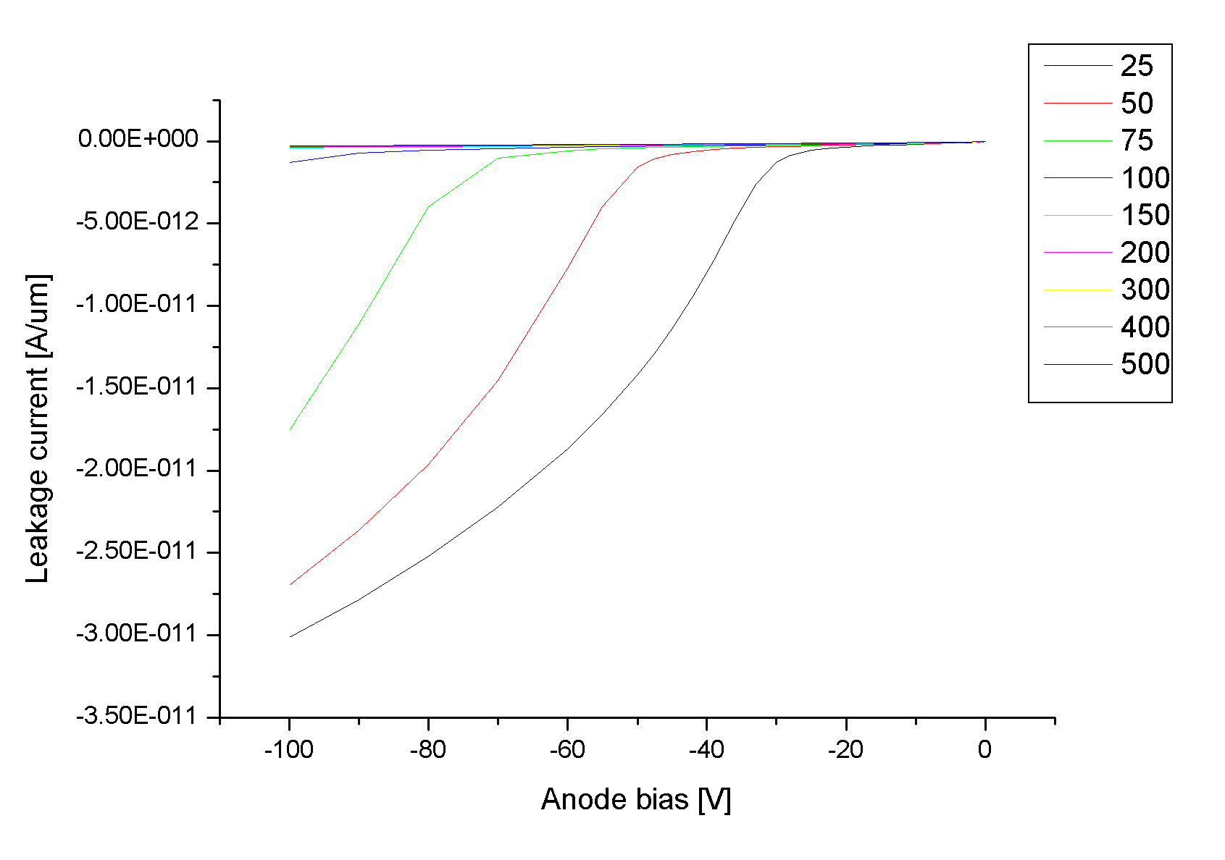
Dicing edge
Leakage current vs. biasing voltage for different distances
The left plot is for a structure without floating implants, the right plot is for a structure with
floating implants.
dist are shown on legend.
An active zone too close to the dicing edge will result in greater leakage unless the edge is passivated.
Inserting a floating strip shortens the required distance to the edge.
© CiS Research Institute, 2023
Notes:
16

Slide 17
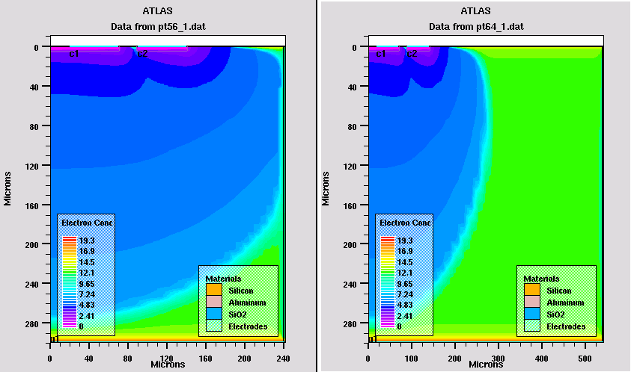
Dicing edge
Electron concentration distribution for two distances
Distance to dicing edge 100um Distance to dicing edge 400µm.
At a distance of 100µm, the space charge region touches the edge.
At a distance of 400µm, the leakage current remains small.
© CiS Research Institute, 2023
Notes:
17

Slide 18
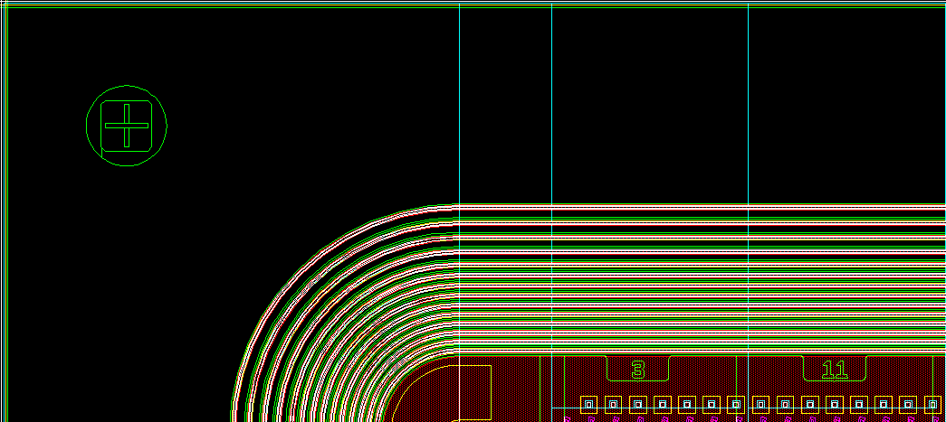
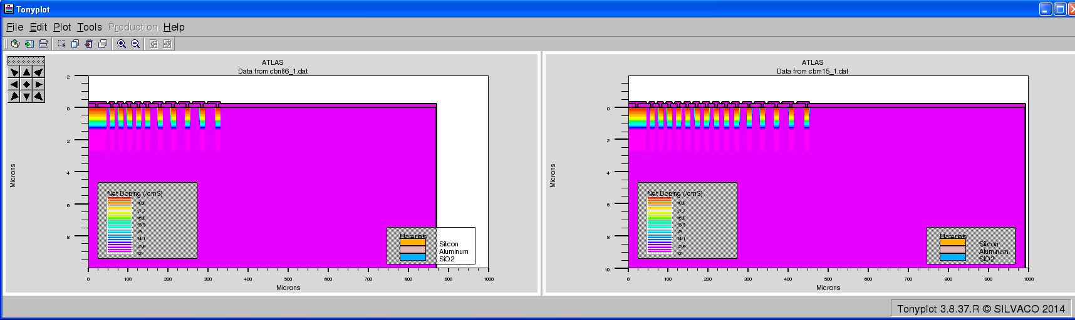
Multi guard ring
The multi guard ring structure is designed to relax the electric field at the strip edge
and to limit the space charge region.
This structure reforms the potential distribution
around the implant edge, so that the peak field strength
is reduced.
Two guard ring structures 10 rings and 15 rings
© CiS Research Institute, 2023
Notes:
86 15
18

Slide 19
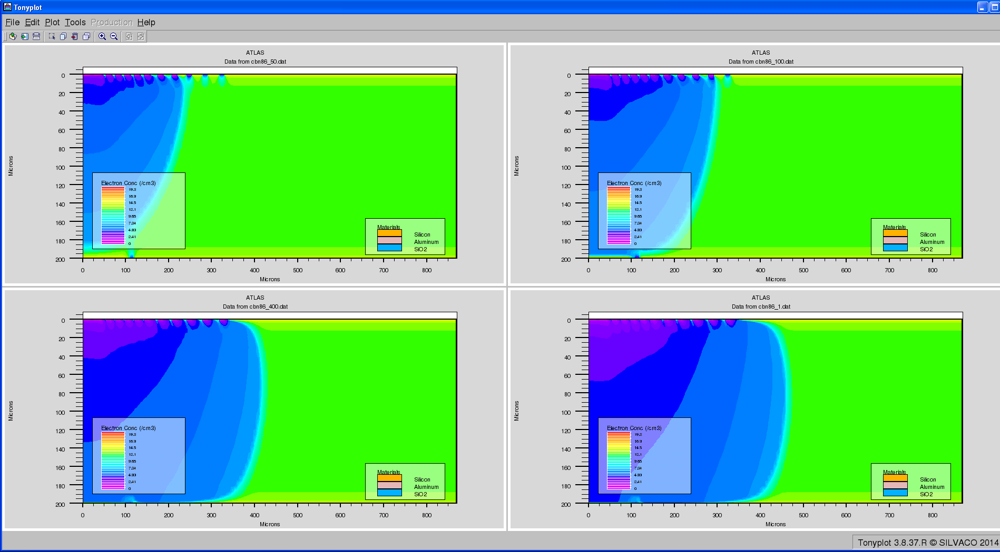
Multi guard ring
The electron concentration distribution for biases of 50, 100, 400, 1000V for the10-ring structure
© CiS Research Institute, 2023
Notes:
50 100 400 1000V
19

Slide 20
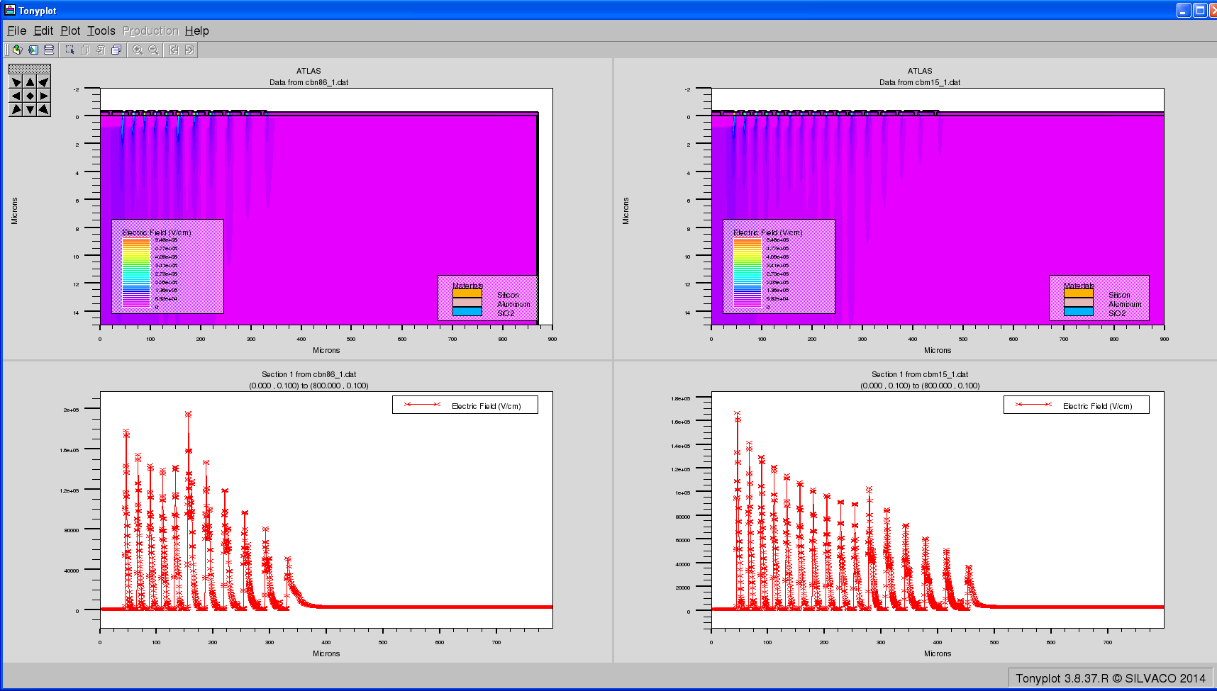
Multi guard ring
The electric field distribution of 1000V for 10 rings and 15 rings guard ring structures
The guard ring with 15 rings has a smaller peak in the electric field
Highly mesh dependent.
© CiS Research Institute, 2023
Notes:
20

Slide 21
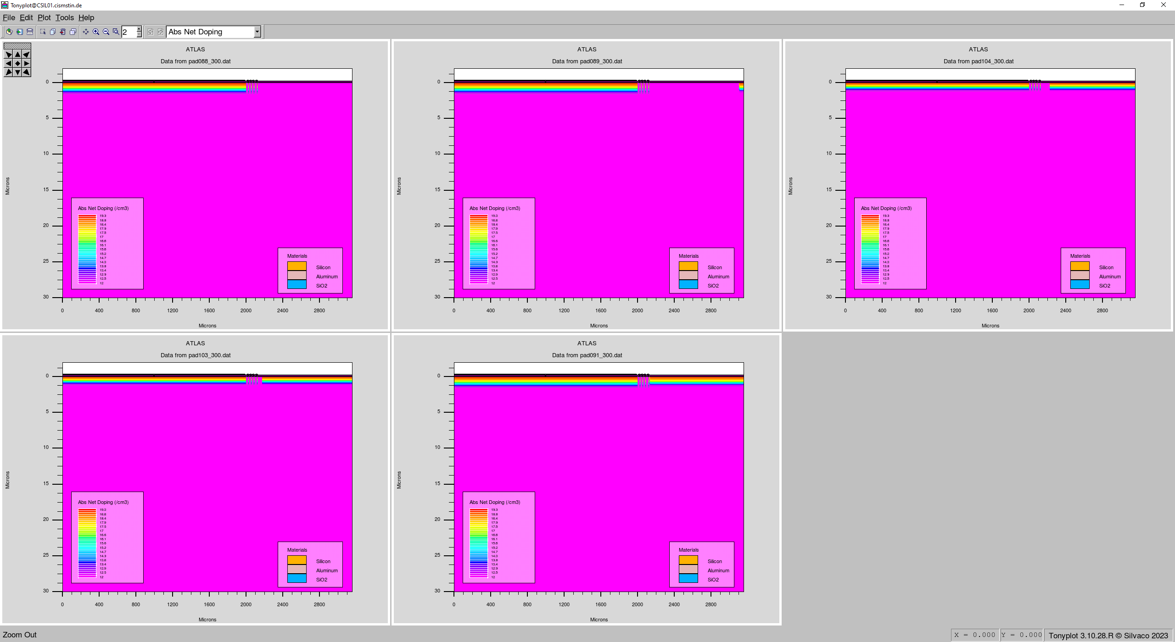
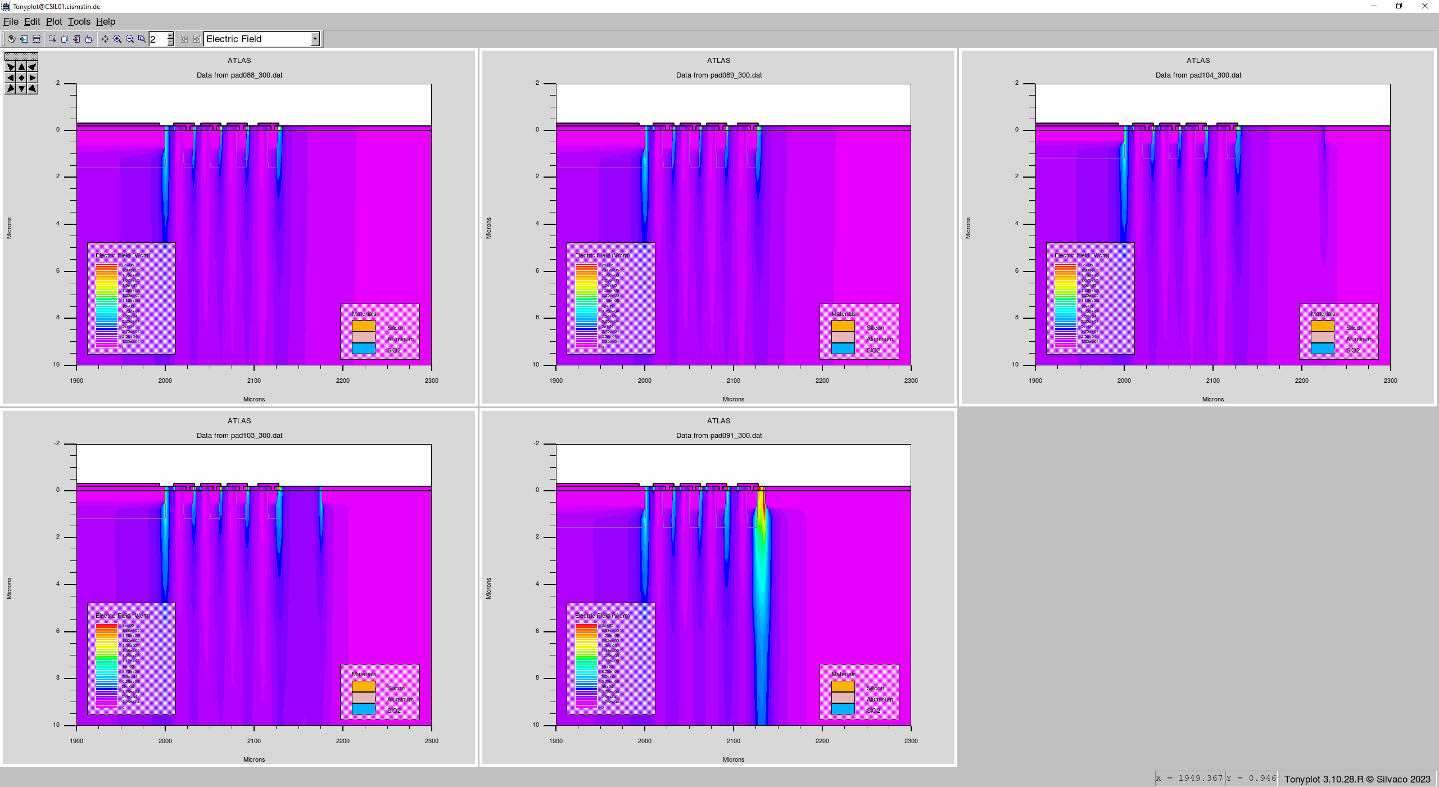
The effect of border implant
We simulate structures of 200µ and 500µ thick with 4 guard rings plus different border implants
Structures
E-Field distributions
© CiS Research Institute, 2023
Notes:
21

Slide 22
The effect of border implant
We simulate 200µ and 500µ thick structures with 4 guard rings, the boundary zone is 1035µ, plus different border implants starting from the chip edge.
For smaller distance the dark current is smaller but the maximum of electric field is higher.
Therefor a compromise must be found for the sensor design.
© CiS Research Institute, 2023
Notes:
22

Slide 23
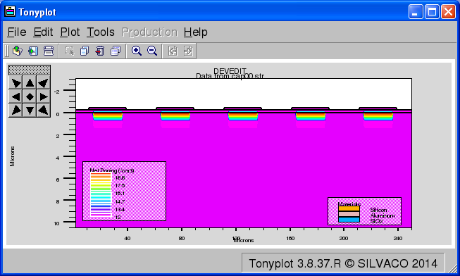
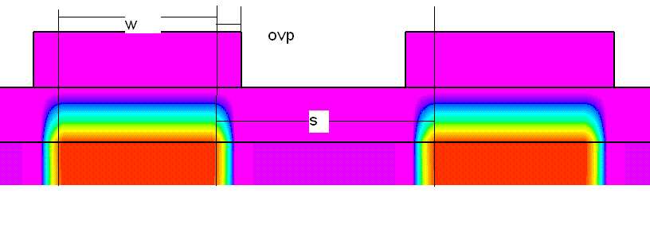
Inter strip capacitance
Above full depletion the inter-strip capacitance is the major contributor to amplifier noise.
A p-in-n microstrip sensor with AC coupled silicon detector, backside with pspray is simulated.
y axis the inter-strip capacitance [F/cm], x axis the metal overlap in [microns].
© CiS Research Institute, 2023
Notes:
23

Slide 24
Inter strip capacitance
The interstrip capacitance is plotted as a function of various geometric parameters to provide
design information.
The interstrip capacitance of the ohmic side is much larger than that of the junction side.
© CiS Research Institute, 2023
Notes:
24

Slide 25
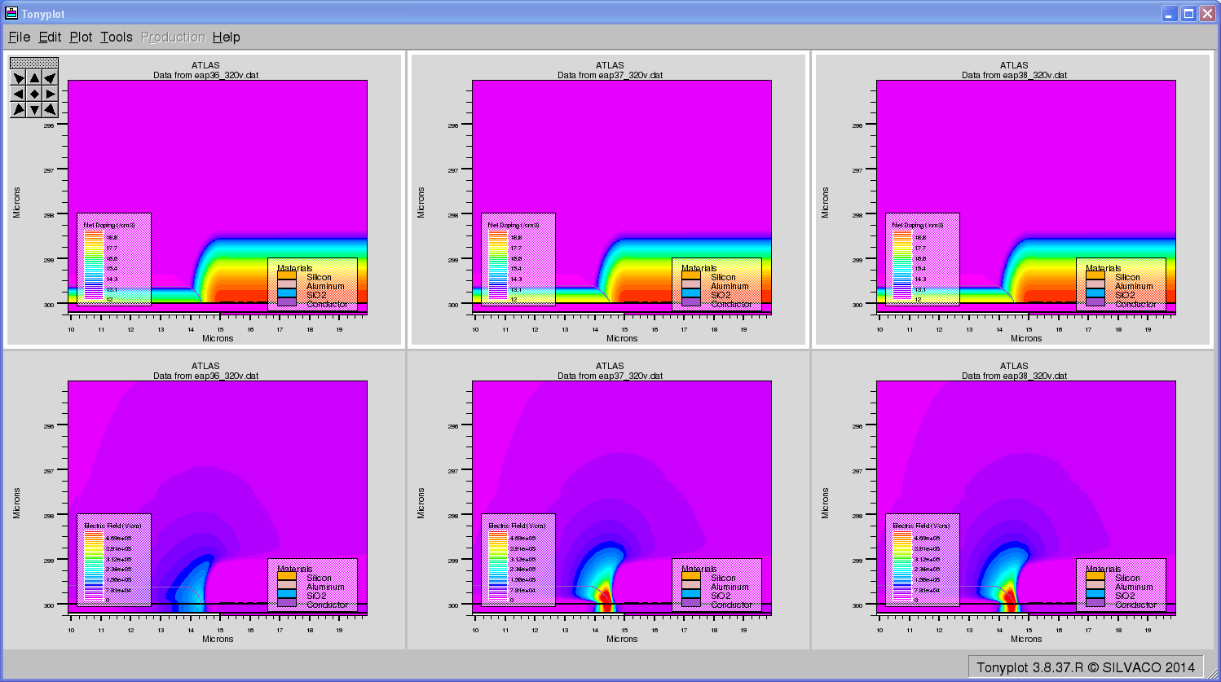
Pspray
Pspray is used as channel isolation for n-in-n structures.
The field strength depends on the structure.
ovb=4um Emax320=198062 V/cm
ovb=0 Emax320=709930 V/cm
ovb=-2um Emax320=709930 V/cm
© CiS Research Institute, 2023
Notes:
25

Slide 26
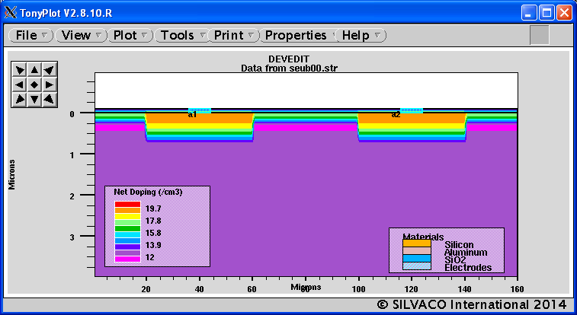
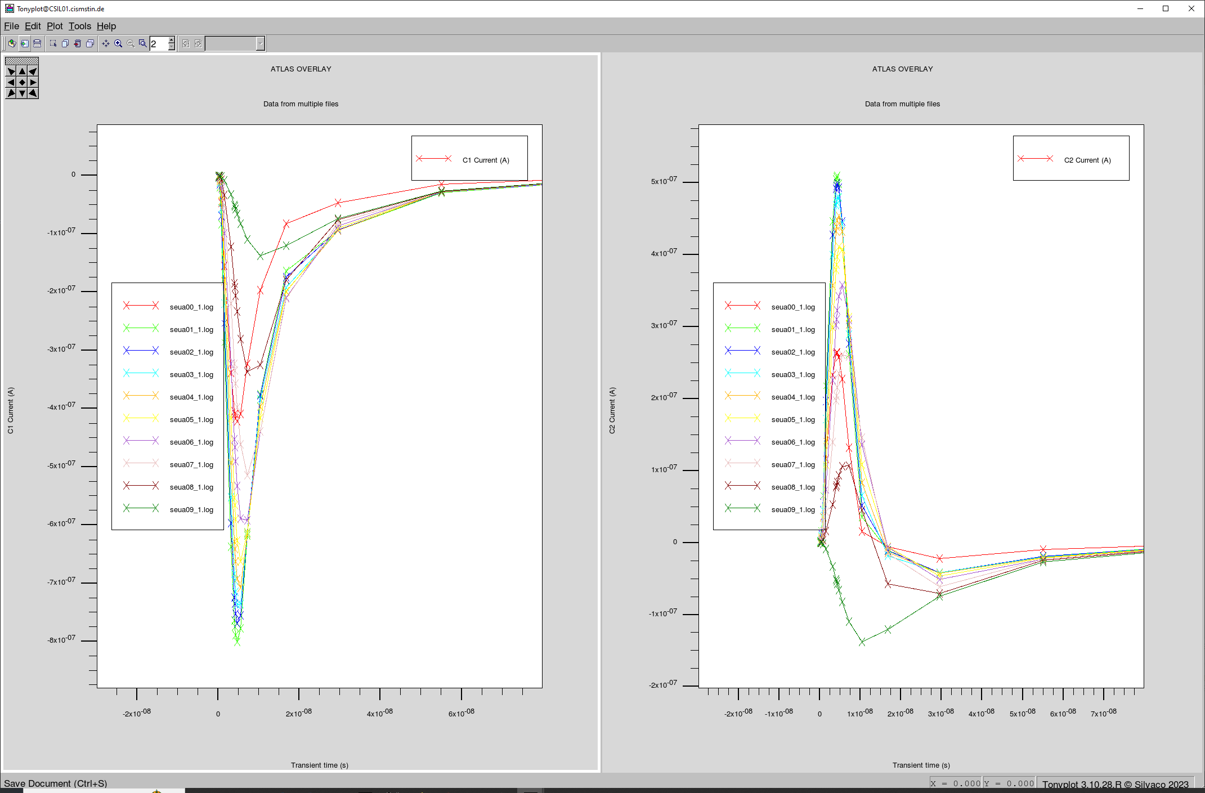
Signal formation
Double sided p-in-n strip detector, substrate n-silicon, strip 40um, gap 40um, the laser scans from 60um(A1 edge) to 80um (gap center). Ohmic side is n-in-n, with pspray. Junction side signals at electrodes A1 and A2 are shown by 5V bias for 10 laser scan positions.
curve | 0 | 1 | 2 | 3 | 4 | 5 | 6 | 7 | 8 | 9
position | 60 | 63 | 66 | 68 | 70 | 72 | 74 | 76 | 78 | 80
© CiS Research Institute, 2023
Notes:
26

Slide 27
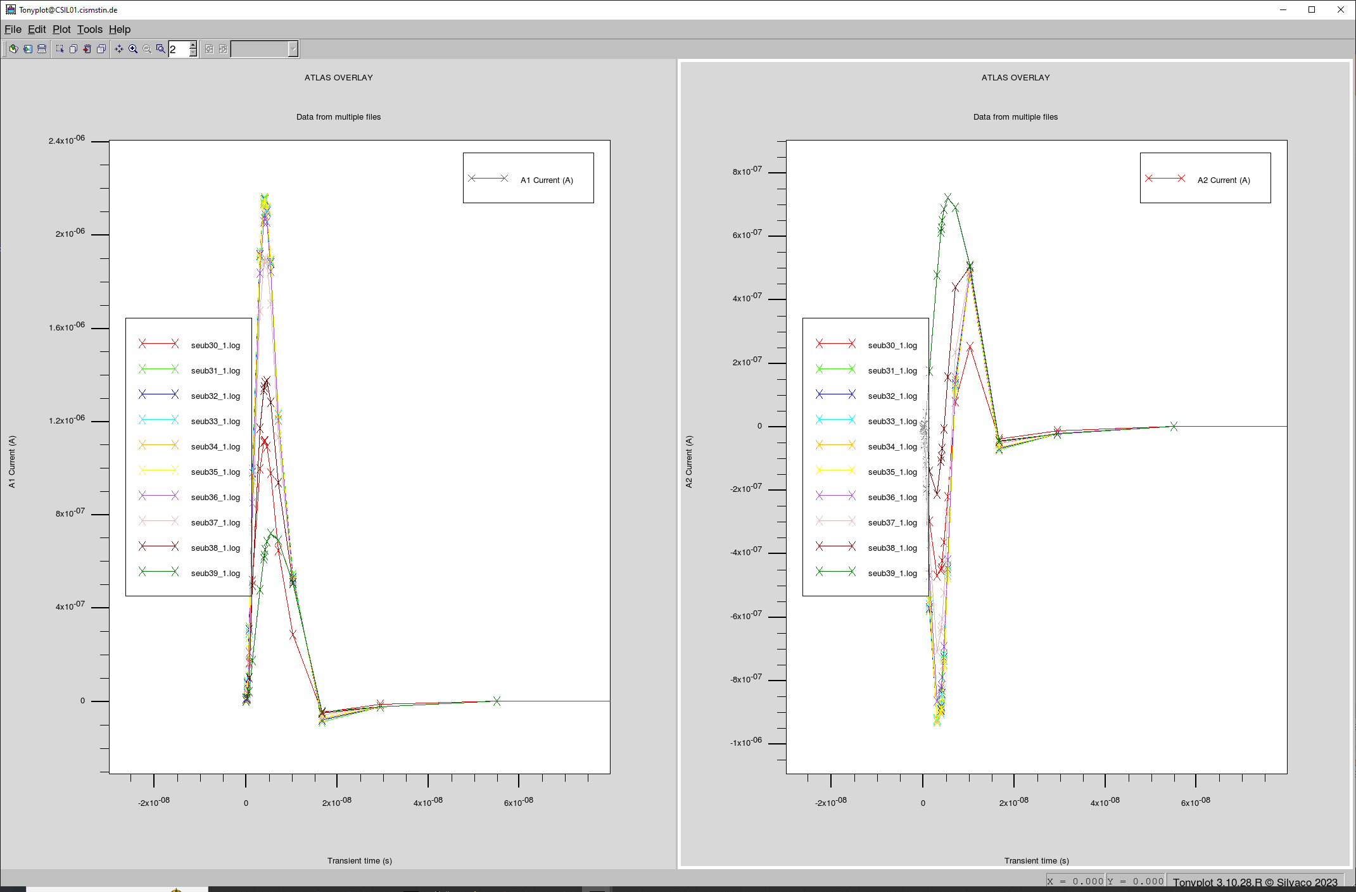
Charge sharing
Ohmic side signals at electrodes A1 and A2 are shown by 200V bias, with pspray
At 200V bias the signal is faster and the amplitude is larger. The signal becomes smaller when the laser is moved away from the A1 stripe, meanwhile the signal of the adjacent A2 stripe become larger.
© CiS Research Institute, 2023
Notes:
27

Slide 28
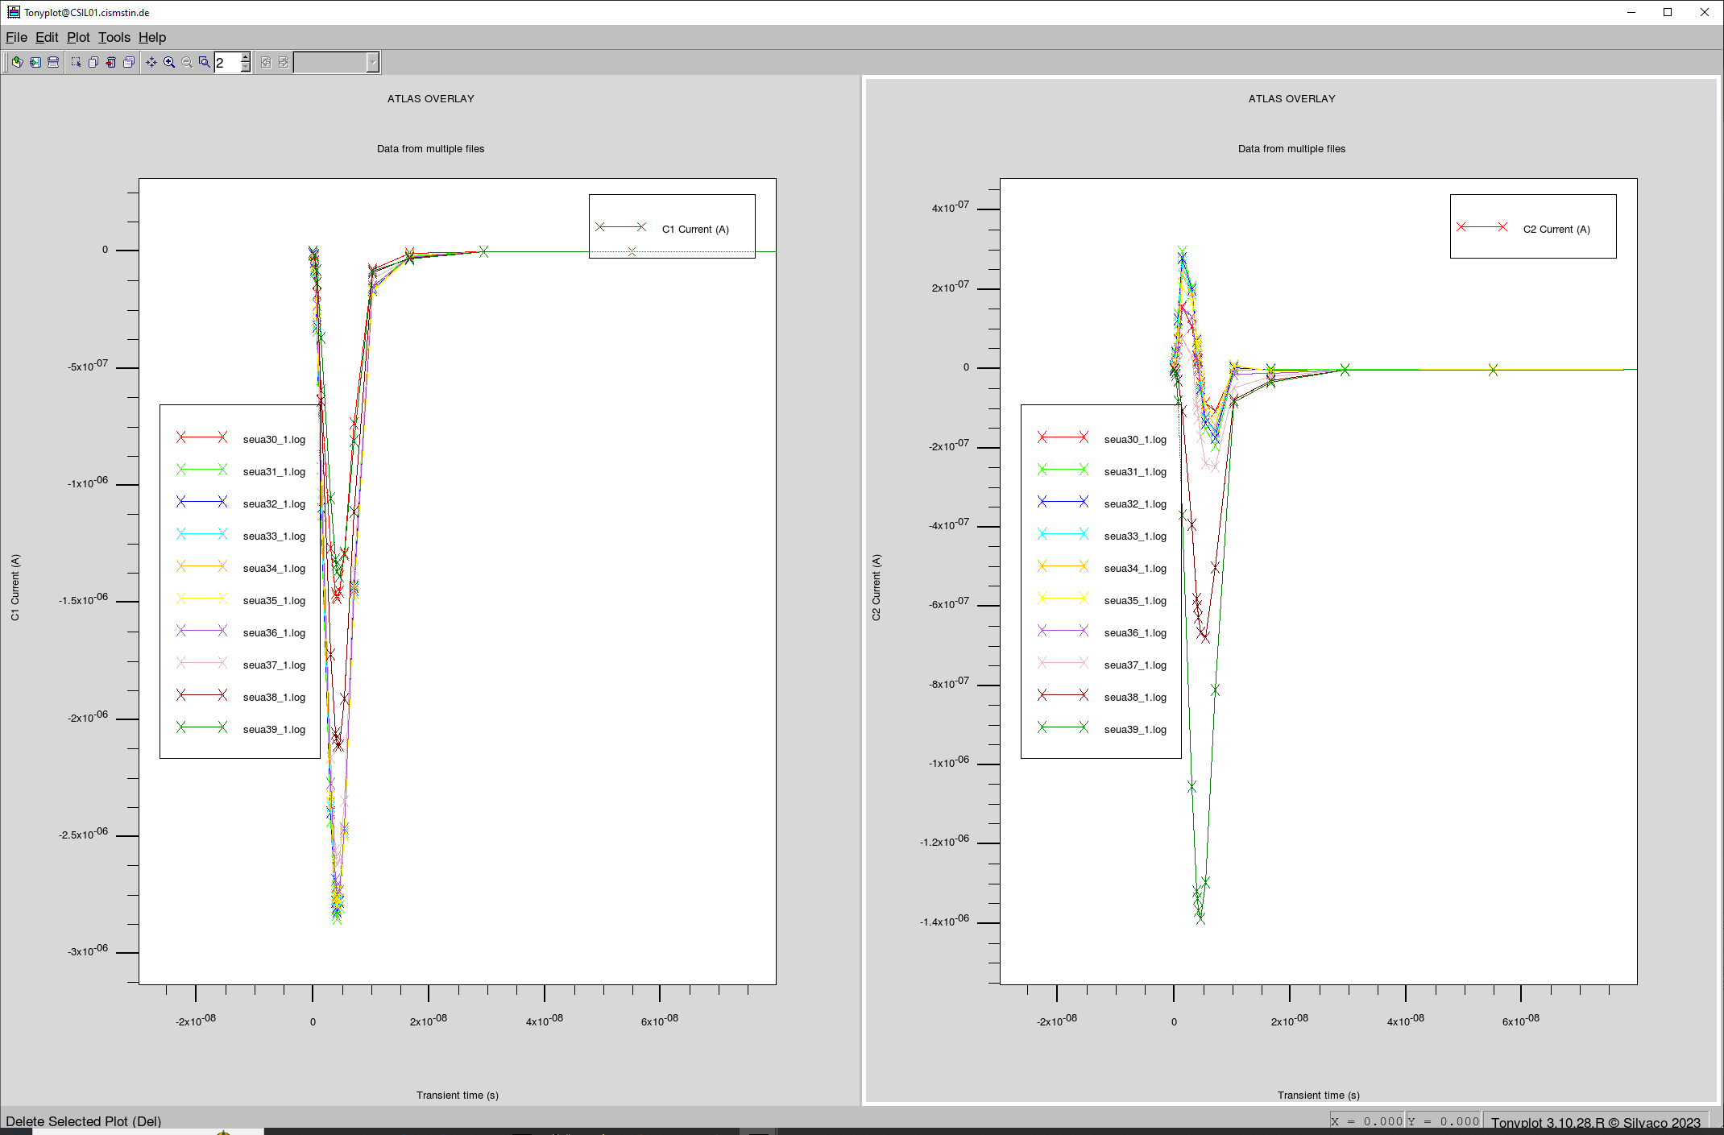
Charge sharing
Signals on junction side at electrodes A1 and A2 by 200V biasing
The signal is faster and larger than that of the ohmic side.
© CiS Research Institute, 2023
Notes:
28

Slide 29
Conclusions
Numerical simulation is useful for process and design and for possible failure analysis
SILVACO input deck script is for most case OK
Electrical simulations agree well with tests if lifetime is scaled
Process simulation and SIMS profile need fine tuning
We have produced high quality micropixel and microstrip sensor for ATLAS CMS CBM ...
Poly resistor and punch through basing
Single or double sided
Double metal possible
Pspray and pstop isolation for n-in-n structure
FZ-n or FZ-p silicon substrate
Detector on thin membrane

Slide 30

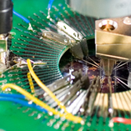
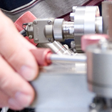
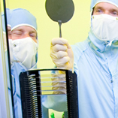
CiS Research Institute
CiS Forschungsinstitut für Mikrosensorik GmbH
Konrad-Zuse-Straße 14
99099 Erfurt
info@cismst.de
www.cismst.de
Managing director:
Prof. Dr. Th. Ortlepp
Mr. Th. Brock
hjfreitag@cismst.de
+49 361 663 1410
© CiS Research Institute, 2023

