Slide 1



Calibration of TCAD Sentaurus simulation models with LGAD measurements
SIMDET 2023
Paris. November 22-24, 2023
Jairo Villegas

Slide 2

Outline
Low Gain Avalanche (LGAD) concept
LGAD research lines at IMB-CNM (in a nutshell)
Electrical Characterization of first LGAD prototypes
Calibration of TCAD Sentaurus simulation models with LGAD measurements:
  Diffusivity of dopants in silicon
  Avalanche mechanism (impact ionization)
Road ahead

Slide 3
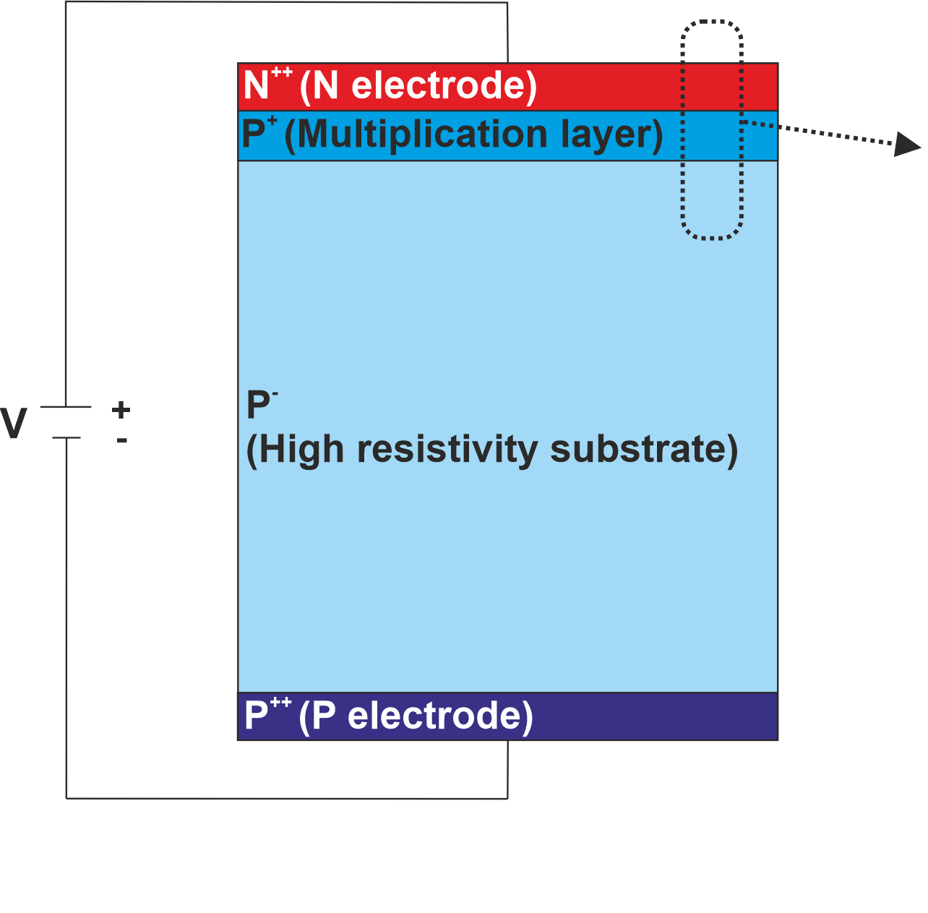
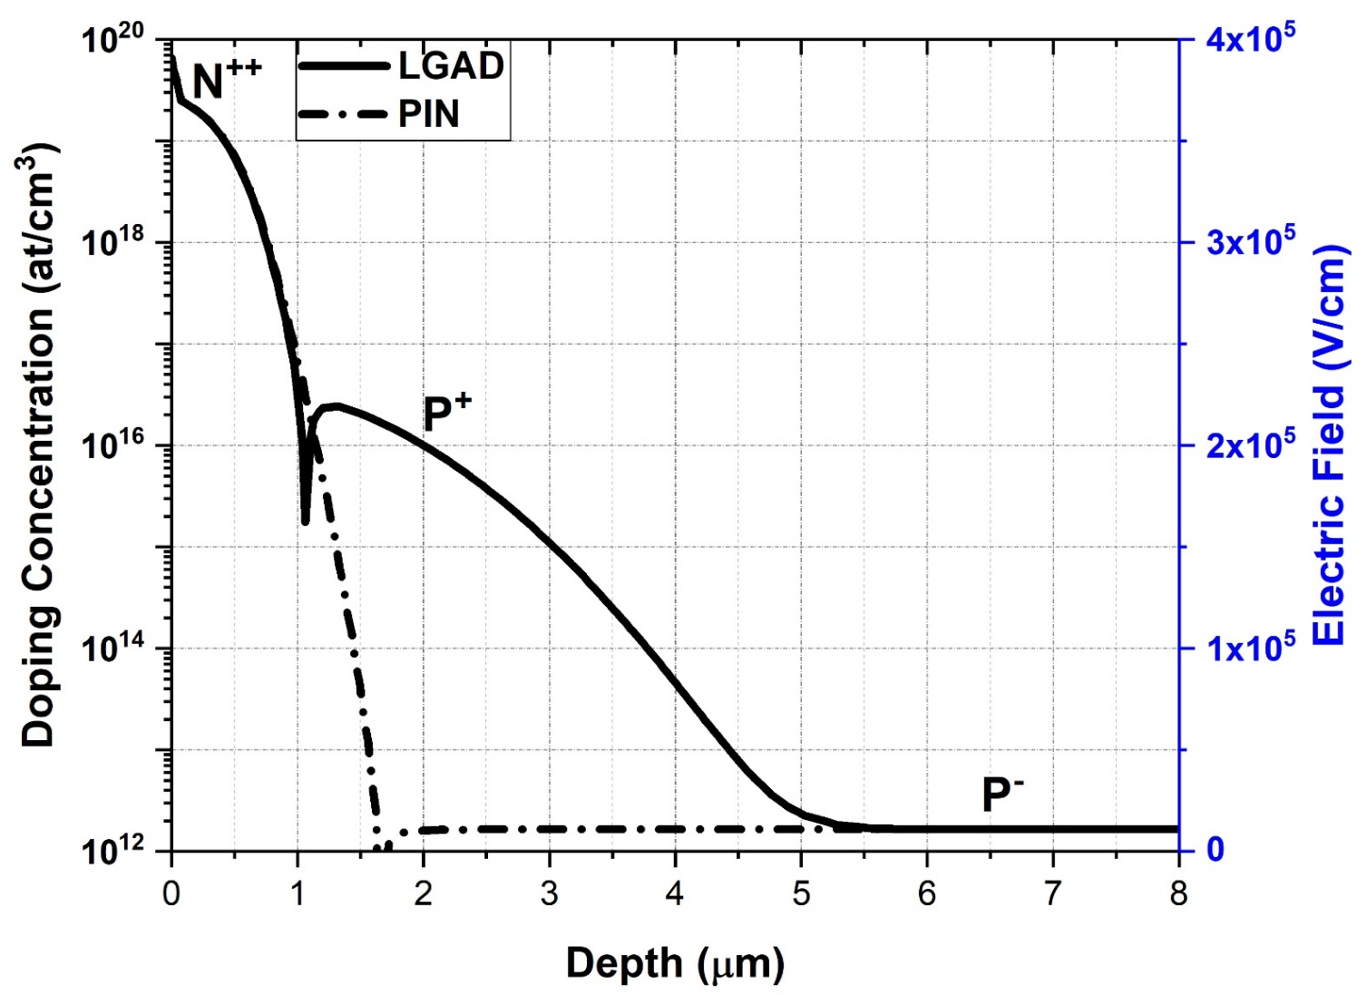
Low Gain Avalanche Detector (LGAD) concept
In contrast to a standard silicon detector (PIN), an LGAD has a moderately doped multiplication layer diffused close to the detector surface.

Slide 4
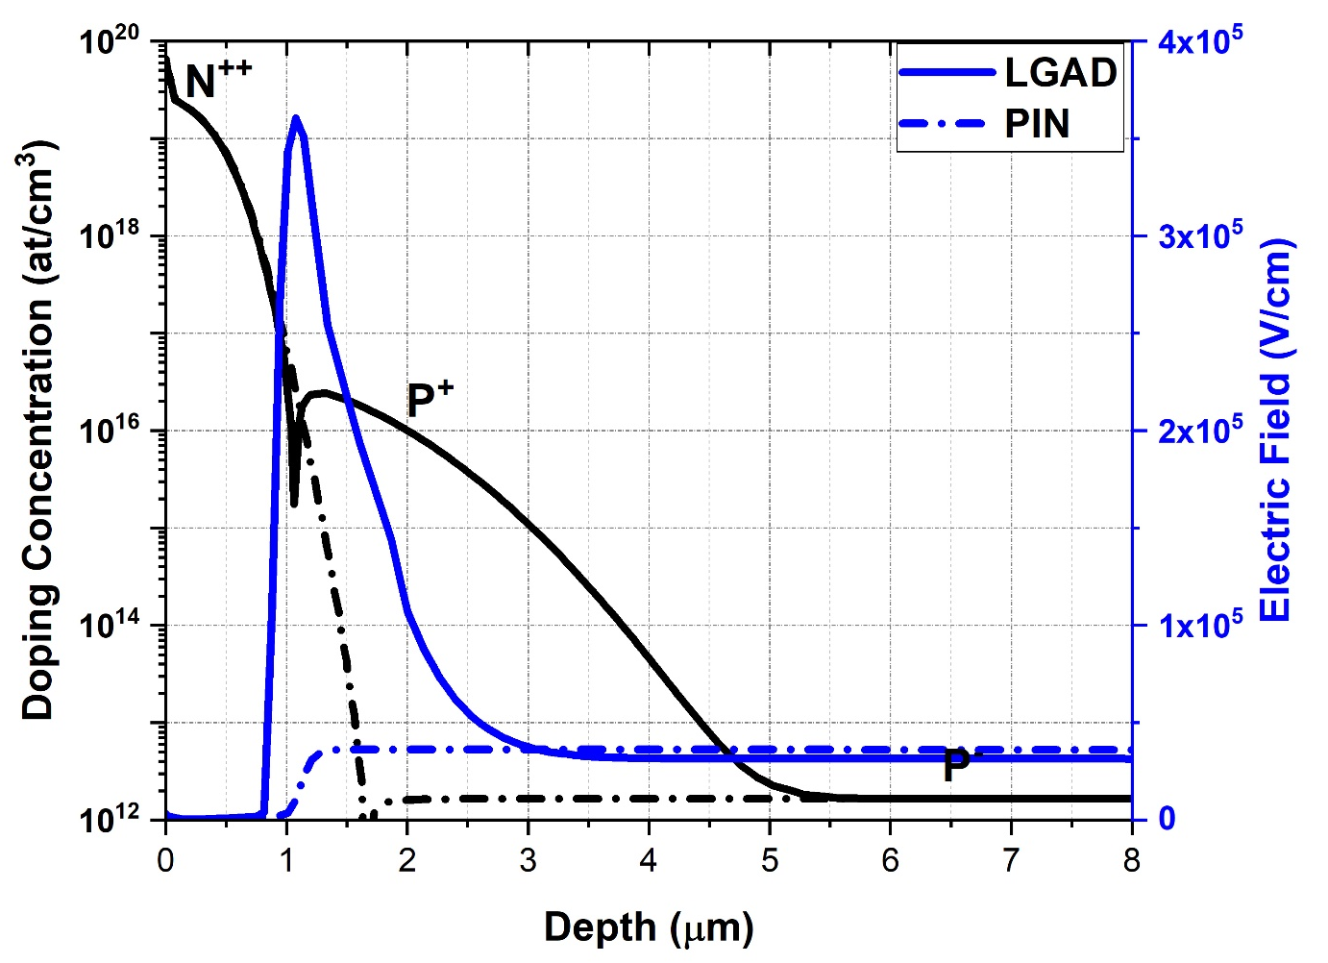
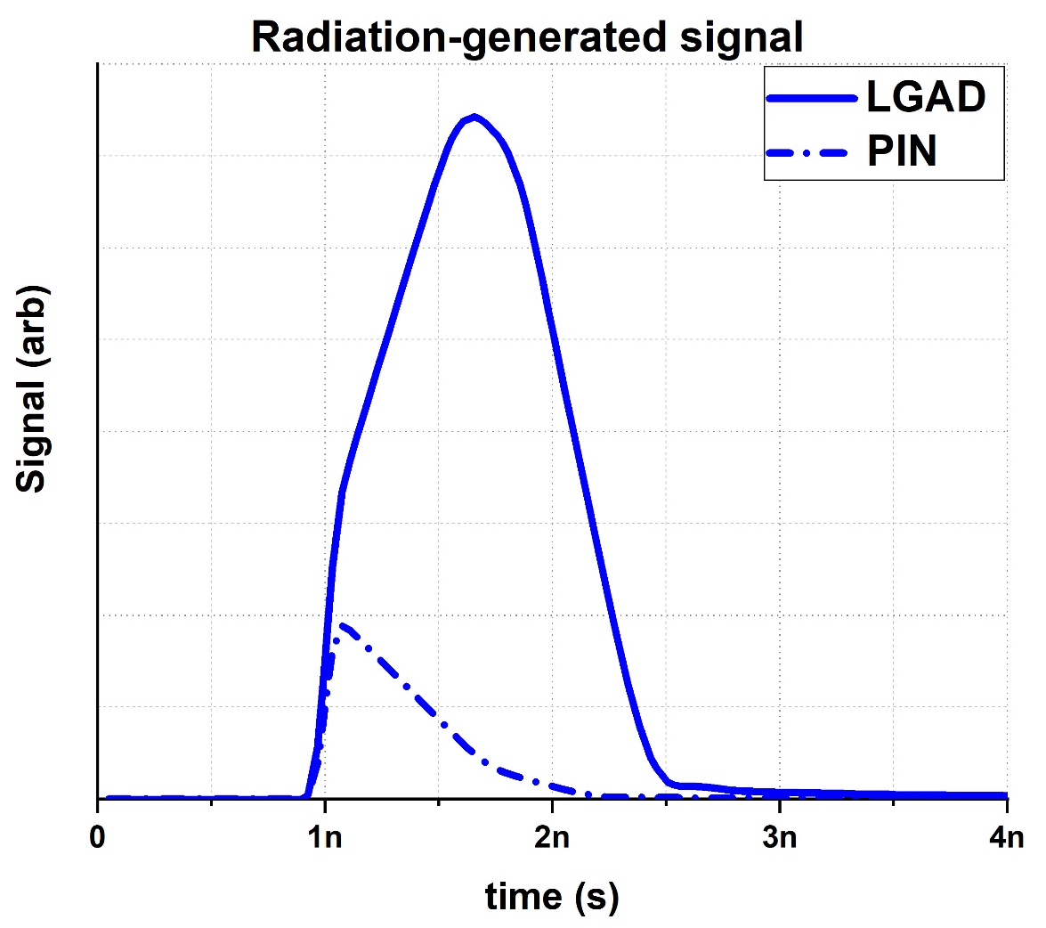

Low Gain Avalanche Detector (LGAD) concept
The presence of such layer enhances the electric field close to the PN junction when the detector is reverse biased, in turn amplifying the radiation-generated signal by an impinging particle.
$$Gain=\frac{CC\left(LGAD\right)}{CC (PIN)}$$
$$Gain=5−20$$

Slide 5
LGAD Research lines at IMB-CNM (in a nutshell)
LGADs for high-penetrating particles detection:
  High-energy charged particles → large range in silicon.
  Hard X-rays (E > 10 keV), IR light → large absorption depth in silicon.
  Fabricated in p-type substrates.
LGADs for low-penetrating particles detection:
  Low-energy charged particles → low range in silicon.
  Soft X-rays (E < 10 keV), UV light → low absorption depth in silicon.
  Fabricated in n-type substrates (nLGAD).

Slide 6
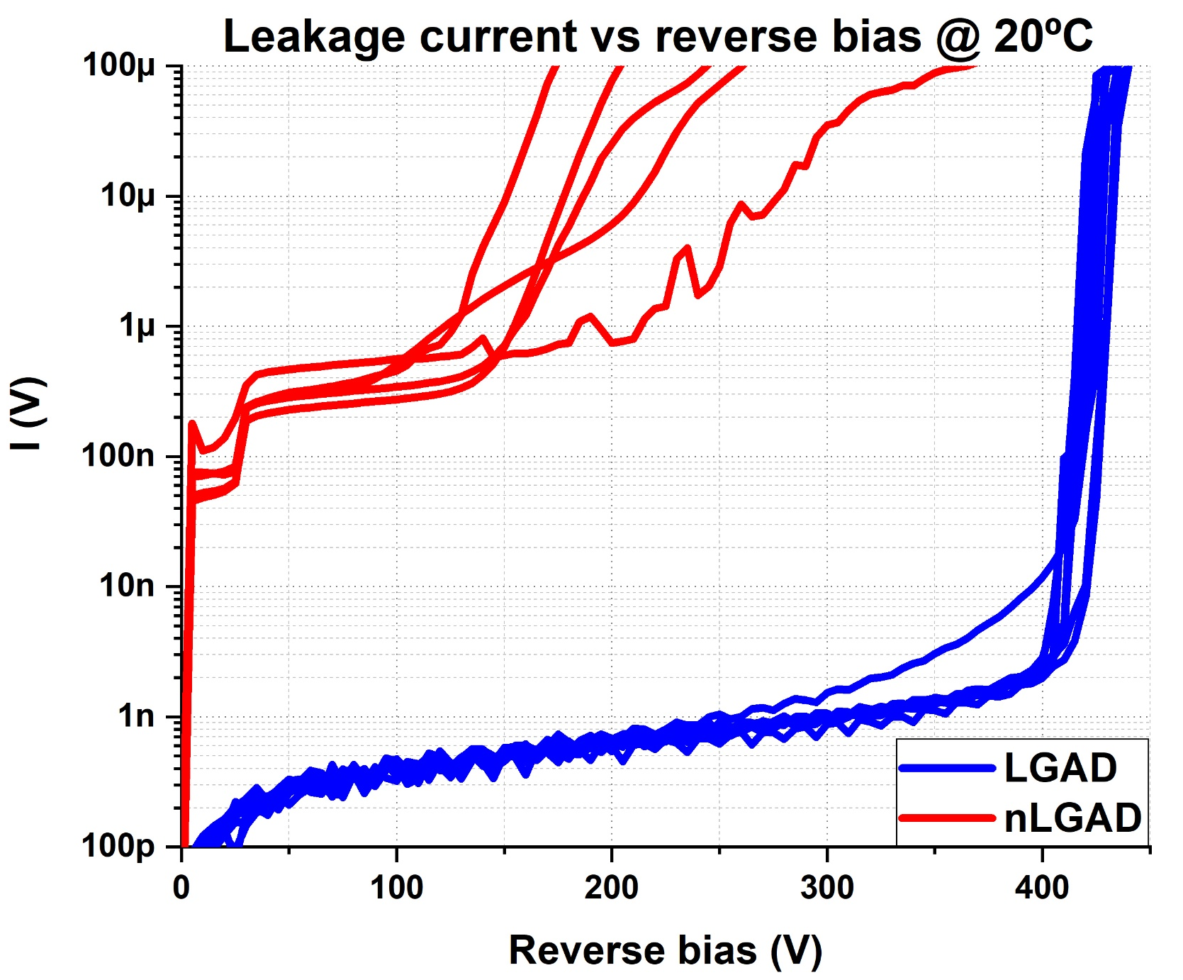
What electrical parameters can be calibrated with TCAD models?
Equipment available at IMB-CNM (at the time of production of first LGAD and nLGADs prototypes):
Probe station for current and capacitance vs reverse bias voltage measurements.
TCT (Transient Current Technique) setup for gain response to IR-light of 1064 nm (high-penetrating particle) and visible light of 404 nm (low-penetrating particle)
External setups: 15 keV X-rays from synchrotron radiation (Diamond LightSource) and TCT setup for gain response to 660 nm light (IFAE, University of Glasgow)

Slide 7
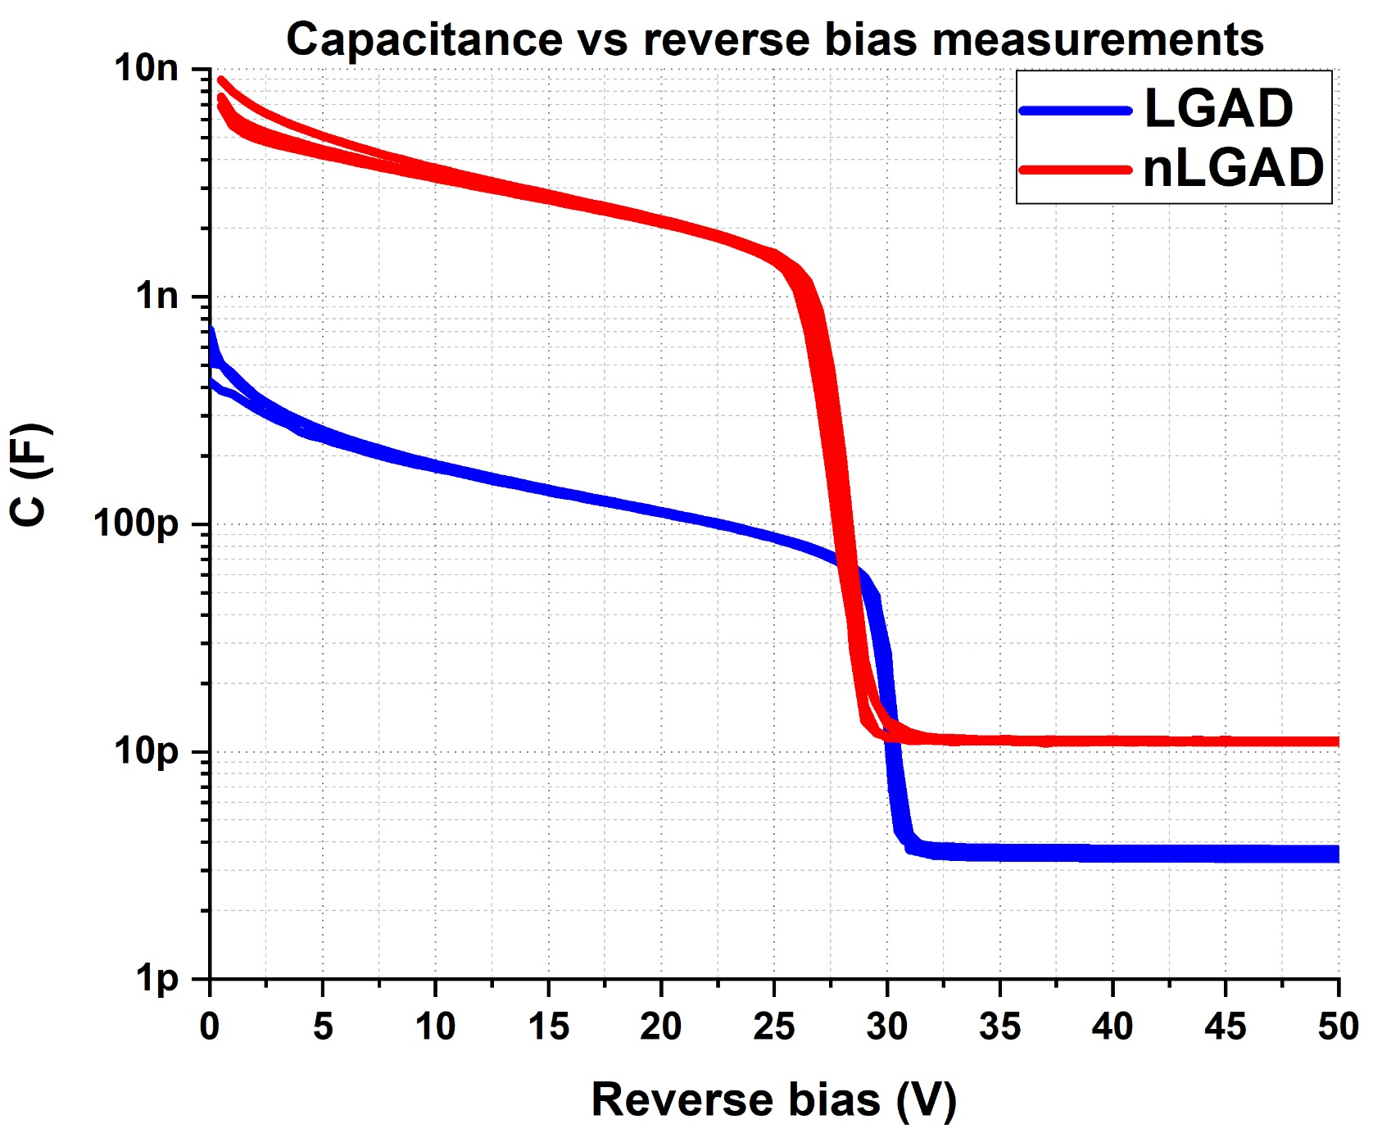
What electrical parameters can be calibrated with TCAD models?
Equipment available at IMB-CNM (at the time of production of first LGAD and nLGADs prototypes):
Probe station for current and capacitance vs reverse bias voltage measurements.
TCT (Transient Current Technique) setup for gain response to IR-light of 1064 nm (high-penetrating particle) and visible light of 404 nm (low-penetrating particle)
External setups: 15 keV X-rays from synchrotron radiation (Diamond LightSource) and TCT setup for gain response to 660 nm light (IFAE, University of Glasgow)

Slide 8
What electrical parameters can be calibrated with TCAD models?
Equipment available at IMB-CNM (at the time of production of first LGAD and nLGADs prototypes):
Probe station for current and capacitance vs reverse bias voltage measurements.
TCT (Transient Current Technique) setup for gain response to IR-light of 1064 nm (high-penetrating particle) and visible light of 404 nm (low-penetrating particle)
External setups: 15 keV X-rays from synchrotron radiation (Diamond LightSource) and TCT setup for gain response to 660 nm light (IFAE, University of Glasgow)
TCT measurements

Slide 9
What electrical parameters can be calibrated with TCAD models?
Equipment available at IMB-CNM (at the time of production of first LGAD and nLGADs prototypes):
Probe station for current and capacitance vs reverse bias voltage measurements.
TCT (Transient Current Technique) setup for gain response to IR-light of 1064 nm (high-penetrating particle) and visible light of 404 nm (low-penetrating particle)
External setups: 15 keV X-rays from synchrotron radiation (Diamond LightSource) and TCT setup for gain response to 660 nm light (IFAE, University of Glasgow)
TCT
TCT
Synchrotron
TCT

Slide 10


What electrical parameters can be calibrated with TCAD models?
LGADs are fabricated with planar technology → some electrical parameters have spatial symmetry.
This allows using 2D TCAD simulation for calibration, rather than 3D (way slower).
Neither capacitance nor leakage current have spatial symmetry, but avalanche breakdown, depletion voltage and gain do.
Depletion voltage
Breakdown voltage

Slide 11

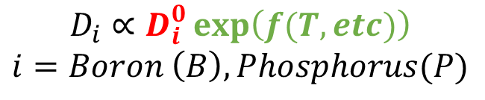

TCAD Sentaurus diffusivity model for depletion voltage prediction
The depletion voltage depends only on the shape of the multiplication layer, which in turn depends on how the dopants diffuse into silicon for a given annealing recipe.
The diffusivity is modelled by an equation that has linear term and an exponential term.
Since small changes in the exponential term lead to great changes in the results, only the linear term of the equation has been taken into account for the simulation calibration.
Diffusivity equation (Charge React Model)
$$D_{i}∝D_{i}^{0}\exp\left(f(T,etc)\right)$$
$$i=Boron \left(B\right), Phosphorus(P)$$
Commands for parametrizing $D_{i}^{0}$
Commands for Implantation and diffusion (Sprocess)

Slide 12
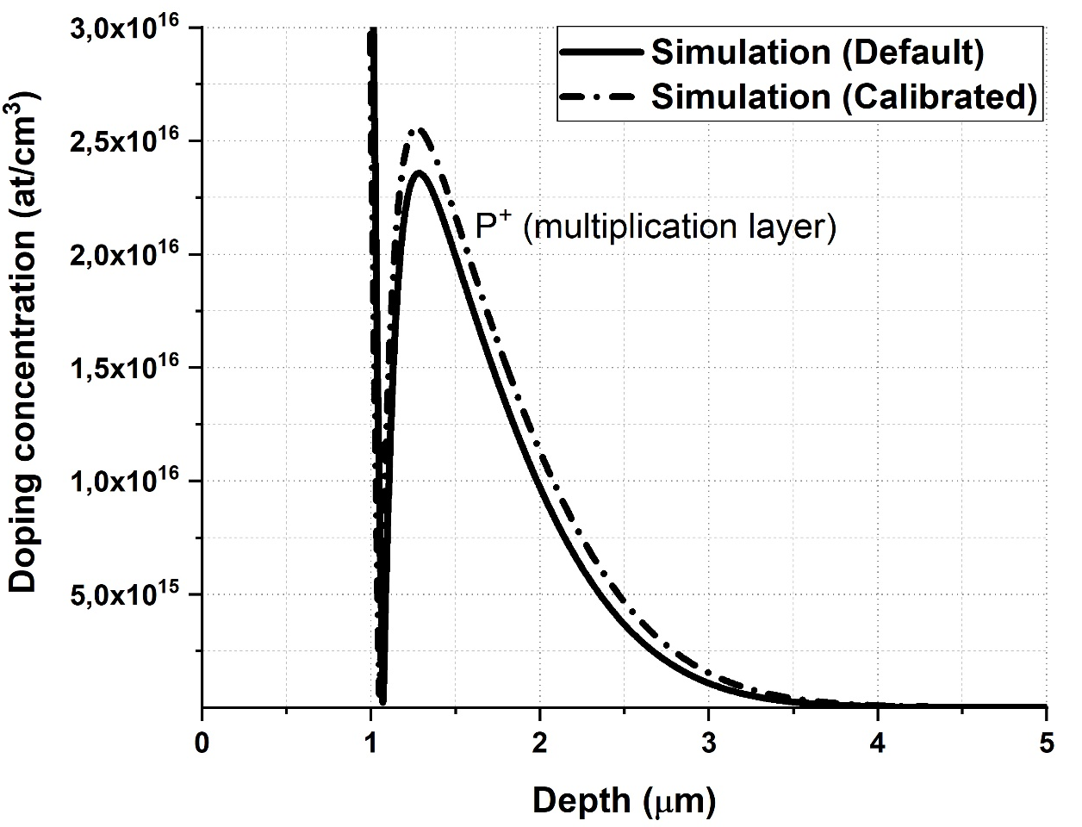
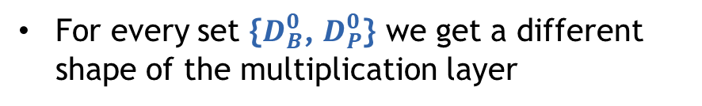


TCAD Sentaurus diffusivity model for depletion voltage prediction
For every set {$D_{B}^{0}$, $D_{P}^{0}$} we get a different shape of the multiplication layer
Diffusivity equation (Charge React Model)
$$D_{i}∝D_{i}^{0}\exp\left(f(T,etc)\right)$$
$$i=Boron \left(B\right), Phosphorus(P)$$
Commands for parametrizing $D_{i}^{0}$

Slide 13
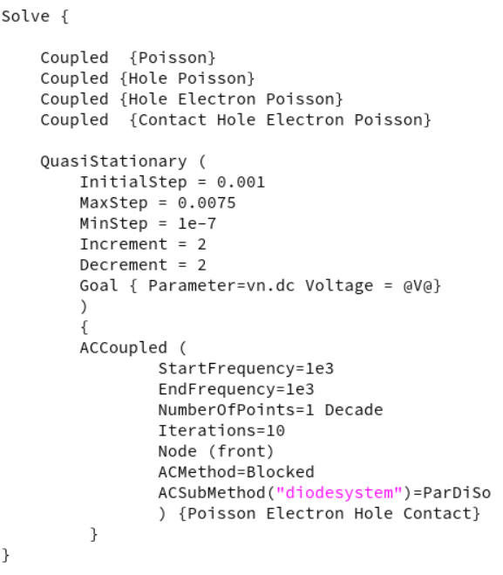
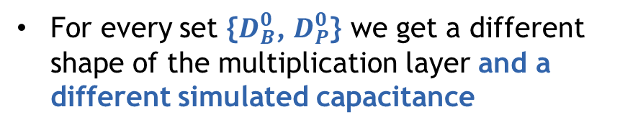
TCAD Sentaurus diffusivity model for depletion voltage prediction
Commands for Sdevice (capacitance vs bias calculation)
For every set {$D_{B}^{0}$, $D_{P}^{0}$} we get a different shape of the multiplication layer and a different simulated capacitance
Max 0.75% of V

Slide 14

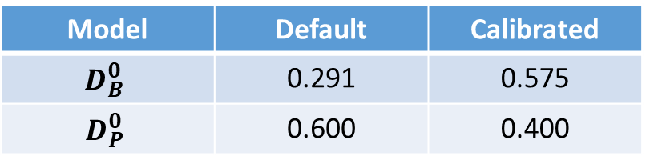
TCAD Sentaurus diffusivity model for depletion voltage prediction
Diffusivity equation (Charge React Model)
$$D_{i}∝D_{i}^{0}\exp\left(f(T,etc)\right)$$
$$i=Boron \left(B\right), Phosphorus(P)$$
Commands for Sprocess
Measured C and simulated C are scaled to better distinguish between depletion voltages
Model | Default | Calibrated
$$D_{B}^{0}$$ | 0.291 | 0.575
$$D_{P}^{0}$$ | 0.600 | 0.400

Slide 15
TCAD Sentaurus diffusivity model for depletion voltage prediction
Diffusivity equation (Charge React Model)
$$D_{i}∝D_{i}^{0}\exp\left(f(T,etc)\right)$$
$$i=Boron \left(B\right), Phosphorus(P)$$
Commands for Sprocess
Measured C and simulated C are scaled to better distinguish between depletion voltages
Model | Default | Calibrated
$$D_{B}^{0}$$ | 0.291 | 0.575
$$D_{P}^{0}$$ | 0.600 | 0.400

Slide 16
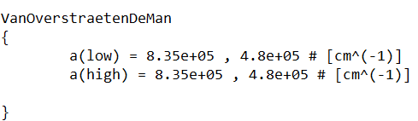
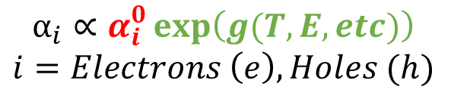
TCAD Sentaurus avalanche model calibration
The breakdown voltage and gain depend on both the shape of the multiplication layer and the impact ionization rate for electrons and holes (that is, by the avalanche mechanism).
As the diffusivity, the avalanche mechanism is modelled by an equation that has linear term and an exponential term. Only the linear term is adjusted.
Impact avalanche ionization rate equation
(Van Overstraeten de Man)
$$α_{i}∝α_{i}^{0}\exp\left(g(T,E,etc)\right)$$
$$i=Electrons \left(e\right), Holes (h)$$
Commands for Sdevice (external text file)

Slide 17
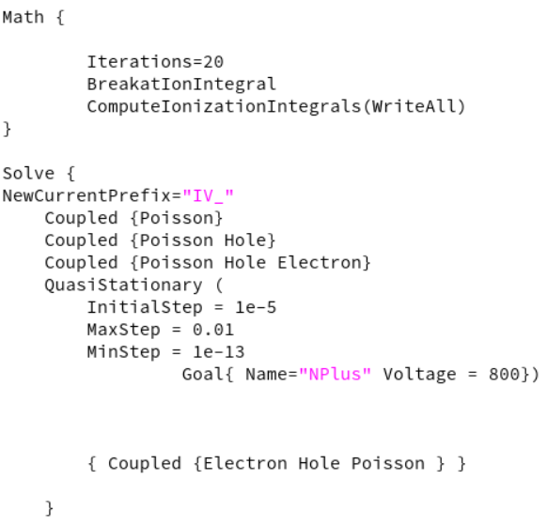
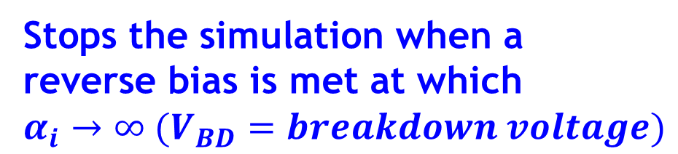
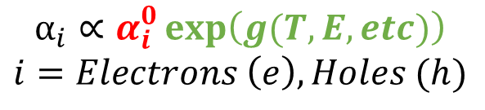
TCAD Sentaurus avalanche model calibration
Stops the simulation when a reverse bias is met at which
$$α_{i}→∞ (V_{BD}=breakdown voltage)$$
Commands for Sdevice (current vs bias calculation)
Impact avalanche ionization rate equation
(Van Overstraeten de Man)
$$α_{i}∝α_{i}^{0}\exp\left(g(T,E,etc)\right)$$
$$i=Electrons \left(e\right), Holes (h)$$
Commands for Sdevice (external text file)

Slide 18
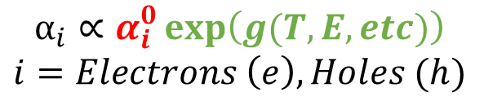
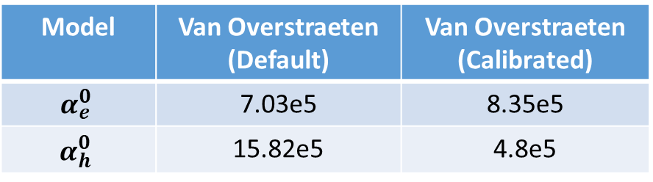
TCAD Sentaurus avalanche model calibration
Impact avalanche ionization rate equation
(Van Overstraeten)
$$α_{i}∝α_{i}^{0}\exp\left(g(T,E,etc)\right)$$
$$i=Electrons \left(e\right), Holes (h)$$
Scaled by 1e6
Commands for Sdevice (external text file)
Model | Van Overstraeten (Default) | Van Overstraeten (Calibrated)
$$α_{e}^{0}$$ | 7.03e5 | 8.35e5
$$α_{h}^{0}$$ | 15.82e5 | 4.8e5

Slide 19
TCAD Sentaurus avalanche model calibration
Impact avalanche ionization rate equation
(Van Overstraeten)
$$α_{i}∝α_{i}^{0}\exp\left(g(T,E,etc)\right)$$
$$i=Electrons \left(e\right), Holes (h)$$
Commands for Sdevice (external text file)
Model | Van Overstraeten (Default) | Van Overstraeten (Calibrated)
$$α_{e}^{0}$$ | 7.03e5 | 8.35e5
$$α_{h}^{0}$$ | 15.82e5 | 4.8e5

Slide 20
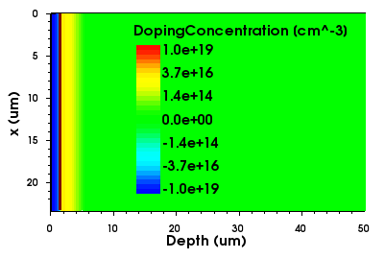
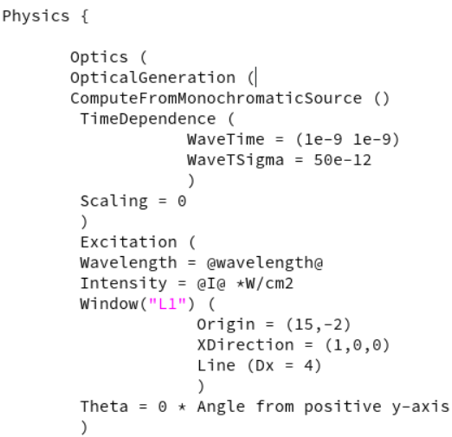
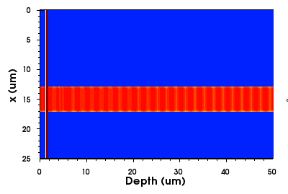
Photon beam detection simulation (Sdevice)
IR beam track

Slide 21
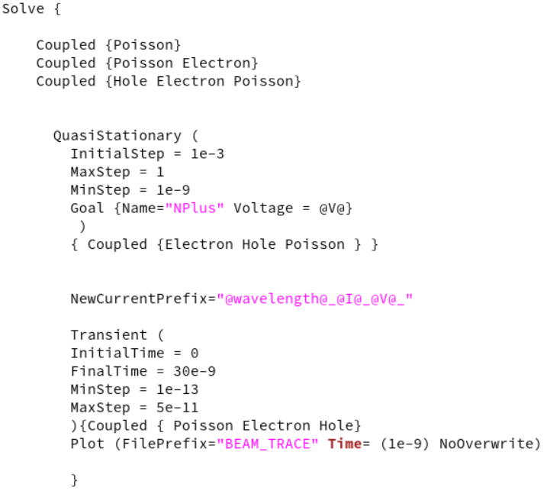
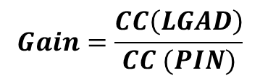
Photon beam detection simulation (Sdevice)
For every voltage point, wavelength and device type (LGAD or PIN) we get a waveform.
1064 nm light
200V
$$Gain=\frac{CC\left(LGAD\right)}{CC (PIN)}$$

Slide 22
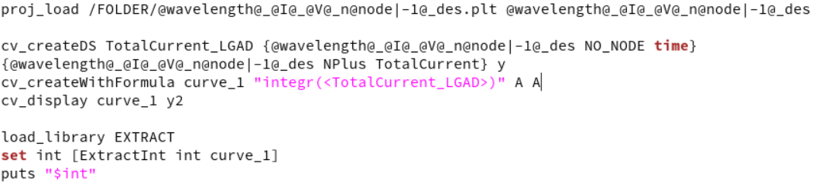
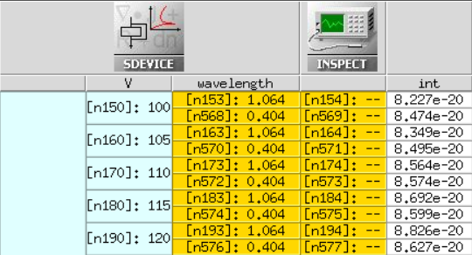
Photon beam detection simulation (Inspect)
Every waveform can be integrated using an inspect command.
The CC is displayed in the interface
1064 nm light
200V
$$Gain=\frac{CC\left(LGAD\right)}{CC (PIN)}$$

Slide 23
TCAD Sentaurus avalanche model calibration
Impact avalanche ionization rate equation
(Van Overstraeten)
$$α_{i}∝α_{i}^{0}\exp\left(g(T,E,etc)\right)$$
$$i=Electrons \left(e\right), Holes (h)$$
Commands (external text file)
Model | Van Overstraeten (Default) | Van Overstraeten (Calibrated)
$$α_{e}^{0}$$ | 7.03e5 | 8.35e5
$$α_{h}^{0}$$ | 15.82e5 | 4.8e5

Slide 24
TCAD Sentaurus avalanche model calibration
Impact avalanche ionization rate equation
(Van Overstraeten)
$$α_{i}∝α_{i}^{0}\exp\left(g(T,E,etc)\right)$$
$$i=Electrons \left(e\right), Holes (h)$$
Commands (external text file)
Model | Van Overstraeten (Default) | Van Overstraeten (Calibrated)
$$α_{e}^{0}$$ | 7.03e5 | 8.35e5
$$α_{h}^{0}$$ | 15.82e5 | 4.8e5

Slide 25
Calibrated model testing with other LGADs production
After the models were calibrated with the previous results, an AC-LGAD production was finished.
The prediction of depletion voltage and gain measurements was consistent.

Slide 26
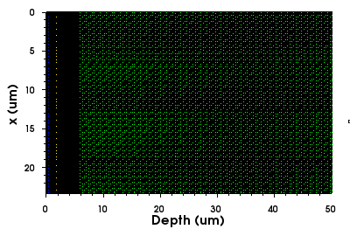
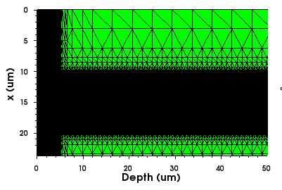
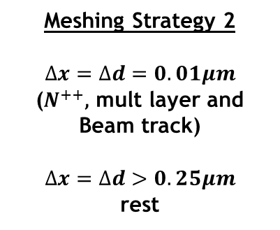
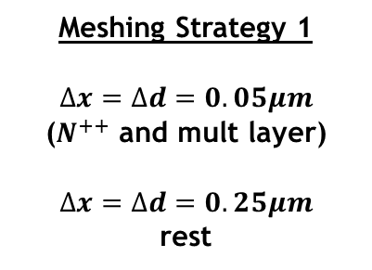


The importance of meshing
Meshing Strategy 1
$$∆x=∆d=0.05μm$$
($N^{++}$ and mult layer)
$$∆x=∆d=0.25μm$$
rest
IR beam track
$≈$4 h per node
Meshing Strategy 2
$$∆x=∆d=0.01μm$$
($N^{++}\text{,} \text{mult} \text{layer}$ and
Beam track)
$$∆x=∆d>0.25μm$$
rest
$≈$2 h per node

Slide 27
The importance of meshing
Meshing Strategy 1
$$∆x=∆d=0.05μm$$
($N^{++}$ and mult layer)
$$∆x=∆d=0.25μm$$
rest
$≈$4 h per node
Meshing Strategy 2
$$∆x=∆d=0.01μm$$
($N^{++}\text{,} \text{mult} \text{layer}$ and
Beam track)
$$∆x=∆d>0.25μm$$
rest
$≈$2 h per node

Slide 28
Road ahead
The work is not finished.
New equipment available at IMB-CNM:
  SRP setup to measure the active doping concentration of samples.
  Sr-90 setup to evaluate the gain of LGADs when irradiated with high-energy electrons (mip).

Slide 29
Road ahead
The work is not finished.
New production of carbonated LGADs is finished. The calibration models:
  Do not predict well the electrical parameters (breakdown and depletion voltage, etc).
  Qualitatively, they predict well the SRP measurements, but quantitatively, they do not.
  Work has to be done to calibrate the models if carbon is present in LGADs.

Slide 30

Acknowledgments
This work has been funded by the Spanish Ministry of Science and Innovation (MCIN/AEI/10.13039/501100011033/) and by the European Union’s ERDF program “A way of making Europe”. Grant references: PID2020-113705RB-C32 and PID2021-124660OB-C22. Also, it was funded by the European Union’s Horizon 2020 Research and Innovation funding program, under Grant Agreement No. 101004761 (AIDAInnova).
Thanks for your attention!

