Slide 1
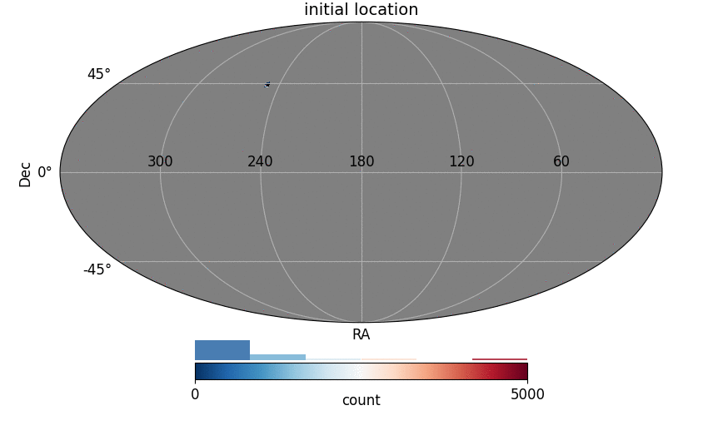
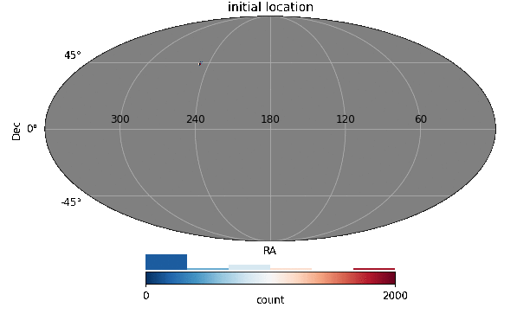
Connectivity
To perform ubercal we need common stars to « glue » exposures
(At a given scale: Focal plane/quadrant/smaller? level)
Connectivity diffusion algorithm
1 star to connect quadrants
10 stars to connect quadrants

