Slide 1
idefics
Thomas Vuillaume, 30/08/2023

Slide 2
IDEFICS
goal
Help local industries in their digital transition building data science and machine learning projects with scientific and infrastructure (MUST) support
partners
LISTIC (Alexandre Benoit)
PROJECTS
ADTP, SKIPLY, Pfeiffer, NTN-SNR, SDIS & PGHM…
GRANTS
FEDER (EU) (ended in June 2023) + region Rhones-Alpes

Slide 3
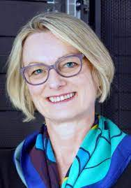
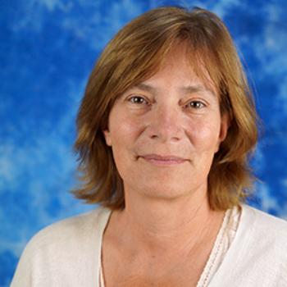
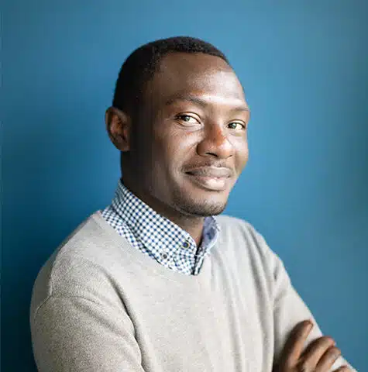
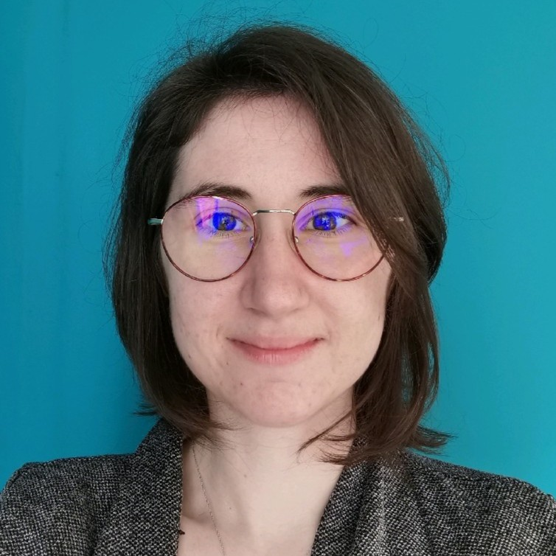
THE TEAM
Thomas Vuillaume
Nadine Neyroud
Frédérique Chollet
Brondon Waffa-Pagou,
Contract ending 03/2024
Maud Coppel
Alexandre Benoit
LISTIC
+ anyone willing to work in this subject ☺

Slide 4
achievements
3 service delivery projects completed: Heliocity, ADTP and SKIPLY
Several others are currently in the definition, validation or awaiting funding phase
2 CIFRE theses: PFEIFFER VACUUM, NTN-SNR
projects with regional companies such as, AST74, SDIS 74, LYNRED…
Several webinars and seminars to popularize artificial intelligence have been organized – next one in November
Mikael Jacquemont, the expert Research Engineer attached to IDEFICS completed his 2-year contract at the end of November 2022
Brondon Waffa-Pagou, engineer in Artificial Intelligence arrived at the beginning of October 2022 for 18 months.
On the MUST platform side, the planned equipment was purchased within the allocated budgets and the computer room was secured.

Slide 5
THANK YOU

