Slide 1
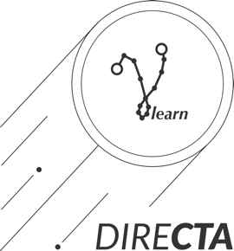
DIRECTA - Deep learnIng in REal time for CTA
Thomas Vuillaume

Slide 2
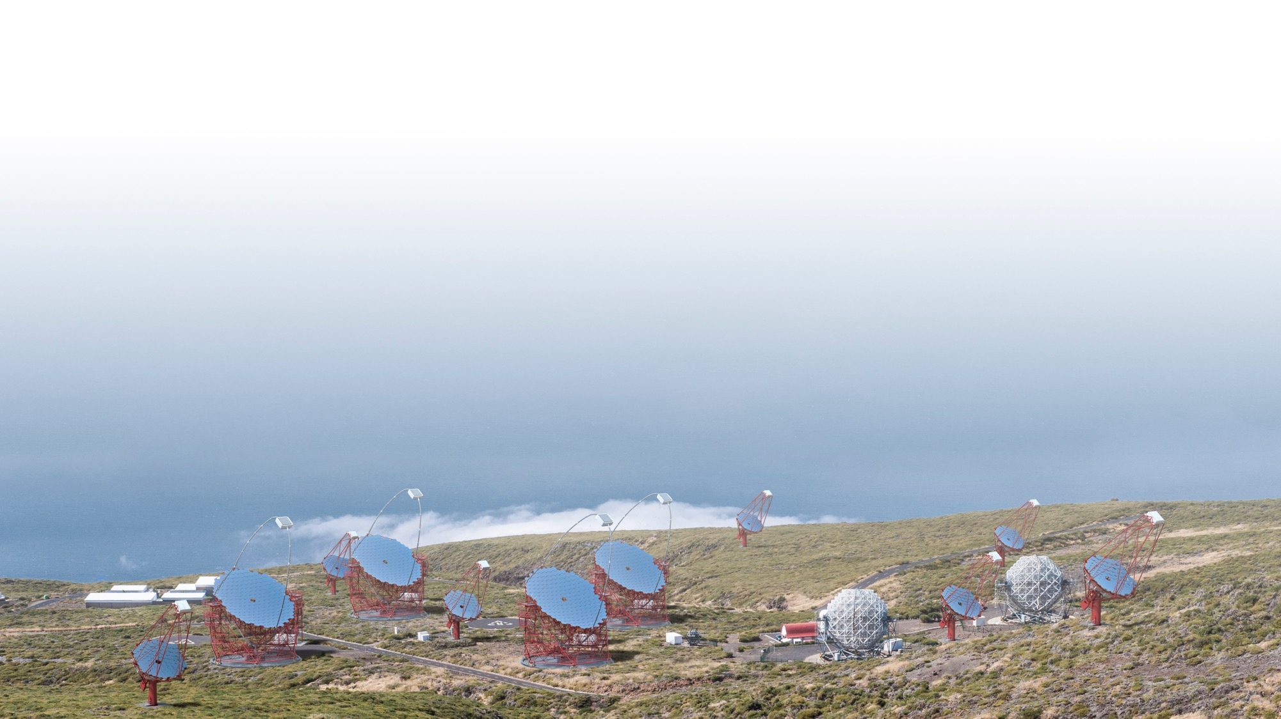








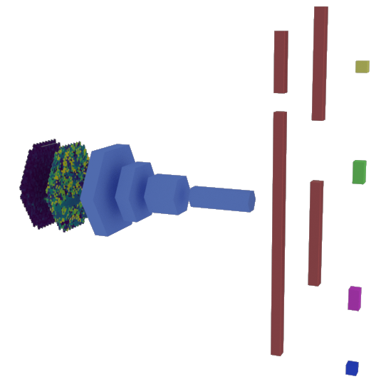

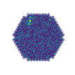

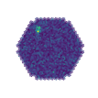
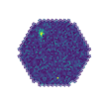
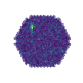
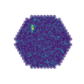
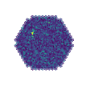
GAMMALEARN
deep learning for the Cherenkov Telescope Array
class
distance
e⁻
direction
Deep Convolutionnal Neural Networks
reconstruct the physical parameters
of the primary particle
from the telescopes images
PetaBytes
of Data !
energy
e⁻
e⁻
e⁻
e⁺
e⁻
e⁺
e⁻
e⁻
e⁺
Contact: thomas.vuillaume@lapp.in2p3.fr

Slide 3
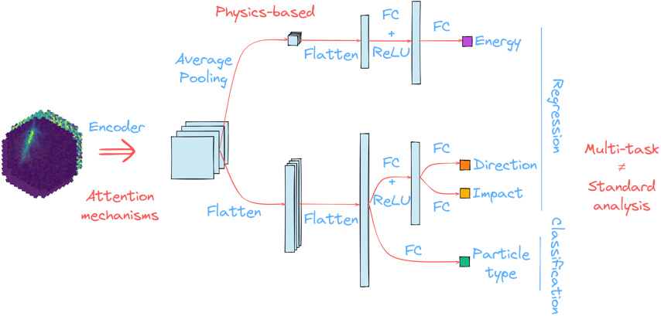
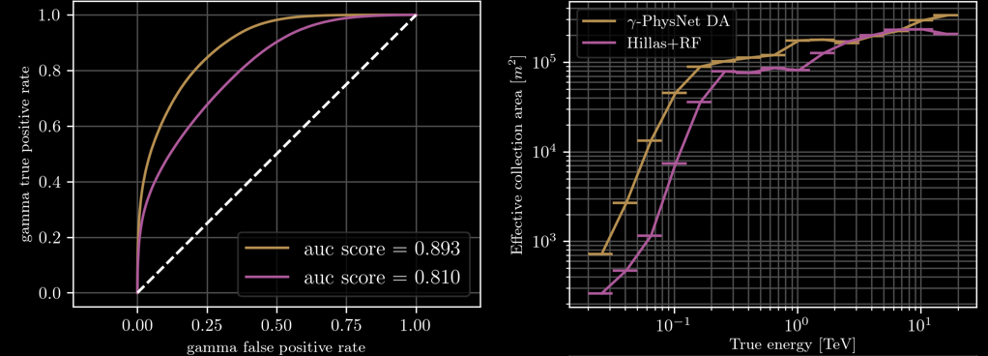
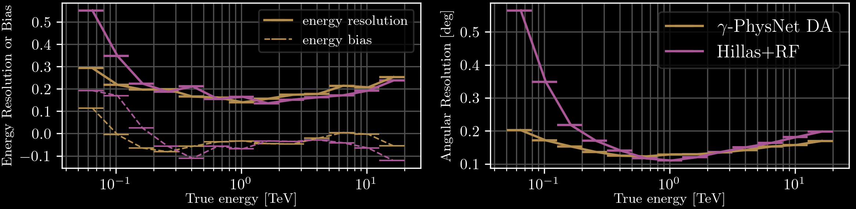
GAMMALEARN RESULTS on LST-1 simulated data
➔ Improved sensitivity, angular resolution and energy resolution compared to the standard analysis
https://arxiv.org/abs/2108.04130

Slide 4
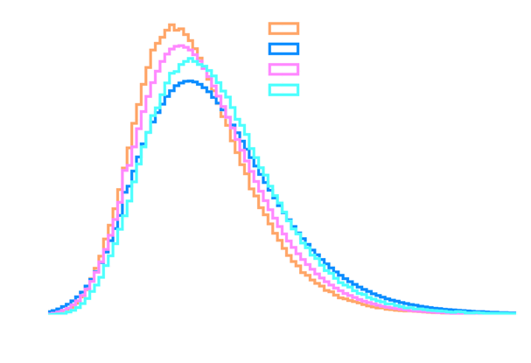
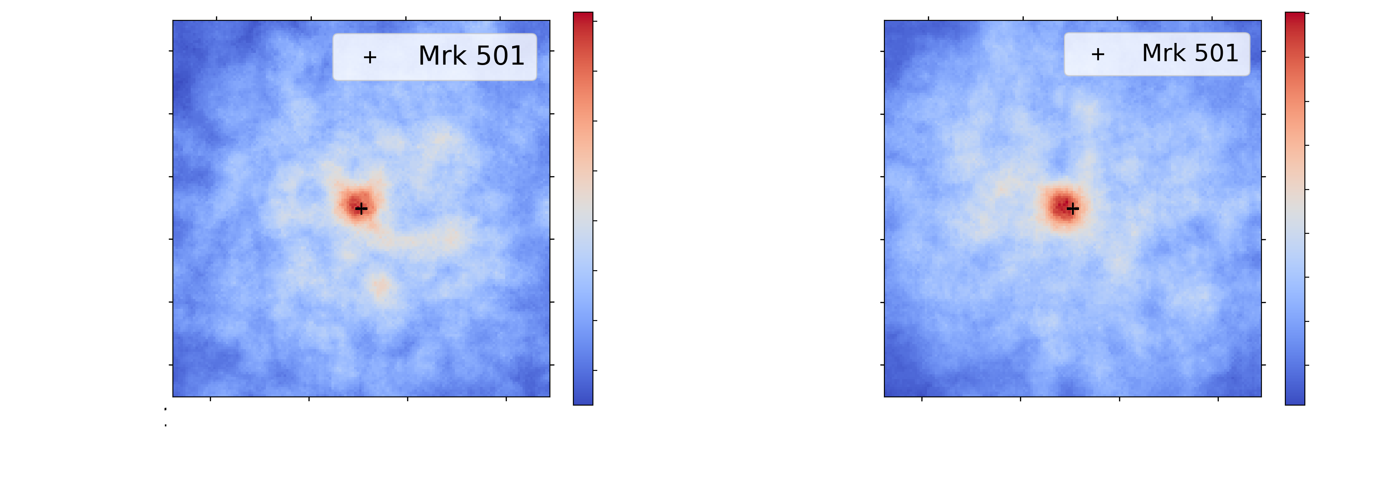

GAMMALEARN RESULTS on LST-1 real data
Mrk501 | Standard analysis | GammaLearn
Excess | 148.7 | 192.7
Background | 238.3 | 226.3
Significance | 7.6𝝈 | 9.8𝝈
➔ Better significance than standard analysis but more sensitive to observation conditions
https://arxiv.org/abs/2108.04130

Slide 5
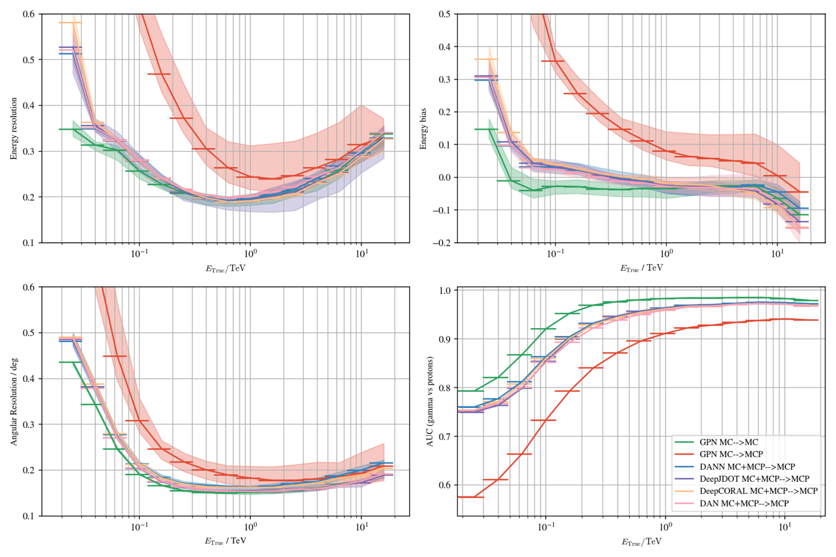
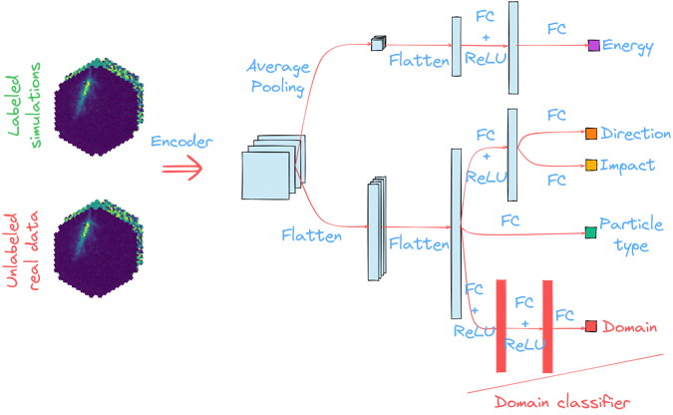
GAMMALEARN current developments
Learning to adapt to observation conditions and differences between simulated and real data with domain adaptation
Accepted for publication in CBMI 2023

Slide 6
The DIRECTA project
GOAL
Bring GammaLearn solutions for event reconstruction in real time
Grant
French ANR (Agence Nationale de la Recherche), 332.241€
Duration
36 months, from ~Feb 2024 to Feb 2027
COSTS
2 years of research engineer, 2 years of postdoctoral researcher

Slide 7
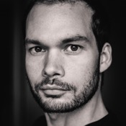
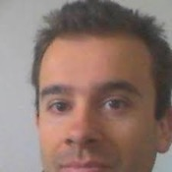


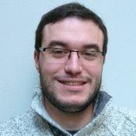
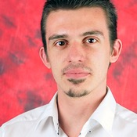
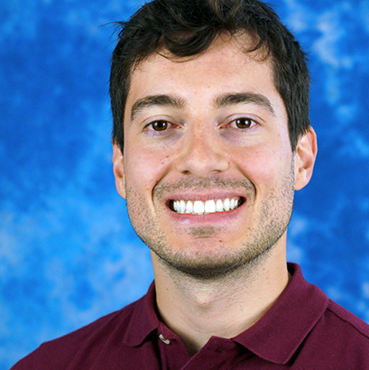
MEET THE TEAM
Thomas Vuillaume¹
PI, research engineer, deep learning and IACT data analysis
Alexandre Benoit²
^{Full Professor, deep learning}
Cyann Plard¹
^{PhD student, data analysis}
Research Engineer
Sami Caroff¹
Co-PI, researcher, transient sources and real-time analysis
Benoit Aubert¹
Research engineer, HPC and real-time expert
Michaël Dell’aiera¹
^{PhD student, deep learning}
Postdoc
1 – LAPP, CNRS, Univ, Savoie Mont-Blanc
2 – LISTIC, Univ. Savoie Mont-Blanc
+ anyone willing to work in this subject ☺

Slide 8
OBJECTIVES
AUTOMATISATION
INTEGRATION
Apply domain adaptation in production and real-time
Deal with obsvervation pointing directions and conditions in an automated way
Integration into ACADA/LST-1 real-time pipeline
PERFORMANCES EVALUATION
EASY TO USE
Real-time and speed performances
Physics performances
Transient sources analysis
Usable tool for collaboration members

Slide 9
TASKS OVERVIEW
Task 1: Dealing with the telescope pointing
T. Vuillaume, A. Benoit, M. Dell’aiera and RE
Task 2: Dealing with changing observation conditions
T. Vuillaume, A. Benoit, M. Dell’aiera and RE
Task 3: Performances of γ-PhysNet in real-time
T. Vuillaume, M. Dell’aiera, RE and PD
Task 4: Include γ-PhysNet in the collaboration real-time pipeline
T. Vuillaume, S. Caroff, P. Aubert, RE, and PD
Task 5: Real data analysis
S. Caroff, C. Plard, RE and PD.

Slide 10
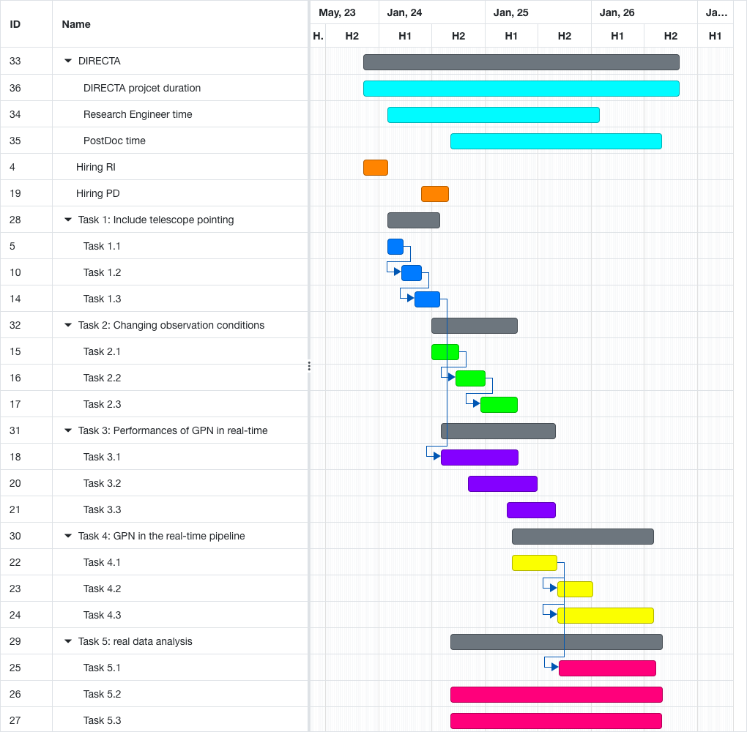
TASKS OVERVIEW

Slide 11
DELIVERABLES
Presentations to the LST collaboration and internal reporting
Presentations in conferences
Technical publication
A workflow running on the LST cluster at La Palma and able to deal with the data observing conditions along with documentation for LST collaboration members to use.
A prototype of real-time LST pipeline, including the CNN in the reconstruction.
Open-source code published in the ESCAPE OSSR.
Analysis and publications of transient and pulsars sources with γ-PhysNet

Slide 12
Job Profiles
Research engineer / dev
Data science pipeline development
Knowledge in machine learning
Depending on candidate, can help for IDEFICS projects
Postdoc
Physicist
Knowledge in machine learning
Knowledge in IACT data analysis

Slide 13
THANK YOU
https://purl.org/gammalearn

