Slide 1
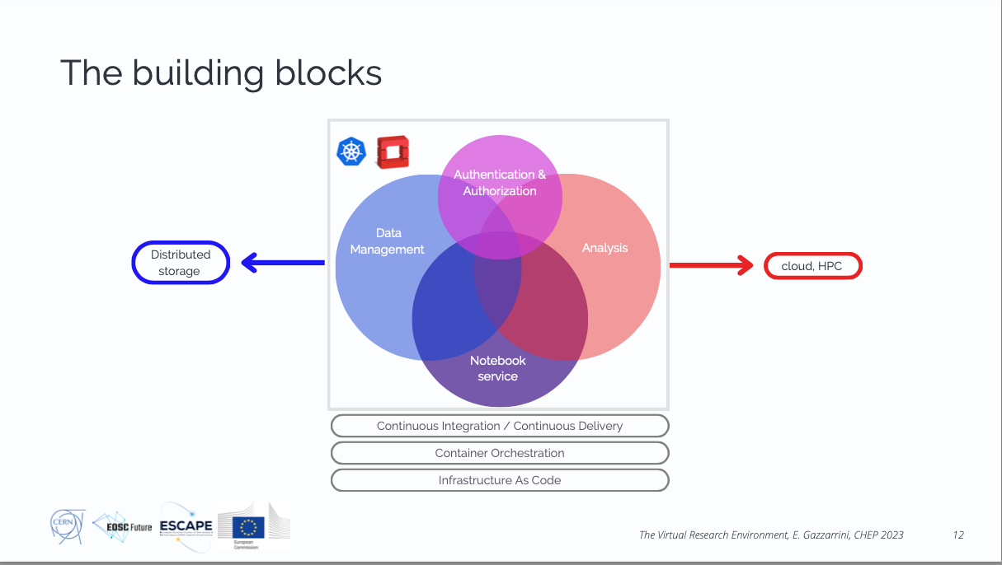

Slide 2
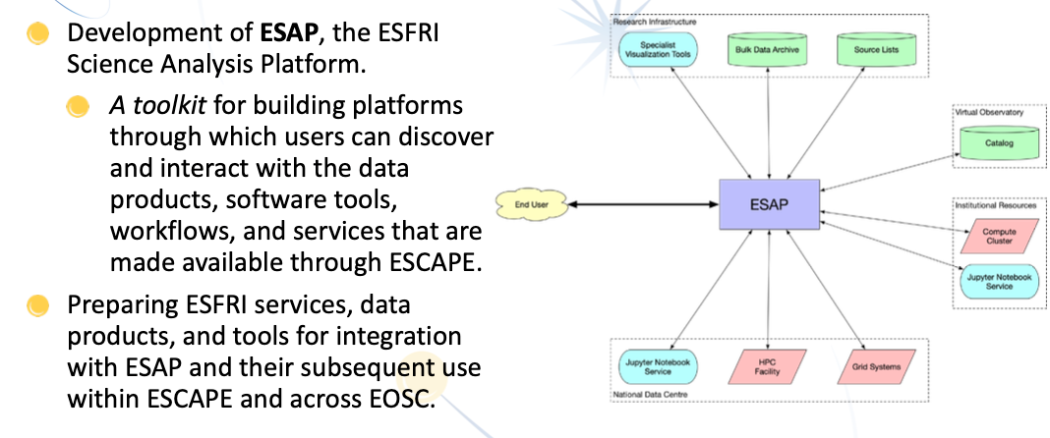
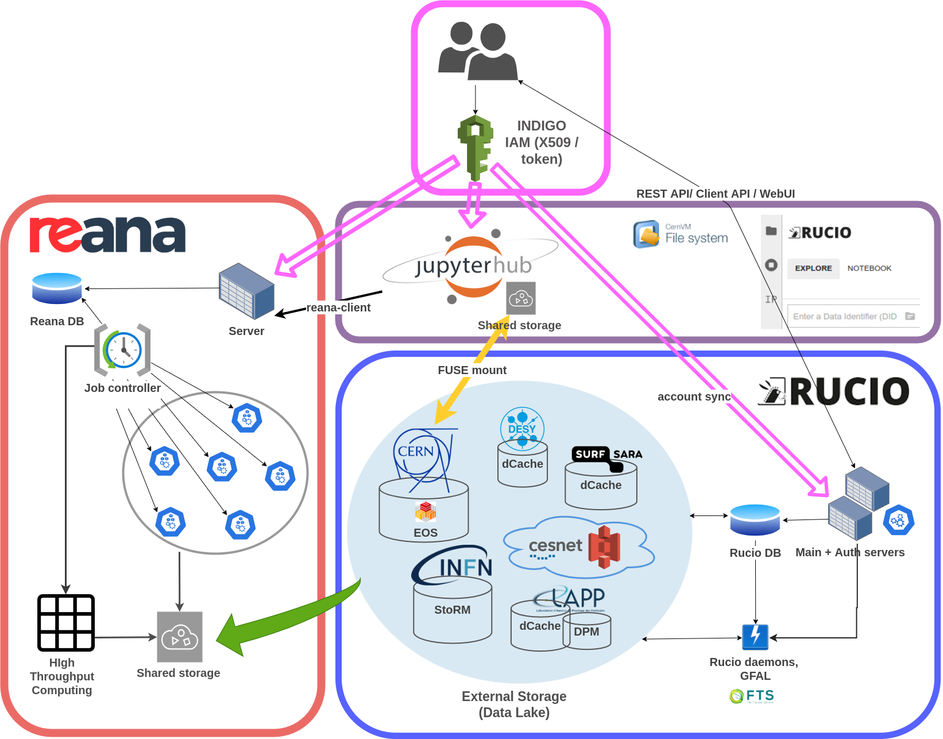
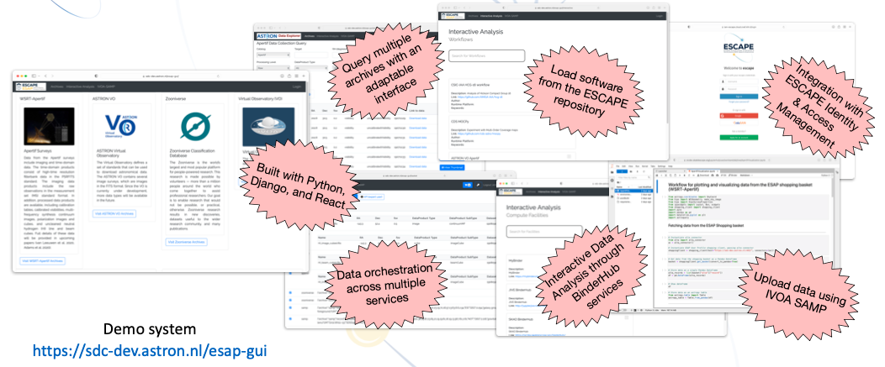
Analysis Platforms & VRE
ESCAPE
Virtual Research Environment

Slide 3

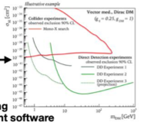
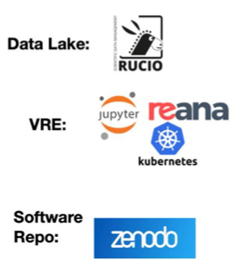

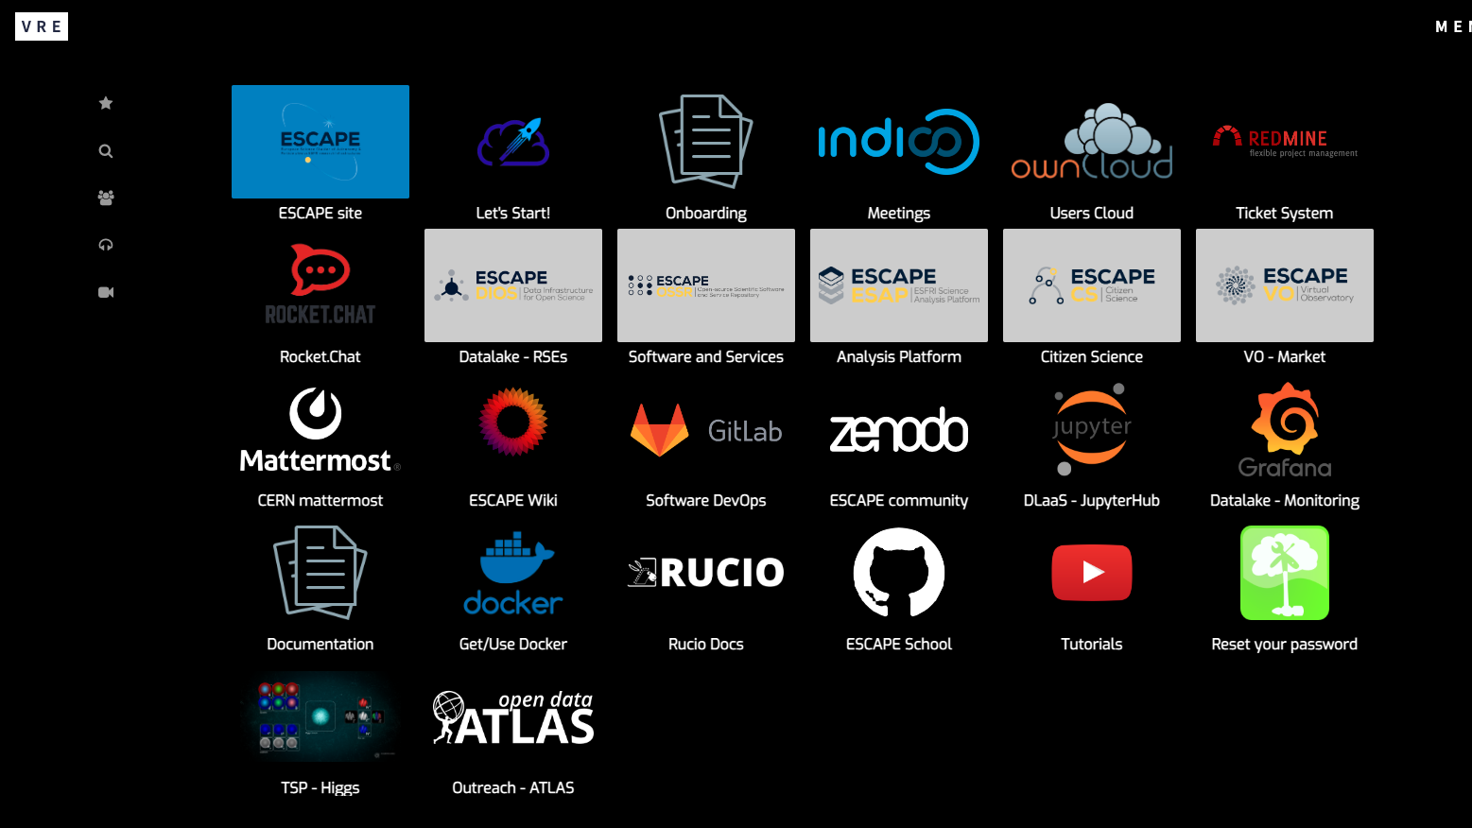
VRE: ESCAPE service composability and EOSC integration
ESCAPE AAI
AAI Federated with EOSC
Publish results to Zenodo
ESCAPE Data Lake (Federated storage)
Virtual Research Environment (VRE)
Hosts/ingests open data sources into a common store;
Includes EOSC Exchange provisioned storage
Virtual Research Environment
Cloud computing using EOSC Exchange provisioned compute, & HPC
Software Repository
Archive of reusable pipelines:
Onboarded to EOSC marketplace
EOSC Core:
+ Helpdesk as a service
(+monitoring)
(+accounting)
Giovanni Lamanna

