Slide 1
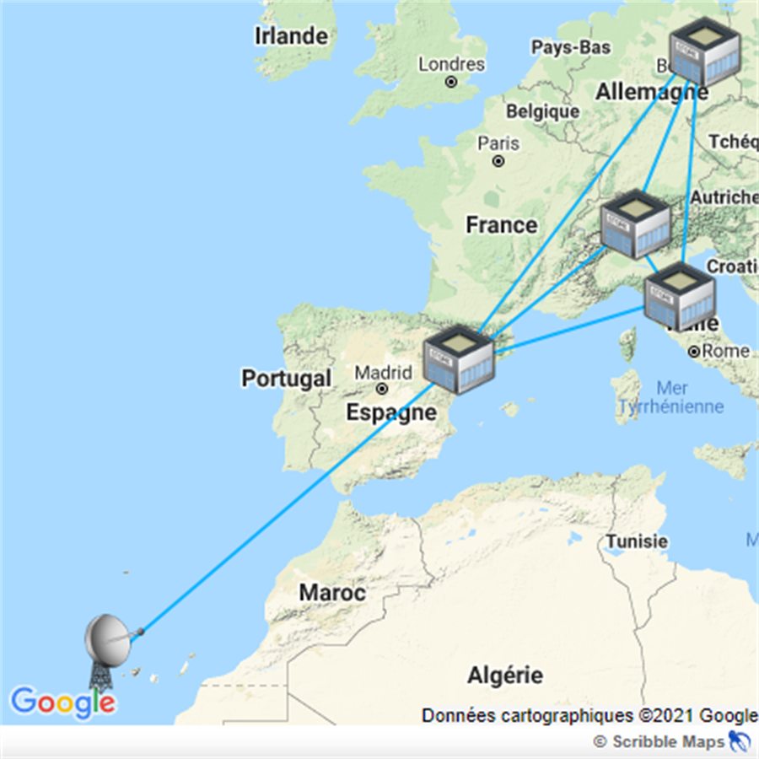
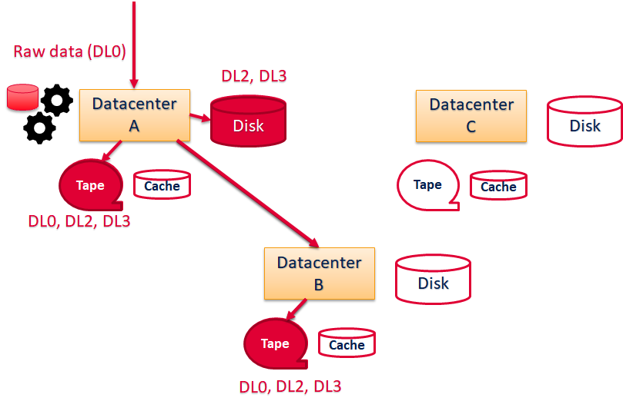
Data Lake ‘s presentation

Slide 2
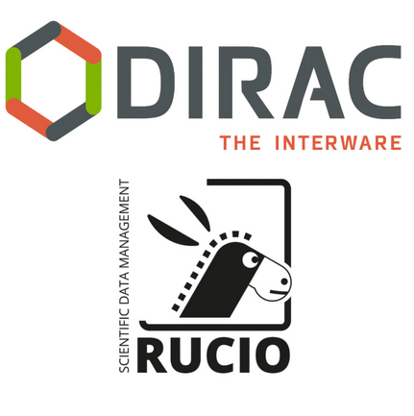
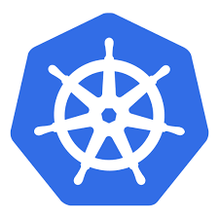
Data Lake’s whish list
from CTA … and others(KM3Net, SKA, LHCb, Belle2, cmb-s4)
Integration with DIRAC (rucio catalog)
Data Lake should interact with VRE / ESAP / RSP, BUT ALSO with a workload manager (i.e. DIRAC)
Work done by Belle2 & Rucio team, but incomplete (more info from CTA consortium presentation)
Workshop in October
K8s deployment :
Some data centers accept only K8s deployment (CSCS in Lugano)
All services must be deployed as containers
Hackathon CSCS to make Rucio & DIRAC’s deployments K8s compliant
Meta Data :
3 implementations / must do performance testing on the query
Build workflow based on Meta Data conditions
RSE hosted in cloud :
In contact with AWS
S3 on Ceph
Cmb
CTA team:
Data Lake : INAF / ETH Zurich
DIRAC ‘s team
Data centers (CSCS, PIC, Desy Zheuthen, INFN frascati)

Slide 3
Data Lake’s wish list (next…)
On site RSE (light, easy to install and to maintain : Apache with WebDav)
Monitoring

