Slide 1
Everse: European virtual institute for research software excellencee
Thomas Vuillaume

Slide 2
SUMMARY
COORDINATOR
CERTH (Centre for Research and Technologies) in Greece, BioSciences
PARTNERS
18 partners (EL, FR, CH, ES, UK, DE, NL, IT, CZ)
GRANT
HORIZON-INFRA-2023-EOSC-01 = 7.8M€ in total
653,125€ for CNRS, to be divided between LAPP (~€450,000.00) and IJCLab
duration
3 years (March 2024 - March 2027)

Slide 3
The call HORIZON-INFRA-2023-EOSC-01
Development of community-based approaches for ensuring and improving the quality of scientific software and code
EVERSE ➔ Building a European network of Research Software Quality based on the five EOSC Science Clusters and national Research Software Expertise Centres and setting the foundations of a future Virtual Institute for Research Software Excellence.
Granted with very good feedback and a note of 14/15

Slide 4
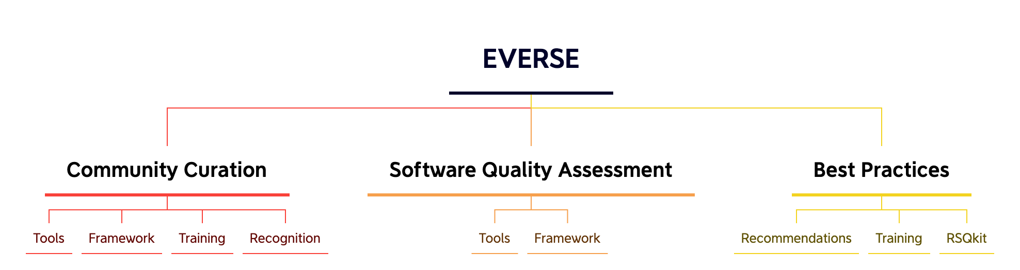

Slide 5
Work packages
 | PMs @LAPP
WP1: Framework of the European Network of Research Software Quality | 0
WP2: Community-led best practices for developing high-quality research software | 12
WP3: Tools and services for software quality and FAIRness | 21
WP4: EOSC Science Cluster Pilots and Driver projects | 0
WP5: Capacity building and recognition | 9
WP6: Project Management & Coordination | 4
 | 46

Slide 6

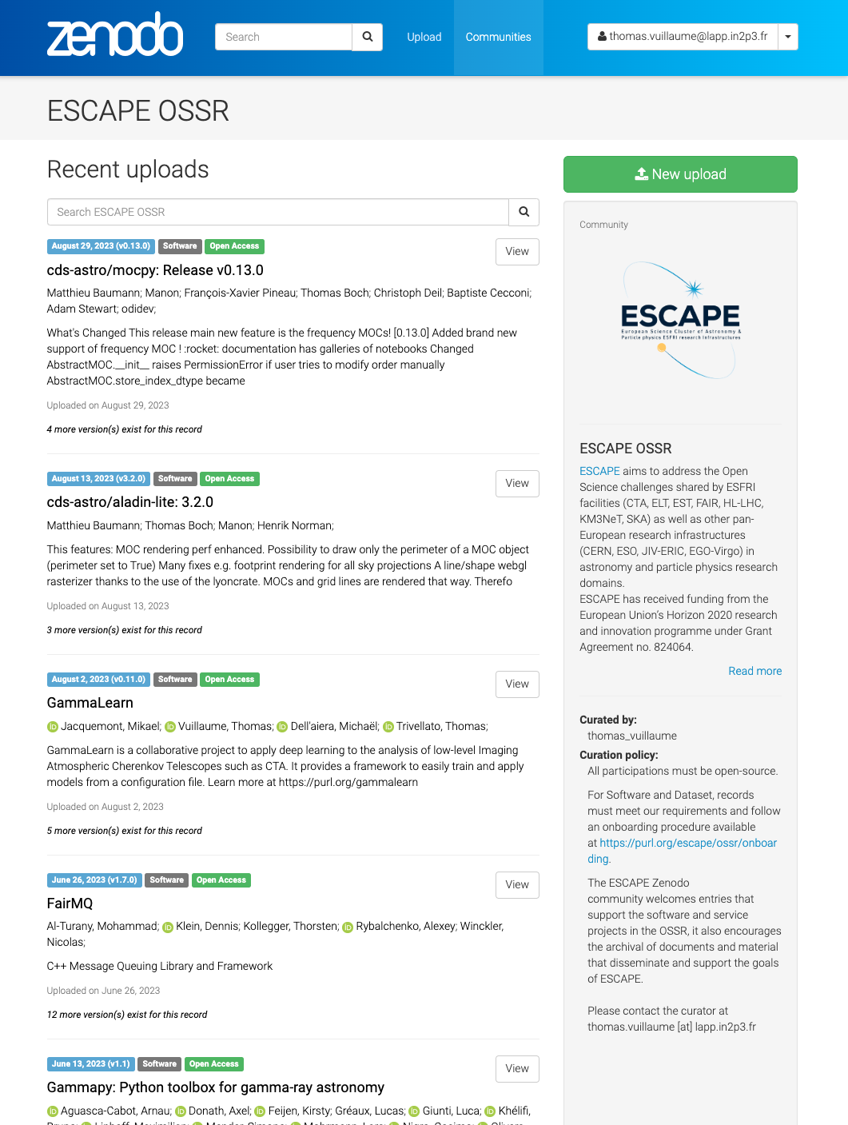
link with ESCAPE OSSR
Publication process
Improves software quality
Improves publication process (in relation with Zenodo as partner in EVERSE)
Improves software quality assessment
Improves community management (high-level quality metrics)
Improves visibility (broader community, better landing page…)
Reward code review and curation
My goal with the OSSR: a science journal publication process focused on software quality → recognition for developers and curators
curation

Slide 7
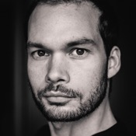
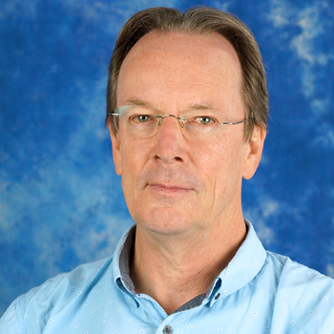

THE TEAM at LAPP
Thomas Vuillaume¹
^{WP3 leader}
Ian Bird¹
Project Manager
Research Engineer
+ anyone willing to work in this subject ☺

Slide 8
Job Profiles
Project Manager
Technical background
EVERSE project management
IDEFICS project management
Organise meetings
Keep tracks of deadlines and deliverables
Reporting
Organise events (workshops, seminars...)
Relation with local industries
RSE/dev
Technical developments for EVERSE, in particular WP3
Reporting and deliverables
Technical developments and maintenance of the OSSR

Slide 9
THANK YOU

